Slide 1
Complex Coronary Cases Supported by:
Boston Scientific Corp.
Abbott-CSI Inc.
Shockwave Medical Inc.
Terumo Vascular Corp.
Johnson & Johnson-Abiomed Inc.
Chiesi Inc.
Haemonetics-Cardiva Inc.
Acist Medical System.

Slide 2
Disclosures
Samin K. Sharma, MD, MSCAI, FACC
Nothing to disclose
Annapoorna S. Kini, MD, MRCP, FACC
Nothing to disclose
Sameer Mehta, MD, FACC (Moderator)
Nothing to disclose

Slide 3
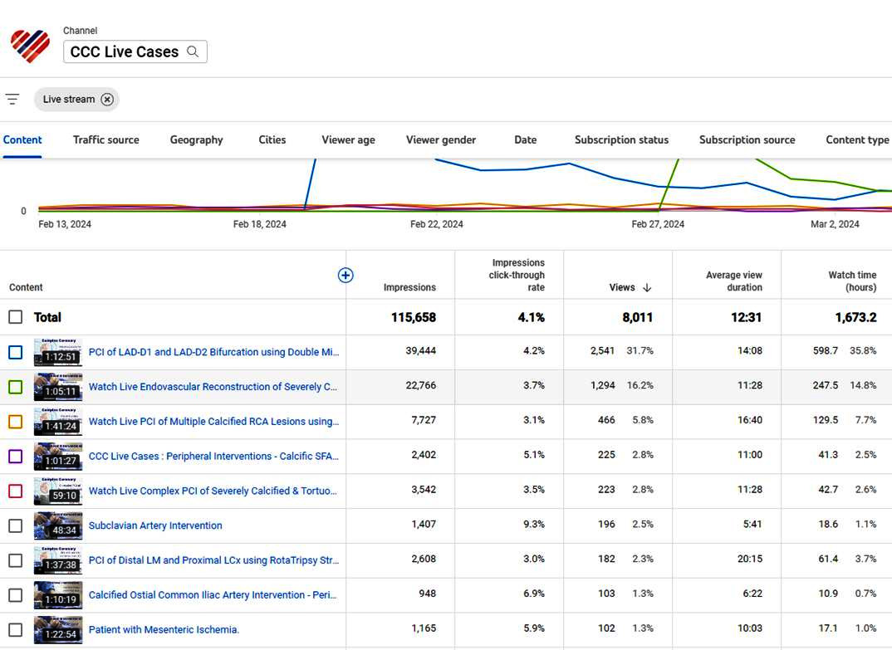
Live Case Views for February 2024

Slide 4
CCC Live Case # 177
Patient Demographics
81 yrs, Female
Present Clinical Presentation
Presented with exertional dyspnea for few months and high Ca+ score of 4320 & abnormal coronary CTA for 2 V CAD and +ctFFR
CAD Risk Factors
Controlled hypertension
Controlled hyperlipidemia
Controlled NIDDM
SAQ-7 score: 68, PAF, COPD
Clinical Variables
No prior known CAD, Echo with 62% EF and no valvular disease
Medications
Aspirin, Amlodipine, Metoprolol XL, Metformin, Dabigatran, Atorvastatin, Inhalers
Cath: Cardiac cath on 1/16/2024 revealed 2 V CAD; 95% calcific nodule in mid RCA, 80% calcified lesions in prox & 95% in distal LCx, Syntax score of 12 and LVEF 60%. Pt underwent successful PCI of LCx lesions using Rota+2 DES (Promus Elite) and did well. Clopidogrel 75 mg daily added.

Slide 5
Angiogram of the Proximal and Distal LCx
Prox LCx 80% lesion
Distal LCx 95% lesion

Slide 6
PTCA of distal LCx
Balloon MINI TREK 2/12 mm 18 atm 10 sec

Slide 7
CBPTCA of the Prox LCx
NC TREK Neo 2.5/12mm @16atm 10 sec
Wolverine 2.5/6 mm @16atm 20 sec

Slide 8
Successful DES of Distal LCx
Promus Elite 2.25/12mm @16atm

Slide 9
Successful DES of Prox LCx
Promus Elite 2.75/16mm @16atm

Slide 10
Final Angio of Prox and Distal LCx PTCS DES

Slide 11
CCC Live Case # 177
Patient Demographics
81 yrs, Female
Present Clinical Presentation
Presented with exertional dyspnea for few months and high Ca+ score of 4320 & abnormal coronary CTA for 2 V CAD and +ctFFR
CAD Risk Factors
Controlled hypertension
Controlled hyperlipidemia
Controlled NIDDM
SAQ-7 score: 68, PAF, COPD
Clinical Variables
No prior known CAD, Echo with 62% EF and no valvular disease
Medications
Aspirin, Amlodipine, Metoprolol XL, Metformin, Dabigatran, Atorvastatin, Inhalers
Cath: Cardiac cath on 1/16/2024 revealed 2 V CAD; 95% calcific nodule in mid RCA, 80% calcified lesions in prox & 95% in distal LCx, Syntax score of 12 and LVEF 60%. Pt underwent successful PCI of LCx lesions using Rota+2 DES (Promus Elite) and did well. Clopidogrel 75 mg daily added.
Plan: Now planned for imaging guided staged PCI of mid RCA calcific nodule using stepped burr RotaTripsy approach.

Slide 12
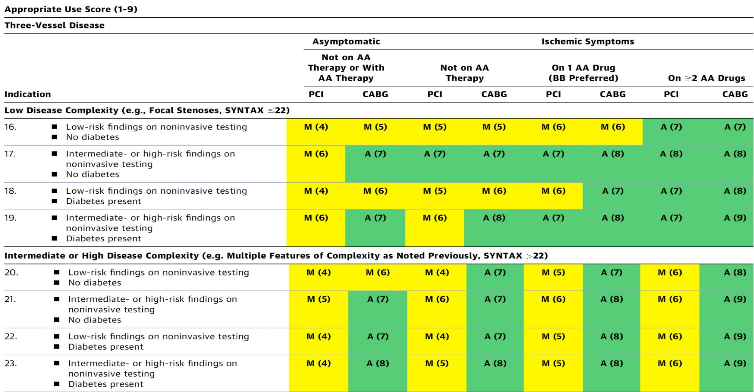
AUC 2017: Two-Vessel Disease
Patel et al., J Am Coll Cardiol 2017;69:2212

Slide 13
Latest Issues in Coronary Intervention
Recent Interventional Trials and Publications:
DCB-ACS Trial, REPLICA-EPIC 18 Study, T-PASS
Trial, 3M DAPT Trials, BEST Extended FU Study
Focused review of the month
Changing Landscape of Ca++ Modification Strategy after IVL:
Use of Calcium Modification Strategies during
PCI after Introduction of Coronary IVL

Slide 14
Latest Issues in Coronary Intervention
Recent Interventional Trials and Publications:
DCB-ACS Trial, REPLICA-EPIC 18 Study, T-PASS
Trial, 3M DAPT Trials, BEST Extended FU Study
Focused review of the month
Changing Landscape of Ca++ Modification Strategy after IVL:
Use of Calcium Modification Strategies during
PCI after Introduction of Coronary IVL

Slide 15
Drug-Coated Balloon for Acute Coronary Syndromes: A Multicenter Randomized Non-inferiority Trial (DCB-ACS) from China
Background
Stent-related complications remain a challenging issue following percutaneous coronary intervention (PCI), especially in acute coronary syndrome (ACS) patients.
Drug-coated balloon (DCB) is a novel therapeutic strategy for ACS to avoid stent-related complications by leaving no metallic implants behind.
There is limited evidence for DCB treatment in ACS patients with de novo lesions.

Slide 16
DCB-ACS Trial: Study Design
Prospective, multicenter, non-inferiority, randomized, controlled T
Primary endpoint:
Fractional flow reserve (FFR) of target lesion at 9 months
Secondary clinical endpoints (12 months):
Target lesion failure
Patient-oriented composite endpoint
Definite and possible thrombotic events
Major bleeding
Rehospitalization due to angina
Stroke.
Secondary angiographic endpoints (9 months):
Late lumen loss; diameter stenosis; binary stenosis.
Yu B, TCT 2023

Slide 17
DCB-ACS Trial: Study Flowchart
ACS patients with percutaneous coronary intervention assessed for eligibility (N=234)
15 centers in China
Screening failure (N=10)
Randomization (N=224)
No DCB or DES (N=8)
Randomly allocated to treatment
and included in full analysis set (N=216)
DCB group
(N=107)
DES group
(N=109)
1 patients received DES
Received DCB (N=106)
Received DES
(N=110)
Death (N=1)
Clinical visit at 9 months
（N=105）
Clinical visit at 9 months
（N=110）
Follow-up at 9 months
CAG: N=87 FFR: N=82
Follow-up at 9 months
CAG: N=83 FFR: N=79
Refusal to follow-up (N=1)
Clinical visit at 12 months
（N=105）
Clinical visit at 12 months
（N=109）
Yu B, TCT 2023

Slide 18
DCB-ACS Trial: Procedural Data
 | Overall n = 231 | DCB n = 113 | DES n = 118 | P Value
Target lesion location |  |  |  | 0.92
- LAD | 100 (43.3) | 49 (43.4) | 51 (43.2)
- LCX | 61 (26.4) | 31 (27.4) | 30 (25.4)
- RCA | 70 (30.3) | 33 (29.2) | 37 (31.4)
Pre-dilation balloon type used
- Cutting balloon | 72 (31.2) | 38 (33.6) | 34 (28.8) | 0.43
- Scoring balloon | 80 (34.6) | 39 (34.5) | 41 (34.7) | 0.97
Mean diameter of DCB or DES, mm | 2.96 ± 0.51 | 2.93 ± 0.47 | 2.99 ± 0.55 | 0.37
Length of DCB or DES, mm | 23.35 ± 5.86 | 23.43 ± 5.77 | 23.28 ± 5.95 | 0.84
OCT | 45 (19.5) | 25 (22.1) | 20 (17.0) | 0.32
IVUS | 4 (1.7) | 2 (1.8) | 2 (1.7) | 1.00
Yu B, TCT 2023

Slide 19
DCB-ACS Trial: Quantitative Coronary Angiographic Results
 | DCB n = 113 | DES n = 118 | P Value
Pre-procedure QCA
- Lesion length, mm | 14.39 (10.46-20.68) | 16.77 (11.82-22.75) | 0.04
- Reference vessel diameter, mm | 2.73 ± 0.54 | 2.77 ± 0.57 | 0.62
- Minimum lumen diameter, mm | 0.93 ± 0.50 | 1.01 ± 0.46 | 0.22
- Diameter stenosis, % | 66.3 ± 14.9 | 63.9 ± 14.4 | 0.21
Post-procedure QCA
- Minimum lumen diameter, mm
In-segment | 1.98 ± 0.40 | 2.33 ± 0.53 | <0.001
In-device | 2.03 ± 0.41 | 2.53 ± 0.51 | <0.001
- Diameter stenosis, %
In-segment | 27.3 ± 9.1 | 15.5 ± 9.4 | <0.001
In-device | 27.0 ± 9.6 | 12.1 ± 8.1 | <0.001
- Acute gain, mm
In-segment | 1.05 ± 0.51 | 1.32 ± 0.55 | <0.001
In-device | 1.10 ± 0.51 | 1.52 ± 0.56 | <0.001
Yu B, TCT 2023

Slide 20
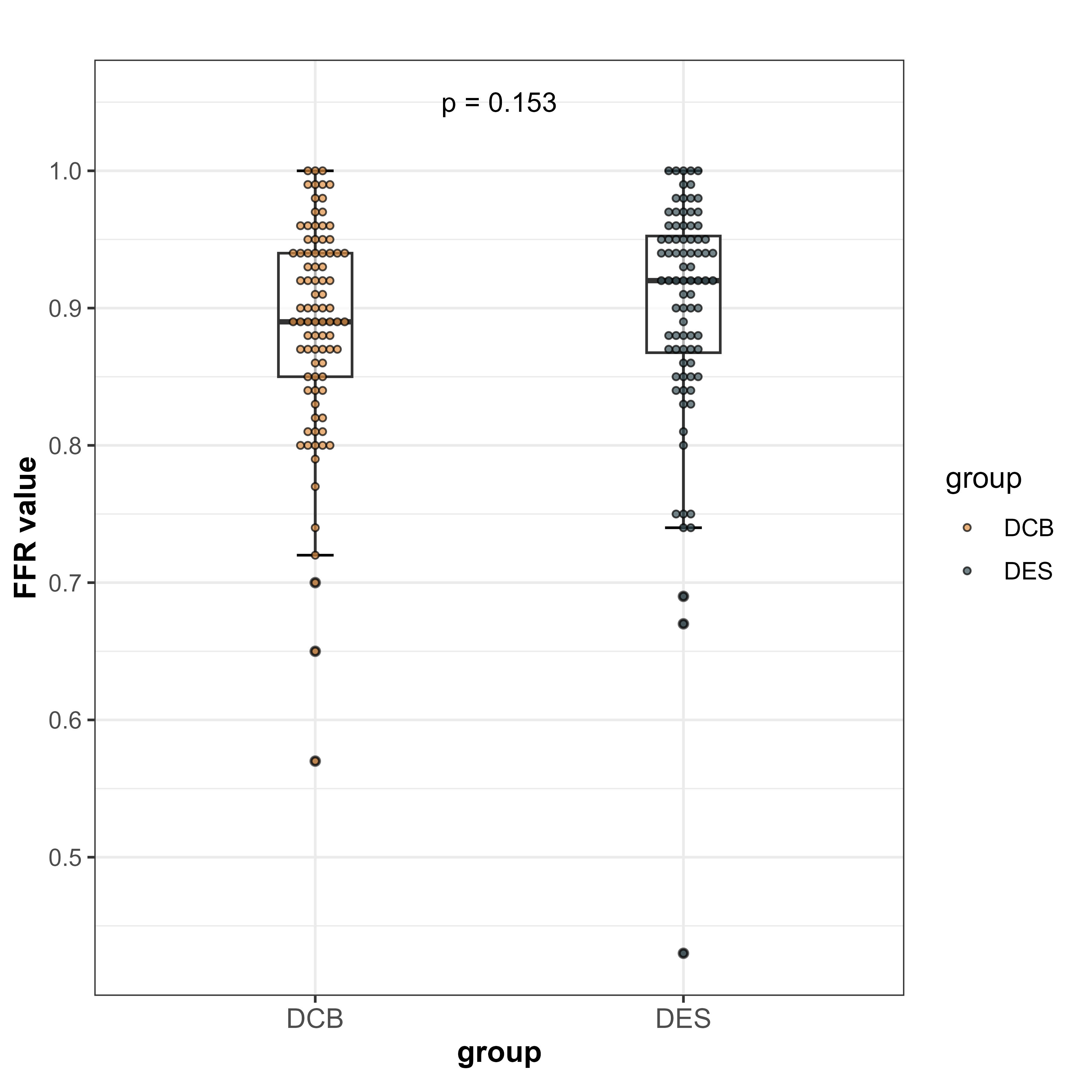
DCB-ACS Trial: Primary Endpoint
FFR at 9 Months
DCB-only strategy was non-inferior to DES for treating de novo lesions in ACS patients in terms of FFR at 9 months.
Zone of noninferiority; Pre-specified margin = -0.05
0.90
0.89
DCB
DES
Yu B, TCT 2023

Slide 21
DCB-ACS Trial: Secondary Endpoint
9 Months Angiographic Findings
 | DCB n = 93 | DES n = 89 | P Value
Late lumen loss, mm
- In-segment | 0.14 ± 0.46 | 0.18 ± 0.55 | 0.56
- In-device | 0.15 ± 0.48 | 0.20 ± 0.57 | 0.54
Binary restenosis
- In-segment | 13 (14.0) | 9 (10.1) | 0.42
- In-device | 13 (14.0) | 7 (7.9) | 0.19
Diameter stenosis, %
- In-segment | 32.1 ± 16.8 | 22.6 ± 20.5 | <0.001
- In-device | 31.8 ± 17.3 | 18.6 ± 20.7 | <0.001
Yu B, TCT 2023

Slide 22
DCB-ACS Trial: Secondary Endpoint
9 Months Clinical Outcomes
All=NS
%
Yu B, TCT 2023

Slide 23
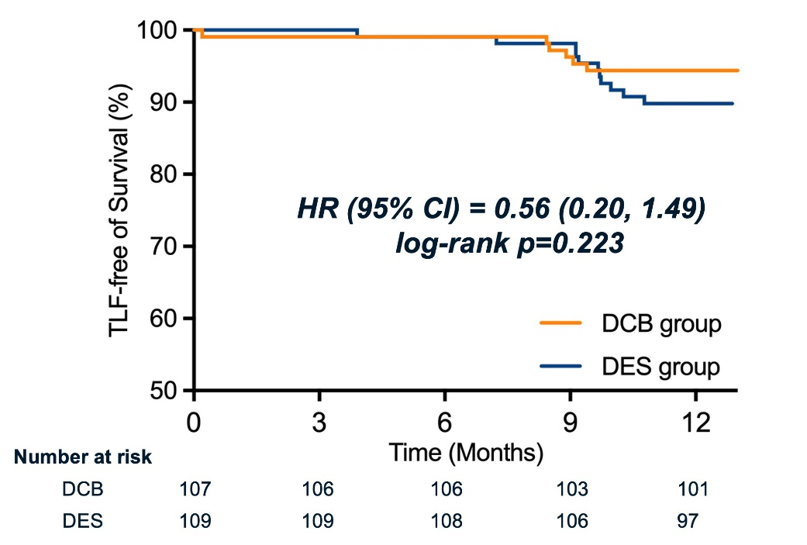
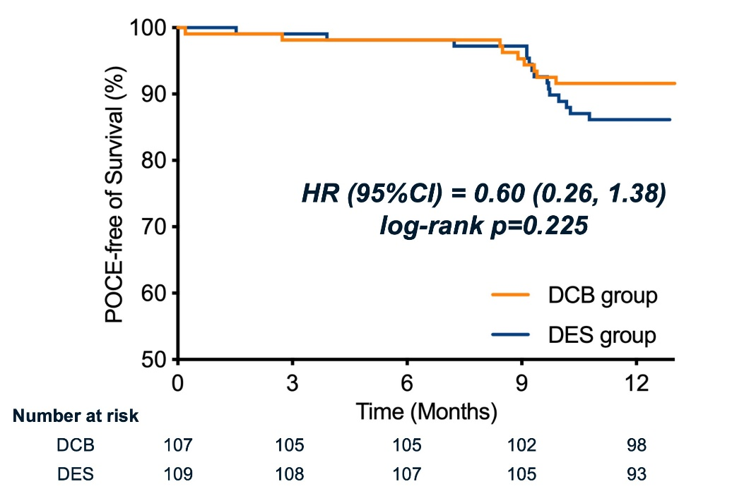
DCB-ACS Trial: Secondary Endpoint at
12 Months
Target lesion failure
(TLF)
Patient-oriented composite endpoint (POCE)
Yu B, TCT 2023

Slide 24
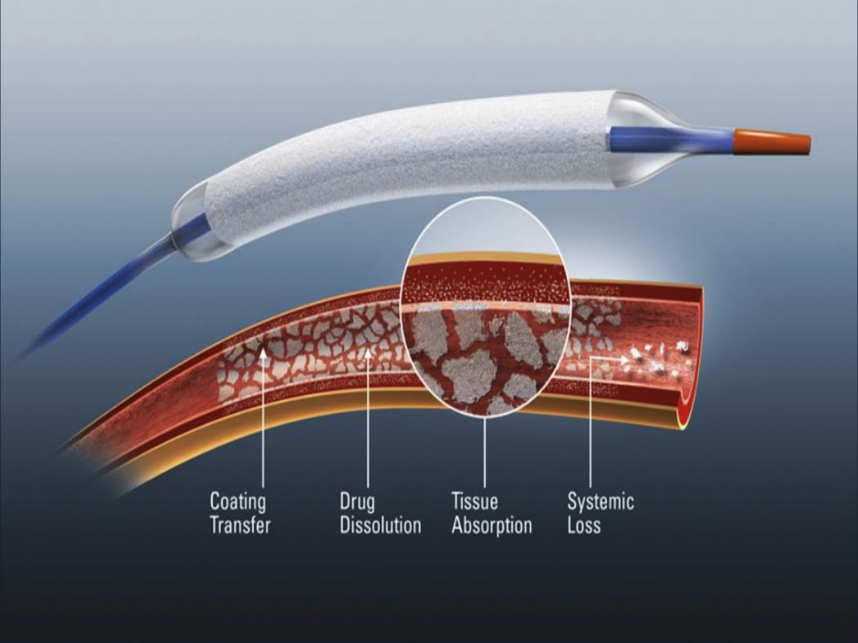

Slide 25
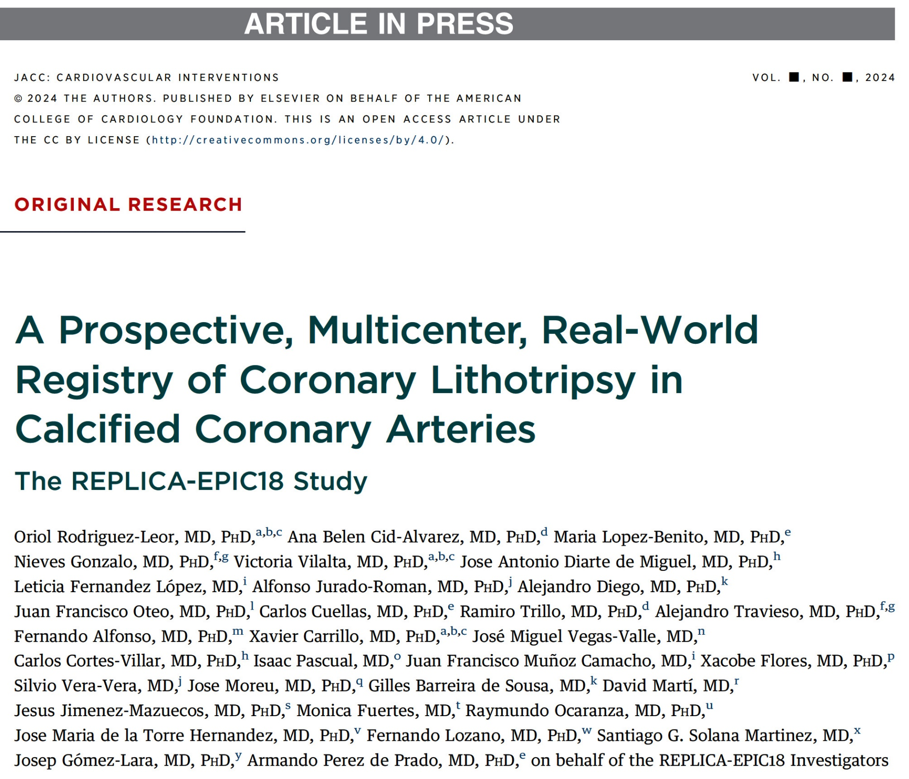
(Registry of Coronary Lithotripsy) Spain

Slide 26
REPLICA-EPIC18 Study: Patients Flow Chart
Patients enrolled
N=426
IVL therapy not possible N=4 (0.9%)
Crossing failure (N=3)
Generator error (N=1)
Received IVL Therapy
N=422 (99.1%)
Acute Coronary Syndrome N=265 (62.8%)
Chronic Coronary Syndrome N=157 (37.2%)
Corelab QCA non-available
N=41 (9.7%)
30-d follow-up non-available
N=1 (0.2%)
Primary Efficacy End Point in
patients with core laboratory QCA analysis available
N=381 (90.3%)
Primary Safety End Point in
patients with 30-day follow-up available
N=421 (99.8%)
Rodriguez-Leor et al., J Am Coll Cardiol Intv Feb. 15, 2024 Epub ahead of print

Slide 27
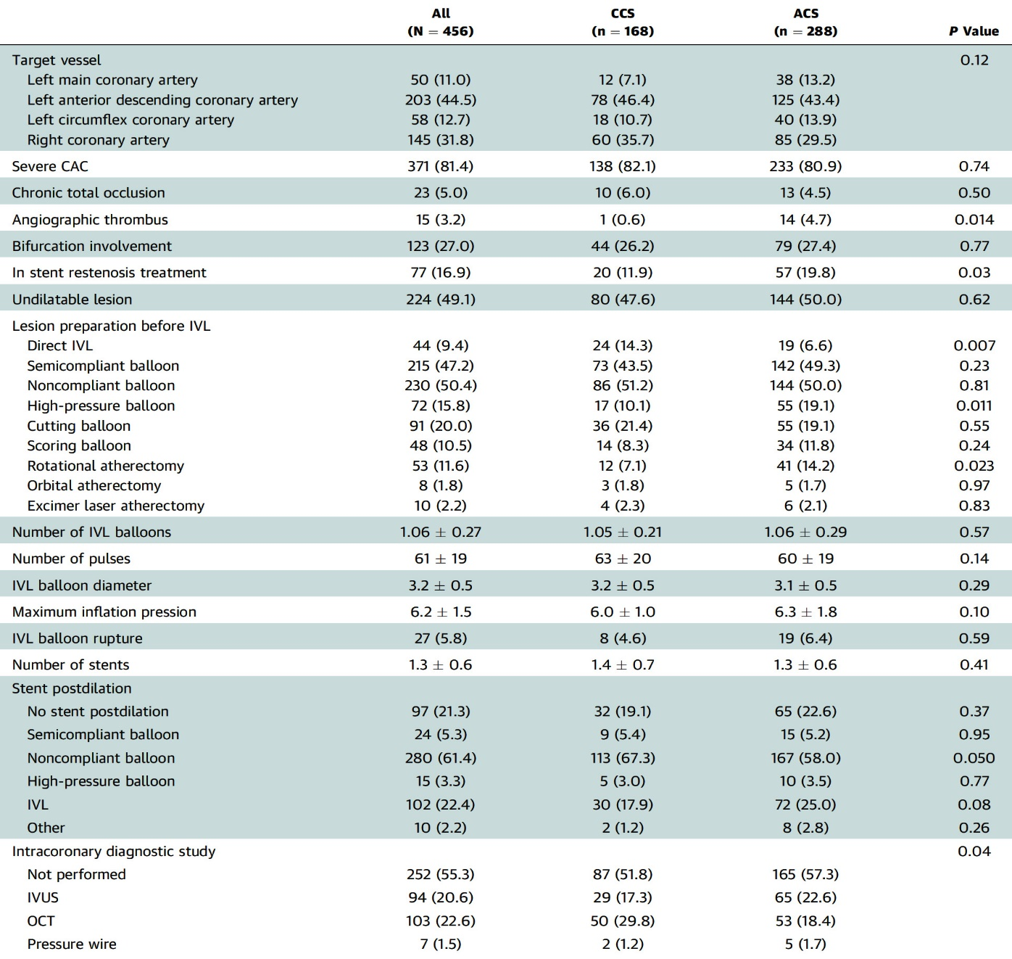
REPLICA-EPIC18 Study: Lesion Characteristics in All Pts Treated with IVL According to ACS or CCS at Admission
Total of 224 lesions (49.1%) were considered undilatable before IVL, and only 44 lesions (9.4%) were directly treated with IVL without plaque preparation (direct IVL was more frequent in pts with ACS);
lesion preparation included semicompliant, noncompliant, and high-pressure balloons, cutting balloon or scoring balloons, as well as RA, OA, or excimer laser atherectomy
IVL balloon rupture was infrequent (5.8%)
Treatment of 197 lesions (43.2%) was guided by intracoronary imaging (IVUS or OCT)
In 102 lesions, IVL was conducted on previously implanted stents: 77 (16.9%) cases due to ISR and 25 were due to stent underexpansion;
Treatment of ISR was more frequent in pts with ACS
Rodriguez-Leor et al., J Am Coll Cardiol Intv Feb. 15, 2024 Epub ahead of print

Slide 28
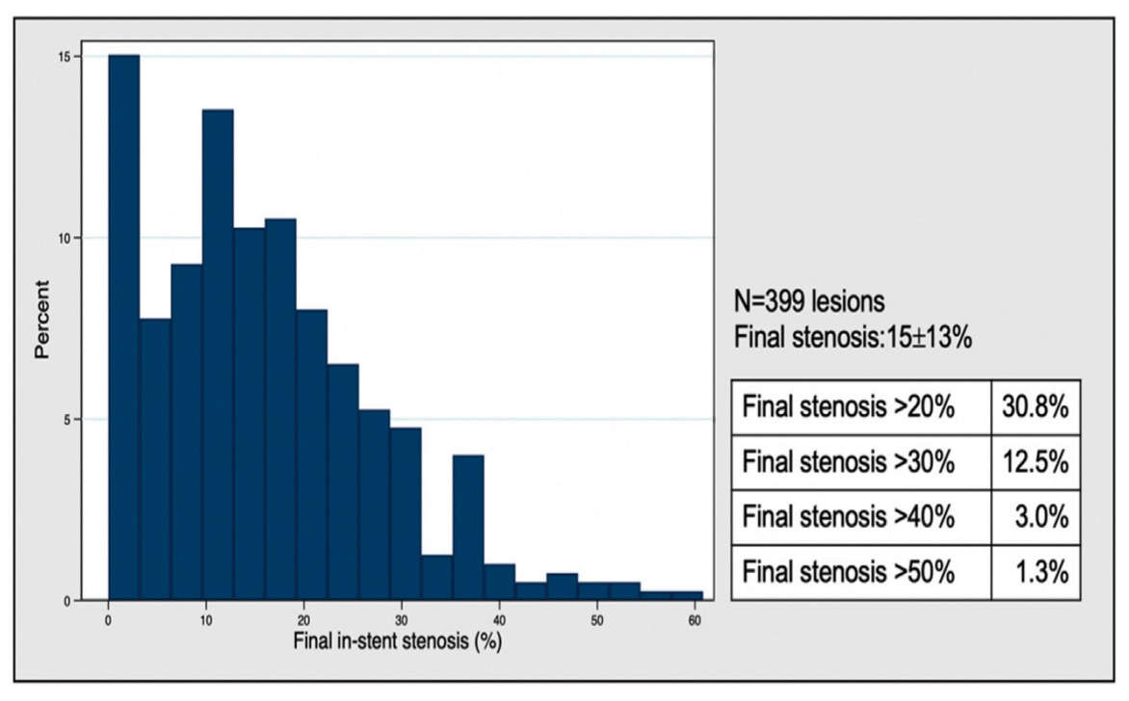
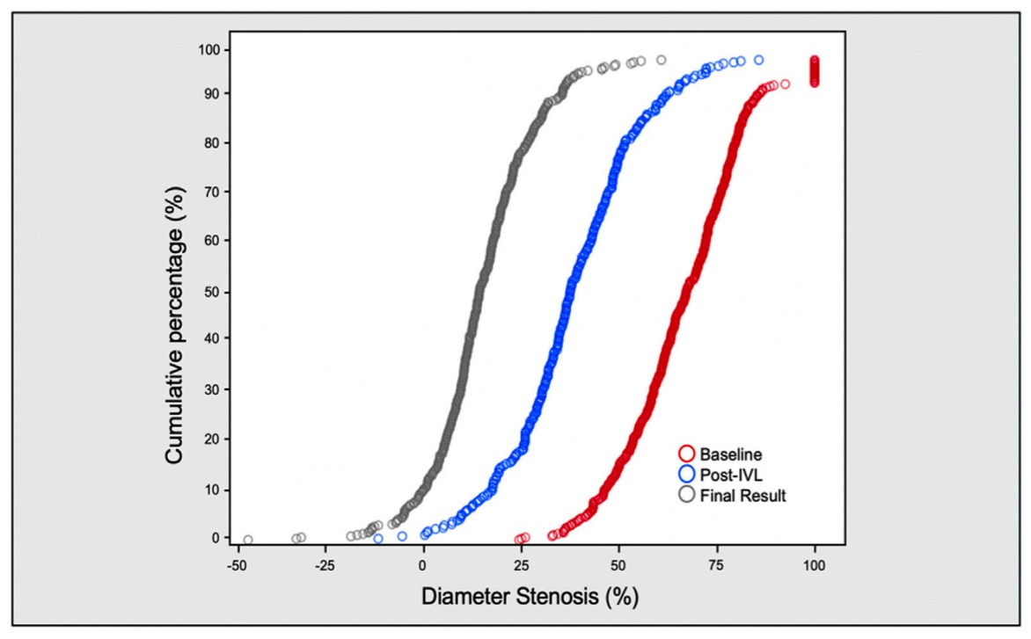
REPLICA-EPIC18 Study: Lesion Characteristics in All Pts Treated with IVL According to ACS or CCS at Admission
Final ISR Distribution (analysis per lesion)
Diameter Stenosis Distribution
Final in-stent stenosis was 15% ± 13% without differences between CCS and ACS patients
A total of 1213 lesions (30.8%) had a final in-stent stenosis ≥20%
Luminal gain and changes in segment diameter stenosis following IVL treatment and final result
Rodriguez-Leor et al., J Am Coll Cardiol Intv Feb. 15, 2024 Epub ahead of print

Slide 29
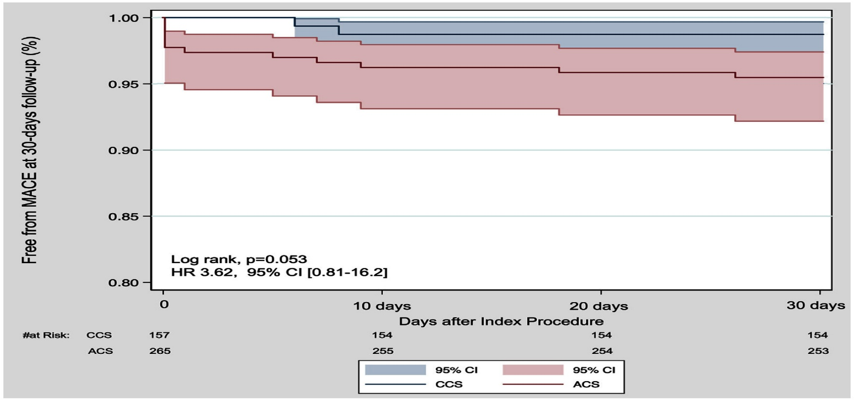
REPLICA-EPIC18 Study: K-M Curves Comparing MACE at 30-D Follow-Up Between CCS and ACS Pts
1.5%
4.5%
The 30-day follow-up was completed in 421 patients (99.8%)
Primary safety (freedom from 30-d MACE) was achieved in 406 patients (96.4%)
Trending to more MACE in patients with ACS when compared with CCS (4.5% vs 1.3%; p=0.073)
No significant difference in clinical outcomes including MACE (2.7 if stenosis <20% vs 2.4 if stenosis ≥20%; p=0.97)
Rodriguez-Leor et al., J Am Coll Cardiol Intv Feb. 15, 2024 Epub ahead of print

Slide 30
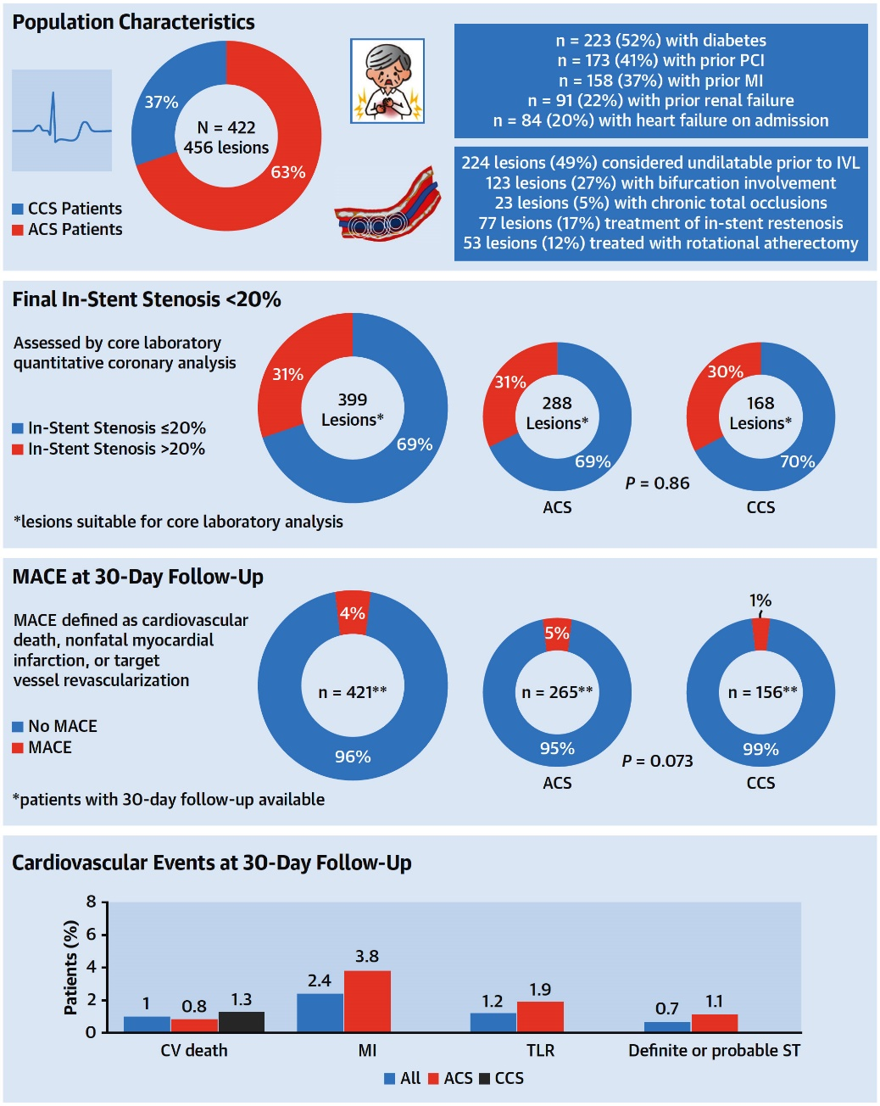
REPLICA-EPIC18 Study: Pt and Lesion Characteristics, Angiographic Success, and CV Events at 30-D Follow-Up
Rodriguez-Leor et al., J Am Coll Cardiol Intv Feb. 15, 2024 Epub ahead of print

Slide 31
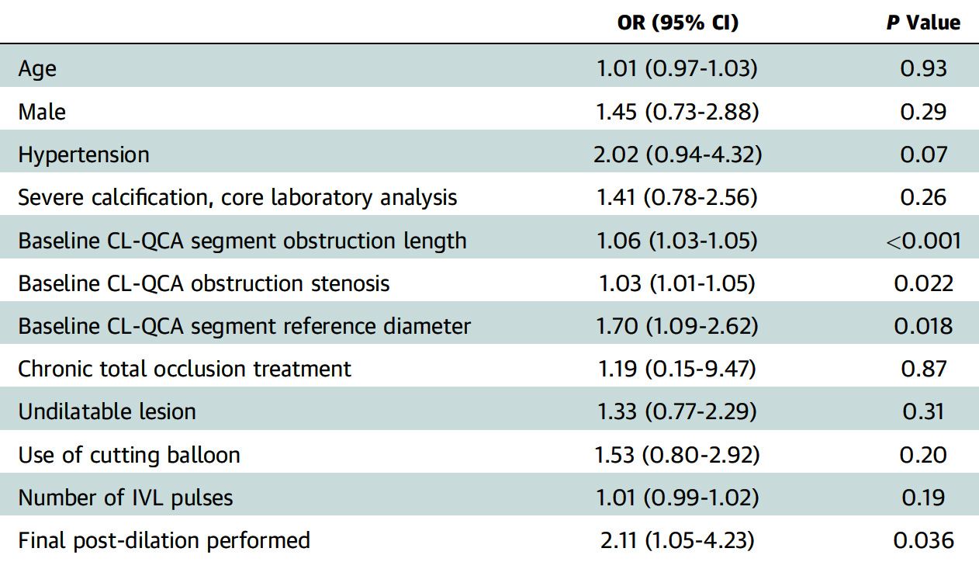
REPLICA-EPIC18 Study: Independent Predictors
of Stent Underexpansion in the Logistic Multivariate Regression Analysis
Rodriguez-Leor et al., J Am Coll Cardiol Intv Feb. 15, 2024 Epub ahead of print

Slide 32
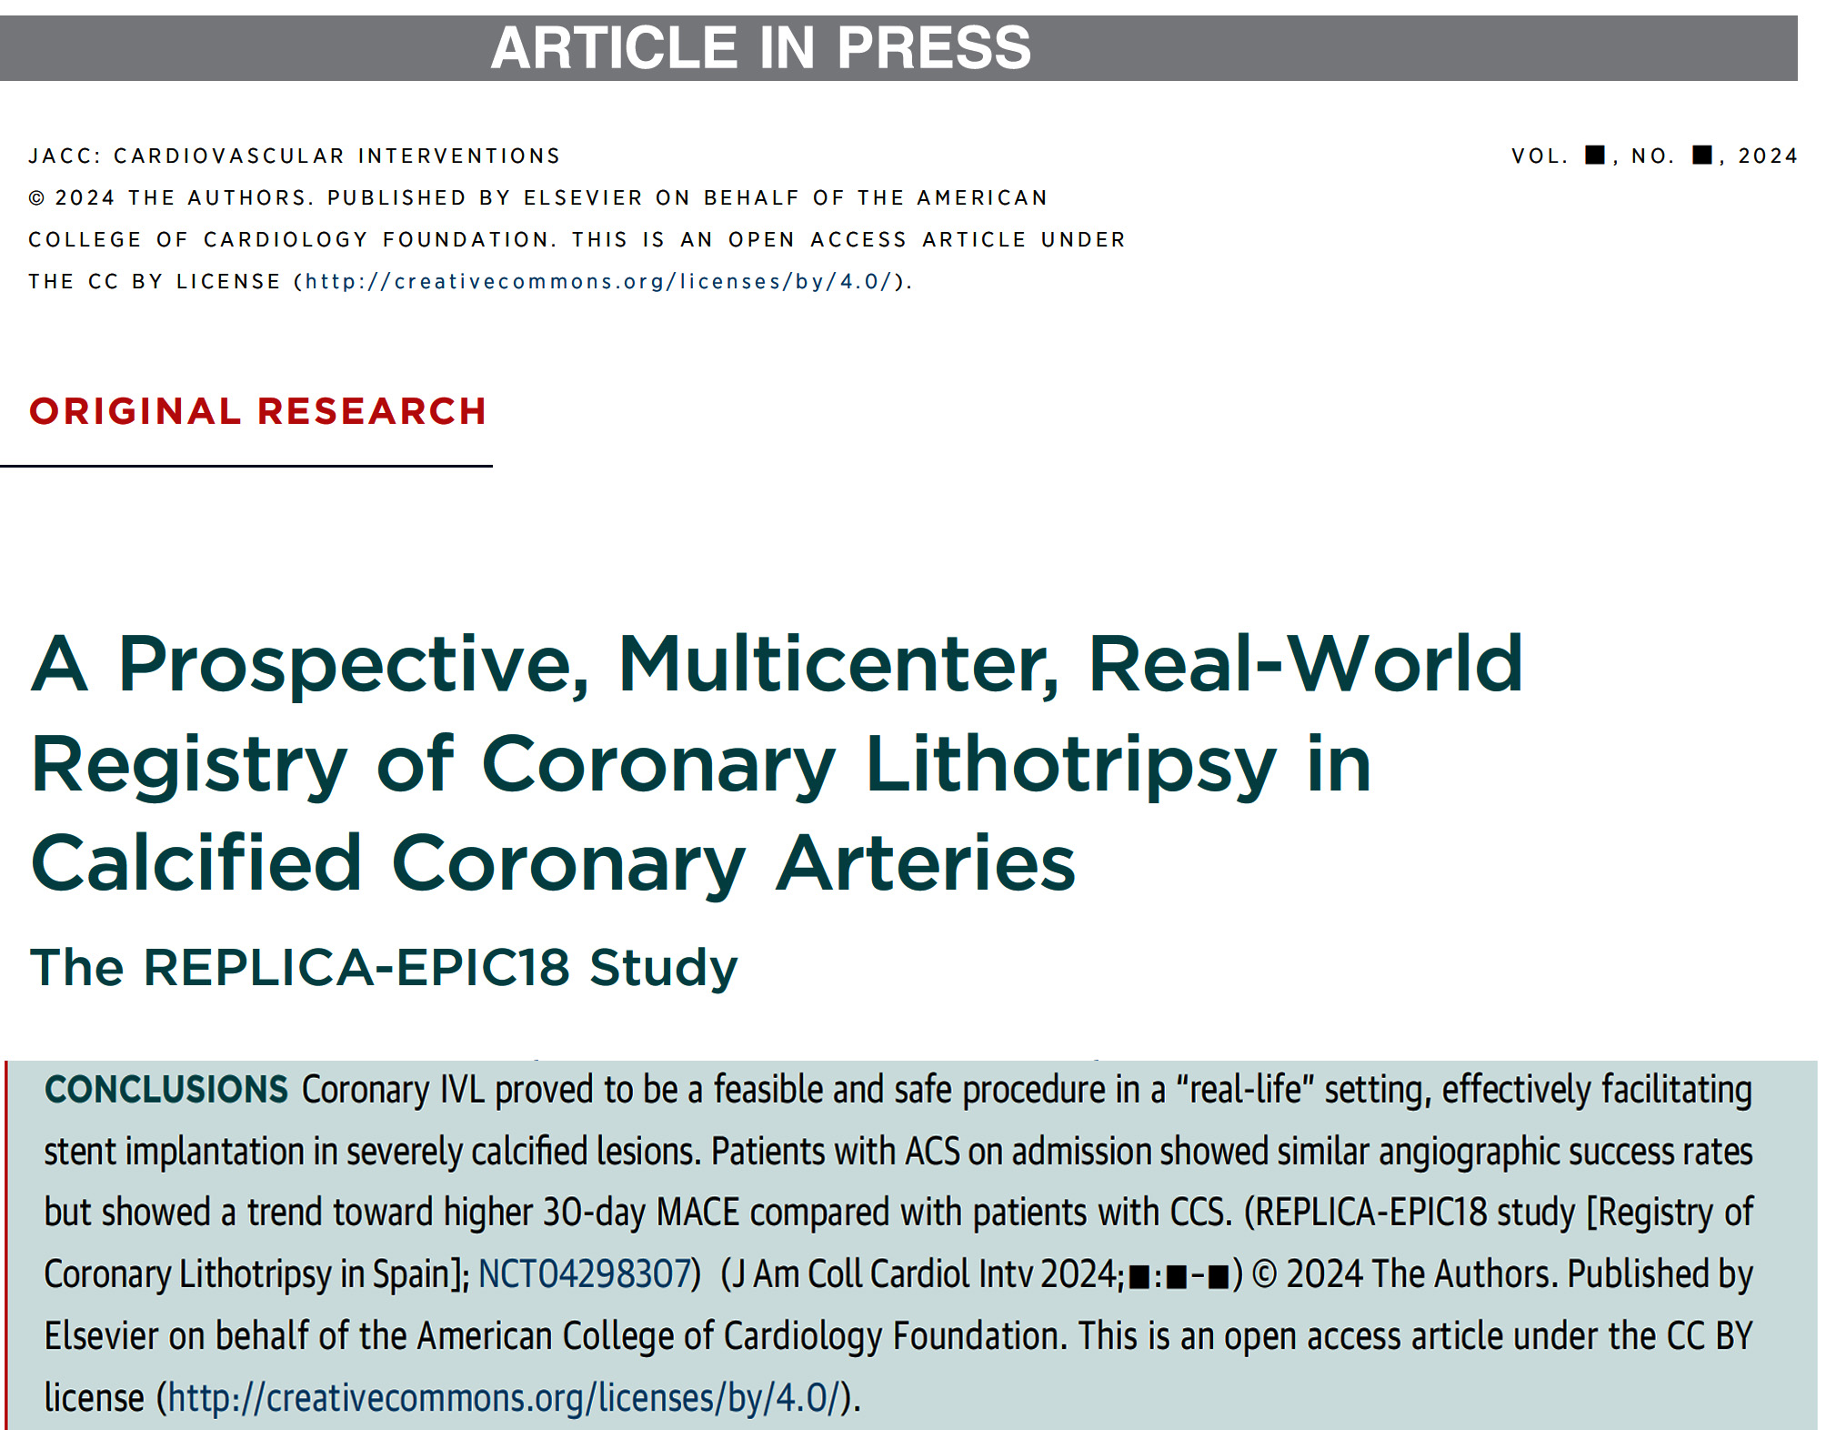

Slide 33
T-PASS Trial
Less Than 1-month Dual Anti-Platelet Therapy Followed by Ticagrelor Monotherapy After Coronary Drug-Eluting Stent Implantation for Acute Coronary Syndrome: A Randomized Trial

Slide 34
T-PASS Trial: Schematic Study Design
≈16Days
Hong et al., Circulation 2024;149:562

Slide 35
T-PASS Trial: Study Flow
2,850 ACS Patients
Randomized
Ticagrelor monotherapy after <1-month DAPT, N=1,426
Ticagrelor-based 12-month DAPT N=1,424
205 | did not receive the allocated therapy
 | 122 | aspirin >30 days
 | 30 | other P2Y12 inhibitor with aspirin
 | 53 | other P2Y12 inhibitor monotherapy
 | 14 | died
 | 8 | lost to follow-up
 | 6 | withdrew consent
164 | did not receive the allocated therapy
 | 111 | other P2Y12 inhibitor with aspirin
 | 42 | P2Y12 inhibitor monotherapy
 | 11 | aspirin monotherapy
 | 14 | died
 | 9 | lost to follow-up
 | 4 | withdrew consent
1426 | were included in intention-to-treat analysis
1424 | were included in intention-to-treat analysis
Hong et al., Circulation 2024;149:562

Slide 36
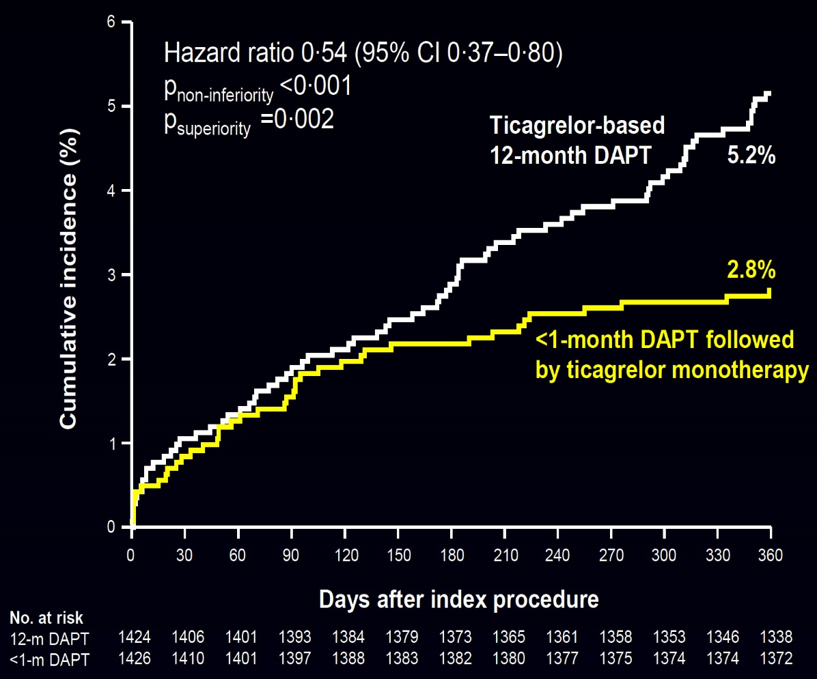
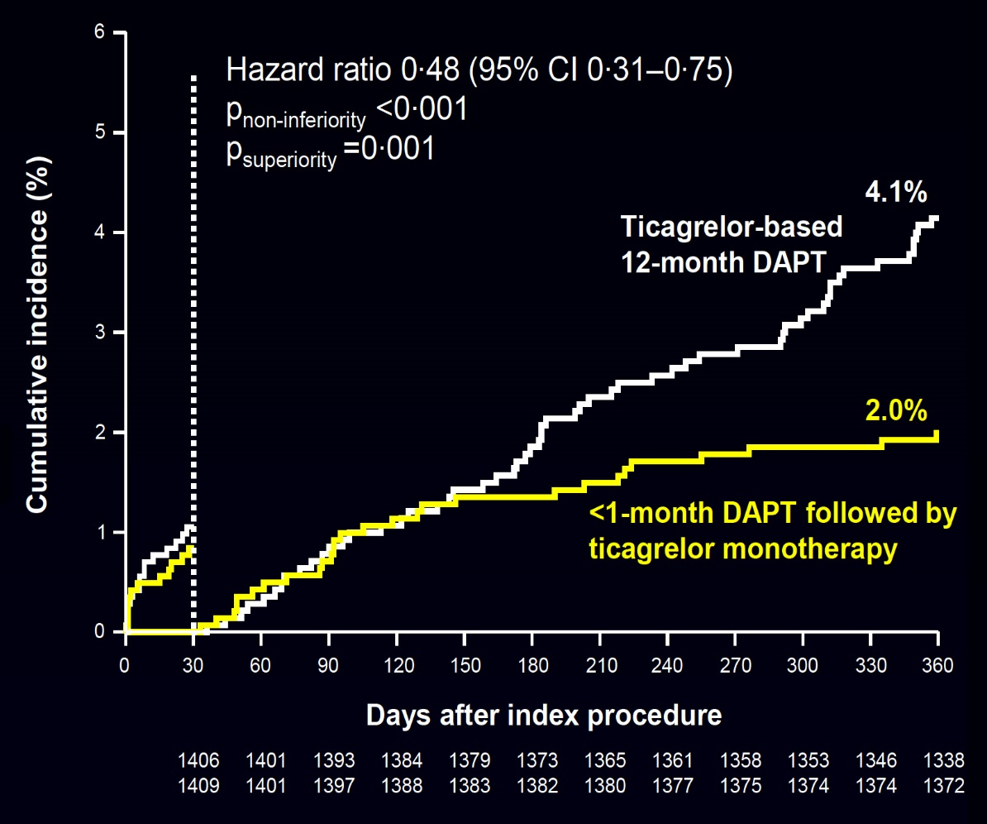
T-PASS Trial: Primary Outcome (NACE)
12-month Clinical Outcome
1-month Land-mark Analyses
Hong et al., Circulation 2024;149:562

Slide 37
T-PASS Trial: Clinical Outcomes at 12 Months
16days
p=0.002
p<0.001
p=0.51
p=0.17
%
p<0.001
p>0.99
p=0.49
p=0.80
p>0.99
NACE Death MI ST Stroke Death, MI Major Major MACE
or Stroke Bleeding Bleeding
BARC type 3-5
BARC type 5
Hong et al., Circulation 2024;149:562

Slide 38
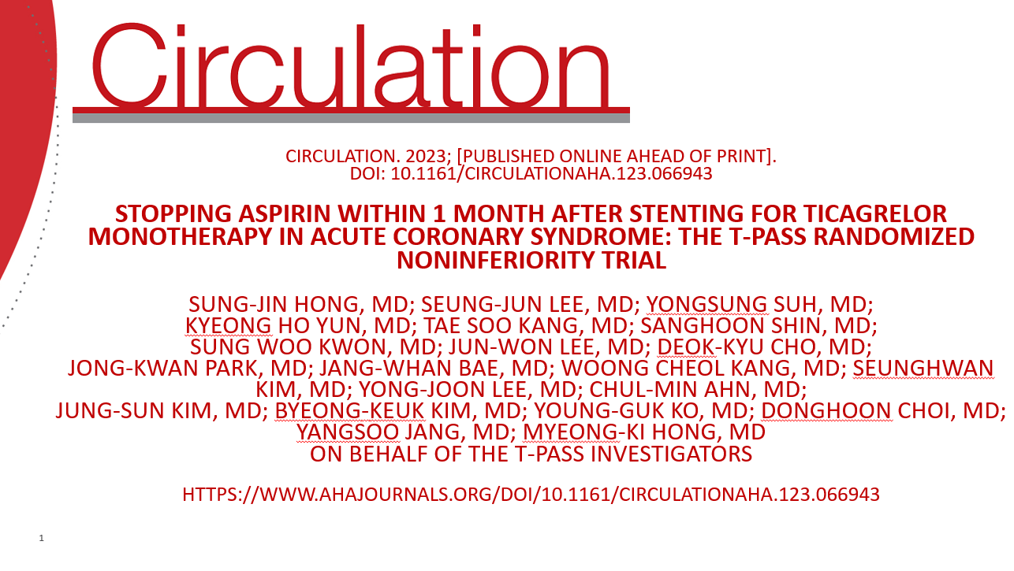
Hong et al., Circulation 2024;149:562

Slide 39
3M DAPT Trials
U.K. and U.S.

Slide 40
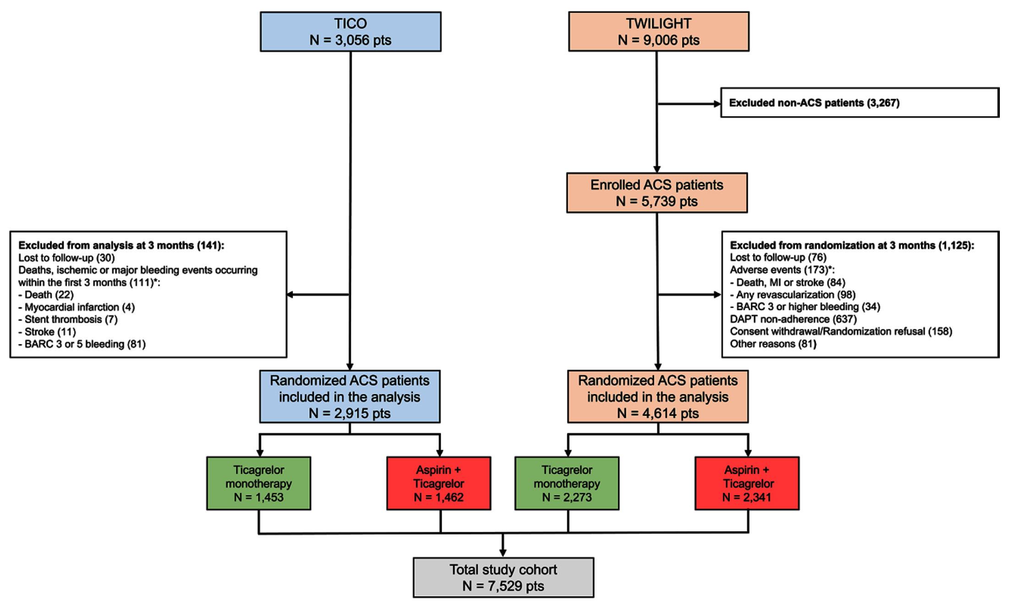
TWILIGHT & TICO Trials: Flowchart of Patient Inclusion
3M
Usman et al., Circulation 2024;143:574

Slide 41
TWILIGHT & TICO Trials: Clinical Outcomes of Individual Patient Data
p<0.001
%
p=0.004
p=0.52
p<0.001
p=0.81
p=0.22
p=0.88
p=0.59
Usman et al., Circulation 2024;143:574

Slide 42
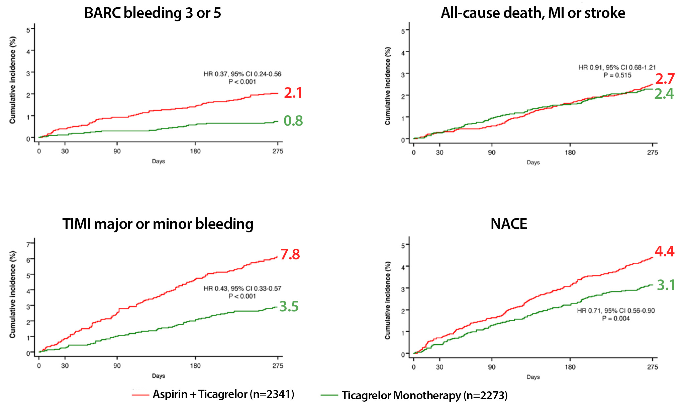
TWILIGHT & TICO Trials: Primary and Secondary Clinical Outcomes
Usman et al., Circulation 2024;143:574

Slide 44
After 1-3M

Slide 45
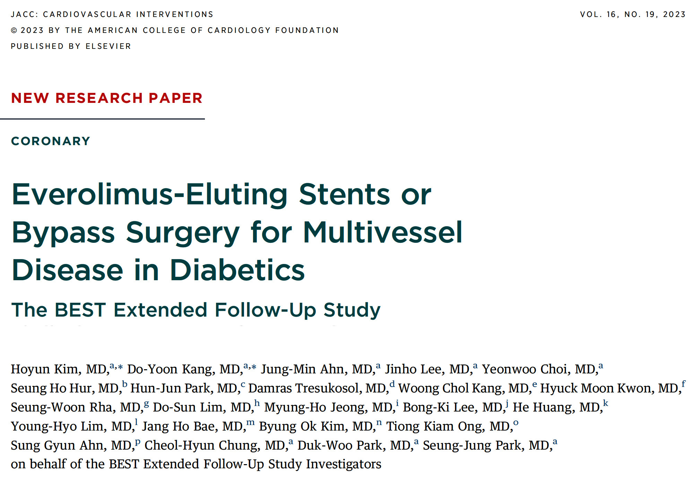
(Multicenter - South Korea, China, Malaysia and Thailand)
(Ten-Year Outcomes of Randomized Comparison of Coronary Artery Bypass Surgery and Everolimus-Eluting Stent Implantation in the Treatment of Patients With Multivessel Coronary Artery Disease)

Slide 46
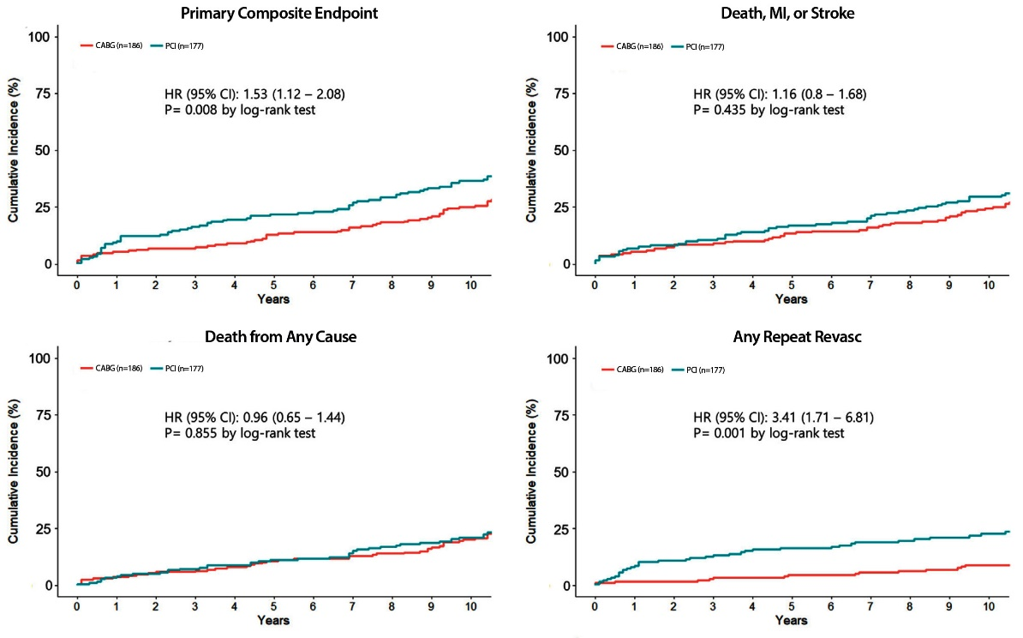
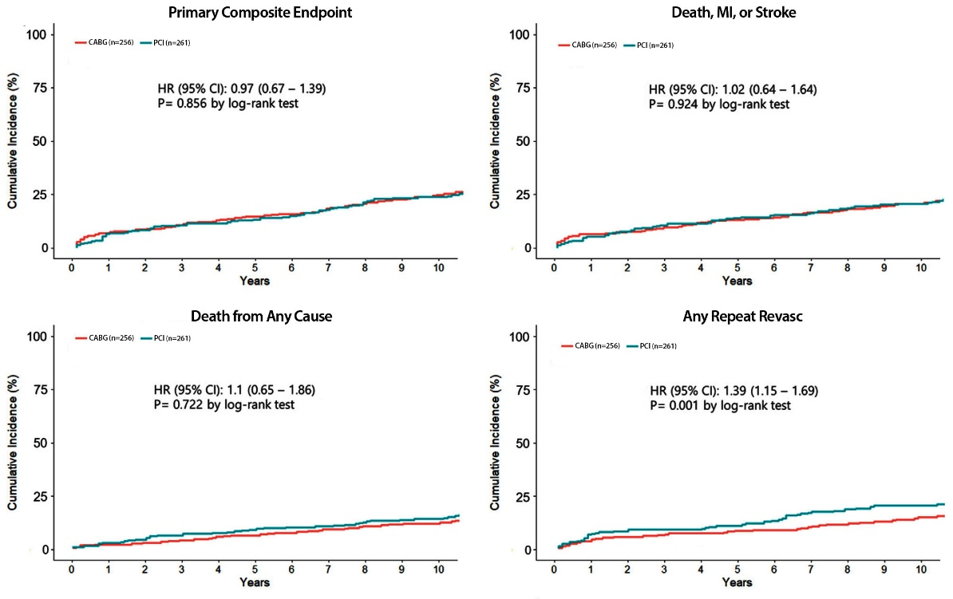
BEST Extended Trial: K-M Curves for the Primary
Endpoint and the Major Secondary Endpoint in Diabetes and Non-diabetes
Diabetic Group
Non-diabetic Group
Significant interaction found between the diabetes status and treatment grp on risk of primary endpoint (p=0.009)
Rates of death and safety composite of death, MI, or stroke were not significantly different between PCI and CABG grps in both diabetics and nondiabetics
Regardless of diabetes status, rate of repeat revasc was significantly higher after PCI than after CABG
Treatment effect of CABG over PCI on risk of repeat revasc was significantly greater in dibetics than in nondiabetics
Kim et al., J Am Coll Cardiol Intv 2023;16:2412

Slide 47
BEST Extended Trial: Long-Term Clinical Endpoints According to Diabetes Status and Treatment Grp
Diabetic Group
Nondiabetic Group
p=0.009
p=0.856
p=0.28
p=0.022
p=0.022
p=0.28
p=0.27
p=0.71
p=0.27
p=0.71
Rate of primary endpoint was significantly higher in PCI grp than in the CABG grp (43% and 32%; HR 1.53; 95% CI: 1.12-2.08; p=0.008
No significant differences was found between grps (29% and 29%; HR 0.97; 95% CI: 0.67-1.39; p=0.856
Kim et al., J Am Coll Cardiol Intv 2023;16:2412

Slide 48
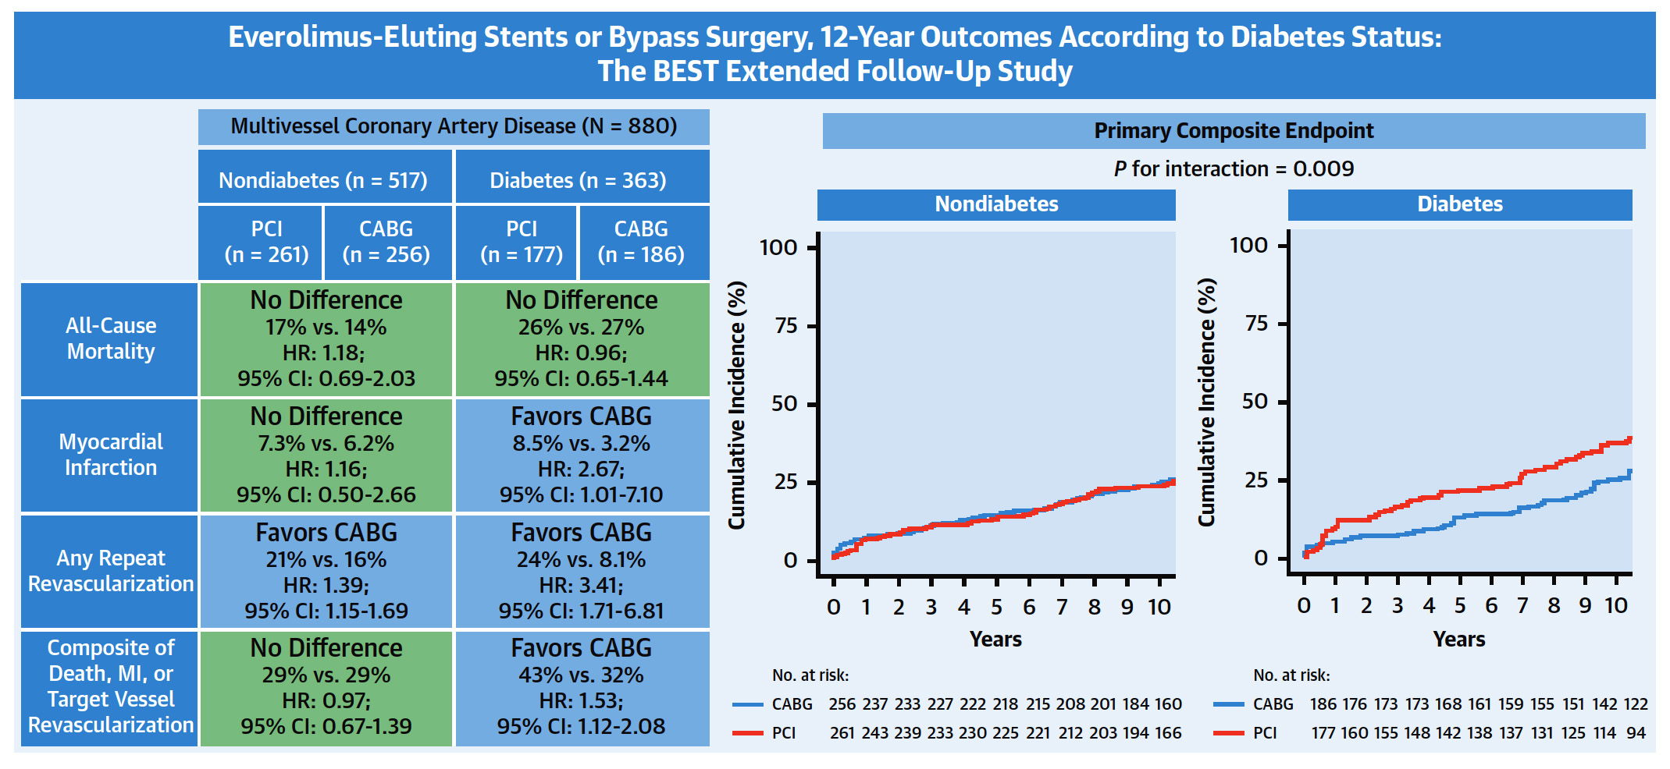
BEST Extended Trial: Summary of the Clinical Outcomes
Kim et al., J Am Coll Cardiol Intv 2023;16:2412

Slide 49
(Multicenter - South Korea, China, Malaysia and Thailand)
(Ten-Year Outcomes of Randomized Comparison of Coronary Artery Bypass Surgery and Everolimus-Eluting Stent Implantation in the Treatment of Patients With Multivessel Coronary Artery Disease)

Slide 50
Latest Issues in Coronary Intervention
Recent Interventional Trials and Publications:
DCB-ACS Trial, REPLICA-EPIC 18 Study, T-PASS
Trial, 3M DAPT Trials, BEST Extended FU Study
Focused review of the month
Changing Landscape of Ca++ Modification Strategies after IVL:
Use of Calcium Modification Strategies during
PCI after Introduction of Coronary IVL

Slide 51
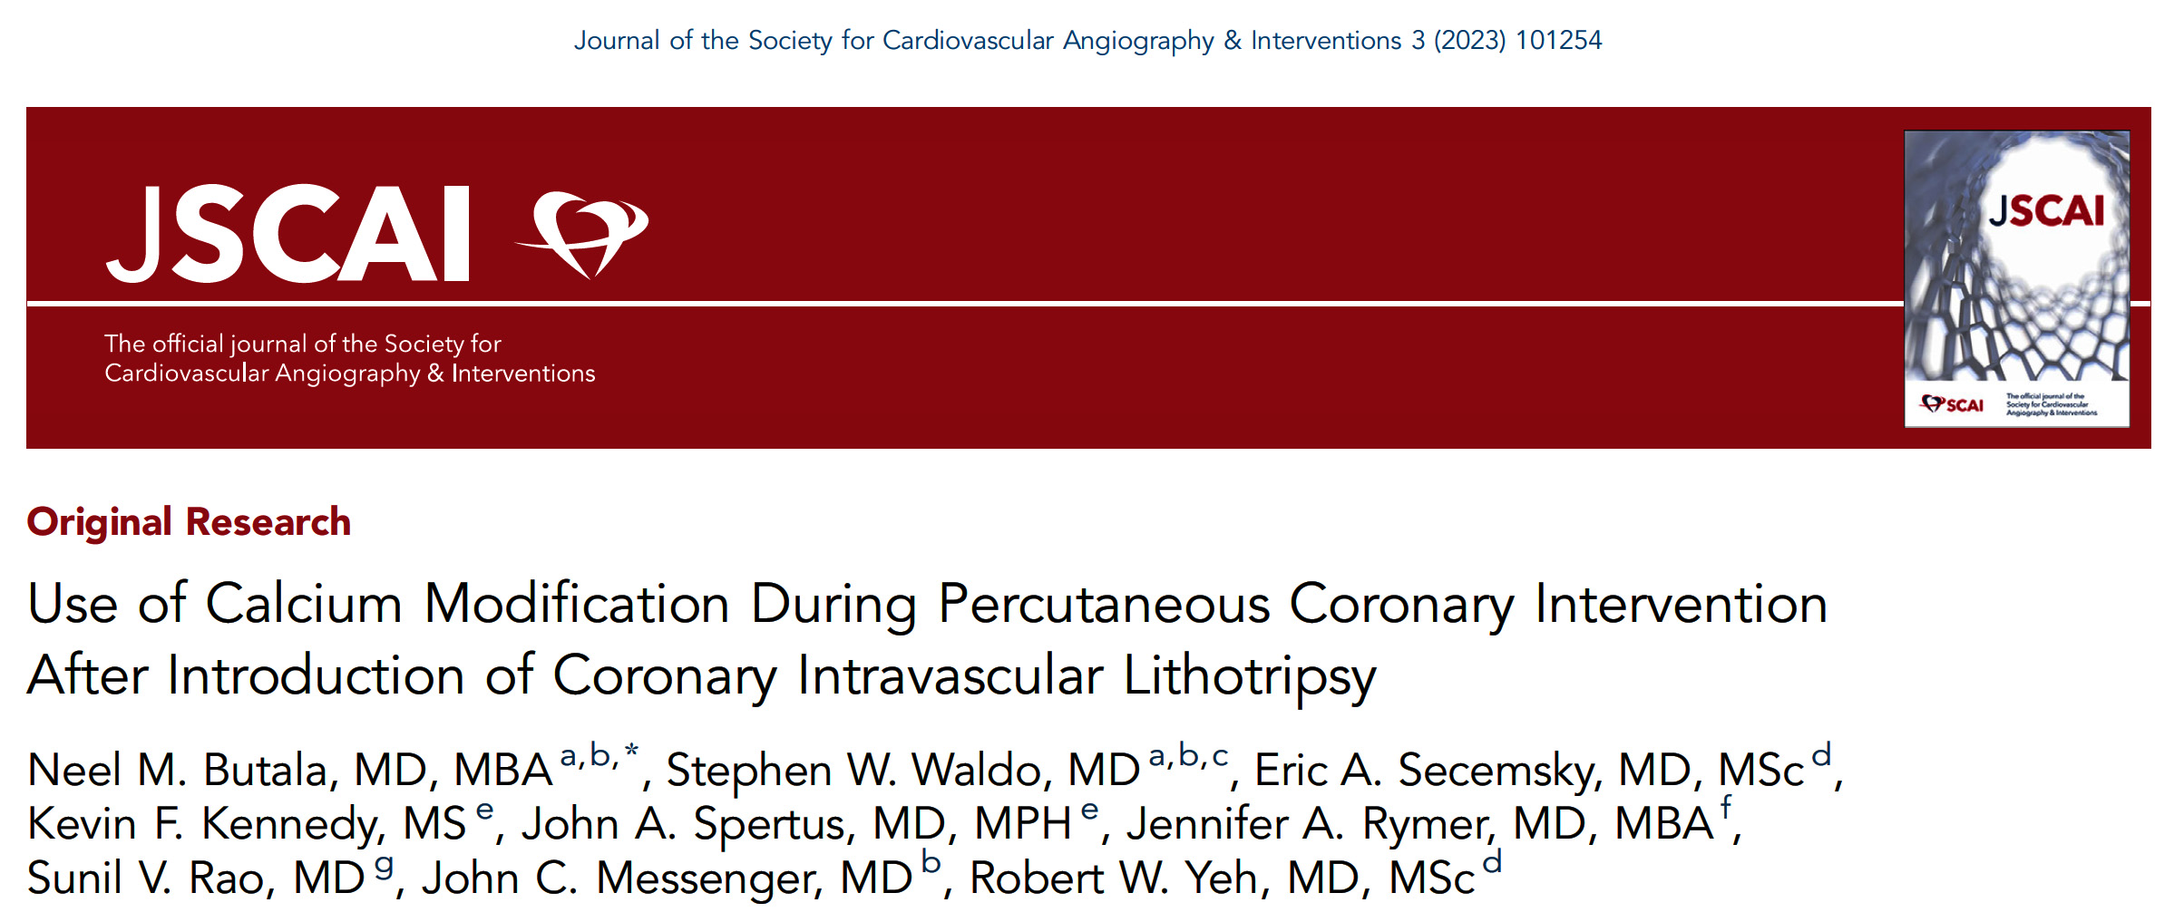
NCDR CathPCI Registry 4/1/2018-12/31/2022

Slide 52
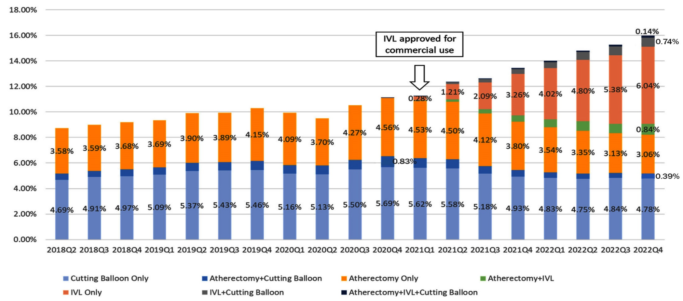
Trends in Use of Calcium Modification Strategies Among Patients Undergoing PCI
16%
11.1%
8.7%
8.7%
Use of calcium modification during PCI increased slightly from 8.7% in Q2 of 2018 to 11.1% in Q4 of 2020.
After commercial introduction of IVL in the 1st quarter of 2021, use of calcium modification increased rapidly to 16% in 4th quarter of 2022; during this period, IVL use increased from 0% to 7.8%, whereas any atherectomy use (alone or in combination with other strategies) decreased from 5.4% to 4.4% (19% decrease).
Butala et al., JSCAI Jan. 22, 2024 Epub ahead of print

Slide 53
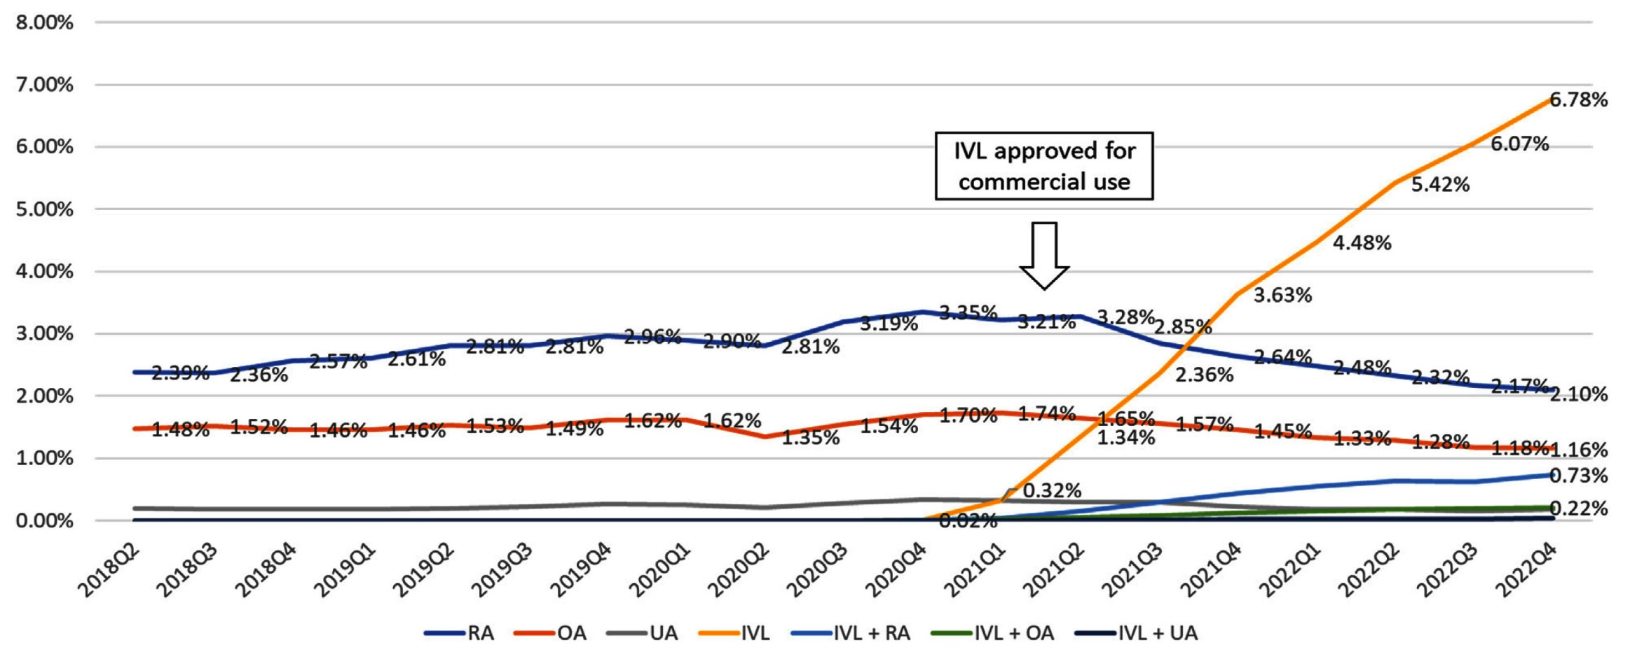
Trends in Use of Type of Atherectomy and IVL Among Patients Undergoing PCI
After the introduction of IVL, there was a slightly greater decrease in the use of OA (19% decrease from 1.7% to 1.4%) compared to RA (16% decrease from 3.4% to 2.8%)
In Q4 of 2022, there was over 3 times greater use of IVL in combination with RA compared with OA (RA, 0.73%; OA 0.22%), which was out of proportion to overall rates of utilization of RA alone versus OA alone in this population (RA, 2.1%; OA 1.2%; RA use 1.8 x that of OA).
Butala et al., JSCAI Jan. 22, 2024 Epub ahead of print

Slide 54
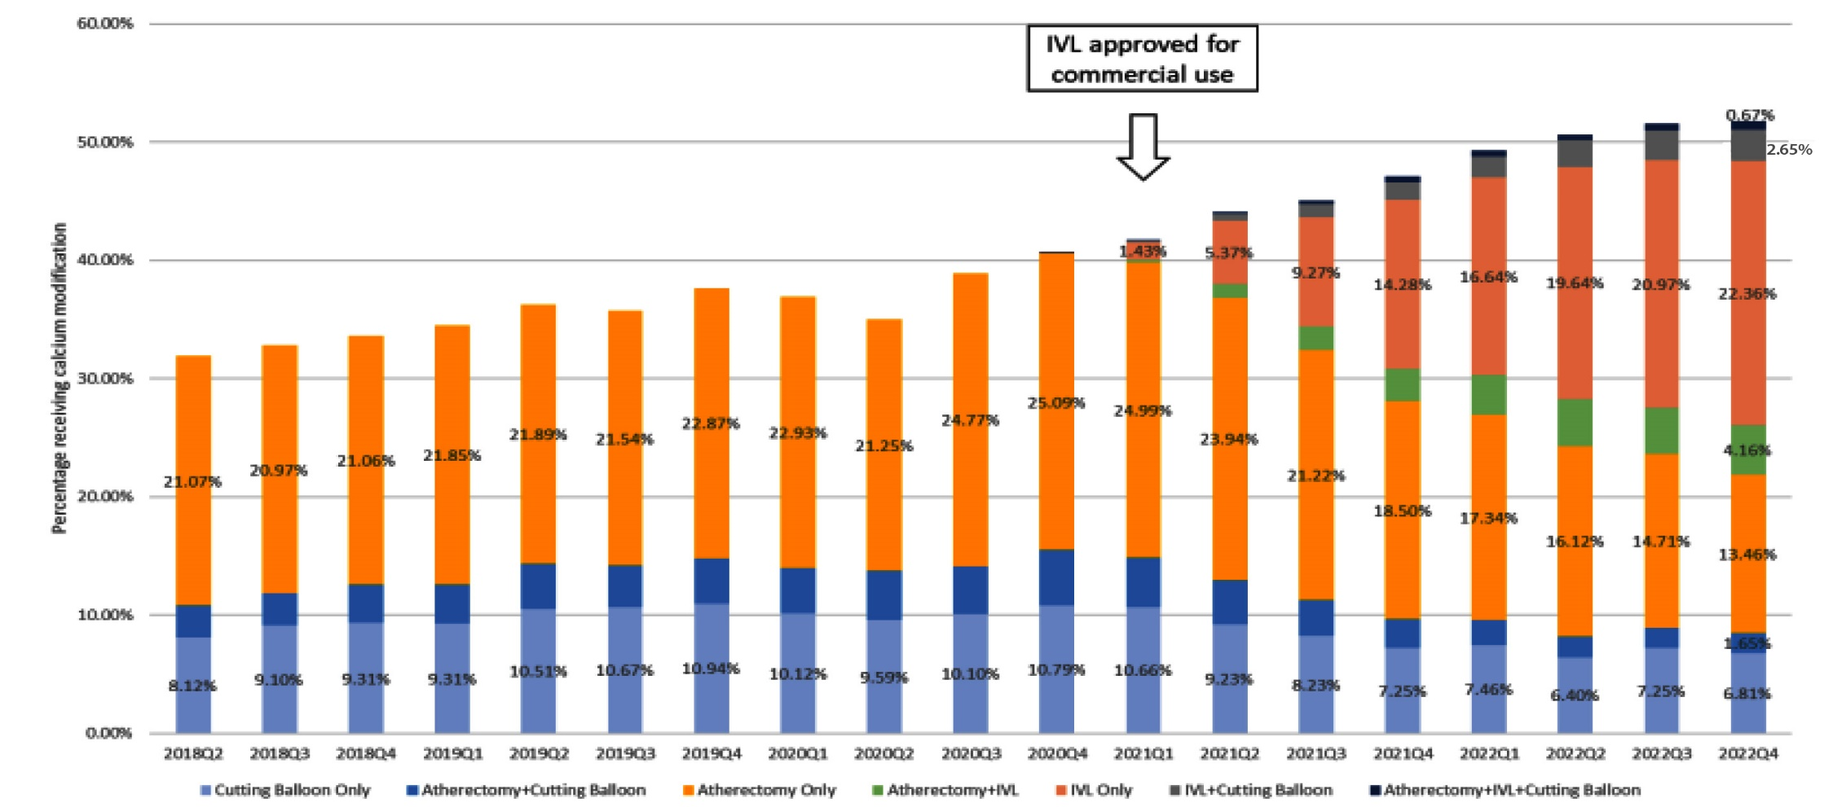
Trends in Use of Calcium Modification Strategies Among Patients Undergoing PCI with a Severely Calcified Lesion
Upon repeating analyses among the subgroup of 322,487 PCIs with any lesion classified by operators as severely calcified (11.8% of original sample), of which 41.5% used calcium modification found similar results overall
There was still rapid uptake in coronary IVL use for severely calcified lesions in the U.S. which led to an overall increase in calcium modification with displacement of atherectomy
Butala et al., JSCAI Jan. 22, 2024 Epub ahead of print

Slide 55
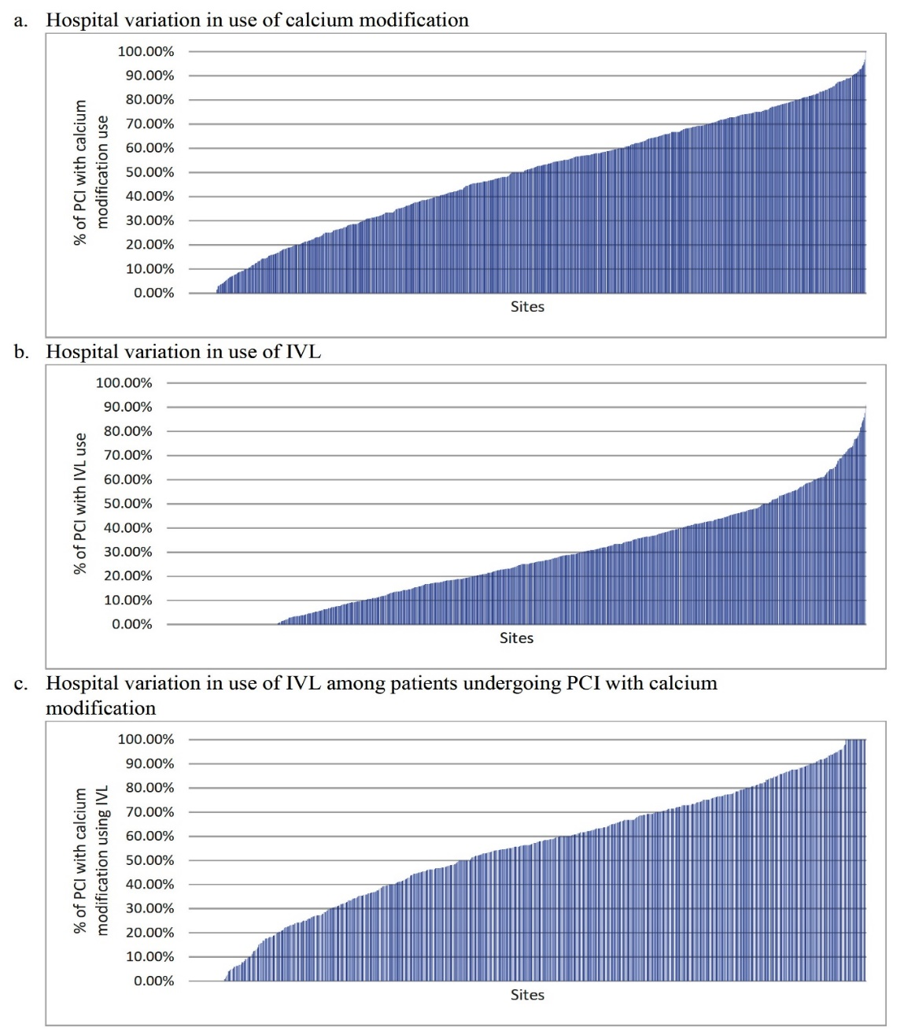
Variation in Calcium Modification Use for PCI of Pts with
a Severely Calcified Lesion Across Hospitals in 2022
Study continued to find wide variation in calcium modification and IVL use across hospitals
Butala et al., JSCAI Jan. 22, 2024 Epub ahead of print

Slide 56
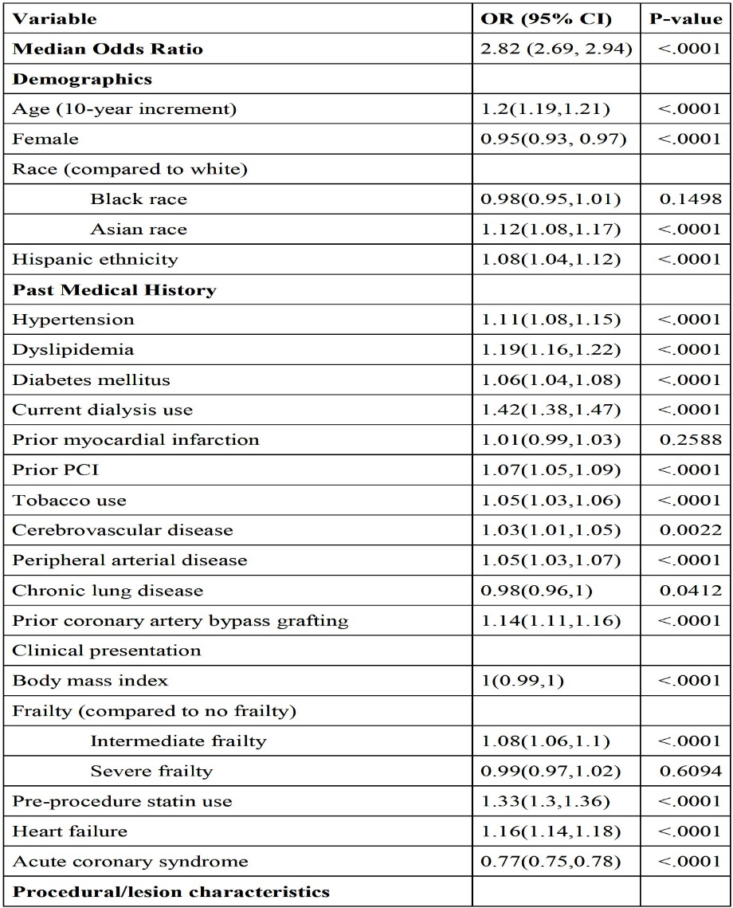
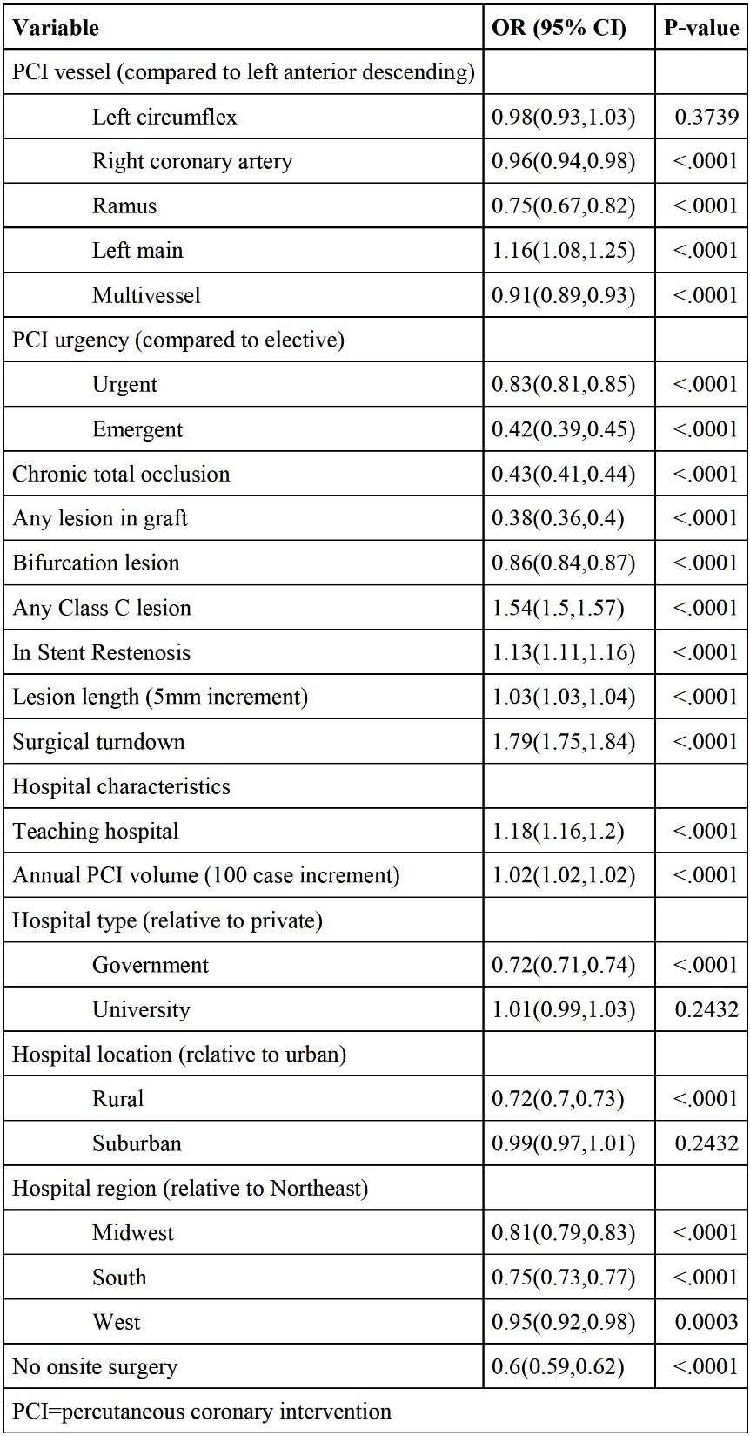
Predictors of Calcium Modification Use During PCI Among Patients Undergoing PCI with A Severely Calcified Lesion
Found evidence of differences in use of IVL were attenuated
Treating hospital remained the strongest predictor of use
Butala et al., JSCAI Jan. 22, 2024 Epub ahead of print

Slide 57
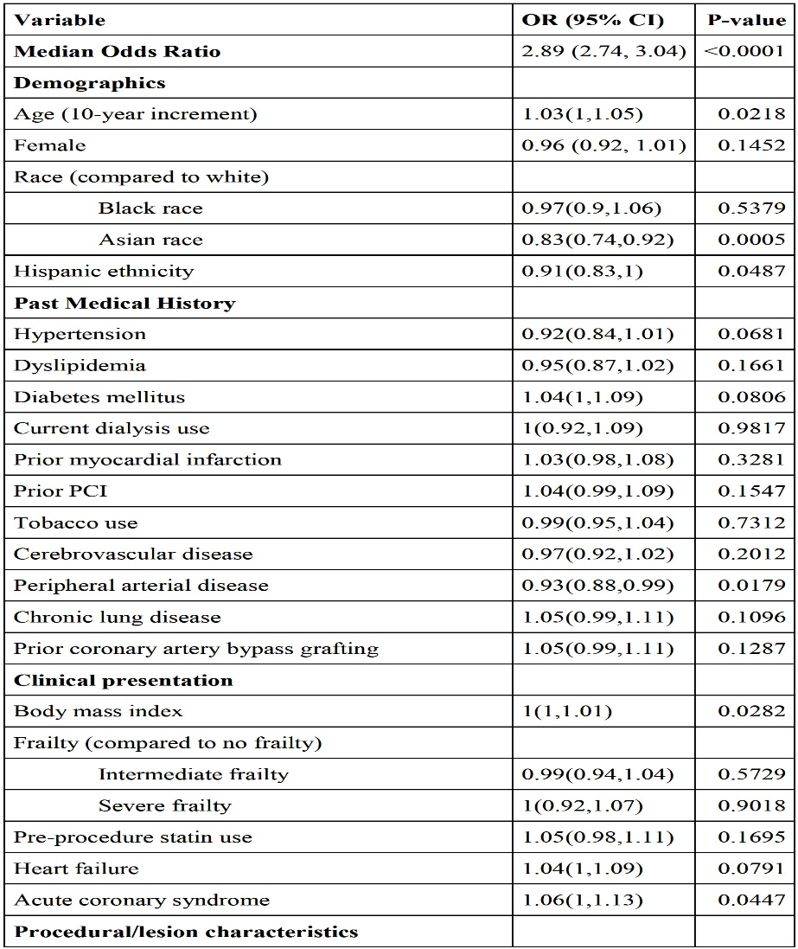
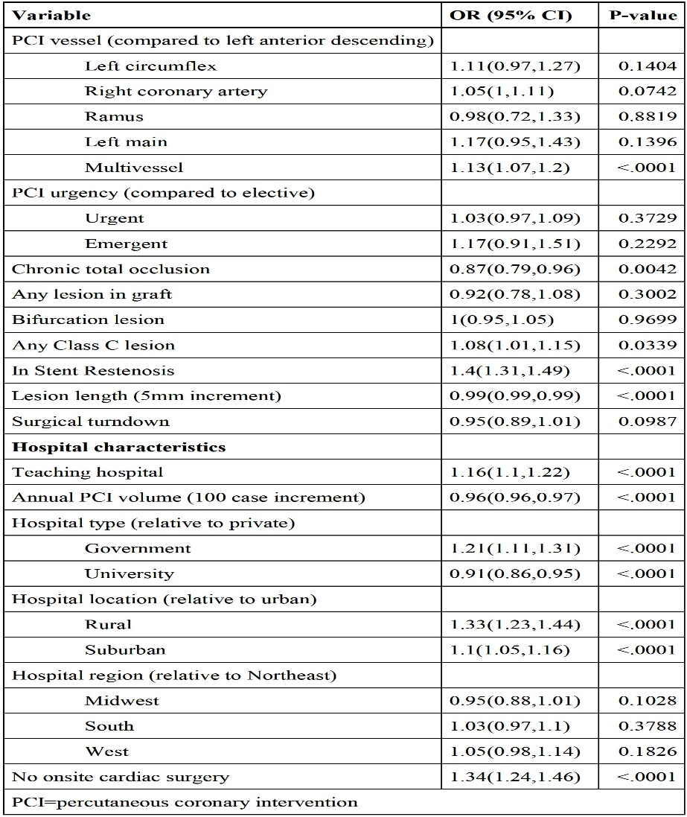
Predictors of IVL Use Among Those Receiving Calcium
Modification at Hospitals with IVL in 2022 Among Pts Undergoing PCI with a Severely Calcified Lesion
Found evidence of differences in use of IVL were attenuated
Treating hospital remained the strongest predictor of use
Butala et al., JSCAI Jan. 22, 2024 Epub ahead of print

Slide 58
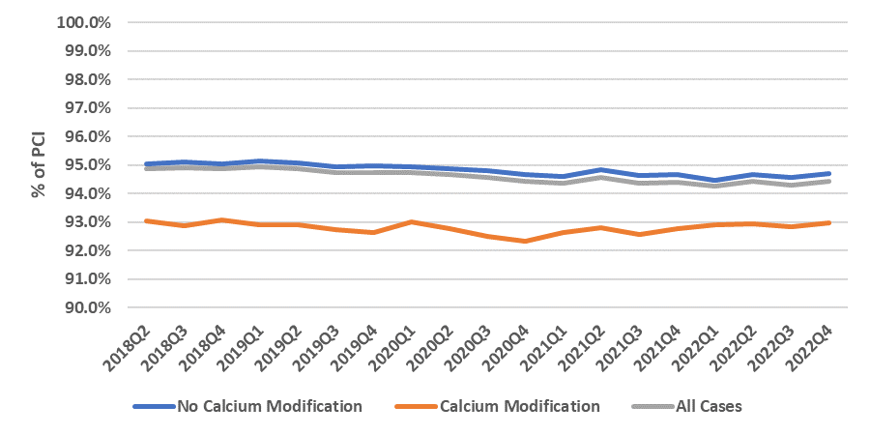
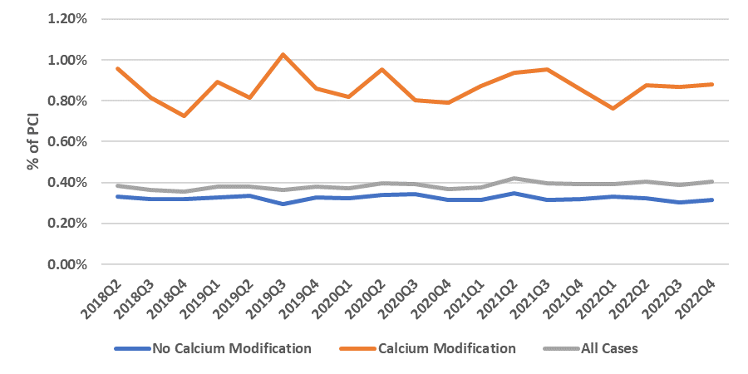
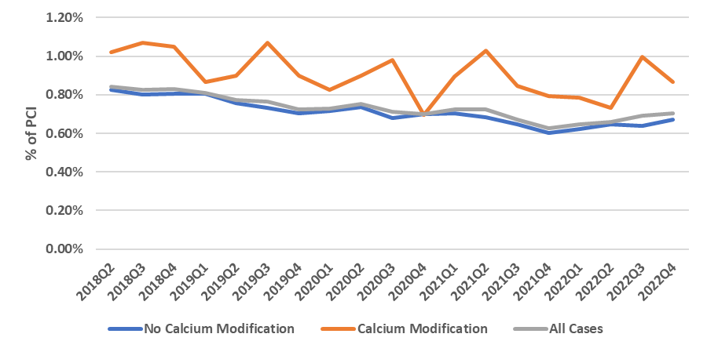
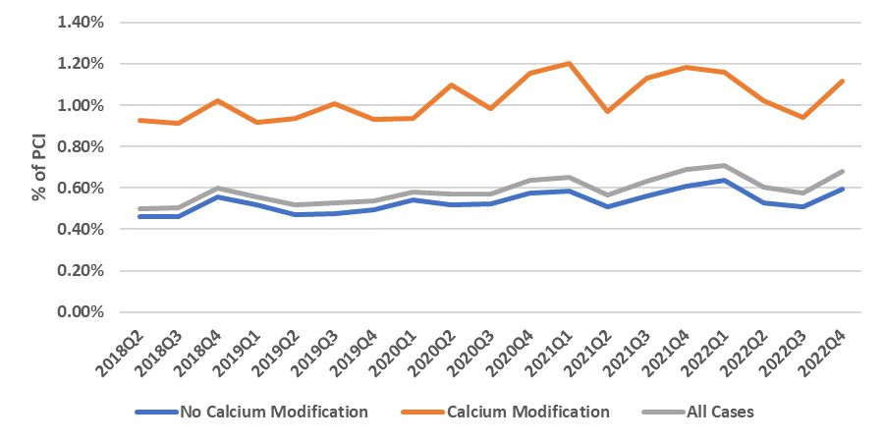
Trends in Outcomes Among Pts Undergoing PCI by Calcium Modification Use
Although PCIs using calcium modification had a lower rate of procedural success and higher rates of perforation, dissection, and in-hospital mortality, there were no apparent trends in these outcomes over the study period
Procedural Success
Perforation
Significant Dissection
In-Hospital Mortality
Butala et al., JSCAI Jan. 22, 2024 Epub ahead of print

Slide 60
Take Home Message: Recent Interventional Trials and Changing Landscape of Ca+ Modification after IVL
DCB vs DES in ACS pts for 9M FFR & MACE:
Differential MACE in CCS vs ACS with IVL:
1-3M vs 12M DAPT with Ticagrelor in ACS pts:
PCI vs CABG in Diabetics pts with MV CAD:
Calcified coronary lesions are increasing due to advancing age and the landscape of the calcium modifying strategies is rapidly changing since the introduction of IVL. Atherectomies (RA, OA, ELCA) have seen the significant steady decline since the IVL introduction, with increase use of device synergy (RA+IVL, OA+IVL). There remains wide race, sex, geographic and hospital variations in the use of IVL as well as in the use of various Ca modifying strategies. Increased hospital finances of the Ca+ modifying devices may explain many of the observed variations. Complications of Ca+ modifying strategies remains high but unchanged.
Notes:
HbA1c in

Slide 61
Question # 1
Following statement is false regarding the results of the DCB-ACS trial comparing DCB vs DES;
Similar MACE between DCB vs DES group
Similar MI rates between DCB vs DES group
Higher FFR value with DCB vs DDES at 9M F/U
Similar stent thrombosis between DCB vs DES group
Numerically lower TVR/TLR with DCB vs DES group
The correct answer is C

Slide 62
Question # 2
Following statements are correct regarding the results of 1-3M DAPT vs 12M DAPT in ACS except;
A. There is no difference in MACE in 2 groups
B. There is significantly lower bleeding rates with 1-3M vs 12M DAPT
C. There is no difference in death rates between 2 groups
D. Similar MI rates between 2 groups
E. Lower ST rate with 1-3M DAPT vs 12M DAPT
The correct answer is E
Notes:
er

Slide 63
Question # 3
Following statement is false regarding the changing landscape of calcium modification strategies since the introduction of IVL;
A. There is a significant rise in the IVL use
B. There is significant decline in atherectomies since IVL introduction
C. Device combinations strategies are increasing
D. Overall procedural/in-hospital complications have decreased since IVL introduction
E. About 50% of the severely calcified lesions are currently undergoing Ca modification strategy
The correct answer is D
Notes:
er

Slide 64
