Slide 1
Structural Heart Live Cases
Supported by:
Edward Lifesciences
Cook Medical
Terumo Medical Corporation
B-Braun Medical
BD Medical

Slide 2
Faculty Involved and Disclosures
Samin K. Sharma, MD, FACC, MSCAI
Nothing to disclose
Annapoorna S. Kini, MD, MRCP, FACC
Nothing to disclose
Sahil Khera, MD, FACC
Nothing to disclose
Gilbert Tang, MD, FACC
Proctor for Medtronic Inc
Stamatios Lerakis, MD, PhD, FACC, FAHA
Nothing to disclose
Pedro Moreno, MD, FACC [Moderator]
Nothing to disclose
Cardiac Anesthesiologist
Joseph Larese, MD

Slide 3
Redo TAVR with 26mm Sapien-3 U Resilia Valve in a failed Embolized Evolut FX Valve with Severe PVL

Slide 4
Structural Heart Live Case #58: FM, 84 y/o M
Presentation: Worsening Dyspnea on exertion, NYHA Class III and frequent pre-syncopal episodes
PMH: HTN, DM2, CAD s/p CABGx4 (1994), AS s/p TAVR 29mm Evolut FX x2 (November 2023 @OSH) complicated by valve embolization, aortic root dissection, and CHB (s/p PPM), PVD s/p stents & right fem-popliteal bypass, Anemia, Right carotid stenosis (80-99%)
Medications: Aspirin 81mg OD, Clopidogrel 75mg OD, Atorvastatin 40mg OD, Metformin 1,000mg BID, Torsemide 20mg OD
Labs: Hgb 8.2, Plt 174, Creat 1.2, INR 1.1
EKG: V-paced 85 bpm
Cardiac Cath: All 4 patent grafts
TEE: LVEF 56%, mod-severe PVL (multiple jets), mean AV gradient 6mmHg, overlapping Evolut FX valves, moderate MR, mild TR

Slide 5
Echocardiogram

Slide 6
Echocardiogram - PVL

Slide 7
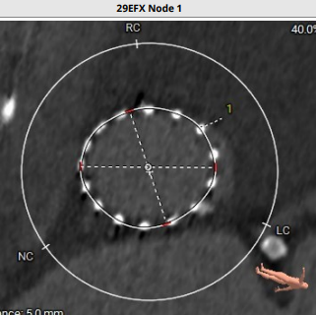
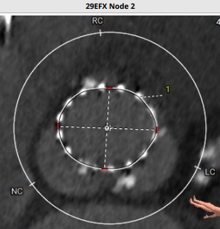
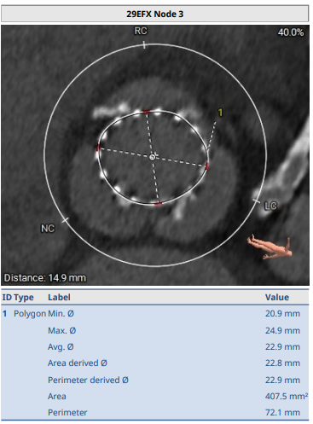
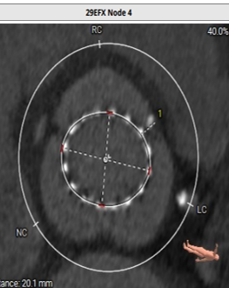
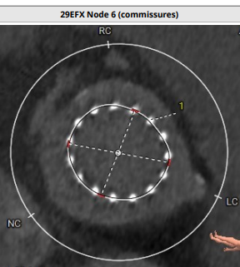
CT TAVR
Node 1
Node 2
Node 3
Area – 474.2 mm ² Perimeter – 77.5 mm
Area – 432.0 mm ² Perimeter – 74.3 mm
Area – 407.5 mm ² Perimeter – 72.1 mm
Node 4
Node 5
Node 6
Area – 400.1 mm ²
Perimeter – 71.4 mm
Area – 390.5 mm ²
Perimeter – 70.3mm
Area – 392.6 mm ²
Perimeter – 70.5 mm

Slide 8
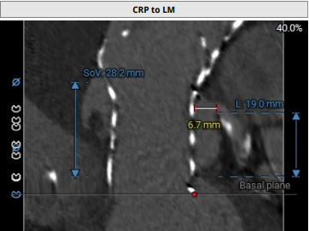
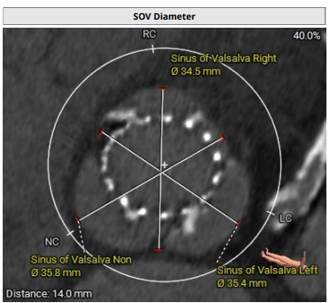
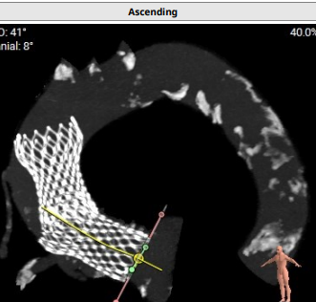
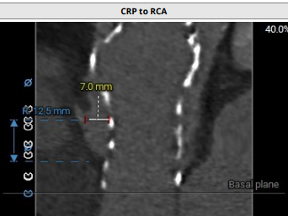
CT TAVR
Sinus of Valsalva
Right – 34.5 mm
Left- 35.4 mm
Non – 35.8 mm
Left coronary height – 19.0 mm
Right coronary height – 12.5 mm
Coronary risk plain to
RCA – 7.0 mm
LM – 6.6 mm

Slide 9
Redo TAV App
Redo TAV APP

Slide 10
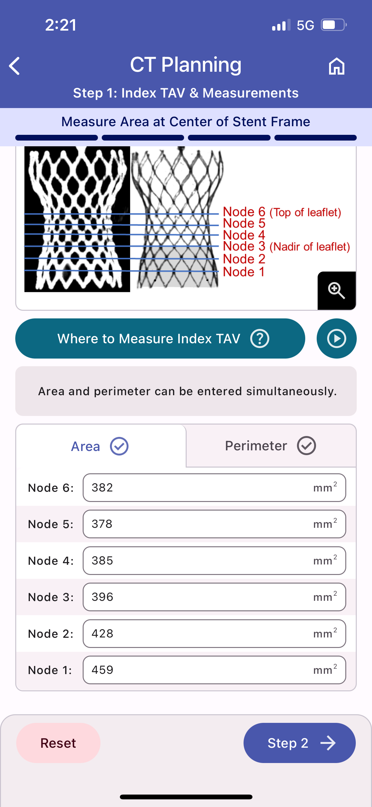
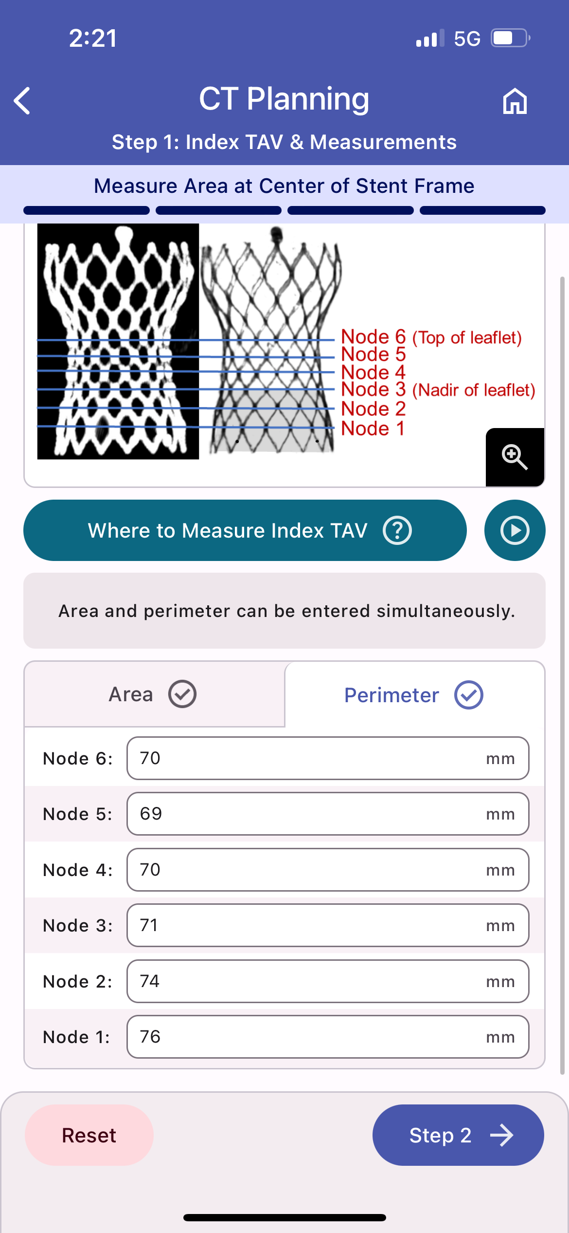
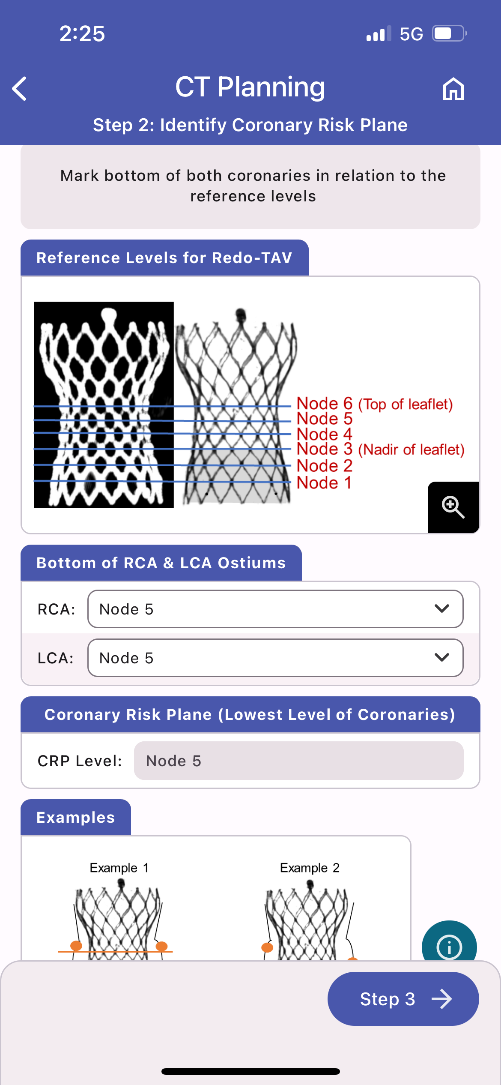
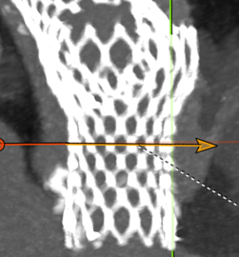
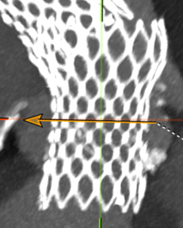
Bottom of RCA at Node 5
Bottom of LCA at Node 5

Slide 11
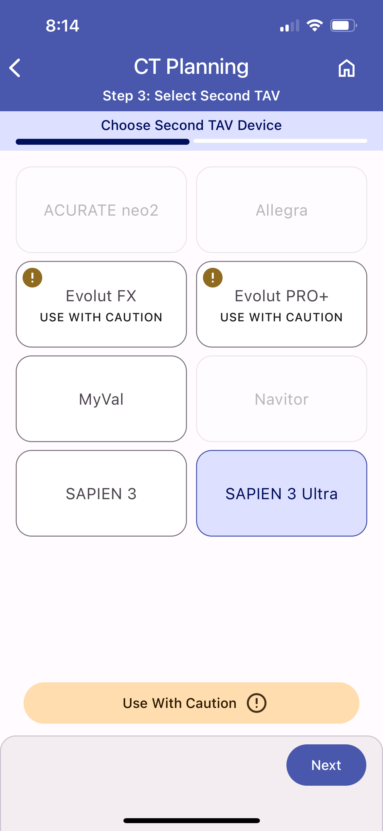
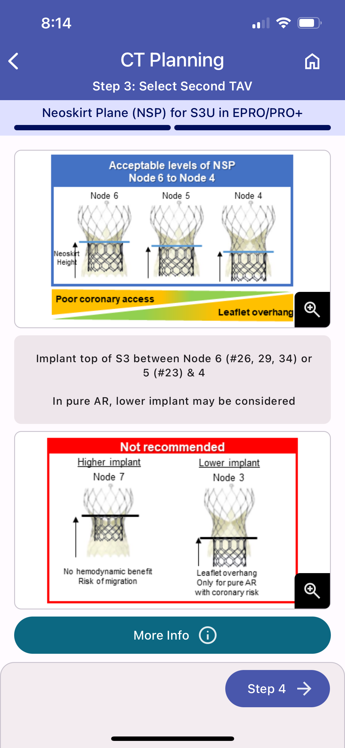
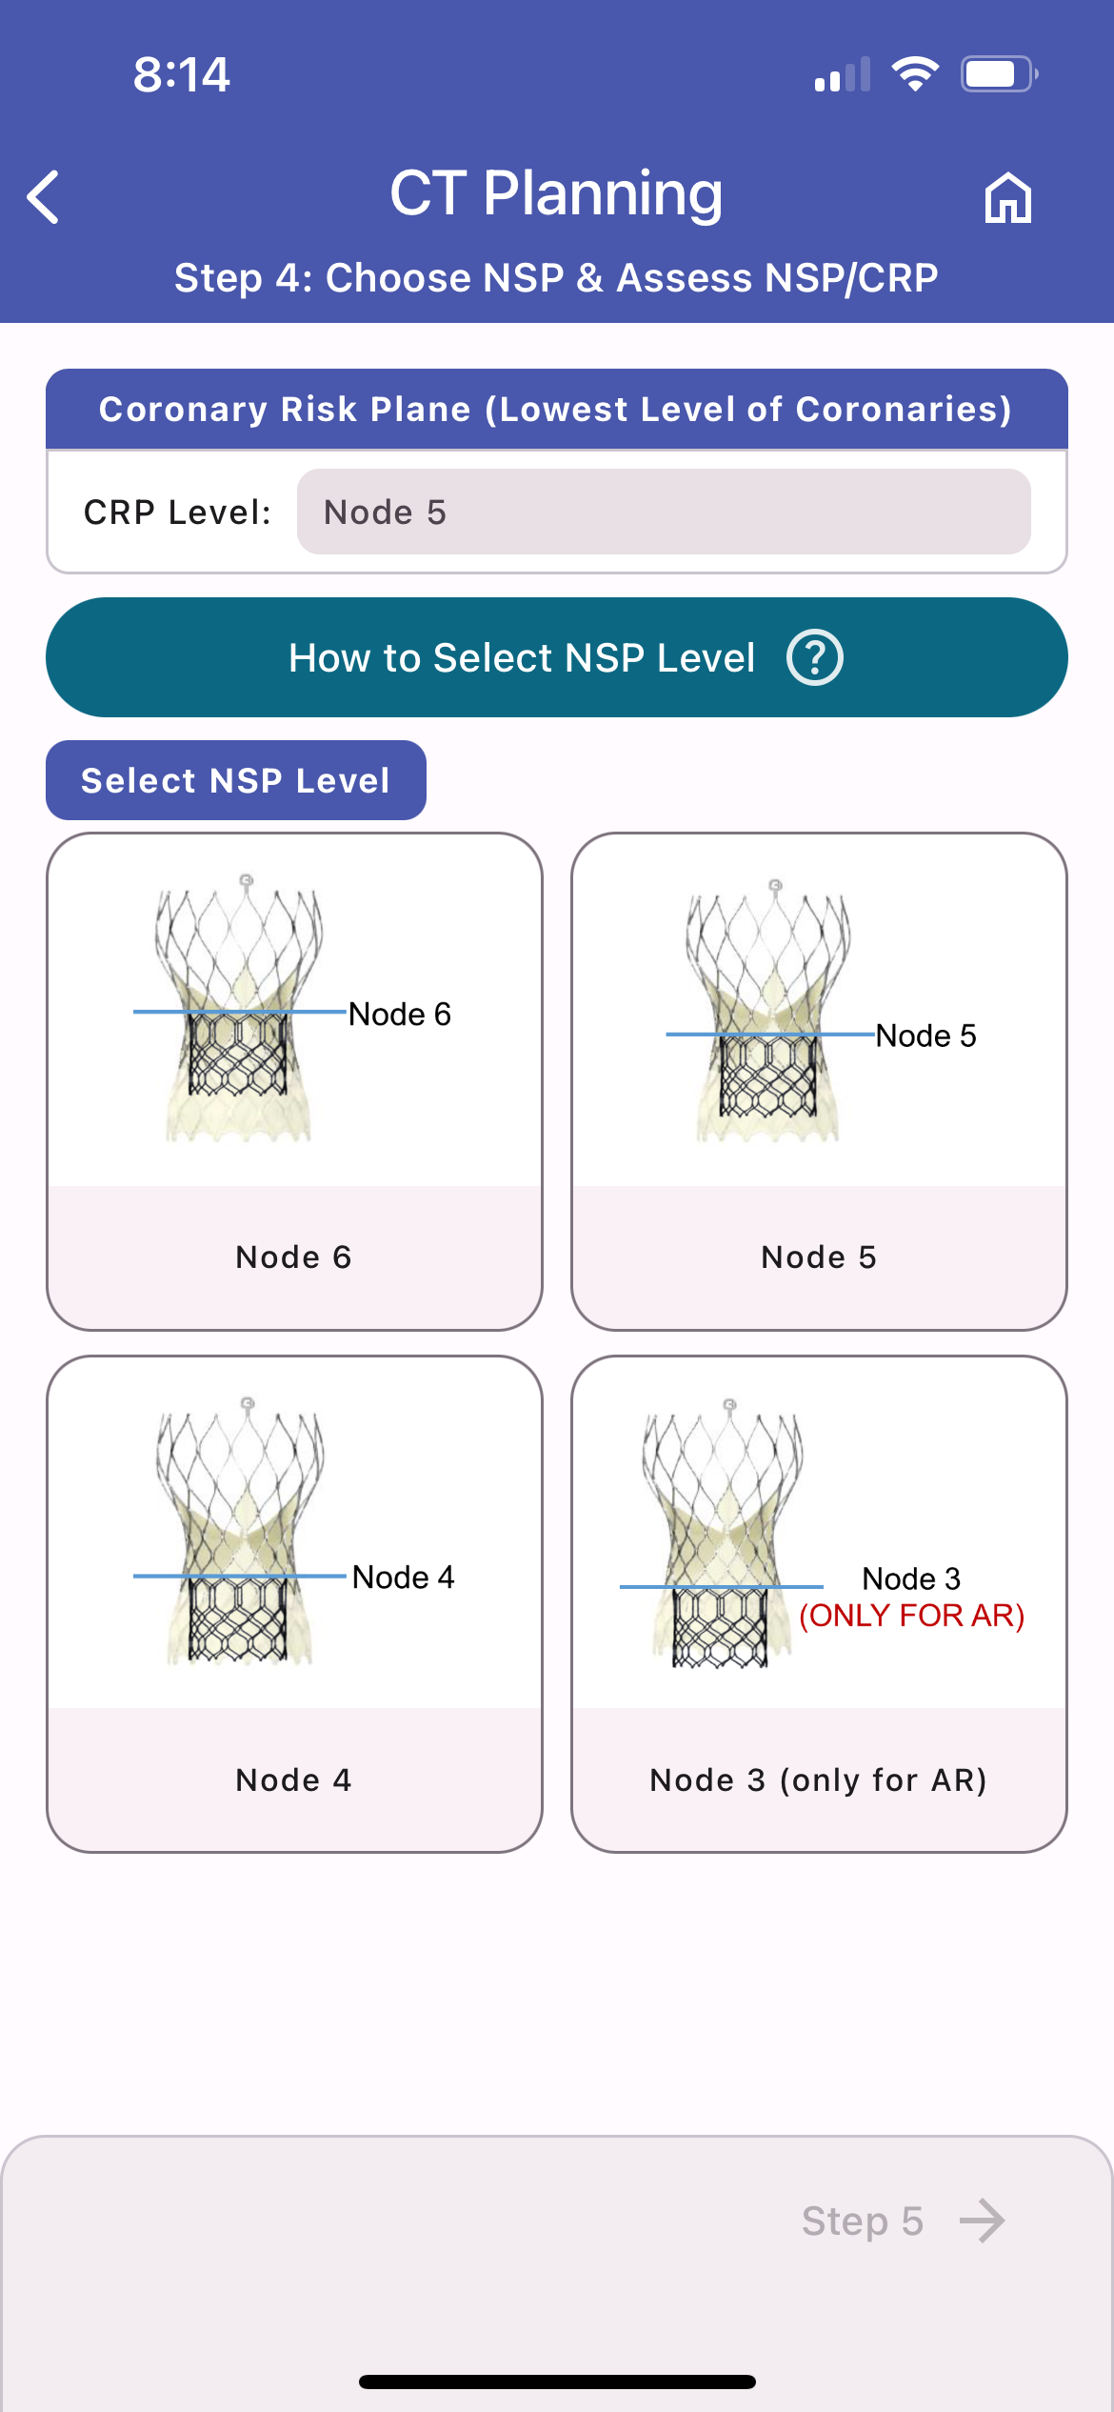

Slide 12
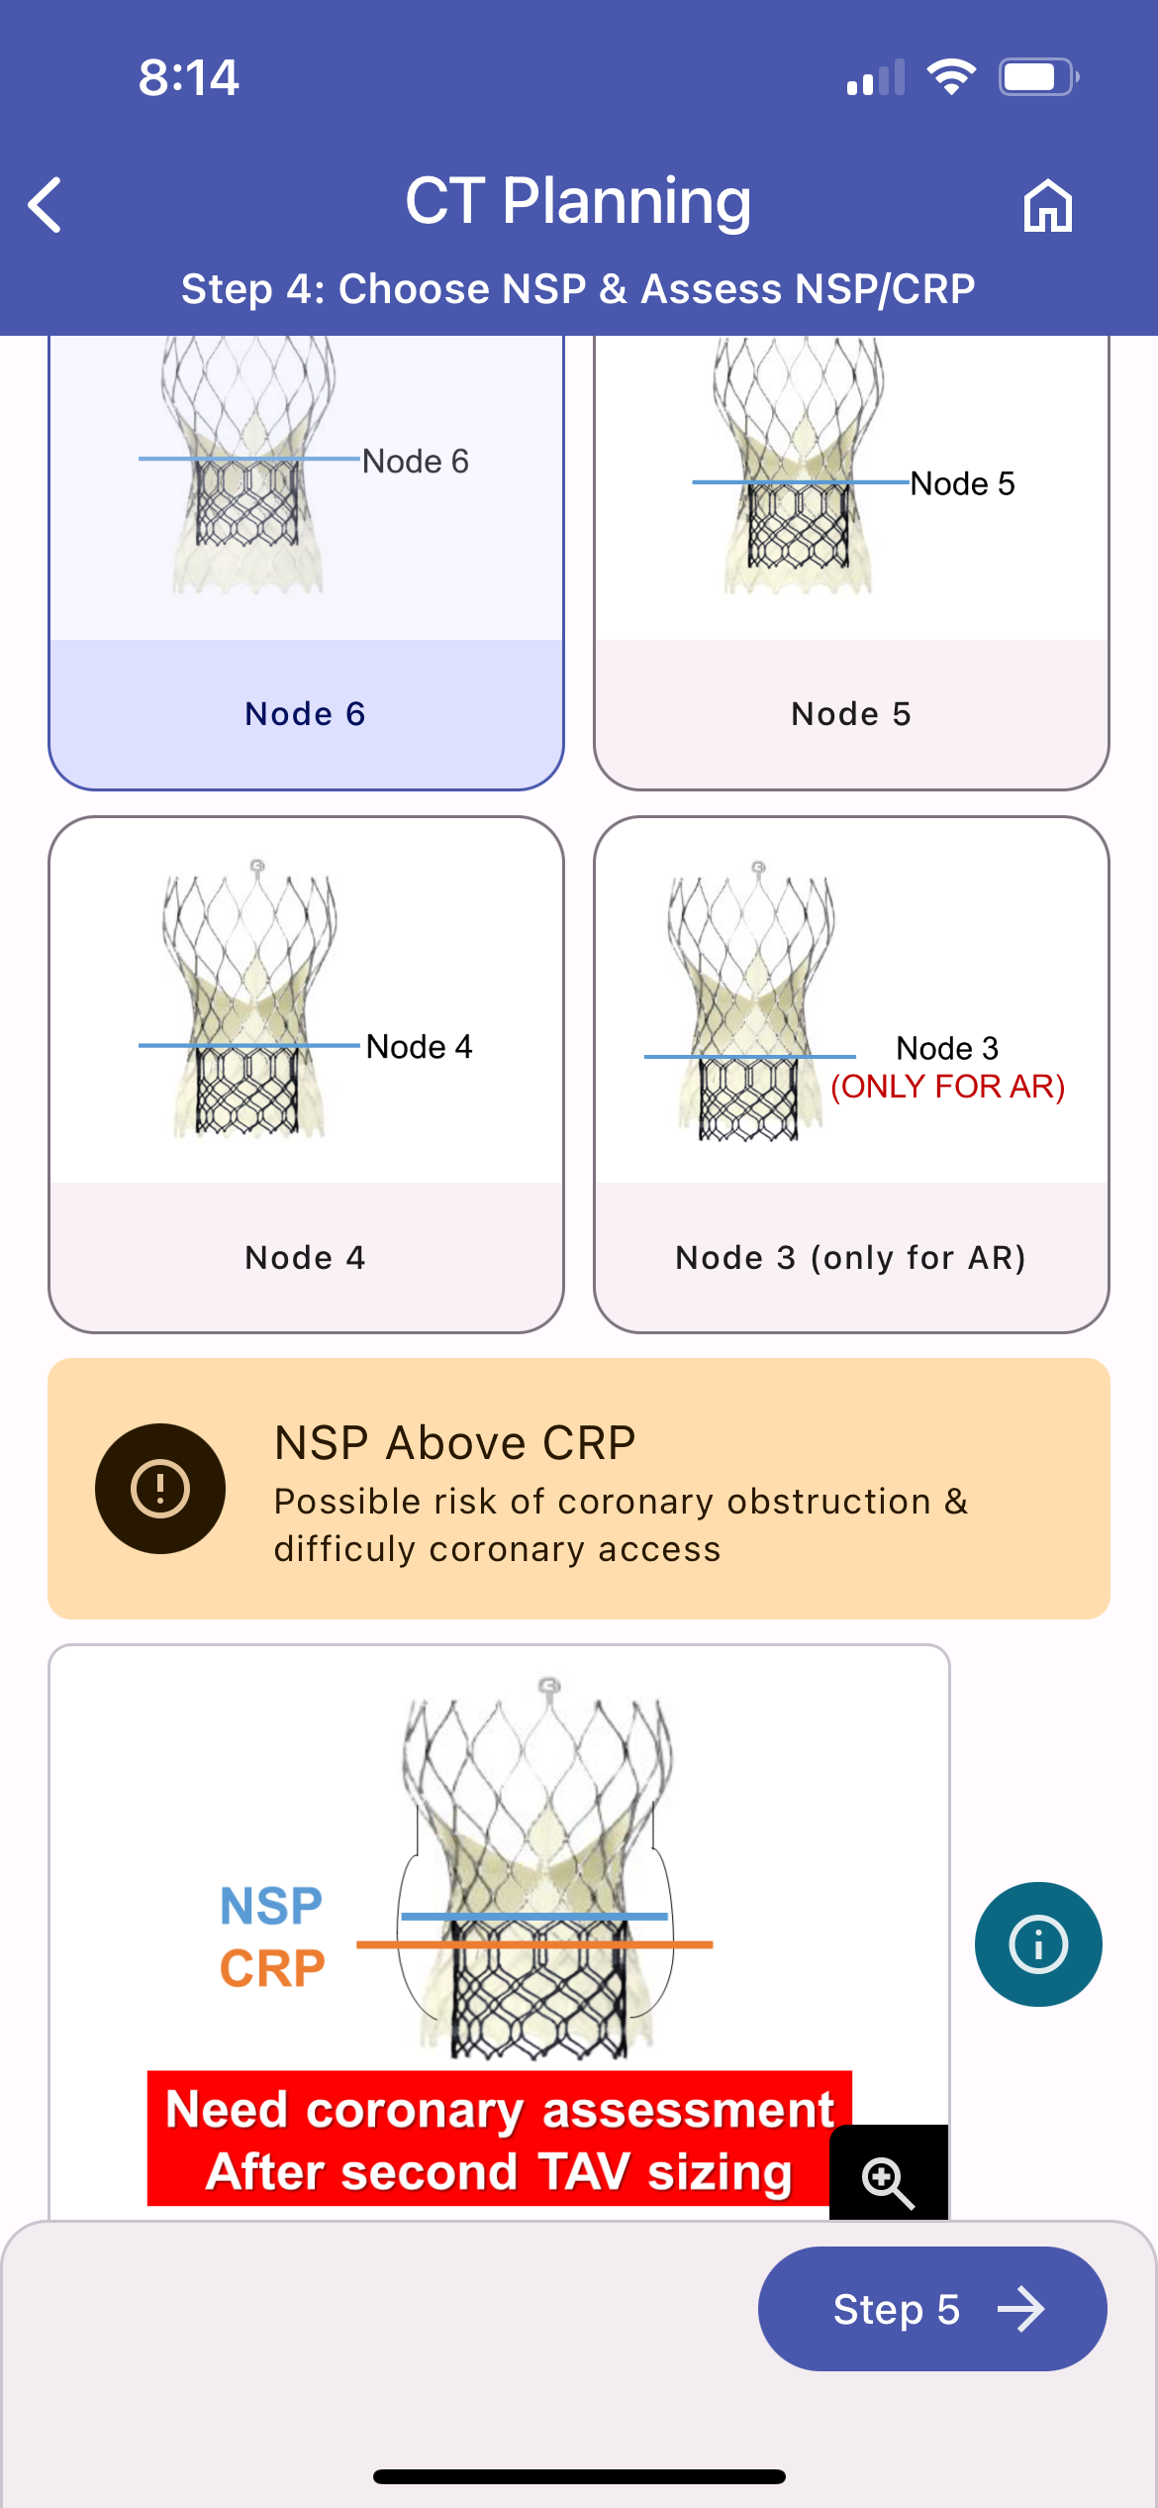
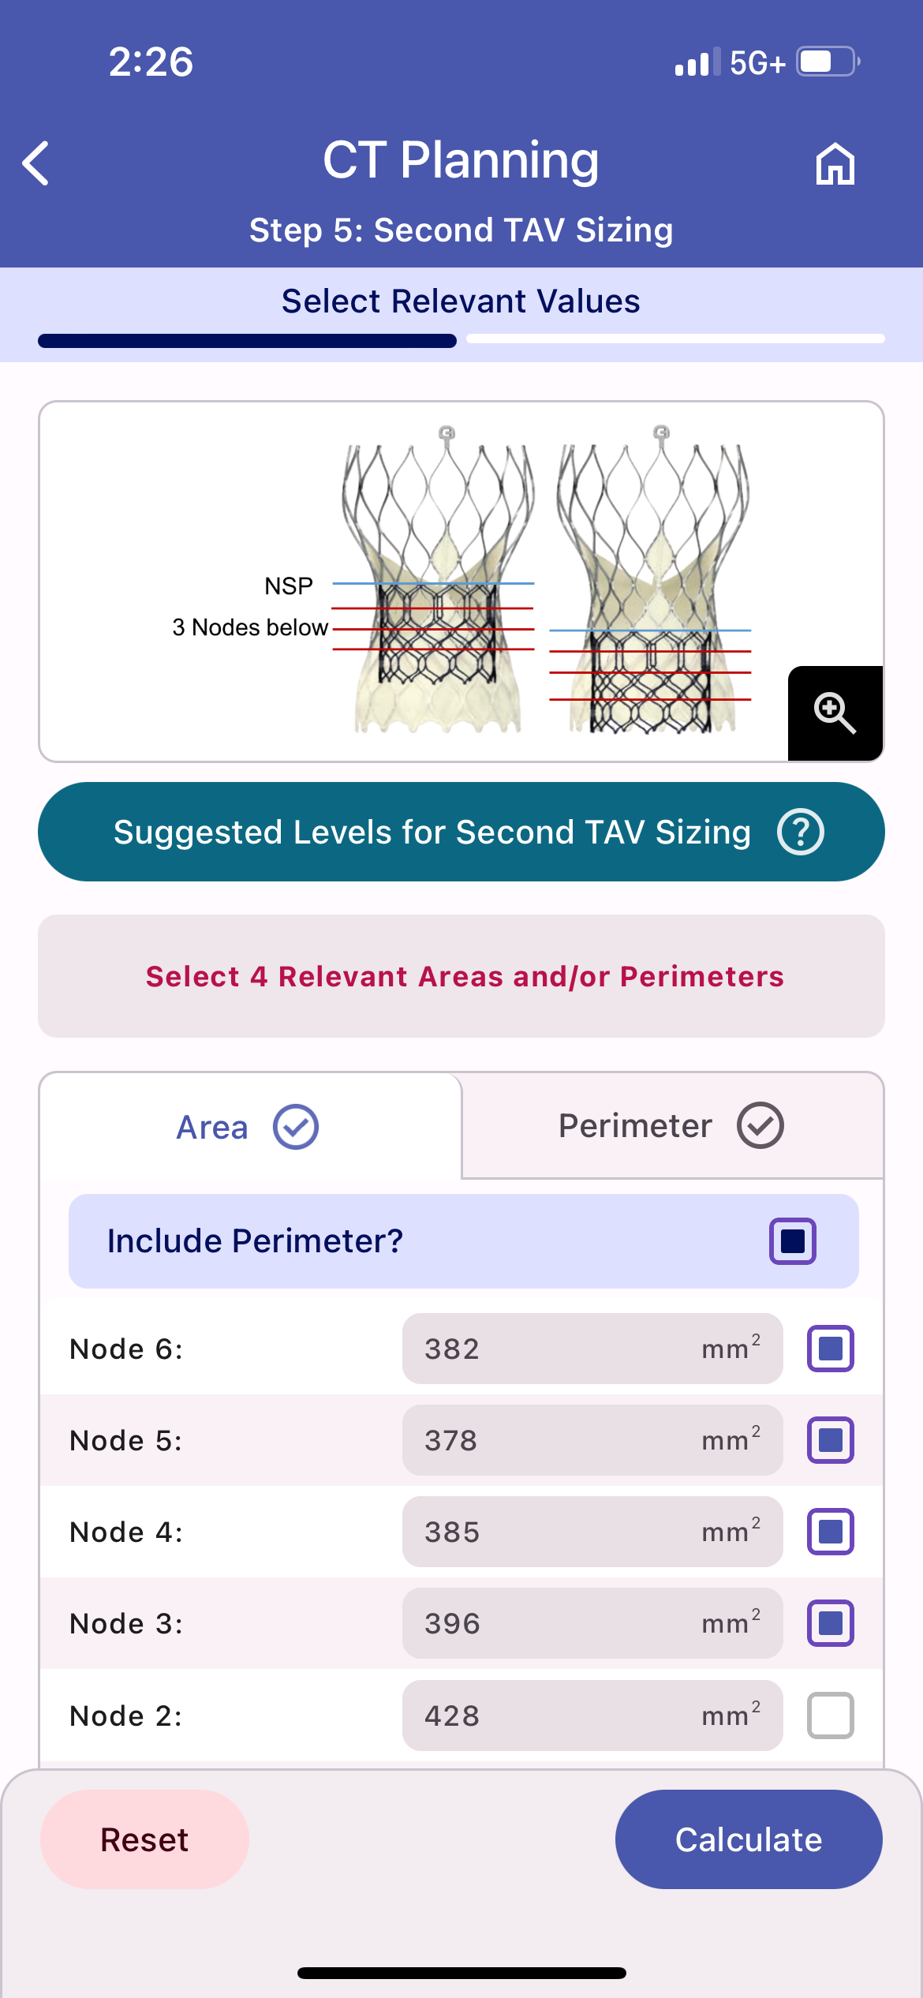
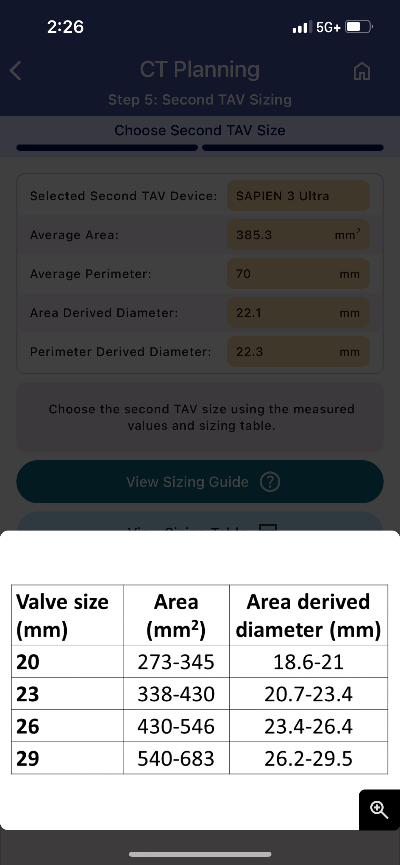
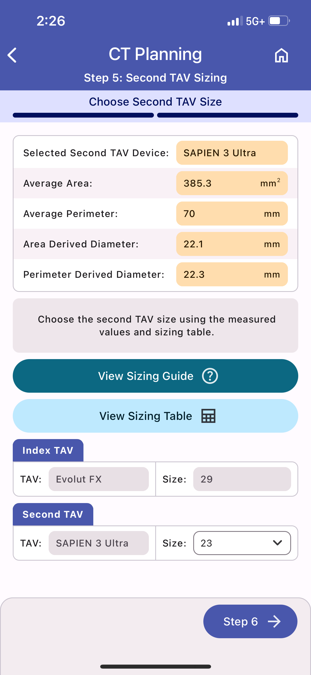
Redo TAV APP

Slide 13
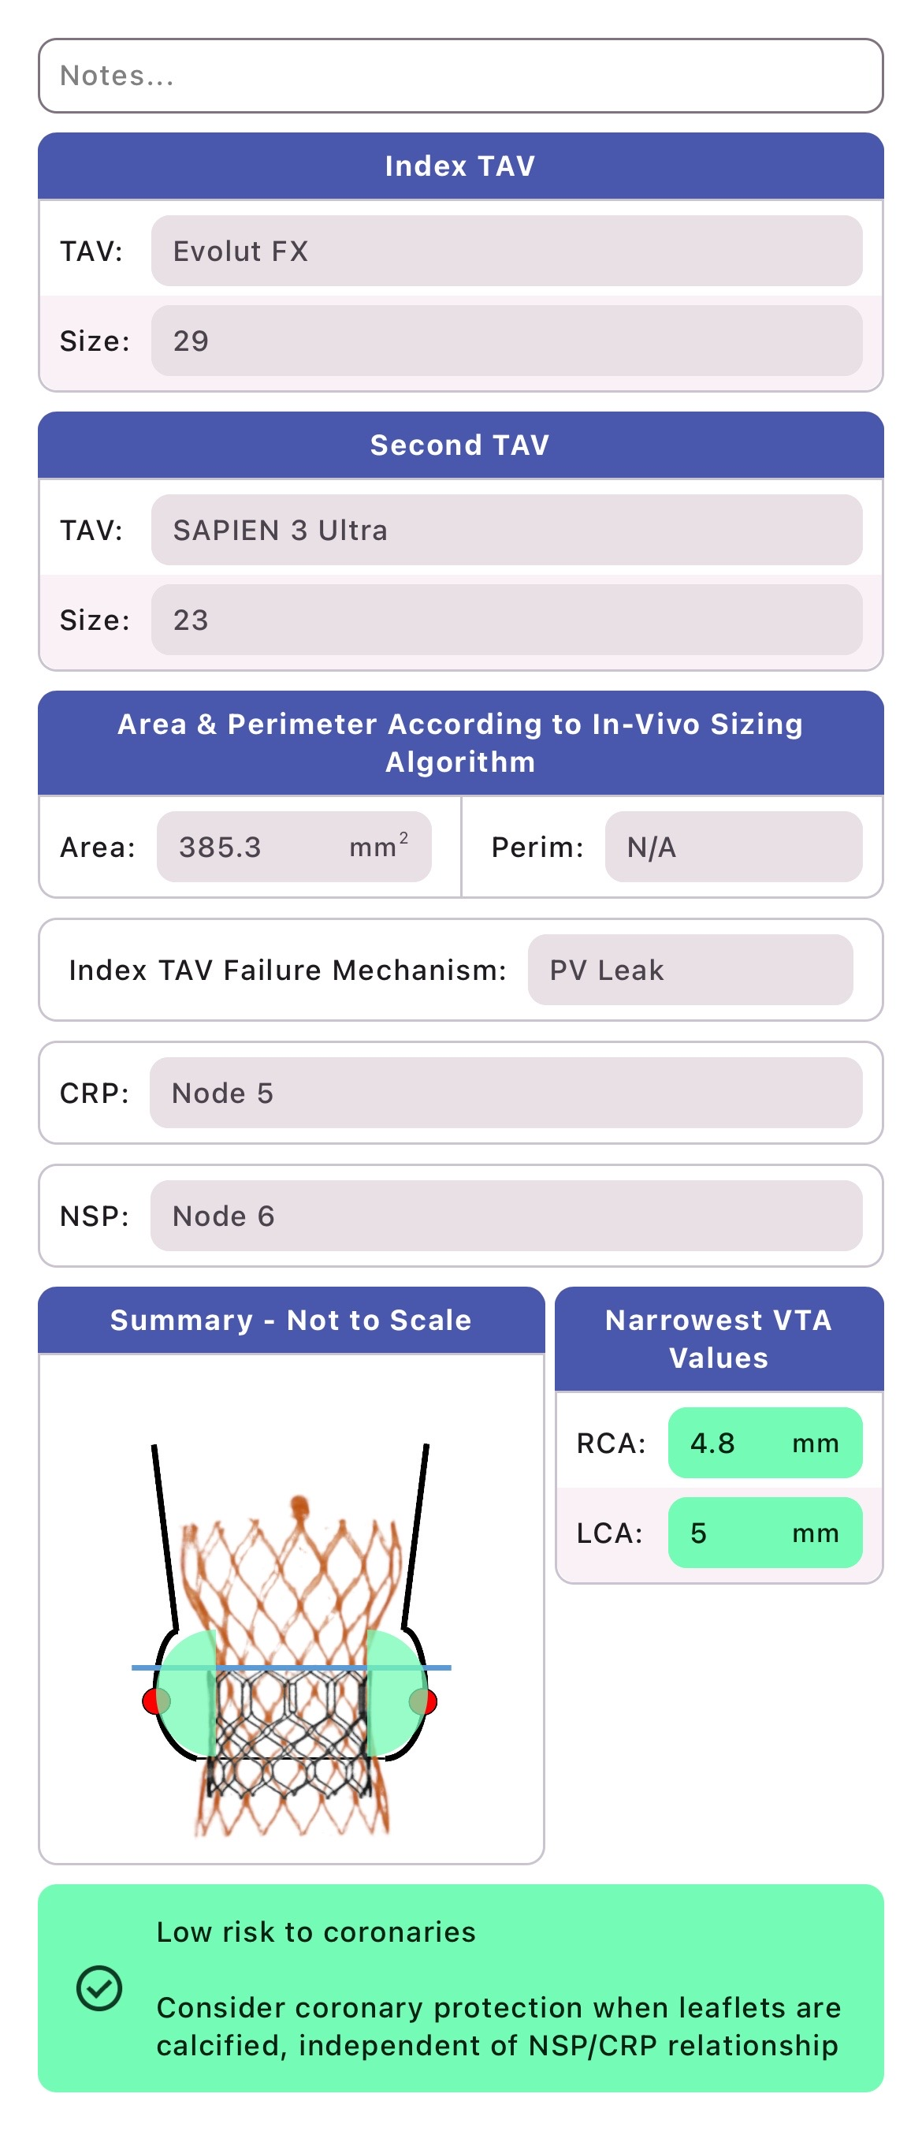
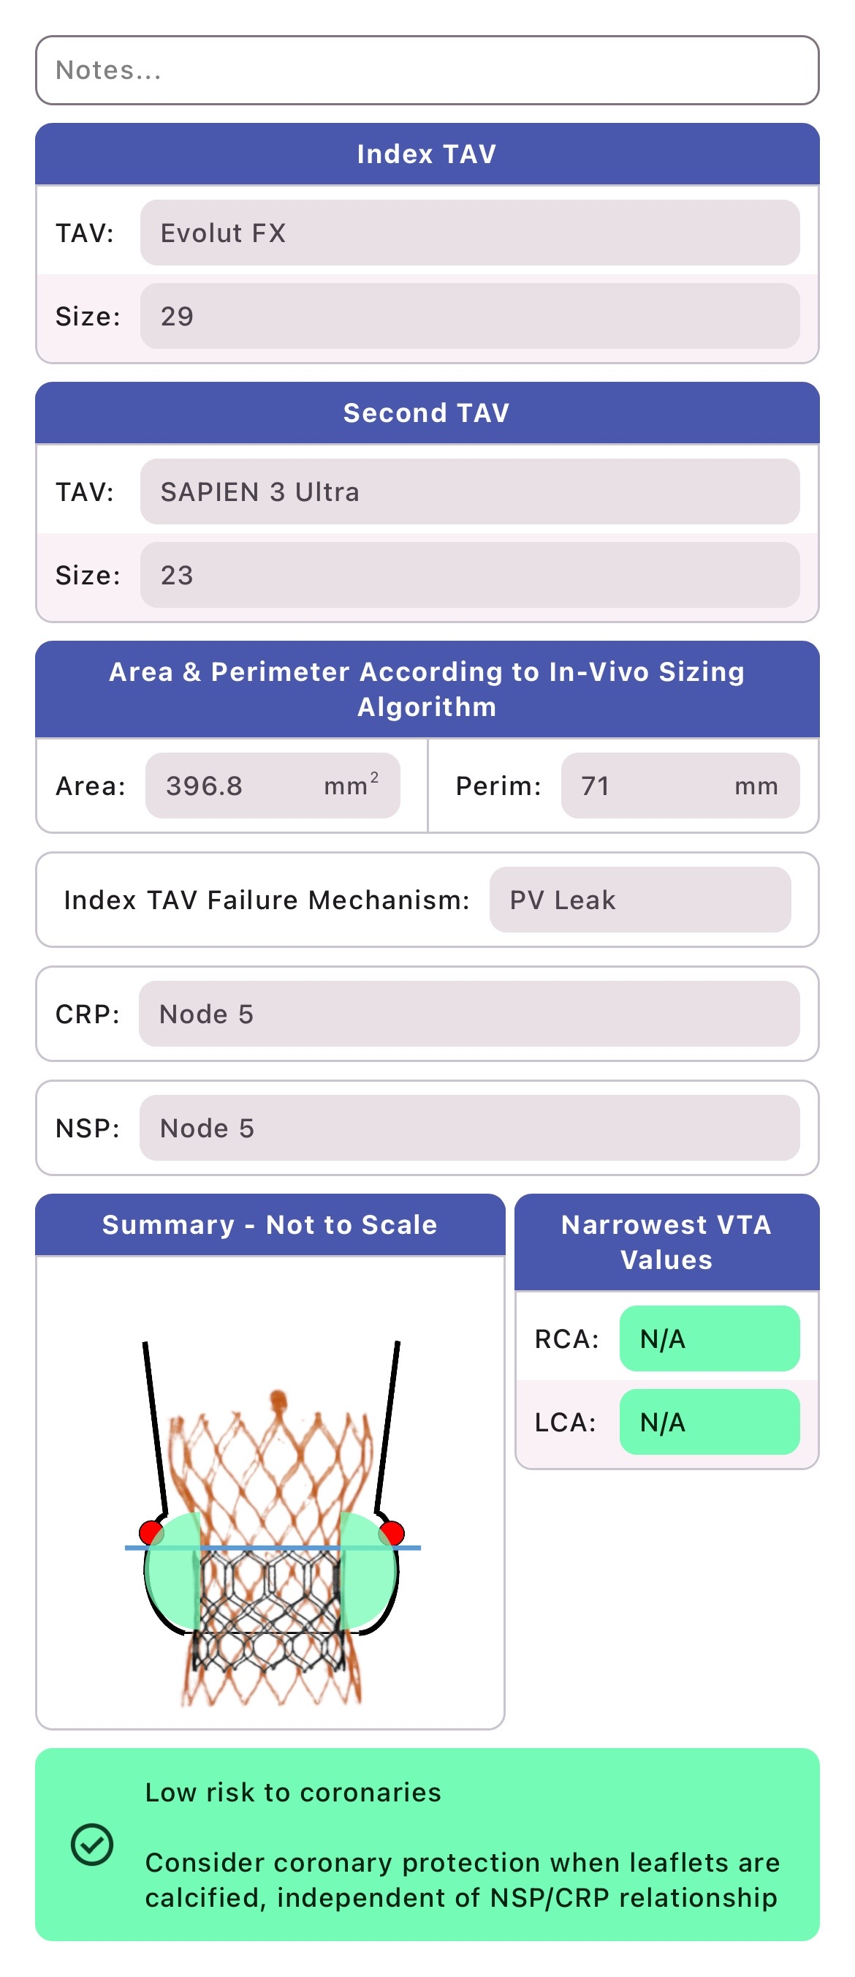
Summary Report for NSP@ Node 6
Summary Report for NSP@ Node 5
Summary Report for NSP@ Node 4
Low coronary risk at all NSP levels
Redo TAV APP

Slide 14
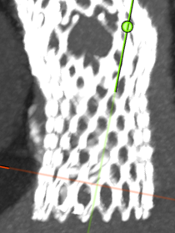
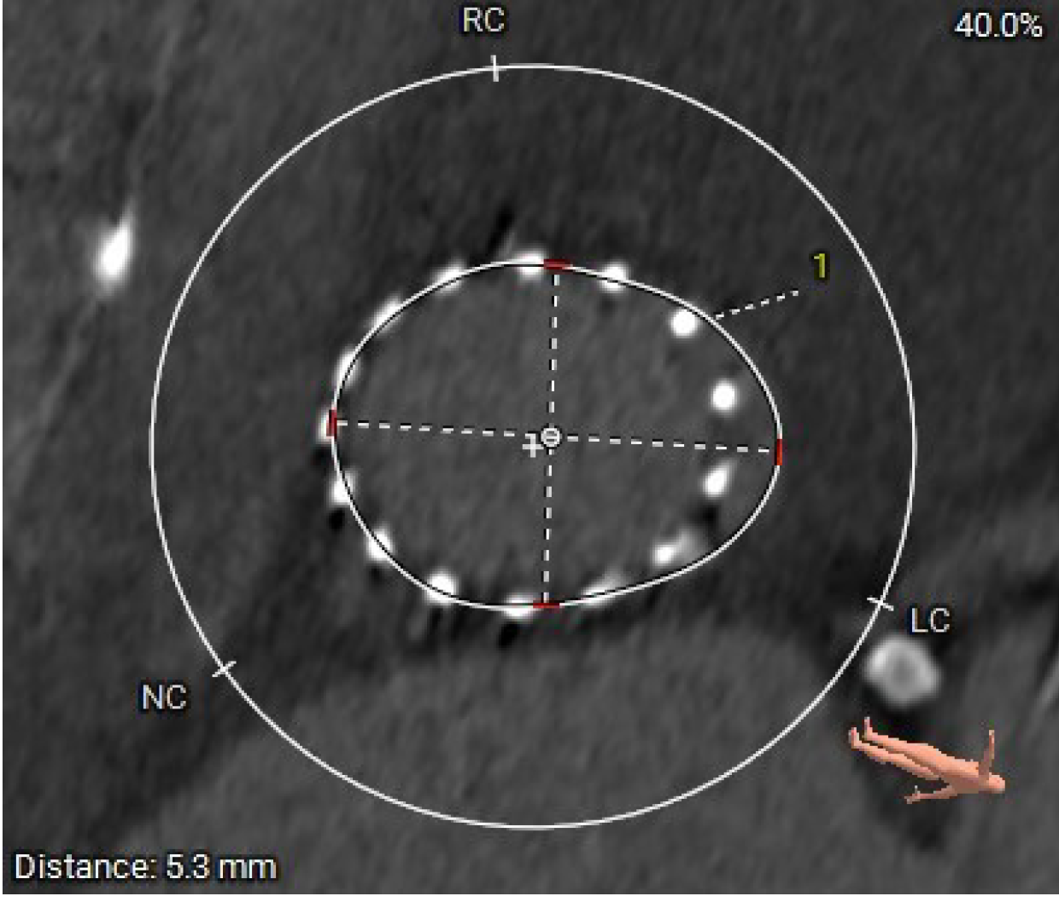
 | Node 6 | Node 5 | Node 4
S3 Size | Not cover PVL portion enough
#23
#26
Still enough coverage of PVL portion?
Native annulus
level
PVL
Quite deep implantation
Redo TAV APP

Slide 15
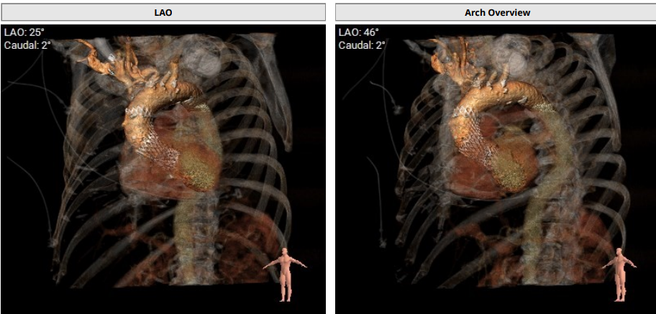
CT TAVR: Great Vessels
Severe Brachiocephalic Tortuosity

Slide 16
Summary of Case
Presentation: 84 yo male with dyspnea on exertion, NYHA Class III and frequent pre-syncopal episodes. Pt had two TAVR valves in 11/23 due to embolization
TEE: Preserved LV systolic dysfunction with moderate-to severe PVL
SAVR risk: High risk for SAVR/TAVR explant; STS 4.8%/expl?
Course: Heart team recommended TAV-in-TAV
Plan: Redo TAVR via percutaneous right femoral artery access using a 26mm Sapien-3 Ultra Resilia valve under conscious sedation

Slide 17
Latest Issues in Transcatheter Structural Heart Interventions
Recent publications in the TAVR Field:
- Redo TAVR vs Native TAVR; 1Yr outcomes
- LYTEN Trial of BEV vs SEV in Small SAV; 1Yr
- 5th Gen BEV TAVR in USA; Sapien-3 Ultra Resilia
- CoreValve Expanded Use TAV-in-SAV; 5Yrs F/u
- Treatment of Severe AS with Ultrasound Therapy

Slide 18
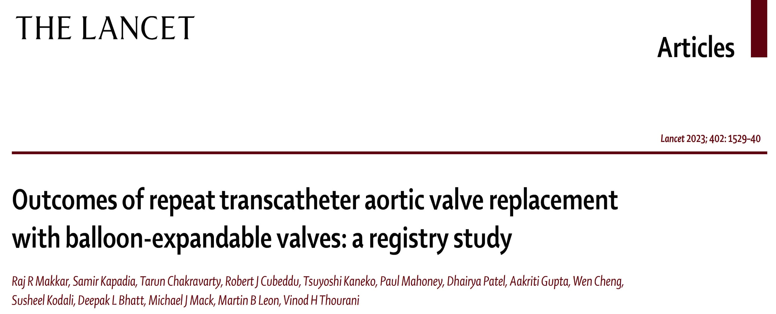
Redo-TAVR Registry

Slide 19
Redo-TAVR with Balloon Expandable Valves:
Propensity Score Matching
Comparisons between redo-TAVR and native TAVR patients were based on propensity score matching analyses
Redo-TAVR vs Native TAVR*
36 Covariates Used for 1:1 Propensity Score Matching
Redo-TAVR
n = 1216
Native TAVR*
n = 333,264
Age, sex (male), BMI, access site, prior PCI, prior CABG, prior stroke, carotid stenosis, PAD, hypertension, diabetes, chronic lung disease, immunocompromise, porcelain aorta, atrial fibrillation, creatinine, hemoglobin level, GFR, aortic valve mean gradient, LVEF, MR, TR,NYHA functional class III/IV, 5-meter walk test, KCCQ-OS, valve size, currently on dialysis, home oxygen, pacemaker, prior ICD, cardiogenic shock w/in 24 hr, aortic regurgitation, prior TIA, STS score, prior surgical repair, and endocarditis
1:1 Propensity-score matching
Redo-TAVR
n = 1216
Native TAVR
n = 1216
* 1681 patients that required a 2nd valve were excluded from the Native TAVR population
Makkar R, EuroPCR 2023

Slide 20
Redo-TAVR with Balloon Expandable Valves:
Procedural Complications
p=0.23
NA
p=0.45
%
p=0.12
p=1.0
p=0.14
Makkar et al., Lancet 2023;402:1529

Slide 21
Redo-TAVR with Balloon Expandable Valves:
In-Hospital and 30-Day Primary Endpoint
Redo-TAVR vs Native TAVR – Adjusted Cohort
In-Hospital
30-Day
p=0.77
p=0.32
p=0.36
p=0.11
%
%
p=0.93
p=0.88
Redo-TAVR (n=1216)
Native TAVR (n=1216)
Makkar et al., Lancet 2023;402:1529

Slide 22
Redo-TAVR Study: 1-Year Outcomes in Propensity
Score-Matched Pts Who Underwent Redo-TAVR
or Native TAVR: TVT Registry Analysis
p=0.14
p=0.40
%
p=0.57
p=0.58
p=0.80
p=0.07
p=0.77
p=0.06
p=0.73
Makkar et al., Lancet 2023;402:1529

Slide 23
Redo-TAVR vs Native TAVR with BAV:
Echo Improvements at 30 Days and 1 Year
30 Days
1 Year
*
Mean Gradient (mmHg)
Mean Gradient (mmHg)
*
*
*
*
*
Redo, n=771 Redo, n=1089 Redo, n=781 Redo, n=312
Native, n=1201 Native, n=1087 Native, n=835 Native, n=429
Redo, n=695 Redo, n=873
Native, n=1181 Native, n=920
Redo-TAVR
Native TAVR
*Redo-TAVR vs Native TAVR is statistically significant, p<0.05
Makkar et al., Lancet 2023;402:1529

Slide 24
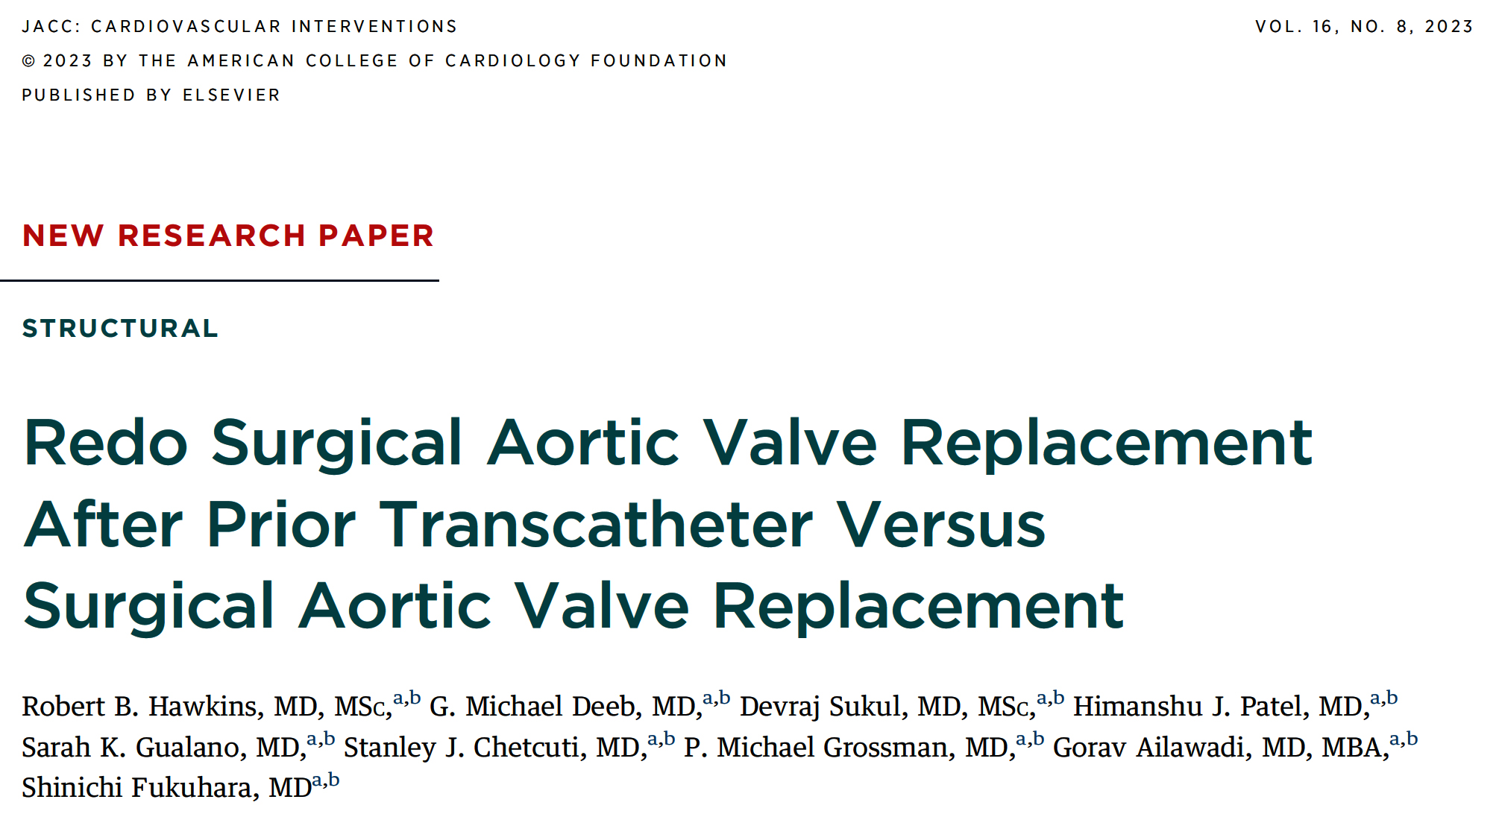
(SAVR)
(TAVR vs SAVR)

Slide 25
Redo of SAVR After Prior TAVR or SAVR:
Short-Term Outcomes for All Pts with Prior SAVR
and/or Prior TAVR
 | TAVR-SAVR (n=1,126) | SAVR-TAVR-SAVR (n=674) | SAVR-SAVR (n=29,306) | P value
Operative mortality | 17% | 12% | 9% | <0.001
Major morbidity | 37% | 31% | 28% | <0.001
Stroke | 5% | 3% | 3% | <0.001
Acute renal failure | 12% | 11% | 7% | <0.001
New Dialysis | 10% | 9% | 5.7% | <0.001
Reoperation | 9% | 9% | 8% | 0.083
Prolonged ventilation | 32% | 28% | 24% | <0.001
Transfusion | 88% | 88% | 82% | <0.001
Hours intubated | 13 (5-42) | 12 (5-37) | 10 (5-23) | <0.001
ICU LOS, h | 95 (48-169) | 77 (45-159) | 69 (39-125) | <0.001
Preoperative LOS, d | 3 (0-8) | 2 (0-8) | 0 (0-5) | <0.001
Postoperative LOS, d | 9 (7-15) | 9 (6-14) | 8 (6-12) | <0.001
Discharge to home | 51% | 63% | 73% | <0.001
Readmission | 17% | 15% | 12% | <0.001
Hawkins et al., J Am Coll Cardiol Intv 2023;16:942

Slide 27
EXPLANTORREDO-TAVR Registry: Study Population
533 Patients from 29 Sites undergoing TAVR Reintervention for THV failure
during separate admissions as initial TAVR
5/2009 – 2/2022
157 TAVR-Explant
Performed for Endocarditis
Primary Cohort for Analysis
(N=396)
Redo-TAVR
(n=215)
TAVR Explant
(n=181)
Median Follow-up:
13.6 months (IQR: 2.4-35.9)
Median Follow-up:
6.7 months (IQR: 1.3-15.9)
Tang et al., J Am Coll Cardiol Intv 2023;16:927

Slide 28
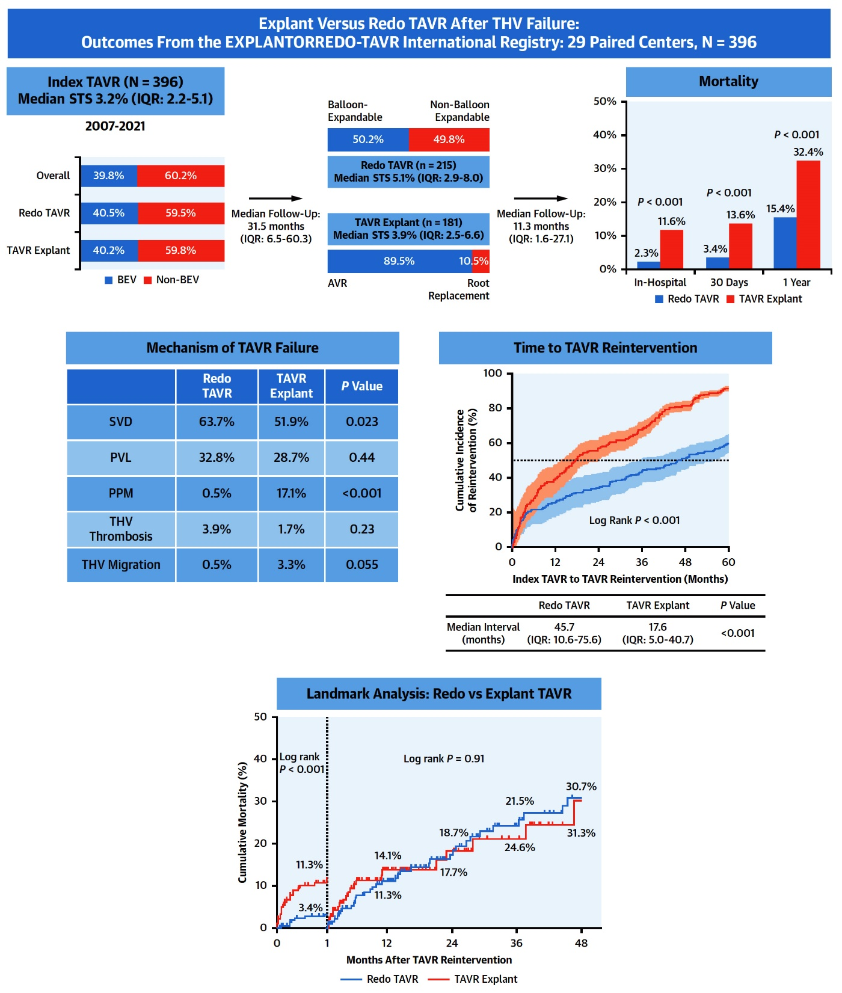
Summary of the EXPLANTORREDO-TAVR International Registry
Tang et al., J Am Coll Cardiol Intv 2023;16:927

Slide 29
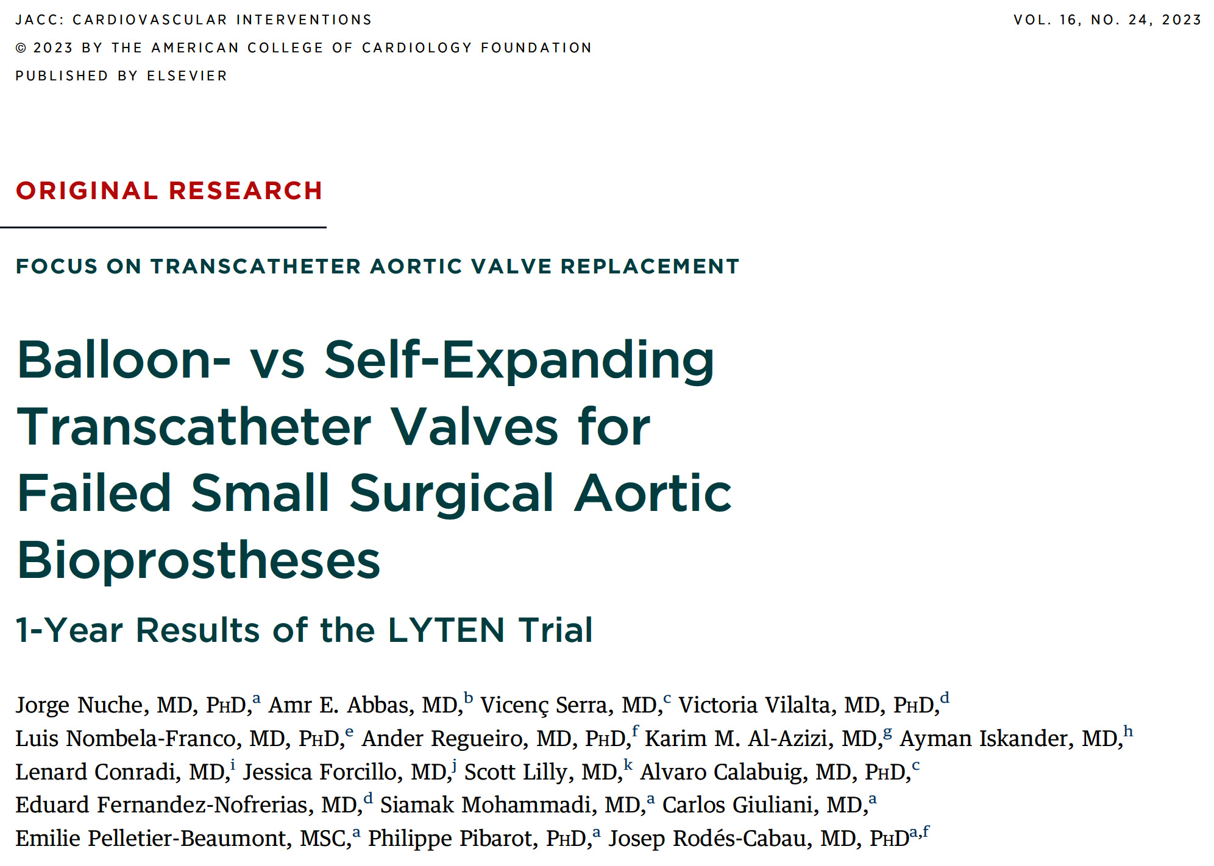
Comparison of the Balloon-Expandable Edwards Valve and Self-Expandable CoreValve Evolut R or Evolut PRO System for the Treatment of Small, Severely Dysfunctional Surgical Aortic Bioprostheses (Canada, USA and Europe)

Slide 30
LYTEN Trial: Flowchart of the Study Population
ViV-TAVR patients randomized to BEV or SEV
N=102 patients
Patients randomized to BEV
(SAPIEN3/ULTRA THV)
N=49 patients
Patients randomized to SEV
(Evolut R/PRO/PRO+ THV)
N=53 patients
1 patient dying before TAVR
2 patients treated medically
1 patient dying before TAVR
Patients undergoing TAVR
N=46
Patients undergoing TAVR
N=52
2 patients withdrawing consent
Patients completing 1-yr FU
N=44
Patients completing 1-yr FU
N=52
3 patients dying before 1-yr FU
8 patients missing 1-yr echo
2 patients dying before 1-yr FU
12 patients missing 1-yr echo
Patients with 1-year
echo-corelab analysis
N=33
Patients with 1-year
echo-corelab analysis
N=38
Nuche et al., J AM Coll Cardiol Intv 2023;16:2999

Slide 31
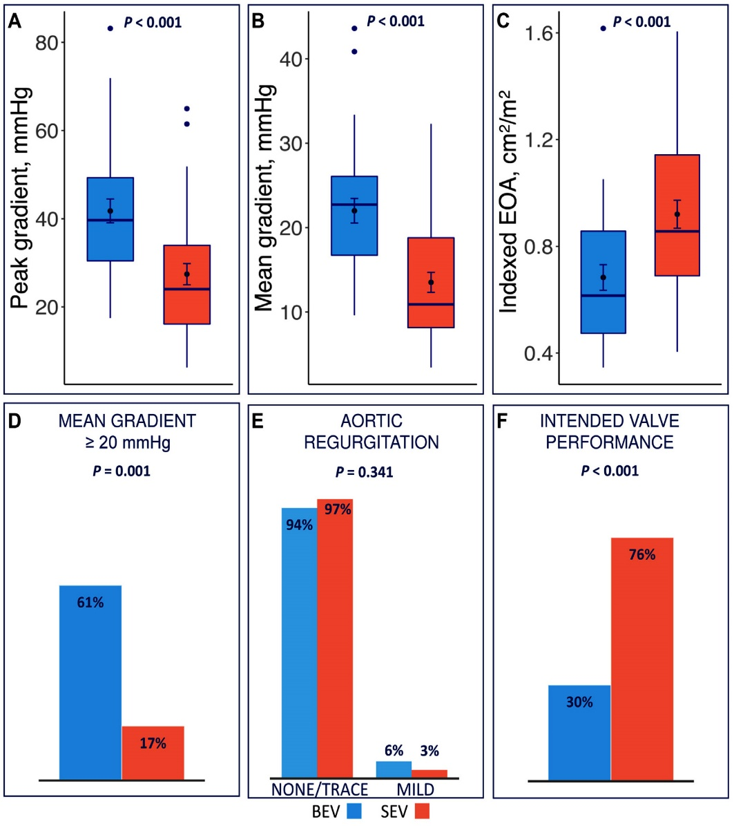
LYTEN Trial: Valve Hemodynamic Performance
at 1-Yr FU Evaluated by Doppler Echo
N=71 BEV: 33 SEV: 38
Patients with a SEV fulfilled more often the criteria for an intended performance of the valve (BEV 30%,
SEV 76%; p<0.001)
Patients receiving a BEV presented with a higher peak (BEV: 42 ± 15 mmHg, SEV: 27 ± 14 mmHg; p<0.001) and mean (BEV: 22 ± 8 mmHg, SEV: 14 ± 7 mmHg; p<0.001) aortic gradients when compared with those receiving a SEV.
Proportion of patients with a mean gradient ≥20 mmHg at 1-yr FU was significantly higher in the BEV grp (BEV 61% vs SEV 17%; p<0.001
Patients receiving a BEV had a smaller indexed EOA (BEV: 0.68 ± 0.27 cm²/m², SEV: 0.92 ± 0.31 cm²/m²; p=0.001) and presented more often an indexed EOA ≤0.65 cm²/m² (BEV 56%, SEV 26%; p=0.011
No patient had a greater than mild AR after 1 year of follow-up
No patient presented a significant valve deterioration between 30-day to the 1-yr doppler echo assessment.
No cases of confirmed valve thrombosis were observed
Nuche et al., J AM Coll Cardiol Intv 2023;16:2999

Slide 32
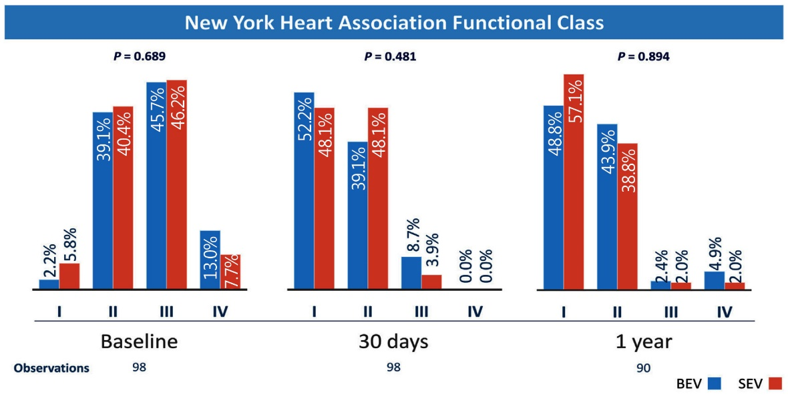
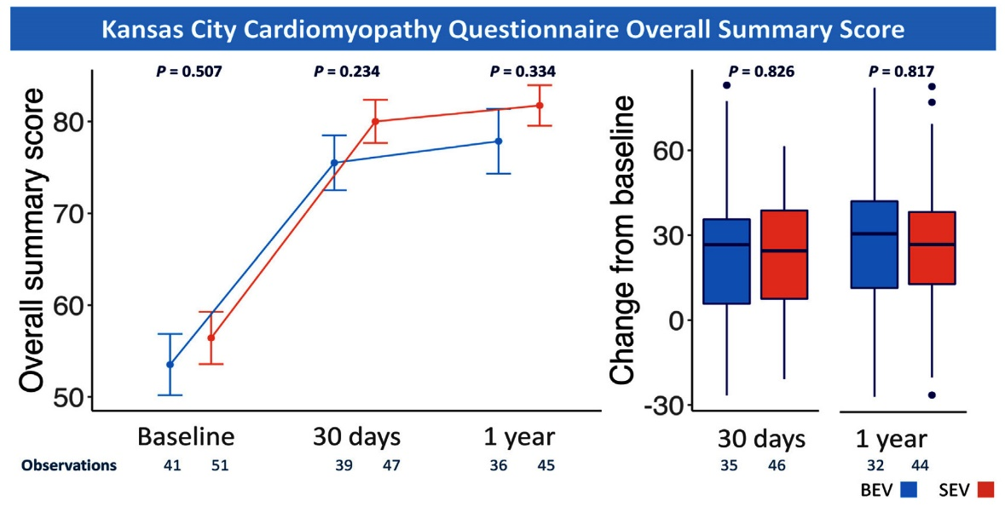
LYTEN Trial: Valve Hemodynamic Performance
at 1-Yr FU Evaluated by Doppler Echo
There were no significant differences in the distribution of the NYHA functional class between the BEV and SEV grps
Proportion of patients of patients with NYHA functional class >ll at 30-day (BEV 8.7% vs SEV 3.9%; p=0.33 and 1-year (BEV 7.3% vs SEV 4.1%; p=0.51) follow-up were similar between both grps
KCCQ overall summary score improved from baseline to the 30-day follow-up in both grps, and remained stable between the 30-day and 1-year follow-up
Absolute change in the KCCQ overall summary score from baseline to 30 days and 1 year was similar in both BEV and SEV grps, and there were no differences in the KCCQ overall summary score between the grps in any of the time points.
Only 9.2% presented a decline of >10 points of the KCCQ overall summary score after 1 year, with no differences between grps (BEV 12.5%, SEV 6.8%; p=0.40
Nuche et al., J AM Coll Cardiol Intv 2023;16:2999

Slide 33
LYTEN Trial: Clinical Outcomes at 1-Year Follow-Up
p=0.28
p=0.51
%
p=0.50
p=0.21
p=0.37
p=0.90
Nuche et al., J AM Coll Cardiol Intv 2023;16:2999

Slide 34
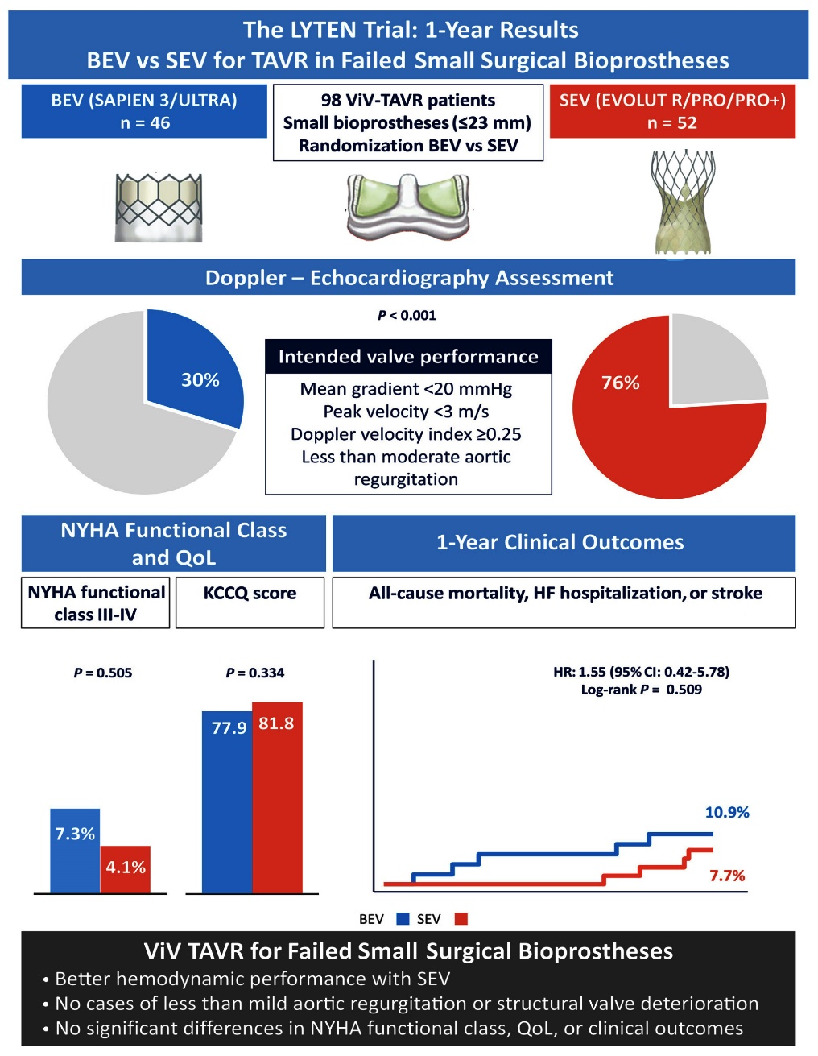
LYTEN Trial: Balloon-Expandable vs Self-Expanding
TAVs for Failed Small Surgical Aortic Bioprostheses
Lyten trial, first randomized clinical trial comparing BEV and SEV systems for treatment of failed small surgical bioprostheses (ViV-TAVR)
Main 1-year outcome results summary:
Rate of intended valve performance was higher in pts receiving a SEV, with persistent lower transvalvular gradients and larger EOA after 1 year
No cases of valve hemodynamic deterioration were described after 1 year
Patient-reported functional status and quality of life (NYHA functional class and KCCQ overall summary score) significantly improved from baseline to 30 days and 1 year, with no significant differences between BEV and SEV
No differences between the groups were found in terms of mortality, heart failure hospitalization, or stroke at 1 year follow-up
Nuche et al., J AM Coll Cardiol Intv 2023;16:2999

Slide 36
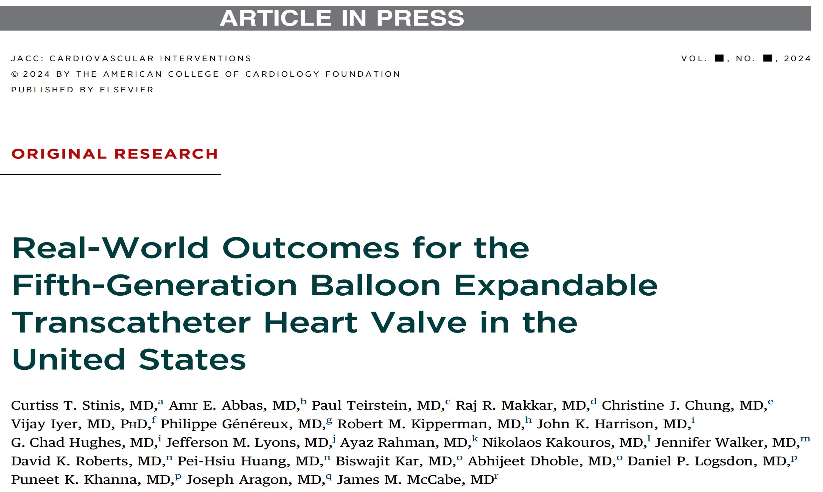
Fifth-generation SAPIEN 3 Ultra Resilia Valve (S3UR) vs SAPIEN 3 (S3) and SAPIEN 3 Ultra (S3U) USA

Slide 37
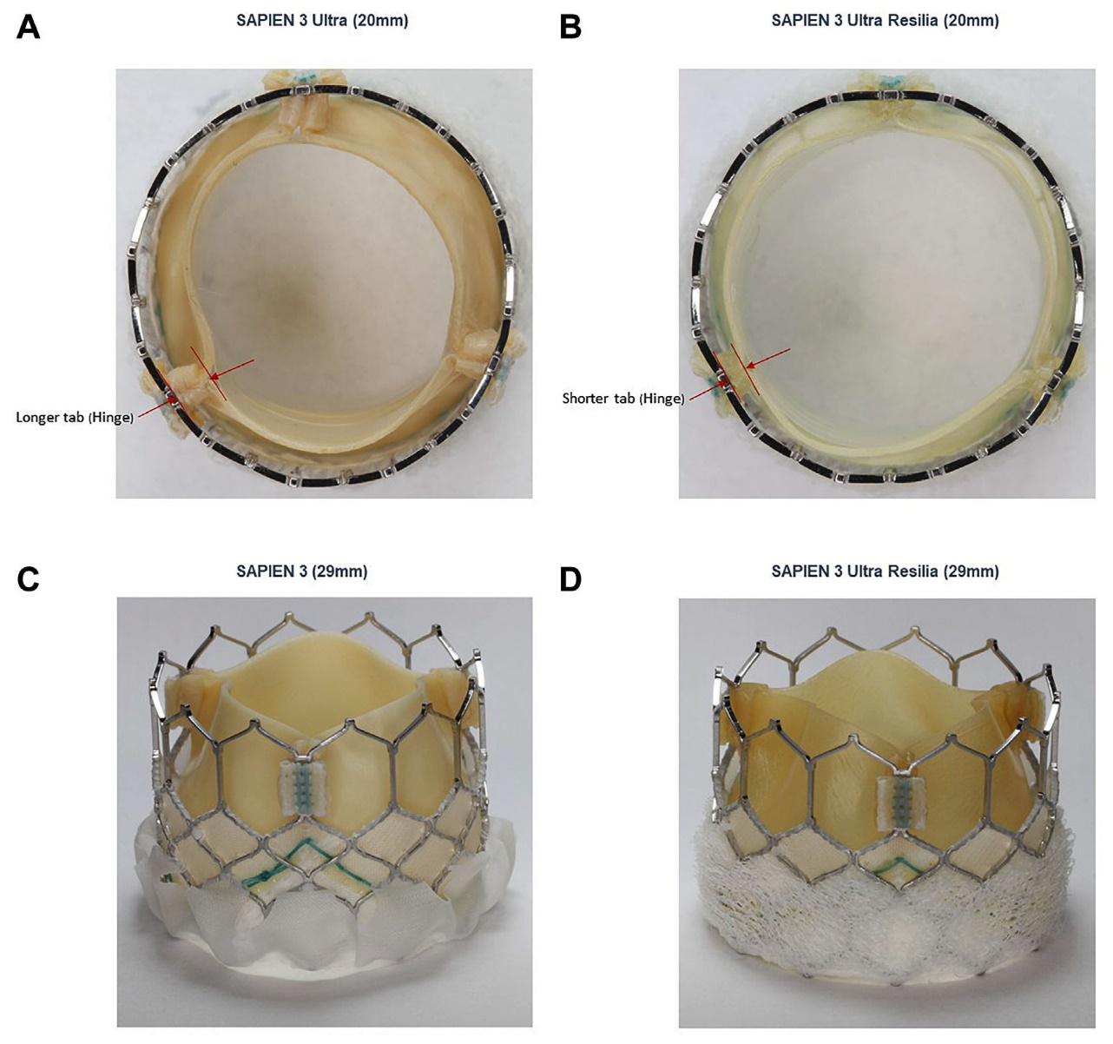
Fifth-Gen S3UR vs S3/S3U Study: Designs Characteristics of the S3UR, S3U and S3 Heart Valves
SAPIEN 3 Ultra (S3U) THV – incorporates an improved sealing skirt to the 20 mm, 23 mm and 26 mm valve sizes, which has been shown to reduce PVL compared to its predecessor the SAPIEN 3 (S3) THV
SAPIEN 3 Ultra Resilia (S3UR ) THV – fifth-gen device and represents the latest iteration of balloon-expandable THV technology; utilizes bovine pericardial leaflet tissue designed to reduce structural valve deterioration (SVD) via calcification, as well as the addition of an improved outer sealing skirt to the 29 mm valve size; 20 mm and 23 mm valve sizes were designed to optimize hemodynamic performance
Refined design of S3UR THV offer potential clinical advantages, especially as TAVR shifts toward treatment of younger and lower-risk pts.
Stinis et al., J Am Coll Cardiol Intv Mar 8, 2024 Epub ahead of print

Slide 38
Fifth-Gen S3UR vs S3/S3U Study: Study Flow Chart
350,634 SAPIEN3, SAPIEN3 Ultra, SAPIEN 3 Ultra RESILIA
Native TAVR Procedure in TVT Registry
June 2015 – June 2023 at 805 sites
49 S3UR procedures before Sept. 12, 2022
189,732 S3/S3U procedures before Jan. 01, 2021
150, 539 S3/S3U
Native TAVR Patients
10,314 S3 Ultra RESILIA
Native TAVR Patients
1:1 Propensity Score Matching
10,312 S3/S3U
Native TAVR Patients
10,312 S3 Ultra RESILIA
Native TAVR Patients
Stinis et al., J Am Coll Cardiol Intv Mar 8, 2024 Epub ahead of print

Slide 39
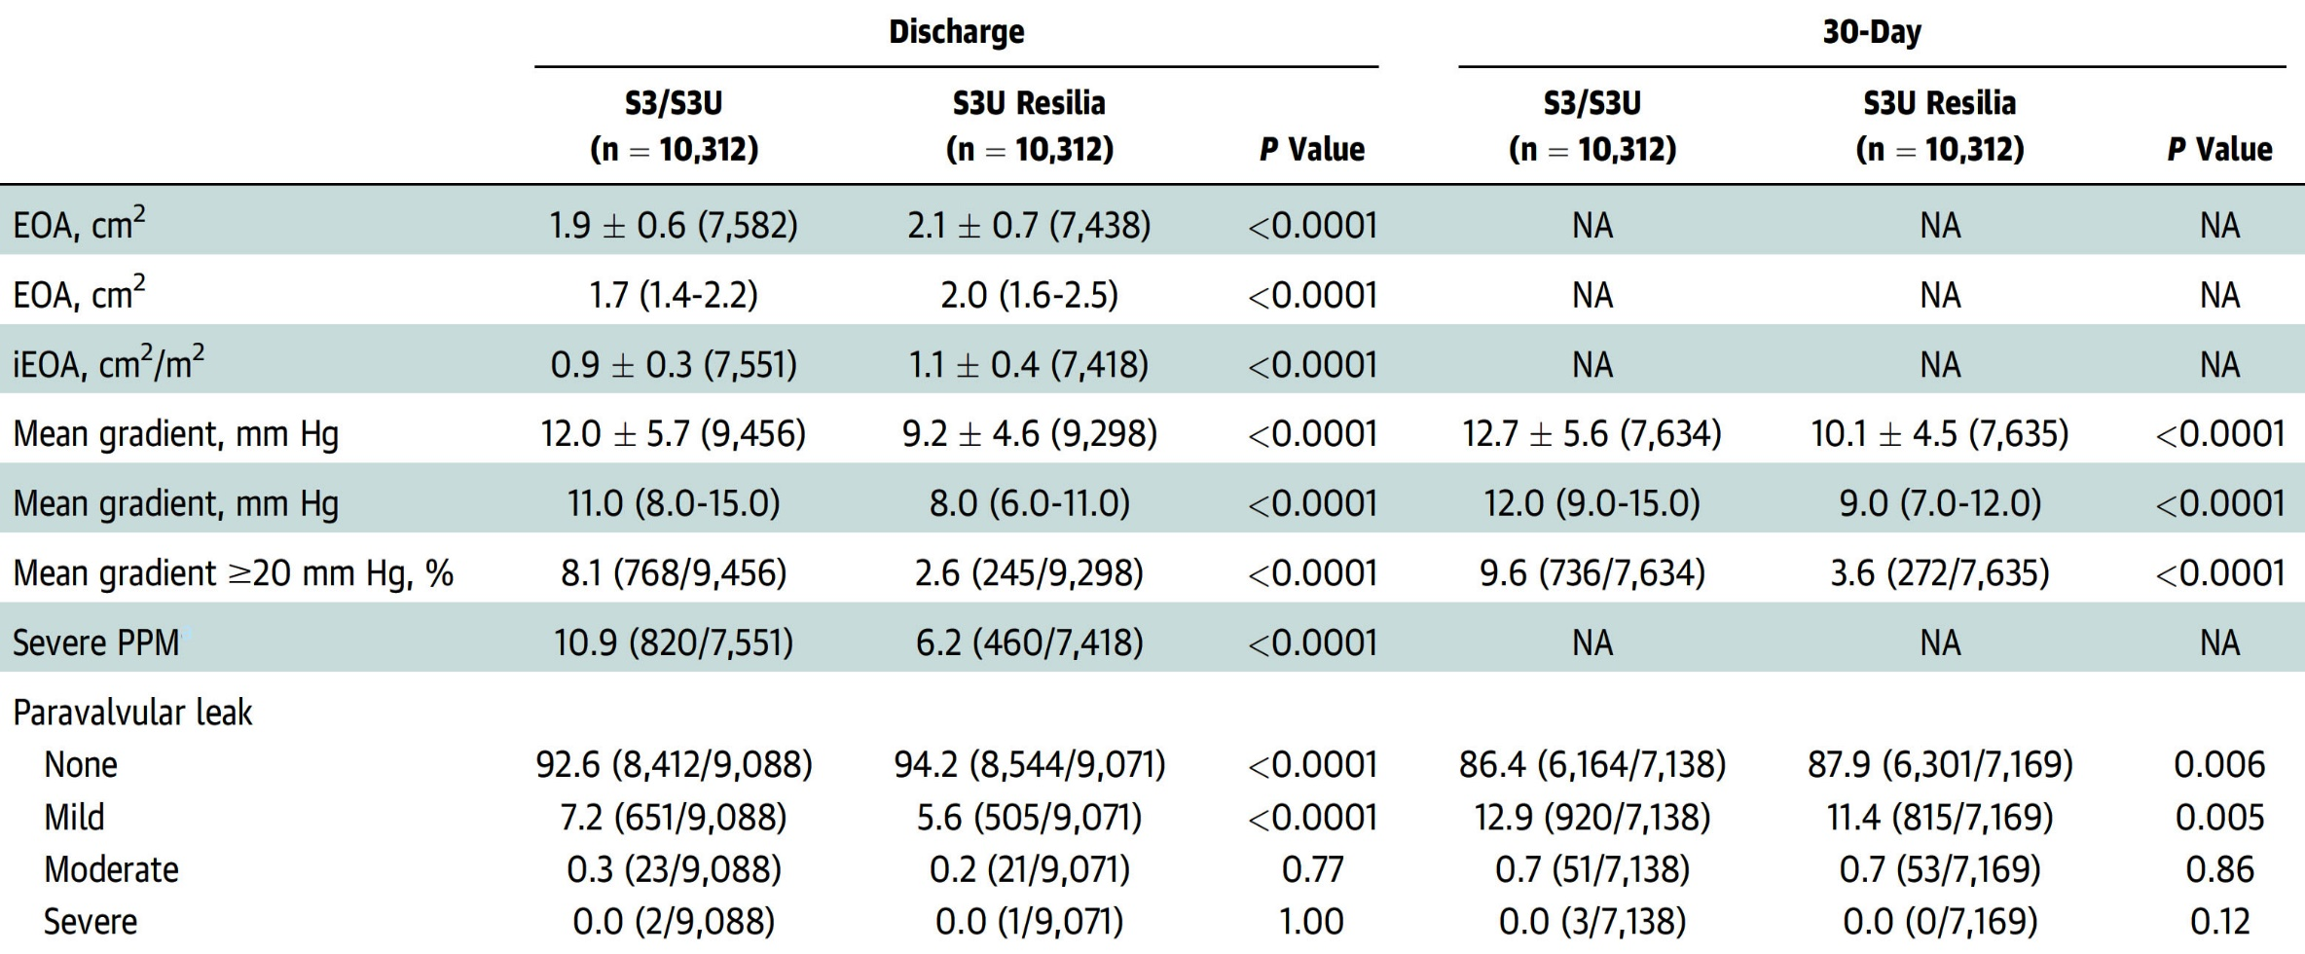
Fifth-Gen S3UR vs S3/S3U Study: Discharge and
30-Day Echo Outcomes for Matched Cohort
Hemodynamic outcomes for the propensity-matched cohorts were assessed via echo before hospital discharge and at 30-days
Stinis et al., J Am Coll Cardiol Intv Mar 8, 2024 Epub ahead of print

Slide 40
Fifth-Gen S3UR vs S3/S3U Study: Echo-Based Gradients
and EOA
Baseline Through Discharge or 30 Days by Valve Type
At 30 days, pts treated with S3UR exhibit lower mean gradients (10.1 ± 4.5 mmHg vs 12.7 ± 5.6 mmHg; p<0.0001); larger proportion of pts exhibiting no PVL (87.9% vs 86.4%; p=0.006) and fewer pts exhibiting mild PVL (11.4% vs 12.9%; p=0.005). Rate of moderate (0.7% vs 0.7%; p=0.86) and severe (0.0% vs 0.0%; p=0.12) PVL remained low and did not differ significantly between groups.
Pts treated with S3UR exhibited a significantly larger AVA (2.1 ± 0.7 cm²; p<0.0001) and lower mean gradients (9.2 ± 4.6 mmHg vs 12.0 ± 5,7 mmHg; p<0.0001) than patients treated with S3/S3U at the time of hospital discharge. Rates of PVL were also significantly lower for pts treated with S3UR vs to S3/S3U, with a larger proportion of pts exhibiting no PVL (94.2% vs 92.6%; p<0.0001), fewer pts with mild PVL (5.6% vs 7.2%; p<0.0001); rates of moderate (0.2 vs 0.3; p=0.77) and severe PVL (0.0% vs 0.0%: p=1.0) remained low and did not differ among the groups at time of hospital discharge
Stinis et al., J Am Coll Cardiol Intv Mar 8, 2024 Epub ahead of print

Slide 41
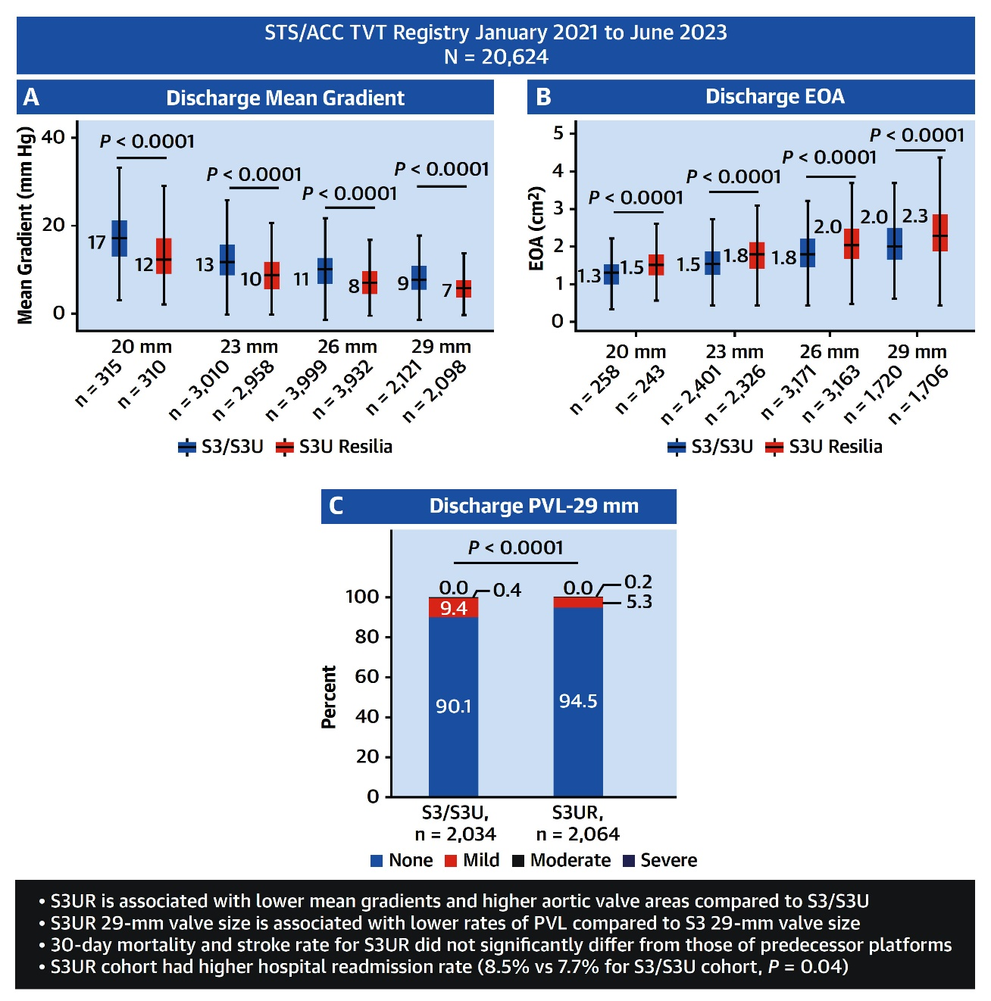
Fifth-Gen S3UR vs S3/S3U Study: Outcomes of SAPIEN 3 Ultra Resilia vs Predecessor Platforms
Stinis et al., J Am Coll Cardiol Intv Mar 8, 2024 Epub ahead of print

Slide 43
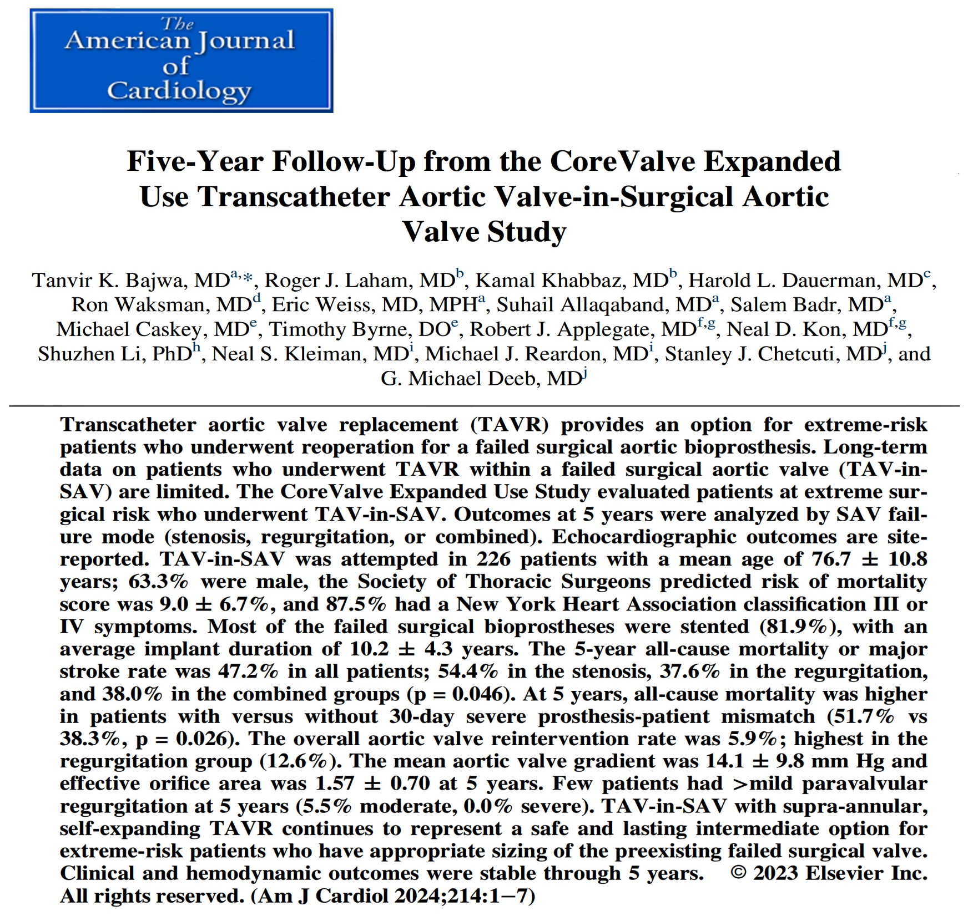
Safety & Efficacy Study of the Medtronic CoreValve® System-Treatment of Symptomatic Severe Aortic Stenosis With Significant Comorbidities in Extreme Risk Subjects Who Need Aortic Valve Replacement (US Nationwide)

Slide 44
CoreValve Expanded Use TAV-in-SAV Study: Patient Flow Diagram
Attempted Implant
N=226
Implanted: 224
Not Implanted: 2
Died: 6
Other: 1
30 Days
98.2% (215/219)
Died: 24
Withdraw: 4
Other: 2
1 Year
96.8% (183/189)
Died: 9
Withdraw: 2
2 Years
97.2% (173/178)
Died: 24
Withdraw: 2
3 Years
93.4% (142/152)
Died: 18
Withdraw: 3
Other: 2
4 Years
95.2% (123/129)
Died: 19
Withdraw: 3
LTF: 3
5 Years
95.2% (99/104)
Bajwa et al., Am J Cardiol 2024;214:1

Slide 45
CoreValve Expanded Use TAV-in-SAV Study:
Five-Year Patient Outcomes
p=0.05
p=0.06
%
p=0.42
p=0.04
p=0.33
p=0.23
p=0.56
Bajwa et al., Am J Cardiol 2024;214:1

Slide 46
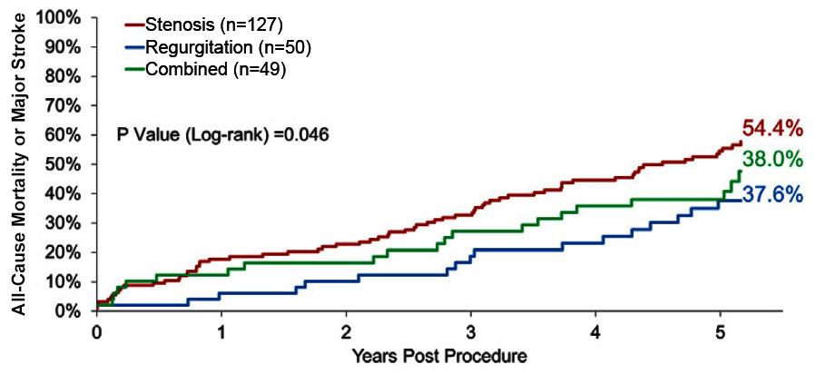
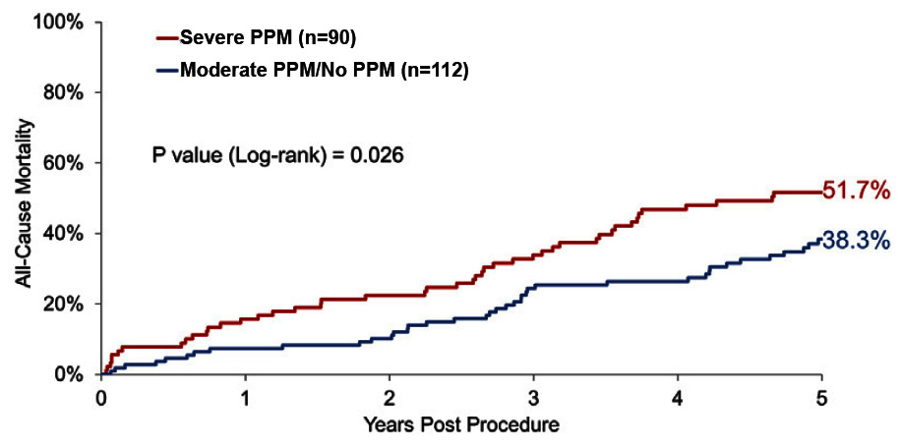
CoreValve Expanded Use TAV-in-SAV Study:
Clinical Outcomes at 5 Years
All-Cause Mortality or
Major Stroke
All-Cause Mortality by 30-D Prosthesis-Patient Mismatch
5-year all-cause mortality or major stroke by surgical valve failure (stenosis, regurgitation, or combined)
All-cause mortality based on the severity of PPM at 30 days after procedure or discharge
Bajwa et al., Am J Cardiol 2024;214:1

Slide 47
CoreValve Expanded Use TAV-in-SAV Study:
Multivariable Predictors of 5-Yr All-Cause Mortality Following TAV-in-SAV
 | Hazard Ratio (95% CI) | P Value
6-Minute hall walk (m) | 0.997 (0.994, <1.000) | 0.037
Prior TIA | 2.571 (1.231, 5.369) | 0.012
Diabetes mellitus | 2.525 (1.312, 4.859) | 0.006
LVEF <30% | 4.357 (1.852, 10.248) | <0.001
Bajwa et al., Am J Cardiol 2024;214:1

Slide 48
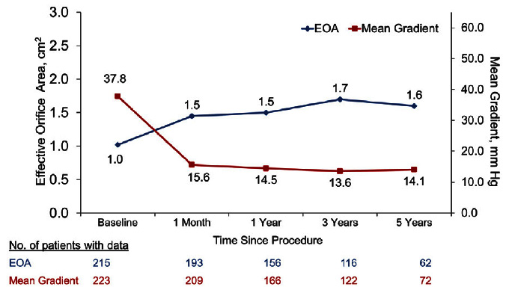
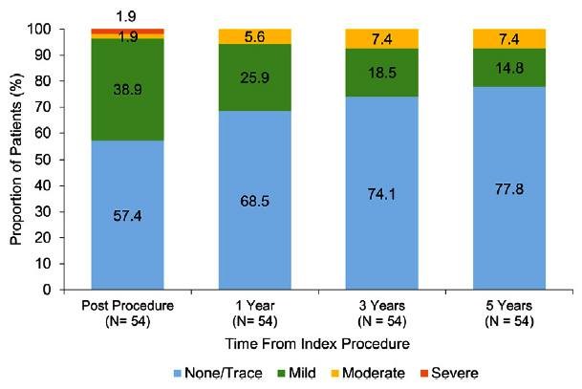
CoreValve Expanded Use TAV-in-SAV Study:
Echocardiographic Outcomes
Aortic Valve Effective Orifice Area and Mean Gradient
Paravalvular Regurgitation
Paired analysis conducted in pts alive at 5 years who had hemodynamic data at each follow-up
There were 57 pts with mean gradient and 36 pts with EOA at each follow-up
Mean gradient similar at 30 days (15.3 ± 9.9 mmHg) and at 5 years (14.2 ±9.2 mmHg)
EOA was also similar at 30 days (1.68 ± 0.80) and 5 years (1.66 ± 0.75)
Severe paravalvular aortic regurg in 54 pts after procedure at 1-, 3- and 5 years
In the regurg failure mode grp, 23.5% of pts had moderate paravalvular aortic Regurg
No moderate paravalvular aortic regurg was present in the stenosis and combined failure modes
Bajwa et al., Am J Cardiol 2024;214:1

Slide 49
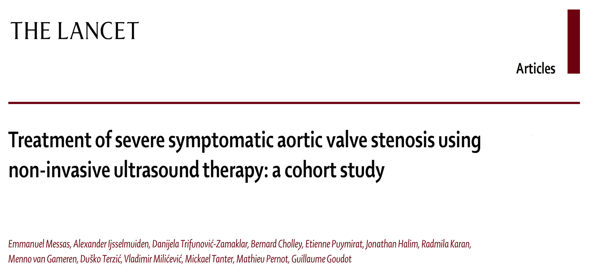
Prospective Controlled, Single-Arm Clinical Investigation for the Treatment of Subject with Severe Symptomatic Aortic Valve Stenosis Using Valvosoft® Pulsed Cavitational Ultrasound Therapy (P-CUT) France

Slide 50
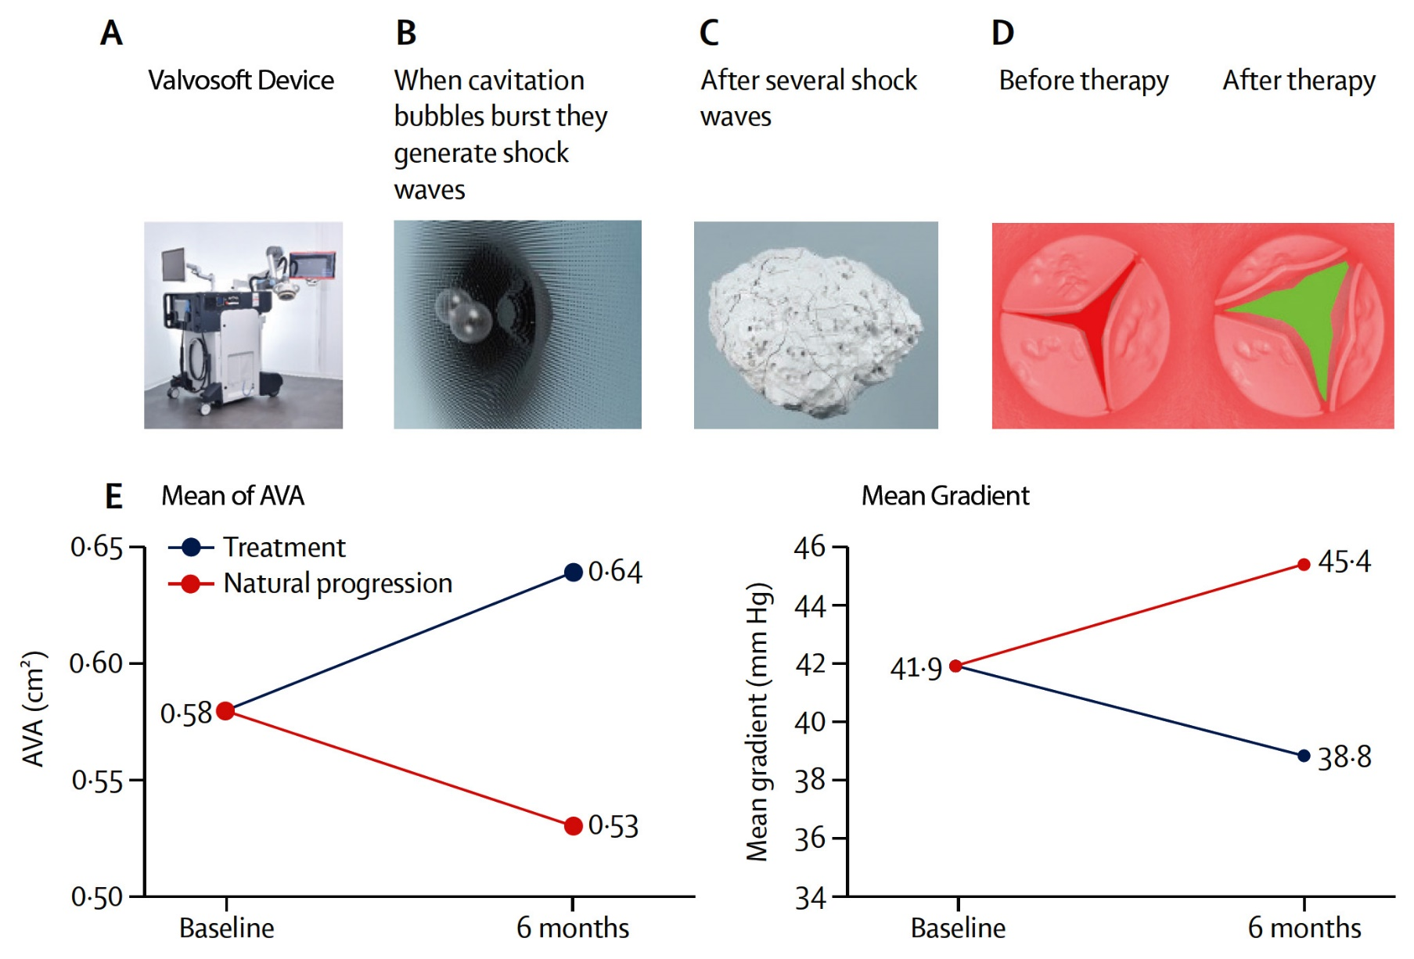
Functionality of the Valvosoft® Device and Primary Outcomes
Messas et al., Lancet 2023;402:2317

Slide 51
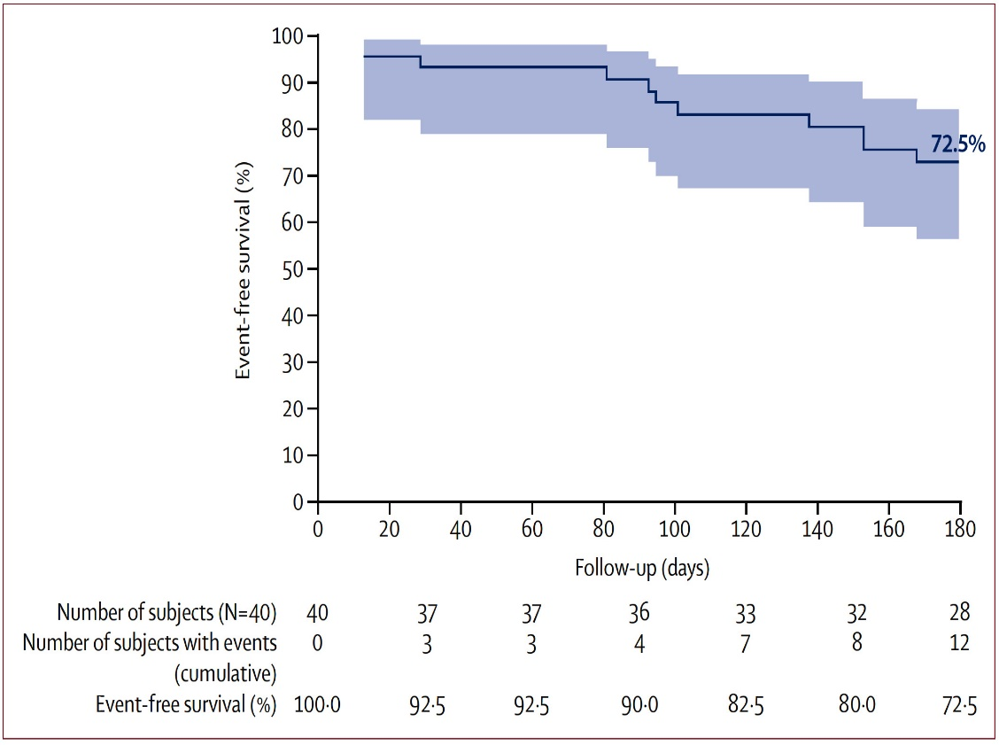
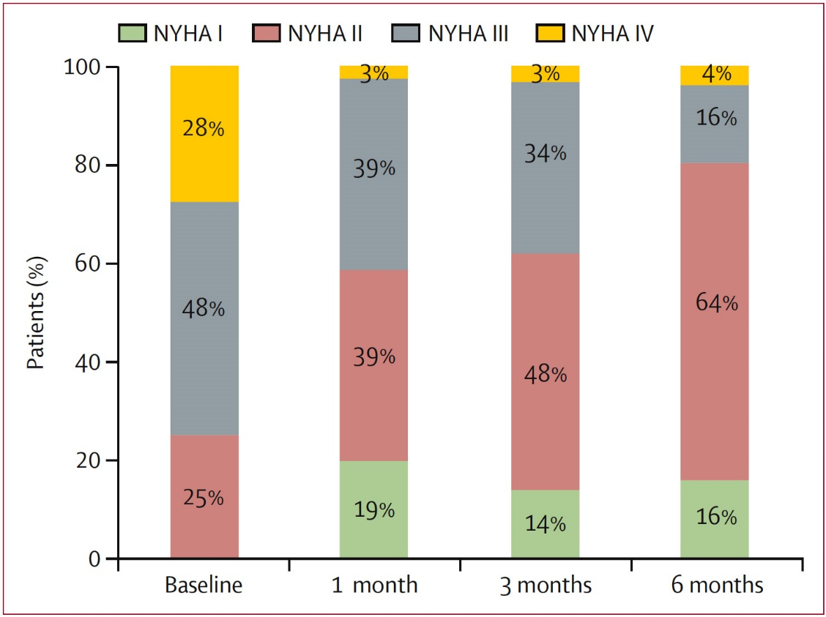
Survival Up to 6 Months (180 Days)
NYHA Classification at Baseline and Follow-Up
Survival at 6 months was 72.5% (95% CI 56,0-83.7); one additional patient died day 188
At baseline, 75% of pts were in NYHA Class III or IV, at 6-month follow-up, it was 20%
Messas et al., Lancet 2023;402:2317

Slide 53
Take Home Messages
Recent Publications in TAVR Field
In selected matched AS pts in-hospital and 1-Yr clinical outcomes of 1st time TAVR are similar to redo TAVR in terms of hard endpoints of death, MI and other major complications. Long-term data @ 5-10 years are awaited. TAVR explant continue to be troublesome in form of higher surgical mortality vs redo TAVR.
A small RCT comparing SEV vs BEV in small aortic surgical prosthetic valve although showed better hemodynamics with SEV vs BEV, but there were no difference in clinical outcomes between 2 valves at 1Yr.
Newer advances in the BEV have resulted in improved valve performance and possibly better long-term durability and hence S3UR valve should the balloon expandable valve choice currently; especially in younger pts.
TAVR in failed surgical aortic valve in high risk pts have shown significant immediate improvement which is sustained at 5yrs F/U.
Newer disruptive noninvasive ultrasound therapy (NIUT) has shown promising results up to 6M in a small series of inoperable severe AS pts but long-term benefits are awaited.

Slide 54
Question # 1
Following statements is not true regarding the outcomes of matched redo TAVR vs native TAVR up to 1-Yr:
Similar mortality rate
Similar stroke rate
Similar major bleeding rates
Similar residual MG post procedure
Correct answer: D

Slide 55
Question # 2
Following are the true outcomes at 1year of the LYTEN trial comparing BEV vs SEV in failed small surgical prosthesis except:
Similar mortality
Similar stroke rates
Similar hemodynamics at 30 days
Similar KCCQ score
Correct answer: C

Slide 56
Question # 3
Following results are true about the 5th generation Sapien 3 Ultra Resilia (S3UR) TAVR compared to Sapien 3/Ultra (S3/S3U) TAVR except:
A. Lower MG with S3UR vs S3/S3U TAVR group
B. Higher EOA with S3UR vs S3/S3U TAVR group at discharge
C. Better long-term outcomes with S3UR vs S3/S3U TAVR group
D. Lower PVL rates with SEUR vs S3/S3U TAVR group
Correct answer: C

