Slide 1
Complex Coronary Cases Supported by:
Boston Scientific Corp.
Abbott-CSI Inc.
Shockwave Medical Inc.
Terumo Vascular Corp.
Johnson & Johnson-Abiomed Inc.
Chiesi Inc.
Haemonetics-Cardiva Inc.
Acist Medical System.

Slide 2
Disclosures
Samin K. Sharma, MD, MSCAI, FACC
Nothing to disclose
Annapoorna S. Kini, MD, MRCP, FACC
Nothing to disclose
Sameer Mehta, MD, FACC (Moderator)
Nothing to disclose

Slide 3
CCC Live Case # 176
Patient Demographics
75 yrs, Male
Present Clinical Presentation
Presented with new onset CCS class III angina, negative SPECT MPI but cCTA revealed significant 2 V CAD and Ca++ score 326
CAD Risk Factors
Controlled hypertension
NIDDM- controlled
SAQ-7 score: 37
Clinical Variables
H/o cardiac arrest in 7/2023 during prostate cancer surgery and got PPM, No prior known CAD, Echo with 58% EF and no valvular disease
Medications
Aspirin, Valsartan, Metoprolol XL, Metformin, Empagliflozin, Atorvastatin
Cath: Cardiac cath on 1/19/2024 revealed 2 V CAD; 95% pRCA, 80% mRCA, long 80-90% moderately calcified LAD lesion with large size 80% D1 & moderate size 90% D2 bifurcation lesions, Syntax score 23 and LVEF 60%. Pt underwent successful PCI of RCA using 2 DES and did well. Prasugrel 5mg daily added.

Slide 4
Angio of Prox (95% blocked) and Mid RCA (80% blocked)

Slide 5
Proximal RCA DES – Synergy XD

Slide 6
Mid RCA DES – Synergy XD

Slide 7
Successful Intervention of Prox and Mid RCA

Slide 8
CCC Live Case # 176
Patient Demographics
75 yrs, Male
Present Clinical Presentation
Presented with new onset CCS class III angina, negative SPECT MPI but cCTA revealed significant 2 V CAD and Ca++ score 326
CAD Risk Factors
Controlled hypertension
NIDDM- controlled
SAQ-7 score: 37
Clinical Variables
H/o cardiac arrest in 7/2023 during prostate cancer surgery and got PPM, No prior known CAD, Echo with 58% EF and no valvular disease
Medications
Aspirin, Valsartan, Metoprolol XL, Metformin, Empagliflozin, Atorvastatin
Cath: Cardiac cath on 1/19/2024 revealed 2 V CAD; 95% pRCA, 80% mRCA, long 80-90% moderately calcified LAD lesion with large size 80% D1 & moderate size 90% D2 bifurcation lesions, Syntax score 23 and LVEF 60%. Pt underwent successful PCI of RCA using 2 DES and did well. Prasugrel 5mg daily added.
Plan: Now planned for staged PCI of LAD-D1 and LAD-D2 bifurcation lesions using double mini-Crush technique.

Slide 9
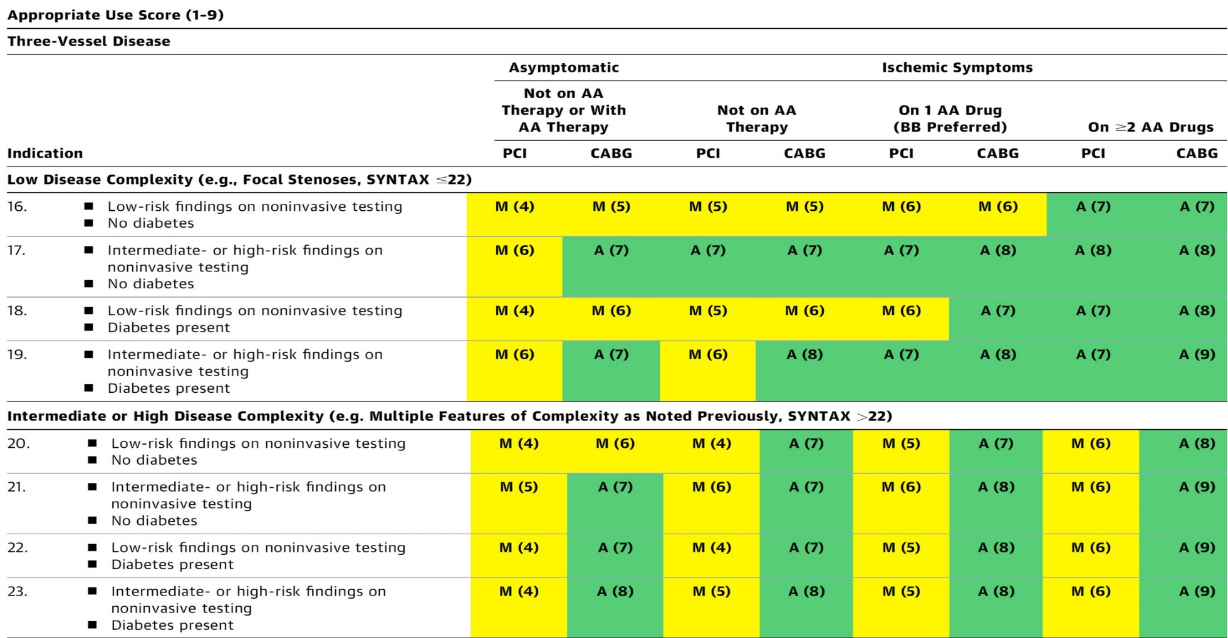
AUC 2017: Two-Vessel Disease
Patel et al., J Am Coll Cardiol 2017;69:2212

Slide 10
Latest Issues in Coronary Intervention
Recent Interventional Trials and Publications:
CorCTA Trial, ARCHITECT Study, OCT-FFR Trial,
Pretreatment with P2Y12i in STEMI
Focused review of the month
Impact of TLR on long-term mortality after LM PCI:
Impact of Target Lesion Revascularization on Long-
term Mortality after PCI for Left Main Disease

Slide 11
Latest Issues in Coronary Intervention
Recent Interventional Trials and Publications:
CorCTA Trial, ARCHITECT Study, OCT-FFR Trial,
Pretreatment with P2Y12i in STEMI
Focused review of the month
Impact of TLR on long-term mortality after LM PCI:
Impact of Target Lesion Revascularization on Long-
term Mortality after PCI for Left Main Disease

Slide 12
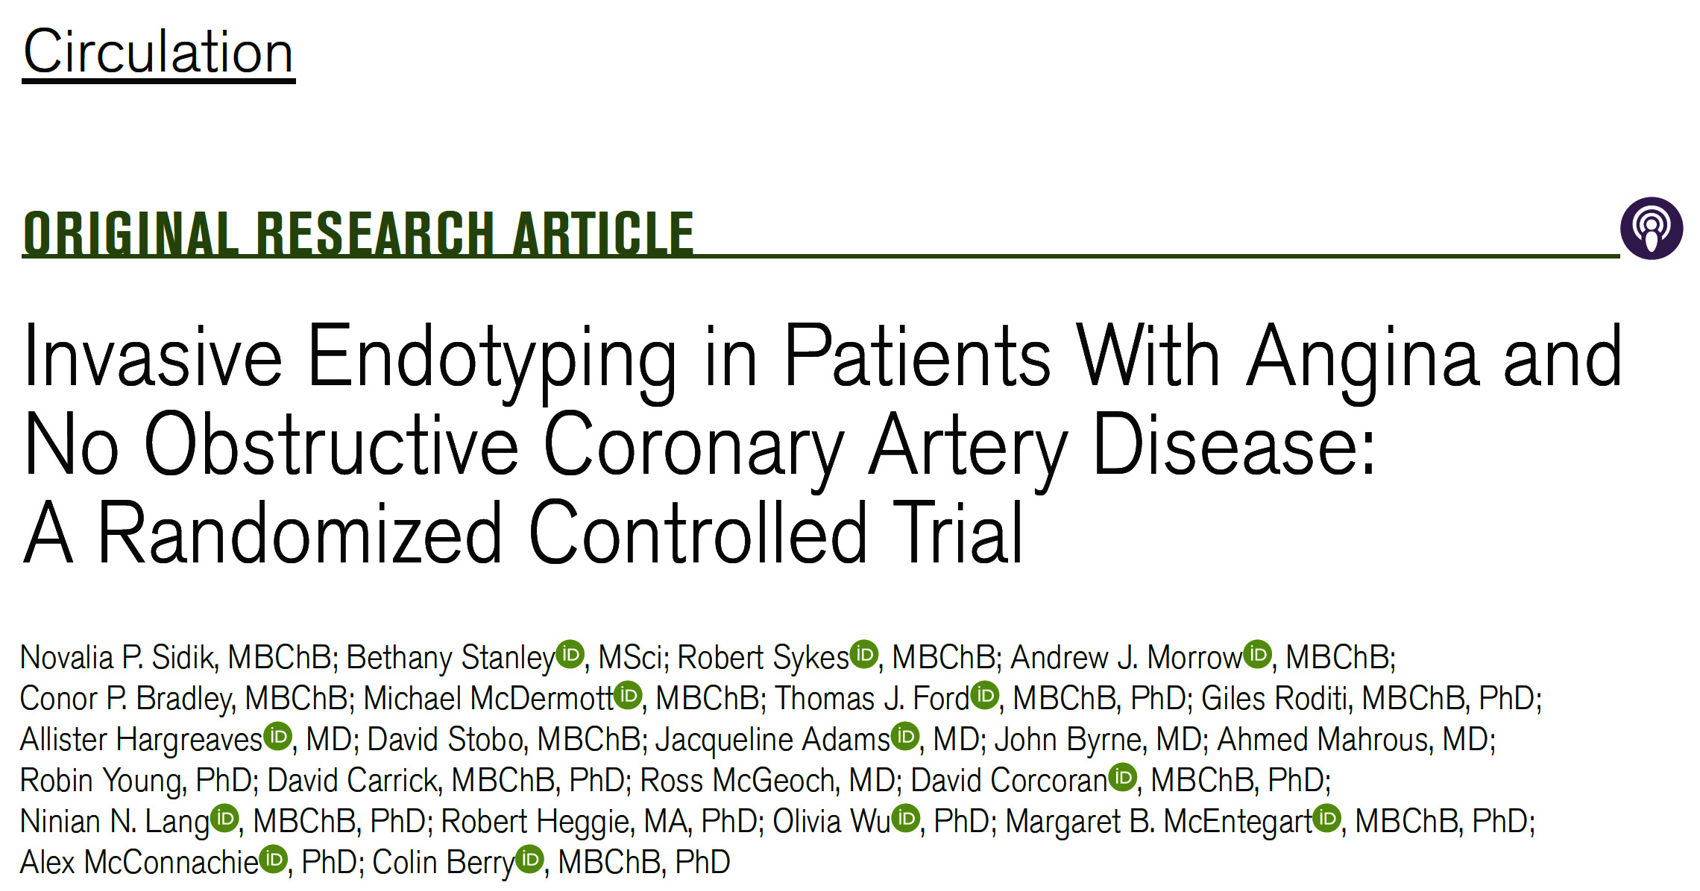
CorCTA Trial
(Coronary Microvascular Functional and CT Angiography) U.K.

Slide 13
CorCTA Trial: Types and Definitions of Endotypes
Vasospastic angina: required that 3 conditions occur during acetylcholine testing:
Clinical significant epicardial vasoconstriction (≥90%);
Reproduction of the usual chest pain;
Ischemic changes on the ECG
Microvascular angina: symptoms of myocardial ischemia, unobstructed coronary arteries, and evidence of microvascular dysfunction (any of abnormal coronary flow reserve, index of microcirculatory resistance or microvascular spasm to acetylcholine).
Definitive microvascular angina diagnosed if all criteria are +,
symptoms of ischemia are present
no obstructive coronary artery disease
only objective of myocardial ischemia
evidence of impaired coronary microvascular function alone
Microvascular spasm: required provocation and reproduction of angina symptoms, ischemic ECG shifts, but no epicardial spasm during Ach testing.
Normal test: denoted no obstructive epicardial coronary artery disease (FFR >0.80) and no coronary vascular dysfunction (coronary flow reserve >2.0, index of microcirculatory resistance <25, and negative acetylcholine testing).
Sidik et al., Circulation 2024;149:7

Slide 14
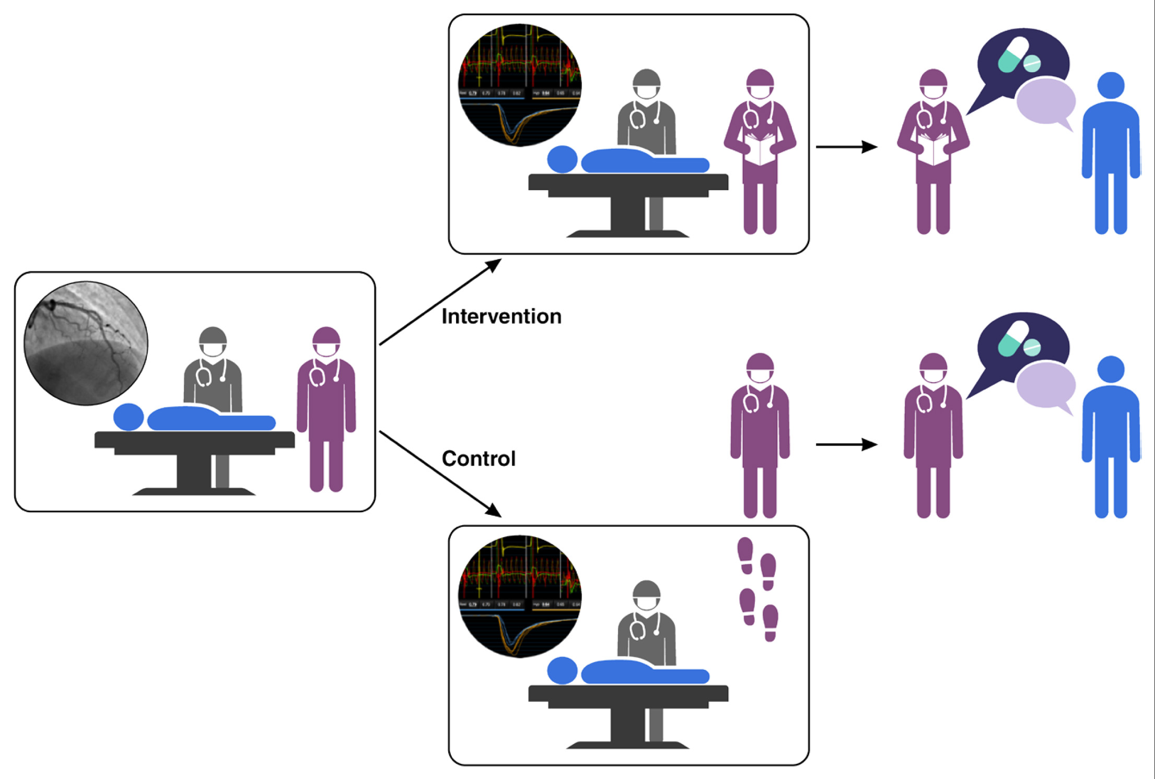
CorCTA Trial: Blinding Procedures in the
Catheter Laboratory
Sidik et al., Circulation 2024;149:7

Slide 15
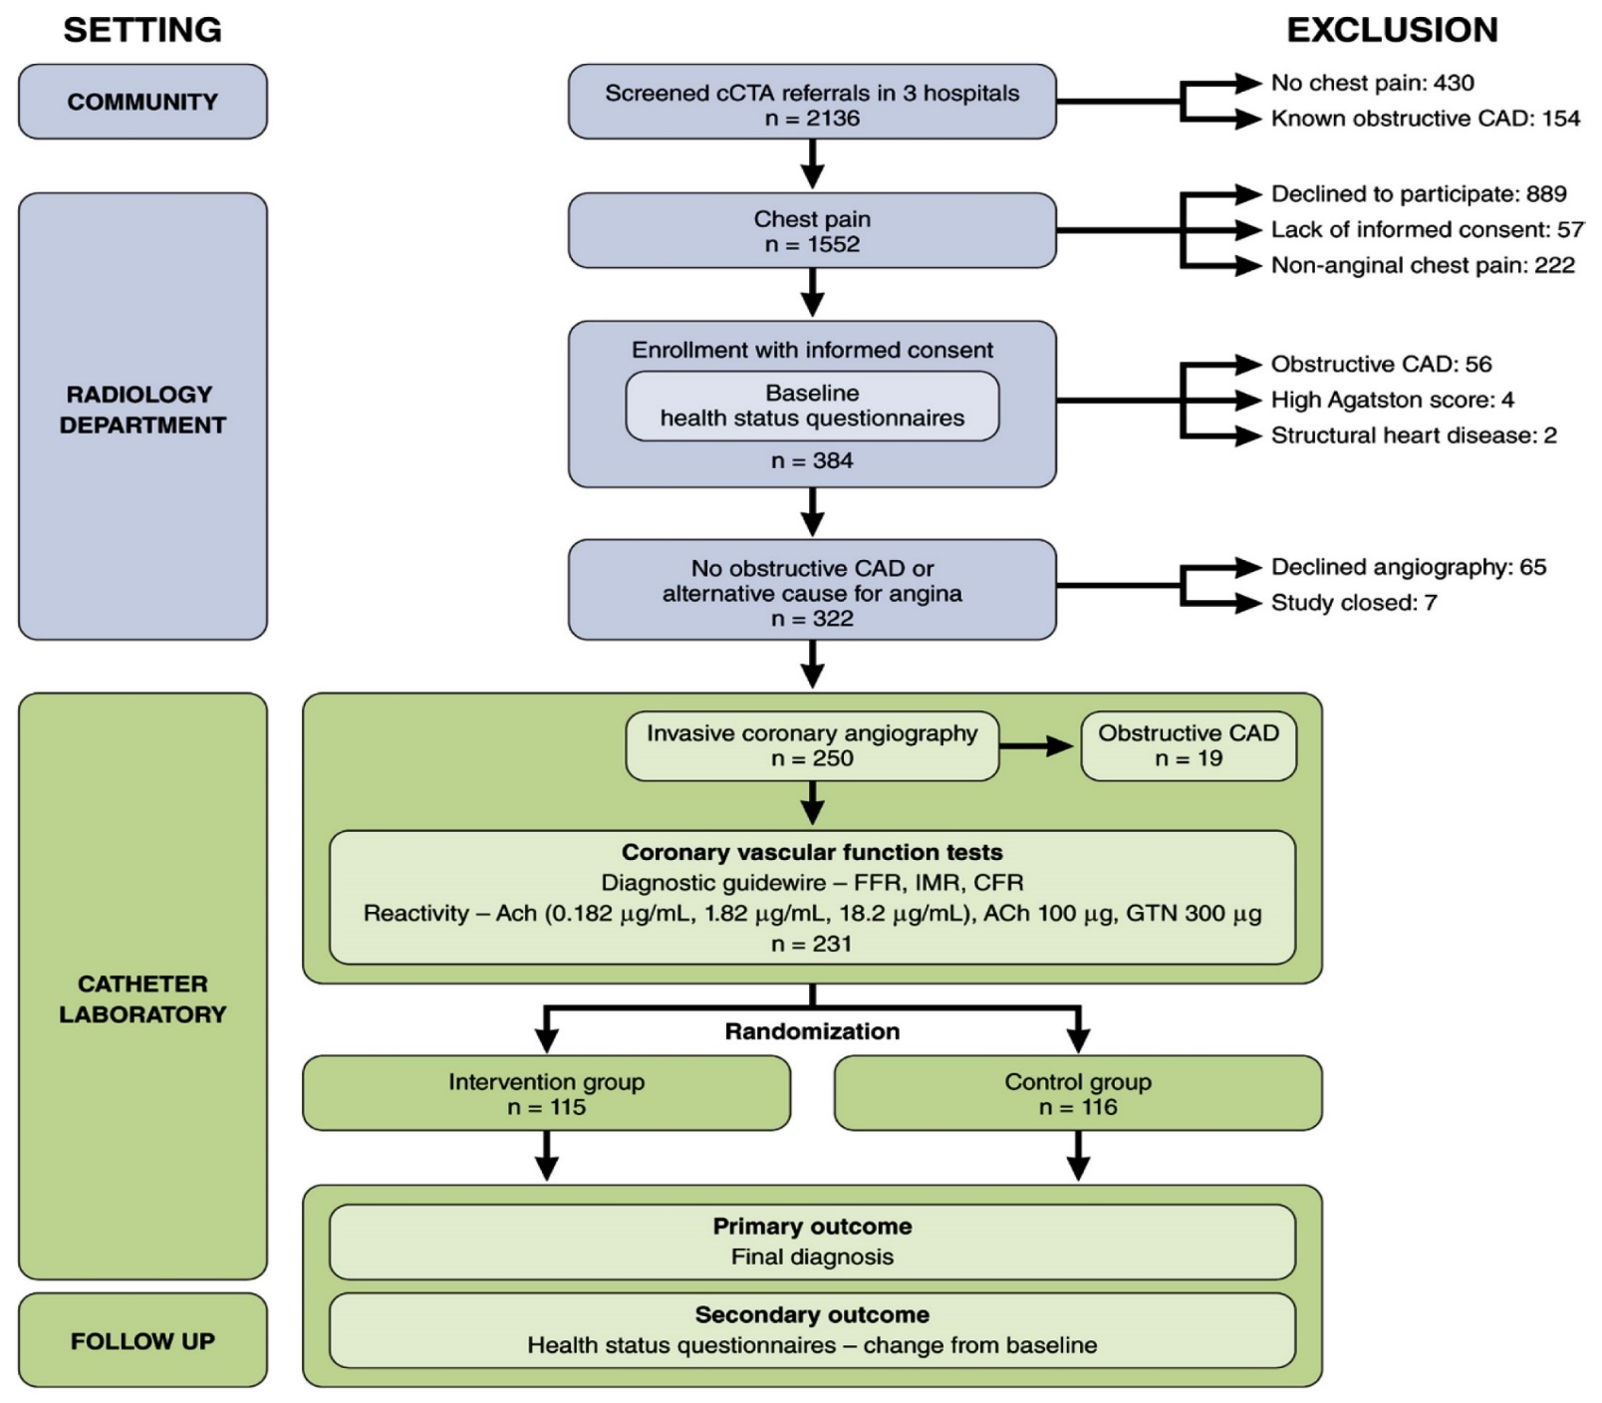
CorCTA Trial: Flow Diagram
Sidik et al., Circulation 2024;149:7

Slide 16
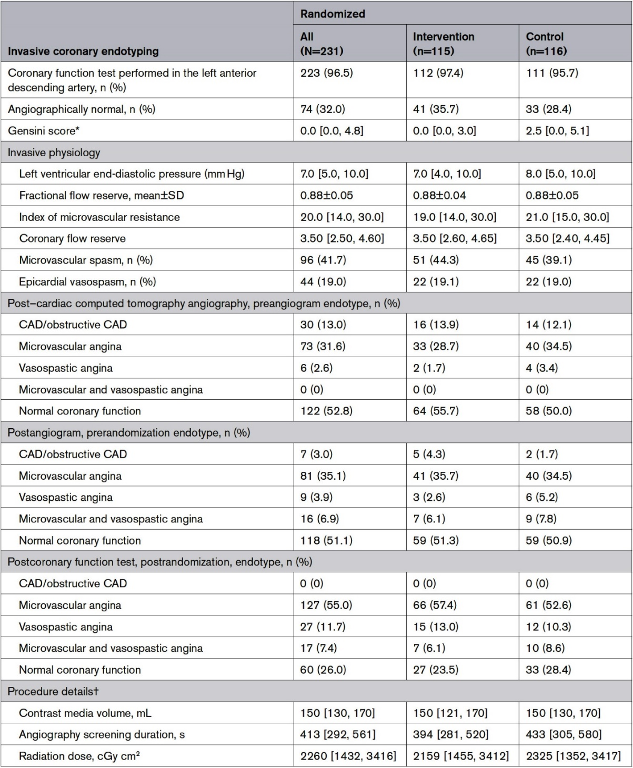
CorCTA Trial: Invasive Coronary Endotyping
Invasive management and true endotypes are shown in table
LAD CA evaluated in 223 (96.5%) pts
Invasive coronary function tests successfully completed in 230 (99.6%) pts
Mean FFR was 0.88 consistent with nonobstructive CAD
Of the 231 pts:
55% had microvascular angina
11.7% had vasospatic angina
7.4% had both microvascular and vasospatic angina
26% had normal coronary function test results
Sidik et al., Circulation 2024;149:7

Slide 17
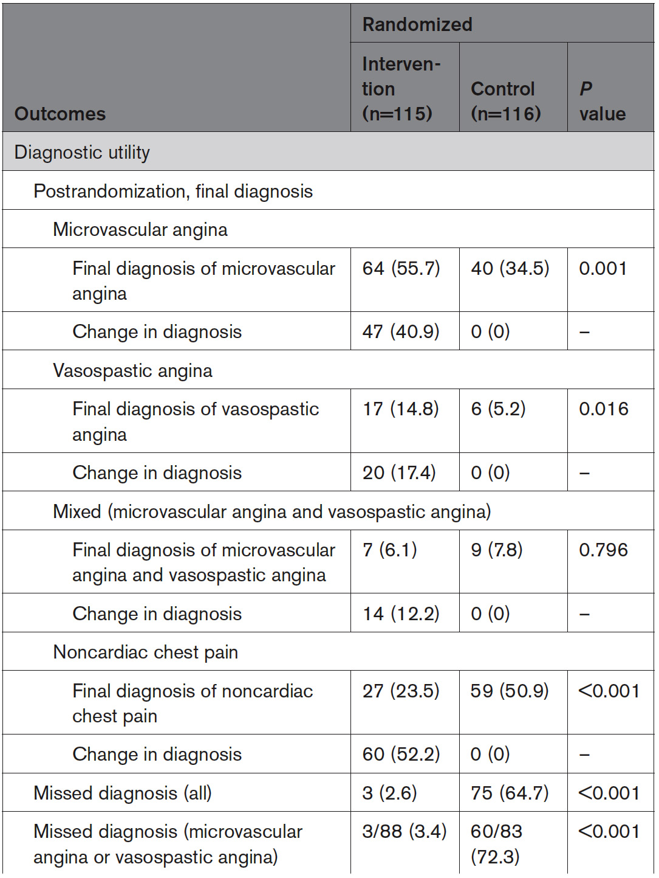
CorCTA Trial: Primary and Secondary Outcomes
Diagnostic Utility, Clinical Utility and Clinical Events
Sidik et al., Circulation 2024;149:7

Slide 18
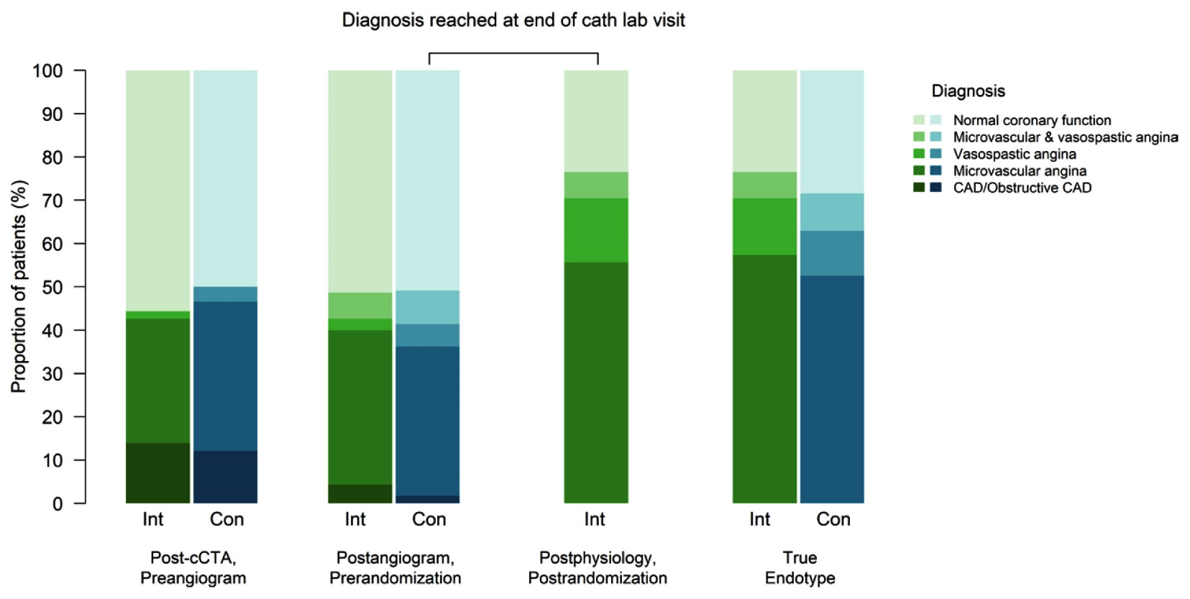
CorCTA Trial: Diagnoses at Sequential Timepoints
Sidik et al., Circulation 2024;149:7

Slide 19
CorCTA Trial: Clinical Events
p=0.53
p=0.31
p=0.20
%
p=0.62
p=1.0
NA
Sidik et al., Circulation 2024;149:7

Slide 20
CorCTA Trial: Follow-Up Response
Time points for SAQ
Sidik et al., Circulation 2024;149:7

Slide 21
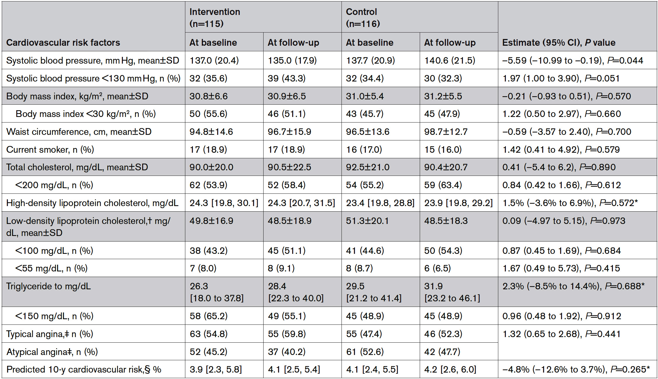
CorCTA Trial: CV Risk Factors by Randomized
Group at Baseline and Follow-Up Visits
Sidik et al., Circulation 2024;149:7

Slide 22
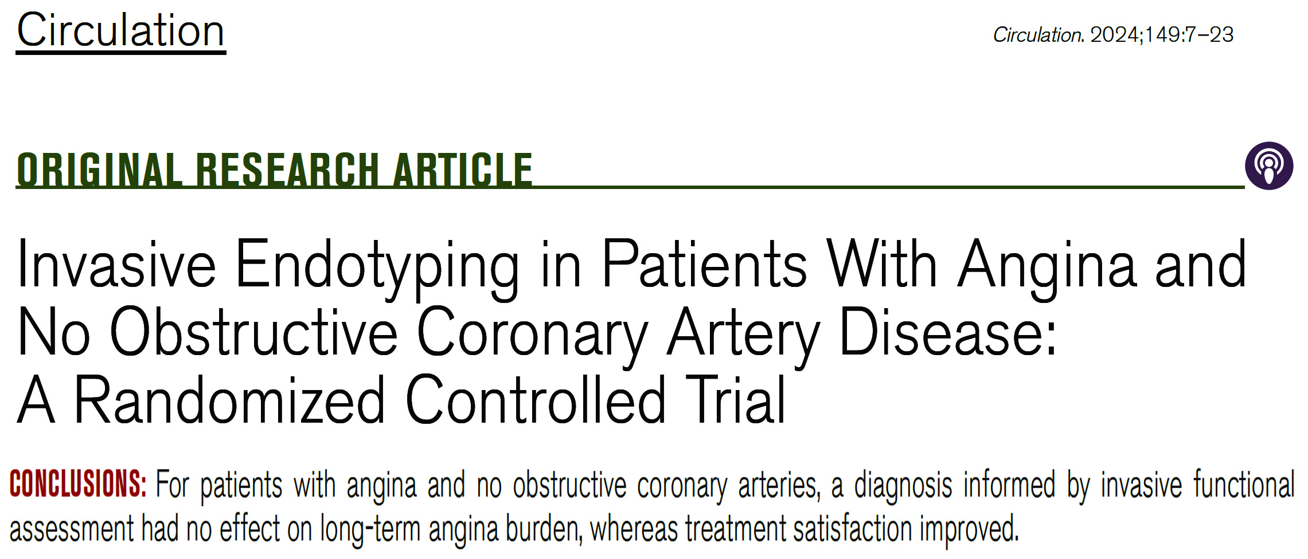
CorCTA Trial

Slide 23
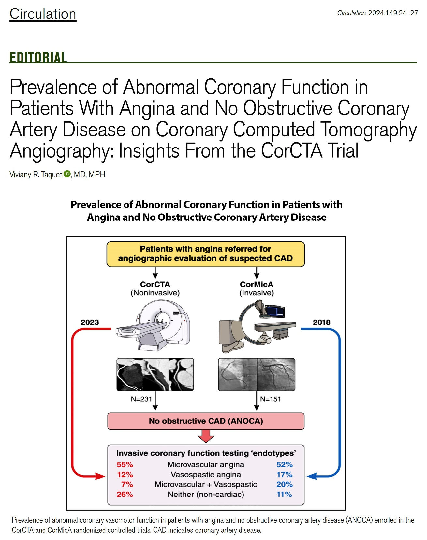

Slide 24
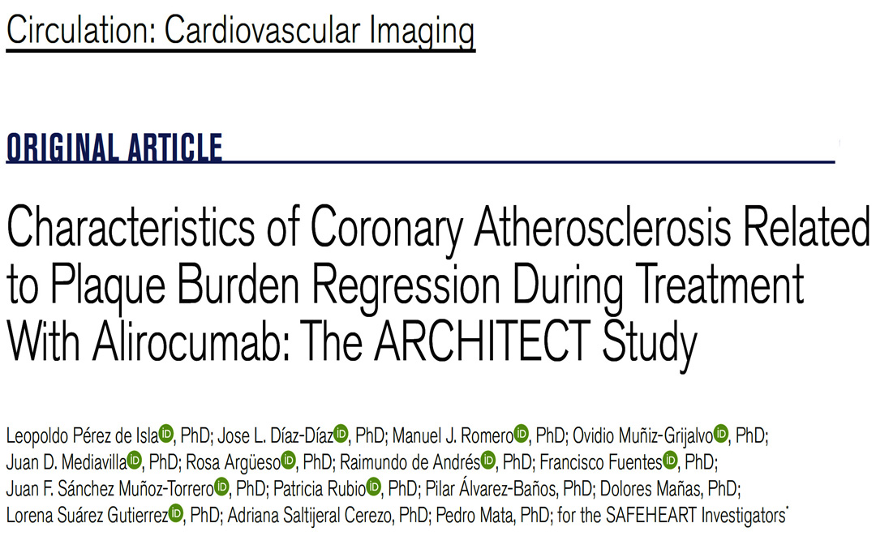
(Effect of Alirocumab on Atherosclerotic Plaque Volume, Architecture and Composition) Spain

Slide 25
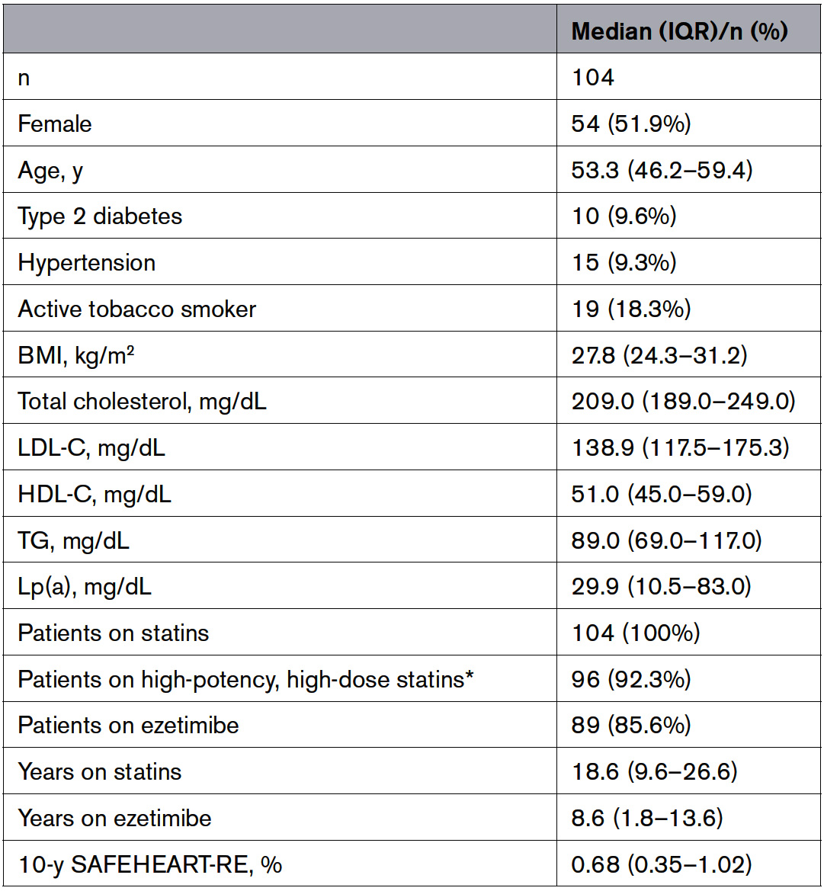
ARCHITECT Study: Baseline Clinical and Biochemical Characteristics
Analyzed population consisted of 104 patients enrolled between June 2018 to October 2019
Median age was 53.3 (46.2-59.4) years
51.9% were women
Pérez de Isla et al., Circ Cardiovasc Imaging 2024;17:e016206

Slide 26
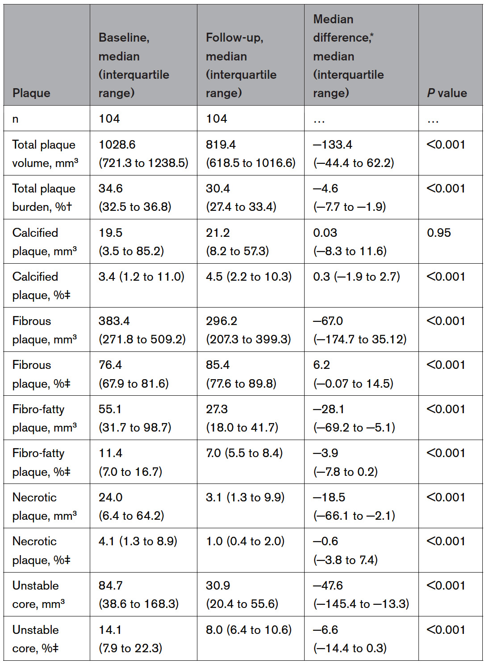
ARCHITECT Study: Plaque Characteristics Changes
Global coronary PB changed from 34.6% (32.5-36.8%) at entry to 30.4% (27.4-33.4%) at follow-up, which is -4.6% (-7.7 to -1.9%; p<0.001) reduction.
Increase in the proportion of calcified plaque (from 3.4 [1.2-11.0] to 4.5 [2.2-10.31]; +0.3%; p<0.001) and increase in fibrous plaque (from 76.4 [67.9-81.6] to 85.4 [77.6-89.8]; +62%; p<0.001) was found
A decrease in the percentage of fibro-fatty plaque (from 11.4 [7.0-16.7] to 7.0 [5.5-8.4]; -3.9%; p<0.001) and necrotic plaque (from 4.1 [1.3-8.9] to 1.0 [0.4-2.0]; -0.6%; p<0.001) was found
Pérez de Isla et al., Circ Cardiovasc Imaging 2024;17:e016206

Slide 27
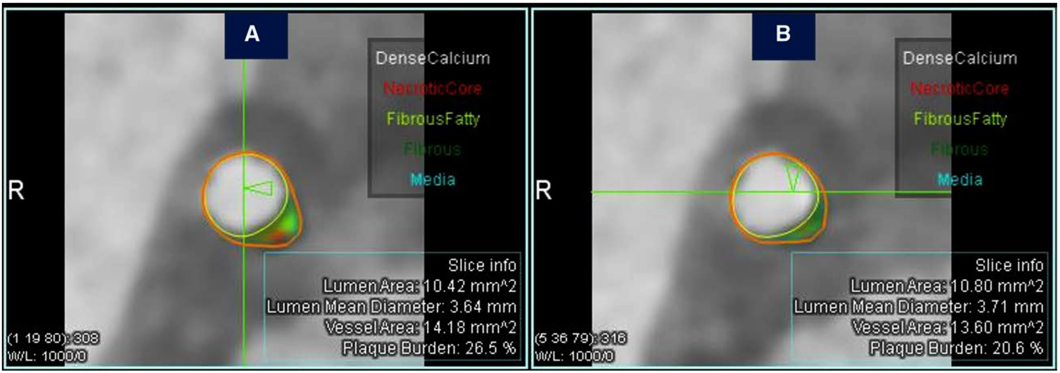
ARCHITECT Study: Plaque Burden Reduction
and Composition Change in the LAD
Before and after 78 weeks of alirocumab treatment
BEFORE
AFTER
Cross-sections obtained immediately proximal to the origin of the first diagonal branch
Coronary plaque burden was reduced from 26.5% to 20.6%
In the follow-up image, an evident change in plaque composition can be seen: when compared with the baseline image, the fibro-fatty (light green) and necrotic (red) components have almost disappeared ad the fibrous plaque (dark green) is the main component
Pérez de Isla et al., Circ Cardiovasc Imaging 2024;17:e016206

Slide 28
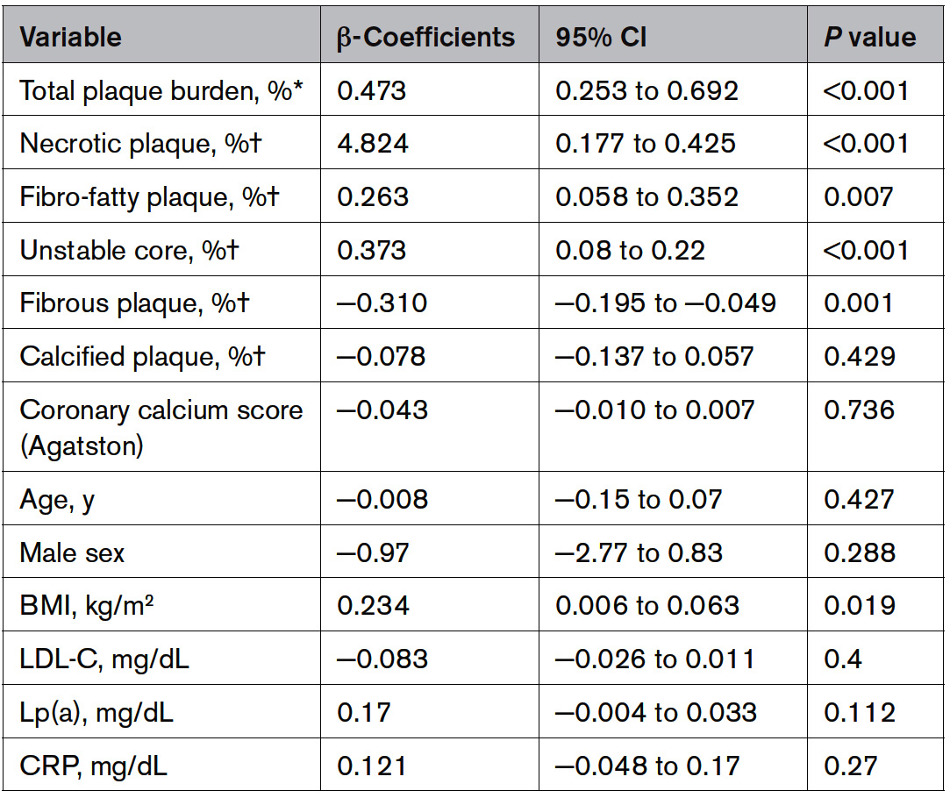
ARCHITECT Study: Linear Regression Univariate Analysis
Showing Association Between Baseline Atherosclerotic Characteristics and Plaque Burden Regression/Progression (Positive β Values Mean Plaque Burden Regression)
*Proportion of total vessel volume; †Proportion of total plaque volume
Pérez de Isla et al., Circ Cardiovasc Imaging 2024;17:e016206

Slide 29
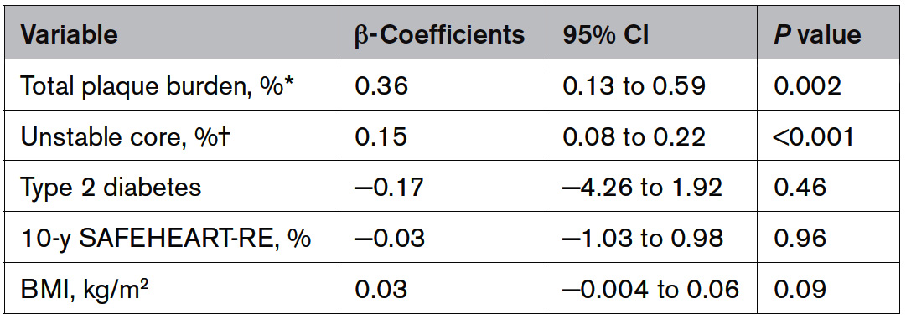
ARCHITECT Study: Linear Regression Multivariate Analysis
Showing Association Between Baseline Atherosclerotic Characteristics and Plaque Burden Regression/Progression (Positive β Values Mean Plaque Burden Regression)
Only plaque burden and unstable core (%) were found as independent predictors of plaque burden regression.
No other clinical or biochemical variables were related to plaque burden regression
Pérez de Isla et al., Circ Cardiovasc Imaging 2024;17:e016206

Slide 31
Optical Coherence Tomography Morphologic and Fractional Flow Reserve Assessment in Diabetes Mellitus Patients
(COMBINE OCT-FFR) - Netherlands

Slide 32
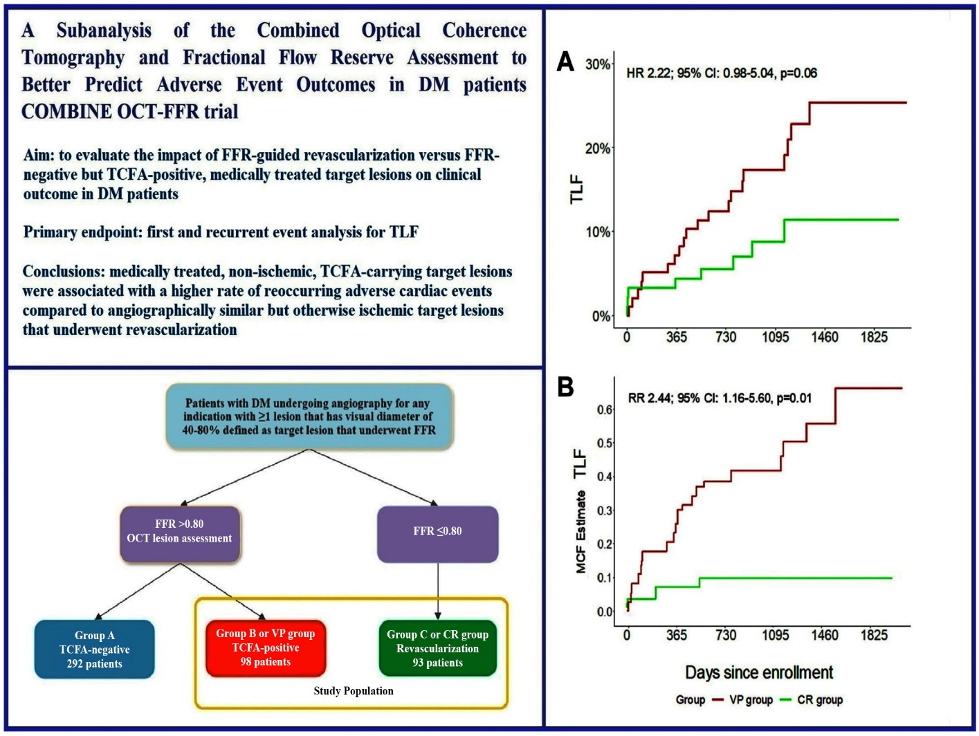
COMBINE OCT-FFR Trial: Outcomes of Medically Treated Non-ischemic TCFA Lesions vs FFR-Guided Complete Revasc in DM Pts
Overview of a sub-analysis of the COMBINE OCT-FFR trial in which the outcomes of DM pts with non-ischemic vulnerable plaque (VP group) were compared to DM pts who underwent complete FFR-guided revasc (CR group).
The primary endpoint was TLF (composite of cardiac death, TV-MI or TLR); secondary endpoint composite of cardiac death, TV-MI, TLR, or hosp due to unstable angina.
(A) – in first-time event analysis, VP grp had higher occurrences of TLF
(B) – In recurrent event analysis, presented as MCF indicating the number of target-lesion oriented events a pt could experience at the designated time of f/u, the VP grp had a statistically significant higher occurrence of TLF
VP – vulnerable plaque, CR – complete revascularization, MCF – mean cumulative function
Hommels et al., JSCAI Dec 12, 2023 Epub ahead of print

Slide 34
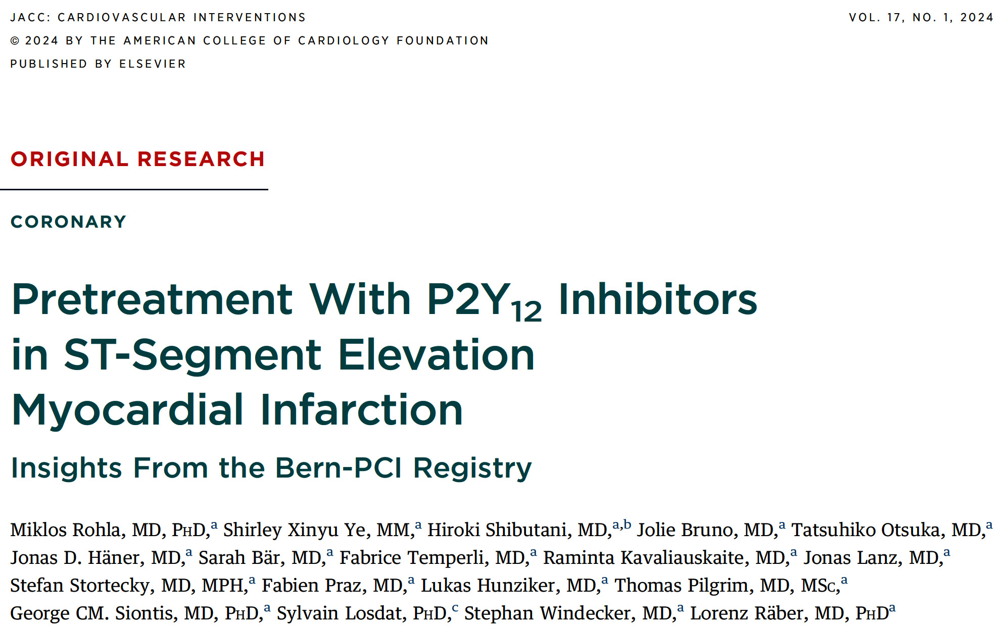

Slide 35
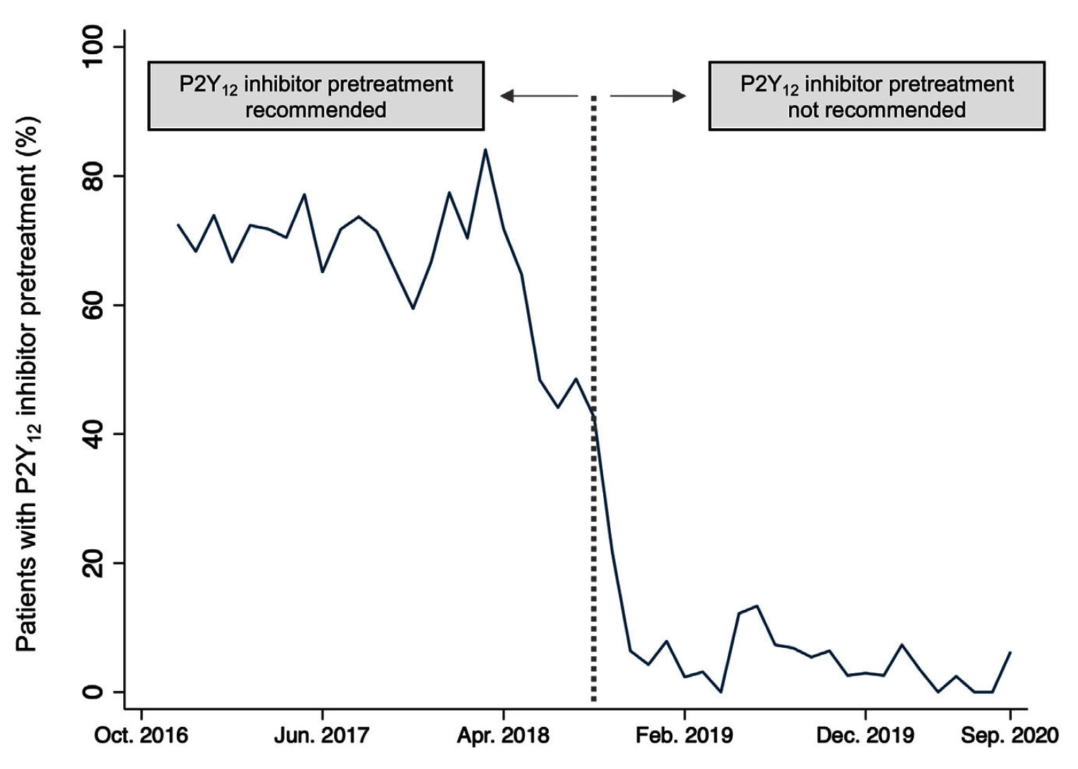
BERN-PCI Registry: Changes in Adherence to Institutional
Guidelines Over Time in Terms of P2Y₁₂ Inhibitor Pretreatment
After institutional recommendations regarding P2Y₁₂ inhibitor pretreatment changed in Sept 2018, there was a rapid adoption of the newly proposed strategy across BERN STEMI network
Rohla et al., J Am Coll Cardiol Intv 2024;17:17

Slide 36
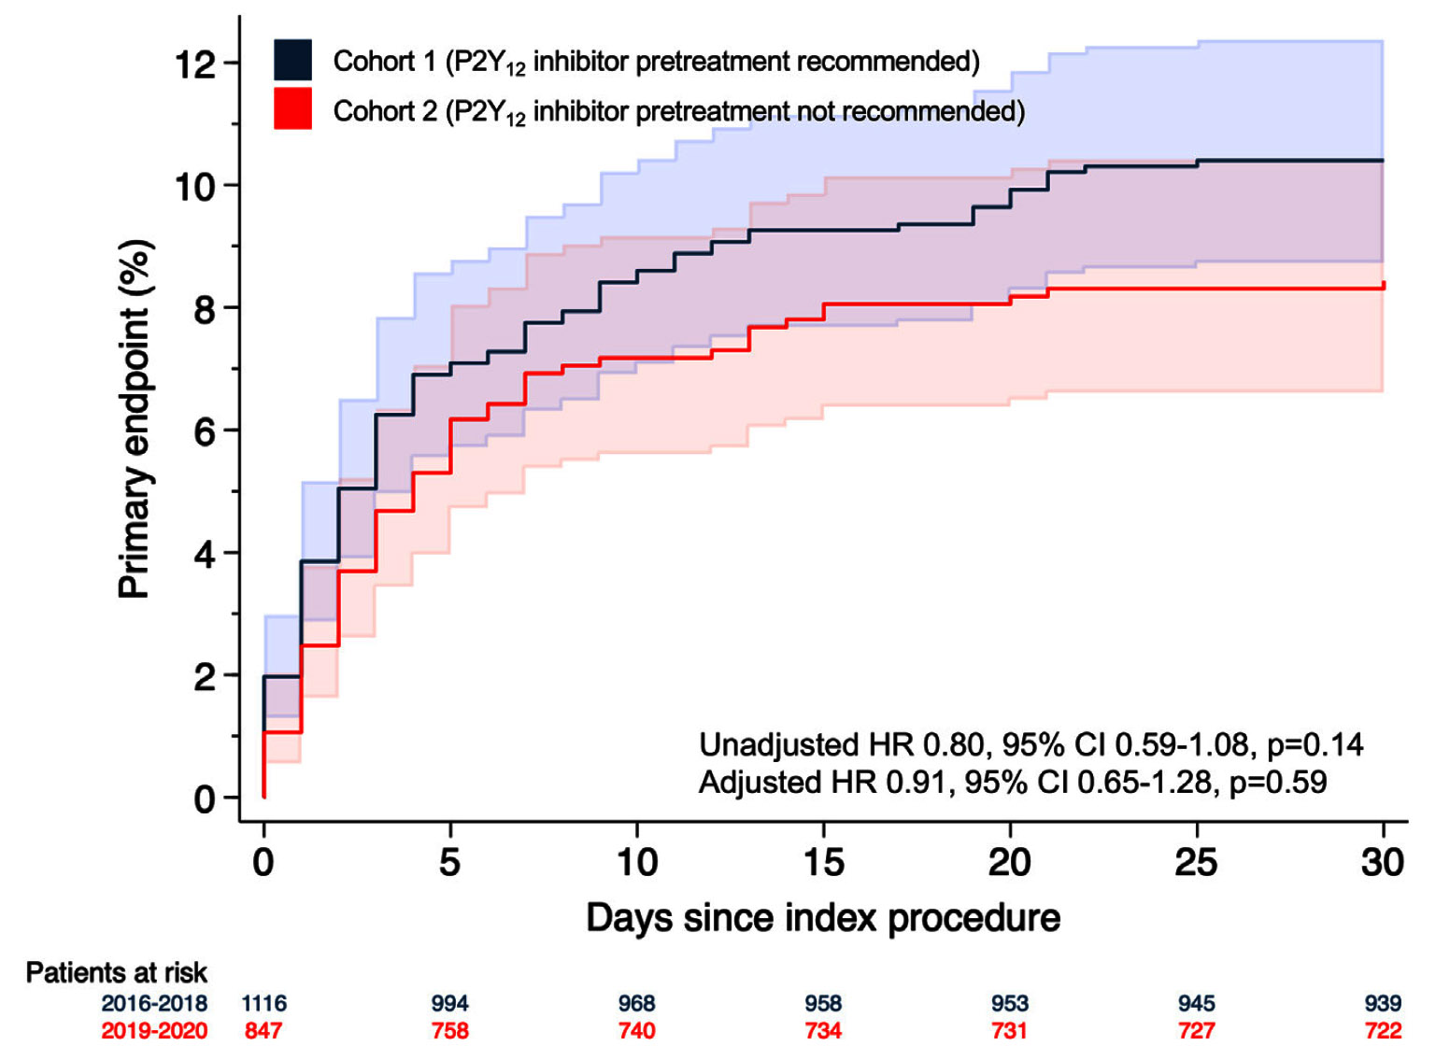
BERN-PCI Registry: MACCEs of Patients in
Cohort 1 and Cohort 2
10.1%
8.1%
Primary endpoint MACCEs occurred in 182 (9.3%) pts within 30 days. MACCE defined as composite of All-cause death, Recurrent MI, Stroke, or Definite ST
Risk of MACCEs was similar in pats in cohort 1 and cohort 2 both in univariate and multivariate analyses (10.1% vs 8.1%; adjusted HR: 0.91; 95% CI: 0.65-1.28; p=0.59)
Rohla et al., J Am Coll Cardiol Intv 2024;17:17

Slide 37
BERN-PCI Registry: Clinical Outcomes Comparing Patients Included in Cohort 1 vs Cohort 2
P2Y12 inh: +++ ---
p=0.59
p=0.35
%
p=0.74
p=0.60
p=0.93
p=0.82
p=1.0
death
MI
BARC type 3 or 5
Rohla et al., J Am Coll Cardiol Intv 2024;17:17

Slide 38
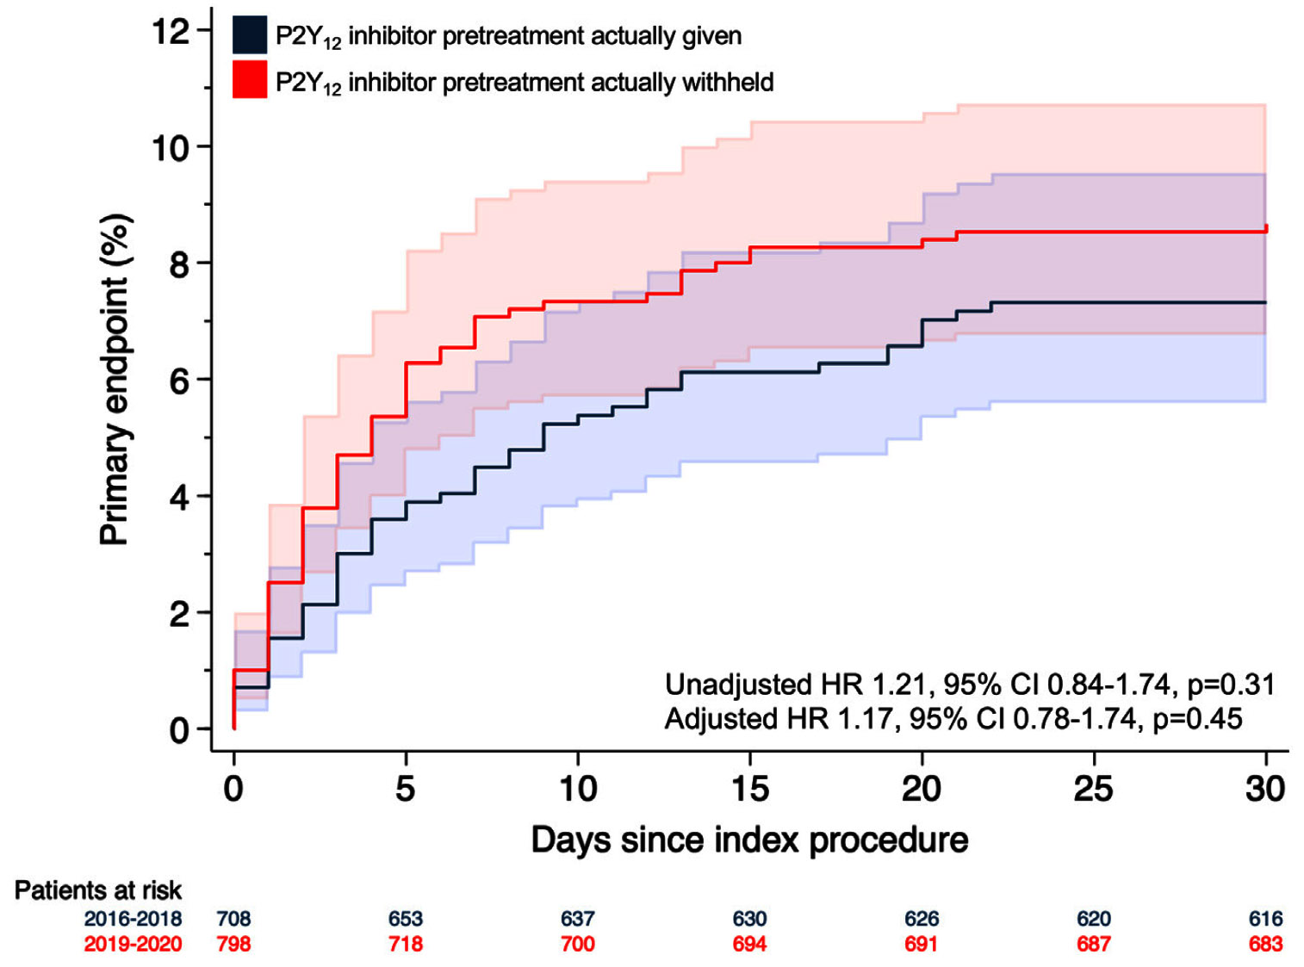
BERN-PCI Registry: MACCEs in Pts Who Did vs
Who Did Not Receive P2Y₁₂ Inhibitor Pretreatment
8.4%
7.1%
Rates of MACCEs were similar between those receiving vs not receiving pretreatment (7.1% vs 8.4%; adjusted HR: 1.17; 95% CI: 0.78-1.74; p=0.45)
Rohla et al., J Am Coll Cardiol Intv 2024;17:17

Slide 39
BERN-PCI Registry: Clinical Outcomes Comparing Pts Who
Did vs Who Did Not Receive P2Y₁₂ Inhibitor Pretreatment as Recommended in the Respective Time Periods
p=0.45
p=0.51
%
p=0.53
p=0.41
p=0.89
p=0.61
p=0.81
death
MI
BARC type 3 or 5
Rohla et al., J Am Coll Cardiol Intv 2024;17:17

Slide 40
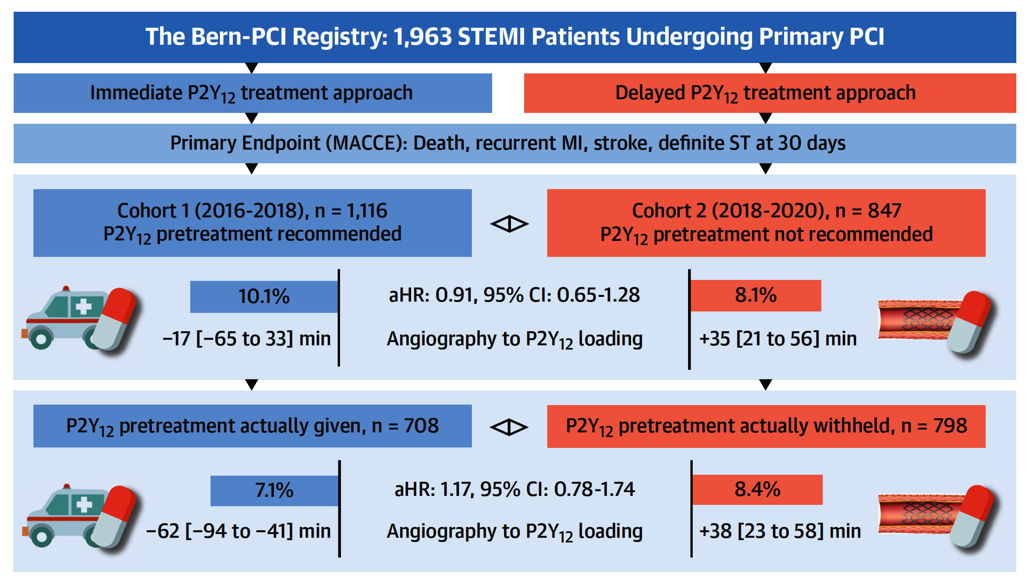
BERN-PCI Registry: Study Design and 30-Day Rates of Major Adverse Cardiac or Cerebrovascular Events
(MACCE defined as all-cause death, recurrent MI, stroke or definite ST)
Among STEMI pts undergoing PCI, rates of MACCEs were similar between pts in whom P2Y₁₂ inhibitor loading was recommended compared with pts in whom P2Y₁₂ loading was recommended after coronary anatomy was confirmed.
Rohla et al., J Am Coll Cardiol intv 2024;17:17

Slide 42
Latest Issues in Coronary Intervention
Recent Interventional Trials and Publications:
CorCTA Trial, ARCHITECT Study, OCT-FFR Trial,
Pretreatment with P2Y12i in STEMI
Focused review of the month
Impact of TLR on long-term mortality after LM PCI:
Impact of Target Lesion Revascularization on Long-
term Mortality after PCI for Left Main Disease

Slide 43
(Seoul, Korea)
IRIS-DES Study – Evaluation of First, Second, and New Drug-eluting Stent in Routine Clinical Practice
IRIS-MAIN – Observational Study for Left Main Disease Treatment
MAIN COMPARE – 10-Year Outcomes of Stents vs Coronary-Artery Bypass Grafting Left Main Coronary Artery Disease
PRECOMBAT – Bypass Surgery vs Angioplasty Using Sirolimus-Eluting Stent in Patients with Left Main Coronary Artery Disease

Slide 44
Prognostic Impact of TLR After LM PCI:
Study Flowchart
Kim et al., J Am Coll Cardiol Intv 2024;17:32

Slide 45
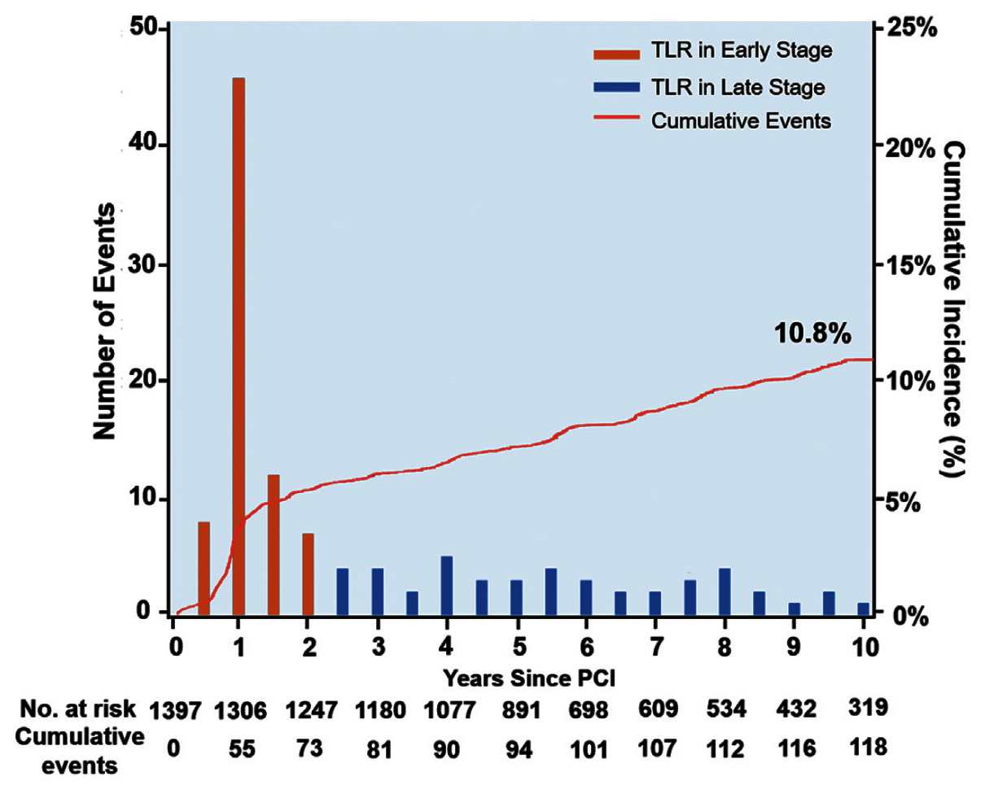
Prognostic Impact of TLR After LM PCI:
Occurrence and Frequency of TLR After LM PCI Over Time
TLR occurs at steady rate during the follow-up period of the 10-years and tends to be more frequent in the first 2 years after initial PCI
Time occurrence of TLR could be divided into early and late stages based on the difference in the incidence intensity
Kim et al., J Am Coll Cardiol Intv 2024;17:32

Slide 46
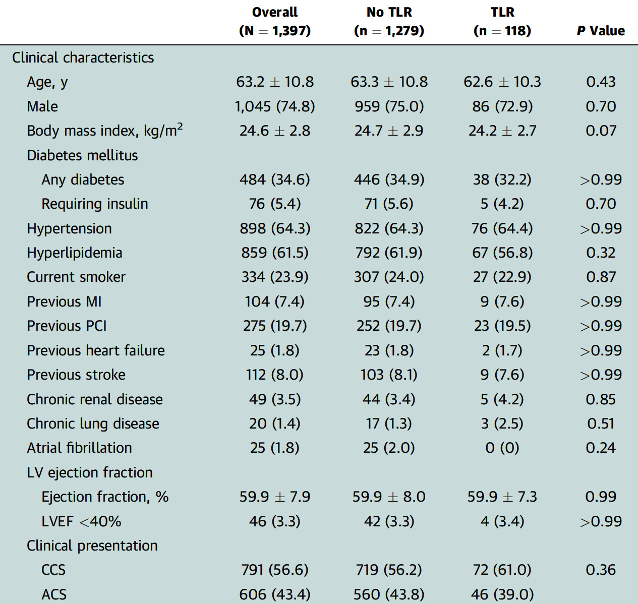
Prognostic Impact of TLR After LM PCI:
Clinical Characteristics
Kim et al., J Am Coll Cardiol Intv 2024;17:32

Slide 47
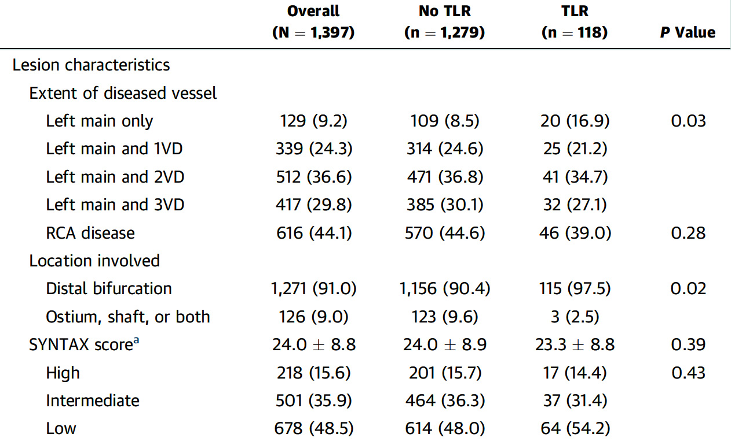
Prognostic Impact of TLR After LM PCI:
Lesion Characteristics
Kim et al., J Am Coll Cardiol Intv 2024;17:32

Slide 48
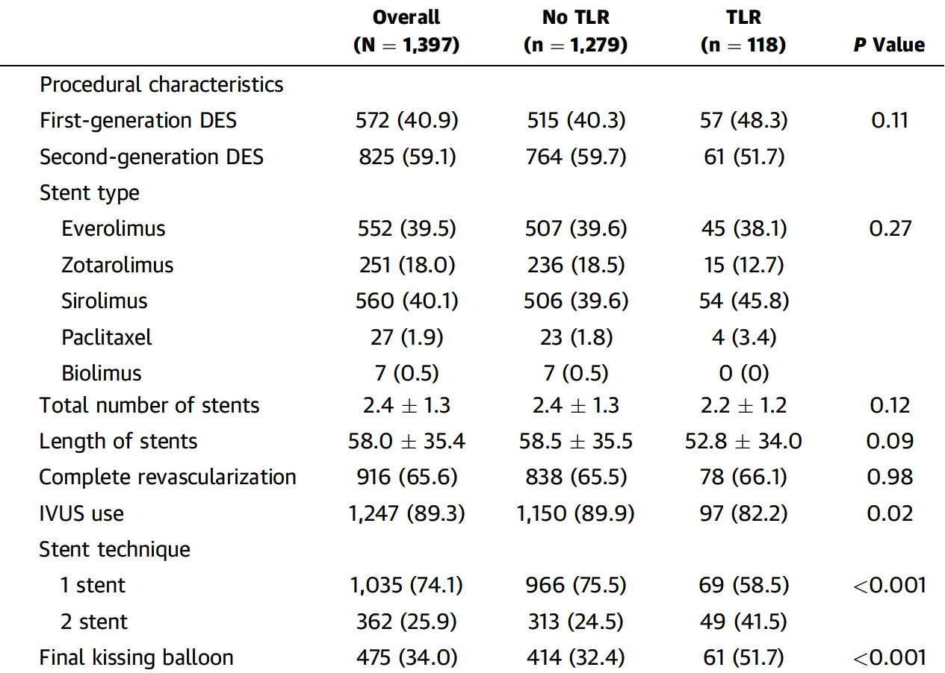
Prognostic Impact of TLR After LM PCI:
Procedural Characteristics
Kim et al., J Am Coll Cardiol Intv 2024;17:32

Slide 49
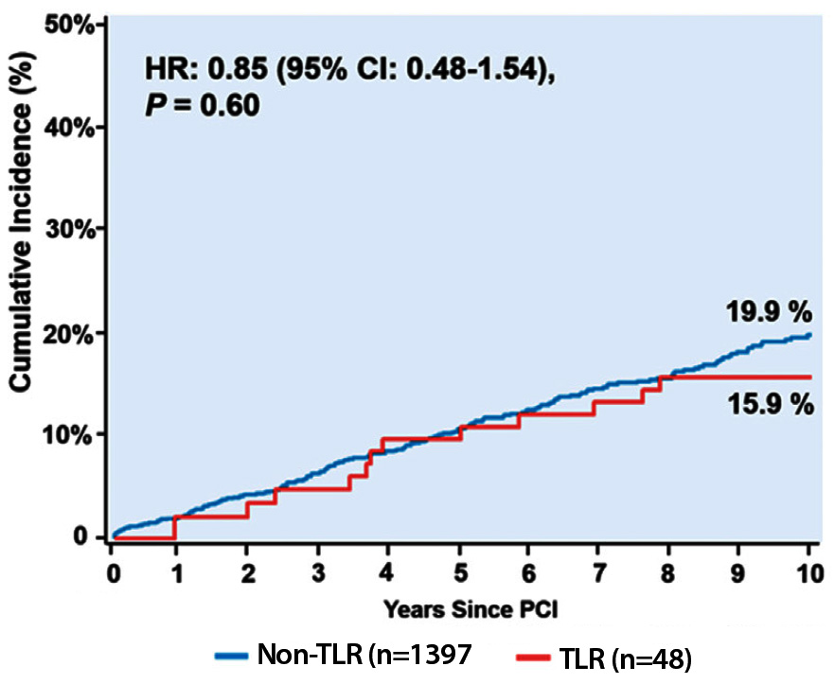
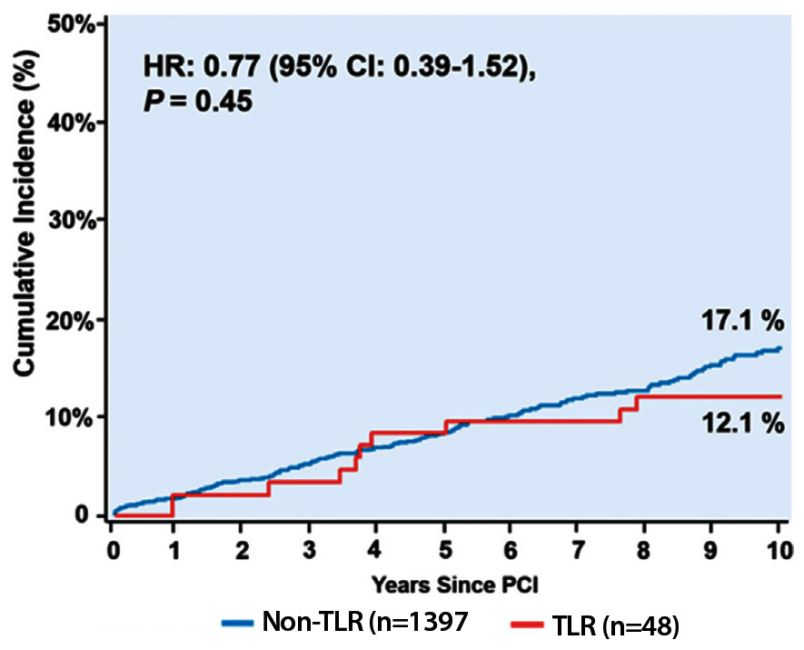
Prognostic Impact of TLR After LM PCI:
Mortality After TLR After LM CPI
All-Cause Mortality (Crude)
Cardiac Death (Crude)
Observed unadjusted event rates of the 10-year all-cause mortality and cardiac death were 15.9% and 12.1% in pts with TLR and 19.9% and 17.1% in patients without TLR, respectively.
Kim et al., J Am Coll Cardiol Intv 2024;17:32

Slide 50
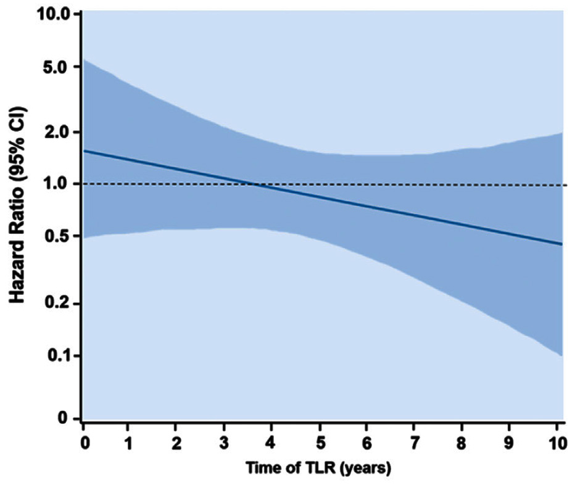
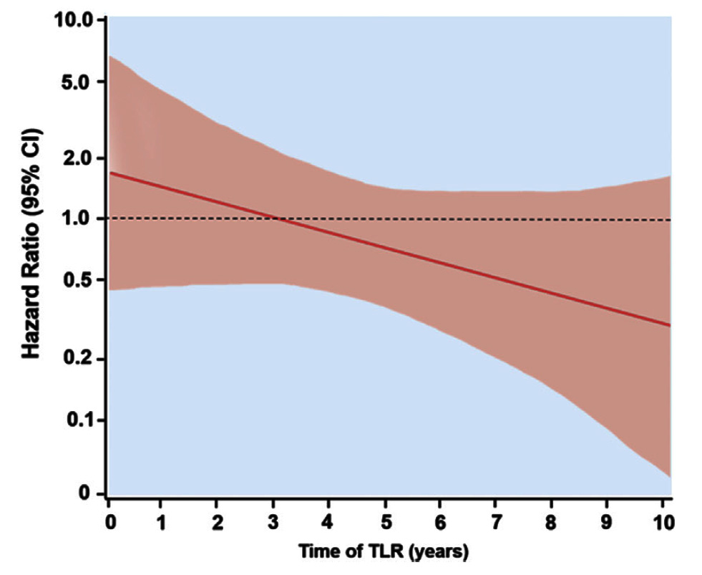
Prognostic Impact of TLR After LM PCI:
Adjusted Risk of Mortality According to Timing of TLR After LM PCI
All-Cause Mortality (Adjusted)
Cardiac Death (Adjusted)
Over the entire follow-up period, time varying Cox models showed that adjusted risks for all-cause mortality and cardiac death according to the period of TLR were high in the early period and declined over time; however this trend was not statistically significant overall.
Kim et al., J Am Coll Cardiol Intv 2024;17:32

Slide 51
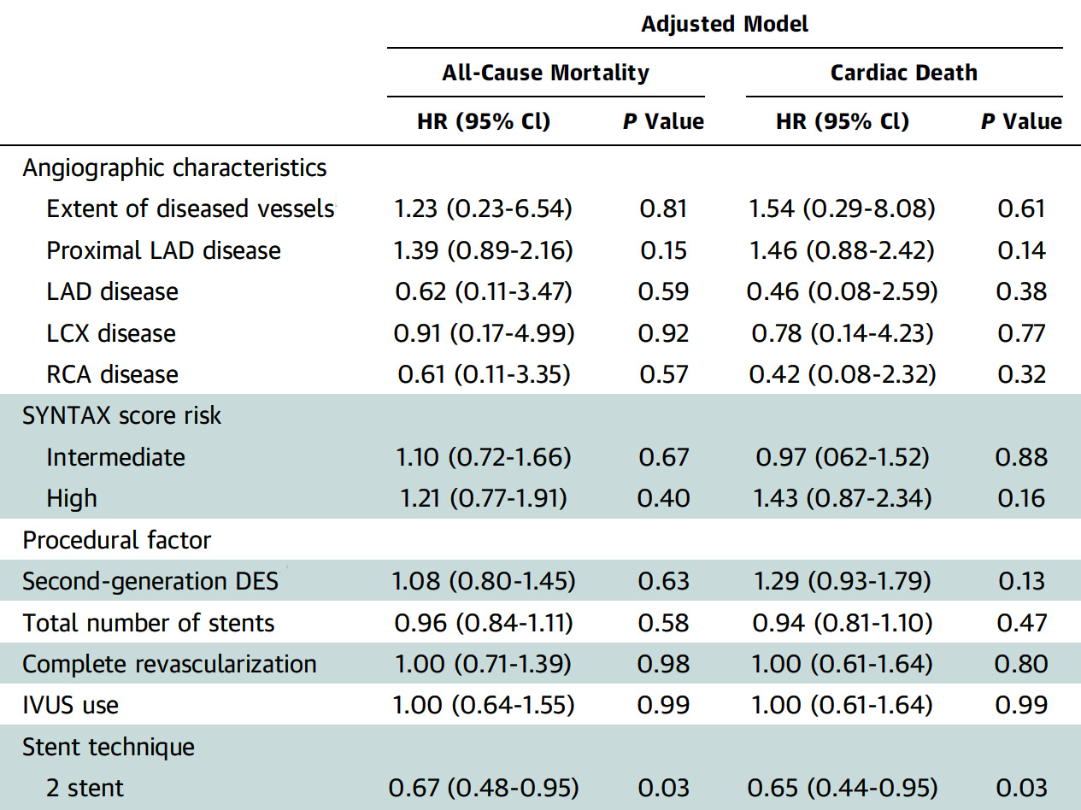
Prognostic Impact of TLR After LM PCI:
Adjusted HR of Covariates of Mortality After LM PCI
Independent predictors of clinical and angiographic characteristics did not emerge
The 2-stent technique as a procedural factor was associated with decreased risks of all cause mortality and cardiac death.
Kim et al., J Am Coll Cardiol Intv 2024;17:32

Slide 52
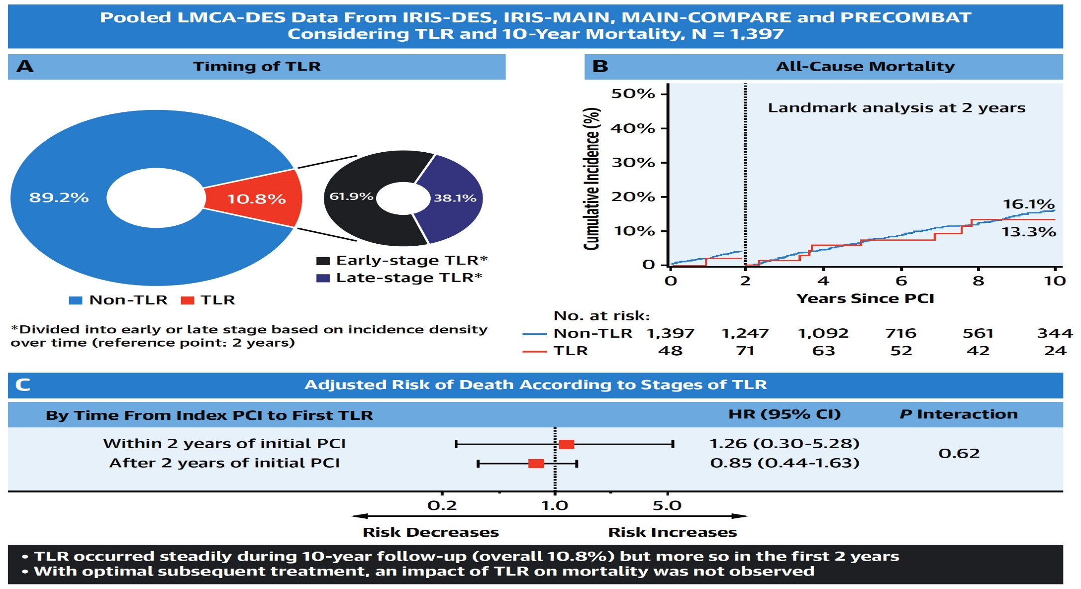
Prognostic Impact of TLR After LM PCI:
Cumulative Incidence and Impact on the Risk of Mortality of TLR After Initial LM PCI
Mechanism of TLR:
-Intimal hyperplasia IH (70%)
-IH & Stent under-expansion (30%
Kim et al., J Am Coll Cardiol Intv 2024;17:32

Slide 55
Take Home Message: Recent Interventional Trials/Publications and Impact of TLR on Long-term Mortality after LM PCI
Invasive functional assessment in no obstructive CAD:
Alirocumab for plaque burden regression and changes:
Higher MACE in medically treated FFR- TCFA in DM:
Policy of P2Y12 inhibitors pre-treatment in STEMI pt:
Incidence of TLR at 10-yrs after LM PCI cumulatively occurs in about 10% of cases, with majority occurring in first 2 yrs and majority received rePCI. Two stent technique and final kissing balloon inflation were the only independent factors associated with TLR with no impact of baseline clinical and procedural factors on TLR. Occurrence of TLR did not adversely impacted the mortality at 10-year follow-up; irrespective of early-stage TLR (<2yrs) vs late-stage TLR. Hence optimal LM PCI is a must.
Notes:
HbA1c in

Slide 56
Question # 1
Following statement is false regarding the results of the CorCTA trial of ANOCA and microvascular assessment in the intervention vs control group;
Similar unplanned hospital admission in intervention group
Similar MI rates in the intervention group
Improved/lower cardiac events in the intervention group
Higher vasospastic angina in the intervention group
Similar angina episodes in the intervention group
The correct answer is C

Slide 57
Question # 2
Following statements are correct regarding the results of P2Y12i pretreatment vs no pretreatment strategy in STEMI pts as per BERN-PCI registry except;
A. There is no difference in MACE in 2 groups
B. There is no difference in MI in 2 groups
C. There is no difference in death rates between 2 groups
D. Similar ST rates between 2 groups
E. Higher bleeding in the pretreatment vs no pretreatment gp
The correct answer is E
Notes:
er

Slide 58
Question # 3
Following statement is false regarding the results of a recent pooled analysis evaluating the impact of TLR on long-term mortality after LM PCI;
A. There is higher incidence of TLR in <2yrs vs >2yrs post PCI
B. Occurrence of TLR did not adversely impacted long-term mortality
C. TLR is more common after 2 stent gp vs 1 stent gp
D. 2 stent technique was independently associated with higher mortality vs 1 stent technique
E. Intimal hyperplasia remains the most common mechanism of TLR
The correct answer is D
Notes:
er

Slide 59
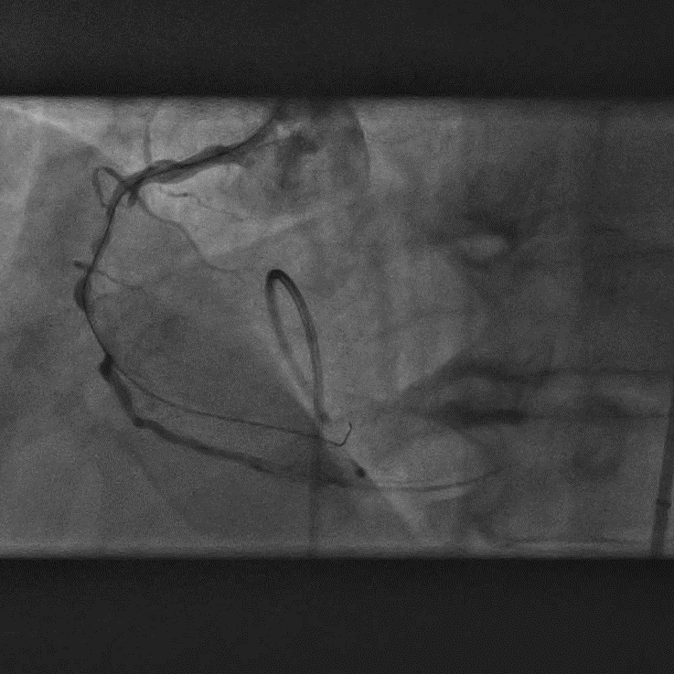
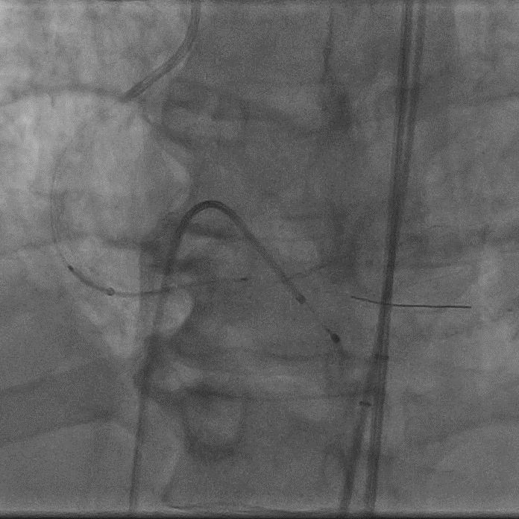
CCC live 1/16/24 PCI of Multiple Calcified Subtotal RCA
Antegrade wire escalation
Initial angio
Stenting
FineCross +
Guide Liner +
mRCA subtotal occlusion
Runthrough NS
→ Fielder
→ Gaia Next 3
→ MiracleBros6
→ Gladius Mongo
Xience Skypoint 3.0x48mm
Xience Skypoint 2.5x48mm
(Durability in subintimal space)

Slide 60
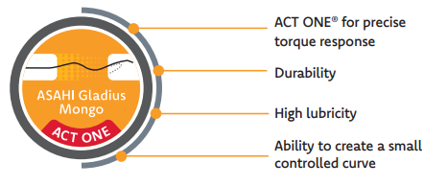
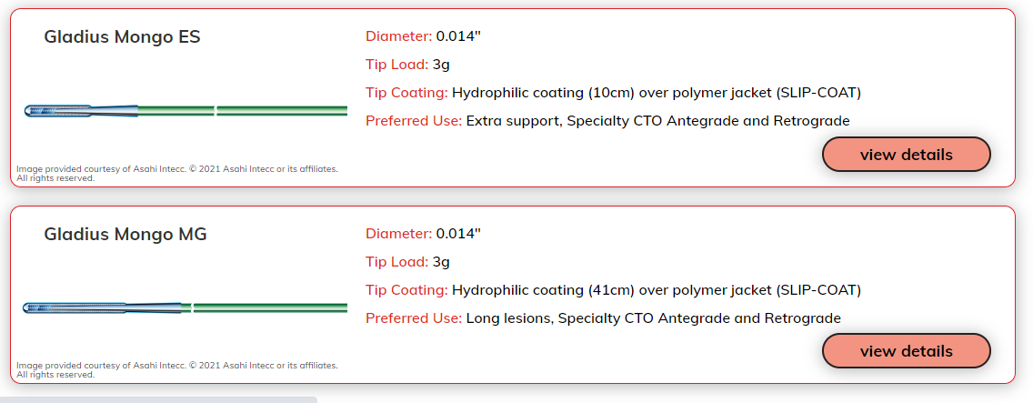
Gladius Mongo MG/ES

Slide 61
Gladius Mongo MG/ES

Slide 62
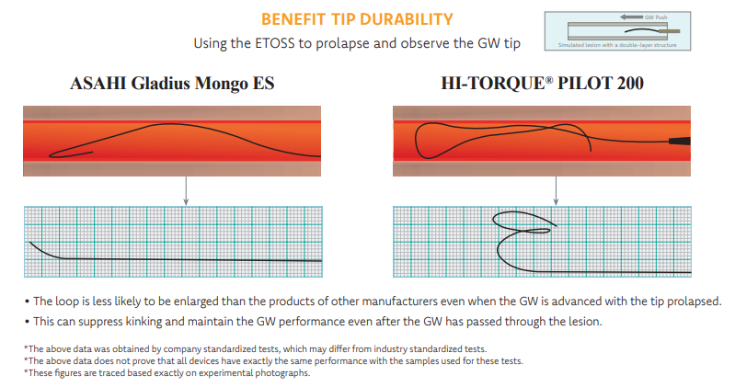
Gladius Mongo MG/ES

Slide 63
Gaia Next 3

Slide 64
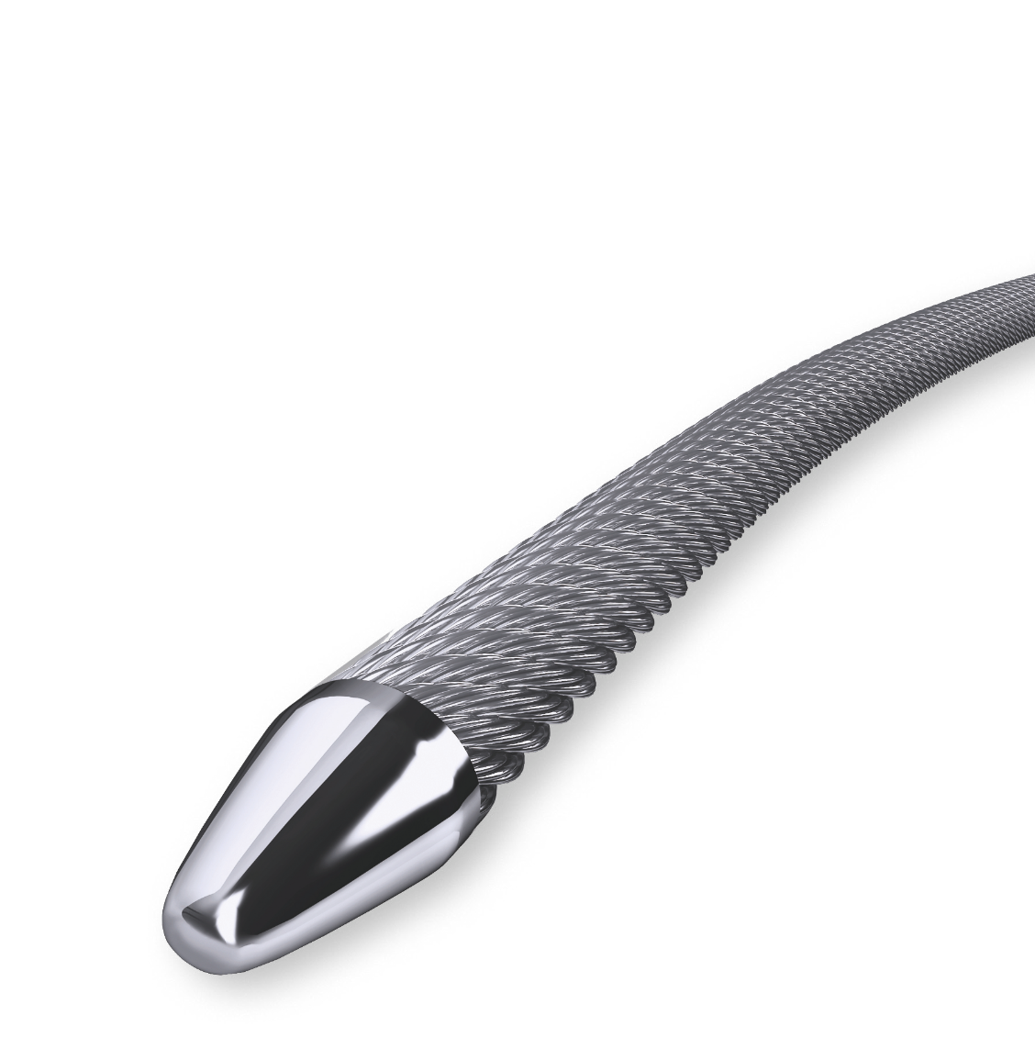
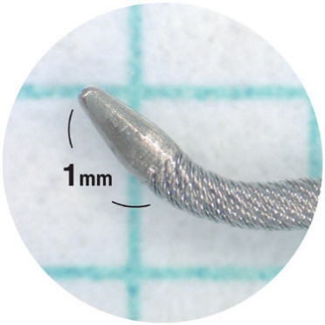
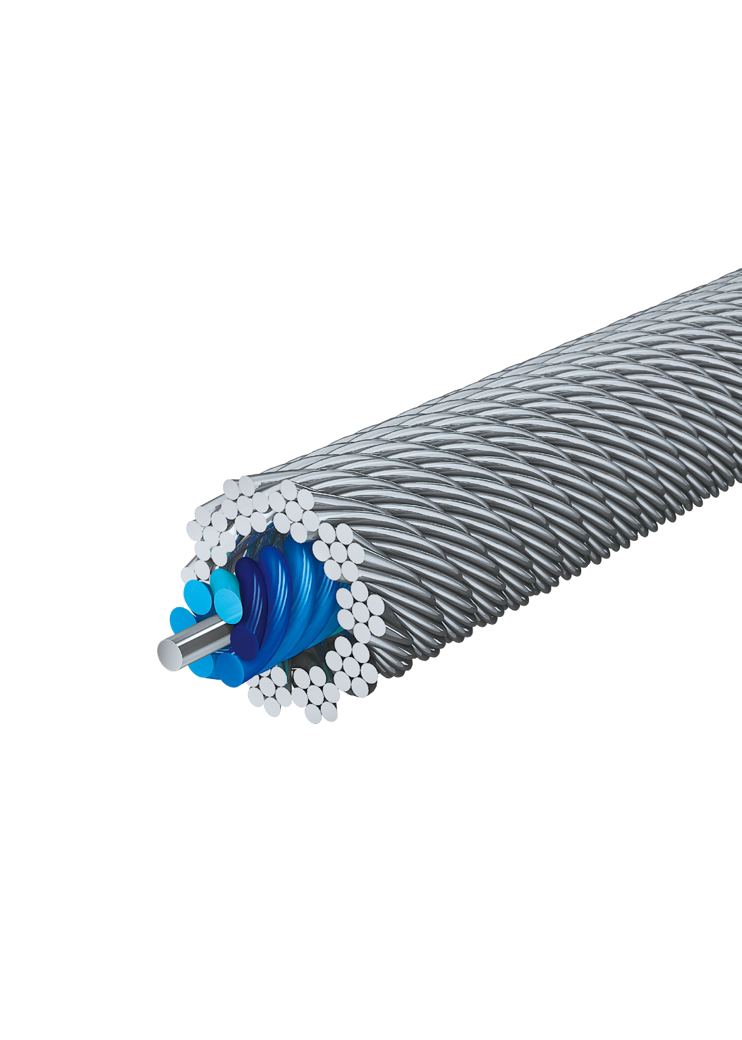
Gaia Next Series
Micro-Cone Tip
For increased penetration
at a lower tip load
XTRAND Coil
Outer spring coil
Made of twisted wires
Increased Tensile Strength
ACT ONE
ASAHI’s coil between the core
and the outer spring coil
for torque response and durability
Core-to-Tip
Wire
From Asahi Gaia Next Brochure

Slide 65
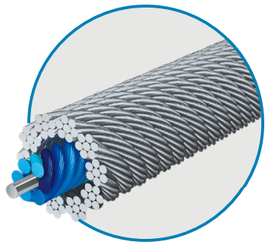
MongoMG
ACT ONE
Gaia Next 3
ACT ONE + XTRAND
ULTIMATEbros Series (example with neither ACT ONE or XTRAND)

Slide 66
MongoMG Vs Gaia Next 3 Main Differences
Mongo MG | Gaia Next 3 | Effect
3.0 gf | 6.0 gf | Mongo less stiff
0.014” tip | 0.012” tip | Smaller diameter = increased penetration
Round Tip | Micro-Cone tip | Mongo less likely to penetrate
Hydrophilic Whole length* | Hydrophilic Tip uncoated* | Mongo is more ‘slippery’ at cost of feedback
Polymer jacket | No Jacket | Mongo more ‘slippery’ again at cost of feedback
Spring Coil | XTRAND Coil | XTRAND offers anti-trapping power.
3 cm tip visible | 15 cm visible | +/- visibility, situation dependent
Straight / J | J only | Pre-shaped options
8.5mm Coil | 15.0mm Coil | Support (short) vs trackability (long) inverse rule
Summary: Propensity to penetrate and go subintimal higher in Gaia, which has more tactile feedback. Mongo is ‘slippery’ and less traumatic but may lack the strength to cross if a lesion is too resistive, and you may not feel as it slips into where it shouldn’t.

Slide 67
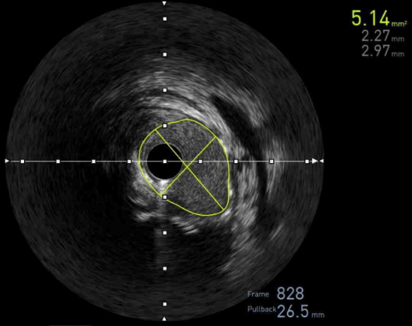
CCC live 1/16/24 PCI of Multiple Calcified Subtotal RCA
Final IVUS
Final angio
MSA in pRCA
Optimal stent expansion

Slide 68
