Slide 1

Structural Heart Live Case: OU 80 yo
Presentation: Dyspnea on exertion, NYHA II. Moderate TAVR PVL found during workup for colostomy reversal
PMH: HTN, HLD, NICM, HFrEF (30%), Afib, OSA, CVA (2018, no residual),
breast cancer (s/p XRT, 2022), non-Hodgkin lymphoma (s/p chemo/rad 2022), colostomy 12/22, TAVR (29mm EV PRO+, 2/2021 @OSH), CRT-D
Medications: Aspirin 81mg OD, Carvedilol 6.25mg BID, Rosuvastatin 5mg OD, Entresto 24/26 BID, Spironolactone 25mg OD
Labs: Hgb 13.2, Plt 92, Creat 0.8, INR 1.0
EKG: BiV paced at 69 bpm, QRS 146ms
TEE: Moderate-severe AV PVL (encircles 30% AV), no transvalvular AR, MG 15mmHg/PV 2.5 m/s, EOA 1.52 cm², moderate MR, mild TR, PFO

Slide 2
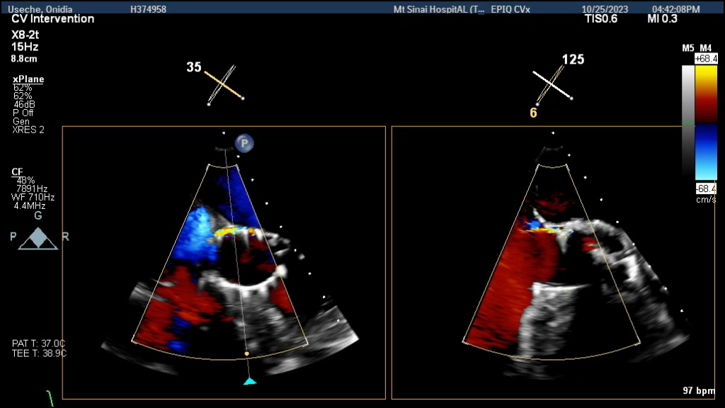
Echocardiogram

Slide 3
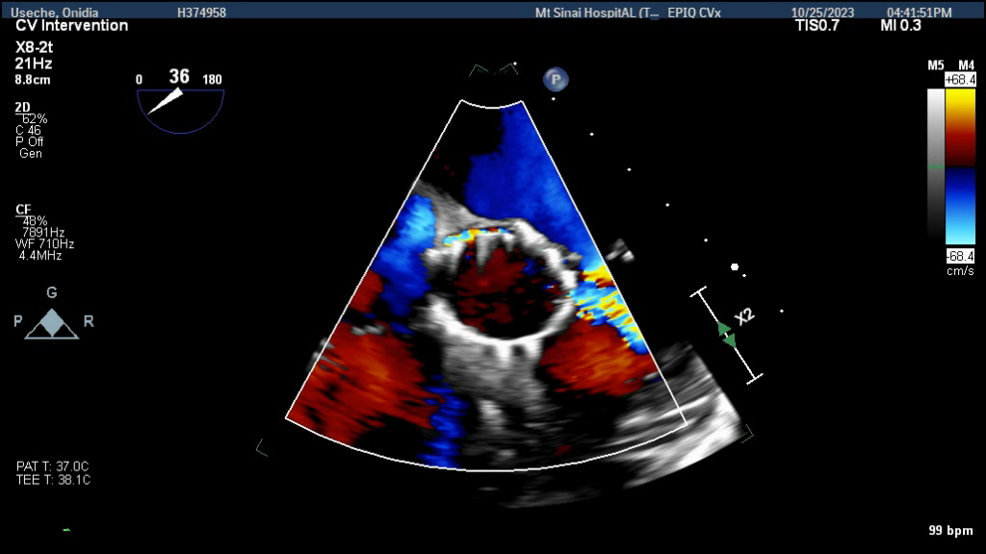
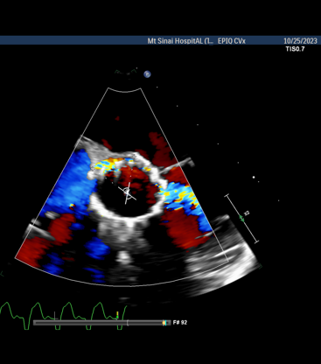
Echocardiogram

Slide 4
Pre-TAVR CT
Annulus Dimensions
Min – 22.4
Max – 26.0
Average 24.2
Area – 457.7
Perimeter 76.7
LVOT Dimensions
Min – 21.3
Max – 26.4
Average 23.8
Area – 453.2
Perimeter 76.4

Slide 5
Pre-TAVR CT
STJ dimensions
Min - 25.2 mm
Max- 27.7 mm
Avg- 26.5 mm
Sinus height
Left - 25.0 mm
Right - 25.1mm
SOV dimensions
Right - 34.9mm
Left - 32.8mm
Non – 31.8mm
Coronary height
Left -15.3mm
Right - 20.2mm

Slide 6
Pre-TAVR CT
Heavily calcified ascending aorta and aortic valve

Slide 7
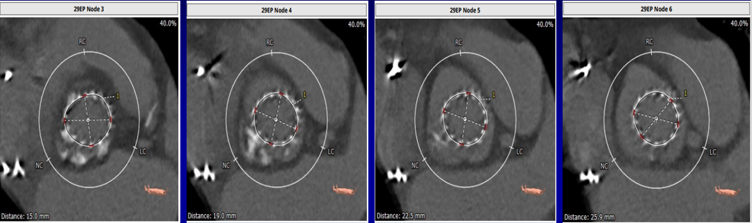
Post Index-TAVR CT
Node 3
Area – 339.9 mm²
Perimeter - 66.0mm
Node 4
Area – 324.9 mm²
Perimeter - 64.2mm
Node 5
Area – 325.6 mm²
Perimeter - 64.2mm
Node 6
Area – 317.9 mm²
Perimeter - 63.4mm

Slide 8
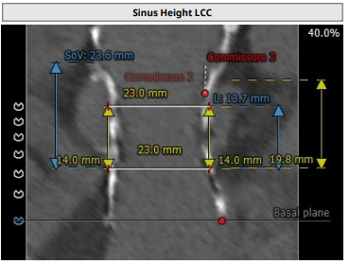
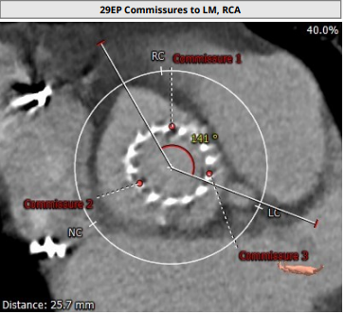
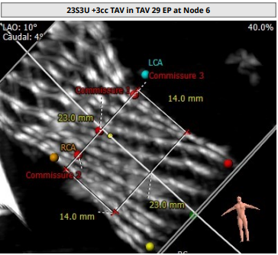
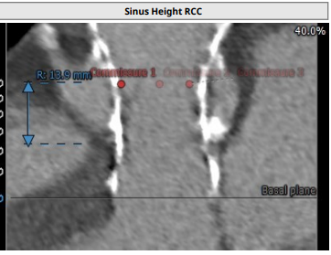
Post Index-TAVR CT
Left coronary height – 13.7mm
Right coronary height – 13.9mm

Slide 9
CTA: Access Anatomy

Slide 10
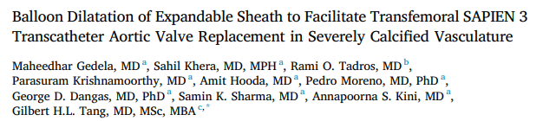
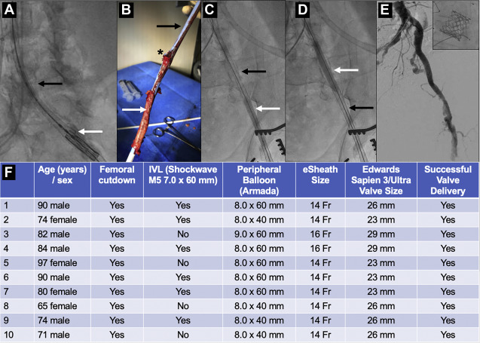

Slide 11
CTA: Arch Vessel Anatomy

Slide 12
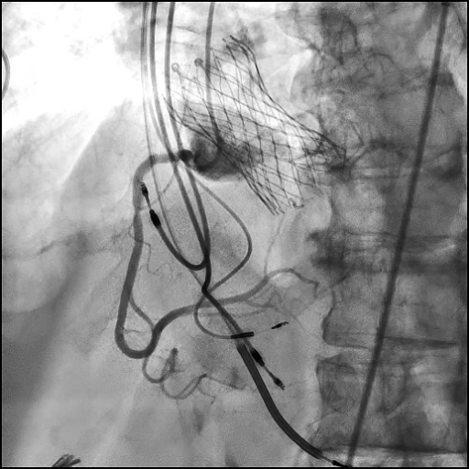
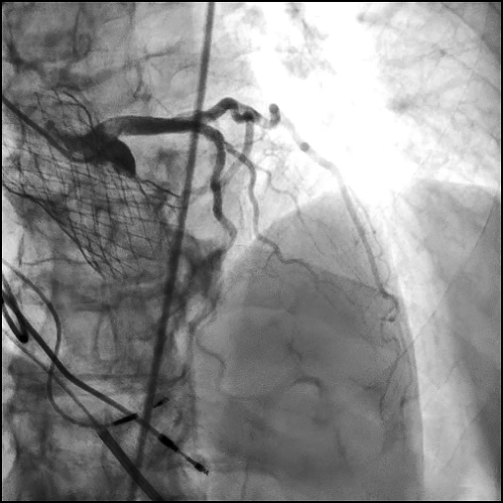
Coronary angiogram

Slide 13
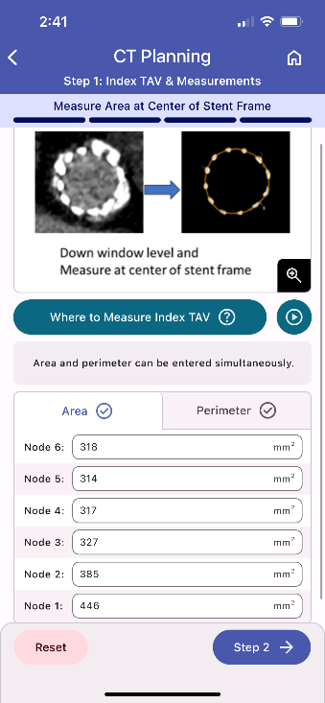
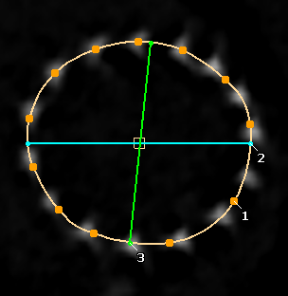
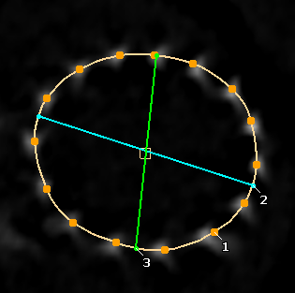
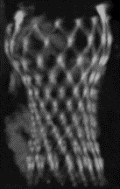
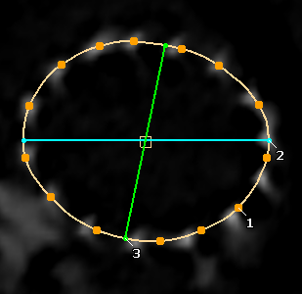
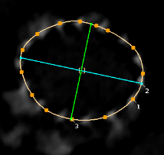
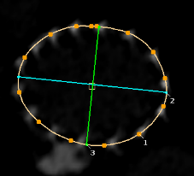
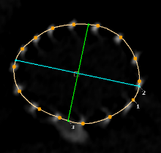
Step 1. Index TAV & Measurements
Node 6 = 318 mm²
Node 5 = 314 mm²
Area / Perimeter measurements
Node 4 = 317 mm²
Node 3 = 327 mm²
N6
N5
N4
N3
N2
N1
Node 2 = 385 mm²
Node 1 = 449 mm²
Redo TAV APP
Courtesy: V Bapat, M Fukui

Slide 14
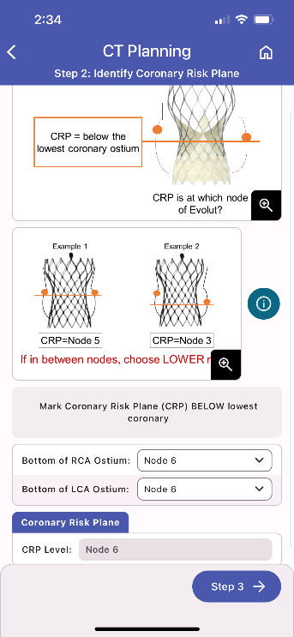
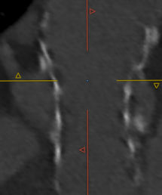
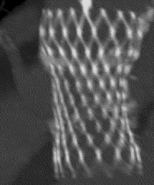
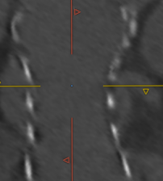
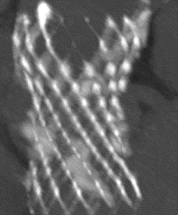
Step 2. Identify Coronary Risk Plane (CRP)
CRP defined as below the LOWEST coronary ostia
RCA
N6.5
Bottom of RCA
= Node 6.5
CRP
= Node 6
LCA
Bottom of LCA
= Node 6
N6
NSP- Neo Skirt Plane
CRP - Coronary risk plane
Redo TAV APP
Courtesy: V Bapat, M Fukui

Slide 15
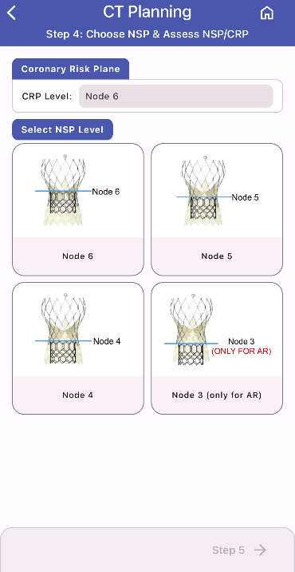
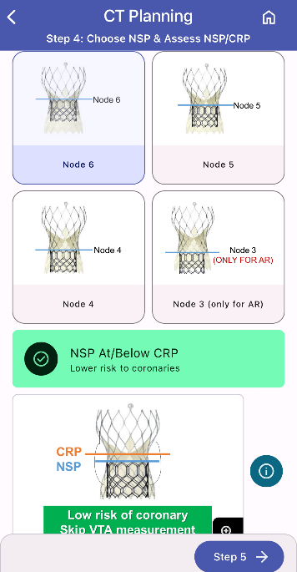

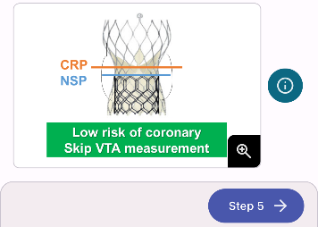
Step 4. Choose NSP & Assess relation between NSP and CRP
Relation between NSP and CRP
If Node 6 is chosen
NSP at CRP
CRP
Node 6
NSP
Node 6
Low risk of coronary
NSP- Neo Skirt Plane
CRP - Coronary risk plane
Redo TAV APP
Courtesy: V Bapat, M Fukui

Slide 16
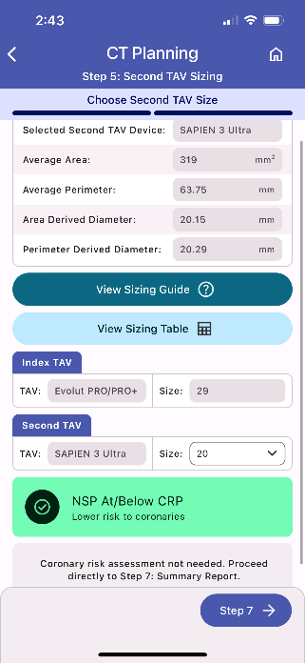

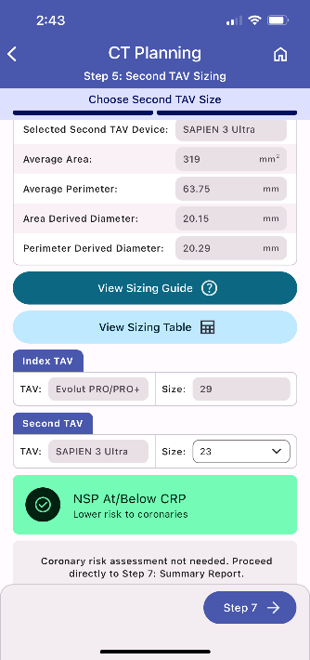
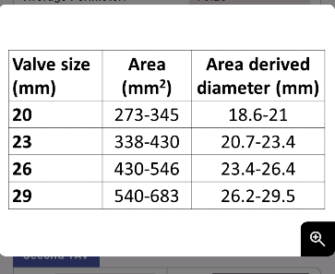
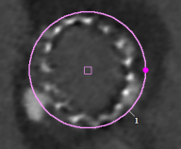
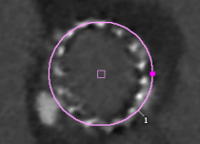
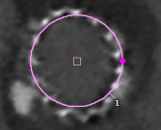
Step 5. Second TAV Sizing
* App calculates the average area but not suggest size. Users will choose the second TAV size
One / two size smaller than in-vitro sizing
Virtual circle #26
#23
#20
Redo TAV APP
Courtesy: V Bapat, M Fukui

Slide 17
Summary of Case
Presentation: 80 yo female with dyspnea on exertion (NYHA III) & moderate TAVR PVL
TEE: Severe LV systolic dysfunction with moderate posterior PVL
SAVR risk: Extreme risk for redo SAVR/TAVR explant. STS risk score 9.7%
Course: Heart team recommended TAV in TAV
Plan: TAV in TAV via percutaneous right femoral artery access using a 23mm Sapien-3 Ultra Resilia with outflow aimed at Node 6.

Slide 18

TAV or SAV Degeneration:
ViV TAVR, TAV-in-TAV, TAVR Explant

Slide 19

Therapeutic Algorithm for Bioprosthetic Aortic Valve Dysfunction (BVD)
BVD
SVD
Non- SVD
Thrombosis
Endocarditis
Any major concerns (i.e. coronary flow or access impairment, residual PPM, etc.)?
Severe PVL
Severe PPM
Treatable by
redo-TAVR?
*BVF feasible?
YES
No
Yes
No
Yes
No
Redo-TAVR
feasible
Redo-TAVR Not indicated or harmful; Hence SAVR++ (if possible)
Tarantini et al., J Am Coll Cardiol Intv 2022;15:1777

Slide 20
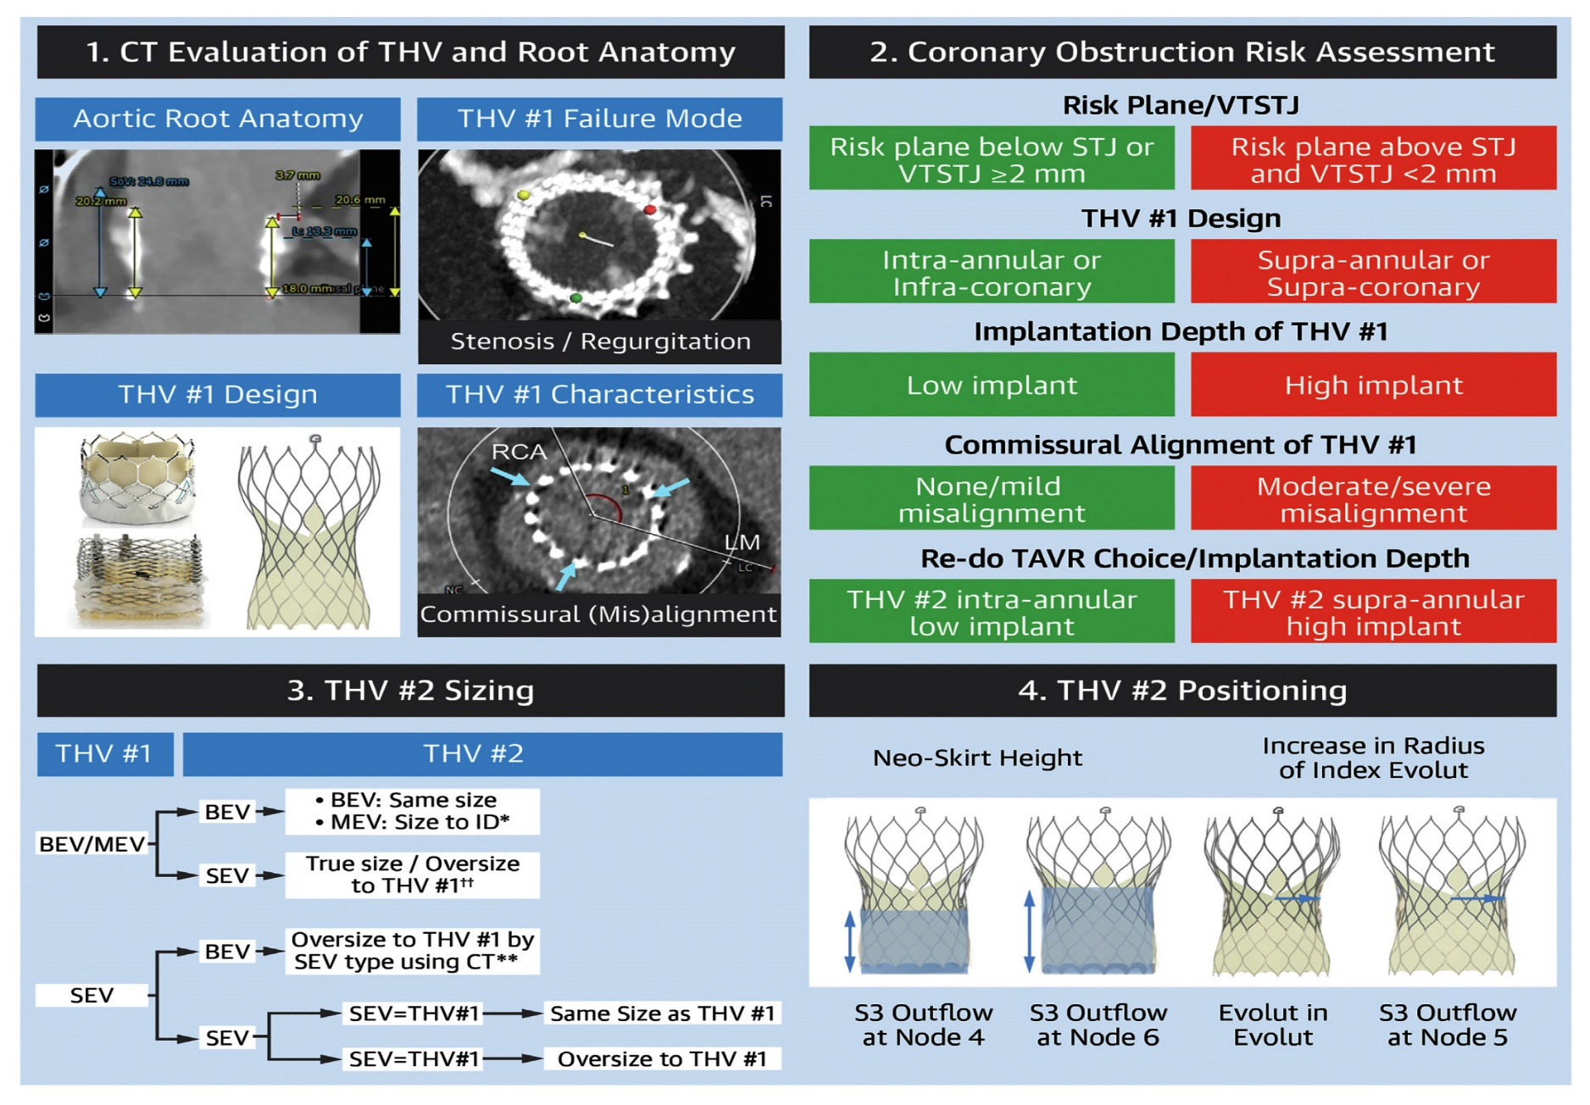
Steps to Consider in TAVR in Failed Transcatheter Bioprosthetic Valves
Tarantini et al., J Am Coll Cardiol Intv 2022;15:1777

Slide 21

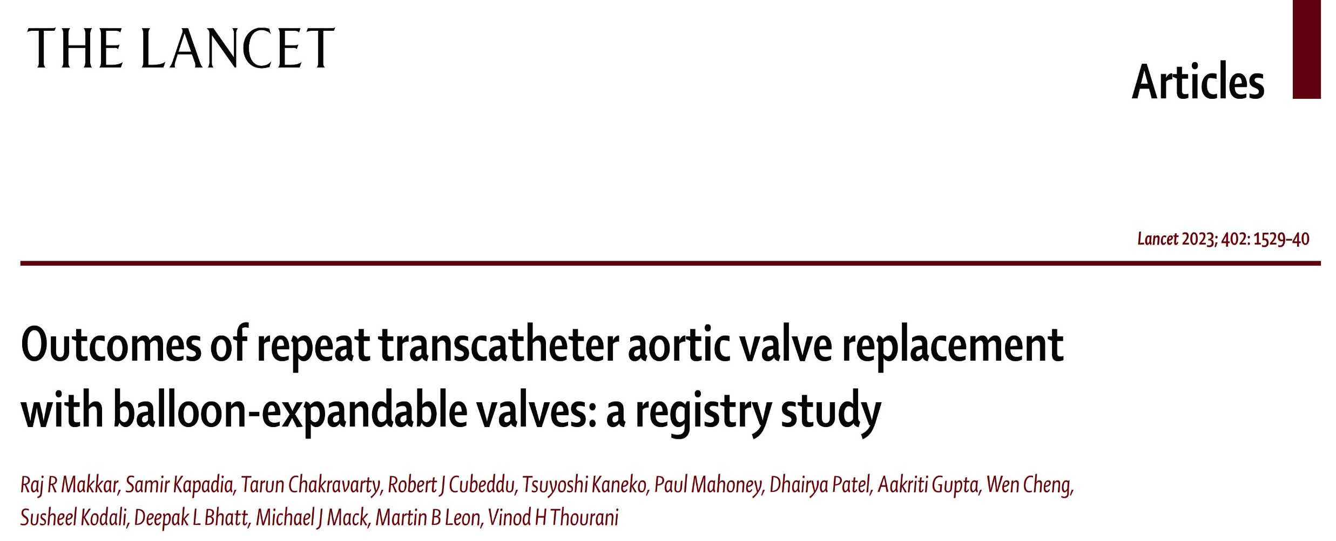
Redo-TAVR Registry

Slide 22
Redo-TAVR Study: 1-Year Outcomes in Propensity
Score-Matched Pts Who Underwent Redo-TAVR
or Native TAVR
p=0.14
p=0.40
%
p=0.57
p=0.58
p=0.80
p=0.07
p=0.77
p=0.06
p=0.73
Makkar et al., Lancet 2023;402:1529

Slide 23
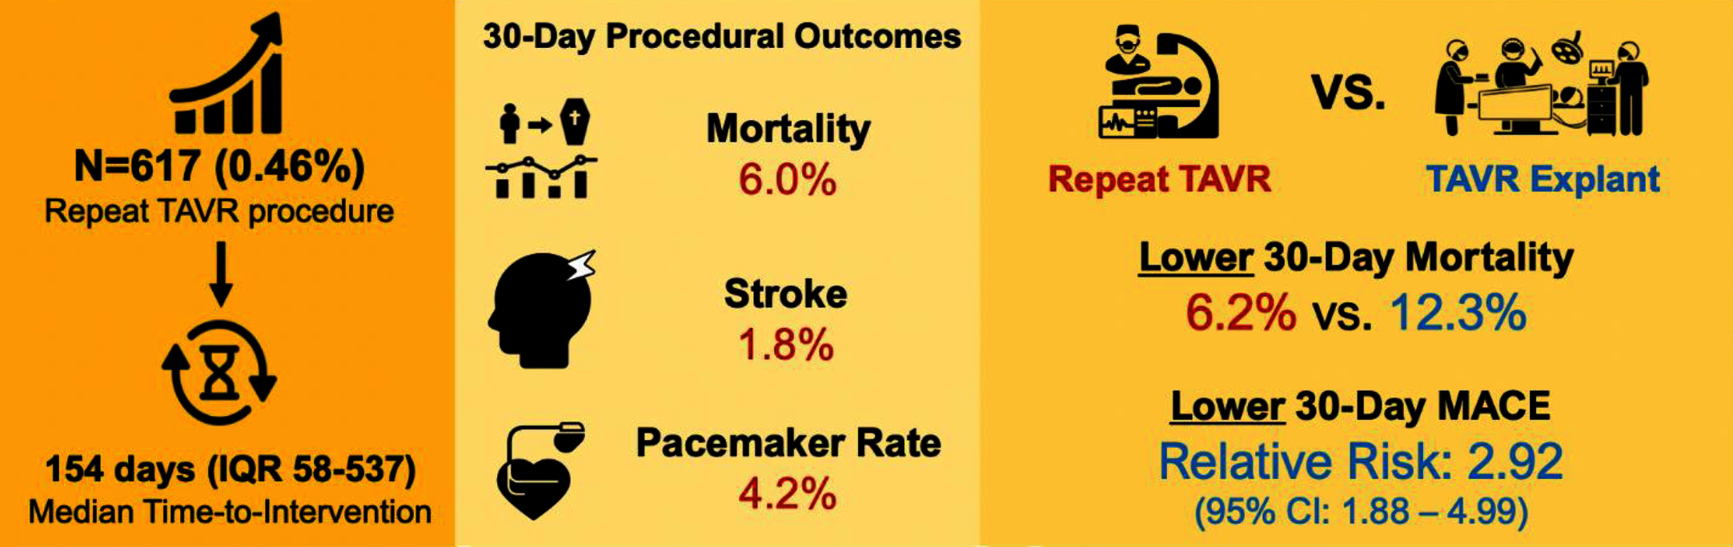
TAV-in-TAV vs TAVR Explant-CMS
Contemporary Repeat TAVR Outcomes in the United States
Repeat TAVR can be performed with acceptable 30-day mortality and may be considered as a potential option in appropriate patients
Percy et al., J Am Coll Cardiol Intv 2021;14:1717

Slide 24
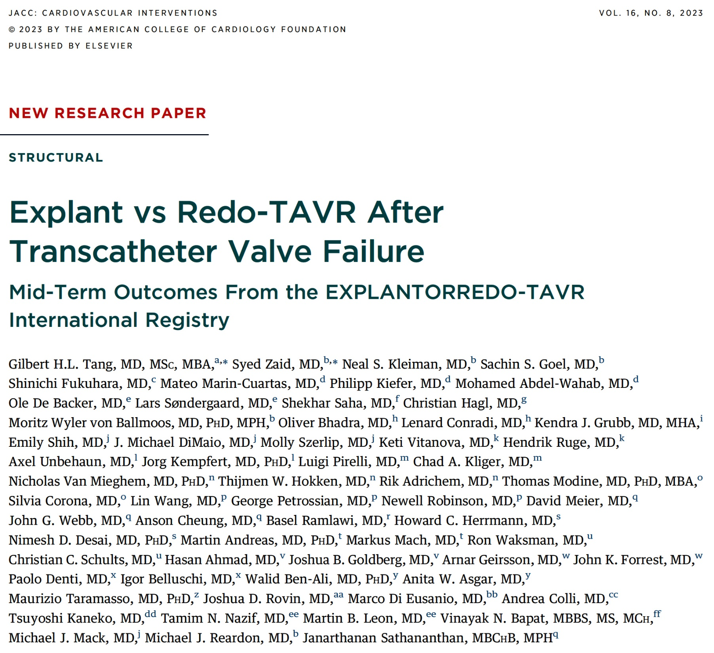


Slide 25
EXPLANTORREDO-TAVR Registry: Study Population
533 Patients from 29 Sites undergoing TAVR Reintervention for THV failure
during separate admissions as initial TAVR
5/2009 – 2/2022
157 TAVR-Explant
Performed for Endocarditis
Primary Cohort for Analysis
(N=396)
Redo-TAVR
(n=215)
TAVR Explant
(n=181)
Median Follow-up:
13.6 months (IQR: 2.4-35.9)
Median Follow-up:
6.7 months (IQR: 1.3-15.9)
Tang et al., J Am Coll Cardiol Intv 2023;16:927

Slide 26
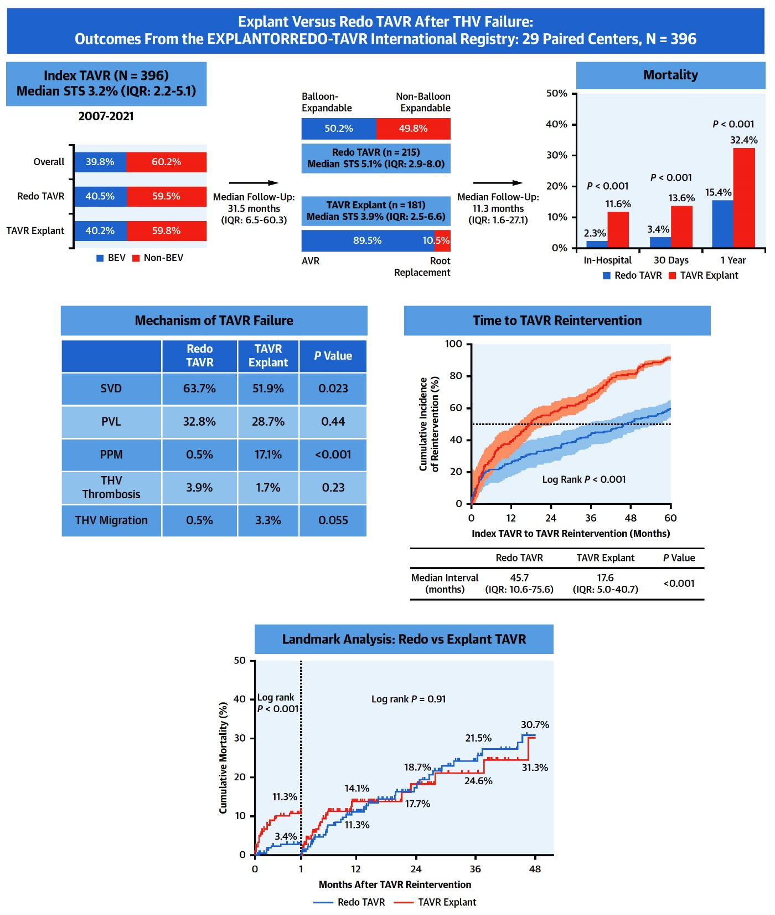
Summary of the EXPLANTORREDO-TAVR International Registry
Tang et al., J Am Coll Cardiol Intv 2023;16:927

Slide 27
TAV-in-TAV vs TAV-in-SAV
TAV-in-TAV
37 cents, N=434
TAV-in-SAV
13 cents, N=624
Exclusion:
223 patients with single procedure
TAV-in-TAV
N=212
TAV-in-SAV
N=595
Exclusion:
29 patients with missing data
Propensity score matching
TAV-in-TAV
N=165
TAV-in-SAV
N=165
Landes et al., J Am Coll Cardiol 2021;77:1

Slide 28
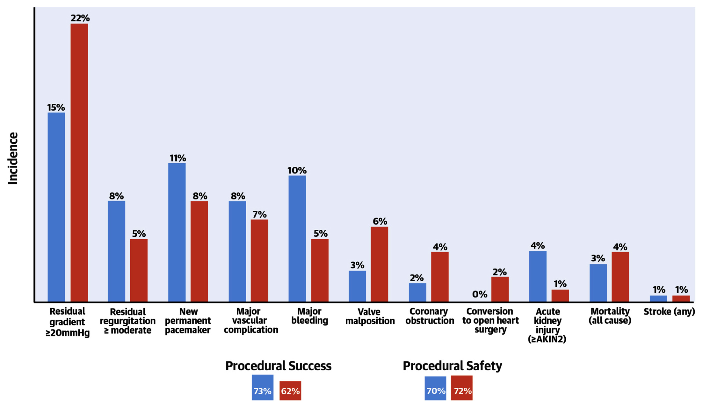
Higher Procedural Success in TAV-in-TAV
TAV-in-TAV had similar mortality/morbidity
to TAV-in-SAV
TAV-in-SAV = 165
TAV-in-TAV = 165
Landes et al., J Am Coll Cardiol 2021;77:1

Slide 29
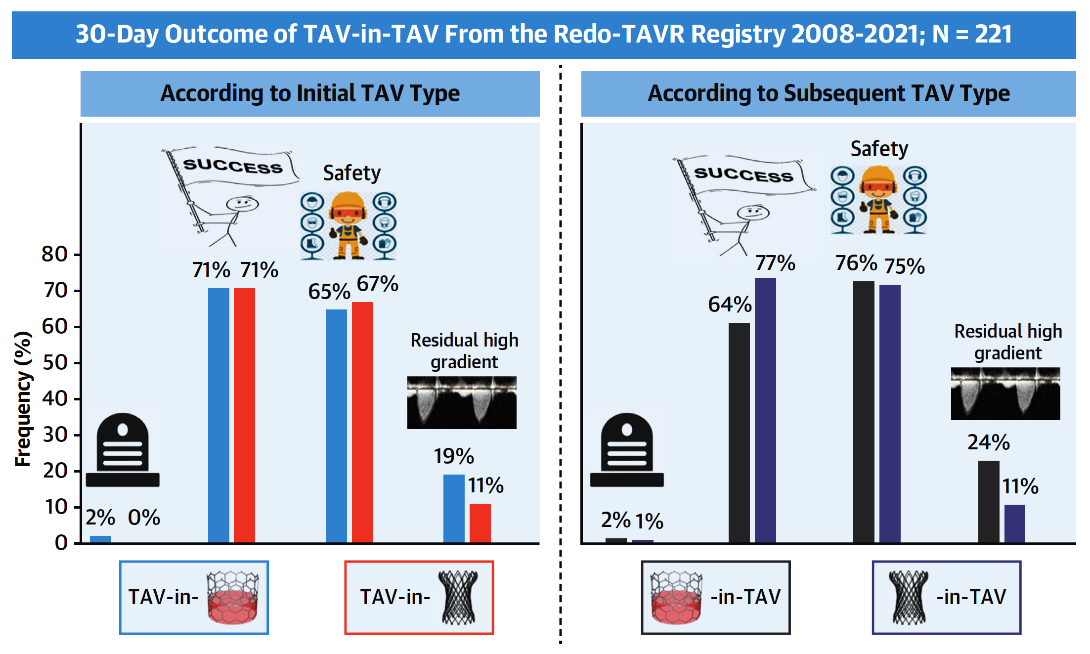
Redo-TAVR Registry: Redo-TAVR Outcomes According to bTAV and sTAV Type
Balloon Expandable vs Self-Expanding
Landes et al., J Am Coll Cardiol Intv 2022;15:1543

