Slide 1
CCC Peripheral Live Case
1/24/2024

Slide 2
Case presentation
74 Year old gentleman for progressively worsening LLE claudication progressing to over the past 6 months ( Rutherford grade 1 category 3) .
Worsening symptoms despite maximal medical therapy and community based SET
PMH: HTN, Hyperlipidemia and NIDM, former smoker, poly-vascular disease ( CAD s/p PCI to LAD and PAD s/p prior PTA)
Medications: Aspirin 81 mg, Atorvastatin 80 mg, Metformin, Cilostazol

Slide 3
Clinical Presentation
Vitals: BP 150/70, HR 72 , Sao2 98% on RA
Pertinent focused vascular exam notable for non palpable non-dopplerable DP pulses bilaterally , and palpable PT pulses bilaterally
Labs: Hgb 15.1, Plts 175K, Cr 0.8
ABI Right 0.8 Left 0.62
Arterial Duplex LLE was notable for occluded L SFA and L ATA with monophasic waveforms in left popliteal, ATA and peroneal artery

Slide 4
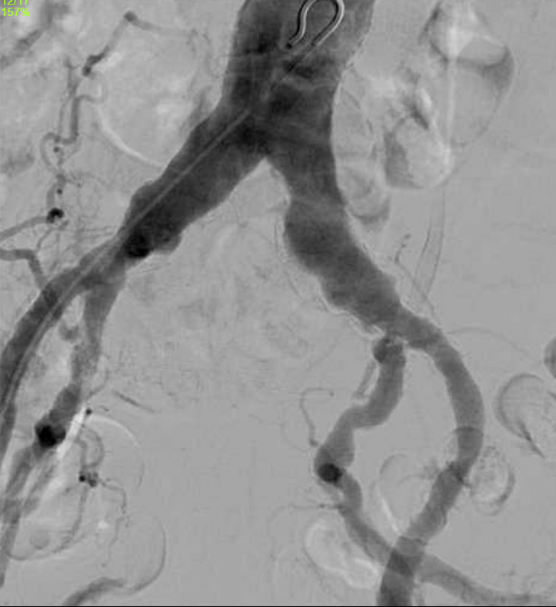

Slide 5
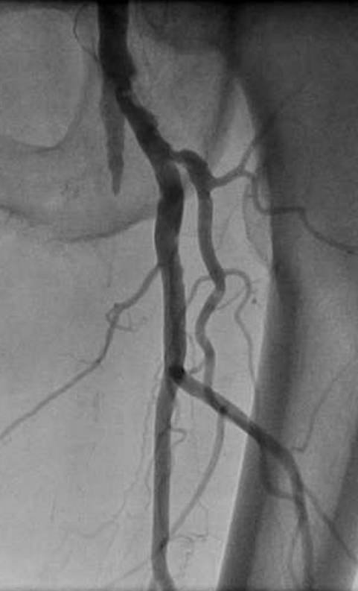
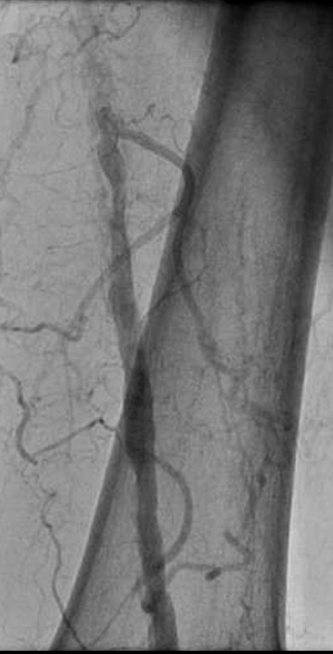

Slide 6
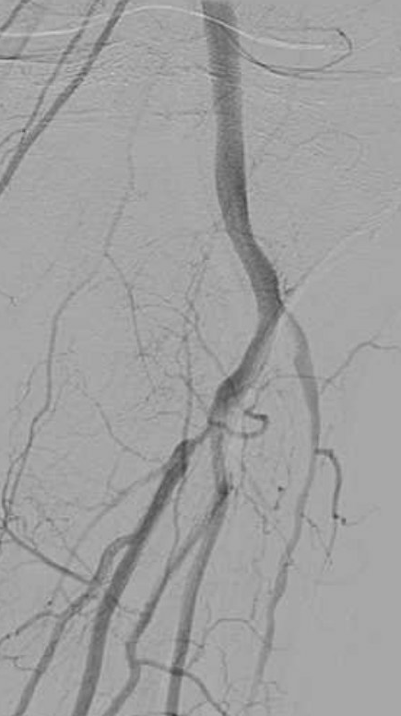
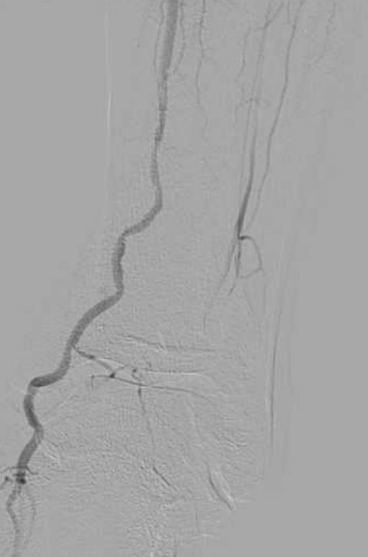

Slide 7
Case Plan
6 Fr RFA Up and over 45 cm destination sheath
Alternate access : possible retrograde distal SFA vs pedal access (single vessel run off to the foot)
Cross true lumen vs subintimal
Stiff angle glide wire (0.035 in) with angled support catheter (Vert Tip) using looped wire technique
Re-enter true lumen in distal SFA just distal to where SFA reconstitutes ( option of Fem-pop bypass in future)
IVUS guidance with distal embolic protection (Nav 6 Emboshield)
Vessel Prep (IVL –Shockwave vs Atherectomy)
DCB vs DES vs BMS vs interwoven nitinol stent (Supera)

Slide 12
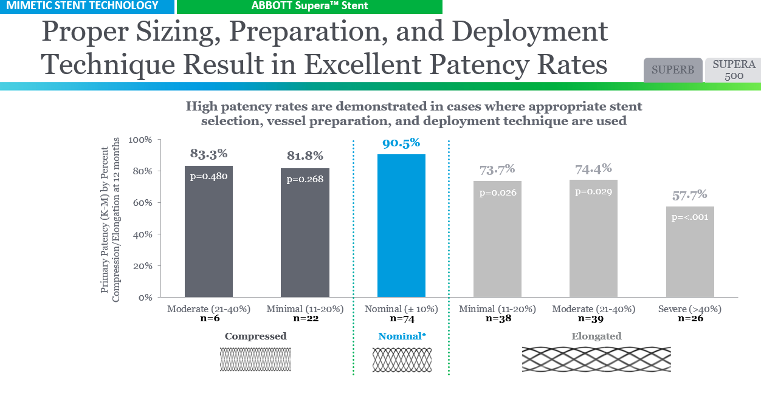

Slide 21
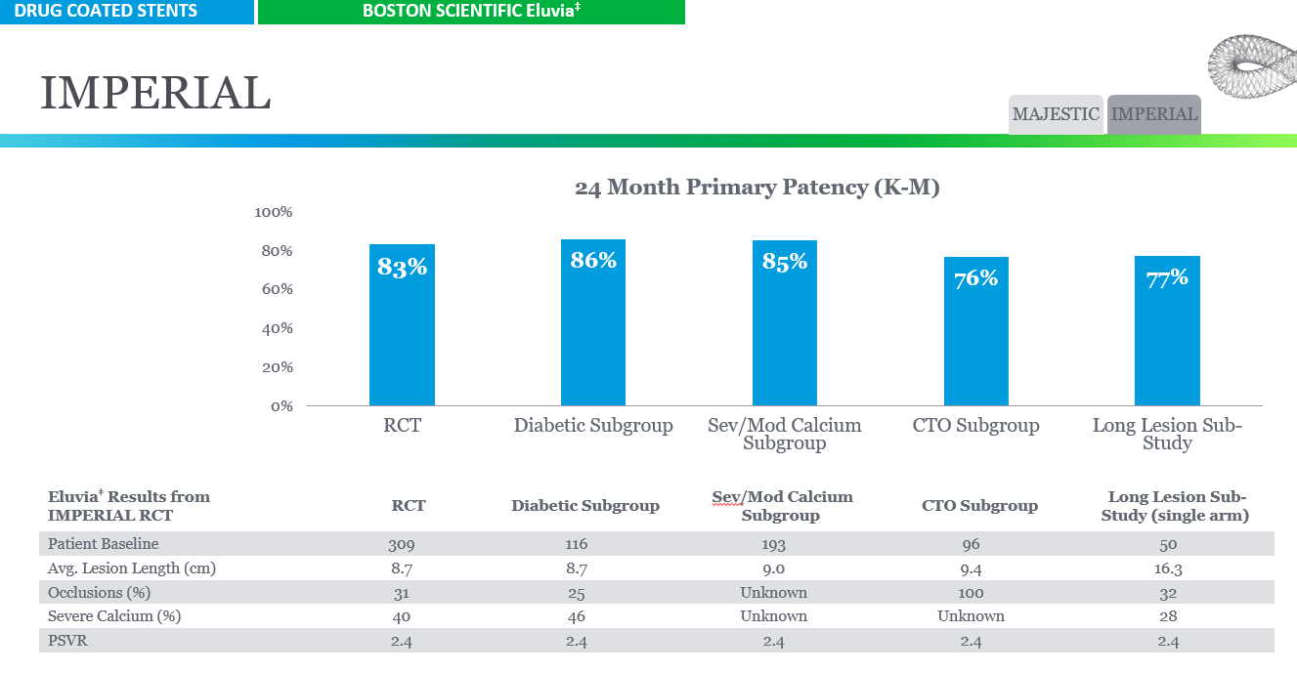

Slide 23
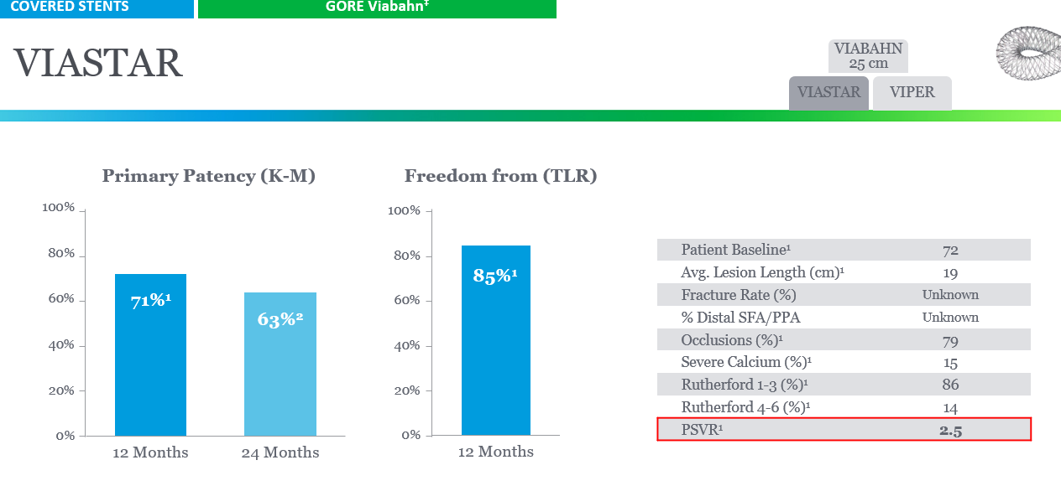

Slide 28
