Slide 1
Structural Heart Live Cases
Supported by:
Edward Lifesciences
Cook Medical
Terumo Medical Corporation
B-Braun Medical
BD Medical

Slide 2
Faculty Involved and Disclosures
Samin K. Sharma, MD, FACC, MSCAI
Nothing to disclose
Annapoorna S. Kini, MD, MRCP, FACC
Nothing to disclose
Parasuram M. Krishnamoorthy, MD, FACC
Nothing to disclose
Gilbert Tang, MD, FACC
Nothing to disclose
Stamatios Lerakis, MD, PhD, FACC, FAHA
Nothing to disclose
Pedro Moreno, MD, FACC [Moderator]
Nothing to disclose
Cardiac Anesthesiologist
Martin Chen, MD

Slide 3
Sapien-3U Resilia ViV TAVR in a Failed Surgical Aortic Valve with Flail Leaflet and Severe AI

Slide 4
Structural Heart Live Case #57: DS, 74 YO M
Presentation: Presents with dyspnea on exertion & acute episode of decompensated HF, NYHA class III
PMH: Severe bicuspid AS s/p SAVR with 29 mm Perimount 2700+ 30 mm Hemashield aortic graft in 2013, HTN and kyphoscoliosis
Recent TTE/TEE @ OSH showed LVEF 60% with acute eccentric AI secondary to flail bioprosthetic valve leaflet. TEE also showed mobile atherosclerotic plaque in proximal aortic arch
Medications: Aspirin, Metoprolol succinate, Furosemide, Irbesartan, Atorvastatin and Empagliflozin
Labs: Hgb 10.1, PLT 297K, Cr 1.18, INR 1.1
EKG: NSR with LVH
TEE: Severe bioprosthetic AI, LVEF 60%, mild MR, moderate TR, mobile atherosclerotic plaque in proximal aortic arch
Cath (1/2/24): normal coronaries

Slide 5
TEE from OSH 12/19/23
LVEF 60% with severe bioprosthetic AI secondary to flail leaflet

Slide 6
TEE from OSH 12/19/23
Severe bioprosthetic AI secondary to flail leaflet

Slide 7
TEE from OSH 12/19/23
Mobile atherosclerotic plaque in proximal aortic arch

Slide 8
LHC 1/2/2024
No coronary obstruction

Slide 9
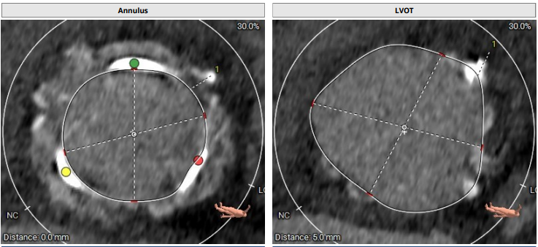
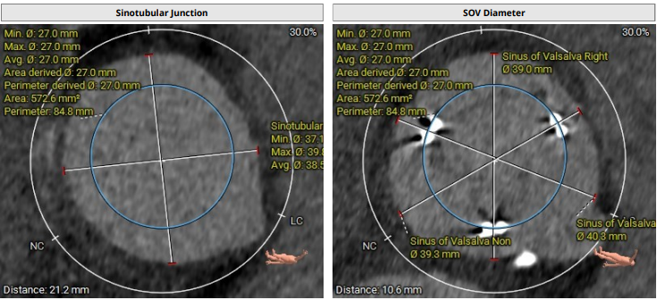
Cardiac CT Analysis
Annulus
Max: 27.9 mm
Min: 25.3 mm
Mean: 26.6 mm
Perimeter = 84.8 mm
Area = 565.4 mm²
LVOT
Max: 33.7 mm
Min: 30.1 mm
Mean: 31.9 mm
STJ
Max: 39.8 mm
Min: 37.1 mm
Mean: 38.5 mm
SOV
RCC: 39 mm
LCC: 40.8 mm
NCC: 39.3 mm

Slide 10
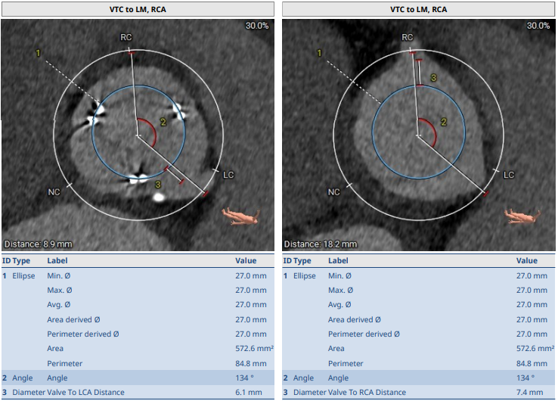
VTC For VIV-TAVR
VTC to RCA
7.4 mm
VTC to LM
6.1 mm

Slide 11
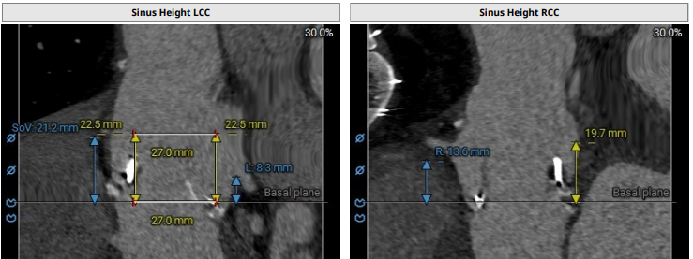
Valve Positioning & Coronary Heights
For VIV-TAVR
LCA height 8.3 mm
RCA height 13.6 mm
Plan for 29mm Sapien-3 Ultra Resilia Valve in 29mm Perimount2700

Slide 12
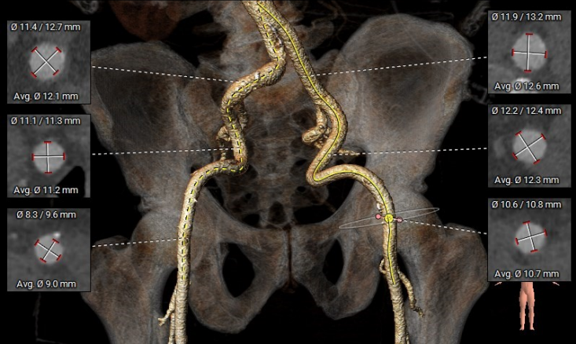
Aorto-Iliac Bifurcation
Tortuous iliac arteries : left > right

Slide 13
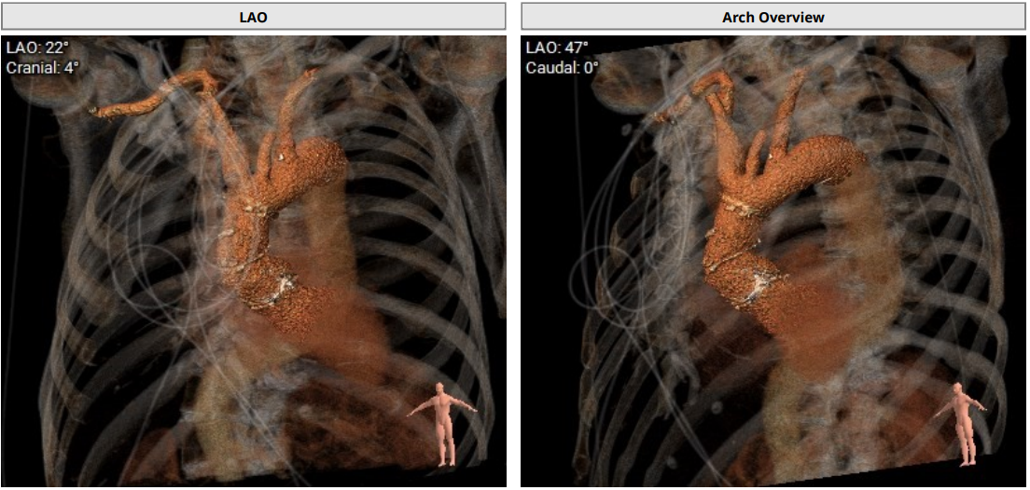
Aortic Arch

Slide 14
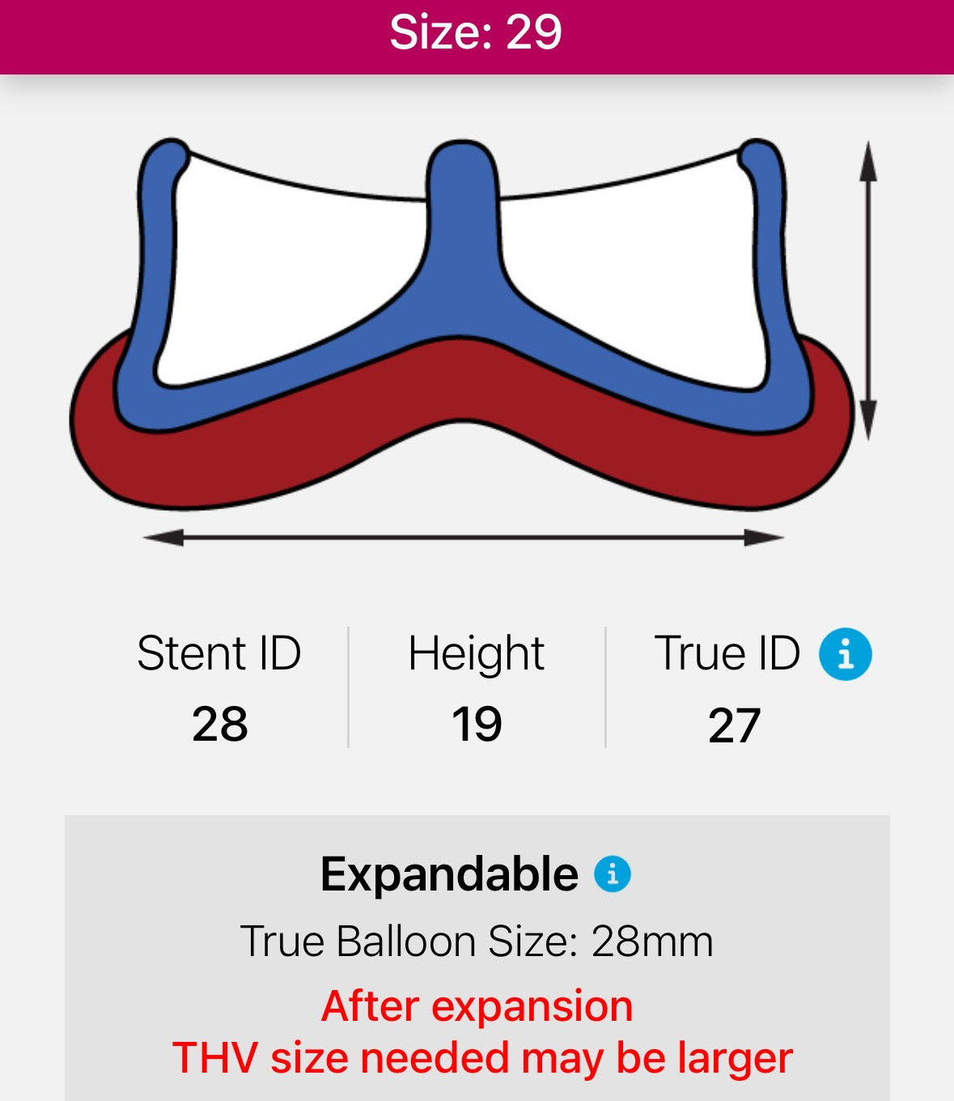
Valve Selection For VIV-TAVR
Key consideration:
No need for bioprosthetic valve fracture and remodeling
Severe AI at baseline
No patient-prosthetic mismatch
Plan for 29mm Sapien-3 Ultra Resilia
in 29mm Perimount 2700
Carpentier-Edwards Perimount 2700

Slide 15
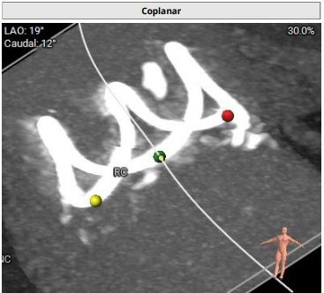
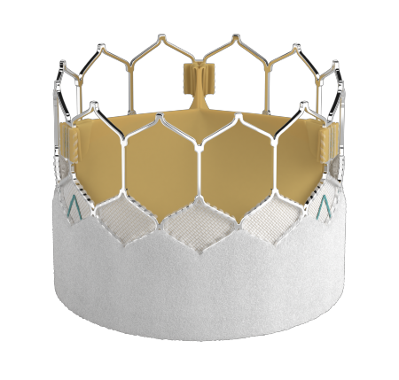
Valve Selection For VIV-TAVR
Plan for 29mm Sapien-3 Ultra Resilia
in 29mm Perimount 2700

Slide 16
Summary of Case
Presentation: 74 yo M, Severe bicuspid AS s/p SAVR with 29 mm Perimount 2700 + 30 mm Hemashield aortic graft in 2013, presented with dyspnea and HF from severe AI secondary to flail surgical valve
TTE: LVEF 60% with acute eccentric AI secondary to flail bioprosthetic valve leaflet, mild MR, moderate TR, mobile atherosclerotic plaque in proximal aortic arch on TEE
STS risk mortality for redo AVR: 1.39% but high risk for cannulation for cardiopulmonary bypass due to the mobile atherosclerotic plaque in proximal aortic arch
Course: Patient was evaluated by heart team to be high surgical risk and recommended TF VIV-TAVR
Plan: TF VIV-TAVR in flail 29mm Perimount 2700+ Hemashield graft with a 29mm Sapien-3 U Resilia valve via right percutaneous femoral arterial access and Sentinel cerebral embolic protection

Slide 17
Latest Issues in Transcatheter Structural Heart Interventions
Recent publications in the TAVR Field:
- Redo TAVR vs Native TAVR outcomes
- FAST-TAVI II Protocol of early discharge
- Deformation of TAVR valve in ViV TAVR
- VIVA Trial of TAVR vs SAVR in small annuli
- SEV vs BEV in small aortic annuli

Slide 18
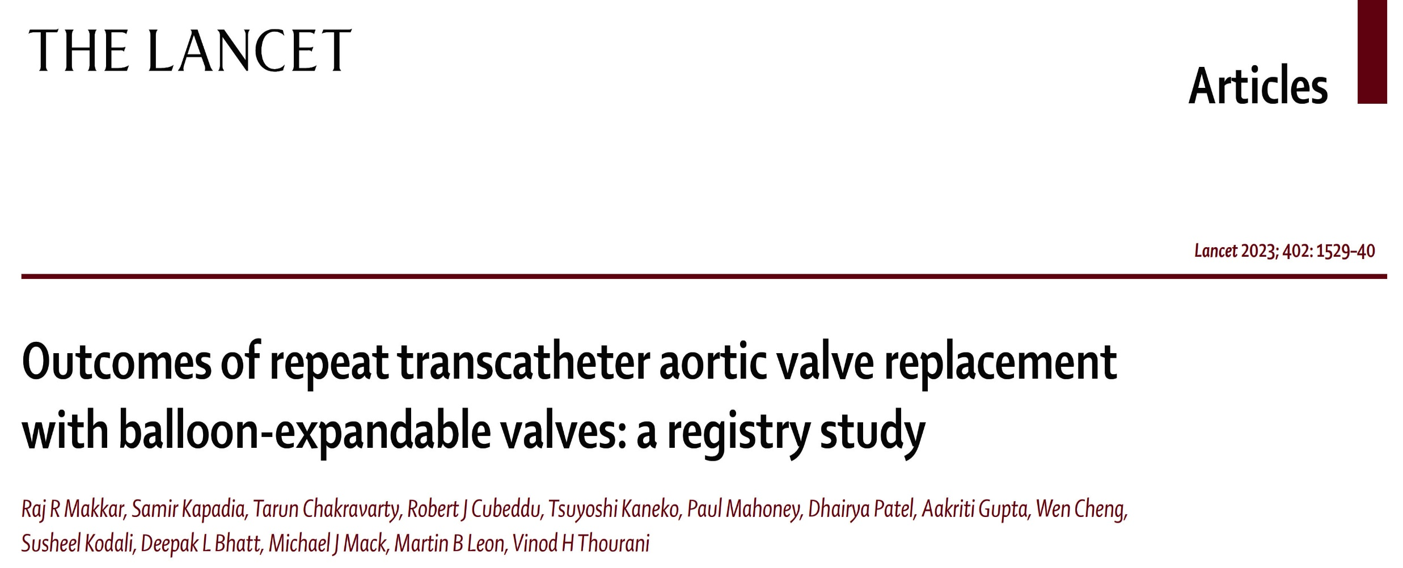
Redo-TAVR Registry

Slide 19
Redo-TAVR with Balloon Expandable Valves:
Study Population
The STS/ACC TVT registry is a national database of all consecutive patients undergoing commercial TAVR in the United States.
348,338 patients underwent TAVR with Edwards balloon-expandable valves
11/09/2011 – 9/30/2022
Median Time to
Redo-TAVR
26.3 months
(5.10, 57.11)
Redo TAVR
N = 1216
Redo-TAVR was defined as a second TAVR procedure performed at a different date than the initial index TAVR procedure
Redo TAVR of Edwards Index THV
N = 475
Redo TAVR of
Non-Edwards Index THV
N = 741
Makkar R, EuroPCR 2023

Slide 20
Redo-TAVR with Balloon Expandable Valves:
Propensity Score Matching
Comparisons between redo-TAVR and native TAVR patients were based on propensity score matching analyses
Redo-TAVR vs Native TAVR*
36 Covariates Used for 1:1 Propensity Score Matching
Redo-TAVR
n = 1216
Native TAVR*
n = 333,264
Age, sex (male), BMI, access site, prior PCI, prior CABG, prior stroke, carotid stenosis, PAD, hypertension, diabetes, chronic lung disease, immunocompromise, porcelain aorta, atrial fibrillation, creatinine, hemoglobin level, GFR, aortic valve mean gradient, LVEF, MR, TR,NYHA functional class III/IV, 5-meter walk test, KCCQ-OS, valve size, currently on dialysis, home oxygen, pacemaker, prior ICD, cardiogenic shock w/in 24 hr, aortic regurgitation, prior TIA, STS score, prior surgical repair, and endocarditis
1:1 Propensity-score matching
Redo-TAVR
n = 1216
Native TAVR
n = 1216
* 1681 patients that required a 2nd valve were excluded from the Native TAVR population
Makkar R, EuroPCR 2023

Slide 21
Redo-TAVR with Balloon Expandable Valves:
Procedural Details
 | Redo-TAVR n = 1216 | Native TAVR n = 1216 | P Value
Transfemoral access | 94.4% | 94.8% | 0.65
Conscious sedation | 35.4% | 46.3% | <0.01
Procedure time (min) | 97.7 ± 62.5 | 87.5 ± 49.4 | <0.01
Contrast volume | 68.2 ± 57.6 | 94.7 ± 57.3 | <0.01
Implant success | 98.8% | 99.1% | 0.46
Valve Size used during the procedure
20 mm | 4.2% | 3.5% | 0.40
23 mm | 36.9% | 36.1% | 0.65
26 mm | 37.3% | 37.8% | 0.79
29 mm | 21.6% | 22.6% | 0.55
Makkar R, EuroPCR 2023

Slide 22
Redo-TAVR with Balloon Expandable Valves:
Procedural Complications
p=0.23
NA
p=0.45
p=0.12
p=1.0
%
p=0.14
Makkar R, EuroPCR 2023

Slide 23
Redo-TAVR with Balloon Expandable Valves:
In-Hospital and 30-Day Primary Endpoint
Redo-TAVR vs Native TAVR – Adjusted Cohort
In-Hospital
30-Day
p=0.77
p=0.32
p=0.36
p=0.11
%
%
p=0.93
p=0.88
Redo-TAVR (n=1216)
Native TAVR (n=1216)
Makkar R, EuroPCR 2023

Slide 24
Redo-TAVR with Balloon Expandable Valves:
Primary Endpoints at 1 Year
Redo-TAVR vs Native TAVR – Adjusted Cohort
Redo-TAVR (n=1216)
Native TAVR (n=1216)
Death
Stroke
HR: 0.99 [95% CI: 0.80, 1.24]
p= 0.961
HR: 0.99 [95% CI: 0.62, 1.60]
p= 0.982
17.7%
17.2%
%
%
3.5%
3.3%
Months
Months
Makkar R, EuroPCR 2023

Slide 25
Redo-TAVR with Balloon Expandable Valves:
Echo Improvements at 30 Days and 1 Year
30 Days
1 Year
*
Mean Gradient (mmHg)
Mean Gradient (mmHg)
*
*
*
*
*
Redo, n=771 Redo, n=1089 Redo, n=781 Redo, n=312
Native, n=1201 Native, n=1087 Native, n=835 Native, n=429
Redo, n=695 Redo, n=873
Native, n=1181 Native, n=920
Redo-TAVR
Native TAVR
*Redo-TAVR vs Native TAVR is statistically significant, p<0.05
Makkar R, EuroPCR 2023

Slide 26
Redo-TAVR Study: 1-Year Outcomes in Propensity
Score-Matched Pts Who Underwent Redo-TAVR
or Native TAVR: TVT Registry Analysis
p=0.14
p=0.40
%
p=0.57
p=0.58
p=0.80
p=0.07
p=0.77
p=0.06
p=0.73
Makkar et al., Lancet 2023;402:1529

Slide 27
Redo-TAVR with Balloon Expandable Valves:
Characteristics and Outcomes by Baseline STS Score
 | STS < 4 n = 303 | STS 4 – 8 n = 406 | STS > 8 n = 400 | P-value
Age (yrs) | 74.2 ± 8.8 | 78.8 ± 9.4 | 80.2 ± 9.0 | <0.0001
STS Score, mean | 2.5 ± 0.9 | 5.8 ± 1.2 | 15.1 ± 9.0 | <0.0001
In-hosp outcomes
Death | 0.7% | 2.5% | 6.3% | 0.0001
Stroke | 1.7% | 1.7% | 2.0% | 0.93
Death & Stroke | 2.3% | 3.9% | 7.3% | 0.006
30-day outcomes
Death | 0.7% | 3.8% | 9.4% | <0.0001
Stroke | 2.0% | 2.0% | 2.4% | 0.95
Death & Stroke | 2.7% | 5.5% | 9.5% | 0.001
1-year outcomes
Death | 8.7% | 14.4% | 26.4% | <0.0001
Stroke | 2.0% | 3.3% | 4.1% | 0.60
Death & Stroke | 9.2% | 17.4% | 27.5% | < 0.0001
Death (%)
Overall Log-Rank P-Value = <0.0001
STS < 4 vs STS 4 – 8 = 0.0124 STS < 4 vs STS > 8 = < 0.0001 STS 4 – 8 vs STS > 8 = < 0.001
STS < 4 (n=303)
STS 4 – 8 (n=406)
STS > 8 (n=400)
26.4%
14.4%
8.7%
Months
Makkar et al., Lancet 2023;402:1529

Slide 28
Redo-TAVR with Balloon Expandable Valves:
Death at 1 Yr According to the Timing of Redo-TAVR
Early redo-TAVR: Performed within a year of the first TAVR
Late redo-TAVR: Performed at least 1 year after the first TAVR
Early Redo-TAVR vs Native TAVR
Late Redo-TAVR vs Native TAVR
Death (%)
Early Redo-TAVR (n=357)
Native TAVR (n=357)
Death (%)
Early Redo-TAVR (n=685)
Native TAVR (n=685)
HR: 0.99 [95% CI: 0.67, 1.47]
p= 0.97
18.1%
17.4%
HR: 0.91 [95% CI: 0.67, 1.24]
p= 0.56
17.6%
15.8%
Months
Months
Makkar et al., Lancet 2023;402:1529

Slide 29
Redo-TAVR with Balloon Expandable Valves:
Primary Outcomes By Valve Type
EW-in-EW vs Native TAVR
EW-in-nonEW vs Native TAVR
Death (%)
EW-in-EW TAVR (n=475)
Native TAVR (n=475)
Death (%)
EW-in-nonEW TAVR (n=741)
Native TAVR (n=741)
HR: 1.08 [95% CI: 0.81, 1.43]
p= 0.61
HR: 0.91 [95% CI: 0.64, 1.28]
p= 0.59
17.9%
16.9%
17.3%
17.1%
Months
Months
Makkar et al., Lancet 2023;402:1529

Slide 30
Redo-TAVR with Balloon Expandable Valves:
Secondary Endpoints at 30 Days and 1 Year
EDWARDS-in-EDWARDS |  |  |  |  | EDWARDS-in-nonEDWARDS
 |  | EW-in-EW n = 475 | Native TAVR n = 475 | P Value | EW-in-nonEW n = 741 | Native TAVR n = 741 | P Value
 | New pacemaker w/o baseline | 8.53 (29) | 8.25 (28) | 0.89 | 10.62 (52) | 7.89 (39) | 0.14
30 Days | New requirement for dialysis | 1.12 (5) | 0.91 (4) | 0.74 | 0.83 (6) | 1.26 (9) | 0.46
 | Aortic valve reintervention | 1.11 (5) | 0.23 (1) | 0.10 | 0.29 (2) | 0.13 (1) | 0.55
 | Major vascular complications | 1.28 (6) | 0.88 (4) | 0.52 | 0.94 (7) | 1.10 (8) | 0.80
 | Any readmission | 6.43 (28) | 10.65 (46) | 0.03 | 9.60 (64) | 11.65 (81) | 0.22
 | New pacemaker w/o baseline | 10.43 (33) | 9.13 (30) | 0.69 | 14.06 (61) | 8.58 (41) | 0.03
1 Year | New requirement for dialysis | 1.43 (6) | 0.91 (4) | 0.53 | 1.78 (9) | 2.31 (14) | 0.40
 | Aortic valve reintervention | 1.11 (5) | 0.58 (2) | 0.25 | 1.12 (5) | 0.13 (1) | 0.08
 | Major vascular complications | 1.28 (6) | 1.13 (5) | 0.76 | 1.24 (8) | 1.34 (9) | 0.86
 | Any readmission | 32.09 (99) | 37.05 (126) | 0.09 | 32.82 (155) | 33.79 (184) | 0.67
*30 day and 1-year events are Kaplan-Meier rate (number of events)
Makkar et al., Lancet 2023;402:1529

Slide 31
Redo-TAVR with Balloon Expandable Valves:
Echo Outcomes at 30 Days and 1 Year
EDWARDS-in-EDWARDS |  |  |  |  | EDWARDS-in-nonEDWARDS
 |  | EW-in-EW n = 475 | Native TAVR n = 475 | P Value | EW-in-nonEW n = 741 | Native TAVR n = 741 | P Value
 | Mean Gradient (mm Hg) | 16.4 ± 8.4 | 12.2 ± 5.7 | <0.01 | 14.1 ± 7.6 | 11.2 ± 4.3 | <0.01
30 Days | Mod/Severe PVL (%) | 1.0% | 2.1% | 0.34 | 4.0% | 2.7% | 0.28
 | Mod/Severe AI (%) | 0.9% | 2.3% | 0.22 | 4.0% | 3.1% | 0.40
 | LVEF (%) | 54.8 ± 12.8 | 56.0 ± 11.9 | 0.23 | 51.3 ± 13.7 | 53.1 ± 13.6 | 0.03
 | Mean Gradient (mm Hg) | 17.2 ± 9.4 | 11.9 ± 5.5 | <0.01 | 13.3 ± 7.2 | 12.2 ± 5.7 | 0.09
1 Year | Mod/Severe PVL (%) | 0.0% | 1.2% | 0.51 | 3.1% | 3.4% | 0.88
 | Mod/Severe AI (%) | 1.5% | 2.8% | 0.70 | 2.2% | 3.9% | 0.33
 | LVEF (%) | 54.9 ± 11.5 | 56.1 ± 11.6 | 0.35 | 53.0 ± 12.5 | 55.1 ± 11.7 | 0.08
Makkar et al., Lancet 2023;402:1529

Slide 32
Redo-TAVR with Balloon Expandable Valves:
Death at 3 Yrs
Redo-TAVR vs Native TAVR
EW-in-EW vs Native TAVR
EW-in-nonEW vs Native TAVR
Early Redo-TAVR (n=1216)
Native TAVR (n=1216)
EW-in-EW TAVR (n=475)
Native TAVR (n=475)
EW-in-nonEW TAVR (n=741)
Native TAVR (n=741)
4.2.2%
40.3%
41.4%
37.4
41.6%
39.6%
%
%
%
HR: 1.0 [95% CI: 0.83, 1.19]
p= 0.98
HR: 1.02 [95% CI: 0.77, 1.35]
p= 0.91
HR: 1.02 [95% CI: 0.81, 1.29]
p= 0.87
Months
Months
Months
Makkar R, EuroPCR 2023

Slide 33
Redo-TAVR with Balloon Expandable Valves: Conclusions
In this series of 1216 propensity-matched patients undergoing redo-TAVR or native TAVR with balloon-expandable SAPIEN valves
There was no difference in death or stroke at 30-days or 1-year or 3-year
Mortality in patients undergoing redo-TAVR was dependent on the surgical risk
Procedural complications, including annulus rupture, conversion to open heart surgery or coronary occlusion, were rare in both groups
AV mean gradients were higher in patients undergoing redo-TAVR, compared with native TAVR
The NYHA class and KCCQ score improvements were clinically comparable between redo-TAVR and native TAVR groups
Regardless of whether redo-TAVR was performed early or late after first TAVR, there was no significant difference in death or stroke
Redo-TAVR with balloon-expandable valves resulted in comparable procedural, echocardiographic and clinical outcomes, regardless of whether the index THV type was balloon-expandable or non-balloon-expandable valve.

Slide 34
Multicenter Cluster Randomized Controlled Study Evaluating the Efficacy of an Intervention Aimed at Reducing the Length of Stay After Transfemoral Transcatheter Aortic Valve Implantation:
The FAST-TAVI II study

Slide 35
FAST-TAVI II Study: Background
TAVI occupies a growing place in the management of AS. It is therefore mandatory to optimize care in order to avoid prolonged waiting list in a context where medical resources are constrained
Lengths of stay (LOS) after TAVI remain extremely variable among centers, in particular in France⁽¹⁾
Since 2012, our group has proposed a « minimalist » approach to simplify the procedure⁽²⁾, to reduce LOS, & favor early discharge (i,e,. within 3 days) after transfemoral TAVI⁽³⁾
¹Durand E et al. Clin Res Cardiol 2021;110:40
²Durand E et al. Am J Cardiol 2015;115:1116
³Durand E et al. JACC Cardiovasc Interv 2012;5:461
Durand E, EuroPCR 2023

Slide 36
TAVR Early Discharge Criteria
NYHA Class ≤II,
No chest pain attributable to cardiac ischemia,
No untreated major arrhythmias,
Pt may have complications on day 0 to 1, but free of signs and symptoms on day 3,
No fever during the last 24 hours and no signs of an infectious cause,
Independent mobilization and self-caring,
Preserved diuresis (>40 ml/hour during the preceding 24 hours), no unresolved acute kidney injury type 3 (according to VARC-2 criteria),
No red blood cell (RBC) transfusion during the preceding 72 hours and stable hemoglobin in two consecutive samples,
No paravalvular leak (PVL) with aortic regurgitation less than moderate,
No stroke/transient ischemic attack (TIA), and no hemodynamic instability.
Barbanti et al., EuroIntervention 2019-15:147

Slide 37
FAST-TAVI II Study: Baseline Characteristics
Variables | Overall (n=1,829) | Control group (n=860) | Intervention group (n=969) | P value
Age, years | 81.9 ± 6.6 | 81.4 ± 7.1 | 82.3 ± 6.2 | 0.003
Male, % | 55.9% | 56.7% | 55.2% | 0.51
EuroSCORE II, % | 4.4 ± 4.5 | 4.8 ± 5.2 | 4.1 ± 3.8 | 0.002
Mean aortic gradient, mmHg | 48.1 ± 14.6 | 48.3 ± 14.4 | 48.0 ± 14.7 | 0.88
LVEF, % | 56.5 ± 10.5 | 56.0 ± 11.2 | 57.0 ± 9.8 | 0.04
Systolic PAP, mmHg | 40.5 ± 13.0 | 41.0 ± 12.6 | 40.0 ± 13.3 | 0.24
Frailty, % | 19.4% | 14.0% | 23.9% | <0.0001
Durand E, EuroPCR 2023

Slide 38
FAST-TAVI II Study: Procedural and Complication Characteristics
Variables | Overall (n=1,829) | Control group (n=860) | Intervention group (n=969) | P value
Procedural Characteristics
Type of valve, % Sapien 3 CoreValve Evolut Pro Others | 59.3% 30.9% 9.8% | 60.5% 30.4% 9.1% | 58.1% 31.4% 10.5% | <0.0001
Valve-in-valve, % | 6.6% | 9.1% | 4.4% | <0.0001
Local anesthesia, % | 97.2% | 95.6% | 98.6% | <0.0001
Complications
Conductive disturbances, % Pacemaker, % | 35.9% 16.2% | 33.5% 16.2% | 38.1% 16.3% | 0.25 0.11
Major vascular complications, % | 1.5% | 1.6% | 1.4% | 0.43
Major/Life-threatening bleeding, % | 2.7% | 3.4% | 2.2% | 0.89
Disabling stroke, % | 0.9% | 1.2% | 0.6% | 0.25
Durand E, EuroPCR 2023

Slide 39
FAST-TAVI II Study: Primary Endpoint
p<0.0001
%
Durand E, EuroPCR 2023

Slide 40
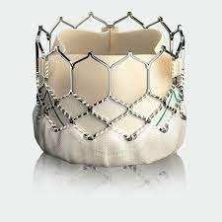
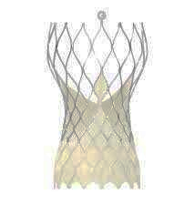
FAST-TAVI II Study: Primary Endpoint According
to Valve Type
Balloon-Expandable Valve
Self-Expandable Valve
p=0.0002
p<0.0001
%
%
Durand E, EuroPCR 2023

Slide 41
FAST-TAVI II Study: Predictive Factors of Failure
of Early Discharge
 | Univariate analysis |  |  |  | Multivariable analysis
Parameter | OR | 95% CI |  | p | OR | 95% CI |  | p
 |  | Lower | Higher |  |  | Lower | Higher
Intervention (ref: no) | 0.529 | 0.439 | 0.637 | <0.0001 | 0.223 | 0.056 | 0.885 | 0.0351
Patient characteristics
Age | 1.006 | 0.992 | 1.020 | 0.4111 | 1.016 | 0.998 | 1.034 | 0.0895
Female | 1.265 | 1.052 | 1.522 | 0.0127 | 1.659 | 1.284 | 2.144 | 0.0006
Congestive HF at admission | 1.766 | 1.323 | 2.359 | 0.0001 | 1.787 | 1.152 | 2.773 | 0.0132
COPD | 1.349 | 0.976 | 1.863 | 0.0695 | 1.143 | 0.741 | 1.762 | 0.5263
Conduction disorders | 4.875 | 3.952 | 6.014 | <0.0001 | 5.947 | 4.553 | 7.766 | <0.001
Valve-in-valve | 1.125 | 0.778 | 1.627 | 0.5316 | - | - | - | -
Creatinine peak | 1.005 | 1.003 | 1.007 | <0.0001 | 1.007 | 1.004 | 1.009 | <0.0001
Center characteristics
Non-university center | 0.853 | 0.693 | 1.050 | 0,1344 | 0.894 | 0.254 | 3.149 | 0.8509
% pts discharged early before the study | 0.188 | 0.052 | 0.676 | 0.0104 | 0.943 | 0.867 | 1.025 | 0.1498
Center volume before the study | 0.999 | 0.998 | 1.000 | 0.0476 | 0.997 | 0.991 | 1.004 | 0.3846
Mean EuroSCORE II | 1.221 | 1.127 | 1.323 | <0.0001 | 0.979 | 0.582 | 1.644 | 0.9293
Durand E, EuroPCR 2023

Slide 42
FAST-TAVI II Study: Secondary Endpoints
30-day death
30-day readmission
p=0.29
p=0.28
%
%
Durand E, EuroPCR 2023

Slide 43
FAST-TAVI II Study: Take Home Messages
The results of our study show that a simple and rapid dedicated training program is effective and safe to reduce LOS and to increase the proportion of patients discharged early after TF TAVI
Similar results were obtained with balloon and self-expandable prostheses
The reduction of LOS makes it possible to reduce resources and to cope with the future increase in indications of TAVI

Slide 44
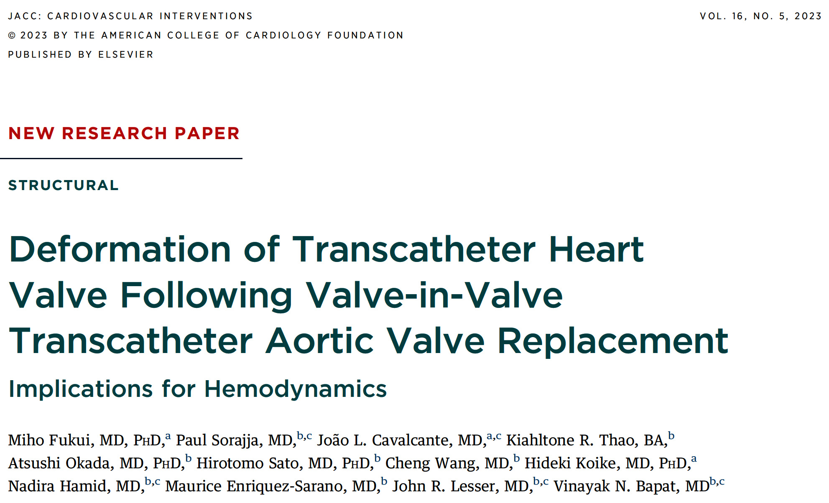

Slide 45
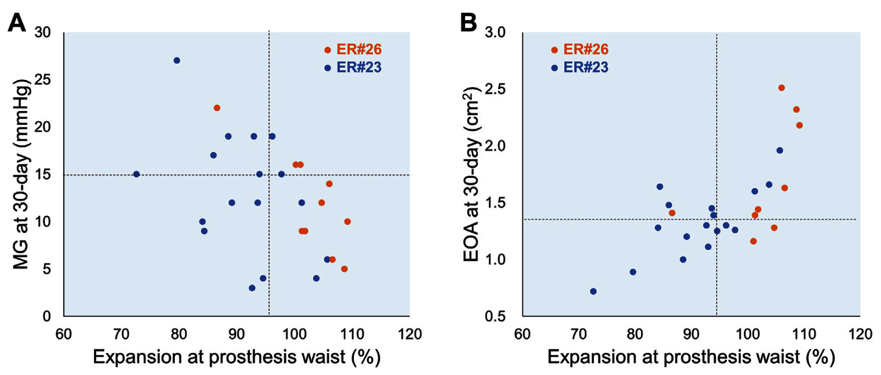
Impact of THV Oversizing on THV Deformation
and Hemodynamics
Among pts who had a small surgical heart valve with a true internal diameter of ≤21 mm and an ideal implant depth <6 mm, those who received a 26mm Evolut prosthesis (n=10) had a larger degree of expansion of the function portion (A) and trend toward larger EOA (B) despite the greater oversizing compared with those with 23 mm Evolut prosthesis (n=17)
Fukui et al., J Am Coll Cardiol Intv 2023;16:515

Slide 46
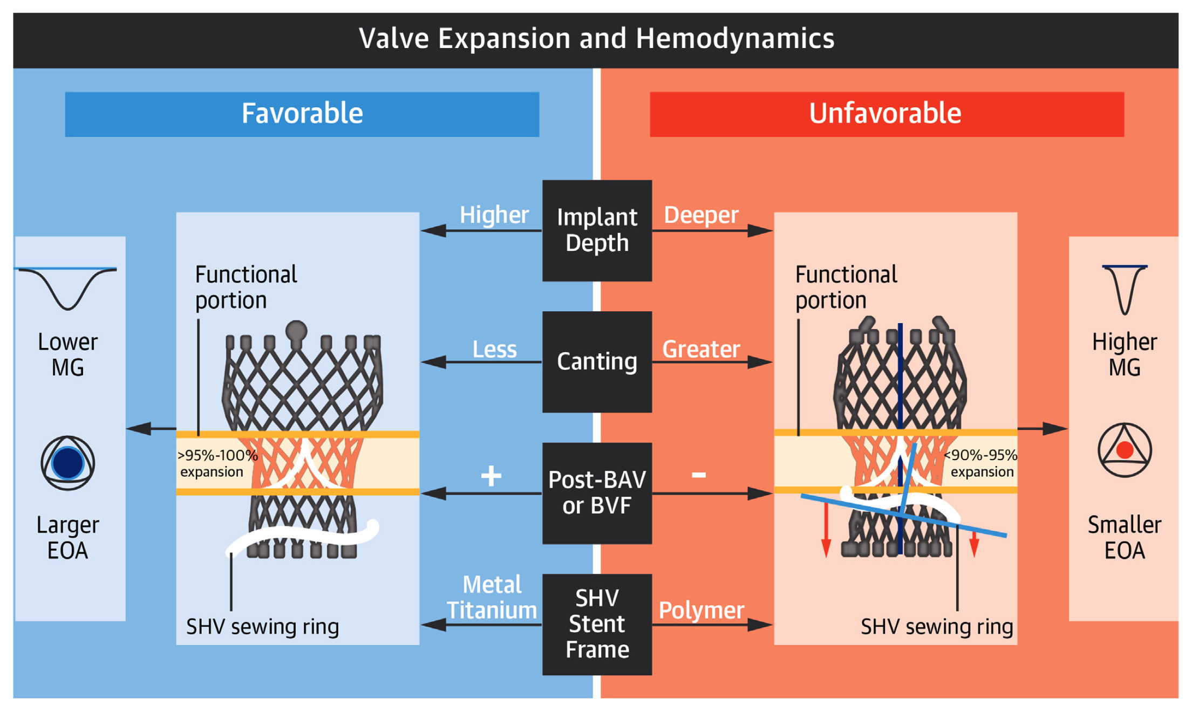
Deformation of THV and Hemodynamics After
Aortic ViV TAVR
Fukui et al., J Am Coll Cardiol Intv 2023;16:515

Slide 48
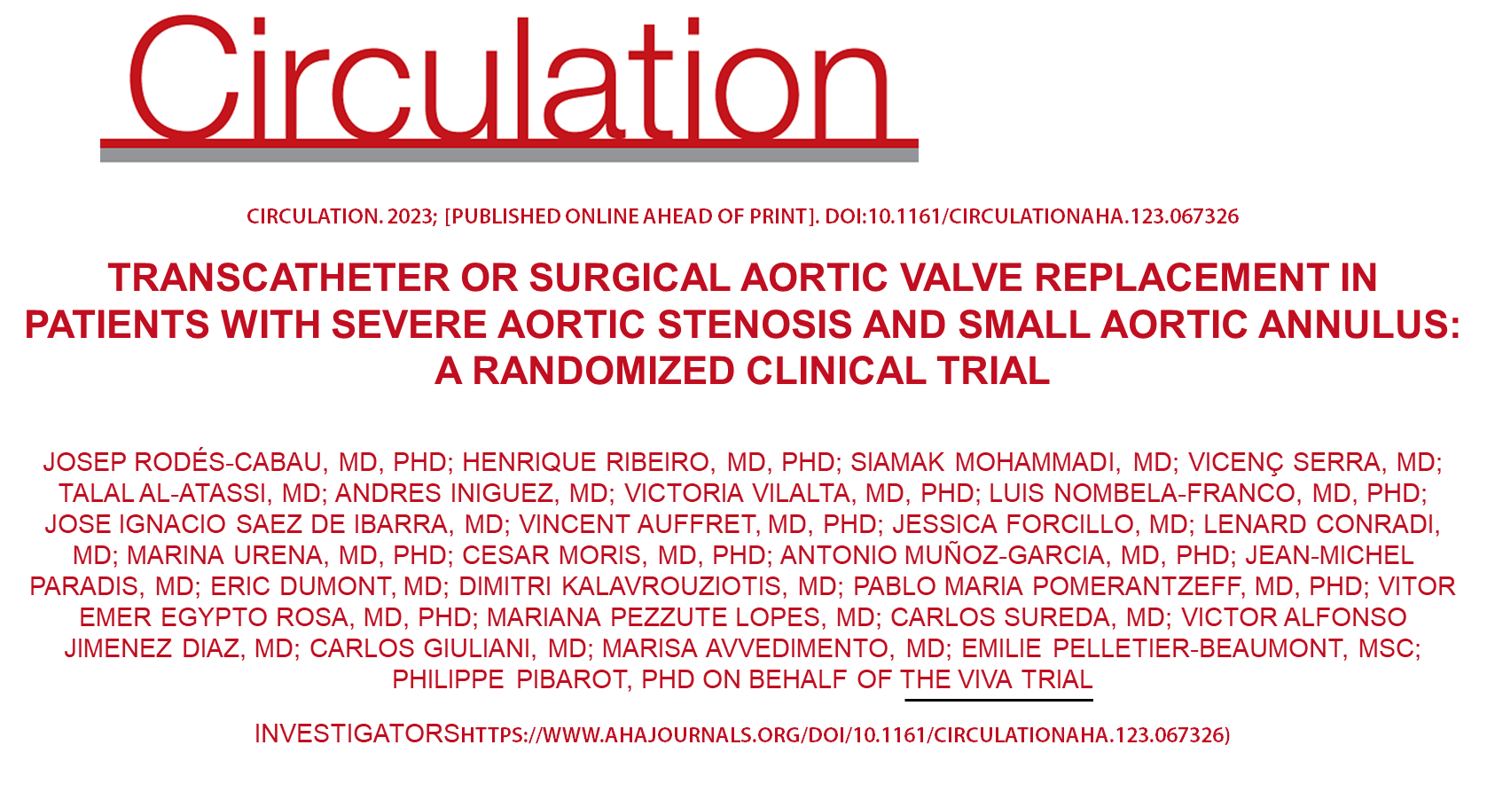
VIVA Trial Study Population Flowchart
Patients eligible after CT evaluation and randomized to either TAVR or SAVR
(n=156) CTA (23 mm annulus)
TAVR group
Patients randomized to TAVR procedure
(n=79)
SAVR group
Patients randomized to SAVR procedure
(n=77)
2 patients excluded
(1 patient with intended use of a THV not approved for the study; 1 patient had a severe MR requiring surgical intervention)
3 patients excluded
(1 patient was deemed not eligible after second CT evaluation; 2 patients withdraw the consent before intervention)
Patients included in the
TAVR group
(n=77)
Patients included in the
SAVR group
(n=74)
1 patient did not undergo echocardiographic evaluation (died before the echocardiographic follow-up)
2 patients did not undergo echocardiographic evaluation (1 patient died before the echocardiographic follow-up; 1 patient without images to provide to the corelab)
Patients with echocardiographic measurements (Core Lab)
(n=76)
Patients with echocardiographic measurements (Core Lab)
(n=72)
Rodés-Cabau et al., Circulation 2023 Oct 26 Epub ahead of print

Slide 49
VIVA Trial: Valve Performance at 60 Days
 | TAVR n=76 | SAVR N=72 | Difference TAVR-SAVR (95%CI) | P value
LVEF, % | 61±6 | 61±8 | 0.30 (-2.27 to 2.87) | 0.82
Mean aortic gradient, mmHg | 11±5 | 11±5 | 0.31 (-1.29 to 1.91) | 0.70
Mean gradient >20 mmHg | 4 (5.3%) | 7 (9.7%) | -4.46 (-13.85 to 3.93) | 0.30
Maximal aortic gradient, mmHg | 22±9 | 21±9 | 0.66 (-2.24 to 3.56) | 0.65
Effective orifice area, cm² | 1.63±0.40 | 1.65±0.45 | -0.02 (-0.16 to 0.12) | 0.79
Effective orifice area indexed, cm²/m² | 0.99±0.28 | 0.98±0.27 | 0.01 (-0.08 to 0.11) | 0.76
Velocity ratio | 0.50±0.11 | 0.50±0.11 | 0.00 (-0.03 to 0.04) | 0.81
Severe PPM or moderate-severe AR (Primary Outcome) | 4/72 (5.6%) | 7/68 (10.3%) | -4.74 (-13.69 to 4.21) | 0.30
Aortic regurgitation* |  |  | - | 0.48
None-trace | 62/75 (82.7%) | 59/68 (86.8%)
Mild | 13/75 (17.3%) | 9/68 (13.2%)
Moderate/Severe | 0/75 (0%) | 0/68 (0%)
PPM (severe) VARC-2** | 4/72 (5.6%) | 7/68 (10.3%) | -4.74 (-13.69 to 4.21) | 0.30
PPM (severe) VARC-3** | 3/72 (4.2%) | 5/68 (7.4%) | -3.19 (-10.29 to 4.55) | 0.49
Rodés-Cabau et al., Circulation 2023 Oct 26 Epub ahead of print

Slide 50
VIVA Trial: Valve Hemodynamics Over Time
52
TAVR
1.7
SAVR
49
1.5
1.5
1.6
AV Mean Gradient (mm Hg)
AV Orifice Area (cm²)
1.4
1.4
13
13
13
0.7
12
12
13
0.7
Rodés-Cabau et al., Circulation 2023 Oct 26 Epub ahead of print

Slide 51
VIVA Trial: Follow-Up Outcomes
(median: 2 [1-4] years)
%
Death Stroke Disabling stroke Major/life- New on-set New PPM Cardiac
threatening bleeding a-fib rehosp
Rodés-Cabau et al., Circulation 2023 Oct 26 Epub ahead of print

Slide 52
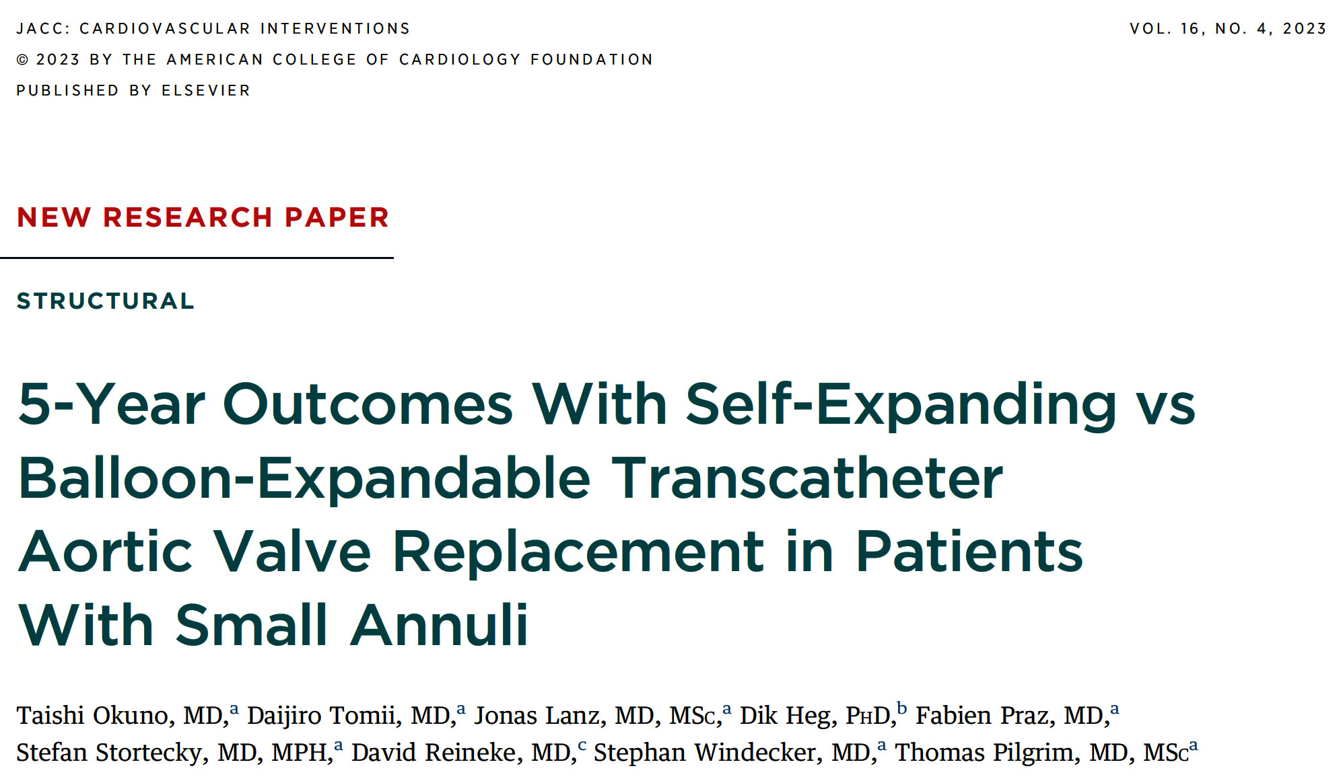
Swiss TAVI Registry
<23mm annulus

Slide 53
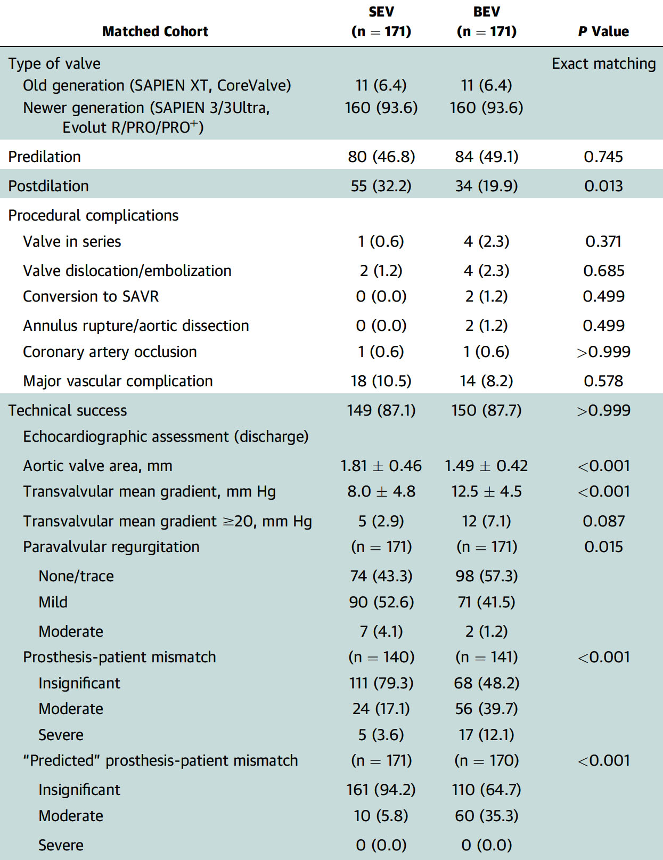
Swiss TAVI Registry: Procedural Characteristics and Complications in the Matched Population
Okuno et al., J Am Coll Cardiol Intv 2023;16:429

Slide 54
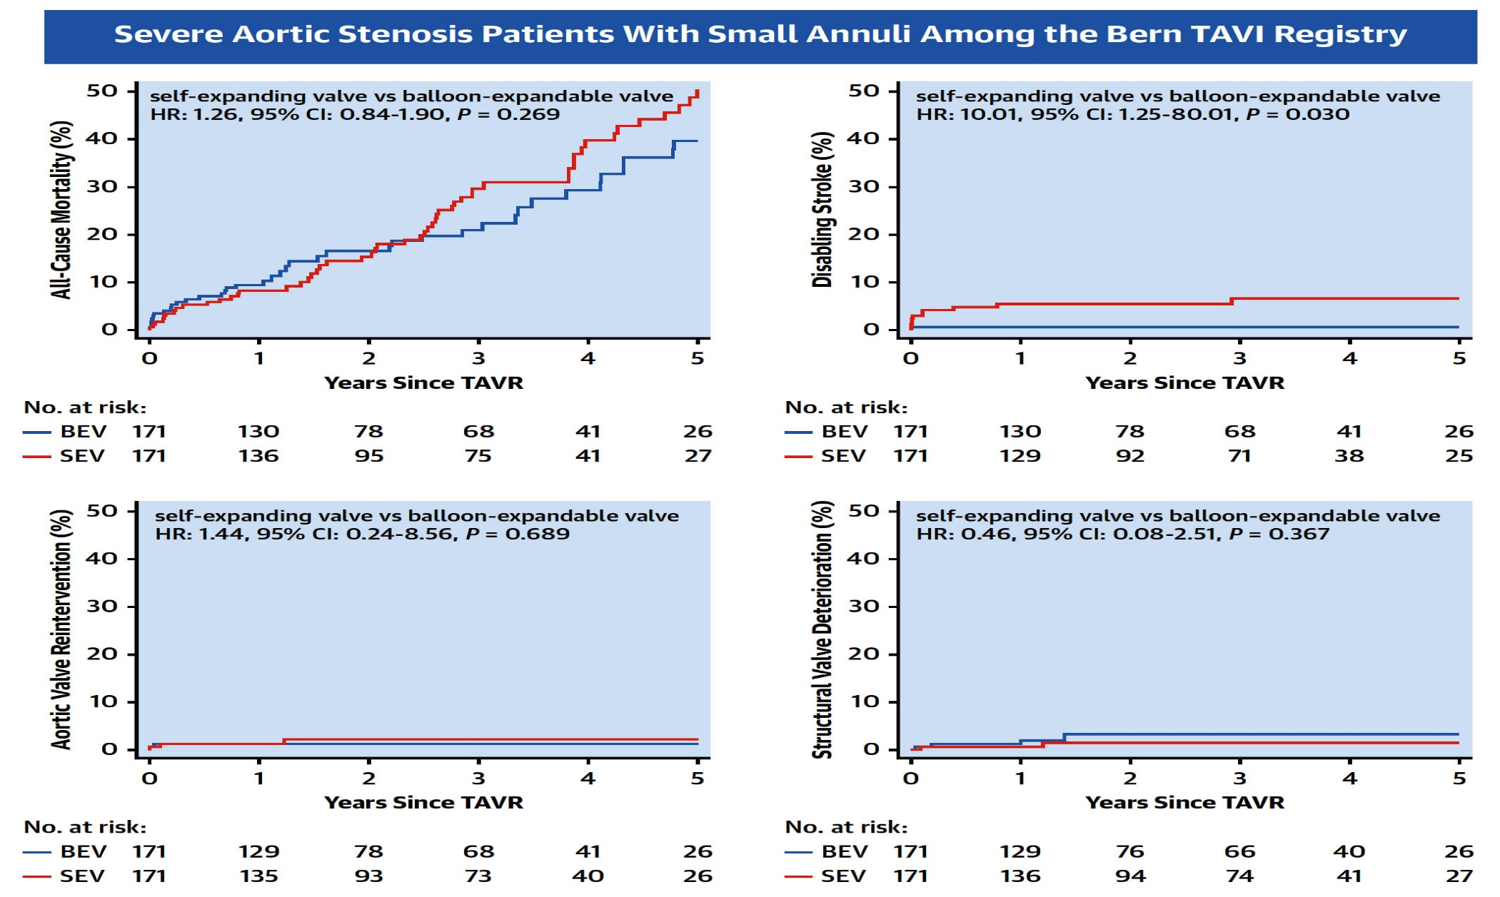
Swiss TAVI Registry: 5-Yr Clinical Outcomes in Self-Expanding (SEV) vs Balloon-Expandable (BEV) THVs in Pts with Small Annuli
Okuno et al., J Am Coll Cardiol Intv 2023;16:429

Slide 55
SMART Trial: Trial Design
Subjects with severe native aortic valve stenosis with a small annulus (≤430 mm² by MDCT)
Randomization
1:1 Stratified by Site and Sex
LBCT ACC 2024
Medtronic
Evolut PRO/PRO+/FX
Approximately 700 randomized subjects at approximately 90 sites in Canada, EMEA and the U.S.
Edwards
SAPIEN 3/SAPIEN 3 Ultra
30-Day and annual follow-ups through 5 years for all subjects
Primary Endpoints: - Mortality, disabling stroke or HF rehospitalization at 12 months (non-inferiority)
- Bioprosthetic valve dysfunction (BVD) at 12 months (superiority)

Slide 56
Take Home Messages
Recent Publications in TAVR Field
In selected matched AS pts short and long-term clinical outcomes up to 3 years, are similar in native TAVR vs redo TAVR using Edward BEV procedures; despite higher residual MG. Long-term outcomes at 5-10 years are awaited.
Selected TAVR pts under a well defined set protocol can be discharged safely in <72 Hrs of observation with 30-day outcomes similar to conventional discharge approach.
Optimal techniques are required to achieve best valve hemodynamics without deformations in ViV TAVR implantation.
In selected AS pts with small annuli, 30-day & 2 year outcomes after TAVR vs SAVR are similar despite a trend towards better hemodynamics in the TAVR gp. Subsequent 5-10yrs F/u is awaited.
Both SEV vs BEV have similar death at 5-year in small annuli with lower residual MG in SEV gp but higher CVA. Long-term outcomes are awaited.

Slide 57
Question # 1
Following statements are true regarding the outcomes of matched redoTAVR vs native TAVR upto 3-years except:
Similar mortality rate
Similar stroke rate
Similar major bleeding rates
Lower residual MG post procedure
Correct answer: D

Slide 58
Question # 2
Following are the predictors of failure of early discharge in FAST-TAVI II trial except :
CHF Class on admission
Conduction disturbances
Male
COPD
Correct answer: C

Slide 59
Question # 3
Following results are true about the trial comparing TAVR vs SAVR in small annuli except;
A. Similar death and stroke at 1 year
B. Higher severe PPM in the TAVR vs SAVR group
C. Lower residual MG in TAVR vs SAVR group
D. Lower bleeding/Afib in TAVR vs SAVR group
Correct answer: B

