Slide 1
Cardiac Cath Lab Volume at MSH
Procedures Over Last Five Years
Total Cath Lab Procedure Volume
Cath Only
Interventions
Biopsies
0.34%
N
4.0%

Slide 2
Interventional Volume & Major Complications 2019-23
Coronary Interventions (PCI)
Endovascular Interventions (PTA)
Major complication: N = 25 13 16 19 16
Major complication: N = 0 1 0 0 1
0.76%
14.3%
N
N
Valvuloplasty (BAV/BMV)
TAVR/TAVI
Major complication: N = 3 4 1 1 0
Major complication: N = 10 15 15 12 15
2023
Septal Ablation = 6
MitraClip = 101
TMVR = 8
TriClip = 12
TTVR = 2
PFO/ASD Closure = 30
LAAO = 7
1.75%
26.4%
N
N
BMV-13 BMV-8 BMV-5 BMV-3 BMV-8

Slide 3
Safety of PCI at MSH Cath Lab
MSH: Temporal Trends in Complications of PCI
2019 (n= 3701)
2020 (n= 2989)
2021 (n= 3828)
2022 (n= 3412)
2023 (n= 3438)
For last 5 yrs+;
<0.4% in-hospital mortality
<0.1% need for urgent CABG
<1.0% major complications of PCI
3429 of 3438 pts in 2023 were discharged alive
%
CS death: 2
n=8
n=8
n=13
n=13
n=9
In-hospital death Urgent CABG Q-wave/Large MI Major Complications
(death, uCABG, MI, CVA)

Slide 4
PCI Complications: MSH vs. NY State Hospitals
Mount Sinai Hospital (N=2552) 2023R-Q3
NY State Hospitals (N=54,930) 2019
%

Slide 5
PCI Complications: MSH vs. ACC-NCDR Hospitals
2022Q3 - 2023Q2
Mount Sinai Hospital (N=3405)
ACC-NCDR Hospitals (N=1,044,414)
%
Risk-adjusted In-hosp death eCABG Stroke Risk-adjusted LOS (days)
In-hosp death pts w/out CS in-hosp bleeding

Slide 6
National PCI Outcome Metrics; Major Complications
Composite: Proportion of PCI Patients with Death, eCABG, Stroke or eTVR; MSH vs. ACC-NCDR (n=1600 hospitals) for 2022Q3 - 2023Q2
<30% of the national average
%
(n= 3405) (n=1,044,414)

Slide 7
NYS-DOH Report of PCI 2017-19
Data on Top 10 Volume Centers in NY State 30-Day RAMR
PCI Statistics 2017-19 | # cases | All cases | Non-Emergency cases | Emergency cases
1. Mount Sinai Hospital | 10,347 | 0.85** | 0.50** | 3.06
2. St. Francis Hospital | 8,750 | 0.93** | 0.60 | 2.48
3. North Shore University Hospital | 7,214 | 1.16 | 0.72 | 3.23
4. NYU Hospitals Center | 6,634 | 0.97 | 0.57 | 3.25
5. NYP Columbia Presbyterian | 6,478 | 1.56* | 1.03* | 3.97
6. St. Josephs Hospital | 6,151 | 1.17 | 0.76 | 3.14
7. Lenox Hill Hospital | 5,557 | 0.61** | 0.37** | 1.73
8. Mount Sinai Beth Israel | 4,416 | 1.00 | 0.55 | 3.46
9. Buffalo General Medical Center | 4,350 | 1.18 | 0.59 | 3.54
10. University Hospital – Stony Brook | 4,247 | 1.44 | 0.90 | 4.01
NYS Total 157,140 1.22 0.79 3.24
http:// www.nyhealth.gov **Risk Adjusted Mortality Rate (RAMR) significantly lower than NY statewide rate
*Risk-Adjusted Mortality Rate (RAMR) significantly higher than NY statewide rate

Slide 8
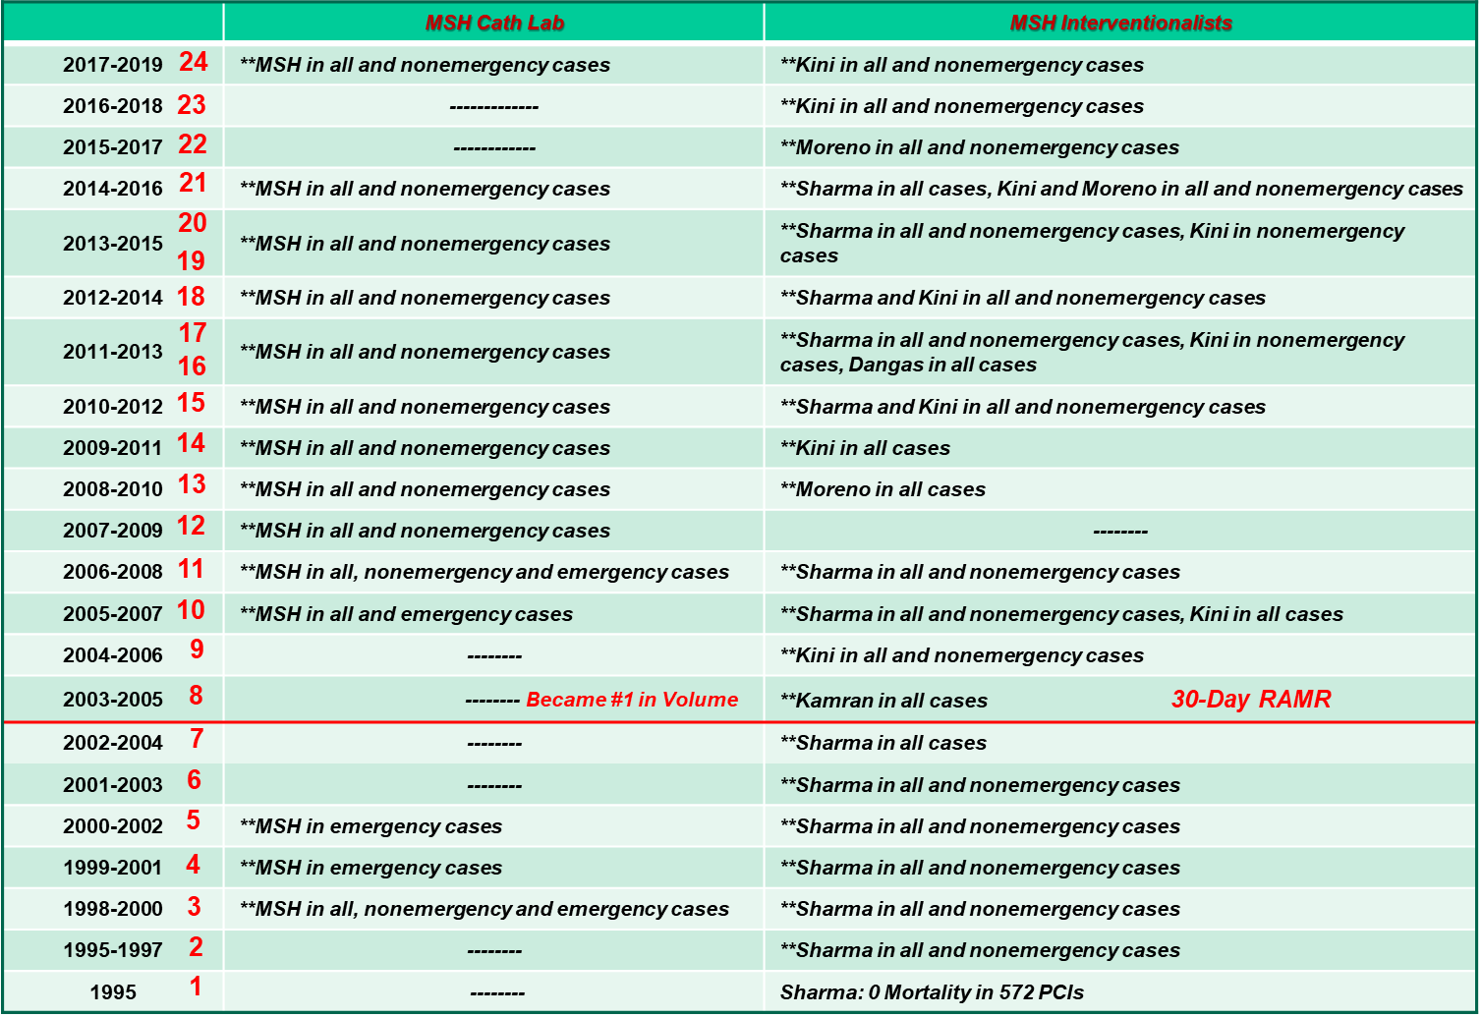
Top for safety for consecutive 24 years;
Feat no other hospital in NYS could do!

Slide 9
Hospital Observed, Expected and Risk-Adjusted Readmission Rates (RARR) for All PCI
in New York State 2019
Hospital | # Cases | Readmissions | All cases RARR % | 95% CI for RARR
Mount Sinai Hospital | 2,873 | 179 | 6.69** | (5.75, 7.75)
NYS Total 48,417 4,274 8.83
** MSH for all 6 consecutive reports
http:// www.nyhealth.gov **Risk-adjusted readmission rate significantly lower than NY Statewide rate

Slide 10
Complex Coronary Cases Supported by:
Boston Scientific Corp.
Abbott-CSI Inc.
Shockwave Medical Inc.
Terumo Vascular Corp.
Johnson & Johnson-Abiomed Inc.
Chiesi Inc.
Haemonetics-Cardiva Inc.
Acist Medical System.

Slide 11
Disclosures
Samin K. Sharma, MD, MSCAI, FACC
Nothing to disclose
Annapoorna S. Kini, MD, MRCP, FACC
Nothing to disclose
Sameer Mehta, MD, FACC (Moderator)
Nothing to disclose

Slide 12
CCC Live Case # 175
Patient Demographics
67 yrs, Male
Present Clinical Presentation
Presented with new onset CCS class II angina and stress MPI for mild inferior and lateral, lateral and apical ischemia. cCTA revealed calcific 3 V CAD
CAD Risk Factors
Controlled hypertension
H/o cardiac arrest 2013
SAQ-7 score: 62, Asthma
Clinical Variables
Echo with 58% EF and no valvular disease
Medications
Aspirin, Amlodipine, Metoprolol XL, Rosuvastatin
Cath: Cardiac cath on 12/18/2023 revealed severely calcified 3 V CAD; multiple calcified 80-99% lesions in RCA, 100% LCx-OM1 & LVEF 60%, Syntax score 35. Pt was referred for CABG but declined after heart team discussion due to patients' wishes & planned for MV PCI.
Plan: Now planned for complex PCI of multiple calcified RCA lesions using rotational atherectomy + IVL (RotaTripsy) & multiple DES.

Slide 13
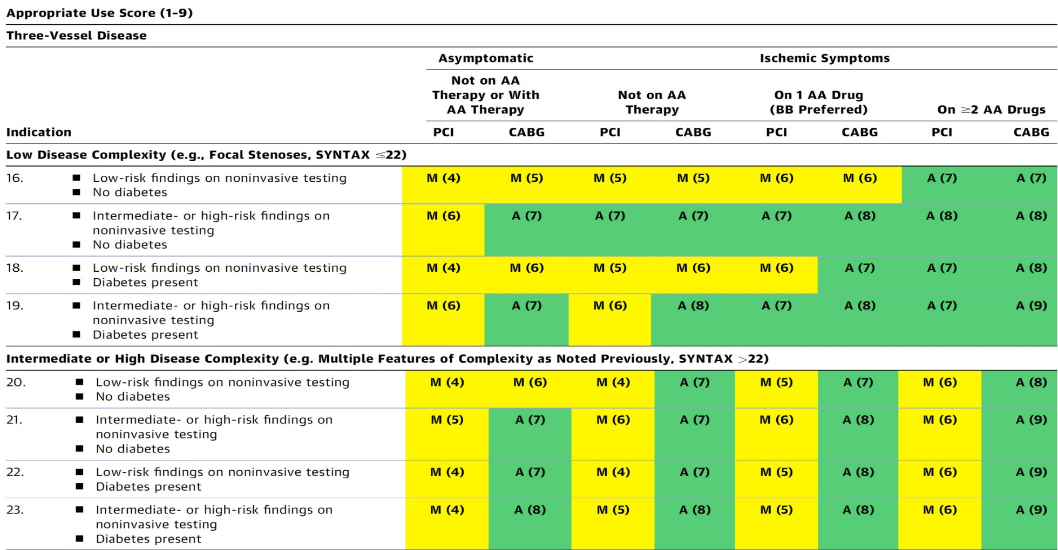
AUC 2017: Two or Three-Vessel Disease
Patel et al., J Am Coll Cardiol 2017;69:2212

Slide 14
Latest Issues in Coronary Intervention
Recent Interventional Trials and Publications:
MINT Trial, COCOA Trial, FLAVOUR Trial- Sex
Impact, ISAR-DESIRE 3 Trial- 10Yrs
Focused review of the month
Benefits of PCI in Stable CAD on no antianginals:
A Placebo Controlled Trial of Percutaneous Coronary
Intervention for Stable Angina; ORBITA 2 Trial

Slide 15
Latest Issues in Coronary Intervention
Recent Interventional Trials and Publications:
MINT Trial, COCOA Trial, FLAVOUR Trial- Sex
Impact, ISAR-DESIRE 3 Trial- 10Yrs
Focused review of the month
Benefits of PCI in Stable CAD on no antianginals:
A Placebo Controlled Trial of Percutaneous Coronary
Intervention for Stable Angina; ORBITA-2 Trial

Slide 16
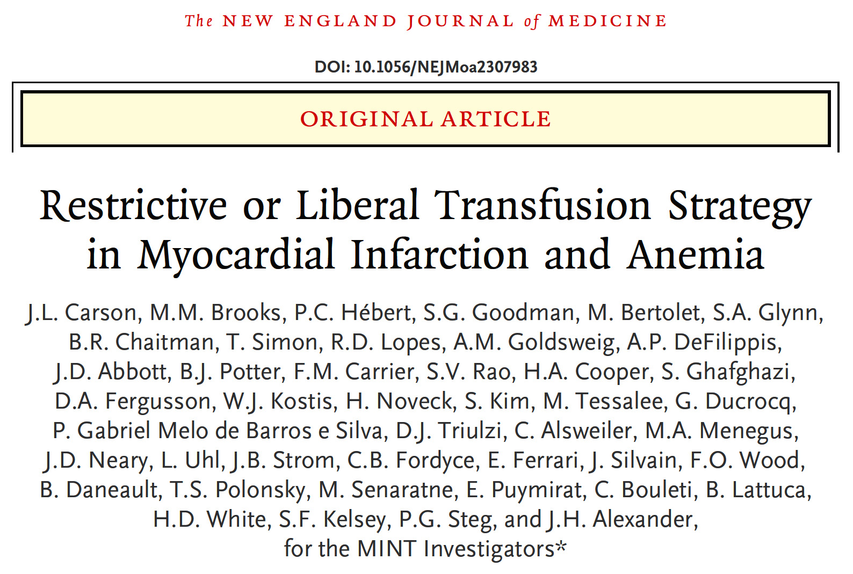
Myocardial Ischemia and Transfusion (USA)

Slide 17
MINT Trial: Background
Low blood count (Anemia) is common in pts with MI
Normal hemoglobin level 13G in men, 12G in women
Indications for red blood cell transfusion in MI patients are controversial
Liberal transfusion -Transfuse at higher blood level: 10G
Restrictive transfusion -Transfuse at lower blood level: 7 to 8G
Trials in other clinical settings suggest use of restrictive transfusion is safe

Slide 18
MINT Trial: Objective
To determine whether the risk of death or MI differed using less blood transfusions and lower hemoglobin level of 7 to 8 as compared to using more blood transfusions with a hemoglobin level of 10 among patients with a heart attack and a blood count <10.

Slide 19
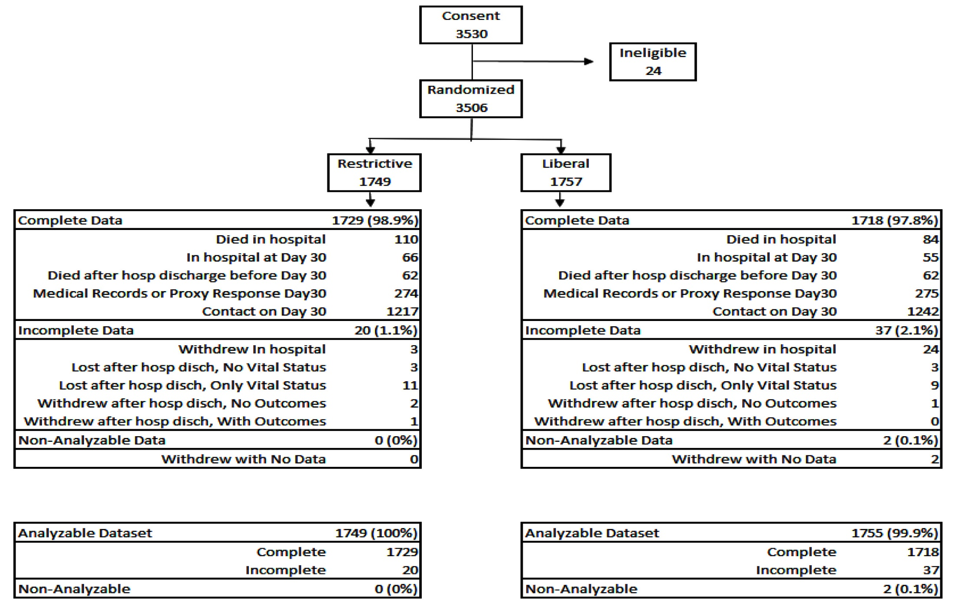
MINT Trial CONSORT Chart
Carson et al., N Engl J Med 2023;389:2446

Slide 20
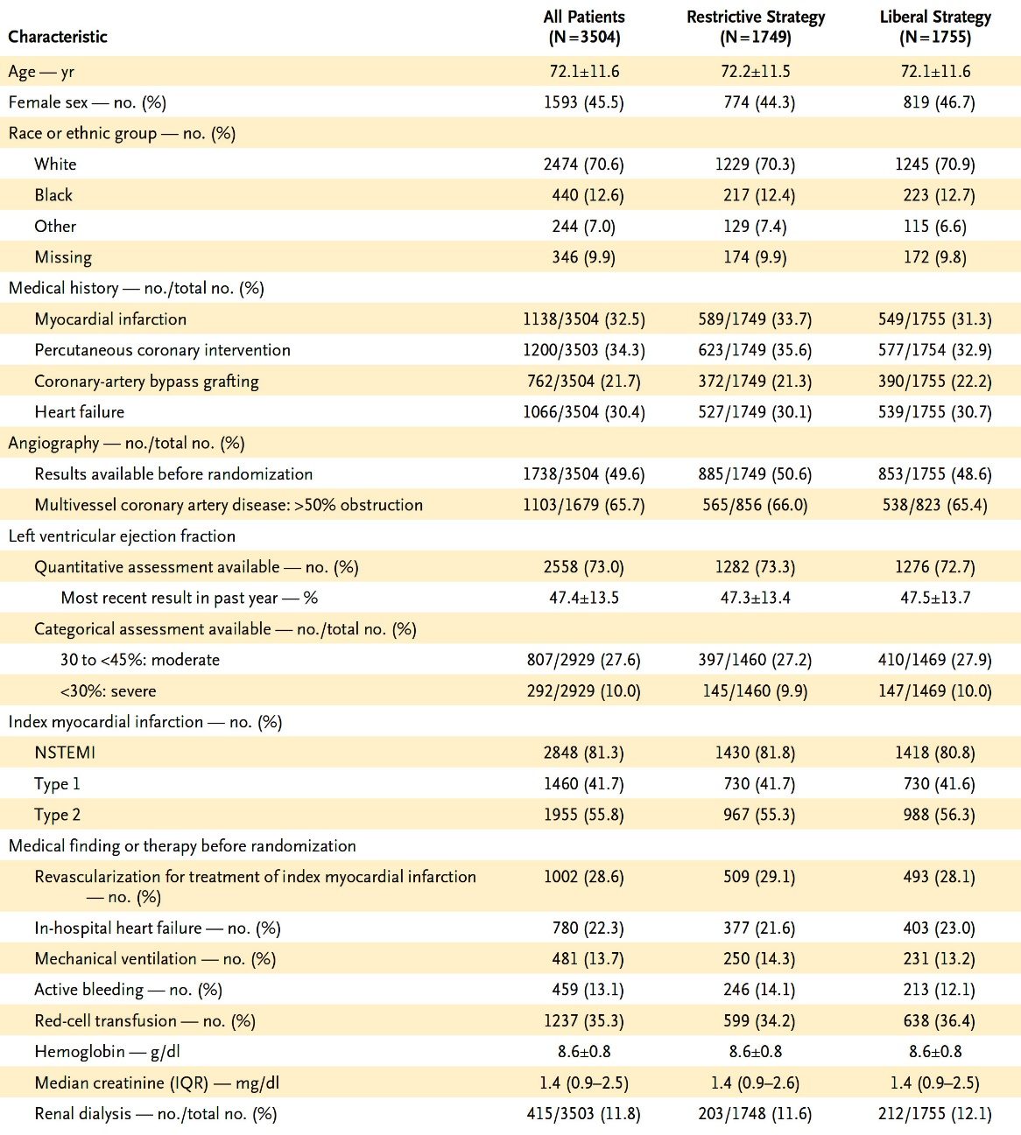
MINT Trial: Characteristics of the Patients at Baseline
3504 patients included in analyses
Mean age = 72.1 years
Female patients = 45.5%
Type 2 MI = 55.8%
Type 1 MI = 41.7%
Pre-randomization mean Hgb level = 8.6/dL
Mean Cr level = 1.4 mg/dL
On ventilator = 13.7%
Renal dialysis = 11.8%
Carson et al., N Engl J Med 2023;389:2446

Slide 21
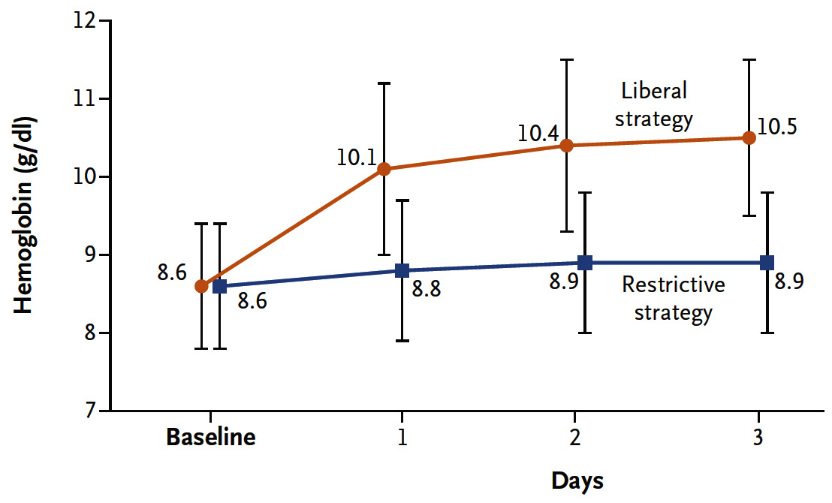
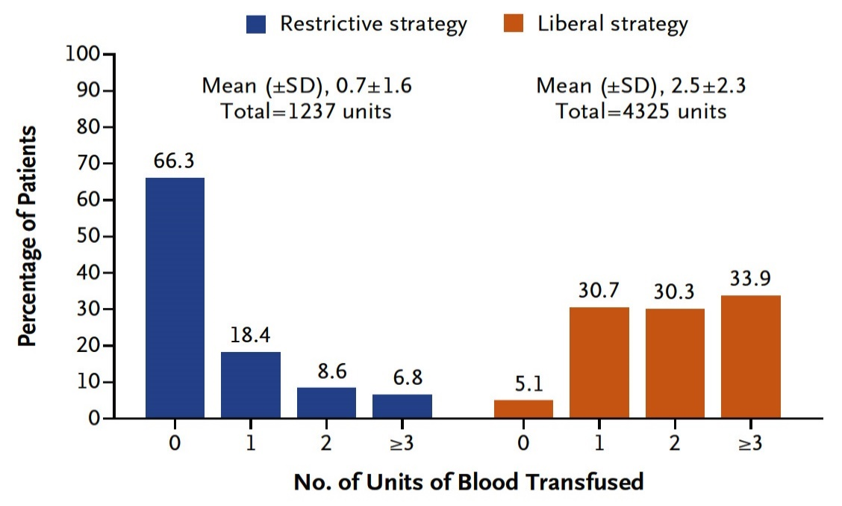
MINT Trial: Hemoglobin Level and Number of
Units of Red-Cell Transfusions
Hemoglobin Level
Units of Blood Transfused
RBC transfused in liberal-strategy gp = 4325U was 3.5x the total number of RBC transfused in restrictive-strategy gp = 1237U
Mean number of RBC units that were transfused in the liberal-strategy gp was 2.5 ± 2.3, vs 0.7 ± 1.6 in the restrictive-strategy gp
Mean Hgb level lower in restrictive-strategy grp vs liberal-strategy grp by 1.3/dL (95% CI: 1.2 to 1.4) on day 1 and lower by 1.6/dL (95% CI: 1.5 to 1.7) in day 3
Carson et al., N Engl J Med 2023;389:2446

Slide 22
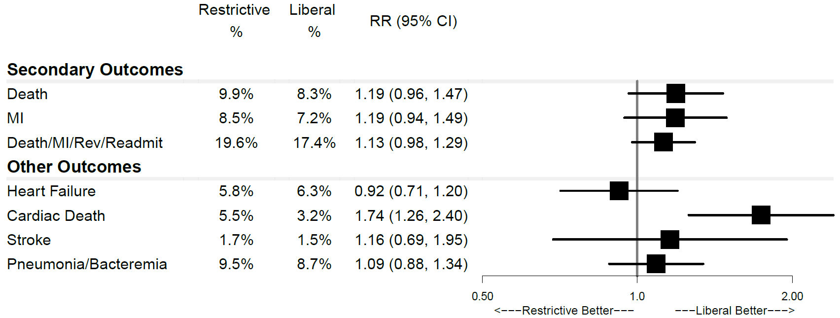
MINT Trial: Primary and Other Outcomes
at 30 Days
Primary Outcome: Death or MI
P = 0.07
295
1749
Restrictive Liberal
(n=1749) (n=1755)
(unadjusted
risk ratio)
255
1755
%
Carson et al., N Engl J Med 2023;389:2446

Slide 23
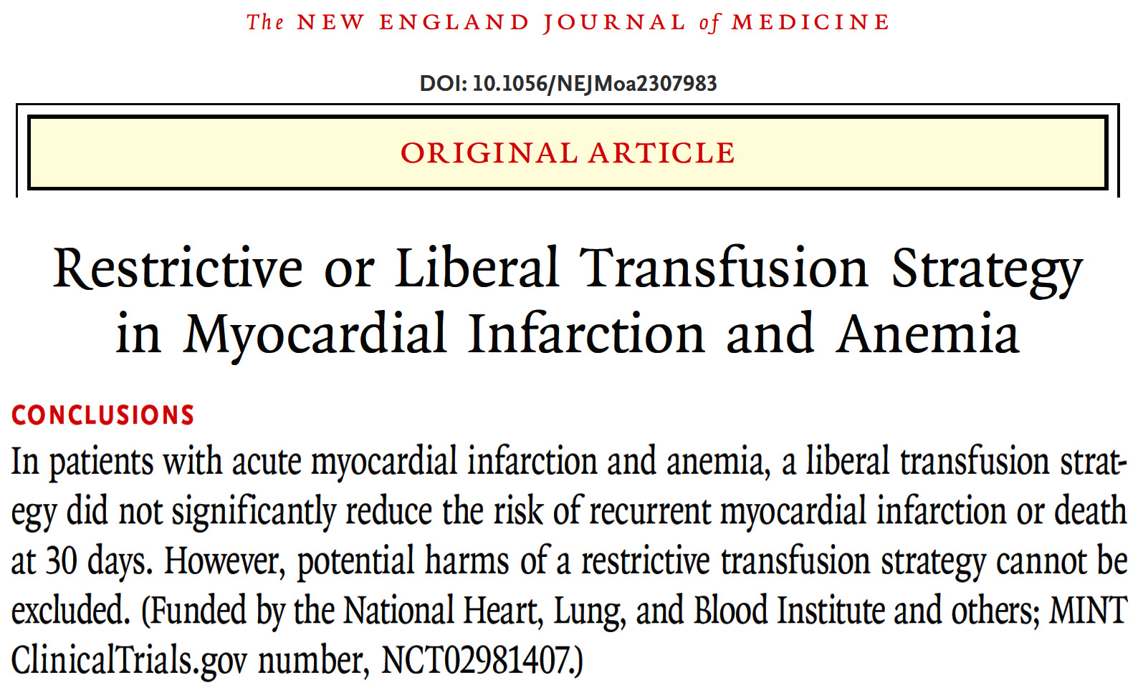
While not statistically significant, the results consistently favored a liberal transfusion strategy

Slide 24
COCOA Trial
Comparison Between Optical COherence Tomography Guidance and Angiography Guidance in Percutaneous Coronary Intervention

Slide 25
COCOA Trial: OCT Criteria for Optimal Stent Implantation
Stent diameter | Stent dimeter = 0-0.25 mm larger than reference lumen diameter at distal reference site
Reference site | Most normal appearance or lipid-arc <180 degree
Stent length | Distance from distal to proximal reference site
Post dilatation | Maximum balloon dimeter = 0-0.25 mm larger than reference lumen diameter at proximal reference site
Goal of stent deployment | Stent expansion index ≥ 0.9 Stent symmetry index ≥ 0.7 Complete stent apposition or malapposed distance < 350 μm No plaque protrusion, thrombus, or edge dissection with potential to provoke flow disturbances
Kubo T, TCT 2023

Slide 26
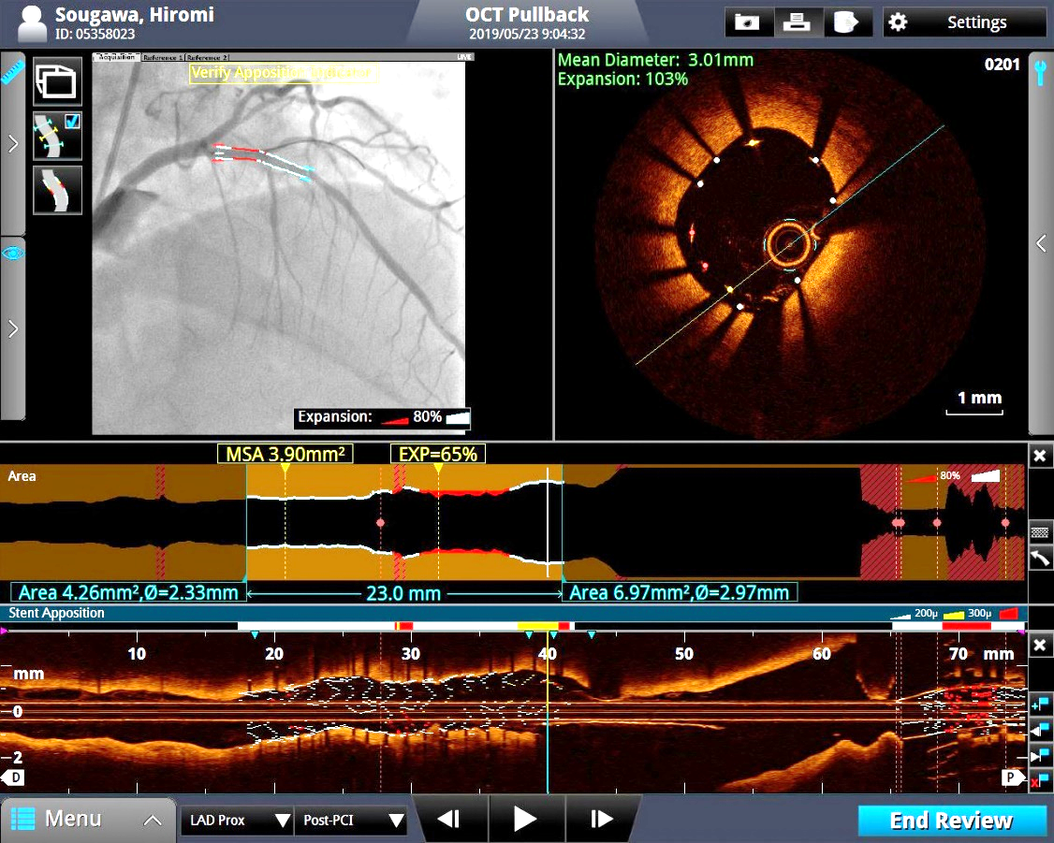
COCOA Trial: Use of OCT Software for PCI Optimization
A
B
Angio-coregistration (A)
MSA site
Malapposition site
⇒ Target of post-dilatation
Automatic measurements（C）
MSA
Stent expansion index
⇒ Underexpansion
Malapposition indicator（B・D）
Color cording
*
Under-expansion
C
D
Kubo T, TCT 2023

Slide 27
COCOA Trial: Patient Flow
550 patients enrolled and randomized
275 allocated to OCT-guided PCI
275 allocated to angiography-guided PCI
7 excluded
3 withdrawal of consent
2 unable to pass OCT catheter
2 no final OCT done
7 excluded
1 withdrawal of consent
1 IVUS use
2 unable to pass OCT catheter
1 no final OCT done
1 failure of OCT image storage
268 included in primary endpoint analysis
268 included in primary endpoint analysis
Kubo T, TCT 2023

Slide 28
COCOA Trial: Procedural Characteristics
 | OCT-guided PCI | Angiography-guided PCI | P-value
Number of stent | 1.03 ± 0.17 | 1.01 ± 0.12 | 0.244
Stent diameter, mm | 3.12 ± 0.49 | 3.02 ± 0.42 | 0.011
Stent length, mm | 23 ± 9 | 23 ± 8 | 0.167
Pre-dilation | 198 (74) | 220 (82) | 0.028
Cutting balloon | 23 (9) | 24 (9) | 1.000
Rotablator | 4 (1) | 0 (0) | 0.124
Distal protection | 10 (4) | 2 (1) | 0.037
Post-dilatation | 173 (65) | 86 (32) | <0.001
Max. balloon diameter, mm | 3.29 ± 0.53 | 3.29 ± 0.49 | 1.000
Max. inflation pressure, atm | 16 ± 4 | 17 ± 4 | 0.549
Contrast volume (mL) | 146 ± 65 | 93 ± 48 | <0.001
Kubo T, TCT 2023

Slide 29
COCOA Trial: Primary Endpoint
Post-PCI Minimum Stent Area
P < 0.001
(mm²)
10
5.95 ± 2.30
8
5.29 ± 1.69
6
Minimum stent area
4
2
0
OCT-guided PCI
Angiography-guided PCI
Kubo T, TCT 2023

Slide 30
COCOA Trial: Secondary Endpoints
 | OCT-guided PCI | Angiography-guided PCI | P-value
Reference lumen area (mm²) | 7.32 ± 2.94 | 7.21 ± 2.59 | 0.621
Minimum stent expansion (%) | 83 ± 17 | 76 ± 15 | <0.001
≥90% | 82 (31) | 55 (21) | 0.010
≥80% to <90% | 63 (24) | 49 (18) | 0.167
<80% | 123 (46) | 164 (61) | <0.001
Mean stent area (mm²) | 7.37 ± 2.53 | 6.57 ± 1.95 | <0.001
Mean stent expansion (%) | 104 ± 18 | 94 ± 16 | <0.001
Dissection | 9 (3) | 9 (3) | 1.000
Stent malapposition | 65 (24) | 128 (48) | <0.001
Tissue protrusion | 75 (28) | 88 (33) | 0.260
Reference segment disease (lipid arc >180˚) | 35 (13) | 64 (24) | 0.002
Kubo T, TCT 2023

Slide 31
COCOA Trial: Conclusion
Compared to angiography-guided PCI, OCT-guided PCI had better acute stenting results, including a significantly larger minimum stent area.

Slide 32
FLAVOUR Trial
FLAVOUR TRIAL
(Fractional Flow Reserve and Intravascular Ultrasound for Clinical Outcomes in Patients with Intermediate Stenosis)

Slide 33
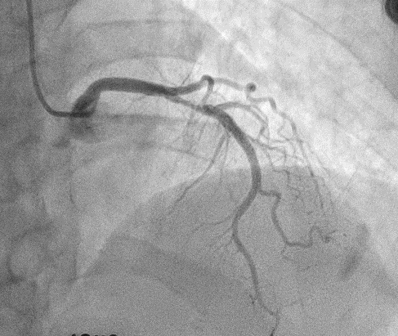
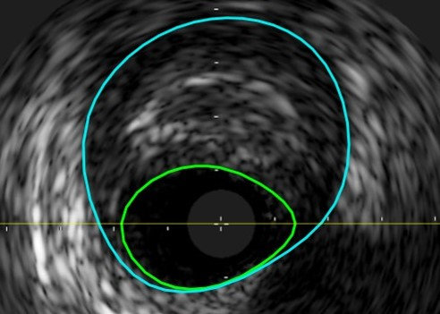
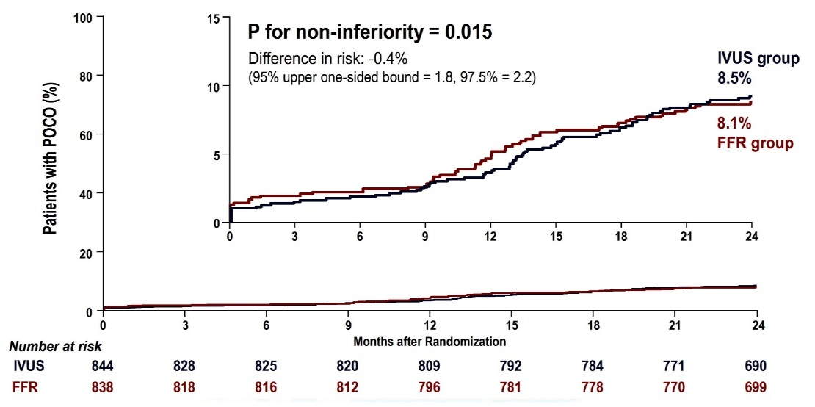
The FLAVOUR Trial: Objective & Results
To compare the efficacy of FFR-guided PCI strategy with IVUS-guided PCI strategy in patients with intermediate coronary stenosis.
Working Hypothesis
The FFR-guided PCI strategy will be non-inferior to the IVUS-guided PCI strategy in regard to clinical outcomes at 2 years
FFR-guided PCI | IVUS-guided PCI
Indications for PCI
FFR ≤ 0.80 | Minimum lumen area (MLA) ≤ 3mm² or MLA 3 to ≤ 4mm² & Plaque burden > 70%
Criteria for optimal PCI
Post-PCI FFR ≥ 0.88 or Post-PCI ∆FFR (FFR across the stent) < 0.05 | Plaque burden at stent edge ≤ 55% Minimal stent area ≥ 5.5mm² or Minimal stent area ≥ distal reference lumen area
Koo et al., N Engl J Med 2022;387:779

Slide 34
FLAVOUR Trial: Baseline Patient Characteristics
 | Total (n=1619) | Women (n=482) | Men (n=1137) | P Value
Age, years | 65.1 ± 9.6 | 67.8 ± 8.4 | 63.9 ± 9.9 | <0.001
BMI, kg/m² | 24.7 ± 3.3 | 24.4 ± 3.6 | 24.8 ± 3.2 | 0.053
ACS, % | 29.8 | 32.0 | 28.8 | 0.234
Diabetes mellitus, % | 33.0 | 35.5 | 32.0 | 0.195
Hypertension, % | 67.9 | 73.0 | 65.7 | 0.005
Current smoking, % | 18.9 | 1.2 | 26.4 | <0.001
Prior MI, % | 5.8 | 2.3 | 7.3 | <0.001
Prior PCI, % | 19.5 | 14.3 | 21.7 | 0.001
LVEF, % | 63.6 ± 8.4 | 65.5 ± 8.2 | 62.8 ± 8.4 | <0.001
Zhang et al., J Am Coll Cardiol Intv 2023;16:2426

Slide 35
FLAVOUR Trial: Lesion and Procedure Characteristics
 | Total (n=1619) | Women (n=482) | Men (n=1137) | P Value
Target lesion distribution, % LAD LCx RCA | 62.4 12.3 25.4 | 63.1 11.6 25.3 | 62.1 12.5 25.4 | 0.853
Diameter stenosis by visual estimation, % | 61.8 ± 8.2 | 61.7 ± 8.0 | 61.9 ± 8.3 | 0.636
Quantitative coronary angiography DS Diameter stenosis, % Lesion length, mm Reference diameter, mm Minimal lumen diameter, mm | 56.8 ± 10.1 20.3 ± 10.7 3.0 ± 0.5 1.3 ± 0.4 | 55.9 ± 10.3 20.0 ± 10.3 2.9 ± 0.5 1.3 ± 0.4 | 57.1 ± 10.0 20.5 ± 10.8 3.0 ± 0.5 1.3 ± 0.4 | 0.016 0.449 <0.001 0.733
FFR, n Pre-PCI FFR Post-PCI FFR | 899 0.83 ± 0.09 0.88 ± 0.06 | 272 0.85 ± 0.08 0.89 ± 0.05 | 627 0.82 ± 0.10 0.88 ± 0.06 | <0.001 0.169
IVUS, n Minimal lumen area, mm Plaque burden, % Area stenosis, % Post-PCI minimal stent area, mm | 854 3.5 ± 1.3 70.1 ± 10.2 71.1 ± 9.0 7.0 ± 2.2 | 245 3.3 ± 1.2 68.2 ± 10.3 69.0 ± 8.6 6.5 ± 2.0 | 609 3.5 ± 1.3 70.9 ± 10.0 72.0 ± 9.0 7.2 ± 2.2 | 0.022 0.001 <0.001 0.001
Target vessel PCI, % | 45.8 | 40.8 | 47.9 | 0.008
Zhang et al., J Am Coll Cardiol Intv 2023;16:2426

Slide 36
FLAVOUR Trial: Sex Differences in the PCI Rate
Sex Differences in PCI Rate Among Total Patients
Sex Differences in PCI Rate According to Strategy
PCI Rate, %
PCI Rate, %
p<0.001
p<0.001
p=0.008
p=0.87
p=0.001
Zhang et al., J Am Coll Cardiol Intv 2023;16:2426

Slide 37
FLAVOUR Trial: Primary Outcomes
p=0.040
p=0.039
%
Zhang et al., J Am Coll Cardiol Intv 2023;16:2426

Slide 38
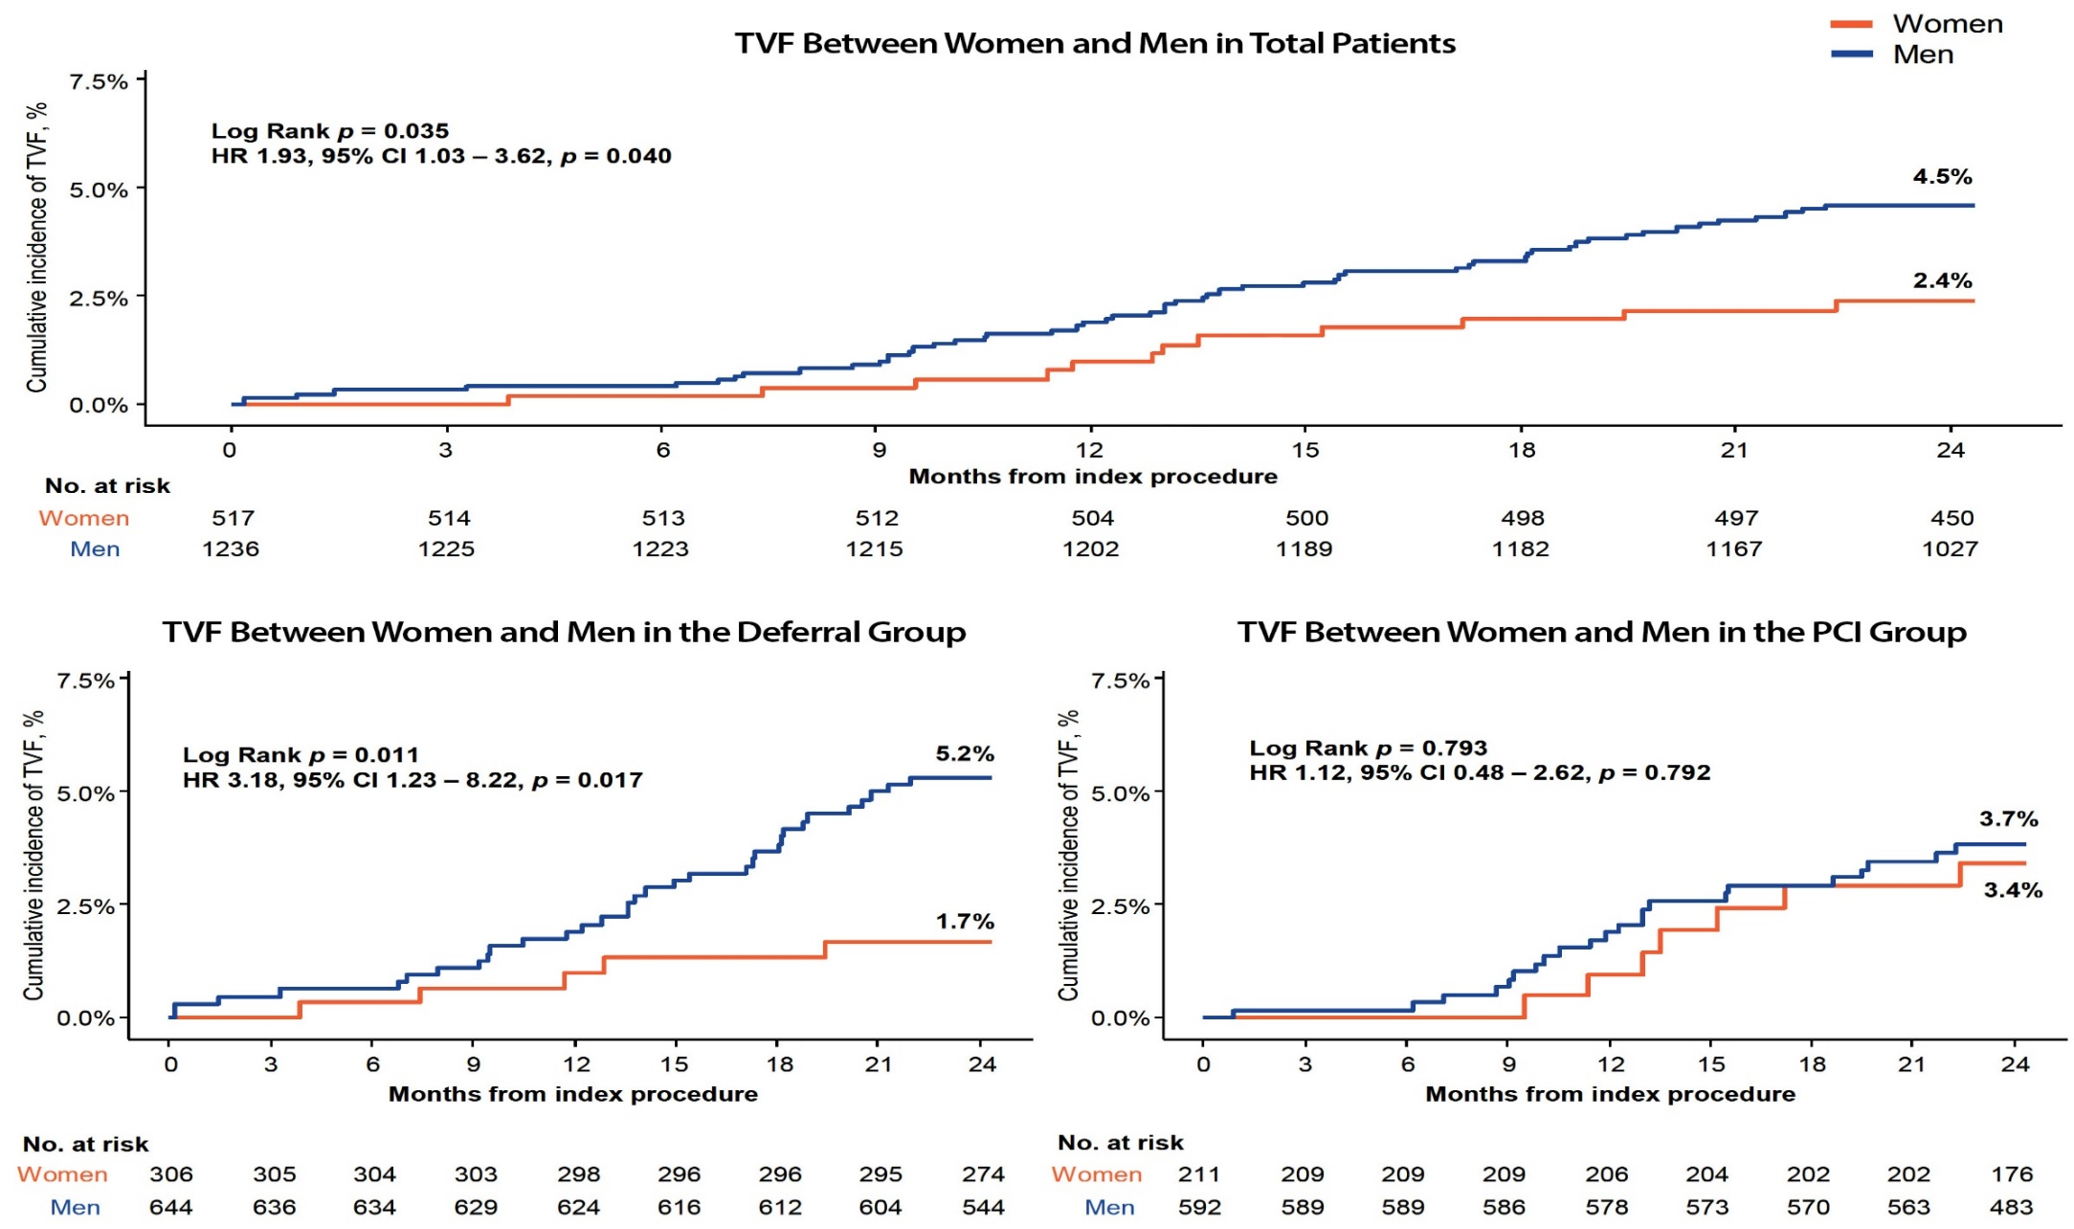
FLAVOUR Trial: Comparison of TVF Between
Men and Women
Zhang et al., J Am Coll Cardiol Intv 2023;16:2426

Slide 39
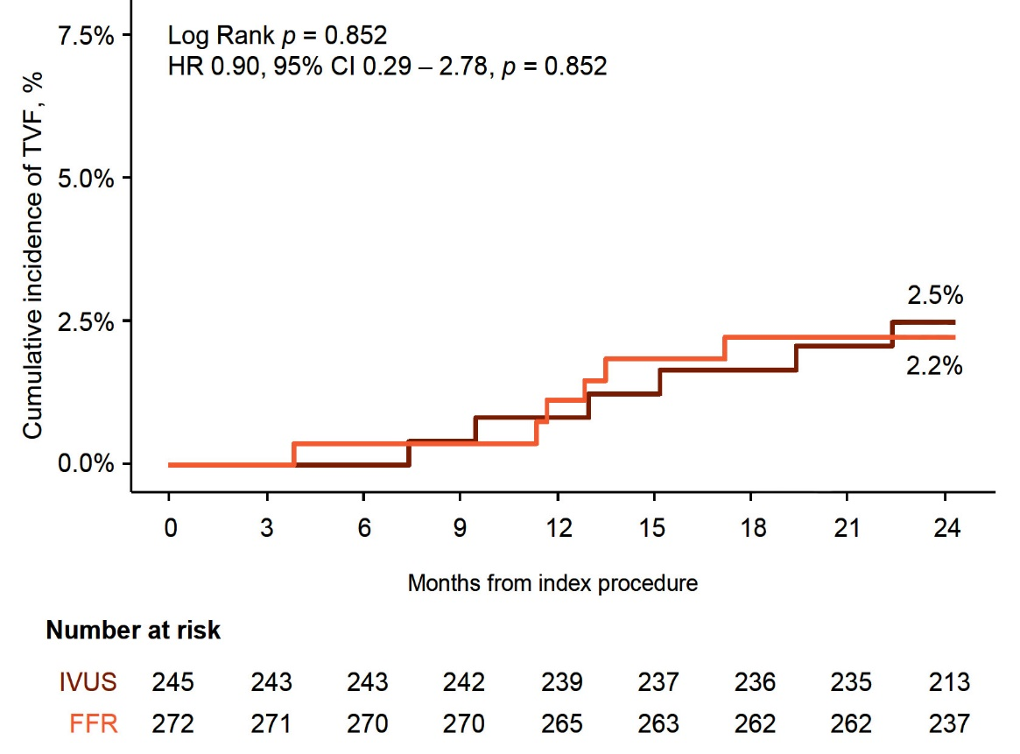
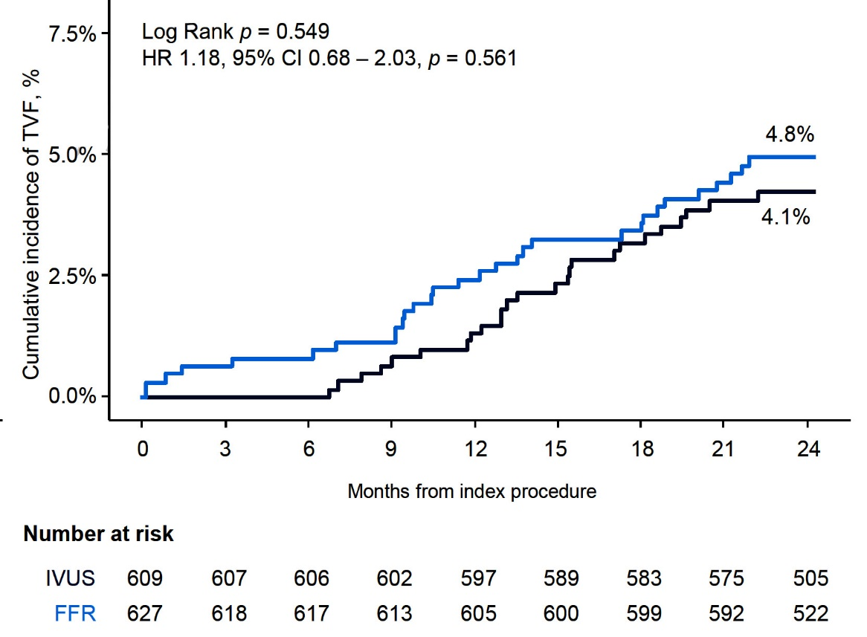
FLAVOUR Trial: Comparison of TVF Between Strategies According to Sex
TVF Between Strategies in Women
TVF Between Strategies in Men
Zhang et al., J Am Coll Cardiol Intv 2023;16:2426

Slide 40
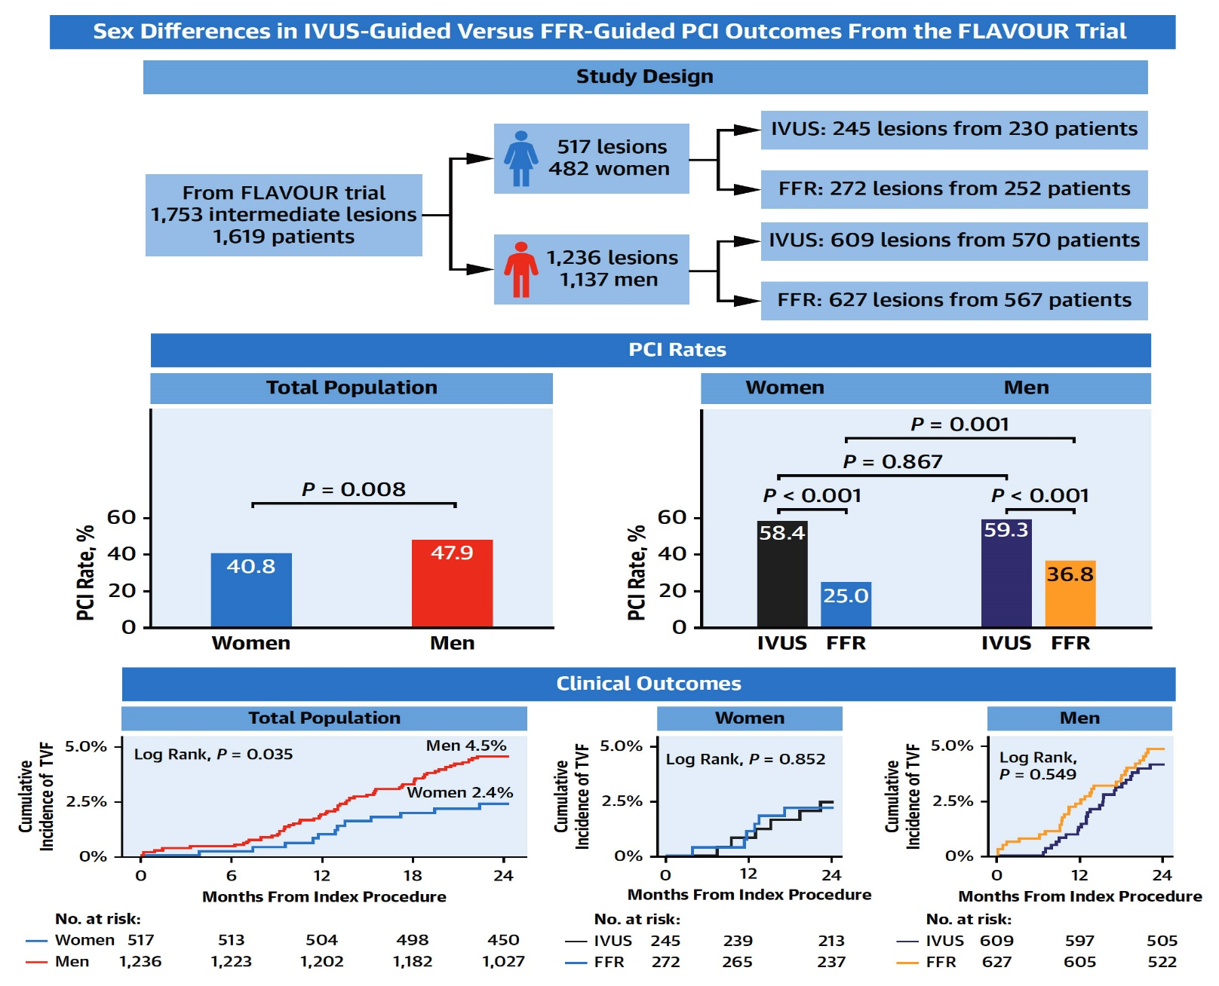
FLAVOUR Trial: Sex Impact on the Treatment
and Clinical Outcomes According to IVUS and FFR
Zhang et al., J Am Coll Cardiol Intv 2023;16:2426

Slide 41
FLAVOUR TRIAL
(Fractional Flow Reserve and Intravascular Ultrasound for Clinical Outcomes in Patients with Intermediate Stenosis)

Slide 42
Efficacy Study of Paclitaxel-eluting Balloon, -Stent vs. Plain Angioplasty for Drug-eluting Stent Restenosis (ISAR-DESIRE 3) Trial – Munich, Germany

Slide 43
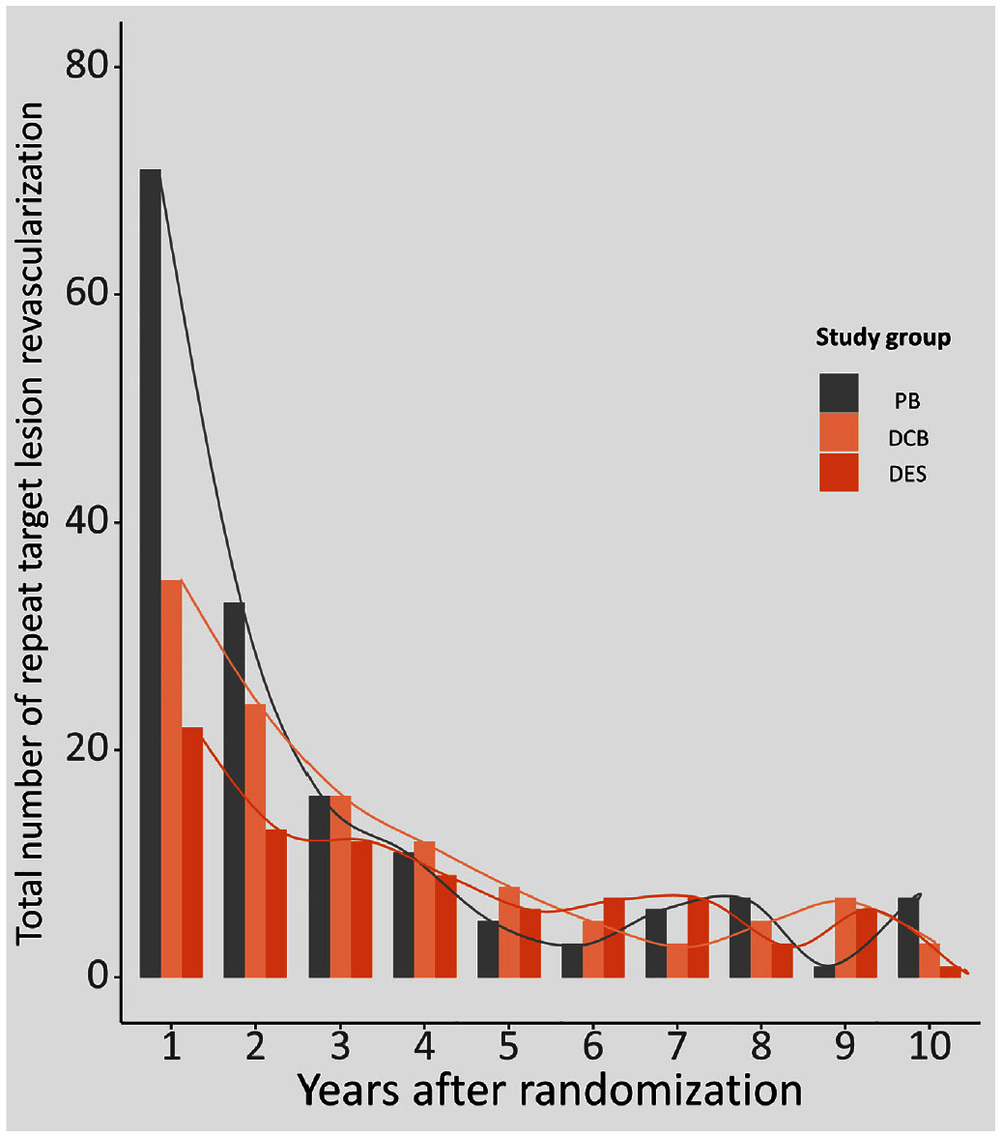
ISAR-DESIRE-3 Trial: Total Number of Repeat TLR According to Randomized Treatment Group at 10 Years
Numbers of R-TLRs initially declined over the years in all 3 groups
There was smaller rise and fall of event rates beyond 5 years
Events declined drastically in the PB group in the first 3 years; fewer events in the PB group
Events in DCB and DES groups declined less abruptly and more constantly over 10 years
Koch et al., J Am Coll Cardiovasc Intv 2024;17:1

Slide 44
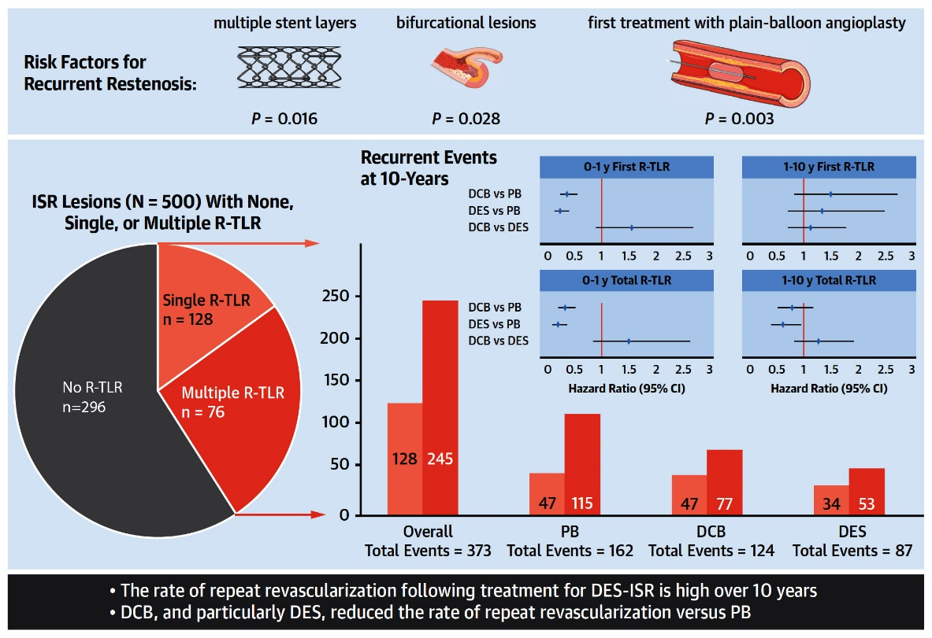
ISAR-DESIRE-3 Trial: Recurrent Revasc Events at 10 Yrs in 500 Lesions (402 pts) with DES ISR Randomized to PB, DCB, or DES
Koch et al., J Am Coll Cardiovasc Intv 2024;17:1

Slide 46
Latest Issues in Coronary Intervention
Recent Interventional Trials and Publications:
MINT Trial, COCOA Trial, FLAVOUR Trial- Sex
Impact, ISAR-DESIRE 3 Trial- 10Yrs
Focused review of the month
Benefits of PCI in Stable CAD on no antianginals:
A Placebo Controlled Trial of Percutaneous Coronary
Intervention for Stable Angina; ORBITA-2 Trial

Slide 47
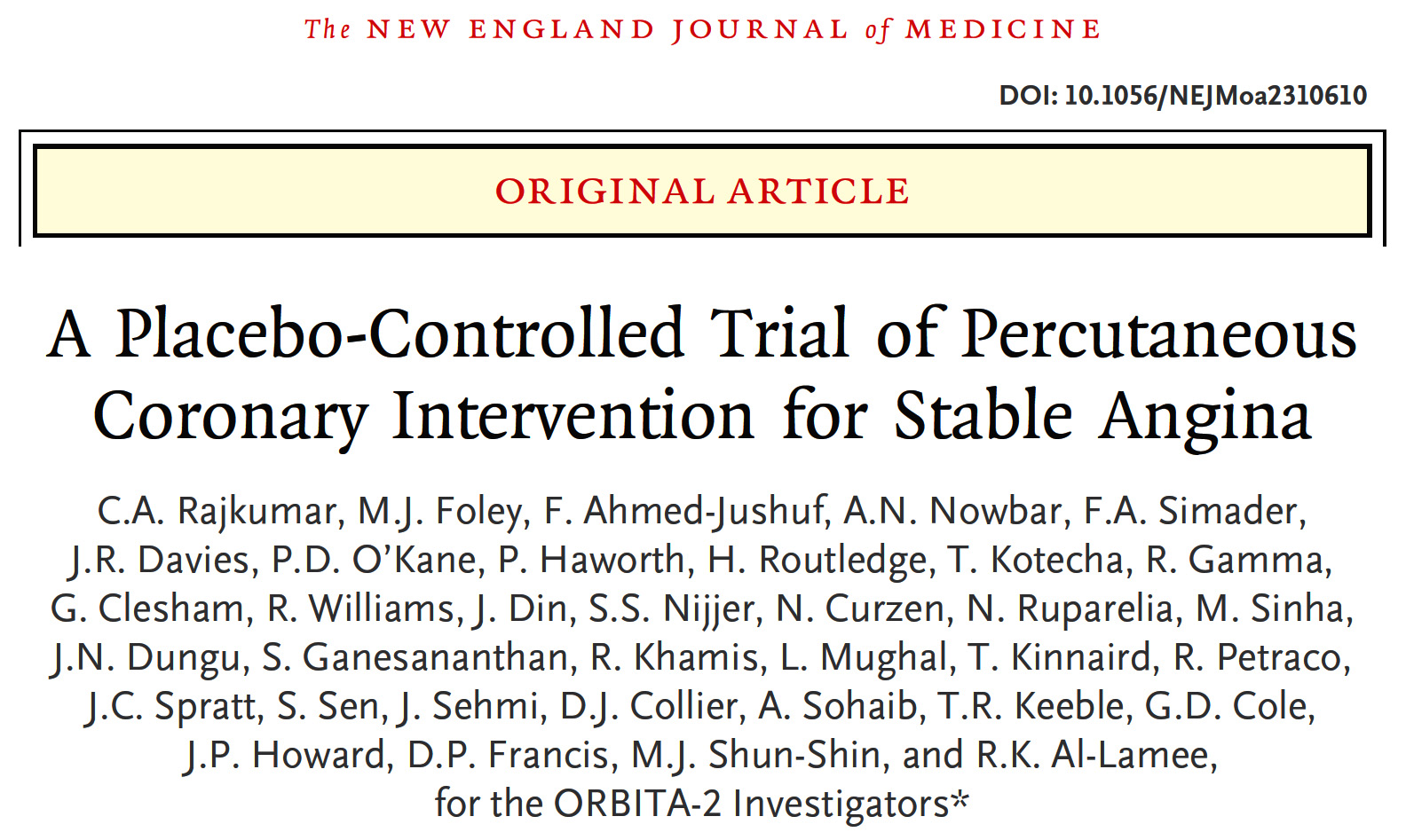
(Objective Randomized Blinded investigation with Optimal Medical Therapy of Angioplasty in Stable Angina) (UK)

Slide 48
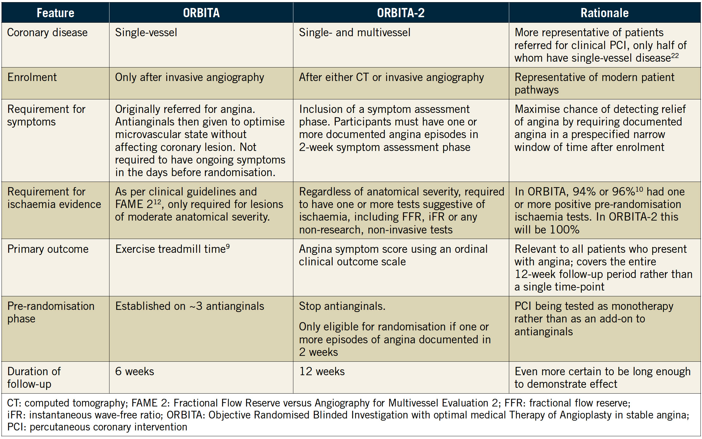
Comparison of Features Between ORBITA and ORBITA 2
Nowbar et al., EuroIntervention 2022;17:1490

Slide 49
ORBITA-2 Trial
Primary question
Does PCI, without antianginal medication, improve angina compared to placebo?

Slide 50
ORBITA-2 Trial
Inclusion criteria
Angina or angina equivalent symptoms
Severe coronary stenosis in ≥1 vessel
Evidence of ischemia: stress imaging or invasive physiology

Slide 51
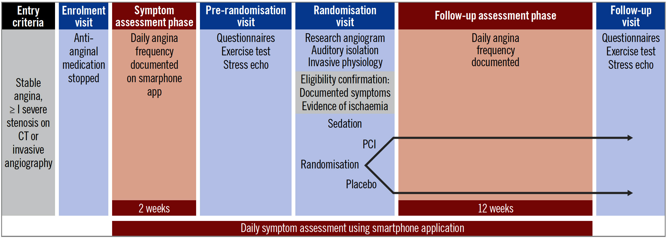
ORBITA 2 Trial Study Design
Nowbar et al., EuroIntervention 2022;17:1490

Slide 52
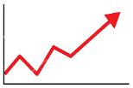
ORBITA-2 Trial: Primary Endpoint
Angina Symptom Score
Episodes of angina
Antianginal units
Unacceptable angina
ACS
Death
Daily angina symptom score by a dedicated Smartphone application
Rajkumar et al., N Engl J Med 2023;389:2319

Slide 53
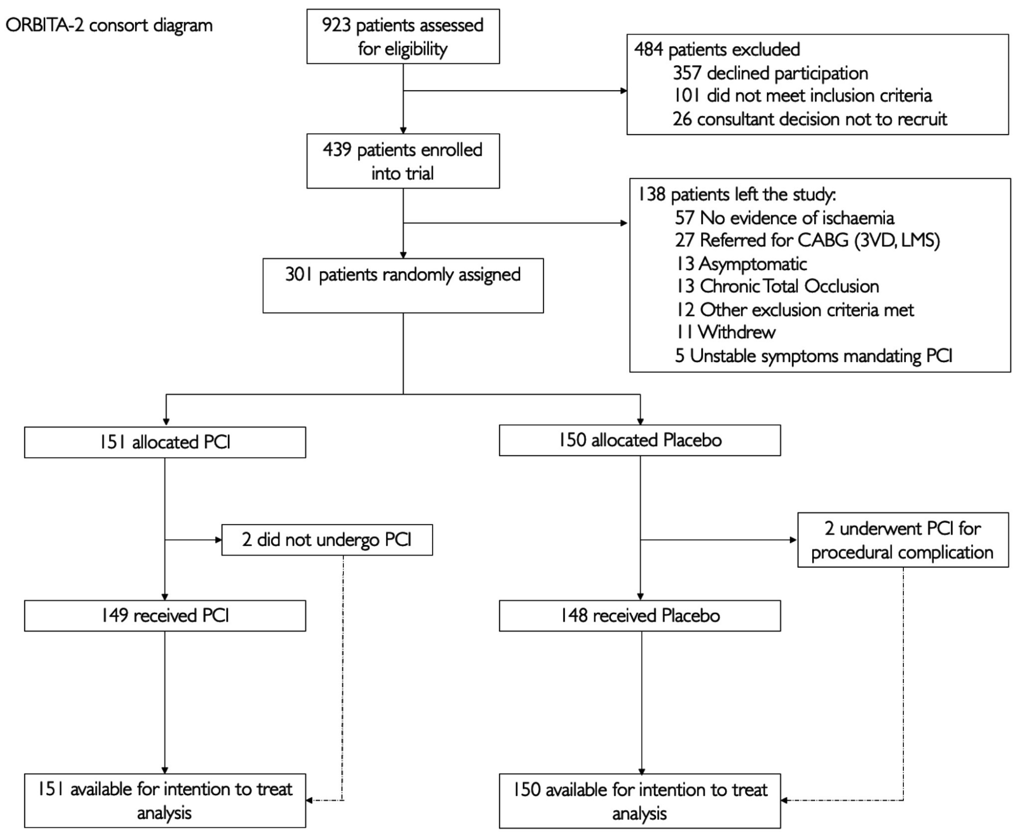
ORBITA-2 Trial Consort Diagram
Rajkumar et al., N Engl J Med 2023;389:2319

Slide 54
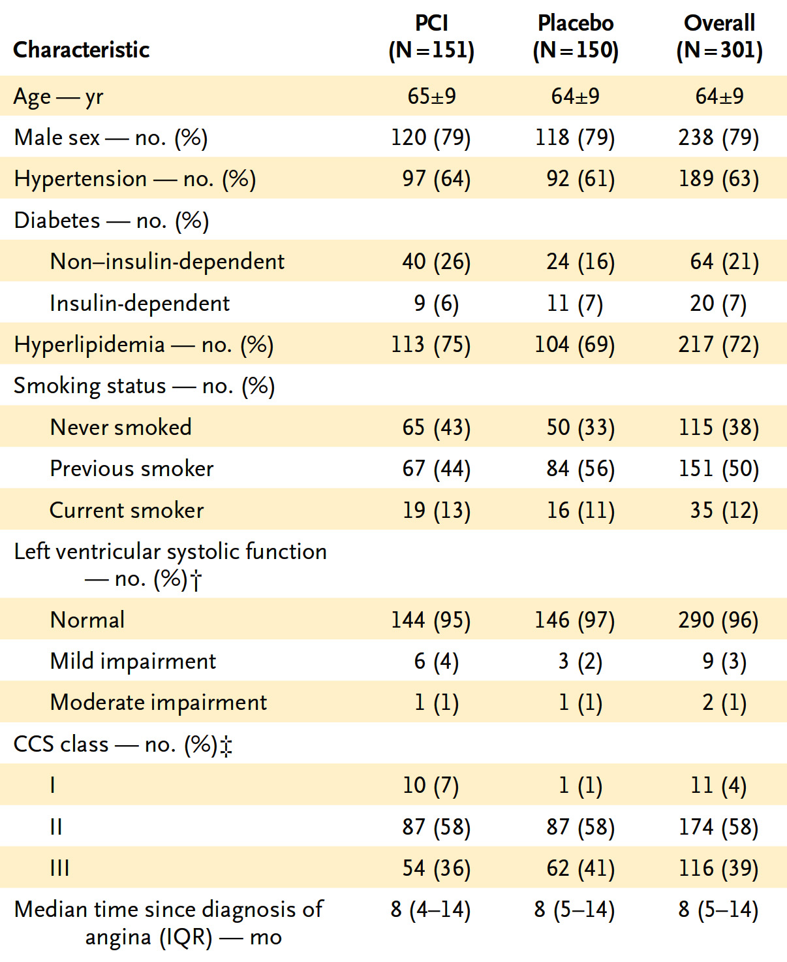
ORBITA-2 Trial: Demographic and Baseline Clinical Characteristics
Rajkumar et al., N Engl J Med 2023;389:2319

Slide 55
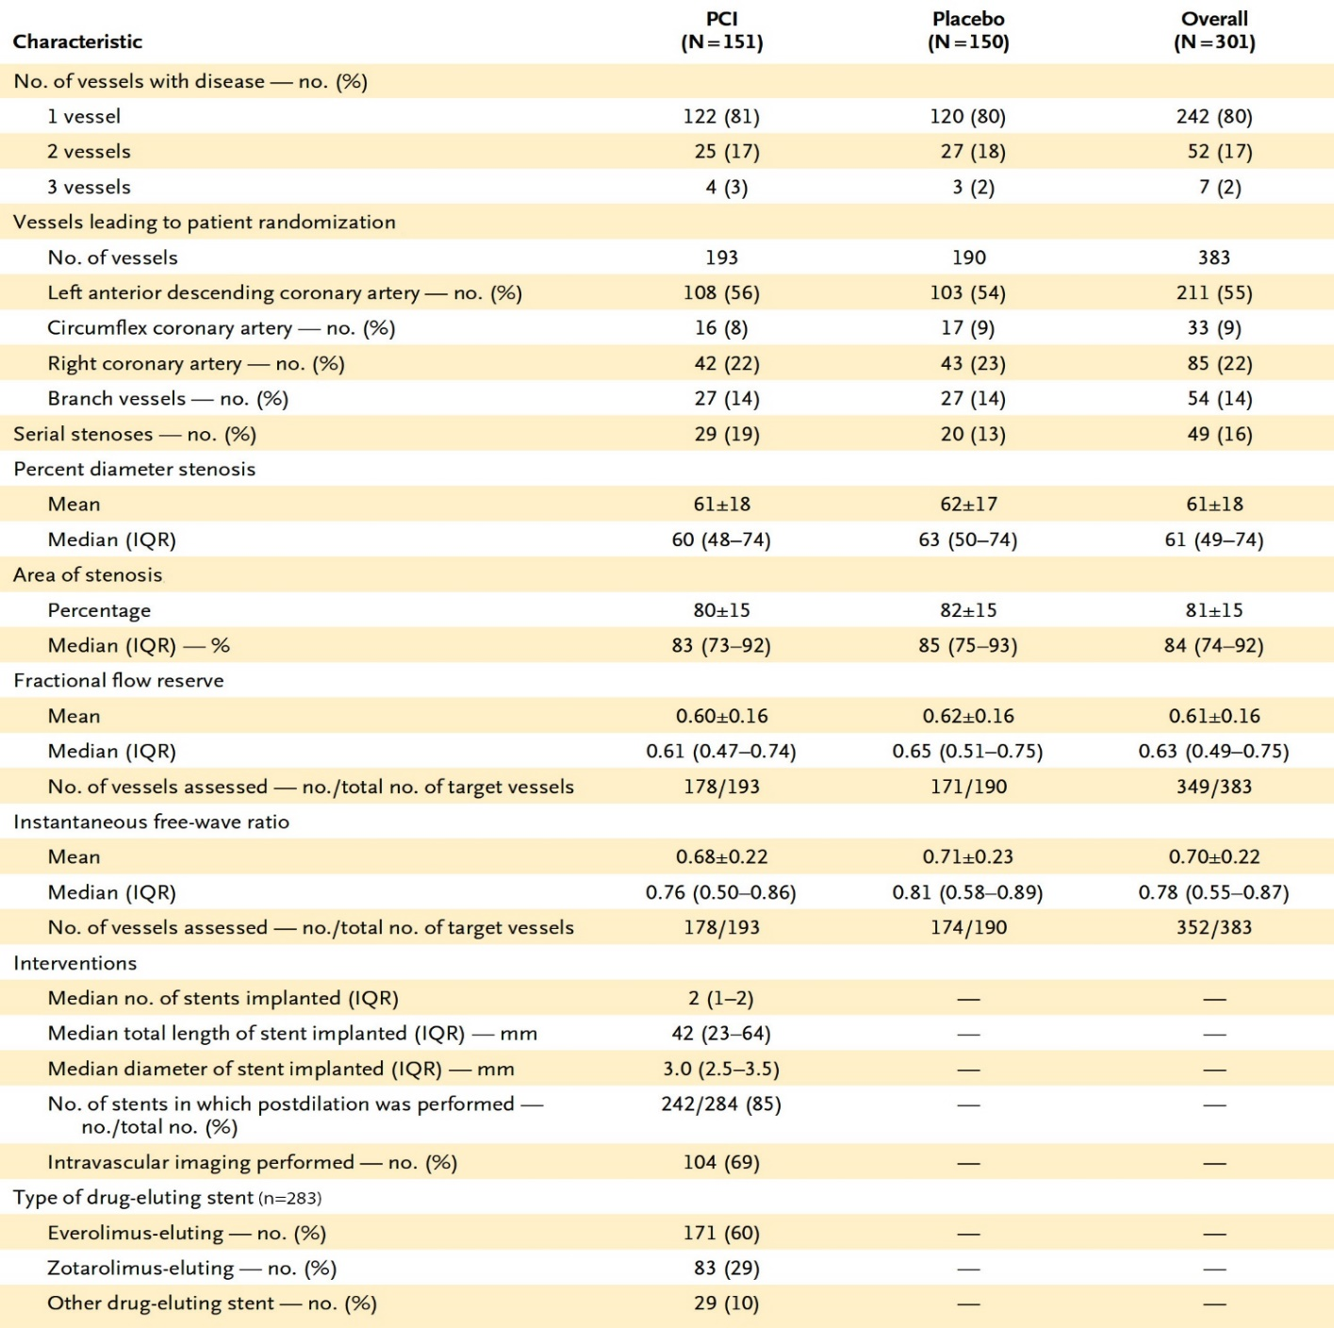
ORBITA-2 Trial: Procedural Characteristics
Radial-artery access used in 288 patients (96%)
Invasive physiological assessment performed in a median of 1 vessel per pt
Cardiac territories with ischemia were identified with use of pre-randomization invasive physiological assessment and pre-enrollment noninvasive functional testing; 80% had ischemia in 1 vessel; 17% in 2 vessels, and 2% in 3 vessels
Rajkumar et al., N Engl J Med 2023;389:2319

Slide 56
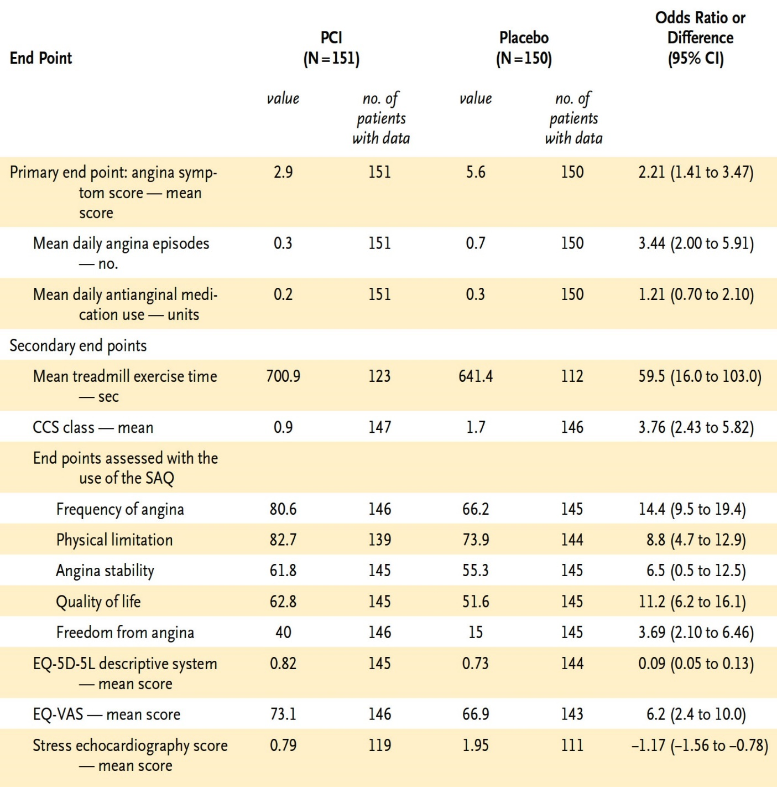
ORBITA-2 Trial: Primary and Secondary Endpoints
Data were available for 99.7% of the 22,823 patient-days in the study
At 12-week follow-up:
mean angina symptom, 2.9 in the PCI grp and 5.6 in placebo grp (OR: 2.21; 95% CI, 1.41 to 3.47; p<0.001
mean daily angina frequency, 0.3 episodes in PCI grp and 0.7 episodes in placebo grp (OR: 3.44, 95% CI, 2.0 to 5.91
mean daily antilingual medication, 0.2 units in the PCI grp and 0.3 units in the placebo grp (OR: 1.21; 95% CI, 0.70 to 2.10
SAQ used to assess scores for frequency of angina, physical limitation, angina stability QoL, and freedom from angina
QoL as assessed with EQ-5D-5L descriptive system and EQ-VAS visual analogue scale
p<0.001
Rajkumar et al., N Engl J Med 2023;389:2319

Slide 57
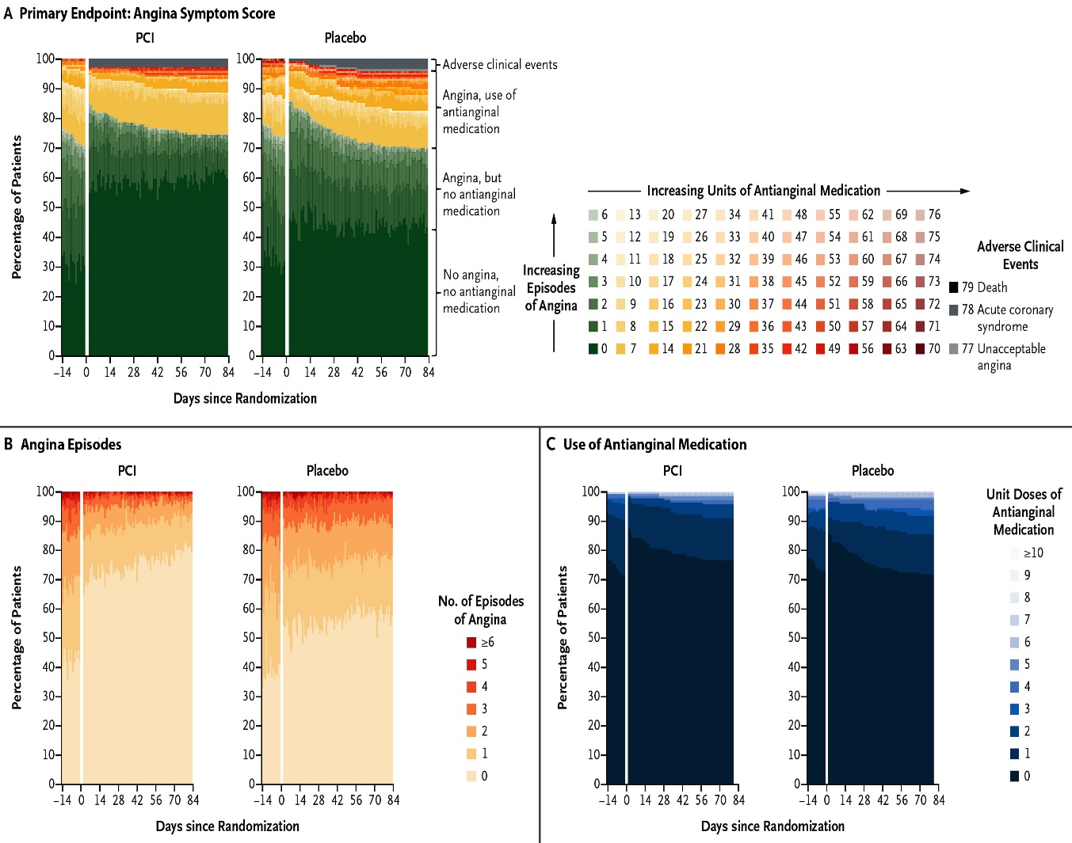
ORBITA-2 Trial: Primary Endpoint - Angina Symptom Score and Its Components at 12 Weeks Follow-Up
mean angina symptom score: PCI gp = 2.9; placebo gp = 5.6.
PCI improved angina symptom score (OR: 2.21 [95%CI: 1.41 to 3.47]), p<0.001
mean daily angina frequency: PCI gp = 0.3 episodes; placebo gp = 0.7
PCI improved angina frequency (OR: 3.44 [95% CI: 2.1 to 5.9])
mean daily use of antianginal medication: PCI gp = 0.2 units; placebo gp = 0.3 units
No difference in antianginal use (OR: 1.21 [95% CI: 0.70 to 2.10)
Angina symptom score
Rajkumar et al., N Engl J Med 2023;389:2319

Slide 58
ORBITA-2 Trial: Adverse Events @ 12Weeks
 | PCI | Placebo
Unacceptable angina Requiring un-blinding | 0 | 1
ACS | 4 | 6
Death | 0 | 0
Spontaneous MI (type 1) | 0 | 6
Major bleeding/CVA | 0/2 | 4/0
Periprocedual MI (type 4a) | 4 | 0
Rajkumar et al., N Engl J Med 2023;389:2319

Slide 59
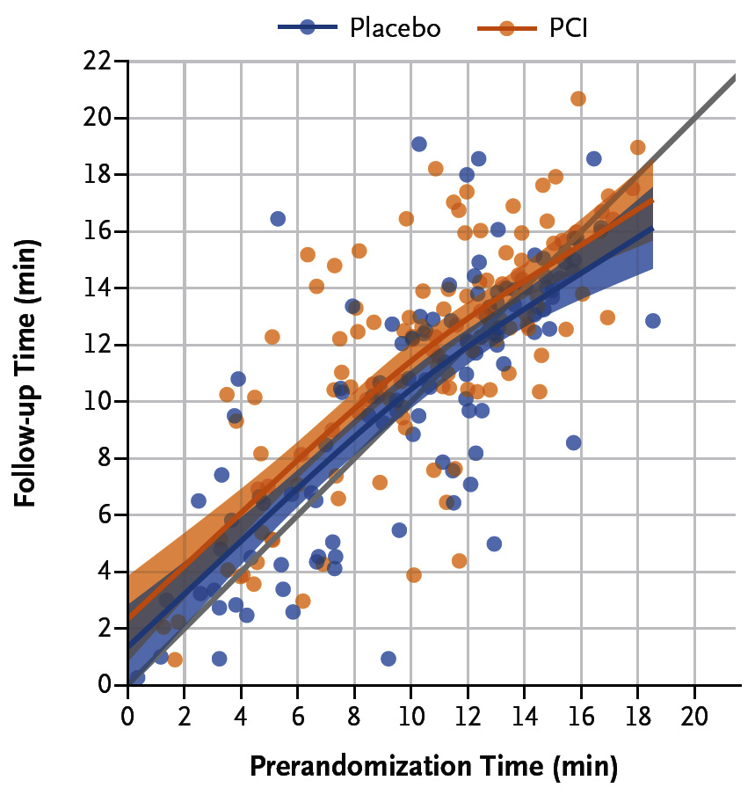
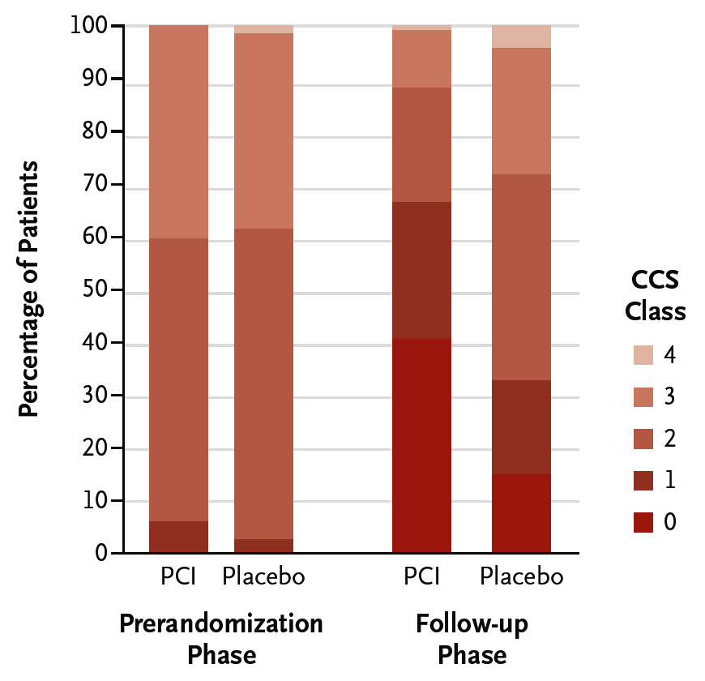
ORBITA-2 Trial: Secondary Endpoints
at 12 Weeks Follow-Up
Time on Treadmill Exercise Test @ 12Week
Distribution of CCS Angina Severity Class
OR: 3.76
(2.43-5.82)
p<0.001
Rajkumar et al., N Engl J Med 2023;389:2319

Slide 60
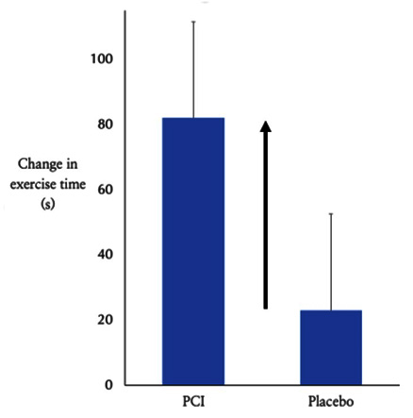
ORBITA-2 Trial: PCI Improved Modified Bruce Exercise Test
+59.5 sec
(16 to 113)
p=0.008
Rajkumar et al., N Engl J Med 2023;389:2319

Slide 61
ORBITA-2 Trial: Secondary Endpoints
at 12 Weeks Follow-Up
Secondary Endpoint | Analysis of Covariance Odds ratio (95% CI) | P Value
SAQ angina frequency | 14.4 (95 to 19.4) | <0.001
SAQ physical limitation | 8.8 (4.7 to 12.9) | <0.001
SAQ angina stability | 6.5 (0.5 to 12.5) | 0.03
SAQ quality of life | 11.2 (6.2 to 16.1) | <0.001
SAQ freedom from angina* | 3.99 (2.28 to 7.0) | <0.001
EQ – 5D descriptive system | 0.09 (0.05 to 0.13) | <0.001
EQ – visual analogue scale | 6.2 (2.4 to 10.0) | 0.002
Stress echocardiography score | -117 (-1.55 to -0.78) | <0.001
*SAQ angina frequency = 100
Rajkumar et al., N Engl J Med 2023;389:2319

Slide 63
ORBITA-2 Trial
Strengths
Limitations
Placebo/sham-controlled
Double-blinded post-PCI
Novel angina scoring system developed with patient input
Daily angina log leveraging mobile app
99.7% complete data
Consistency of effect across endpoints
Population mainly male, race/ethnicity unreported, mostly CCS II
80% single vessel dx
Primary endpoint-angina symptom score – not validated in any other trial
Short-term follow-up
Not powered for clinical outcomes
Rajkumar et al., N Engl J Med 2023;389:2319

Slide 64
ORBITA vs ORBITA-2 Trial
 | ORBITA | ORBITA-2
Coronary disease | Single vessel only | Single and multivessel disease
Ischemia evidence | Guideline-directed, only required for moderate severity lesions | Mandatory for all stenoses regardless of severity
Primary endpoint | Treadmill exercise time | Angina symptom score
Duration of follow-up | 6 weeks | 12 weeks
Antianginal medication | Guideline-directed antianginal medication (mean 3 at randomization) | Without antianginal medication
Rajkumar et al., N Engl J Med 2023;389:2319

Slide 65
ORBITA vs ORBITA-2 Trial
 | ORBITA | ORBITA-2
Coronary disease | Single vessel only | Single and multivessel disease
Ischemia evidence | Guideline-directed, only required for moderate severity lesions | Mandatory for all stenoses regardless of severity
Primary endpoint | Treadmill exercise time +16.6sec over in PCI gp | Angina symptom score 2.9 in PCI vs 5.6 placebo
Duration of follow-up | 6 weeks | 12 weeks
Antianginal medication | Guideline-directed antianginal medication (mean 3 at randomization) | Without antianginal medication
Rajkumar et al., N Engl J Med 2023;389:2319

Slide 67
New Paradigm in Management of Stable CAD
Initial Maximal Medical Therapy → PCI only if refractory symptoms or side effects
Post-ORBITA 2 Trial
Stable CAD
Management
?Cost, Resource Utilization, Capacity
Initial PCI → Medical Therapy only if symptomatic

Slide 68
Take Home Message: Recent Interventional Trials/Publications and Placebo Controlled Trial of PCI in Stable Angina
OCT guided vs Angio guided PCI for stent optimization:
Liberal over restrictive transfusion strategy in MI & anemia:
Outcomes of women over men after IVUS and FFR:
PBA over DCB or DES treatment strategy for DES ISR:
Second placebo controlled trial of PCI, ORBITA-2 compared PCI vs no antianginal MT revealed lower antianginal episodes & anginal symptoms, higher treadmill exercise duration but no difference in the antianginal use. These short term benefit of PCI at 12 weeks may results in better long-term outcomes after PCI in stable angina pts, establishing its validity in stable CAD. Also numerically higher MI occurrence in the placebo gp just @3M may adversely result in poor long-term outcomes.
Notes:
HbA1c in

Slide 69
Question # 1
Following statement is false regarding the results of the COCOA trial comparing OCT guided vs angio guided PCI;
Larger MSA in OCT gp vs angio gp
Better stent expansion in OCT gp vs angio gp
Lower contrast use in OCT gp vs angio gp
Lower stent mal-apposition in OCT gp vs angio gp
Higher post dilatation in OCT gp vs angio gp
The correct answer is C

Slide 70
Question # 2
Following statements are correct regarding the PCI outcomes in women vs men in the FLAVOUR trial comparing IVUS with FFR, except;
A. Overall lower PCI rate in women vs men
B. Lower PCI rate in FFR gp vs IVUS gp in women
C. Lower death and MI rates in women vs men
D. Similar TVF rates with FFR vs IVUS in women
E. Similar overall TVF in women vs men
The correct answer is E
Notes:
er

Slide 71
Question # 3
Following statement is false regarding the results of the ORBITA-2 trial comparing PCI vs placebo;
A. Lower angina symptoms in PCI gp vs placebo gp
B. Lower antianginal use in PCI gp vs placebo gp
C. Lower mean daily angina episodes in PCI gp vs placebo gp
D. Longer exercise treadmill duration time in PCI gp vs placebo gp
E. Numerical higher spontaneous MI in placebo gp vs PCI gp
The correct answer is B
Notes:
er

Slide 72
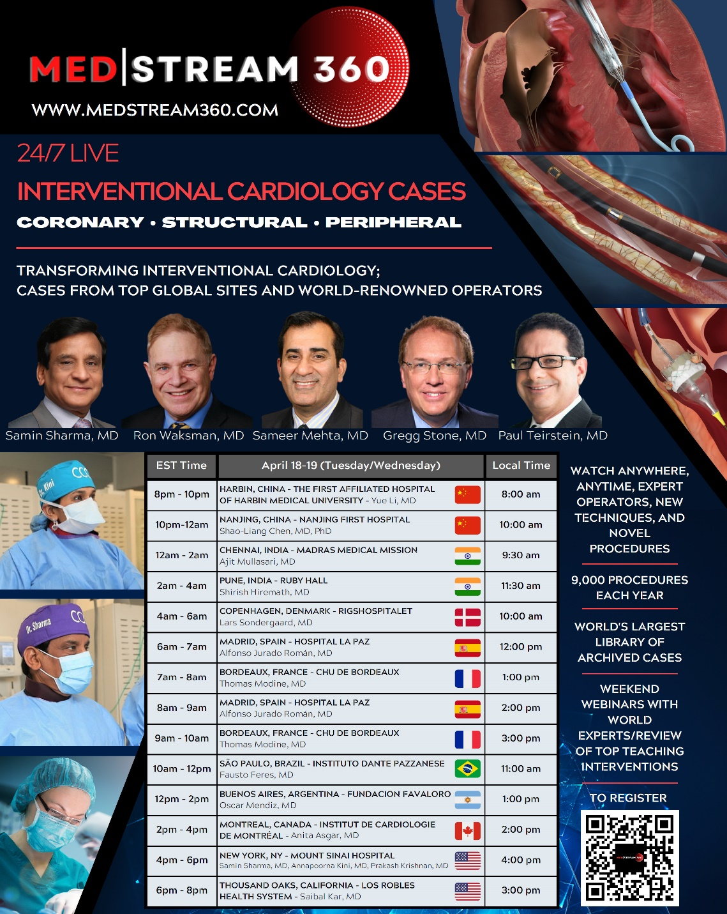
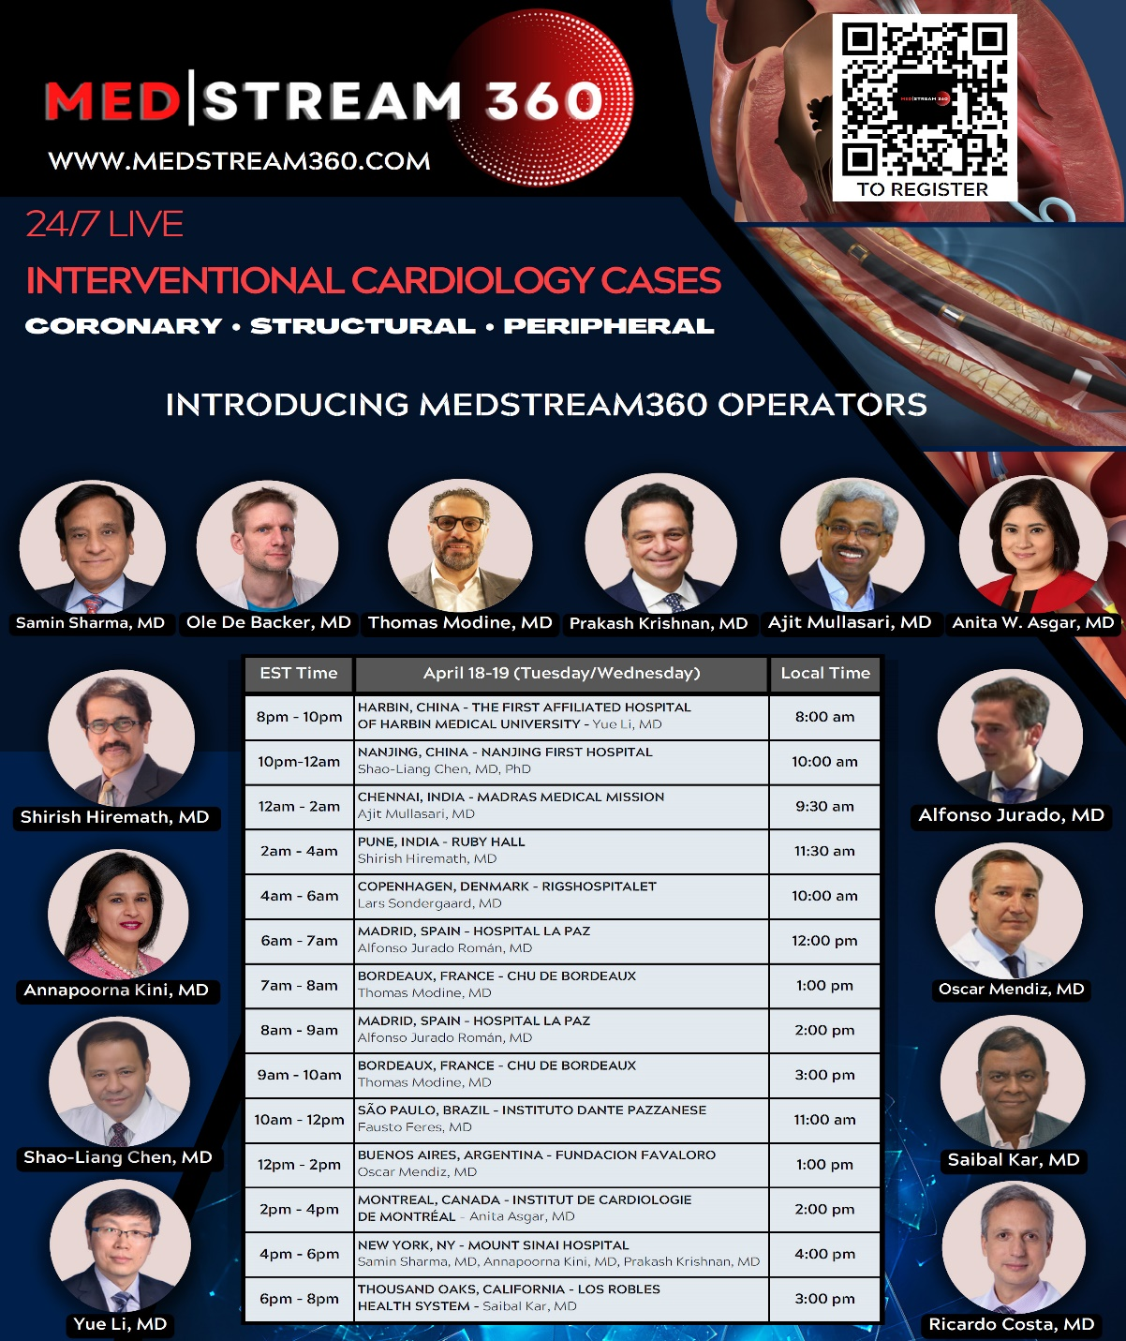

Slide 73
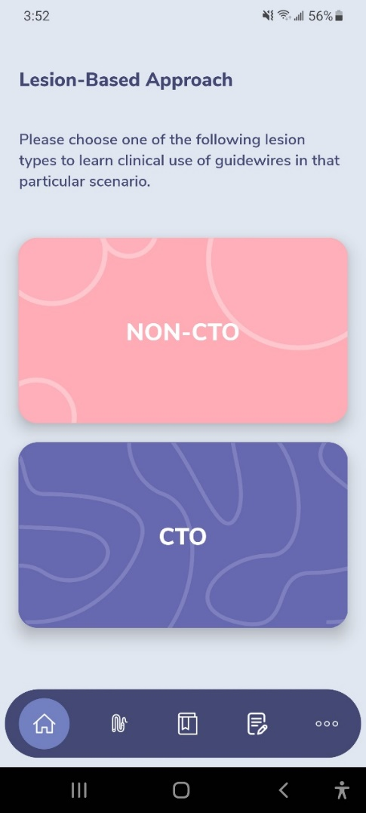
GuidewireAID – Out on both Android and iOS!
Apple ® and App Store® are registered trademarks of Apple Inc.
Download for Free!

Slide 74
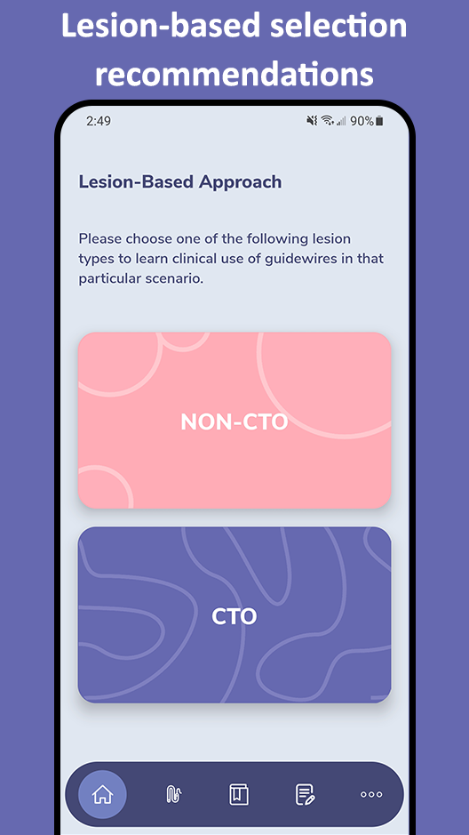
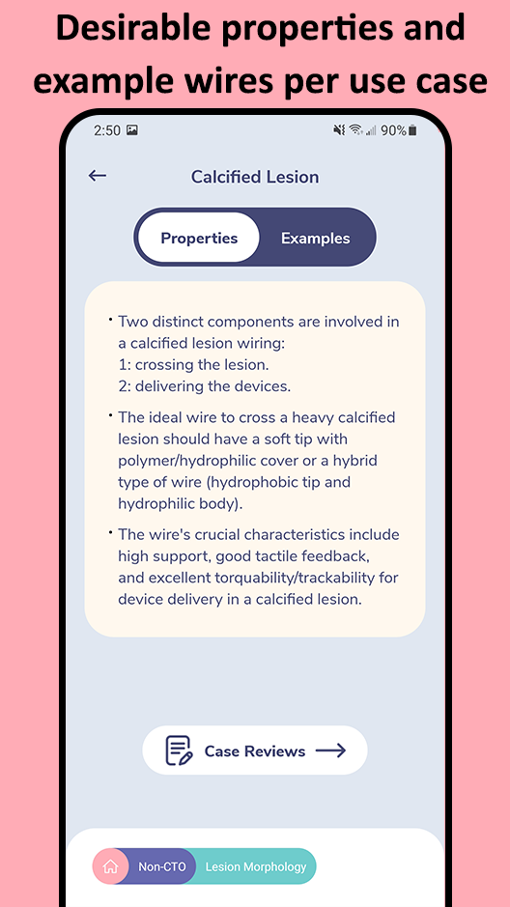
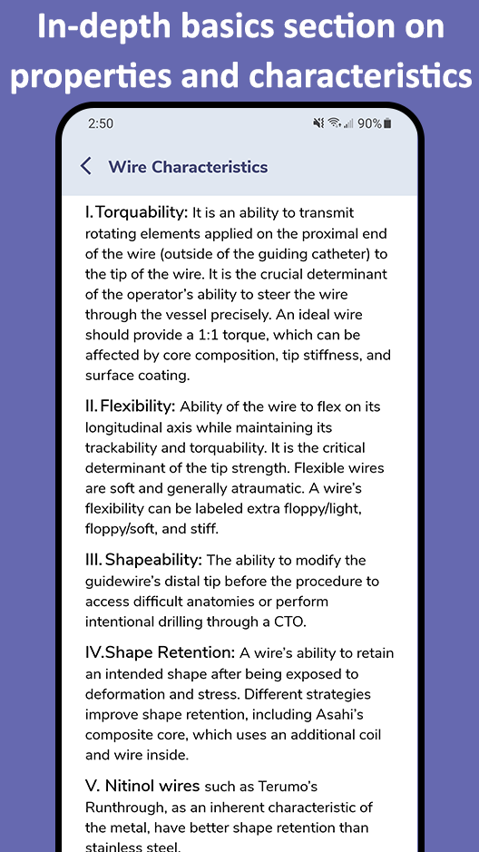
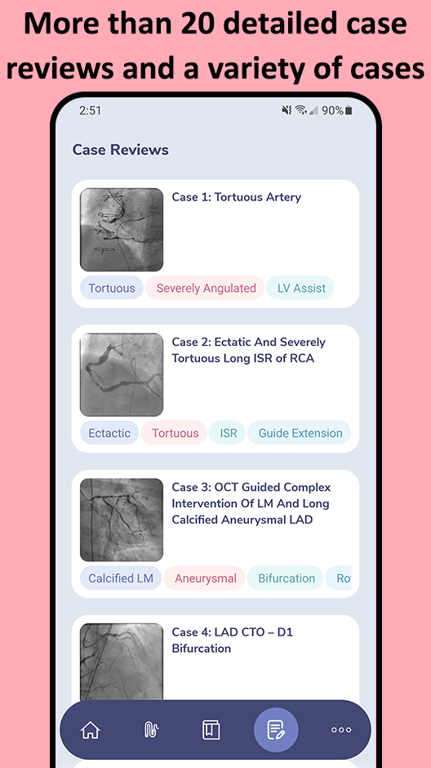
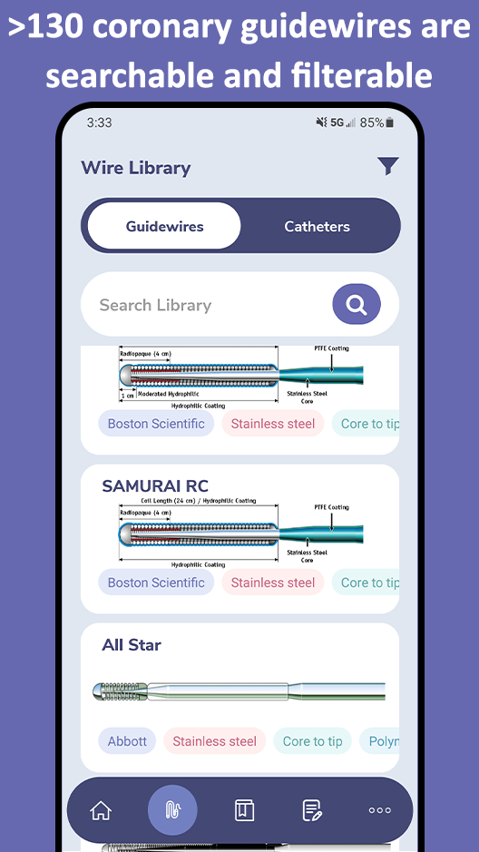
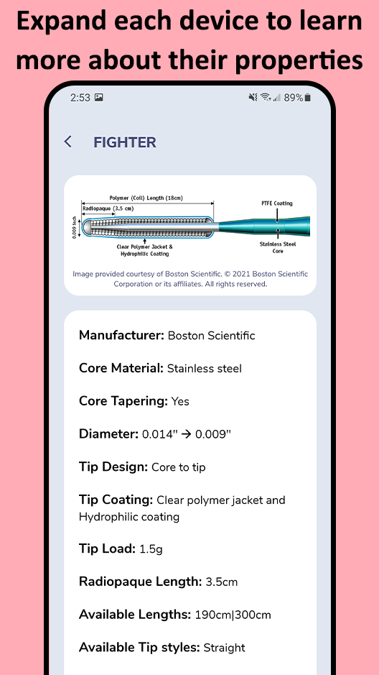
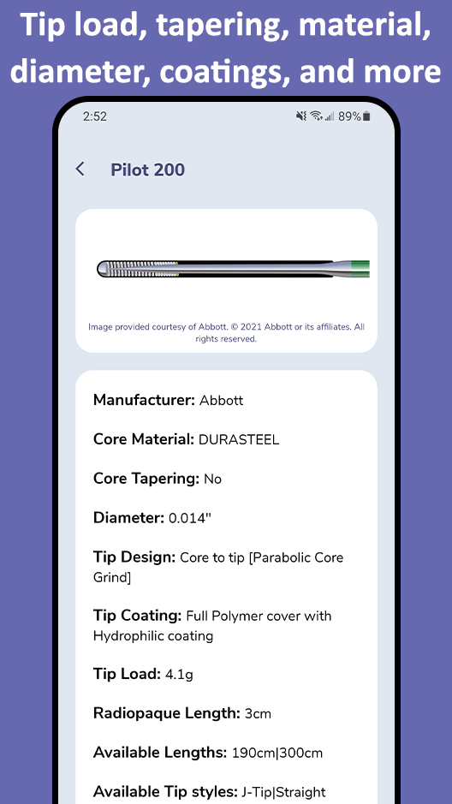
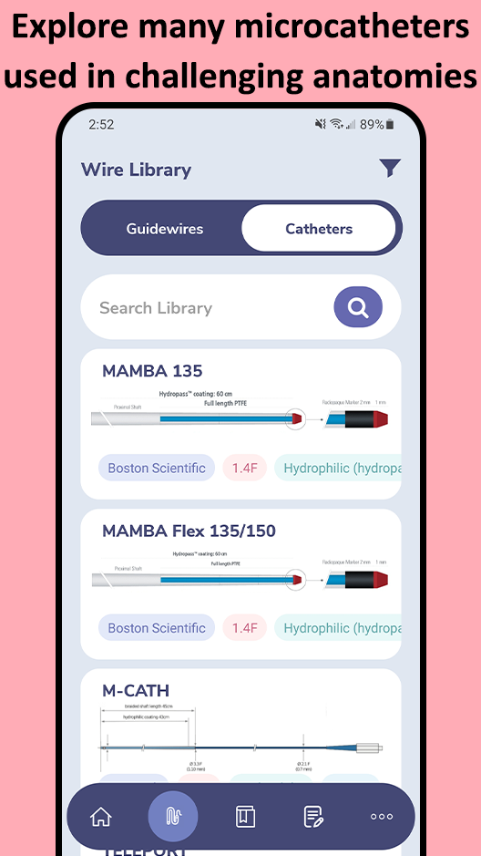
In addition to the web app at www.CardiologyApps.com/GuidewireAID, the iOS and Android mobile app is out now to download for free!

Slide 75
Abbott’s Pilot Family

Slide 76
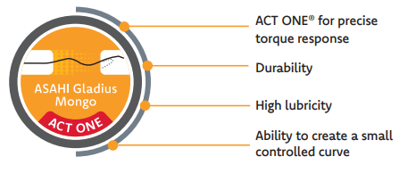
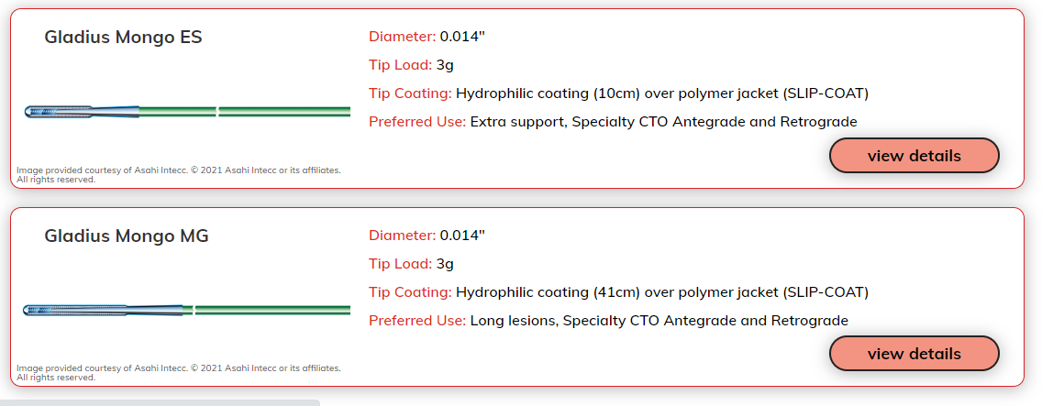
Gladius Mongo MG/ES

Slide 77
Gladius Mongo MG/ES

Slide 78
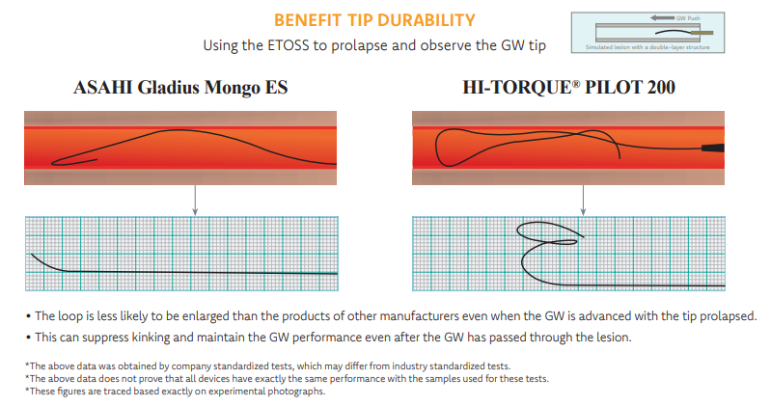
Gladius Mongo MG/ES

Slide 79
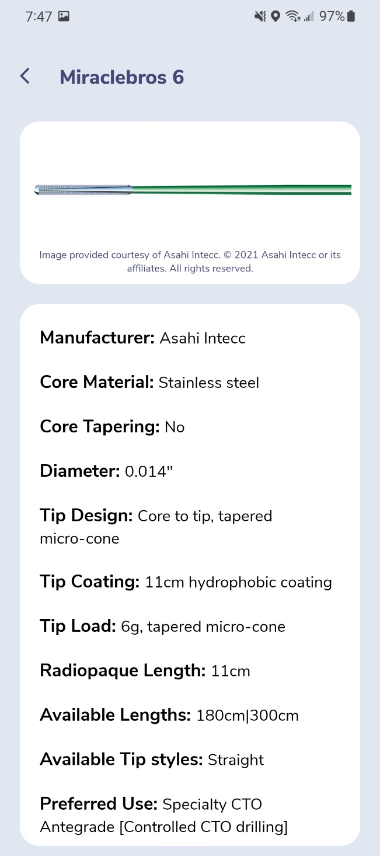
MirableBros 6

Slide 80
Gladius Mongo MG/ES

Slide 81
GuidewireAID – Our common CTO MicroCatheters

Slide 82
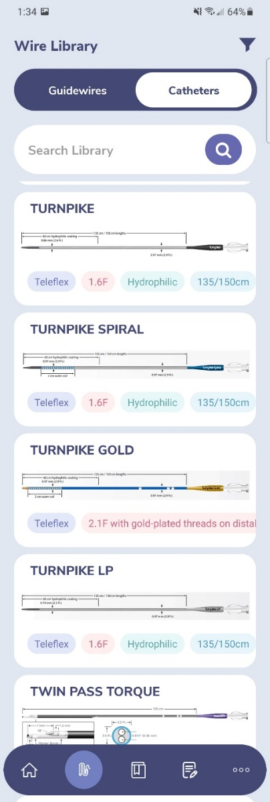
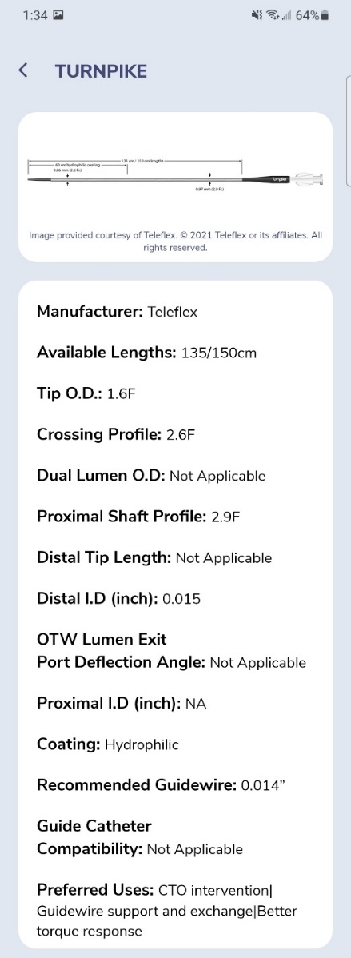
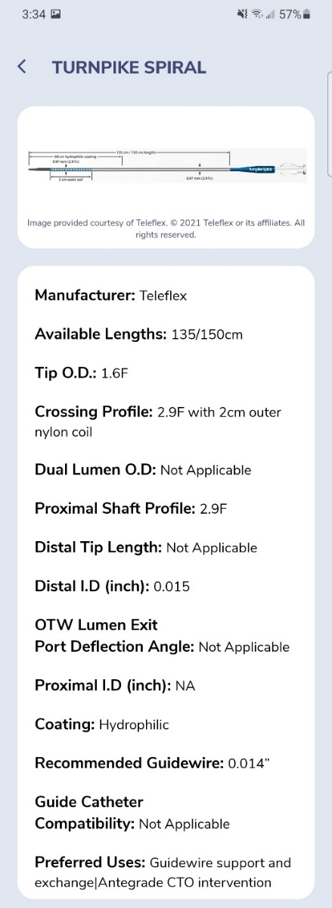
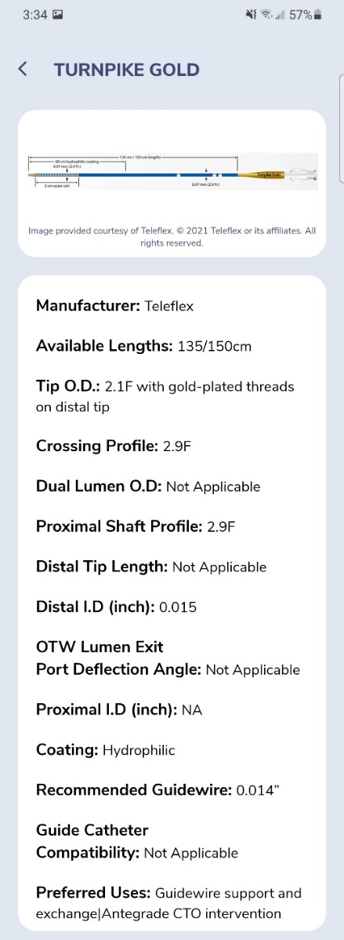
GuidewireAID – Our common CTO Microcatheters

