Slide 1
Complex Coronary Cases Supported by:
Boston Scientific Corp.
Abbott-CSI Inc.
Shockwave Medical Inc.
Terumo Vascular Corp.
Johnson & Johnson-Abiomed Inc.
Chiesi Inc.
Haemonetics-Cardiva Inc.
Acist Medical System.

Slide 2
Disclosures
Samin K. Sharma, MD, MSCAI, FACC
Nothing to disclose
Annapoorna S. Kini, MD, MRCP, FACC
Nothing to disclose
Sameer Mehta, MD, FACC (Moderator)
Nothing to disclose

Slide 3
CCC Live Case # 174
Patient Demographics
72 yrs, Male s/p CABG 2013
Present Clinical Presentation
Presented with DOE/intermittent chest pains and a +stress MPI for antero-septal, lateral and apical ischemia
CAD Risk Factors
Controlled hypertension
H/o cardiac arrest 2013, s/p AICD
SAQ-7 score: 62, Asthma
Clinical Variables
Echo with 58% EF and no valvular disease
Medications
Aspirin, Amlodipine, Metoprolol XL, Rosuvastatin, Inhalers
Cath: Cardiac cath on 11/6/2023 revealed severely calcified 3 V CAD; multiple calcified lesions in tortuous LAD, 100% LCx-OM1 with patent LIMA, 100% mid RCA with patent SVG & LVEF 60%. PCI was deferred due to insurance approval.

Slide 4
Native LAD
Prox LAD – 80% occluded
Distal – 90% occluded

Slide 5
Native LAD
Prox LAD – 80% occluded
Distal – 90% occluded

Slide 6
LV Gram

Slide 7
Native RCA Total Occlusion

Slide 8
Patent SVG to RCA RPDA

Slide 9
Patent LIMA to LCx OM1

Slide 10
Patent LIMA to LCx OM1

Slide 11
CCC Live Case # 174
Patient Demographics
72 yrs, Male s/p CABG 2013
Present Clinical Presentation
Presented with DOE/intermittent chest pains and a +stress MPI for antero-septal, lateral and apical ischemia
CAD Risk Factors
Controlled hypertension
H/o cardiac arrest 2013, s/p AICD
SAQ-7 score: 62, Asthma
Clinical Variables
Echo with 58% EF and no valvular disease
Medications
Aspirin, Amlodipine, Metoprolol XL, Rosuvastatin, Inhalers
Cath: Cardiac cath on 11/6/2023 revealed severely calcified 3 V CAD; multiple calcified lesions in tortuous LAD, 100% LCx-OM1 with patent LIMA, 100% mid RCA with patent SVG & LVEF 60%. PCI was deferred due to insurance approval.
Plan: Now planned for PCI of extremely tortuous calcified LAD lesions using rotational atherectomy & multiple DES and IVUS optimization.

Slide 12
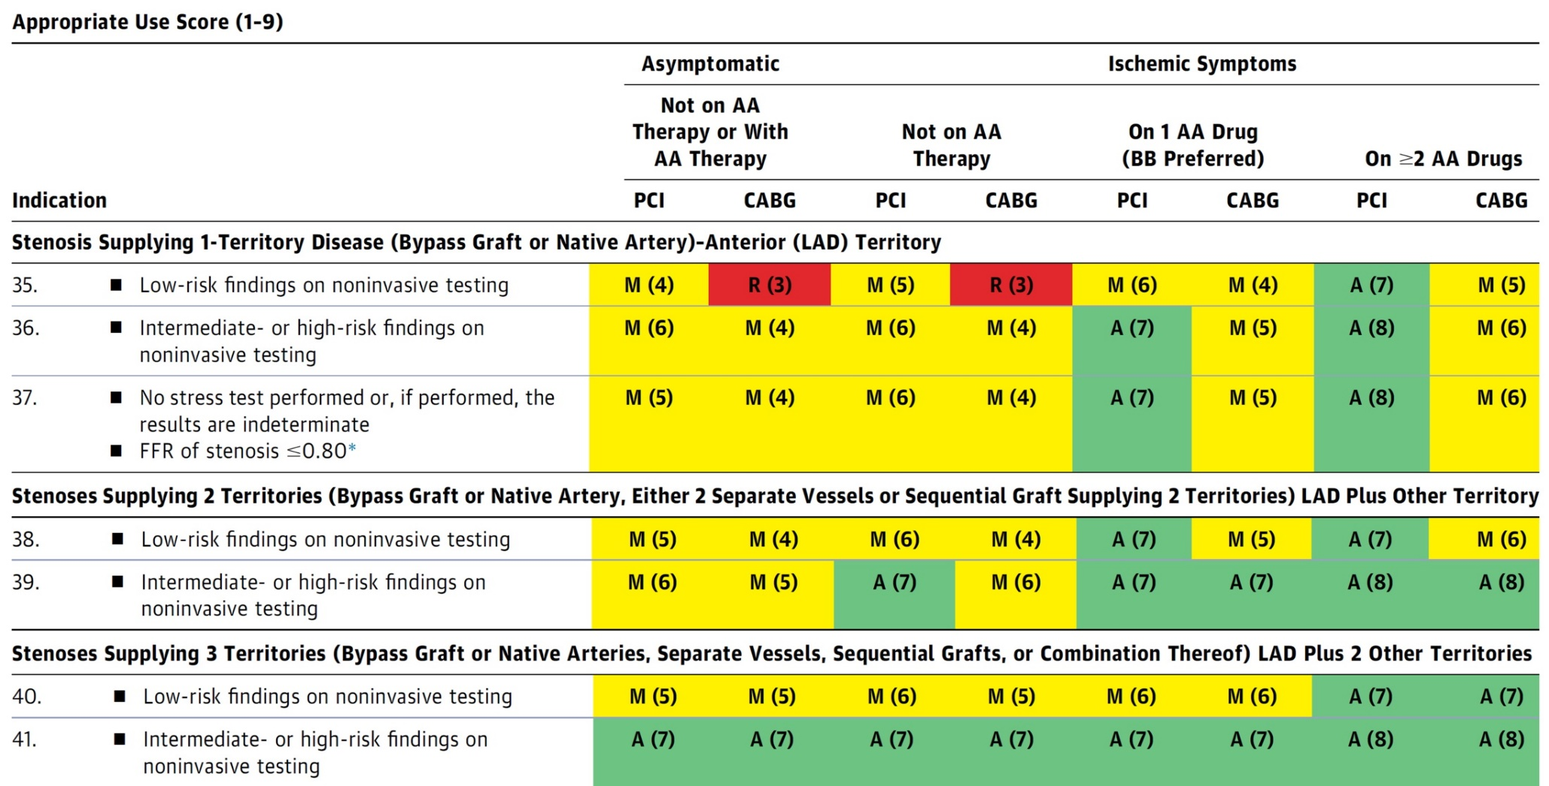
AUC 2017: IMA to LAD Not Patent
Patel et al., J Am Coll Cardiol 2017;69:2212

Slide 13
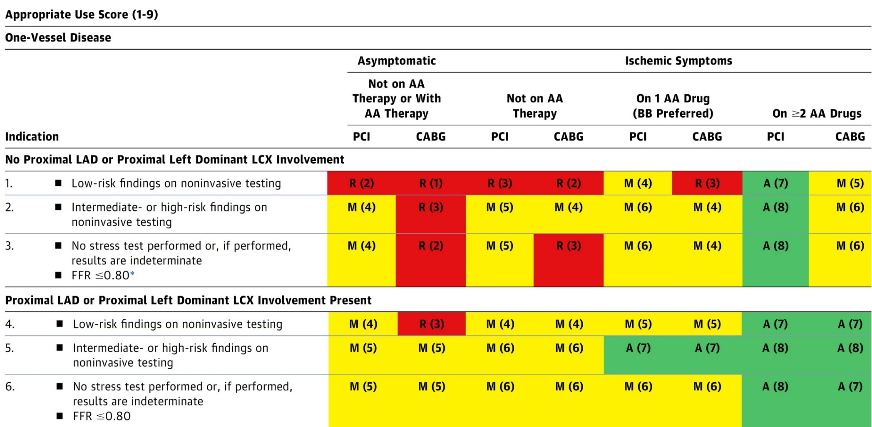
AUC 2017: One-Vessel Disease
Patel et al., J Am Coll Cardiol 2017;69:2212

Slide 14
Latest Issues in Coronary Intervention
Recent Interventional Publications on Ca++ management:
Prep-Calc-Combo study, ROTACUT vs COPS
trials comparison, ISR lumen expansion with IVL,
RotaScore for bailout Rota use
Focused review of the month
Rotational vs Orbital Atherectomy Comparison:
Direct Comparison of Rotational vs Orbital Atherectomy
for Calcified Lesions Guided by OCT: DIRO TRIAL

Slide 15
Latest Issues in Coronary Intervention
Recent Interventional Publications on Ca++ management:
Prep-Calc-Combo study, ROTACUT vs COPS
trials comparison, ISR lumen expansion with IVL,
RotaScore for bailout Rota use
Focused review of the month
Rotational vs Orbital Atherectomy Comparison:
Direct Comparison of Rotational vs Orbital Atherectomy
for Calcified Lesions Guided by OCT: DIRO TRIAL

Slide 16
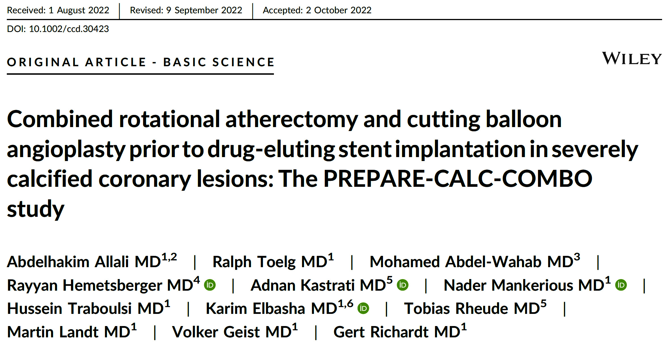

Slide 17
PREPARE-CALC-COMBO Study Flowchart
110 symptomatic patients with severely calcified CAD amendable to PCI
Inclusion criteria:
Age above 18 years and consentable
Angiographically proven CAD
Anginal symptoms and/or reproducible ischemia
De-novo lesion in a native coronary artery
Target reference vessel diameter 2.25 and 4.0 mm
Luminal diameter reduction of 50-100%
Severe calcification of the target lesion
Exclusion criteria:
Myocardial infarction (within 1 week)
Decompensated heart failure
Limited long term prognosis due to other conditions
Target lesion is in a coronary artery bypass graft
Target lesions is an in-stent restenosis
Target vessel thrombus
Informed consent
Rota-Cut lesion preparation + Orsiro SES
OCT at the end of the procedure
Angiographic endpoint: OCT endpoint:
- in-stent ALG - Stent expansion
Reangio: Clinical follow-up:
9 months (LLL) in-hospital, 9 months, 1 and 2 years
Allali et al., Catheter Cardiovasc Interv 2022;100:979

Slide 18
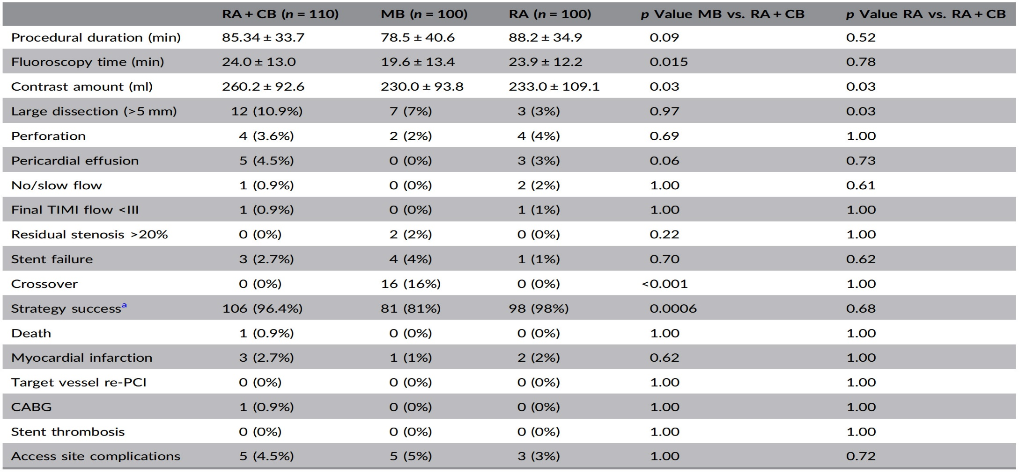
PREPARE-CALC-COMBO Study:
Procedural and In-Hospital Outcome
Strategy success was achieved in 96.4% cases
Large coronary dissections occurred in 10.9% of pts (vs. 7%, p=0.97 with MB vs. 3%, p=0.003 with RA)
Coronary perforation, pericardial effusion and no/slow flow phenomena were not significantly different between PREPARE-CALC-COMBO grp and the PREPAREP-CALC treatment arms
Allali et al., Catheter Cardiovasc Interv 2022;100:979

Slide 19
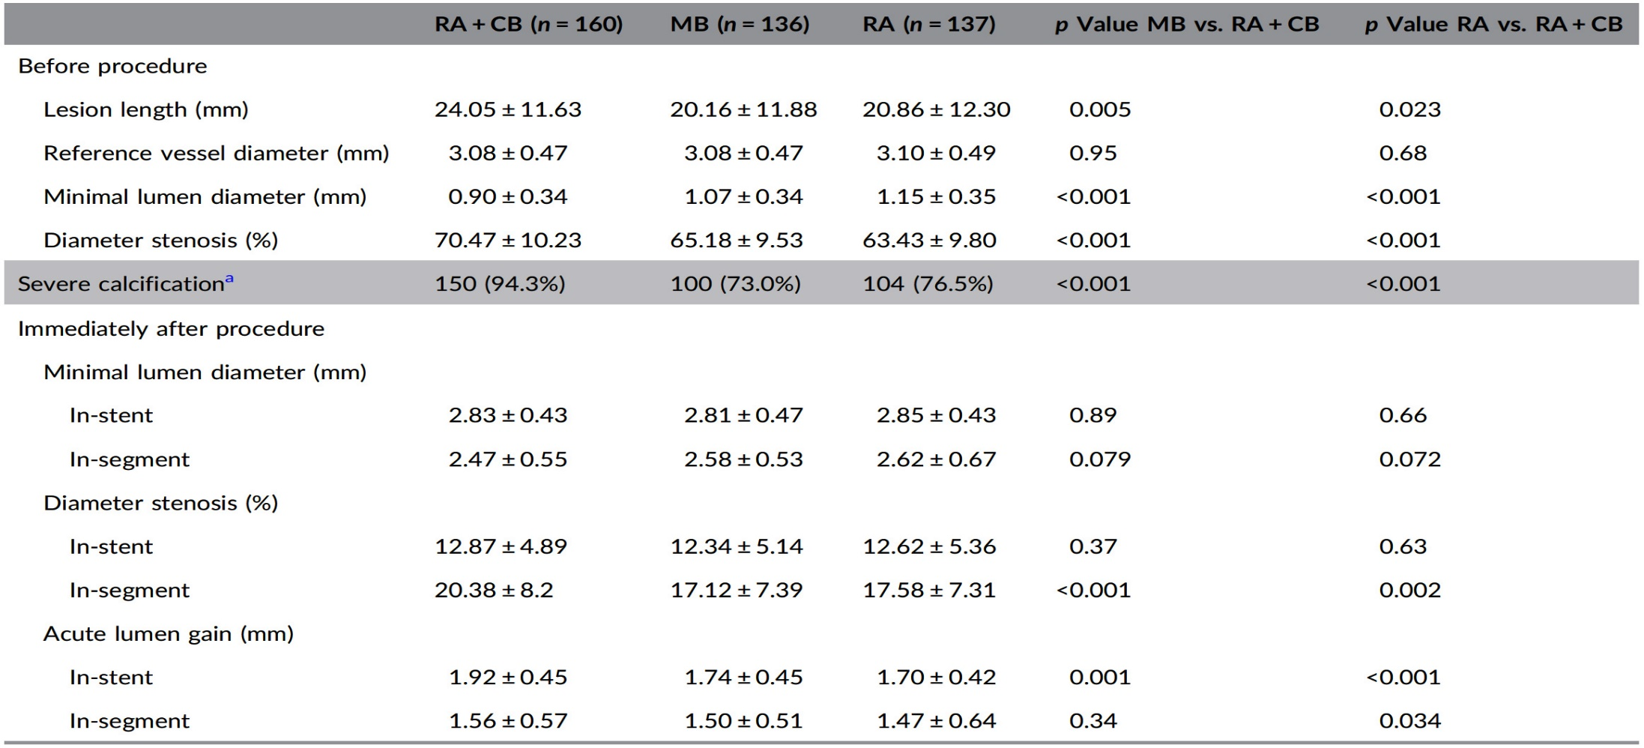
PREPARE-CALC-COMBO Study:
Baseline and Procedural QCA Data
In PREPARE-CALC-COMBO, treated lesions were longer (24.05 ± 11.63 mm vs 20.16± mm in MB grp; p=0.005 and 20.86±12.30 mm in RA grp; p=0.023)
Higher diameter stenosis (Rota-Cut: 70.47 ± 10.23% vs MB: 65.18 ± 9.53% and vs RA: 63.43 ± 9.80; p<0.001)
6.7% moderately calcified lesions with significant difference compared to both control arms of the PREPARE-CALC trial (27% with moderate calcification in MB grp and 23.5% in RA grp, both p<0.001)
Allali et al., Catheter Cardiovasc Interv 2022;100:979

Slide 20
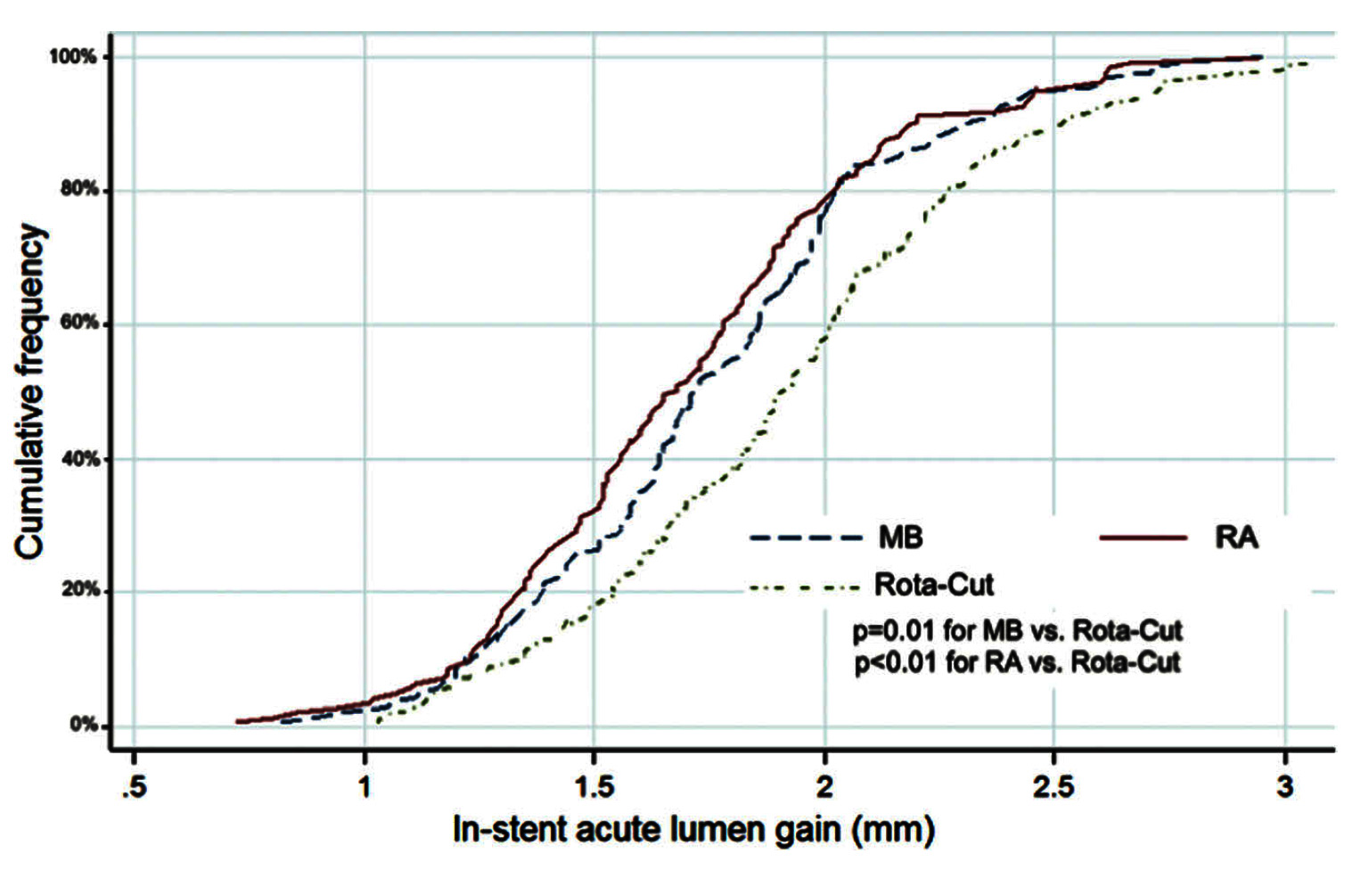
PREPARE-CALC-COMBO Study:
Primary Endpoint of In-stent ALG
In-stent ALG primary endpoint was significantly higher in the Rota-Cut grp (1.92 ± 0.45 mm) compared to the control grp of MB (1.74 ± 0.45 mm; p=0.001) and RA (1.70 ± 0.42 mm; p<0.001)
Allali et al., Catheter Cardiovasc Interv 2022;100:979

Slide 21
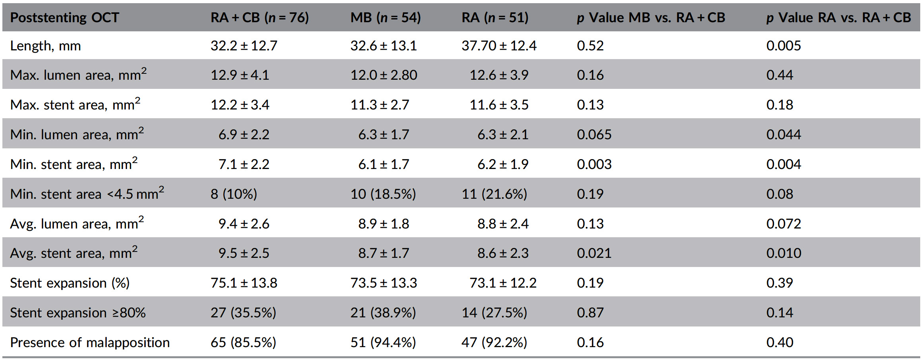
PREPARE-CALC-COMBO Study:
Optical Coherence Tomography Measurement
SE≥ 80% was reached in 35.5% of cases (vs. 38.9% with MB; p = 0.85% and 27.5% with RA; p = 0.14)
Rota-Cut combination resulted in higher MSA (7.1 ± 2.2 vs 6.1 ± 1.7 mm² in MB grp; p=0.003 and 6.2 ± 1.9 mm² in RA grp; p=0.004)
Allali et al., Catheter Cardiovasc Interv 2022;100:979

Slide 22
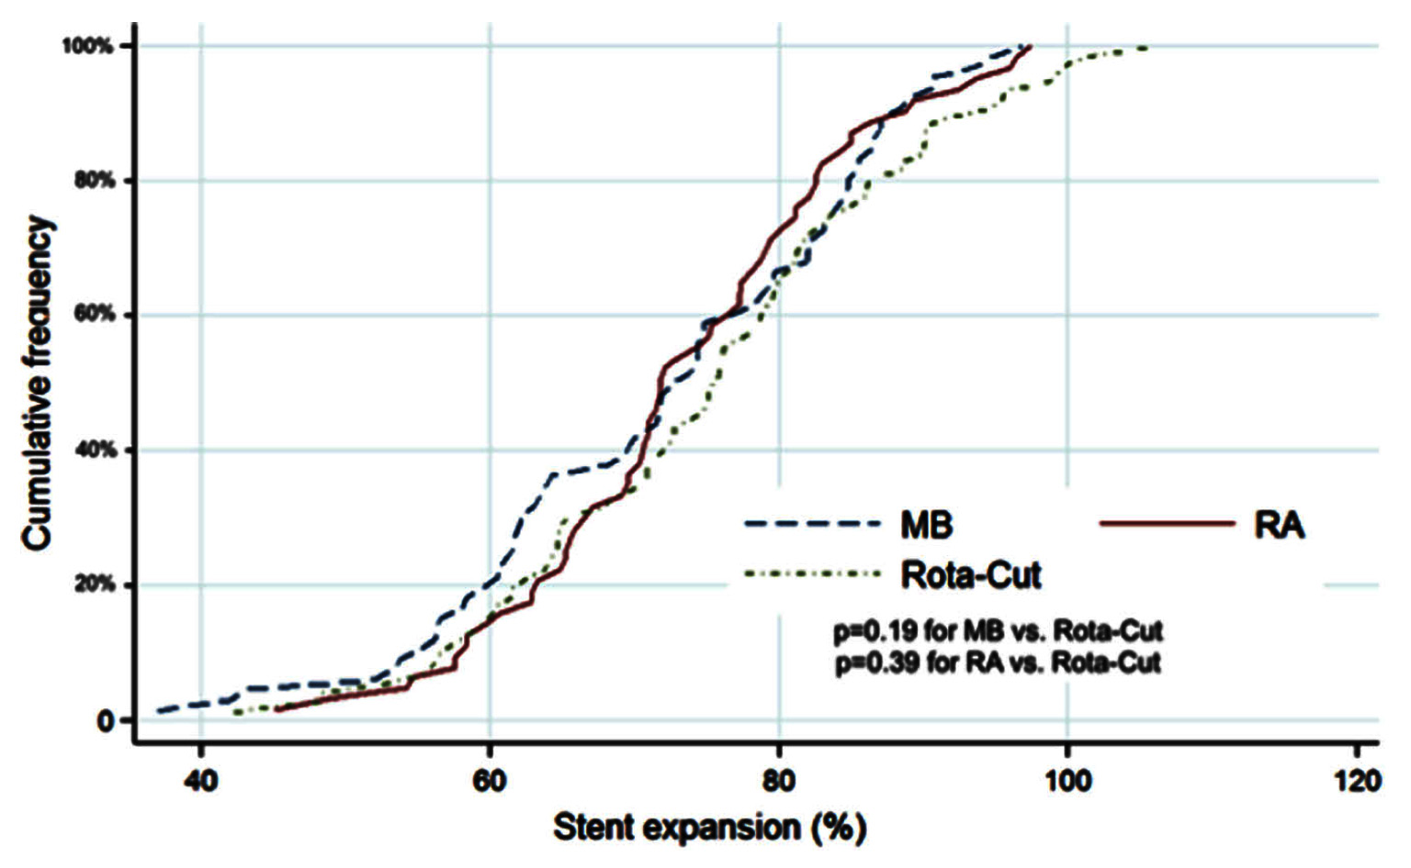
PREPARE-CALC-COMBO Study:
Co-primary Endpoint of Stent Expansion in OCT
SE, the co‐primary endpoint, was comparable between the Rota‐Cut population and the historical control groups (75.1 ± 13.8% vs. 73.5 ± 13.3 with MB vs. 73.1 ± 12.2 with RA; p = 0.19 and p = 0.39, respectively)
Allali et al., Catheter Cardiovasc Interv 2022;100:979

Slide 24
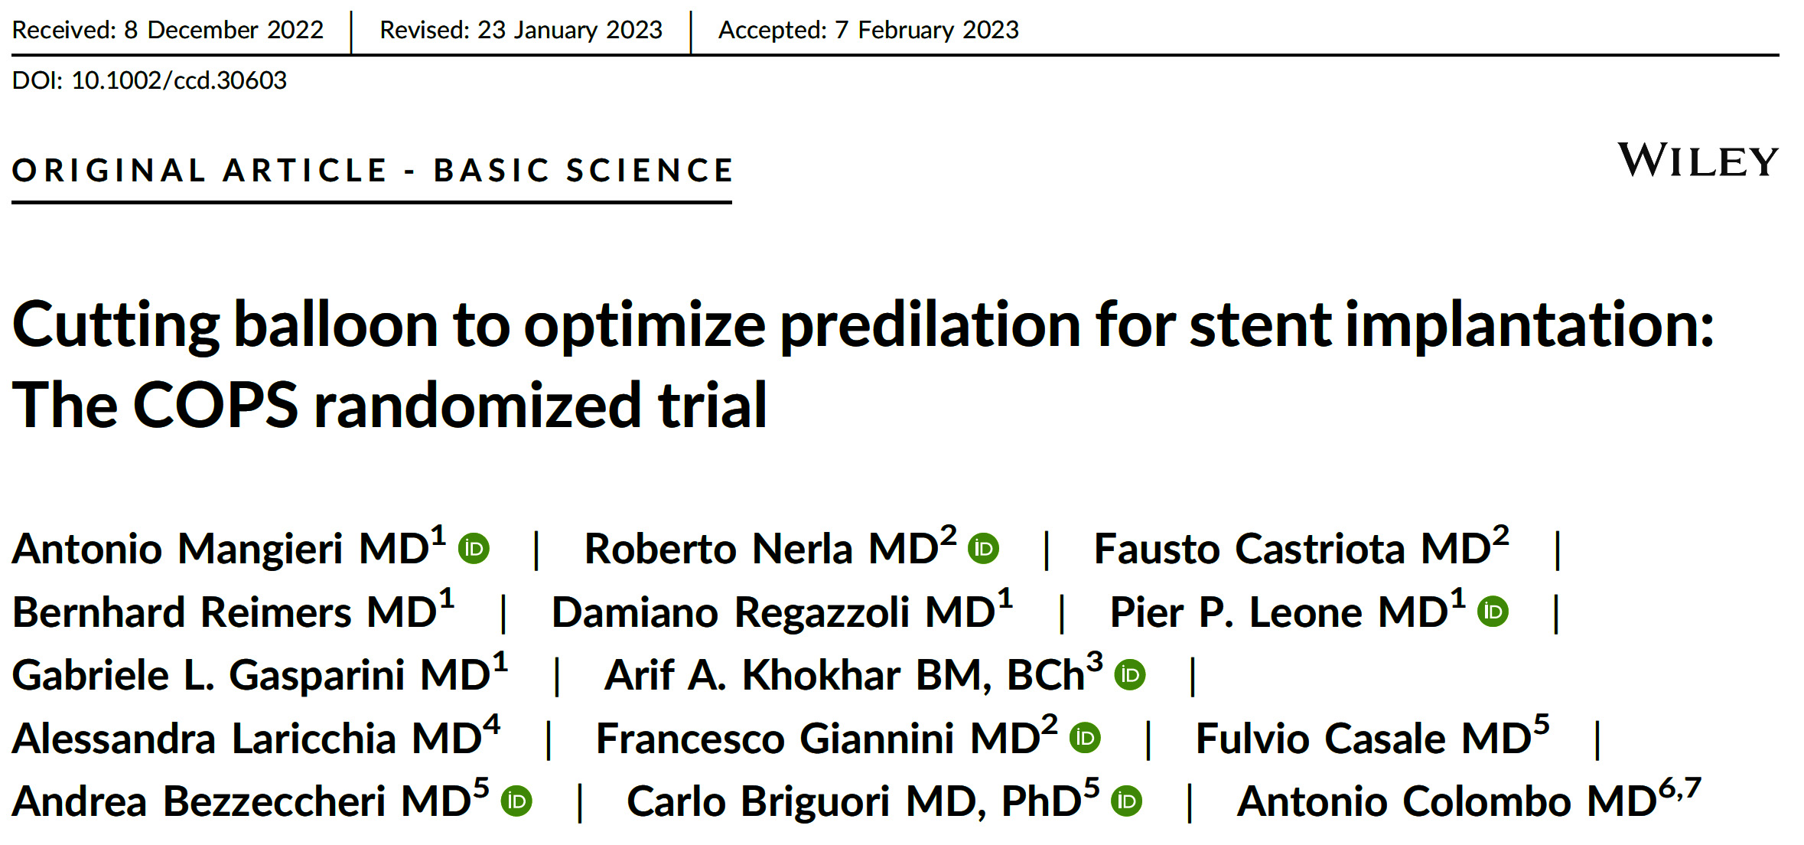
Cutting Balloon to Optimize Predilatation for Stenting
Prospective, randomized, multicenter open-label trial which enrolled 100 patients with significant calcified lesions evaluated at IVUS
Randomization 1:1
Cutting Balloon N=50
NC Balloo N=50

Slide 25
COPS Trial: Procedure Characteristics
 | Overall | CB (n=44) | NCB (n=43) | P value
Predilatation atmospheres | 18.6±4.7 | 18.3±5 | 19±4.5 | 0.463
Number of stent implanted | 1.3±0.4 | 1.3±0.5 | 1.2±0.4 | 0.314
Total Stent Length (mm) | 32.9±12 | 31.6±12 | 34.2±12 | 0.837
Stent Diameter (mm) | 3.3±0.4 | 3.4±0.3 | 3.3±0.4 | 0.737
Post dilatation | 77.0% | 75.0% | 79.0% | 0.885
Diameter of the balloon for post dilatation | 3.5±0.5 | 3.6±0.6 | 3.5±0.4 | 0.497
Post dilatation atmospheres | 20.9±0.6 | 20±5.2 | 21.7±5.4 | 0.201
IVUS Data
Final MSA (mm²) | 6.8±1.9 | 7.1±1.7 | 6.5±2.1 | 0.116
Minimal Stent Diameter | 2.6±0.4 | 2.7±0.4 | 2.5±0.4 | 0.064
Final MSA at calcium site | 7.7±2.1 | 8.1±2 | 7.3±2.1 | 0.035
Minimal stent diameter at calcium site | 2.8±0.5 | 2.9±0.7 | 2.7±0.4 | 0.016
Eccentricity index at calcium site | 0.82±0.8 | 0.84±0.7 | 0.8±0.8 | 0.013
Mangieri et al., Catheter Cardiovasc Interv 2023;101:798

Slide 26
COPS Trial: Procedure Results
 | Overall (n=87) | CB (n=44) | NCB (n=43) | P value
Device failure | 3.4% | 6.8% | 0.0% | 0.517
Additional use of rotational atherectomy | 1.1% | 2.2% | 0.0% | 0.79
Ellis type 1 vessel rupture | 2.2% | 4.4% | 0.0% | 0.189
Implantation of a covered stent | 1.1% | 2.2% | 0.0% | 0.65
Final TIMI flow >3 | 87 (100) | 44 (100) | 43 (100) | 0.854
One year Follow-up
Deaths | 3.4% | 1.1% | 4.6% | 0.342
Cardiac deaths | 1.1% | 0.0% | 2.3% | 0.887
Stroke | 0.0% | 0.0% | 0.0% | 0.91
MI | 0.0% | 0.0% | 0.0% | 0.96
TLR | 3.4% | 1.1% | 4.6% | 0.49
Mangieri et al., Catheter Cardiovasc Interv 2023;101:798

Slide 27
ROTACUT Trial: Study Design
Patients with indication for PCI of a calcified lesion for which rotational atherectomy (RA) is deemed indicated
60 Patients randomized (1:1)
29 patients assigned to lesion preparation with RA and cutting balloon angioplasty (CBA) followed by DES implantation (+/- post-stent dilatation)
31 patients assigned to lesion
preparation with RA and
non-compliant balloon angioplasty
(NCBA) followed by DES implantation
(+/- post-stent dilatation)
Primary endpoint: Minimum stent area (MSA; mm2)
as assessed by post-procedural IVUS (blinded to operator)
Additional IVUS and angiographic endpoints and device related endpoints
Clinical follow-up at 30 days & 270 days: MACE and major bleeding

Slide 28
ROTACUT Trial Procedural Characteristics:
RA and CBA/NCBA
 | ROTA + CBA N=29 (48.3%) | ROTA + NCBA N=31 (51.7%) | P-value
Rotational atherectomy
Burr size, in mm | 1.6±0.1 | 1.6±0.2 | 0.674
CBA/NCBA
Maximum balloon diameter, mm | 3.2±0.4 | 3.3±0.5 | 0.416
Maximum balloon length, mm | 8.7±5.1 | 20.0±6.5 | <.001
Maximum balloon inflation pressure, atm | 12.3±3.9 | 15.8±3.9 | <.001
Maximum stent diameter, mm | 3.3±0.4 | 3.4±0.5 | 0.349
Minimum stent diameter, mm | 3.2±0.4 | 3.3±0.5 | 0.203
Total stent length, mm | 39.4±16.7 | 37.7±13.2 | 0.661
Post-treatment dilatation, n (%) | 28 (96.6) | 26 (83.9) | 0.196
Maximum diameter | 3.5±0.4 | 4.0±2.2 | 0.247
Maximum inflation pressure | 17.1±2.3 | 17.1±2.9 | 0.927

Slide 29
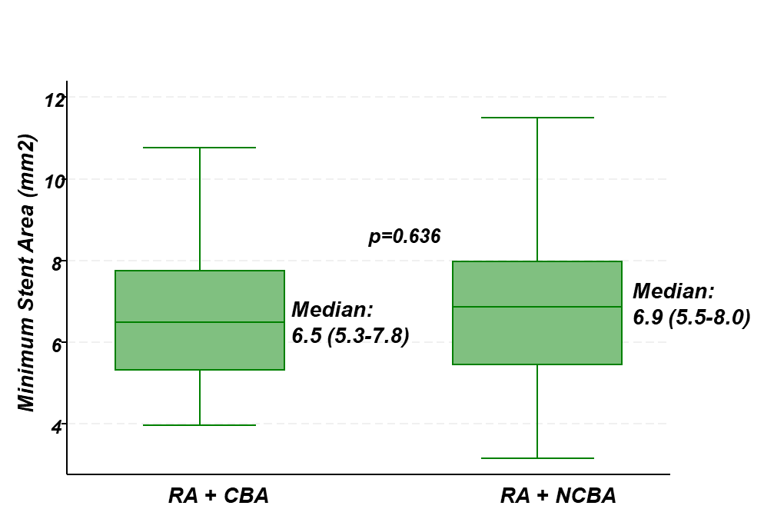
ROTACUT Trial Primary Endpoint: Minimum Stent Area on Final IVUS
 | ROTA + CBA N=29 (48.3%) | ROTA + NCBA N=31 (51.7%) | P-value
Minimum stent area, mm², mean±SD | 6.7±1.7 | 6.9±1.8 | 0.685
In-segment minimum lumen area, mm² | 5.9±1.4 | 6.4±1.9 | 0.291
Final minimum stent expansion, % | 86.1±17.5 | 78.6±14.7 | 0.076
Final mean stent expansion, % | 112.5±19.4 | 104.2±13.5 | 0.058

Slide 30
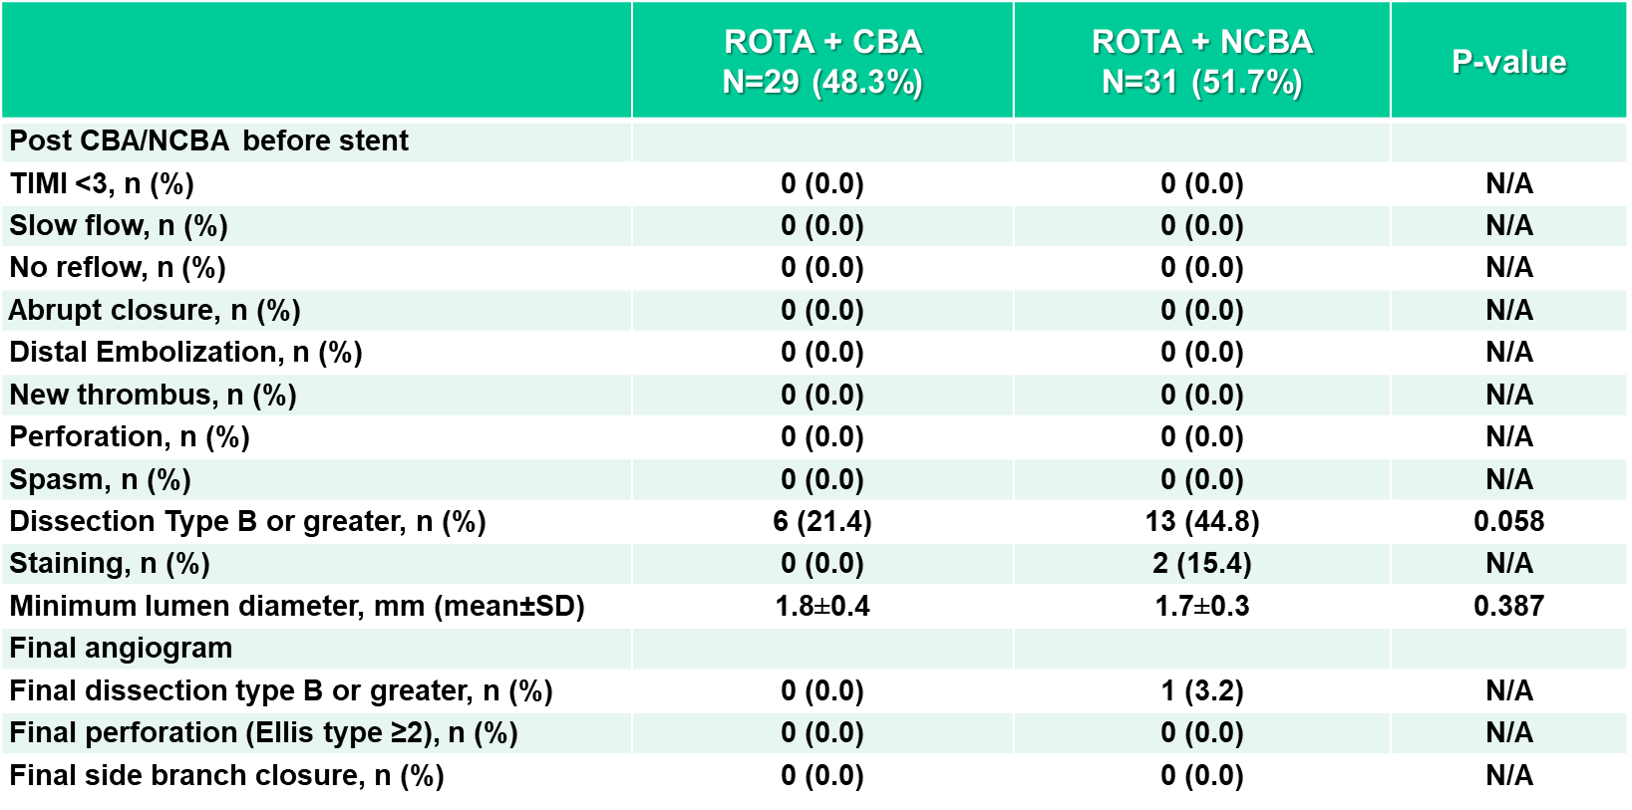
ROTACUT Trial: Other Angiographic Endpoints
Number of events (%)
All-cause death | 0 (0.0%) | 0 (0.0%) | N/A | N/A
Myocardial infarction | 2 (6.9%) | 1 (3.2%) | 2.14 (0.19 - 23.6) | 0.535
TLR | 0 (0.0%) | 0 (0.0%) | N/A | N/A
Stent thrombosis | 0 (0.0%) | 0 (0.0%) | N/A | N/A
Major bleeding (BARC 3 or 5) | 0 (0.0%) | 0 (0.0%) | N/A | N/A
Vascular complications | 0 (0.0%) | 0 (0.0%) | N/A | N/A

Slide 31
RCT of Cutting Balloon vs NCBA for Lesion Optimization Present Implantation
 | COPS |  |  |  | ROTACUT Trial
 | CB |  | NCBA |  | RA + CB |  | RA + NCBA
Number of Pts | 100 |  |  |  | 60
IVUS | 100% |  |  |  | 100%
Vessel / Lesion location | LAD | 59.1% |  | 60.3% | Prox | 44.8% |  | 45.2%
 | RCA | 32.0% |  | 25.0% | Mid | 51.7% |  | 54.8%
Calcium Arc (degrees) | 274 ± 84 |  | 258 ± 85 |  | 319 ± 61.2 |  | 303.5 ± 63.7
Lesion length (mm) | 23.5 ± 9.6 |  | 25.1 ± 9.8 |  | 31.3 ± 11.9 |  | 32.8 ± 11.2
Reference vessel diameter (mm) | 3.51 ± 0.3 |  | 3.39 ± 0.4 |  | 3.2 ± 0.4 |  | 3.3 ± 0.5
Predilation atmosphere | 18.3 ± 5 |  | 19 ± 4.5 |  | 14.4 ± 1.9 |  | 14.6 ± 1.8
Stent diameter (mm) | 3.4 ± 0.3 |  | 3.3 ± 0.4 |  | 3.3 ± 0.4 |  | 3.4 ± 0.5
Post dilation atmosphere | 20 ± 5.2 |  | 21.7 ± 5.4 |  | 12.3 ± 2.3 |  | 17.1 ± 2.9
Minimal stent diameter | 2.7 ± 0.4 |  | 2.5 ± 0.4 |  | 3.2 ± 0.4 |  | 3.3 ± 0.5
Final MSA | 7.1 ± 1.7 |  | 6.5 ± 2.1 |  | 6.7 ± 1.7 |  | 6.9 ± 1.8

Slide 32
RCT of Cutting Balloon vs NCBA for Lesion Optimization Present Implantation
Procedural Results
 | COPS |  | ROTACUT Trial
 | CB | NCBA | RA + CB | RA + NCBA
Device failure | 6.8% | 0.0% | 0.0% | 0.0%
Rotational atherectomy | 2.2% | 0.0% | 100% | 100%
Perforation | 4.4% | 0.0% | 0.0% | 0.0%
Covered stent | 2.2% | 0.0% | 0.0% | 0.0%
MI | 0.0% | 0.0% | - | -
TLR | 1.1% | 4.6% | - | -

Slide 33
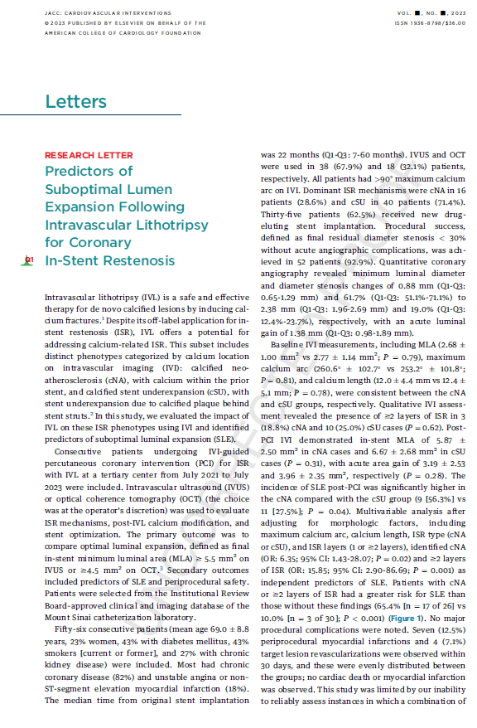
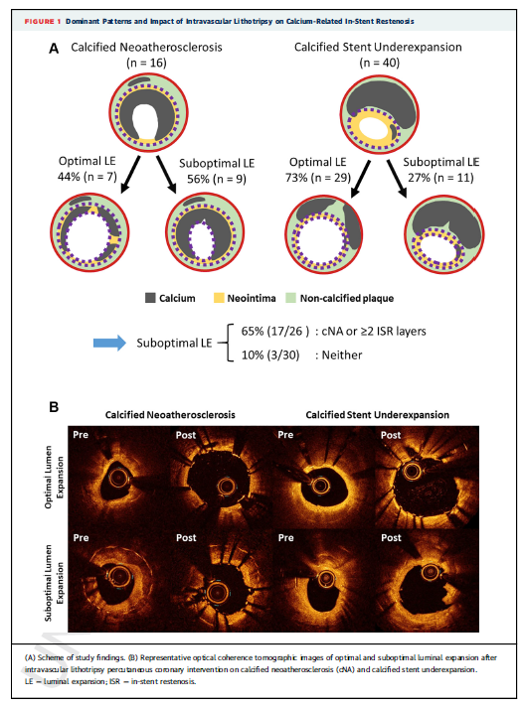
Simultaneous Publication TCT 23 /JACC CaVI
Predictors of Suboptimal Lumen Expansion following IVL for ISR Lesions
Yasumura, Sharma, Kini et al., J Am Coll Cardiol Oct 23, 2023, Epub ahead of print

Slide 34
Background
Intravascular lithotripsy (IVL) is a safe and effective therapy for de novo calcified lesions by inducing calcium fractures.¹
Despite its off-label use for in-stent restenosis (ISR), IVL has potential to address calcium-related ISR.
This subset includes distinct phenotypes categorized by calcium location on intravascular imaging (IVI).²
cNA
cSU
Calcified neoatherosclerosis (cNA): calcium within the prior stent
Calcified stent underexpansion (cSU): stent underexpansion due to calcium behind stent
*
*
*
*
¹ Hill et al., J Am Coll Cardiol 2020;76:2635
² Giustino et al., J Am Coll Cardiol 2022;80:348

Slide 35
Aim
This study evaluates the impact of IVL on calcium-related ISR using IVI (IVUS/OCT).
The primary outcomes was to compare optimal lumen expansion.
Optimal lumen expansion: Final in-stent minimum lumen area (MLA) >5.5mm² on IVUS or >4.5mm² on OCT.³
The secondary outcomes included predictors of suboptimal lumen expansion (SLE) and periprocedural safety.
Yasumura, Sharma, Kini et al., J Am Coll Cardiol Oct 23, 2023, Epub ahead of print

Slide 36
Study Design
Patients: Consecutive patients undergoing IVI-guided PCI with IVL for calcium-related ISR* at a tertiary center from July 2021 to July 2023 were included. (*≥90 degrees of calcium)
IVI: IVUS/OCT choice was at the operator’s discretion to evaluate ISR mechanisms, post-IVL calcium modification, and stent optimization.
SLE (suboptimal lumen expansion): Final in-stent minimum lumen area (MLA) <5.5mm² on IVUS or <4.5mm² on OCT
56 patients between July 2021 and July 2023 were included
38 (68%) IVUS and 18 (32%) OCT-guided
Clinical follow-up at 30 days
Patient characteristics
Age 69.0 ± 8.8 years, 23% female, 43% DM, 43% smoker, and 27% CKD.
Presentation: 82% chronic coronary disease, 18% unstable angina or NSTEMI.
The median time from original stent implantation was 22 [7-60, IQR] months.
Yasumura, Sharma, Kini et al., J Am Coll Cardiol Oct 23, 2023, Epub ahead of print

Slide 37
Summary
QCA results
Dominant ISR mechanism by IVI
16 (29%) cNA and 40 (71%) cSU
 | cNA (n = 16) | cSU (n = 40) | P value
Pre-PCI QCA
RVD, mm | 2.4 ± 0.6 | 2.4 ± 0.7 | NS
MLD, mm | 1.0 ± 0.4 | 0.9 ± 0.5 | NS
DS, % | 59 ± 11 | 64 ± 17 | NS
Lesion length, mm | 27 ± 15 | 26 ± 14 | NS
Post-PCI QCA
MLD, mm | 2.4 ± 0.6 | 2.3 ± 0.6 | NS
DS, % | 20 ± 11 | 21 ± 13 | NS
Acute gain, mm | 1.4 ± 0.6 | 1.4 ± 0.7 | NS
Procedural Characteristics
35 (63%) received new DES implantation.
IVL balloon size was 3.4 ± 0.4 mm.
Procedural success* in 52 (93%).
*Final DS <30% without acute angiographic complications.
No major procedural complications (dissection, perforation).
Clinical outcomes (30 days)
 | cNA (n = 16) | cSU (n = 40) | P value
Death | 0 | 0 | NS
Spontaneous MI | 0 | 0 | NS
Peri-procedural MI | 3 (19) | 4 (10) | 0.31
TLR | 2 (13) | 2 (5) | 0.32
Yasumura, Sharma, Kini et al., J Am Coll Cardiol Oct 23, 2023, Epub ahead of print

Slide 38
Intravascular Imaging (IVUS/OCT) Results
Parameters | Calcified Neoatherosclerosis (n = 16) | Calcified Stent Underexpansion (n = 40) | P value
Pre-IVI
MLA, mm² | 2.68 ± 1.00 | 2.77 ± 1.14 | 0.79
Max calcium arc, ° | 260.6 ± 102.7 | 253.2 ± 101.8 | 0.81
Calcium length, mm | 12.0 ± 4.4 | 12.4 ± 5.1 | 0.78
≥2 layers of stents | 3 (18.8) | 10 (25.0) | 0.62
Calcified nodule | 2 (12.5) | 4 (10.0) | 0.79
Post-IVI
MSA, mm² | 5.87 ± 2.50 | 6.67 ± 2.68 | 0.31
Suboptimal lumen expansion | 9 (56.3) | 11 (27.5) | 0.04
Acute area gain, mm² | 3.19 ± 2.53 | 3.96 ± 2.35 | 0.28
Yasumura, Sharma, Kini et al., J Am Coll Cardiol Oct 23, 2023, Epub ahead of print

Slide 39
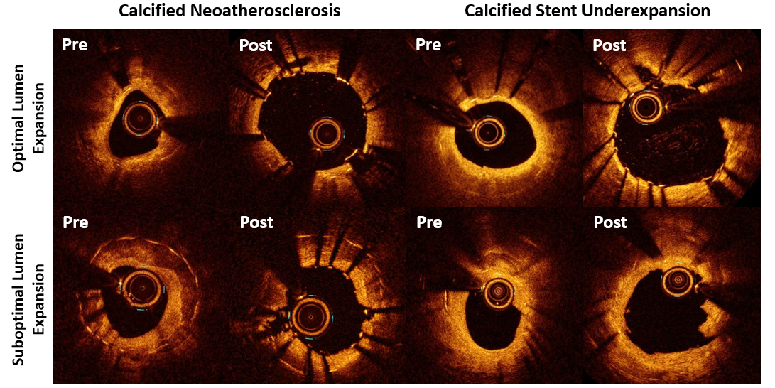
Representative OCT Cases
Yasumura, Sharma, Kini et al., J Am Coll Cardiol Oct 23, 2023, Epub ahead of print

Slide 40
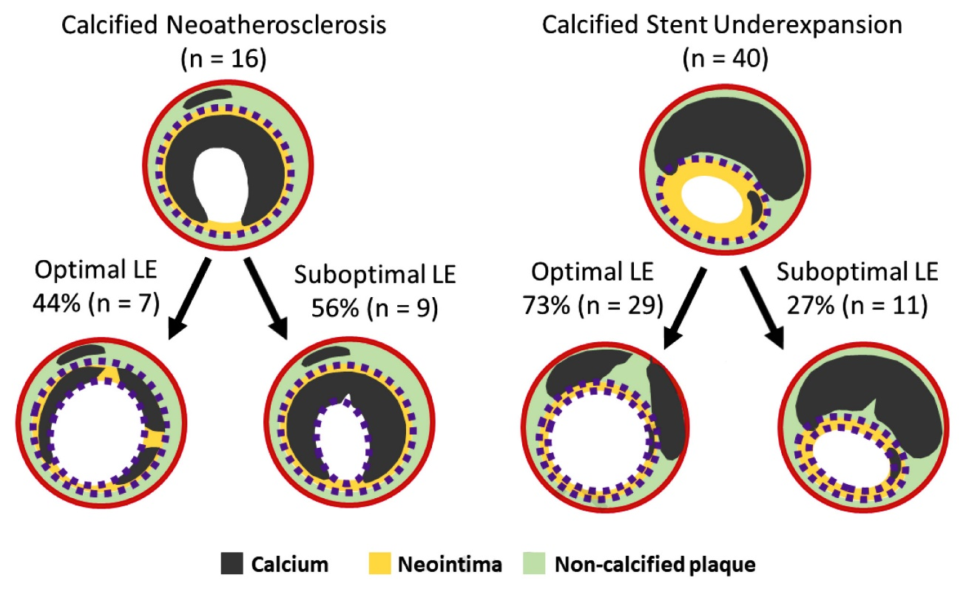
Predictors of Suboptimal Lumen Expansion Following IVL for Coronary ISR
Multivariable analysis*
Calcified Neoatherosclerosis: OR 6.35 [95% CI: 1.43-28.07], p = 0.02.
≥2 ISR layers: OR 15.85 [95% CI: 2.90-86.69], p = 0.001
N =56
*Adjusting for morphologic factors (max calcium arc,
calcium length, ISR types, ISR layers)
Suboptimal Lumen Expansion
65% (17/26) : cNA or ≥2 ISR layers
10% (3/30) : Neither of them
p < 0.001
Yasumura, Sharma, Kini et al., J Am Coll Cardiol Oct 23, 2023, Epub ahead of print

Slide 41
Predictors of Bailout Rota Use: Study Flowchart
Pooled data set of ROTAXUS and
PREPARE-CALC
n=440 patients, n=600 lesions
Excluded (n=220)
Patients randomized to RA
Patients randomized to balloon predilatation (standard or modified)
n=220 patients, n=314 lesions
Single patient with unknown crossover status
≈16%
Angioplasty only group
(PCI accomplished without the need for RA)
n=188 patients, n=266 lesions
Bail-out RA group
(PCI only possible with bail-out RA)
n=31 patients, n=47 lesions
Allali et al., EuroIntervention 2022;17:1506

Slide 42
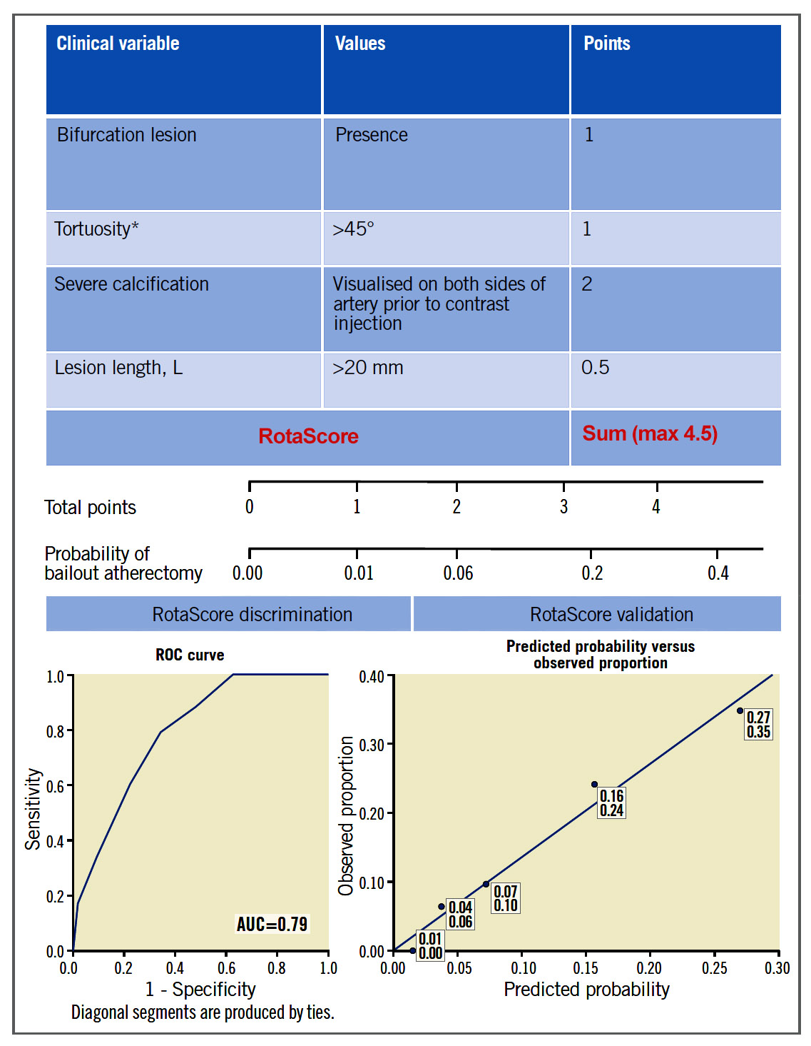
Atherectomy Scoring System: Derived from Rotaxus and Prepare-Calc Trials (“ROTASCORE”)
Components of the scoring system
Change in probability of requiring bail-out atherectomy as a function of RotaScore
Calibration of RotaScore
Allali et al., EuroIntervention 2022;17:1506

Slide 43
Latest Issues in Coronary Intervention
Recent Interventional Publications on Ca++ management:
Prep-Calc-Combo study, ROTACUT vs COPS
trials comparison, ISR lumen expansion with IVL,
RotaScore for bailout Rota use
Focused review of the month
Rotational vs Orbital Atherectomy Comparison:
Direct Comparison of Rotational vs Orbital Atherectomy
for Calcified Lesions Guided by OCT: DIRO TRIAL

Slide 44
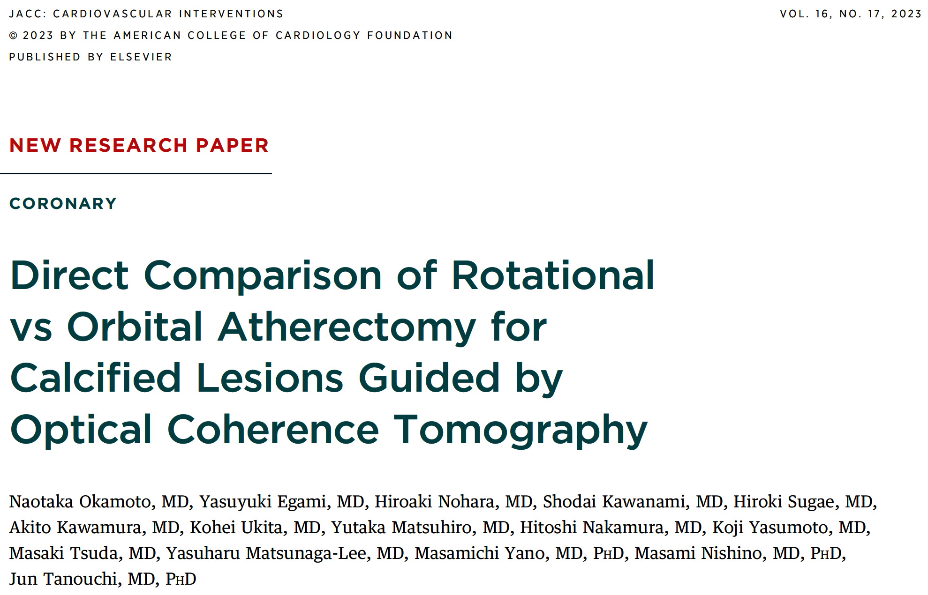
DIRO Trial (Japan)
[Direct Comparison of RA vs OA for Calcified Lesions Guided by OCT]

Slide 45
DIRO Trial: Study Flowchart
Stable coronary artery disease patients with calcified lesions (n=100)
Maximal calcifications arc ≥180° by OCT examination
Moderate or severe calcification by angiography when the OCT catheter did not cross the lesion
RA (n=50)
Randomization 1:1
OA (n=50)
Pre-OCT analysis (n=45)
Tissue modification assessment (n=28)
Post-OCT analysis (n=43)
Pre-OCT analysis (n=44)
Tissue modification assessment (n=33)
Post-OCT analysis (n=45)
Procedural outcomes (n=50)
Procedural outcomes (n=50)
8-month clinical outcomes (n=50)
8-month clinical outcomes (n=50)
8-month follow-up OCT (n=37)
8-month follow-up OCT (n=27)
Okamoto et al., J Am Coll Cardiol Intv 2023;16:2125

Slide 46
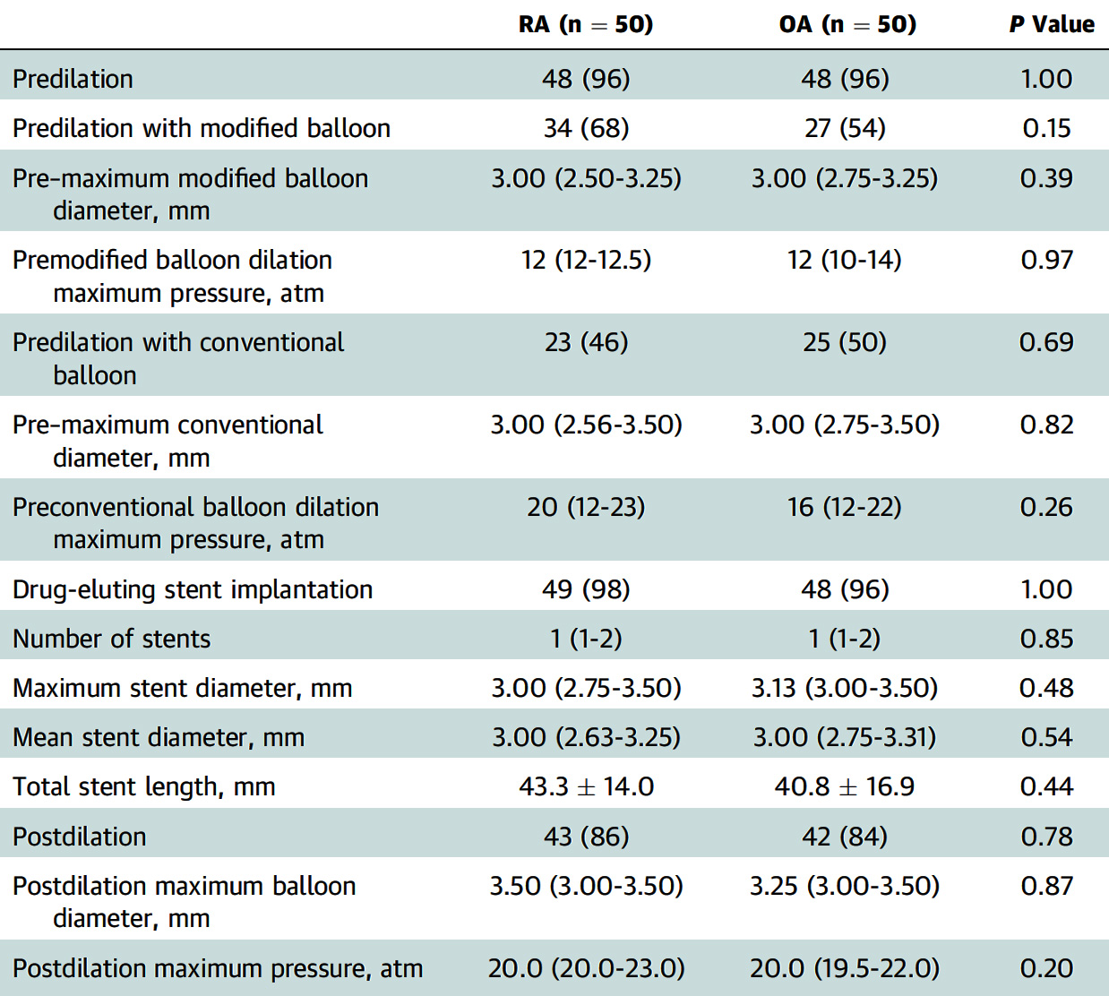
DIRO Trial: Procedural Characteristics
Okamoto et al., J Am Coll Cardiol Intv 2023;16:2125

Slide 47
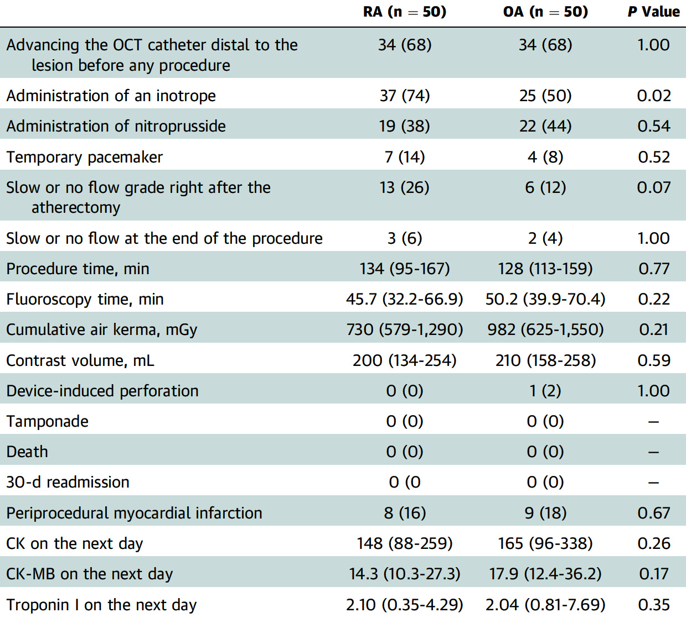
DIRO Trial: Procedural Outcomes
Okamoto et al., J Am Coll Cardiol Intv 2023;16:2125

Slide 48
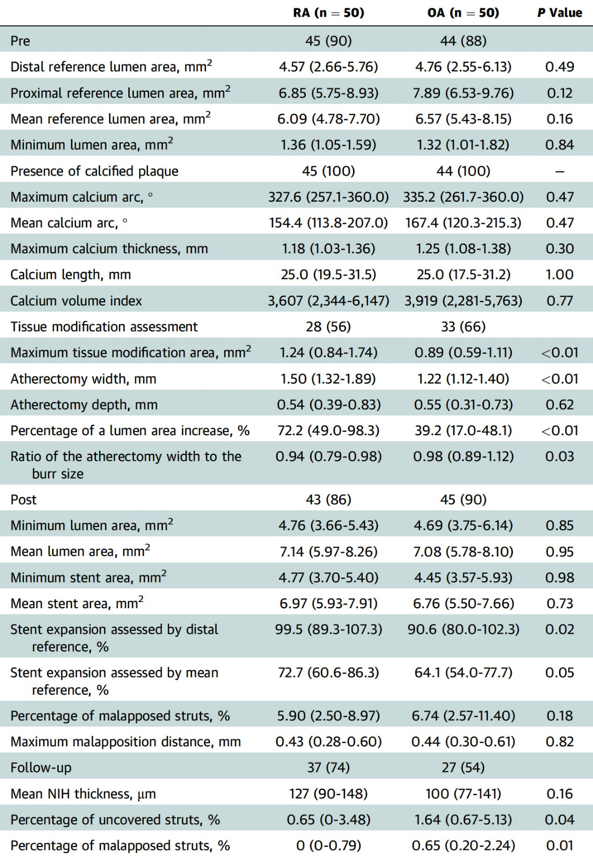
DIRO Trial: Optical Coherence Tomography Findings
Okamoto et al., J Am Coll Cardiol Intv 2023;16:2125

Slide 49
DIRO Trial: Tissue Modification Based on
the Burr Size
Okamoto et al., J Am Coll Cardiol Intv 2023;16:2125

Slide 50
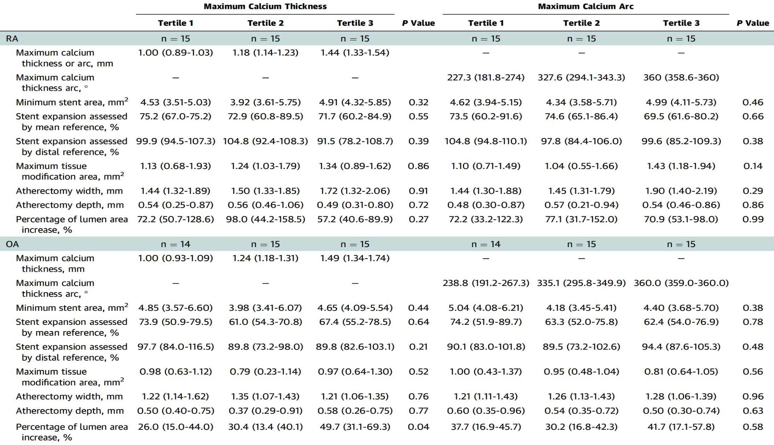
DIRO Trial: The Relationship Between Calcium Distribution
and Tissue Modification or Stent Expansion in RA and OA Groups
Okamoto et al., J Am Coll Cardiol Intv 2023;16:2125

Slide 51
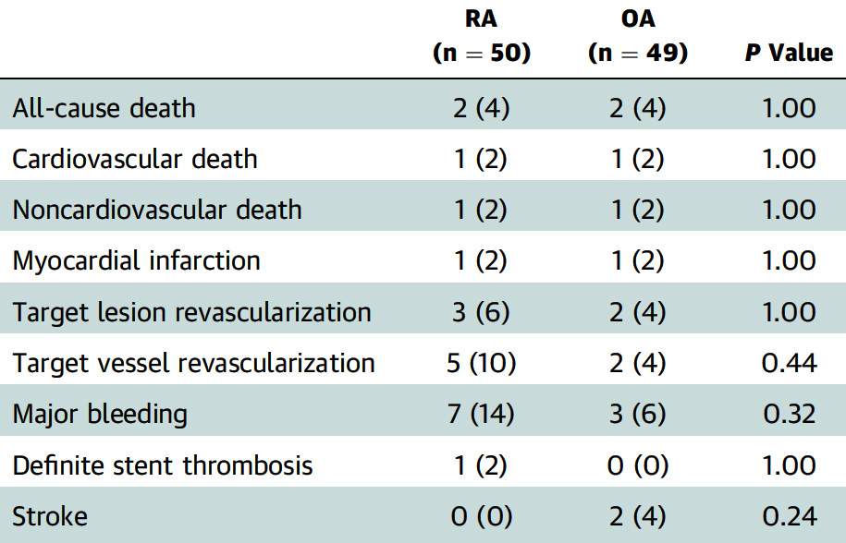
DIRO Trial: 8-Month Clinical Outcomes
Okamoto et al., J Am Coll Cardiol Intv 2023;16:2125

Slide 52
DIRO Trial: The Difference Between Rotational Atherectomy and Orbital Atherectomy
Okamoto et al., J Am Coll Cardiol Intv 2023;16:2125

Slide 53
DIRO Trial (Japan)
[Direct Comparison of RA vs OA for Calcified Lesions Guided by OCT]

Slide 54
Take Home Message: Recent Interventional Publications on Ca++ management and Comparison of RA vs OA for Calcified lesions by OCT
Combined RA+CB for plaque modification:
Combined RA+CB for final MSA improvement:
Outcomes in ROTACUT over COPS trial:
IVL efficacy in Ca+ neoathero vs stent underexpanded ISR:
First RCT comparing RA vs OA in calcified lesions revealed better plaque modifications, atherectomy width, lumen area increase, stent expansion and less mal-apposed stent struts. There were higher minor procedural events with RA vs OA with no difference in major complications. These data needs to be verified in a larger RCT and until then RA remains the main atherectomy strategy (80%) for the treatment of ca++ lesions. We are eagerly waiting for the final results of the ECLIPSE trial of OA (TCT 2024).
Notes:
HbA1c in

Slide 55
Question # 1
Following statement is false regarding the results of the PREPARE-CALC-COMBO study;
RA+CB is used in more severe calcified lesions
Acute lumen gain is higher with RA+CB gp vs others
Higher stent expansion in RA+CB gp vs others
Higher MSA in RA+CB gp vs others
No difference in stent mal-apposition between 3 gps
The correct answer is C

Slide 56
Question # 2
Following statement is true regarding the findings of the RotaCut trial vs COPS trial except;
A. Similar MACE between 2 trials
B. Similar MSA between 2 trials
C. Trend towards better stent expansion in CB vs NCB group in 2 trials
D. Similar higher acute gain between 2 trials
E. Similar maximum CB inflation pressure in 2 trials
The correct answer is E
,
Notes:
er

Slide 57
Question # 3
Following statement is false regarding the results of the DIRO trial comparing RA with OA;
A. Post atherectomy NCB pressure was similar
B. RA group had lower 8M MACE vs OA group
C. Higher tissue modifications with RA vs OA group
D. Higher stent expansion in RA vs OA group
E. Less mal-apposed stent struts with RA vs OA
,
The correct answer is B
Notes:
er

Slide 58
