Slide 1
Structural Heart Live Cases
Supported by:
Edward Lifesciences
Cook Medical
Terumo Medical Corporation
B-Braun Medical
BD Medical

Slide 2
Faculty Involved and Disclosures
Samin K. Sharma, MD, FACC, MSCAI
Nothing to disclose
Annapoorna S. Kini, MD, MRCP, FACC
Nothing to disclose
Sahil Khera, MD, FACC
Nothing to disclose
Shinobu Itagaki, MD, FACC
Nothing to disclose
Stamatios Lerakis, MD, PhD, FACC, FAHA
Nothing to disclose
Pedro Moreno, MD, FACC [Moderator]
Nothing to disclose
Cardiac Anesthesiologist
Morgan Montgomery MD

Slide 3
Sapien TMVR in a High Risk Patient with Degenerated Surgical Mitral Valve Prosthesis

Slide 4
Structural Heart Live Case # 56: FG, 69 y/o F
Presentation: Worsening NYHA III symptoms of SOB, decreased exercise tolerance and leg edema despite trial of AC for presumed mitral-HALT.
PMH: HTN, HLD, IDDM, HFrEF (EF 40-45% ) s/p AICD, CAD s/p multiple PCIs (most recently on 05/2021 to mLAD), PAD s/p multiple PTAs, TIA (2017), ex-smoker, fibromyalgia, nonrheumatic MV regurgitation s/p MVR with a 29 mm Perimount 6900 valve 15 yrs ago.
Medications: Atorvastatin, Losartan, Amlodipine, ISMN, Furosemide
Labs: Hgb 10.3, PLT 212K, K 4.2, Cr 1.23, INR
EKG (11/30/2023): NSR with LVH and iRBBB
TEE (10/18/2023): Abnormal mitral prosthesis due to valve stenosis. The mean MV gradient through the prosthesis was 7mmHg at 65bpm. The lateral leaflet of the bioprosthetic MV is fixed and thickened. The EF is 40-45% with no evidence of LAA thrombus.

Slide 5
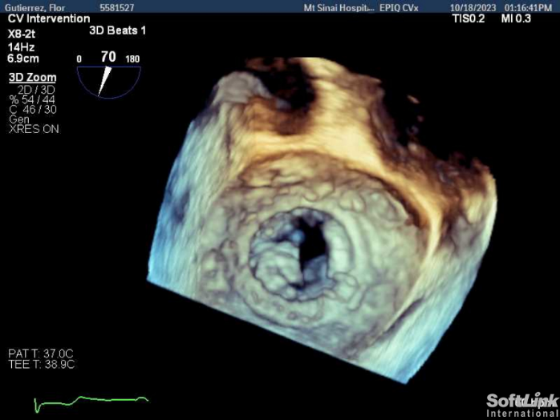
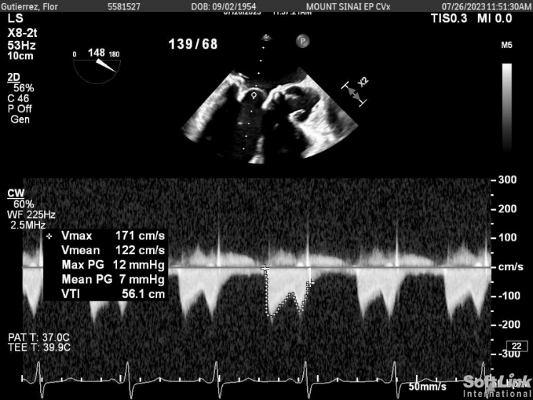
TEE
Mitral prosthesis degeneration with leaflet immobility. The mean mitral valve gradient through the prosthesis was 7 mmHg at 65 BPM. The EF is 40-45% with no evidence of LAA thrombus

Slide 6
TEE
Mitral prosthesis degeneration with leaflet immobility. The mean mitral valve gradient through the prosthesis was 7 mmHg at 65 BPM. The EF is 40-45% with no evidence of LAA thrombus

Slide 7
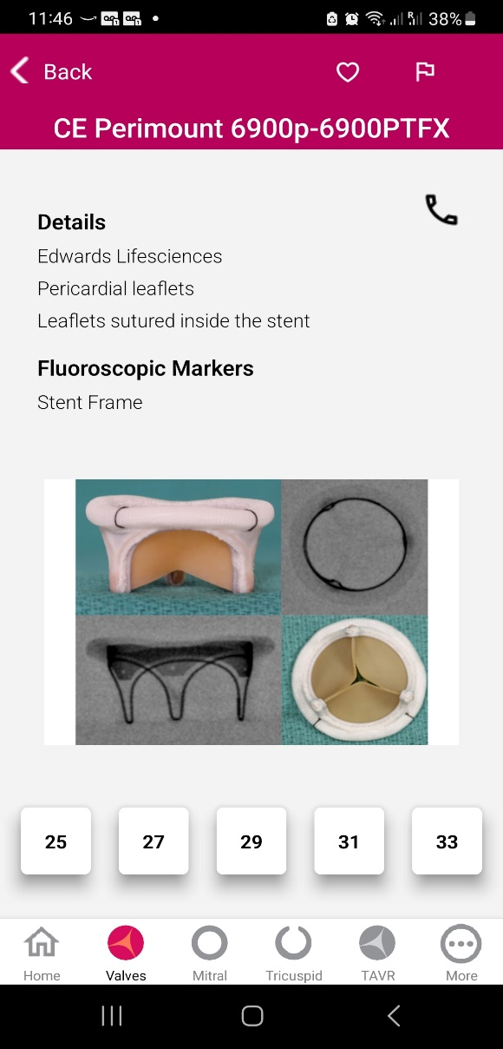
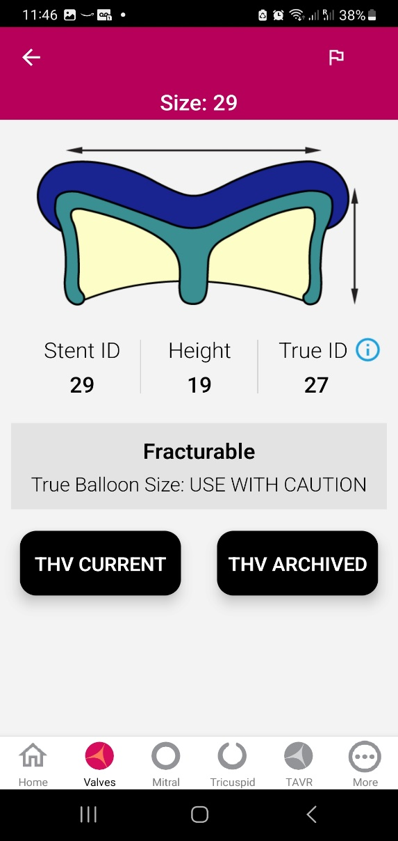
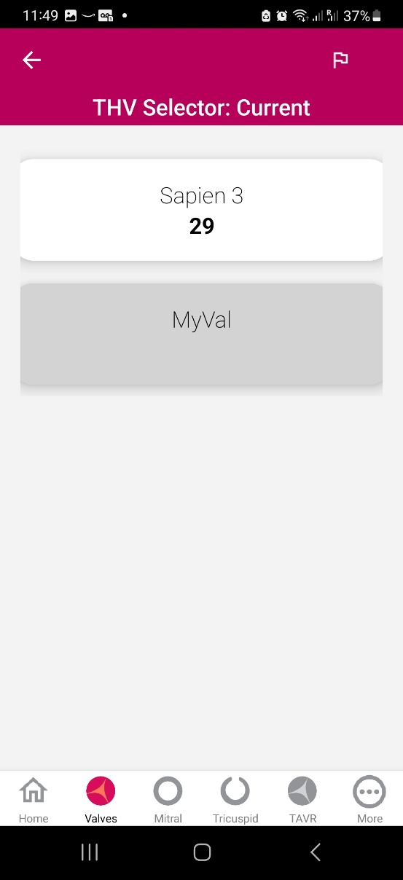
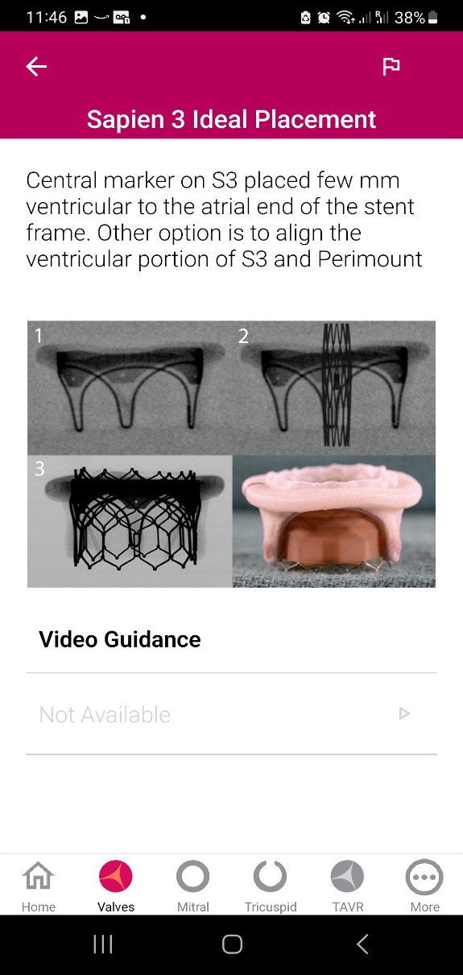
Valve selection – ViV Mitral App
Dr Vinayak Bapat

Slide 8
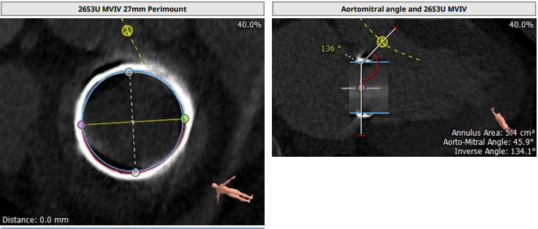
CTA
29 mm + 2cc Sapien-3 Ultra Resilia valve in a degenerated 29 mm Perimount 6900 valve. TT: 26.7 mm
AP: 25.8 mm
Perimeter = 82.8 mm
Area = 5.4 cm²
Aorto-mitral angle: 136˚

Slide 9
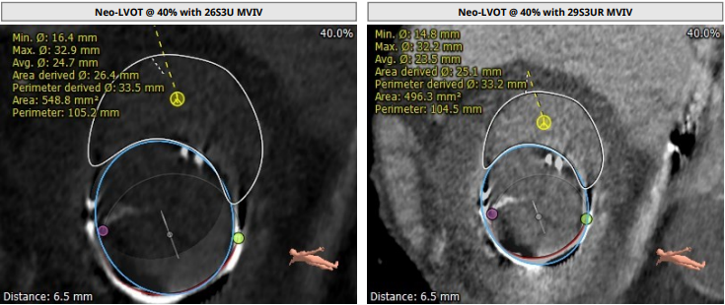
CTA

Slide 10
Summary of Case
Presentation: 69 y/o with worsening NYHA III symptoms of SOB, decreased exercise tolerance and leg edema
TEE: Degenerated mitral valve bio-prosthesis with leaflet immobility. The mean mitral valve gradient through the prosthesis was 7 mmHg at 65 BPM. The EF is 40-45% with no evidence of LAA thrombus
STS risk mortality for redo MVR: 4.5%
Course: Patient was evaluated by heart team and recommended TF-TMVR for being the high surgical risk due to comorbid conditions
Plan: TF valve-in-valve TMVR via right percutaneous femoral vein access using 29mm + 2cc Sapien-3 Ultra Resilia valve in a
degenerated 29 mm Perimount 6900 valve.

Slide 11
Latest Issues in Transcatheter Structural Heart Interventions
Recent publications in the TMVR Field:
- MITRAL Trial: 5 year outcomes
- Trans-apical TMVR: Tendyne 2+ Yrs
- Trans-septal TMVR: Apollo EFS 1Yr
- New TMVR devices

Slide 12
MITRAL Trial: Outcomes of TMVR for Degenerated Bio-prostheses, Failed Annuloplasty Rings and Mitral Annular Calcification
Objective
We aimed to evaluate and compare the procedural and clinical outcomes of patients undergoing TMVR for degenerated
bio-prostheses (valve-in-valve [ViV]),
failed annuloplasty rings (valve-in-rings [ViR]) and severe MAC (valve-in-MAC [ViMAC])

Slide 13
MITRAL Trial: Clinical Outcomes at 30-Days
ViV (n=322)
p<0.001
ViR (n=141)
ViMAC (n=58)
p<0.001
%
p=0.03
p=0.07
p=0.05
p=0.15
Yoon SH, ESC 2018

Slide 14
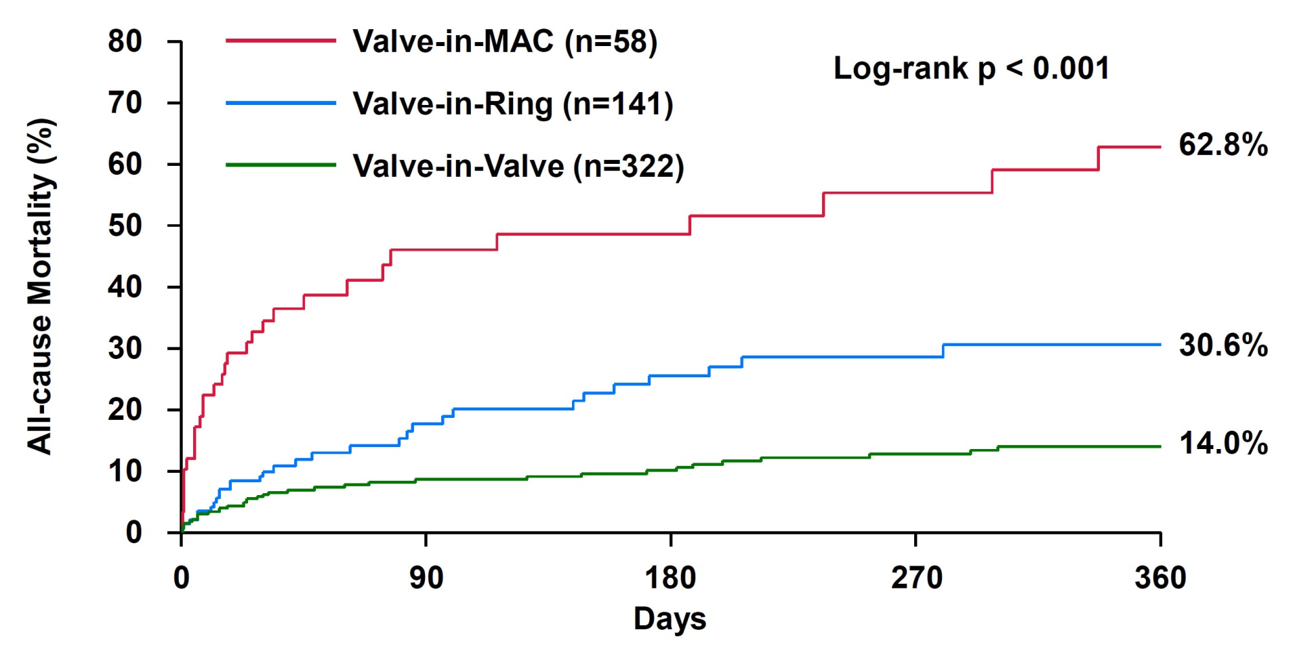
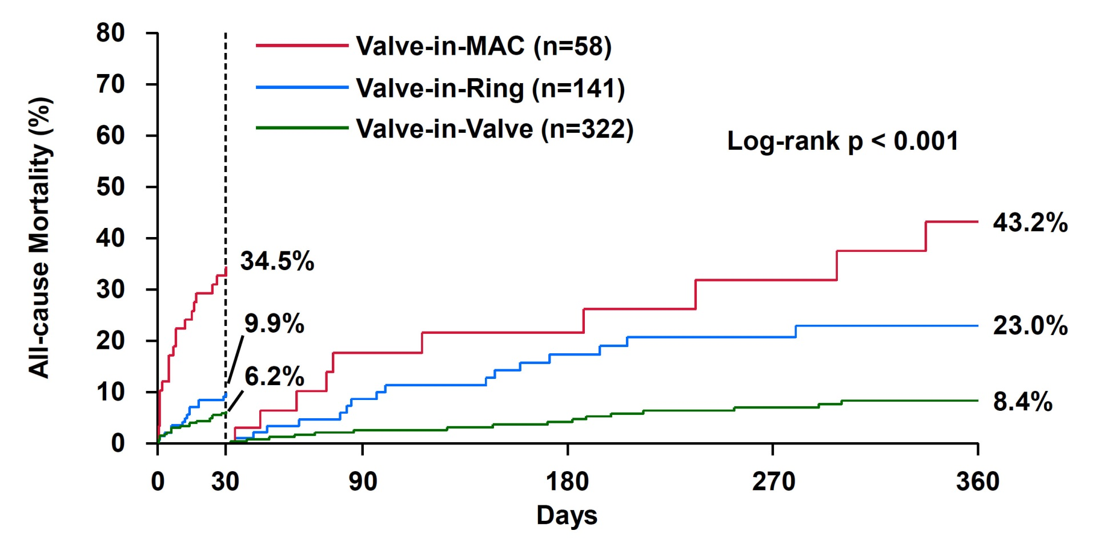
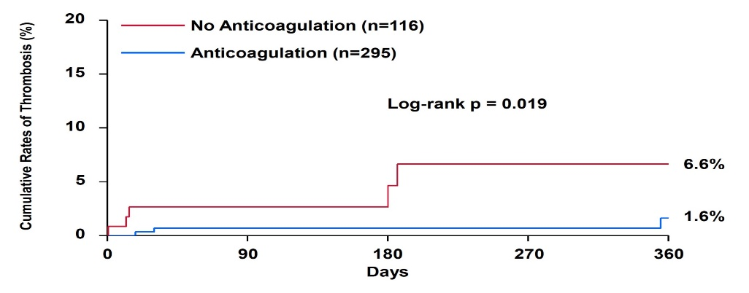
MITRAL Trial: All-Cause Mortality According to TMVR Indication
Landmark Analysis
Yoon S et al, EHJ 2019:40;441

Slide 15
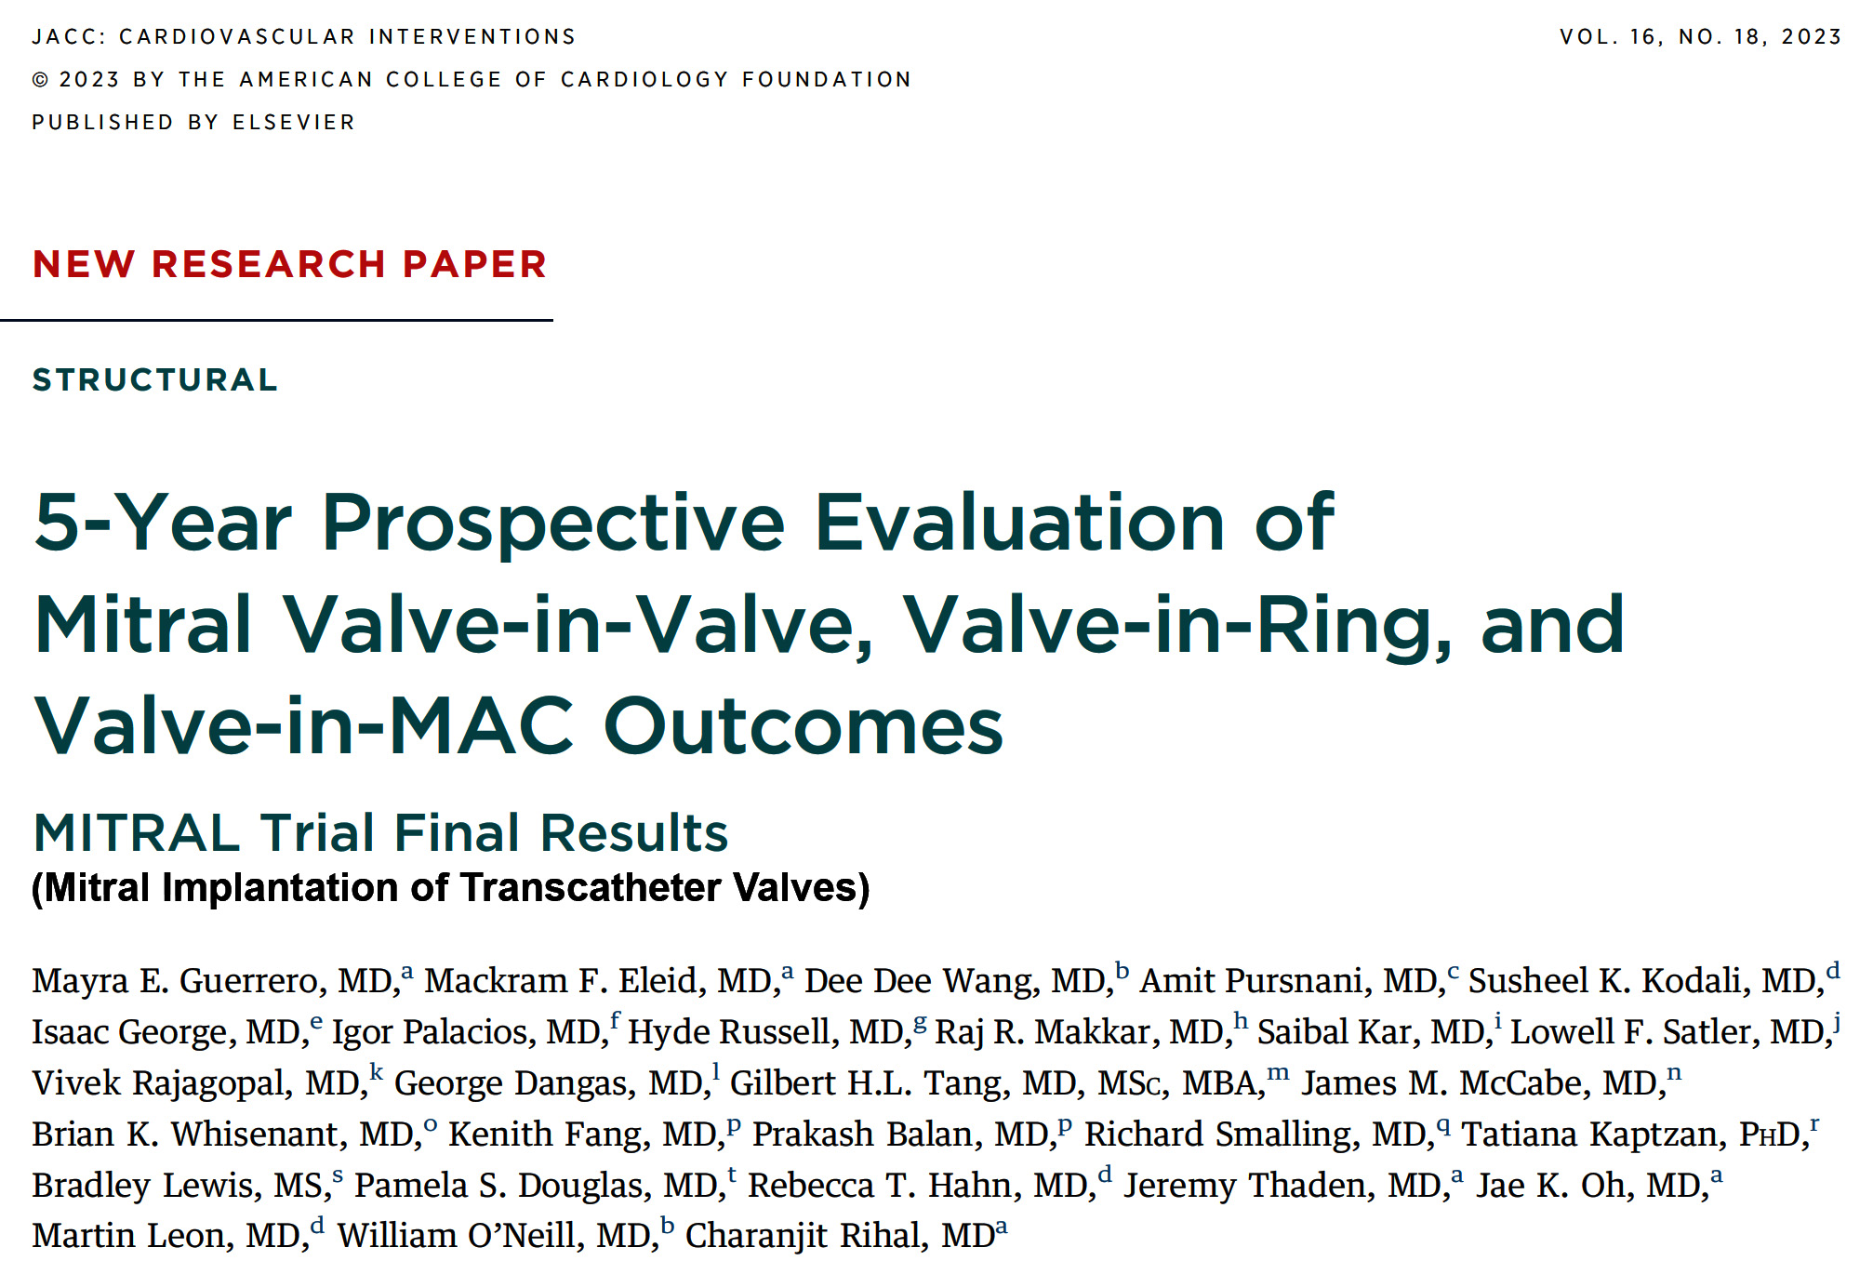
(U.S.)

Slide 16
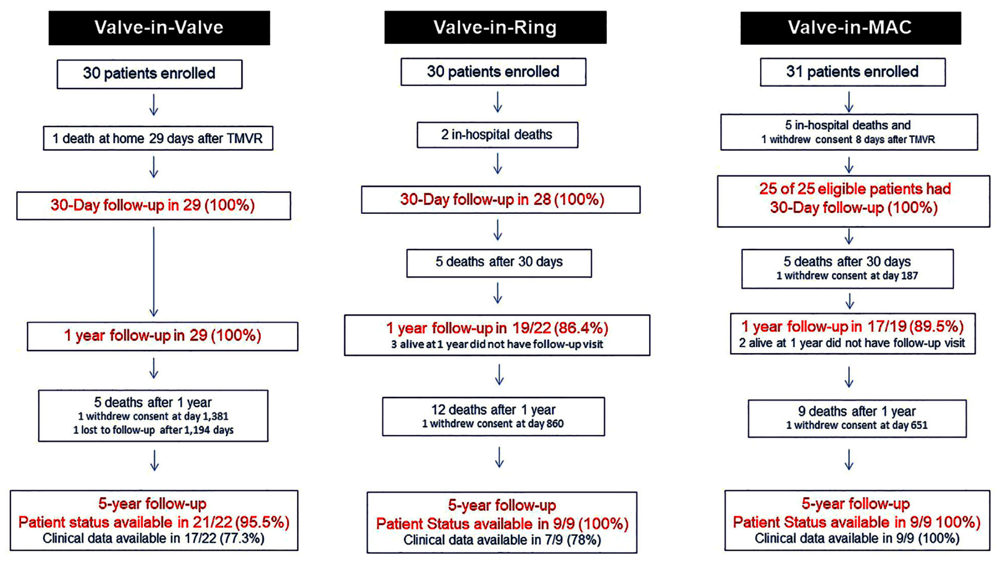
MITRAL Trial: Patient Flow
Guerrero et al., J Am Coll Cardiol Intv 2023;16:2211

Slide 17
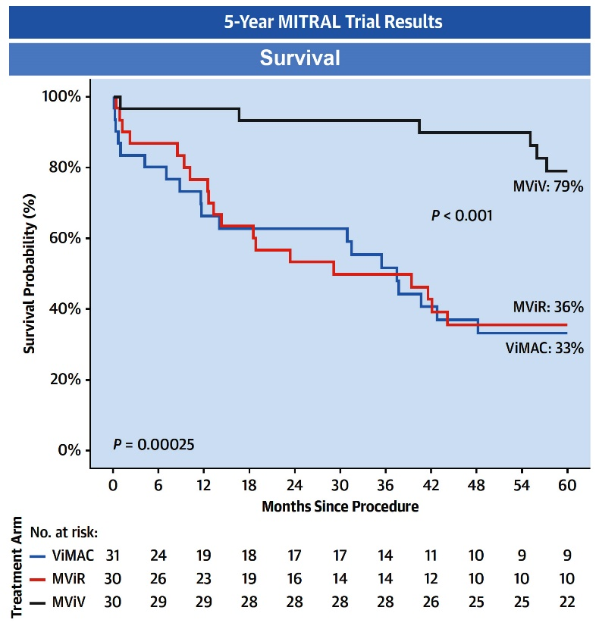
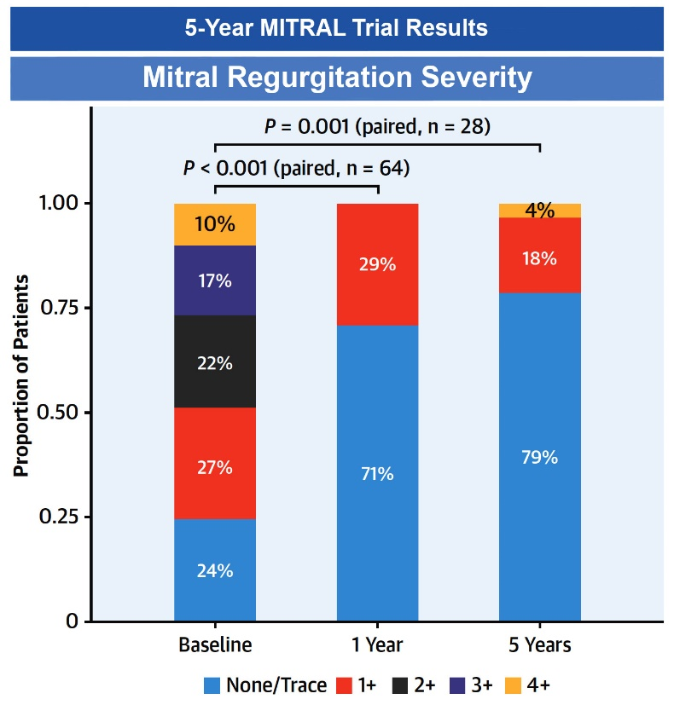
MITRAL Trial: 5-Year Outcomes of Mitral
Valve-in-Valve, Valve-in-Ring, and Valve-in-MAC
Guerrero et al., J Am Coll Cardiol Intv 2023;16:2211

Slide 18
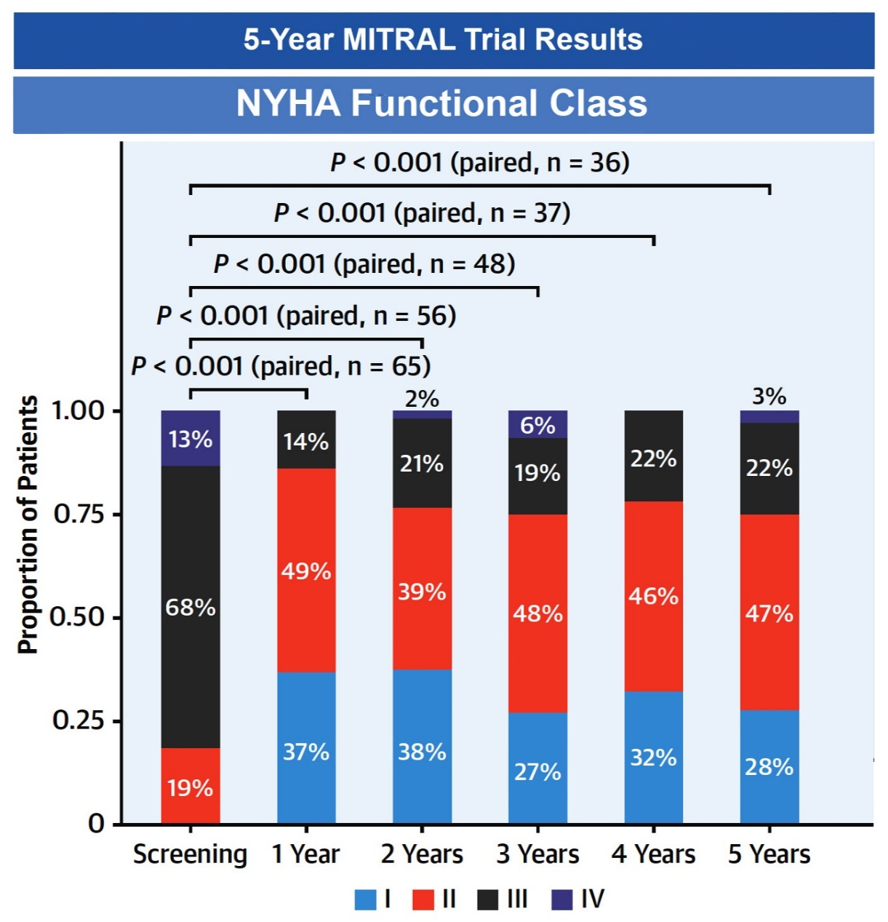
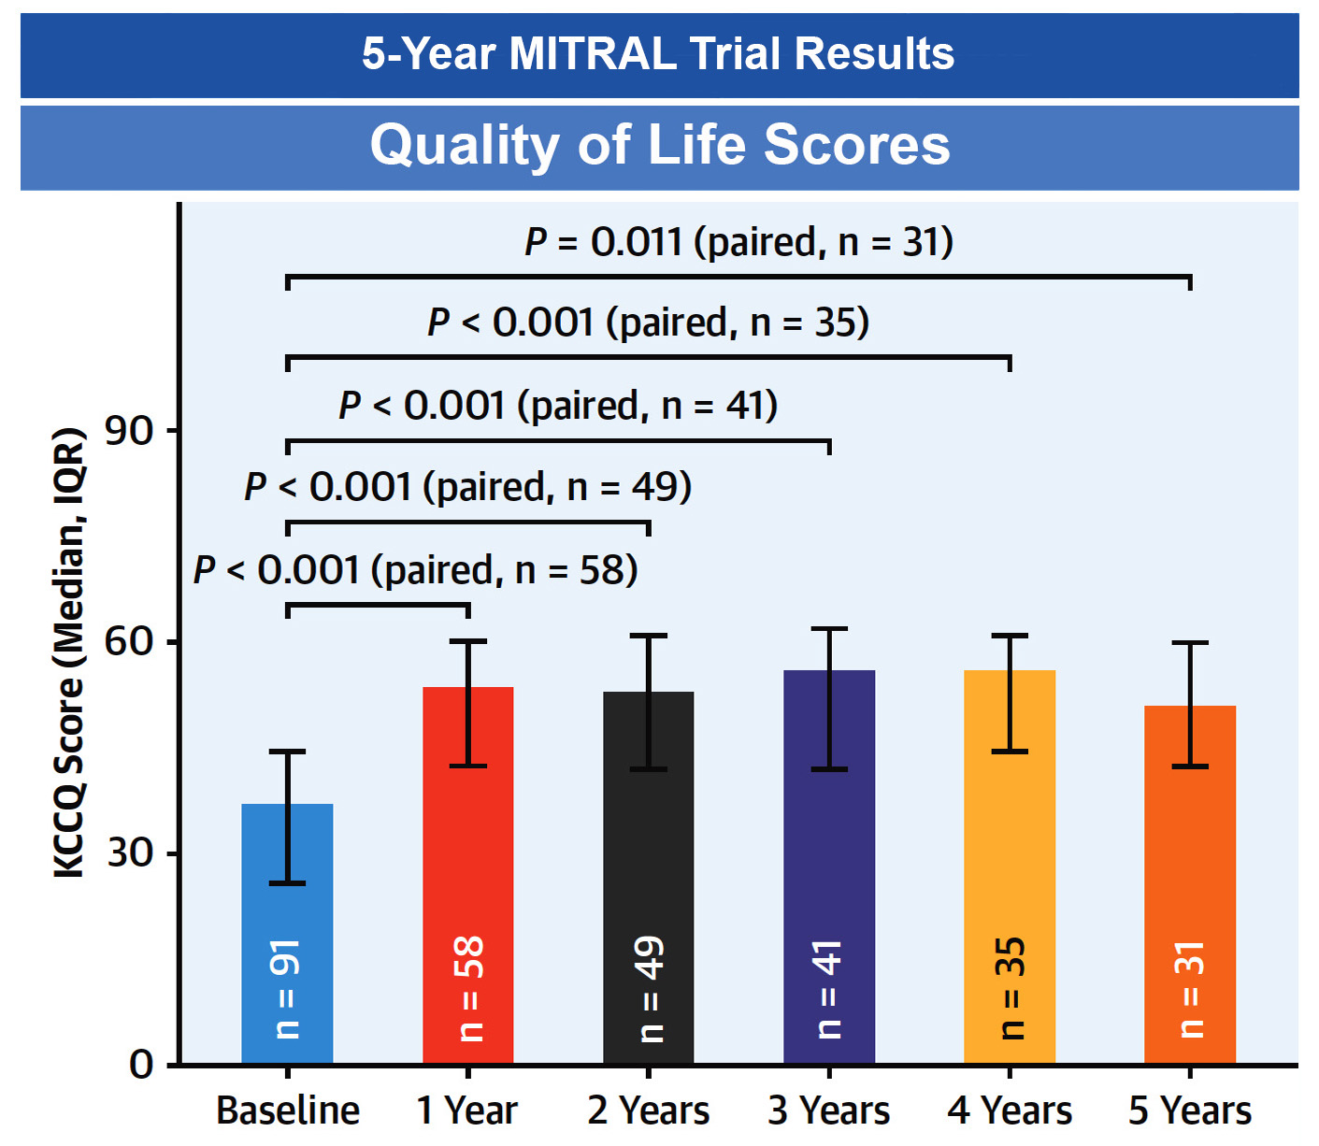
MITRAL Trial: 5-Year Outcomes of Mitral
Valve-in-Valve, Valve-in-Ring, and Valve-in-MAC
Guerrero et al., J Am Coll Cardiol Intv 2023;16:2211

Slide 19
(U.S.)

Slide 21
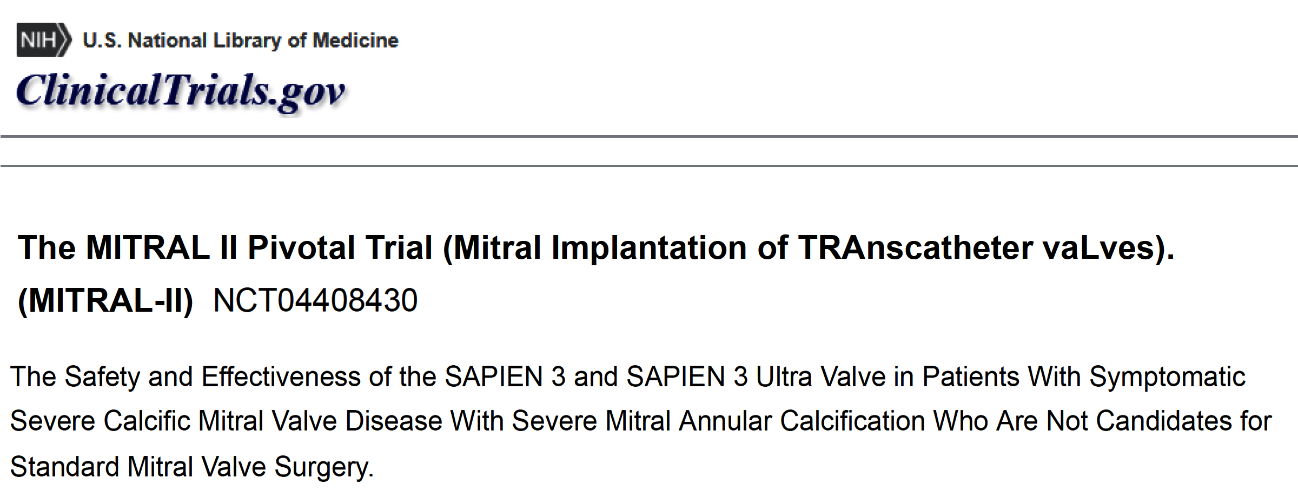

Slide 22
Direct Transatrial TMVR
Intraoperative images of transatrial TMVR
After exposing the mitral valve and resecting the anterior mitral valve leaflet
annular sutures are placed with caution, avoiding MAC where possible
Sapien 3 transcatheter aortic valve prepared before deployment by reinforcing the valve skirt with a polytetrafluoroethelyne felt strip
Valve deployed with the skirt toward the delivery system handle
Valve secured by tying down the annular sutures
Chehab et al., J Am Coll Cardiol 2022;80:722

Slide 23
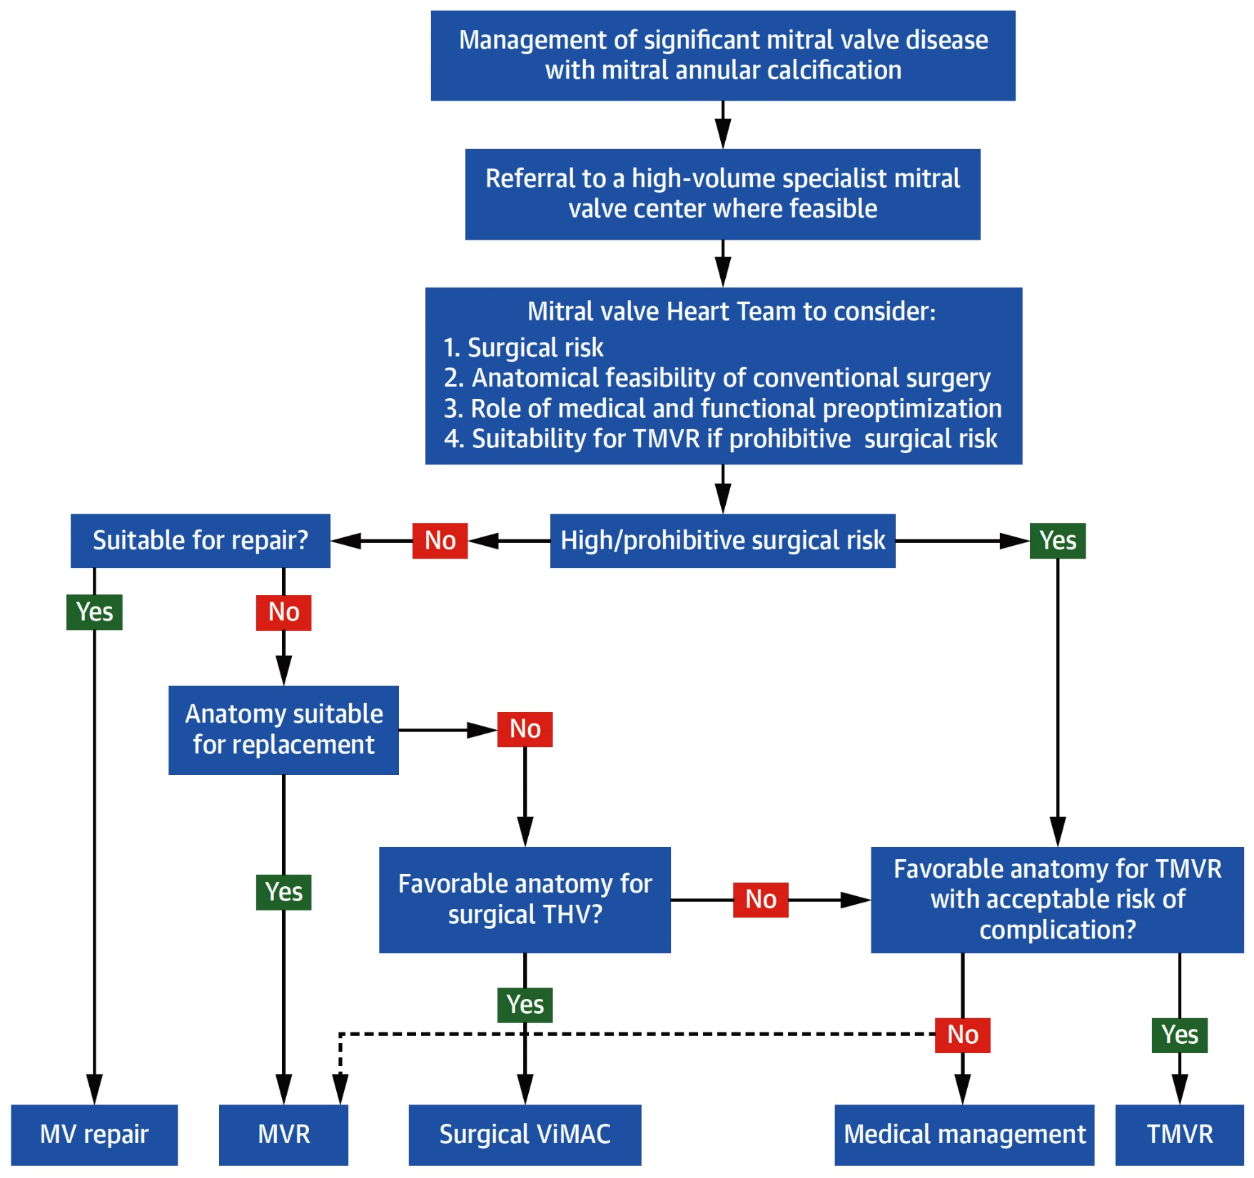
Proposed Treatment Algorithm for Patients with MAC Requiring Valve Intervention
Chehab et al., J Am Coll Cardiol 2022;80:722

Slide 24
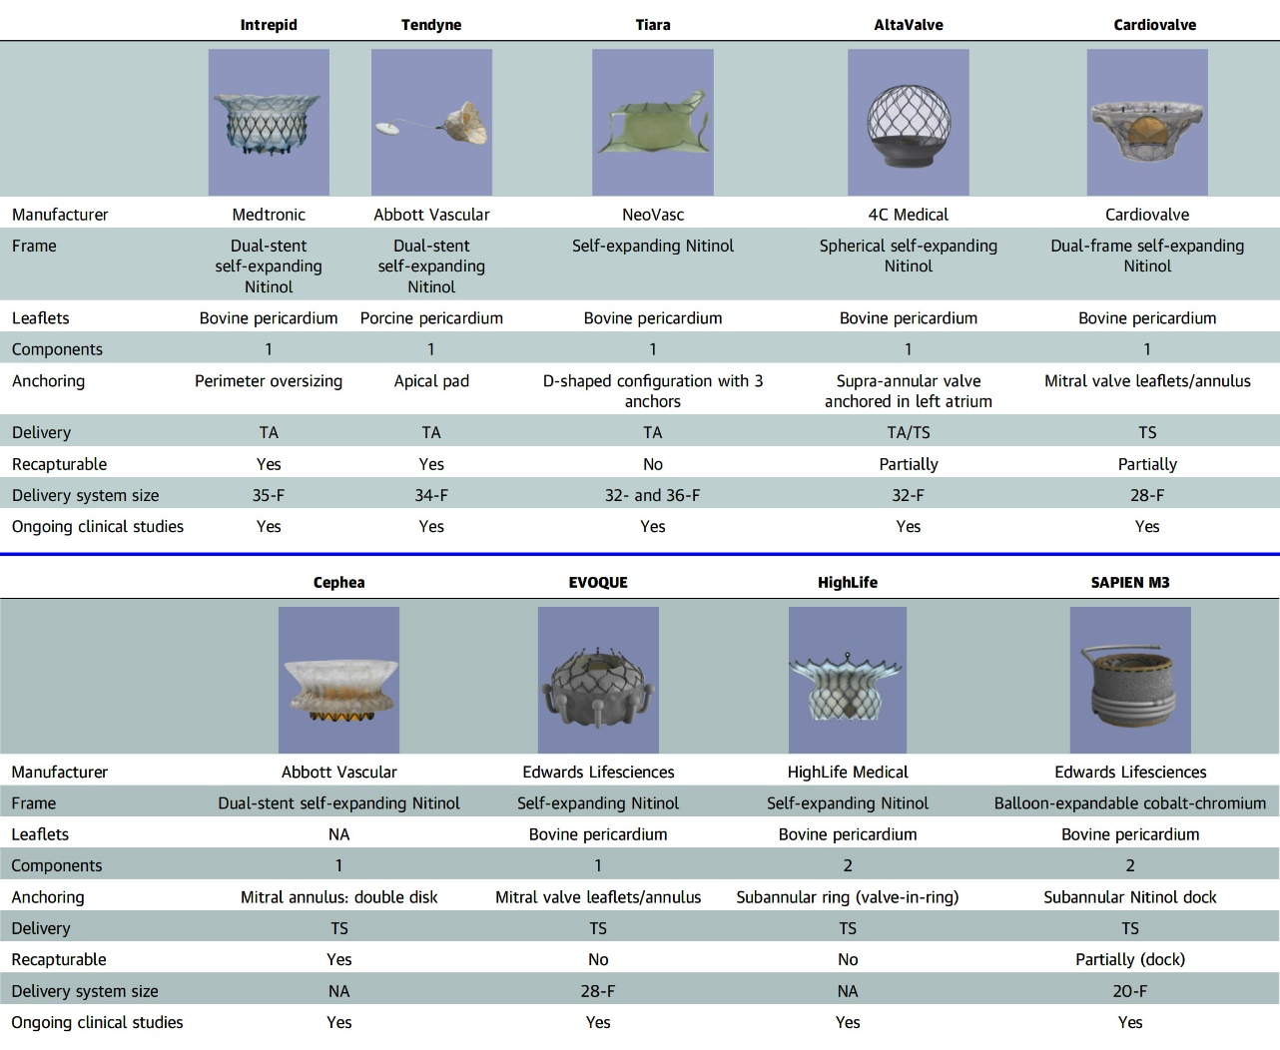
Summary of TMVR Device Characteristics
Hensey et al., J Am Coll Cardiol Intv 2021;14:489

Slide 25
TMVR: Early Clinical Experience
Abbott
Tendyne
Edwards CardiAQ
Edwards
Fortis
Medtronic Twelve
Neovasc
Human Experience | 112 cases | 12 cases | 23 cases | 68 cases | 20 cases
First Implant | October-2013 | June-2012 | February-2014 | September-2014 | January-2014
Longest Pt F/U | 2 year+ | 1 year+ | 2 years+ | 2 years+ | 2 years+
Patient Population | Clinically Significant Severe MR and High Risk Surgical Candidates, NYHA II-IV
FMR Etiology | 86% (n=22) | 64% (n=11) | 100% (n=13) | 73% (n=15) | 54% (n=11)
Successful Deployment | 21/23 | 9/11 | 10/13 | 14/15 | 9/11
30-Day Mortality | 1/23 | 5/11 | 5/13 | 2/15 | 3/11
30-Day Rehosp | 3/23 | Data not available | Data not available | 1/14 | Data not available
MR Grade 0 at F/U | 19/19 | Data not available | 8/9 | 13/14 | Data not available

Slide 26
Ongoing Pivotal RCT of TMVR Devices
Device | Sponsor | Comparator
Intrepid (APOLLO Trial) | Medtronic TMVR | Surgical MV Replacement
Tendyne (SUMMIT Trial) | Abbott TMVR | Surgical MV Repair/Replacement
Subgroups: MitraClip or TMVR device only in high surgical risk

Slide 27
Tendyne™ SUMMIT Pivotal Trial Roll-In and MAC Arm Outcomes
Clinical Trial to Evaluate the Safety and Effectiveness of Using the Tendyne Transcatheter Mitral Valve System for the Treatment of Symptomatic Mitral Regurgitation (SUMMIT)
USA and Canada
NCT03433274

Slide 28
SUMMIT Tendyne™ Trial: TMVR System
Designed for the Mitral Anatomy to Eliminate MR
Dual-frame provides customized anatomic fit and maintains stable hemodynamic performance
Caution: Investigational device. Limited by Federal (U.S.) law to investigational use only
Rogers J, TCT 2023

Slide 29
SUMMIT Tendyne™ Trial: Study Design
Symptomatic MR Grade III/IV, or severe mitral annular calcification (MAC)*, **
Heart Team deems transcatheter treatment more approachable than surgery and anatomy amenable to Tendyne™ TMVR?
Exclude Subject
NO
YES
Randomization (1:1)
(N=382)
Heart Team deems valve anatomy amenable to transcatheter repair, meets MitraClip™ indications?
Subject has severe MAC?
Tendyne™
(Non-repairable Cohort) N=325
YES
NO
NO
Early Experience
YES
Tendyne™
(Treatment)
MitraClip™
(Control)
Tendyne™ Roll-in Subjects up to 2 per site
N=100
Tendyne™
(Severe MAC
Cohort) N=103
Tendyne™ (MAC CAP Cohort) N=up to 150 (upon FDA approval)
1-year follow-up
30-d follow-up
Primary Endpoint: Freedom from all-cause mortality and HFH at 12-m post index procedure
*2017 ASE Guidelines
**With MR ≥ Grade III, severe MS, or moderate MR with moderate or greater MS
Rogers J, TCT 2023

Slide 30
SUMMIT Tendyne™ Trial: Baseline Characteristics
Subject Characteristics (n=100) | (%) or mean ± SD
Age (yrs) | 75.2 ± 7.5
Men | 54.0
BMI (kg/m²) | 27.8 ± 5.5
NYHA functional class ≥III | 69.0
Frailty Score ≥ 2 | 46.0
Hypertension | 91.0
CAD | 69.0
Prior MI | 37.0
Prior CABG | 36.0
PAD | 13.0
HFH within 12 months | 41.0
 | (%) or mean ± SD
COPD | 37.0
Diabetes mellitus | 33.0
GFR <60 mL/min/1,73 m² | 44.0
Prior Stroke or TIA | 11.0
LV ejection fraction (%) | 48.6 ± 10.3
Grade III or IV MR severity | 98.0
Etiology of MR
Primary | 29.6
Secondary | 69.4
Mixed | 1.0
STS-PROM (%) | 6.5 ± 4.0
Rogers J, TCT 2023

Slide 31
SUMMIT Tendyne™ Trial: Procedural Outcomes (N=100)
Procedural Outcomes (n=100) | (%)
Procedural Survival | 100.0
Technical success* | 94.0
Valve implanted† | 97.0
Emergency surgery/intervention | 3.0
CPB | 3.0
Procedural stroke | 1.0
*MVARC definition
†Two valves retrieved, no secondary valve implanted; one procedure aborted prior to implant
Rogers J, TCT 2023

Slide 32
SUMMIT Tendyne™ Trial: Adverse Events
%
Rogers J, TCT 2023

Slide 33
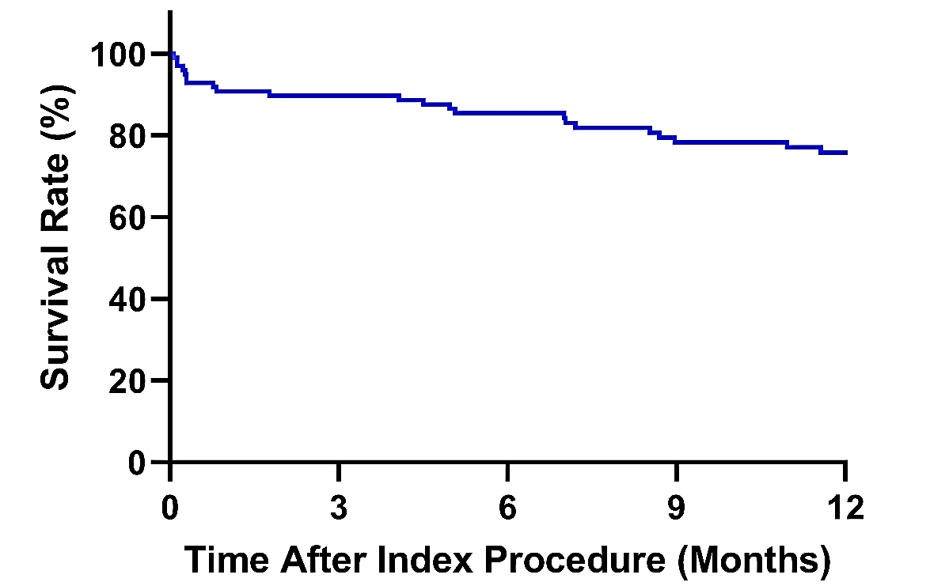
SUMMIT Tendyne™ Trial: 1-Year Survival
74.3%
At Risk | 100 | 85 | 77 | 59
Day | 0 | 90 | 180 | 365
Events* | 2 | 12 | 16 | 24
Survival Rate* (%) | 98.0% | 87.9% | 83.7% | 74.3%
Rogers J, TCT 2023

Slide 34
SUMMIT Tendyne™ Trial: MR Severity
%
97.7%
0/1+
100%
0/1+
96.5%
0/1+
Baseline One-month Six-month 1-year
N=100 N=86 N=76 N=57
Rogers J, TCT 2023

Slide 35
SUMMIT Tendyne™ Trial: Echo Assessment
Paired Analysis
Core Laboratory Measurements
Rogers J, TCT 2023

Slide 36
SUMMIT Tendyne™ Trial: HF Symptoms and QoL
NYHA Classification
KCCQ Overall Score
100
80
68.7
(51.4, 92.7)
63.8
(44.9, 81.4)
57.4
(37.3, 79.7)
53.7
(34.6, 71.2)
60
%
%
40
Mean (Q1, Q3)
20
Baseline 1-mo 6-mo 1-year
N=100 N=88 N=76 N=60
0
Baseline
N=100
1-Month
N=86
6-Month
N=76
1-Year
N=62
Rogers J, TCT 2023

Slide 37
SUMMIT Severe MAC Outcomes

Slide 38
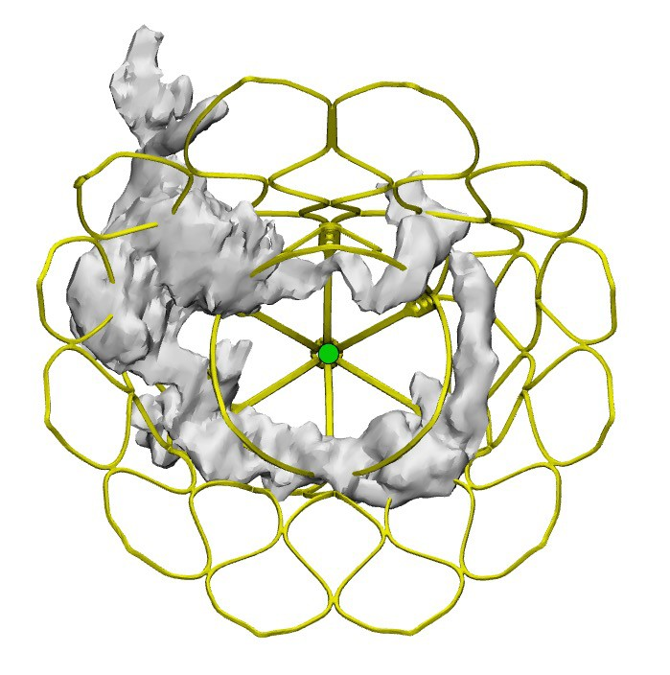
SUMMIT Tendyne™ Trial: Subject Screening and Enrollment
474 patients screened in US and Canada
MR 3+ or greater, severe MS, or moderate MR+MS
Primary Reasons for Screening Failure (75%):
Insufficient neoLVOT
Annular dimensions outside of treatable range
Interaction with inner valve frame
120 patients approved by Subject Eligibility Committee
17 patients exited prior to treatment
103 patients treated with Tendyne™ TMVR system
Rogers J, TCT 2023

Slide 39
SUMMIT Tendyne™ Trial: Baseline Characteristics
Subject Characteristics (n=103) | (%) or mean ± SD
Age (yrs) | 78.0 ± 6.5
Men | 44.7
BMI (kg/m²) | 30.1 ± 6.4
NYHA functional class ≥III | 73.8
Frailty Score ≥ 2 | 55.3
Hypertension | 89.3
CAD | 61.2
Prior MI | 15.5
Prior CABG | 27.5
COPD | 29.1
Diabetes mellitus | 52.4
 | (%) or mean ± SD
HFH within 12 months | 29.1
GFR <60 mL/min/1,73 m² | 55.3
LV ejection fraction (%) | 56.1 ± 9.5
Grade III or IV MR severity | 89.0
Etiology of MR
Primary | 90.3
Secondary | 6.8
Mixed | 2.9
Severe MS | 10.7
Severe MS & MR ≥ Grade II | 6.8
STS-PROM (%) | 7.1 ± 3.9
Rogers J, TCT 2023

Slide 40
SUMMIT Tendyne™ Trial: Procedural Outcomes (N=100)
Procedural Outcomes (n=103) | (%)
Procedural Survival | 98.1
Technical success* | 94.2
Valve implanted† | 100.0
Emergency surgery/intervention | 5.8
CPB | 2.9
Procedural stroke | 0.0
*MVARC definition
†One valve retrieved with no secondary valve implanted
Rogers J, TCT 2023

Slide 41
SUMMIT Tendyne™ Trial: Adverse Events
%
Rogers J, TCT 2023

Slide 42
SUMMIT Tendyne™ Trial: MR Severity
%
100%
MR Grade 1 or less
Rogers J, TCT 2023

Slide 43
SUMMIT Tendyne™ Trial: HF Symptoms and QoL
NYHA Classification
KCCQ Overall Score
%
mean
± SD
Rogers J, TCT 2023

Slide 44
SUMMIT Tendyne™ Trial: Echo Assessment
Paired Analysis
Core Laboratory Measurements
Rogers J, TCT 2023

Slide 45
SUMMIT MAC Arm Key Takeaways
First description of the early outcomes of 103 subjects using a transapical TMVR for severe MAC and MR/MS
Procedural success was high with a 30d mortality of 6.8%
Major bleeding complications most frequent procedural event
MR elimination associated with 30-day hemodynamic improvements, functional status and quality of life
Meaningful changes in cardiac output and forward SV
Reduced MV gradient; no significant increase in LVOT gradient
Reduced HF symptoms
Primary endpoint to be evaluated at one year post-procedure
Rogers J, TCT 2023

Slide 46
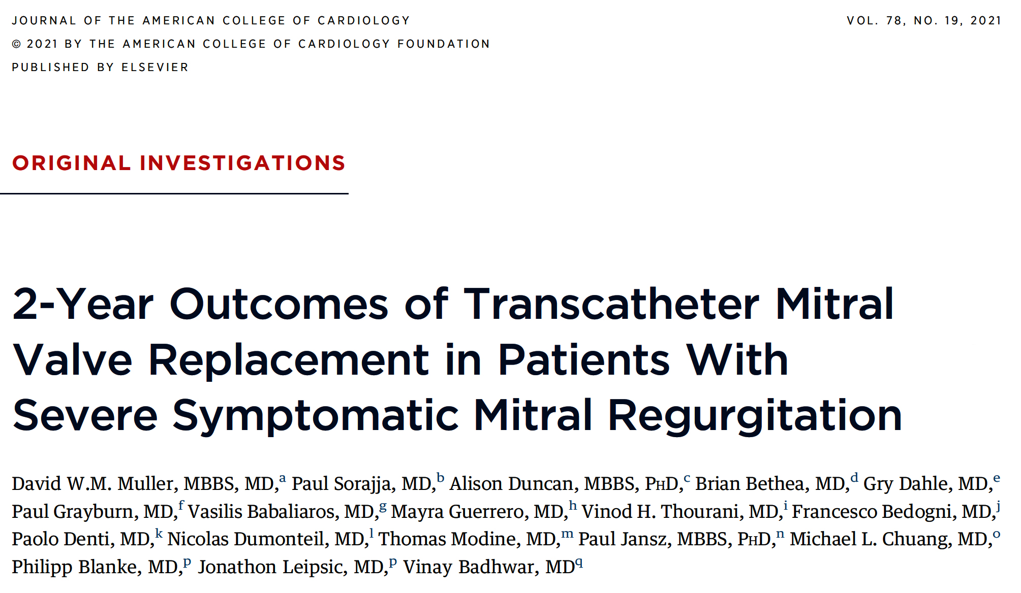

Slide 47
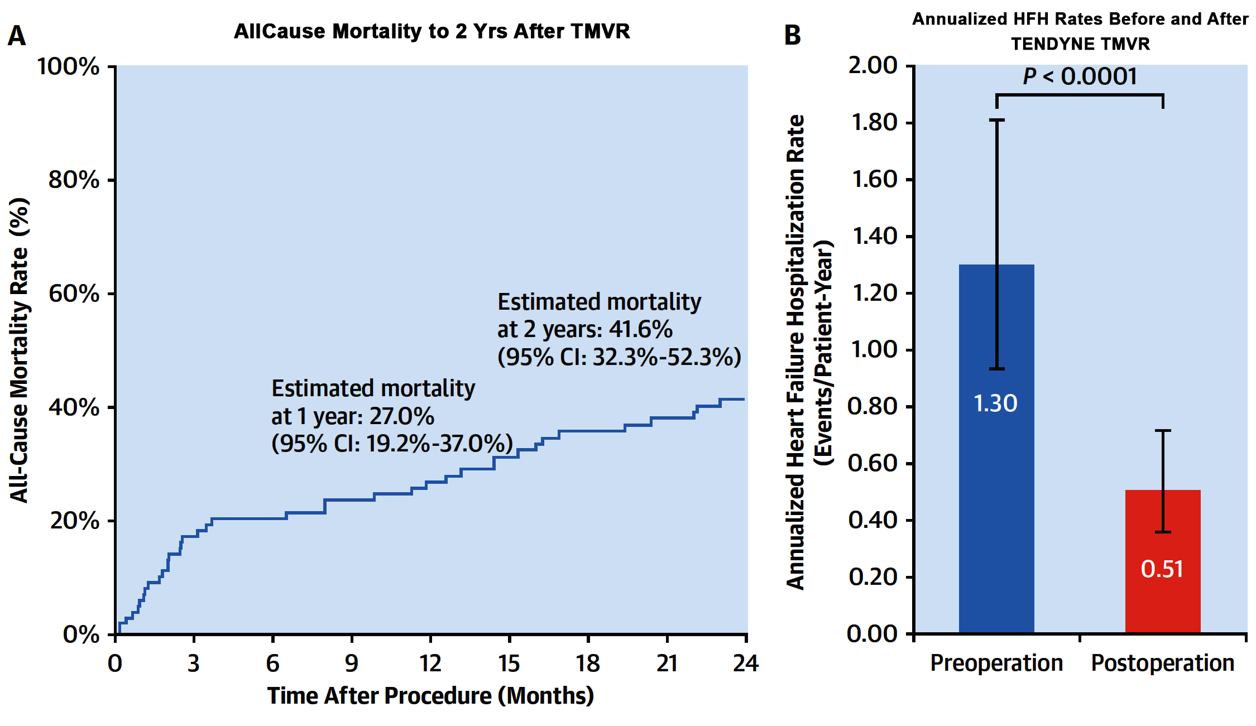
TENDYNE ECS: 2-Yr Clinical Outcomes with TENDYNE TMVR
Muller et al., J Am Coll Cardiol 2021;78:1847
Muller et al., J Am Coll Cardiol 2021;78:1847

Slide 48
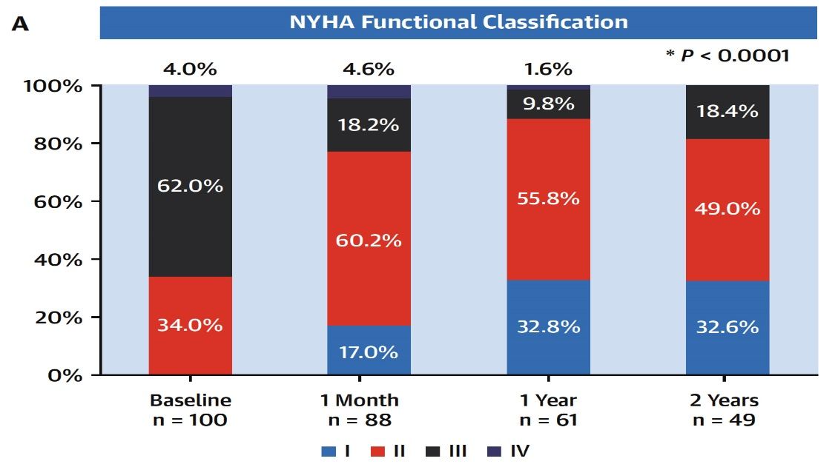
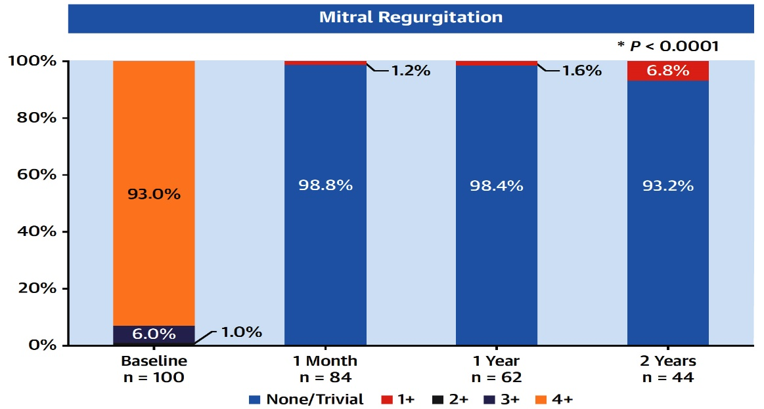
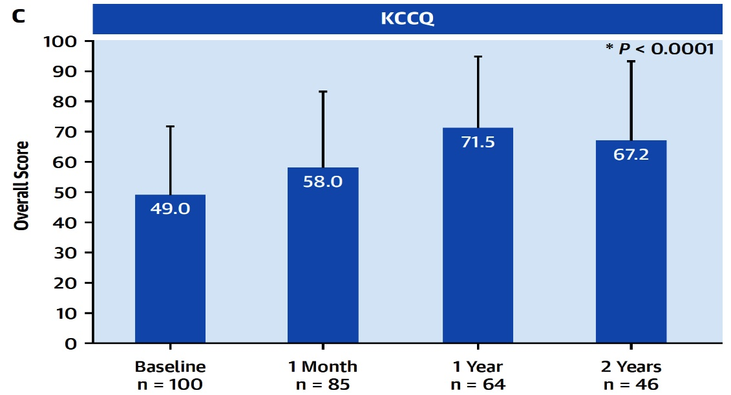
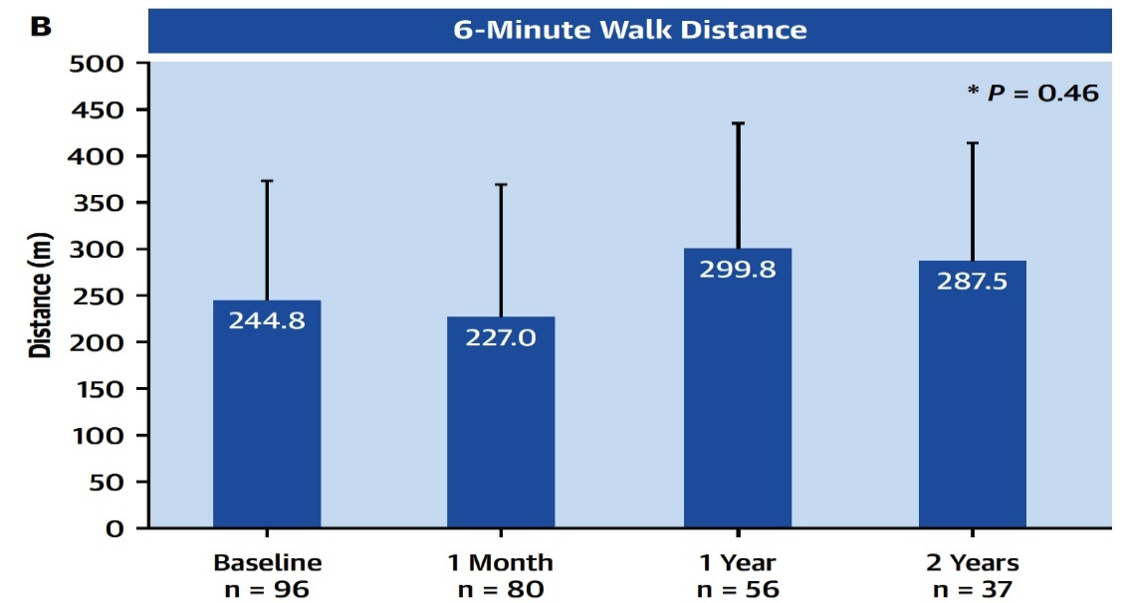
TENDYNE ECS: MR, Functional Capacity and QoL Assessment
Muller et al., J Am Coll Cardiol 2021;78:1847

Slide 49
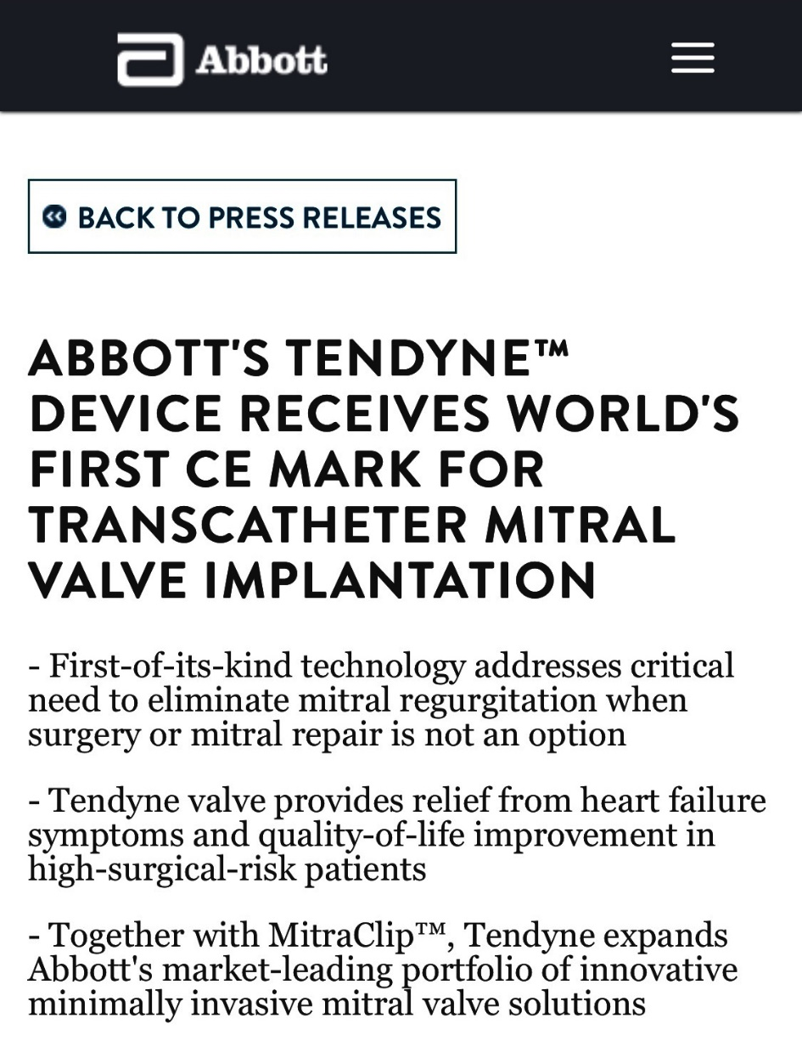

Slide 50
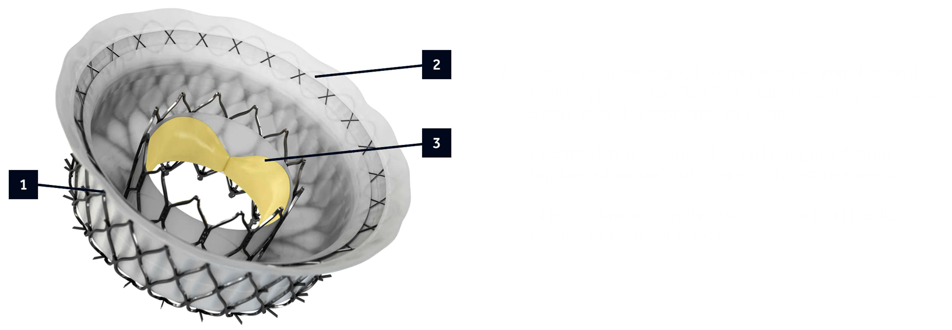
APOLLO Trial Design
Evaluating the safety and efficacy of the Intrepid™ Transcatheter Mitral Valve Replacement System for patients with moderate-to-severe to severe symptomatic mitral regurgitation (MR), with or without mitral annular calcification (MAC), who are unsuitable for transcatheter edge-to-edge repair (TEER) or surgical mitral valve interventions.
Assembly by Multidisciplinary Heart Team
Primary Cohort
(stratified Primary and Secondary MR)
MAC Cohort
TMVR
TMVR

Slide 51
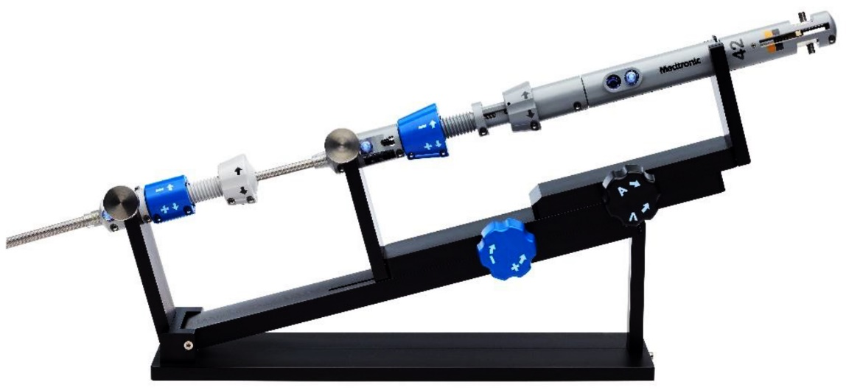
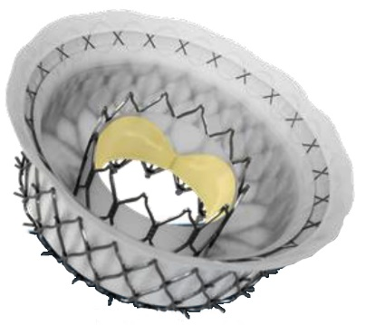
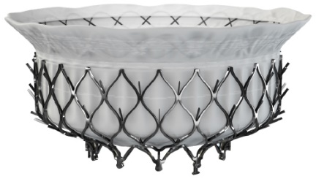
Intrepid TMVR EFS System
Intrepid™ TMVR Delivery System
Intrepid™ Valve Design
Transfemoral access with dilator and 35-F sheath
Cradle and delivery catheter with familiar transeptal MV maneuvers
Conformable outer stent anchors without leaflet capture
Circular inner stent with 27 mm tri-leaflet bovine pericardial valve; symmetrical design without need for rotational alignment
24- and 48-mm valves currently and 54-mm valve in development
Identical valve design used in transapical studies
Zahr F, TCT 2021

Slide 52
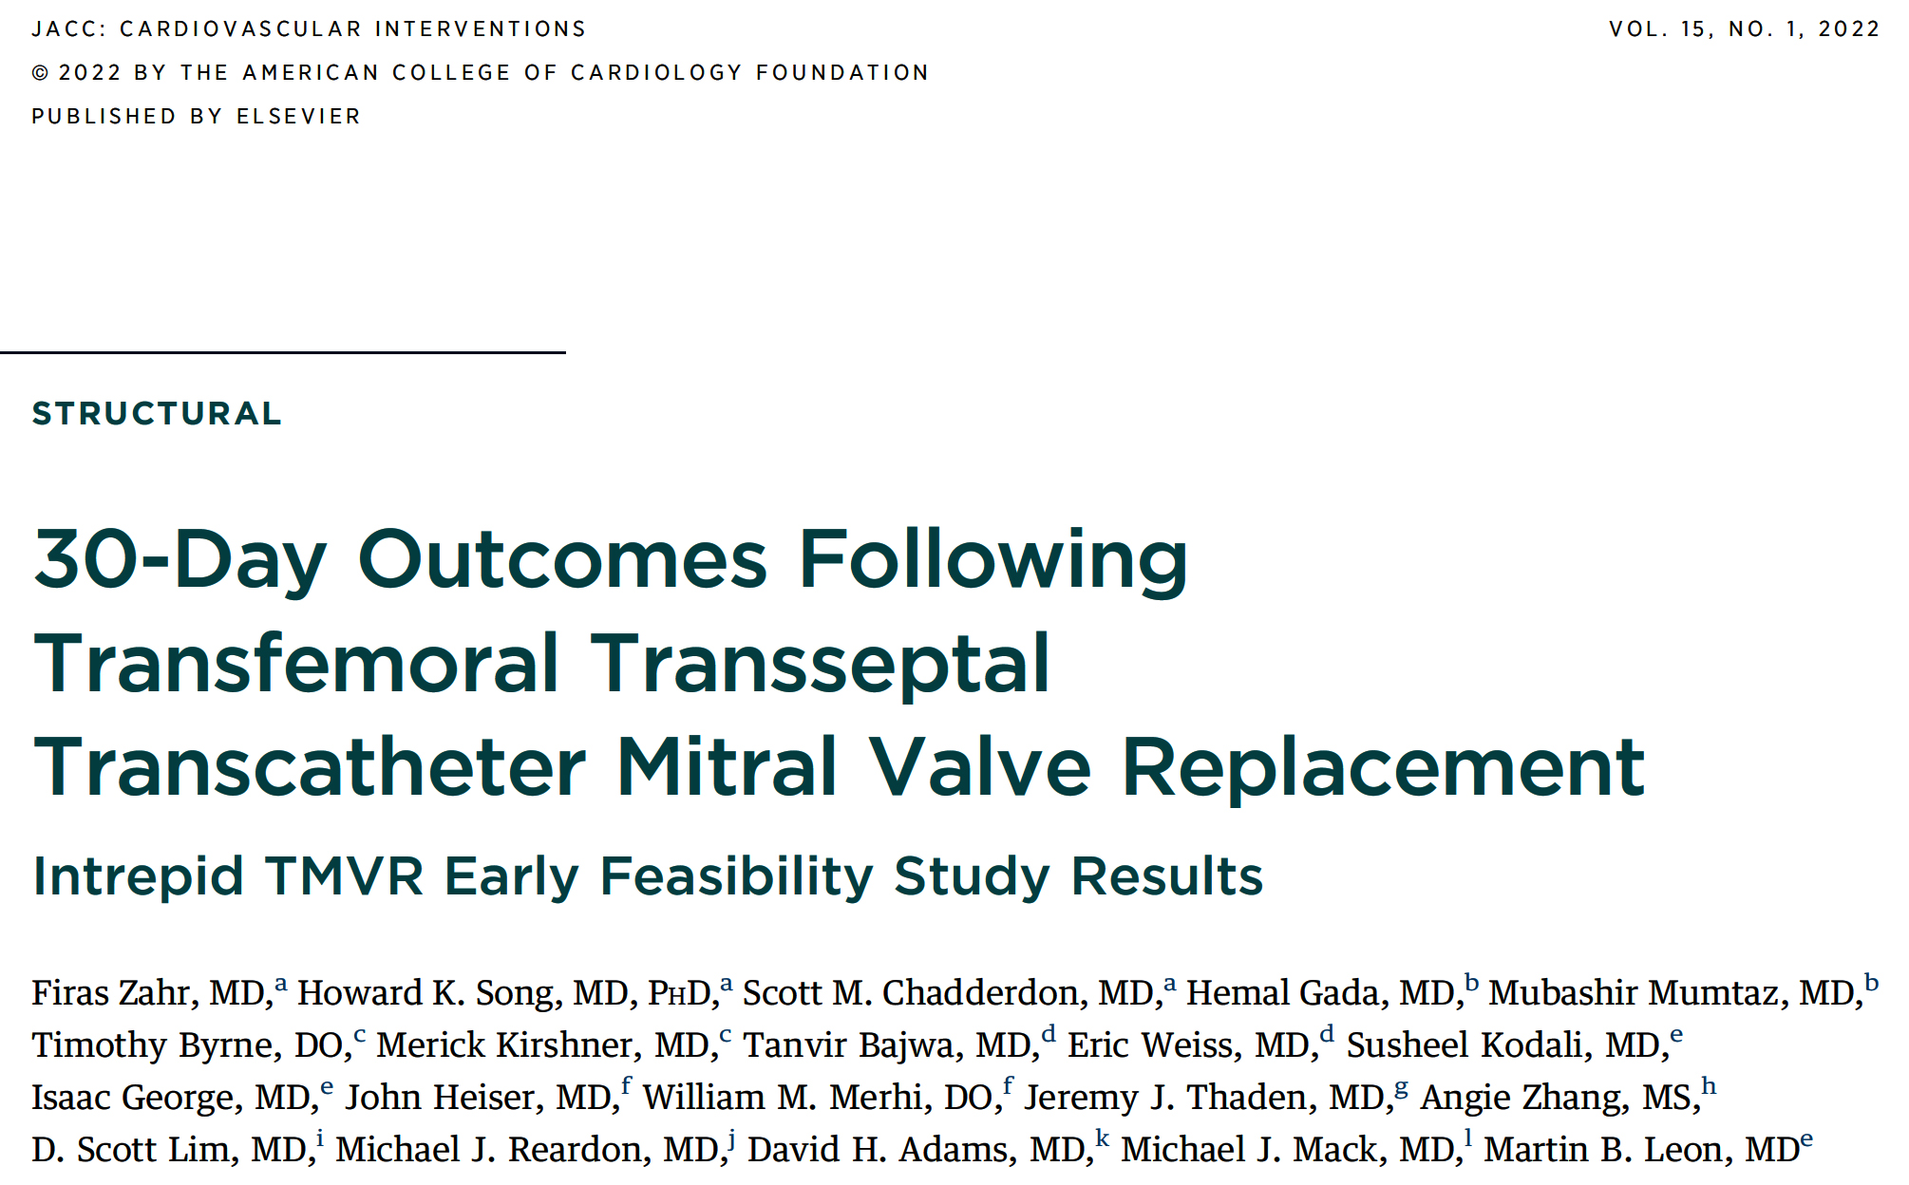

Slide 53
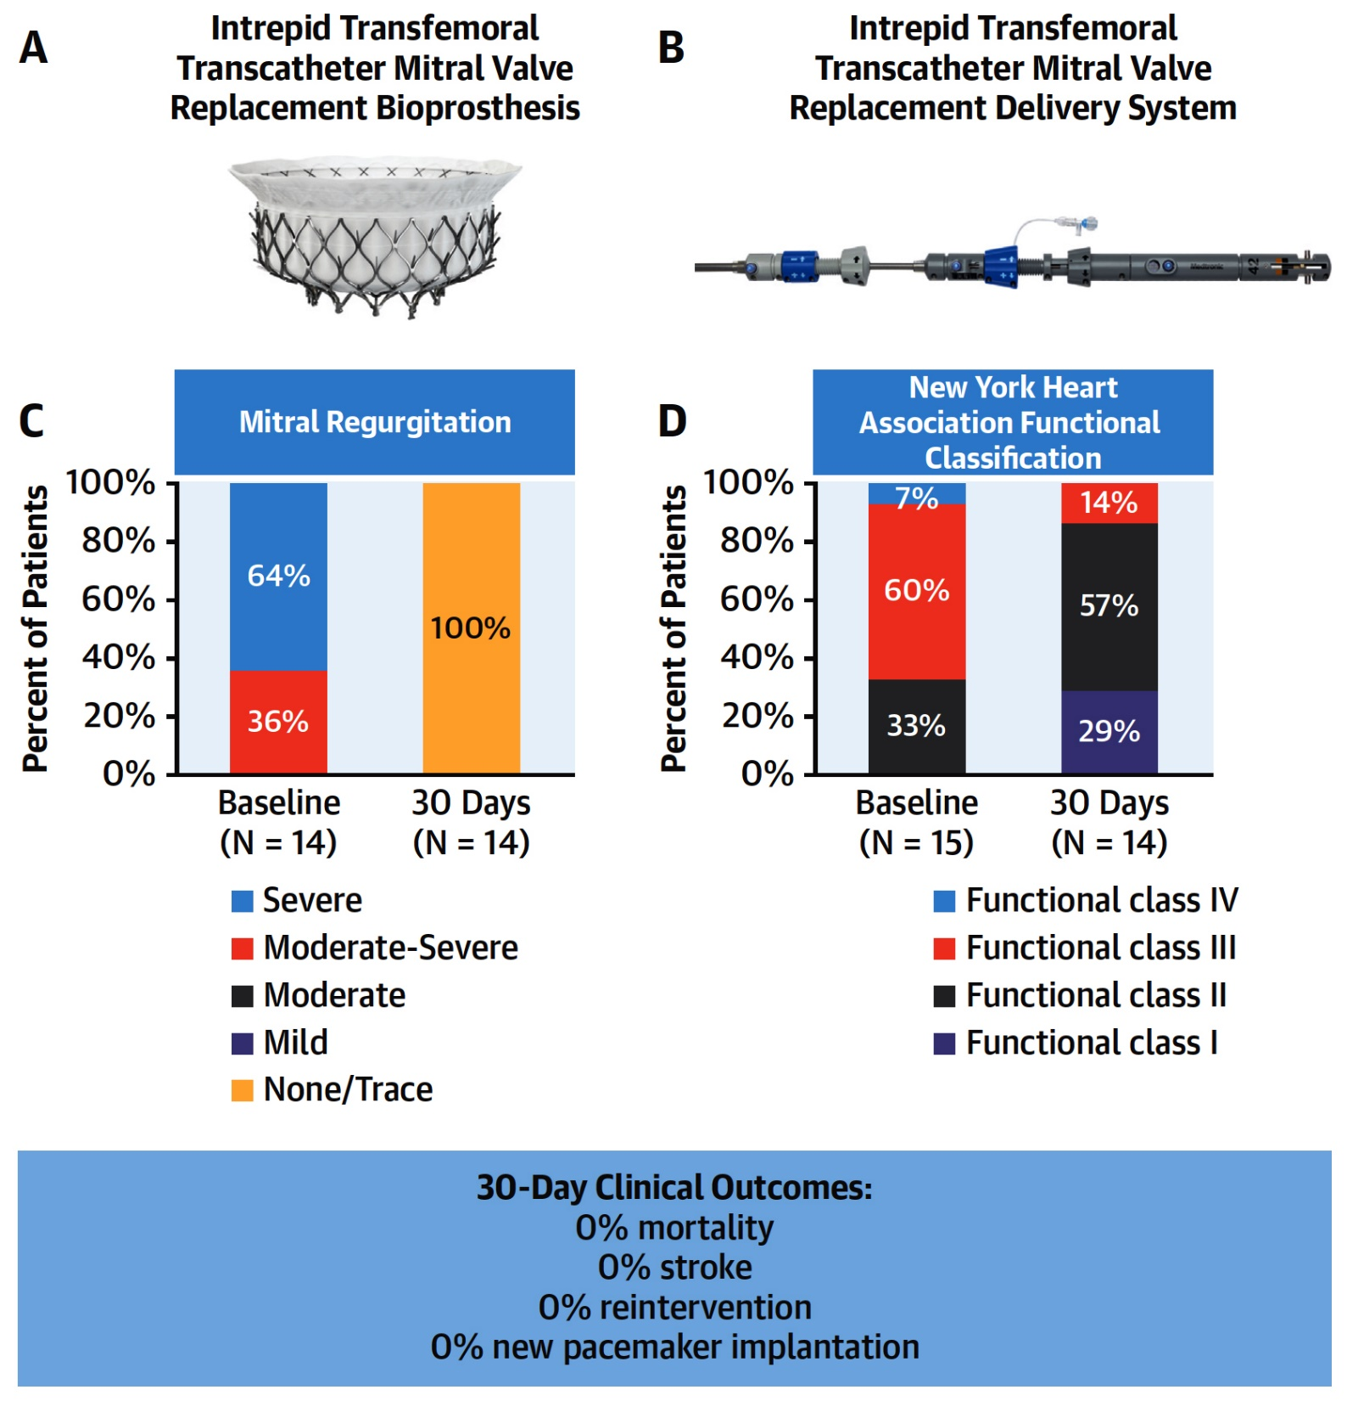
30-Day Outcomes From the Intrepid TMVR EFS Study
73% ASD closure
40% vascular compls
Zahir et al., J Am Coll Cardiol Intv 2022;15:80

Slide 54
1-Year Outcomes Following Transfemoral Transseptal Transcatheter Mitral Valve Replacement: Intrepid TMVR Early Feasibility Study Results (U.S. Multicenter))
Firas Zahr, MD¹; Howard K. Song, MD PhD¹; Scott Chadderdon, MD¹; Hemal Gada, MD²; Mubashir Mumtaz, MD²; Timothy Byrne, MD³; Merick Kirshner, MD³; Samin Sharma, MD⁴; Susheel Kodali, MD⁵; Isaac George, MD⁵; John Heiser, MD⁶; William Merhi, DO⁶; Leora Yarboro, MD⁷; Paul Sorajja, MD⁸; Vinayak Bapat, MD⁸; Tanvir Bajwa, MD⁹; Eric Weiss, MD⁹; Jeremy J. Thaden, MD¹⁰; Elizabeth Gearhart¹¹; Scott Lim, MD⁷; Michael Reardon, MD¹²; David Adams, MD⁴; Michael Mack, MD¹³; Martin B. Leon, MD⁵

Slide 55
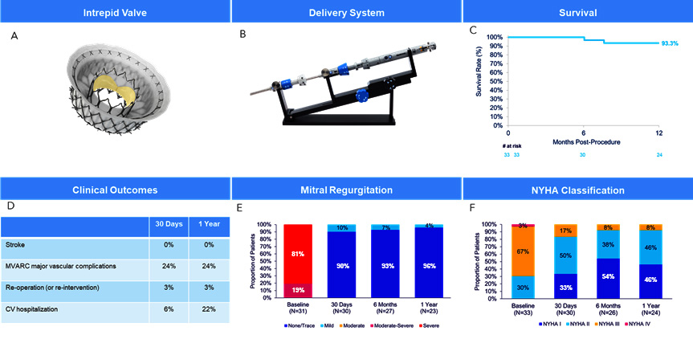
1-Year Outcomes from the Intrepid Transcatheter Mitral Valve Replacement Early Feasibility Study
(A) Intrepid transfemoral bioprosthesis. The Intrepid bioprosthesis, available in 42- and 48-mm valve sizes, is composed of an inner Nitinol stent, an outer Nitinol fixation ring, and a woven polyester skirt attached at the top of the fixation ring that flares outward to form an atrial brim. Reproduced with permission from Medtronic. (B) Intrepid delivery system. Reproduced with permission from Medtronic. (C) Survival free of all-cause mortality. (D) Key clinical outcomes. (E) Mitral regurgitation over time. Echocardiographic data are on implanted patients only and core laboratory adjudicated. (F) New York Heart Association classification over time.
Zahr, Byrne, Sharma et al.

Slide 56
Conclusions
Results of the Intrepid Transfemoral TMVR System in a larger cohort continue to demonstrate excellent valve function and safe transfemoral valve delivery. This study documented favorable performance with no mortality, stroke, at 30 days, and a significant reduction in MR severity to trace or none in most implanted patients. This excellent performance continued to 1 year, demonstrating the favorable impact of this therapy and setting the stage for larger trials aimed at further improvement of clinical outcomes.

Slide 57
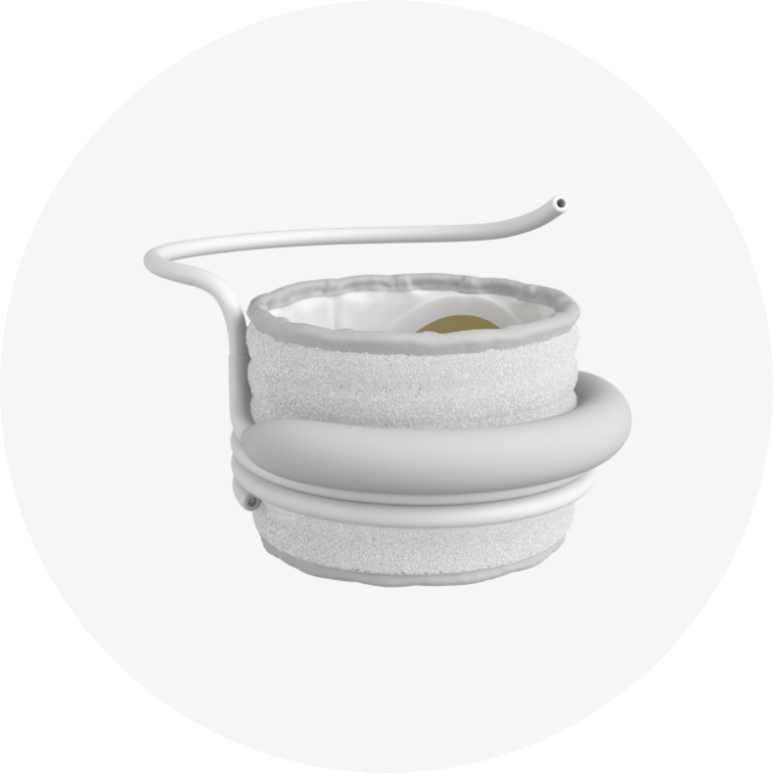
SAPIEN M3 TMVR System
The SAPIEN M3 dock:
Nitinol dock designed to encircle native mitral leaflets to provide an anchor for the SAPIEN M3 valve
The SAPIEN M3 valve:
Specifically engineered to respect the native mitral anatomy
Leverages 29 mm SAPIEN 3 valve tissue and frame
Includes full-frame PET skirt

Slide 58
SAPIEN M3 TMVR System - The ENCIRCLE Trial
NCT04153292
Purpose:
This is a single-arm, multicenter study to establish the safety and effectiveness of the Edwards SAPIEN M3 transcatheter mitral valve replacement system in subjects with symptomatic, at least 3+ mitral regurgitation (MR) for whom commercially available surgical or transcatheter treatment options are deemed unsuitable.
Trial Design
Subjects deemed unsuitable for commercial treatment options as assessed by the Heart Team
Main Study
(n= up to 300)
MAC Registry
(n= 100)
Failed TEER Registry
(n= 100)
Primary Endpoint:
Death and Heart Failure Rehospitalization at 1 Year
Follow-up: 30 days, 6 mos, 1 year and annually through 5 years

Slide 59
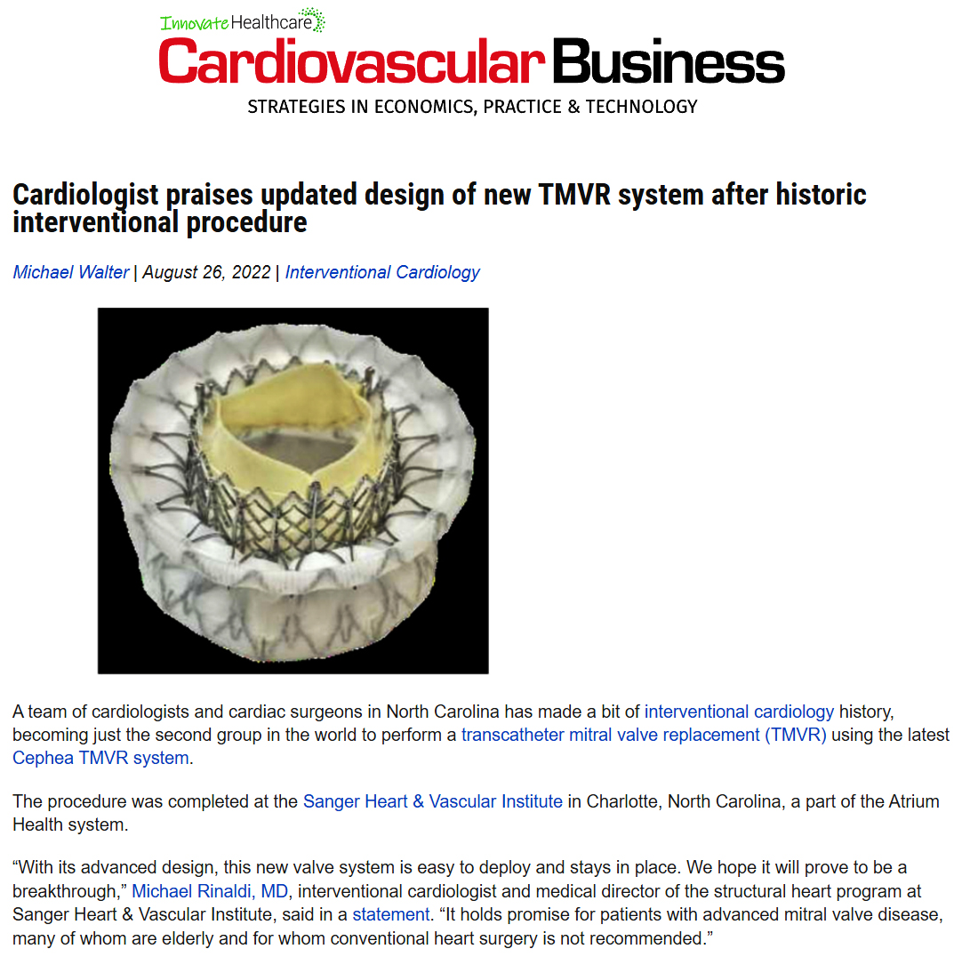

Slide 60
Factors Influencing MVr (TEER) vs TMVR
Transcatheter Edge-to-Edge Repair | TMVR
Contraindication to anticoagulation | Commissural MR
Central MR | Broad MR jet (extending commissure to commissure
Adequate mitral valve area (>4 cm²) | Small mitral valve area (<3.5 cm²)
Absence of stenosis | Mixed mitral valve disease/predominant stenosis
Absence of leaflet calcification at grasping zone | Calcification at grasping zone
Long leaflets | Short PMVL (<7 mm)
Non-excessive flail (i.e., gap <10 mm width <15 mm) | Significant tethering of PMVL
Coaptation depth <11 mm | Large flail gap/width
Coaptation ≥2 mm | Large coaptation gap
Not favorable for TMVR: high-risk for LVOT obstruction, asymmetric MAC with risk for PVL | Multiple prolapsing segments (Barlow’s disease)
Concomitant significant TR amenable to plication | Cleft/perforation

Slide 61
Take Home Messages
TMVR Update 2023
TMVR devices are increasing and their use is evolving in the carefully planned clinical research trials. Initial data of TMVR devices are satisfactory with very high procedural success rates with reasonably low complications. Only subgroup of TMVR in MAC remains challenging with high short and long-term mortality. Sapien PHV is the most commonly device used for high surgical risk MV disease pts especially ViV procedures.
Newer devices for TMVR have great promise and trans-septal TMVR is poised to change this field with excellent device performance, safety with increasing focus in reducing vascular complications.
MV degeneration due to MAC continue to be challenging and newer devices are focusing in the treatment of this vey high risk challenging subset. Advance imaging modalities (3D TEE, 4D/virtual CT) are vital in careful pt selection and proper procedural planning.

Slide 62
Question # 1
Following statements are correct for 5-year outcomes of the MITRAL trial of high risk MR involving ViV, ViR or ViMAC except:
Sustained benefit in death and HFH is noted in all TMVR types
Sustained QOL improvement in all TMVR types
Sustained reduction in MR in all TMVR types
TMVR done for ViR has the highest mortality at F/U
Correct answer: D

Slide 63
Question # 2
Following statement are true regarding the 1 year outcomes of the Intrepid trans-septal TMVR except :
Significant reduction in MR persists up to 1 year
Significant reduction in NYHA class persists up to 1 year
Vascular complication occurs in 10-15% of cases
Procedural success continued to increase over time
Correct answer: C

Slide 64
Question # 3
Following are the trials including the TMVR devices except:
A. SUMMIT
B. COAPT
C. APOLLO
D. ENCIRCLE
Correct answer: B

