Slide 1
CCC Endovascular Live Case: Multilevel Complex Fem/pop and BTK CTO
Division of Endovascular Interventions
The Mount Sinai Hospital
Wednesday, December 13, 2023

Slide 2
History of Presenting Illness
67 year-old gentleman referred for bilateral lifestyle-limiting claudication progressive to ischemic rest pain (L>R) with < 1 block of activity (Rutherford Grade II, Category 4).
PMHx: CAD s/p 1V CABG (2019) in DR c/b CHB s/p PPM, HFrEF 2/2 ICM, Subclavian thrombosis on lifelong AC, PVD s/p left GSV RFA (2022), HTN, HLD, NIDDMII
Social Hx: Never smoker
Medications: Warfarin, Plavix, Crestor, Zetia, Entresto, Carvedilol, Lasix

Slide 3
Noninvasive Vascular Diagnostics
ABI/PVR:
Left Lower Arterial Duplex:

Slide 4
Diagnostic Peripheral Angiogram

Slide 5
Case Plan
Access:
- Contralateral RIGHT CFA access with 6F Destination long sheath
- Left pedal access (+/-)
Adjunctive Therapy:
- Atherectomy (+/-)
- Atherotomy (+/-)
Destination Therapy:
- DCB vs Stent
- PTA vs Atherotomy BTK

Slide 6
Life – BTK Trial

Slide 7
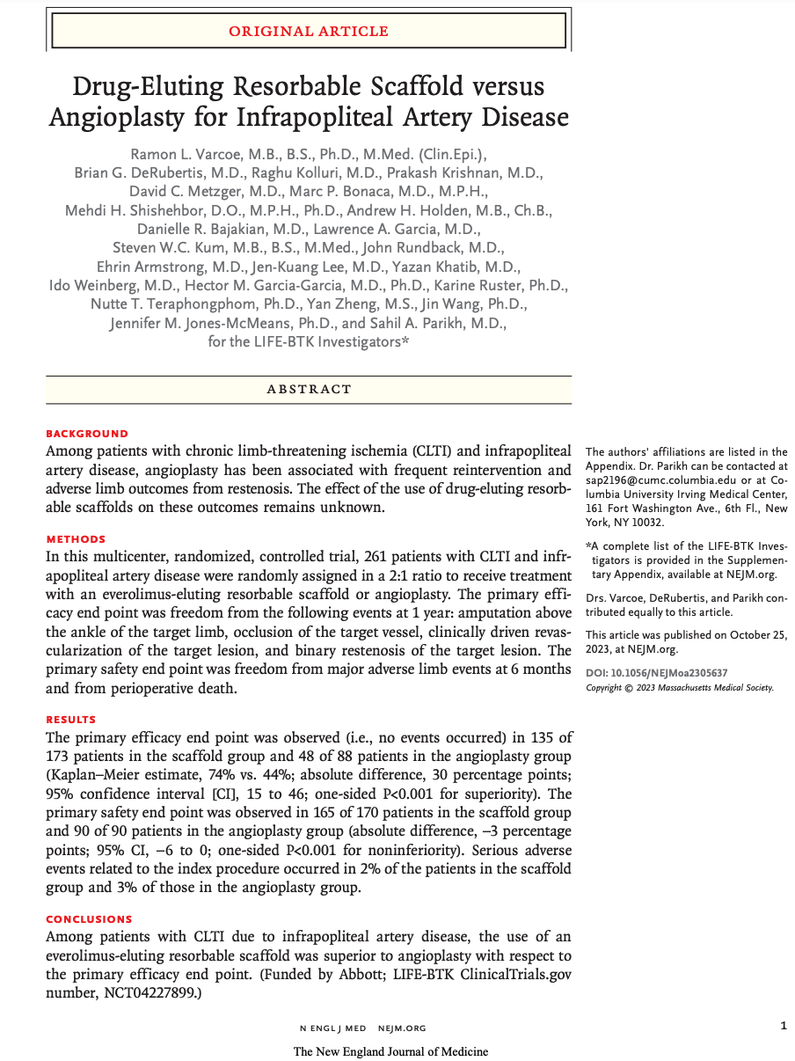
Life-BTK Trial

Slide 8
Life-BTK Trial

Slide 9
Life-BTK Trial

Slide 10
Life-BTK Trial

Slide 11
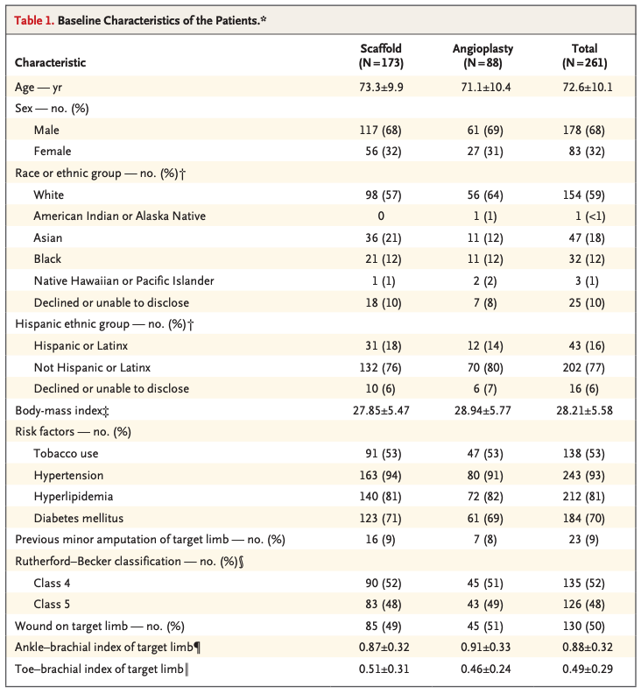
Life-BTK Trial

Slide 12
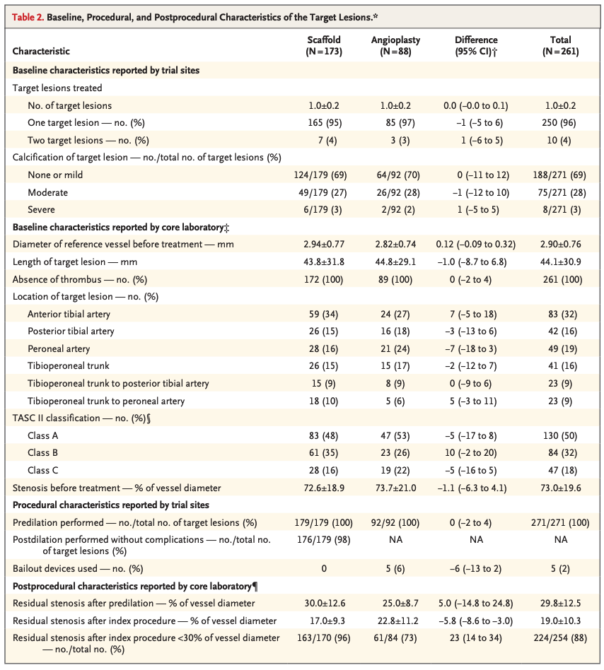
Life-BTK Trial

Slide 13
Life-BTK Trial

Slide 14
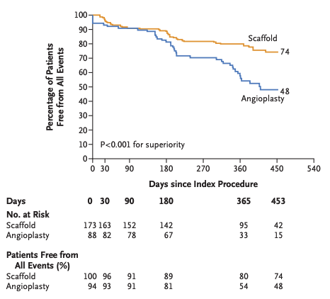
Life-BTK Trial

Slide 15
Thank You/Any Questions?

