Slide 1
Learn From The Masters
Managing Calcified Coronary Lesions
Complex made Simple with IVUS Guidance
Supported by:
Boston Scientific Corporation (BSC) India
EHCC Jaipur
MSH New York

Slide 2
Disclosures
Samin K. Sharma, MD, MSCAI, FACC
Nothing to disclose
Annapoorna S. Kini, MD, MRCP, FACC
Nothing to disclose

Slide 3
Live Case #12
Patient Demographics
85 yrs, M with PAD but no CAD
Present Clinical Presentation
Presented with new onset CCS class I angina & SPECT MPI revealing multi-vessel ischemia
CAD Risk Factors
Hypertension- controlled
Hyperlipidemia- controlled
IRDM- Controlled
Afib on NOAC, Asthma (on 3 inhalers)
SAQ-7: 72. PAD s/p PTAs
Clinical Variables
No prior CAD history, active, exerciser, normal EF on echo
Medications
Aspirin, Lisinopril, Amlodipine, Atorvastatin, ISMN (added), Metoprolol XL (added), Insulin, Glucophage, Symbicort, Inhalers
Cath: Cath on October 30th 2023 revealed calcific 3 V CAD; 95% pLAD with 70% dLAD, 90% calcified LCx, multiple 80-90% calcified RCA lesions, LVEF 60% & Syntax score 38. After heart team discussion, CABG declined and pt underwent RotaDES to LAD lesions.
Plan: Now planned for high-risk IVUS guided complex PCI of multiple calcified lesions in a tortuous RCA using Rotational atherectomy.

Slide 4
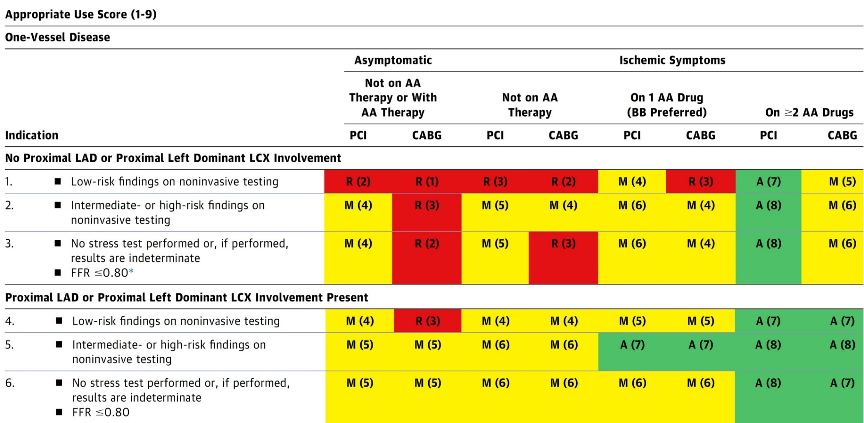
AUC 2017: One-Vessel Disease
Patel et al., J Am Coll Cardiol 2017;69:2212

Slide 5
Treatment of Individual Patients Subgroups
Recommendations for the Treatment of Calcified Lesions
Recommendations for Use of Intravascular Imaging
Recommendations for Hemodynamic Support in Complex PCI
Lawton et al., J Am Coll Cardiol 2022; 79:e21

Slide 6
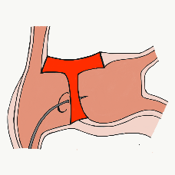
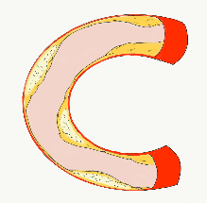
More than 45,800 unique downloads
Cath Lab Apps CardiologyApps.com
iOS 5/5 stars
9896 downloads
Android 4.4/5 stars
8245 downloads
Released sept 2017
iOS 5/5 stars
6068 downloads
Android 4.8/5 stars
3850 downloads
Released June 2018
iOS 5/5 stars
2073 downloads
Android N/A stars
549 downloads
Released March 2018
iOS 5/5 stars
1074 downloads
Android N/A stars
547 downloads
Released Sept 2018
iOS 5/5 stars
931 downloads
Android 5/5 stars
538 downloads
Released June 2019
WebApp Only*
2600 unique users
4800 sessions
Released August 2020
BifurcAID
OCTAID
TAVRcathAID
TranseptAID
CalcificAID
ComplicAID
*Also available
as WebApp
Download Apps
For Free on Both:
WebApps available free on
www.CardiologyApps.com
Apple ® and App Store® are registered trademarks of Apple Inc.
Notes:
These are the apps we have created which will provide digital algorithms for our future ambitious projects to make our cath labs smarter.

Slide 7
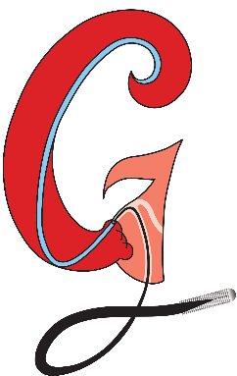
Apps Coming Soon…
STEMIcathAID – STEMI patient transfer platform designed to optimize communication between key members, record key performance metrics for AHA’s Mission: Lifeline program, and avoid costly false activations through direct CCL contact.
GuidewireAID – This application covers the design of coronary guidewires and the resulting properties they exhibit during use in the lab. Over two dozen teaching cases, a dense wire library with more than a hundred wires, and a robust search function provide a lot of tailored learning opportunities.
BifurcAID 3D – An animated bifurcation lesion treatment educational application and website. With two views, detailed descriptions, and more, BifurcAID 3D helps make clear the complex steps in techniques such as Minicrush, DK Crush and Culotte, as well as provisional approached and bailout techniques.

Slide 8
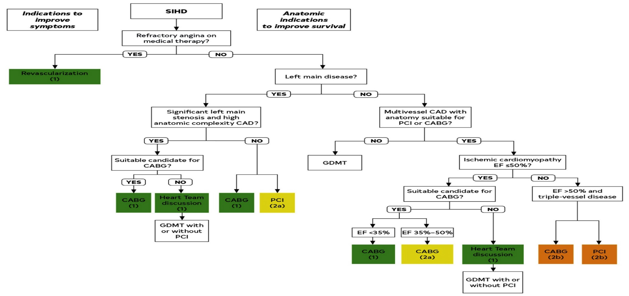
Revascularization to Improve Survival in SIHD Compared to Medical Therapy
Lawton et al., J Am Coll Cardiol 2022:79;e21-129

Slide 9
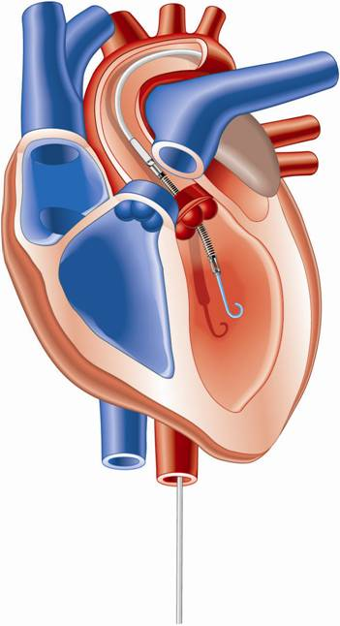
Percutaneous LV Assist Devices
PTVA:
TandemHeart
IMPELLA:
Recovers 2.5/CP
IABP

Slide 10
LV Support during High-risk PCI:
LVEF + Lesion Complexity
LVEF >40%
LVEF 20-40%
LVEF <20%
Simple PCI
Complex PCI
Simple PCI
Complex PCI: High Syntax score >32/ STS>5 Extensive revascularization
Simple or Complex: Inoperable cases
None
?IABP/?Impella
None or IABP
No support
Impella
/IABP (if Impella is CI)
Impella/PTVA
Being evaluated in the randomized Protect IV trial
Notes:
10

Slide 11
LV Support during High-risk PCI:
LVEF + Lesion Complexity
LVEF >40%
LVEF 20-40%
LVEF <20%
Simple PCI
Complex PCI
Simple PCI
Complex PCI: High Syntax score >32/ STS>5 Extensive revascularization
Simple or Complex: Inoperable cases
None
Impella is ok
None or IABP
No support
Impella
/IABP (if Impella is CI)
Impella/PTVA
Notes:
11

Slide 12
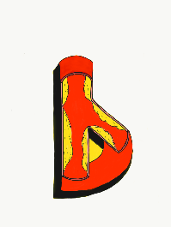
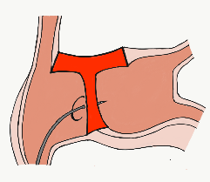
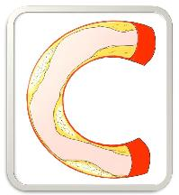
BifurcAID
TAVRcathAID
ComplicAID
Mobile App
Coming soon…
GuidewireAID
Cath Lab
Apps
BifurcAID 3D
CalcificAID
OCTAID
TranseptAID

Slide 13
Outcomes of PCI vs CABG up to 5 yrs
What we know so far?
CABG++
Lower repeat revascularization
Durable angina relief
Lower mortality in subgroups of high syntax score & MV DM
Better QOL parameters
PCI++
Rapid recovery and lower LOS
Better short term results
Lower CVA
Improvement in LVEF
Similar outcomes in LM & low syntax score (<32) pts
What happens in 5-10+ yrs?

Slide 14
More than 35,800 unique downloads
Cath Lab Apps CardiologyApps.com
iOS 5/5 stars
9896 downloads
Android 4.4/5 stars
8245 downloads
Released sept 2017
iOS 5/5 stars
6068 downloads
Android 4.8/5 stars
3850 downloads
Released June 2018
iOS 5/5 stars
2073 downloads
Android N/A stars
549 downloads
Released March 2018
iOS 5/5 stars
1074 downloads
Android N/A stars
547 downloads
Released Sept 2018
iOS 5/5 stars
931 downloads
Android 5/5 stars
538 downloads
Released June 2019
WebApp Only*
2600 unique users
4800 sessions
Released August 2020
BifurcAID
OCTAID
TAVRcathAID
TranseptAID
CalcificAID
ComplicAID
*Also available
as WebApp
Download Apps
For Free on Both:
WebApps available free on
www.CardiologyApps.com
Apple ® and App Store® are registered trademarks of Apple Inc.
Notes:
These are the apps we have created which will provide digital algorithms for our future ambitious projects to make our cath labs smarter.

