Slide 1
CCC Endovascular Live Case: Complex BTK CTO Intervention with Orbital Atherectomy
Division of Endovascular Interventions
The Mount Sinai Hospital
Wednesday, November 1, 2023

Slide 2
History of Presenting Illness
81 year-old gentleman referred for bilateral lifestyle-limiting claudication progressive to ischemic rest pain (L>R) with < 1 block of activity (Rutherford Grade II, Category 4).
PMHx: CAD s/p PCI mRCA (2016), PAD s/p left EIA stent (2020), HTN, HLD, NIDDMII
Social Hx: Active smoker
Medications: ASA, Plavix, Metformin, Sitagliptan, Rosuvastatin, Toprol XL

Slide 3
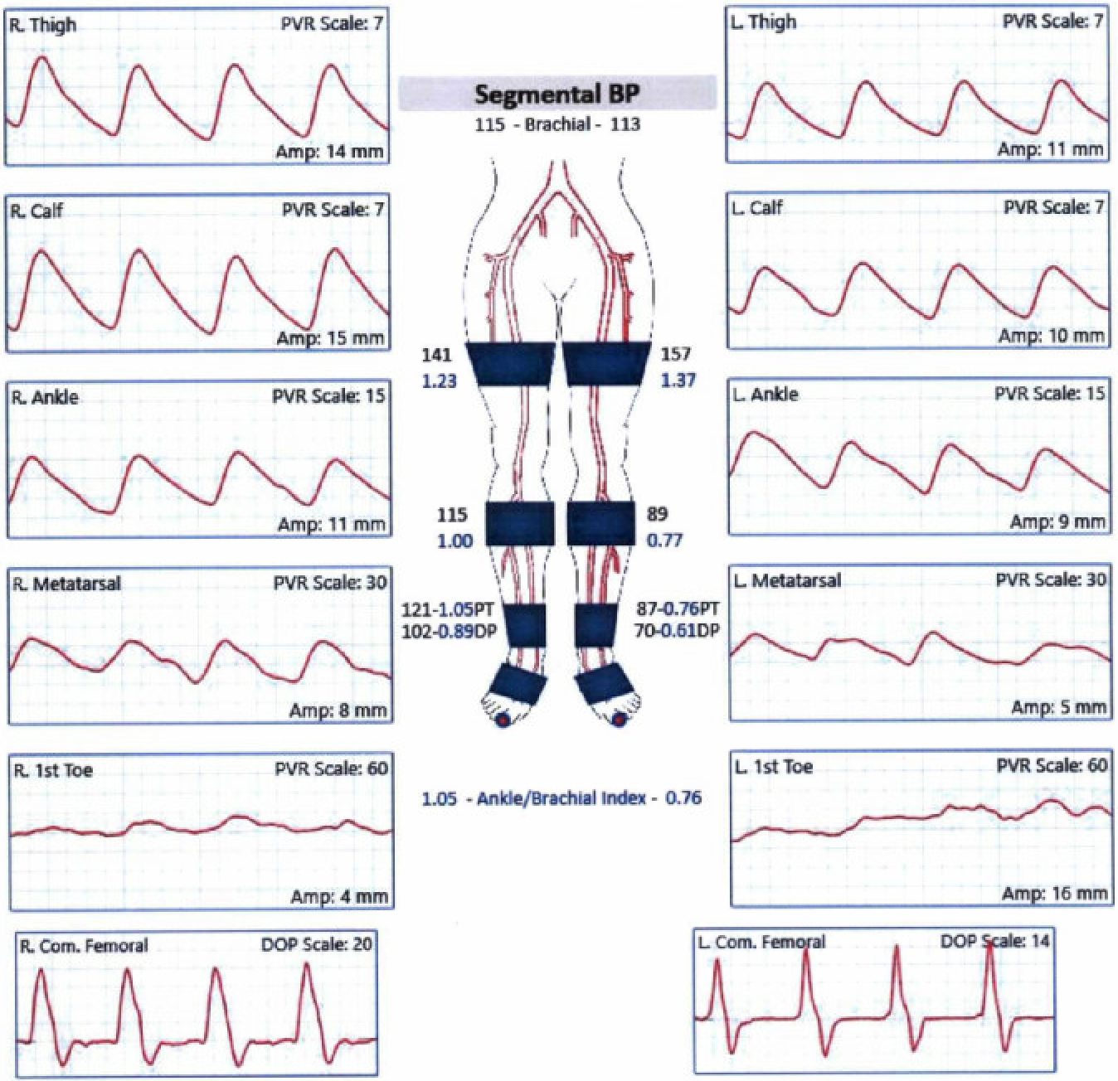
Noninvasive Vascular Diagnostics
ABI/PVR:

Slide 4
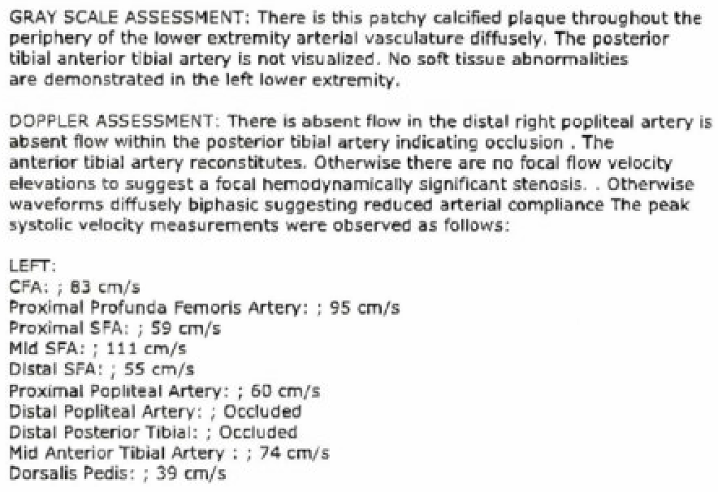
Noninvasive Vascular Diagnostics
Left Lower Arterial Duplex:

Slide 5
Diagnostic Peripheral Angiogram

Slide 6
Case Plan
Access:
- Right CFA access with 6F Destination long sheath
- Left pedal access (+/-)
Adjunctive Therapy:
- Orbital atherectomy with Diamondback 360 OAD
- (+/-) atherotomy
Destination Therapy:
- PTA +/- stent (bailout)

Slide 7
Orbital Atherectomy

Slide 8
Diamondback 360 Peripheral Orbital Atherectomy Device (OAD)

Slide 9
Diamondback 360 Peripheral Orbital Atherectomy Device (OAD)

Slide 10
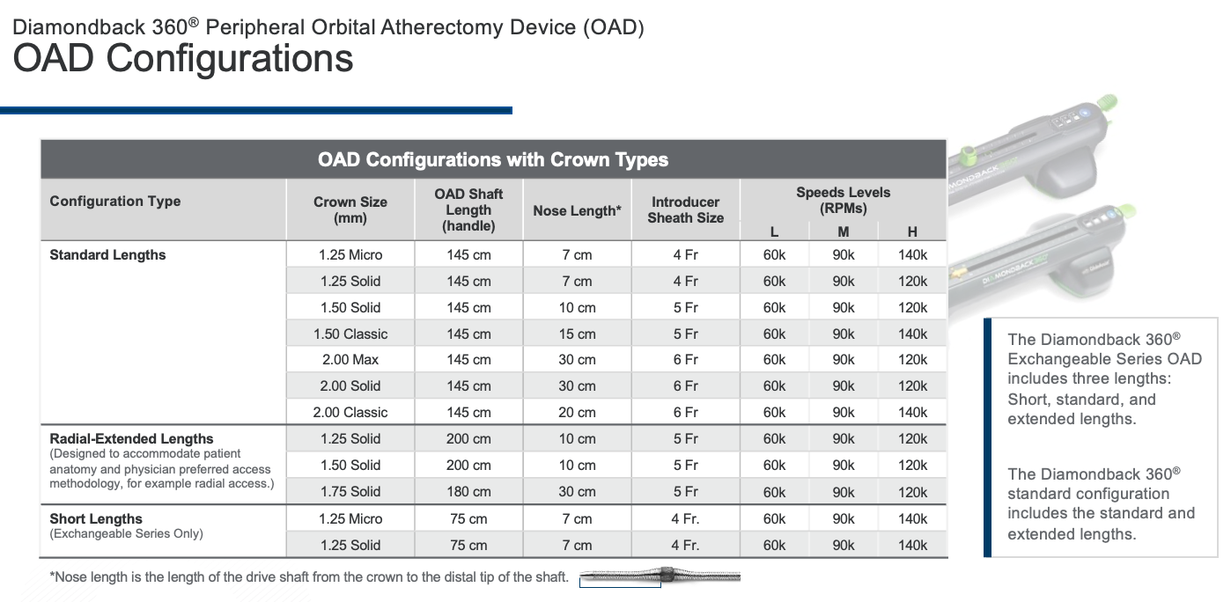
Diamondback 360 Peripheral Orbital Atherectomy Device (OAD)

Slide 11
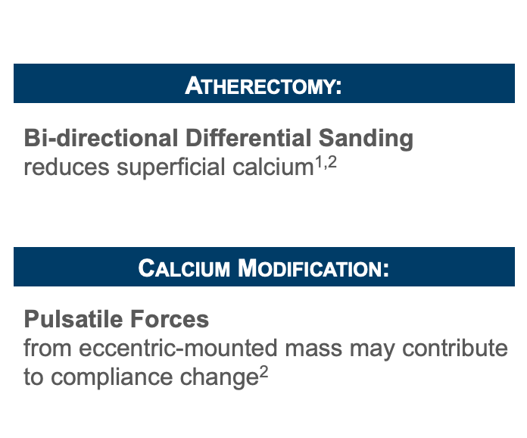
Diamondback 360 Peripheral Orbital Atherectomy Device (OAD) MOA

Slide 12
Diamondback 360 Peripheral Orbital Atherectomy Device (OAD)

Slide 13
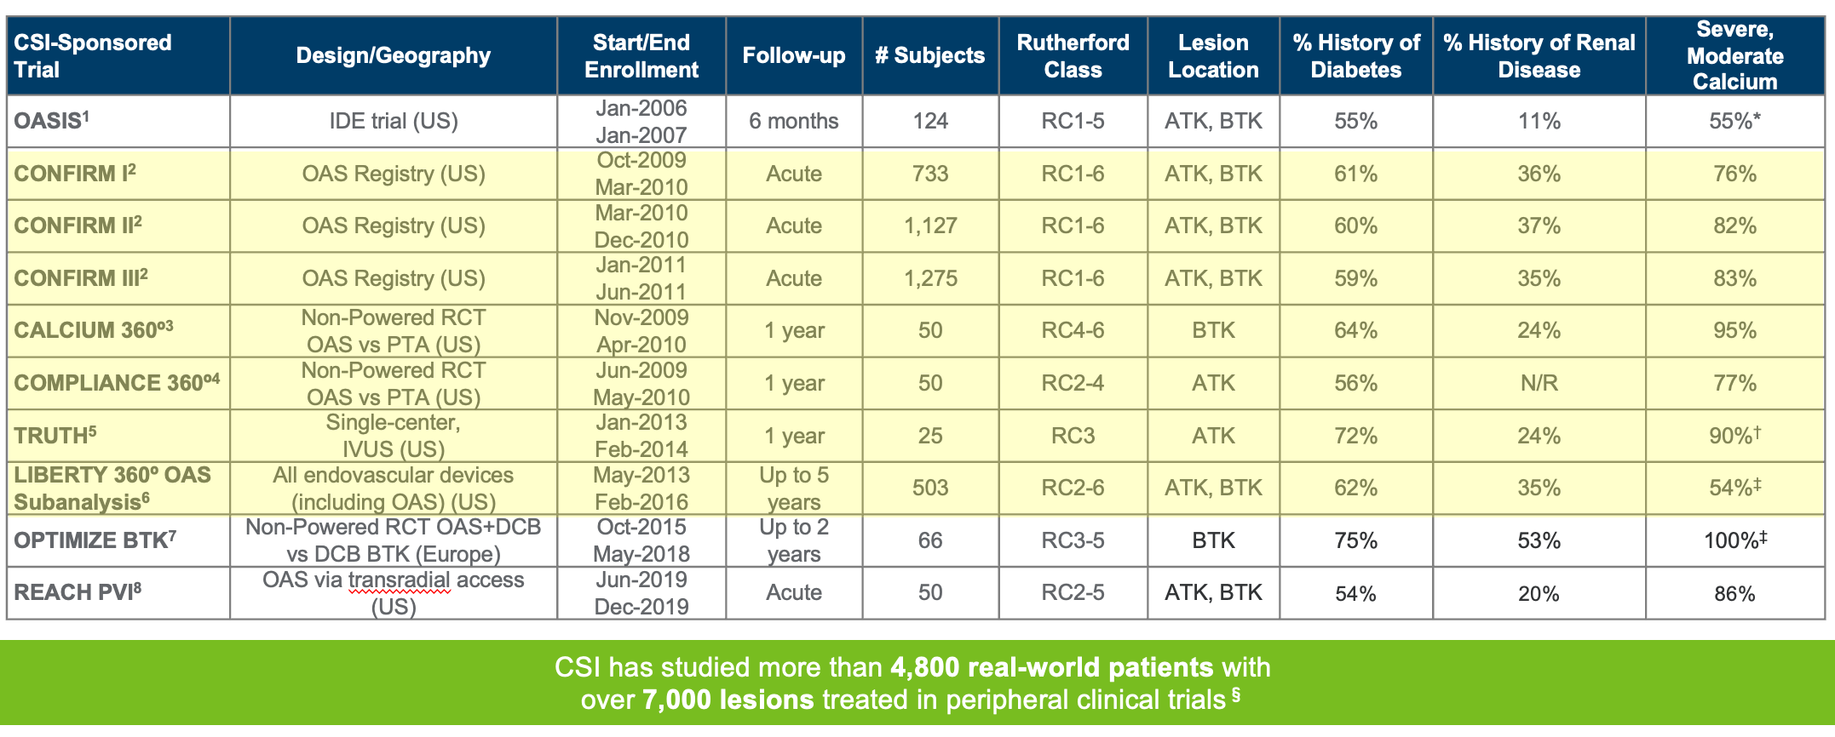
Diamondback 360 Peripheral Orbital Atherectomy Device (OAD) Data

Slide 14
Thank You/Any Questions?

