Slide 1
CCC Endovascular Live Case: Complex Intervention in Patient with Calcific Multilevel Peripheral Arterial Disease
Division of Endovascular Interventions
The Mount Sinai Hospital
Wednesday, September 23, 2023

Slide 2
History of Presenting Illness
63 year-old gentleman presents with progressive bilateral lower extremity lifestyle-limiting claudication that has progressed to rest pain with a right lower extremity non-healing wound (Rutherford Grade III, Category 5) despite maximized optimal medical therapy and SET. His ambulation is limited to <1 city block. Patient had a right SFA stent placed out-of-state and right toe amputations.
PMHx: HTN, HLD, IDDMII, CAD s/p CABG + subsequent PCIs, PAD s/p OSH intervention
Social Hx: Current smoker
Medications: Eliquis, Brillinta, Lisinopril, Carvedilol, Atorvastatin, Insulin

Slide 3
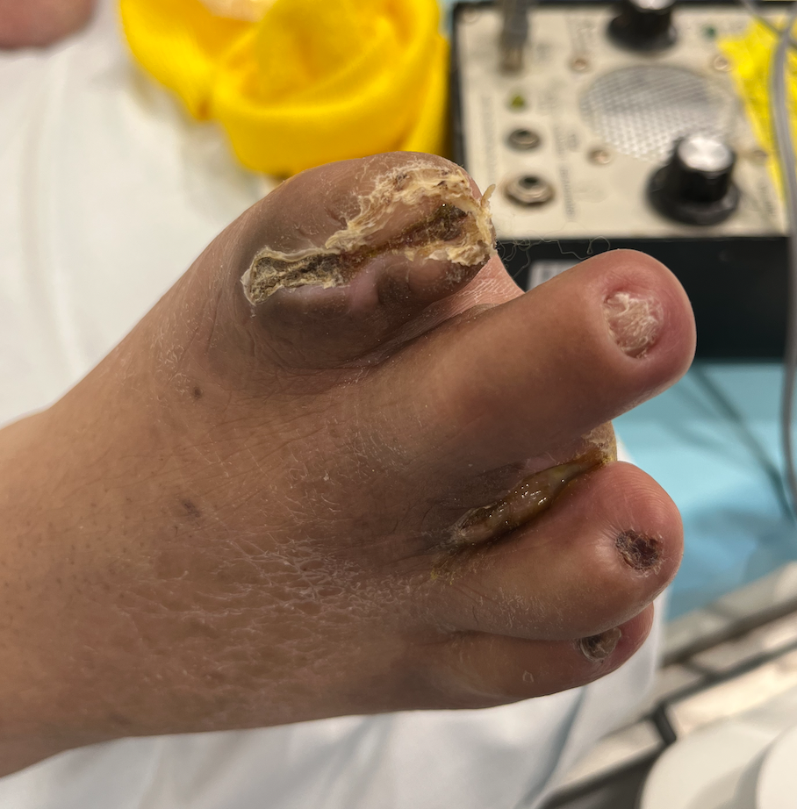
Physical Exam
- Bilateral femoral pulses are palpable but diminished
- Bilateral DP pulses are dopplerable
- Bilateral PT pulses are absent
- Superficial skin changes of bilateral lower extremities with scaly skin, sparse body hair
- Bilateral poor nail formation

Slide 4
Previous Peripheral Angiogram

Slide 5
Right Lower Extremity Intervention
Multilevel intervention performed
Proximal and distal right SFA
Proximal right posterior tibial artery
Proximal right peroneal artery

Slide 6
Case Plan
Access:
- Right CFA access with 6F Destination long sheath
Adjunctive Therapy:
- Intravascular lithotripsy with Shockwave (Shockwave Medical) diffuse calcific disease
- Atherectomy for debulking
- Filter deployment (long calcific multilevel disease)
Destination Therapy:
- DCB + SES vs Drug stent

Slide 7
Thank You/Any Questions?

