Slide 1
Complex Coronary Cases Supported by:
Abbott Vascular Inc.
Boston Scientific Corp.
Terumo Vascular Corp.
Cardiovascular Systems Inc.
Shockwave Medical Inc.
Abiomed Inc.
Chiesi Inc.
Cardinal Health Cordis Inc.

Slide 2
Disclosures
Samin K. Sharma, MD, MSCAI, FACC
Nothing to disclose
Annapoorna S. Kini, MD, MRCP, FACC
Nothing to disclose
Sameer Mehta, MD, FACC (Moderator)
Nothing to disclose
Joseph Sweeny, MD (Discussant about MVD)

Slide 3
CCC Live Case # 171
Patient Demographics
64 yrs, Male, CCD for 22 yrs
Present Clinical Presentation
Presented with CCS Class III angina and a +stress MPI for MV ischemia done as pre-op risk stratification for laminectomy spine surgery
CAD Risk Factors
Controlled Hyperlipidemia
Controlled Hypertension
Diet controlled DM
SAQ-7 score: 79, Ex-smoker
Clinical Variables
s/p multiple PCIs, last LCx PCI in 9/22/2011. Echo with 50% EF in the past and no valvular disease
Medications
Aspirin, Clopidogrel, Metoprolol, ISMN, Atorvastatin, Fenofibrate
Cath: Cardiac cath on 8/1/2023 revealed 2 V CAD; 70% prox-mid LAD under-expanded calcified multi-stent ISR with neo-atherosclerosis (on IVVUS), 70% jailed D2 (Medina 1,1,1), 90% LCx-LPL1 ISR , LCX-OM2 total occlusion ISR, non-obstructive RCA with Syntax score 28 and LVEF 48%. Pt underwent Atherotomy+DES Promus Elite to LCx-LPL1 and did well.

Slide 4
ISR – prox and mid LAD

Slide 5
CBA of LPL1
Wolverine 2.50/16 mm 18 atm 10 sec

Slide 6
Post CBA of ISR of LPL1

Slide 7
Post Stenting of LPL1
Promus Elite 2.50/16 mm 14 atm 10 sec

Slide 8
IVUS of the LAD

Slide 9
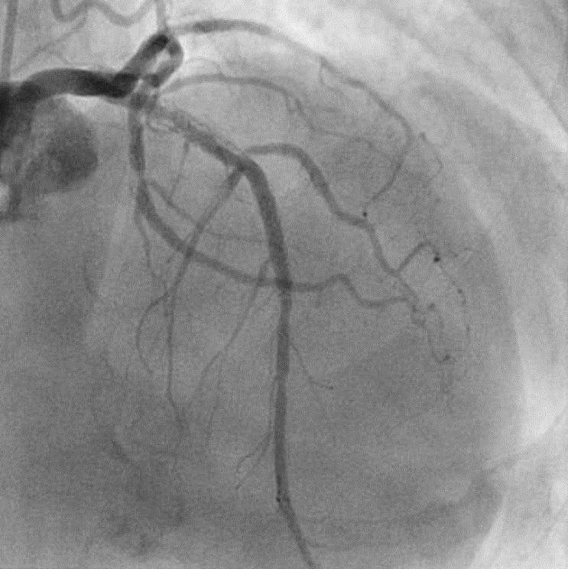
August 1, 2023
IVUS pullback
(pLAD: 2 layer ISR; Cypher 3.5x18 in BMS)
?
(A)
(B)
*
*
*
(A)
Reverberation (artifact)
(B)
*
?
*
*
Calcified Neoatherosclerosis
Calcified
Stent-underexpansion
(= calcium inside stent)
(= calcium outside stent)
Notes:
Run 4 and 5

Slide 10
CCC Live Case # 171
Patient Demographics
64 yrs, Male, CCD for 15yrs
Present Clinical Presentation
Presented with CCS Class III angina and a +stress MPI for MV ischemia done as pre-op risk stratification for laminectomy spine surgery
CAD Risk Factors
Controlled Hyperlipidemia
Controlled Hypertension
Diet controlled DM
SAQ-7 score: 79, Ex-smoker
Clinical Variables
s/p multiple PCIs, last LCx PCI in 9/22/2011. Echo with 50% EF in the past and no valvular disease
Medications
Aspirin, Clopidogrel, Metoprolol, ISMN, Atorvastatin, Fenofibrate
Cath: Cardiac cath on 8/1/2023 revealed 2 V CAD; 70% prox-mid LAD under-expanded calcified multi-stent ISR with neo-atherosclerosis (on IVVUS), 70% jailed D2 (Medina 1,1,1), 90% LCx-LPL1 ISR , LCX-OM2 total occlusion ISR, non-obstructive RCA with Syntax score 28 and LVEF 48%. Pt underwent Atherotomy+DES Promus Elite to LCx-LPL1 and did well.
Plan: Now planned for staged PCI of calcified under-expanded LAD/D2 ISR using RotaTripsy and Mini-Crush stenting with OCT guidance.

Slide 11
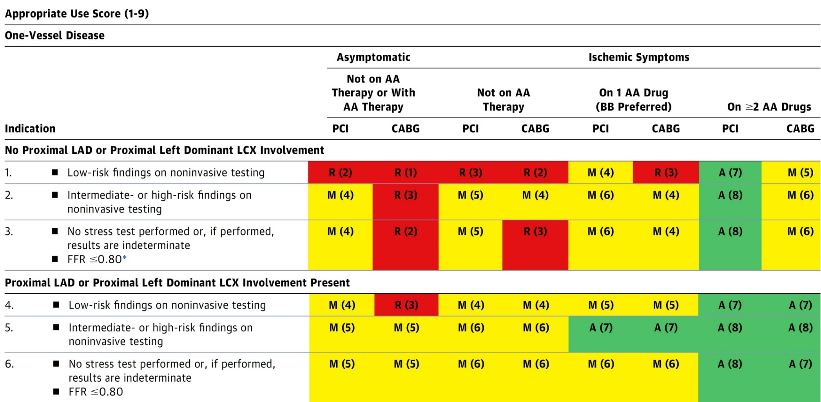
AUC 2017: One-Vessel Disease
Patel et al., J Am Coll Cardiol 2017;69:2212

Slide 12
Latest Issues in Coronary Intervention
Interventional Imaging Trials from ESC 2023:
ILUMIEN IV Trial, OCTOBER Trial, Imaging Trial’s
Network Meta-Analysis, OCTIVUS Trial
Focused review of the month
Comprehensive Management of ANOCA Part 1 & 2:
Definition, Patient Population, Diagnosis,
Program Development, Treatment and Research
Initiatives by Micro Vascular Network (MVN)

Slide 13
Latest Issues in Coronary Intervention
Interventional Imaging Trials from ESC 2023:
ILUMIEN IV Trial, OCTOBER Trial, Imaging Trial’s
Network Meta-Analysis, OCTIVUS Trial
Focused review of the month
Comprehensive Management of ANOCA Part 1 & 2:
Definition, Patient Population, Diagnosis,
Program Development, Treatment and Research
Initiatives by Micro Vascular Network (MVN)

Slide 14
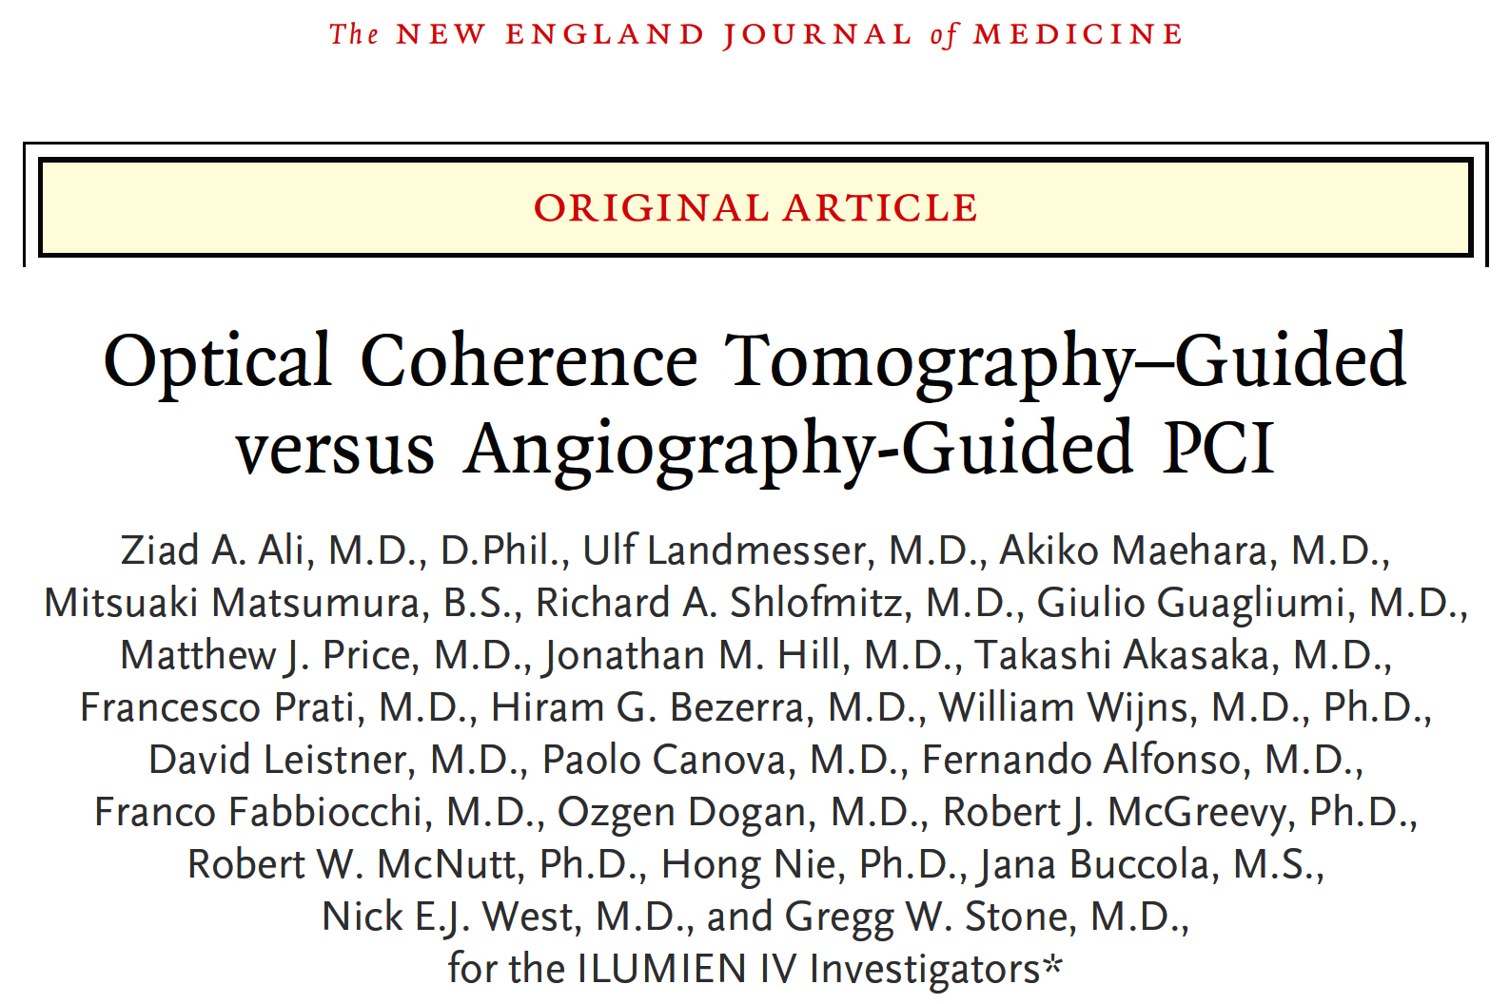

Slide 15
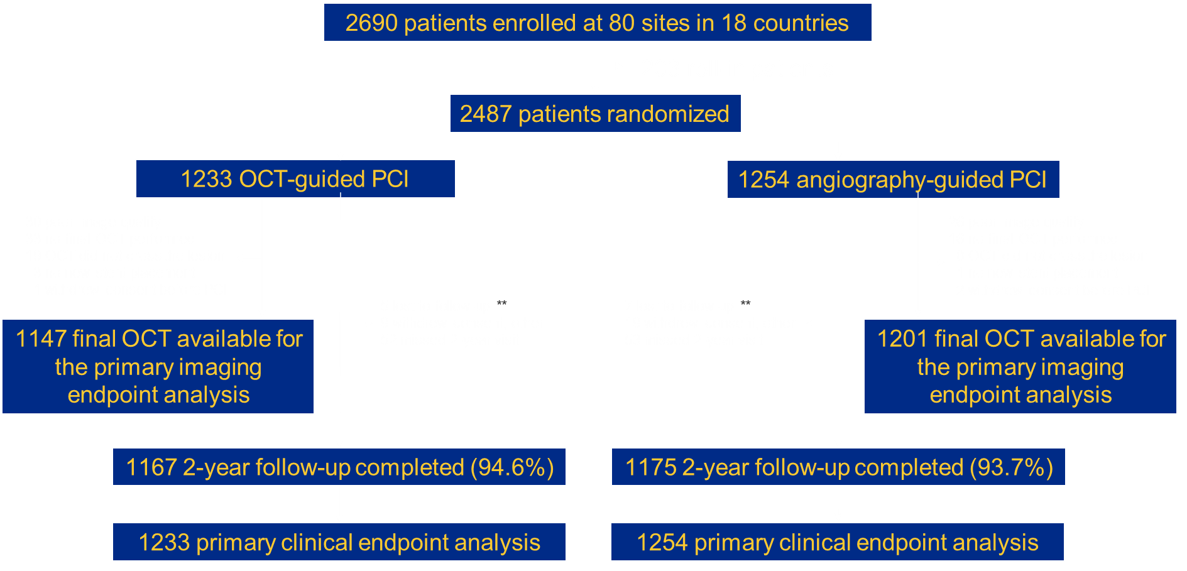
ILUMIEN IV Trial: Enrollment, Randomization,
and Follow-Up
Ziad et al., N Engl J Med Aug 27, 2023, Epub ahead of print

Slide 16
ILUMIEN IV Trial: Qualifying Characteristics
 | OCT | Angio | Difference
 | (n=1231) | (n=1250) | [95% CI]
Medication-treated diabetes mellitus | 40.4% | 39.8% | 0.5% (-3.3, 4.4)
Long or multiple lesions | 69.3% | 65.9% | 3.4% (-0.3, 7.0)
NSTEMI | 24.5% | 23.8% | 0.6% (-2.8, 4.0)
Angiographic severe calcification | 11.4% | 11.7% | -0.3% (-2.8, 2.2)
In-stent restenosis (ISR) | 10.6% | 11.0% | -0.5% (-2.9, 2.0)
Chronic total occlusion (CTO) | 7.6% | 6.3% | 1.3% (-0.7, 3.3)
STEMI (>24 hours from onset) | 5.4% | 5.6% | -0.2% (-2.1, 1.6)
Bifurcation with 2 planned stents | 3.2% | 3.4% | -0.2% (-1.6, 1.3)
Ziad et al., N Engl J Med Aug 27, 2023, Epub ahead of print

Slide 17
ILUMIEN IV Trial: Procedural Characteristics
 | OCT | Angio | Difference
 | (n=1233) | (n=1254) | [95% CI]
Stents per patient | 1.7 ± 0.9 | 1.6 ± 0.8 | 0.1 (0.0, 0.2)
Stent length, mm | 44.2 ± 23.8 | 40.5 ± 24.0 | 3.8 (1.9, 5.6)
Maximal stent diameter, mm | 3.22 ± 0.48 | 3.11 ± 0.40 | 0.11 (0.07, 0.14)
Post-dilatation balloons used, n | 1.6 ± 1.2 | 1.3 ± 1.2 | 0.3 (0.2, 0.4)
Maximum device size, mm | 3.67 ± 0.56 | 3.37 ± 0.47 | 0.31 (0.27, 0.34)
Maximum inflation pressure, atm | 19.8 ± 3.1 | 18.4 ± 3.3 | 1.4 (1.2, 1.7)
Procedure duration, min | 68.3 ± 38.3 | 50.0 ± 35.4 | 18.3 (15.4, 21.2)
Fluoroscopy duration, min | 20.9 ± 13.8 | 17.4 ± 11.8 | 3.6 (2.6, 4.6)
Radiation dose, Gy | 2.01 ± 1.75 | 1.55 ± 1.36 | 0.46 (0.32, 0.60)
Contrast volume, mL | 231.9 ± 88.2 | 198.3 ± 81.7 | 33.7 (27.0, 40.4)
Ziad et al., N Engl J Med Aug 27, 2023, Epub ahead of print

Slide 18
ILUMIEN IV Trial: Primary Imaging Endpoint
Final post-PCI MSA by OCT (mm²)
OCT L=1222 | Angio L=1328 | Difference [95% CI] | P-Value
5.72 ± 2.04 | 5.36 ± 1.87 | 0.36 (0.21, 0.51) | <0.001
Ziad et al., N Engl J Med Aug 27, 2023, Epub ahead of print

Slide 19
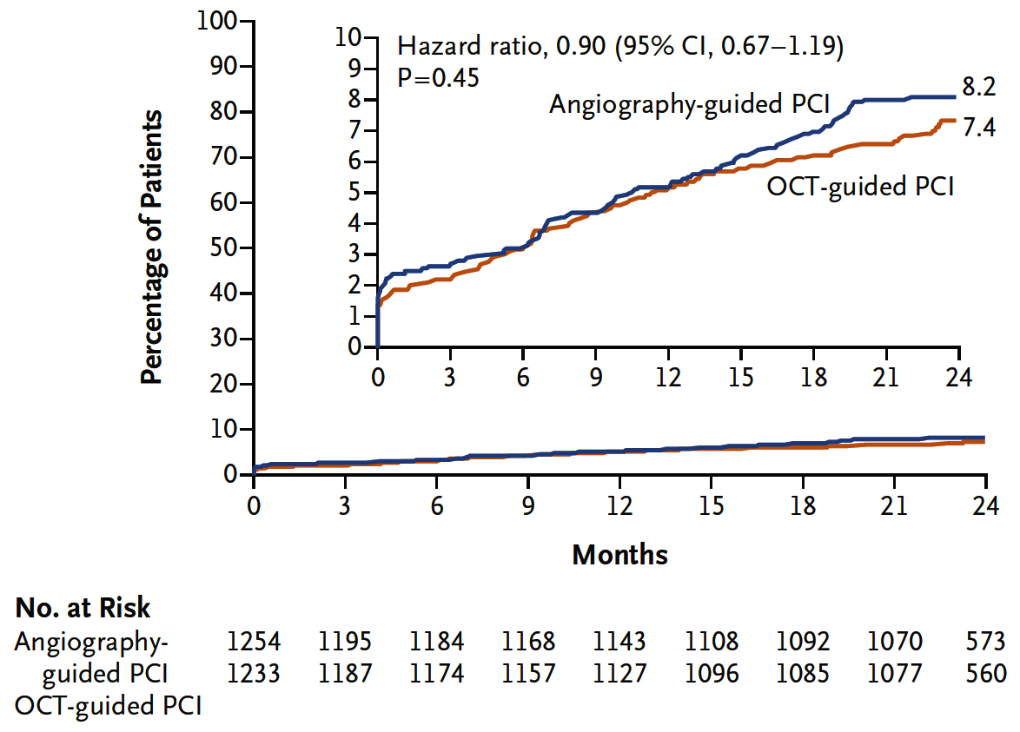
ILUMIEN IV Trial: Patients with TVF
Ziad et al., N Engl J Med Aug 27, 2023, Epub ahead of print

Slide 20
ILUMIEN IV Trial: Clinical and Safety Endpoints at 2 Years
p=0.45
%
p=0.02
Ziad et al., N Engl J Med Aug 27, 2023, Epub ahead of print

Slide 21
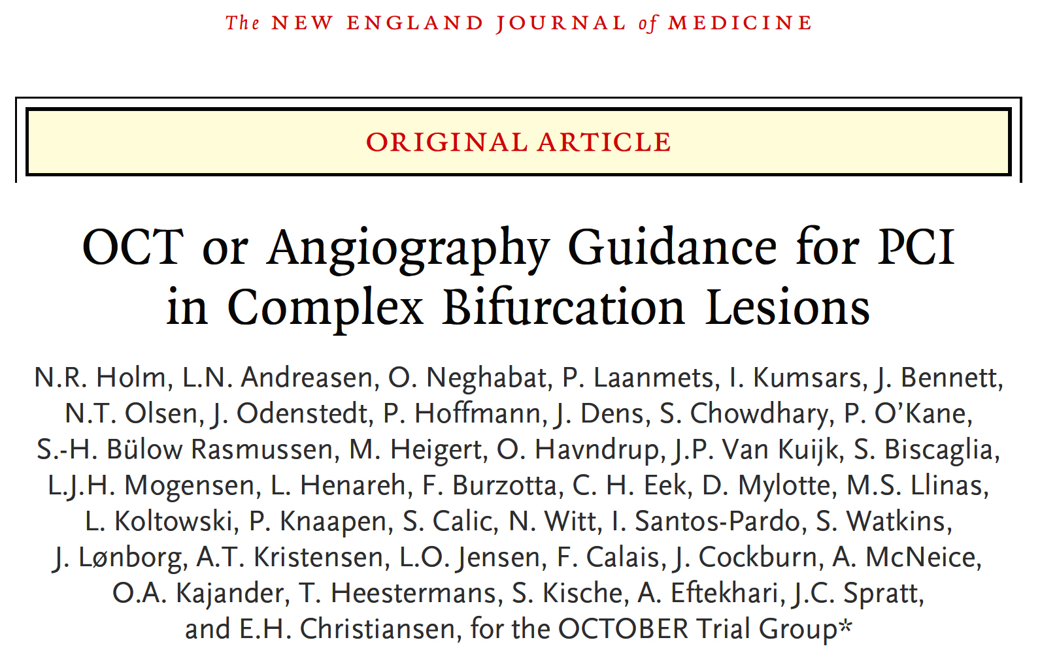

Slide 22
OCTOBER TRIAL Overview
Patients with stable angina, unstable angina or NSTEMI.
True bifurcation lesion. Side branch reference size ≥2.5 mm
1200 patient
OCT guiding
Stepwise guidance protocol
1:1
Angiographic guiding
IVUS not encouraged, but allowed LM lesions
N=600
N=601
Primary endpoint: MACE at median two years
MACE: Cardiac death, target lesion MI, ischemia-driven target lesion revascularization
Holm et al., N Engl J Med Aug 27, 2023, Epub ahead of print

Slide 23
OCTOBER TRIAL: Inclusion/Exclusion Criteria
Clinical criteria
Inclusion
18 years old
Stable angina
Exclusion
STEMI <72 h
Cardiogenic shock
Prior CABG
eGFR <50 mL/min/1.73²
Life expectancy <2 years
EF <30%
NYHA >II
Angiographic criteria
Inclusion
Main vessel: Reference size ≥ 2.75mm
Side branch: Reference size ≥ 2.5mm
≥50% stenosis in both vessels
Left-main or non left-main bifurcations
Exclusion
Severe tortuosity
Chronic total occlusion
Large thrombus in the LM artery
Holm et al., N Engl J Med Aug 27, 2023, Epub ahead of print

Slide 24
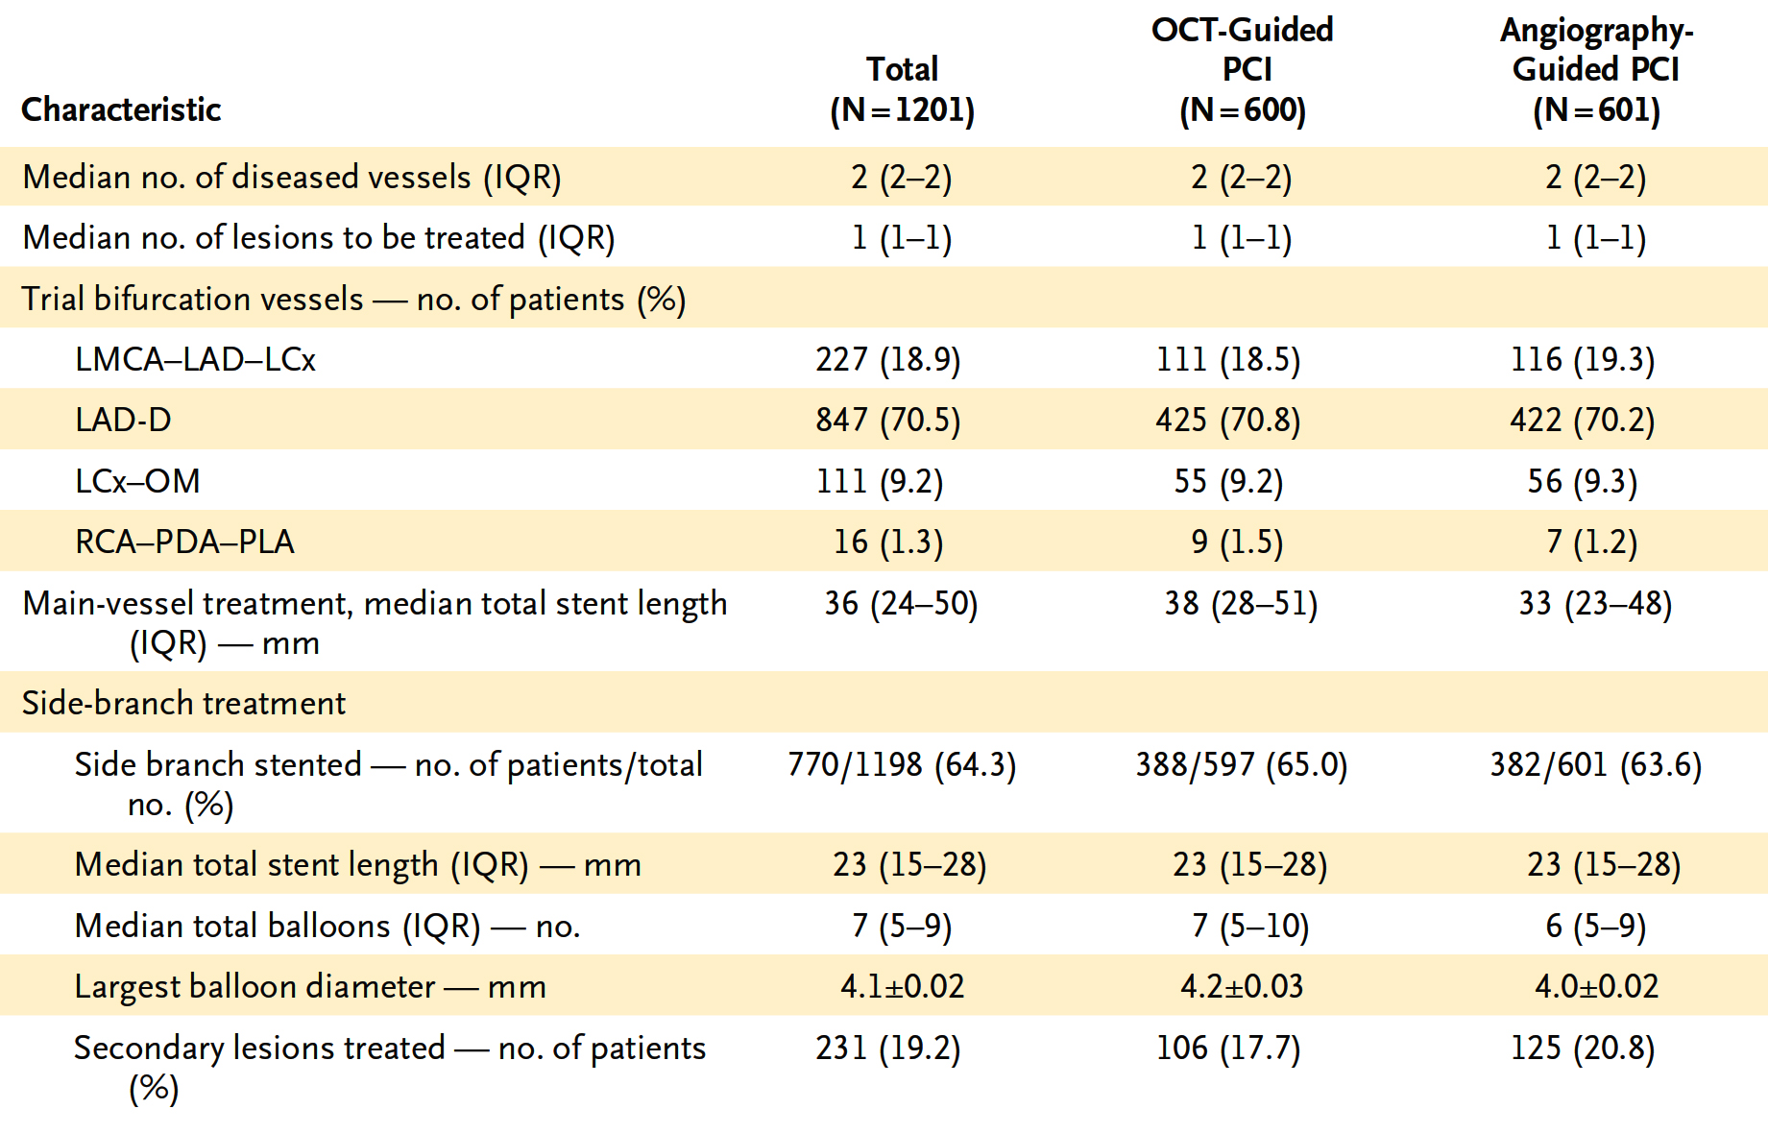
OCTOBER TRIAL: Procedural Characteristics
Holm et al., N Engl J Med Aug 27, 2023, Epub ahead of print

Slide 25
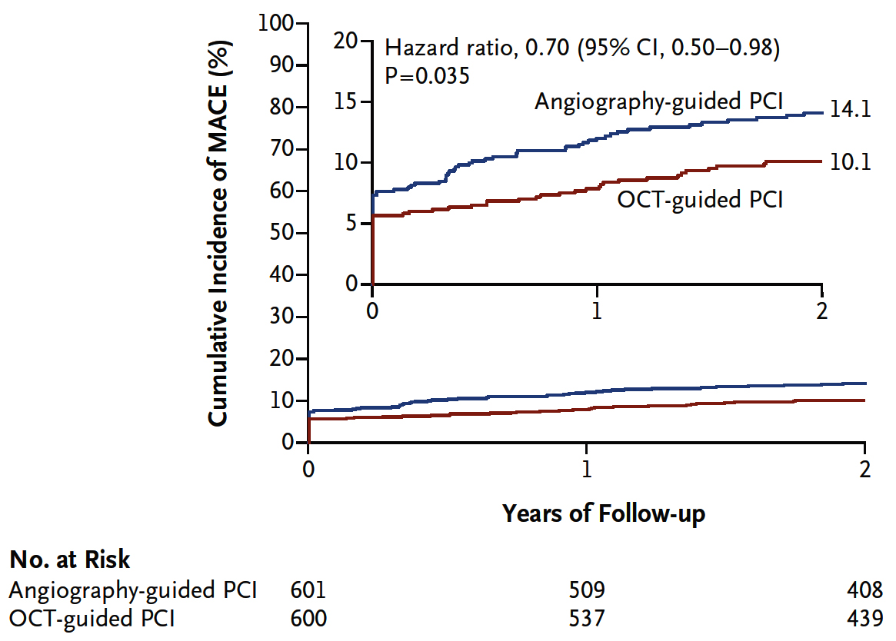
OCTOBER TRIAL: Primary Endpoint
MACE: Death from a cardiac cause, target-lesion MI, or ischemia-driven TLR
Holm et al., N Engl J Med Aug 27, 2023, Epub ahead of print

Slide 26
OCTOBER TRIAL: Primary and Secondary Endpoints
HR: 0.76
95% CI: (0.56-1.01)
HR: 0.70
95% CI: (0.50-0.98)
HR: 0.90
95% CI: (0.60-1.34)
%
HR: 0.60
95% CI: (0.32-1.13)
HR: 0.56
95% CI: (0.28-1.10)
HR: 0.70
95% CI: (0.34-1.47)
Holm et al., N Engl J Med Aug 27, 2023, Epub ahead of print

Slide 27
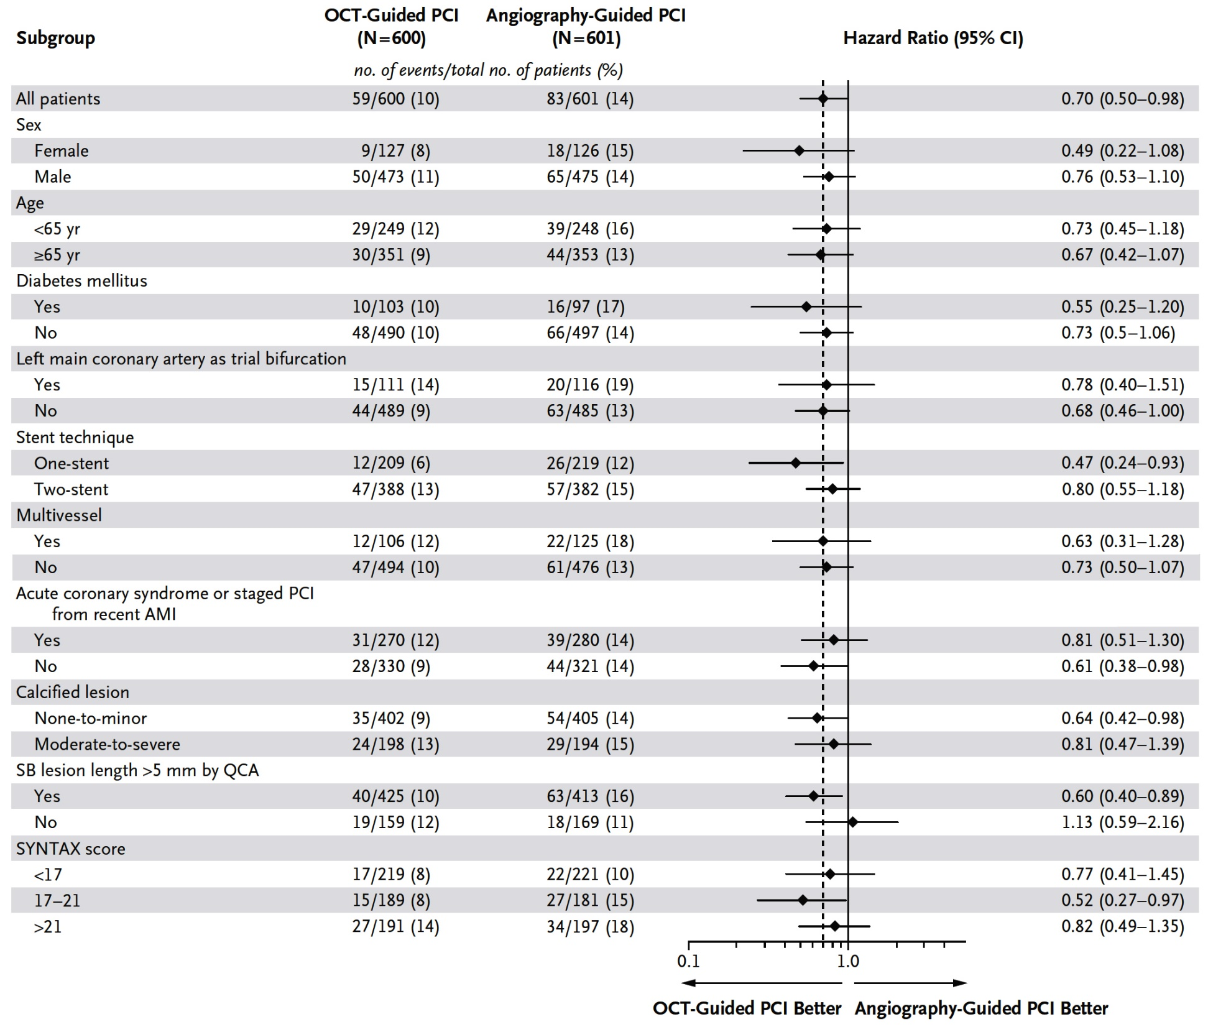
OCTOBER TRIAL: Subgroup Analysis of the Primary Endpoint
Holm et al., N Engl J Med Aug 27, 2023, Epub ahead of print

Slide 28
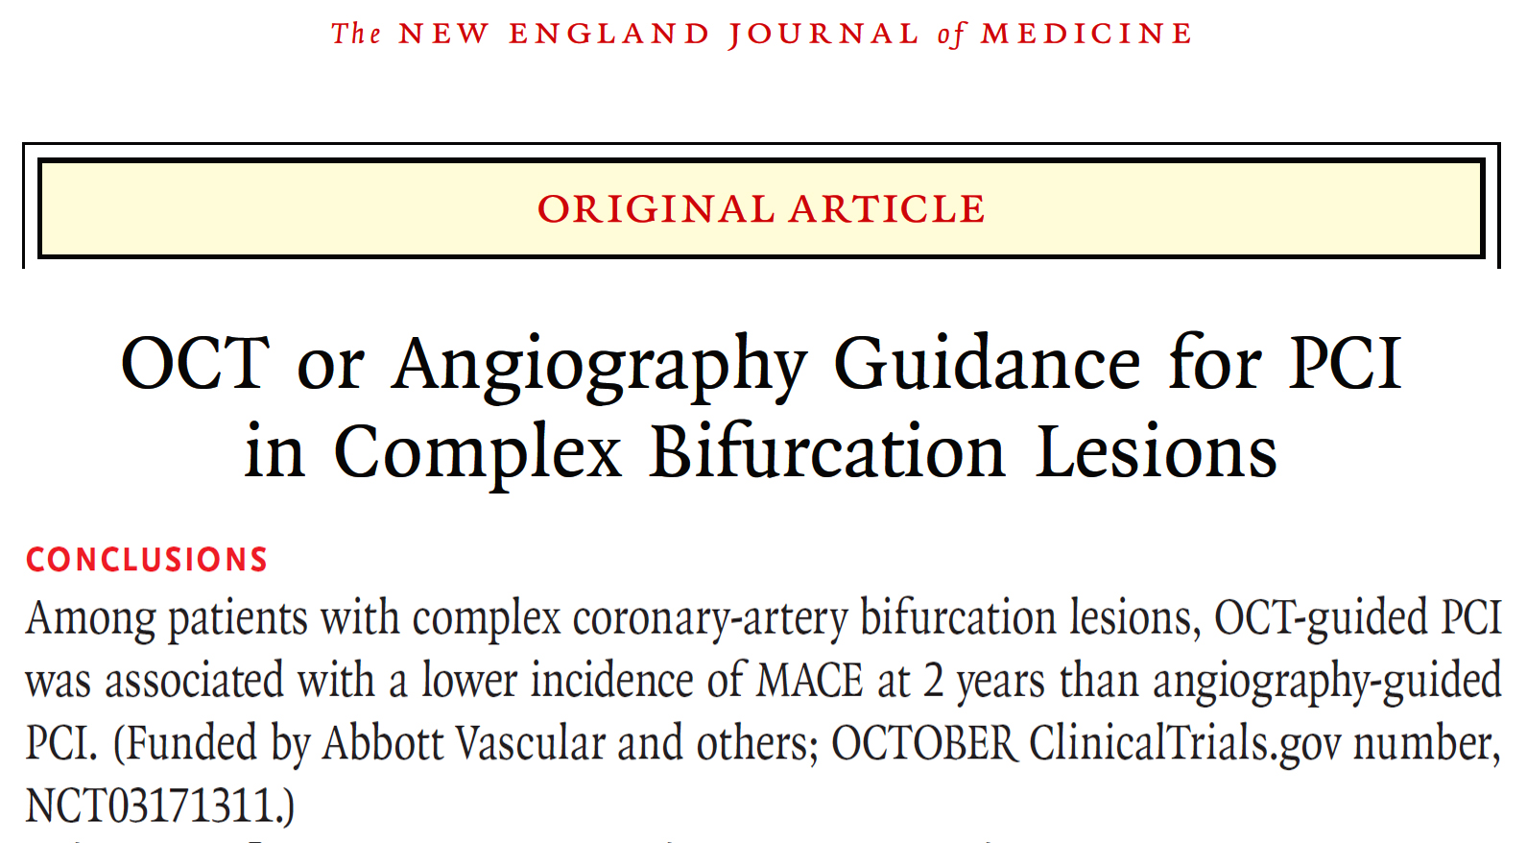

Slide 29
Intravascular Imaging Guidance for PCI: A “Real-Time” Updated Network Meta-Analysis

Slide 30
Nodal Map of Direct Relationships
OCT or IVUS
OCT or IVUS vs Angio trials (1)
RENOVATE-COMPLEX-PCI
20 randomized trials
OCT vs Angio trials (6)
OCTACS
KIM et al
DOCTORS
ROBUST
ILUMIEN IV
OCTOBER
IVUS vs Angio trials (9)
HOME DES IVUS
AVIO
RESET
AIR-CTO
CTO IVUS
Tan et al
Liu et al
IVUS-XPL
ULTIMATE
1
Angio
6
8
11
9
OCT vs IVUS vs Angio trials (2)
ILUMIEN III
iSIGHT
2
2
OCT
IVUS
2
4
2
OCT vs IVUS trials (2)
MISTIC
OPINION
Stone G, ESC 2023

Slide 31
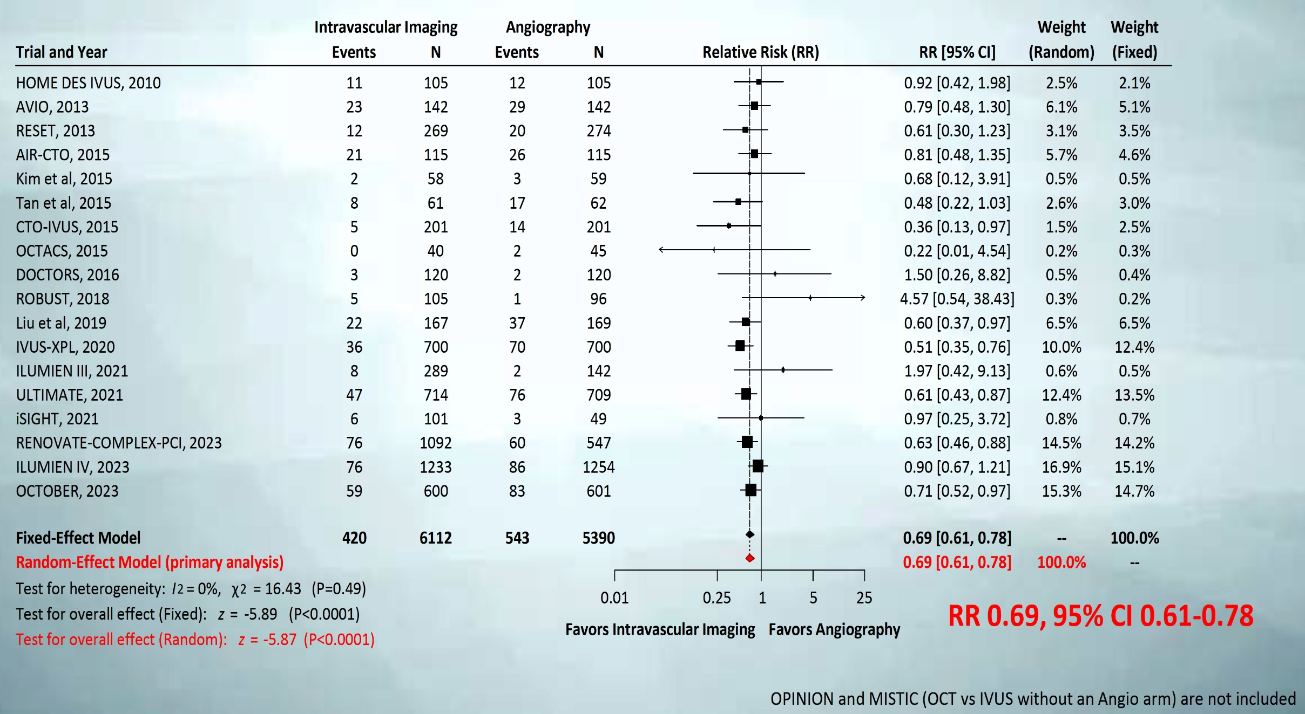
TLF (Direct Evidence): IV Imaging (OCT or IVUS) vs. Angio 18 trials, 11,502 patients, 963 events
Stone G, ESC 2023

Slide 32
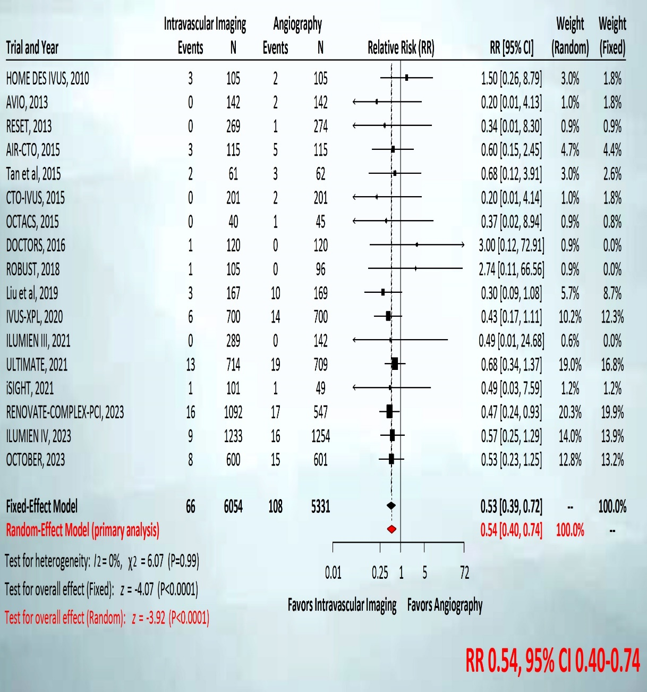
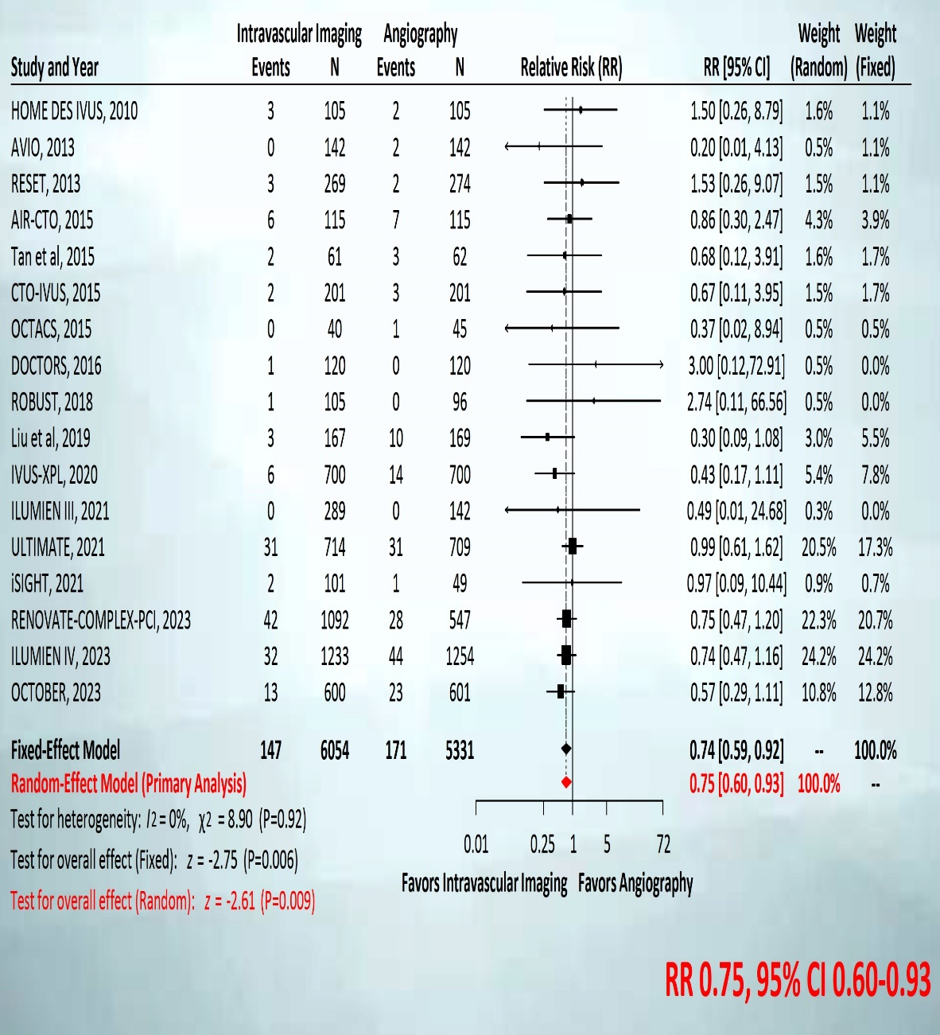
Death (Direct Evidence): IV Imaging vs. Angio 17 trials, 11,385 patients, 174 events
Cardiac Death
All Cause Death
Stone G, ESC 2023

Slide 33
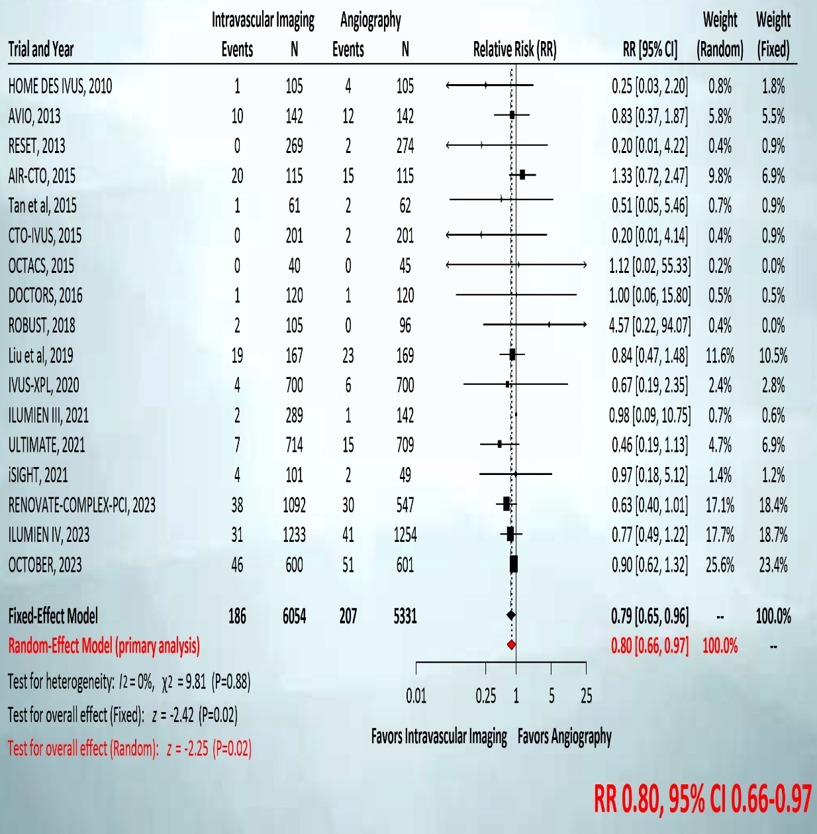
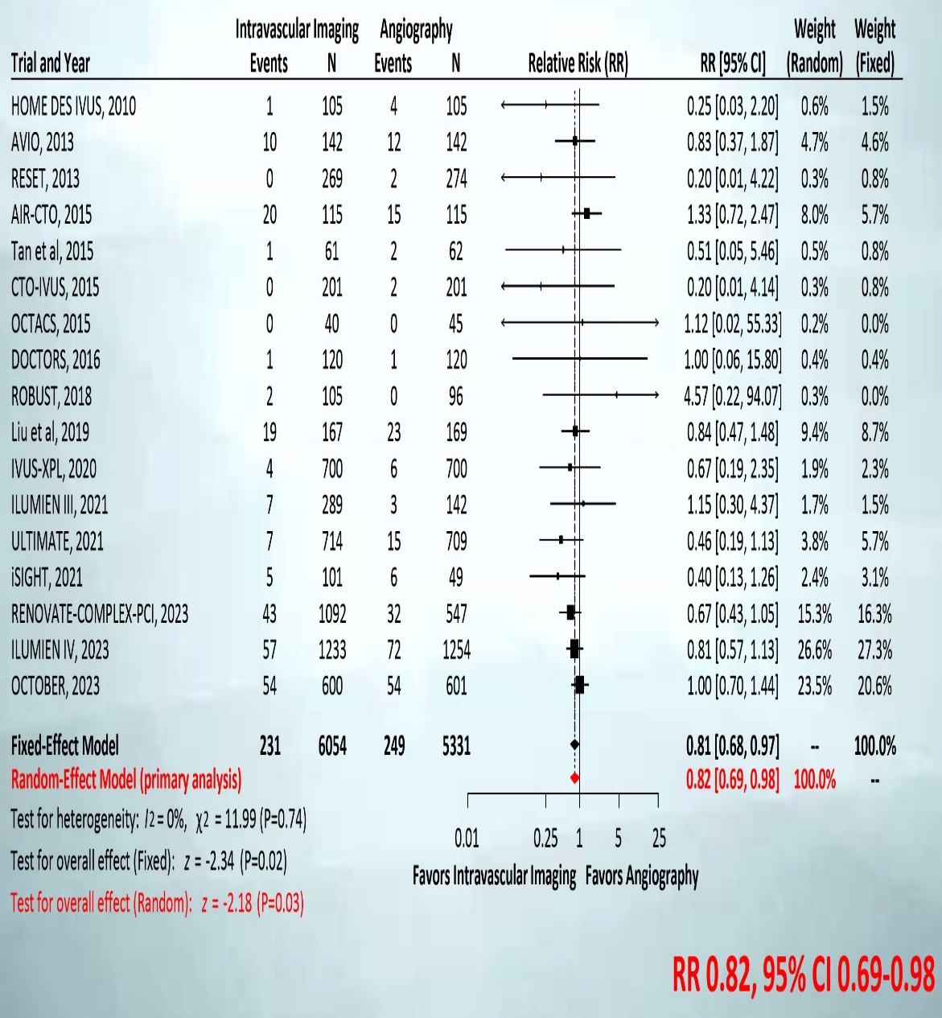
MI (Direct Evidence): IV Imaging vs. Angio 17 trials, 11,385 patients, 393 events
TV - MI
ALL - MI
Stone G, ESC 2023

Slide 34
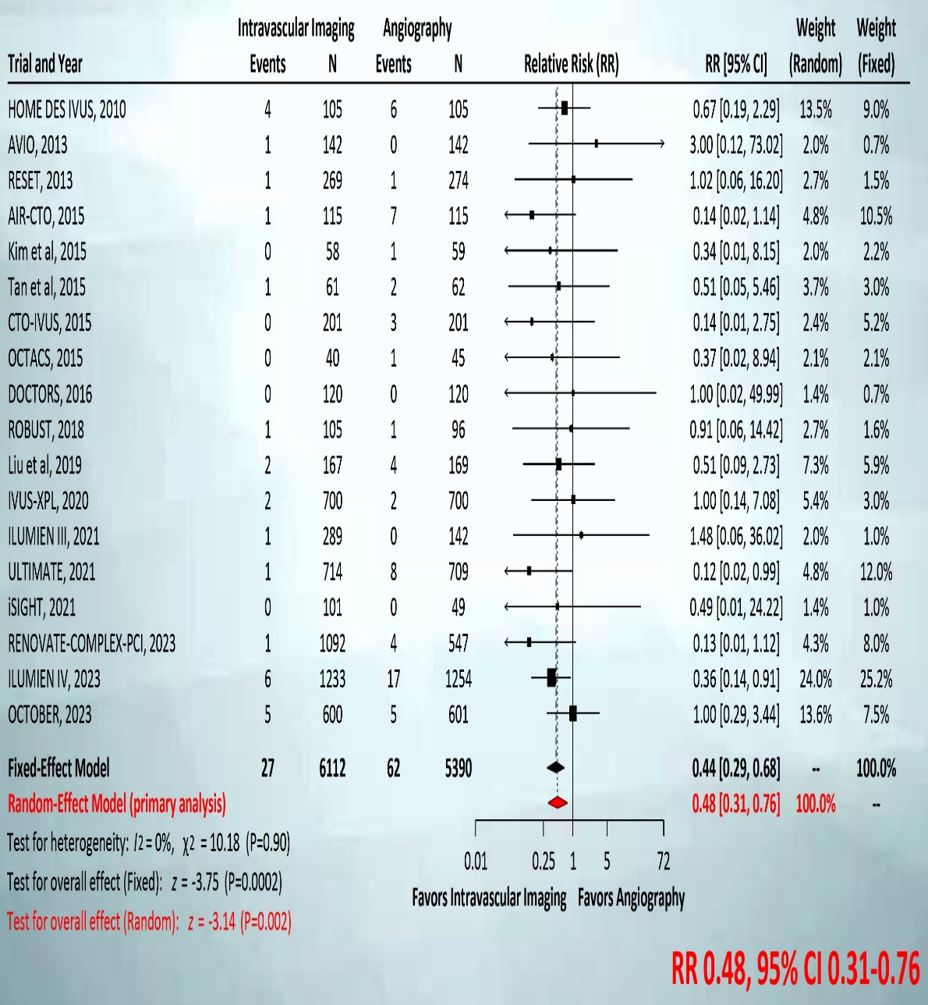
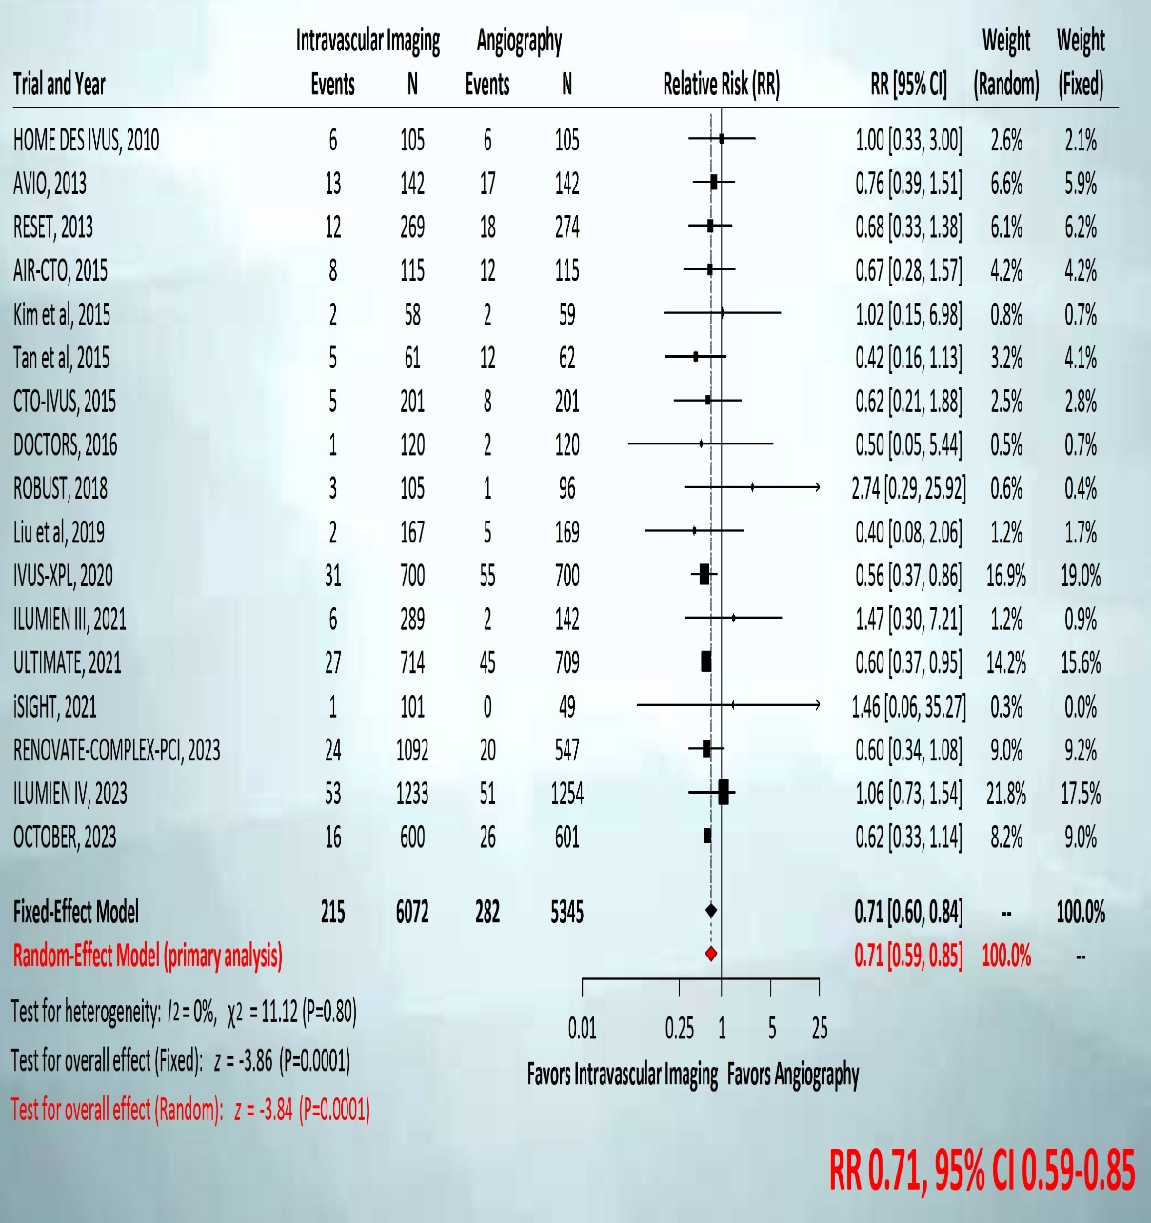
Stent Thrombosis/TLR: IV Imaging vs. Angio 18 trials, 11,502 patients, 89 events
Stent Thrombosis
TLR
Stone G, ESC 2023

Slide 35
Network Evidence: All Outcomes IVI-guided (OCT or IVUS) PCI vs Angiography-guided PCI
Outcome | N trials | N pts | N events | Direct estimate | % evidence | Indirect estimate | % evidence | Network estimate
TLF | 18 | 11,502 | 963 | 0.69 [0.61, 0.78] | 100 | - | - | 0.69 [0.61, 0.78]
- Cardiac death | 17 | 11,385 | 174 | 0.54 [0.40, 0.74] | 100 | - | - | 0.54 [0.40, 0.74]
- TV-MI | 17 | 11,385 | 393 | 0.80 [0.66, 0.97] | 100 | - | - | 0.80 [0.66, 0.97]
- TLR | 17 | 11,417 | 497 | 0.71 [0.59, 0.85] | 100 | - | - | 0.71 [0.59, 0.85]
Stent thrombosis | 17 | 11,385 | 89 | 0.48 [0.31, 0.76] | 100 | - | - | 0.48 [0.31, 0.76]
All-cause death | 17 | 11,385 | 318 | 0.75 [0.60, 0.93] | 100 | - | - | 0.75 [0.60, 0.93]
All MI | 17 | 11,385 | 480 | 0.82 [0.69, 0.98] | 100 | - | - | 0.82 [0.69, 0.98]
TVR | 17 | 11,417 | 589 | 0.71 [0.61, 0.84] | 100 | - | - | 0.71 [0.61, 0.84]
Stone G, ESC 2023

Slide 36
Network Evidence: All Outcomes OCT-guided PCI vs IVUS-guided PCI
Outcome | N trials | N pts | N events | Direct estimate | % evidence | Indirect estimate | % evidence | Network estimate
TLF | 4 | 1316 | 48 | 0.89 [0.51, 1.57] | 19 | 1.32 [1.00, 1.73] | 81 | 1.22 [0.96, 1.56]
- Cardiac death | 4 | 1316 | 3 | 1.32 [0.25, 6.98] | 15 | 1.12 [0.56, 2.27] | 85 | 1.15 [0.60, 2.20]
- TV-MI | 4 | 1316 | 14 | 0.97 [0.34, 2.79] | 14 | 1.06 [0.69, 1.64] | 86 | 1.05 [0.70, 1.57]
- TLR | 4 | 1316 | 34 | 0.78 [0.39, 1.52] | 25 | 1.51 [1.02, 2.22] | 75 | 1.28 [0.91, 1.79]
Stent thrombosis | 4 | 1316 | 4 | 0.93 [0.19, 4.51] | 26 | 1.15 [0.45, 2.96] | 74 | 1.09 [0.48, 2.45]
All-cause death | 4 | 1316 | 12 | 1.26 [0.44, 3.62] | 19 | 0.91 [0.55,1.50] | 81 | 0.97 [0.61, 1.52]
All MI | 4 | 1316 | 21 | 1.26 [0.52, 3.02] | 17 | 1.12 [0.75, 1.67] | 83 | 1.14 [0.79, 1.64]
TVR | 4 | 1316 | 60 | 1.10 [0.67, 1.80] | 34 | 1.52 [1.07, 2.17] | 66 | 1.36 [1.02, 1.82]

Slide 37
Conclusions
Conclusions
The present network meta-analysis from 20 RCTs in 12,428 pts with f/p ranging from 6-60 months demonstrates that:
Compared with angiography-guided PCI, IVI-guided PCI with OCT or IVUS reduces TLF by 31%, driven by 46%, 20%, and 29% reductions in cardiac death, TV-MI, and TLR respectively
IVI-guided PCI also reduces stent thrombosis by 52%, all MI by 18%, and all-cause death by 25%
Outcomes were similar for OCT-guided PCI and IVUS-guided PCI

Slide 38
OCT (Optical Coherence Tomography)-Guided or IVUS (Intravascular Ultrasound)-Guided PCI:
The OCTIVUS Randomized Clinical Trial

Slide 39
OCTIVUS Trial Design
Optical Coherence Tomography–guided versus IntraVascular UltraSound–guided percutaneous coronary intervention
2,000 patients with obstructive CAD undergoing PCI in routine PCI clinical practice
A permuted block size of 4 or 6, stratified randomization by (1) trial center
OCT-guided PCI strategy
(N=1,000)
IVUS-guided PCI strategy
(N=1,000)
The composite primary end point (target-vessel failure) was cardiac death, target-vessel myocardial infarction, or ischemia-driven target vessel revascularization at 1-year
Kang et al., Am Heart J 2020;228:72

Slide 40
OCTIVUS Trial: Inclusion and Exclusion Criteria
INCLUSION
EXCLUSION
Men or women at least age ≥ 19 years.
Patients with obstructive coronary artery disease (native or restenotic) undergoing PCI with contemporary drug-eluting stents or drug-coated balloons (only for in-stent restenotic lesion) under intracoronary imaging guidance.
The patient or guardian agreed to the study protocol and the schedule for clinical follow-up, and provided informed written consent, as approved by the appropriate Institutional Review Board/Ethical Committee of the respective clinical site.
ST-elevation myocardial infarction.
Severe renal dysfunction (eGFR <30 mL/min/1.73 m²), unless patient is on renal replacement therapy.
Cardiogenic shock or decompensated heart failure with severe left ventricular dysfunction (left ventricular ejection fraction < 30%).
Life expectancy < 1 years for any non-cardiac or cardiac causes.
Any lesion characteristics resulting in the expected inability to deliver the intracoronary imaging catheter during PCI (e.g., severe vessel calcification or tortuosity).
Kang et al., Circulation Aug 23, 2023, Epub ahead of print

Slide 41
OCTIVUS Trial: Patient Flow and Follow-Up
Screened (3879)
(from April 12, 2018, through January 14, 2022)
Randomized (2008)
OCT-guided PCI (1005)
IVUS-guided PCI (1003)
1 Failure to pass imaging device
25 Cross-over to IVUS-guided PCI by
the operator’s discretion
1 Did not use intravascular imaging
devices by the operator’s
discretion
1 Failed PCI
1 Failure to pass imaging device
6 Cross-over to OCT-guided PCI by
the operator’s discretion
4 Withdrew consent at <12 mo
8 Were lost to follow-up at <12 mo
2 Withdrew consent
6 Were lost to follow-up
At 12-month follow-up:
993 (98.8%) Completed follow-up
At 12-month follow-up:
995 (99.2%) Completed follow-up
1005 (100%) Were included
in the intention-to-treat analysis
1003 (100%) Were included
in the intention-to-treat analysis
Kang et al., Circulation Aug 23, 2023, Epub ahead of print

Slide 42
OCTIVUS Trial: Procedural Characteristics
 | OCT-Guided PCI (N = 1005) | IVUS-Guided PCI (N = 1003) | P Value
PCI approach |  |  | 0.99
Radial access | 639 (63.6) | 638 (63.6)
Femoral access | 366 (36.4) | 365 (36.4)
PCI modality
Use of drug-eluting stents | 970 (96.5) | 973 (97.1) | 0.45
Used of drug-coated balloons (only for ISR lesion) | 35 (3.5) | 29 (2.9)
Total no. of lesions treated per patient | 1.3±0.6 | 1.4±0.6 | 0.36
Mean number of stents per patient | 1.6±1.0 | 1.6±1.0 | 0.38
Total stent length per patient — mm | 47.2±32.4 | 47.8±32.2 | 0.69
Post-dilatation with larger or high-pressure balloon — no. (%) | 931 (92.6) | 917 (91.5) | 0.35
Total amount of contrast media used — mL | 238.3±112.4 | 199.8±109.7 | <0.001
Total PCI time — min | 46.1±23.6 | 48.9±25.1 | <0.001
Kang et al., Circulation Aug 23, 2023, Epub ahead of print

Slide 43
OCTIVUS Trial: Procedural Outcomes
 | OCT-Guided PCI (N = 1005) | IVUS-Guided PCI (N = 1003) | P Value
Procedural success — no. (%)
Angiography-based‖ | 993 (98.8) | 990 (98.7) | 0.84
Imaging-based† | 476 / 986 (48.3) | 546 / 995 (54.9) | 0.003
Procedural complications requiring active intervention — no. (%)‡
Any | 22 (2.2) | 37 (3.7) | 0.047
IVUS or OCT related complications | 0 (0) | 0 (0)
‖ Angiographic device success is defined as successful PCI at the intended target lesion with final in-stent residual stenosis of less than 30% by quantitative coronary angiography.
† By patient-level analyses: imaging-based device success is defined as successful PCI at the intended target lesion, which fulfills all optimal criteria for stent implantation by IVUS or OCT.
‡ Procedural complications requiring active intervention, which were related to PCI or use of intravascular imaging (i.e., procedural safety outcomes).
Kang et al., Circulation Aug 23, 2023, Epub ahead of print

Slide 44
OCTIVUS Trial: Core Lab-Imaging Analysis
Lesion-Level Analysis
 | OCT-Guided PCI (N = 1005 Patients) (N = 1279 Lesions) | IVUS-Guided PCI (N = 1003 Patients) (N = 1271 Lesions) | P Value
Core Lab Imaging analysis – final post-PCI
Minimum stent area — mm² | 5.60 ± 2.01 | 6.70 ± 2.37 | <0.001
Minimum stent expansion — % | 85.36 ± 17.49 | 91.37 ± 22.31 | <0.001
Minimum stent area by distal reference lumen area -% | 134.81 ± 47.75 | 126.04 ± 39.12 | <0.001
Optimization Imaging-Guided PCI Criteria
All stent-optimization criteria met — no./total no. (%) | 613 / 1148 (53.4%) | 743 / 1236 (60.1%) | 0.001
Optimal stent expansion† | 712 / 1148 (62.0%) | 860 / 1236 (69.6%) | <0.001
Plaque burden at stent landing zone < 50% | 708 / 800 (88.5%) | 1016 / 1186 (85.7%) | 0.07
No major malapposition§ | 1059 / 1147 (92.3%) | 1209 / 1235 (97.9%) | <0.001
No large dissection¶ | 1114 / 1141 (97.6%) | 1222 / 1231 (99.3%) | 0.001
A relative stent expansion of >90% — no./total no.(%) | 394 / 1025 (38.4%) | 575 / 1179 (48.8%) | <0.001
*Plus–minus values are means ± SD. ‡ Optimal stent expansion was defined as a relative stent expansion of >80% (an in-stent minimum stent area divided by average reference lumen area). In lesions with non-evaluable reference lumen area, optimal stent expansion was defined as an absolute in-stent minimum stent area of >5.5 mm² by IVUS and >4.5 mm² by OCT.
§ Extensive stent malapposition was defined as an acute stent malapposition of ≥0.4 mm with longitudinal extension >1 mm of the stent over its entire length against the vessel wall.
¶ Large dissection was defined as a dissection that occurred 5mm from the edge of the stent, extended to extensive lateral >60º, longitudinal extension >2mm, and flap extending to media or adventitia.
Kang et al., Circulation Aug 23, 2023, Epub ahead of print

Slide 45
OCTIVUS Trial: Primary Endpoint
TVF: Cardiac death, TV-MI, or TVR
5%
4%
3%
2%
1%
0%
Hazard ratio, 0.80 (95% CI, 0.47–1.36)
P for noninferiority <0.001
3.1%
IVUS-guided
Patients (%)
2.5%
OCT-guided
0 | 3 | 6 | 9 | 12
Months since Randomization
No. at Risk
OCT-guided PCI
IVUS-guided PCI
1005 | 990 | 984 | 979 | 912
1003 | 985 | 981 | 969 | 893
Kang et al., Circulation Aug 23, 2023, Epub ahead of print

Slide 46
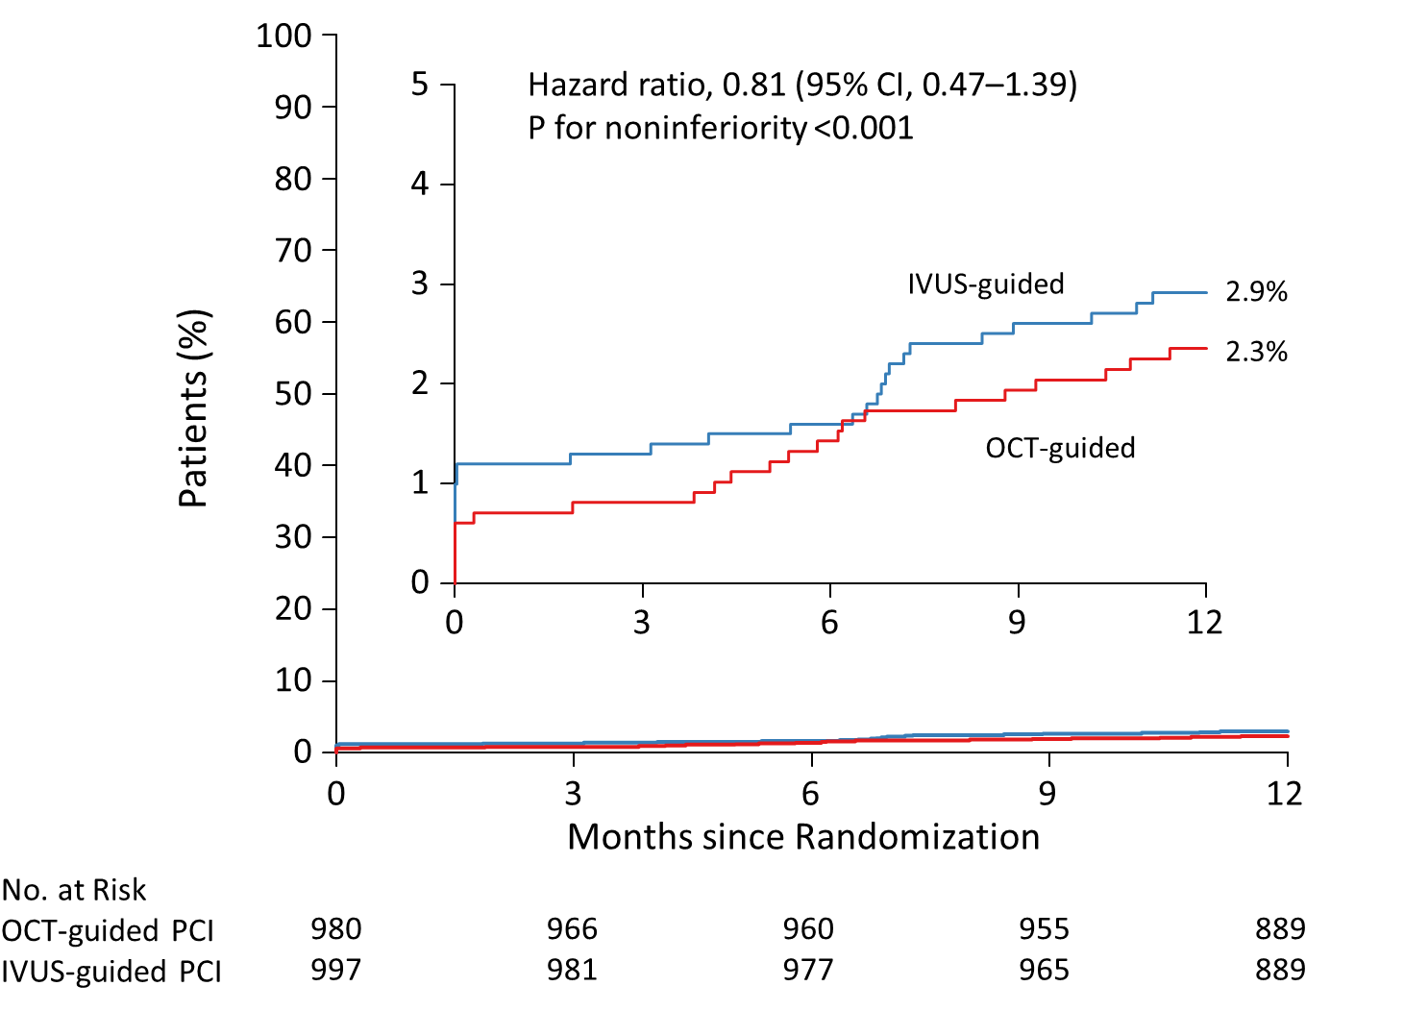
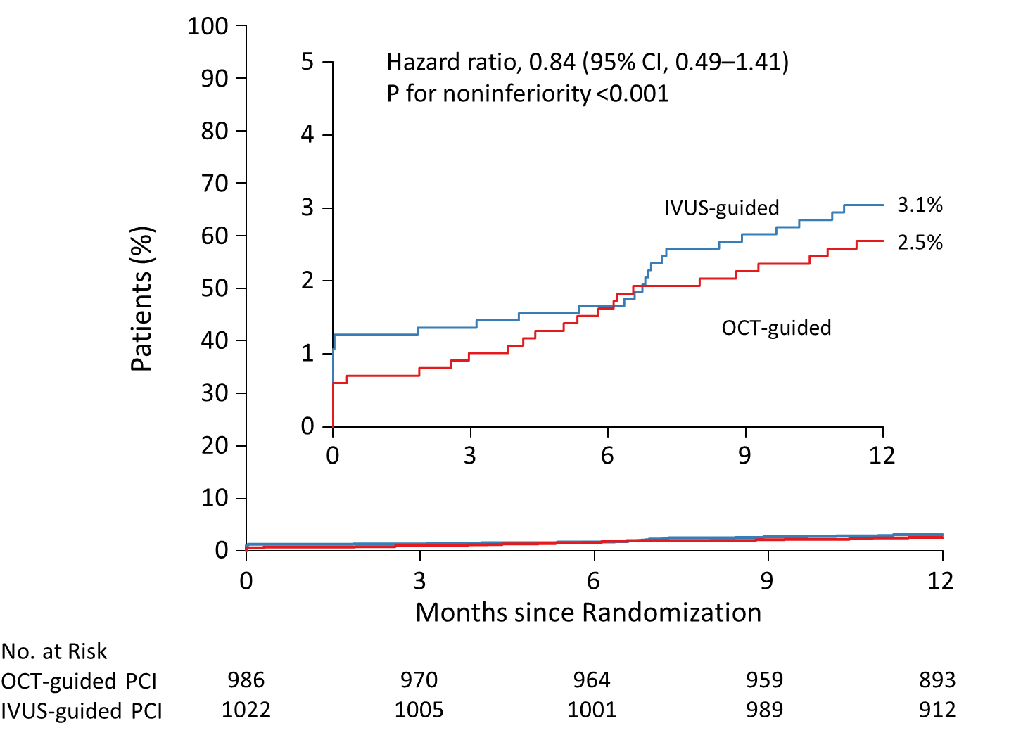
OCTIVUS Trial: Sensitivity Analysis
Primary Endpoint in the
Per-Protocol Population
Primary Endpoint in the
As-Treated Population
Kang et al., Circulation Aug 23, 2023, Epub ahead of print

Slide 47
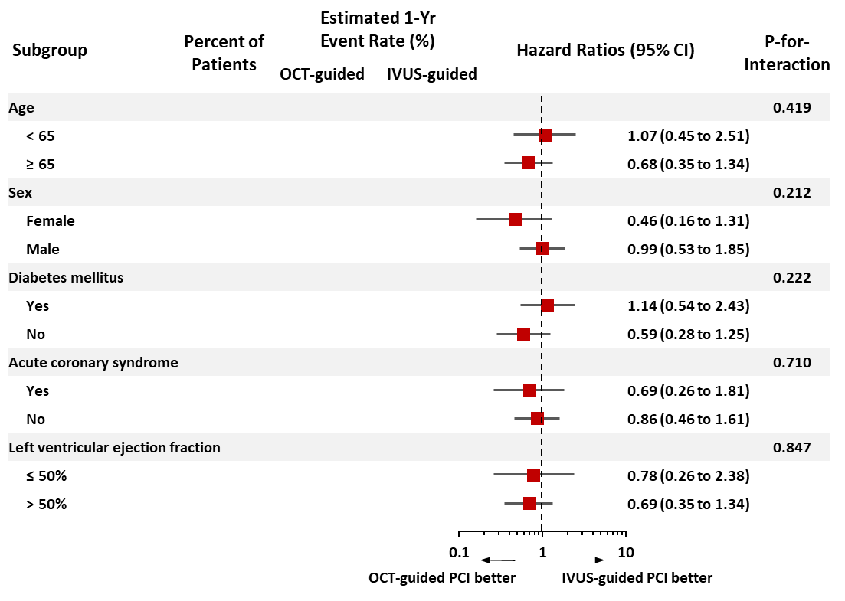
OCTIVUS Trial: Pre-specified Key Groups Analysis
Clinical Factors
Kang et al., Circulation Aug 23, 2023, Epub ahead of print

Slide 48
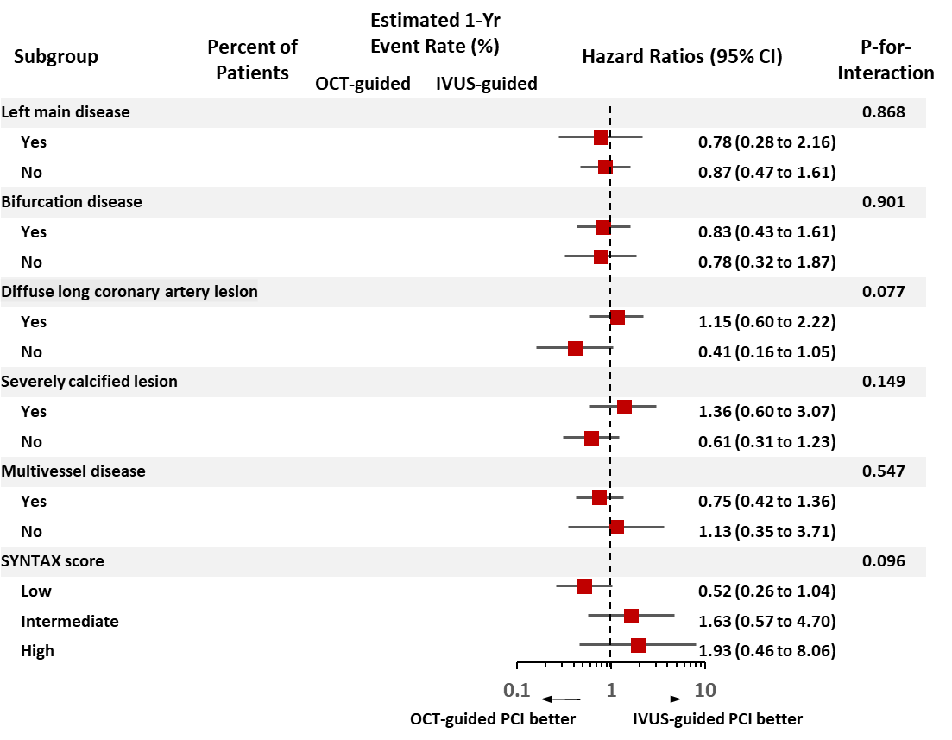
OCTIVUS Trial: Pre-specified Key Groups Analysis
Anatomical Factors
Kang et al., Circulation Aug 23, 2023, Epub ahead of print

Slide 49
OCTIVUS Trial: CV Outcomes at 1 and 2 Yrs
1 Year Outcomes
2 Years Outcomes
%
%
Kang et al., Circulation Aug 23, 2023, Epub ahead of print

Slide 50
Circulation. 2023; [published online ahead of print]. DOI: 10.1161/CIRCULATIONAHA.123.066429
Optical Coherence Tomography-Guided or Intravascular Ultrasound-Guided Percutaneous Coronary Intervention: The OCTIVUS Randomized Clinical Trial
Do-Yoon Kang, MD; Jung-Min Ahn, MD; Sung-Cheol Yun, PhD; Seung-Ho Hur, MD; Yun-Kyeong Cho, MD; Cheol Hyun Lee, MD; Soon Jun Hong, MD; Subin Lim, MD; Sang-Wook Kim, MD; Hoyoun Won, MD; Jun-Hyok Oh, MD; Jeong Cheon Choe, MD; Young Joon Hong, MD; Yong‑Hoon Yoon, MD; Hoyun Kim, MD; Yeonwoo Choi, MD; Jinho Lee, MD; Young Won Yoon, MD; Soo-Joong Kim, MD; Jang-Ho Bae, MD; Duk-Woo Park, MD; and Seung-Jung Park, MD for the OCTIVUS Investigators
Circulation
https://www.ahajournals.org/doi/10.1161/CIRCULATIONAHA.123.066429

Slide 51
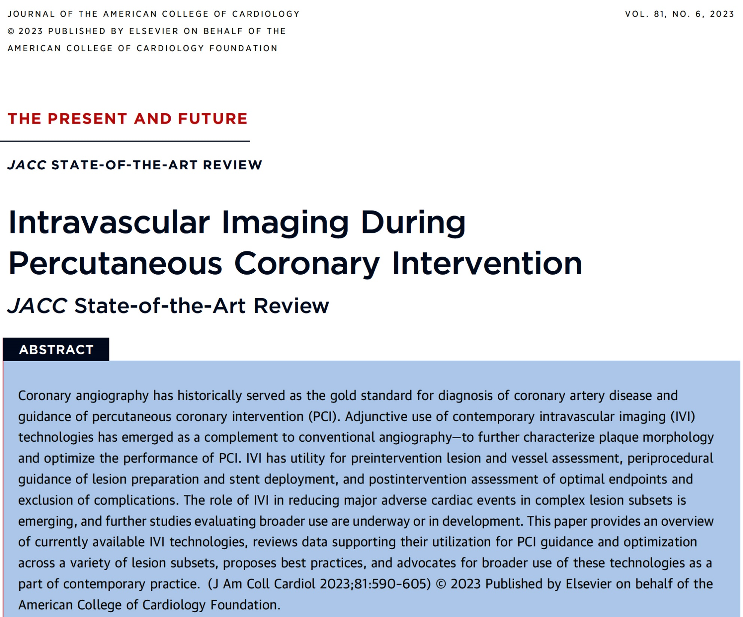
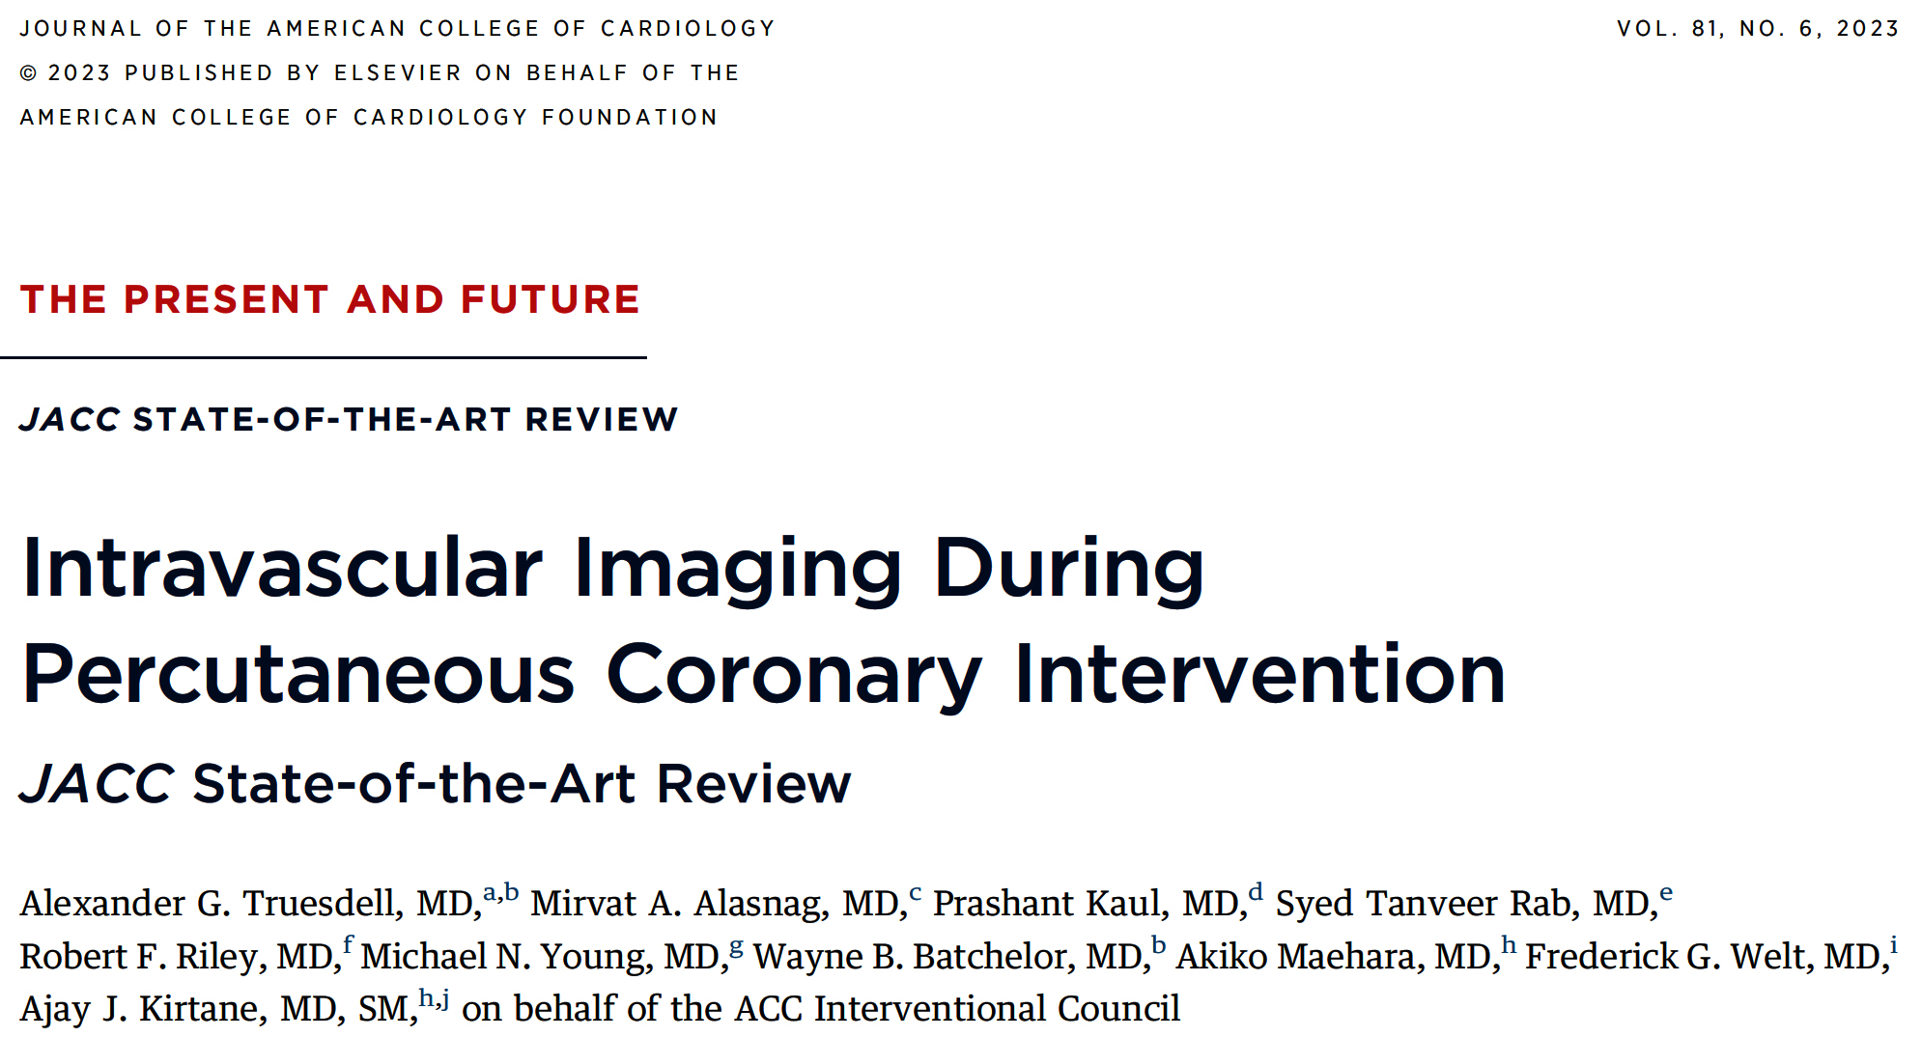

Slide 52
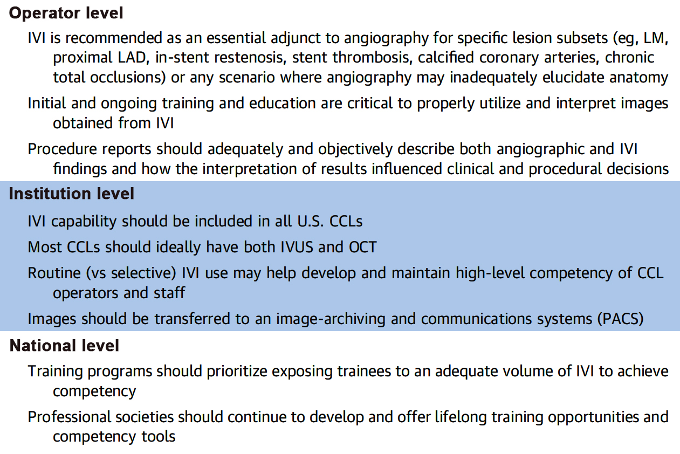
Programmatic Recommendations for Intravascular Imaging
Truesdell et al., J Am Coll Cardiol 2023;81:590

Slide 53
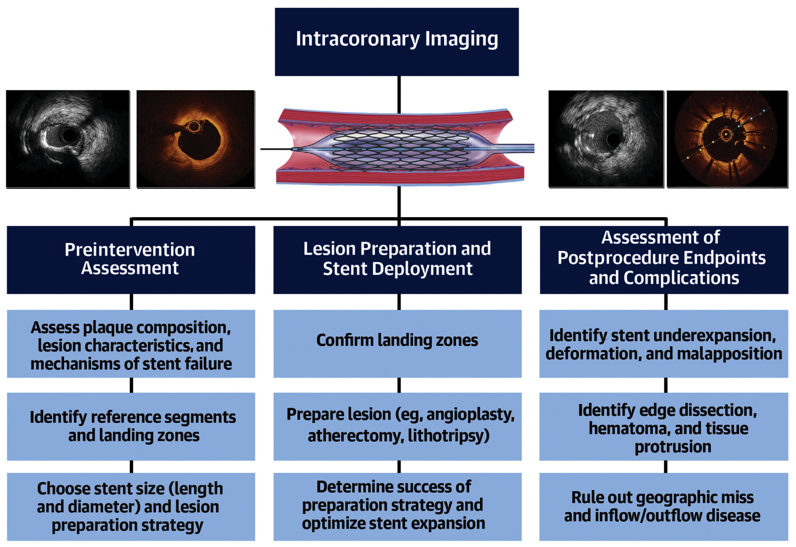
Best Practice Summary for Use of IC Imaging
Done in 22% of PCIs in US as per ACC-NCDR 2021-22
≈ 75% 25%
≈ 75% 25%
Truesdell et al., J Am Coll Cardiol 2023;81:590

Slide 54
Latest Issues in Coronary Intervention
Interventional Imaging Trials from ESC 2023:
ILUMIEN IV Trial, OCTOBER Trial, Imaging Trial’s
Network Meta-Analysis, OCTIVUS Trial
Focused review of the month
Comprehensive Management of ANOCA Part 1 & 2:
Definition, Patient Population, Diagnosis,
Program Development, Treatment and Research
Initiatives by Micro Vascular Network (MVN)

Slide 55
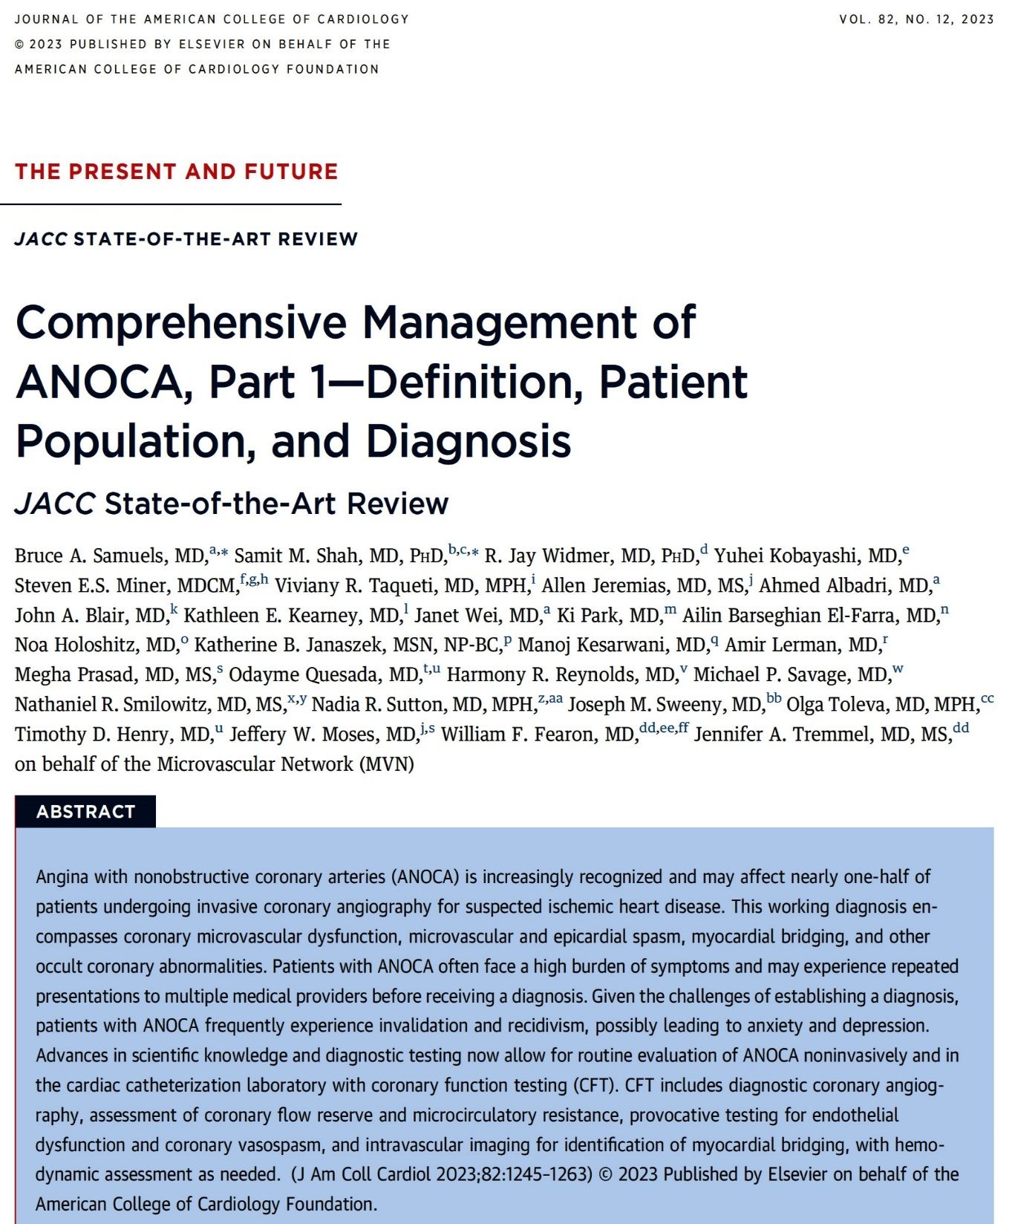
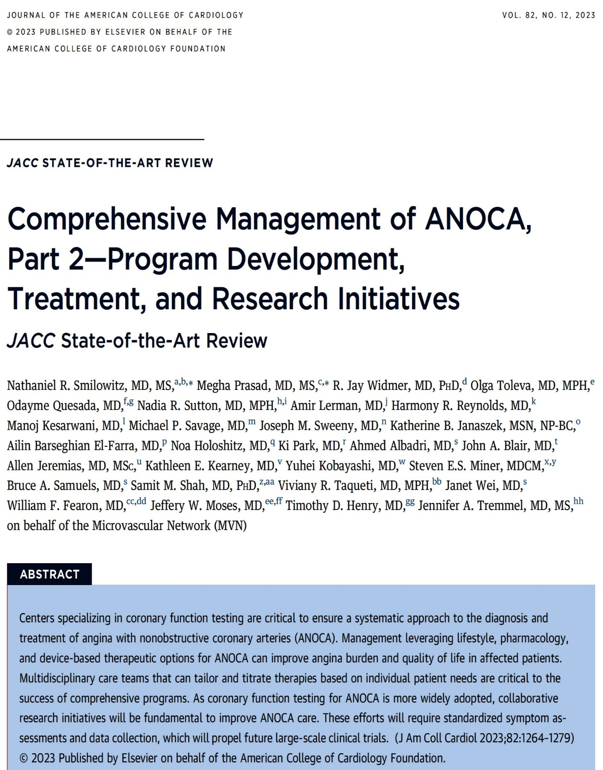

Slide 56
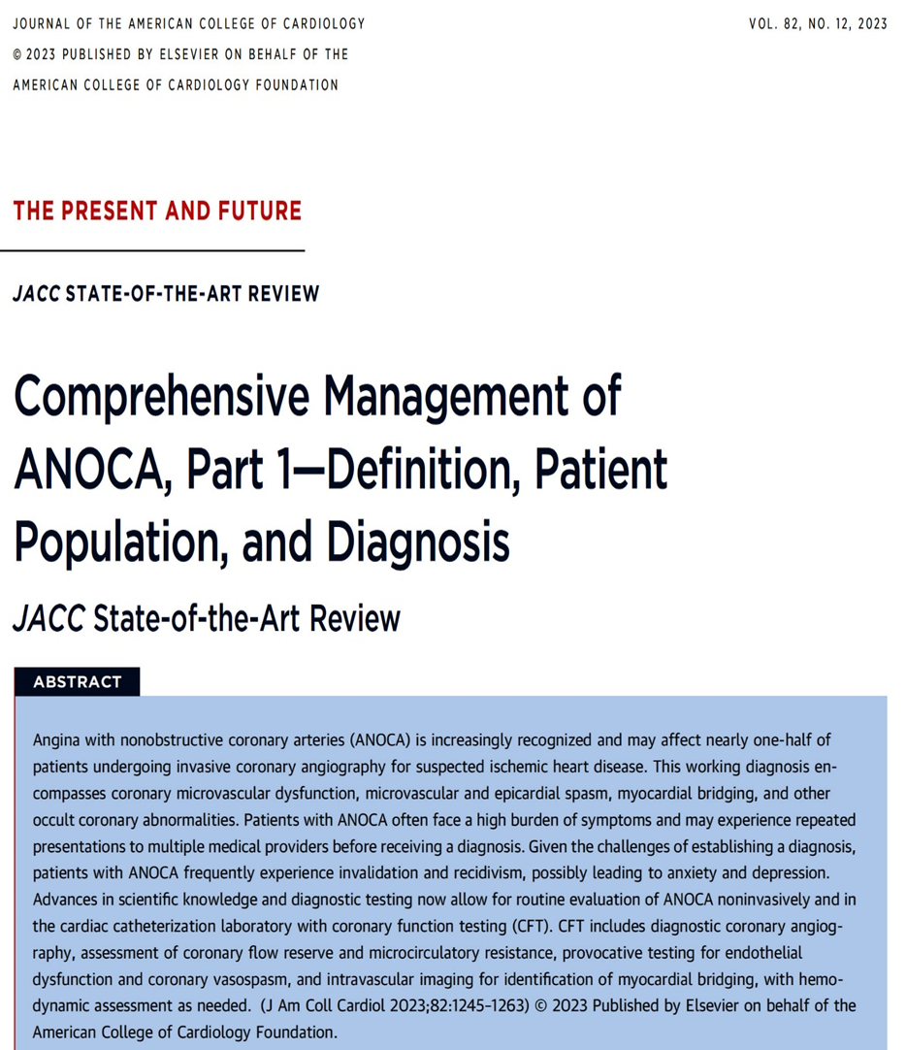
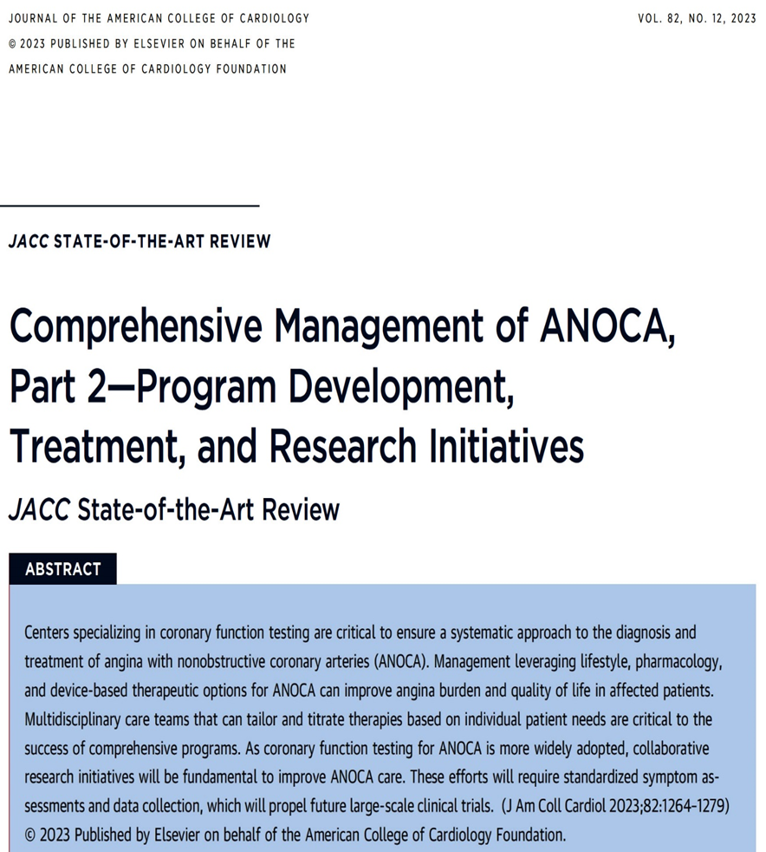
ANOCA (Angina with non-obstructive coronary arteries)
INOCA (Ischemia with non-obstructive coronary arteries)

Slide 57
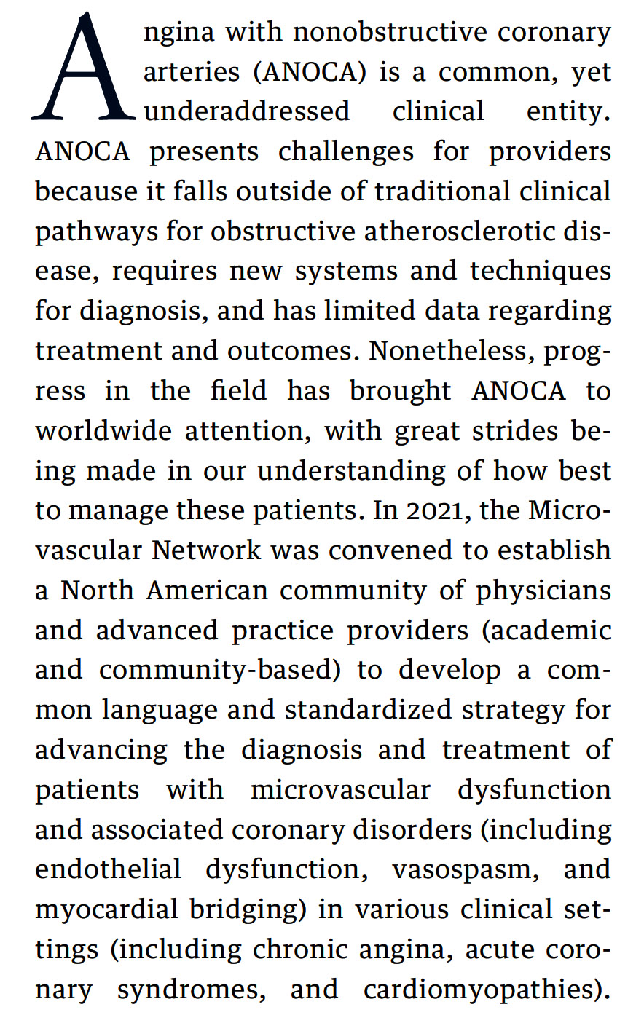
Samuels et al., J Am Coll Cardiol 2023;82:1245

Slide 58
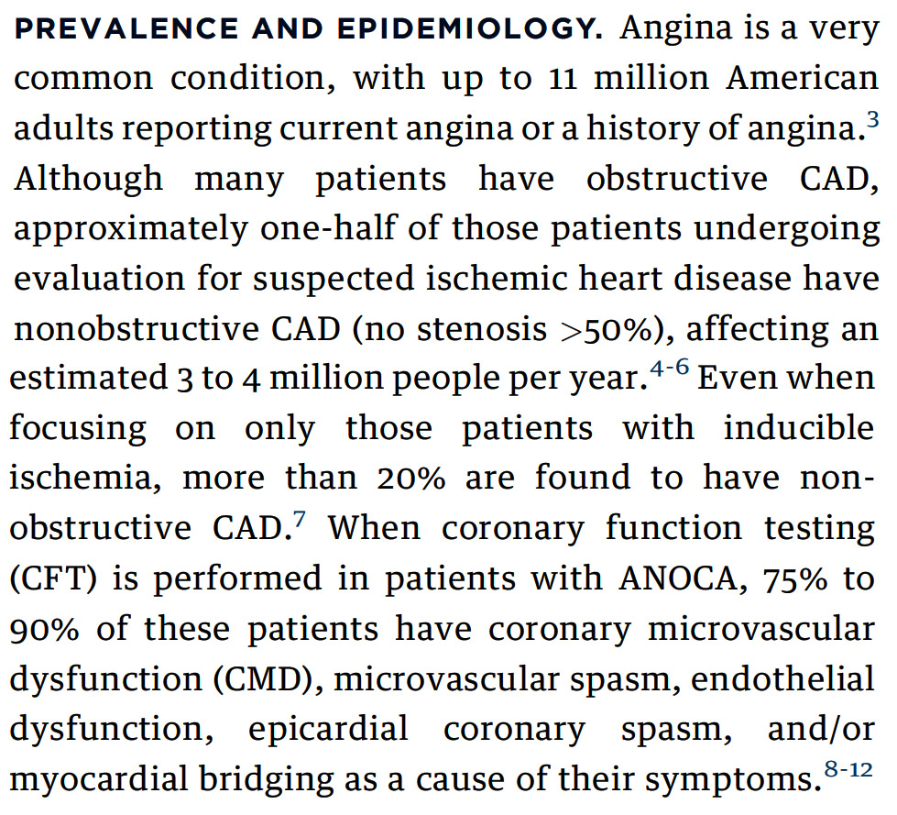
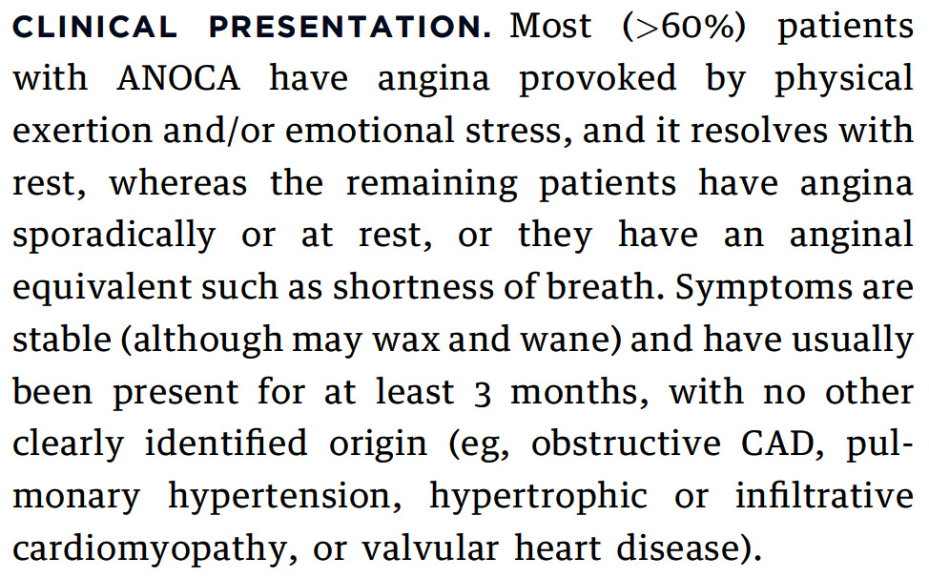
Identification of the ANOCA Patient
Samuels et al., J Am Coll Cardiol 2023;82:1245

Slide 59
Definitions
Samuels et al., J Am Coll Cardiol 2023;82:1245

Slide 60
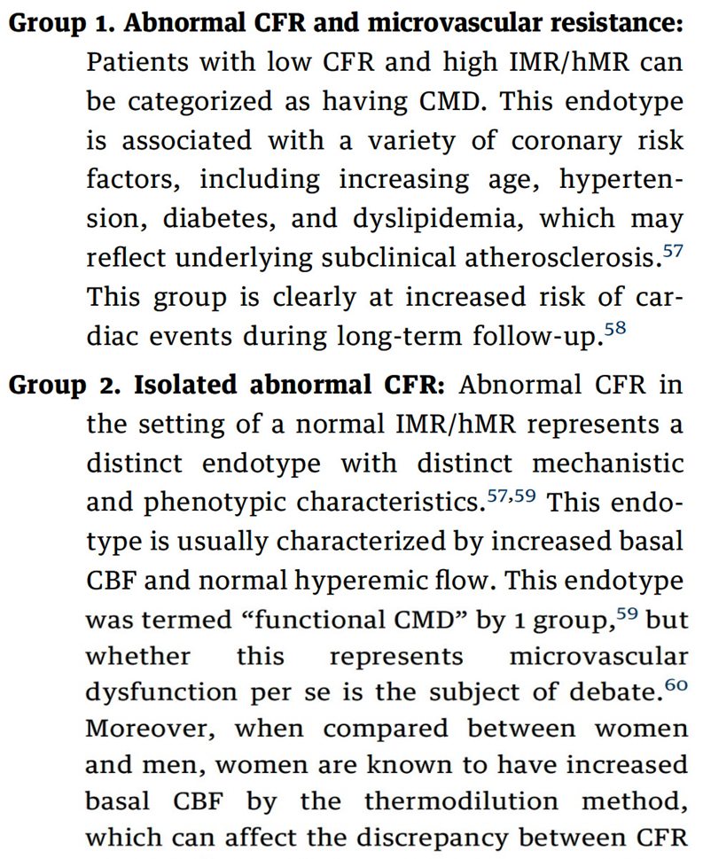
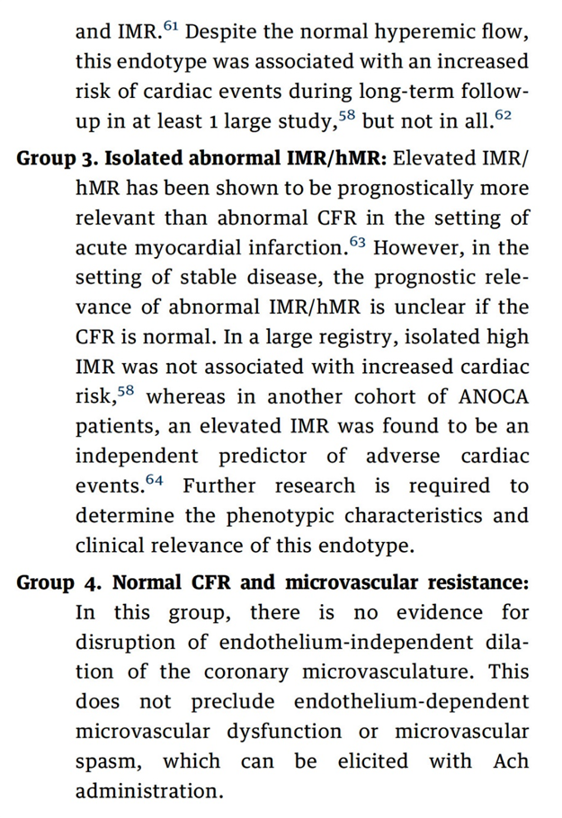
Interpretation of Results
Samuels et al., J Am Coll Cardiol 2023;82:1245

Slide 61
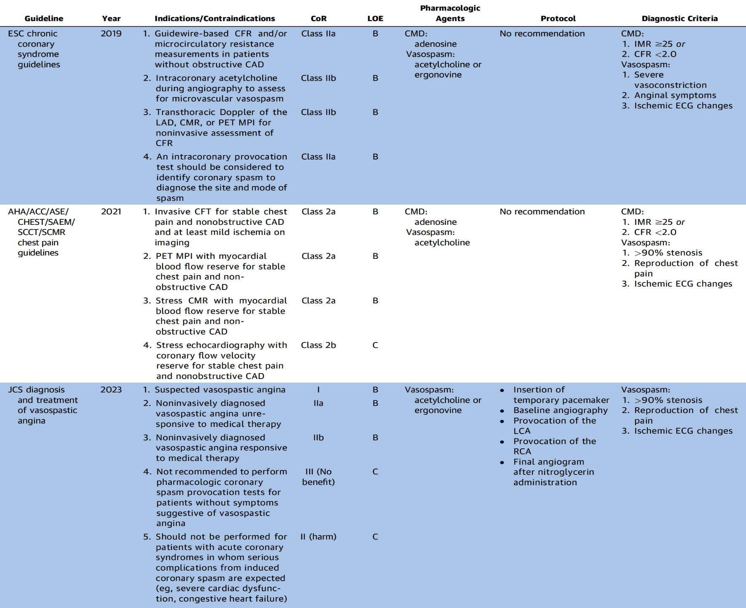
Summary of Coronary Functional Testing (CFT) Guidelines Recommendations
Samuels et al., J Am Coll Cardiol 2023;82:1245

Slide 62
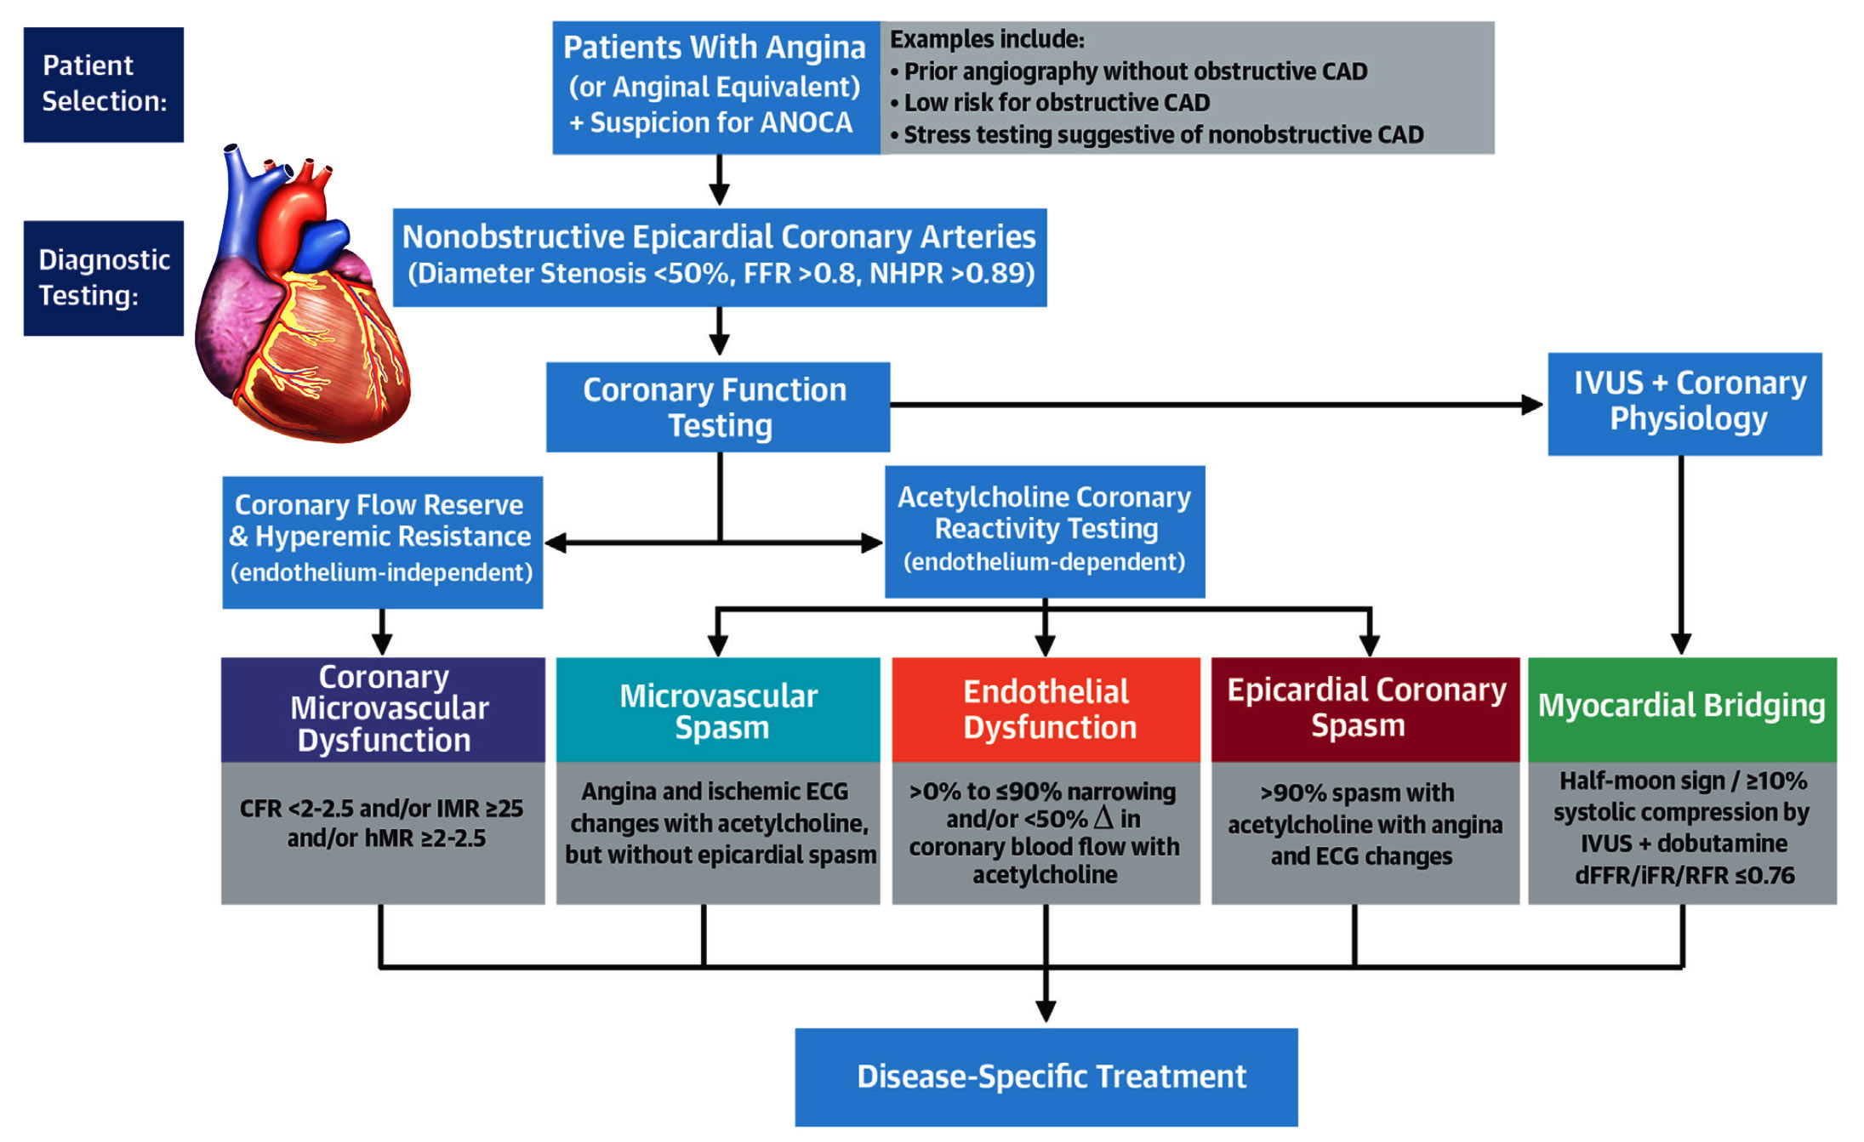
Invasive Diagnostic Pathway for Patients with ANOCA
Samuels et al., J Am Coll Cardiol 2023;82:1245

Slide 63
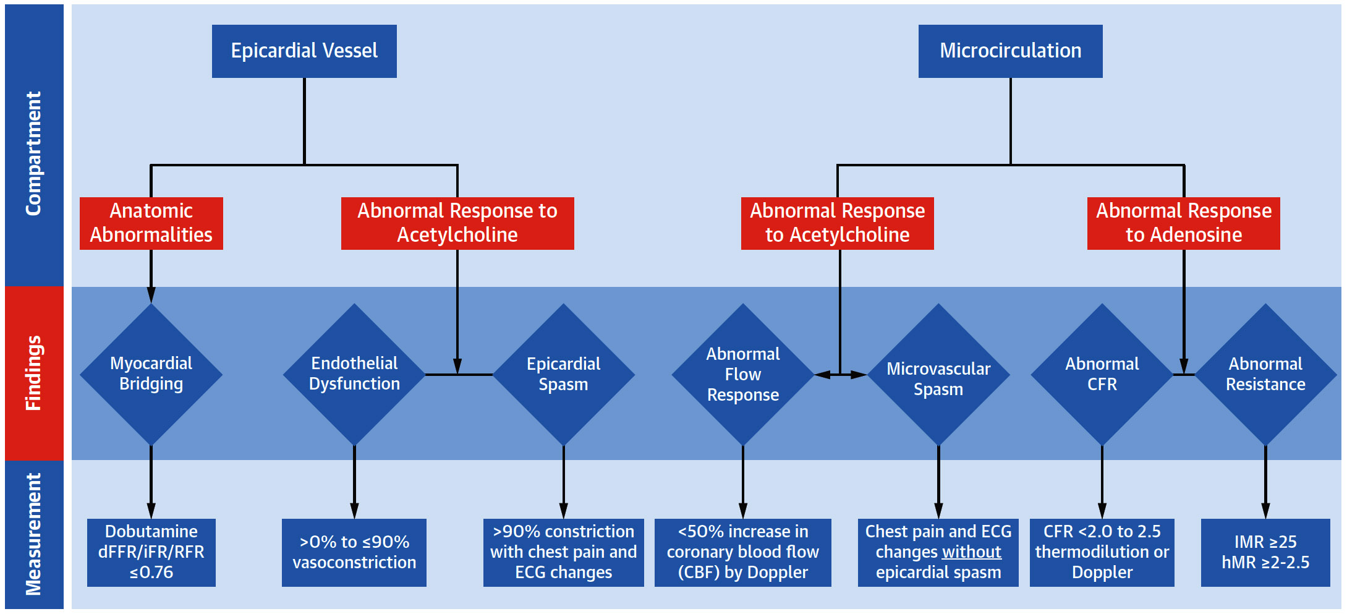
Underlying Causes of Angina with Nonobstructive Coronary Arteries
Stratified by vascular compartment, physiologic finding, and measurement
Samuels et al., J Am Coll Cardiol 2023;82:1245

Slide 64
Comparison of Coronary Doppler and Thermodilution Techniques
 | Coronary Doppler | Thermodilution
Access site | Radial or femoral | Radial or femoral
Coronary wire | ComboWire (Philips) | Pressure Wire X (Abbott)
Epicardial assessment (FFR) | Yes | Yes
Nonhyperemic pressure ratio | No | Yes (RFR)
Coronary flow reserve | Yes | Yes
Adenosine administration for CFR | Intracoronary or intravenous | Intravenous
Microvascular assessment | Hyperemic microvascular resistance | Index of microcirculatory resistance
Endothelial assessment (Ach) | Qualitative assessment of epicardial vasomotion (angiography) and quantitative calculation of coronary blood flow (requires both flow velocity and QCA vessel diameter measurements | Qualitative assessment of epicardial vasomotion (angiogrpahy)
Complications | Minimal | Minimal
Samuels et al., J Am Coll Cardiol 2023;82:1245

Slide 65
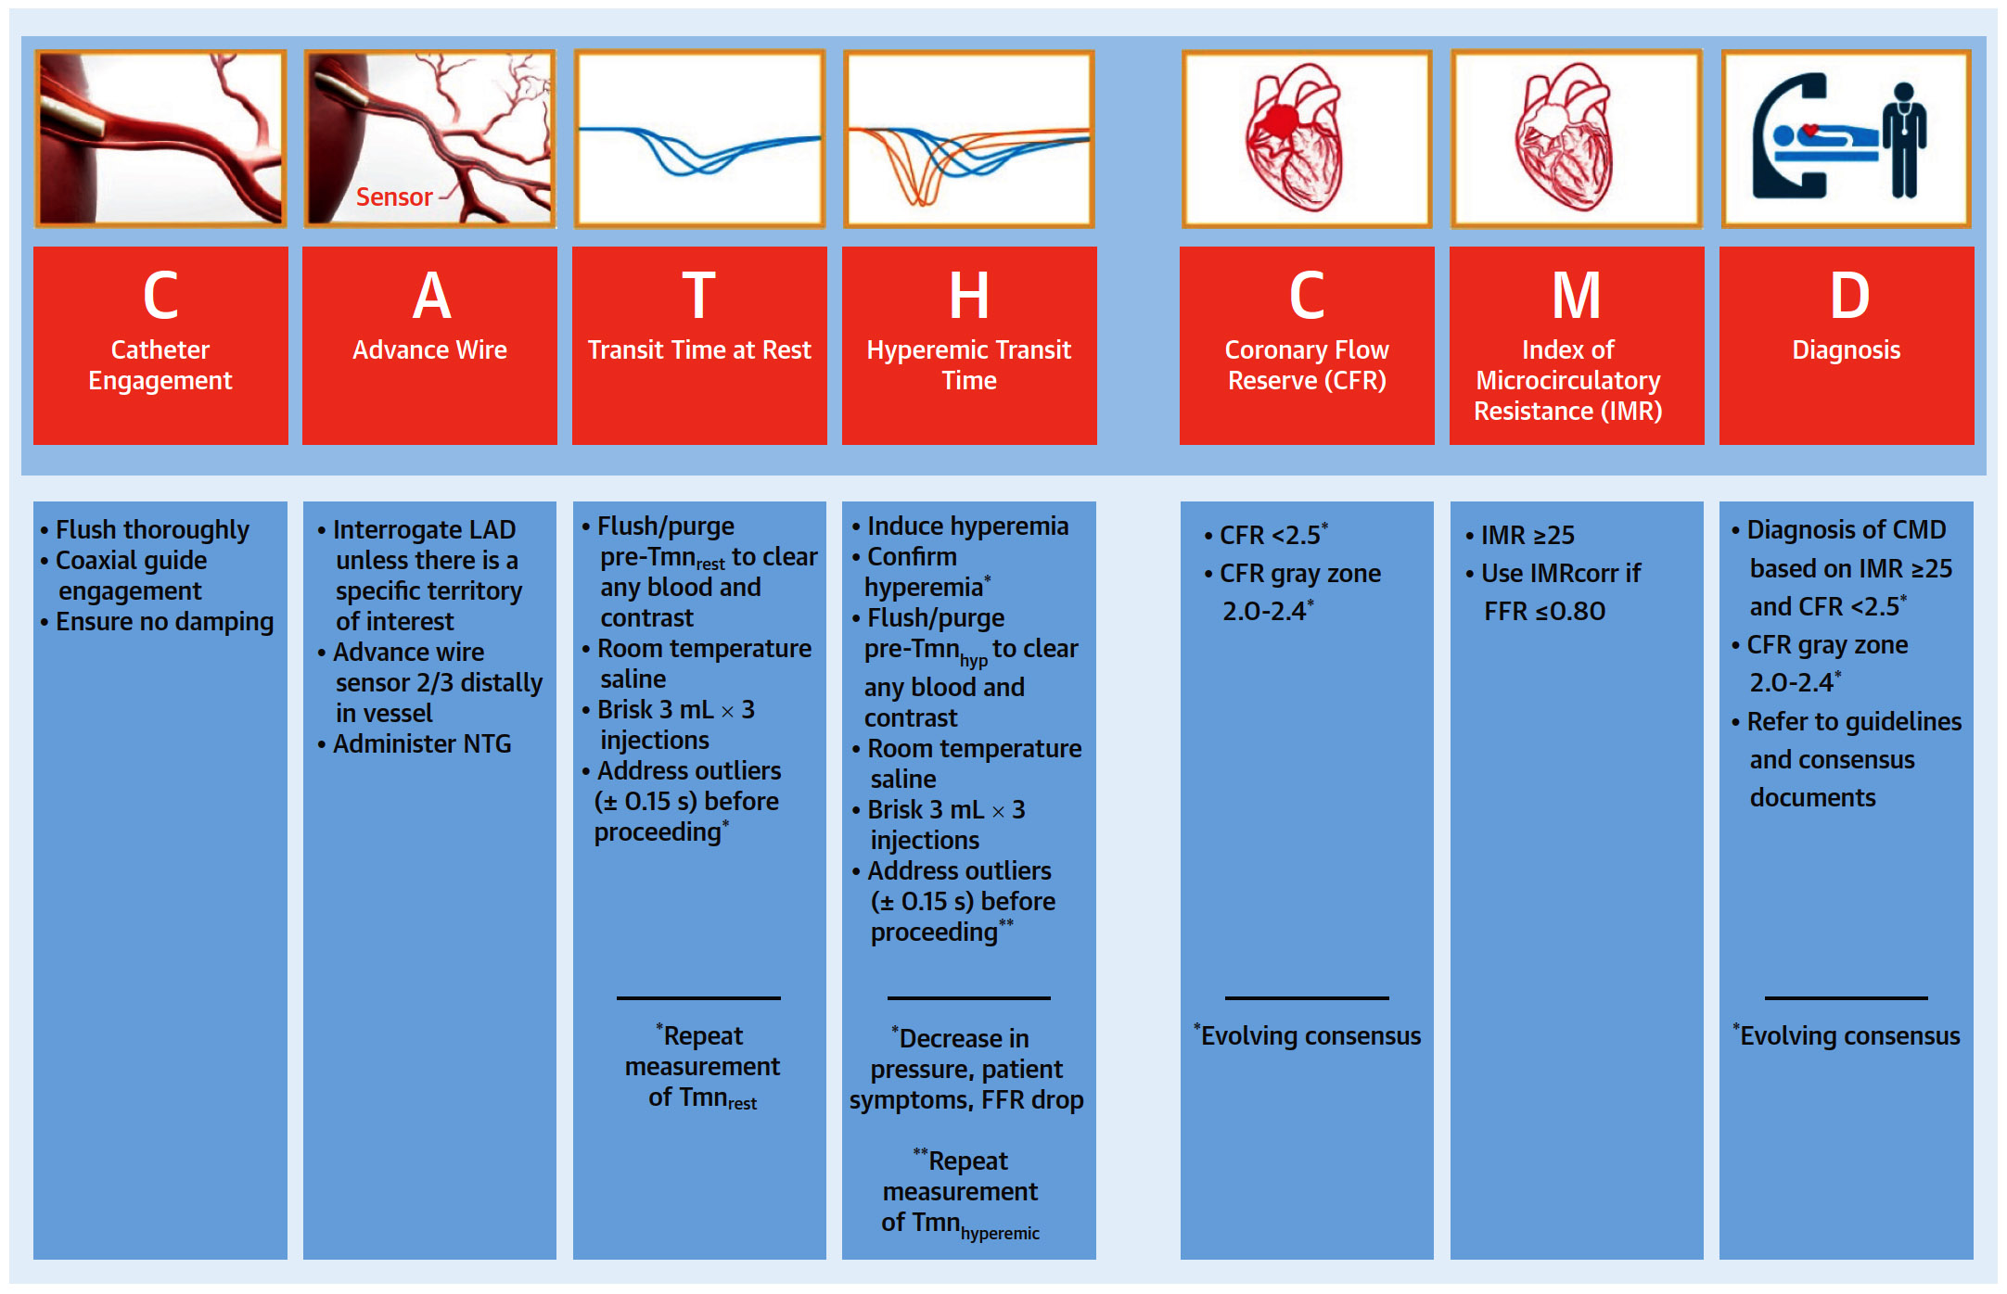
Assessment of Coronary Microvascular
Dysfunction Using Thermodilution
Samuels et al., J Am Coll Cardiol 2023;82:1245

Slide 66
Acetylcholine (Ach) Preparation of IC Administration
Reconstitution | Reconstitute 20 mg powder with 2 mL provided diluent, yielding a concentration of 20 mg/2 mL (10 mg/mL)
Dilution | Add the 12 mL (20 mg) of Ach to a 1,000 mL of NS, yielding a concentration of 20 µg/mL
Administration | Draw up 20 µg/mL solution for intracoronary administration: 1 mL: 20 µg 2.5 mL: 50 µg 5 mL: 100 µg 10 mL: 200 µg
Samuels et al., J Am Coll Cardiol 2023;82:1245

Slide 67
Resources Required for a CFT Center
Core Personnel | Equipment | Multidisciplinary Collaborations
Interventional cardiologists who perform invasive CFT | General cardiac catheterization imaging and physiology systems to rule out epicardial coronary disease | Cardiovascular rehabilitation
Noninvasive cardiologists, including imaging experts and clinicians providing ongoing care | Invasive coronary physiology system (thermodilution or Doppler) | Weight loss program providers
Nurses and advanced practice providers | Intravascular imaging | Nutritional and dietary counseling
Research staff to facilitate data collection and enroll patients in clinical trials | Echocardiography and cardiac stress imaging equipment Advanced cardiac imaging program (PET/CMR) advised but not required | Mental health providers and psychiatry Pain management and anesthesiology Obstetrics and gynecology (for catamenial chest pain)
Smilowitz et al., J AM Coll Cardiol 2023;82:1264

Slide 68
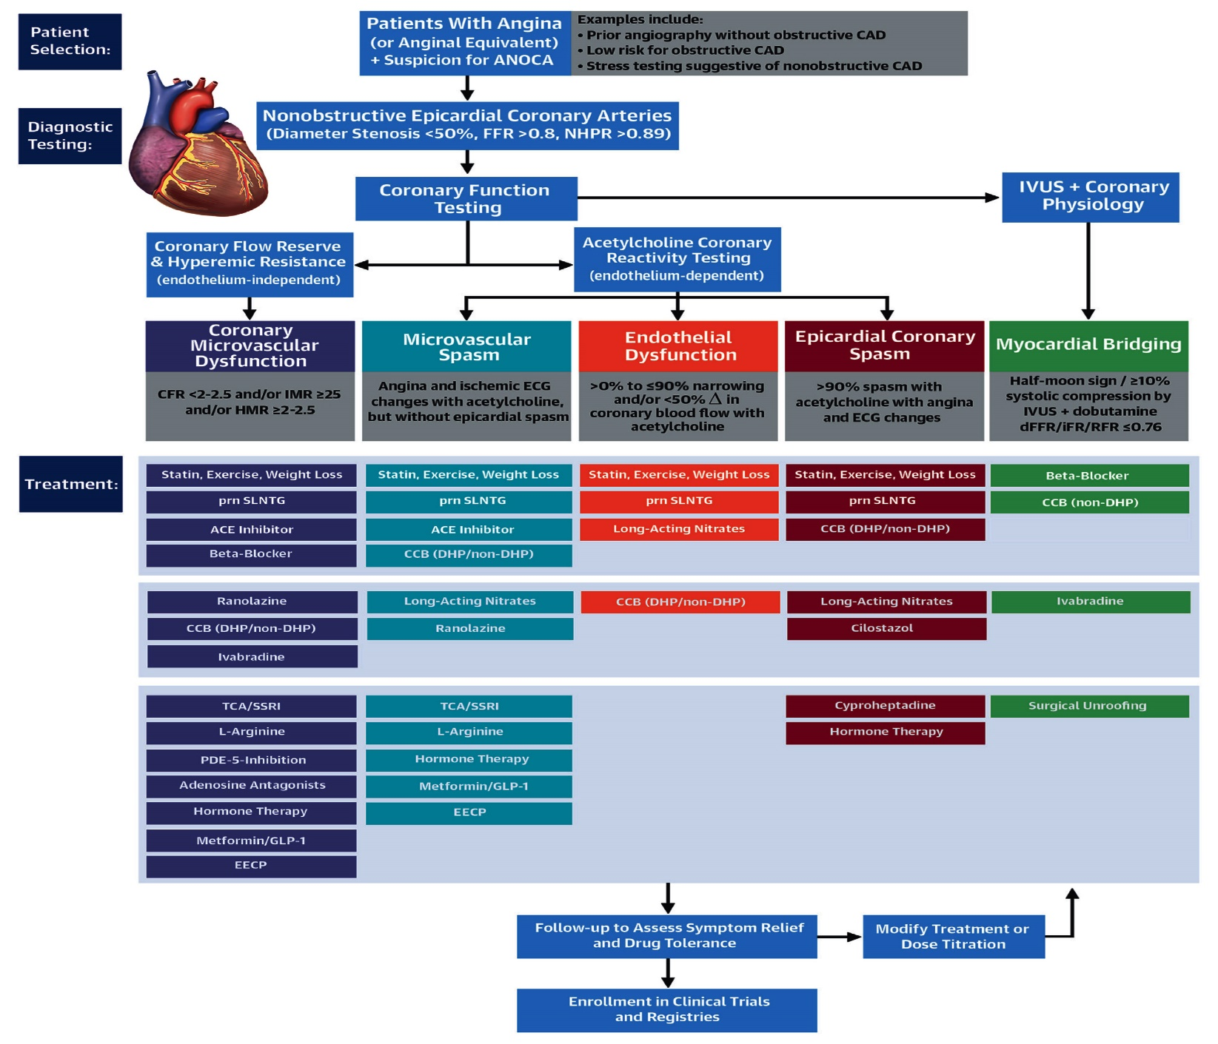
Invasive Diagnostic and Treatment Pathway for Pts with ANOCA
Smilowitz et al., J AM Coll Cardiol 2023;82:1264

Slide 69
Invasive Treatment Pathway for Pts with ANOCA
Smilowitz et al., J AM Coll Cardiol 2023;82:1264

Slide 70
Evidence Based Therapies for ANOCA Due to Epicardial Coronary Spasm and Endothelial Dysfunction
Evidence Based Therapies for Angina with Nonobstructive Coronary Arteries Due to Myocardial Bridging
Epicardial Coronary Spasm & Endothelial Dysfunction
Drug Therapy Evidence of benefit CCB Cilostazol Cyproheptadine Fasudil Long-acting nitrates Metformin Short-acting nitrates Statins
Myocardial Bridging
Drug Therapy Evidence of benefit Beta-blockers CCB Ivabradine Statins
Procedure / Device-Based Therapy Limited Data Surgical Unroofing
Smilowitz et al., J AM Coll Cardiol 2023;82:1264

Slide 71
Procedure- and Evidence-Based Therapy
for ANOCA
Nerve Stimulation: Transcutaneous electrical nerve stimulation mitigates abnormal pain perception, improves angina, and increases exercise tolerance through pain signal neuromodulation.
Enhanced External Counterpulsation (EECP): Noninvasive method to increase diastolic augmentation and decrease afterload.
Ongoing Device-Based Clinical Trials. Coronary sinus reducer therapy. Coronary sinus reducer narrows the coronary sinus to induce a controlled restriction in venous drainage, thereby increasing coronary sinus pressures and myocardial perfusion through redistribution of flow. COSIMA (COronary SInus Reducer for Treatment of Refractory Microvascular Angina) Trial.
Smilowitz et al., J AM Coll Cardiol 2023;82:1264

Slide 72
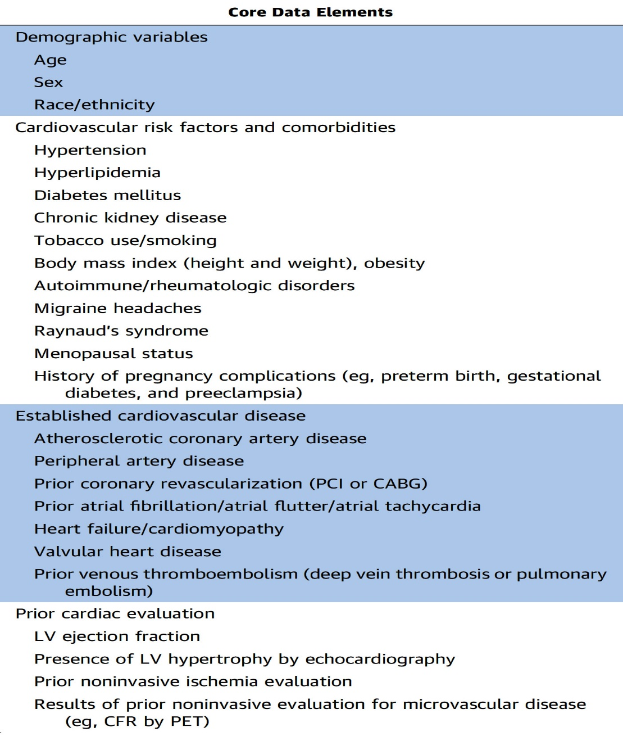
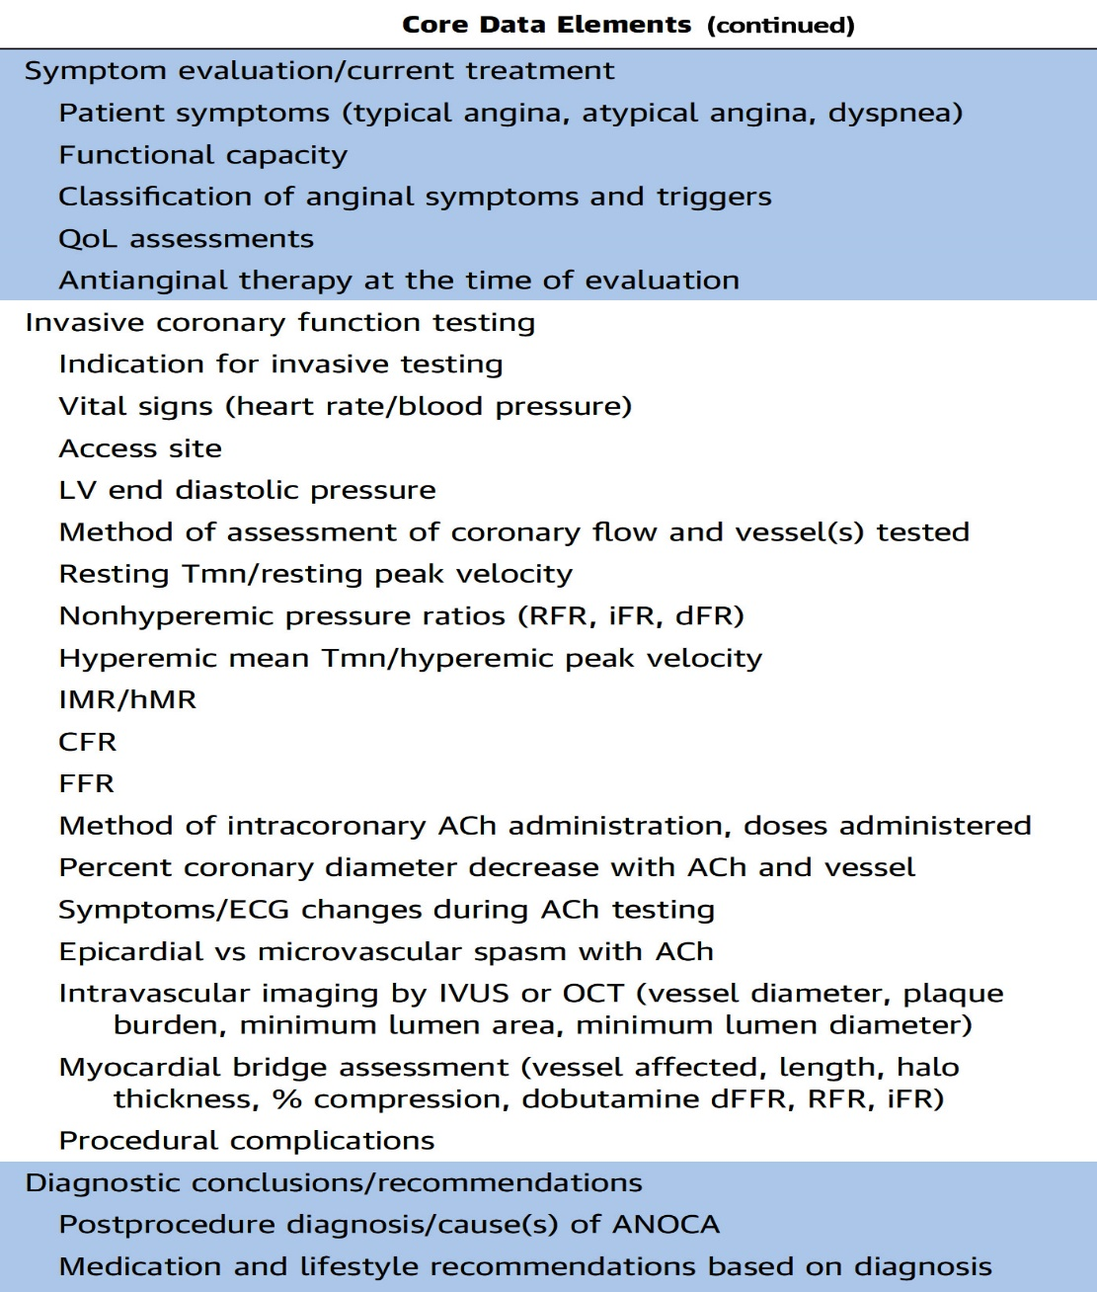
Core Data Elements for Clinical Reporting of Coronary Function Testing and Research Data Collection
Smilowitz et al., J AM Coll Cardiol 2023;82:1264

Slide 73
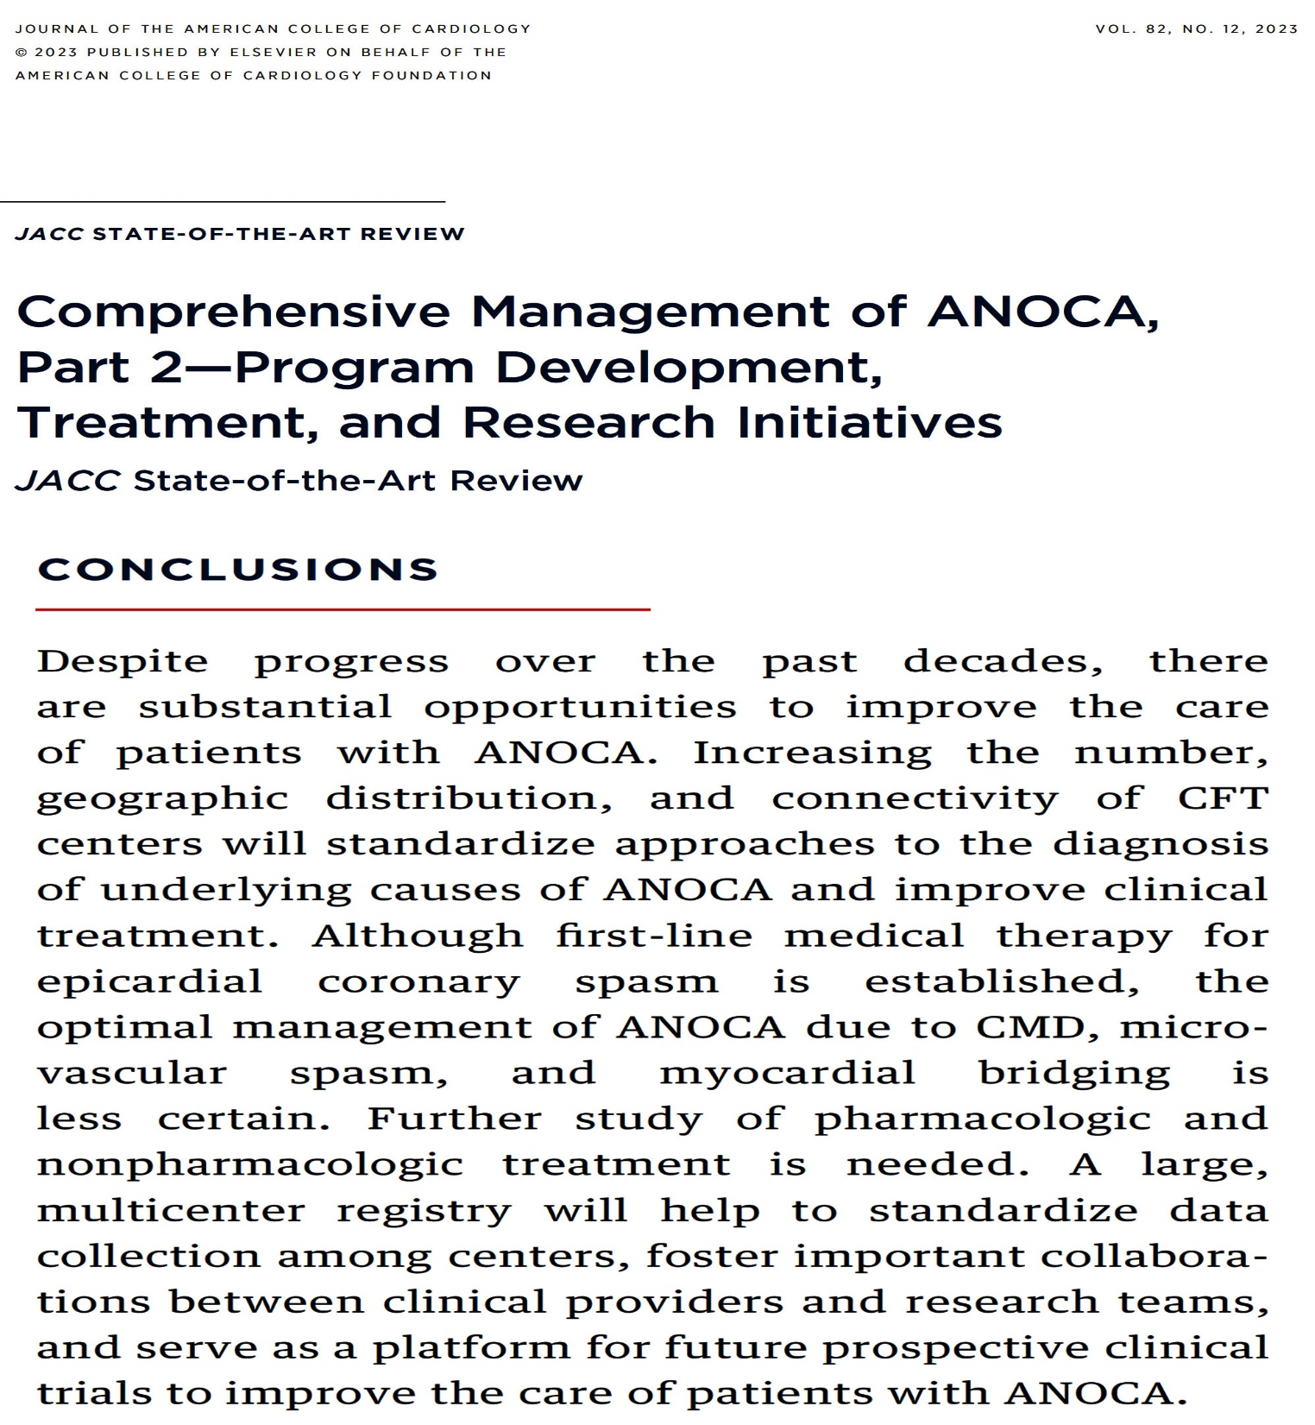

Slide 74
Take Home Message: Imaging Interventional Trials from ESC 2023 and Update in ANOCA
Meta-analysis of Imaging vs Angio guided PCI:
OCT vs Angio guided PCI of Bifurcation lesions:
OCT vs Angio guided PCI of Complex lesions:
OCT vs IVUS imaging guided PCI:
Recent updated review on the topic of angina with non-obstructive coronary arteries (ANOCA) has succinctly outlined the definition, prevalence, diagnosis and treatment. ANOCA is increasingly being recognized in the clinical practice and requires a dedicated program to make the correct diagnosis and appropriate management strategy. Lifestyle management, appropriate disease specific pharmacotherapy and in some cases device based therapeutic options can improve angina burden and QOL in these ANOCA pts.
Notes:
HbA1c in

Slide 75
Question # 1
Following statement is false regarding the final results of the ILUMIEN trial of OCT vs Angio guided PCI;
Similar TLF in OCT vs Angio group
Higher post PCI MSA in OCT vs Angio group
Higher thrombosis in OCT vs Angio group
Similar MI in OCT vs Angio group
Similar ID-Revasc in OCT vs Angio group
The correct answer is C

Slide 76
Question # 2
Following statement is false regarding the results of the OCTOBER trial comparing OCT vs Angio guided PCI in bifurcation lesions;
A. Similar POCE between 2 groups
B. Similar mortality between 2 groups
C. Similar Stent thrombosis between 2 groups
D. Similar ID-TLR and MI between 2 groups
E. Similar MACE between 2 groups
The correct answer is E
,
Notes:
er

Slide 77
Question # 3
Following statement is True regarding the results of the OCTIVUS comparing OCT vs IVUS PCI;
A. Similar Contrast use between 2 groups
B. Similar Stent Optimization criteria met between 2 groups
C. Similar >90% Stent expansion in IVUS vs OCT group
D. Lower MACE in IVUS vs OCT group
E. Lower mal-apposition in IVUS vs OCT group
The correct answer is E
,
Notes:
er

Slide 78
