Slide 1
Angiosome Directed Revascularization of Left Posterior Tibial Artery CTO in patient with CLTI

Slide 2
Case Presentation
76 year old woman presenting with nonhealing left great toe skin ulcer and ischemic changes for 4 months (Rutherford class 3/ Category 5 , WiFi 131)
PMH: Hypertension, Hyperlipidemia, Diabetes, CAD, Pacemaker .
Medications: Aspirin, metformin, glipizide, atorvastatin 40 mg, furosemide
Social History: Non-smoker, no alcohol, no IVDU

Slide 3
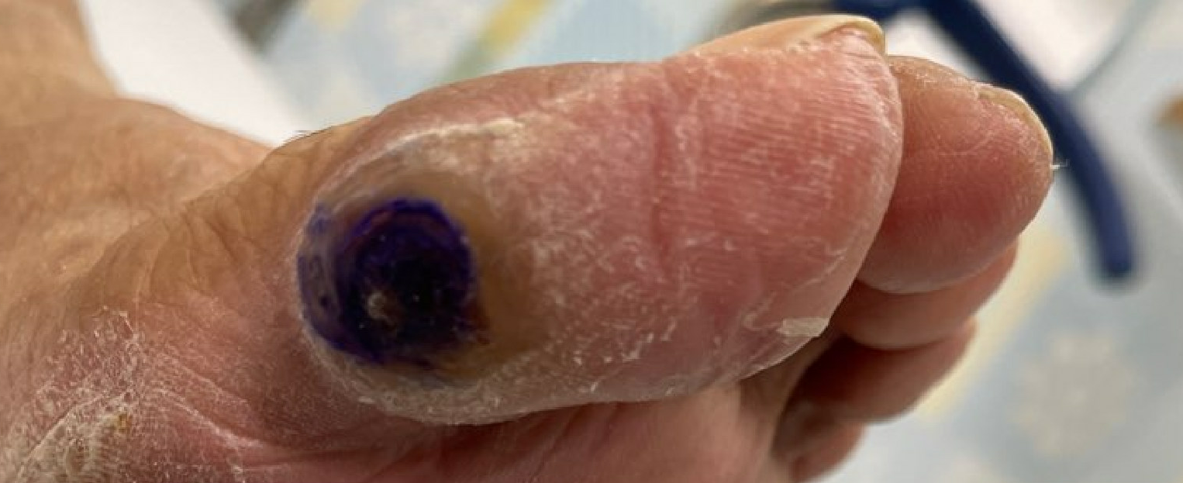
Case Presentation
Noninvasive Evaluation:
ABI Right 0.67, Left 0.52
Arterial Duplex US: Dopplerable monophasic DP and PT bilaterally

Slide 4
Angiosomes of the Foot

Slide 5
Critical Limb Ischemia
The first concept of critical limb ischemia (CLI) emerged in 1982
Originally, CLI was defined as systolic blood pressure in the ankle (ankle pressure, AP) < 40 mmHg, with pain at rest and AP < 60 mmHg with tissue necrosis
Diabetic patients were excluded from this concept.

Slide 6
Background to WiFi classification
Previously-existing classification systems for threatened limbs do not generally cover all three pillars (wound, ischemia, and infection) of the extremity at risk of amputation.
Rutherford and Fontaine classifications are primarily based on the degree of ischemia
Wagner classification does not differentiate between the causes of ischemic and infectious gangrene

Slide 7
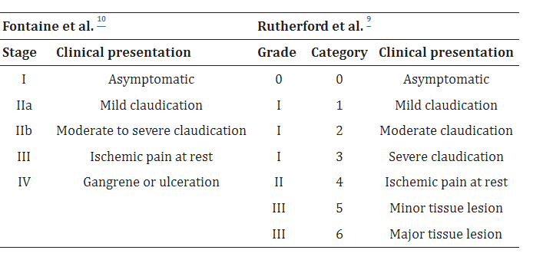
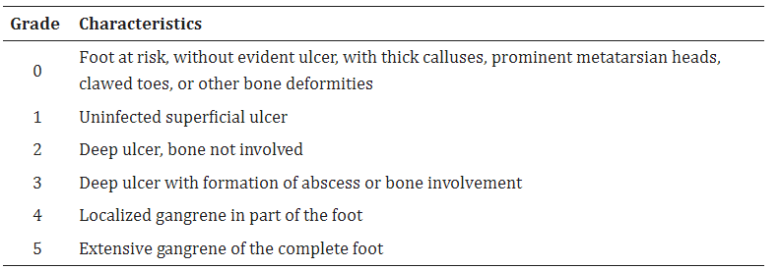
Wagner Classification

Slide 8
WiFi Classification
The Society for Vascular Surgery was proposed a classification system for the threatened lower limb, based on the three main factors that have an impact on limb amputation risk: Wound (W), Ischemia (I) and foot Infection (“fI”) - the WIfI classification.
The classification’s purpose is to provide accurate and early risk stratification for patients with threatened lower limbs
Assist with clinical management, enabling comparison of alternative therapies
predicting risk of amputation at 1 year and the need for limb revascularization.

Slide 9
SVS WiFi Classification
The SVS classification system covers the three most important parameters that put a limb at risk of amputation: wound, ischemia, and foot infection.
The SVS WIfI classification attributes a 4-grade scale to each letter or parameter running from 0 to 3, where 0 represents absent, 1 mild, 2 moderate, and 3 severe
After grading, the scores attributed to each letter are combined and analyzed using two tables: one gives an estimation of the risk of amputation at 1 year and an estimation of the need for and benefit of revascularization
Based on the results, the limb is classified for risk of amputation and need of revascularization at clinical stages 1, 2, 3, or 4: very low, low, moderate, and high risk of amputation or benefit from revascularization, respectively
Notes:
Stage 5 is reserved for feet that cannot be saved, even with revascularization.

Slide 10
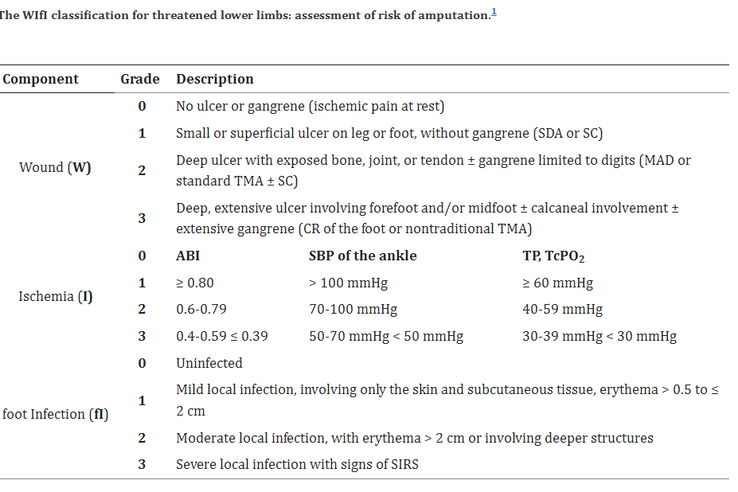

Slide 11
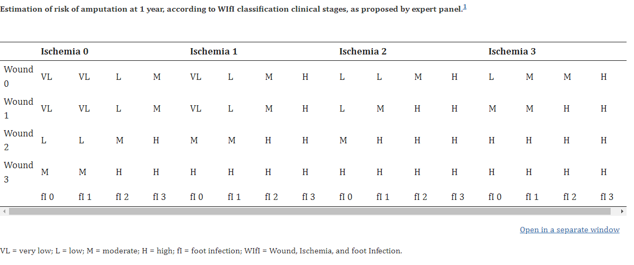

Slide 12
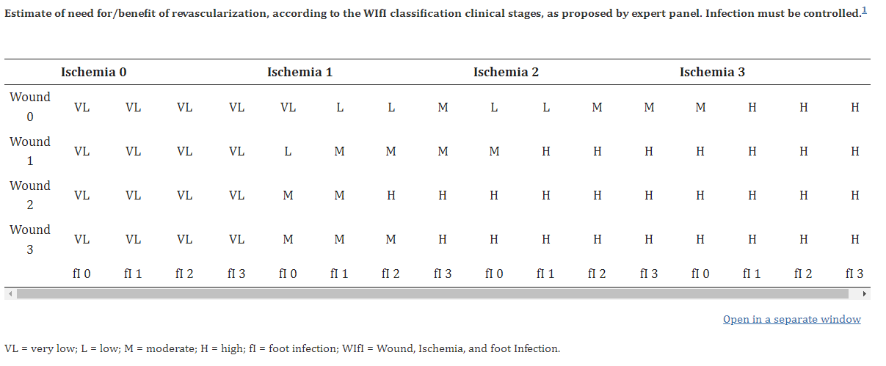

Slide 13
WiFi Classification
The system was created to precisely define the burden of the disease.
It is Analogous to the TNM classification for cancer, aiding in clinical management and enabling comparisons between similar groups of patients and alternative treatments
The target population for this system includes any patient with ischemic pain at rest, with confirmatory objective hemodynamic studies (ankle-brachial index [ABI] < 0.40, AP < 50 mmHg, TP < 30 mmHg; DFU; and with ulceration of the foot or unhealed lower limb wound with duration ≥ 2 weeks and/or gangrene of lower limb or foot

Slide 14
WiFi Classification
The following conditions are excluded:
patients with pure venous ulcers
wounds related to non-atherosclerotic conditions (for example: vasculitis, collagen vascular disease, Buerger’s disease, radiation)
acute limb ischemia
ischemia due to emboli
acute trauma/mutilated extremity

Slide 15
Conclusion WiFi Classification
One of the primary outcomes expected from creation of the WIfI classification was the capacity to predict the need for revascularization of the threatened limb.
At higher classification stages, revascularization proved beneficial for reducing the risk of amputation by 25%
SVS WIfI classification expert panel proposed that revascularization would be highly beneficial/necessary for almost all patients with grade 3 ischemia and selected patients with grade 2 ischemia.

Slide 16
References
Mills JL, Sr, Conte MS, Armstrong DG, et al. The society for vascular surgery lower extremity threatened limb classification system: risk stratification based on Wound, Ischemia, and foot Infection (WIfI) J Vasc Surg.
Mills JL., Sr Update and validation of the Society for Vascular Surgery wound, ischemia, and foot infection threatened limb classification system. Semin Vasc Surg. 2014
Bell PRF, Charlesworth D, DePalma RG, et al. The definition of critical ischaemia of a limb. Working party of the international vascular symposium. Br J Surg. 1982
Rutherford RB, Baker JD, Ernst C, et al. Recommended standards for reports dealing with lower extremity ischemia: Revised version. J Vasc Surg. 1997
Fontaine R, Kim M, Kieny R. Surgical treatment of peripheral circulation disorders. Helv Chir Acta. 1954
Causey MW, Ahmed A, Wu B, et al. Society for Vascular Surgery limb stage and patient risk correlate with outcomes in an amputation prevention program. J Vasc Surg. 2016
Robinson WP, Loretz L, Hanesian C, et al. Society for Vascular Surgery Wound, Ischemia, foot Infection (WIfI) score correlates with the intensity of multimodal limb treatment and patient-centered outcomes in patients with threatened limbs managed in a limb preservation center. J Vasc Surg. 2017

