Slide 1

Complex Coronary Cases Supported by:
Abbott Vascular Inc.
Boston Scientific Corp.
Terumo Vascular Corp.
Cardiovascular Systems Inc.
Abiomed Inc.
Chiesi Inc.
Shockwave Medical Inc.
Cardinal Health Cordis Inc.

Slide 2
Disclosures
Samin K. Sharma, MD, MSCAI, FACC
Nothing to disclose
Annapoorna S. Kini, MD, MRCP, FACC
Nothing to disclose
Sameer Mehta, MD, FACC (Moderator)
Nothing to disclose

Slide 3

CCC Live Case # 161
Patient Demographics
37 yrs, male
Present Clinical Presentation
Presented with CCS class IV angina and cath @OSH revealed 3 V CAD, CABG recommended but declined and underwent PCI
CAD Risk Factors
Hyperlipidemia
Smoker
SAQ score: 45
Clinical Variables
No prior cardiac history and recent echo revealed EF 60%.
Medications
ASA, Clopidogrel, Losartan, Metoprolol XL, ISMN, Atorvastatin, Ezetimibe
Cath: Cath on 10/4/2022 revealed 3 V CAD: 100% distal RCA with extensive collaterals from LAD, 80% mid LAD, 70% D2, 90% LCx-OM1, 100% distal LCx with Syntax score 33 and normal LV function. In view of extensive CAD, CABG was recommended but declined due to young age. Pt underwent successful PCI of mLAD, LCx-OM1 and dLCx CTO using three Promus DES. Pt continued to have class II angina but has limited activity since PCI.
Plan: Now planned for staged PCI of distal RCA CTO (as part of CR) using antegrade approach and if fails, then retrograde approach.

Slide 4

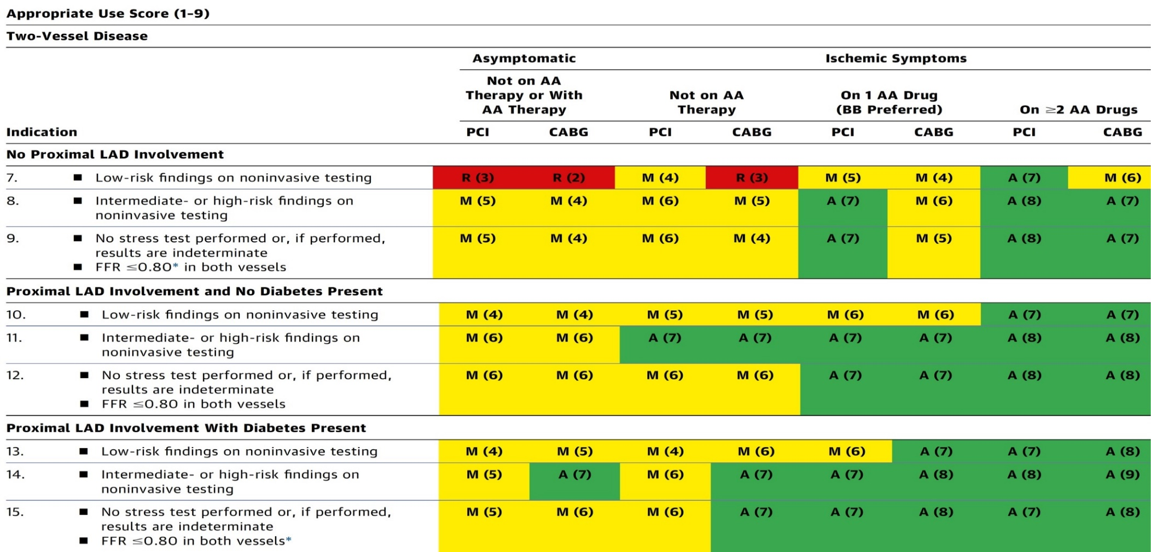
AUC 2017: Two-Vessel Disease
Patel et al., J Am Coll Cardiol 2017;69:2212

Slide 5

Latest Issues in Coronary Intervention
Key Interventional Trials from TCT/AHA 2022:
BRIGHT-4 Trial, EXIT-CALC Trial, ECMO-CS
Trial
Focused review of the month
Impact of Revascularization on Low EF:
Change in LVEF with coronary revascularization
and subsequent risk for adverse CV outcomes

Slide 6
Latest Issues in Coronary Intervention
Key Interventional Trials from TCT/AHA 2022:
BRIGHT-4 Trial, EXIT-CALC Trial, ECMO-CS
Trial
Focused review of the month
Impact of Revascularization on Low EF:
Change in LVEF with coronary revascularization
and subsequent risk for adverse CV outcomes

Slide 7
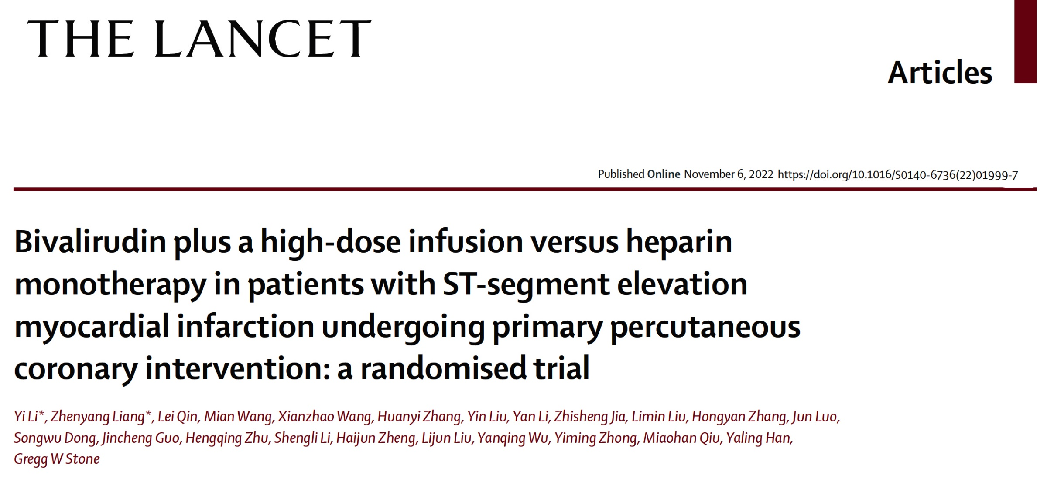
(Usual PCI dose 1.75 mg/kg/hr for 2-4 hrs)

Slide 8
Bivalirudin vs. Heparin Anticoagulation During Primary PCI in STEMI
Six completed randomized trials have reported conflicting results¹⁻⁶
Substantial heterogeneity was present in the prior trial designs:
Routine vs. selective use of GPIIb/IIIa inhibitors (GPI) + heparin
Use, dose and duration of a post-PCI bivalirudin infusion
Radial vs. femoral vascular access
Post hoc analyses suggest that bivalirudin with a 2-4 hour post-PCI high-dose infusion 1.75mg/kg/h and heparin monotherapy are the two regimens likely to minimize both ischemic and hemorrhagic complications in STEMI pts undergoing pPCI with radial access
These two regimens have not been compared in an adequately powered randomized trial
1. N Engl J Med 2008; 358(21): 2218-30. (HORIZONS-AMI)
2. N Engl J Med 2013; 369(23): 2207-17. (EUROMAX)
3. Lancet 2014; 384(9957): 1849-58. (HEAT PPCI)
4. JAMA 2015; 313(13): 1336-46. (BRIGHT)
5. N Engl J Med 2015; 373(11): 997-1009. (MATRIX)
6. N Engl J Med 2017; 377(12): 1132-42. (VALIDATE-SWEDEHEART)

Slide 9
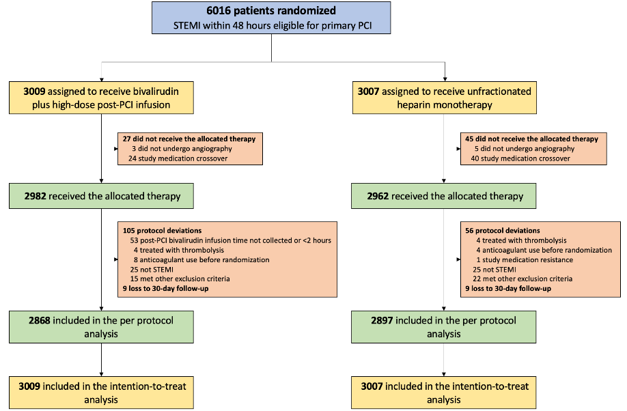
BRIGHT-4 Trial: Patient Flow
87 Sites in China
Feb 14, 2019 - Apr 7, 2022
99.7% 30-day follow-up
Li et al., Lancet 2022 Nov 6 Epub ahead of print

Slide 10
BRIGHT-4 Trial: Patient Flow
Characteristic | Heparin (N=3007) | Bivalirudin (N=3009)
Age, years | 60.6 ± 12.2 | 60.5 ± 12.1
Male | 78.9% | 78.1%
Diabetes mellitus | 23.2% | 22.2%
Hypertension | 50.5% | 52.0%
BMI (kg/m²) | 65.0 ± 3.8 | 24.8 ± 3.6
Prior MI | 6.6% | 6.2%
Prior PCI | 6.2% | 6.2%
Prior stroke | 11.4% | 11.7%
Killip class III-IV | 10.7% | 10.2%
Sx-door time, hr | 3.3 (1.7-6.7) | 3.3 (1.7-6.4)
>12 hours | 12.2% | 11.0%
Characteristic | Heparin (N=3007) | Bivalirudin (N=3009)
P2Y12 inhibitor
Clopidogrel | 34.4% | 33.7%
Ticagrelor | 65.6% | 66.3%
Transradial access | 92.6% | 93.6%
Revascularization | 98.4% | 98.1%
PCI | 98.1% | 97.8%
CABG | 0.4% | 0.4%
Door-wire time, hr | 1.1 (0.9-1.7) | 1.1 (0.9-1.6)
Thrombus aspiration | 17.9% | 18.1%
TIMI 0/1 pre (site read) | 83.4% | 82.0%
TIMI 3 post (site read) | 97.5% | 98.5%
Li et al., Lancet 2022 Nov 6 Epub ahead of print

Slide 11
BRIGHT-4 Trial: Study Drug Treatments
 | Heparin (N=3007) | Bivalirudin (N=3009) | P value
Heparin | 98.7% | 0.8% | -
Total dose, IU | 5570 (4800-6775) | - | -
Bivalirudin | 1.3% | 99.2% | -
Post-PCI infusion administered | - | 2953/2953 (100.0%) | -
Post-PCI infusion duration, hr | - | 3.0 (2.2-4.0) | -
Additional bolus of study medications | 35.1% | 3.5% | <0.0001
Peak activated clotting time, sec | 267 (238-317) | 321 (278-365) | <0.0001
GPI for procedural complications | 13.7% | 11.5% | 0.01
Li et al., Lancet 2022 Nov 6 Epub ahead of print

Slide 12
BRIGHT-4 Trial: Primary Endpoint
All-cause Death or BARC Types 3-5 Bleeding
Heparin monotherapy
Bivalirudin with high-dose infusion
Heparin
4.4%
ARR: 1.3%
NNT: 76
3.1%
All-cause death or BARC
types 3-5 bleeding (%)
Bivalirudin
Hazard ratio: 0.69, 95%CI: 0.53-0.91
P=0.0070
No. at risk:
Days since randomization
Heparin 3007 2913 2896 2889 2882 2877 2875
Bivalirudin 3009 2942 2927 2924 2919 2918 2917
Li et al., Lancet 2022 Nov 6 Epub ahead of print

Slide 13
BRIGHT-4 Trial
All-cause Death
BARC 3-5 Bleeding
Heparin monotherapy
Bivalirudin with high-dose infusion
Heparin monotherapy
Bivalirudin with high-dose infusion
3.9%
3.0%
Hazard ratio: 0.21, 95%CI: 0.08-0.54
P=0.0014
All-cause death (%)
BARC types 3-5 bleeding (%)
Hazard ratio: 0.75, 95%CI: 0.57-0.99
P=0.0420
0.8%
0.2%
Days since randomization
No. at risk:
Days since randomization
No. at risk:
Heparin 3007 2924 2908 2903 2896 2891 2889
Bivalirudin 3009 2944 2929 2926 2922 2921 2920
Heparin 3007 2989 2987 2985 2983 2983 2983
Bivalirudin 3009 3005 3005 3005 3004 3004 3004
Li et al., Lancet 2022 Nov 6 Epub ahead of print

Slide 14
BRIGHT-4 Trial: BARC 3-5 Bleeding
BARC types 3-5 bleeding | Heparin (n=24) | Bivalirudin (n=5)
Access site-related | 1 (4.2%) | 0 (0.0%)
Non-access site-related | 23 (95.8%) | 5 (100.0%)
Gastrointestinal | 17 (70.8%) | 4 (80.0%)
Intracranial | 3 (12.5%) | 1 (20.0%)
Other | 3 (12.5%) | 0 (0.0%)
Blood transfusion | 14 (58.3%) | 2 (40.0%)
Mean volume, units | 2.3 ± 0.7 | 1.8 ± 0.4
Surgery to treat bleeding | 0 (0.0%) | 0 (0.0%)
Endoscopic procedure for bleeding | 4/17 (23.5%) | 1/4 (25.0%)
DAPT discontinuation* after bleeding† | 21 (87.5%) | 4 (80.0%)
Stent thrombosis after bleeding† | 0 (0.0%) | 0 (0.0%)
Death after bleeding† | 10 (41.7%) | 2 (40.0%)
*Discontinuation of either aspirin or a P2Y12 inhibitor or both.
†Within the 30-day follow-up period.
Li et al., Lancet 2022 Nov 6 Epub ahead of print

Slide 15
BRIGHT-4 Trial: Reinfarction and Stent Thrombosis
Reinfarction
Stent Thrombosis
Heparin monotherapy
Bivalirudin with high-dose infusion
Heparin monotherapy
Bivalirudin with high-dose infusion
Hazard ratio: 0.68, 95%CI: 0.37-1.26
P=0.22
Hazard ratio: 0.33, 95%CI: 0.17-0.66
P=0.0015
Reinfarction (%)
Stent thrombosis (%)
1.1%
0.8%
0.6%
0.4%
Days since randomization
Days since randomization
No. at risk:
No. at risk:
Heparin 3007 2993 2992 2986 2985 2983 2982
Bivalirudin 3009 3002 2998 2995 2994 2994 2992
Heparin 3007 2983 2980 2976 2975 2974 2974
Bivalirudin 3009 3002 2999 2999 2998 2998 2998
Li et al., Lancet 2022 Nov 6 Epub ahead of print

Slide 16
BRIGHT-4 Trial: Incidence of MACCE & NACE
MACCE
NACE
Heparin monotherapy
Bivalirudin with HD infusion
Heparin monotherapy
Bivalirudin with HD infusion
MACCE (%)
5.2%
5.6%
NACE (%)
4.1%
4.2%
Hazard ratio: 0.79, 95%CI: 0.62-1.00
P=0.0509
Hazard ratio: 0.74, 95%CI: 0.59-0.94
P=0.0124
Days since randomization
Days since randomization
No. at risk
No. at risk
Heparin 3007 2906 2880 2869 2862 2855 2853
Bivalirudin 3009 2926 2903 2896 2891 2891 2887
Heparin 3007 2895 2869 2858 2850 2843 2841
Bivalirudin 3009 2924 2901 2894 2889 2889 2885
Li et al., Lancet 2022 Nov 6 Epub ahead of print

Slide 17
BRIGHT-4 Trial: 30-Day Outcomes (ITT)
Events | Heparin (N=3007) | Bivalirudin (N=3009) | Hazard ratio (95%CI) | P value
Primary endpoint | 4.4% | 3.1% | 0.69 (0.53-0.91) | 0.0070
All-cause death | 3.9% | 3.0% | 0.75 (0.57-0.99) | 0.0420
BARC 3-5 bleeding | 0.8% | 0.2% | 0.21 (0.08-0.54) | 0.0014
Access site-related | 0.03% | 0 | - | -
Non-access site-related | 0.8% | 0.2% | 0.22 (0.08-0.57) | 0.0019
Reinfarction | 0.8% | 0.6% | 0.68 (0.37-1.26) | 0.22
Ischemia-driven TVR | 0.6% | 0.3% | 0.50 (0.22-1.11) | 0.09
Stroke | 0.5% | 0.5% | 1.07 (0.52-2.22) | 0.85
Stent thrombosis | 1.1% | 0.4% | 0.33 (0.17-0.66) | 0.0015
Acute (<24 hours) | 0.5% | 0.1% | 0.29 (0.09-0.87) | 0.0268
Subacute (1-30 days) | 0.6% | 0.2% | 0.37 (0.15-0.87) | 0.0231
MACCE | 5.2% | 4.1% | 0.79 (0.62-1.00) | 0.051
BARC bleeding, types 2-5 | 2.6% | 2.1% | 0.82 (0.59-1.14) | 0.24
Acquired thrombocytopenia | 4.2% | 3.3% | 0.79 (0.60-1.03) | 0.08
NACE | 5.6% | 4.2% | 0.74 (0.59-0.94) | 0.0124
Li et al., Lancet 2022 Nov 6 Epub ahead of print

Slide 18
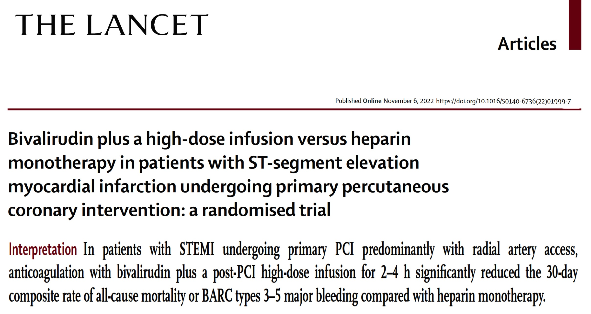

Slide 19
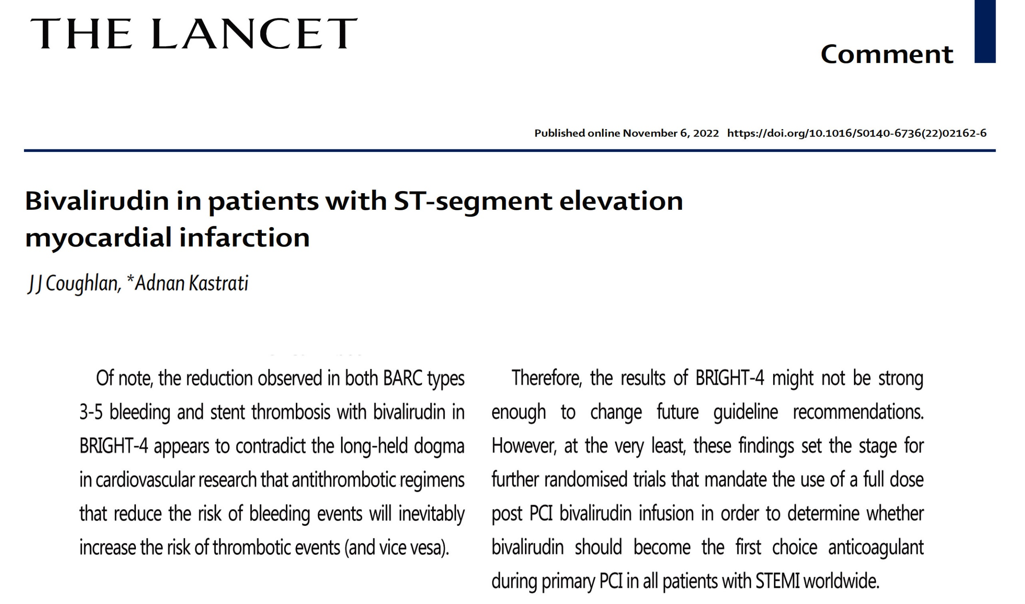

Slide 20
EXpansion of Stents After Intravascular LithoTripsy versus Conventional Predilatation in CALCified Coronary Arteries
EXIT-CALC Trial – A Prospective, Randomized Study

Slide 21
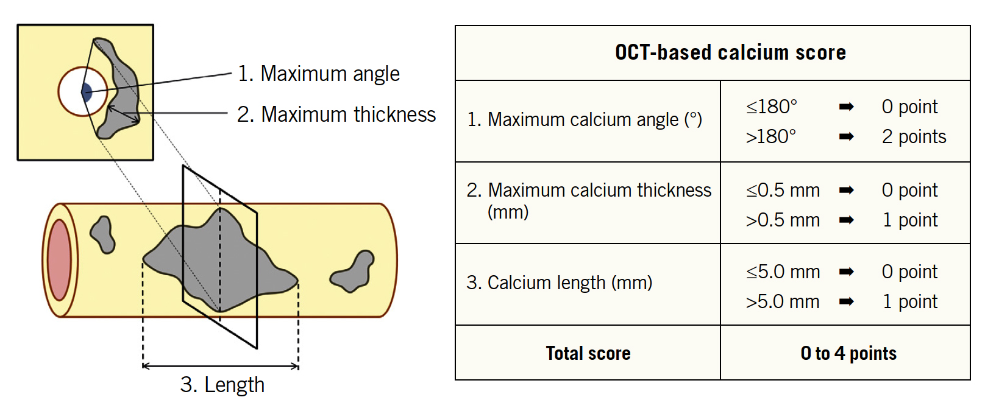
EXIT-CALC Study Design
Prospective, randomized study to evaluate stent expansion after IVL versus balloon angioplasty prior to stenting, in a predefined subset of severely calcified lesions with a high probability of stent under-expansion
  Eligible for enrollment if the OCT-derived Ca+ score was 4
Fujino et al., EuroIntervention 2018;13:e2182

Slide 22
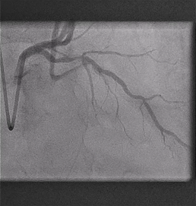
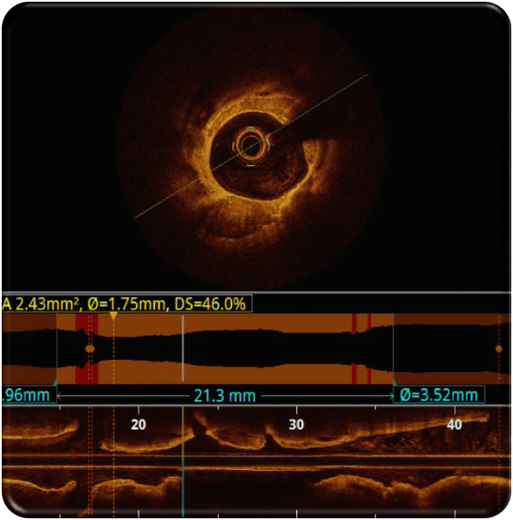
EXIT-CALC Study Flow Chart
EXIT-CALC Study Flow Chart
Coronary Angiography
OCT run #1 Assessment of calcium score
Randomization
Intravascular Lithotripsy
IVL
Balloon Angioplasty
BA
OCT run #2
Stenting and post-dilatation
Stenting and post-dilatation
OCT run #3
OCT endpoints
Vinck M, TCT 2022

Slide 23
EXIT-CALC Trial: Baseline Clinical Characteristics
 | Total (n=40) | Lithotripsy (n=19) | Conventional (n=21) | p-value
Male no (%) | 26 (65%) | 11 (58%) | 15 (71%) | 0.370
Age, years | 76.4 ± 7.1 | 76.7 ± 6.7 | 76.1 ± 7.6 | 0.781
BMI, kg/m² | 27.7 ± 5.1 | 28.6 ± 5.3 | 26.8 ± 4.9 | 0.264
Risk Factors (%)
Diabetes Mellitus | 35 | 32 | 38 | 0.666
Dyslipidemia | 63 | 63 | 62 | 0.935
Hypertension | 63 | 63 | 62 | 0.935
Current smoking | 53 | 47 | 57 | 0.158
Prior MI (%) | 28 | 16 | 38 | 0.115
Prior PCI (%) | 40 | 53 | 29 | 0.121
Prior CABG (%) | 10 | 11 | 10 | 0.916
Left ventricular function (EF) (%) |  |  |  | 0.688
Normal (> 50%) | 65 | 74 | 57
Reduced (30 - 50%) | 23 | 26 | 28
Severely reduced (< 30%) | 3 | 0 | 5
Vinck M, TCT 2022

Slide 24
EXIT-CALC Trial: Procedural Characteristics
 | Total (n=40) | Lithotripsy (n=19) | Conventional (n=21) | p-value
Predilatation
Compliant balloon (%) |  | - | 7 (33.3)
Non-compliant balloon (%) |  | - | 14 (66.7)
Scoring balloon (%) |  | - | 8 (38.1)
Diameter (mm) |  | 3.2 ± 0.4 | 2.8 ± 0.5
Pressure (atm) |  | 4.9 ± 1.0 | 15.4 ± 3.3
No. of pulses |  | 74 ± 11 | -
Stent(s) (n) | 1.7 ± 0.6 | 1.8 ± 0.6 | 1.6 ± 0.6 | 0.526
Length (mm) | 30.5 ± 12.2 | 29.4 ± 12.1 | 31.7 ± 12.5 | 0.437
Diameter (mm) | 3.2 ± 0.4 | 3.3 ± 0.4 | 3.2 ± 0.4 | 0.349
Pressure (atm) | 15.4 ± 2.3 | 14.9 ± 2.3 | 15.8 ± 2.3 | 0.110
Postdilatation, type of balloon
Compliant (%) | 4 (10.0) | 2 (10.5) | 2 (9.5)
Non-compliant (%) | 39 (97.5) | 18 (94.7) | 21 (100)
Diameter (mm) | 3.6 ± 0.4 | 3.6 ± 0.4 | 3.6 ± 0.5 | 0.809
Pressure (atm) | 18.8 ± 3.6 | 18.0 ± 2.5 | 19.5 ± 4.2 | 0.106
Vinck M, TCT 2022

Slide 25
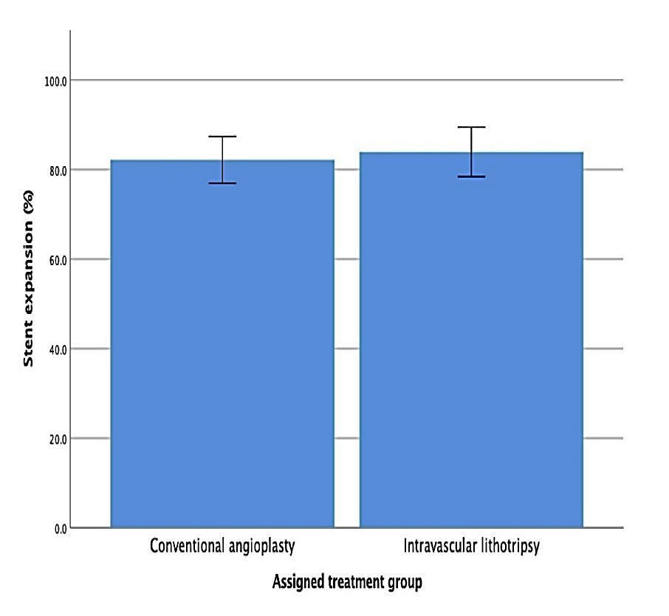
EXIT-CALC Trial: Study Results
Stent expansion
  IVL 83.9 ± 10.3 %
  BA 82.2 ± 11.5 %
Procedural and clinical outcomes
  100% procedural success
  no periprocedural complications
  no MACE reported at 30 days follow-up
P=0.63
82.2 ± 11.5 %
83.9 ± 10.3 %
Vinck M, TCT 2022

Slide 26
EXIT-CALC Trial: OCT Results
 | Total (n=40) | Lithotripsy (n=19) | Conventional (n=21) | p-value
Baseline OCT (first)
Maximum calcium angle (°) | 346 ± 33 | 345 ± 35 | 347 ± 32 | 0.861
Maximum calcium thickness (mm) | 1.1 ± 0.2 | 1.1 ± 0.2 | 1.1 ± 0.2 | 0.470
Calcium length (mm) | 22.9 ± 5.1 | 23.0 ± 4.5 | 22.9 ± 5.7 | 0.948
Minimal lumen area (mm²) | 1.9 ± 0.7 | 1.9 ± 0.7 | 1.8 ± 0.6 | 0.992
Lesion length (mm) | 15.9 ± 8.0 | 16.3 ± 6.9 | 15.5 ± 9.1 | 0.780
OCT after pre-treatment (second)
Minimal lumen area (mm²) | 3.0 ± 1.2 | 3.2 ± 1.2 | 2.9 ± 1.1 | 0.317
Coronary dissection | 73 | 63 | 81 | 0.056
Calcium fracture | 55 | 79 | 33 | 0.009
Final OCT (third)
Minimal stent area (mm²) | 6.4 ± 1.7 | 6.6 ± 1.5 | 6.2 ± 1.8 | 0.414
Stent expansion (%) | 82.9 ± 10.9 | 83.9 ± 10.3 | 82.2 ± 11.5 | 0.630
Edge dissection >60° | 13 | 0 | 24 | 0.036
Stent malapposition | 28 | 26 | 29 | 0.860
Vinck M, TCT 2022

Slide 27
EXIT-CALC: Conclusions
In severely calcified lesions as defined by the highest calcium score on OCT, no significant difference in stent expansion was observed after plaque modification by intravascular lithotripsy as compared with balloon angioplasty
In the balloon angioplasty group, stent expansion was higher than anticipated
  aggressive predilatation, including scoring balloons is adequate in majority of Ca++ cases

Slide 28
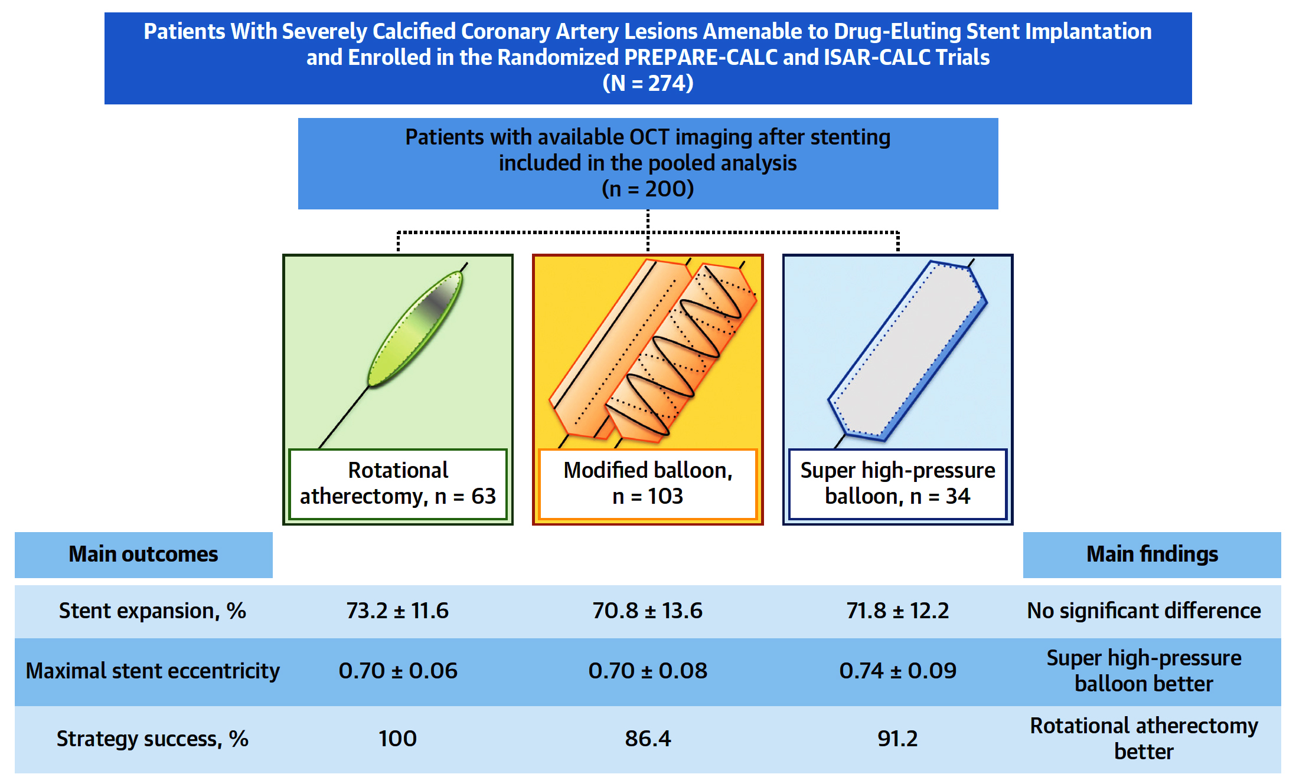
Rotational Atherectomy or Balloon-Based Techniques
for Severely Calcified Coronary Artery Disease
Rheude et al., J Am Coll Cardiol Intv 2022;15:1864

Slide 29

EXTRACORPOREAL MEMBRANE OXYGENATION
IN THE THERAPY OF CARDIOGENIC SHOCK
Primary Results from the Multicenter Randomized
ECMO-CS Trial

Slide 30
ECMO-CS Trial: Current Management of Cardiogenic Shock
Oxygen
Consider inotropes/
vasopressors
Consider short-term
MCS
+
+
Ventilatory support
Class I
Class IIa
Class IIb
Early conservative therapy
Immediate ECMO implantation
ECMO-CS trial compared:
vs.
in rapidly deteriorating or severe cardiogenic shock
Ostadal et al., Circulation 2022 Nov 6 Epub ahead of print

Slide 31
ECMO-CS Trial: Trial Procedure and Endpoints
Immediate ECMO implantation
Early conservative therapy
Randomization 1:1
or
Downstream ECMO allowed in case of hemodynamic worsening (rise of lactate by 3 mmol/L)
Primary composite endpoint:
Death from any cause, resuscitated circulatory arrest, and implementation of another mechanical circulatory support (including ECMO in the conservative arm) at 30 days
Ostadal et al., Circulation 2022 Nov 6 Epub ahead of print

Slide 32
ECMO-CS Trial: Patient Flow
Patients randomized
N = 122
Randomized ECMO
N = 61
Randomized
Conservative
N = 61
Absence of informed consent
N = 3
Absence of informed consent
N = 2
Analyzed
ECMO
N = 58
Analyzed
Conservative
N = 59
Ostadal et al., Circulation 2022 Nov 6 Epub ahead of print

Slide 33
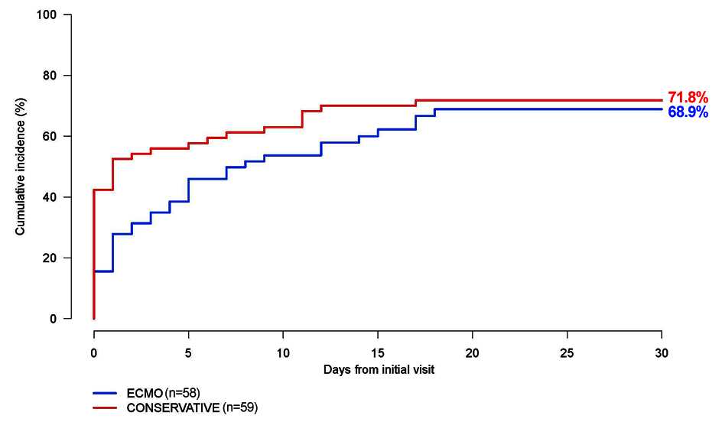
ECMO-CS Trial: Primary Composite Endpoint at 30 Days
Death from Any Cause, Resuscitated Arrest, Another MCS
Log-Rank test: P = 0.21
HR 0.72; 95% CI, 0.46 to 1.12
Ostadal et al., Circulation 2022 Nov 6 Epub ahead of print

Slide 34
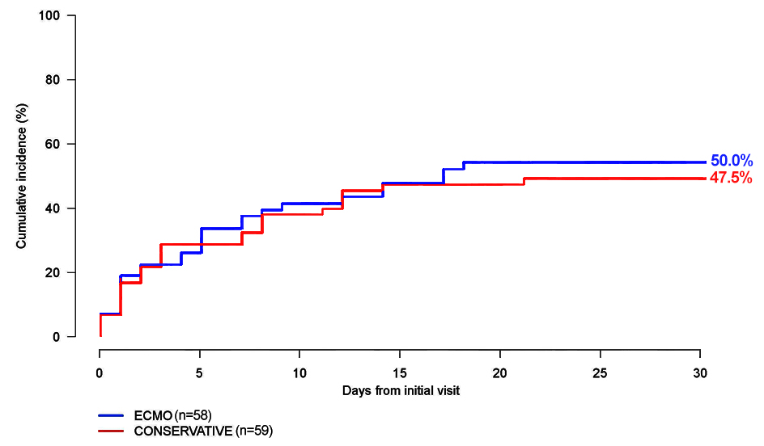
ECMO-CS Trial: Primary Endpoint at 30 Days
Death from Any Cause
HR 1.11; 95% CI, 0.66 to 1.87
Ostadal et al., Circulation 2022 Nov 6 Epub ahead of print

Slide 35
ECMO-CS Trial: Secondary Endpoint at 30 Days
 | ECMO | Conservative | Hazard ratio
 | N = 58 | N = 59 | (95% CI)
Primary composite endpoint | 37 (63.8 %) | 42 (71.2 %) | 0.72 (0.46; 1.12)
Death from any cause | 29 (50.0 %) | 28 (47.5 %) | 1.11 (0.66; 1.87)
Resuscitated cardiac arrest | 6 (10.3 %) | 8 (13.6 %) | 0.79 (0.27; 2.28)
Another mechanical circulatory support | 10 (17.2 %) | 25 (42.4 %) | 0.38 (0.18; 0.79)
Downstream ECMO in early conservative arm |  | 23 (39.0 %)
Safety endpoints | ECMO | Conservative | P-value
Serious adverse events | 35 (60.3 %) | 36 (61.0 %) | 0.941
Bleeding | 18 (31.0 %) | 12 (20.3 %) | 0.185
Leg ischemia | 8 (13.8 %) | 3 (5.1 %) | 0.107
Stroke | 3 (5.2 %) | 0 (0.0 %) | 0.119
Pneumonia | 18 (31.0 %) | 18 (30.5 %) | 0.951
Sepsis | 23 (39.7 %) | 23 (39.0 %) | 0.941
Ostadal et al., Circulation 2022 Nov 6 Epub ahead of print

Slide 36
ECMO-CS Trial: Secondary Endpoint at 30 Days
Primary endpoint
Rapidly deteriorating (SCAI D-E, N = 45) | 27 (60.0 %)
Severe (SCAI D, N = 72) | 52 (72.2 %)
Death from any cause
Rapidly deteriorating (SCAI D-E, N = 45) | 18 (40.0 %)
Severe (SCAI D, N = 72) | 39 (54.4 %)
Ostadal et al., Circulation 2022 Nov 6 Epub ahead of print

Slide 37
ECMO-CS Trial: Conclusions
Immediate implementation of ECMO in patients with rapidly deteriorating or severe cardiogenic shock did not improve clinical outcomes compared with an early conservative strategy that permitted downstream use of ECMO in case of hemodynamic worsening
A substantial proportion of patients with early conservative therapy required downstream use of ECMO or other MCS due to further deterioration of hemodynamic status
Ostadal et al., Circulation 2022 Nov 6 Epub ahead of print

Slide 38
Latest Issues in Coronary Intervention
Key Interventional Trials from TCT/AHA 2022:
BRIGHT-4 Trial, EXIT-CALC Trial, ECMO-CS
Trial
Focused review of the month
Impact of Revascularization on Low EF:
Change in LVEF with coronary revascularization
and subsequent risk for adverse CV outcomes

Slide 39
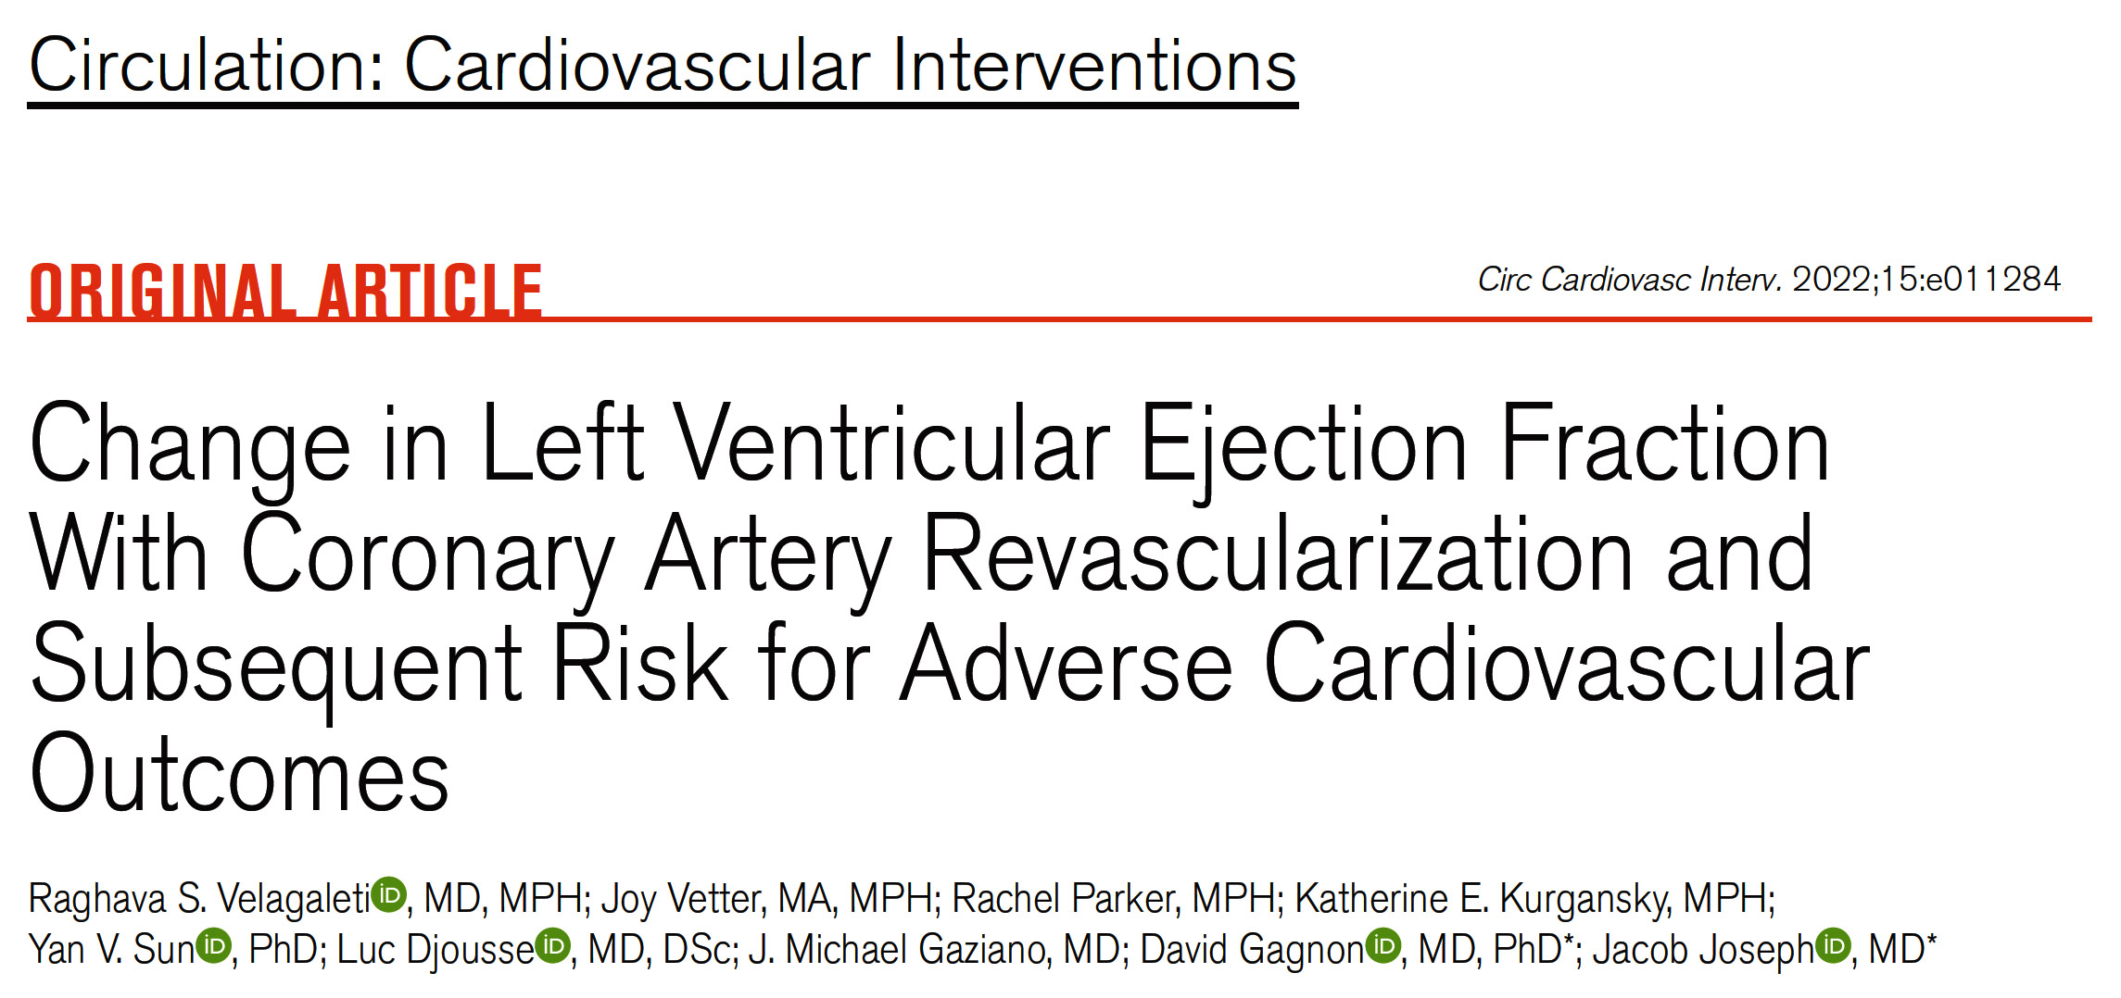

Slide 40
Schematic for Study Sample Compilation
Patients >65ys with HF diagnosis code ever and LVEF ever recorded from Boston VA System
N=1,165,153
5 Delta-EF Categories
Category 0: EF ≤ -5
Category 1: EF -5 – <0
Category 2: EF = 0
Category 3: EF 0 - <5
Category 4: EF ≥5
First revascularization procedure between 1995 and 2010
N=42,538
EF recorded 1 year before or after revascularization
N=39,931
1st EF within 1 year before revascularization (EF <50)
N=13,633
2nd EF within 1 year after revascularization
N=30,488
EF1 <50 and recorded EF2 N=10,400
Missing or implausible data N=329
Final cohort
N=10,071
Velageleti et al., Circ Cardiovasc Interv 2022;15:e011284

Slide 41
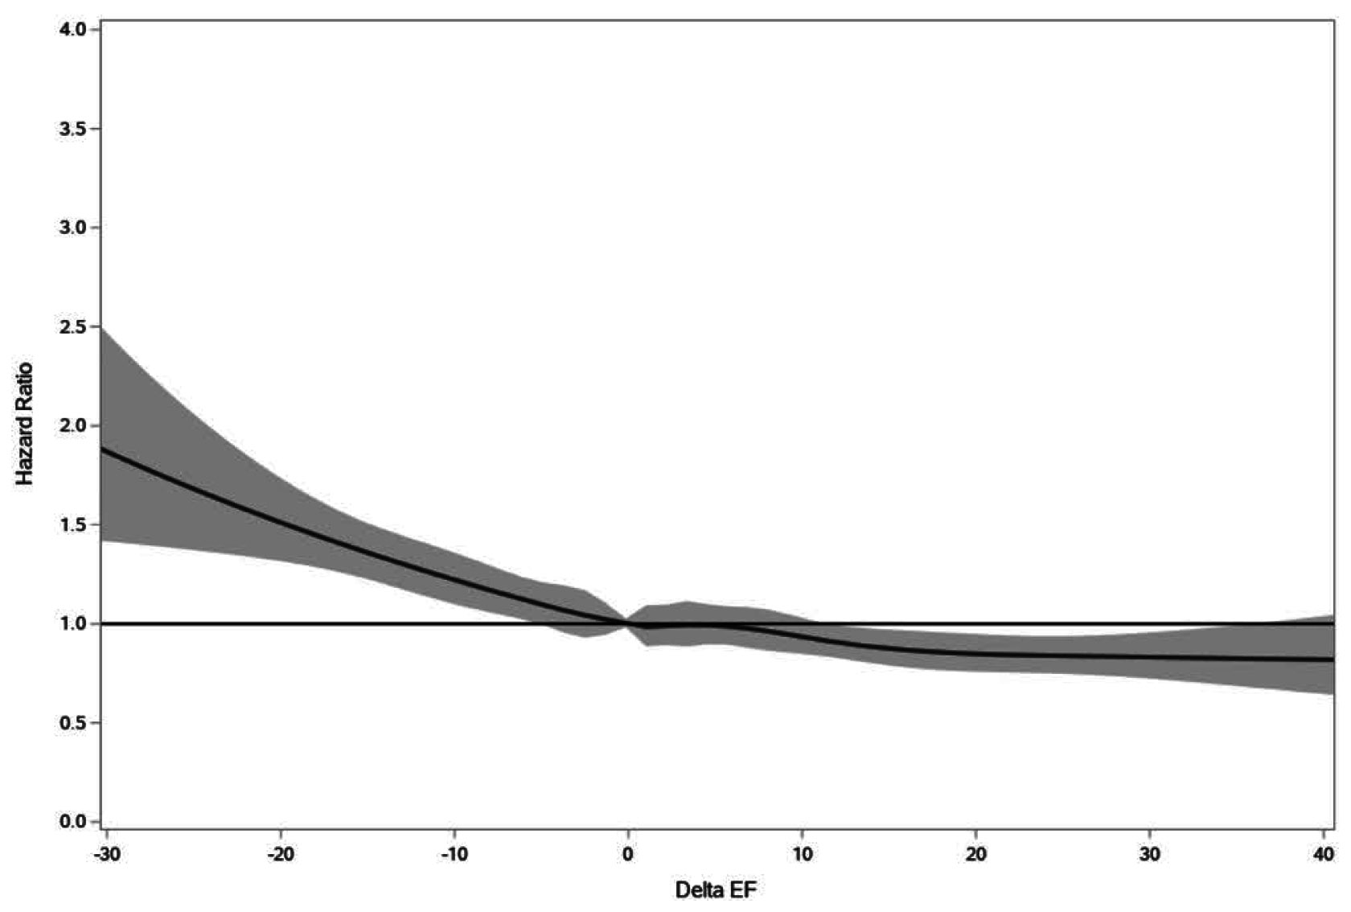
Cubic Spline Relating Delta-EF to Mortality
Velageleti et al., Circ Cardiovasc Interv 2022;15:e011284

Slide 42
5 Delta-EF Categories – PCI and CABG Stratum
Category 0, EF ≤-5 Category 1, EF -5 - <0 Category 2, EF = 0 Category 3, EF 0 - <5 Category 4, EF ≥5
Delta-EF Categories
Velageleti et al., Circ Cardiovasc Interv 2022;15:e011284

Slide 43
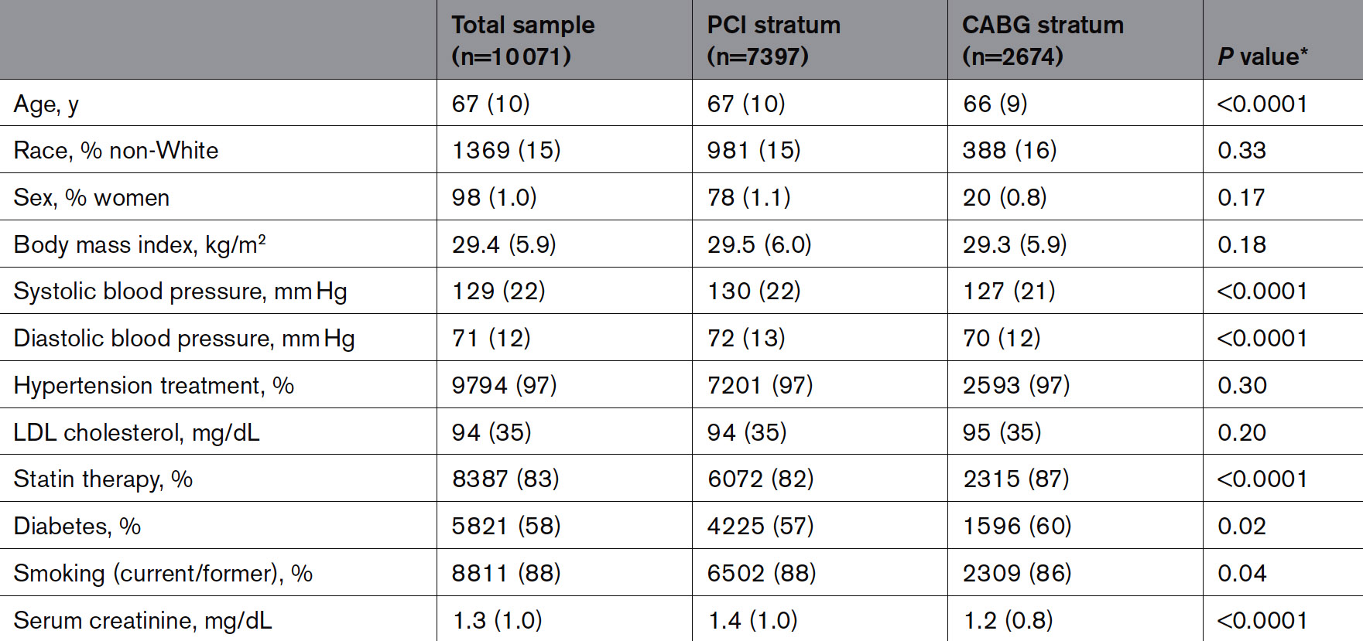
Baseline Categories of Study Participants
Velageleti et al., Circ Cardiovasc Interv 2022;15:e011284

Slide 44
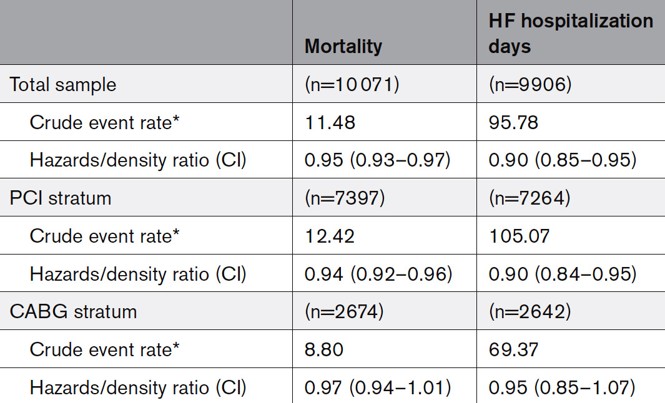
Crude Events Rates and Multivariable-Adjusted Hazards Ratios and Incidence Density Ratios Relating to Delta-EF to Clinical Outcomes of Interest
Velageleti et al., Circ Cardiovasc Interv 2022;15:e011284

Slide 45
Secondary Analyses: Mortality Rates and Multivariable-Adjusted Hazards Ratios Across Categories of Delta-EF
Overall
5% improvement in EF;
=5% ↓ in death
p<0.0001
%
In PCI subgroup
5% improvement in EF;
=6% ↓ in death
In CABG subgroup
5% improvement in EF;
No significant ∆ in death
p<0.0001
p=0.13
%
%
Velageleti et al., Circ Cardiovasc Interv 2022;15:e011284

Slide 46
Secondary Analyses: HF Hospitalization Rates and Multivariable-Adjusted Incidence Density Ratios Across Delta-EF Categories
Overall
5% improvement in EF;
=10% ↓ in HF hos days
p=0.0003
Days
In PCI subgroup
5% improvement in EF;
=10% ↓ in HF hos days
In CABG subgroup
5% improvement in EF;
No significant ∆ in HF days
p=0.0005
p=0.63
Days
Days
Velageleti et al., Circ Cardiovasc Interv 2022;15:e011284

Slide 47
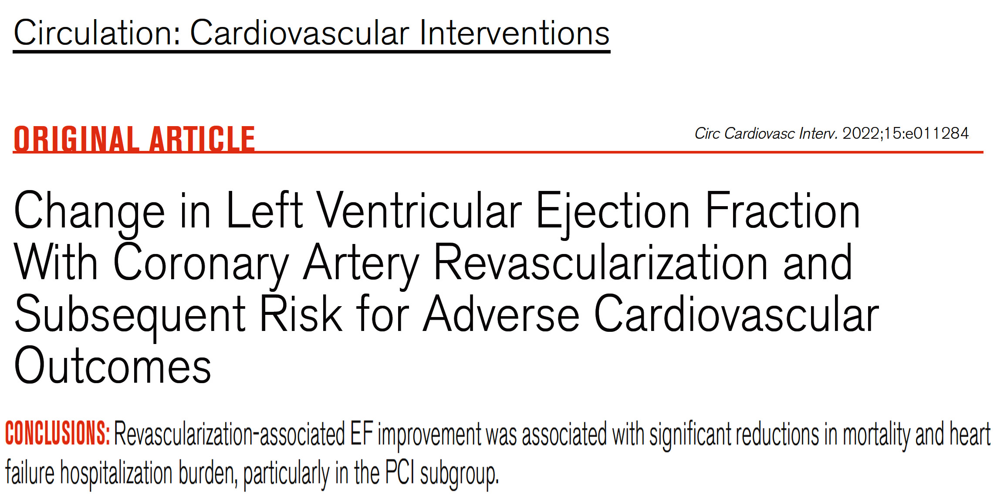

Slide 48
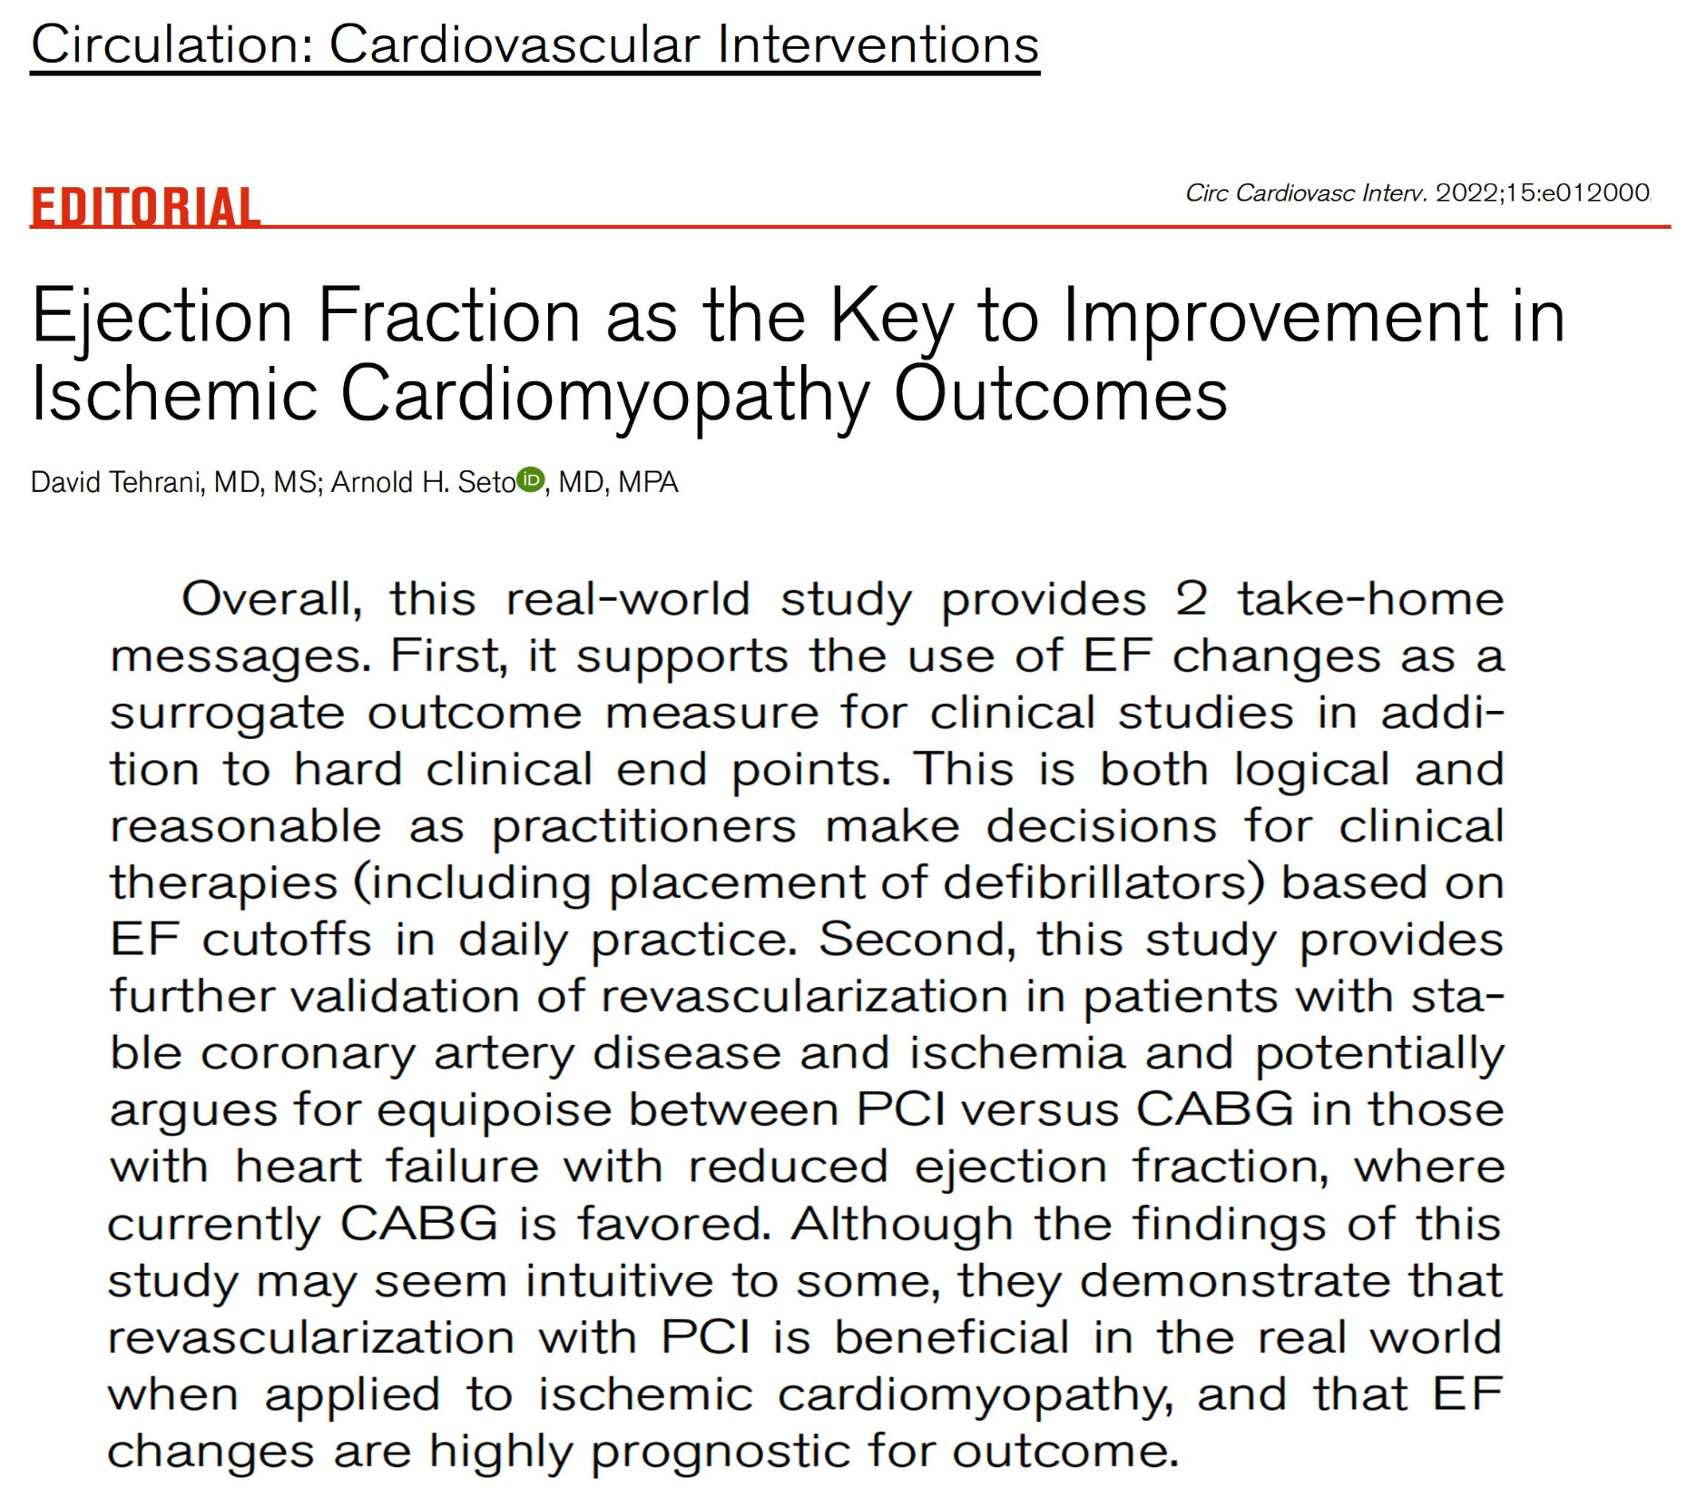

Slide 49
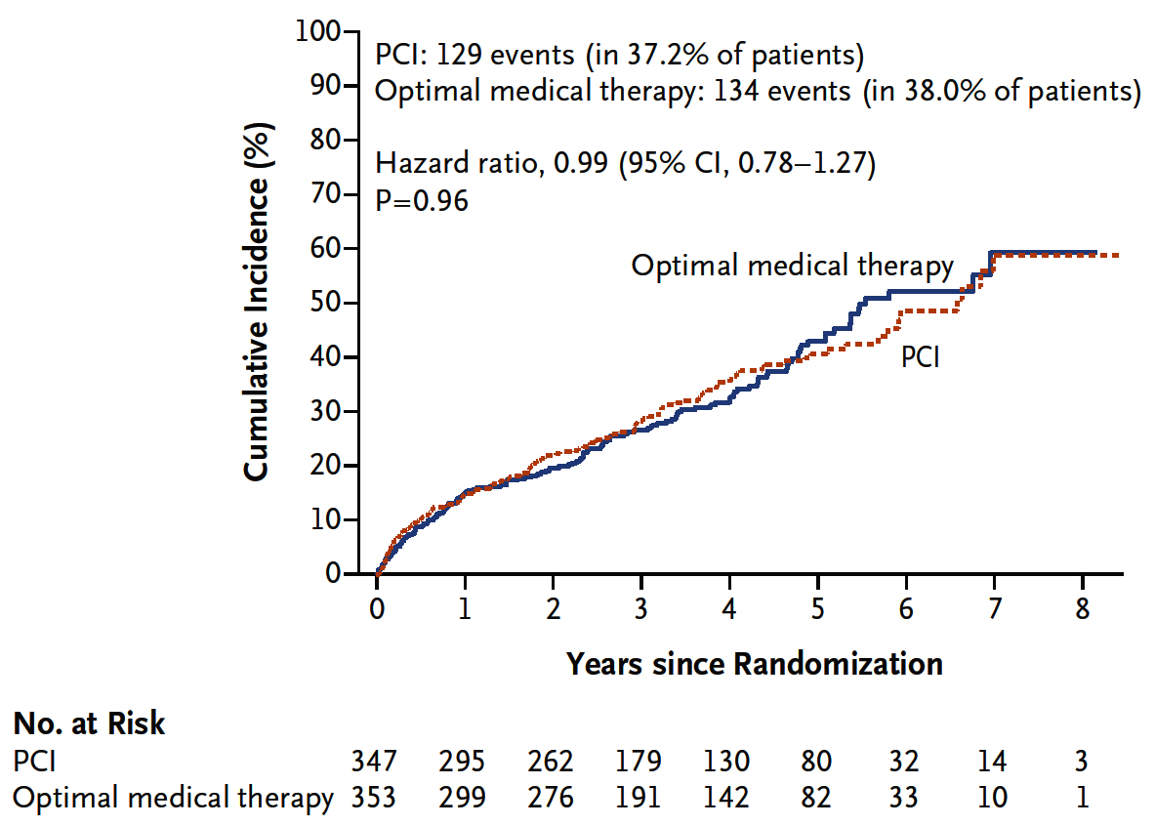
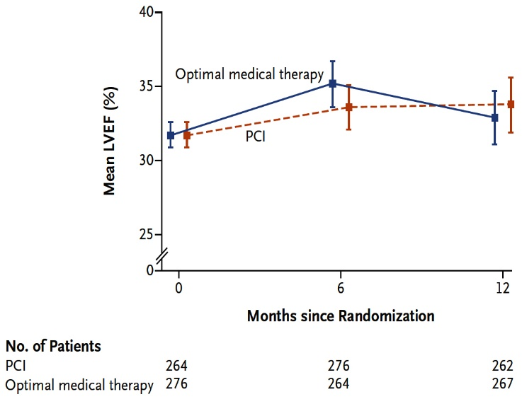
REVIVED-BCIS 2 Trial: Primary Outcome of Death
or Hospitalization for HF
Echocardiographic LVEF
Perera et al., N Engl J Med 2022 Aug 27 Epub ahead of print

Slide 50


Take Home Message:
Key Interventional Trials TCT/AHA 2022 and
Change in LVEF after revascularization and MACE
Bivalirudin with high dose infusion in STEMI PCI:
IVL vs NC BA for stent expansion in Ca++ lesions:
Immediate ECMO vs EST (delayed ECMO) in CS:
Coronary artery revascularization (PCI or CABG) in pts with low EF has variable response of improvement and its impact on subsequent death and HF hospitalization days at mean f/u of 5 years. While CABG is routinely favored in these pt subset, current registry study showed that improvement in EF after PCI was significantly associated with reduction in mortality and HF hospitalization while there was no clear cut correlation after CABG in this elderly pt subset.
Notes:
HbA1c in

Slide 51

Question # 1
Following is the true statements of the BRIGHT-4 trial comparing Bivalirudin vs heparin in STEMI PCI at 30-days except;
  Bivalirudin gp had lower mortality
  Bivalirudin gp had lower BARC 3-5 bleeding
  Bivalirudin gp had lower MACE and NACE
  Bivalirudin gp had slightly higher ST
  Bivalirudin gp had similar re-infarction
The correct answer is D

Slide 52

Question # 2
Following statement is false regarding the results of the EXIT-CALC trial comparing IVL vs BA in Ca++ lesions PCI;
  A. Similar MSA post PCI
  B. Similar stent expansion
  C. Similar MACE
  D. Higher edge dissection after IVL vs BA gp
  E. Similar Ca++ fracture after IVL vs BA gp
,
The correct answer is E

Slide 53
Question # 3
Following statement is false regarding the impact of coronary revascularization on LVEF change in HF hospitalization after PCI vs CABG in pts with low EF:
  Both PCI and CABG are associated with rise in LVEF
  5% rise in LVEF is associated with 5% reduction in death
  5% rise in LVEF is associated with 10% in HF hospitalization
  Impact of LVEF improvement was similar in both CABG and PCI gp
  There was gradient with delta change in LVEF improvement and corresponding reduction in death and HF hospitalization
The correct answer is D

