Slide 1
Complex Coronary Cases Supported by:
Abbott Vascular Inc.
Boston Scientific Corp.
Terumo Vascular Corp.
Cardiovascular Systems Inc.
Abiomed Inc.
Chiesi Inc.
Shockwave Medical Inc.
Cardinal Health Cordis Inc.

Slide 2
Disclosures
Samin K. Sharma, MD, MSCAI, FACC
Nothing to disclose
Annapoorna S. Kini, MD, MRCP, FACC
Nothing to disclose
Sameer Mehta, MD, FACC (Moderator)
Nothing to disclose

Slide 3
CCC Live Case # 168
Patient Demographics
67 yrs, Male
Present Clinical Presentation
Presented with CCS class III angina and +stress MPI for anterior & infero-lateral ischemia
CAD Risk Factors
Controlled Hyperlipidemia
Current Smoker
Prior MI, Anemia, GERD, Gout
SAQ-7 score:33
Clinical Variables
s/p CABG x3 in 6/2014, s/p multiple PCIs last being CBPTCA to distal LAD via LIMA on 5/2/2023. EF 60%
Medications
Aspirin, Prasugrel, Metoprolol XL, Nitropatch, Ranolazine, Olmesartan, Atorvastatin
Cath: Cardiac cath on 5/2/2023 revealed 3 V CAD; TO distal RCA filling via SVG, multiple, calcified 80% lesions in mid LAD with DES ISR in dLAD, TO DES ISR to LAD-D2, TO prox LCx with distal vessel fills via RCA, patent LIMA to LAD with distal LAD ISR, occluded SVG to D2, patent SVG to RPDA with 80-90% lesions in retrograde limb supplying 80% RPL & CTO & LVEF 62%. Pt underwent successful PTCA+atherotomy PCI dLAD via LIMA & did well.

Slide 4
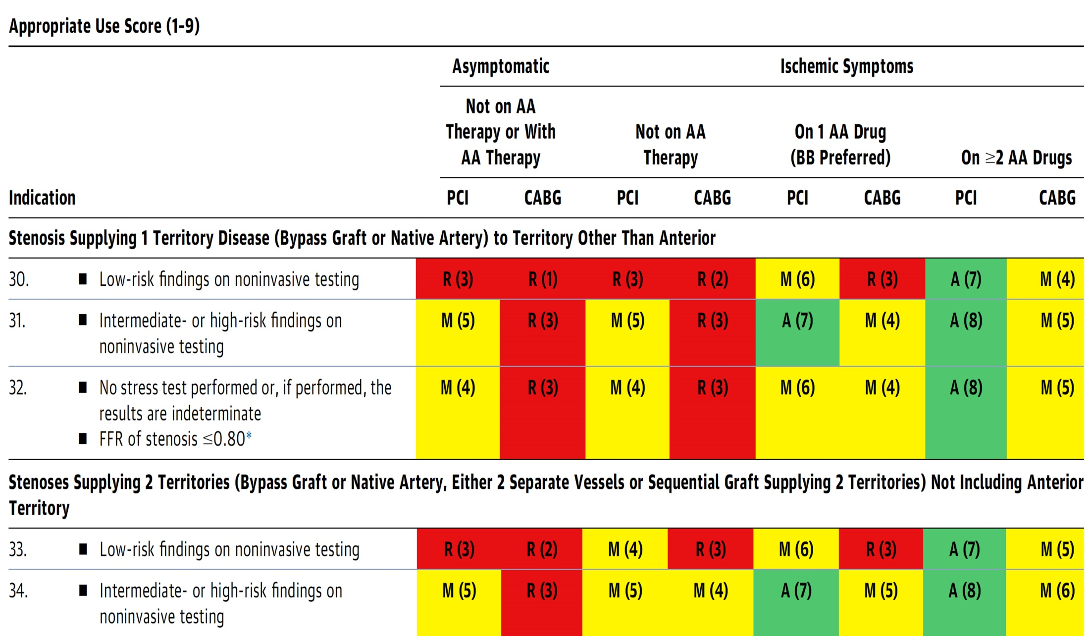
AUC 2017: IMA to LAD Patent Without Stenosis
Patel et al., J Am Coll Cardiol 2017;69:2212

Slide 5
CCC Live Case # 168
Patient Demographics
67 yrs, Male
Present Clinical Presentation
Presented with CCS class III angina and +stress MPI for anterior and infero-lateral ischemia
CAD Risk Factors
Controlled Hyperlipidemia
Current Smoker
Prior MI, Anemia, GERD, Gout
SAQ-7 score:33
Clinical Variables
s/p CABG x3 in 6/2014, s/p multiple PCIs last being CBPTCA to distal LAD via LIMA on 5/2/2023. EF 60%
Medications
Aspirin, Prasugrel, Metoprolol XL, Notropatch, Ranolazine, Olmesartan, Atorvastatin
Cath: Cardiac cath on 5/2/2023 revealed 3 V CAD; TO distal RCA filling via SVG, multiple, calcified 80% lesions in mid LAD with DES ISR in dLAD, TO DES ISR to LAD-D2, TO prox LCx with distal vessel fills via RCA, patent LIMA to LAD with distal LAD ISR, occluded SVG to D2, patent SVG to RPDA with 80-90% lesions in retrograde limb supplying 80% RPL & CTO & LVEF 62%. Pt underwent successful PTCA+atherotomy PCI dLAD via LIMA & did well.
Plan: Now planned for imaging guided staged complex PCI of SVG to RPDA retrograde limb and/or LCx CTO.

Slide 6
Latest Issues in Coronary Intervention
Interventional Trials from EuroPCR 2023:
Define Flair 5-Yr, FAME 3 3-Yr, EBC Main 3-Y
PICCOLETO II 3-Yr, Post-PCI QFR in Flavour
Focused review of the month
Calcified Nodule Imaging and Outcomes:
Impact of Eruptive vs Non-eruptive calcified nodule
morphology on acute and long-term outcomes after
stenting

Slide 7
Latest Issues in Coronary Intervention
Interventional Trials from EuroPCR 2023:
Define Flair 5-Yr, FAME 3 3-Yr, EBC Main 3-Y
PICCOLETO II 3-Yr, Post-PCI QFR in Flavour
Focused review of the month
Calcified Nodule Imaging and Outcomes:
Impact of Eruptive vs Non-eruptive calcified nodule
morphology on acute and long-term outcomes after
stenting

Slide 8
5-Year Follow Up of the
DEFINE FLAIR Trial

Slide 9
DEFINE FLAIR Trial: Study Overview
Multicenter randomized trial (17 countries, >45 centers) comparing patient outcomes associated with FFR- or iFR-based decision making.
2492 patients (1242 iFR, 1250 FFR).
Non-inferiority hypothesis met: iFR was not inferior to FFR at 1-year FU for MACE (HR 0.95, 95% CI 0.68-1.33; Risk difference -0.2, 95% CI -2.3 – 1.8).
 | iFR (N=1242) | FFR (N=1250) | P value
Age | 65.5 (10.8) | 65.2 (10.6) | n/s
Stable CAD | 986 (79.4%) | 1012 (81.0%) | n/s
Congestive HF | 77 (6.2%) | 67 (5.4%) | n/s
Mean value (iFR or FFR) | 0.91 (0.09) | 0.83 (0.09) | -
≥1 functionally significant lesions present (per patient) | 426 (34.3%) | 486 (38.9%) | 0.02
Revascularisation performed | 590 (47.5%) | 667 (53.4%) | <0.01
Nº stents placed (per patient) | 0.66 (0.92) | 0.72 (0.96) | 0.09
Lost to 5-year follow-up | 19% | 18% | n/s
Escaned J, EuroPCR 2023

Slide 10
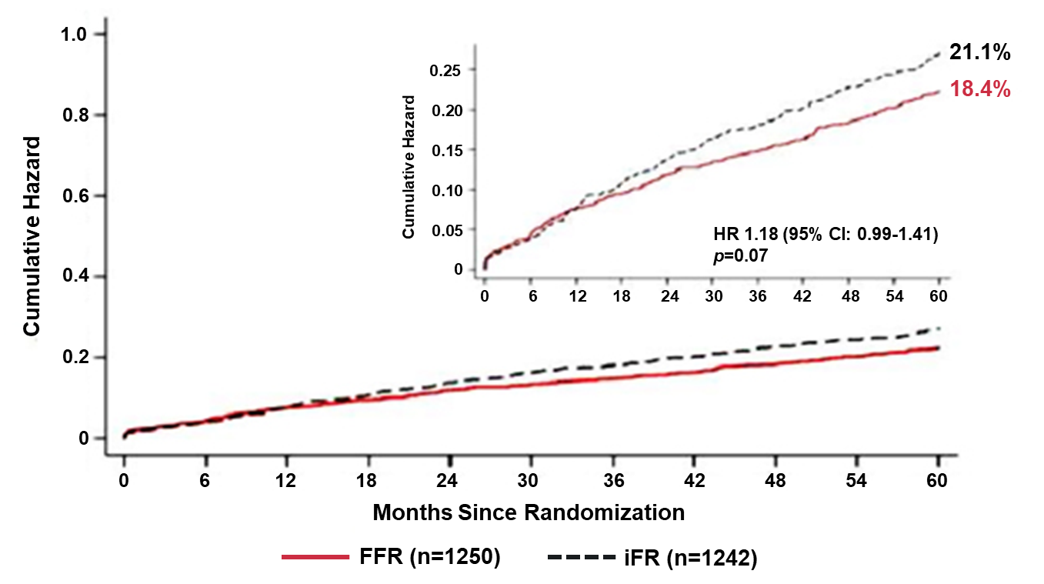
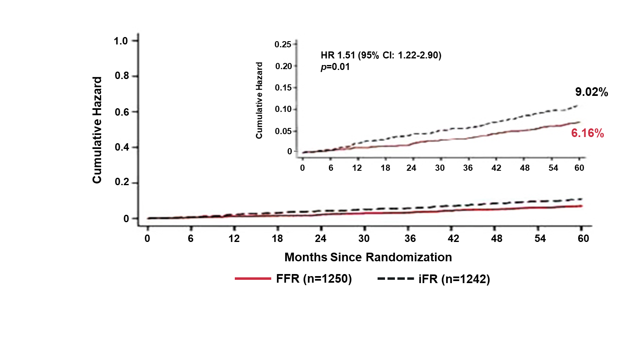
DEFINE FLAIR Trial: 5-Yr Primary Endpoint
Outcomes after FFR vs iFR in Stable CAD
MACE
All-Cause Mortality
Escaned J, EuroPCR 2023

Slide 11
DEFINE FLAIR Trial: Clinical Results @ 5Yrs
p=0.02
p=0.96
%
p=0.01
p=0.80
Escaned J, EuroPCR 2023

Slide 12
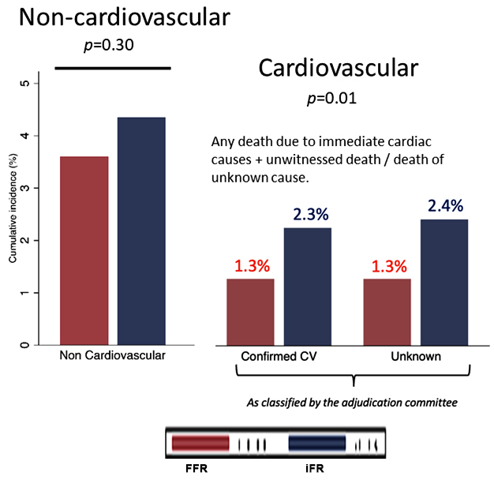
DEFINE FLAIR Trial: 5-Yr Mortality
All-Cause Mortality
Non-Cardiovasc/CV Mortality
Escaned J, EuroPCR 2023

Slide 13
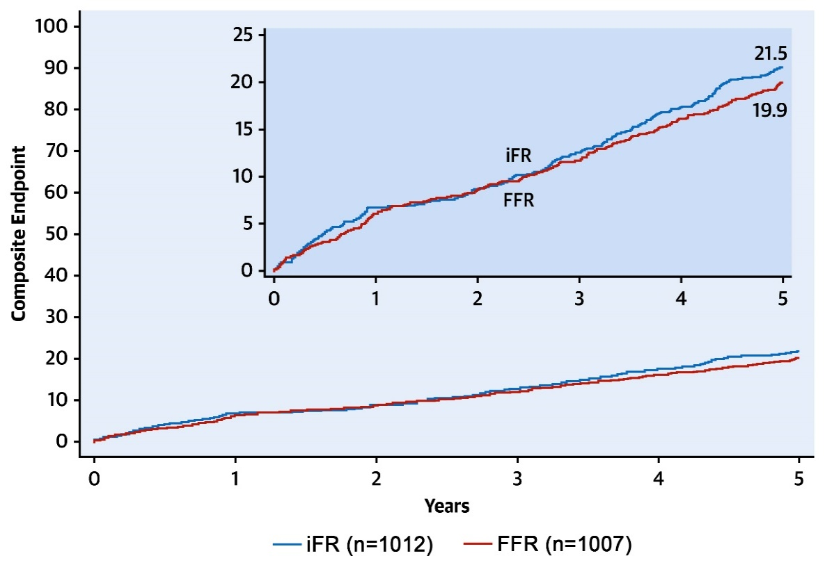
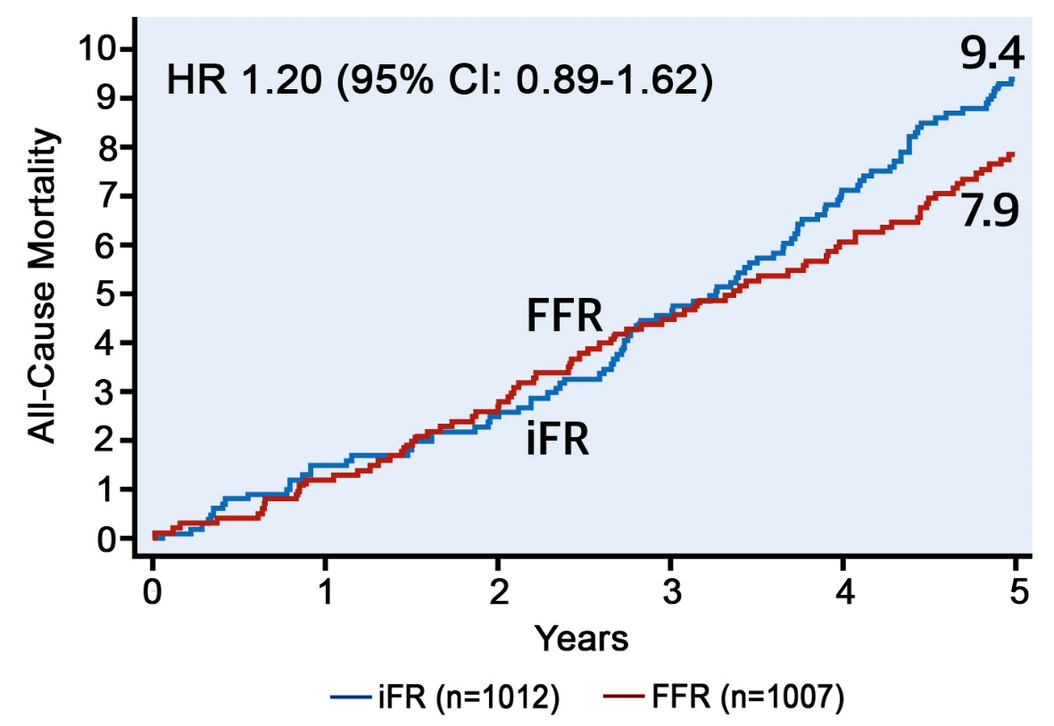
DEFINE FLAIR Trial: Comparison with the
5-Yr iFR SWEDEHEART Results
MACE
All-Cause Mortality
HR 1.09 (95% CI: 0.90-1.33)
Götberg et al., J Am Coll Cardiol 2022;79:965

Slide 14
FFR-Guided PCI versus CABG
Three-Year Follow-Up of the Randomized FAME 3 Trial

Slide 15
FAME 3 Trial: Study Design
Investigator-initiated, multicenter, randomized, controlled study
All Comers with 3V-CAD (not involving Left Main)
amenable to PCI or CABG by Heart Team
at 48 centers in Europe, North America, Australia and Asia
FFR-Guided PCI
stent all lesions with FFR ≤0.80
(N=757)
CABG
based on coronary angiogram
(N=743)
Primary Endpoint:
MACCE at 1 year: all-cause death, MI, stroke or repeat revascularization
Key Secondary Endpoint
3 year follow-up for composite of death/MI/stroke
Complete follow-up at 3 years: 96.5%
Zimmerman F, EuroPCR 2023

Slide 16
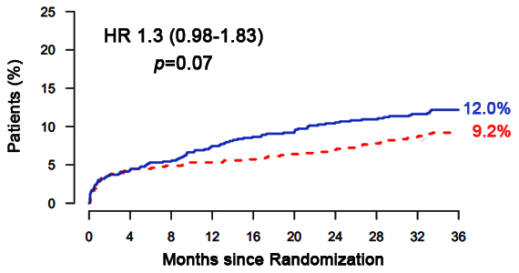
FAME 3 Trial: Key Secondary Endpoint
Death, MI, or Stroke at 3-year Follow-Up
Zimmerman F, EuroPCR 2023

Slide 17
FAME 3 Trial: Secondary Endpoint at
3-Year Follow-Up
p=0.002
Δ5.2% (NNT 19)
p=0.001
Δ2.8% (NNT 36)
%
p=0.02
p=0.88
p=0.56
Zimmerman F, EuroPCR 2023

Slide 18
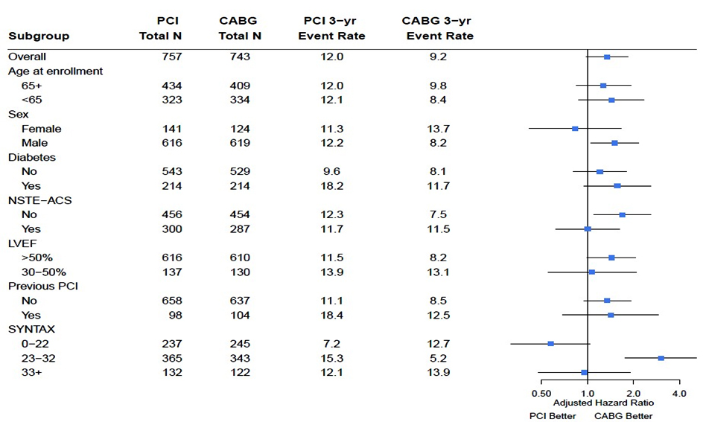
FAME 3 Trial: Subgroup Analyses
(Death, MI or Stroke) at 3-Year Follow-Up
Zimmerman F, EuroPCR 2023

Slide 19
FAME 3 Trial: Comparison with SYNTAX Trial (3VD Cohort) at 3-Year Follow-Up
Death, MI, or Stroke
Death
% Death at 3 Years
% Death at 3 Years
p=0.04
p=0.07
p=0.03
p=0.88
Zimmerman F, EuroPCR 2023

Slide 20
FAME 3 Trial: Conclusions
In patients with 3V-CAD comparing FFR-guided PCI and CABG after three years of follow-up:
No significant difference in the composite of death, MI, or stroke (pre-specified key secondary endpoint)
No difference in death and stroke
Lower rate of MI (NNT 36) and repeat revascularization (NNT 19) after CABG
Shared decision making becomes increasingly important to discuss the trade-offs between revascularization strategies.
In patients with low SYNTAX tertile PCI is favorable over CABG
In patients with more complex 3V-CAD, CABG remains the treatment of choice

Slide 21
The European Bifurcation Club Left Main
Coronary Stent Study – A Randomized Comparison of Stepwise Provisional vs Systematical Dual Stenting Strategies
(EBC MAIN – 3 Year Results)

Slide 22
EBC MAIN Trial: Study Design
Randomized comparison of provisional strategy vs a systematic dual stent strategy for true bifurcation LM disease with Resolute Onyx™ DES
Stable or unstable angina patients with ULM bifurcation disease (type 1,1,1 or 0,1,1; both branches >2.75 mm) requiring PCI
EBC initiated
30 European Canters
Lead investigator – David-Hildick-Smith
Medtronic funded
Study Device: Resolute Onyx™ DES
Stepwise provisional
N=230
Dual-stent strategy
N=237
6 mo 12 mos 3 yr 5 yr
Primary endpoint: Composite of death, MI and TLR at 1 yr
Secondary endpoints: Death, MI, TLR each at 12 months
Angina status, ST, death, MI, TLR at 3 and 5 years
Procedural endpoints: Procedural and technical success
Procedural and in-hospital MACE
Procedure duration, fluoroscopy and cost
Hildick-Smith D, EuroPCR 2023

Slide 23
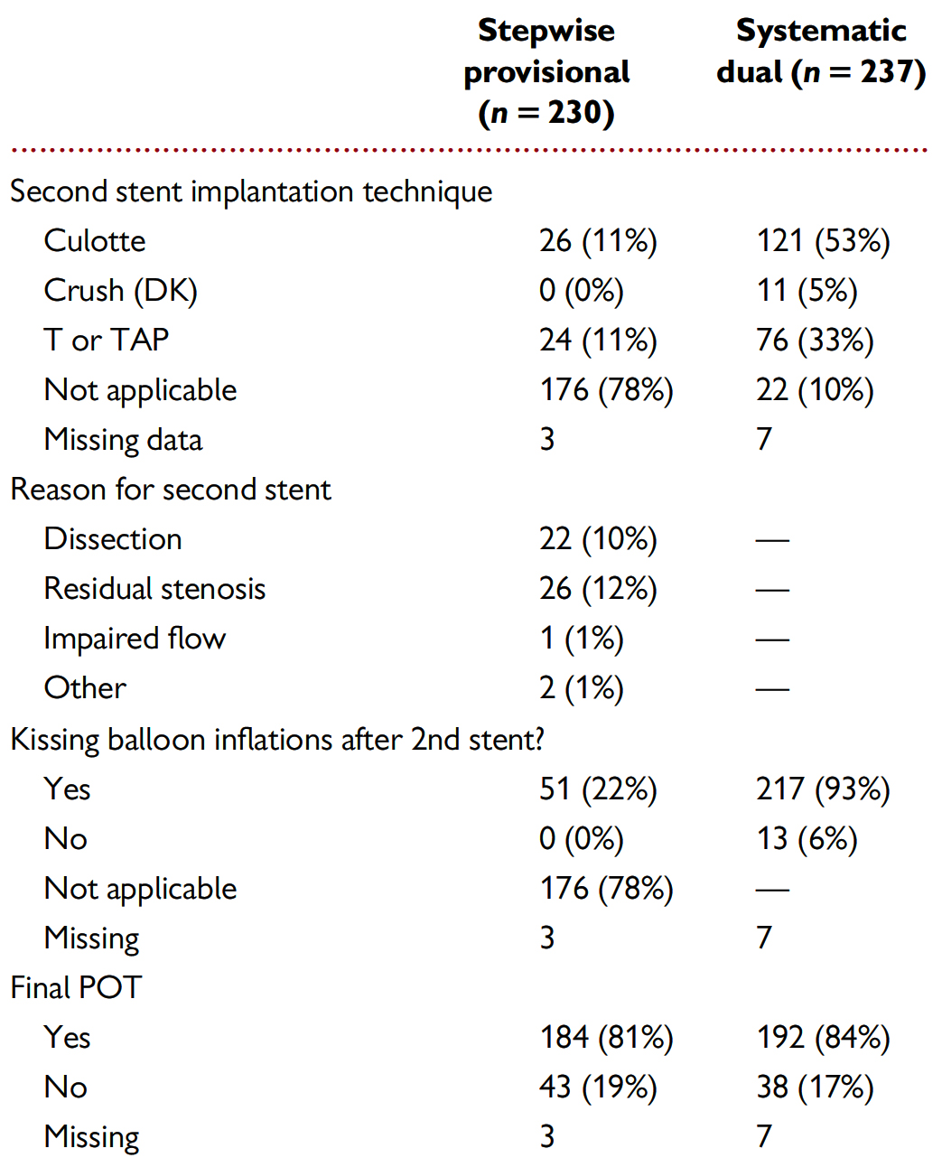
EBC MAIN: Procedural Characteristics
Hildick-Smith et al., Eur Heart J 2021;42:3829

Slide 24
EBC MAIN Trial: Clinical Results at 1 Year
p=0.34
p=0.99
p=0.16
%
p=0.48
p=0.09
Hildick-Smith et al., Eur Heart J 2021;42:3829

Slide 25
EBC MAIN Trial: Clinical Results at 3-Yrs
p=0.13
%
p=0.27
p=0.02
p=0.75
Hildick-Smith D, EuroPCR 2023

Slide 26
EBC MAIN Study: Clinical Results
1-Year Clinical Results
3-Year Clinical Results
p=0.13
P=NS
%
%
p=0.02
p=0.27
p=0.75
Hildick-Smith D, EuroPCR 2023

Slide 27
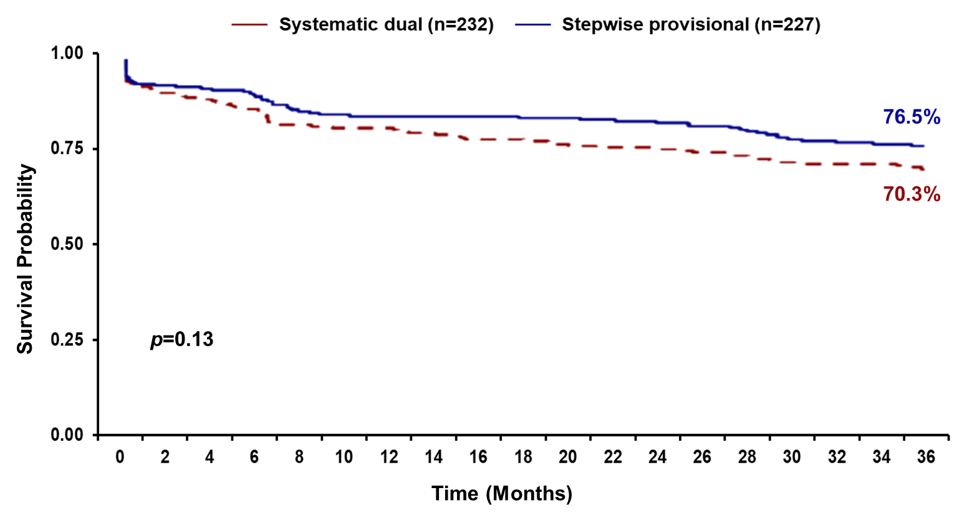
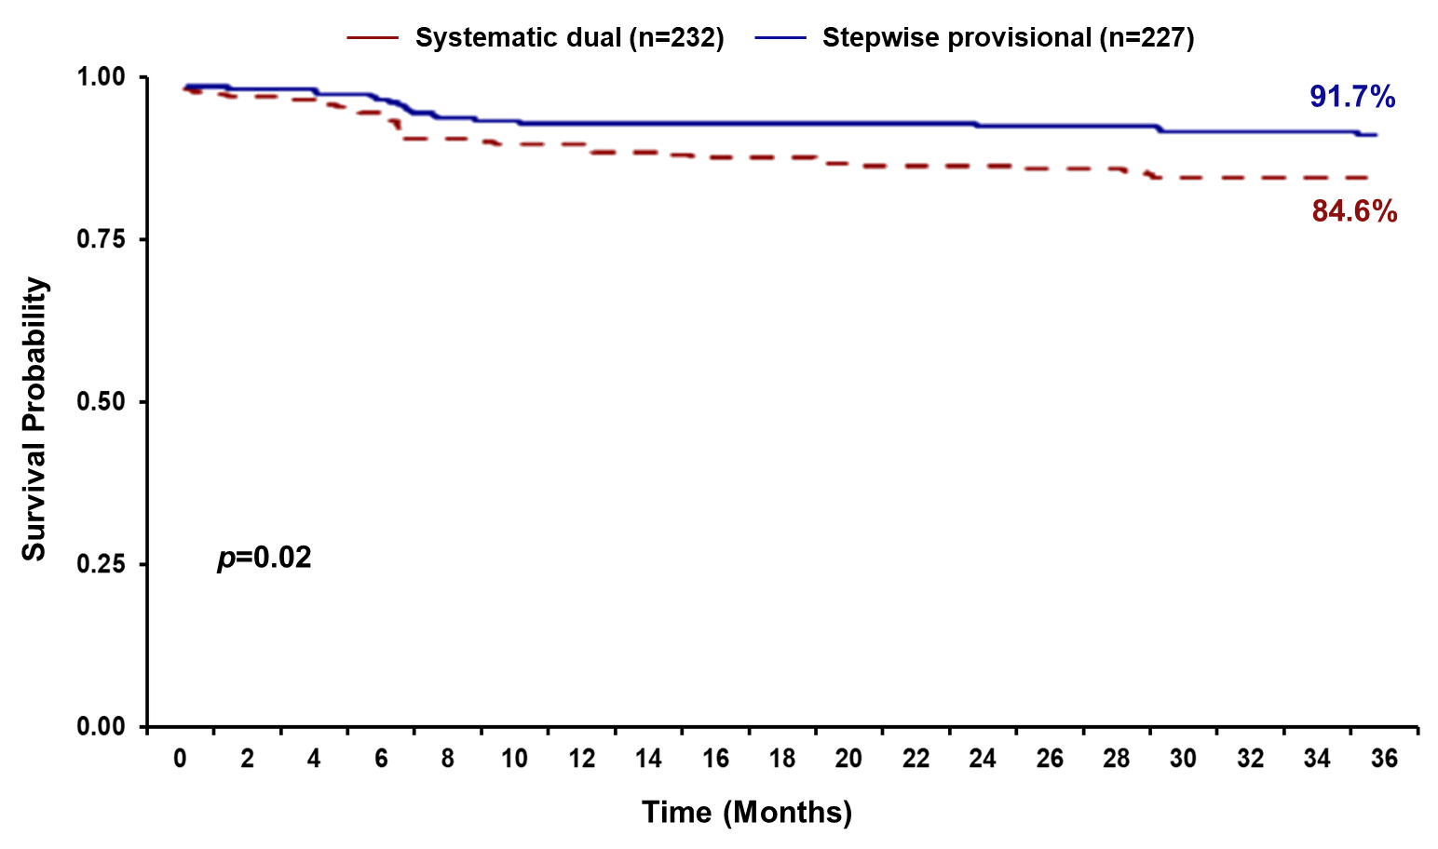
EBC MAIN: 3-Yr Primary Endpoint
EBC MAIN: 3-Yr TLR
Hildick-Smith D, EuroPCR 2023

Slide 28
EBC MAIN: Conclusions
Good outcomes at 3 years with bifurcation left main stem PCI
No difference in 3-yr primary endpoint (death/MI/TLR) between groups
Almost twice as much TLR in the systematic dual stent group
Only 20% of patients in provisional group required a second stent
It is not necessary to decide the number of stents before you start
The stepwise provisional approach is the technique of choice for bifurcation left main stem stenosis

Slide 29
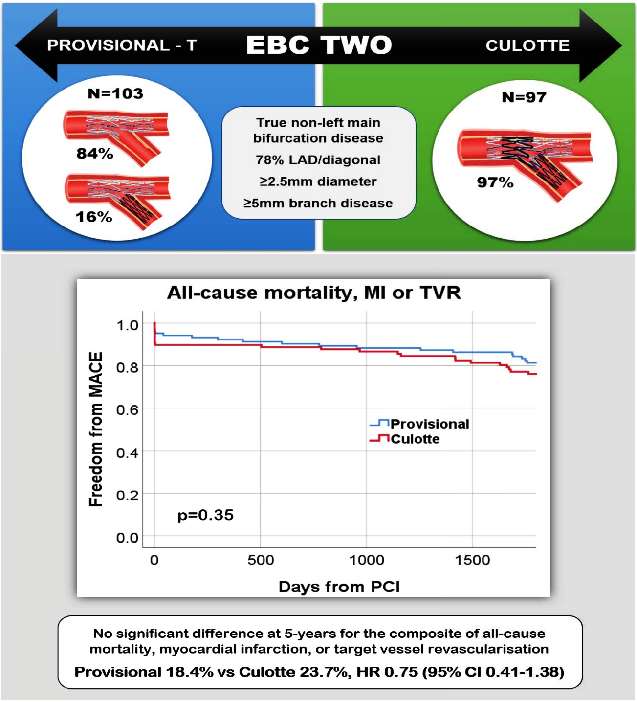
EBC TWO Study: Provisional-T vs Culotte Stenting
MACE at
5 Years
Arunothayaraj et al., EuroIntervention 2023 May 19 Epub ahead of print

Slide 30
EBC TWO Study: Primary & Secondary Endpoints @ 5-Yrs
For non-LM True Bifurcation Lesion
p=0.36
p=0.30
%
p=0.85
p=0.84
p=0.61
Arunothayaraj et al., EuroIntervention 2023 May 19 Epub ahead of print

Slide 32
Study Flowchart and Follow-Up of PICCOLETO II Study
PICCOLETO II, an academic, investigator-driven, international RCT Study Flow Chart
Patients with de novo lesions with natives
(diameter ≤2.75 mm visual ly)
Enrollment:
May 2015 –
May 2018
170 screened and not enrolled
232 patients enrolled
Centralized blocks randomization 1:1
(prior to guidewire insertion)
5 lost
8 refused
118 Elutax SV DCB
Predilatation, DCB dilatation for 30-60 sec
3 lost
7 refused
114 EES
105 with angio follow up (89%)
104 with angio follow up (90%)
6 months in- lesion LLL
(core lab)
2 lost
4 refused
108 with 12-month clinical F/U
106 with 12-mo clinical F/U
2 lost
3 refused
102 with 36-month clinical F/U
101 with 36-mo clinical F/U
36 months clinical assessment
(CEC adjudicated)
Cortese et al., J Am Coll Cardiol Intv 2023 April 19 Epub ahead of print

Slide 33
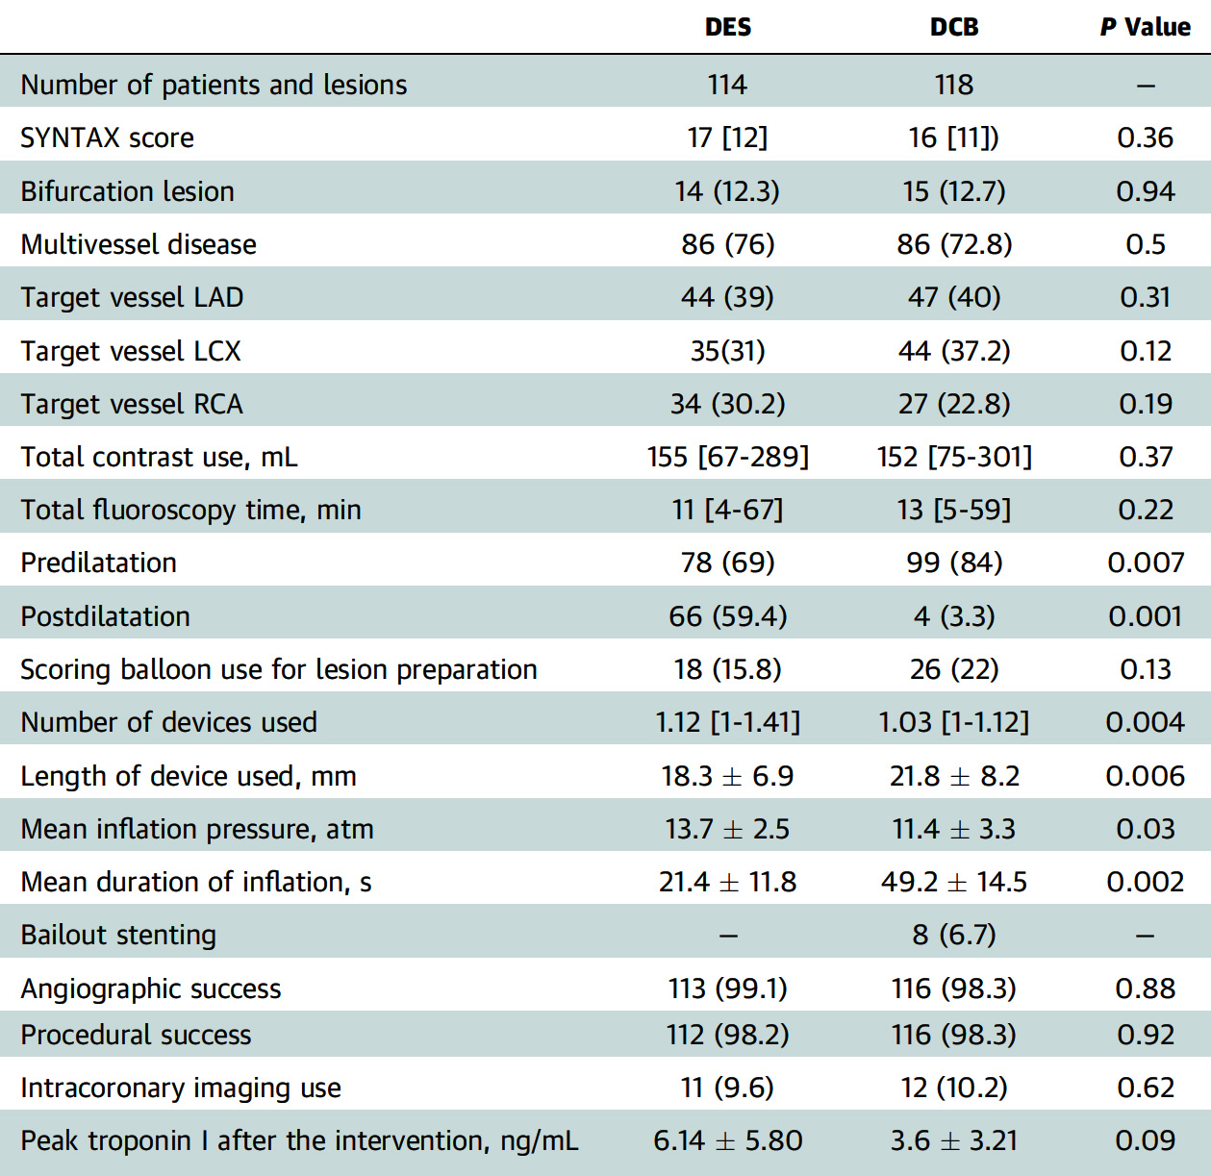
PICCOLETO II Study: Lesion Characteristics and Procedural Aspects
Cortese et al., J Am Coll Cardiol Intv 2023;16:1054

Slide 34
PICCOLETO II Study: Clinical Outcome After 3 Years
p=0.05
p=0.18
%
p=0.14
p=0.98
p=0.04
p=0.56
Cortese et al., J Am Coll Cardiol Intv 2023;16:1054

Slide 36
Prognostic Value of Post-PCI QFR (Quantitative Flow Ratio) in the Randomized FLAVOUR Trial

Slide 37
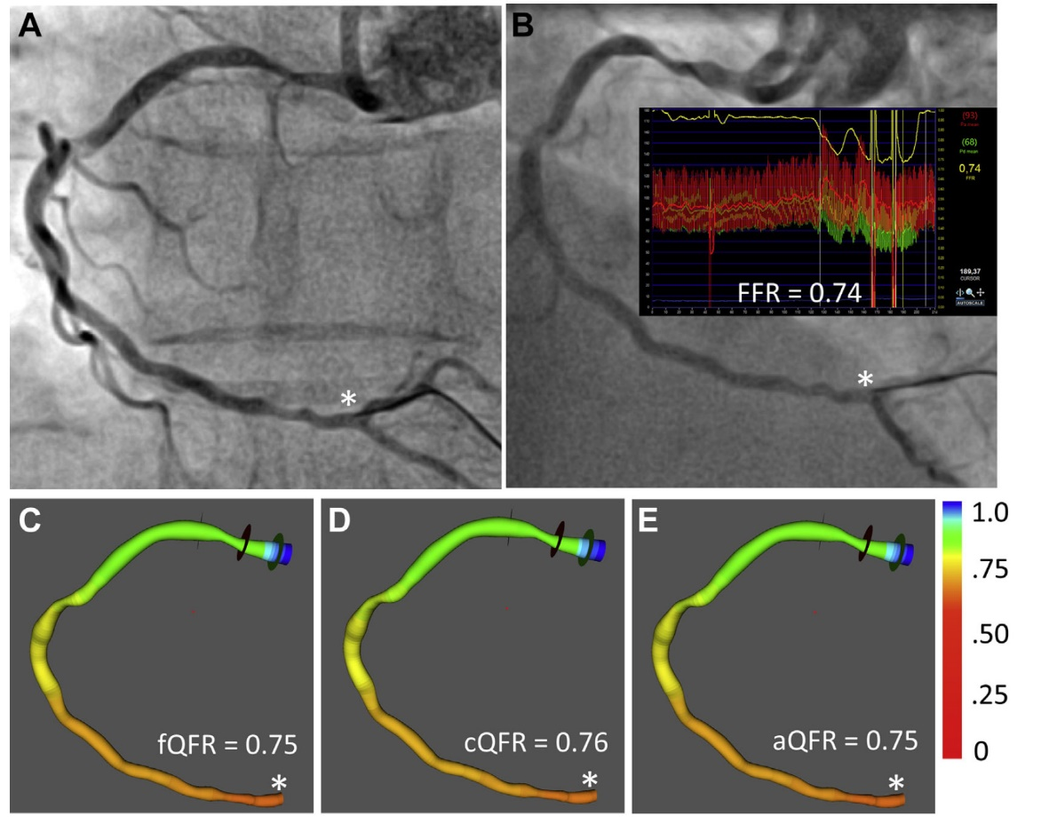
Computation of QFR Angiography on RCA with Physiologically Significant Stenosis
AI based Computation of FFR from 3D QCA and TIMI frame count
A, B – coronary angiography shows RCA with lesions. FFR measured by pressure-wire at * was 0.74.
C – computed fixed-flow QFR at * was 0.75.
D – computed contrast-flow QFR was 0.76, mean flow velocity calculated on angiographic runs acquired without maximum hyperemia was 0.17 m/s.
E. Computed adenosine-flow QFR at * was 0.75 and hyperemic flow velocity calculated on angiographic runs acquired during maximum hyperemia was 0.37 m/s.

Slide 38
FLAVOUR Trial: Study Flowchart
Patients with at least 1 PCI treated vessel in FLAVOUR trial
801 patients, 831 vessels
25 vessels excluded
Inadequate or suboptimal image quality (n = 22)
Image failed to be imported (n = 3)
Post-PCI μQFR
777 patients, 806 vessels
FFR-guidance
283 patients, 293 vessels
IVUS-guidance
494 patients, 513 vessels
Stent analysis
441 patients, 459 vessels
54 vessels excluded
Post-PCI IVUS not available (n = 39)
Inadequate IVUS images (n = 12)
POBA only (n = 3)
2-year target vessel failure as a composite of cardiac death, target vessel MI and TVR
Tu S, EuroPCR 2023

Slide 39
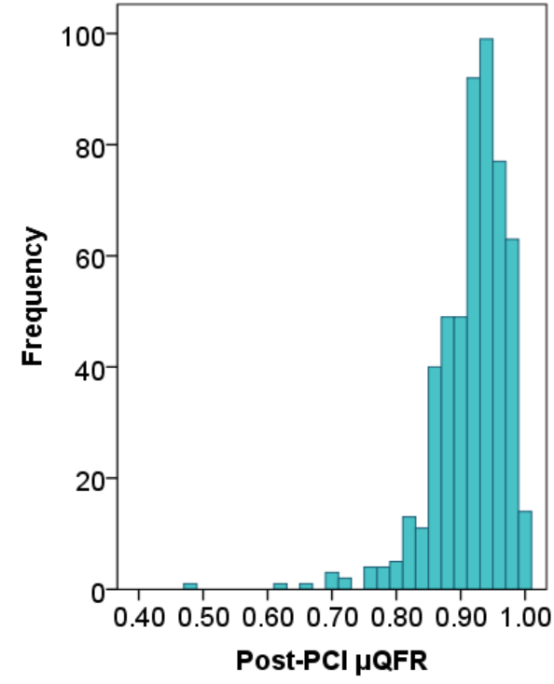
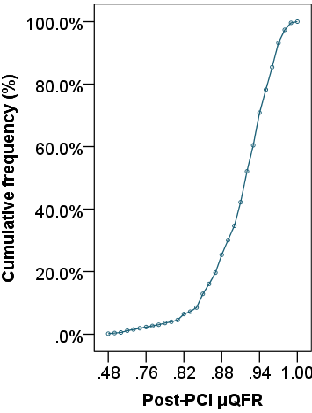
FLAVOUR Trial: Key Baseline and Procedural Characteristics
Patient (n = 777)
Age, years | 65 [58, 72]
Female | 26.0%
Diabetes mellitus | 34.5%
Multivessel disease | 59.7%
Clinical presentation
Stable angina | 56.6%
Unstable angina | 36.8%
STEMI | 0.5%
NSTEMI | 1.9%
Others | 4.1%
Baseline SYNTAX score | 9 [7, 13]
Post-PCI SYNTAX score | 2 [0, 5]
Vessel (n = 806)
Interrogated vessels
LAD | 63.6%
LCx | 12.2%
RCA | 24.2%
Mean number of stents | 1.2 ± 0.4
Total stent length, mm | 28 [21, 38]
Mean stent diameter, mm | 3 [2.75, 3.5]
PCI optimization | 58.2%
N = 806
Mean 0.92 ± 0.05
Median 0.93 [0.90, 0.96]
<0.90: 24.7%
≤0.80: 2.7%
0.93, 50.0%
Tu S, EuroPCR 2023

Slide 40
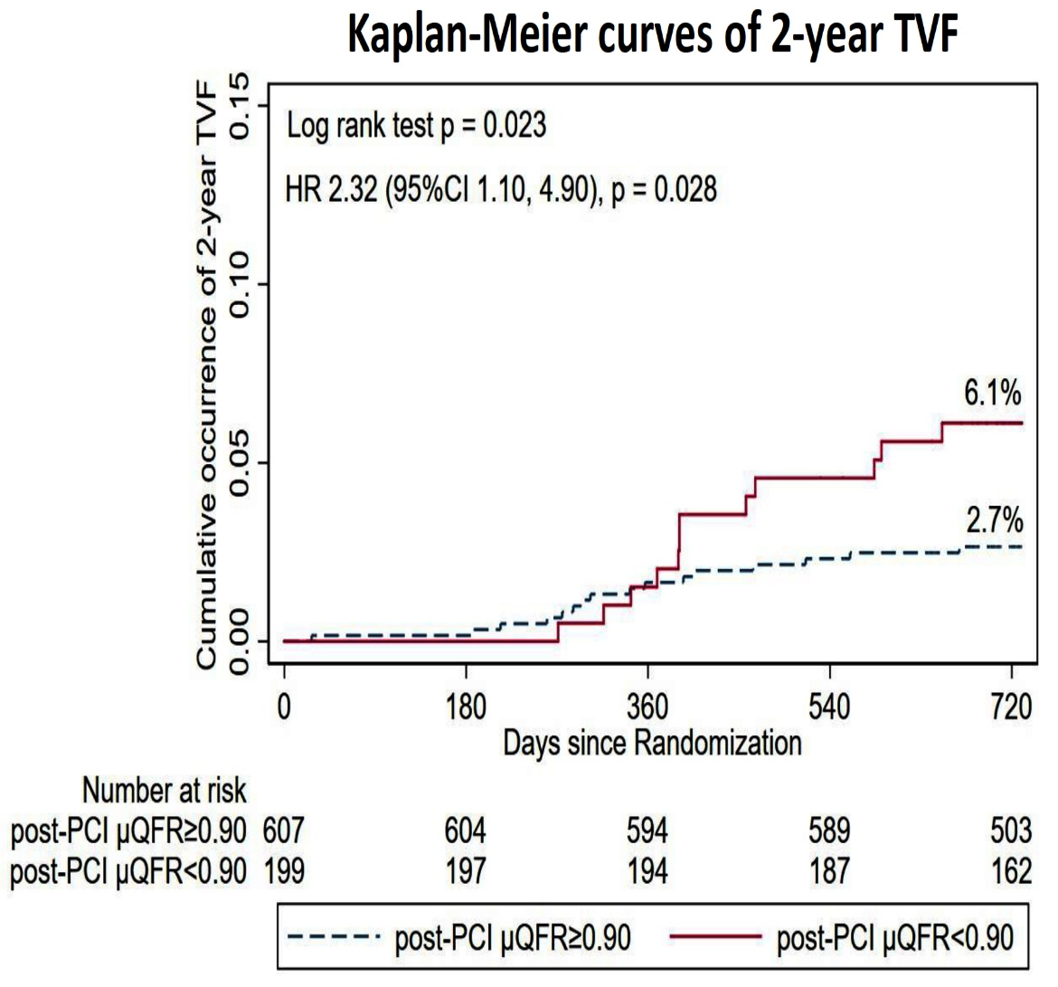
FLAVOUR Trial: Post-PCI µQFR for Predicting
2-Year TVF
2-Yr Events Stratified by Post-PCI µQFR
K-M Curves of 2-Year TVF
Tu S, EuroPCR 2023

Slide 41
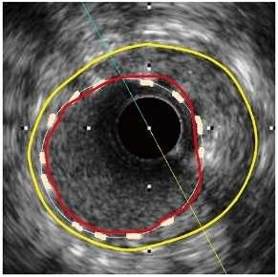
FLAVOUR Trial: Reconstruction and
Quantification of Stent in IVUS by AI
External elastic laminar
Reference lumen contour with step-down across bifurcations
Lumen contour Stent strut
Under-expansion
Malapposition
Over-expansion
Step-down reference lumen
Expansion = ^{Stent area} <80%
Max strut-lumen distance D_{m} >200 μm
Malapposition length = No. of frames with D_{m} > 200 μm × slice thickness
Expansion = ^{Stent area} >120%
Reference area
Under-expansion length = No. of frames
with expansion <80% × slice thickness
Reference area
Over-expansion length = No. of frames
with expansion >120% × slice thickness
Tu et al., Comput Med Imaging Graph 2023;104:102166

Slide 42
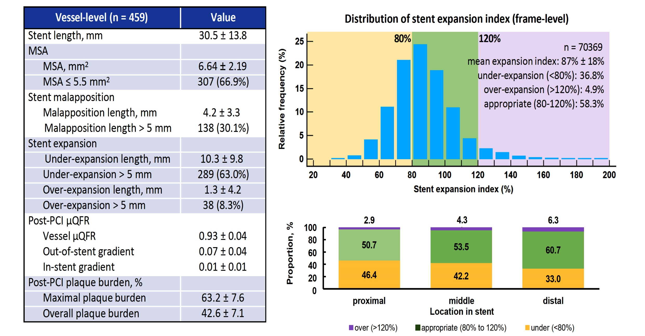
FLAVOUR Trial: Post-PCI µQFR, Stent Parameters,
and Plaque Burden in IVUS Group
Tu S, EuroPCR 2023

Slide 43
FLAVOUR Trial: Post-PCI µQFR, Stent Parameters
For Predicting 2-Year TVF
Vessel-level (n = 459) | Unadjusted HR (95% CI) | p
As continuous variable
Post-PCI μQFR (per 0.1 decrease) | 2.42 (1.17, 5.04) | 0.018
MSA, mm² (per 1.0 decrease) | 1.22 (0.90, 1.66) | 0.196
Stent under-expansion length, mm | 1.004 (0.95, 1.06) | 0.876
Stent over-expansion length, mm | 1.04 (0.97, 1.12) | 0.286
Stent malapposition length, mm | 1.02 (0.88, 1.19) | 0.785
As dichotomous variable
Post-PCI μQFR < 0.90 | 6.14 (2.18, 17.24) | 0.001
MSA ≤ 5.5 mm² | 2.35 (0.85, 6.48) | 0.099
Stent under-expansion length > 5 mm | 0.66 (0.24, 1.82) | 0.420
Stent over-expansion length > 5 mm | 4.27 (1.36, 13.42) | 0.013
Stent malapposition length > 5 mm | 0.85 (0.27, 2.66) | 0.774
Tu S, EuroPCR 2023

Slide 44
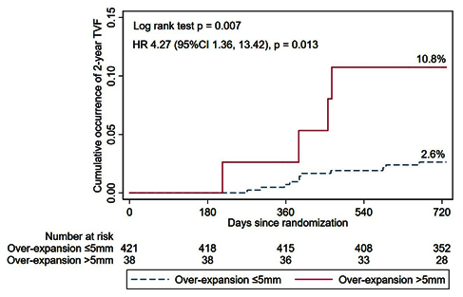
FLAVOUR Trial: Stent Over-Expansion on IVUS for Predicting 2-Year TVF
Kaplan-Meier Curves of 2-Year TVF
Multivariate regression | Adjusted HR (95% CI), p
Model 1
over-expansion > 5 mm | 4.27 (1.36, 13.42), p = 0.013
LAD lesion | NS
age | NS
male | NS
diabetes mellitus | NS
acute coronary syndrome | NS
Smoking | NS
Model 2
over-expansion > 5 mm | 4.26 (1.36, 13.38), p = 0.013
minimal stent area | NS
post-PCI plaque burden | NS
total stent length | NS
Model 3
over-expansion > 5 mm | 3.49 (1.08, 11.25), p = 0.036
post-PCI μQFR < 0.90 | 6.58 (2.18, 19.83), p = 0.001
post-PCI SYNTAX score | NS
Tu S, EuroPCR 2023

Slide 45
Latest Issues in Coronary Intervention
Interventional Trials from EuroPCR 2023:
Define Flair 5-Yr, FAME 3 3-Yr, EBC Main 3-Y
PICCOLETO II 3-Yr, Post-PCI QFR in Flavour
Focused review of the month
Calcified Nodule Imaging and Outcomes:
Impact of Eruptive vs Non-eruptive calcified nodule
morphology on acute and long-term outcomes after
stenting

Slide 46
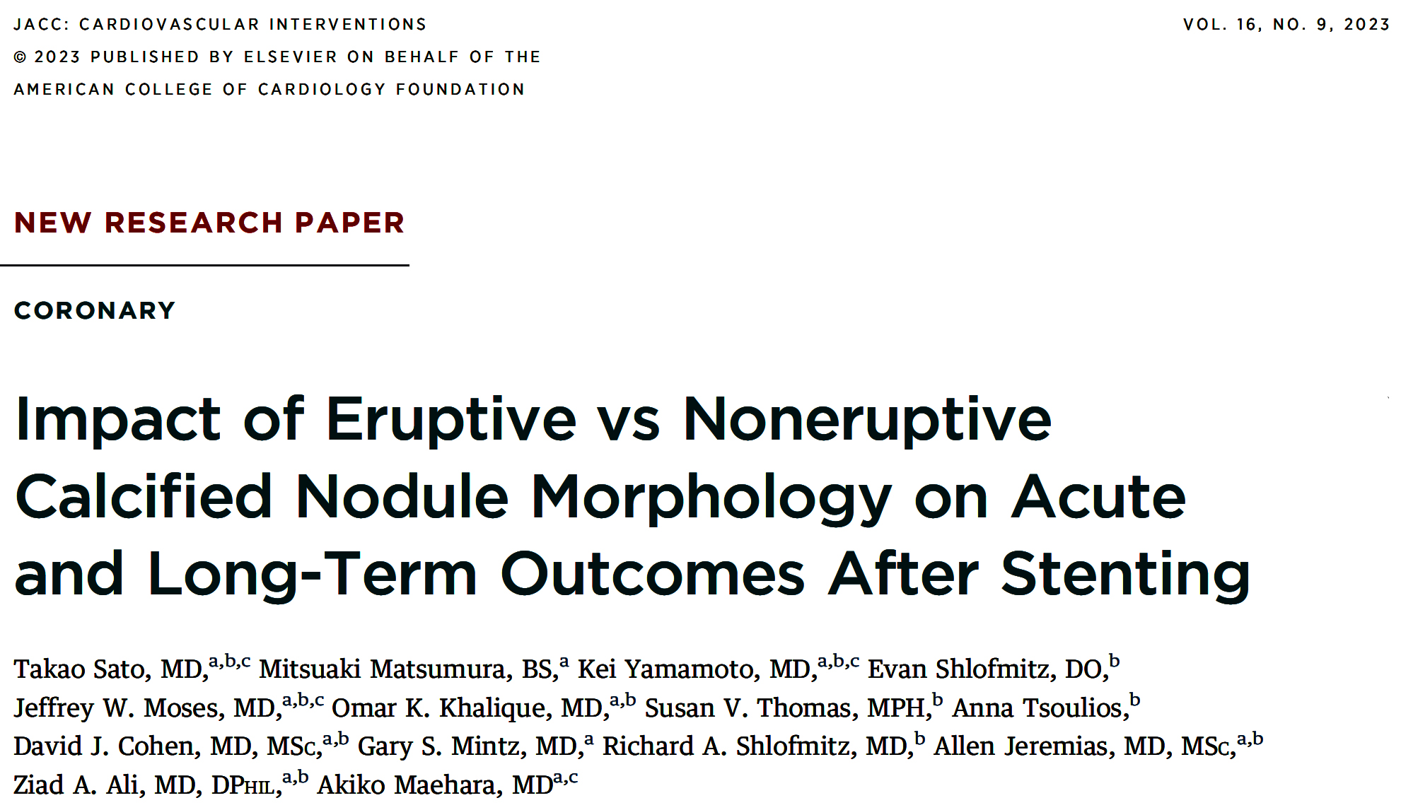

Slide 47
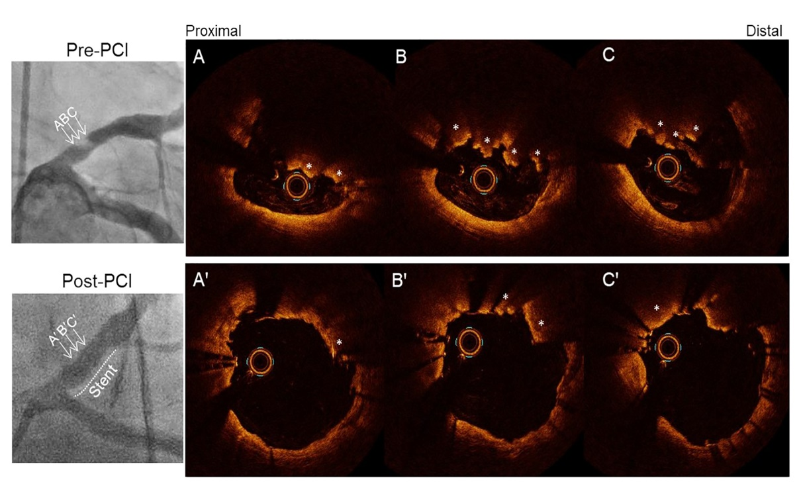
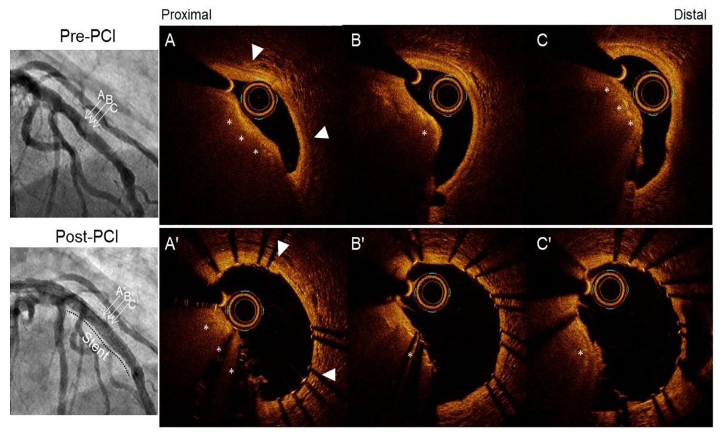
Representative Images of Eruptive CN and Noneruptive CN
Eruptive CN (Early stage)
Noneruptive CN (Healed chronic stage)
Sato et al., J AM Coll Cardiol Intv 2023;16:1024

Slide 48
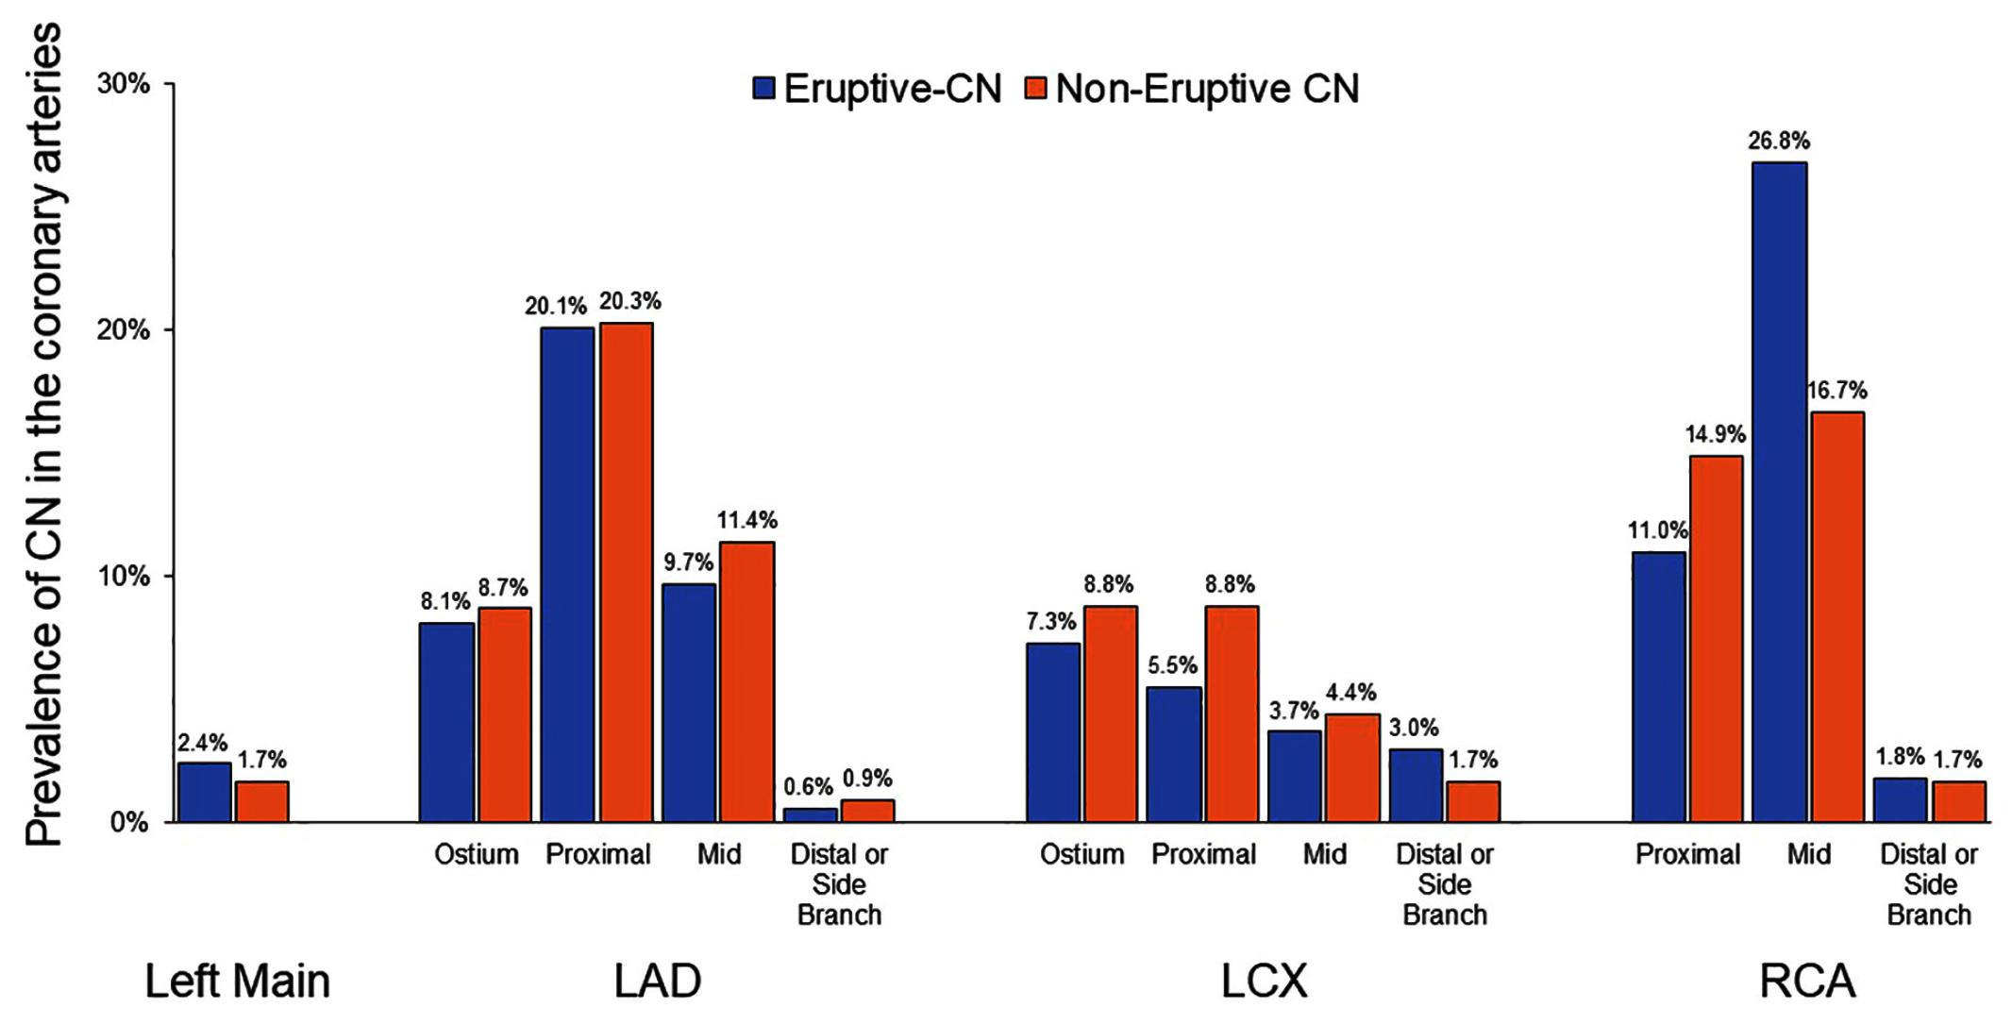
Coronary Artery Distribution of Calcified Nodules
Sato et al., J AM Coll Cardiol Intv 2023;16:1024

Slide 49
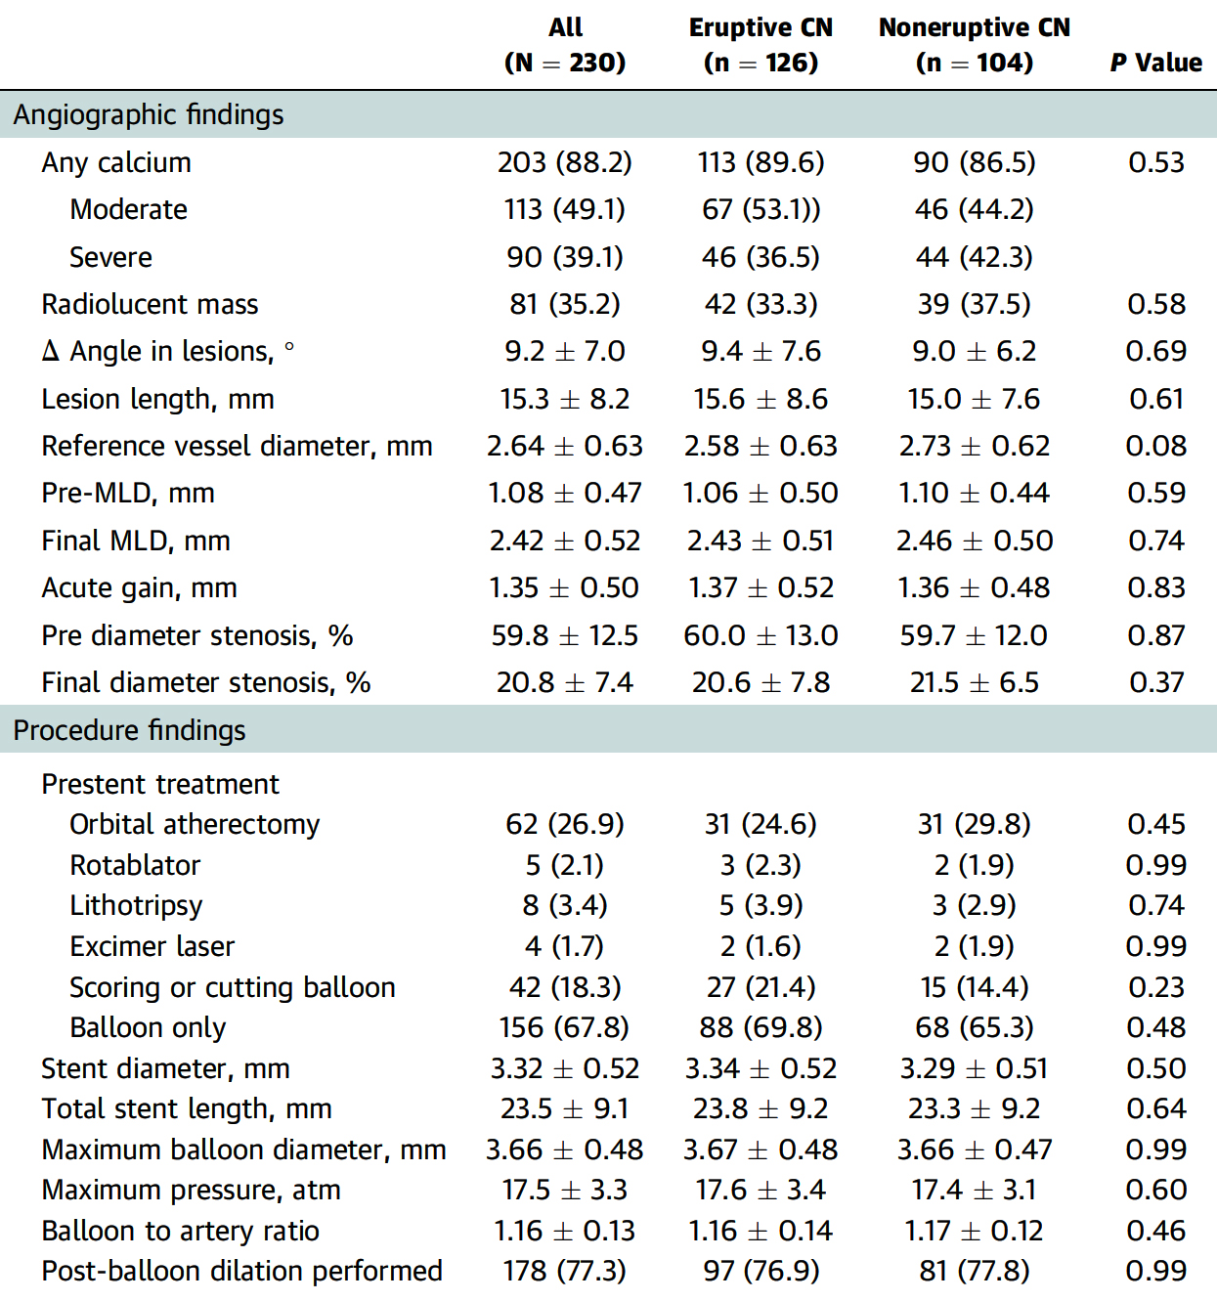
Angiographic Characteristics and Procedural Details
Sato et al., J AM Coll Cardiol Intv 2023;16:1024

Slide 50
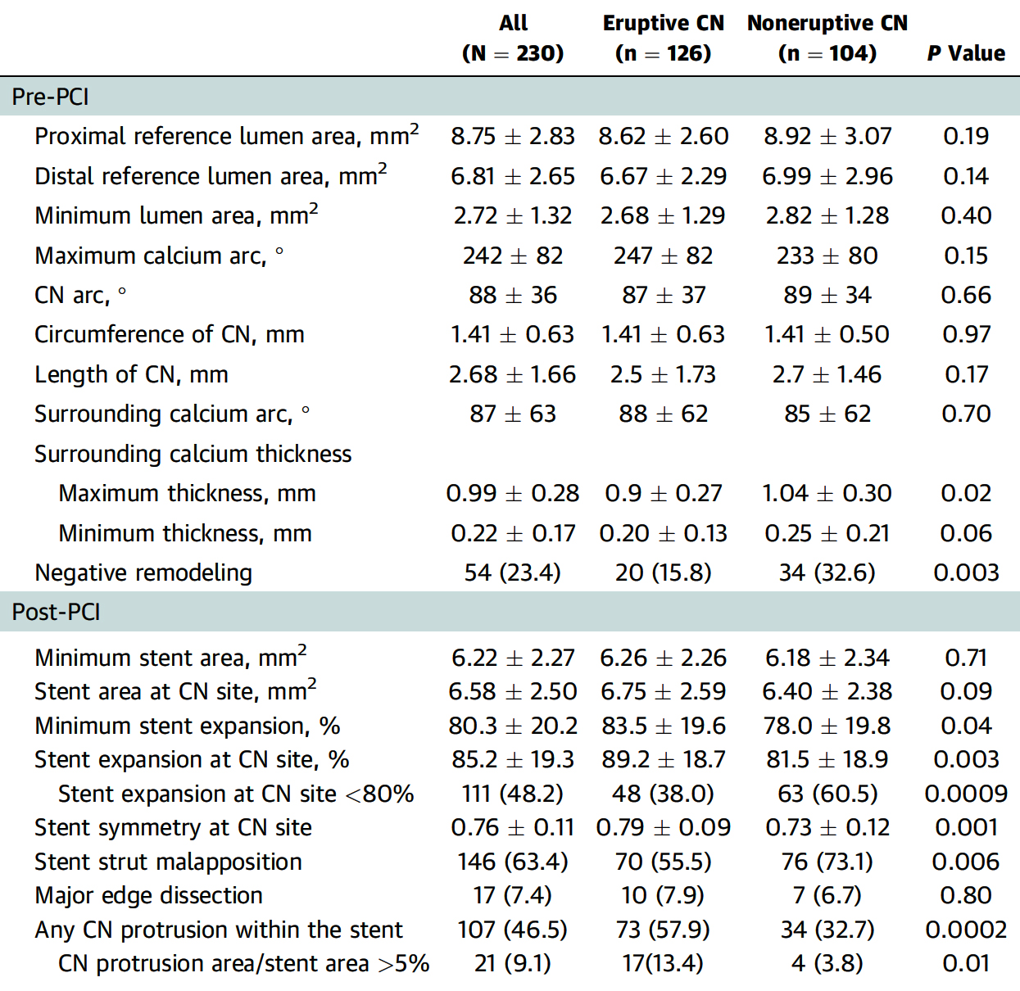
Optical Coherence Tomography (OCT) Findings
Sato et al., J AM Coll Cardiol Intv 2023;16:1024

Slide 51
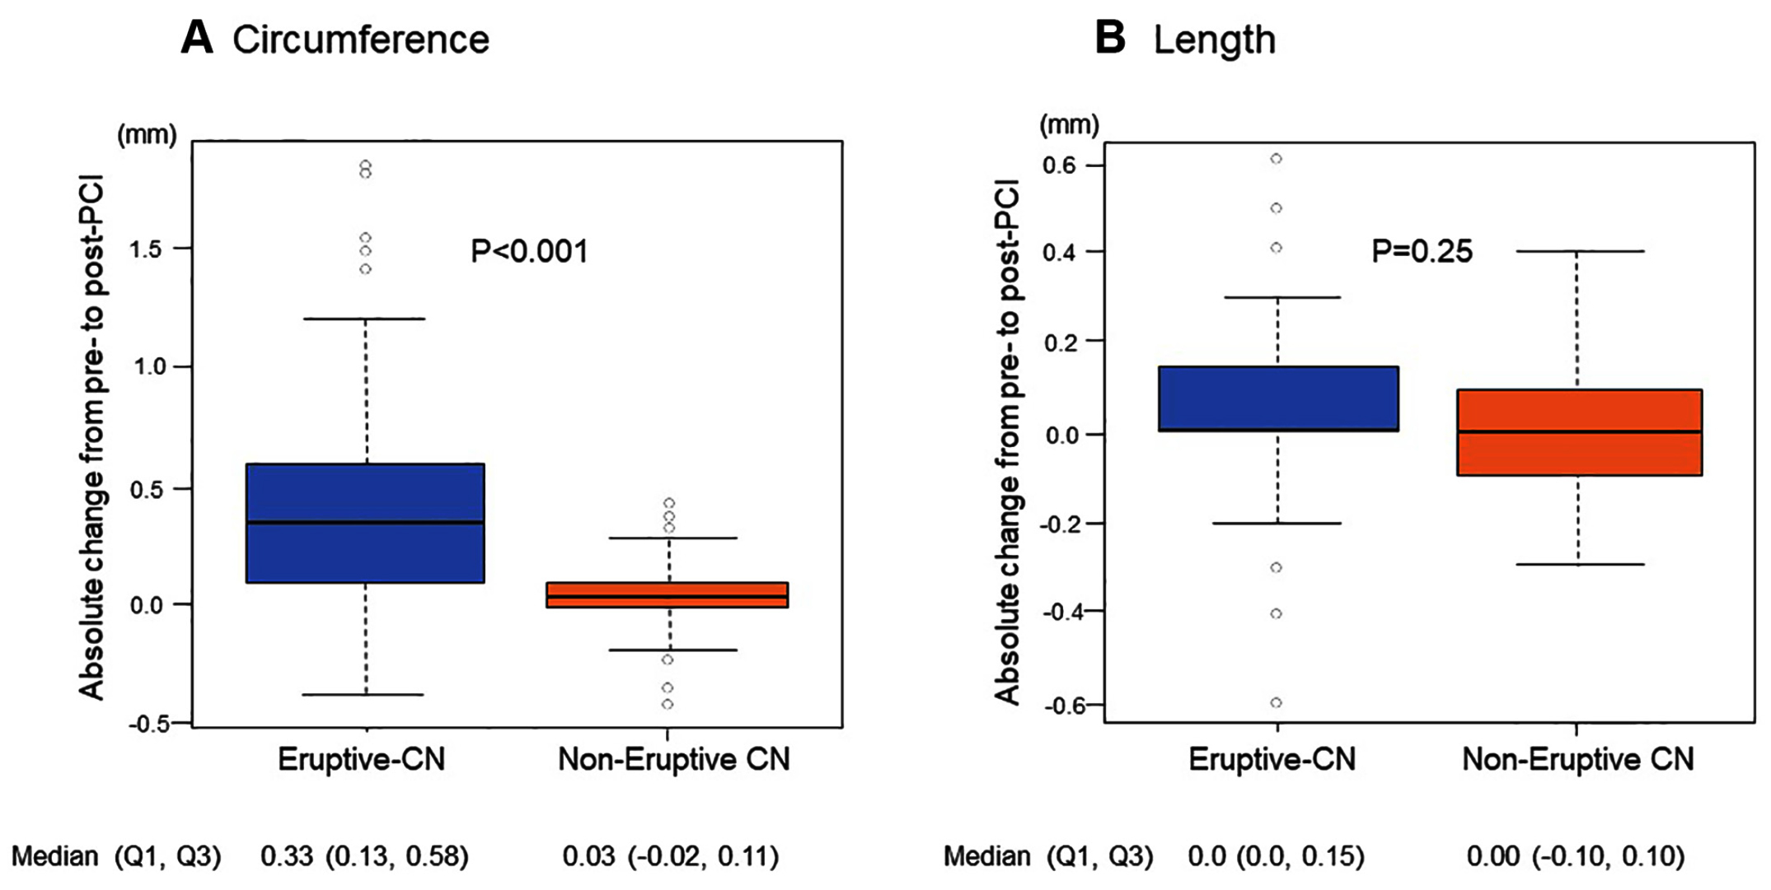
CN Deformation Post-PCI
Absolute changes in the CN circumference pre-PCI and Post-PCI in the eruptive CN and Noneruptive CN groups. Changes in the CN circumference in the eruptive CN group is significantly larger than that in the noneruptive CN group.
Absolute changes in the longitudinal length of CN pre-PCI and post-PCI in the eruptive CN and noneruptive CN groups. There is no difference in the change in the longitudinal length of CN between eruptive CN and Noneruptive CN groups
Sato et al., J AM Coll Cardiol Intv 2023;16:1024

Slide 52
2-Year Clinical Outcomes
p=0.11
p=0.04
%
p=0.15
NS
Sato et al., J AM Coll Cardiol Intv 2023;16:1024

Slide 53
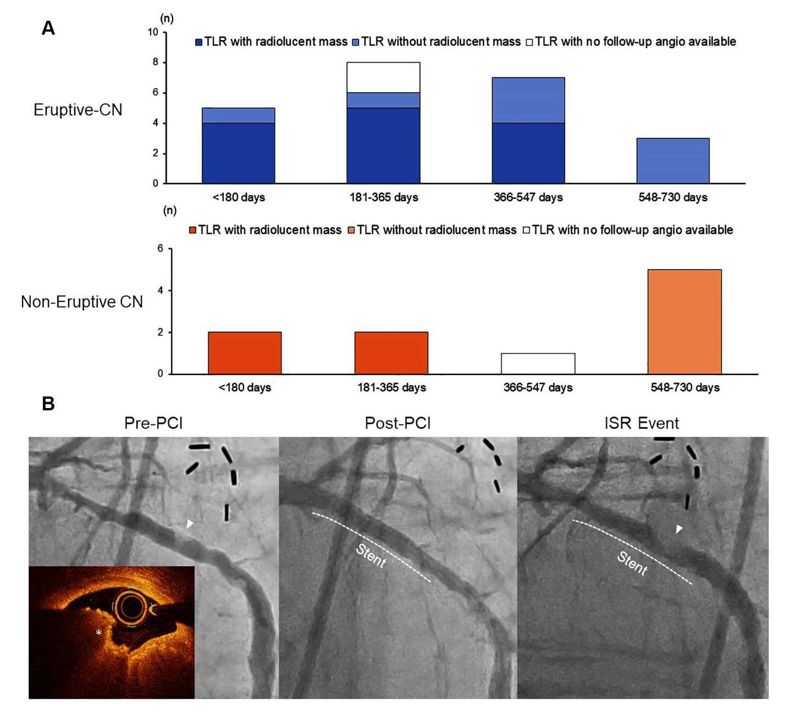
The Relationship Between Timing of TLR and Angiographic Radiolucent Mass
Radiolucent masses are more frequently observed in early TLR.
Representative case with pre-PCI angio showing a radiolucent mass (white arrow) and OCT confirms an eruptive CN (white asterisk).
6 mos later, pt presented with new onset chest pain, coronary angio reveals a radiolucent mass within the stent (white arrowhead) indicating reprotruding of the CN
Sato et al., J AM Coll Cardiol Intv 2023;16:1024

Slide 54
Clinical and Morphologic Factors Associated With 2-Yr
TLF in the Multivariable Hazards Model
 | HR (95% CI) | P Value
Eruptive CN vs noneruptive CN, reference | 2.07 (1.01-4.50) | 0.048
Circumference of CN, per mm | 1.65 (1.01-2.71) | 0.047
∆ Angle in lesions, per 10° | 2.43 (1.63-3.63) | 0.00001
Stent area at CN site, per mm² | 0.78 (0.65-0.94) | 0.009
Age, per 10 years | 0.66 (0.42-1.03) | 0.07
Diabetes mellitus | 1.40 (0.68-2.89) | 0.35
Chronic kidney diseaseª | 1.59 (0.65-3.87) | 0.30
Sato et al., J AM Coll Cardiol Intv 2023;16:1024

Slide 55
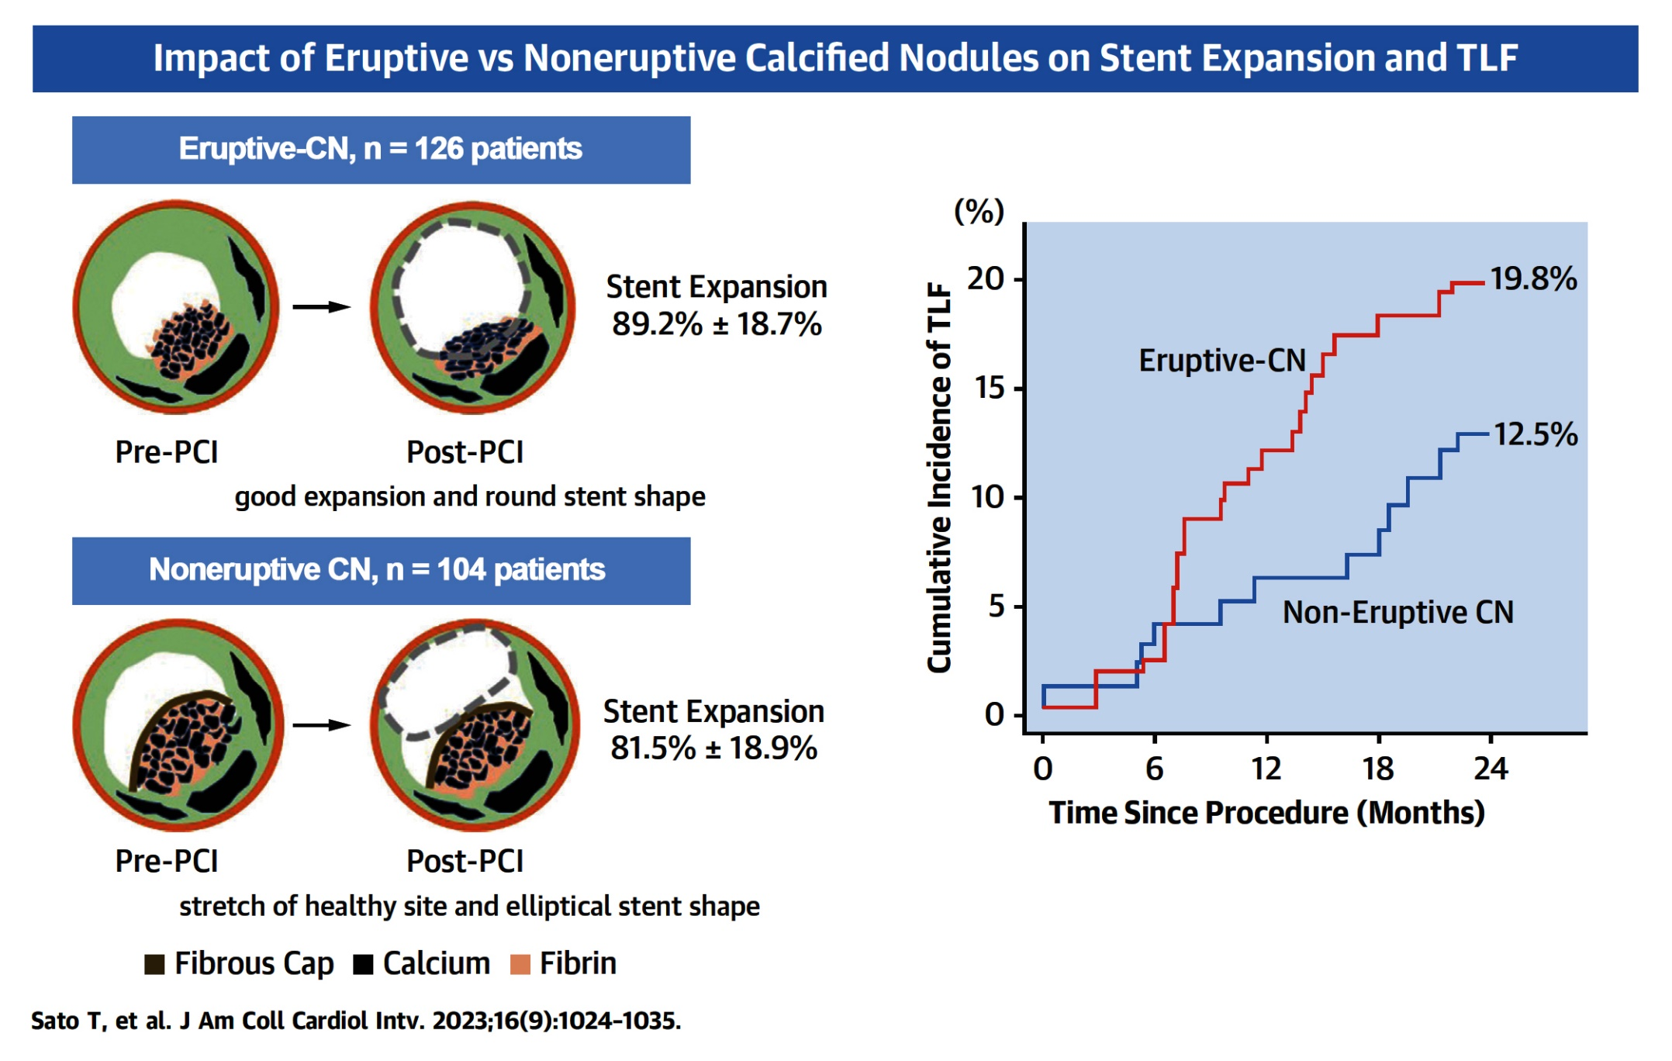
Study Findings and Outcomes
Sato et al., J AM Coll Cardiol Intv 2023;16:1024

Slide 58
Take Home Message: Interventional Trials from EuroPCR 2023 and Impact of Ca+ nodule morphology on acute and long-term outcomes after stenting
iFR vs FFR for overall MACE at 5-yrs:
iFR vs FFR for mortality and Total TLR at 5-yrs:
CABG vs FFR guided PCI for MV CAD at 3 years:
Stepwise provisional vs Dual stenting for dLM @3 yrs:
DCB over DES in small vessels @ 3yrs:
Calcific nodules (CN) are being increasingly recognized by imaging during PCI in 5-30% of ca+ lesions, and many cause ACS. Eruptive CN seems to represent early stage of atherosclerosis vs established staged for noneruptive CN. Both CN behaves differently to PCI; eruptive CN has better stent expansion & CN deformation but higher TLR/TVF at f/u. Hence appropriate treatment of CN during PCI is vital.
Notes:
HbA1c in

Slide 59
Question # 1
Following statement is false regarding the outcomes of iFR vs FFR at 5 years in the Define Flair trial;
Similar MACE rates between 2 groups at 5 years
Similar MI rates between 2 groups at 5 years
Similar Mortality rates between 2 groups at 5 years
Similar Unplanned revascularization between 2 groups at 5 ys
Higher overall TLR in iFR gp vs FFR gp at 5 years
The correct answer is C

Slide 60
Question # 2
Following statement is false regarding the results of FAME 3 trial comparing FFR guided PCI vs CABG at 3 years;
A. Similar mortality between 2 groups
B. Similar stroke rates between 2 groups
C. Higher TLR in PCI gp vs CABG gp
D. Trend towards higher MACE in PCI gp vs CABG gp
E. Similar MI rates in PCI gp vs CABG gp
The correct answer is E
,
Notes:
er

Slide 61
Question # 3
Following statement is incorrect regarding the short and 2-year outcomes of Eruptive vs Noneruptive CN encountered during OCT guided PCI;
Better stent expansion in eruptive vs noneruptive CN
More uniform/circular stent expansion in eruptive vs noneruptive CN
No impact of atheroablation in both types of CN
Lower TLR in eruptive vs noneruptive CN at 2 years
Less negative remodeling in eruptive vs noneruptive CN
The correct answer is D

Slide 62
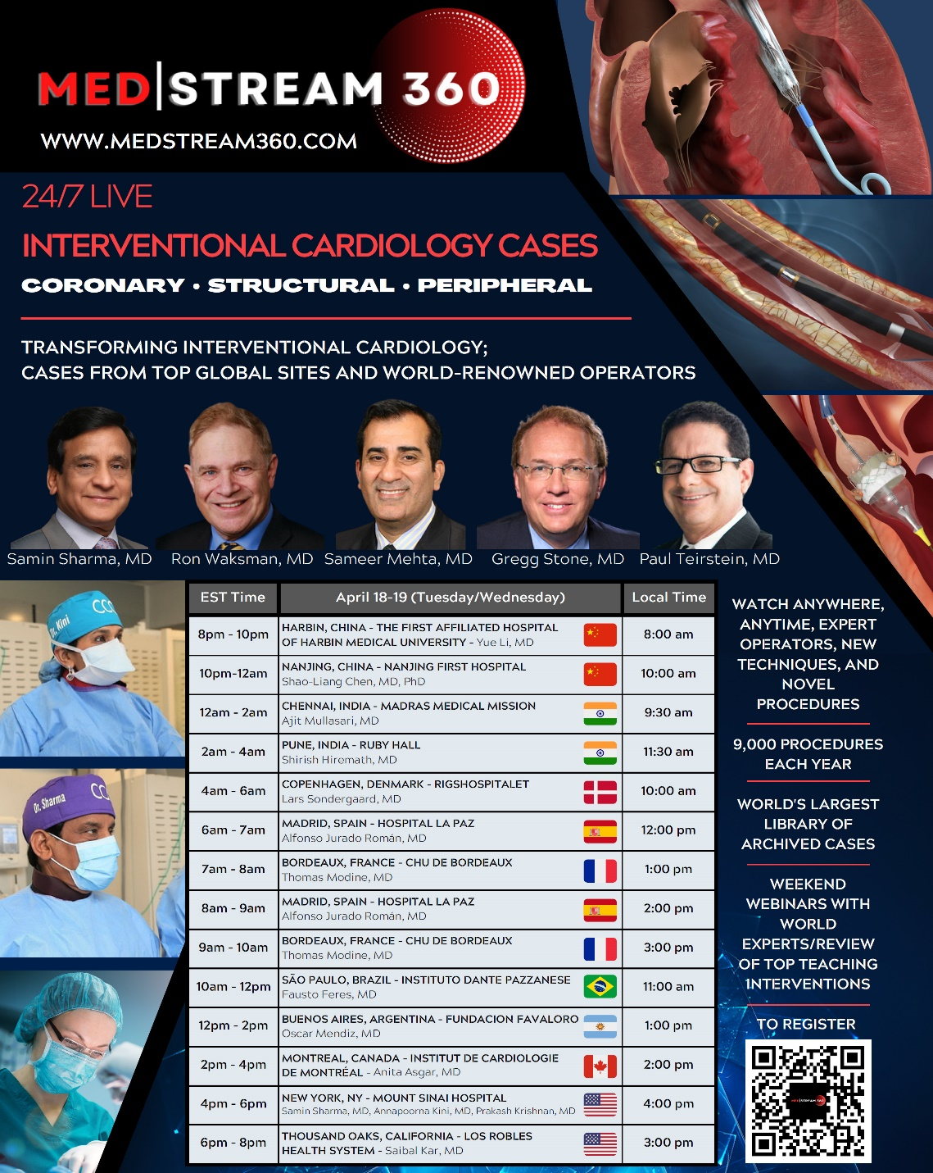
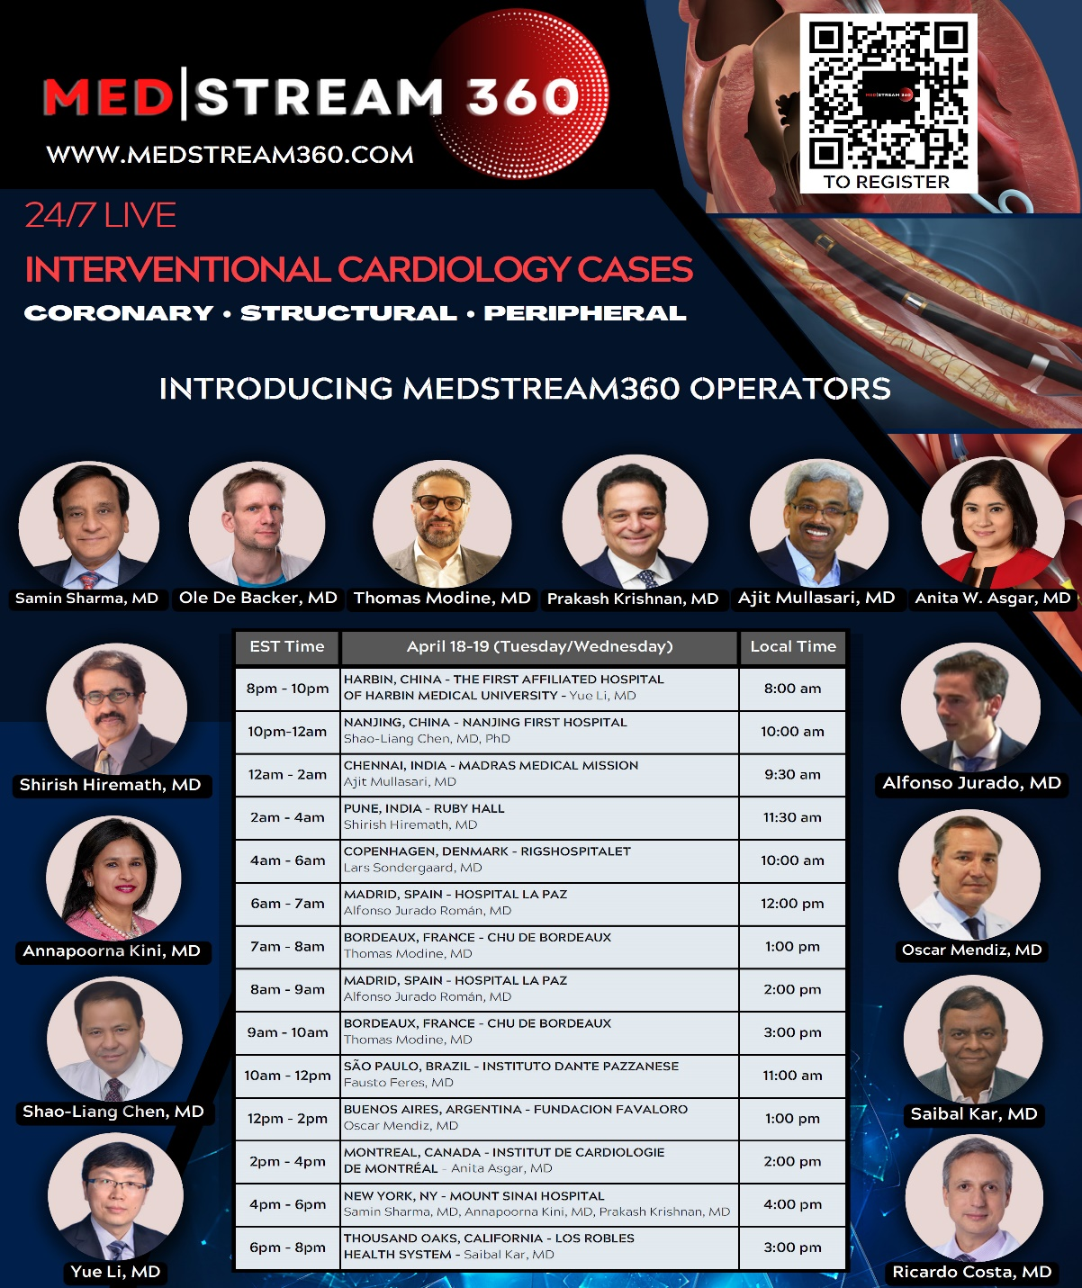

Slide 64
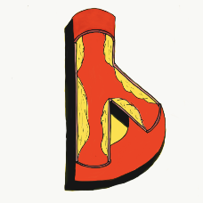
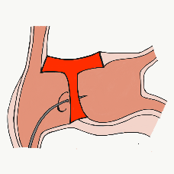
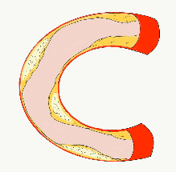
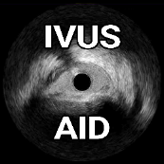
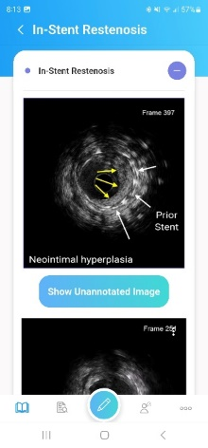
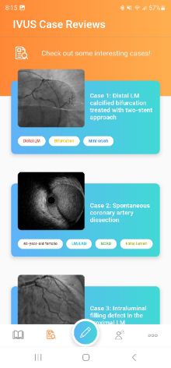
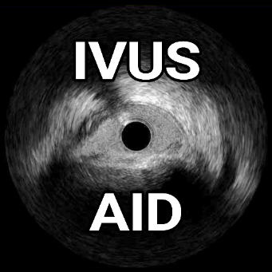
Growing Library of Educational Applications
Learn more at CardiologyApps.com
Already released and past 76,500 downloads...
Newly released:
IVUSAID
Also
AngioAID 3D
HemodynamicsAID
With more
coming soon!!!
DeviceAID
Mobile app
Updated
BifurcAID
(to Android)
Updated
CalcificAID

