Slide 1
Structural Heart Live Case from Mount Sinai Hospital
TAVI NOW Summit 2023; India
Supported by:
Edwards Lifesciences
Sun Pharma

Slide 2
Faculty Involved and Disclosures
Samin K. Sharma, MD, FACC, MSCAI (Interventionalist)
Nothing to disclose
Annapoorna S. Kini, MD, MRCP, FACC (Interventionalist)
Nothing to disclose
Sahil Khera, MD, FACC (Interventionalist)
Nothing to disclose
Gilbert Tang, MD, FACC (Cardiac Surgeon)
Proctor for Medtronics
Stamatios Lerakis, MD, PhD, FACC, FAHA (Echocardiographer)
Nothing to disclose
Morgan Montgomery MD (Cardiac Anesthesiologist)
Nothing to disclose

Slide 3
TF-TAVR with a 29mm Sapien-3 Ultra Resilia valve in a Low Flow Low Gradient Severe Aortic Stenosis with CKD stage IV

Slide 4
Case Presentation: SI, 90 y/o M
Presentation: Worsening NYHA III HF symptoms (SOB and fatigue)
PMH: HTN, HLD, HFrEF (EF 45%), CKD Stage 4 (e GFR 24.34 mL/min/1.73 m2), prostate cancer (s/p seed therapy), gout, anxiety and CLL (s/p chemotherapy 2000). s/p CRT-D 9/8/21
Medications: Metoprolol, Apixaban, Hydralazine, Mexilitine, Atorvastatin, Bumetanide
Labs: Hgb 14.0, PLT 152K, Na 141, K 4.0, Cr 2.54, INR 1.4
EKG (06/12/2023): AF with controlled HR of 60 bpm and QRS of 114 msec.
TTE (06/15/2023): Moderately decreased left ventricular systolic function, EF 40%, Severe LFLG aortic stenosis (PG/MG/PV/AVA: 35/22/2.96/0.47). SVI 13ml/M2.
Cath (2020): Non-Obstructive CAD

Slide 5
TTE
Severe LFLG AS with severely reduced LV systolic function and moderate MR

Slide 6
Cardiac MR: Annulus & LVOT
Annulus
Max: 33.4 mm
Min: 25.6 mm
Mean: 29.5 mm
Perimeter = 92.3 mm
Area = 657.1 mm²
LVOT
Max: 36.5 mm
Min: 25.2 mm
Mean: 30.9 mm
Perimeter = 98.7 mm
Area = 723.2 mm²

Slide 7
CTA: Annulus
Annulus
Max: 31.1 mm
Min: 24.2 mm
Mean: 27.6 mm
Perimeter = 87.4 mm
Area = 591.6 mm²

Slide 8
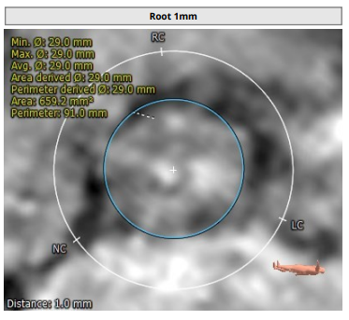
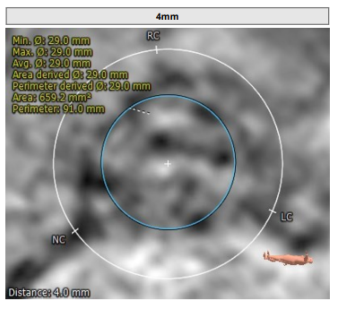
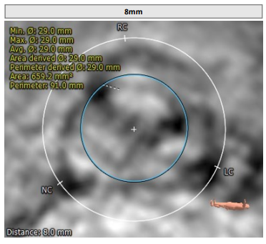
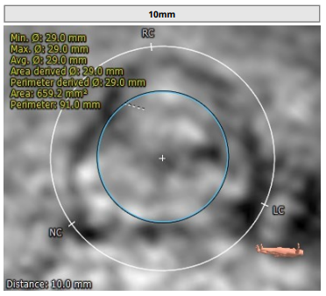
Cardiac MR : Root Analysis

Slide 9
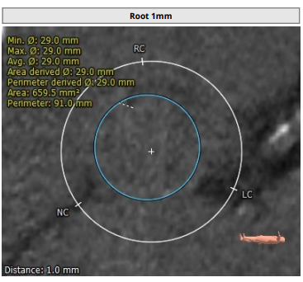
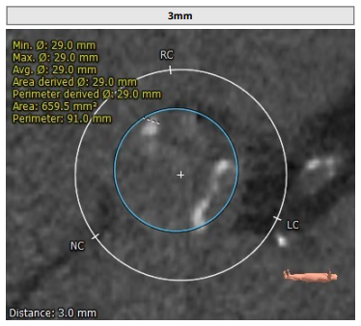
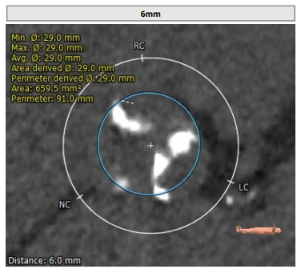
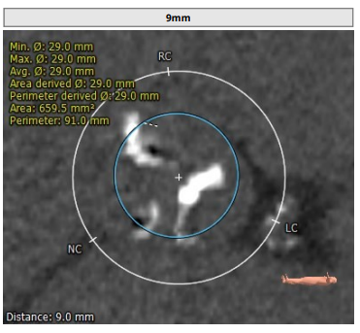
CTA : Root Analysis

Slide 10
Cardiac MR: STJ & SOV Diameter
STJ
Max: 35.6 mm
Min: 35.5 mm
Mean: 35.6 mm
SOV Diameter
SOV Left: 39.2 mm
SOV Right: 36.4 mm
SOV Non: 38.0 mm

Slide 11
CTA: STJ & SOV Diameter
STJ
Max: 35.2 mm
Min: 34.5 mm
Mean: 34.8 mm
SOV Diameter
SOV Left: 38.3 mm
SOV Right: 33.7 mm
SOV Non: 35.3 mm

Slide 12
Cardiac MR: Sinus Height LCC & RCC
SOV height: 27.0 mm
Left coronary height 15.3 mm
Right coronary 16.4 mm

Slide 13
CTA: Sinus Height LCC & RCC
SOV height: 26.6 mm
Left coronary height 13.6 mm
Right coronary 19.4 mm

Slide 14
Aortic Root Angle
Horizontal Aorta

Slide 15
Calcification & Hockey Puck view

Slide 16
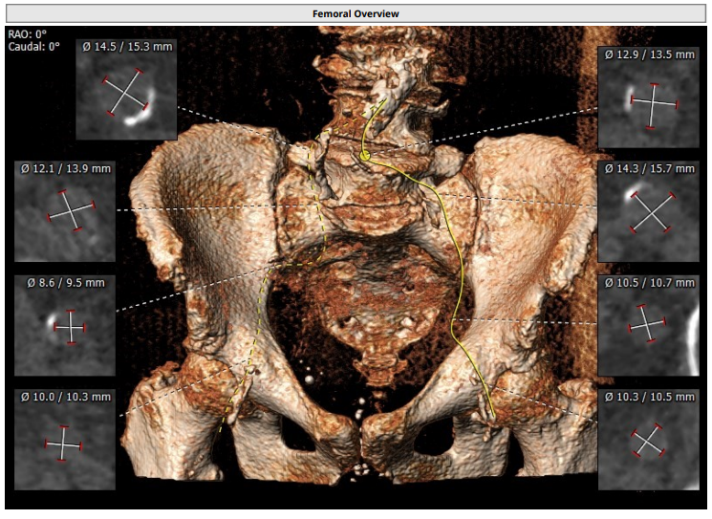
Access Anatomy

Slide 17
Summary of Case
Presentation: 90 y/o M with worsening NYHA Class III symptoms
TTE: Moderately decreased left ventricular systolic function, EF 40%, Severe low flow low gradient aortic stenosis (PG/MG/PV/AVA 35/22/2.96/0.47 sq cm) and moderate MR
STS risk mortality for AVR: 5.3%
Course: Evaluated by heart team & recommended TF-TAVR
Plan: TF TAVR with a 29mm Sapien-3 Ultra Resilia with Sentinel cerebral embolic protection device via right percutaneous femoral artery access. Minimal contrast due to CKD.

Slide 18
The Challenge of Calcification and the Structural Valve Deterioration That Results From It
Flameng et al., J Thorac Cardiovasc Surg 2015;149:340

Slide 19
RESILIA Tissue Calcium-Blocking Technology
Flameng et al., J Thorac Cardiovasc Surg 2015;149:340

Slide 20
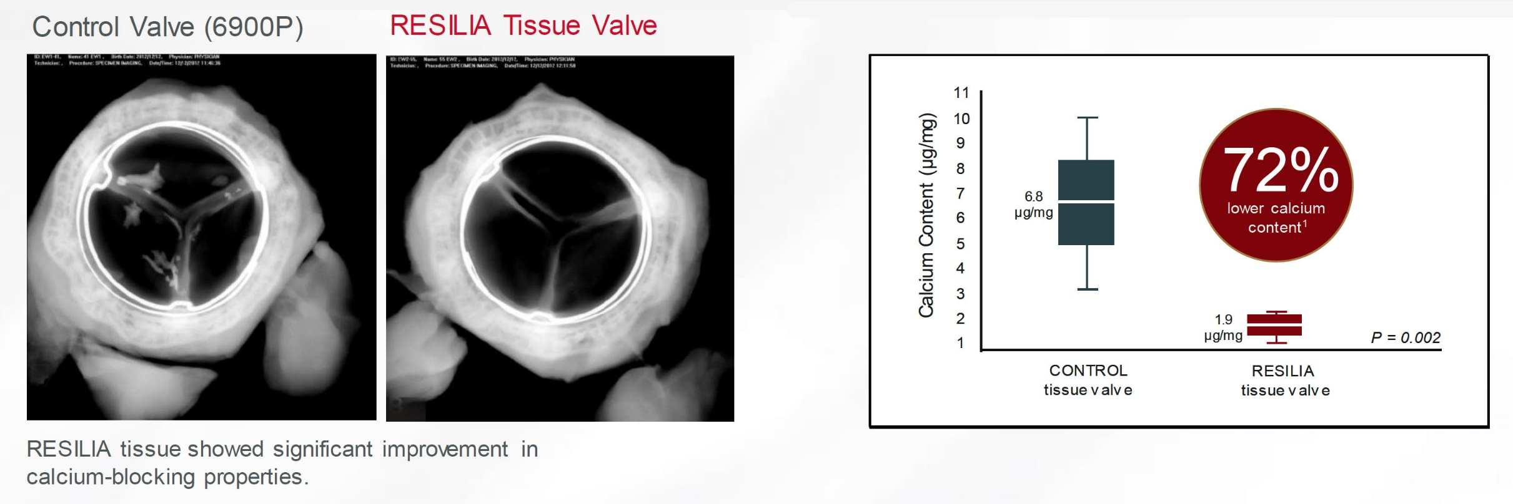
RESILIA Tissue Reduced Calcification When Compared to Traditional Surgical Valve Tissue Treatment
Flameng et al., J Thorac Cardiovasc Surg 2015;149:340

Slide 21
COMMENCE Aortic Trial: No Cases of SVD at 5 Years
Bavaria et al., Ann Thorac Surg Jan 20, 2022 Epub ahead of print

Slide 22
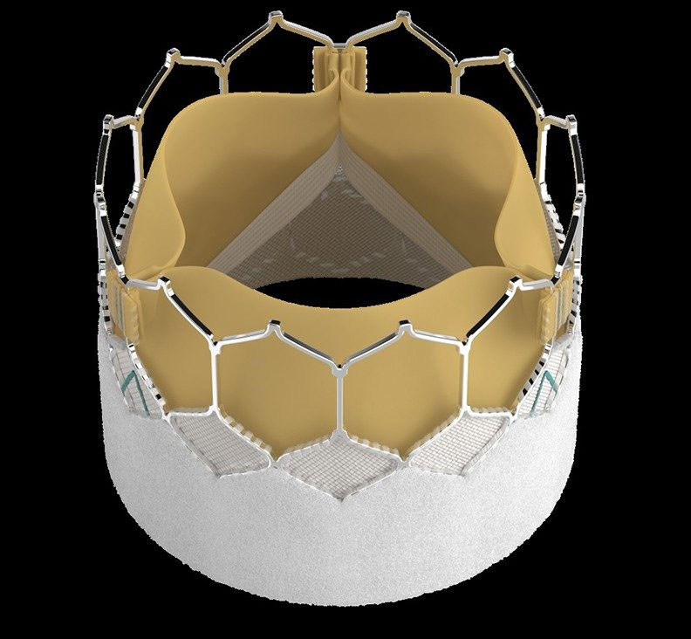
INSPIRIS RESILIA TAVI Valve
The special technology used in the RESILIA tissue on the INSPIRIS valve blocks the calcium from depositing on the tissue. Less calcium build-up could potentially allow the valve to last longer.
First of its kind expandable valve frame designed for potential valve-in-valve procedures.
The INSPIRIS valve is built on the proven Carpentier-Edwards Perimount valve design – which has helped over one million patients worldwide.
the INSPIRIS valve typically will not require you to take blood thinners for the long-term – unless you have other risk factors or medical conditions that would require it.

