Slide 1
Structural Heart Live Cases
Supported by:
Medtronic Inc
Cook Inc.
Terumo Medical
B-Braun

Slide 2
Faculty Involved and Disclosures
Samin K. Sharma, MD, FACC, MSCAI
Nothing to disclose
Annapoorna S. Kini, MD, MRCP, FACC
Nothing to disclose
Sahil Khera, MD, FACC
Nothing to disclose
Gilbert Tang, MD, FACC
Proctor for Medtronics
Stamatios Lerakis, MD, PhD, FACC, FAHA
Nothing to disclose
Pedro Moreno, MD, FACC [Moderator]
Nothing to disclose
Cardiac Anesthesiologist
Cesar Rodriguez-Diaz, MD

Slide 3
TAVR with a 26mm Evolut-FX Valve in a very small patient

Slide 4
Structural Heart Live Case #53 : OA, 67 y/o F
Presentation: Worsening angina & exercise intolerance 2M
PMH: HTN, HLD, low body weight/BSA (weight 63kg, height 149cm, BSA:1.57 kg/m2)
Medications: Aspirin, Atorvastatin, Metoprolol XL
Labs: Hgb 13.0, PLT 248K, K 4.2, Cr 0.6
EKG (05/27/2023): NSR, PR 160ms, QRS 80ms
TTE (05/18/2023): LVEF 63%, severe aortic valve stenosis (PG/MG/AVA/PV: 108/68/0.8/5.2), trivial AR

Slide 5
TTE
- Severely calcified and restricted aortic valve
- PG/MG/AVA/PV: 108/68/0.8/5.2
- Preserved LV function

Slide 6
CTA: Aortic annulus, LVOT
Aortic Annulus
Max: 24.5 mm
Min: 19.5 mm
Mean: 22.0 mm
Perimeter = 69.9 mm
Area = 378 mm²
LVOT
Max: 18.0 mm
Min: 21.7 mm
Mean: 19.9 mm
Perimeter = 63.2 mm
Area = 311 mm²

Slide 7
CTA: STJ and SOV

Slide 8
CTA: STJ height and Coronary Height
SOV height: 19.4 mm
Left coronary height: 14 mm
Right coronary height: 11 mm

Slide 9
CTA: Aortic Angle

Slide 10
CTA: Aorta and Aortic Arch

Slide 11
CTA: Aorto-iliac Bifurcation

Slide 12
Summary of Case
Presentation: 67 yo F with severe symptomatic AS & low BSA
TTE: Severe native AS, EF 63%
STS risk mortality for second redo AVR: 2.3%
Course: Patient was evaluated by heart team, deemed to be at high surgical risk due to frailty, small BSA and elected for TF TAVR
Plan: TF TAVR with a 26mm Evolut FX valve via right percutaneous femoral arterial access and Sentinel cerebral embolic protection device

Slide 13
Latest Issues in Transcatheter Structural Heart Interventions
Recent publications in the TAVR Field:
- 3 Year Outcomes of Evolut Low-risk Trial
- Optimize Pro Study
- Sex Differences in TAVR Outcomes
- Redo SAVR after prior TAVR vs SAVR Registry
- EXPLANTORREDO TAVR Registry

Slide 15
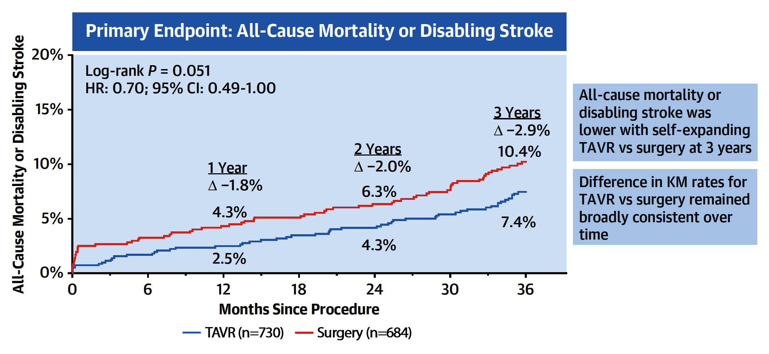
3-Year Outcomes From the Evolut
Low Risk Trial
Forrest et al., J Am Coll Cardiol 2023;81:1663

Slide 16
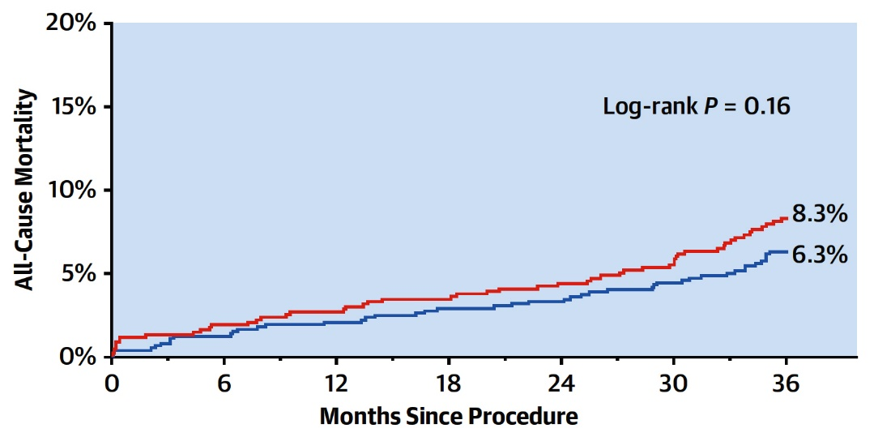
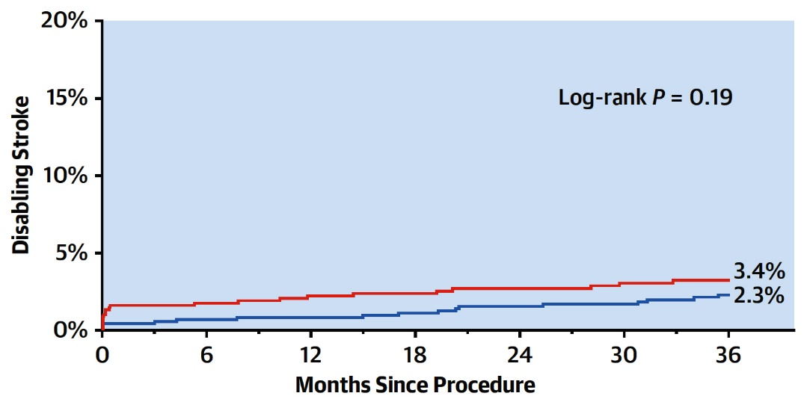
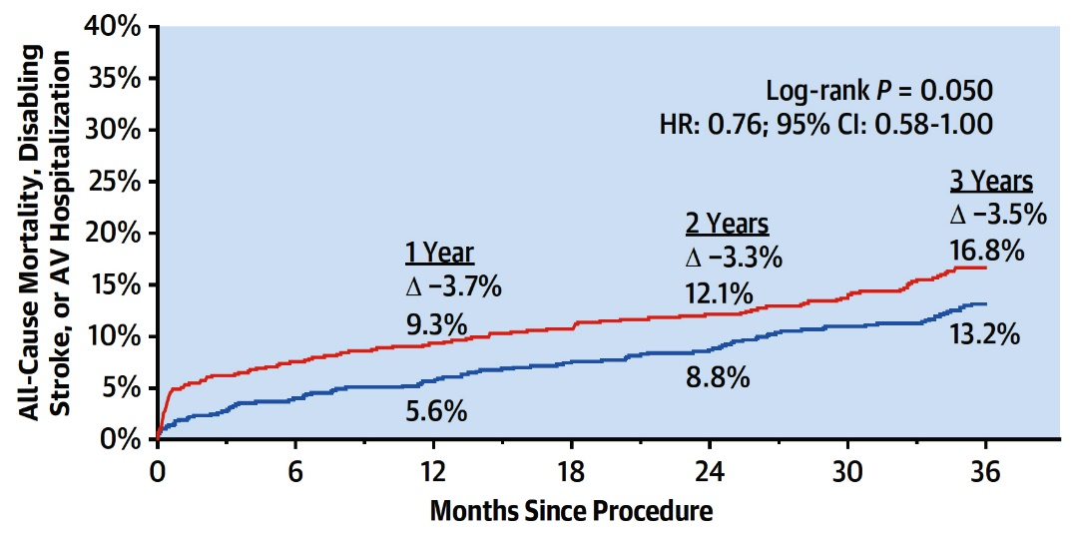
Evolut Low Risk Trial: All-Cause Mortality, Disabling
Stroke and Landmark Analysis of Primary Endpoint
All-Cause Morality
Disabling Stroke
SAVR (n=684)
SAVR (n=684)
TAVR (n=730)
TAVR (n=730)
Landmark Analysis of Primary Endpoint
SAVR (n=684)
TAVR (n=730)
Forrest et al., J Am Coll Cardiol 2023;81:1663

Slide 17
Evolut Low Risk Trial: 3-Year Clinical Outcomes
and Valve Performance
p<0.001
p<0.001
%
p=0.05
p=0.20
p=0.16
p=0.55
p=0.67
p=0.30
p=0.92
p=0.84
Clinical Outcomes
Valve Performance
Forrest et al., J Am Coll Cardiol 2023;81:1663

Slide 18
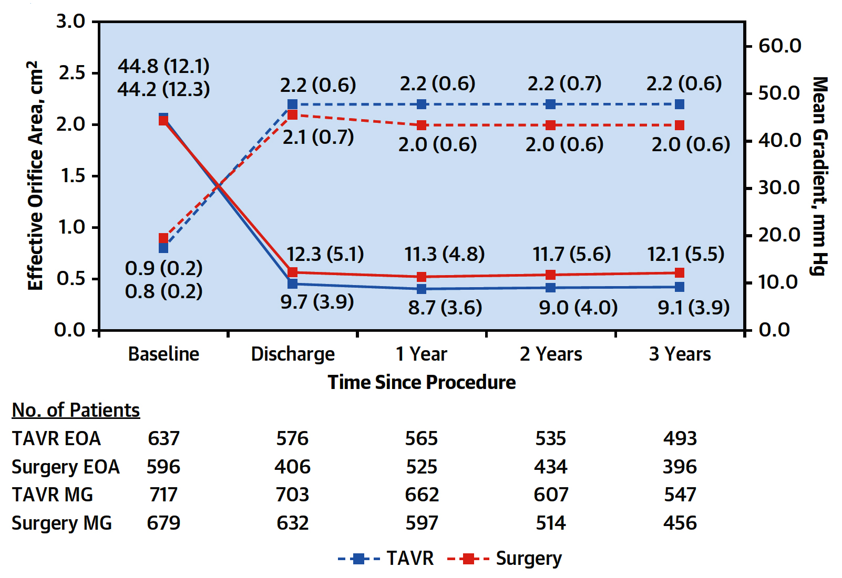
Evolut Low Risk Trial: Hemodynamic Valve Performance
Echocardiographic Findings at 3 Years
TAVR grp consistently significantly lower AV MG (9.1 mmHg TAVR vs 12.1 mmHg SAVR; difference: -3.0; 95% CI: -3.6 to 2.4; p<0.001) and significantly larger EOA (2.2 cm² TAVR vs 2.0 cm² SAVR; difference: 0.2; 95% CI: 0.2-0.3; p<0.001)
Forrest et al., J Am Coll Cardiol 2023;81:1663

Slide 19
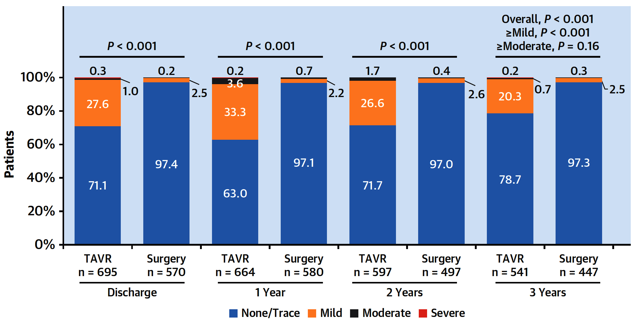
Evolut Low Risk Trial: Hemodynamic Valve Performance
Paravalvular Regurgitation at 3 Years
Between 1 an 3 years, no increase in paravalvular regurgitation observed for either TAVR or SAVR groups
Forrest et al., J Am Coll Cardiol 2023;81:1663

Slide 20
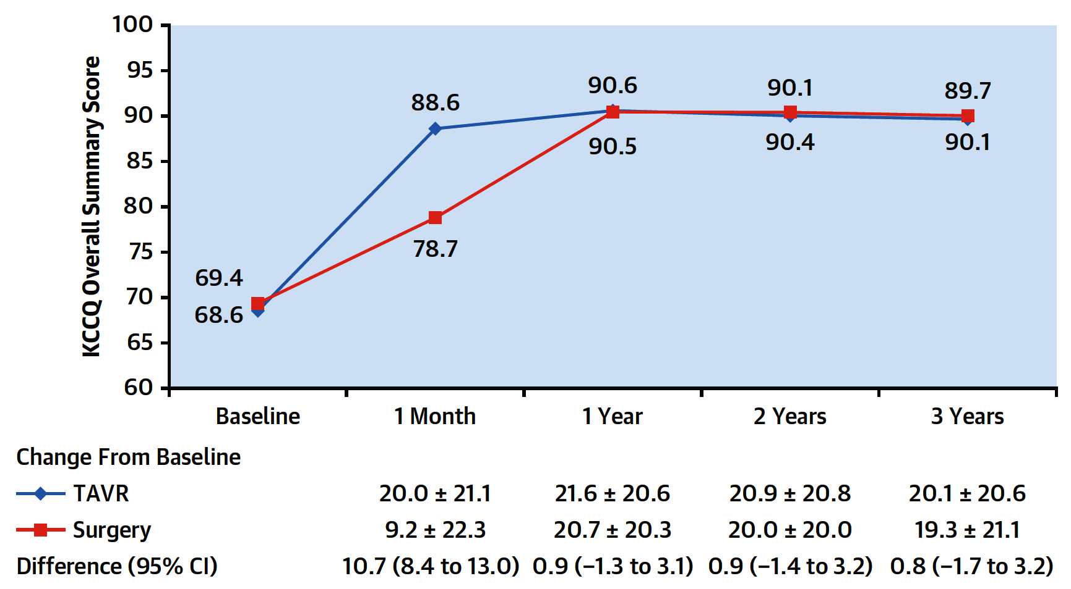
Evolut Low Risk Trial: KCCQ Overall Summery Score
Patients who underwent TAVR had more rapid improvement in QoL at 30 days
TAVR and SAVR maintained improvements between years 1 and 3
At 3 years, there was approximately 20-point increase from baseline KCCQ for TAVR and SAVR consistent with a very large improvement in QoL
Forrest et al., J Am Coll Cardiol 2023;81:1663

Slide 21
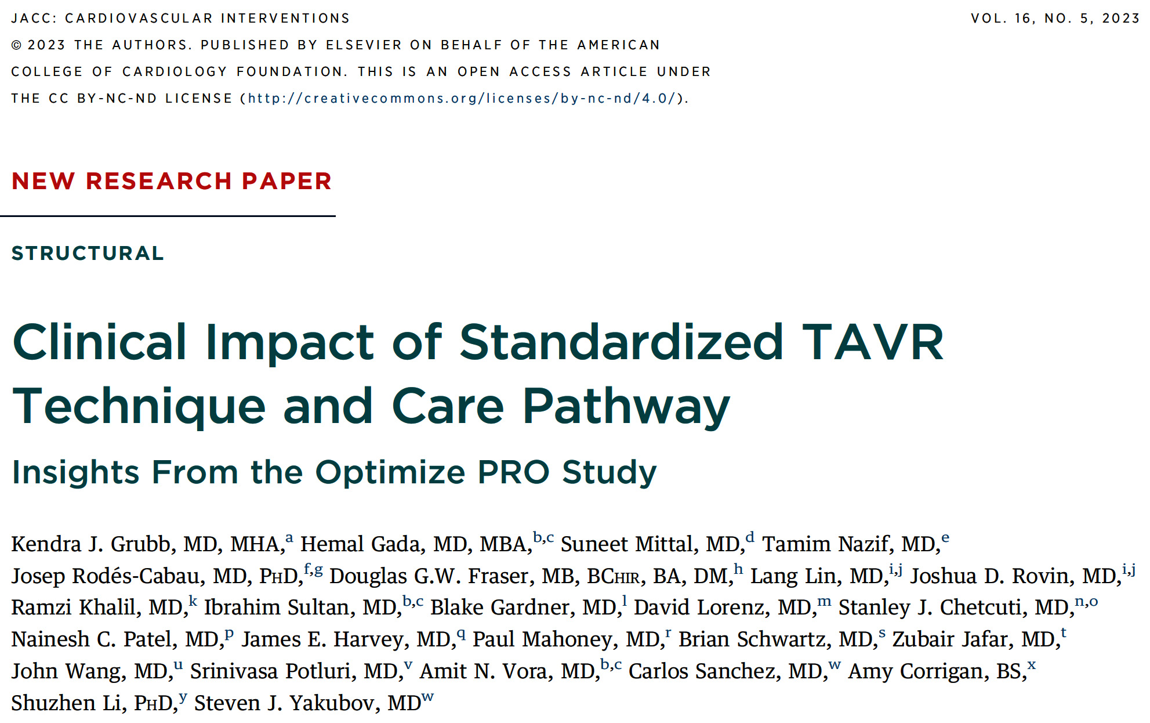

Slide 22
Optimize PRO: Study Design
Non-randomized, prospective, post-market study
Conducted in the United States, Canada, Europe, Middle East, and Australia
Symptomatic Severe AS
“Optimized” post- procedure care pathway
Attempted Procedures
Medtronic Evolut PRO or Evolut Pro + device suitability inclusion criteria
“Optimized” procedure
“Optimized” post- procedure care pathway
“Optimized” conduction disturbance management pathway
No AV Conduction Disturbance
AV Conduction Disturbance
Procedural Efficiency & Collect
Economic Value Data
Validate post procedural conduction disturbance management
Primary Endpoint: Rate of all-cause mortality or all-stroke at 30 days
Secondary Endpoints:
Median days LOS
% of subjects with ≥ moderate AR at discharge
Rate of new PPI at 30 days
1 Year Follow-up
Grubb K, EuroPCR 2022

Slide 23
Optimize PRO Study: Optimized TAVI Care Pathway with Evolut PRO/PRO+
Pre-Procedure
Peri-Procedure
Post-Procedure
12-lead ECG
Early discharge plan with multi-disciplinary team
Screening checklist
Valve deployment using the cusp overlap technique
Pre-BAV not required
Avoid general anesthesia
Use transfemoral access only
Minimize central lines
12-lead ECG within 2 Hours
If no pre-existing RBBB or ECG changes remove all lines*
Mobilize within 4-6 hours
Consider PACU or stepdown unit vs ICU
TTE and ECG prior to discharge
* Follow to conduction disturbance pathway if patients has pre-existing RBBB or ECG changes (PR and QRS increase ≥20 ms)
Grubb K, EuroPCR 2022

Slide 24
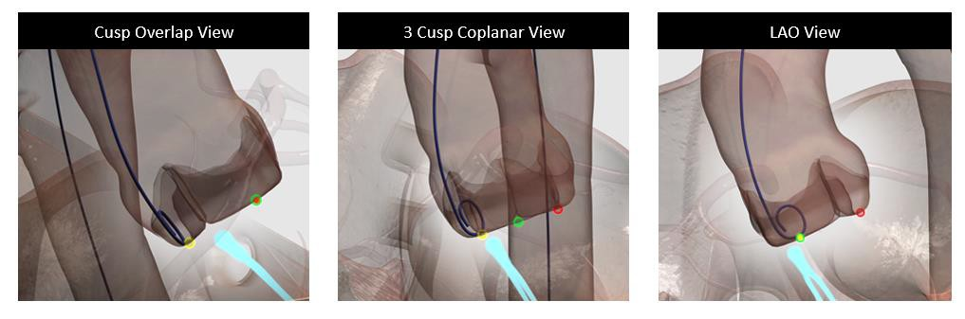
Optimize PRO Study: Cusp Overlap Technique with Evolut PRO/PRO+
Key Steps*
Initial deployment in the cusp overlap projection to estimate implant depth at the NCC
Deploy with the marker band positioned at mid-pigtail or higher
Assess depth in cusp overlap view
Roll LAO. Remove any remaining parallax. Estimated depth at the LCC
Redeployment in cusp overlap view, if applicable
Assess final implant depth on the NCC
*Use of Lunderquist guidewire is highly recommended.
Grubb K, EuroPCR 2022

Slide 25
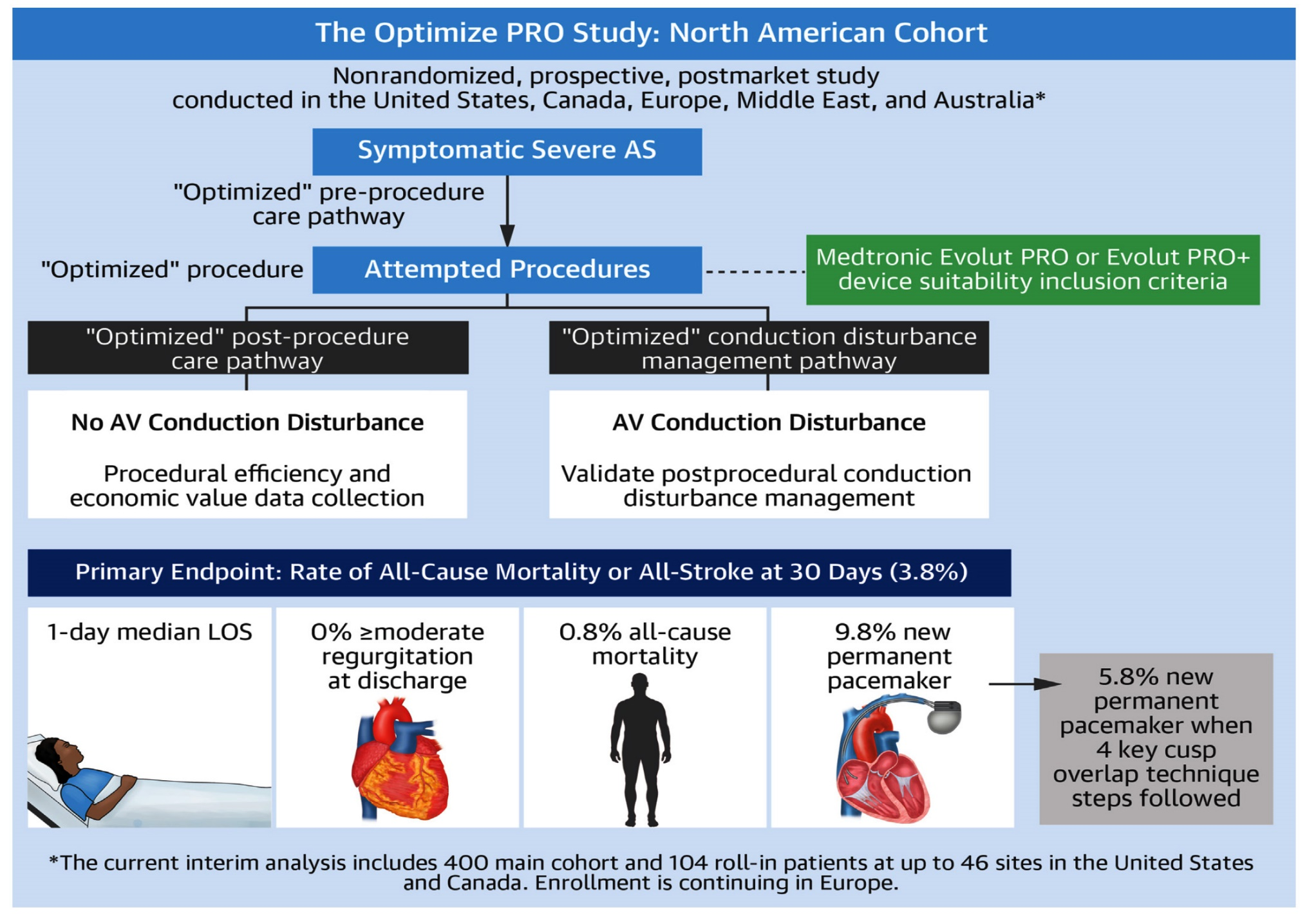
Optimize PRO Study Design and Interim Results
Grubb et al., J Am Coll Cardiol Intv 2023;16:558

Slide 26
Optimize PRO Study: 30-Day PPM Implantation
Rate With or Without Lunderquist Guidewire Stratified by Valve by Size
30-Day PPM Implantation Rate
per Proportion
N = | 3 | 82 | 181 | 78 | 344
 | 1 | 20 | 22 | 10 | 53
Grubb et al., J Am Coll Cardiol Intv 2023;16:558

Slide 28
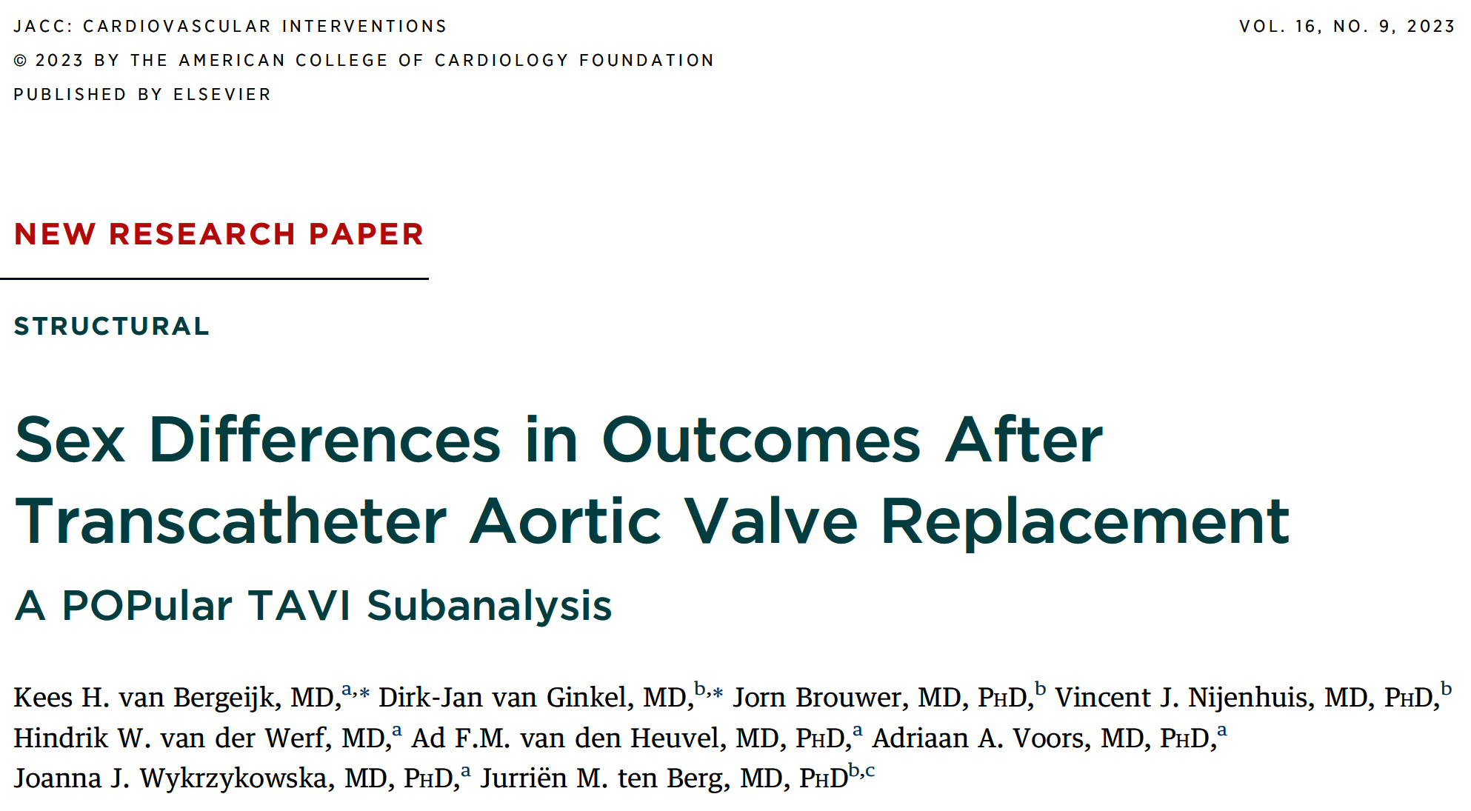

Slide 29
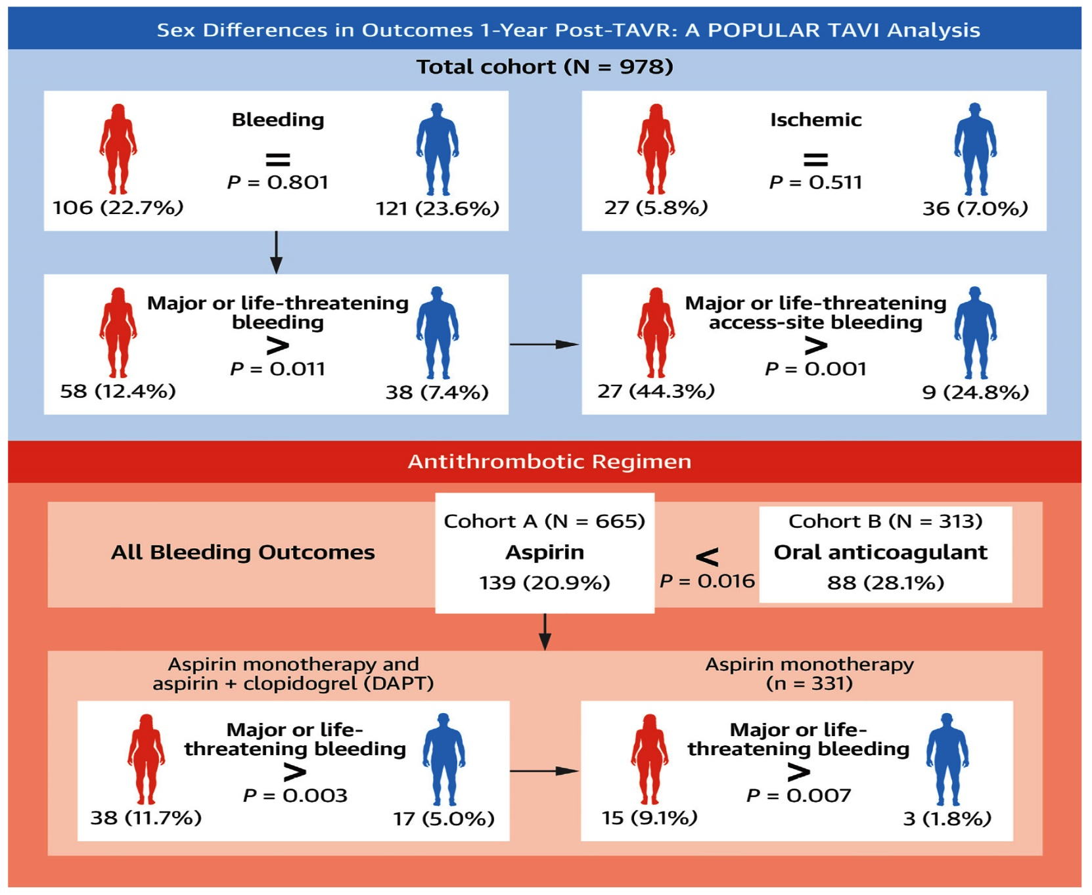
POPular TAVI Trial: Sex Differences in Outcomes
1-Year Post-TAVR
van Bergeijk et al., J Am Coll Cardiol Intv 2023;16:1095

Slide 30
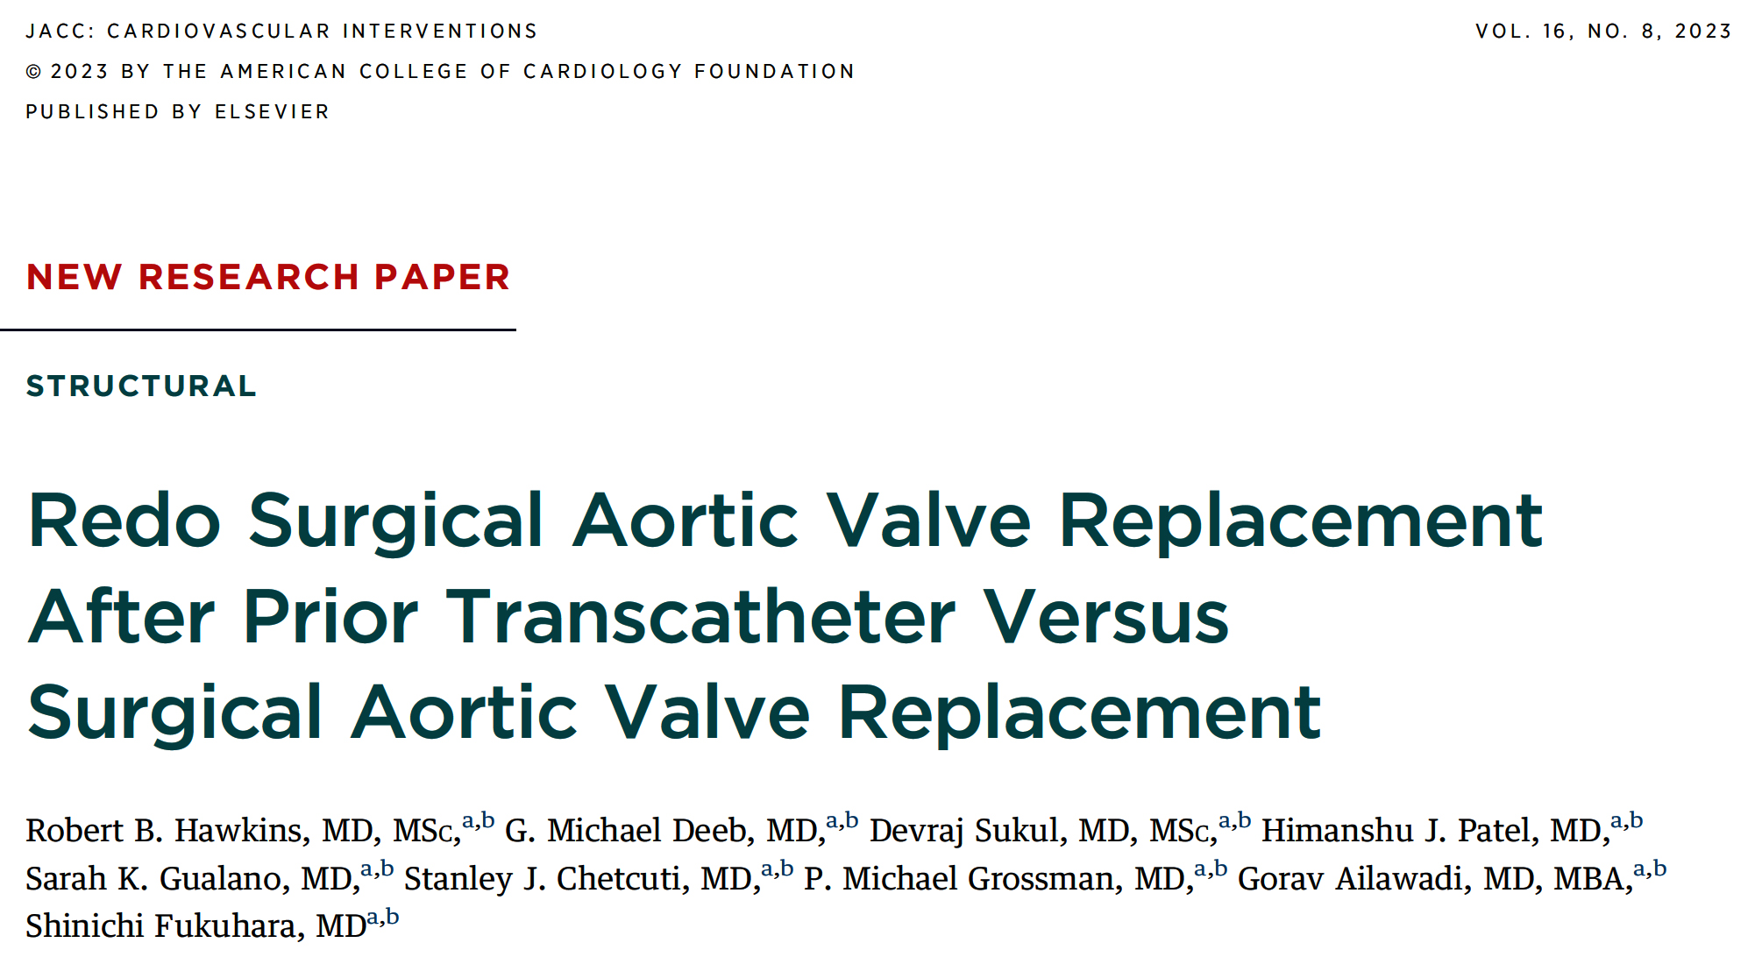

Slide 31
Redo of SAVR After Prior TAVR or SAVR: Consort Diagram
STS PUF Cohort
(n=48,220)
Sequential exclusions
Endovasc procedure (n=22)
Emergent TAVR explant (n=206)
Unplanned AVR (n=140)
Explanted mechanical AV (n=9,669)
Prior AVR (n=75)
Prior homograft (n=1,732)
Prior autograft (n=56)
Unknown explanted aortic prosthesis (n=1,511)
Prior VAD/heart transplant (n=29)
Other prior root replacement (n=3,062)
Primary aortic disease (n=423)
Primary other disease: tumor, trauma, HOCM, supravalvular stenosis (n=211)
Complete Cohort (n=31,106)
TAVR-SAVR (n=1,126)
SAVR-TAVR-SAVR (n=674)
SAVR-SAVR (n=29,306)
Missing risk score
(n=15,449)
Concomitant Op (n=18,370)
SAVR-TAVR-SAVR (n=674)
PROM Cohort (n=15,657)
TAVR-SAVR (n=544)
SAVR-TAVR-SAVR (n=318)
SAVR-SAVR (n=14,826)
Isolated AVR (n=12,062)
TAVR-SAVR
(n=531)
SAVR-SAVR
(n=11,531)
PS Match
TAVR-SAVR
(n=433)
SAVR-SAVR
(n=433)
Hawkins et al., J Am Coll Cardiol Intv 2023;16:942

Slide 32
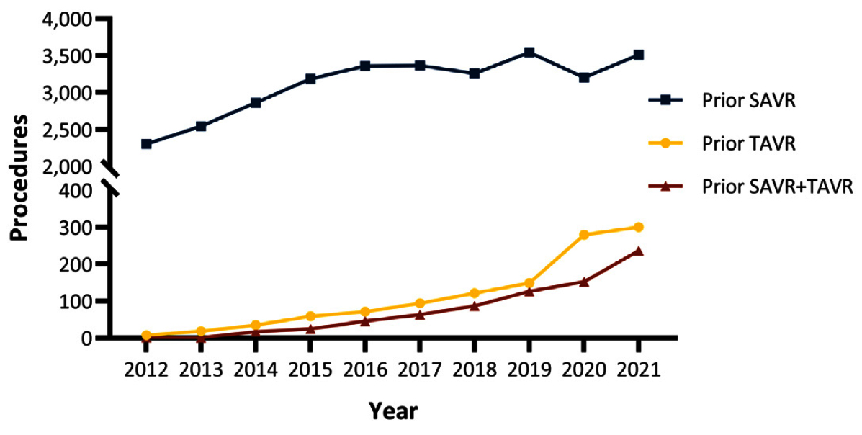
Redo of SAVR After Prior TAVR or SAVR: Reoperative AVR Cases
Total patients included in the analysis = 31,106; prior SAVR (SAVR-SAVR) n=29,306, prior TAVR (TAVR-SAVR) n=1,126, prior SAVR+TAVR (SAVR-TAVR-SAVR) n=674
Significant increase in prior TAVR cases between 2011-2021,with linear regression showing increase of 31.8 cases per year; SAVR+TAVR cases increased by 23.8 cases per year; prior SAVR increased by 115 cases per year
From 2015-2021 there was improvement with prior TAVR cases increasing by 42.8 cases per year, SAVR+TAVR increased by 35.6 and Prior SAVR increasing to 29.7 cases per year
Hawkins et al., J Am Coll Cardiol Intv 2023;16:942

Slide 33
Redo of SAVR After Prior TAVR or SAVR:
Short-Term Outcomes for All Pts with Prior SAVR
and/or Prior TAVR
 | TAVR-SAVR (n=1,126) | SAVR-TAVR-SAVR (n=674) | SAVR-SAVR (n=29,306) | P value
Operative mortality | 17% | 12% | 9% | <0.001
Major morbidity | 37% | 31% | 28% | <0.001
Stroke | 5% | 3% | 3% | <0.001
Acute renal failure | 12% | 11% | 7% | <0.001
New Dialysis | 10% | 9% | 5.7% | <0.001
Reoperation | 9% | 9% | 8% | 0.083
Prolonged ventilation | 32% | 28% | 24% | <0.001
Transfusion | 88% | 88% | 82% | <0.001
Hours intubated | 13 (5-42) | 12 (5-37) | 10 (5-23) | <0.001
ICU LOS, h | 95 (48-169) | 77 (45-159) | 69 (39-125) | <0.001
Preoperative LOS, d | 3 (0-8) | 2 (0-8) | 0 (0-5) | <0.001
Postoperative LOS, d | 9 (7-15) | 9 (6-14) | 8 (6-12) | <0.001
Discharge to home | 51% | 63% | 73% | <0.001
Readmission | 17% | 15% | 12% | <0.001
Hawkins et al., J Am Coll Cardiol Intv 2023;16:942

Slide 34
Redo of SAVR After Prior TAVR or SAVR:
Risk-Adjusted Outcomes of Prior TAVR
Redo SAVR and Operative Mortality in the Society of Thoracic
Surgeons Adult Cardiac Surgery Database 2011-2021
TAVR → SAVR
N=1,126
Mortality
17%
SAVR → TAVR → SAVR
N=674
Mortality
12%
SAVR → SAVR
N=29,306
Mortality
9%
Propensity-Score Matching
TAVR → isolated SAVR
N=433
Mortality
11.3 % (OR:1.7%)
SAVR → isolated SAVR
N=433
Mortality
6.7%
Hawkins et al., J Am Coll Cardiol Intv 2023;16:942

Slide 35
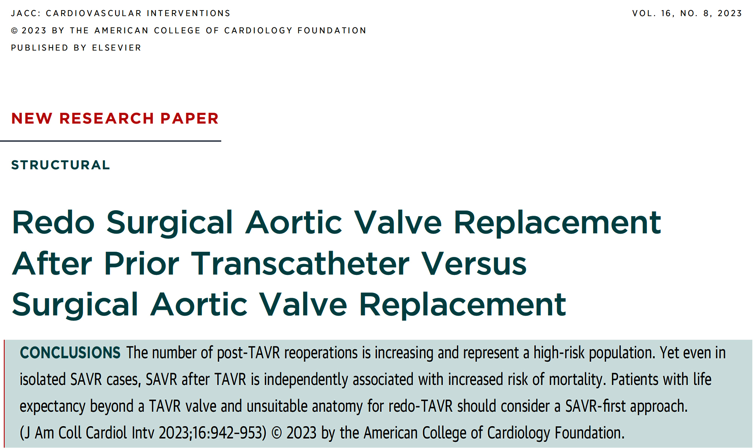

Slide 37
EXPLANTORREDO-TAVR Registry: Study Population
533 Patients from 29 Sites undergoing TAVR Reintervention for THV failure
during separate admissions as initial TAVR
5/2009 – 2/2022
157 TAVR-Explant
Performed for Endocarditis
Primary Cohort for Analysis
(N=396)
Redo-TAVR
(n=215)
TAVR Explant
(n=181)
Median Follow-up:
13.6 months (IQR: 2.4-35.9)
Median Follow-up:
6.7 months (IQR: 1.3-15.9)
Tang et al., J Am Coll Cardiol Intv 2023;16:927

Slide 38
EXPLANTORREDO-TAVR Registry: Temporal
Trends in Annual Reinterventions for Failed TAVR
N
Tang et al., J Am Coll Cardiol Intv 2023;16:927

Slide 39
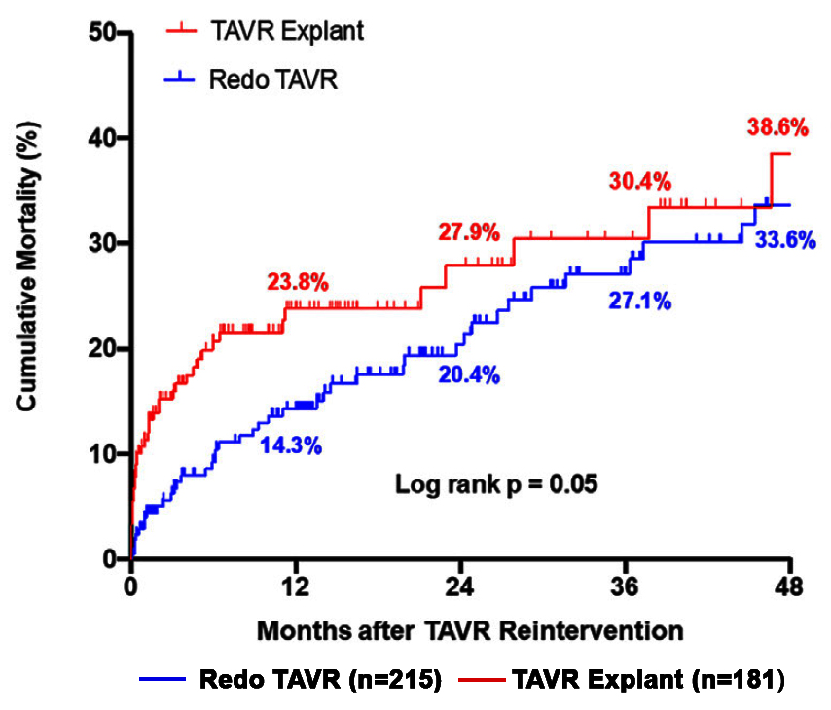
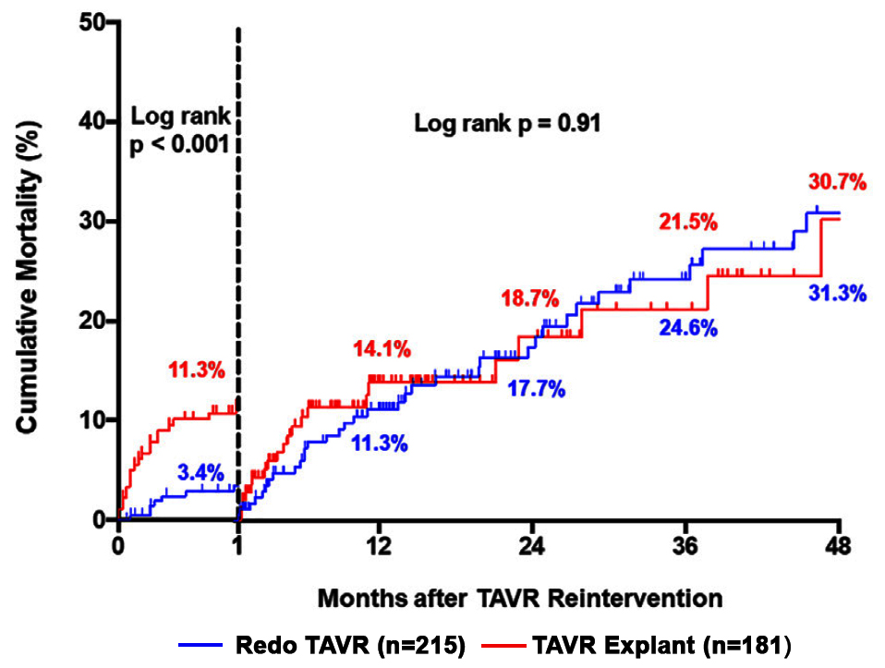
EXPLANTORREDO-TAVR Registry: K-M Analysis for
All-Cause Mortality After Reintervention for Failed TAVR
Landmark Analysis Stratified by THV Reintervention
Stratified by THV Reintervention
Tang et al., J Am Coll Cardiol Intv 2023;16:927

Slide 40
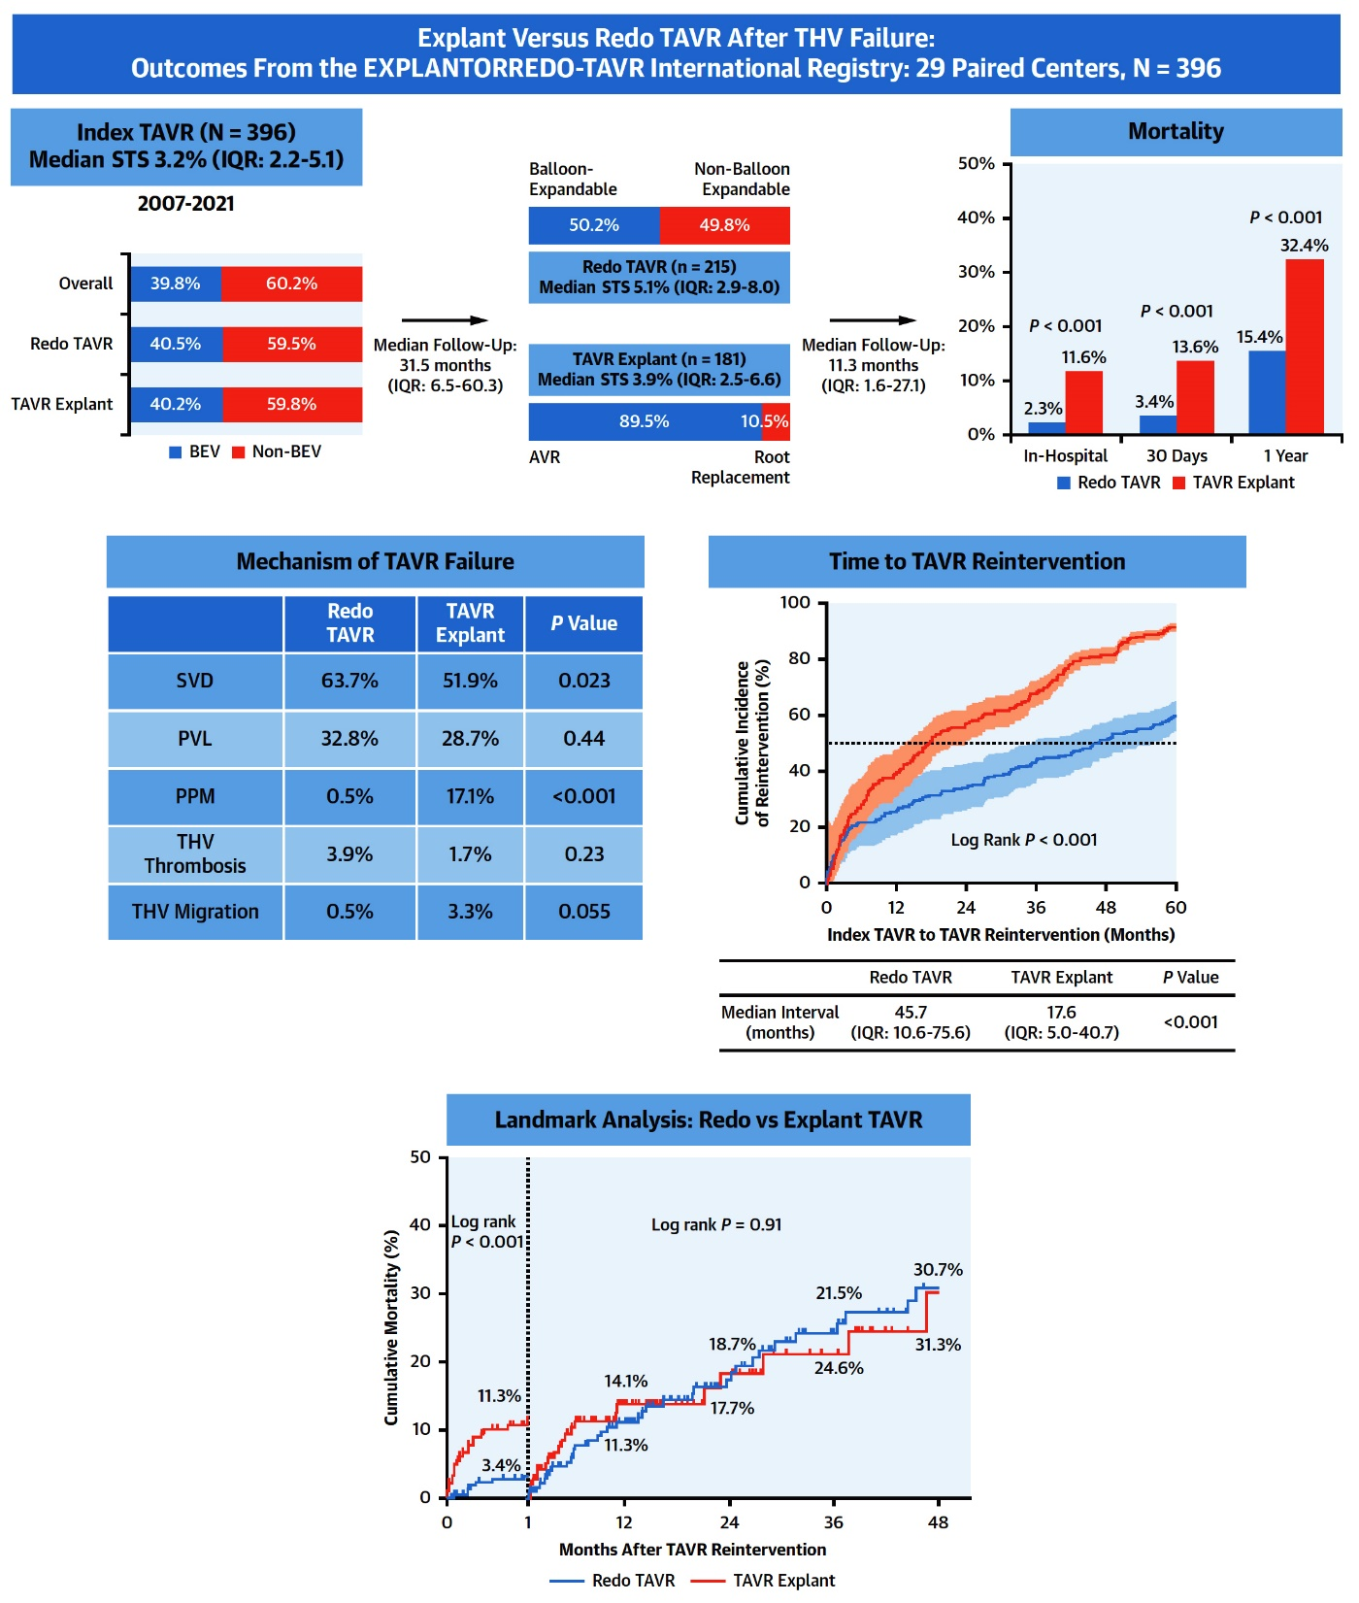
Summary of the EXPLANTORREDO-TAVR International Registry
Tang et al., J Am Coll Cardiol Intv 2023;16:927

Slide 41
EXPLANTORREDO-TAVR Registry: Reintervention Stratified by Type of Initial TAVR
THV #1
Redo TAVR TAVR Explant
Overall
p=0.92
THV #2: BEV THV #2: Non-BEV
Redo TAVR
p=0.04
Aortic Valve Replacement Root Replacement
TAVR Explant
p=0.09
Tissue Valve Mechanical Valve
p=0.83
%
Tang et al., J Am Coll Cardiol Intv 2023;16:927

Slide 44
Take Home Messages
Recent Publications in the TAVR Field
Three year data of low risk Evolut TAVR revealed lower mortality/CVA with TAVR compared to SAVR. These favorable result along with better AV area and lower mean gradient after TAVR has established TAVR as a definitive and effective therapy for all AS pts. EVOLUT TAVR valve outcomes can be improved by optimizing the procedural results. Women have higher bleeding & vascular complication with similar mortality/MACE outcomes vs men.
Recent registry report has revealed redo SAVR after TAVR or SAVR to have higher once done after TAVR vs SAVR, Hence pts who are expected to last more then TAVR life duration should preferentially first go for SAVR.
A multicenter registry comparing explant TAVR vs redo TAVR revealed redo TAVR as the viable option after TAVR valve degeneration with lower mortality. Hence TAV-i-TAV can be favorably recommended for SVD causing failed TAVR.

Slide 45
Question # 1
Following statements are correct for 3-year outcomes of Evolut Low risk trial except:
TAVR has lower death/stroke vs SAVR
TAVR has lower death/stroke/re-hospitalization vs SAVR
TAVR has higher PPM vs SAVR
TAVR has higher valve thrombosis vs SAVR
Correct answer: D

Slide 46
Question # 2
Following statement is false regarding the outcomes of the Optimize Pro study for Evolut TAVR:
Short 1-day median LOS
No >moderate PVL
>10% PPM need
<1% all cause death
Correct answer: C

Slide 47
Question # 3
Following statement is false about the redo SAVR or TAVR after TAVR:
A. Redo SAVR has lower mortality after SAVR vs TAVR
B. TAVR in TAVR has higher mortality then TAVR explant
C. TAVR in TAVR is usually done for SVD
D. Redo SAVR is usually done for PPM
Correct answer: B

