Slide 1
HPI:
57 yo woman htn, venous disease with chronic DVT. Has extensive history starting from provoked DVT in the perioperative setting of knee surgery. Unclear if the INR was continuously therapeutic in the initial treatment period. Now suffering from post thrombotic syndrome with L >R swelling (redness and pain in the left leg) and CT Venogram showing venous outlet obstruction. CEAP: C4, Es, Ad, Pr,o (Clinical-Etiology-Anatomy-Pathophysiology).
11/2012: Presented to ER with left knee pain in the post operative period following knee surgery and US showed acute DVT in left CFV, femoral vein, popliteal vein. Underwent thrombectomy of L CFV by popliteal approach and Cragg-McNamara catheter was placed→TPA was infused for 24 hours. DC’d on coumadin.

Slide 2
Case:
02/12/13: Seen in clinic with therapeutic INR, symptoms improved but not fully resolved.
04/2013: Came to clinic for contralateral leg knee surgery clearance: Recommendation made for left Iliac and lower extremity venous ultrasound - if acute DVT, consider IVC filter prior to knee surgery while coumadin is interrupted as last DVT was in post operative period. Duplex showed: Remote (old) deep vein thrombosis of the common femoral vein, femoral vein, profunda femoral vein and popliteal vein. There is deep venous incompetence. There is an improvement since prior study of 11/28/2012.

Slide 3
Case:
04/15/2013: Successful Optease Cordis IVC Filter placement in perioperative period for knee surgery while coumadin held → coumadin restarted post.
06/2015: Continued coumadin, seen in office. US duplex venous ordered: Deep Veins: There is remote (old) deep vein thrombosis of the common femoral vein, profunda femoral vein, femoral vein, popliteal vein and gastrocnemius vein. This is unchanged since the prior study done on 5/12/2014. There is deep venous incompetence as described below. Superficial Veins: There is remote (old) superficial vein thrombosis of the great saphenous vein and small saphenous vein. There is superficial vein incompetence (by color Doppler analysis) of mid thigh great saphenous vein varicosities. Perforators: There is perforator vein incompetence.

Slide 4
Case:
Lost to follow up until 2019 office visit: came to office feeling well. Wanted to come off coumadin. Was switched to Xarelto 10 mg QD.
Followed up again 2021: l>r leg swelling, pain. CT venogram ordered: no thrombus in IVC filter. Long segment stenosis extending from the left common iliac to left common femoral vein with associated calcifications, likely sequelae of prior DVT.
Followed up again 04/2023: CT venogram ordered.
Meds: Xarelto 10 mg QD, amlodipine 2.5 mg QD

Slide 5
CT Scan:

Slide 6
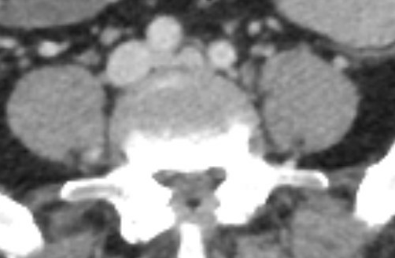
CT Scan:
CT Read: Diminutive left common iliac vein with proximal compression into the right common iliac artery consistent with chronic occlusive sequela of DVT associated with May Thurner syndrome. Multiple venous collaterals within the subcutaneous tissue. Correlate with signs and symptoms of post-thrombotic syndrome.

Slide 7
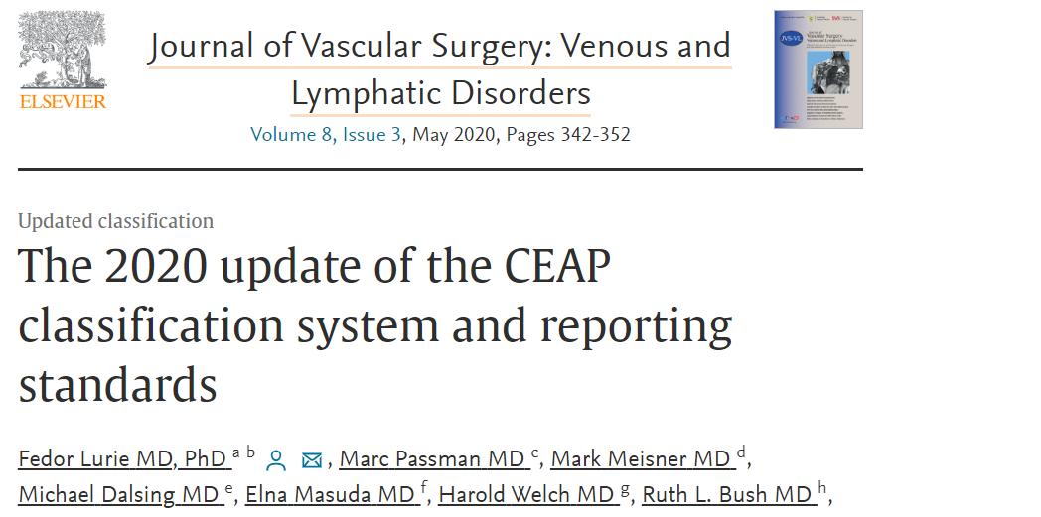
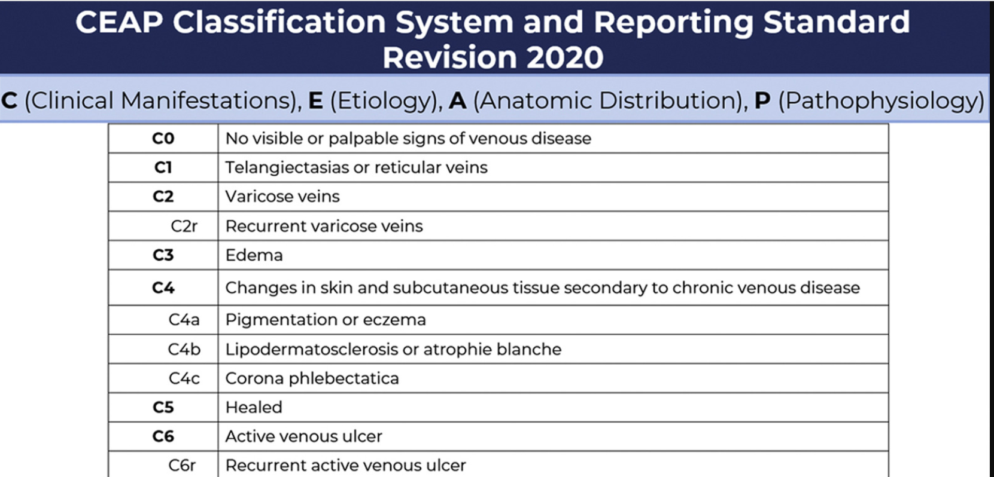
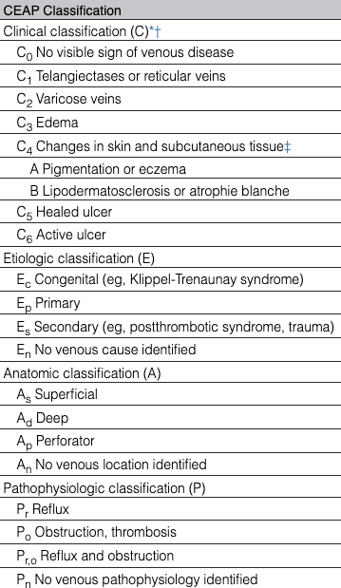
Notes:
Developed in 1993, updated in 1996, and revised in 2004, CEAP is a classification system based on clinical manifestations of chronic venous disorders, on current understanding of the etiology, the involved anatomy, and the underlying venous pathology.

Slide 8
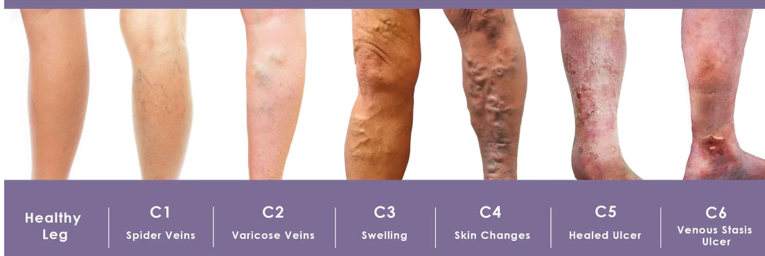
CEAP

Slide 9
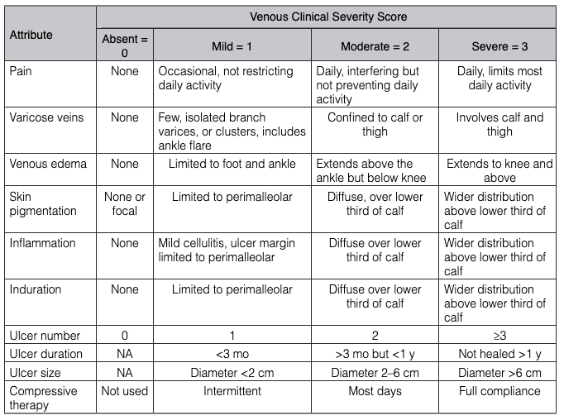
Venous Clinical Severity Score

Slide 10
Case Plan
Plan for IVC removal and stenting of left sided venous outflow based on IVUS findings after multidisciplinary discussion with vascular surgery.

Slide 11
IVC Removal
Notes:
Paper put out by SIR. Guidelines for insertion and removal of IVC filter.

Slide 12
Notes:
Why retrieve: device related complications, fda reported complications, most common migration and embolization.

Slide 13
Notes:
VTE: Veno-thrombo-emobolism

Slide 15
Notes:
FDA: issued guidance saying, SIR recommendation. By SIR routine removal not recommended.

Slide 17
Notes:
Many institutions have clinic number on reports given for IVC filter clinic removal.

Slide 18
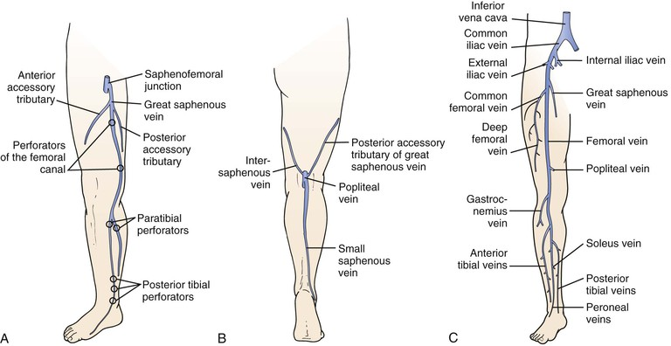
Anatomy of Lower Ext Venous System
Notes:
Perforators: superficial to deep.

Slide 19
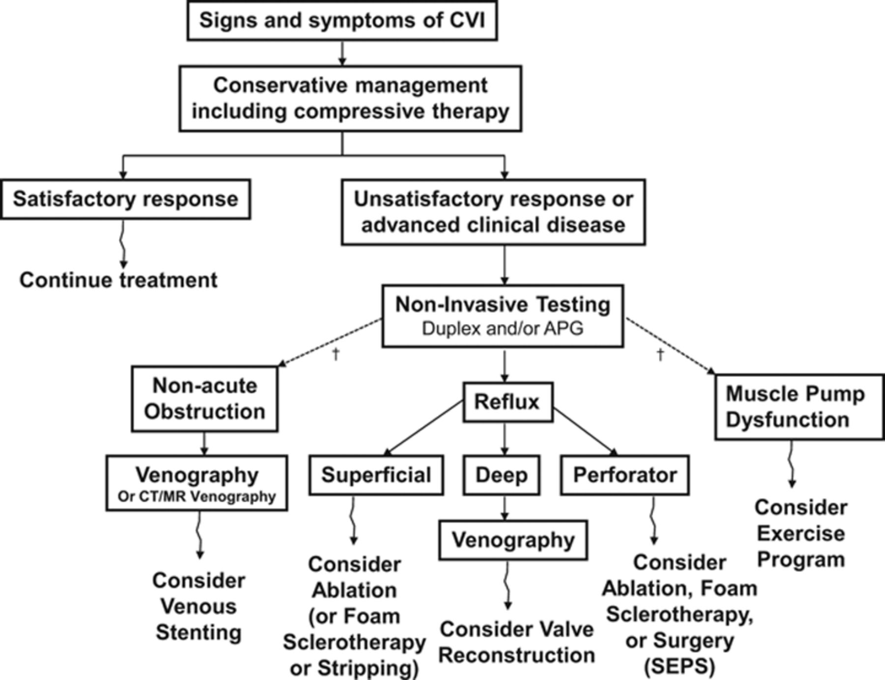

Slide 20
Imaging Modalities:
Venous Duplex
Evaluation of suprainguinal vessels is limited.
Can evaluate for reflux actively
Low cost, no radiation, no contrast
Axial imaging
Good evaluation for proximal vessels
Requires use of contrast
Suboptimal timing can lead to suboptimal visualization
MRI may be more sensitive, but has more false positives
Venography
2D image is not ideal to visual compression
Invasive
Should not be used alone
Intravascular Ultrasound
Direct visualization
Invasive
Should be used in conjunction with venography in patients with clinical syndromes

Slide 21
Iliac Vein Compression:
Eur J Vasc Endovasc Surg (2020) 60, 118e125
Notes:
Timeline. In 1851, Virchow’s cadaveric observation on higher prevalence of left sided iliofemoral. Deep vein thrombosis (DVT) had been misquoted. In 1906, McMurrich hypothesised the congenital pathogenesis of the adhesions at the origin of the left common iliac vein (LCIV). In 1943, Ehrich and Krumbahaar confirmed that adhesions were located at a point where the right common iliac artery (RCIA) crosses the LCIV. In 1957, May and Thurner, both in a cadaveric and a histological study, confirmed the existence of this condition and the preponderance of left laterality due to chronic pulsation. In 1961, Negus et al. showed the relationship between the RCIA and LCIV. In 1965 and 1967, Cockett and Thomas first described the iliac compression syndrome with the help of the serial intra-osseous per-trochanteric venography. In 1978, Usui et al. observed hypertrophy and band formation in the tunica media of the LCIV in 50% of the patients. In 2004, Kibbe et al., in an imaging study, found that 66% of asymptomatic patients had >25% LCIV compression. In 2014, Mitsuoka et al., in a cadaveric histological study, described the “spurs” when incidentally found in six of 28 cadavers.

Slide 22
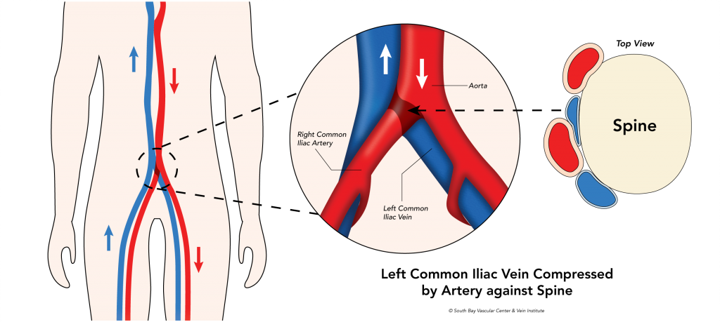

Slide 23
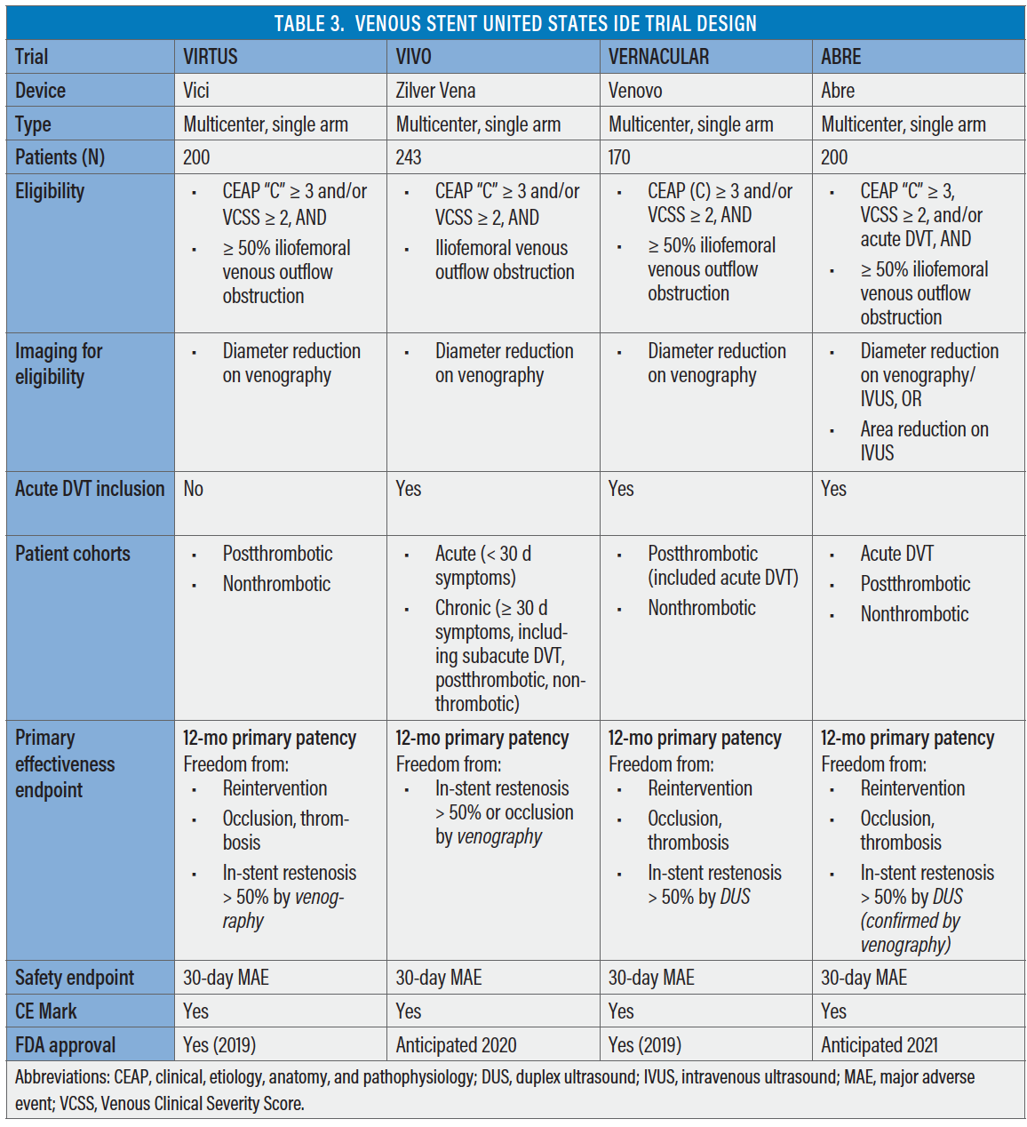
Notes:
Single arm trials. Patency. Wall stent not used anymore.

Slide 24
Endovascular treatment for Iliac Compression
Treatment usually involves stenting
Venous stent patency has been shown to be acceptable
Data from thrombolytic studies of iliofemoral DVTs showed better patency when stents were used
Vein specific stents now available, with even improved patency
Wallstent (Bos Sci)
72 month patency of 87%
Vici Stent (Bos Sci) VIRTUS Trail
12 month patency 84%
Venovo (Bard) VERINACULAR Trial
36 month patency of 84%
Zilver Vena (Cook) VIVO Trial
36 month patency 90.3%
Abre (Medtronic) ABRE Trial
24 month patency 85.7%
Notes:
Single arm trials. Patency. Wall stent not used anymore.

Slide 25
