Slide 1
Learn From The Masters
Managing Calcified coronaries with Rotational Atherectomy
Application of HD IVUS in Complex PCI (IVUSAID)
Supported by:
Boston Scientific Corporation (BSC) India
EHCC Jaipur
MSH New York

Slide 2
Disclosures
Samin K. Sharma, MD, MSCAI, FACC
Nothing to disclose
Annapoorna S. Kini, MD, MRCP, FACC
Nothing to disclose

Slide 3
Live Case #8
Patient Demographics
76yrs, F post CABG
Present Clinical Presentation
Presented with new onset CCS class III angina and recent stress MPI for apical & lateral ischemia (4/23)
CAD Risk Factors
Hypertension
Hyperlipidemia
SAQ-7: 75
PAD s/p PTA
Clinical Variables
Multiple CAD risk factors, s/p CABG x2 6/21. Stress MPI was negative in 7/2022. Known PAD s/p PTAs.
PAF failed ablations
Medications
Aspirin, Metoprolol XL, Losartan-HCTZ, Atorvastatin, Ezatimibe
Cath: Cath on May 5th 2023 revealed 3 V+LM CAD with patent LIMA-RIMA Y graft; calcified 90% dLM, 80% calcified LAD with 80% D2 bifurcation (1,1,0), 80% pLCx, 100% RCA fills distally via collaterals and LVEF 62%. Pt developed CHB requiring temporary PM after cath but need for PPM.
Plan: Now planned for IVUS guided complex PCI of LM bifurcation and LAD/D2 using rotational atherectomy and DES with MiniCrush technique.

Slide 4
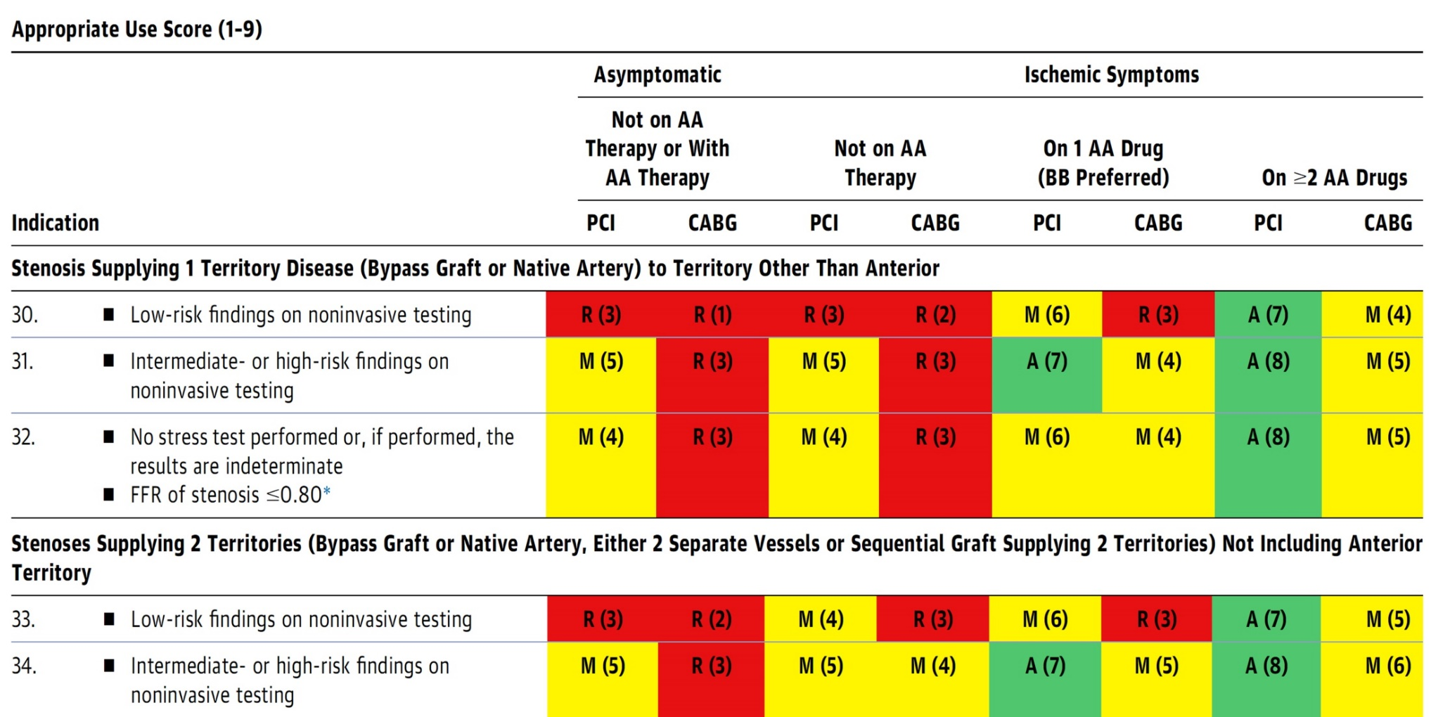
AUC 2017: IMA to LAD Patent Without Stenosis
Patel et al., J Am Coll Cardiol 2017;69:2212

Slide 5
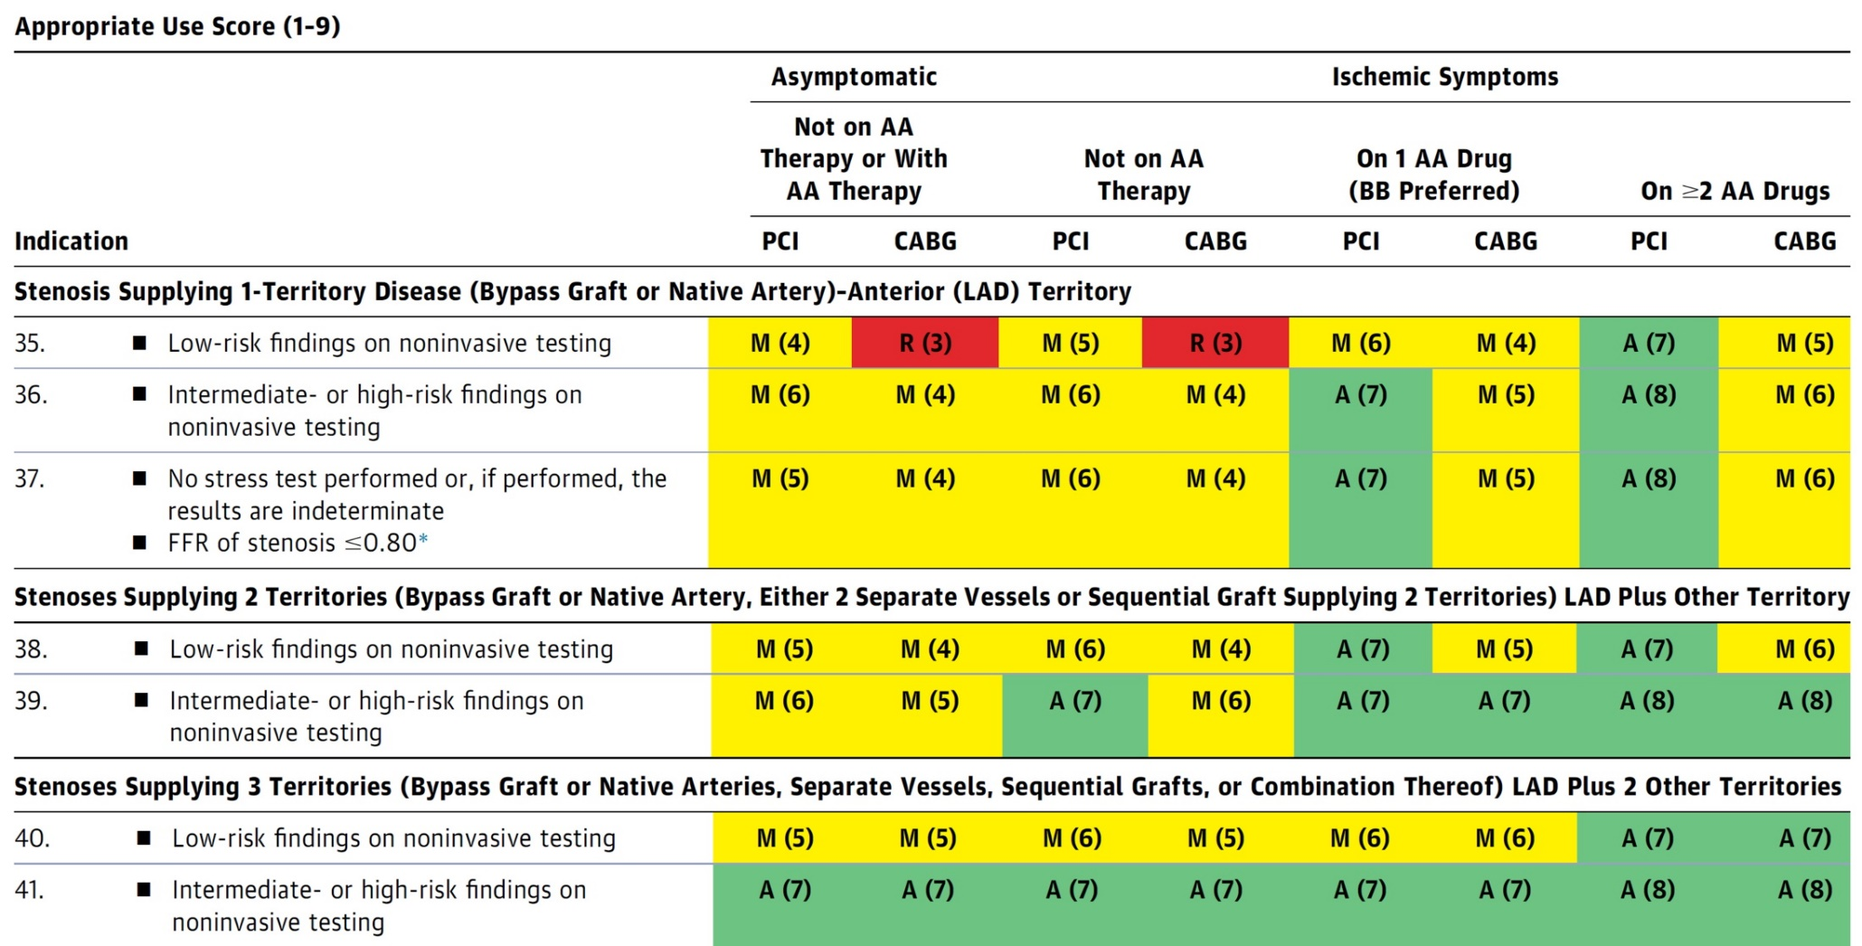
AUC 2017: IMA to LAD Not Patent
Patel et al., J Am Coll Cardiol 2017;69:2212

Slide 6
Use of Coronary Physiology to Guide Revascularization with PCI
Recommendations for the Use of Coronary Physiology to Guide Revascularization
Recommendations for Intravascular Ultrasound to Assess Lesion Severity
Lawton et al., J Am Coll Cardiol 2022:79;e21-129

Slide 7
Treatment of Individual Patients Subgroups
Recommendations for the Treatment of Calcified Lesions
Recommendations for Use of Intravascular Imaging
Recommendations for Hemodynamic Support in Complex PCI
Lawton et al., J Am Coll Cardiol 2022; 79:e21

Slide 8
Specific Indications for PCI
Recommendations for Radial and Femoral Approach for PCI
Recommendations for Use of Intravascular Imaging
Lawton et al., J Am Coll Cardiol 2022; 79:e21

Slide 9
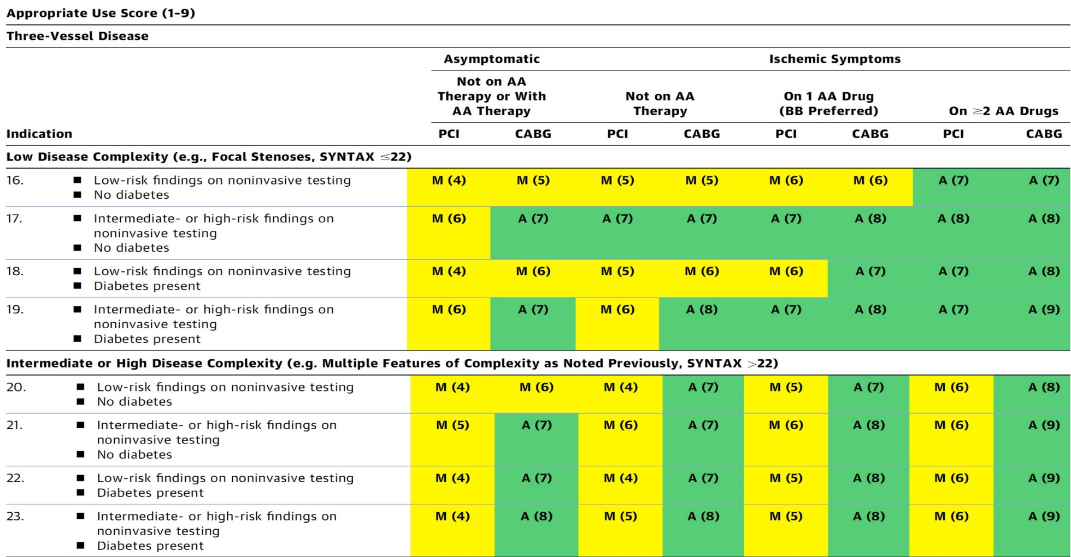
AUC 2017: Three- Vessel CAD
After Heart team discussion: A
Patel et al., J Am Coll Cardiol 2017;69:2212

Slide 10
Assessment and Predicting Patient Risk
Recommendation for the Heart Team
Recommendation to Predicting Patient Risk of Death with CABG: STS Risk
Recommendation for Defining Coronary Artery Lesion Complexity: SYNTAX Score
Assessment of Risk Factors Not Qualified in the STS Score
Syntax score 21; STS score 2.1
Lawton et al., J Am Coll Cardiol 2022:79;e21-129

Slide 11
Patients with Complex Disease and Diabetes
Recommendations for Patients with Complex Disease
Recommendations for Patients with Diabetes
Lawton et al., J Am Coll Cardiol 2022; 79:e21

Slide 12
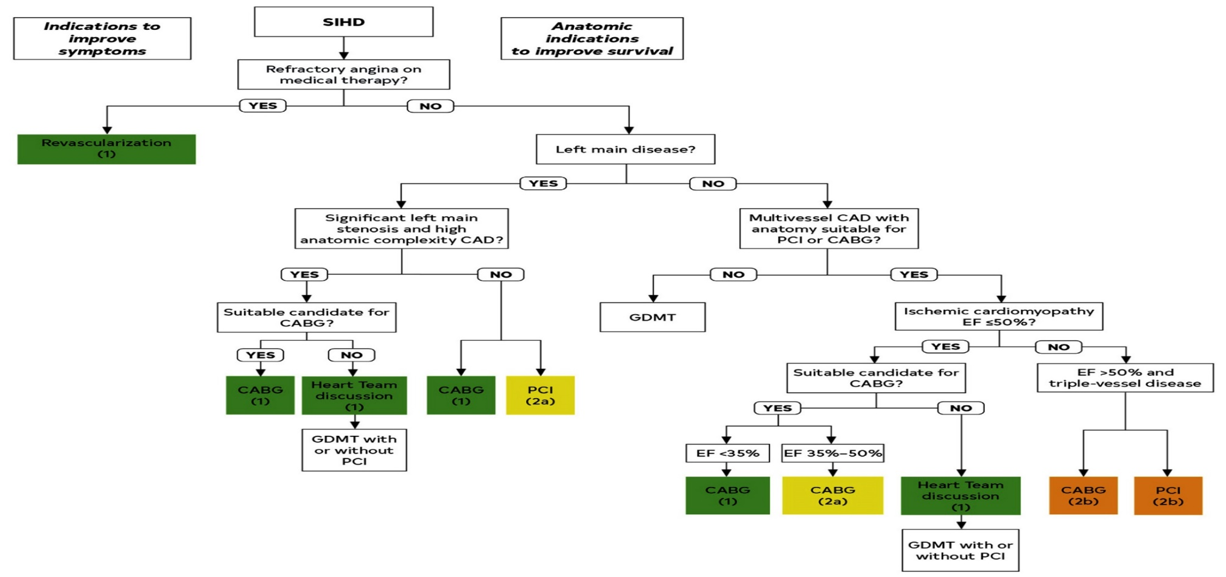
Revascularization to Improve Survival in SIHD Compared to Medical Therapy
Lawton et al., J Am Coll Cardiol 2022:79;e21-129

Slide 13
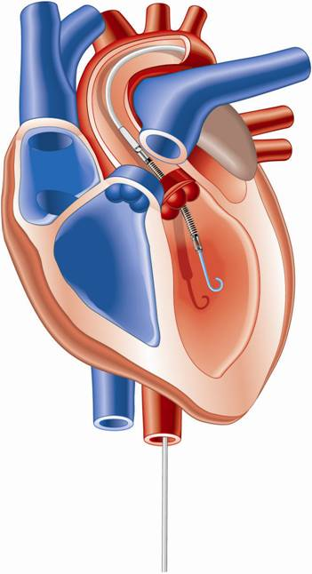
Percutaneous LV Assist Devices
PTVA:
TandemHeart
IMPELLA:
Recovers 2.5/CP
IABP

Slide 14
LV Support during High-risk PCI:
LVEF + Lesion Complexity
LVEF >40%
LVEF 20-40%
LVEF <20%
Simple PCI
Complex PCI
Simple PCI
Complex PCI: High Syntax score >32/ STS>5 Extensive revascularization
Simple or Complex: Inoperable cases
None
?IABP/?Impella
None or IABP
No support
Impella
/IABP (if Impella is CI)
Impella/PTVA
Being evaluated in the randomized Protect IV trial
Notes:
14

Slide 15
LV Support during High-risk PCI:
LVEF + Lesion Complexity
LVEF >40%
LVEF 20-40%
LVEF <20%
Simple PCI
Complex PCI
Simple PCI
Complex PCI: High Syntax score >32/ STS>5 Extensive revascularization
Simple or Complex: Inoperable cases
None
Impella is ok
None or IABP
No support
Impella
/IABP (if Impella is CI)
Impella/PTVA
Notes:
15

Slide 16
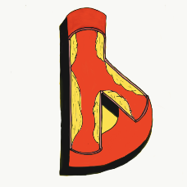
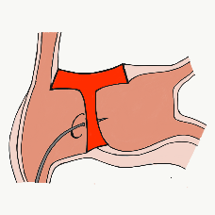
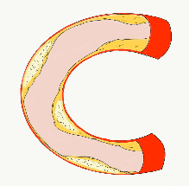
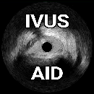
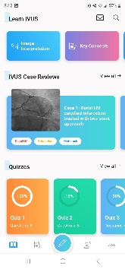
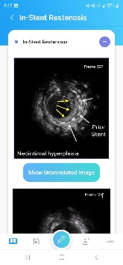
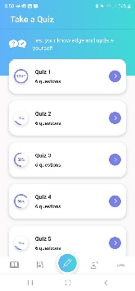
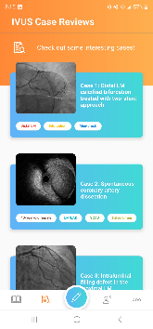
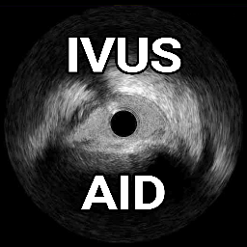
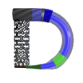
Growing Library of Educational Applications
Learn more at CardiologyApps.com
Already released and past 76,500 downloads...
Newly released:
IVUSAID
Also
AngioAID 3D
HemodynamicsAID
With more
coming soon!!!
DeviceAID
Mobile app
Updated
BifurcAID
(to Android)
Updated
CalcificAID

Slide 17
IVUSAID – Out now on iOS, Android, and WebApp
Visit CardiologyApps.com/IVUSAID to use the WebApp version of IVUSAID.
Key Concepts
Principles of IVUS
Image Interpretation
Annotated images and pullbacks of various IVUS findings
Case Reviews
Detailed case presentations with annotated findings in complex clinical IVUS cases
Quizzes
50 quizzes to test your IVUS interpretation competence on various systems
Recommended Reading
Compiled list of papers to understand IVUS guidelines

Slide 18
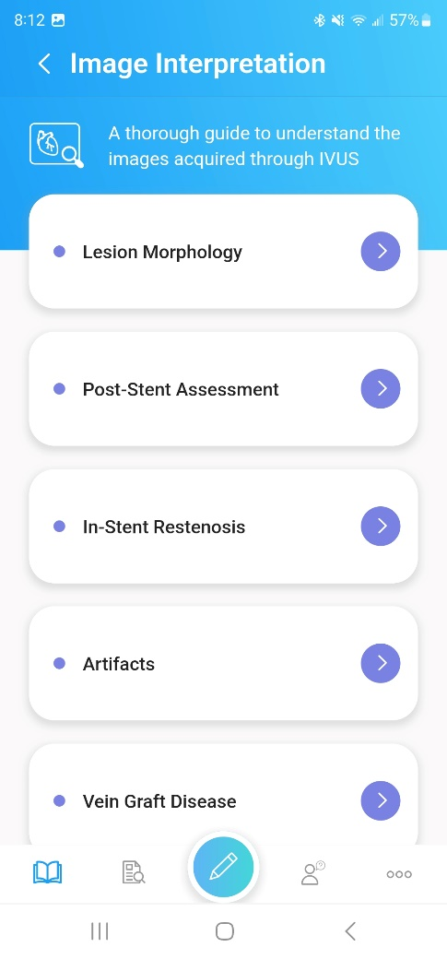
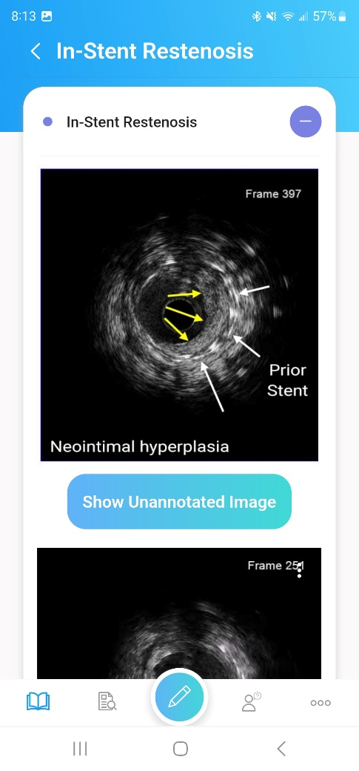
IVUSAID – Image Interpretation Sections

Slide 19
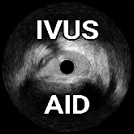
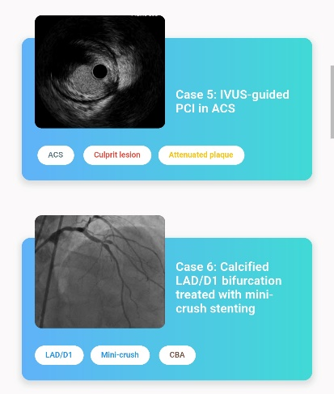
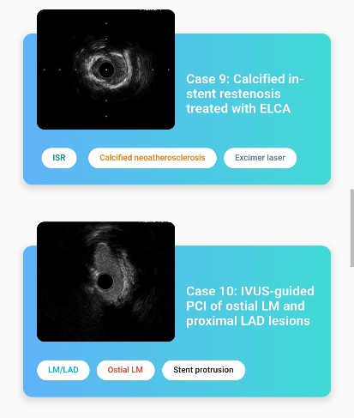
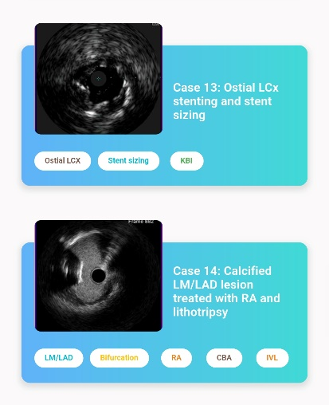
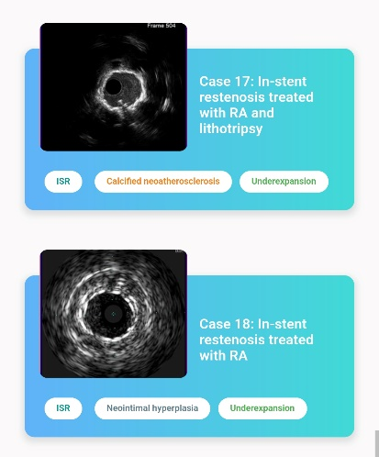
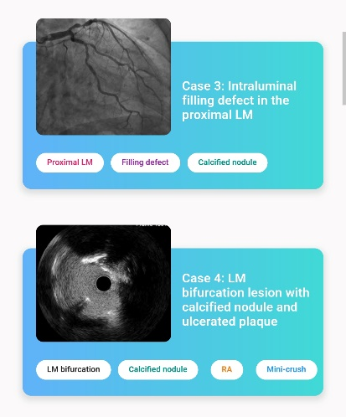
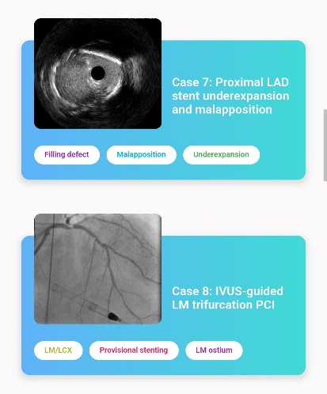
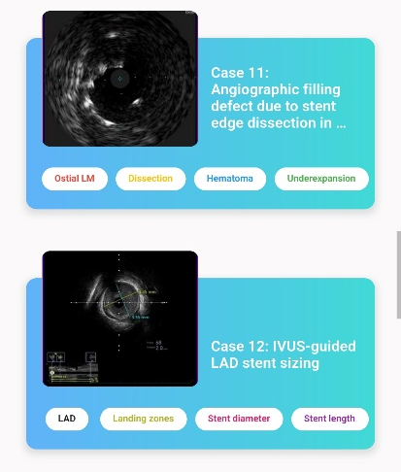
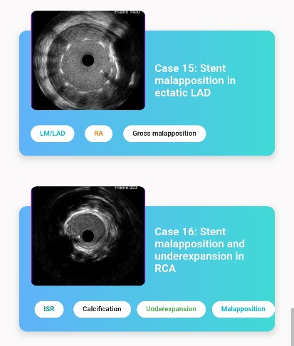
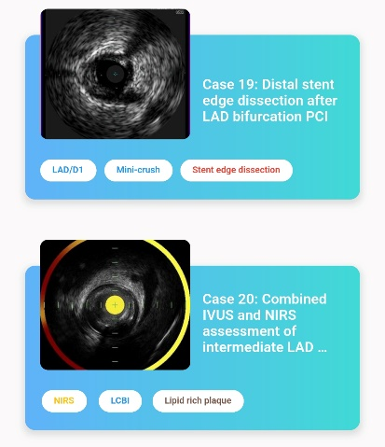
IVUSAID – Cases

Slide 20
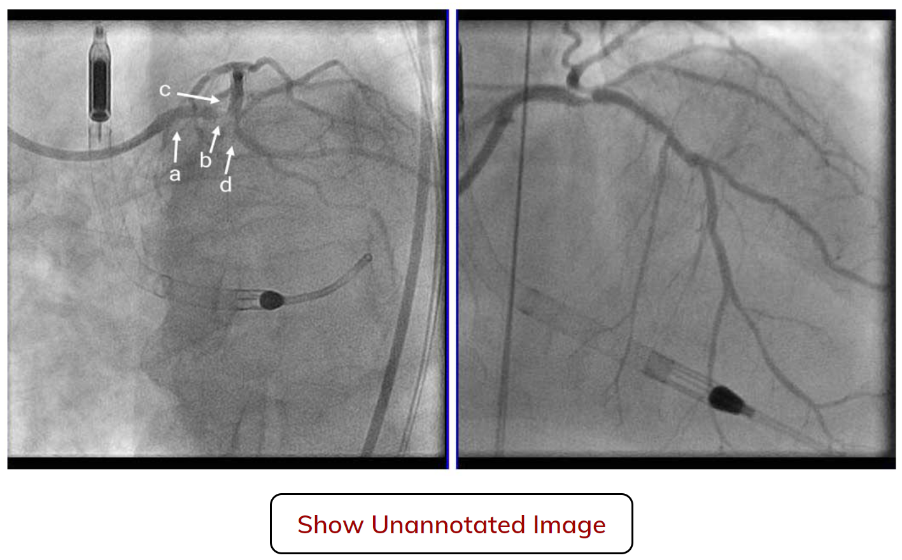
IVUSAID – Sample Case from WebApp
Case Presentation
A 74-year-old male with chest pain for the past day came to outside hospital for coronary angiography, which showed 95% stenosis of the LM, 80-90% stenosis of the proximal LCX, and 80-90% stenosis in the ramus intermedius. He has a history of hypertension, NIDDM, and hyperlipidemia and has had multiple PCI procedures. The diagnosis was non-STEMI with worsening chronic heart failure, therefore the decision was made to perform Impella-assisted PCI. Echocardiography showed reduced left ventricular systolic wall motion (Ejection Fraction of 40-45%).

Slide 21
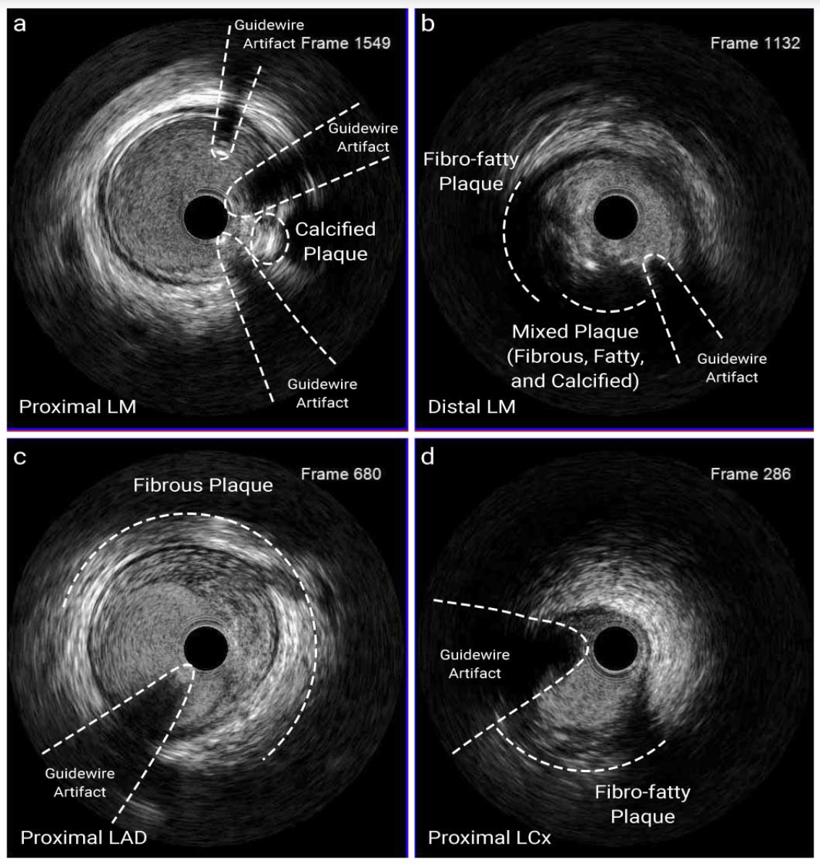
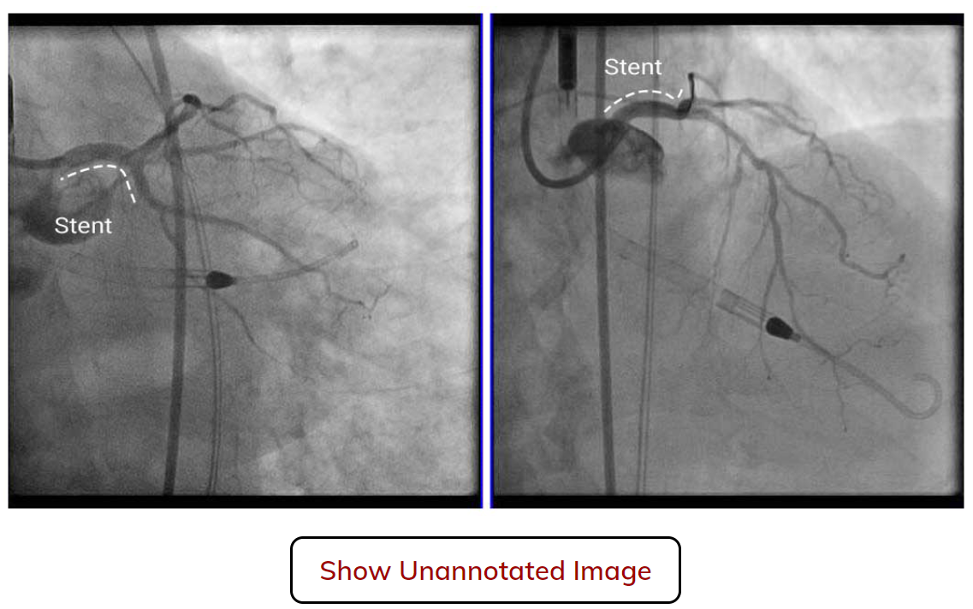
IVUSAID – Sample Case from WebApp
Explore this LM Trifurcation case as well as 20 other cases including SCAD, Dissection, Underexpansion, IRS, calcified lesions, and malapposition.
FINAL ANGIO

Slide 22
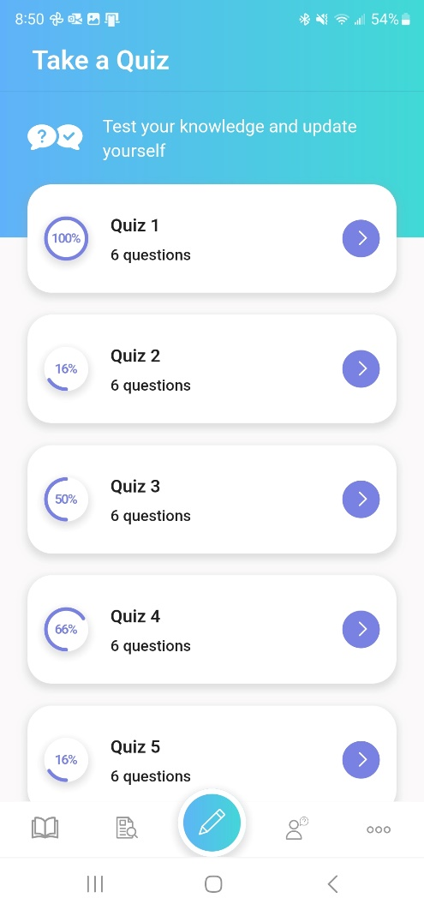
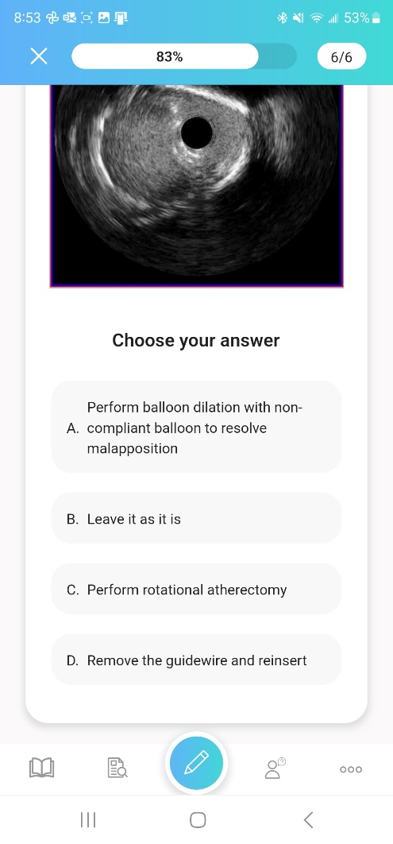
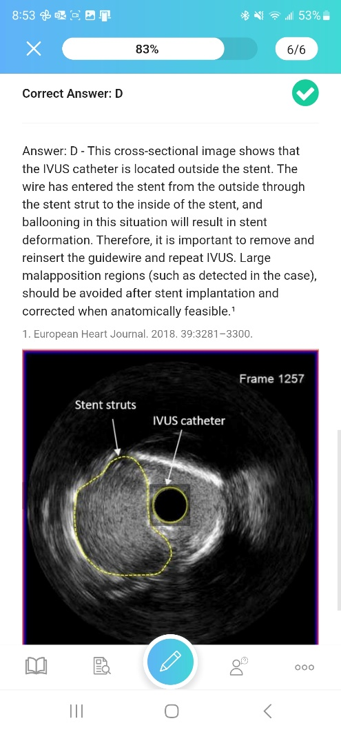
IVUSAID – Quizzes

Slide 23
Growing Library of Educational Applications
Learn more at CardiologyApps.com
Already released and past 76,500 downloads...
Newly released:
IVUSAID
Also
AngioAID 3D
HemodynamicsAID
With more
coming soon!!!
DeviceAID
Mobile app
Updated
BifurcAID
(to Android)
Updated
CalcificAID

Slide 24
Outcomes of PCI vs CABG up to 5 yrs
What we know so far?
CABG++
Lower repeat revascularization
Durable angina relief
Lower mortality in subgroups of high syntax score & MV DM
Better QOL parameters
PCI++
Rapid recovery and lower LOS
Better short term results
Lower CVA
Improvement in LVEF
Similar outcomes in LM & low syntax score (<32) pts
What happens in 5-10+ yrs?

