Slide 1

Complex Coronary Cases Supported by:
Abbott Vascular Inc.
Boston Scientific Corp.
Terumo Vascular Corp.
Cardiovascular Systems Inc.
Abiomed Inc.
Chiesi Inc.
Shockwave Medical Inc.
Cardinal Health Cordis Inc.

Slide 2
Disclosures
Samin K. Sharma, MD, MSCAI, FACC
Nothing to disclose
Annapoorna S. Kini, MD, MRCP, FACC
Nothing to disclose
Sameer Mehta, MD, FACC (Moderator)
Nothing to disclose
Kefel Dou, MD, PhD, FACC (Guest Moderator)
Deputy Director of the Coronary Heart Disease Center, Fuwai Hospital, China

Slide 3

CCC Live Case # 166
Patient Demographics
59 yrs, Male
Present Clinical Presentation
Presented with CCS class III angina and +stress MPI for anterior, lateral and inferior ischemia
CAD Risk Factors
Controlled Hyperlipidemia
Current Smoker
SAQ-7 score:56
Clinical Variables
No prior cardiac history, EF 45-52% on echo
Medications
Aspirin, Amlodipine, Atorvastatin
Cath: Cardiac cath on 3/27/2023 revealed 2 V CAD with mid LAD CTO (J-CTO 3) D1 bifurcation (1,1,1), 80% LCx-OM1, FFR negative RCA lesion, LVEF 52% and Syntax score 27. Pt underwent successful PCI of LCx-OM1 using Xience Skypoint DES and did well. Clopidogrel 75mg daily and Metoprolol XL 50mg were added.
Plan: Now planned for imaging and contralateral angiography guided staged complex PCI of CTO LAD-D1 bifurcation using Mini-Crush technique.

Slide 4

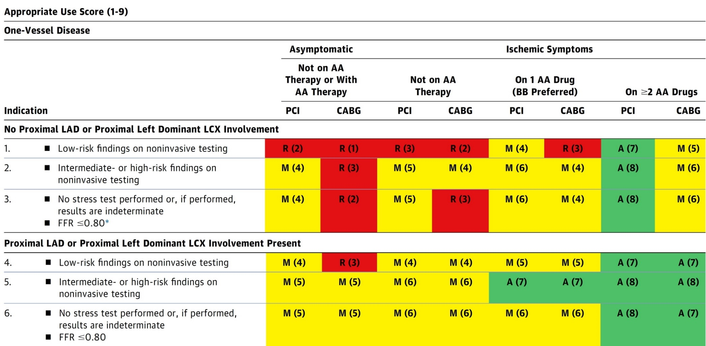
AUC 2017: One-Vessel Disease
Patel et al., J Am Coll Cardiol 2017;69:2212

Slide 5

Latest Issues in Coronary Intervention
Key Interventional Trials form ACC 2023:
BIOVASC Study, Revived-BCIS-2 Trial,
TARGET Randomized Trial
Focused review of the month
Real world revascularization of LM disease:
Real world examination of revascularization
strategies for Left main Coronary Disease in Canada

Slide 6
Latest Issues in Coronary Intervention
Key Interventional Trials form ACC 2023:
BIOVASC Study, Revived-BCIS-2 Trial,
TARGET Randomized Trial
Focused review of the month
Real world revascularization of LM disease:
Real world examination of revascularization
strategies for Left Main Coronary Disease in Canada

Slide 7

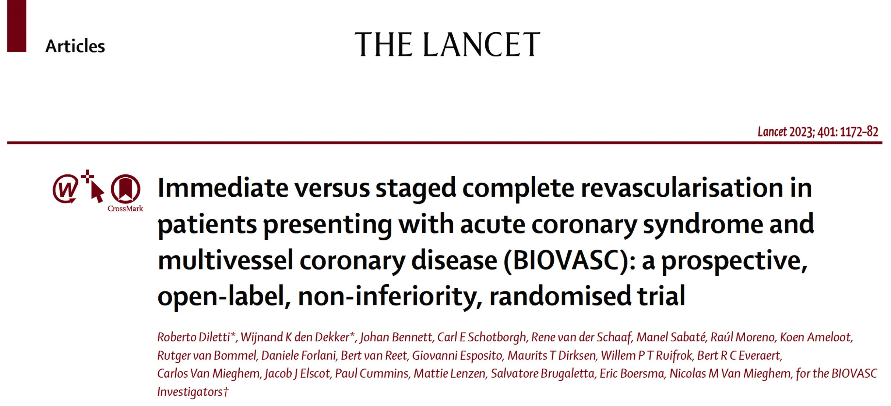

Slide 8
BIOVASC Trial Study Design
ACS with multivessel disease and clear culprit lesion
N=1525
Multivessel disease was defined as 2 or 3 coronary arteries with a diameter of 2.5 mm and 70% stenosis by visual estimation or + coronary physiology testing
1:1 Randomization
Immediate complete revascularization during the index procedure
N=764
Staged complete revascularization within 6 weeks from index procedure
N=764
Composite primary outcome of all-cause mortality, MI, any unplanned ID-revascularization and cerebrovascular events at 1-year post index procedure
Diletti et al., Lancet 2023;401:1172

Slide 9
BIOVASC Study: Baseline Characteristics
 | Immediate Complete Revascularization N=764 | Staged Complete Revascularization N=761
Age, years | 65.7 (57.2–72.9) | 65.3 (58.6–72.9)
Male sex | 598 (78.3) | 589 (77.4)
BMI | 27.3 (24.6–30.1) | 27.3 (24.8–29.9)
Presentation
STEMI | 305 (39.9) | 303 (39.8)
NSTEMI | 402 (52.6) | 388 (51.0)
UA | 57 (6.5) | 70 (9.2)
Medical history
Previous PCI | 83 (10.9) | 121 (15.9)
History of MI | 69/763 (9.0) | 89/761 (11.7)
Peripheral artery disease | 35/763 (4.6) | 33/761 (4.3)
Valve disease | 25/762 (3.3) | 17/759 (2.2)
Chronic obstructive pulmonary disease | 54/763 (7.1) | 46/761 (6.0)
Atrial fibrillation or flutter | 38/764 (5.0) | 29/760 (3.8)
Renal insufficiency | 41 (5.4) | 37 (4.9)
History of stroke | 37/763 (4.8) | 27/761 (3.5)
Hypertension | 423 (55.4) | 395 (51.9)
Diabetes | 158 (20.7) | 163 (21.4)
Hypercholesterolemia | 385/762 (50.5) | 399/760 (52.5)
Family history of CVD | 237/762 (31.1) | 250/754 (33.2)
Diletti et al., Lancet 2023;401:1172

Slide 10
BIOVASC Study: Procedural Characteristics
 | Immediate Complete Revascularization N=764 | Staged Complete Revascularization N=761 | P value
Complete revascularization | 740/764 (96.9%) | 726/760 (95.5%) | 0.17
FFR/iFR | 118 (15.4%) | 177 (23.3%) | <0.001
IVUS/OCT | 45 (5.9%) | 111 (14.6%) | <0.001
Total hospital stay, days | 3 (2-5) | 4 (3-6) | <0.001
Time to staged procedure, days | NA | 15 (4-28)
No. of stents Index procedure | 3 (2-4) | 1 (1-2) | <0.001
No. of stents Index + staged procedure | 3 (2-4) | 3 (2-4) | 0.014
Stent length Index procedure | 61 (44-85) | 30 (22-47) | <0.001
Stent length Index + staged procedure | 61 (44-85) | 67 (45-93) | 0.015
Index procedure duration, minutes | 64 (47-84) | 45 (34-61) | <0.001
Index + staged procedure duration, minutes | 117/730 (16.0%) | 148/712 (20.8%)
Lesion complexity
Type A | 179/1569 (11.4%) | 161/1541 (10.4%)
Type B1 | 445/1569 (28.4%) | 429/1541 (27.8%)
Type B2 | 654/1569 (22.6%) | 345/1541 (22.4%)
Type C | 591/1569 (37.7%) | 606/1541 (39.3%)
Procedure during off-hours | 207 (27.1%) | 221 (29.0%)
Diletti et al., Lancet 2023;401:1172

Slide 11
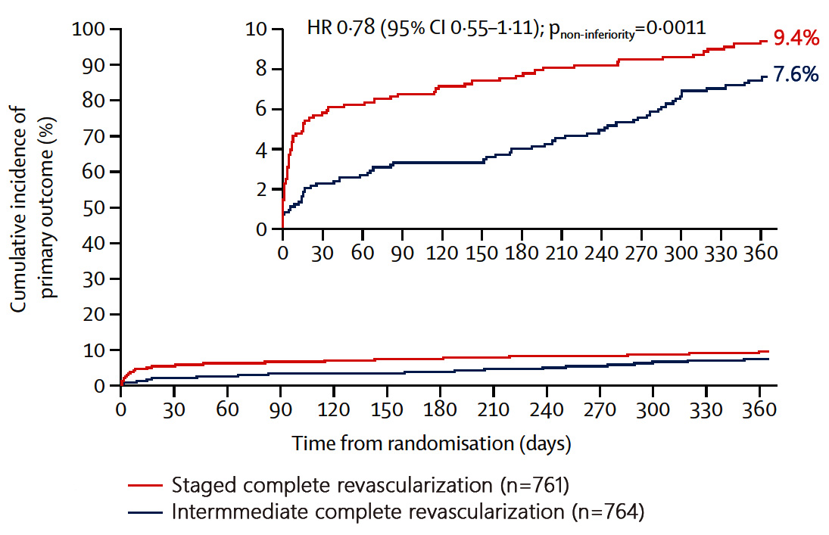
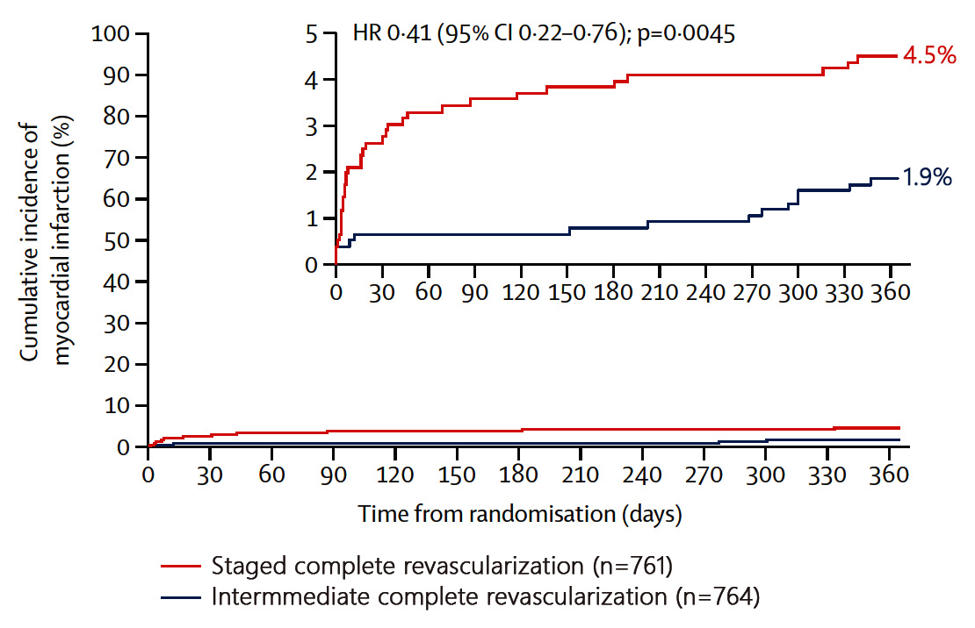
BIOVASC Study: Primary Outcome & MI @ 1Yr
Primary Outcome
Myocardial Infarction
Diletti et al., Lancet 2023;401:1172

Slide 12
BIOVASC Study: Primary and Secondary Outcomes at 1 Year
p=0.001
p=0.03
p=0.02
p=0.005
%
p=0.30
p=0.83
p=0.25
p=0.78
Diletti et al., Lancet 2023;401:1172

Slide 13
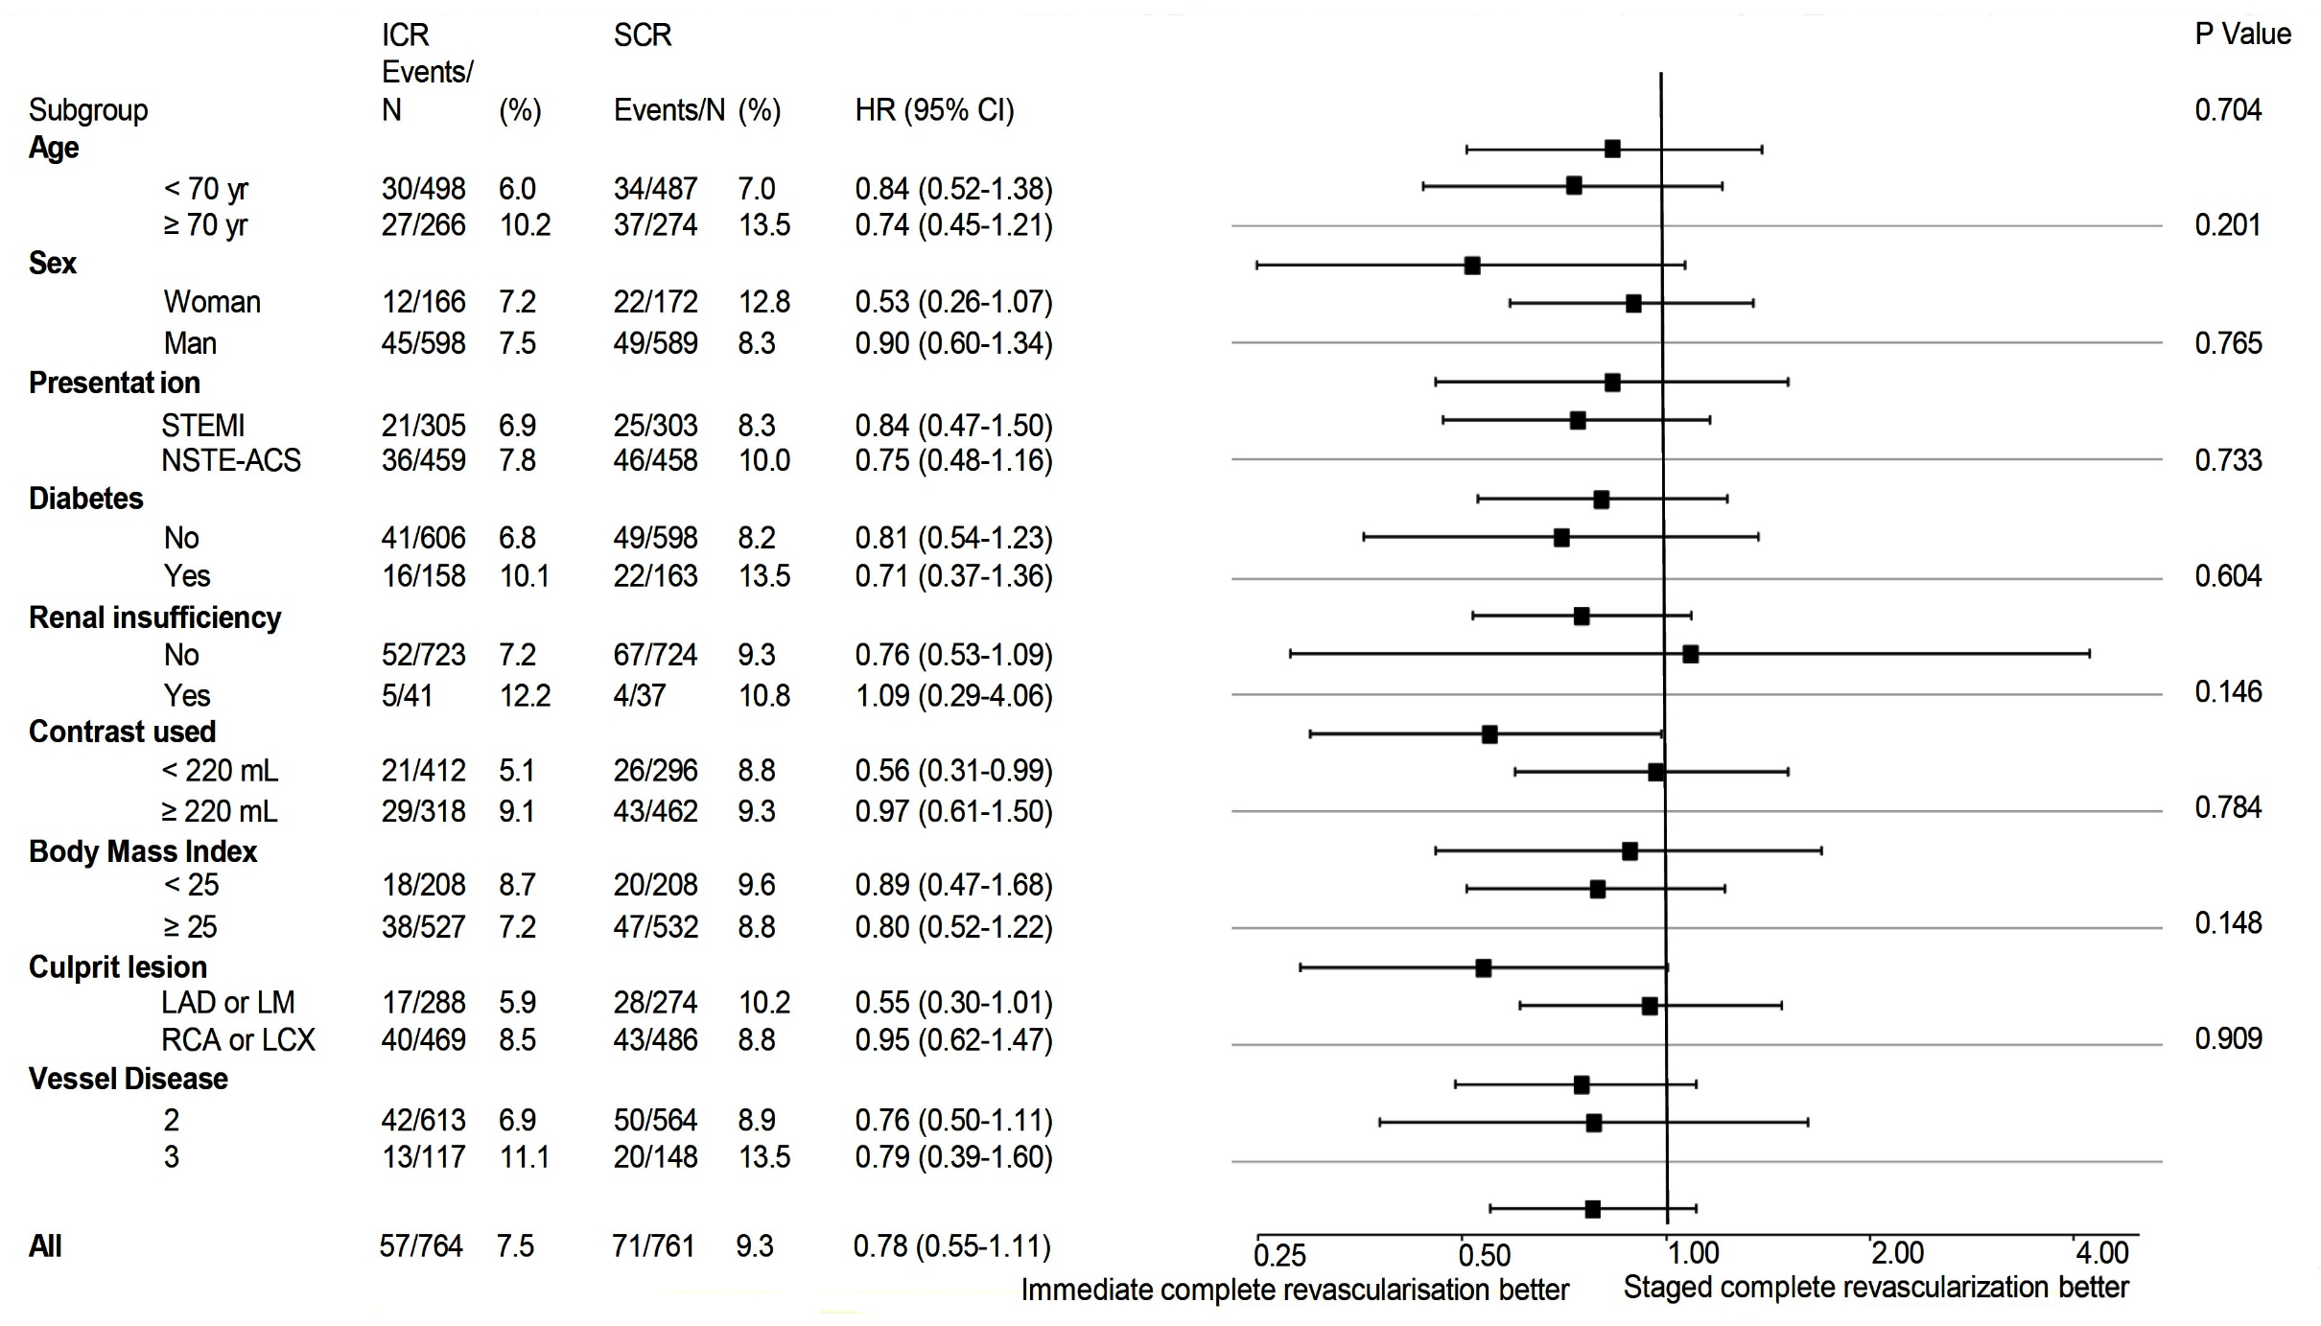
BIOVASC Study: Subgroup Analysis
Diletti et al., Lancet 2023;401:1172

Slide 14
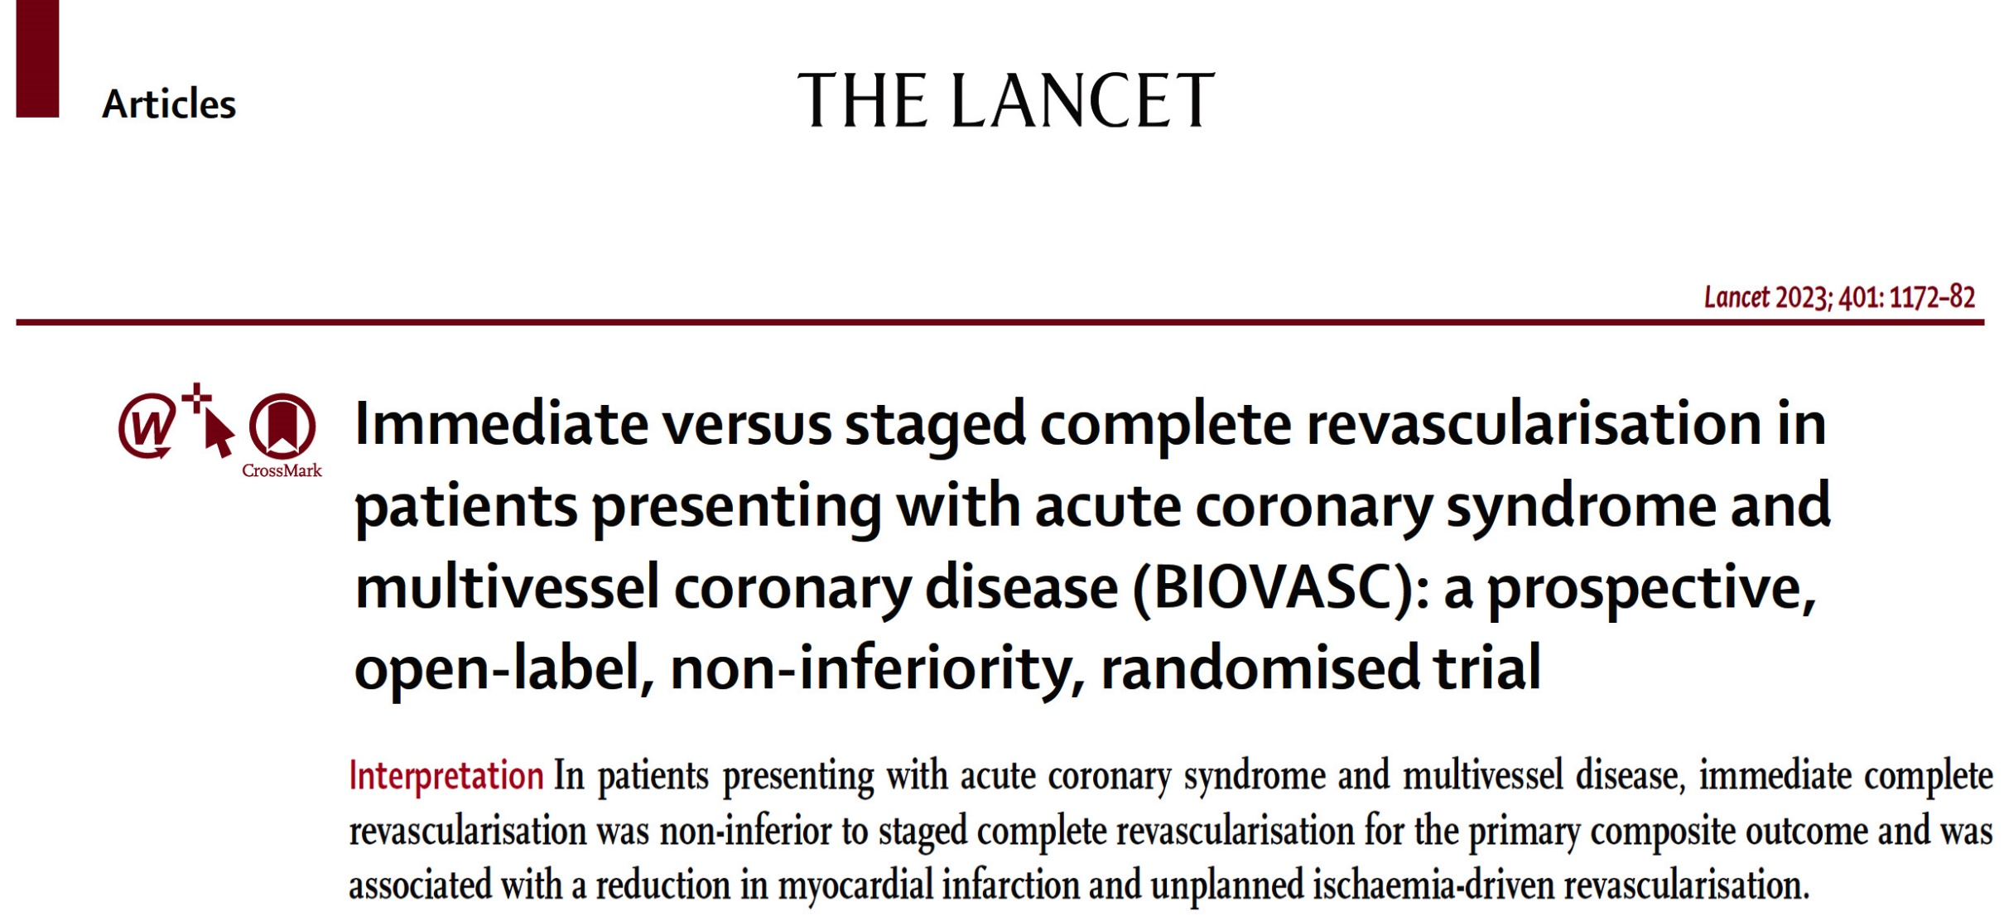

Slide 15
Effect of Myocardial Viability, Functional Recovery and PCI on Clinical Outcomes in the REVIVED-BCIS-2 Trial

Slide 16
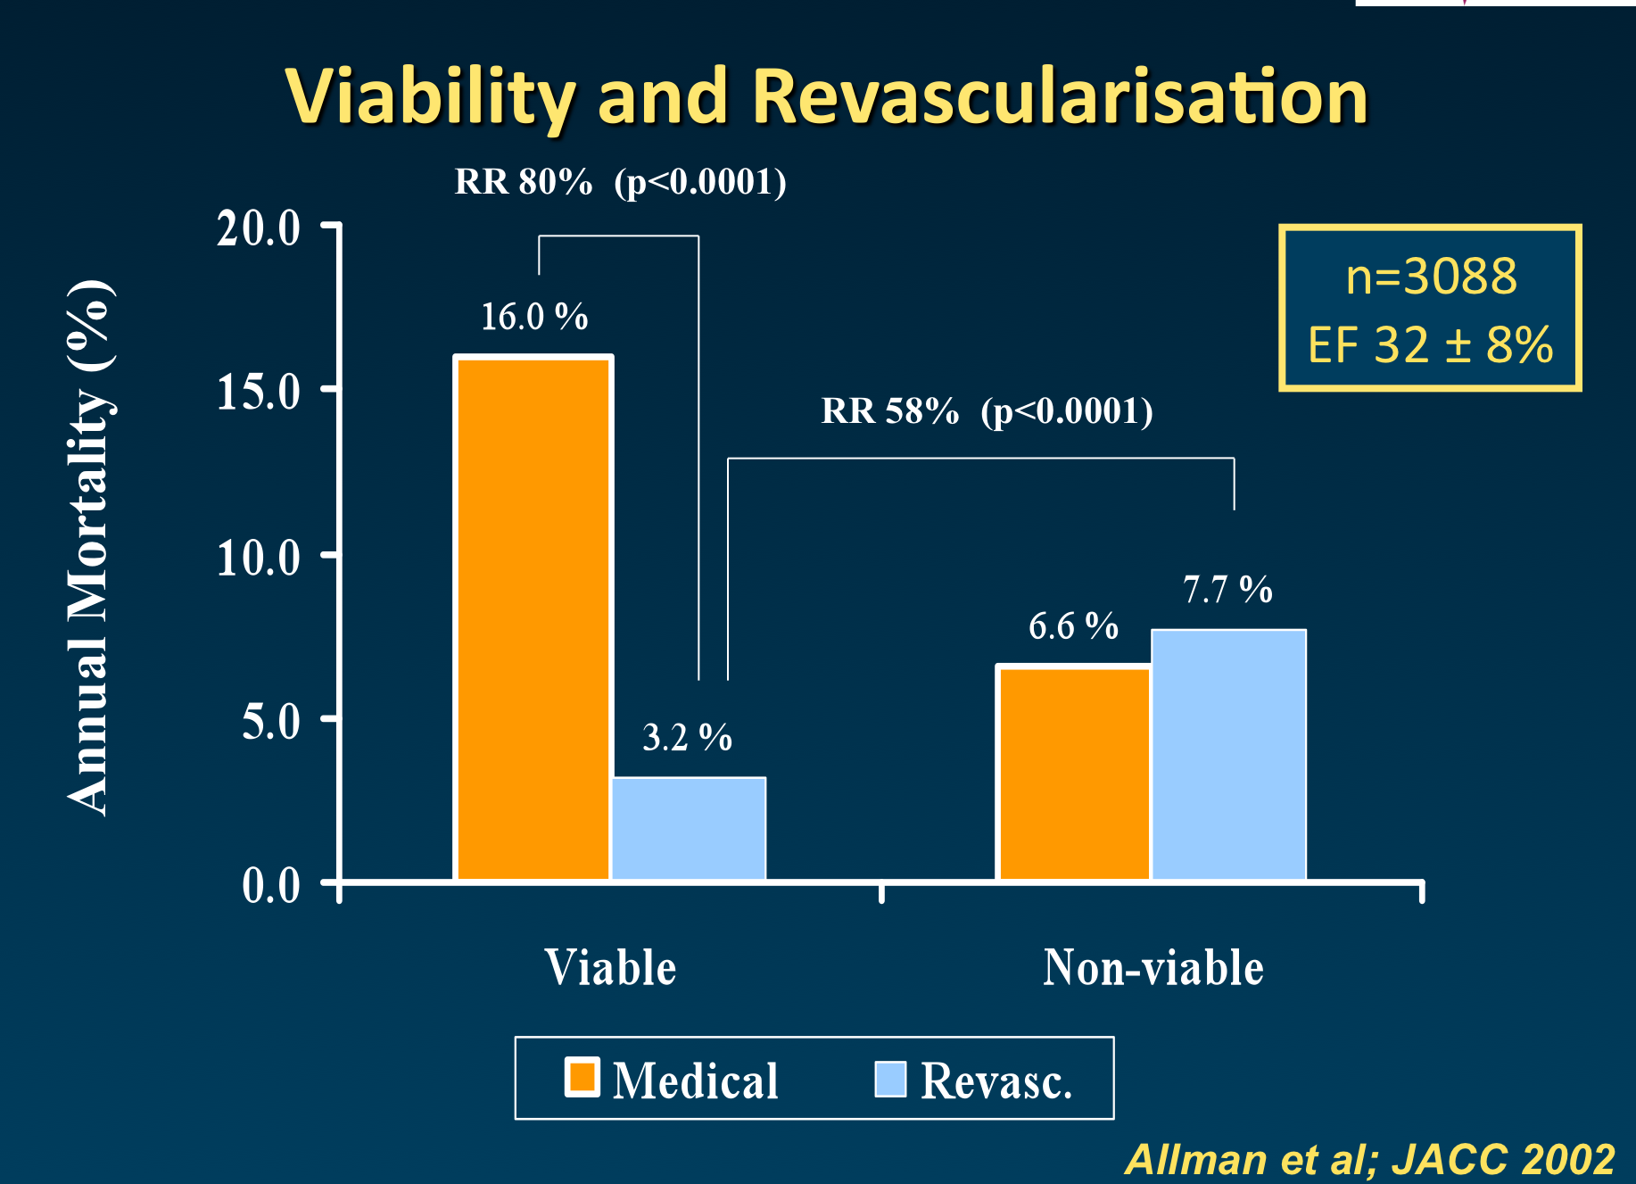
Myocardial Viability Testing and Impact of Revasc on Prognosis in Pts with CAD and Left Ventricular Dysfunction: A Meta-Analysis
Death rate of pts with and without myocardial viability treated by revasc and medical therapy
Binary Viability Classification
SPECT/PET/DSE
Observational
Meta-analysis
Allman et al., J Am Coll Cardiol 2002;39:1151

Slide 17
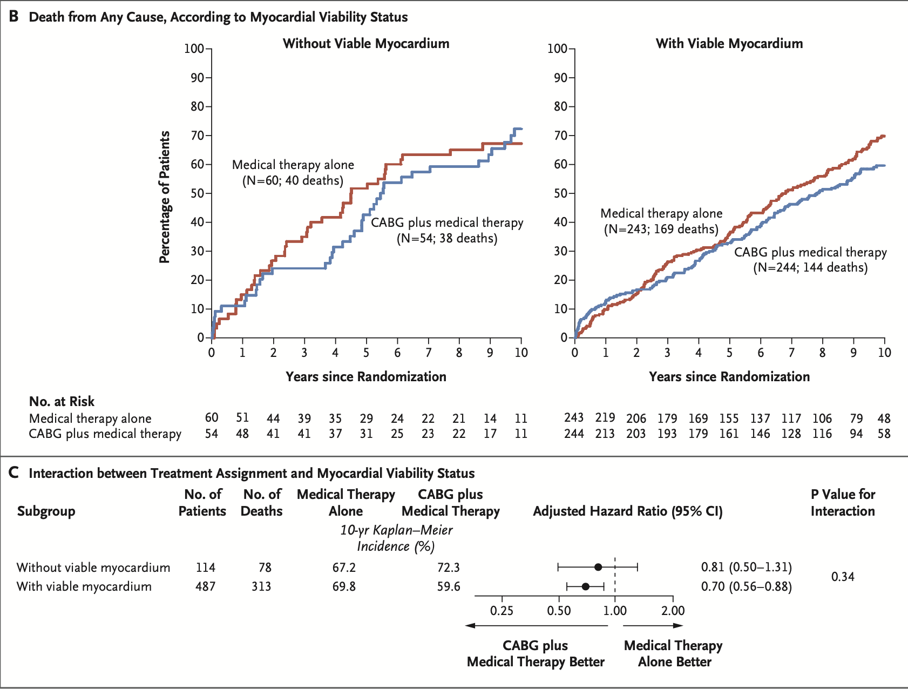
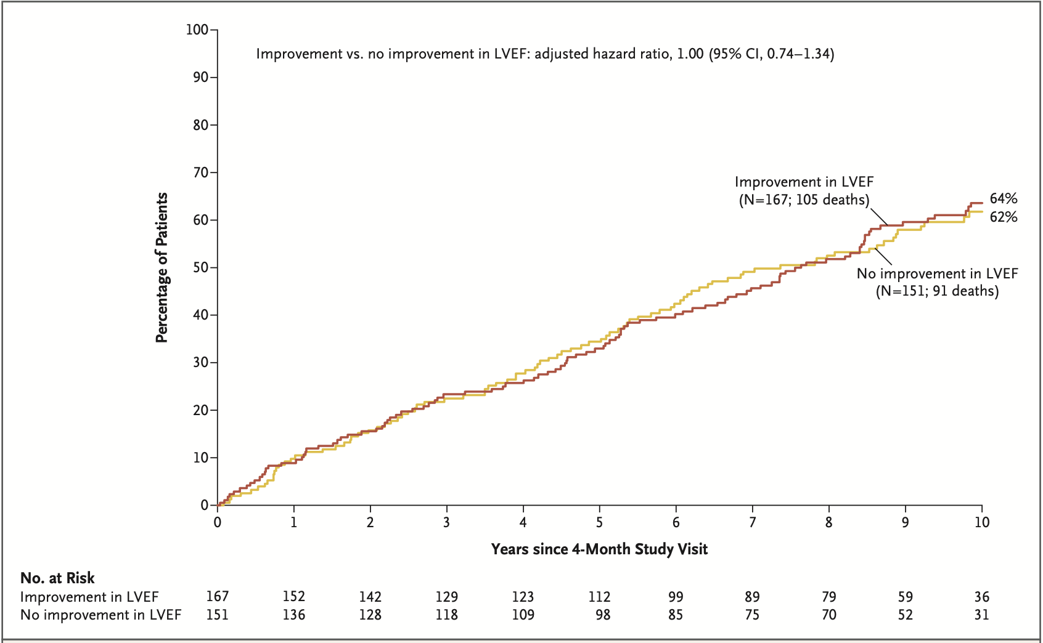
STICH (ES) Viability Study
Bonow et al., N Engl J Med 2011;364:1617; Panza et al., N Engl J Med 2019;381:739

Slide 18
REVIVED-BCIS-2 Trial
Primary Outcome
All-cause death or hospitalisation for heart failure
Major Secondary Outcome
Left ventricular ejection fraction at 6- and 12-months
Perera et al, N Engl J Med 2022;387:1351

Slide 19
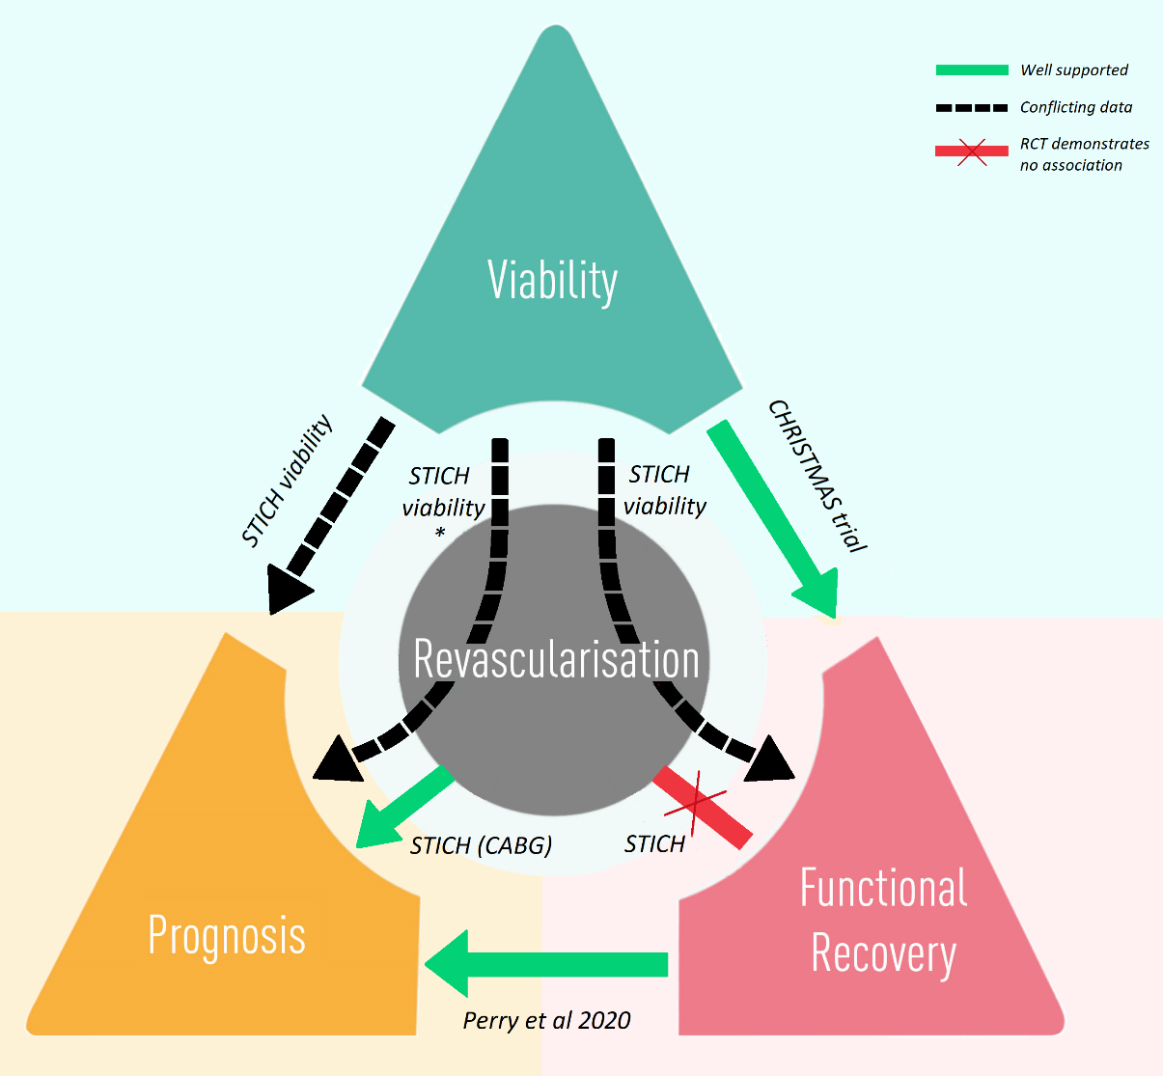
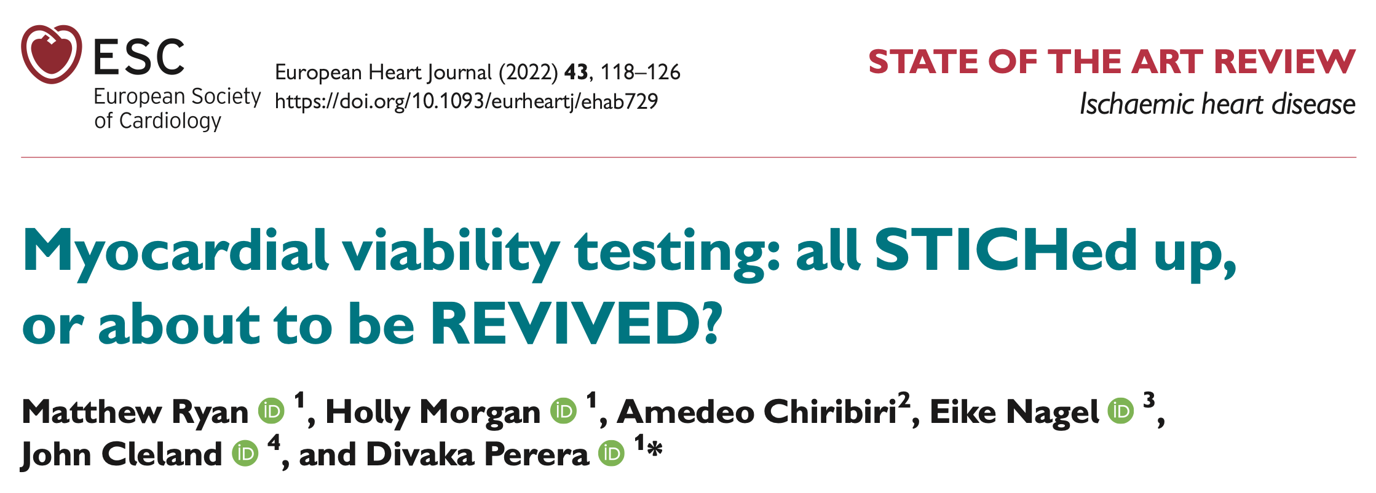

Slide 20
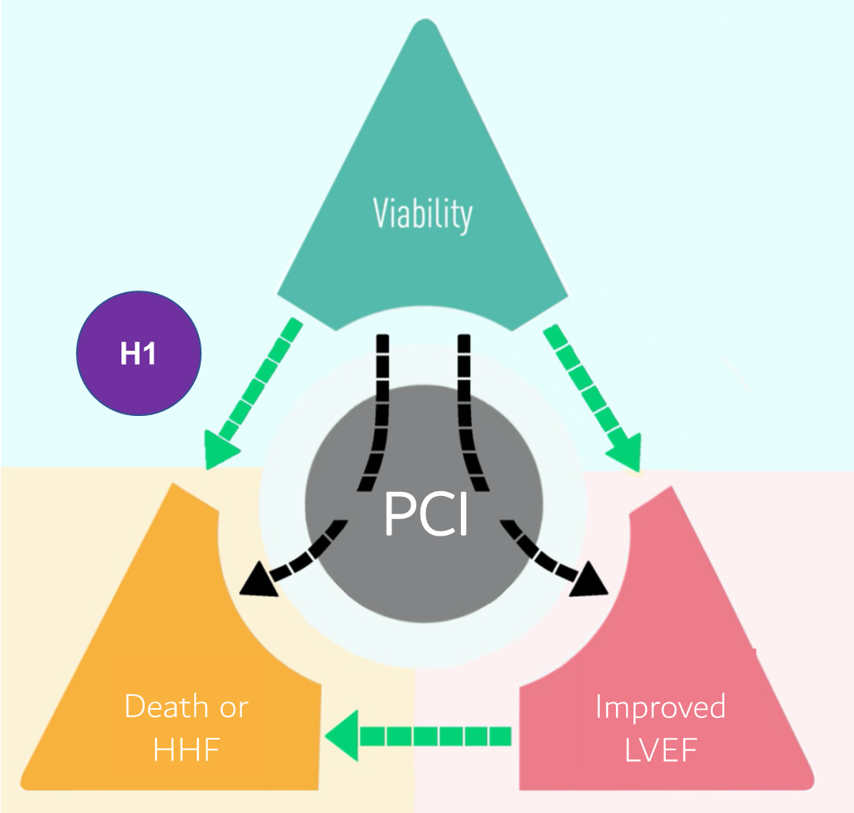
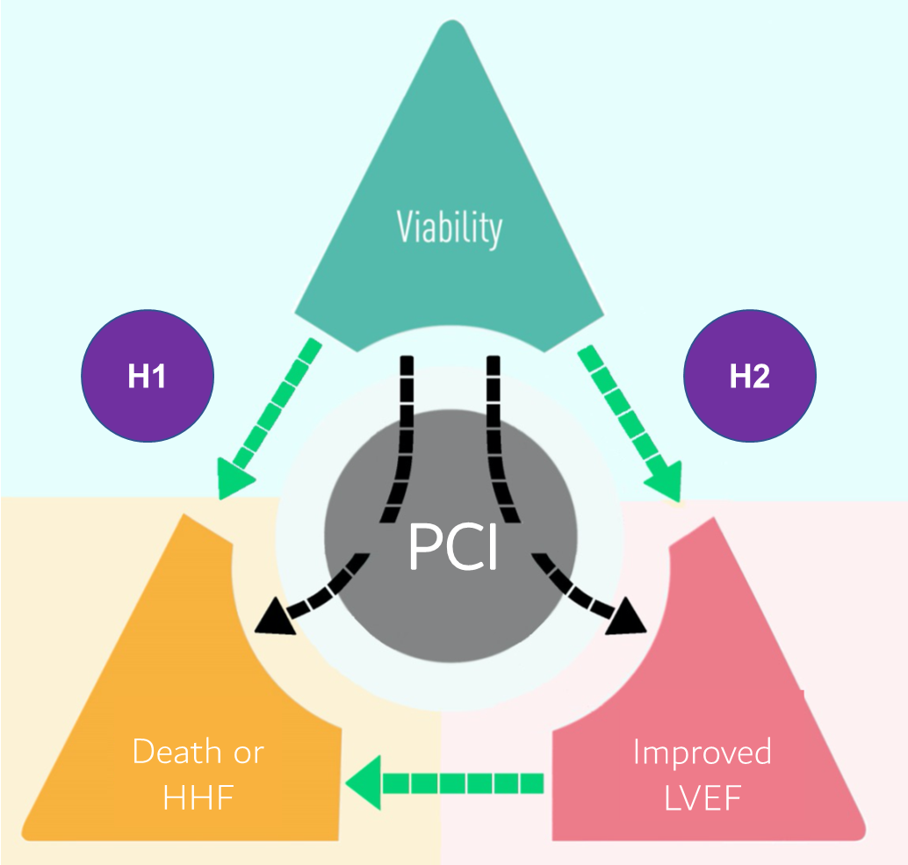
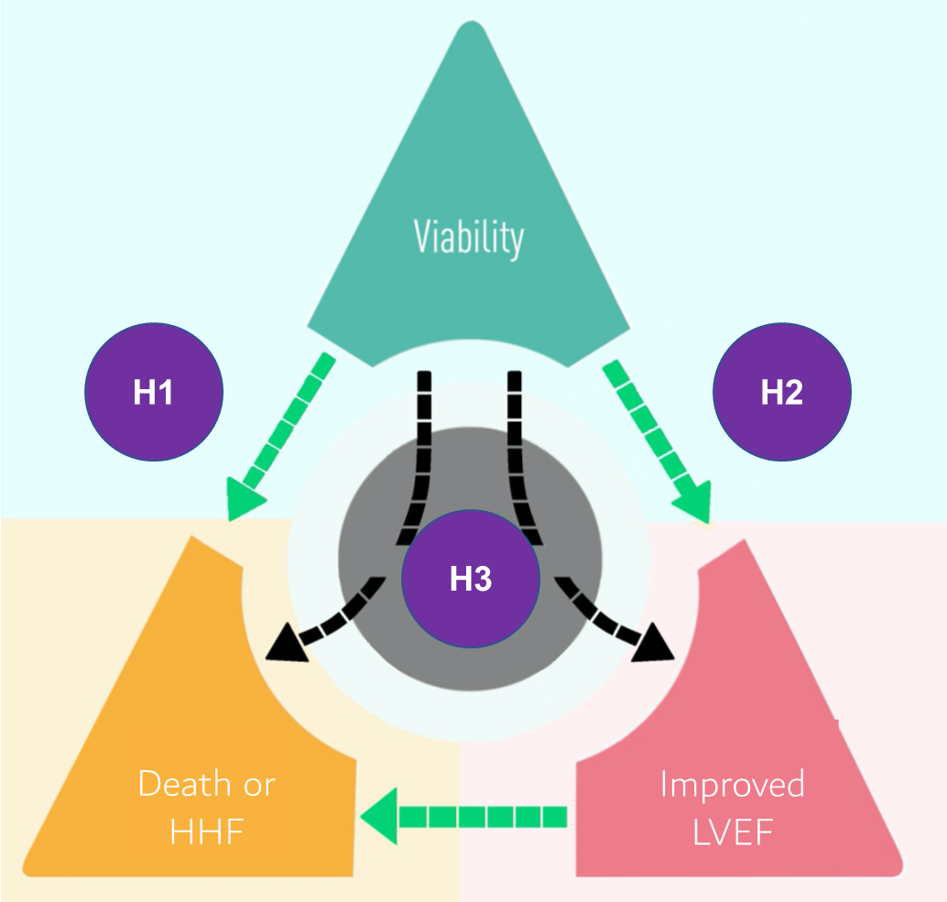
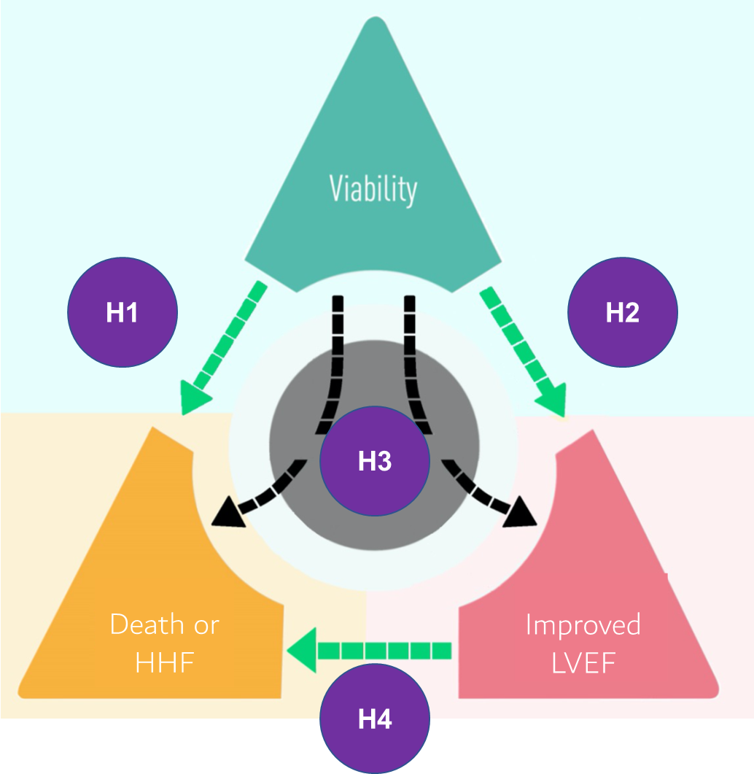
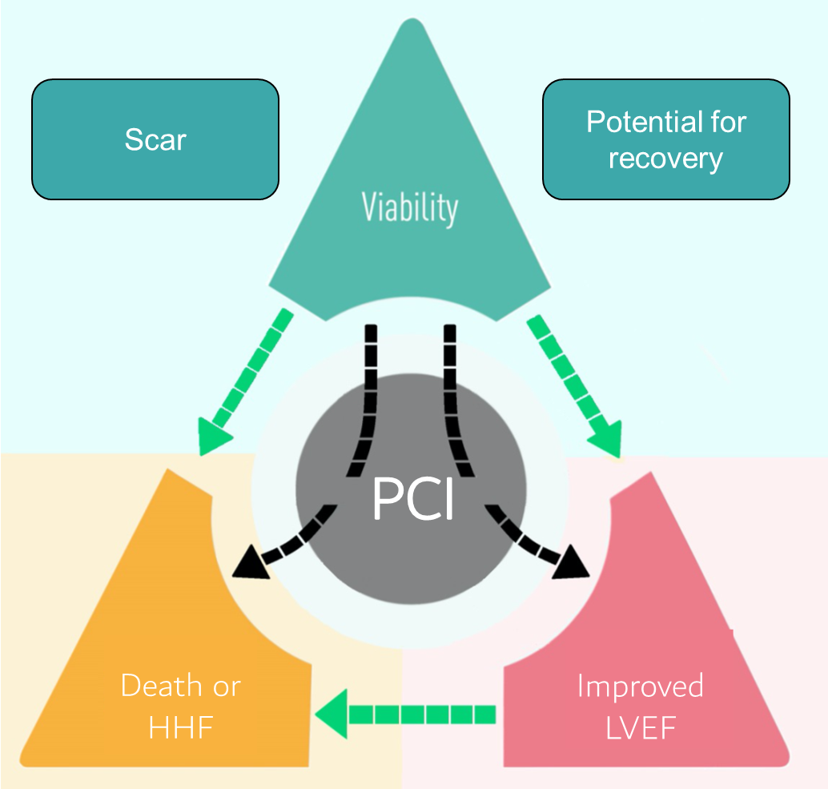
Hypothesis 1
Viability characterization predicts
event-free survival
Hypothesis 2
Viability characterization predicts
left ventricular recovery
Hypothesis 3
Viability characterization predicts response to PCI vs OMT
Hypothesis 4
Left ventricular recovery predicts
event-free survival
Viability characterized by continuous variables
Perera D, ACC 2023

Slide 21
REVIVED-BCIS-2 Trial: Viability Characterization
Potential for Recovery
610 patients
Wall motion
Potential for recovery
All Viable Myocardium
Normokinetic
Normal
All segments
+
Dysfunctional-Viable
DSE (CR)
CMR LGE ≤25%
Dysfunctional-Viable
Dysfunctional
(% of LV)
Non-Viable
DSE (no CR)
CMR LGE >25%
Perera D, ACC 2023

Slide 22

REVIVED-BCIS-2 Trial: Viability Characterization
Scar Burden
478
patients
Wall motion
Segmental scar
0
1 - 25
All segments
Scar Burden
(% of LV)
26 - 50
51 - 75
76 - 100
Perera D, ACC 2023

Slide 23
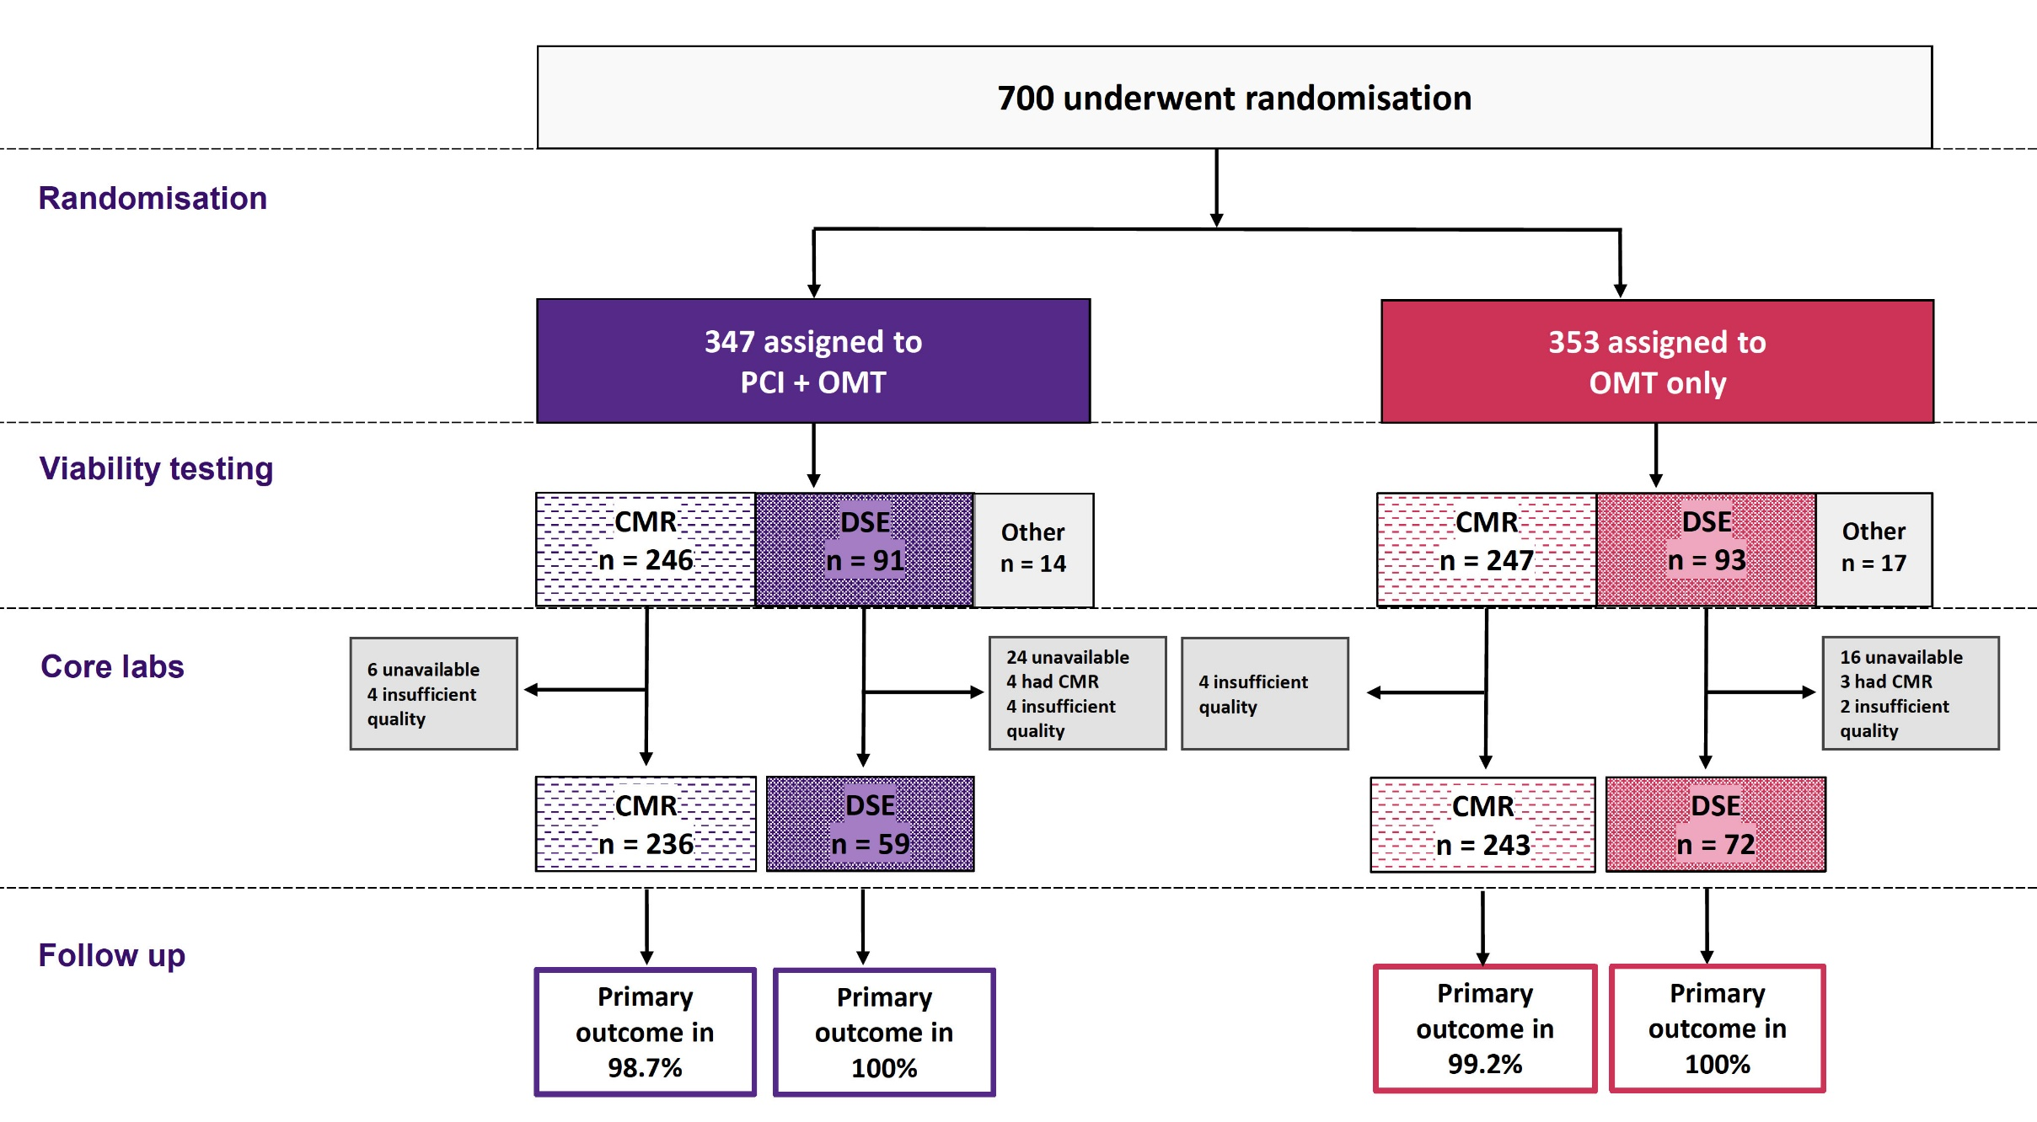
REVIVED-BCIS-2 Trial Design
Perera D, ACC 2023

Slide 24
REVIVED-BCIS-2 Trial: Death or HHF by Viability Characterization
All-Viable Myocardium
HR 0.93 (CI 0.87 to 1.00)*
p=0.048 (adjusted)
Dysfunctional-Viable Myocardium
HR 0.98 (CI 0.93 to 1.04)*
p=0.56 (adjusted)
*per 10% increase in volume
Perera D, ACC 2023

Slide 25
REVIVED-BCIS-2 Trial: Death or HHF by Scar Burden
HR 1.18 (CI 1.04 to 1.33)
p=0.009 (adjusted)
per 10% increase in scar volume
Perera D, ACC 2023

Slide 26
REVIVED-BCIS-2 Trial: Treatment Effect by Viability Characterization
Adjusted hazard ratio 0.98 (0.61 to 1.59)
Adjusted hazard ratio 0.83 (0.54 to 1.28)
Adjusted hazard ratio 1.28 (0.79 to 2.10)
p for interaction = 0.43
Perera D, ACC 2023

Slide 27
REVIVED-BCIS-2 Trial: Left Ventricular Recovery by Viability Characterization
Binary LV recovery: ≥ median change (4.7% EF)
Perera D, ACC 2023

Slide 28
REVIVED-BCIS-2 Trial: Treatment Effect by Viability Characterization
Perera D, ACC 2023

Slide 29
REVIVED-BCIS-2 Trial: Treatment Effect by Viability Characterization
HR 0.62 (0.41 to 0.95)
p=0.029 (adjusted)
Perera D, ACC 2023

Slide 30
REVIVED-BCIS-2 Trial: Conclusions
PCI does not improve prognosis or LV recovery in ischemic cardiomyopathy, compared to OMT alone, regardless of viability characteristics at baseline
✅
✅
Scar burden adversely predicts prognosis and likelihood
of LV recovery in ischemic cardiomyopathy
independent of baseline LVEF or extent of CAD
❌
❌
The abundance of dysfunctional-yet-viable segments was not associated with
prognosis or likelihood of LV recovery
✅

Slide 31
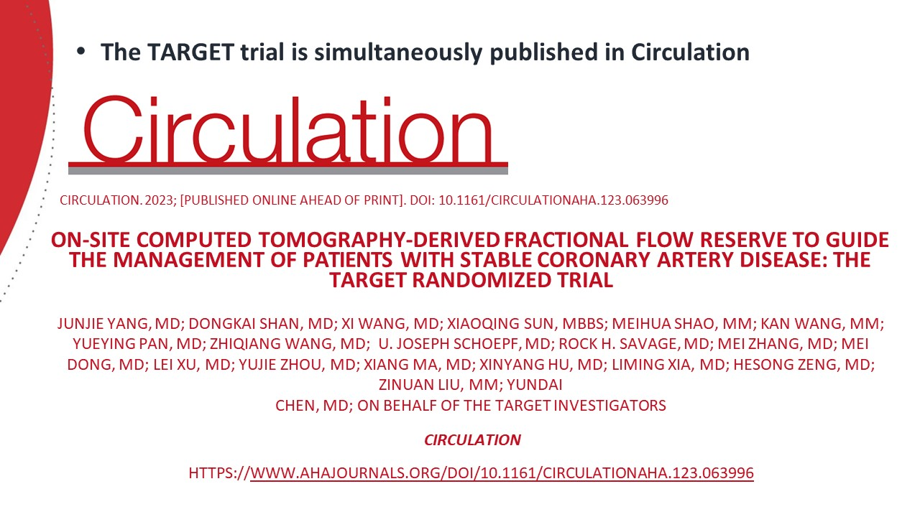

Slide 32
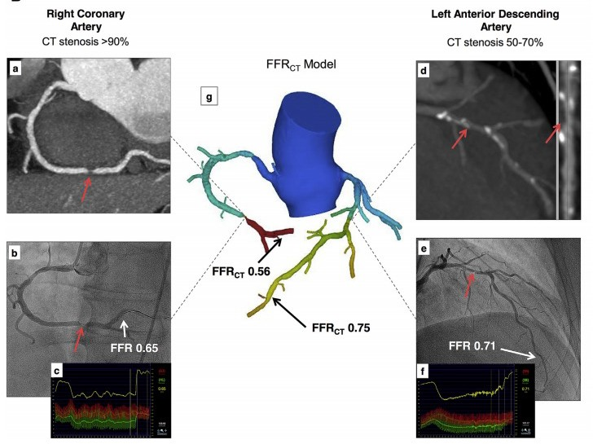
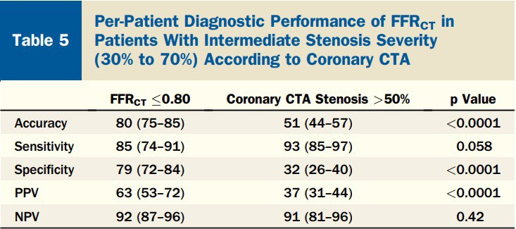
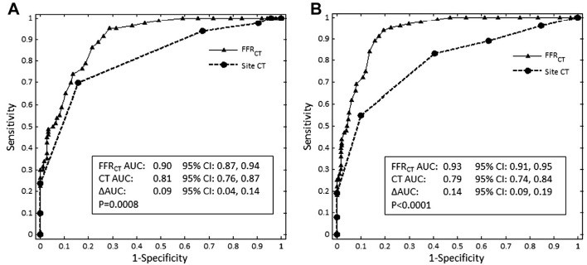
TARGET Trial: Background – CT-FFR Enables Functional Assessment for CAD
The NXT Trial
Per-patient
Per-vessel
J Am Coll Cardiol. 2014 Apr 1;63:1145
Yang et al., Circulation Mar 4, 2023 Epub ahead of print

Slide 33
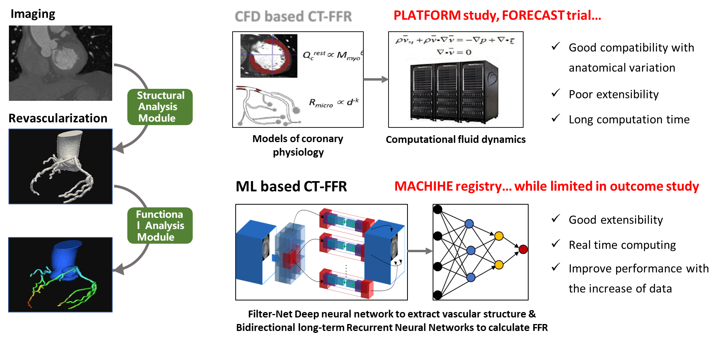
TARGET Trial: Background – Two Major
Algorithms for CT-FFR Calculation
CFD based CT-FFR
Yang et al., Circulation Mar 4, 2023 Epub ahead of print

Slide 34
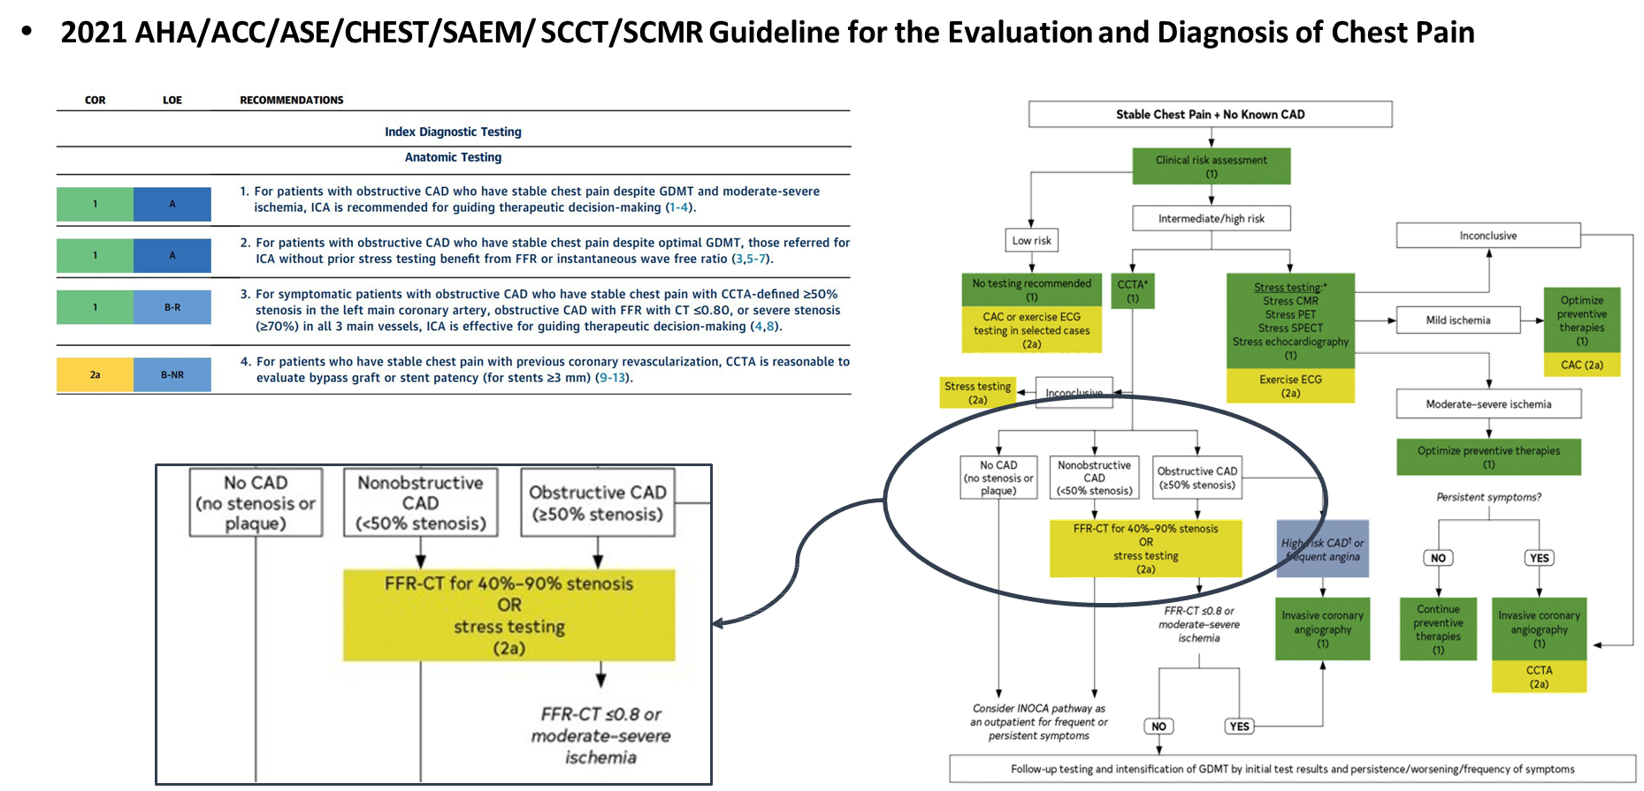
TARGET Trial: Background – Guideline Recommendation for CT-FFR
J Am Coll Cardiol. 2021 Nov 30;78(22):e187-e285.
Yang et al., Circulation Mar 4, 2023 Epub ahead of print

Slide 35
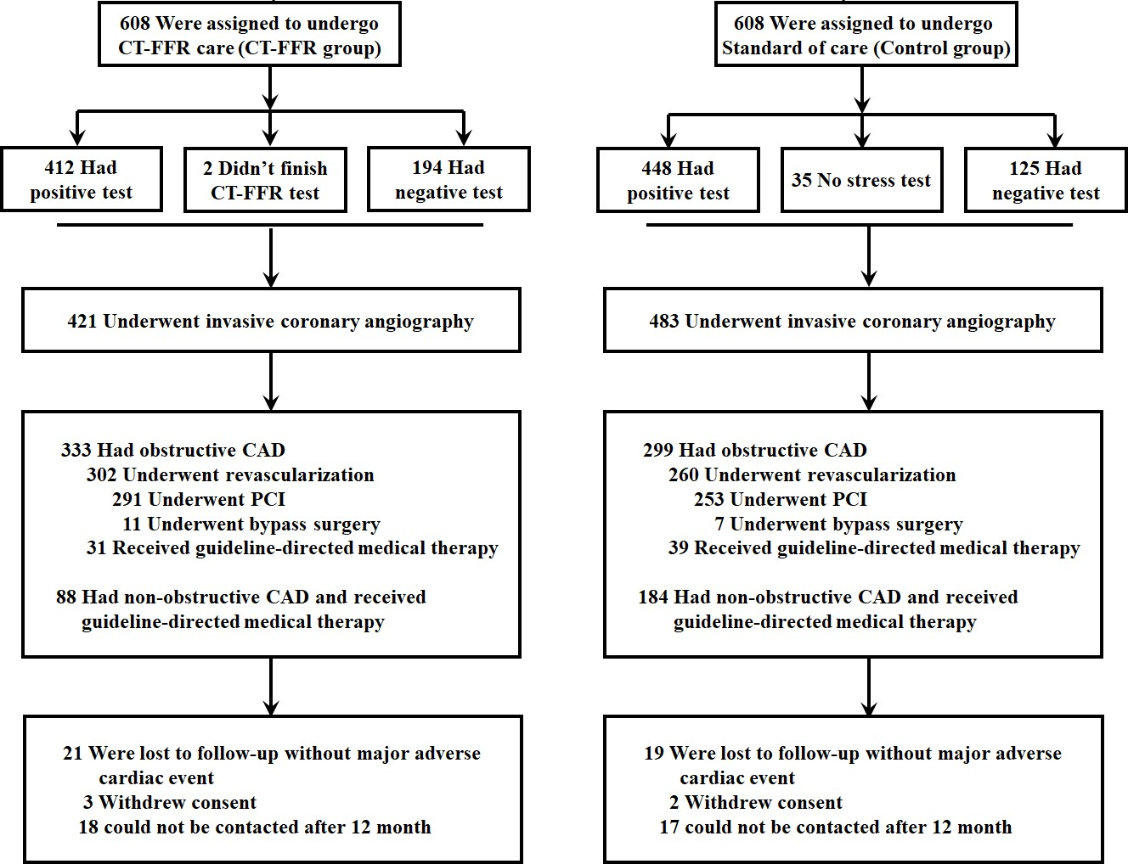
TARGET Trial: Enrollment, Randomization and Follow-up Flow Chart (CTA: 30-90% stenosis)
Yang et al., Circulation Mar 4, 2023 Epub ahead of print

Slide 36
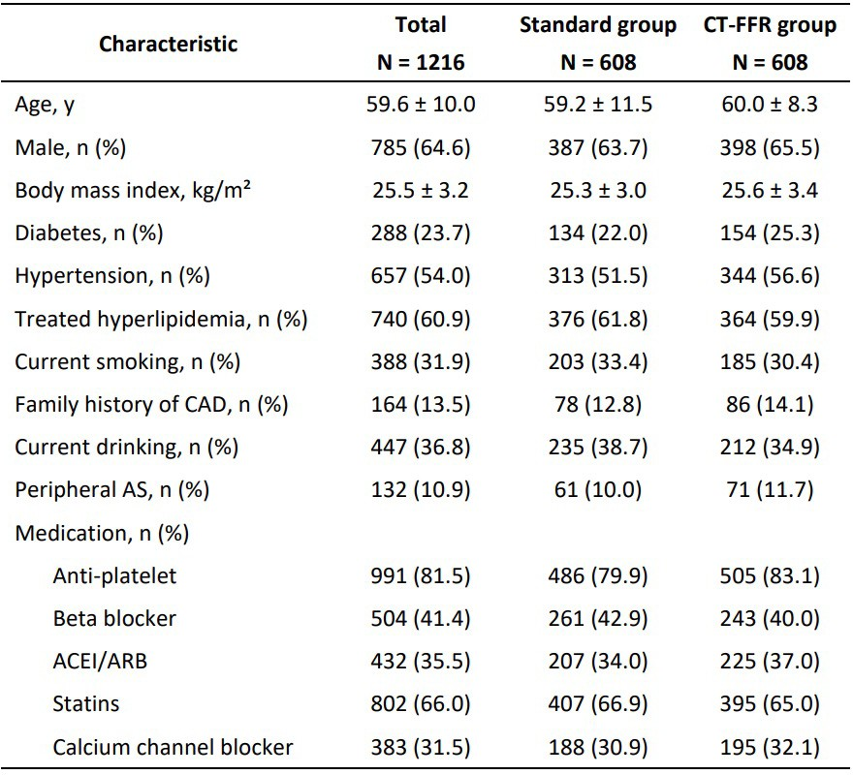
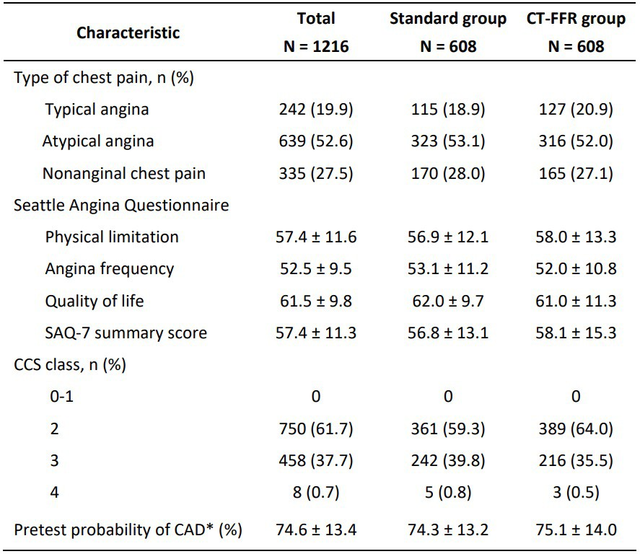
TARGET Trial: Baseline Characteristics at Randomization
Yang et al., Circulation Mar 4, 2023 Epub ahead of print

Slide 37
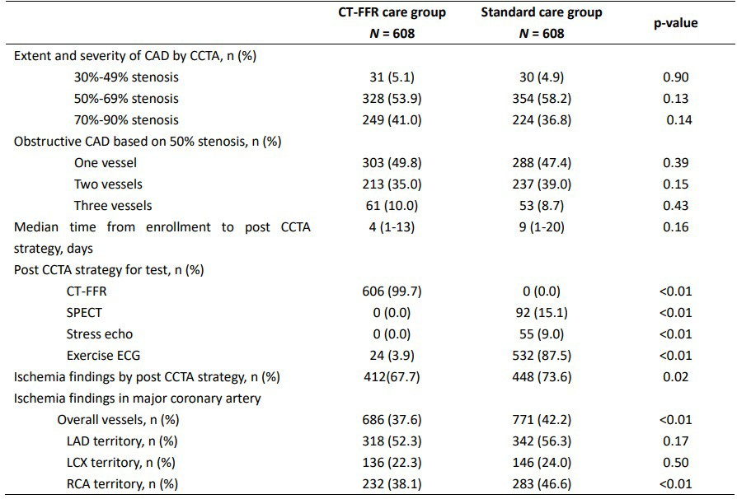
TARGET Trial: Results of Diagnostic Strategy During Initial Management
Yang et al., Circulation Mar 4, 2023 Epub ahead of print

Slide 38
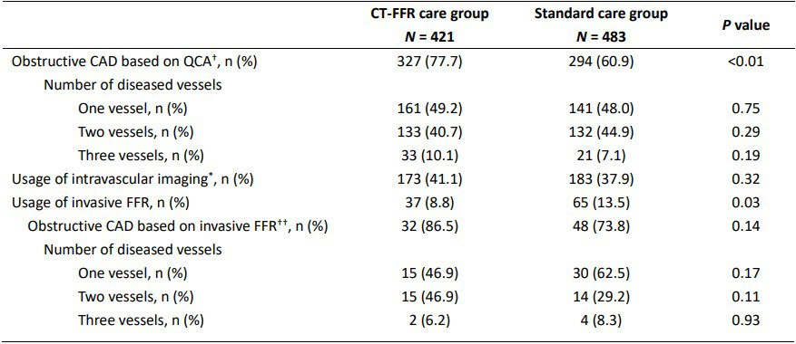
TARGET Trial: Results of Diagnostic Strategy During Invasive Coronary Angiography
Yang et al., Circulation Mar 4, 2023 Epub ahead of print

Slide 39
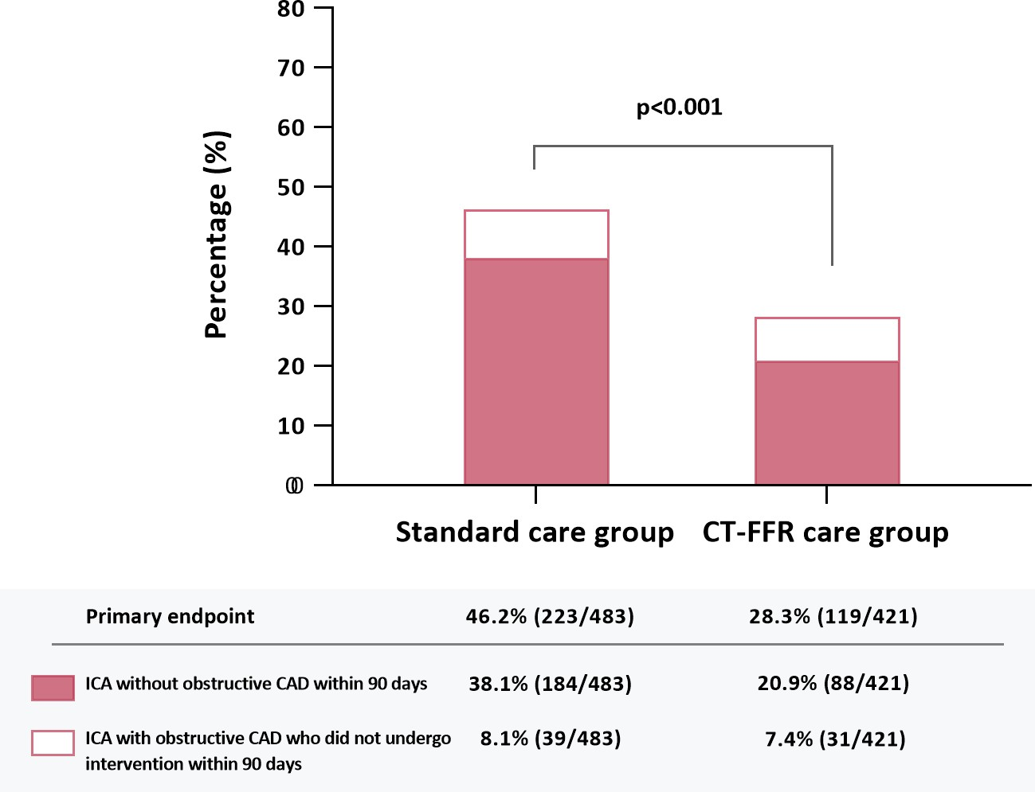
TARGET Trial: Primary Endpoint
As compared to the standard gp, the proportion of pts undergoing ICA without obstructive CAD or with obstructive CAD who did not undergo intervention within 90 days was significantly reduced in the CT-FFR group (28.3% vs. 46.2% P<0.01).
This was mainly driven by a reduction in the proportion of patients found to have no-obstructive CAD in the CT-FFR group compared to the standard group (20.9% vs. 38.0%).
Yang et al., Circulation Mar 4, 2023 Epub ahead of print

Slide 40
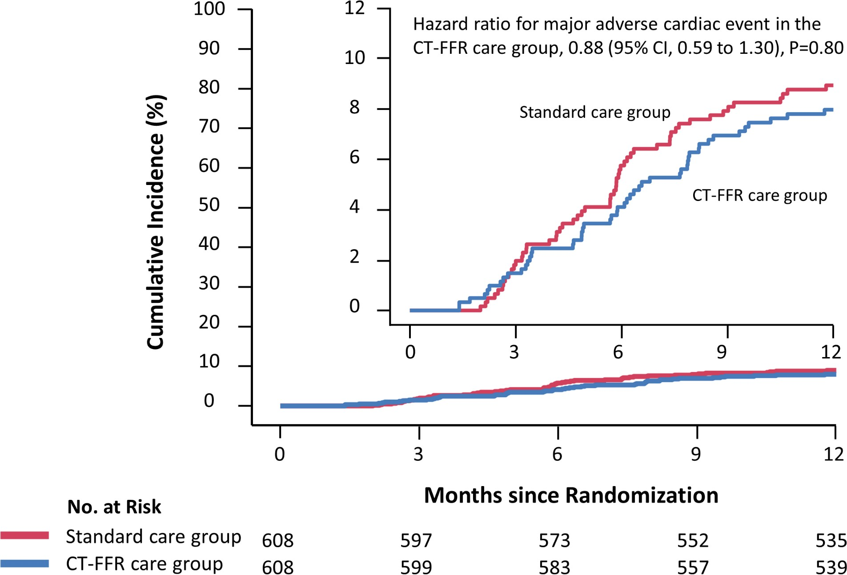
TARGET Trial: MACE
MACE did not differ significantly
(hazard ratio, 0.88; P=0.8)
Rate of major adverse cardiovascular events
 | CT-FFR group (n=608) | Standard group (n=608) | P Value
At least 1 events | 48 (8.2) | 54 (9.2) | 0.55
Hosp unstable angina | 39 (6.6) | 44 (7.5) | 0.58
Revasc after 90 days | 7 (1.2) | 16 (2.7) | 0.06
Non-fatal MI | 7 (1.2) | 9 (1.5) | 0.62
Cardiovasc death | 2 (0.3) | 1 (0.2) | 0.62
Yang et al., Circulation Mar 4, 2023 Epub ahead of print

Slide 41
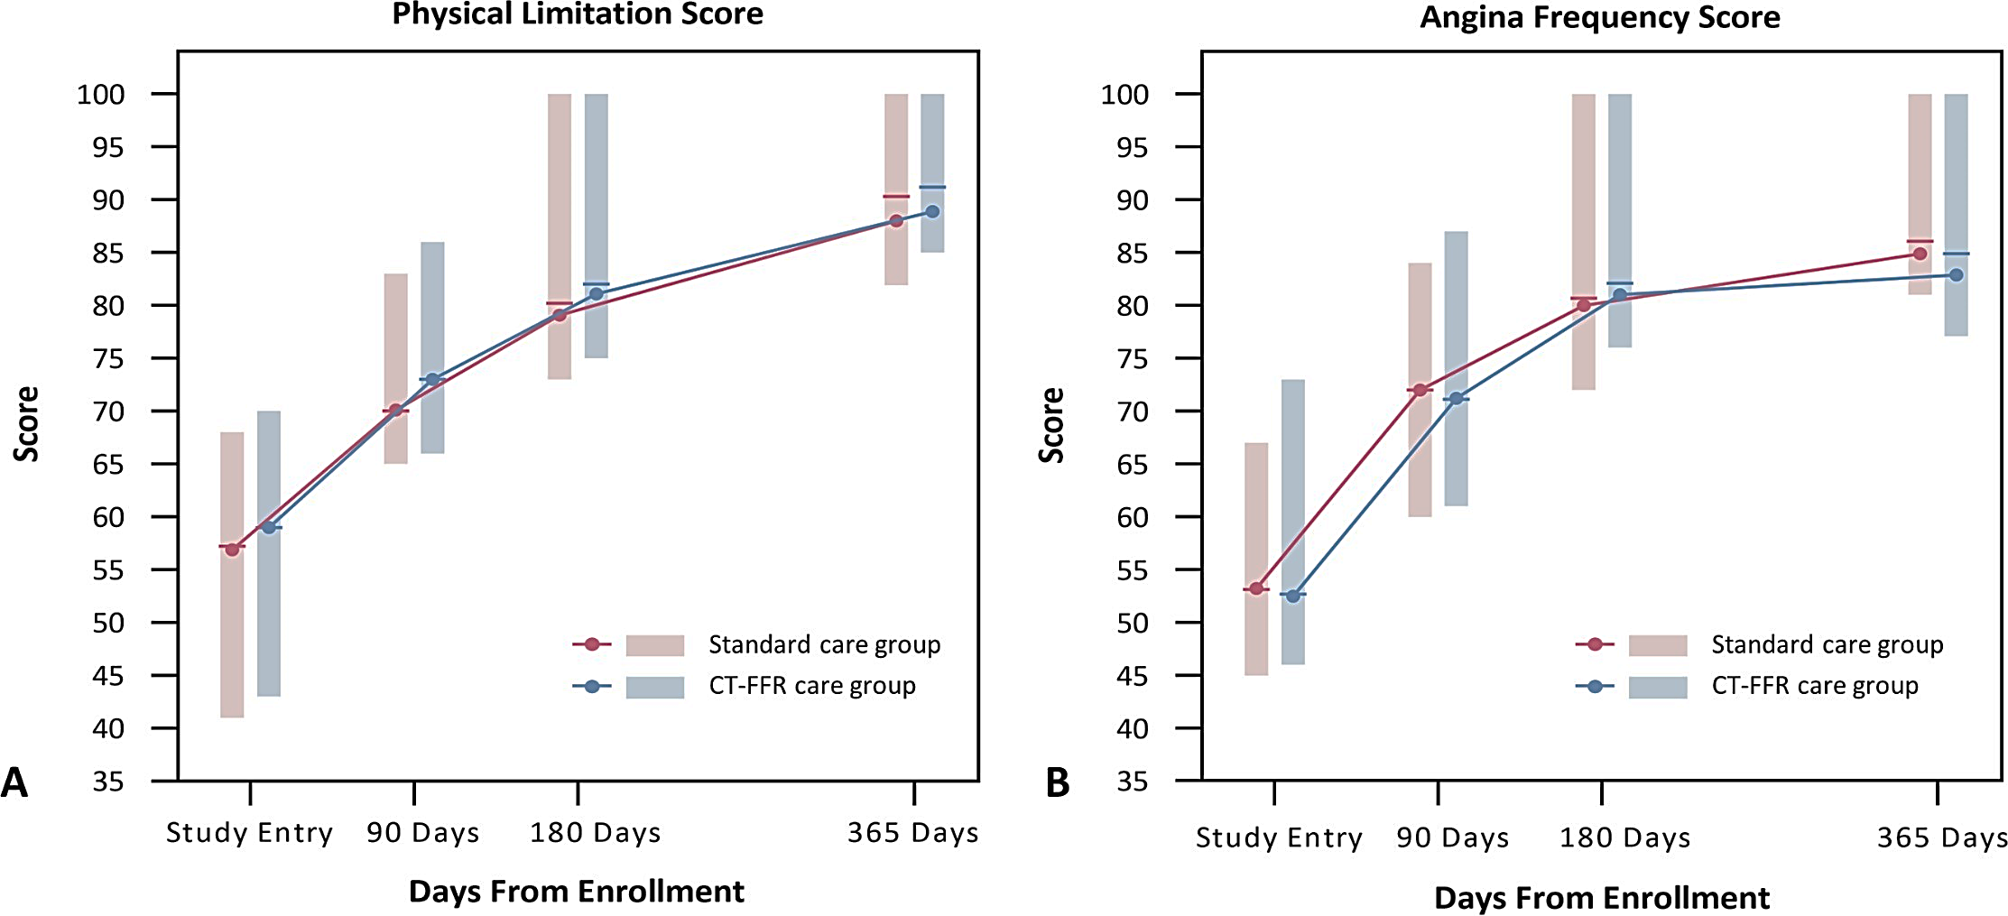
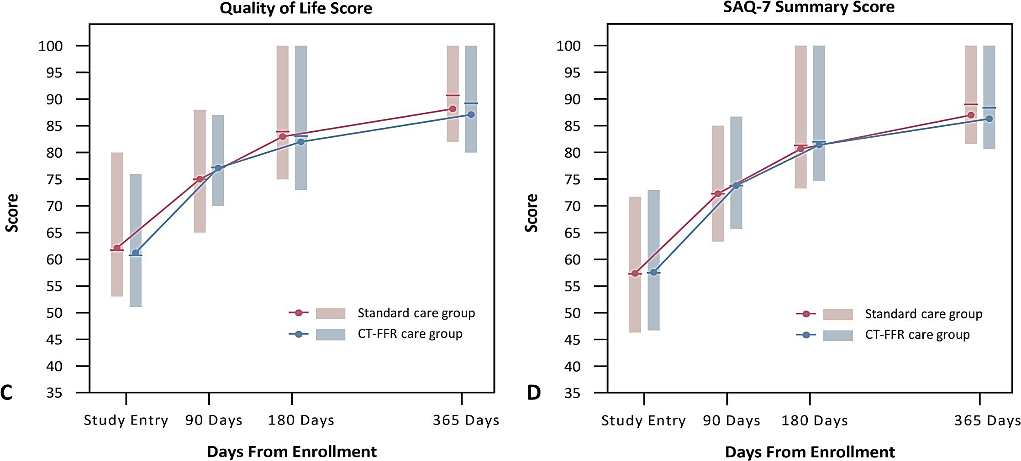
TARGET Trial: QoL Based on SAQ-7
SAQ-7 consists of physical limitation score, angina frequency score and quality of life score.
Yang et al., Circulation Mar 4, 2023 Epub ahead of print

Slide 42
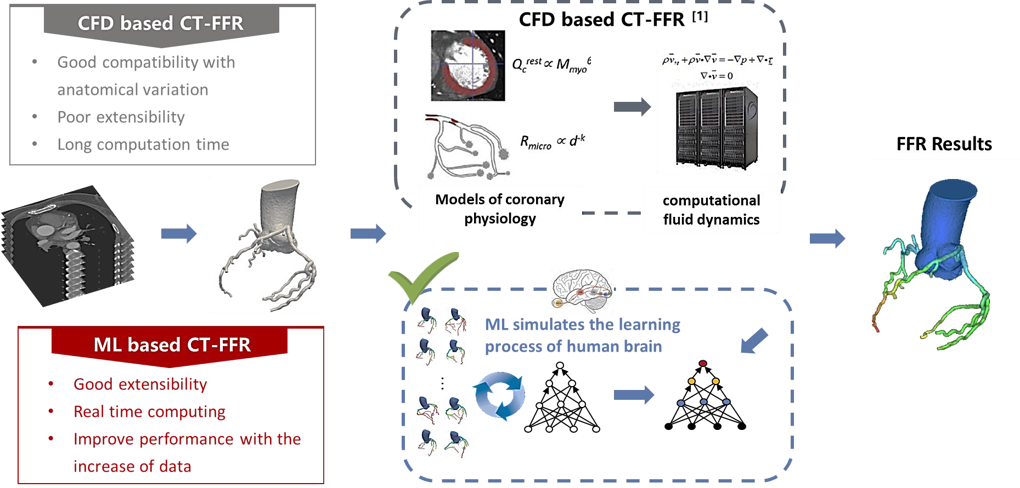
TARGET Trial: An On-Site Strategy is Pragmatic and May be
Preferred to Meet the Demand of Clinical Practice Under Various Clinical Settings
Yang et al., Circulation Mar 4, 2023 Epub ahead of print

Slide 43
TARGET Trial: Conclusions
In stable pts with intermediate (30%-90%) stenosis detected by CCTA, an on-site ML based CT-FFR strategy is feasible, safe and effective.
Compared with the standard care pathway, on-site CT-FFR reduced the proportion of pts with stable CAD undergoing ICA without obstructive disease or requiring intervention within 90 days.
The on-site CT-FFR strategy increased revascularization overall without improving quality of life or reducing major adverse cardiovascular events, though a trend towards a lower cost was observed.
Yang et al., Circulation Mar 4, 2023 Epub ahead of print

Slide 44
Latest Issues in Coronary Intervention
Key Interventional Trials form ACC 2023:
BIOVASC Study, Revived-BCIS-2 Trial,
TARGET Randomized Trial
Focused review of the month
Real-world revascularization of LM disease:
Real-world examination of revascularization
strategies for Left Main Coronary Disease in Canada

Slide 45
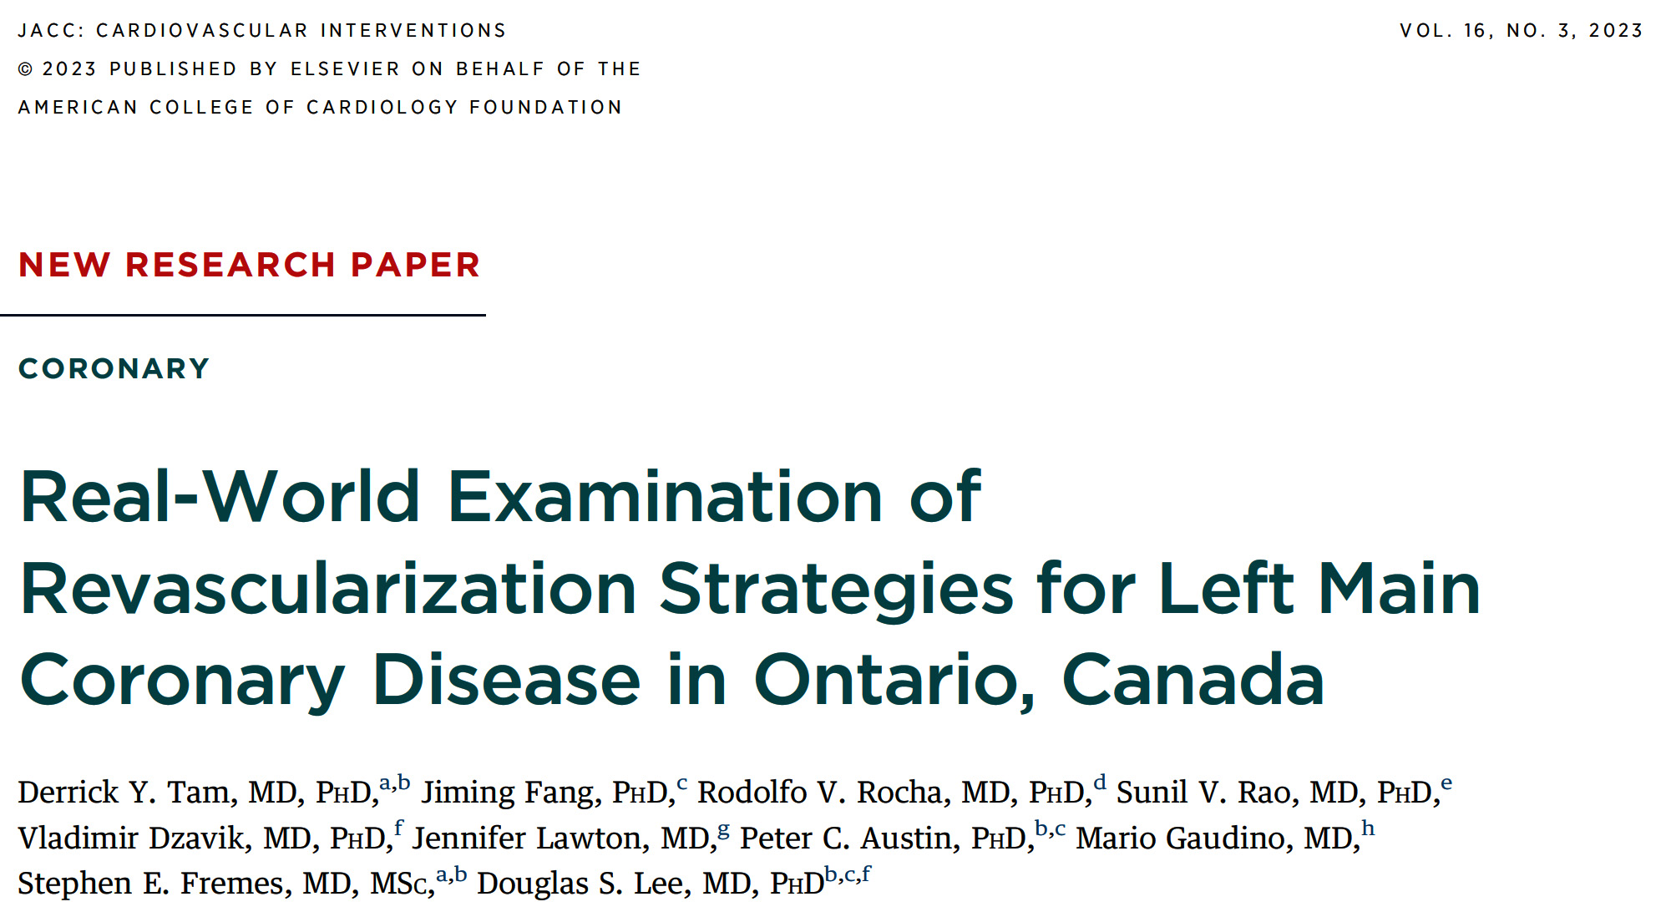

Slide 46
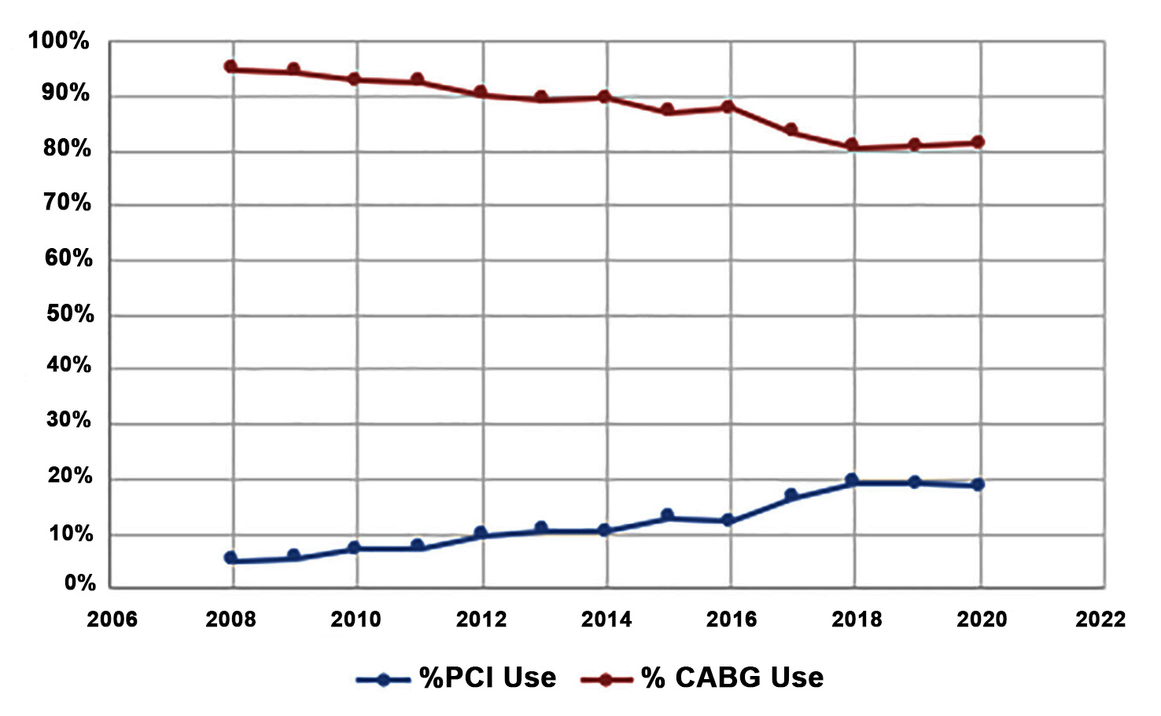
Time Trends in PCI and CABG for Left Main Disease
PCI (N=1,299); CABG (N=21,287)
Over entire study period (2008-2020), annual increase in proportion of pts with LMD undergoing PCI (p<0.005) with concomitant decrease in pts receiving CABG
Tam et al., J Am Coll Cardiol Intv 2023;16:277

Slide 47
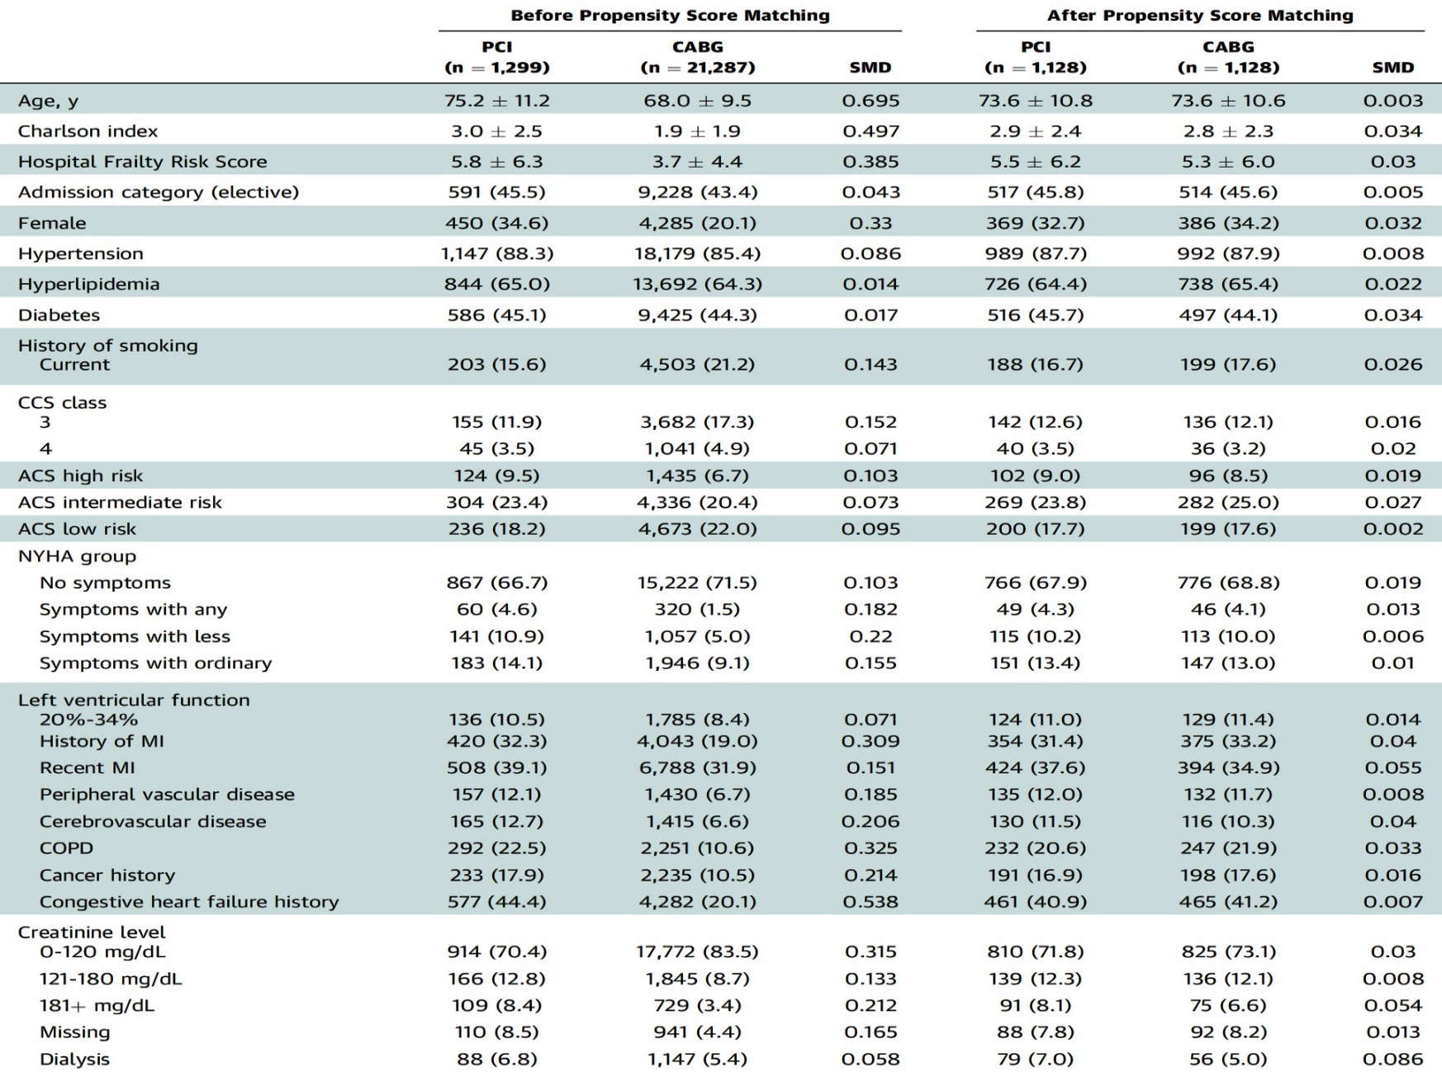
Baseline and Institutional Characteristics Before and
After Propensity Score Matching
Tam et al., J Am Coll Cardiol Intv 2023;16:277

Slide 48
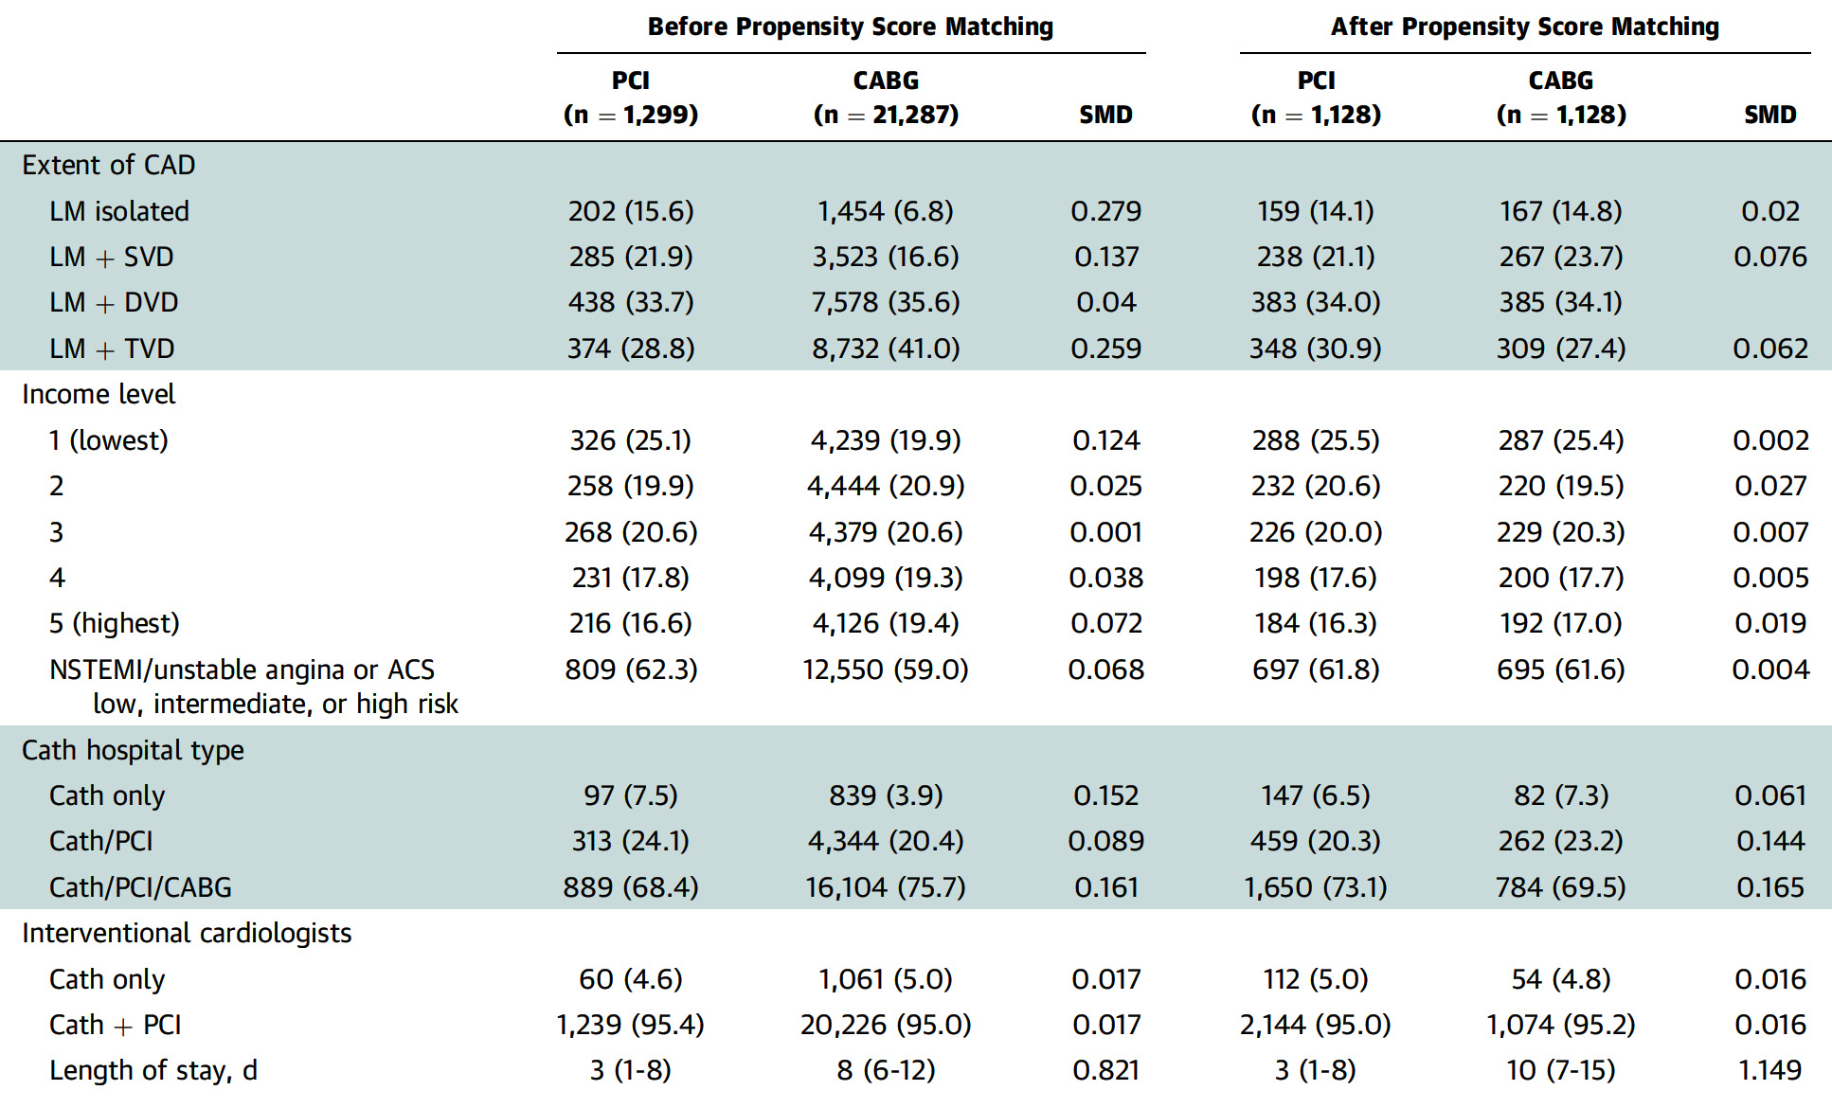
Baseline and Institutional Characteristics Before and
After Propensity Score Matching
Tam et al., J Am Coll Cardiol Intv 2023;16:277

Slide 49
Early Outcomes Before and After Propensity
Score Matching
Before Propensity Score Matching
After Propensity Score Matching
p<0.0001
p=NS
p<0.0001
p=0.19
Tam et al., J Am Coll Cardiol Intv 2023;16:277

Slide 50
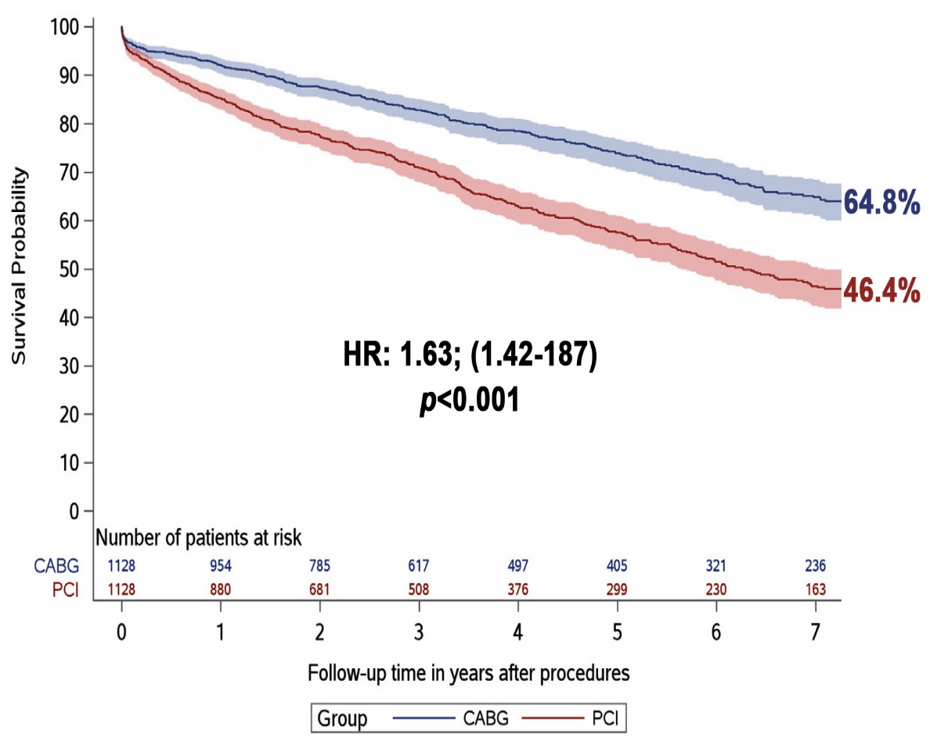
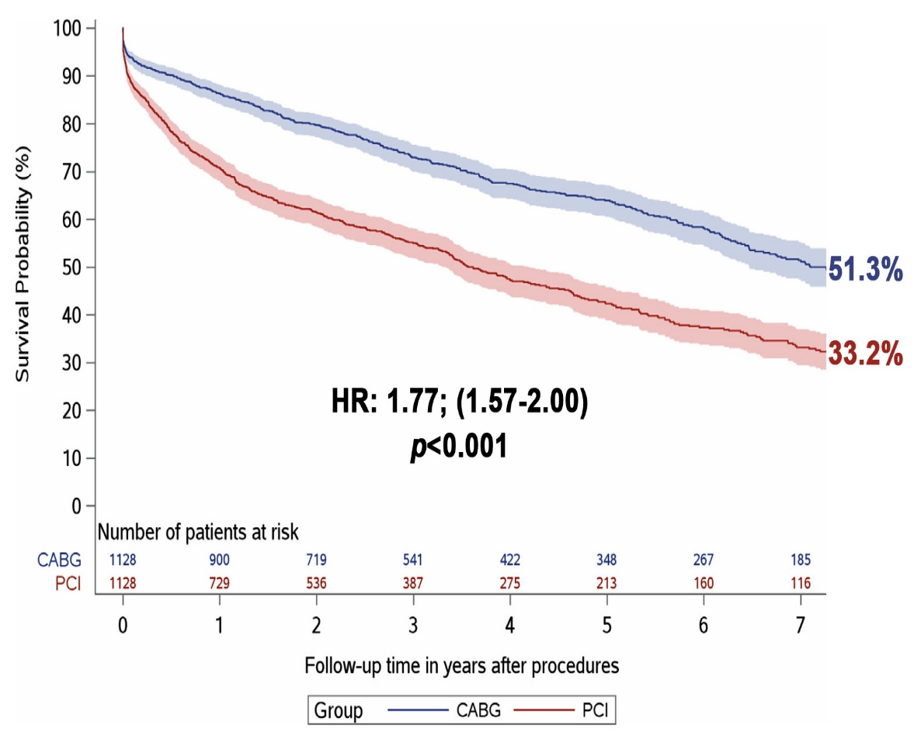
LM Revascularization: Primary Matched Analysis
Freedom from All-Cause Mortality at 7 Years Between PCI and CABG
Freedom from MACCE at 7 Years Between PCI and CABG
Tam et al., J Am Coll Cardiol Intv 2023;16:277

Slide 51
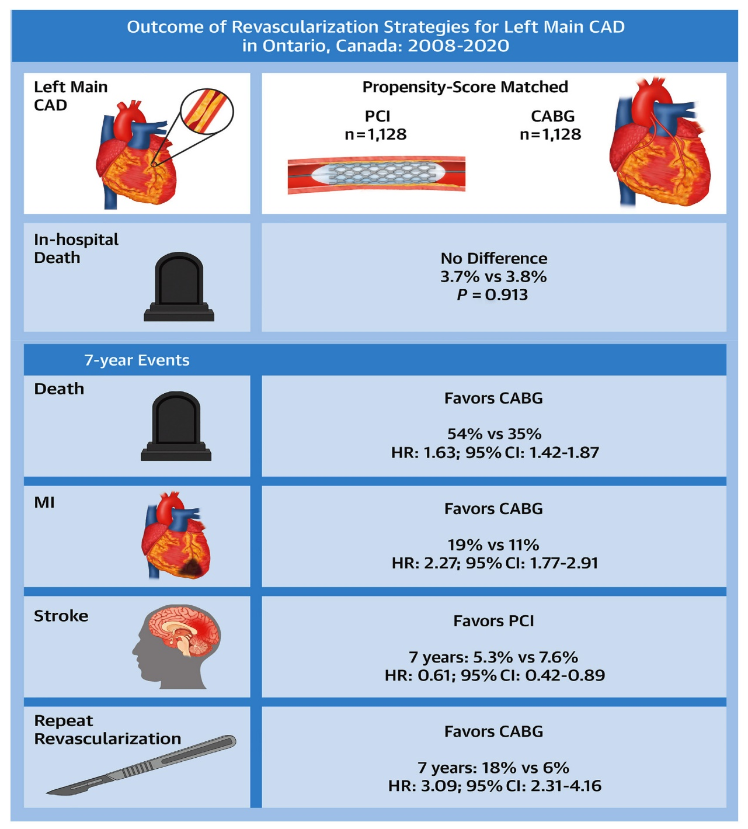
Summary of Key Study Findings
No difference in in-hosp death (3.7% vs 3.8%; p= 0.91) between PCI and CABG in pts undergoing revascularization with LM disease
All-cause mortality higher with PCI along with late AMI & late repeat revascularization at 7 years
Late stroke (5.3% vs 7.6%; HR: 0.61; (0.42-0.89) higher in CABG group at 7 years
Tam et al., J Am Coll Cardiol Intv 2023;16:277

Slide 52
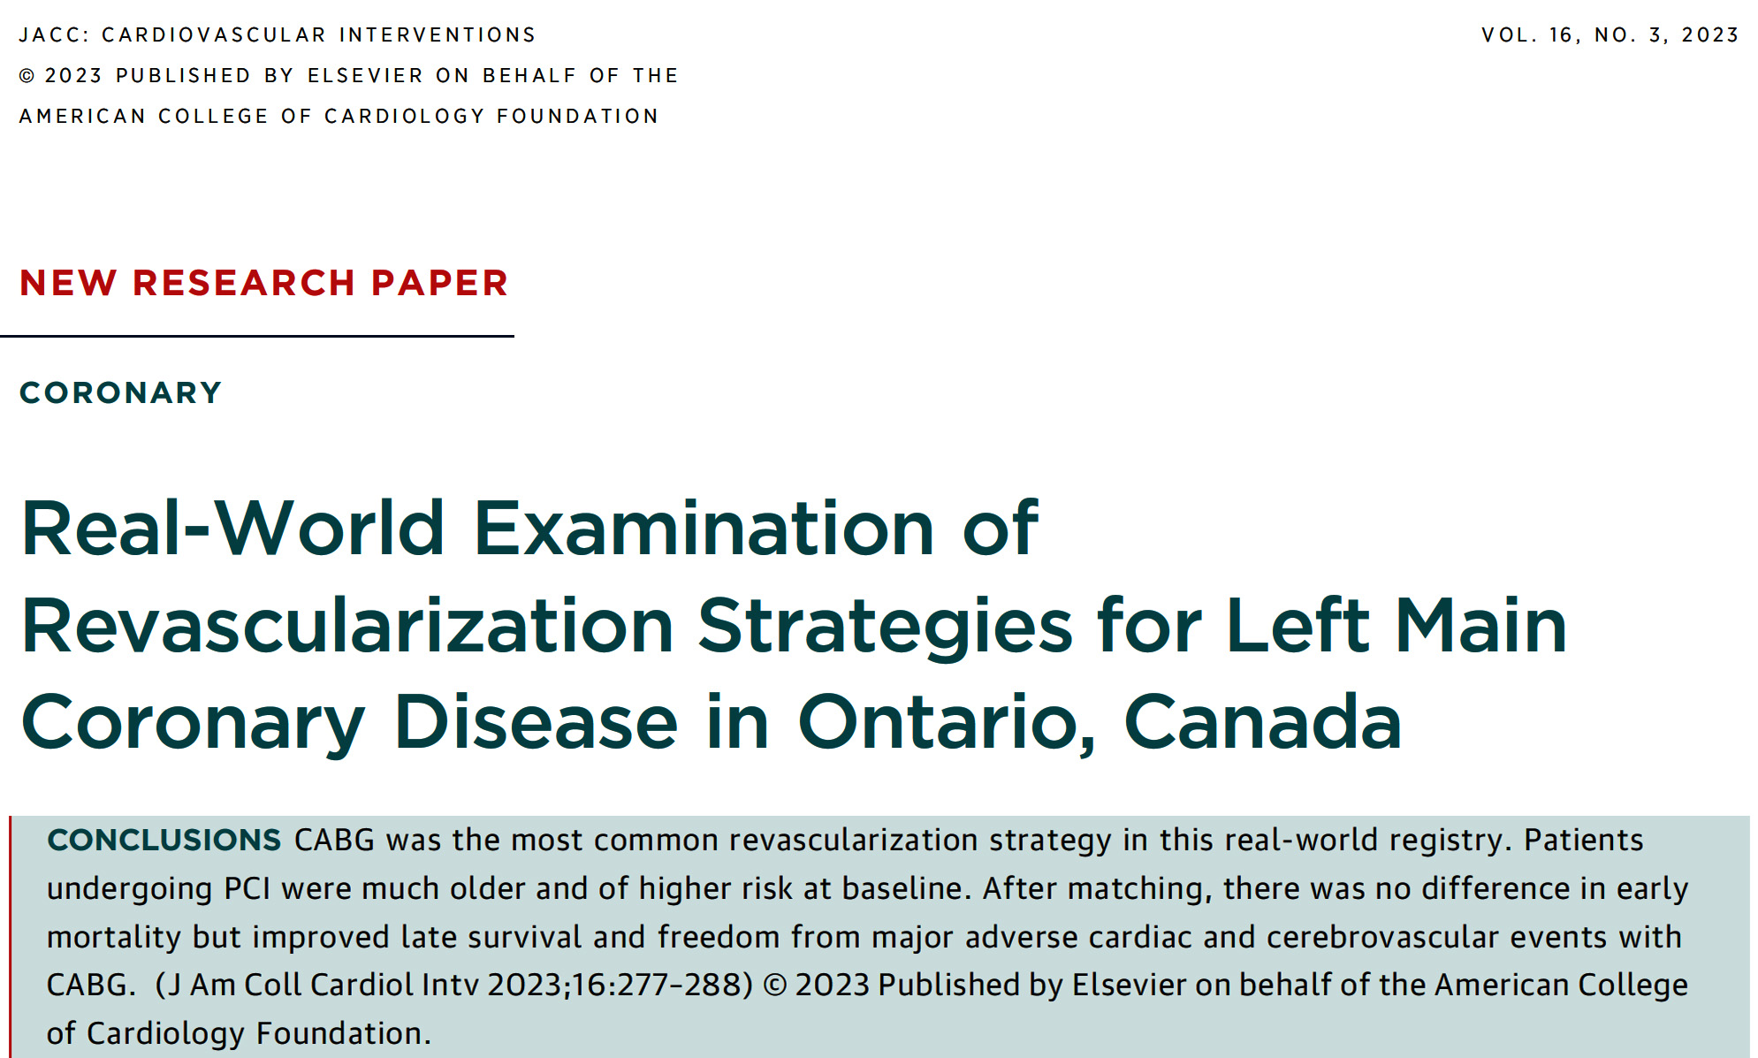

Slide 53
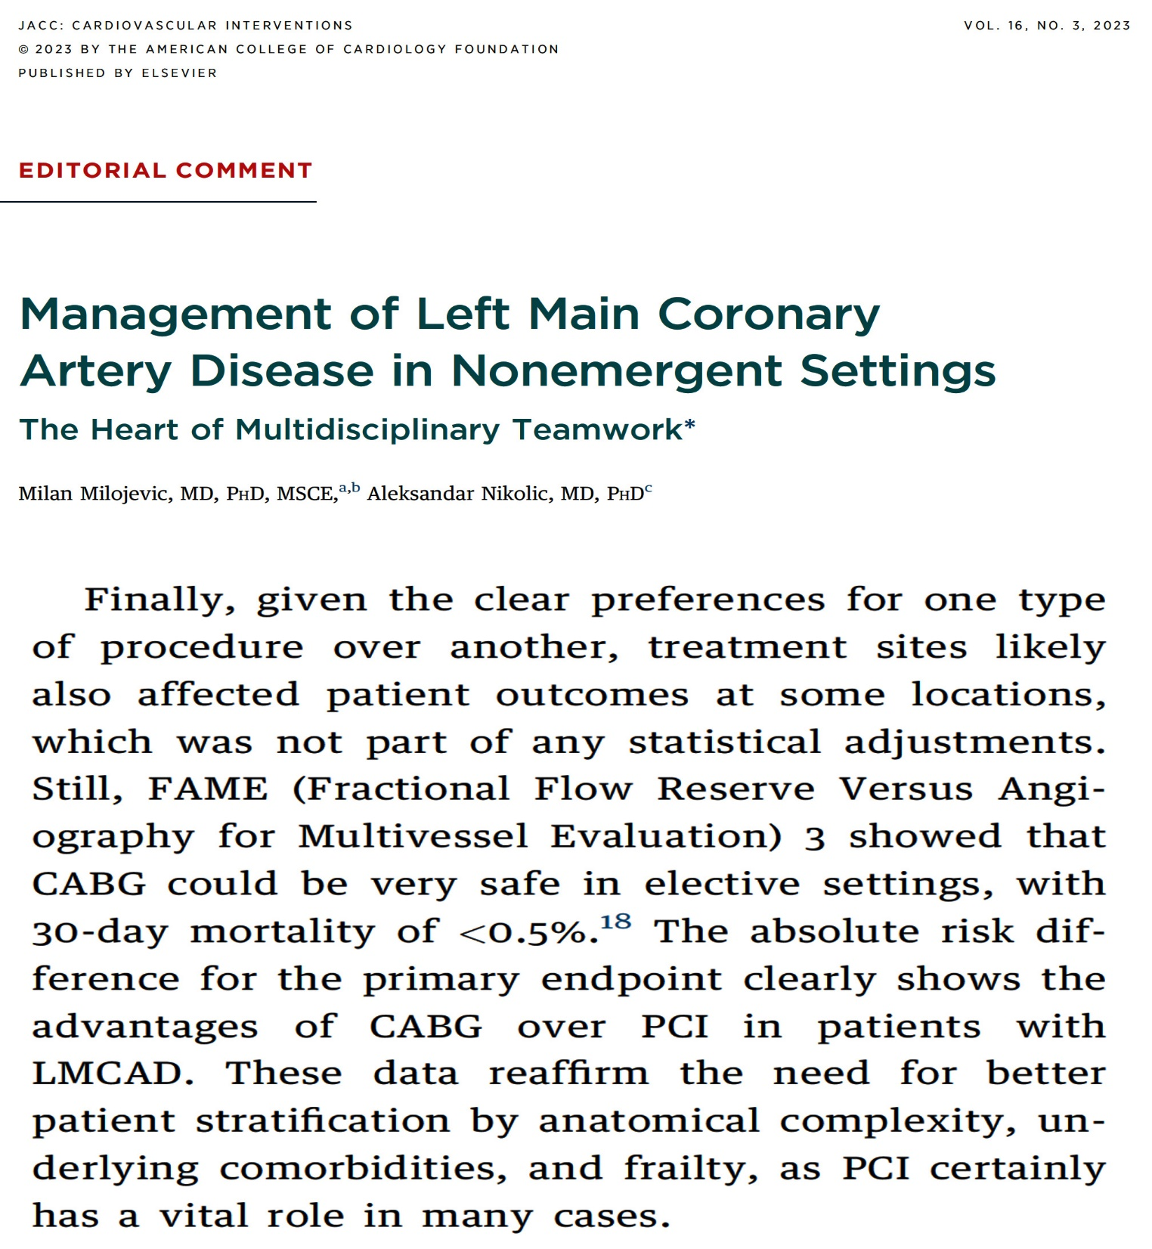

Slide 54

Take Home Message:
Key Interventional Trials from ACC 2023 and LM Revascularization
Immediate vs staged complete revascularization in ACS:
PCI vs OMT to improve LVEF even in viable myocardium:
Dysfunctional/viable myocardium doesn’t predicts prognosis or LV recovery:
Scar burden predicts adverse prognosis and LV recovery:
ML based onsite CT-FFR to reduce noCAD & Revasc:
A recent report from Canada regarding short and long-term outcomes after LM revascularization suggested lower mortality, MI & revascularization but higher CVA after CABG vs PCI at 7 year F/U. There were similar short term mortality outcomes between 2 strategies despite the fact that PCI pts were older and have higher comorbidities. These findings underscores the importance of Heart team decision in recommending appropriate revascularization in LM disease pts considering pt’s comorbidities and expected survival.
Notes:
HbA1c in

Slide 55

Question # 1
Following statement is false regarding the relationship of dysfunctional and viable myocardium in the REVIVE-BCIS-2 trial except;
  PCI does not improve LV recovery even in dysfunctional myocardium
  Presence of scar predicts adverse prognosis and less LV recovery
  PCI predicts prognosis and LV recovery in dysfunctional but viable myocardium
  Dysfunctional myocardium is not associated with prognosis
  Dysfunctional but viable myocardium is not associated with LV recovery
The correct answer is C

Slide 56

Question # 2
Following statement is false regarding the results of BIOVASC trial of immediate vs staged complete revascularization in ACS;
  A. Immediate Revasc is associated with lower primary outcomes
  B. Immediate Revasc is associated with lower MI
  C. Immediate Revas is associated with lower ID urgent Revascularization
  D. Immediate revascularization had similar major bleeding incidence
  E. Immediate Revasc is associated with trend towards lower mortality
,
The correct answer is E
Notes:
er

Slide 57
Question # 3
Following statements is false regarding the recent report about LM revascularization in Canada by PCI vs CABG:
  CABG had lower mortality at 7 years
  CABG had lower MACCE at 7 years
  CABG had lower early MI
  CABG had lower CVA at 7 years
  CABG had similar early death and CVA in propensity matches pts
The correct answer is D

Slide 58
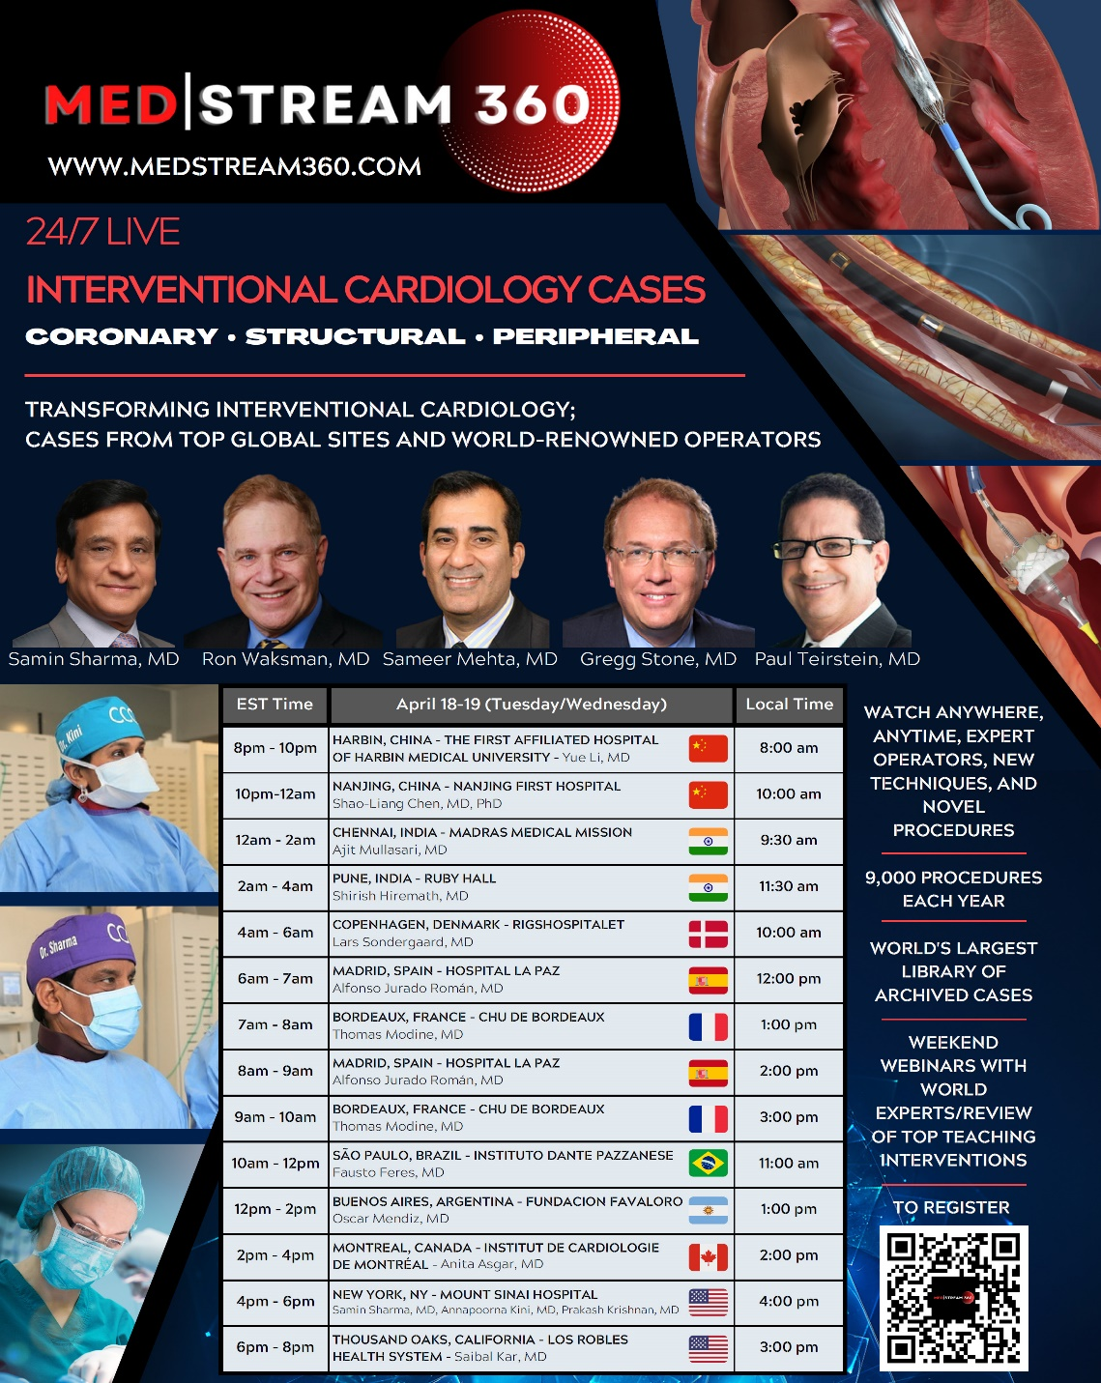
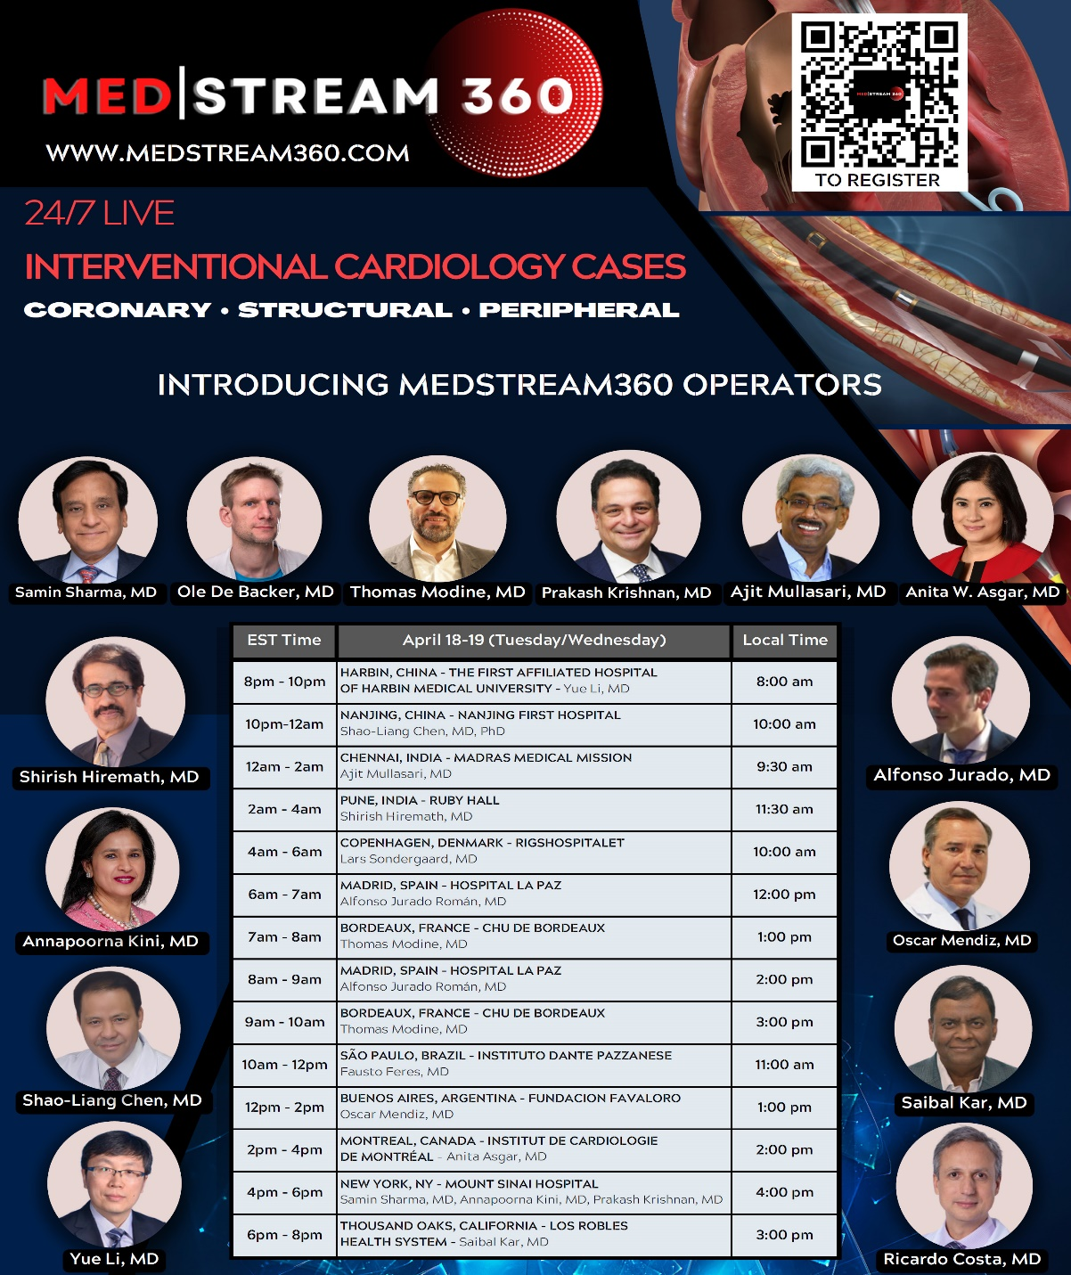

Slide 59
