Slide 1
Multi-Level CTO in Rutherford V Patient with Prior Failed Intervention Attempt
4/26/23

Slide 2
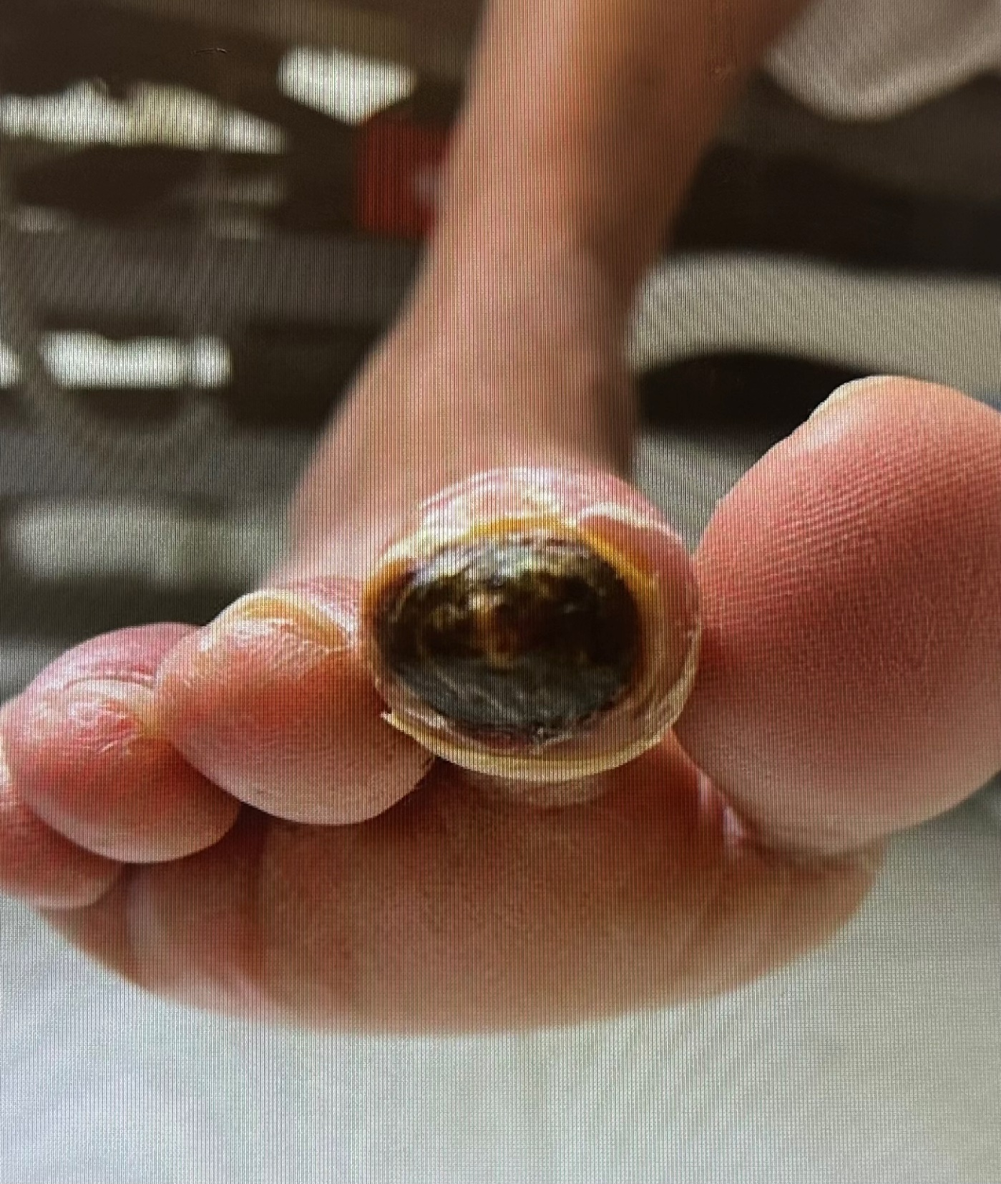
HPI:
71 year old male referred to MSH with non healing ulcers (Rutherford V), after failed attempts to revascularize b/l LE
PMHx: IDDM, hypothyroidism, CKD (Cr 1.5-1.8), and HTN
Social Hx: Former smoker
Medications: Glipizide, Metformin, Levothyroxine, Januvia, Amlodipine, Lipitor, gabapentin, Lisinopril, Prilosec, insulin
PE: With bilateral lower ext non healing ischemic ulcers. Dopplerable monophasic DP and PT

Slide 3
Previous Intervention:
Left prox SFA atherectomy, and DES (Zilver PTX)
Left mid to distal SFA IVL, DCB, BMS (Supera)
Left peroneal PTA and DES (Xiance Skypoint)
Prox AT and PT remain CTO but filled via peroneal collaterals.

Slide 6
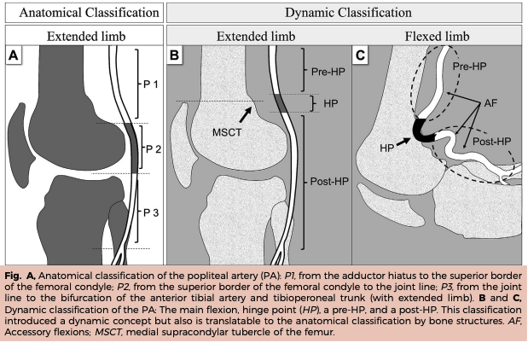
Popliteal Classification:
LifeStent Resilient (2004)
Primary patency 81.5%
4.6% Popliteal all P1
Everflex Durability II (2007)
Primary patency 67.7%
2.1% Popliteal all P1
Smart Stroll (2008)
Primary patency 66.5%
15.6% Popliteal all P1
Complete SE Vascular
Primary patency 72.6%
Zilver PTX (2005)
Primary patency 82.7%
4.6% Popliteal all P1
Supera Superb (2014)
Primary patency 86%
1.9% Popliteal all P1
Randomized Data from ETAP:
PTA (44.9%) vs lifestent (67.4%)
TLR (50.4 vs 15.4%)
Fracture 1 year 3.4% (n: 2)
Even In.Pact DCB only included P1

Slide 7
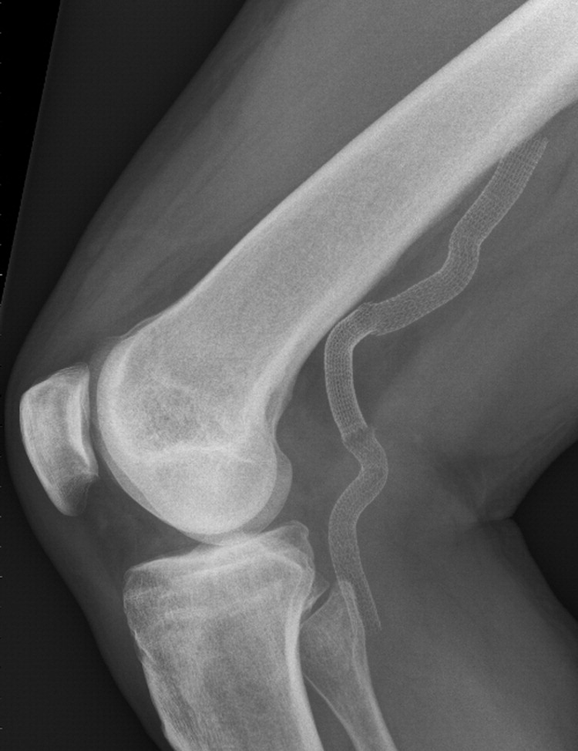
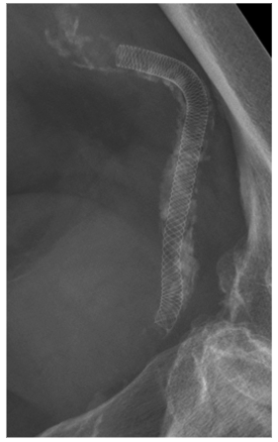

Slide 8
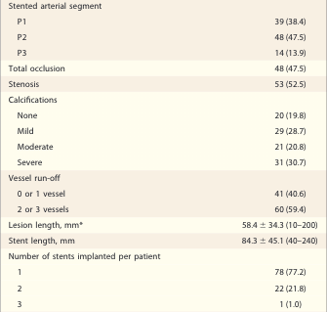
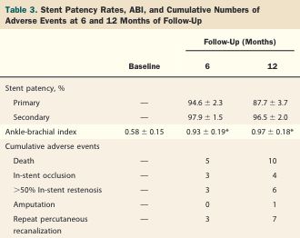
Leipzig SUPERA Popliteal Artery Stent Registry (2013)
101 patients, 125 stents, 12 month follow up.

Slide 9
Real-World results of Supera Stent Implantation for Popliteal Artery Atherosclerotic Lesions: 3 year Outcome
50 limbs in 46 patients Mostly P1 patients some P2 (14 patients)
Primary patency
12 months: 89.6%
24 months: 72.3%
36 months: 70.2%
5 patients died during follow up
Zero stent fractures on radiograph
TASC-D lesions was a significant predictor for stent occlusion

Slide 10
Popliteal Case Considerations:
Is endovascular the best approach?
Is there a total occlusion?
What segments are involved?
Are there important pergenicular collaterals?
What is the runoff?
Is retrograde access a realistic option?
Is re-entry in the tibial vessels challenging?
Will the destination therapy involve a durable scaffold?

Slide 11
Trail | Randomization Groups | Number of Patients | Primary Outcome | Lesions
YUKON-BTK | Sirolimus-eluting Stent vs BMS | 161 CLI and Claudication Rutherford 2 - 5 | 12 month patency (80.6% vs 55.6%; P = .004) | Single de novo, <5 mm
DESTINY | XIENCE Everolimus-eluting stent vs BMS | 140 CLI Rutherford 4 - 5 | 12 month patency (85.2% vs 54.4%; P = .0001) | Maximum of two focal lesions. Total lesion length <40 mm. Excluded bifurcations
ACHILLES | Irolimus-eluting stent vs standard PTA | 200 CLI Rutherford 3 - 5 | 12 month restenosis by angiography (22.4% vs 41.9%; P = .019) | Total lesion length < 120 mm. Excluded bifurcations
IDEAS | DESs (zotarolimus/sirolimus/everolimus stents) vs Paclitaxel drug-coated balloons (DCBs) | 50 CLI Rutherford 3 - 6 | 6-month angiographic restenosis (28% vs 57.9%; P = .046) | Single lesions > 70 mm
PADI | Paclitaxel-eluting stent vs PTA/BMS | 137 CLI Rutherford 4 - 6 | 5 year amputation-free survival (31.8% vs 20.4%; P = .041) | Single lesion < 60 mm
SAVAL | Nitinol Self expanding stent. Paclitaxel polymer coated vs PTA | 201 subjects Rutherford 4 - 5 (2:1) | 12 month Primary patency (DES: 68.0 vs PTA 76.0) and MACE (91% vs 95.3%) | total lesion length < 140 mm. 2.5-3.25 vessel size

Slide 13
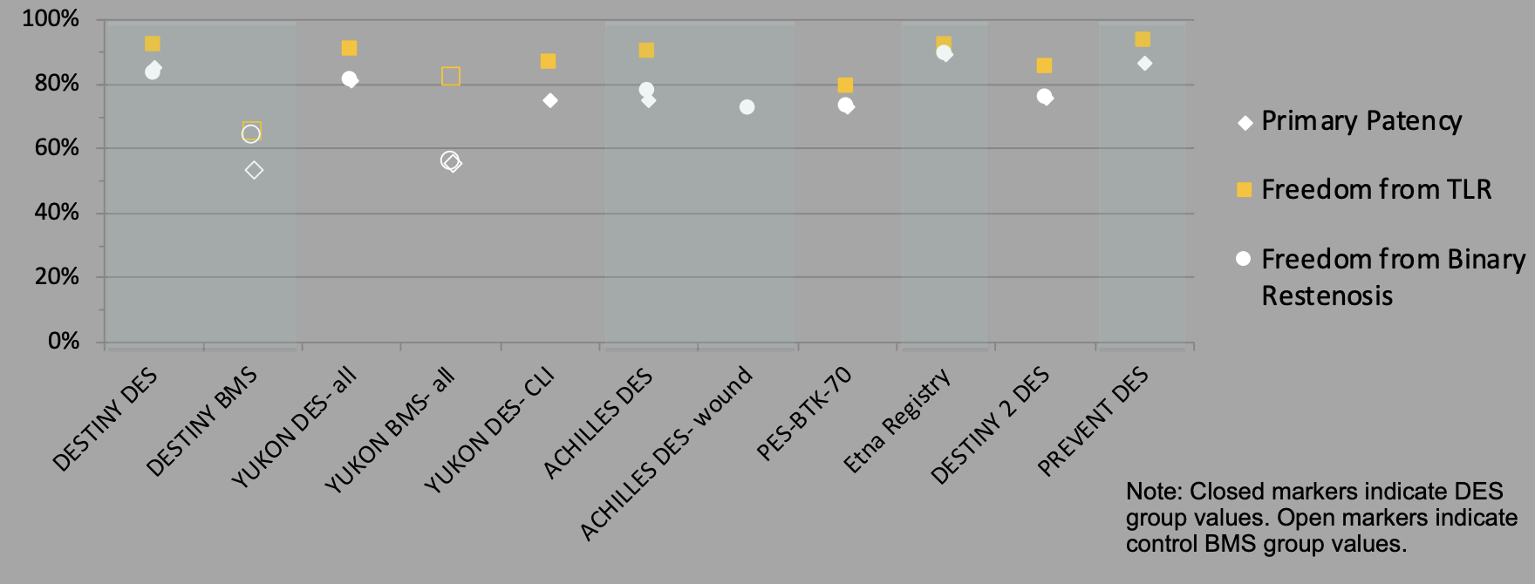

Slide 14
