Slide 1
Complex Coronary Cases Supported by:
Abbott Vascular Inc.
Boston Scientific Corp.
Terumo Vascular Corp.
Cardiovascular Systems Inc.
Abiomed Inc.
Chiesi Inc.
Shockwave Medical Inc.
Cardinal Health Cordis Inc.

Slide 2
Disclosures
Samin K. Sharma, MD, MSCAI, FACC
Nothing to disclose
Annapoorna S. Kini, MD, MRCP, FACC
Nothing to disclose
Sameer Mehta, MD, FACC (Moderator)
Nothing to disclose

Slide 3
CCC Live Case # 165
Patient Demographics
68 yrs, Male with CABG and PCIs
Present Clinical Presentation
Presented with CCS class II angina and +stress MPI for anterior, lateral and inferior ischemia
CAD Risk Factors
Controlled Hyperlipidemia
Controlled Hypertension
+F/H, Covid-19 in 2/2022
SAQ-7 score:57
Clinical Variables
s/p multiple PCIs including SKS of LAD/D1 bifurcation, then restenosis, s/p CABG x4 2015, prior 2 MIs, EF 45% on echo
Medications
Aspirin, Clopidogrel, Metoprolol XL, Amlodipine, Losartan, Pravastatin
Cath: Cath on 2/14/2023 revealed extensive native 3 V CAD with occluded SVG to RCA, occluded LIMA to LAD and patent SVG to D1 and jump to LPL: multiple 80% calcified RCA lesions and 90% calcified under-expanded SKStent in prox-mid LAD & 100% D1 filling via SVG, 100% LCx filling via SVG. Pt underwent successful RotaDES of RCA using 2 Promus Elite DES and did well.
Plan: Now planned for imaging guided staged complex PCI of calcified under-expanded SKS in LAD using RA+IVL

Slide 4
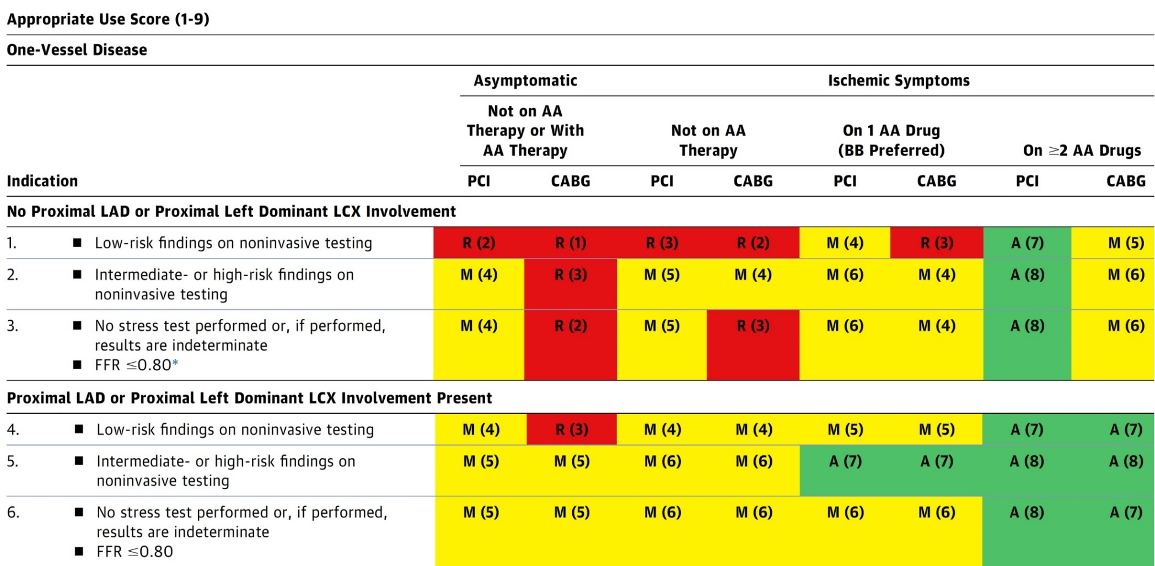
AUC 2017: One-Vessel Disease
Patel et al., J Am Coll Cardiol 2017;69:2212

Slide 5
Latest Issues in Coronary Intervention
Key Interventional Trials form ACC 2023:
HOST-IDEA, RENOVATE-COMPLEX-PCI, YELLOW-III
Focused review of the month
Beyond Coronary Artery Stenosis in SIHD:
Evolving Management Paradigm for Stable Ischemic
Heart Disease Patients

Slide 6
Latest Issues in Coronary Intervention
Key Interventional Trials form ACC 2023:
HOST-IDEA, RENOVATE-COMPLEX-PCI, YELLOW-III
Focused review of the month
Beyond Coronary Artery Stenosis in SIHD:
Evolving Management Paradigm for Stable Ischemic
Heart Disease Patients

Slide 7
Comparison Of 3-month Versus 12-month Dual Antiplatelet Therapy After Coronary Intervention Using The Contemporary Drug-eluting Stents With Ultrathin Struts And Advanced Polymer Technology:
The HOST-IDEA Randomized Clinical Trial

Slide 8
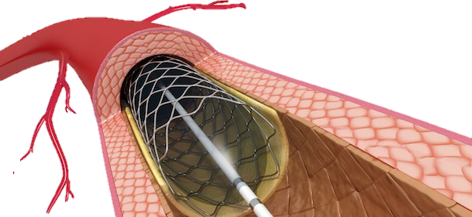
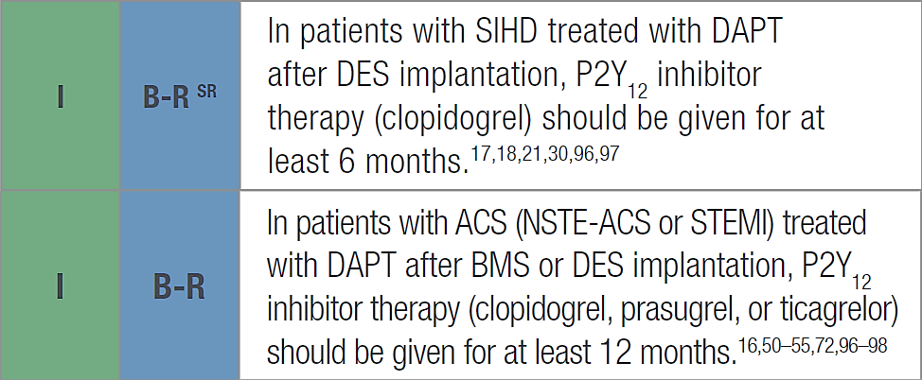
HOST-IDEA Trial: Background
Current guidelines recommend DAPT for 6 months in SIHD patients and 12 months in ACS patients.
Third-generation DES with ultrathin struts and advanced polymer technology have theoretical benefits that minimize the risk of stent-related complications.
Data are limited regarding short-term DAPT after PCI using third-generation DES with ultrathin struts and advanced polymer technology (Orsiro, Coroflex ISAR).
Third-generation DES may allow shortened default duration of DAPT.
2016 ACC/AHA Guideline
Han et al., Circulation 2023 March 5, 2023 Epub ahead of print

Slide 9
HOST-IDEA Trial: Study Flow
2,173 patients enrolled
137 did not meet inclusion criteria
111 used different stents
4 did not receive PCI
4 were withdrawn by physicians
18 did not provide consent
23 met exclusion criteria
16 STEMI
6 used anticoagulant at admission
1 treated in-stent restenosis
2,013 randomized
1,002 assigned to 3-month DAPT
268 did not follow protocol
244 discontinued DAPT >150days
23 discontinued DAPT <60days
1 DAPT duration missing
1,011 assigned to 12-month DAPT
50 did not follow protocol
49 discontinued DAPT <300days
1 DAPT duration missing
13 Lost to follow-up
7 Withdrew consent
6 Lost contact or moved
6 Lost to follow-up
3 Withdrew consent
3 Lost contact or moved
1,002 included in intention-to-treat analysis
1,011 included in intention-to-treat analysis
Han et al., Circulation 2023 March 5, 2023 Epub ahead of print

Slide 10
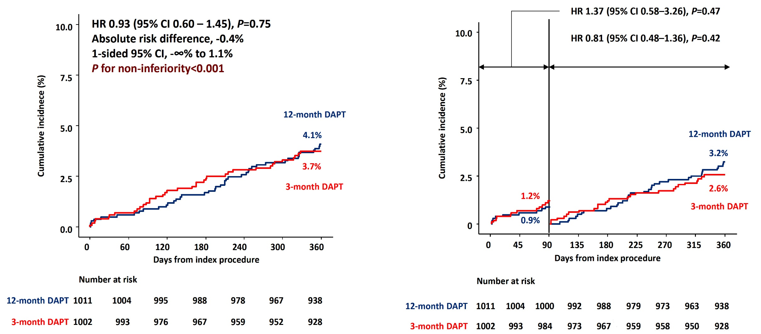
HOST-IDEA Trial: Primary Endpoint
NACE (cardiac death, TVMI, CD-TLR, ST, and major bleeding) at 12 months
Han et al., Circulation 2023 March 5, 2023 Epub ahead of print

Slide 11
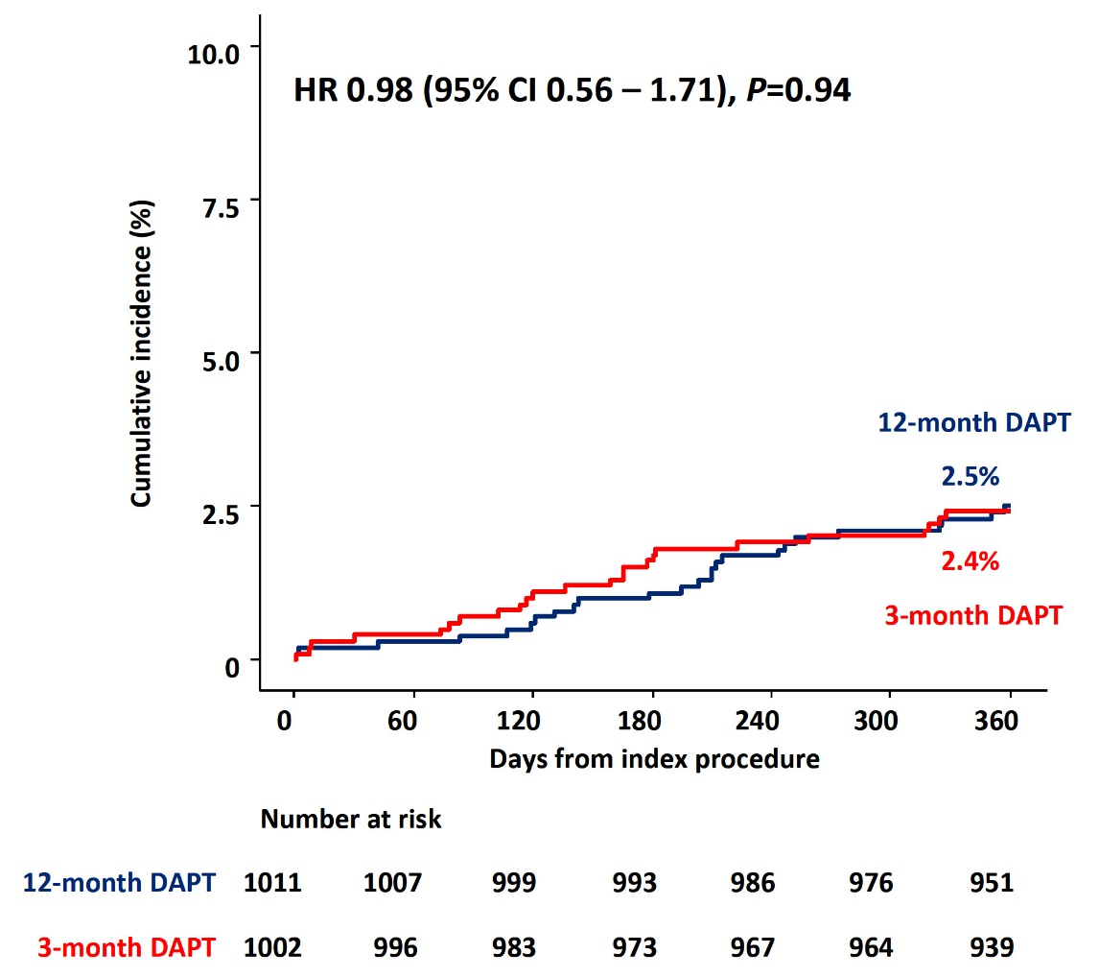
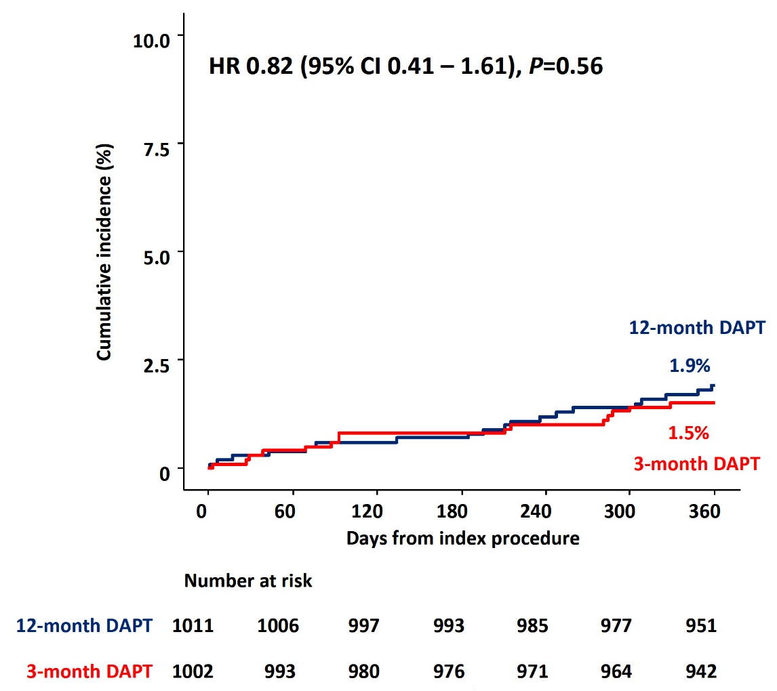
HOST-IDEA Trial: Secondary Endpoints
Target Lesion Failure
(Cardiac death, TVMI, CD-TLR)
Major Bleeding
(BARC Type 3 or 5)
Han et al., Circulation 2023 March 5, 2023 Epub ahead of print

Slide 12
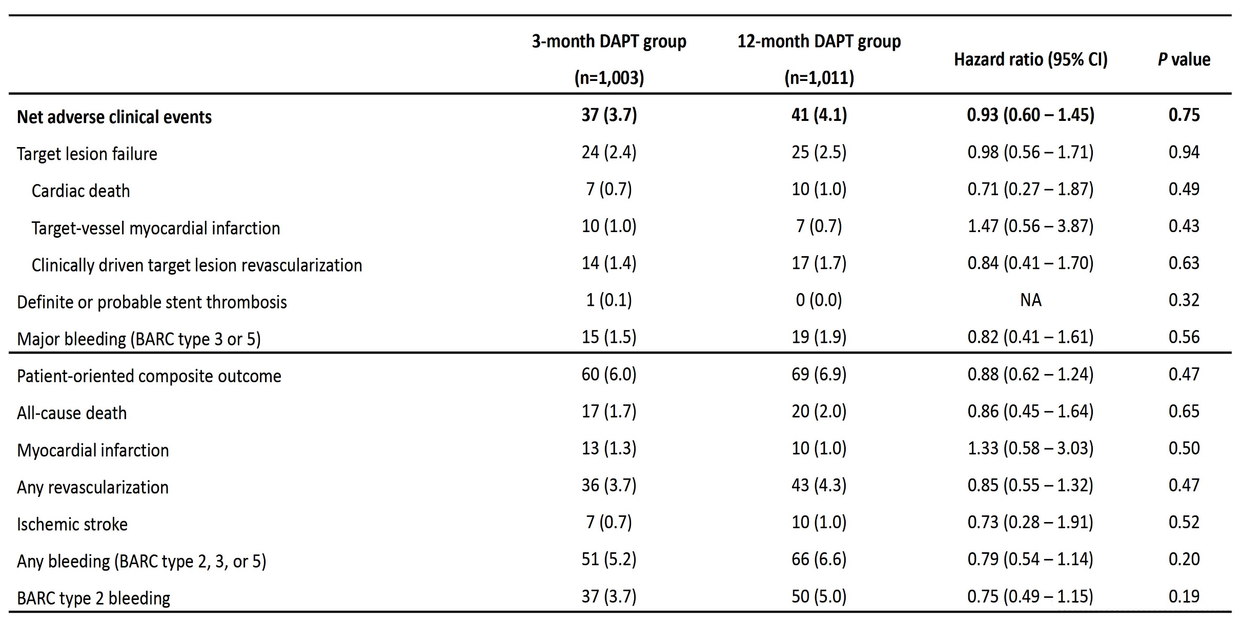
HOST-IDEA Trial: All Clinical Outcomes
at 12 Months
Han et al., Circulation 2023 March 5, 2023 Epub ahead of print

Slide 13
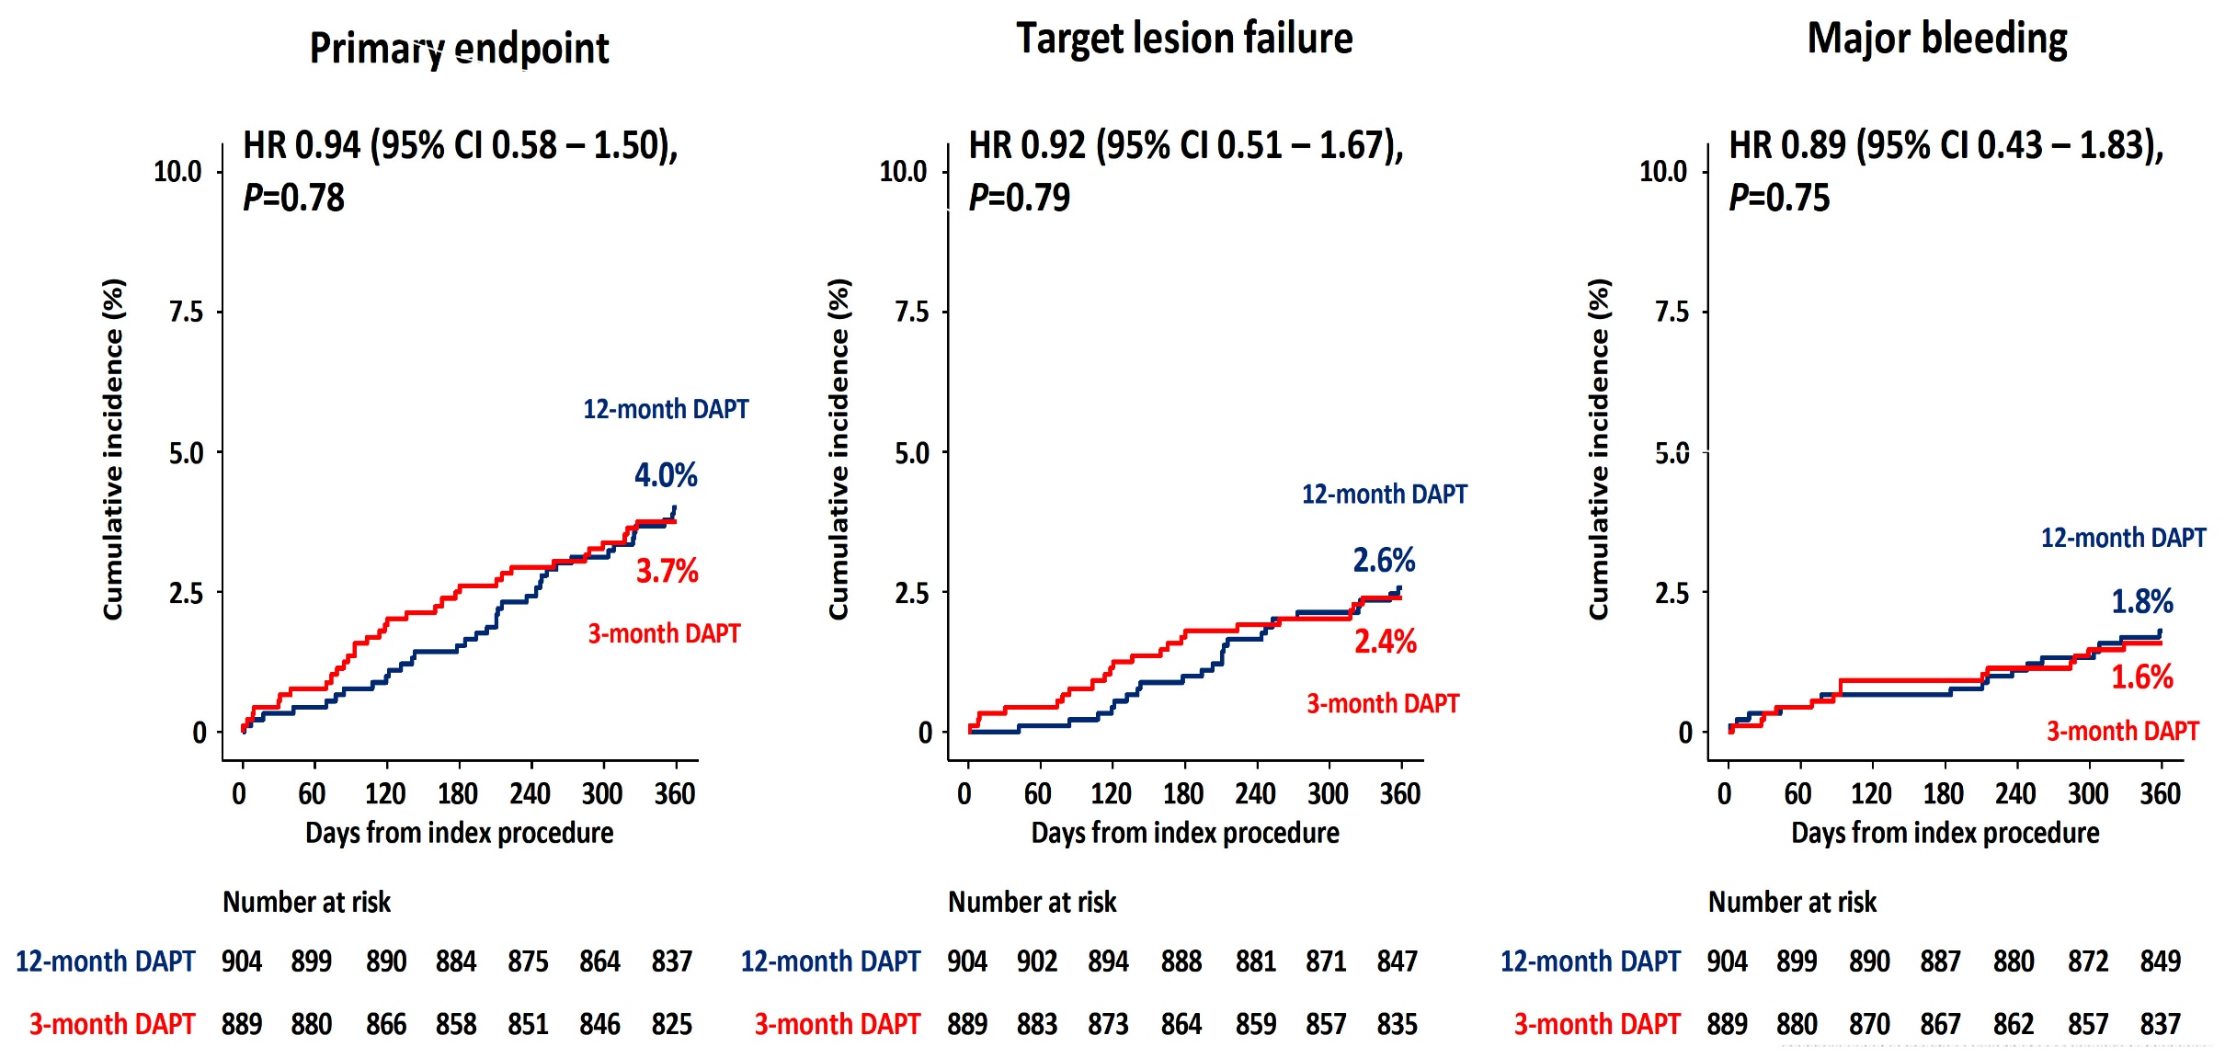
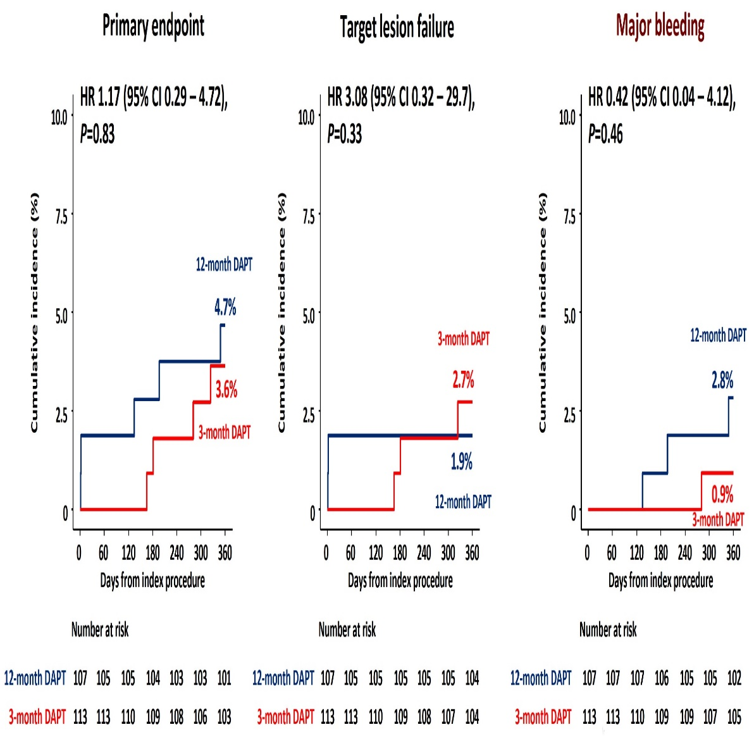
HOST-IDEA Trial: Clinical Outcomes in
Clopidogrel Users (~90%) Potent P2YI Users (~10%)
Han et al., Circulation 2023 March 5, 2023 Epub ahead of print

Slide 14
HOST-IDEA Trial: Conclusions
Among the general population excluding patients with STEMI
3-month DAPT was non-inferior to 12-month DAPT for NACE at 12 months after PCI using third-generation DES with ultrathin struts and advanced polymer technology
Han et al., Circulation 2023 March 5, 2023 Epub ahead of print

Slide 15
COMPARISON OF 3-MONTH VERSUS 12-MONTH DUAL ANTIPLATELET THERAPY AFTER CORONARY
INTERVENTION USING THE CONTEMPORARY DRUG-ELUTING STENTS WITH ULTRATHIN STRUTS AND ADVANCED POLYMER TECHNOLOGY: THE HOST-IDEA RANDOMIZED CLINICAL TRIAL
CIRCULATION. 2023; [PUBLISHED ONLINE AHEAD OF PRINT]. DOI: 10.1161/CIRCULATIONAHA.123.064264
JUNG-KYU HAN; DOYEON HWANG; SEOKHUN YANG; SANG-HYEON PARK; JEEHOON KANG; HAN-MO YANG; KYUNG WOO PARK; HYUN-JAE
KANG; BON-KWON KOO; SEUNG-HO HUR; WEON KIM; SEOK YEON KIM; SANG-HYUN PARK; SEUNG HWAN HAN;
SANG-HYUN KIM; SANGHOON SHIN; YONG HOON KIM; KYUNGIL PARK; NAMHO LEE; SEUNG JIN LEE; JIN WON KIM; HYO-SOO KIM
CIRCULATION
HTTPS://WWW.AHAJOURNALS.ORG/DOI/10.1161/CIRCULATIONAHA.123.064264
23

Slide 16
STOPDAPT-2 ACS: Clinical Outcomes at 1 Year
Hazard ratio (95%CI)
1.49
(0.83-2.67)
1.01
(0.42-2.43)
1.91
(1.06-3.44)
1.53 (0.43-5.43)
2.29
(0.70-7.42)
1.38
(0.63-3.00)
0.41
(0.20-0.83)
Cumulative Incidence
(CKMB >=10*ULN)
Watanabe H et al., JAMA Cardiol 2022;7:407

Slide 17
One-Month DAPT Trial: Subgroup Analyses for Primary Endpoint
Subgroup | No. /Total (%) |  |  |  |  |  | HR (95% CI) |  | p value for interaction
 | 1-month DAPT |  |  | 6–12-month DAPT
All patients | 88/1507 (5.9) |  |  | 98/1513 (6.5) |  |  | 0.90 (0.68 - 1.20)
Age, years |  |  |  |  |  |  |  |  | 0.941
<65 | 31/616 (5.1) |  |  | 35/615 (5.8) |  |  | 0.89 (0.55 - 1.44)
≥65 | 57/891 (6.4) |  |  | 63/898 (7.1) |  |  | 0.91 (0.63 - 1.30)
Sex |  |  |  |  |  |  |  |  | 0.532
Men | 66/1039 (6.4) |  |  | 70/1048 (6.8) |  |  | 0.95 (0.68 - 1.33)
Women | 22/468 (4.8) |  |  | 28/465 (6.1) |  |  | 0.77 (0.44 - 1.35)
Diabetes mellitus |  |  |  |  |  |  |  |  | 0.519
Yes | 48/564 (8.6) |  |  | 49/571 (8.7) |  |  | 0.99 (0.66 - 1.47)
No | 40/943 (4.3) |  |  | 49/942 (5.3) |  |  | 0.82 (0.54 - 1.24)
Hypertension |  |  |  |  |  |  |  |  | 0.594
Yes | 69/1007 (6.9) |  |  | 73/1002 (7.3) |  |  | 0.94 (0.68 - 1.30)
No | 19/500 (3.9) |  |  | 25/511 (5.0) |  |  | 0.78 (0.43 - 1.41)
Chronic kidney disease |  |  |  |  |  |  |  |  | 0.688
Yes | 23/202 (11.6) |  |  | 28/206 (13.9) |  |  | 0.82 (0.47 - 1.42)
No | 65/1305 (5.0) |  |  | 70/1307 (5.4) |  |  | 0.93 (0.67 - 1.31)
Clinical presentation |  |  |  |  |  |  |  |  | 0.013
Stable angina | 47/933 (5.1) |  |  | 67/895 (7.6) |  |  | 0.67 (0.46 - 0.97)
ACS | 41/574 (7.2) |  |  | 31/618 (5.1) |  |  | 1.43 (0.89 - 2.27)
Multivessel disease |  |  |  |  |  |  |  |  | 0.212
Yes | 60/867 (7.0) |  |  | 59/878 (6.8) |  |  | 1.04 (0.72 - 1.48)
No | 28/640 (4.4) |  |  | 39/635 (6.2) |  |  | 0.70 (0.43 - 1.15)
Favors
1-month DAPT
Favors
6–12-month DAPT
0.1
1
10
Hong S-J et al. J Am Coll Cardiol Intv 2021:14:1801

Slide 18
Intravascular Imaging-Guided Versus Angiography-Guided Complex PCI
The RENOVATE-COMPLEX-PCI Trial

Slide 19
Study Design
RENOVATE-COMPLEX-PCI Trial (NCT03381872)
1,620 Patients with Complex Coronary Artery Lesions Undergoing PCI
* Definition of Complex Coronary Artery Lesions
① True bifurcation (Median 1,1,1/1,0,1/0,1,1) with side branch ≥2.5mm
② Chronic total occlusion (≥3 months) as target lesion
③ PCI for unprotected left main disease
④ Implanted stent length ≥38mm
⑤ Multivessel PCI (≥2 vessels treated at one PCI session)
⑥ Multiple stent needed (≥3 more stent per patient)
⑦ In-stent restenosis lesion as target lesion
⑧ Severely calcified lesion (encircling calcium in angiography)
⑨ Ostial lesion in LAD, LCX, and RCA
Randomized (2:1) for Treatment Strategy of Target Lesions
(Stratified by acute coronary syndrome and participating centers)
Imaging-Guided Strategy
N = 1,080
Angiography-Guided Strategy
N = 540
Imaging-Guided Strategy
N = 1,080
Angiography-Guided Strategy
N = 540
All patients were followed until 1 year after last patient enrollment
Hahn J-Y, ACC 2023

Slide 20
RENOVATE-COMPLEX-PCI Trial Endpoints
Primary End Point
Target vessel failure
A composite of cardiac death, target vessel-related MI, and clinically-driven target vessel revascularization
Secondary End Point
Target vessel failure without procedure-related MI
Cardiac death or target vessel-related MI
Target vessel-related MI with or without procedure-related MI
Non-target vessel-related MI
Any MI with or without procedure-related MI
Target lesion revascularization
Target vessel revascularization
Any revascularization (clinically-driven)
Definite stent thrombosis
Total amount of contrast
Incidence of contrast-induced nephropathy
Total procedural time
Total medical cost
Definition of Clinical Events
Spontaneous MI according to 3rd Universal Definition¹
Other clinical events according to ARC-2 criteria³
Procedure-related MI according to SCAI Definition²
Hahn J-Y, ACC 2023

Slide 21
RENOVATE-COMPLEX-PCI Trial: Target-Lesion and
Procedural Characteristics
Characteristics | Total (N=1639) | Imaging-guided PCI (N=1092) | Angio-guided PCI (N=547)
Target-lesion Characteristics
Complex coronary lesions - no. (%)
True bifurcation lesion with side branch ≥2.5mm | 21.9 | 21.3 | 23.0
Chronic total occlusion (≥3 months) | 19.5 | 20.1 | 18.1
Unprotected left main coronary artery disease | 11.7 | 12.6 | 9.9
Long coronary lesion (implanted stent ≥38 mm in length) | 54.8 | 56.5 | 51.4
Multivessel PCI (≥2 vessels treated at one PCI session) | 37.9 | 37.5 | 38.9
Multiple stents (≥3 more stent per patient) | 18.6 | 19.0 | 17.7
In-stent restenosis | 14.4 | 14.5 | 14.3
Severely calcified (encircling calcium in angiography) | 14.1 | 14.4 | 13.5
Ostial coronary lesion (LAD, LCX, RCA) | 15.3 | 16.7 | 12.6
Number of vessels with disease - no. (%)
1-vessel disease | 32.1 | 31.3 | 33.6
2-vessel disease | 37.9 | 38.5 | 36.7
3-vessel disease | 30.0 | 30.2 | 29.6
Procedural characteristics
Total no. of target lesions treated | 1.5±0.7 | 1.5±0.7 | 1.5±0.7
Intravascular imaging devices used - no./total no. (%) | 1091/1639 (66.6) | 1078/1092 (98.7) | 13/547 (2.4)
Intravascular ultrasound | 813/1091 (74.5) | 800/1078 (74.2) | 13/13 (100.0)
Optical coherence tomography | 278/1091 (25.5) | 278/1078 (25.8) | 0/13 (0.0)
Volume of contrast media used - ml | 207.3±116.5 | 214.2±118.5 | 193.7±111.3
Procedural time - min | 65.0 (47.0-89.0) | 70.0 (51.0-95.0) | 53.5 (40.0-75.0)
Procedural success - no. (%) | 98.4 | 98.3 | 98.7
Lee et al., N Engl J Med Mar 5, 2023, Epub ahead of print

Slide 22
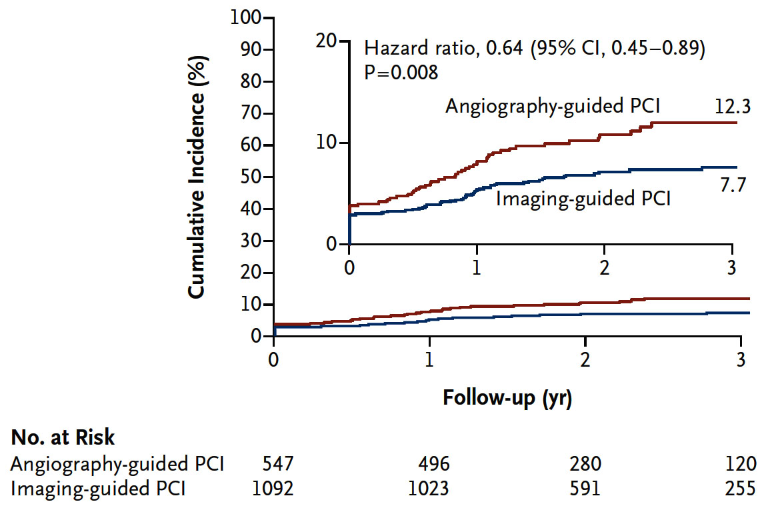
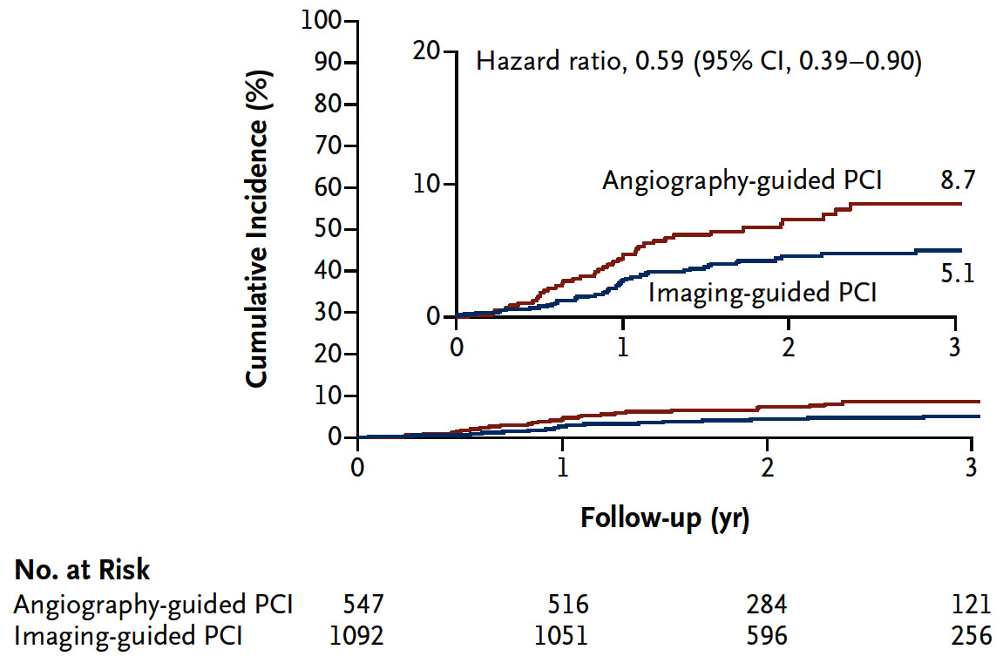
RENOVATE-COMPLEX-PCI Trial: Primary &
Secondary Endpoints
Primary Endpoint: Target Vessel Failure
(composite of death from cardiac causes, TV-MI, or CD-TVR)
Secondary Endpoint: TVF without Procedure MI
Lee et al., N Engl J Med Mar 5, 2023, Epub ahead of print

Slide 23
RENOVATE-COMPLEX-PCI Trial: Primary and
Secondary Endpoints
p=0.008
%
Lee et al., N Engl J Med Mar 5, 2023, Epub ahead of print

Slide 24
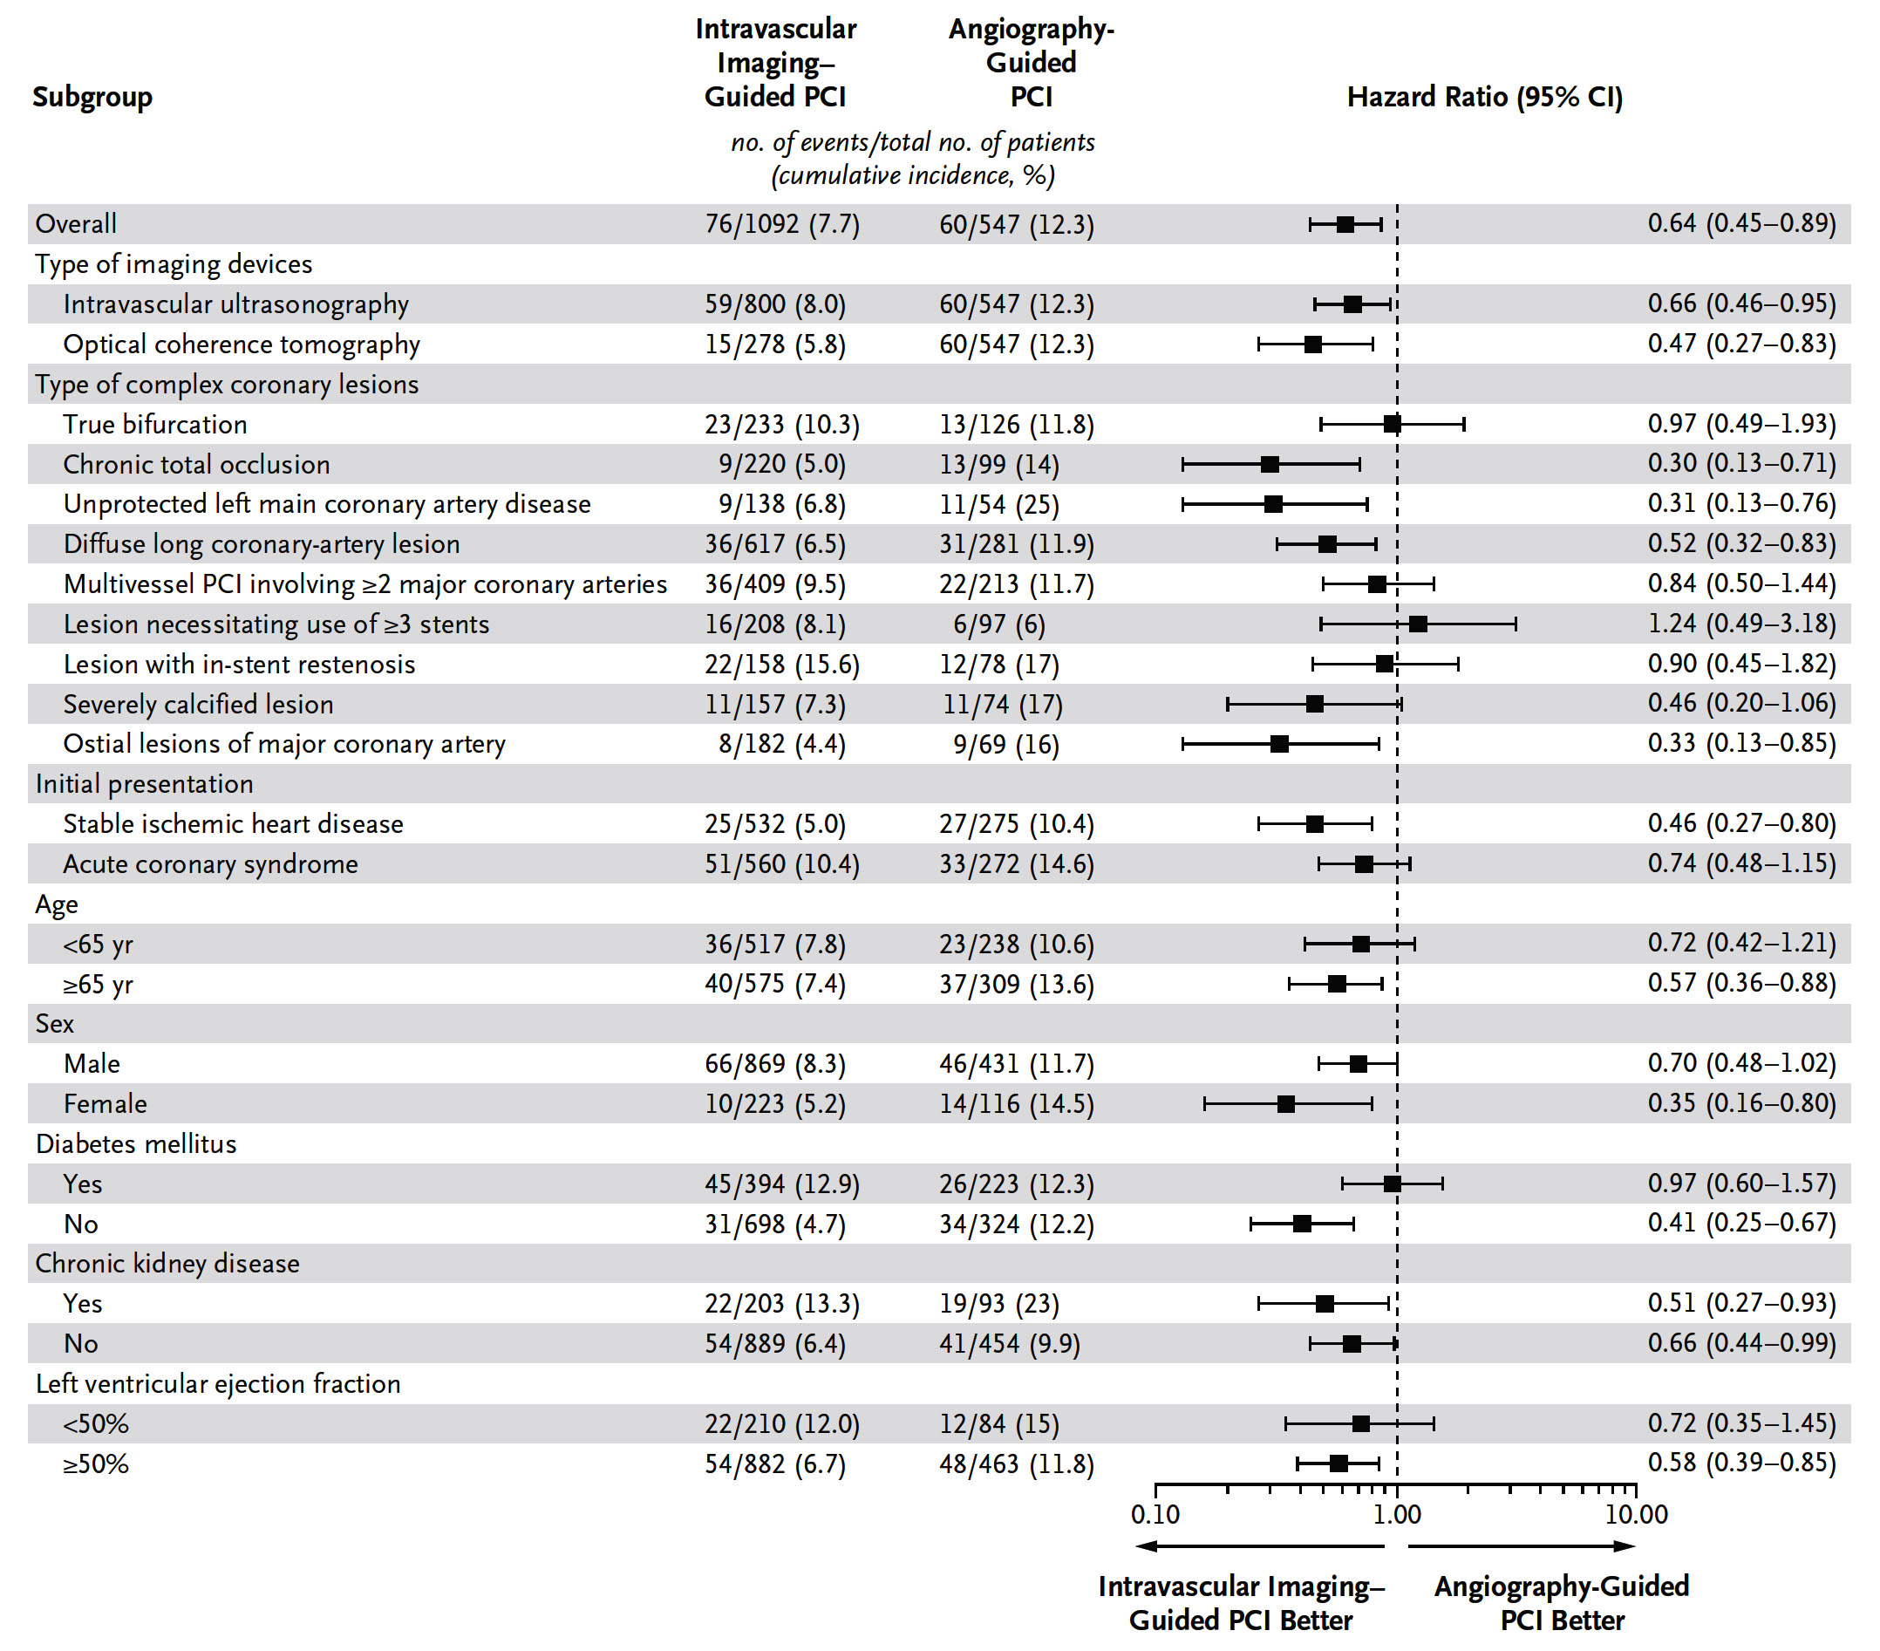
RENOVATE-COMPLEX-PCI Trial: Pre-specified Subgroup Analysis of the Primary Endpoint
Lee et al., N Engl J Med Mar 5, 2023, Epub ahead of print

Slide 25
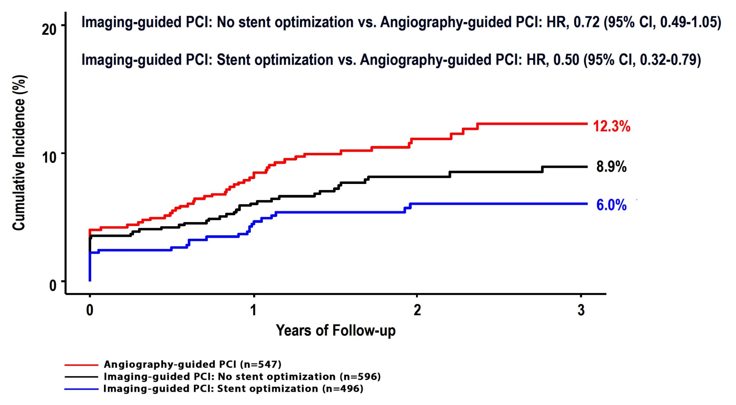
RENOVATE-COMPLEX-PCI Trial: Imaging-Guided Procedural Optimization
Lee et al., N Engl J Med Mar 5, 2023, Epub ahead of print

Slide 26
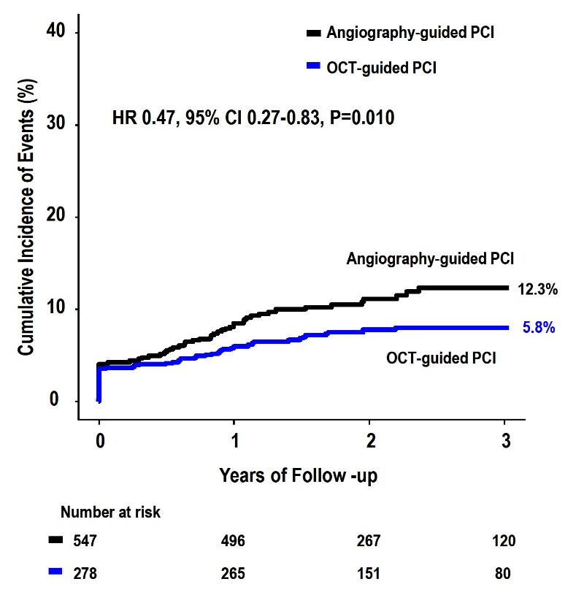
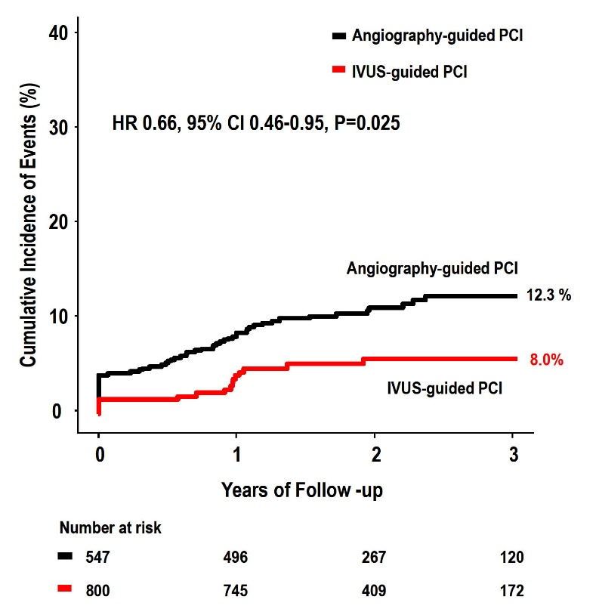
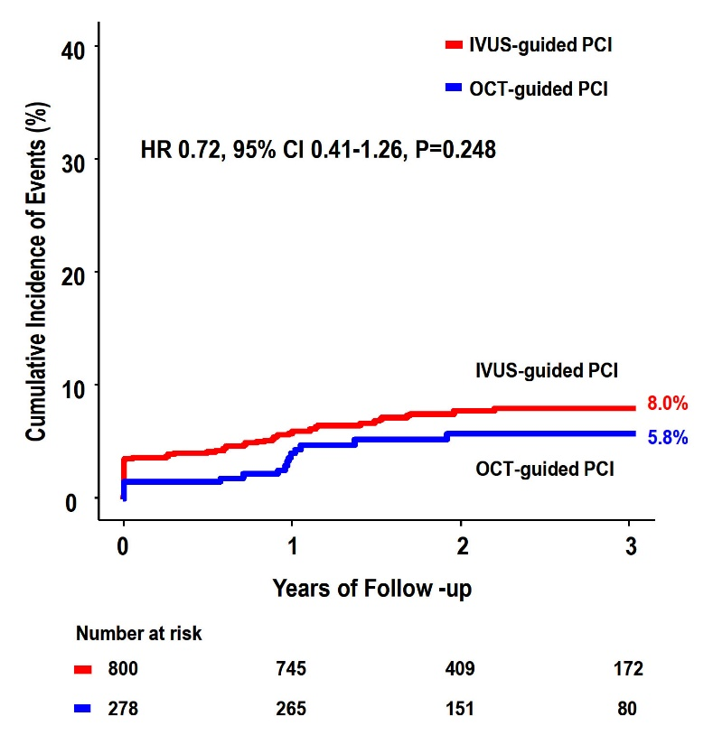
RENOVATE-COMPLEX-PCI Trial: Imaging-guided PCI vs Angio-Guided PCI
OCT-guided PCI vs
Angio-guided PCI
IVUS-guided PCI vs
Angio-guided PCI
OCT-guided PCI vs
IVUS-guided PCI
Lee et al., N Engl J Med Mar 5, 2023, Epub ahead of print

Slide 27
RENOVATE-COMPLEX-PCI: Conclusions
Among patients with complex coronary artery lesions,
Intravascular imaging-guided PCI was associated with a lower incidence of a composite of cardiac death, target vessel-related myocardial infarction, or clinically driven target vessel revascularization compared to angiography- guided PCI.
The RENOVATE-COMPLEX-PCI trial support the intravascular imaging-guided PCI in treatment of patients with complex coronary artery lesions undergoing PCI.

Slide 28
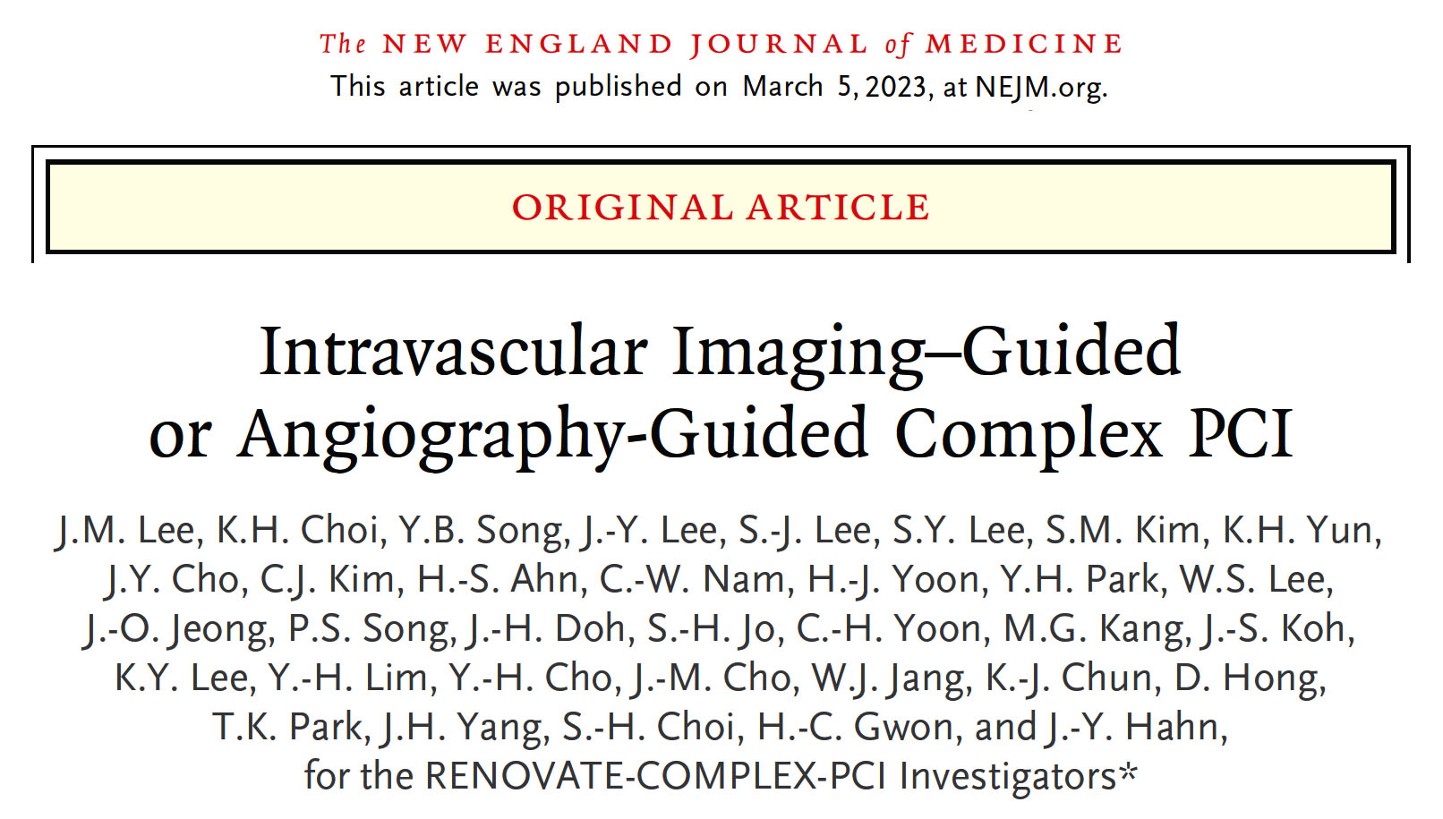
Simultaneous publication

Slide 29
Effect of Evolocumab on Coronary Plaque Characteristics in Stable Coronary Artery Disease:
A Multimodality Imaging Study (The YELLOW III Study)
Kini A, et al

Slide 30
YELLOW III: Background
Despite high intensity statin therapy, a considerable residual risk of cardiovascular events remains in patients with CAD. PCSK9 inhibitors has reduced this residual risk.
Evaluation of these effects are associated with:
Reduction in percent atheroma volume (PAV) by IVUS in patients with stable CAD (GLAGOV)¹
Increase in minimum fibrous cap thickness (FCT) by Optical Coherence Tomography (OCT) in NSTEMI (HUYGENS)²
Reduction of Lipid Core Burden Index (maxLCBI4 mm) by NIRS (PACMAN-AMI)³
Previous studies from our group showed reduced maxLCBI4 mm (YELLOW I)⁴ and increased FCT (YELLOW II)⁵ in obstructive lesions of patients with CAD after rosuvastatin 40 mg for 6-12 weeks.
¹ Nicholls et al., JAMA 2016;316:2373-2384
² Nicholls et al., JACC Cardiovasc Imaging 2022;15:1308-1321
³ Räber et al., JAMA 2022;327:1771-1781
⁴ Kini et al., JACC 2013; 62(1):21-29
⁵ Kini et al., JACC 2017; 69(6):628-640

Slide 31
YELLOW III Study
Aim: assess the effect of 26 weeks of evolocumab on coronary plaque morphology using intravascular imaging (OCT and NIRS/IVUS) and peripheral blood mononuclear cell (PBMC) gene expression analysis in patients with stable CAD on maximally tolerated statin therapy
Primary endpoints:
Change in minimal fibrous cap thickness (FCT) assessed by OCT
Change in maximal lipid-core burden index within 4 mm (maxLCBI_{4mm}) by NIRS
Secondary endpoints:
Change in maximal lipid arc, lipid length, lipid volume index, macrophage accumulation and calcification assessed by OCT
Change in percent atheroma volume (PAV) and total atheroma volume (TAV) assessed by IVUS
Changes in PBMC gene expression
Kini A, ACC 2023

Slide 32
YELLOW III: Study Design
LDL-C ≥ 80 mg/dL (low/moderate)
LDL-C ≥ 60 mg/dL (high-dose statin)
LDL-C ≥ 100 mg/dL (statin intolerance)
Patients with stable CAD undergoing cardiac catheterization (at least 4 weeks on max tolerated statin therapy)
Non-obstructive lesion (30-50% stenosis) identified by angiography in a non-culprit vessel
Yes
Lipid rich plaque: Max Lipid Arc >90° Minimal FCT ≤ 120 µm
Baseline
After culprit vessel PCI: OCT of the study lesion
No
NIRS/IVUS of the study lesion
EXCLUDE
Evolocumab: 140 mg every 2 weeks in addition to statins (26 weeks)
PBMC mRNA analysis at Baseline and Follow-up
Follow-up
OCT and NIRS/IVUS of the study lesion
Clinical follow-up at 1, 6, 12 month
Kini A, ACC 2023

Slide 33
YELLOW III Study: Flow of Patients
329 Patients screened for enrollment
192 Excluded
89 LDL-C criteria not met
84 No suitable lesion on angiography 14 No lipid plaque with thin FCT on OCT 4 Withdrew consent before procedure
1 Creatinine criteria not met
137 Patients enrolled
(8 statin intolerant)
27 Excluded
11 Patient preference (no FU, took drug) 7 Consent withdrawal
4 Lost to follow-up
2 Withdrew consent before taking 1st dose
2 Died
1 Treatment discontinuation (f/u done)
110 Completed 26-week F/U (7 statin intolerant )
Kini A, ACC 2023

Slide 34
YELLOW III: Baseline Characteristics
 | N=137
Age, y | 66.0 (9.7)
Men | 98 (71.5)
BMI | 31.6 (19.3)
Hypertension | 127 (92.7)
Previous PCI | 97 (70.8)
Previous MI | 32 (23.4)
Current smoking | 14 (10.2)
History of smoking | 51 (37.2)
Diabetes | 74 (54.0)
Baseline statin use | N=129*
High intensity ** | 91 (71)
Moderate intensity | 38 (29)
Low intensity | 0
Coronary vessel
LAD | 29
LCx | 36
RCA | 70
RI | 2
* 8 statin intolerant patients; ** atorvastatin ≥40 mg or rosuvastatin ≥20 mg
Kini A, ACC 2023

Slide 35
YELLOW III Study: Biochemical Measures
N=110 | Baseline | Follow-Up (26 weeks) | Absolute Change | P value
Total cholesterol, md/dL | 168.7 ± 48.7 | 104.7 ± 33.5 | -64.0 ± 45.9 | <0.001
LDL cholesterol, md/dL | 96.8 ± 31.1 | 39.1 ± 27.2 | -57.7 ± 29.0 | <0.001
HDL cholesterol, md/dL | 43.4 ± 9.8 | 45.2 ± 12.3 | 1.8 ± 8.4 | 0.05
Triglycerides, mg/dL | 132.0 ± 91.0 | 103.4 ± 66.8 | -28.6 ± 78.8 | 0.32
Total/HDL cholesterol | 4.5 ± 3.8 | 2.8 ± 4.4 | -1.7 ± 5.9 | 0.004
High-sensitivity CRP, mg/L | 3.2 ± 4.7 | 3.7 ± 6.7 | 0.34 ± 4.1 | 0.87
Kini A, ACC 2023

Slide 36
YELLOW III Study: Primary Imaging Endpoints
N=110 | Baseline | Follow-Up (26 weeks) | Absolute Change | P value
OCT
Minimal fibrous cap thickness, µm | 70.9 ± 21.7 | 97.7 ± 31.1 | 26.8± 22.3 | <0.001
FCT <65 µm, N (%) | 53 (48) | 14 (13) |  | <0.001
Patients with increased fibrous cap*, N (%) |  | 88 (80)
NIRS
maxLCBI₄ _{mm} | 306.8 ± 177.6 | 213.3 ± 168.0 | -93.7 ± 140.5 | <0.001
Patients with decreased maxLCBI_{4 mm,} N (%) |  | 86 (76)
* 22 (20%) non-responders, of which 10 patients had FCT < 65 µm
Kini A, ACC 2023

Slide 37
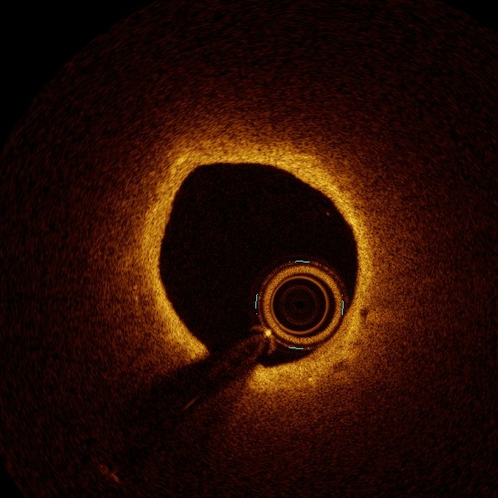
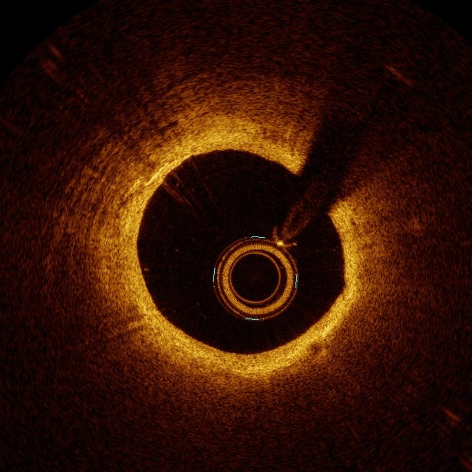
YELLOW III Study: Increase in Minimal Fibrous Cap Thickness (OCT)
P<0.001
120
97.3
90
70.9
2
6.8
60
60 µm
90 µm
30
Baseline
Follow-up
0
BL
1
FU
Kini A, ACC 2023

Slide 38
YELLOW III Study: Increase in Minimal Fibrous Cap Thickness (OCT)
100%
26
75%
61
FTC, n (%) | Baseline | Follow-up
<54 µm | 27 (25) | 7 (6)
55-84 | 54 (49) | 36 (33)
>84 | 29 (26) | 67 (61)
50%
49
25%
33
25
0%
6
Baseline
Follow-up
FCT <54 FCT 54-84 FCT>84
Kini A, ACC 2023

Slide 39
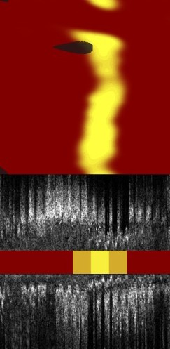
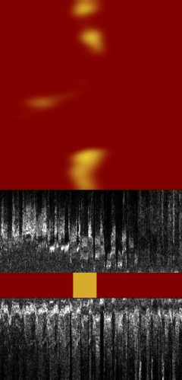
YELLOW III Study:MaxLCBI4mm Reduction (NIRS)
400
P<0.001
306.8
300
782
235
213.1
200
100
Baseline
Follow-up
0
BL
1
FU
Kini A, ACC 2023

Slide 40
YELLOW III Study: Secondary Imaging Endpoints OCT
OCT | Baseline | Follow-up (26 weeks) | Absolute Change | P Value
Lipid
Maximum lipid arc,° | 189.1 ± 73.4 | 161.6 ± 68.7 | -28.3 ± 38.7 | <0.001
Average lipid arc,° | 114.5 ± 43.0 | 100.3 ± 36.1 | -14.8 ± 24.6 | <0.001
Lipid length, mm | 10.4 ± 6.0 | 8.9 ± 5.6 | -1.5 ± 2.2 | <0.001
Lipid volume index, mm° | 1259.4 ± 994.5 | 972.0 ± 855.7 | -290.2 ± 369.9 | <0.001
Macrophages
Maximum macrophage arc,° | 148.2 ± 72.5 | 122.1 ± 67.7 | -26.5 ± 41.3 | <0.001
Average macrophage arc,° | 83.4 ± 36.5 | 71.2 ± 32.0 | -11.6 ± 24.8 | <0.001
Macrophage length, mm | 9.6 ± 5.7 | 7.6 ± 5.2 | -2.0 ± 2.4 | <0.001
Macrophage volume index,° | 876.4 ± 757.6 | 590.0 ± 557.3 | -288.6 ± 369.7 | <0.001
Calcium
Maximum calcium arc,° | 98.6 ± 55.7 | 98.6 ± 54.6 | 3.0 ± 25.0 | 0.36
Average calcium arc,° | 61.1 ± 26.1 | 61.2 ± 25.1 | 0.3 ± 16.7 | 0.72
Calcium length, mm | 6.4 ± 4.9 | 6.7 ± 4.7 | 0.45 ± 1.80 | 0.03
Kini A, ACC 2023

Slide 41
YELLOW III Study: Secondary Imaging Endpoints IVUS and NIRS
N=110 | Baseline | Follow-Up (26 weeks) | Absolute Change | P value
IVUS
Total atheroma volume, mm³ | 137.2 ± 72.8 | 131.2 ± 71.8 | -60 ± 12.5 | <0.001
Patients with reduced TAV, N (%) |  | 81 (74)
Percent atheroma volume, % | 51.6 ± 8.9 | 50.2 ± 8.7 | -1.38 ± 1.48 | <0.001
Patients with reduced PAV, N (%) |  | 91 (83)
NIRS
Lesion LCBI | 139.9 ± 96.2 | 90.1 ± 82.7 | -49.6 ± 80.6 | <0.001
Patients with decreased lesion LCBI, N (%) |  | 79 (72)
Kini A, ACC 2023

Slide 42
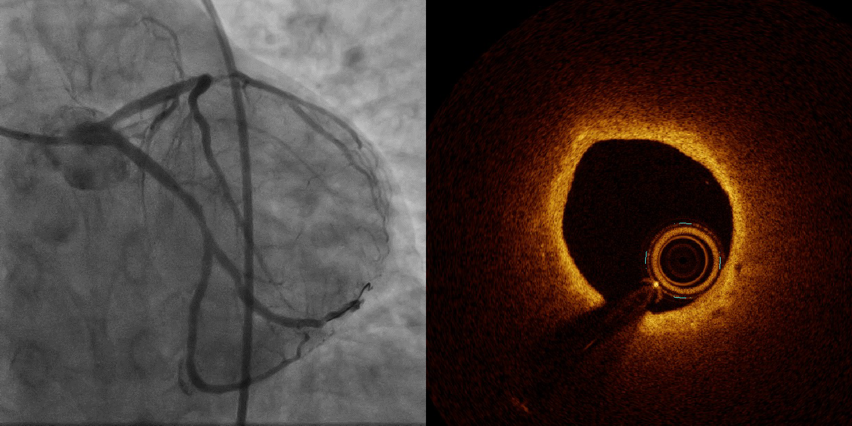
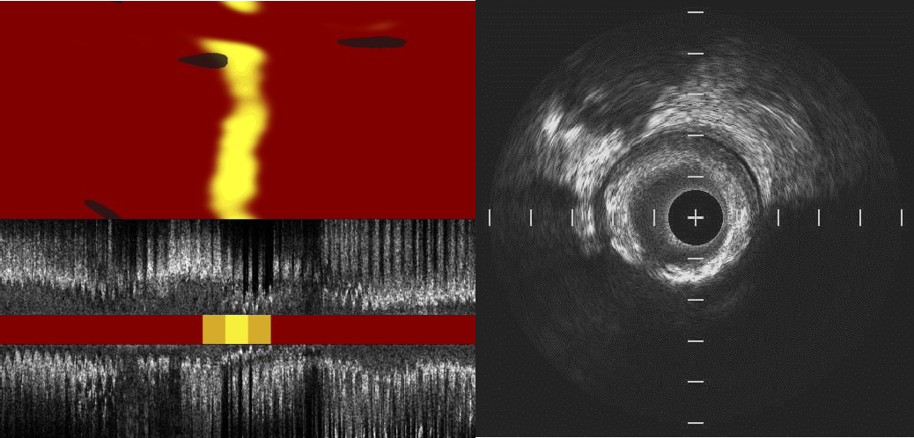
YELLOW III Study: Case 1 Plaque Stabilization
mFCT ↑, LCBI ↓
Baseline
LDL-C: 80.4 mg/dl
mFCT: 60 µm
maxLCBI4mm: 782
PAV: 48.7%
Follow-up
LDL-C: 34 mg/dl
mFCT: 90 µm
maxLCBI4mm: 235
PAV: 45.2%
Kini A, ACC 2023

Slide 43
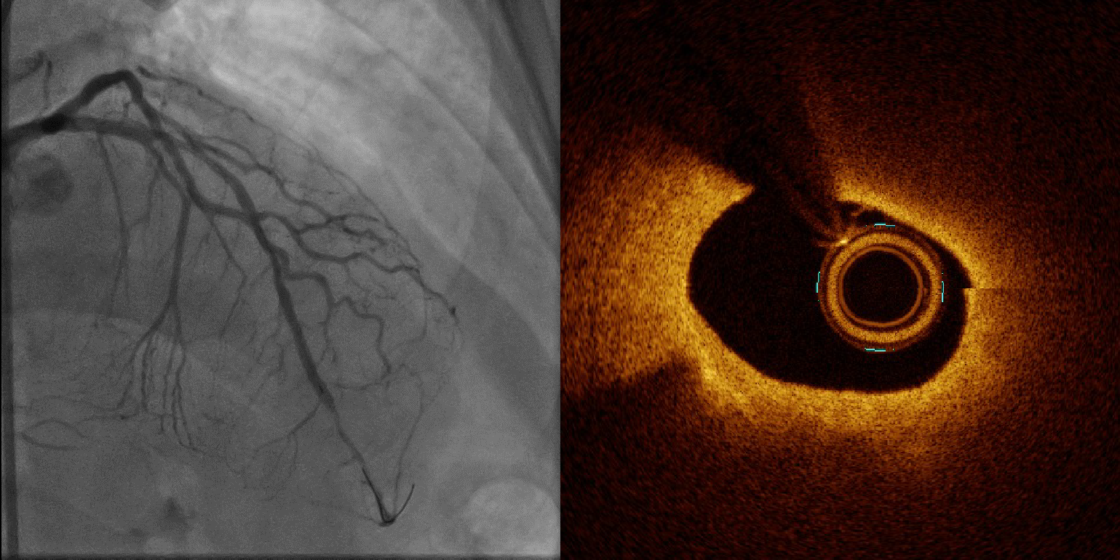
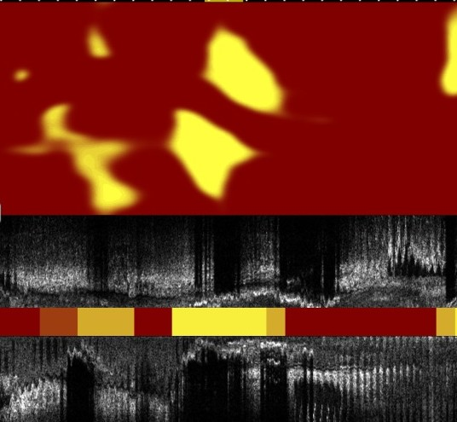
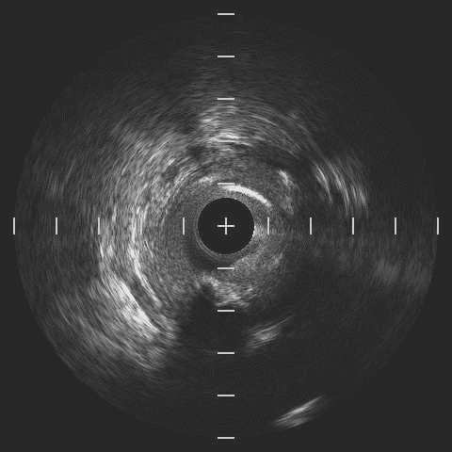
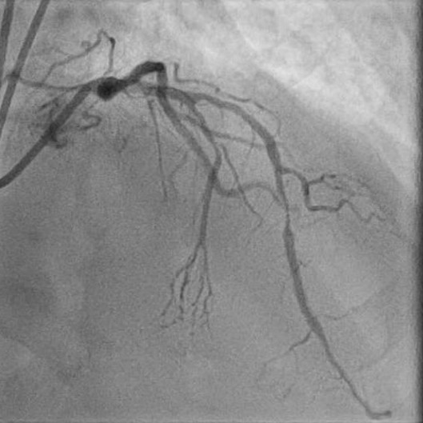
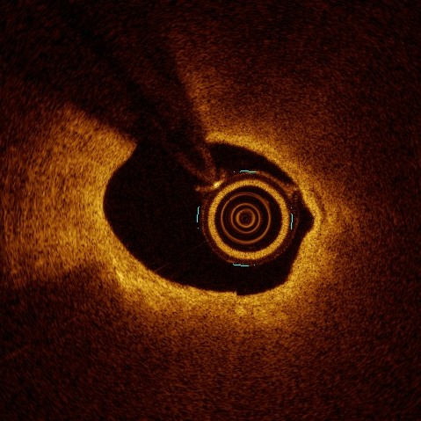
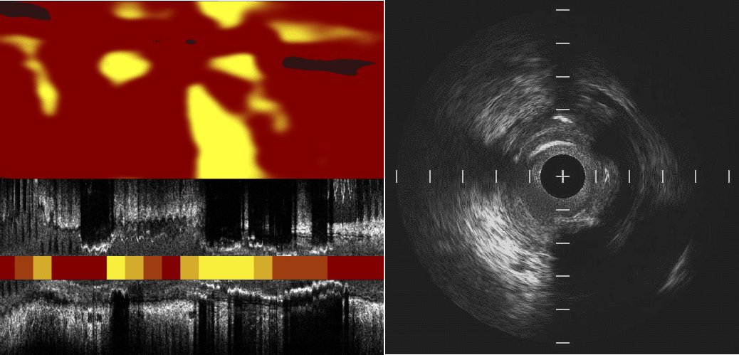
YELLOW III Study: Case 2 No Beneficial Changes in Plaque Morphology
mFCT →, LCBI ↑
Baseline
mFCT: 50 µm
maxLCBI4mm: 586
PAV: 67.9%
Follow-up
LDL-C: 7 mg/dl
mFCT: 50 µm
maxLCBI4mm: 690
PAV: 67.2%
Kini A, ACC 2023

Slide 44
YELLOW III Study: Conclusions
In patients with stable CAD on maximally tolerated statins, more intensive lipid lowering with addition of evolocumab for 26 weeks resulted in significant and substantial increase in the minimum FCT by OCT, reduction in NIRS maxLCBI_{4mm} and reduction in atheroma volume by IVUS in angiographically non-obstructive lesions
The prevalence of high-risk vulnerable TCFA lesions was reduced from 48% to 13%
First multimodality imaging report in stable patients with non-obstructive lesions and lower levels of LDL-C at baseline (compared to previous trials) further supports aggressive lipid lowering in the patient population
At 6 month follow-up, 20% patients did not demonstrate FCT thickening and 24% subjects did not experience LCBI reduction. PBMC transcriptomic data will allow create predictive models for detecting subjects who demonstrate the greatest response regarding plaque morphology to PCSK9 inhibition therapy

Slide 45
Latest Issues in Coronary Intervention
Key Interventional Trials form ACC 2023:
HOST-IDEA, RENOVATE-COMPLEX-PCI, YELLOW-III
Focused review of the month
Beyond Coronary Artery Stenosis in SIHD:
Evolving Management Paradigm for Stable Ischemic
Heart Disease Patients

Slide 46
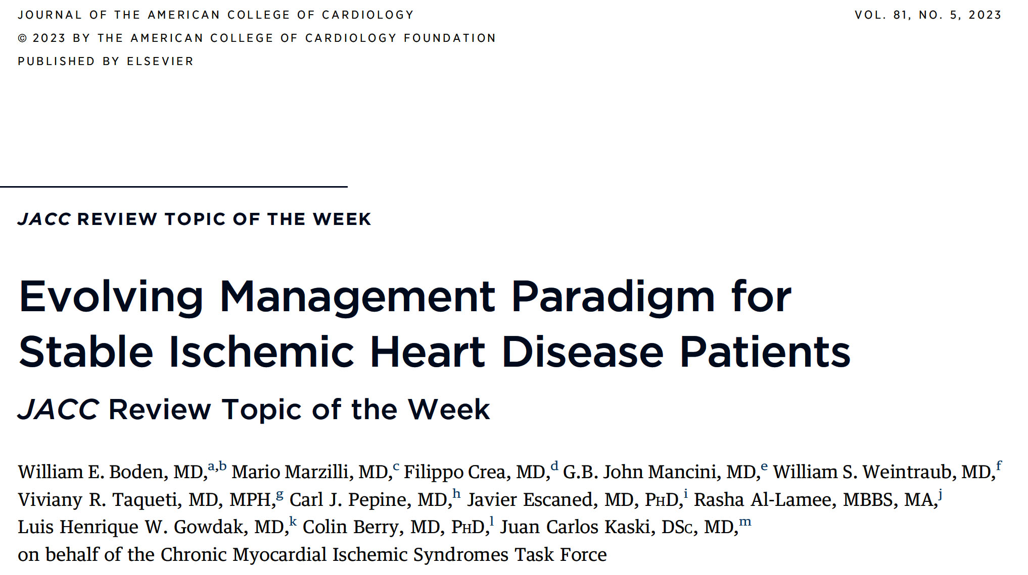

Slide 48
Highlights: Paradigm Shift in Stable Angina Management
Several mechanisms other than obstructive coronary artery disease may cause myocardial ischemia.
A conservative approach to management, including noninvasive testing, lifestyle interventions, and goal-directed multifaceted medical therapy, is evidence based and often effective in patients with stable angina.
Pharmacologic and procedural approaches to stable ischemic heart disease are complementary, and integrating these can optimize outcomes.

Slide 49
Why We Need A Paradigm Shift in Our Approach
to Angina and Ischemia
Angina may be due to obstructive CAD and/or INOCA;
Most patients presenting with chronic angina do not have epicardial coronary obstructions;
If CCTA is the initial diagnostic test and obstructive coronary stenoses are excluded, subsequent testing should include stress perfusion imaging, positron emission tomography, and/or invasive functional coronary angiography with pharmacologic testing to detect.
Boden et al., J Am Coll Cardiol 2023;81:505

Slide 50
Clinical Assessment of Myocardial Ischemia and CAD
Boden et al., J Am Coll Cardiol 2023;81:505

Slide 51
Why We Need A Paradigm Shift in Our Approach
to Angina and Ischemia
Of interest, a comprehensive noninvasive diagnostic
approach that contemplates both anatomic and functional issues may be provided by multimodality
imaging such as PET/CCTA or “dynamic” CCTA and could be viewed as a noninvasive “onestop shop” model to diagnose angina and suspected CAD, both obstructive and non-obstructive. Ongoing RCTs will determine whether dynamic CCTA fulfills this promise.
Boden et al., J Am Coll Cardiol 2023;81:505

Slide 52
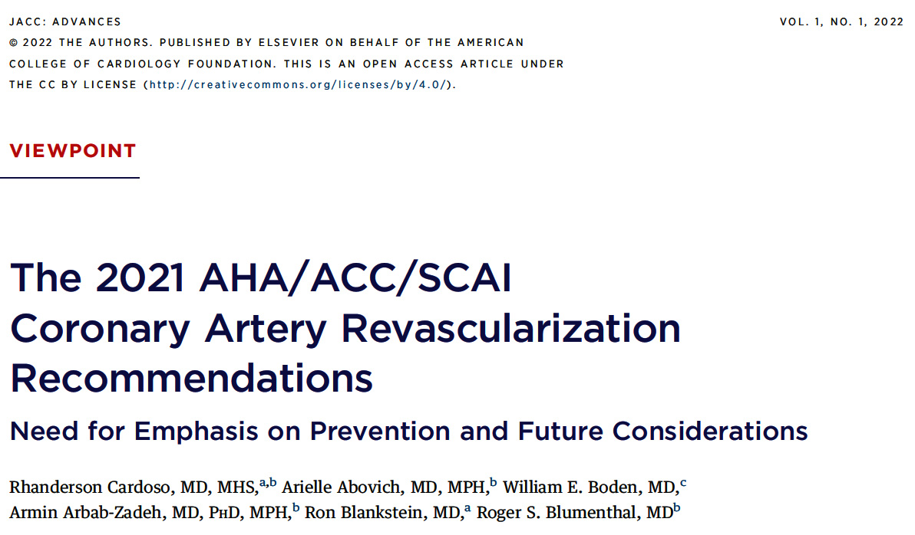

Slide 53
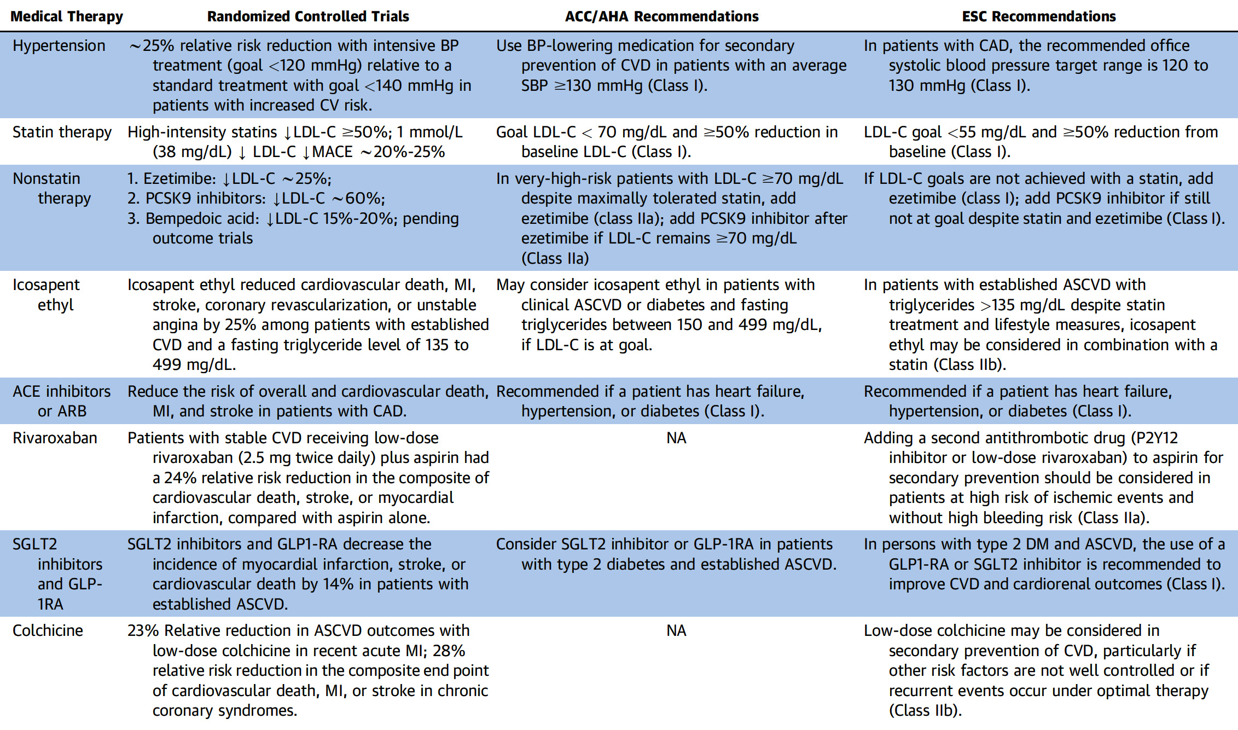
Optimal Preventive Pharmacotherapy for PTs with Established CAD Being Considered for Coronary Revasc
Cardoso et al., JACC Adv 2022 Mar, 1 (1) https://doi.org/10.1016/j.jacadv.2022.100006

Slide 54
Lifestyle Interventions and Guideline-Directed Medical Therapy for Patients with Established CAD
GDMT is significantly underutilized in pts who undergo coronary revasc
Pts with established CAD who are considered for revasc benefit from implementation of healthy lifestyle changes and GDMT for reduction of atherosclerotic cv events
Cardoso et al., JACC Adv 2022 Mar, 1 (1) https://doi.org/10.1016/j.jacadv.2022.100006

Slide 55
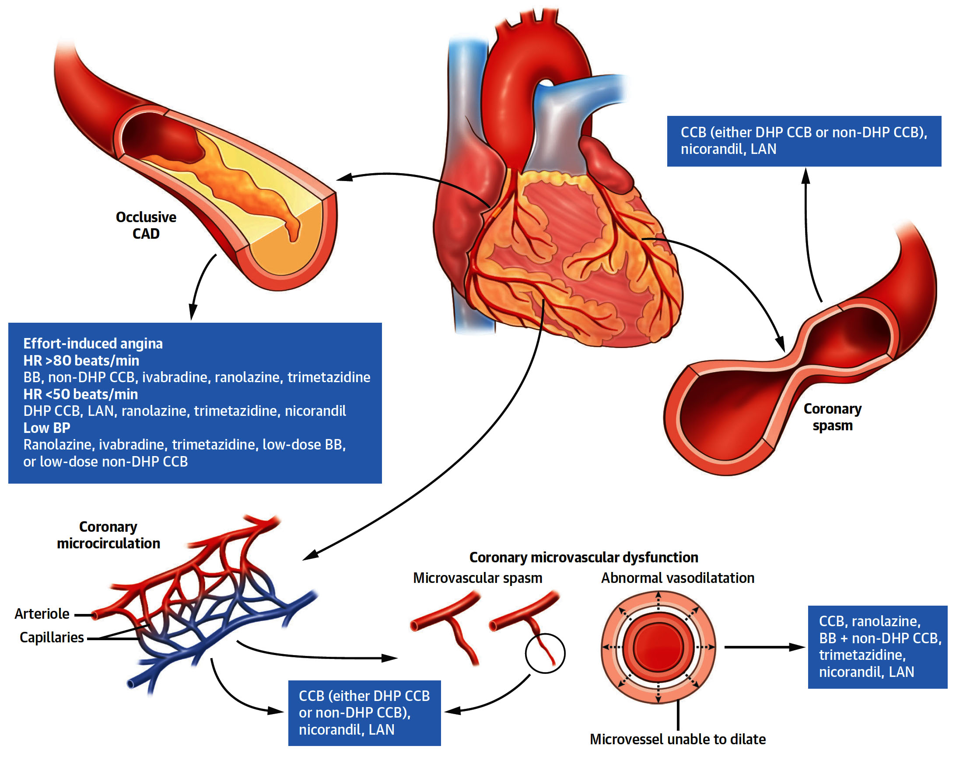
Antianginal Treatment Directed to the Mechanism Responsible for Ischemia
Boden et al., J Am Coll Cardiol 2023;81:505

Slide 56
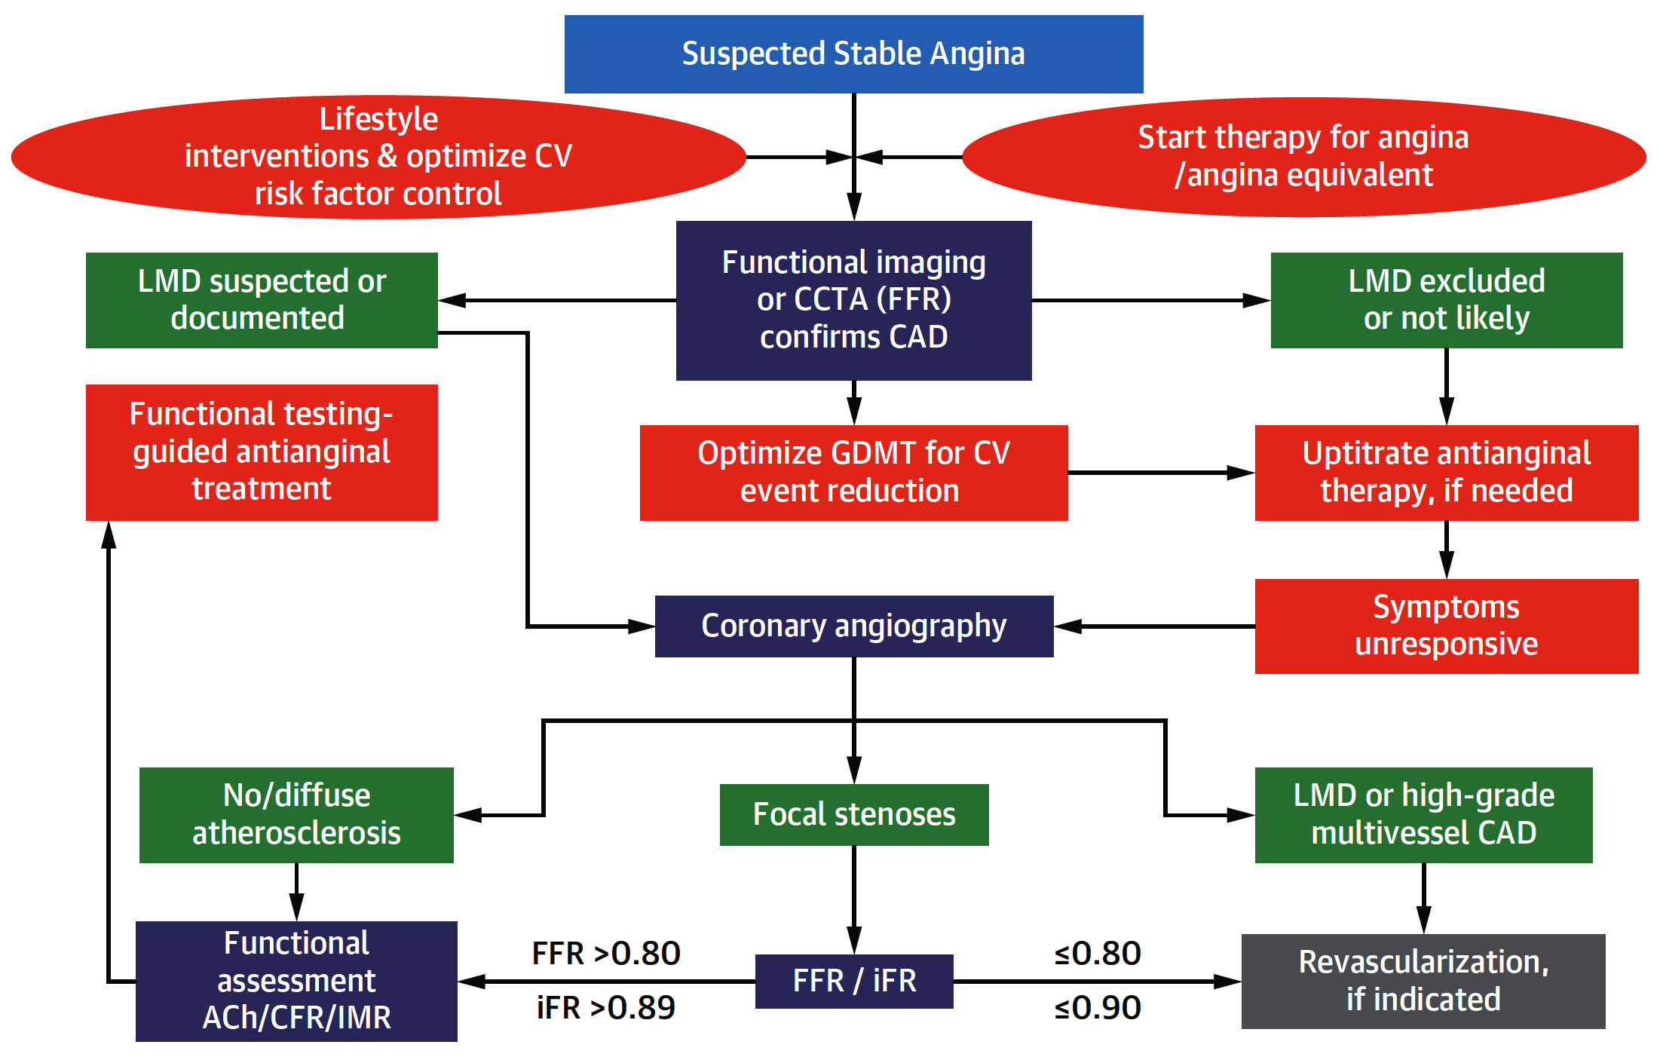
Management Algorithm for Obstructive and Non-obstructive Coronary Causes of Angina
Boden et al., J Am Coll Cardiol 2023;81:505

Slide 57
New Paradigm for SIHD: Where Do We Go from Here?
We need to expand our current scientific thinking about the many causes and mechanisms of both angina and myocardial ischemia and uncouple the narrow association of ischemia with obstructive epicardial disease as the guiding approach to management. Both angina and ischemia have many causes, but obstructive epicardial disease may or may not be the underlying pathogenetic mechanism. Therefore, our nomenclature should reflect the actual causes of ischemia and angina beyond the currently used terms “coronary” and “disease,”. Better nomenclature might be considered, such as “acute and chronic myocardial ischemic syndromes.”
We must embrace a more enlightened management approach. Assessments of ischemia that do not delineate abnormal coronary angiographic findings should not necessarily shift diagnostic and therapeutic considerations to non-cardiac causes of angina but rather to exploring nonepicardial coronary causes (i.e. CMD and vasospastic disorders).
We must invest in developing newer management strategies and health care delivery models that may better align with treatments proven to benefit patients and society. Proven secondary prevention strategies and lifestyle interventions in contemporary GDMT continue to be underutilized, particularly in the United States, where as few as 40% to 50% of eligible CAD subjects are treated according to established clinical practice guidelines, including those who have been revascularized. This underscores the critical importance of concomitant preventive therapies in enhancing event-free survival and improving outcomes in stable CAD patients who had undergone CABG or PCI.
In this way, perhaps we can rebalance patient management in a way that does not view procedural and pharmacologic interventions as competing treatments but rather as complementary and additive therapeutic approaches best suited to achieving optimal clinical outcomes and symptom relief for our patients.
Boden et al., J Am Coll Cardiol 2023;81:505

Slide 59
Take Home Message: Key Interventional Trials from ACC 2023 & Evolving Paradigm of SIHD
3 month vs 12 month DAPT after new gen DES (ACS):
PCSK-9 inhibitor to reduce TCFA and LCBI in SIHD:
Intravascular imaging improve MACE in comp PCI:
There is a mounting evidence that non-epicardial coronary causes of angina and ischemia such as microvascular dysfunction, vasospasm and derangements of myocardial metabolism are more prevalent than coronary obstruction. These factors are not routinely considered in diagnosis and management of SIHD. Clearly there is a need to manage CAD beyond relieving obstruction to overall improve prognosis of pts with SIHD.
Notes:
HbA1c in

Slide 60
Question # 1
Following statement is false regarding the outcomes of the RENOVATE-COMPLEX-PCI trial comparing IVI vs Angio guided complex PCI except;
Lower TVF with IVI vs Angio
Lower TLR with IVI vs Angio
Similar ST in IVI vs Angio
Lower MI in IVI vs Angio
Lower death in IVI vs Angio
The correct answer is C

Slide 61
Question # 2
Following statement is false regarding the results of Yellow–III trial except;
A. Significant reduction in LDL
B. Significant reduction in TCFA
C. Significant reduction in LCBI
D. Significant reduction in macrophages on OCT
E. All pts responded with reduction in TCFA and LCBI
,
The correct answer is E
Notes:
er

Slide 62
Question # 3
Following statements is false regarding the evolving paradigm of the SIHD:
Majority of angina symptoms are not due to coronary stenosis
Microvascular dysfunction is a common cause of angina
Guideline directed medical therapy is practiced in minority
Vasospastic angina is a rare cause of angina
Revascularization is beneficial in LM and 3 V CAD
The correct answer is D

