Slide 1
Complex Coronary Live Case Series
In collaboration with
www.CCClivecases.org
from
Cardiac Cath Lab, Mount Sinai Heart, NY, USA
in
Association with CME MEDIQUEST

Slide 2
Disclosures
Samin K. Sharma, MD, MSCAI, FACC
Nothing to disclose
Annapoorna S. Kini, MD, MRCP, FACC
Nothing to disclose
Manoj Chopda, MBBS, MD, DM (Guest Faculty)
Rahul Manik Shewale, MBBS, MD, FCCI (Moderator)

Slide 3
Manoj Chopda, MD (Medicine), DM (Cardiology)
Interventional Cardiologist
Magnum Heart Institute
Nashik, Maharashtra
Rahul Manik Shewale, MD (Medicine), DM (Cardiology), FCCI
Interventional Cardiologist
Magnum Heart Institute
Nashik, Maharashtra
Dr. Manoj Chopda is an Interventional Cardiologist at Magnum Heart Institute, Nashik. Dr. Chopda is also working for NRHM (National Rural health Mission) and Jeevandayee Yojana for contributing in his social work under a registered charitable trust "Nashik Hirday Mitra Charitable Trust" for serving the people under poverty line.
Dr. Rahul Manik Shewale is an Interventional Cardiologist at Magnum Heart Institute, Nashik. He completed his studies in MD in Internal Medicine from Pune and DM in Cardiology from Bombay Hospital Institute of Medical Sciences, Mumbai. He has done his international fellowships in CCL Mount Sinai Hospital, New York and training in pediatric cardiology from B. J. Wadia Hospital, Mumbai. He completed training under Padmavibushan, Padmabhushan, Padmashri Late Dr. B. K. Goyal and Professor Satyavan Sharma. He is skilled in coronary angiography, PCI, balloon mitral valvuloplasty, structural heart disease, pacemaker and many more.

Slide 5
Live Case #27
Patient Demographics
79 yrs, M
Present Clinical Presentation
Presented with CCS Class IV angina with EKG changes na d-TnI
CAD Risk Factors
Controlled hypertension
Controlled hyperlipidemia
PAF, Smoldering Myeloma
SAQ-7 score: 7, Thyroiditis
Clinical Variables
No known prior CAD, echo revealed mild diffuse LV hypokinesis, LVEF 50%
Medications
Clopidogrel, Rivaroxaban, Bisoprolol, ISMN, Atorvastatin, Ezetimibe, Synthroid
Cath: Cardiac cath on February 9th 2023 3 V CAD: 80% prox LAD, 90% pLCx, multiple calcified anterior takeoff RCA lesions with distal bifurcation, LVEF 50% and Syntax score 22. Pt underwent successful PCI of LAD and LCx using 2 Promus Elite DES and did well.
Plan: Now planned for imaging guided PCI of multiple lesions with bifurcation in anterior takeoff RCA.

Slide 6
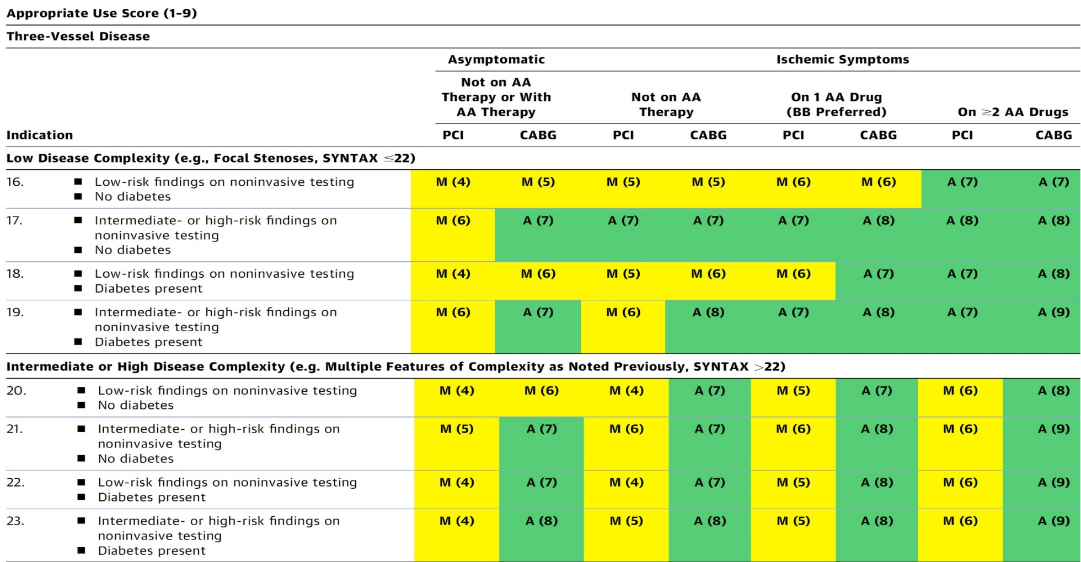
AUC 2017: Three Vessel CAD
Patel et al., J Am Coll Cardiol 2017;69:2212

Slide 7
Assessment and Predicting Patient Risk
Recommendation for the Heart Team
Recommendation to Predicting Patient Risk of Death with CABG: STS Risk Score
Recommendation for Defining Coronary Artery Lesion Complexity: SYNTAX Score
Assessment of Risk Factors Not Qualified in the STS Score
Syntax score 22; STS score 12.2
Lawton et al., J Am Coll Cardiol 2022:79;e21-129

Slide 8
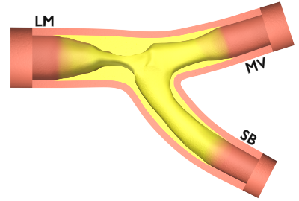
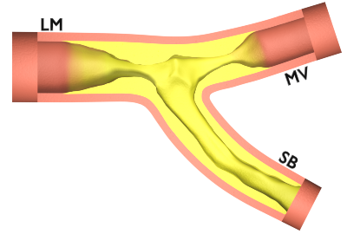
Simple LM Bifurcation
Complex LM Bifurcation
Distal LM >70% and LAD/LCX (<50%)
Distal LM ≤50 % with MV >70%, SB ≤ 50%, length <10 mm
Distal LM with MV (larger vessel) >70%, SB <50%, length ≥10 mm
Distal LM with both branches ≥50%
Severely calcified
PS
[68% Simple]
Two Stents
[32% Complex]
1
2
1
2
Chen et al., J Am Coll Cardiol Intv 2014; 7:1267
Stone et al., N Engl J Med 2016;37:3399-3405
Ferenc et al. Eur Heart J 2008;29:2859–2867
Chen et al., J Am Coll Cardiol Intv 2019;12:1927

Slide 9
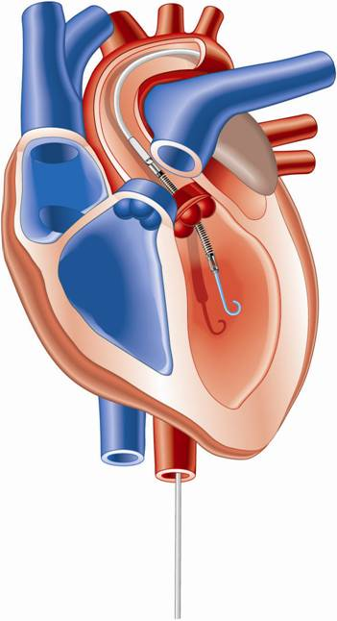
Percutaneous LV Assist Devices
PTVA:
TandemHeart
IMPELLA:
Recovers 2.5/CP
IABP

Slide 10
LV Support during High-risk PCI:
LVEF + Lesion Complexity
LVEF >40%
LVEF 20-40%
LVEF <20%
Simple PCI
Complex PCI
Simple PCI
Complex PCI: High Syntax score >32/ STS>5 Extensive revascularization
Simple or Complex: Inoperable cases
None
?IABP/?Impella
None or IABP
No support
Impella
/IABP (if Impella is CI)
Impella/PTVA
Being evaluated in the randomized Protect IV trial
Notes:
10

Slide 11
DKCRUSH-V Trial: Operator Experience
Operator requirements:
≥ 300 PCIs per year for 5 years
≥ 20 LM PCIs per year
Submit 3 to 5 DK crush cases to the committee to demonstrate technical competence with the approach
The results of the trial may not be replicated by less experienced operators
Chen et al., J Am Coll Cardiol Intv 2019;12:1927

Slide 12
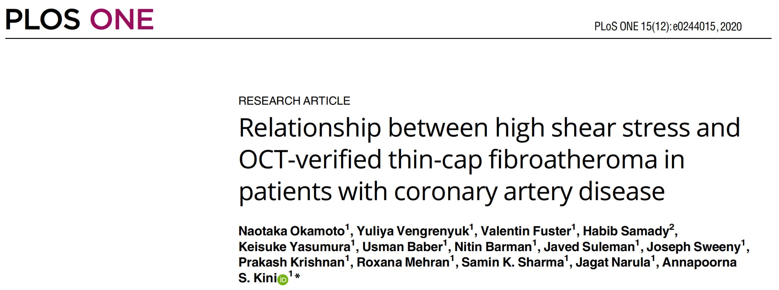

Slide 13
High Mean WSS in the Prox Segment of Coronary Lesions
is Associated with the Presence of Thin-Cap Fibroatheroma Verified by OCT
Thin-cap fibroatheroma lesion identified by OCT with minimal fibrous cap thickness 60 µm; WSS measured in the prox segment of the lesion 16.5 Pa
Lesion with thick fibrous cap of 170 µm; prox WSS 3.81 Pa
Okamoto, Sharma, Kini et al., PLoS ONE 2020;15:e0244015

Slide 14
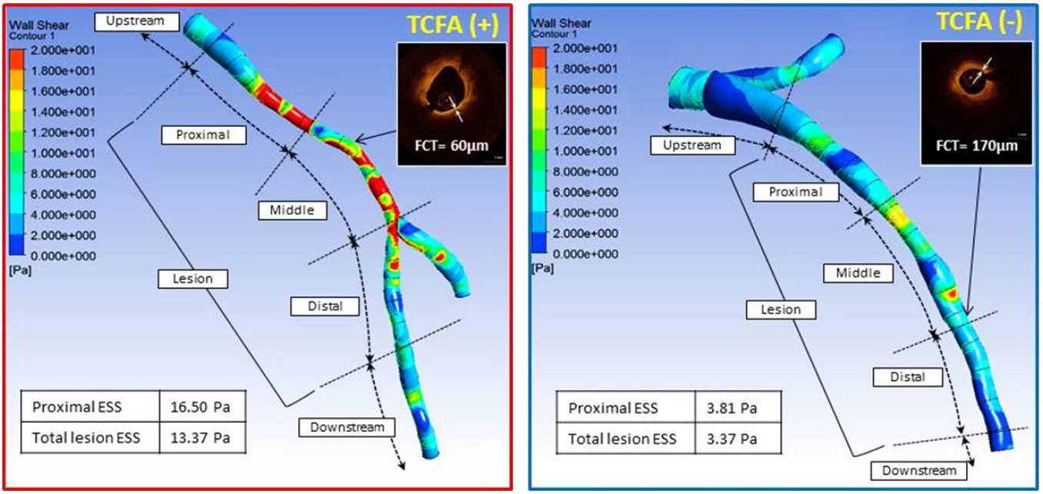
Angiography-Based Assessment of Wall Shear in Obstructive Coronary Lesions
CFD analysis was performed in models reconstructed from two angiographic projections:
Mean WSS was calculated in the whole lesion (A) and in three lesion sub-segments: proximal, middle and distal (B).
OCT imaging was performed in the same lesion to identify TCFA lesions
Okamoto, Sharma, Kini et al., PLoS ONE 2020;15:e0244015

Slide 15
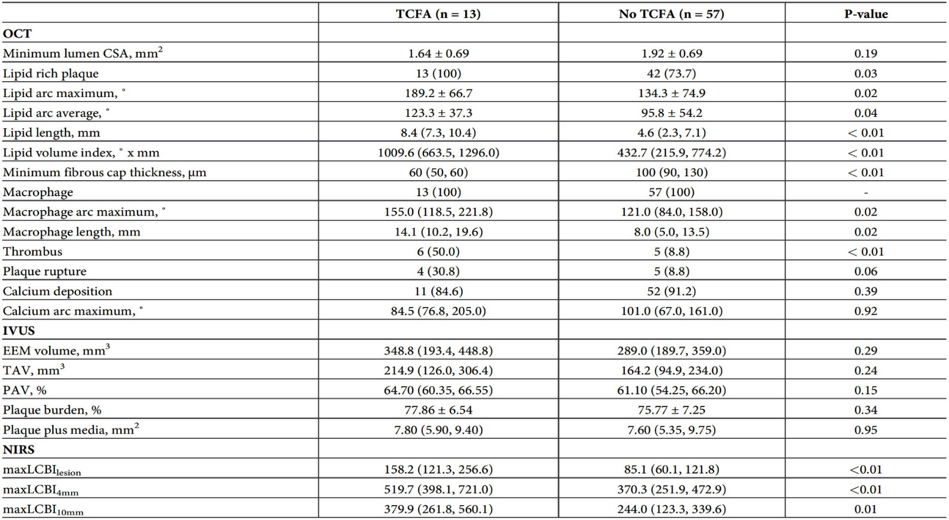
Intravascular Imaging Data
Okamoto, Sharma, Kini et al., PLoS ONE 2020;15:e0244015

Slide 16
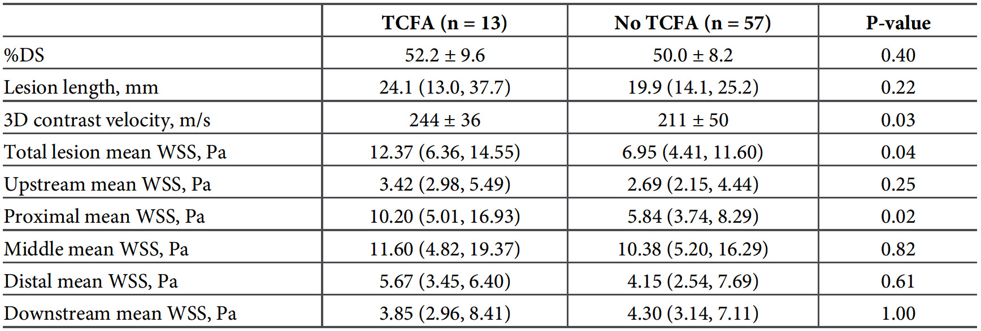
Angiographically Derived Measurements and Computational Fluid Dynamics Findings
Okamoto, Sharma, Kini et al., PLoS ONE 2020;15:e0244015

Slide 17
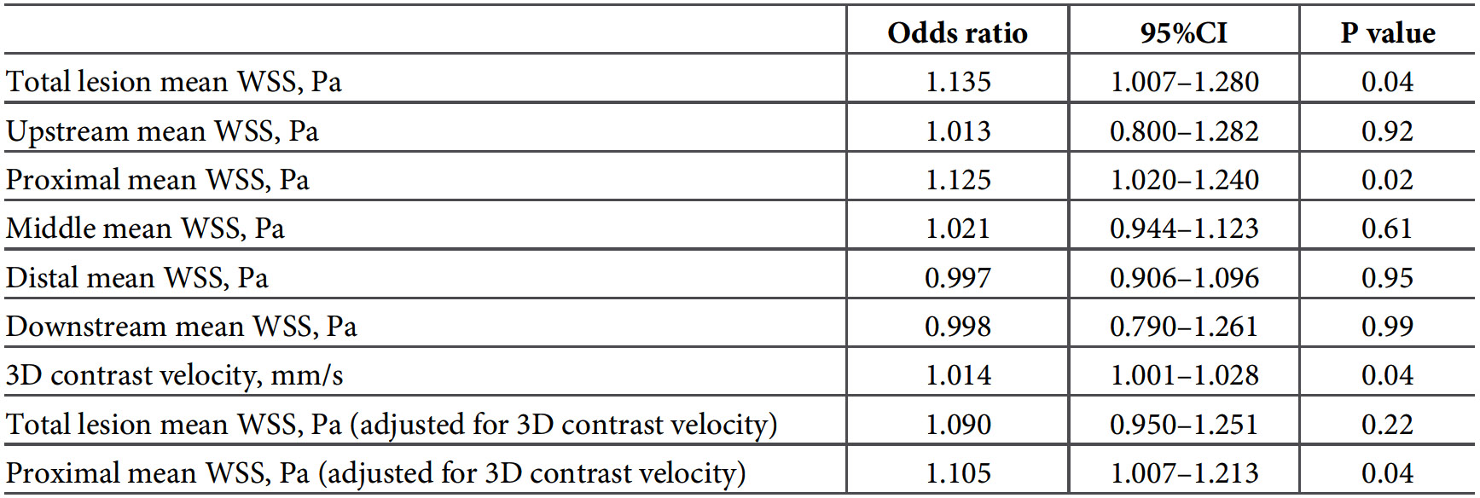
Relationship Between TCFA and Hemodynamics
Okamoto, Sharma, Kini et al., PLoS ONE 2020;15:e0244015

Slide 18
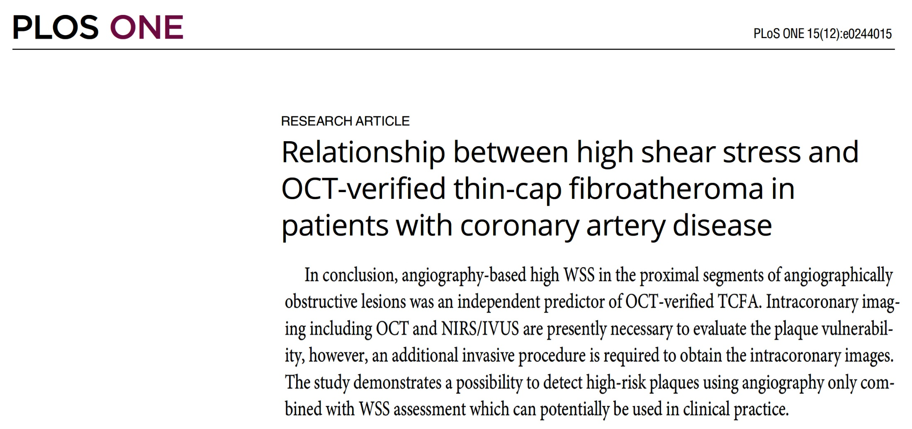

Slide 19
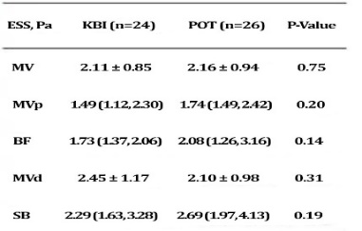

Slide 20
Proportion of Patients Who Experienced
Cardiac Death after uLM PCI
Patients grouped into tertiles according to operator experience who performed the procedure
%
Mean: 5.8 (2.7, 9.4) 24.4 (19.2, 29.1) 38.3 (33.1, 43.4)
Operator experience defined as the mean number of LM PCI procedures performed by the operator per year.
Xu et al., J Am Coll Cardiol Intv 2016;9:2086

Slide 21
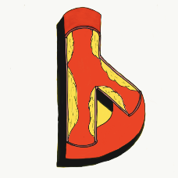
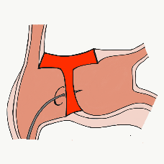
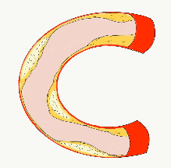
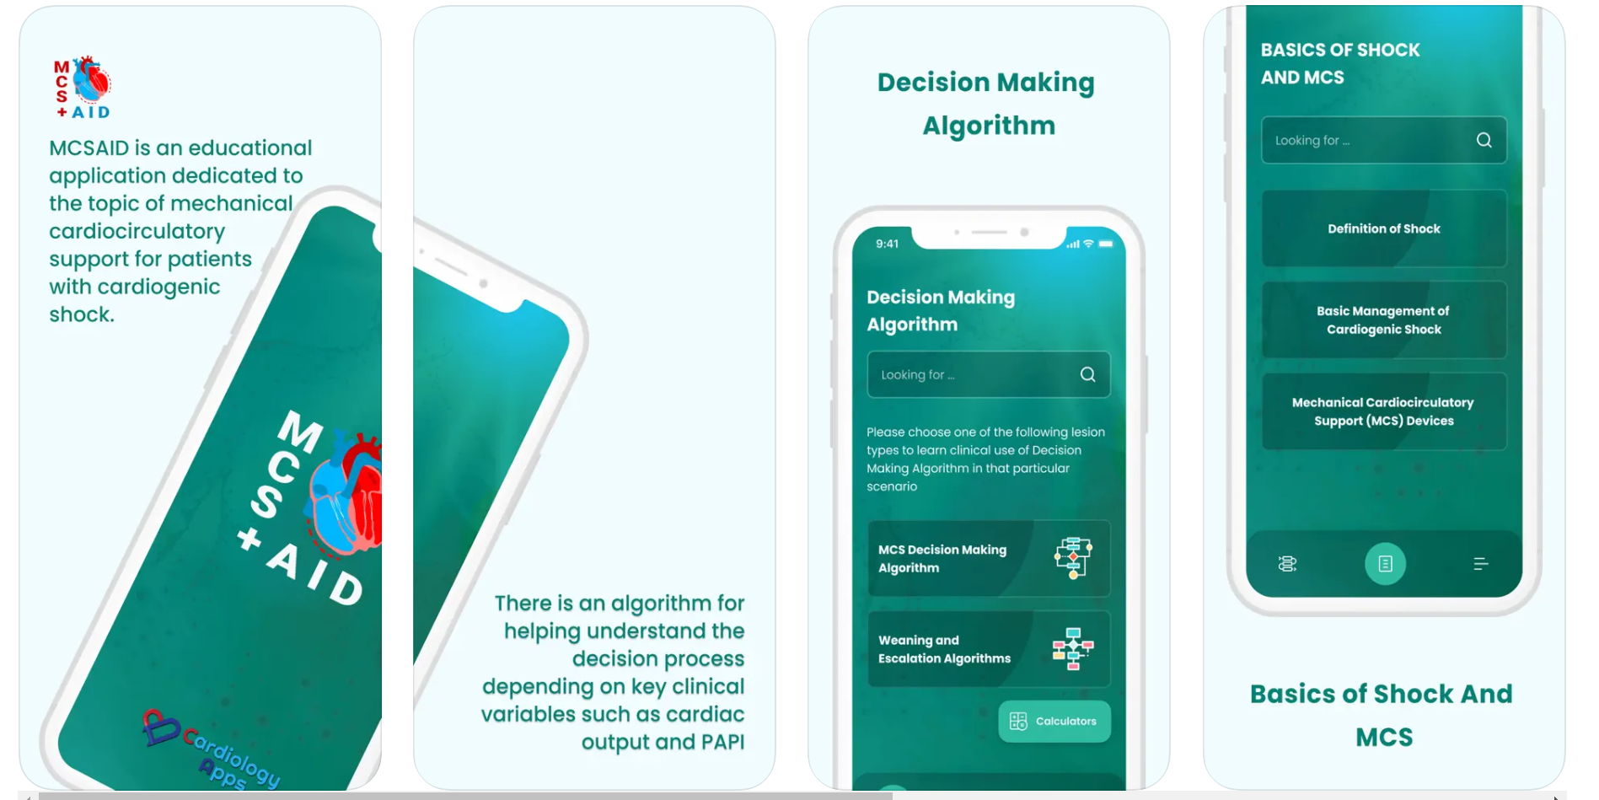
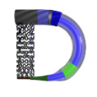
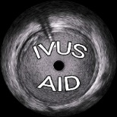
Growing Library of educational applications
Already released and past 70,000 downloads...
Newly released; MCSAID
With more coming soon!!!
Also
AngioAID 3D
HemodynamicsAID
Updated
CalcificAID
DeviceAID
Mobile app
Updated
BifurcAID
IVUSAID

