Slide 1
Complex Coronary Live Case Series
In collaboration with
www.CCClivecases.org
from
Cardiac Cath Lab, Mount Sinai Heart, NY, USA
in
Association with CME MEDIQUEST

Slide 2
Disclosures
Samin K. Sharma, MD, MSCAI, FACC
Nothing to disclose
Annapoorna S. Kini, MD, MRCP, FACC
Nothing to disclose
Arindam Pande, MBBS, MD, DM, FESC, FSCAI, FACC, FRCP (Guest Faculty)
Abhishek Roy, MBBS, MD, DNB (Cardiology) (Moderator)

Slide 3
Arindam Pande, MBBS (Hons), MD (Med), DM (Cardiology), FESC,
FSCAI (USA), FACC (USA), FRCP (Glasg)
Senior Consultant, Interventional Cardiologist, Department of Cardiology
Medica Superspeciality Hospital, Kolkata
Abhishek Roy, MBBS, MD (Int. Med.), DNB (Cardiology)
Interventional Cardiologist
Medica Superspecialty Hospital, Kolkata
Dr. Arindam Pande is Senior Consultant Interventional Cardiologist, Department of Cardiology, at Medica Superspeciality Hospital, Kolkata. He has more than 50 publications in reputed International and National peer reviewed medical journals, also contributed more than 10 chapters in different cardiology text books and peer reviewer of many indexed medical journals including Indian Heart Journal and BMJ. He is awarded with many awards including 1st place winner at TCT International Fellows Challenging Case Presentation 2016, best case presentation award, TCTAP 2016 and Prof. Sital Ghosh Memorial Medal for best post graduate trainee in MD Medicine for 2010. He is PI of ‘REMOLUTION Study’, ‘Milestone registry’ and co-investigator of ‘REVALUATION Study’. He has Organized Eastern India’s first Hands-on CRT Training Workshop at Medica SuperSpecialty Hospital in collaboration with Medtronic as Course Director in March 2021. He is a member of many renowned societies including Cardiological Society of India, Indian Medical Association, West Bengal Academy of Echocardiography, ACC, ESC, AHA, SCAI, and RCPS (Glasg).
Dr. Abhishek Roy is an exceptional Interventional Cardiologist at Medica Superspecialty Hospital, Kolkata and has had an outstanding record throughout his academic days. He completed his MBBS, followed by MD in Internal Medicine from Kolkata, and went on to obtain a DNB in Cardiology from Narayana Health – Rabindranath Tagore International Institute of Cardiac Sciences, Mukundapur, Kolkata. Throughout his medical education, he has received numerous medals and accolades. He has authored numerous publications in renowned national and international journals and contributed several chapters to cardiology textbooks. With extensive experience in coronary and peripheral intervention, pacemaker and device implantation, electrophysiology and cardiac structural intervention, Dr. Roy is a knowledgeable and skilled practitioner in accordance with current global standards. 0

Slide 5
Live Case #26
Patient Demographics
65 yrs, M
Present Clinical Presentation
Presented with CCS Class II angina & DOE. Pt had +ctFFR of LM and prox LAD (0.72).
CAD Risk Factors
Controlled hypertension
Controlled hyperlipidemia
SAQ-7 score: 73
Ex-smoker
Clinical Variables
No known prior CAD, echo revealed mild diffuse LV hypokinesis, LVEF 50%
Medications
Aspirin, Bisoprolol, Amlodipine, Lisinopril, Atorvastatin
Cath: Cardiac cath on January 17th 2023 revealed 2 V+LM CAD: calcified 60% distal LM bifurcation, 95% calcified prox LAD and 70% pLCx bifurcation, LVEF 50% and Syntax score 24. IVUS revealed MLA of LM 3.3mm2, LAD 4mm2 and LCx 2.5mm2 with +FFR.
Plan: Now planned for imaging guided PCI of LM-LAD and LCx bifurcation lesion using Mini-Crush technique and possibly Rotational atherectomy (if moderate Ca++ on IVI).

Slide 6
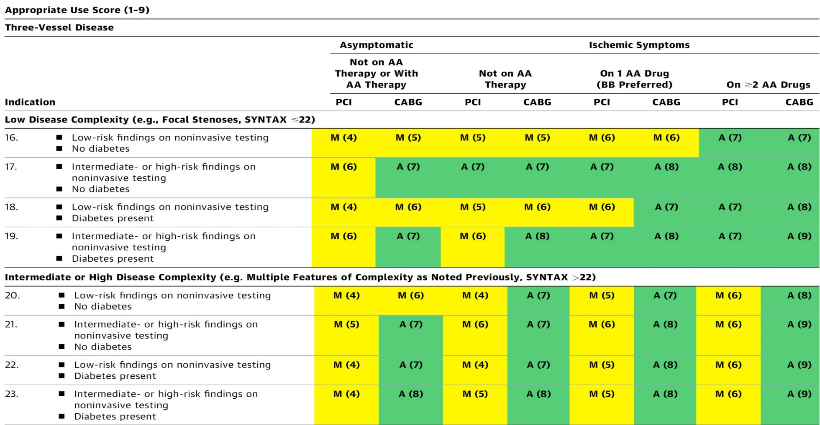
AUC 2017: Left Main + 2/3 V CAD
Patel et al., J Am Coll Cardiol 2017;69:2212

Slide 7
Assessment and Predicting Patient Risk
Recommendation for the Heart Team
Recommendation to Predicting Patient Risk of Death with CABG: STS Risk Score
Recommendation for Defining Coronary Artery Lesion Complexity: SYNTAX Score
Assessment of Risk Factors Not Qualified in the STS Score
Syntax score 24; STS score 1.2
Lawton et al., J Am Coll Cardiol 2022:79;e21-129

Slide 8
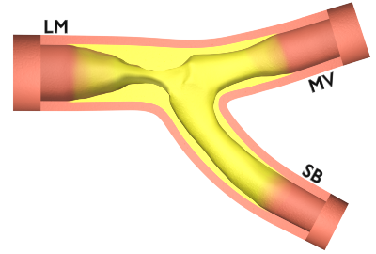
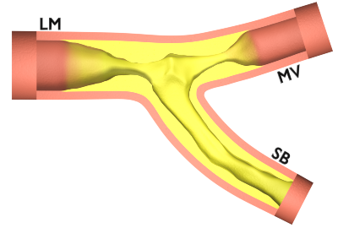
Simple LM Bifurcation
Complex LM Bifurcation
Distal LM >70% and LAD/LCX (<50%)
Distal LM ≤50 % with MV >70%, SB ≤ 50%, length <10 mm
Distal LM with MV (larger vessel) >70%, SB <50%, length ≥10 mm
Distal LM with both branches ≥50%
Severely calcified
PS
[68% Simple]
Two Stents
[32% Complex]
1
2
1
2
Chen et al., J Am Coll Cardiol Intv 2014; 7:1267
Stone et al., N Engl J Med 2016;37:3399-3405
Ferenc et al. Eur Heart J 2008;29:2859–2867
Chen et al., J Am Coll Cardiol Intv 2019;12:1927

Slide 9
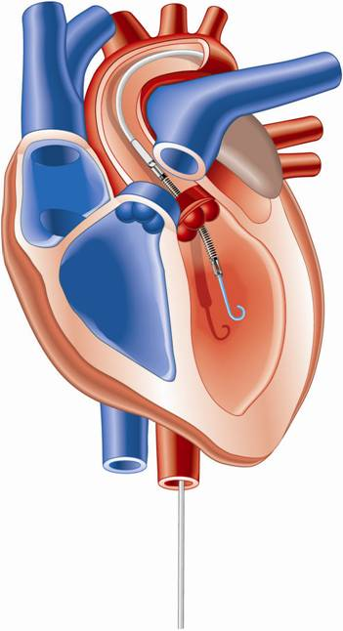
Percutaneous LV Assist Devices
PTVA:
TandemHeart
IMPELLA:
Recovers 2.5/CP
IABP

Slide 10
LV Support during High-risk PCI:
LVEF + Lesion Complexity
LVEF >40%
LVEF 20-40%
LVEF <20%
Simple PCI
Complex PCI
Simple PCI
Complex PCI: High Syntax score >32/ STS>5 Extensive revascularization
Simple or Complex: Inoperable cases
None
?IABP/?Impella
None or IABP
No support
Impella
/IABP (if Impella is CI)
Impella/PTVA
Being evaluated in the randomized Protect IV trial
Notes:
10

Slide 11
DKCRUSH-V Trial: Operator Experience
Operator requirements:
≥ 300 PCIs per year for 5 years
≥ 20 LM PCIs per year
Submit 3 to 5 DK crush cases to the committee to demonstrate technical competence with the approach
The results of the trial may not be replicated by less experienced operators
Chen et al., J Am Coll Cardiol Intv 2019;12:1927

