Slide 1
HPI: 62 yo with ESRD on HD, CAD (most recent PCI 02/2022→4.0x12mm Synergy DES to pLAD), HTN, HLD, Non-Insulin dependent diabetes here with non healing ulcer on anterior portion of left great toe/hallux. Rutherford Category V.
Meds: Lipitor 40 mg QD, Metoprolol XL 50 mg QD, Nifedipine 60 mg QD, Aspirin 81 mg QD, Plavix 75 mg QD.
Exam: Dopplerable PT pulses left side

Slide 2
Diagnostics:

Slide 3
Angiogram:

Slide 4
Angiogram:

Slide 5
Heart/Vascular team discussion
Due to non healing ulcer and ongoing pain, the patient was brought to cath lab for left SFA CTO revascularization.

Slide 6
Case discussion points
Algorithms for crossing CTOs
CTO crossing Techniques and Devices
Treatment of Calcium once you cross

Slide 7
Algorithms
Notes:
A retrospective analysis was conducted of imaging and procedure data from 114 consecutive symptomatic patients (mean age 69±11 years; 84 men) with claudication (Rutherford category 3) or critical limb ischemia (Rutherford category 4-6) who underwent endovascular interventions for 142 CTOs. CTO cap morphology was determined from a review of angiography and duplex ultrasonography and classified into 4 types (I, II, III, or IV) based on the concave or convex shape of the proximal and distal caps. Results: CTOP type II CTOs were most common and type III lesions the least common. Type I CTOs were most likely to be crossed antegrade and had a lower incidence of severe calcification. Type IV lesions were more likely to be crossed retrograde from a tibiopedal approach. CTOP type IV was least likely to be crossed in an antegrade fashion. CTOP type I lesions were easiest to cross in antegrade fashion and type IV the most difficult. Lesion length >10 cm, severe calcification, and CTO types II, III, and IV benefited from the addition of retrograde tibiopedal access.

Slide 8
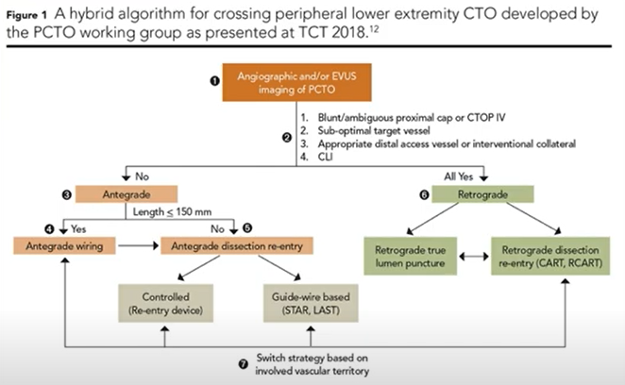
Algorithms
Notes:
Couple years later PCTO group led by Dr.Banerjee published their way of doing it. Bottom line is no perfect way. A PCTO Working Group composed of nine interventional cardiologists, one vascular surgeon and one interventional radiologist, and led by Bannerjee and colleagues, has recently taken on the similar challenge of delineating an evidence-based algorithmic approach to tackling peripheral CTO in the lower extremities (Figure 1).¹²
This sophisticated proposal combines analysis of CTOP classification with distal and collateral vessel analysis with clinical indication for revascularization to guide peripheral operators through the decision-making for treatment of peripheral CTO. The algorithm selectively recommends antegrade, retrograde and hybrid techniques as well as strategies for the performance of each. It represents a heroic advance in our approach to the treatment of peripheral CTO.¹²
Within each of the pathways (antegrade, retrograde, hybrid) there are many distinct crossing tactics which can be utilized and their distinct effectiveness should be studied further. The coronary literature has "named" many of these tactics (such as STAR/subintimal tracking and reentry, Mini-STAR, LAST (limited antegrade subintimal tracking), etc., explained later). Peripheral operators use many (though not all) of the same techniques, but we discuss them (and thus teach them) less frequently in the peripheral CTO literature.

Slide 9
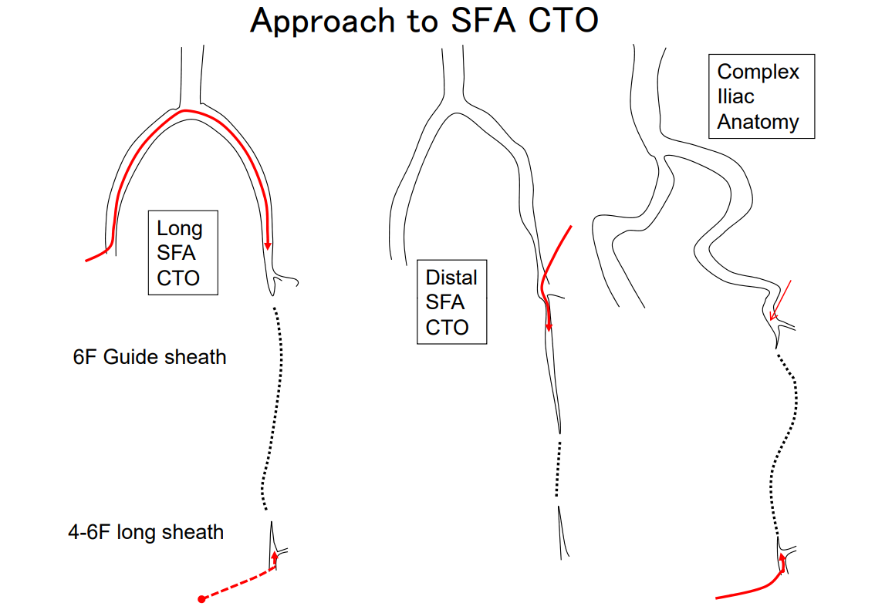
Access
Notes:
Access: what about access: so many access. Radial all the way down to the tibials. Most common probably up and over to start with. Don’t forget about CFA or antegrade SFA.

Slide 10
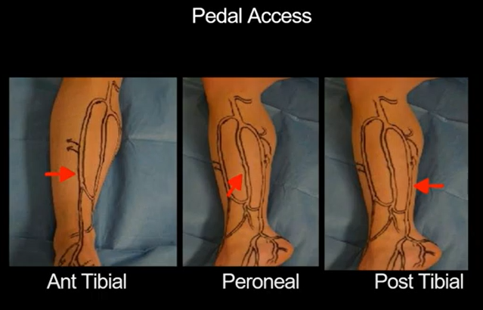
Access
Notes:
Often times start up and over and if can’t get through, go to pedal after creating dissecting channels/planes. Can be US guided (hocket stick probe), contrast guided (road map) or fluro guided if enough calcium. Higher you go on leg, compartments are larger, risk of compartment syndrome gets higher so need to be careful. Use hockey stick proble for pedal. frequency 12 MHz linear probe or a hockey stick probe.

Slide 11
Pedal Access
Advantages
Risks
Preserves “endovascular first” – 20% of infrapopliteal lesions not crossable with antegrade approach
Small diameter vessels increases pushability of wire
Distal cap often softer/easier to access
Safety advantage to avoid bleeding in select patients
Smaller diameter → vasospasm and thrombus formation
Difficulty cannulating small, heavily calcified vessels
Staff/operator familiarity
Foot is our “end organ”!
Vasc and Endovasc Surg 2018; 52: 593-595
J Vasc Surg 2014;60:375-82

Slide 12
Pedal Access
Single center
N =13
Ultrasound guided access and 4F micro-introducer sheath with check-flo valve
Technical success in 9/13
No major access site complications
Limb salvage rate at 17 months was 77% (10/13)
J Vasc Surg 2014;60:375-82
Notes:
Retrograde pedal access has been shown in numerous studies to be safe and effective when antergrade access unsuccessful in treating complex pedal disease or popliteal artery CTO. This is just one singe center study of my many/retrospective data of 13 patients that were primarly rutherford 5/6 in which retrograde access obtained sheathless fashion. All interventions were performed in a sheathless fashion using a 0.014- or 0.018-inch "bareback" wire as support for a 2- or 2.5-mm balloon angioplasty catheter to cross and treat tibial chronic total occlusions that could not be treated through an antegrade approach. Routine anticoagulation and dual-antiplatelet therapy were used periprocedurally. At a mean follow-up of 17.1 ± 10.3 months, the limb salvage rate was 77% (10 of 13).

Slide 13
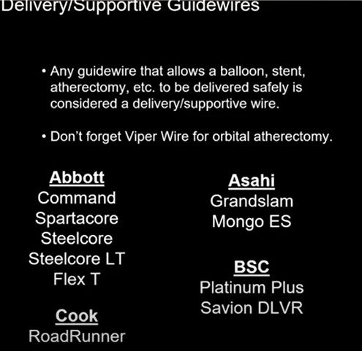
Guidewires
Notes:
What about guidewires: lot of them, hard to remember names. Try a few and stick to them. 3 categories, frontline (get you somewhere), CTO (to cross CTO), finally delivery support wires to get equipment down. Many company make similar wires. Lot of what you use is dependent on what you are comfortable with and what you use in training. Don’t need to know them all. 2 facts about guidewire: when escalation 0.014 to 0.018, increasing the strength (proportion to radius to the 4th). Increasing strength of guidewire to cross about 3X. Typically we start with 0.018 glide wire. How about tip load: the minimum grams of pressues needed to deflect the distal 1 cm of guidewire 2 mm. Wire escalation technique. More likely to dissect or penetrate a cap but also need to worry about dissection/perforation.

Slide 14
Notes:
Inflating a balloon over the retrograde guide wire, followed by advancement of the antegrade guide wire into the distal true lumen (controlled antegrade and retrograde tracking and dissection[CART], Figure 6).12
Inflating a balloon over the antegrade guide wire, followed by advancement of the retrograde guide wire into the proximal true lumen (reverse CART, Figure 6).
Illustration of reentry techniques used during retrograde chronic total occlusion (CTO) interventions. 1, Step-by-step illustration of the controlled antegrade and retrograde tracking and dissection technique (reproduced with permission from Surmely et al).¹² The retrograde guide wire reaches the distal CTO cap (1A) and is advanced into the chronic total occlusion (CTO) subintimal space (1B). A balloon is advanced over the retrograde guide wire into the subintimal space (1C) where it is inflated (1D), enabling advancement of the antegrade guide wire into the space created by the balloon (1E), which communicates with the distal true lumen (1F). 2, Illustration of the controlled antegrade and retrograde tracking and dissection (CART), reverse CART, and confluent balloon techniques (reproduced with permission from Brilakis et al).¹

Slide 15
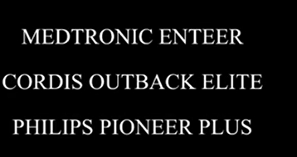
Devices:
CTO Crossing Devices:
CTO Re-entry Devices:
Notes:
What about CTO crossing devices and re-entry devices. Crossing devices often used to drill through cto cap (distal or proximal) where as re-entry devices more for getting back in if the the sub-intimal space.

Slide 16
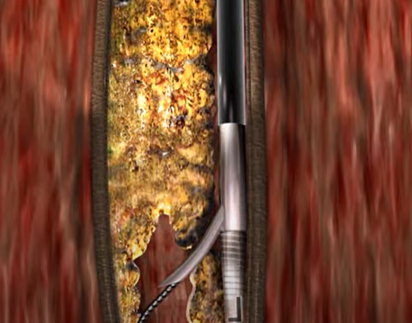
Outback Device: Cordis
The Outback catheter (Cordis) is advanced over a .014-inch wire.
Using simple, orthogonally oriented radiopaque markings to direct a re-entry needle toward the true lumen under fluoroscopic guidance, the “L” and “T” helps orient the re-entry cannula toward the true lumen under fluoroscopy.
A 22-gauge nitinolol cannula deploys into the true lumen, followed by wire passage.
The needle is retracted and device removed. After balloon dilatation, stenting can be performed if indicated.

Slide 17
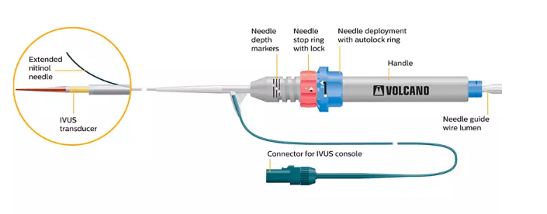
Pioneer Plus Re-entry CTO device
The Pioneer catheter (Philips Volcano) is another re-entry catheter that is advanced over an .014-inch wire.
The catheter is advanced into subintimal plane beyond the distal cap and adjacent to the site of reconstitution.
With intravascular ultrasound (IVUS) guidance one can orientate the re-entry cannula toward the true lumen and a nitinol needle is deployed into the true lumen, allowing the wire to safely enter the true lumen.

Slide 18
Pioneer Plus Re-entry CTO device

Slide 19
Treatment of Calcium
Important to note because:
Difficult to manage regardless of revascularization strategy
Acute and long term endovascular outcomes are worse when severe calcium is present
Goals of optimizing Calcium in Vessel?
Lumen diameter
Stent performance
Drug Delivery
Notes:
Lumen diameter related to patency, better expanded stent, improve drug delivery, improve ISR outcomes.

Slide 20
Devices Available
Laser, Athero-ablative
Rotational devices:
CSI, sands atheroma debris relatively small 1-7 u
Directional Atherectomy (Silverhawk)
Phoenix Atherectomy system (rotates/deflects)
Jet Stream (rotates and aspirates)
Rotarex (atherectomy and aspiration)
Shockwave IVL
Notes:
Laser atheroablative, last three (pheonex, rotational and aspirational). Some of these more used for ISR (laser, rotarex) and not so much for calcium. Better for another talk.

Slide 21
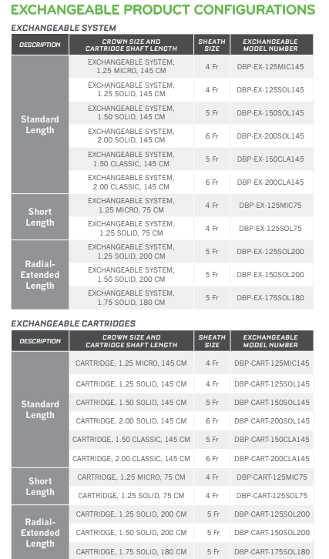
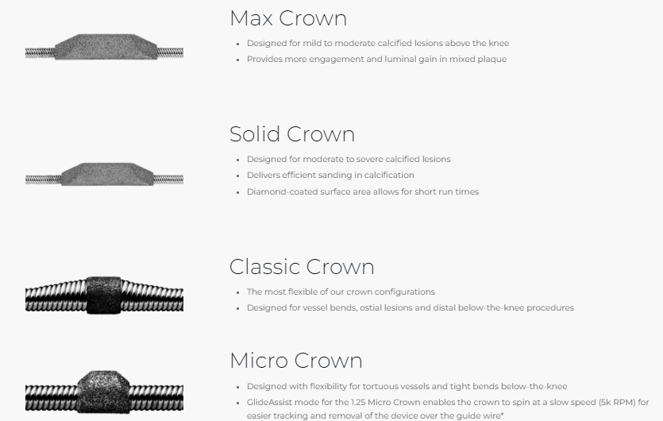
CSI
Facilitate crown contact with 360 degrees of the vessel wall
Differentially sand away calcium from atherosclerotic tissue
Notes:
Sizes variable from 1.25 to 2.0 burr, main advantage also longer 200 cm shaft for radial procedures at least up to the knee. All 6f compatible, most of the time 1.50 to 1.75 good.

Slide 22
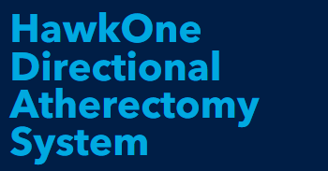
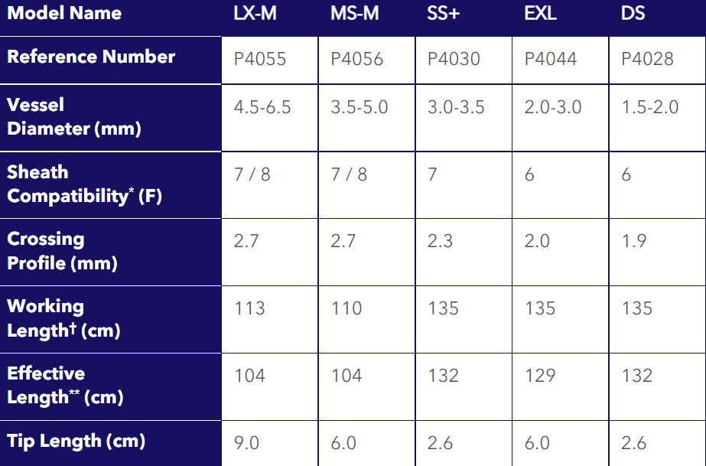
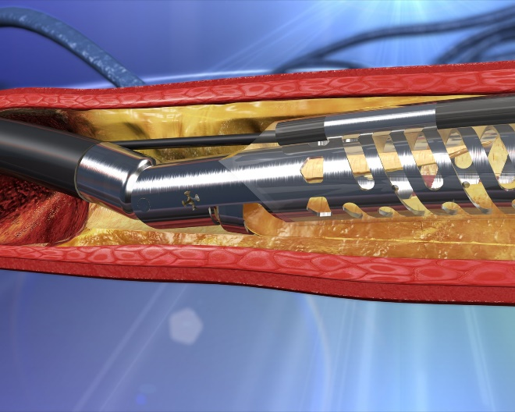
Easy to use, drive shaft and cutter blades whose direction can be changed.
Typically use hawk one (SFA, hawk M, big SFA or CFA Hawk LS or LX.
Notes:
Hawk one, tubrohawk and silver hawk systems. Top table is hawk one devices and bottom table is silver hawk.

Slide 23
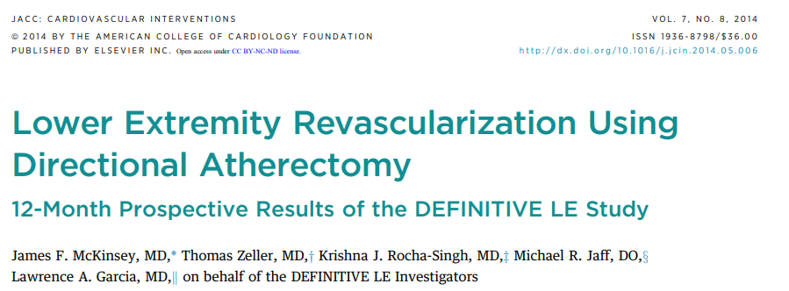
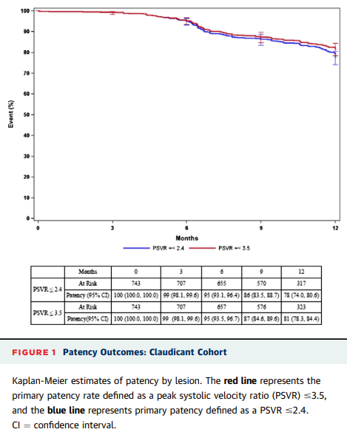
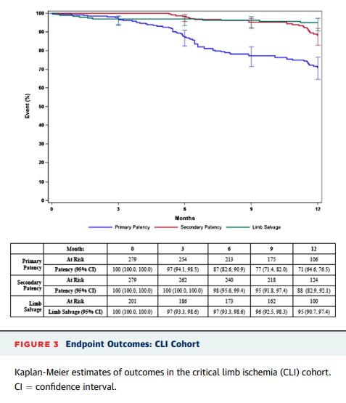
Notes:
Large 800+ single arm trial looking at effectiveness and safety/duratbility of atherectomy in the treatment of PAD. Infainguinal lesion length of up to 20 cm, primary endpoints were primary patency at 12 months for claudicants and freedom from unplanned amputation for CLI patients. 12 months patency was 78% in claudicants (no difference between diabetics vs. non diabetics using PSVR </=2.4) and freedom from major unplanned amputation of the target limb at 12 months in CLI subjects was 95% at one year. Adverse events included embolization, perforation, abrupt closure. 15% pop lesions in the claudicatns, 17% in CLI patients. Adjunctive procedures like Pta only performed per physician discretion and if <30% residual stenosis not done. Duplex determined primary patency in LCI lesions was 71%. Stent placement rate of 3.2$ was low.

Slide 24
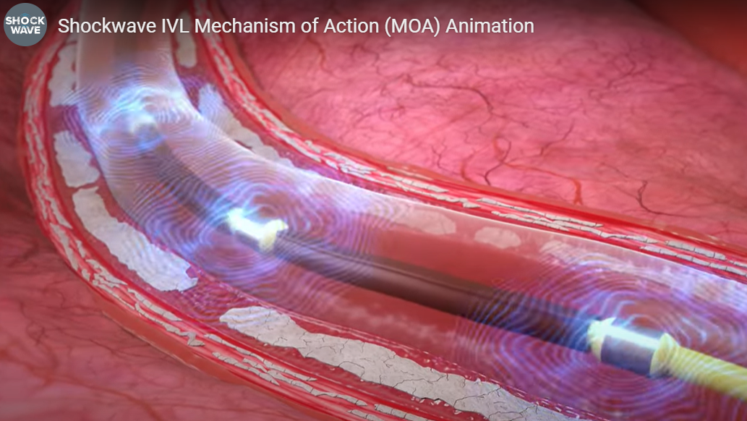
IVL
Iliacs, CFA, SFA, Poplital and below the knee
M5+, S4
Similar technology to lithotripsy used to treat kidney stones but less energy needed than traditional lithotripsy
Goal to fracture the calcium not ablate it
Series of emitters on balloon which fire across the electrodes and create vapor bubble which expands spherically and creates the “shockwave”
Waves travel deeply between soft tissue because of similar acoustic impedance between water and soft tissue and fracture occurs when shockwave encounters tissue of different impedance such as transition to superficial and deep calcium
Notes:
Shockwave, approved to treat iliacs, CFA, SFA, popliteal and below the knee. M5+ (replaced M5, 2 emissions per seconds instead of 1 per second such that get same amount of energy in ½ the time). S4 below the knee. New now have 8 mm size in the M5+. Same technology as lithotropsy used to treat kidney stones. Less energy needed than traditional lithotripy bc of close proximity to artery (inside it). Goal only to fracture not ablate it. Uses shockwave which increases increased peak pressure for 1 microsecond, negative pressure trough. Series of emitters on balloons. Fire across electrodes which creates vapor bubble which expands sphericaly which creates the shockwave. They travel deeply between the soft tissue bc of similar acoustic impudence between water and soft tissue. Fracture occurs when shockwave encounters tissue of different acoustic impendence such as transition to superficial and deep calcium.

Slide 25
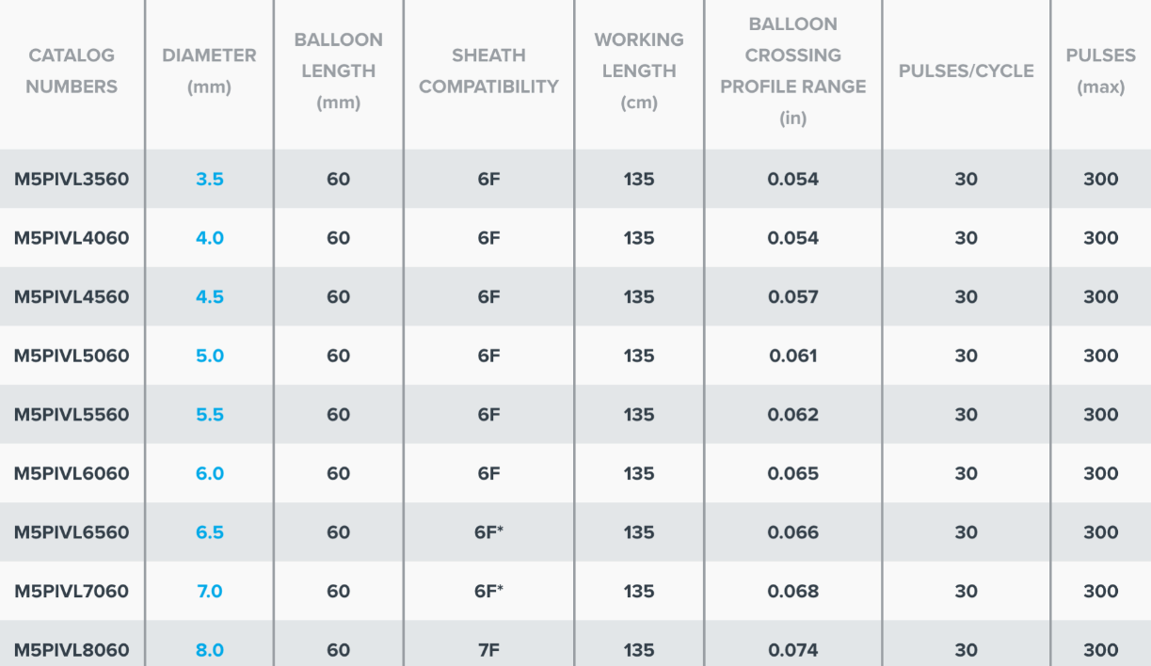
S4
M5+

Slide 26
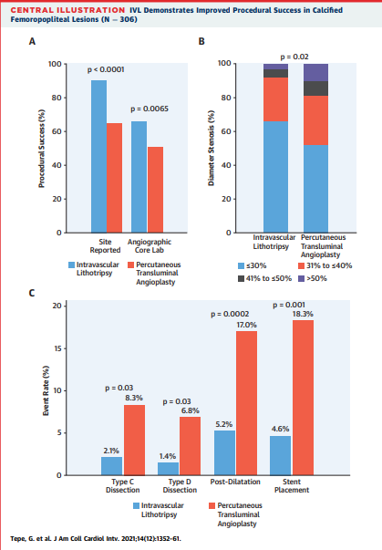
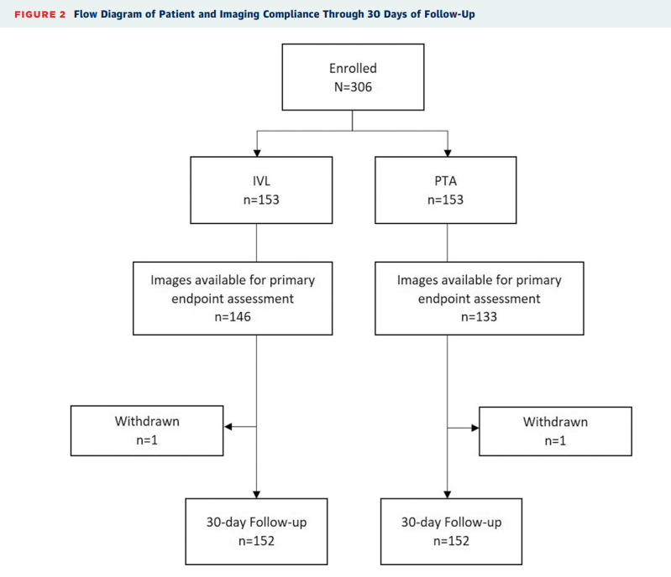
Notes:
30 day outcomes from PAD III trial, published in JACC. Short term outcomes with fem-pop moderate to severe calcified lesions in Rutherford 2-4 patients with prep using IVL or PTA prior to DCB/stent if needed. Primary end point was procedureal success (residual stenosis <30% without flow limiting dissection_ prior to DCB or stenting. Results: about 30% CTO in each group, primary SFA but about 10-20% popliteal lesions (more in the IVL group). Success great in IVL 65% vs. 50% and percentage of lesions with residual stenosis <30% greater in IVL, 66% vs 52%, flow limiting dissection greater in PTA groupi 6.8% vs. 1.4$ in IvL. Post dil and needed for stent placement also higher in PTA group. Target lesion revasc at 30 days similar between 2 groups. IVL is effective vessel prep strategy to facilitate endo treatment in calcified vessels, suggests IVL safe and effective methoid in treating moderate to severely calcified vessels fem/pop as compated to plain old PTA.

Slide 27
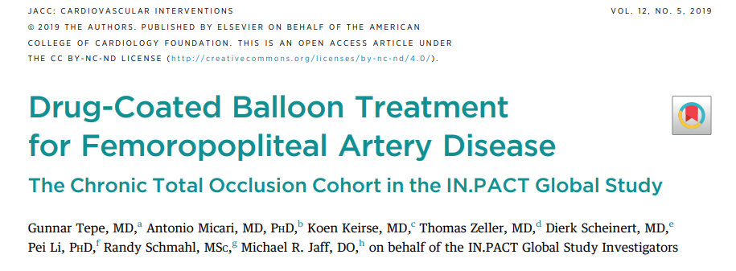
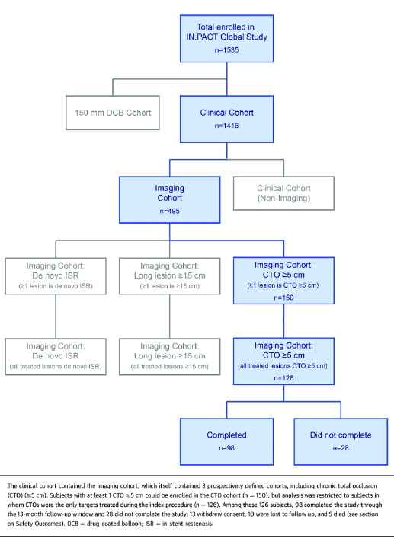
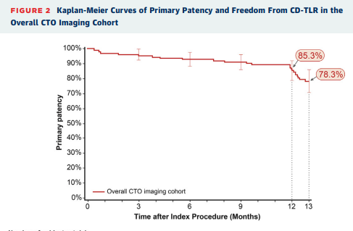
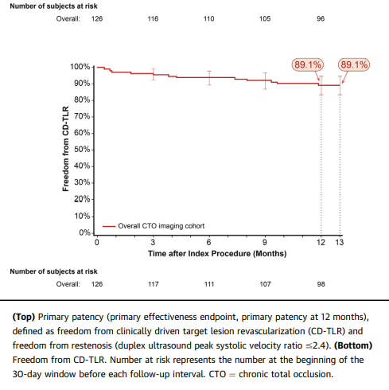
Notes:
How about drug coated technology in CTO. In PACT SFA randomized trial showed effictness of DCB in SFA/pop lesions. This was single arm study in which did a subset of just CTO interventions (fem/pop). 30% or so included proximal pop, 70% of lesions calcified. Primarily claudicants with average CTO length of about 12 cm.
METHODS The IN.PACT Global Study is an international single-arm study that enrolled 1,535 patients with symptomatic femoropopliteal artery disease. The study contains prospectively defined cohorts with prospectively planned imaging analyses, including a CTO ($5 cm) cohort in which subjects underwent duplex ultrasonography analyzed by an independent core laboratory. The primary safety endpoint was a composite of freedom from device- and procedure-related mortality through 30 days, and freedom from major target limb amputation and target vessel revascularization through 12 months. An independent Clinical Events Committee adjudicated all adverse events. The primary effectiveness endpoint was primary patency at 12 months, defined as freedom from clinically driven target lesion revascularization and freedom from restenosis. RESULTS The CTO imaging cohort had 126 subjects with 127 lesions (mean lesion length 22.83 9.76 cm). Primary patency by Kaplan-Meier estimate was 85.3% through 12 months. Provisional stenting was performed in 46.8% of lesions. The primary safety composite endpoint was achieved by 88.7% of subjects. There

Slide 28
Thank you

