Slide 1
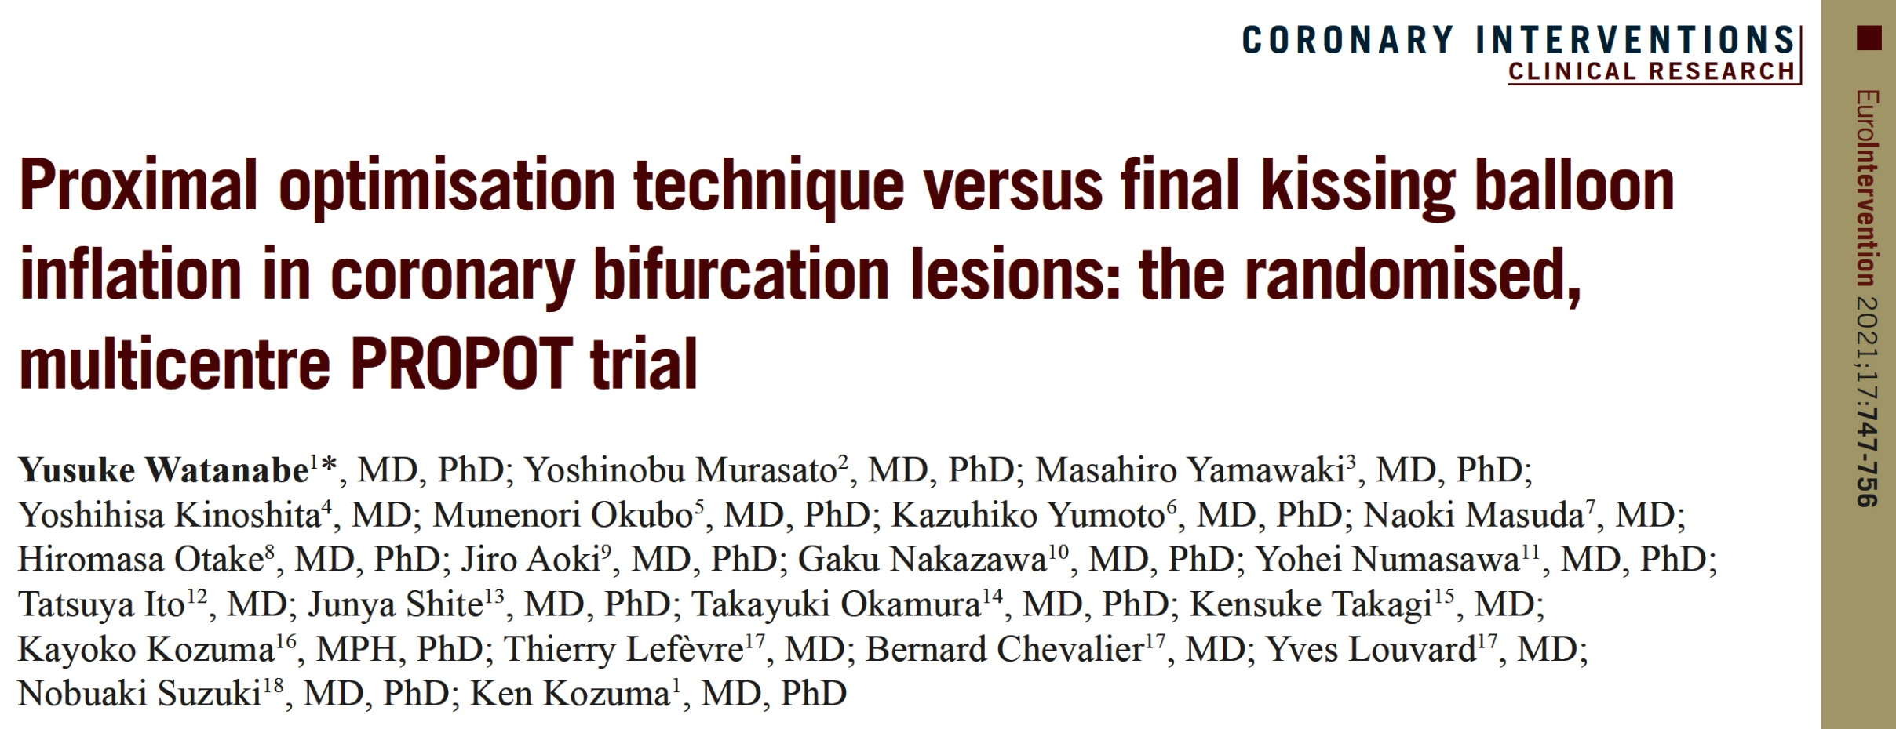

Slide 2
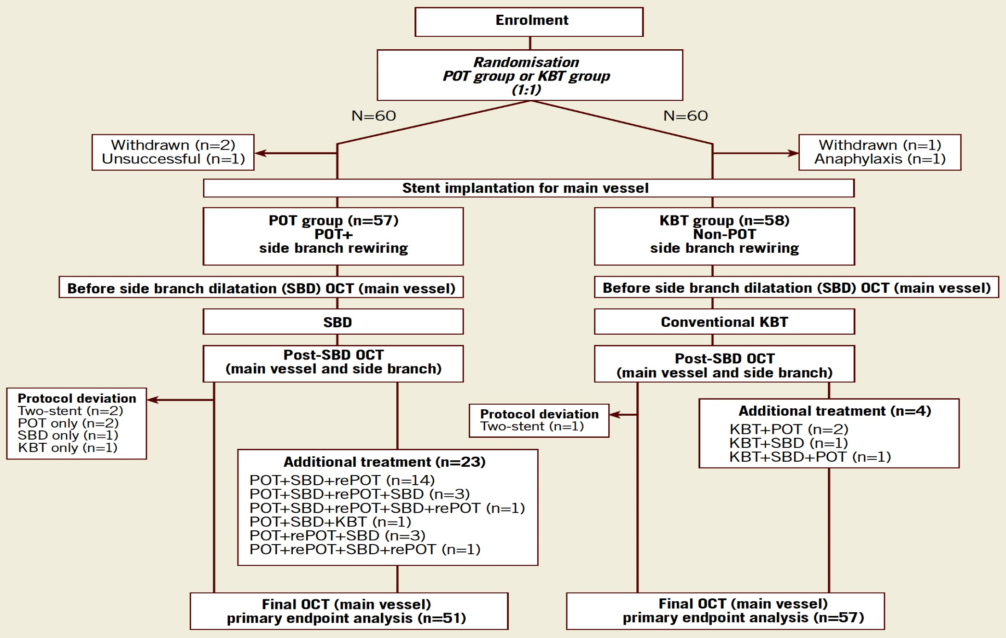
PROPOT Trial Design
Watanabe et al., EuroIntervention 2021;17:747

Slide 3
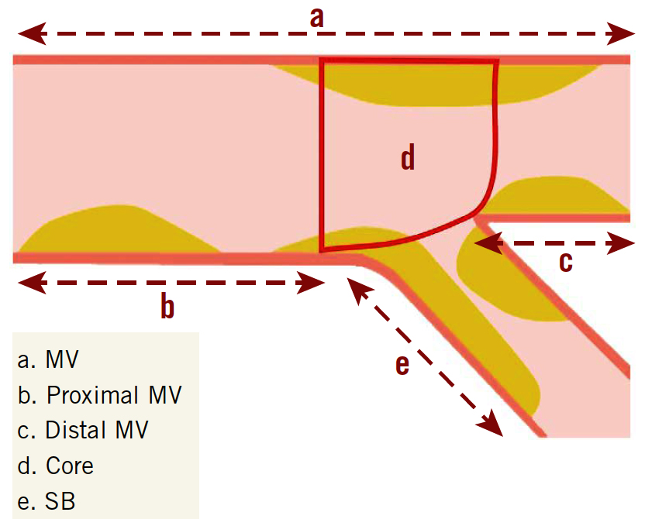
PROPOT: Subsequent Analysis by Quantitative Coronary Angiography
Watanabe et al., EuroIntervention 2021;17:747

Slide 4
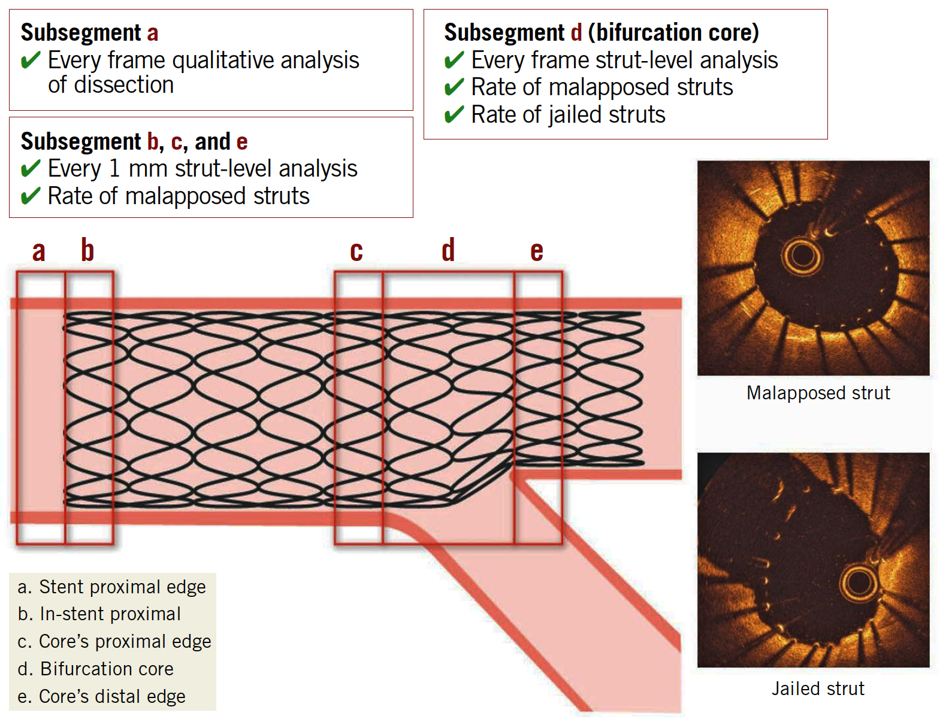
PROPOT: Subsequent Analysis by OCT
Watanabe et al., EuroIntervention 2021;17:747

Slide 5
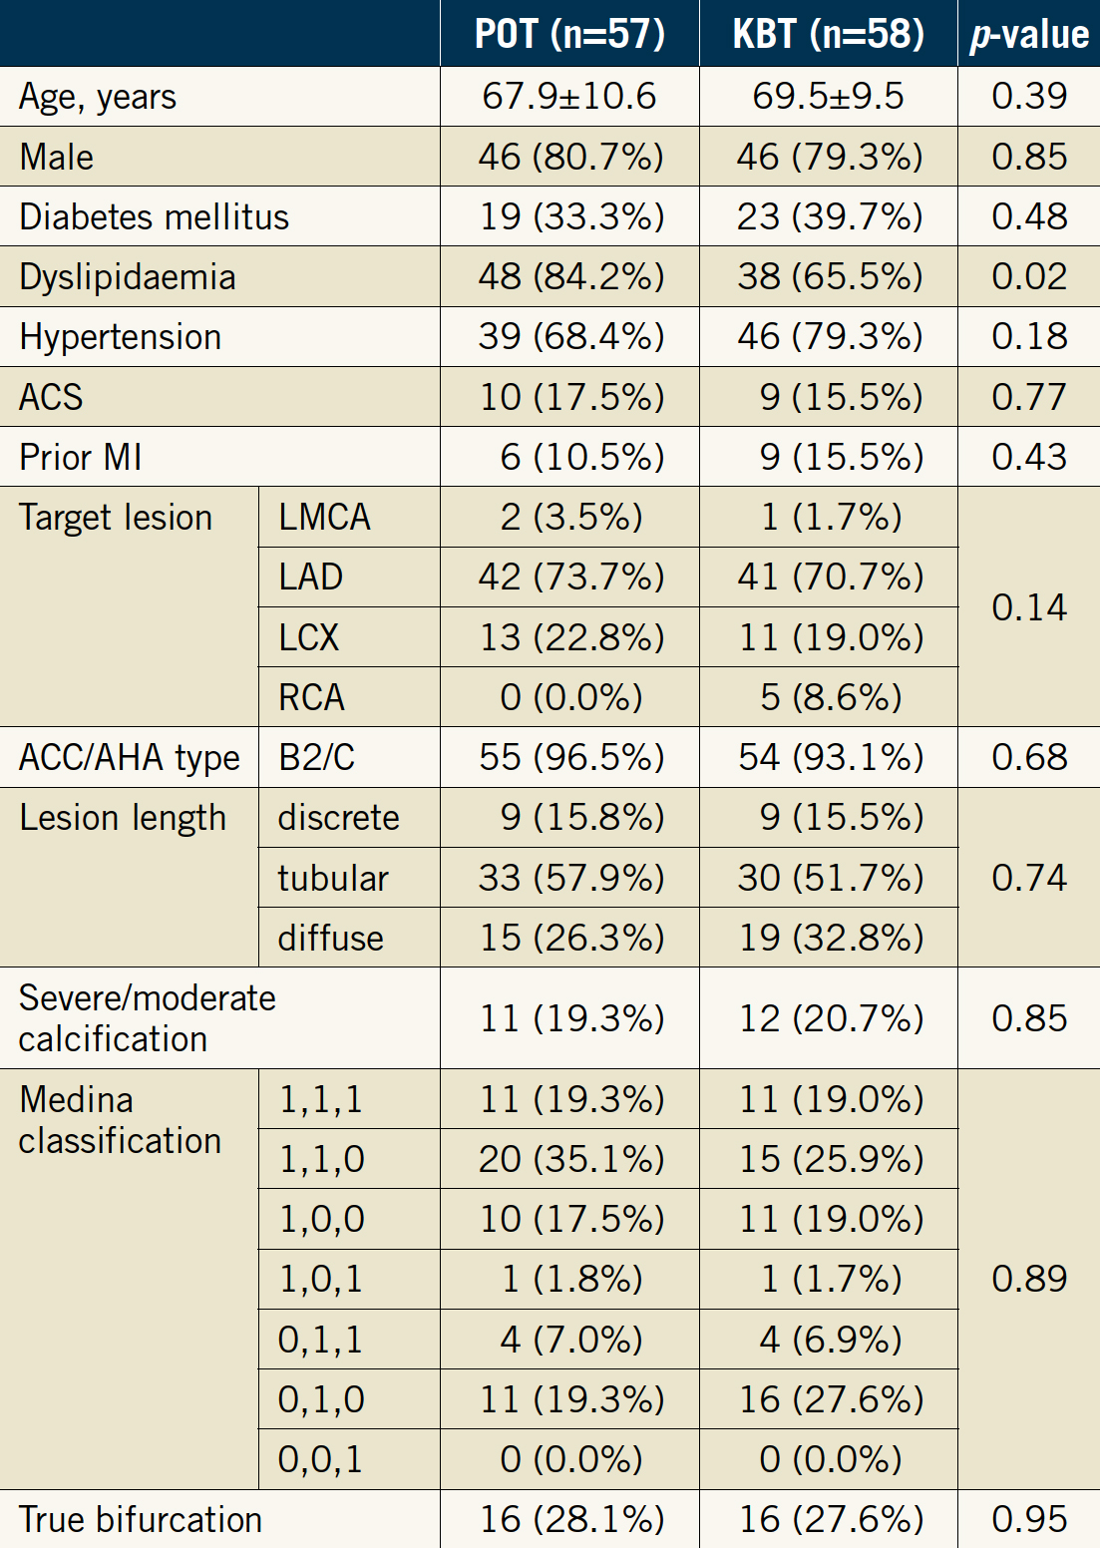
PROPOT: Study Population
Watanabe et al., EuroIntervention 2021;17:747

Slide 6
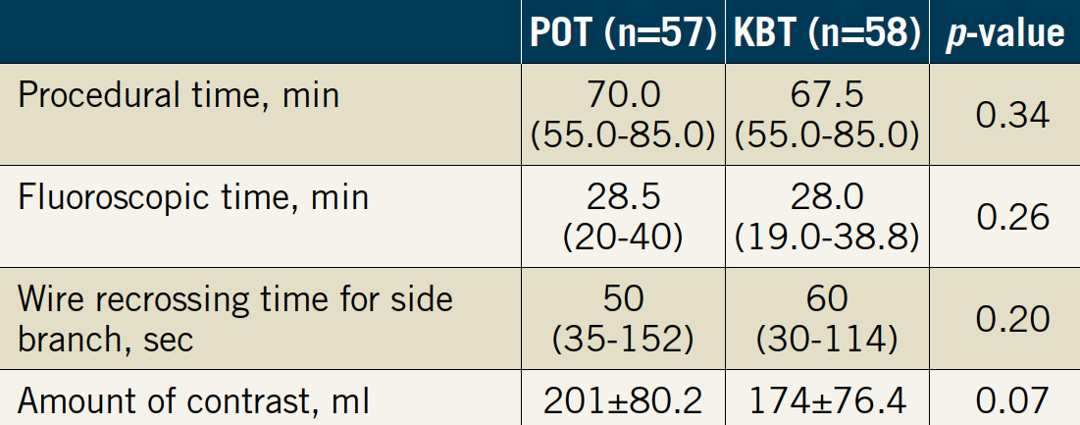
PROPOT: Procedural Outcomes
Watanabe et al., EuroIntervention 2021;17:747

Slide 7
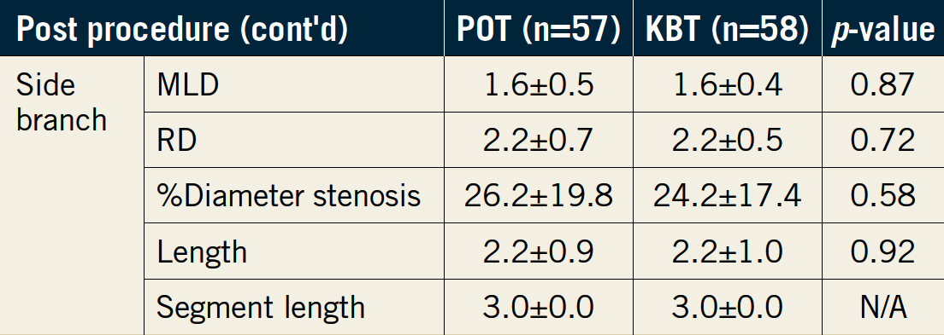
PROPOT: QCA Results
Post-Procedural QCA Measurements
In-stent percent diameter stenosis was higher in POT group (15.8±8.2 vs 15.3±6.3, p=0.02)
Watanabe et al., EuroIntervention 2021;17:747

Slide 8
PROPOT: Malapposed Strut Rate as Assessed by Final OCT
Before SBD vs final p=0.01 p<0.01 p<0.01 p<0.01 p=0.10 p=0.65 p<0.01 p=0.24
%
In-stent proximal Core’s proximal edge Bifurcation score Core’s distal edge
(Segment b) (Segment c) (Segment d) (Segment e)
POT vs KBT
Before SBD p=0.12 p=0.58 p=0.37 p=0.70
Final p=0.11 p=0.33 p=0.67 p=0.59
Watanabe et al., EuroIntervention 2021;17:747

Slide 9
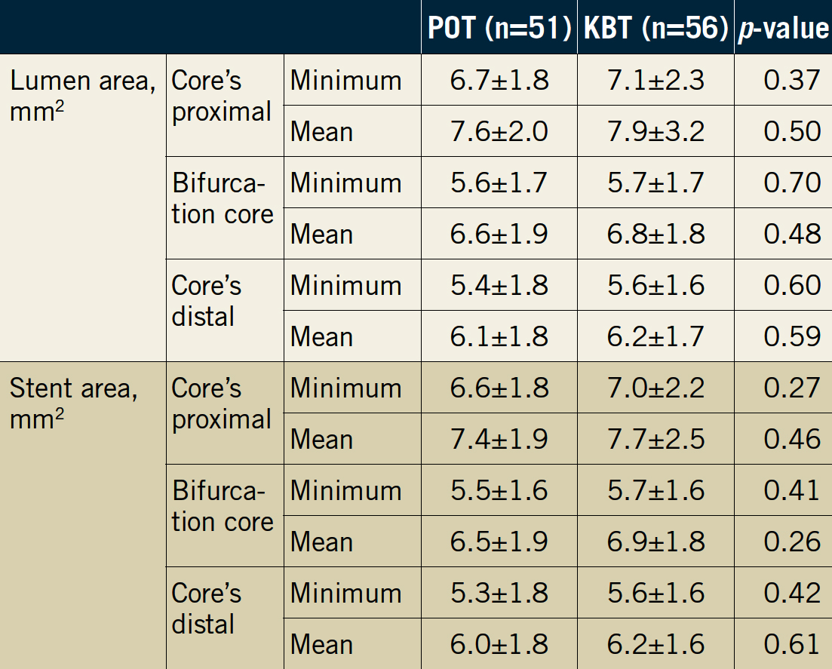
PROPOT: OCT Results
Watanabe et al., EuroIntervention 2021;17:747

Slide 10
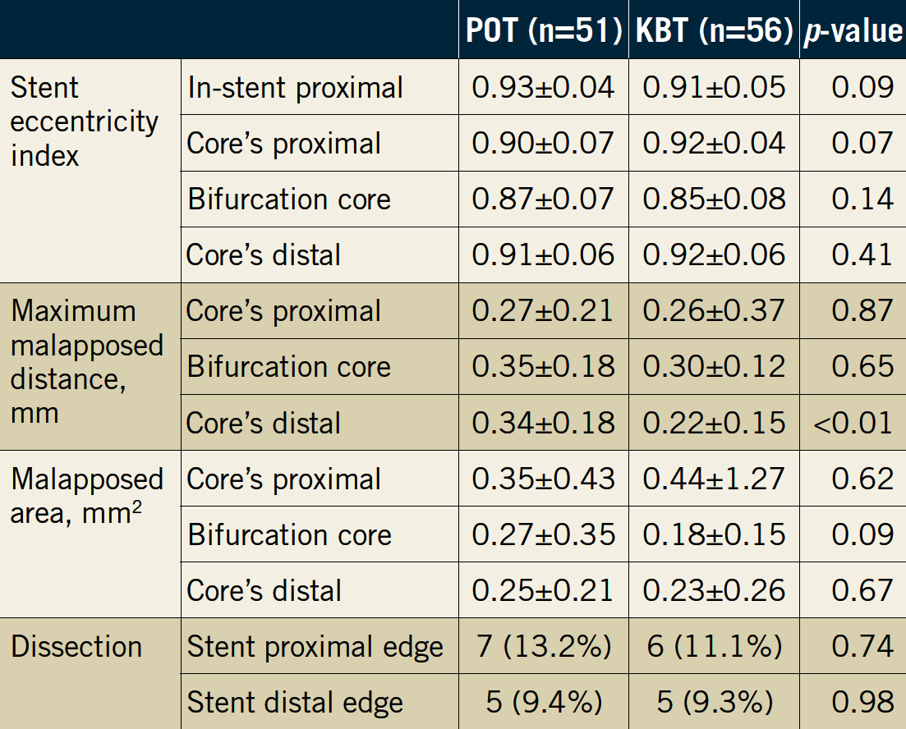
PROPOT: OCT Results
Watanabe et al., EuroIntervention 2021;17:747

Slide 11
PROPOT: 1-Year Clinical Outcomes
%
Watanabe et al., EuroIntervention 2021;17:747

Slide 12
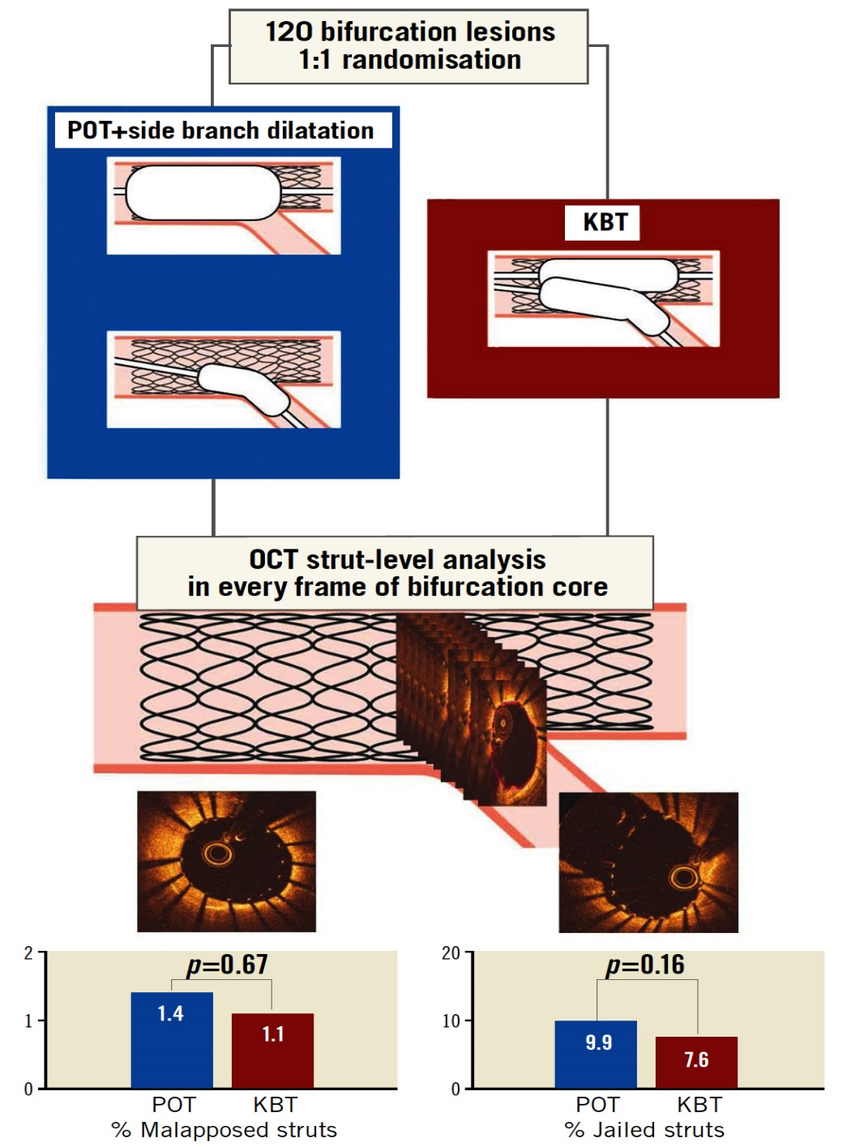
Overview of the PROPOT Trial
Malapposed strut rate assessed by final OCT
Primary endpoint at bifurcation core POT = 1.4% and KBT = 1.1% (p=0.67)
Jailed strut rate at bifurcation core POT = 9.9% and KBT = 7.6% (p=0.16)
Watanabe et al., EuroIntervention 2021;17:747

Slide 13
PROPOT: Rate of Jailed Struts at the Bifurcation Core Before SBD and at the End of the Procedure
POT vs KBT
Before SBD p=0.44
Final p=0.16
%
Before SBD
vs final
POT before SBD
POT final
KBT before SBD
KBT final
Watanabe et al., EuroIntervention 2021;17:747

Slide 14
PROPOT: Importance of POT Balloon Position
appropriate POT balloon positioning is essential to avoid a carina shift
inappropriate distal location of the POT balloon risks distal MV overstretch and carina shift to the SB
inappropriate proximal location may lead to stent malapposition and underexpansion around the carina
Watanabe et al., EuroIntervention 2021;17:747

