Slide 1
TF-TAVR with a 34mm Evolut FX Valve in a Low Flow Low Gradient Severe Aortic Stenosis: Horizontal Aorta and CKD stage IV (Scr 2.3mg/dL)
HYDERABAD
VALVES 2022
11th-12th November, 2022
DAY 1

Slide 2
Faculty Involved and Disclosures
Samin K. Sharma, MD, FACC, MSCAI
Nothing to disclose
Annapoorna S. Kini, MD, FACC
Nothing to disclose
Sahil Khera, MD
Nothing to disclose
Gilbert Tang, MD, MSc, MBA, FACC
Physician proctor for Medtronic
Stamatios Lerakis, MD, PhD, FACC, FAHA
Nothing to disclose
Cardiac Anesthesiologist
Eric Fried, MD

Slide 3
MSH Live Case #7: HJ, 87 y/o M
Presentation: Worsening NYHA III symptoms of SOB, and an episode of syncope
PMH: HTN, HLD, DM, Hypothyroid, CKD, Carotid disease, AF, Smoker, Bladder Cancer
Medications: Atorvastatin, Amiodarone, Apixaban, Aspirin, Metoprolol, Amlodipine, Synthyroid, Insulin
Labs: Hgb 12.8, PLT 331K, K 5.0, Cr 2.3 (today Scr 1.8), INR 1.4
EKG (10/12/2022): AF with controlled HR of 70 bpm.
TEE (06/15/2022): Moderate to severely decreased left ventricular systolic function, EF 30%, Severe low flow low gradient aortic stenosis (PG/MG/PV/AVA: 34/21/2.9/0.92)

Slide 4
TTE
Severe LFLG AS with severely reduced LV systolic function

Slide 5
Cardiac MR: Annulus & LVOT
Annulus
Max: 32.5 mm
Min: 24.5 mm
Mean: 28.5 mm
Perimeter = 91.2 mm
Area = 634.4 mm²
LVOT
Max: 33.5 mm
Min: 24.8 mm
Mean: 29.1 mm
Perimeter = 92.4 mm
Area = 650.6 mm²

Slide 6
CTA: Annulus
Annulus
Max: 30.6 mm
Min: 26.5 mm
Mean: 28.6 mm
Perimeter = 90.6 mm
Area = 647.3 mm²

Slide 7
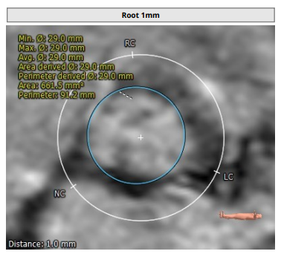
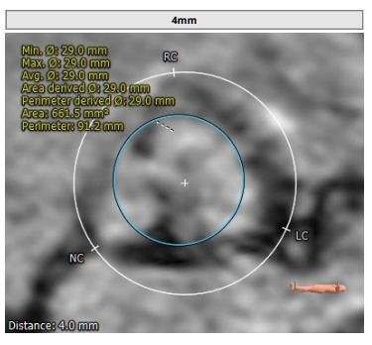
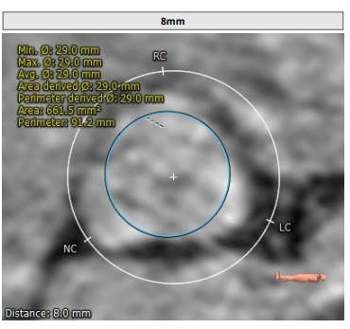
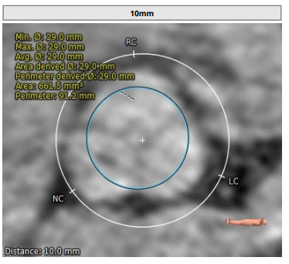
Cardiac MR : Root Analysis

Slide 8
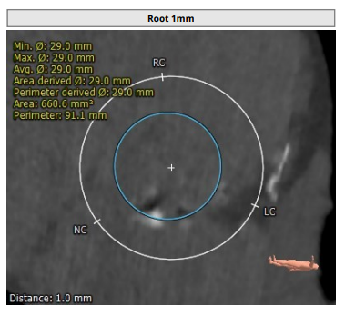
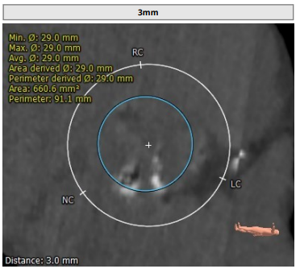
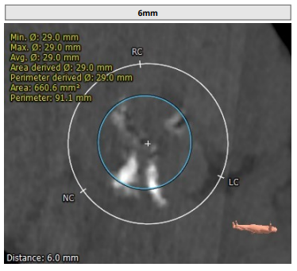
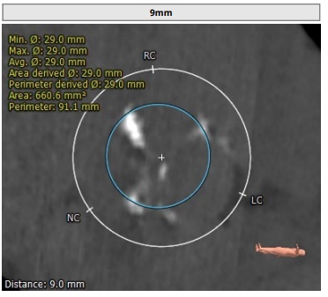
CTA : Root Analysis

Slide 9
Cardiac MR: STJ & SOV Diameter
STJ
Max: 32.1 mm
Min: 31.4 mm
Mean: 31.8 mm
SOV Diameter
SOV Left: 40.8 mm
SOV Right: 39.5 mm
SOV Non: 37.1 mm

Slide 10
CTA: STJ & SOV Diameter
STJ
Max: 36.6 mm
Min: 35.8 mm
Mean: 36.2 mm
SOV Diameter
SOV Left: 40.5 mm
SOV Right: 38.6 mm
SOV Non: 43.2 mm

Slide 11
Cardiac MR: Sinus Height LCC & RCC
SOV height: 30.4 mm
Left coronary height 21.4 mm
Right coronary 25.1 mm

Slide 12
CTA: Sinus Height LCC & RCC
SOV height: 36.0 mm
Left coronary height 17.2 mm
Right coronary 22.9 mm

Slide 13
Cardiac MR: Aortic Root Angle
Horizontal Aorta

Slide 14
CTA: Calcification & Hockey Puck view

Slide 15
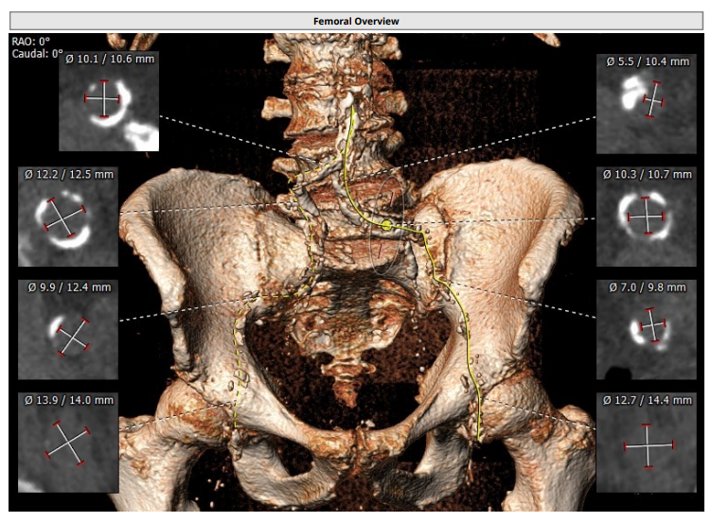
Non-Contrast CTA: Access Anatomy

Slide 16
Summary of Case
Presentation: 87 y/o M with worsening NYHA Class III symptoms, and an episode of syncope
TEE: Moderate to severely decreased left ventricular systolic function, EF 30%, Severe low flow low gradient aortic stenosis (PG/MG/PV/AVA 34/21/2.9/0.92 sq cm)
STS risk mortality for redo MVR: 3.29%
Course: Patient was evaluated by heart team and recommended TF-TAVR with minimal contrast use (CKD stage IV)
Plan: TF TAVR with a 34mm Evolut Fx via Rt percutaneous femoral artery access ad use of sentinel EPS device (provided favorable anatomy)

