Slide 1
Complex Coronary Live Case Series
In collaboration with
www.CCClivecases.org
from
Cardiac Cath Lab, Mount Sinai Heart, NY, USA
in
Association with CME MEDIQUEST

Slide 2
Disclosures
Samin K. Sharma, MD, MSCAI, FACC
Nothing to disclose
Annapoorna S. Kini, MD, MRCP, FACC
Nothing to disclose
Vijin Joseph V.F., MBBS, MD, DNB (Guest Faculty)
Jimmy George, MBBS, MD, DM (Moderator)

Slide 3
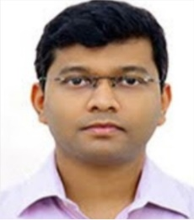
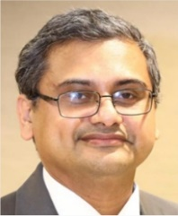
Vijin Joseph V. F. MBBS, MD (General Medicine), DNB (Cardiology) Consultant Interventional Cardiologist, Lisie Heart Institute, Lisie Hospital, Kochi, Kerala
Jimmy George, MBBS, MD, DM Consultant Interventional Cardiologist Lisie Heart Institute, Lisie Hospital Kochi, Kerala
Dr. Vijin Joseph is a Consultant Cardiologist at Lisie Heart Institute, Lisie Hospital, Kochi. He completed his MBBS from Dr. B. R. Ambedkar Medical College, Bangalore, MD (General Medicine) from Yenepoya Medical College, Mangalore and DM (Cardiology) from Lisie Heart Institute, Kochi. He is a member of Cardiology society of India and Tranvancore Medical Council, Kerala. He is actively involved in research and publications. He published and presented his research work in renowned journals and scientific meetings.
Dr. Jimmy George is Consultant Interventional Cardiologist at Lisie Heart Institute, Lisie Hospital, Kochi. He is Treasurer & Organising Secretary (2018 onwards) of Cardiovascular Research Society; Present Executive Committee Member 2022, CSI Kerala; Present Executive Committee Member 2022, ICCK Interventional Cardiology Council Kerala; Present Executive Committee Member 2022, SCIP Society of Coronary Imaging & Physiology-India ; Present Executive Committee Member 2022, Past Secretary 2021 , Past Joint Secretary 2020, Cochin Cardiology Forum; Lisie Research Executive Committee member 2022 and International Faculty in 2022 TCT-AsiaPacific Seoul .

Slide 5
Live Case #24
Patient Demographics
63 yrs, M
Present Clinical Presentation
Presented with CCS Class II angina for few months and +stress echo for multi-vessel ischemia
CAD Risk Factors
Controlled hypertension
Controlled hyperlipidemia
Ex-smoker, SAQ score:52
Clinical Variables
No prior cardiac medical history until few months ago. Echo revealed EF 65% and ischemia on Stress echo.
Medications
Aspirin, Metoprolol, Atorvastatin, Losartan
Cath: Cardiac cath on August 15th 2022 revealed 3 V CAD: long 70-80% calcific mid LAD/D1 bifurcation, 90% pLCx, 100% prox RCA filling via bridge and retrograde collaterals LVEF 65% and Syntax score 30. Pt underwent ssuccessful DES PCI of pLCx using Synergy XD DES and did well, Started on Ticagrelor 90mg twice daily & ISMN 30mg daily.
Plan: Now planned for staged PCI of RCA CTO using antegrade, and if failed retrograde approach.

Slide 6
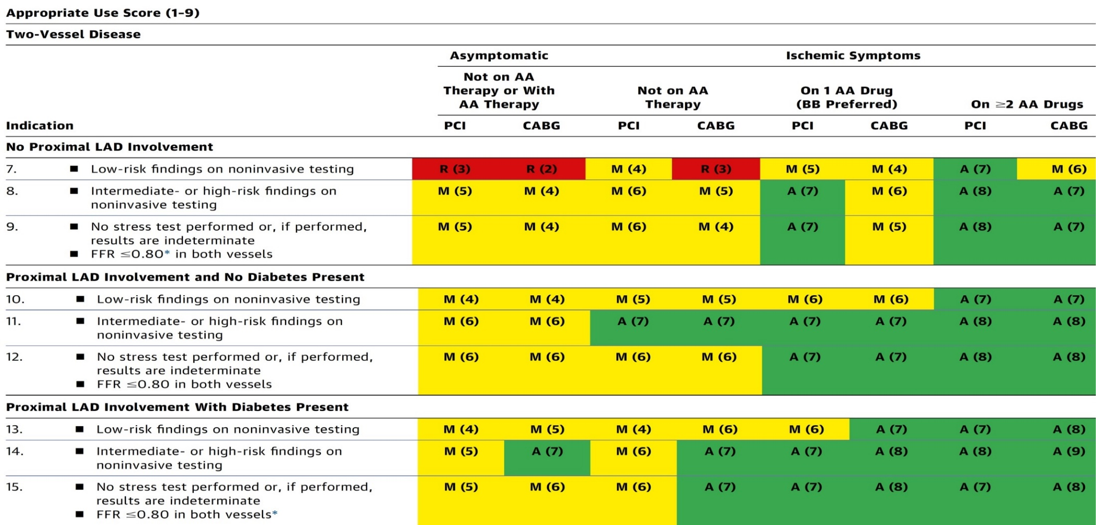
AUC 2017: Two-Vessel Disease
Patel et al., J Am Coll Cardiol 2017;69:2212

Slide 7
Patients with Complex Disease and Diabetes
Recommendations for Patients with Complex Disease
Recommendations for Patients with Diabetes
Lawton et al., J Am Coll Cardiol 2022; 79:e21

Slide 8
Treatment of Individual Patients Subgroups
Recommendations for the Treatment of Calcified Lesions
Recommendations for the Treatment of Pts with Stent Restenosis
Recommendations for Hemodynamic Support in Complex PCI
Lawton et al., J Am Coll Cardiol 2022; 79:e21

Slide 9
Treatment of Individual Patients Subgroups

Slide 10
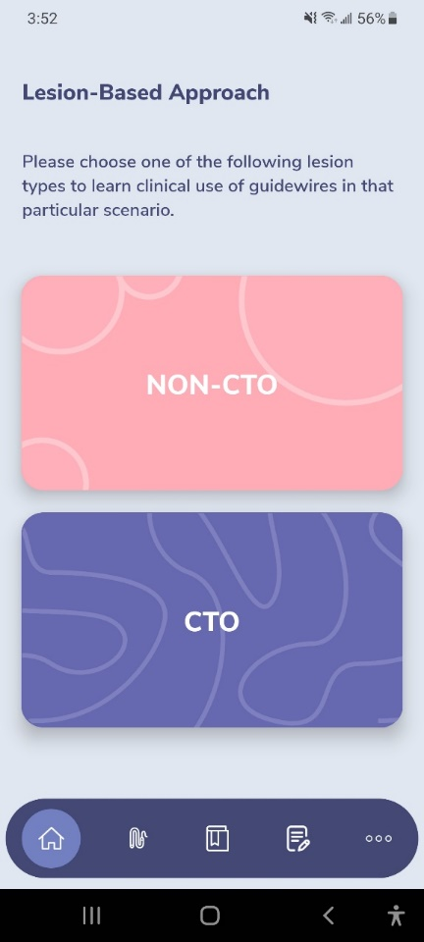
GuidewireAID – Out on both Android and iOS!
Apple ® and App Store® are registered trademarks of Apple Inc.
Download for Free!

Slide 11
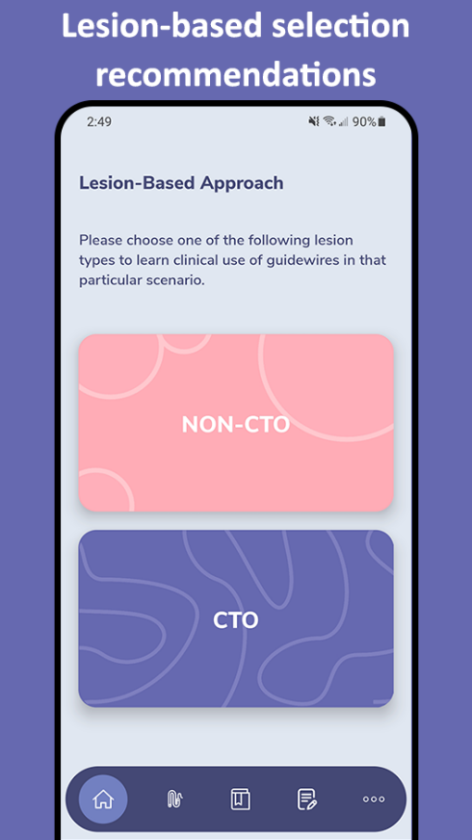
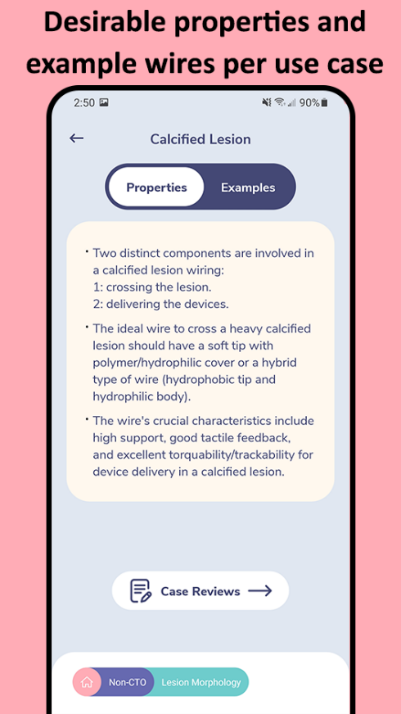
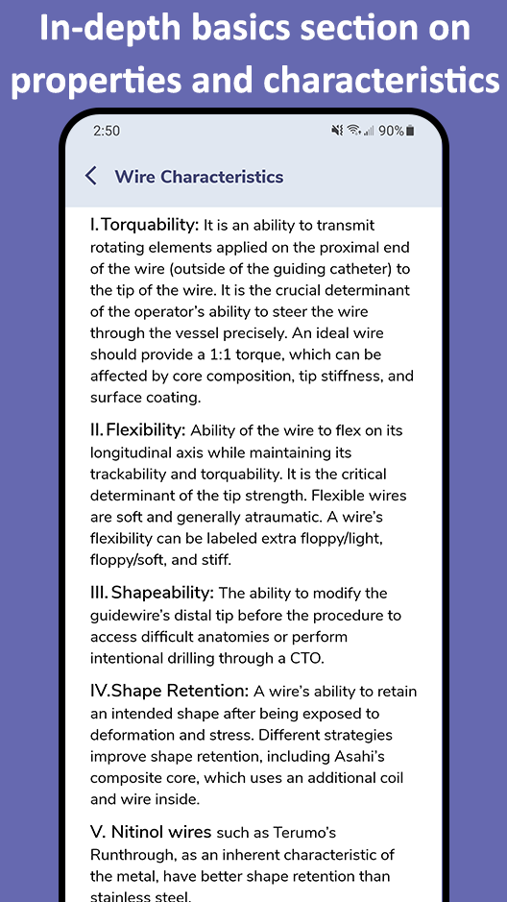
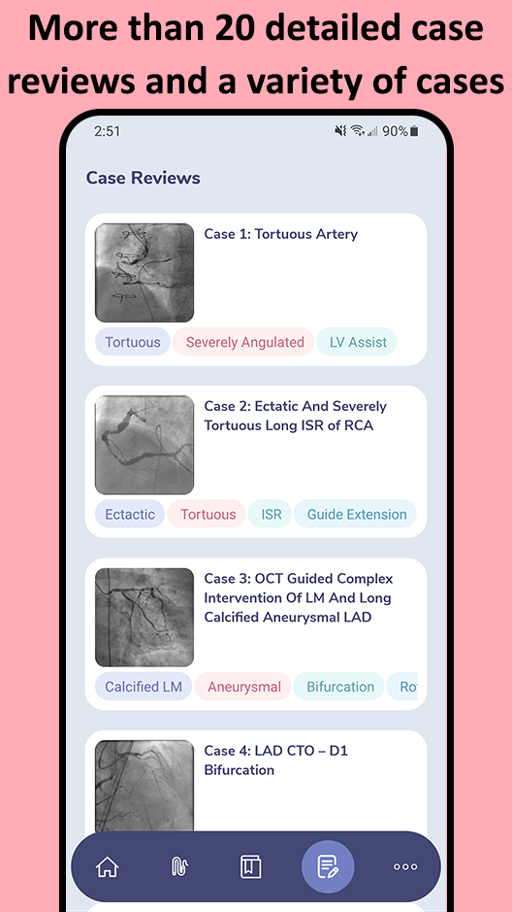
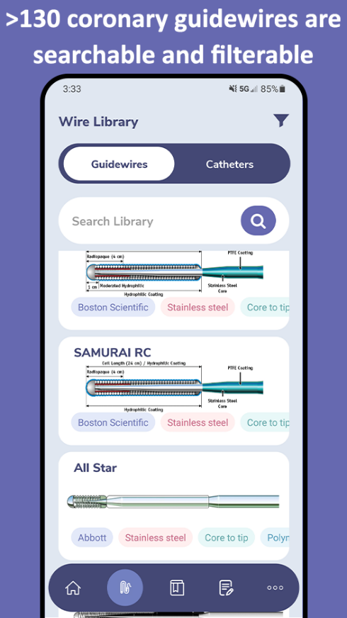
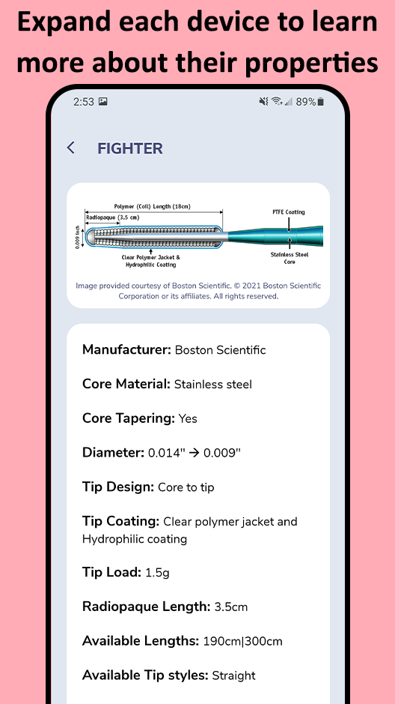
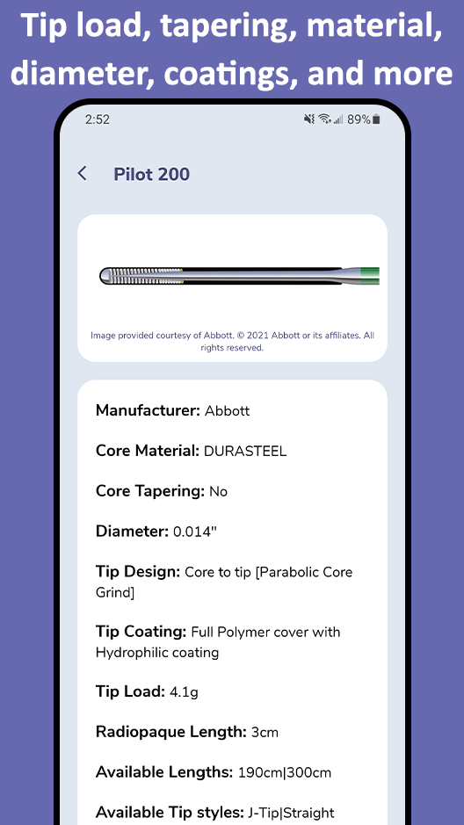
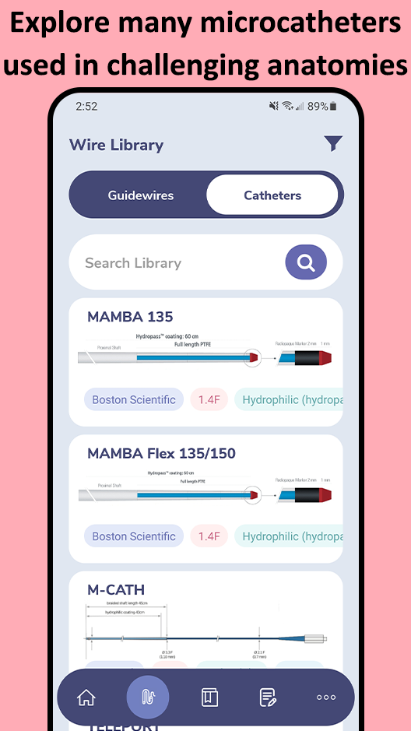
In addition to the web app at www.CardiologyApps.com/GuidewireAID, the iOS and Android mobile app is out now to download for free!

Slide 12
CTO Wire Escalation – Sample Toolkit

Slide 13
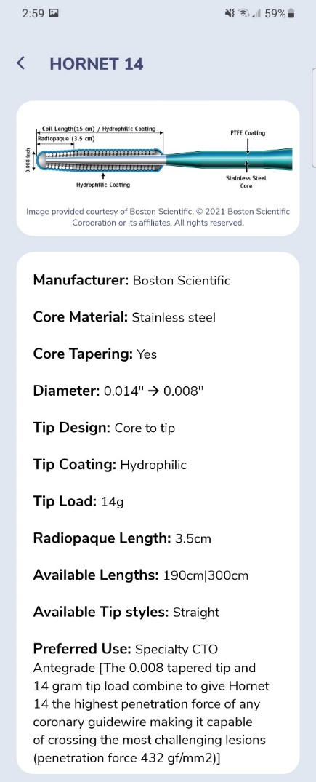
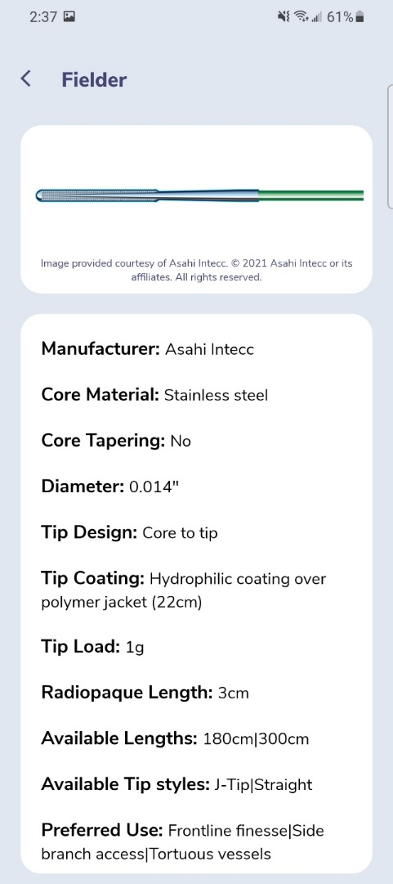
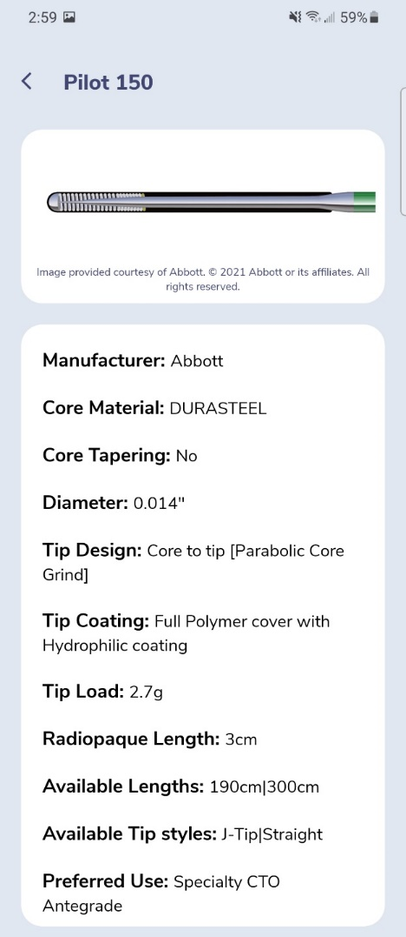
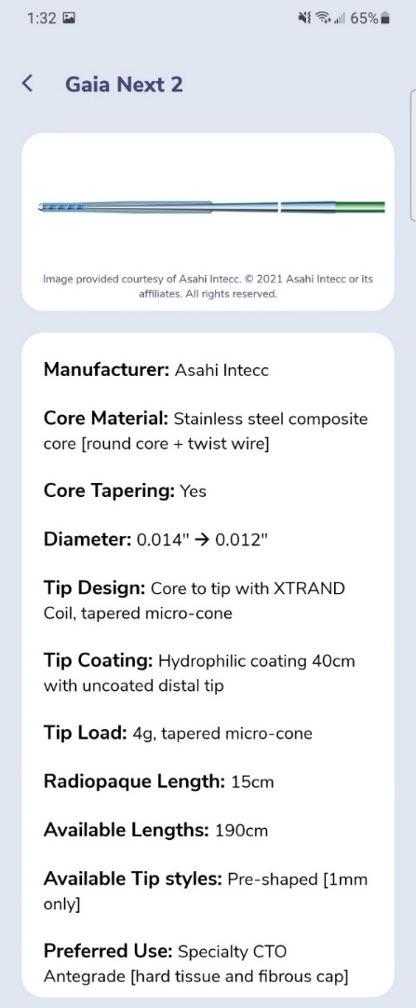
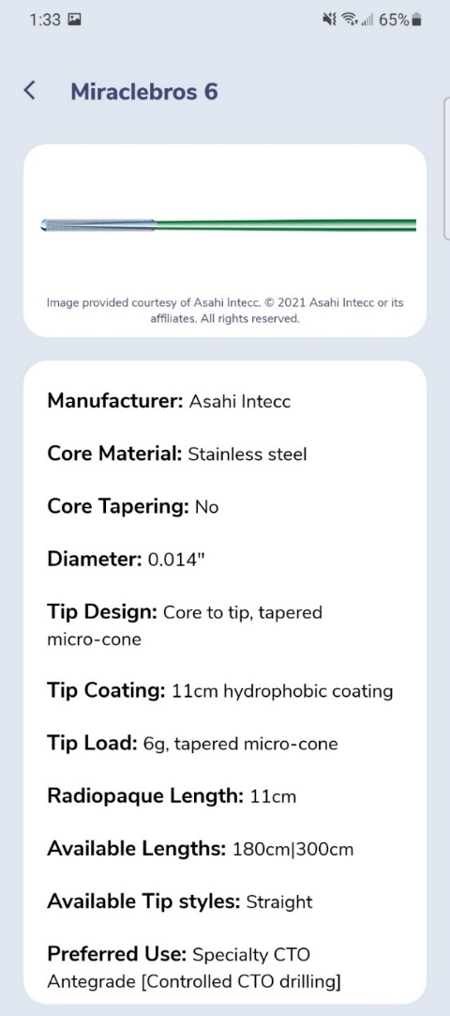
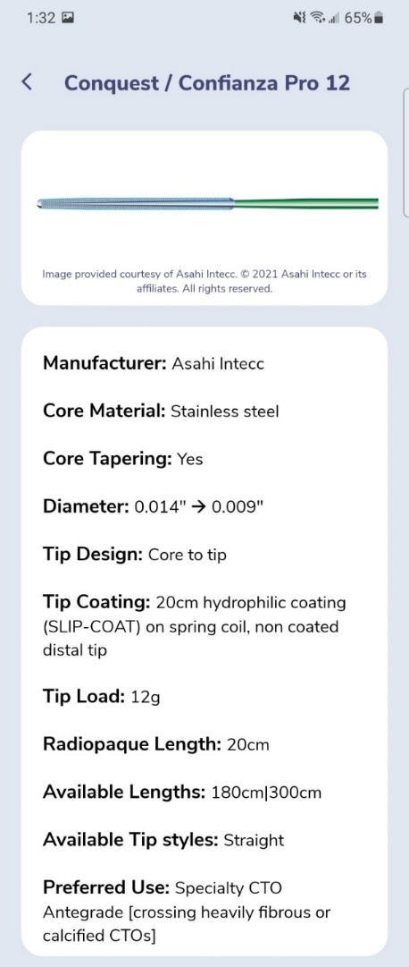
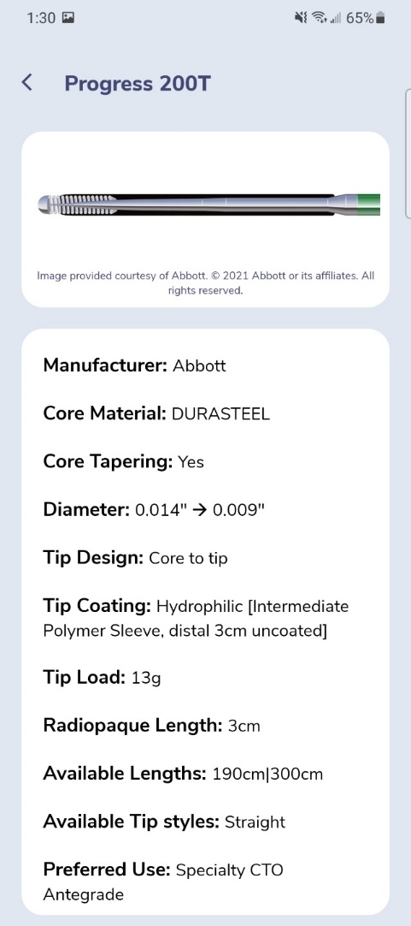
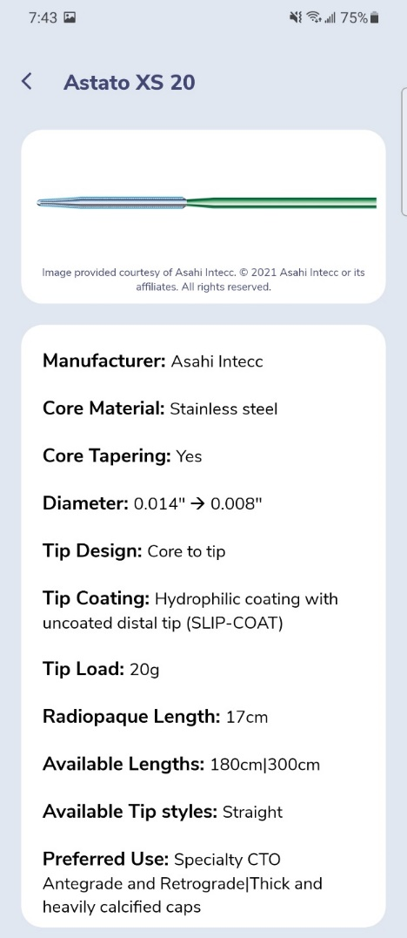
Low Tip Load
Non-tapered
High Tip Load
Tapered
CTO Wire Escalation

Slide 14
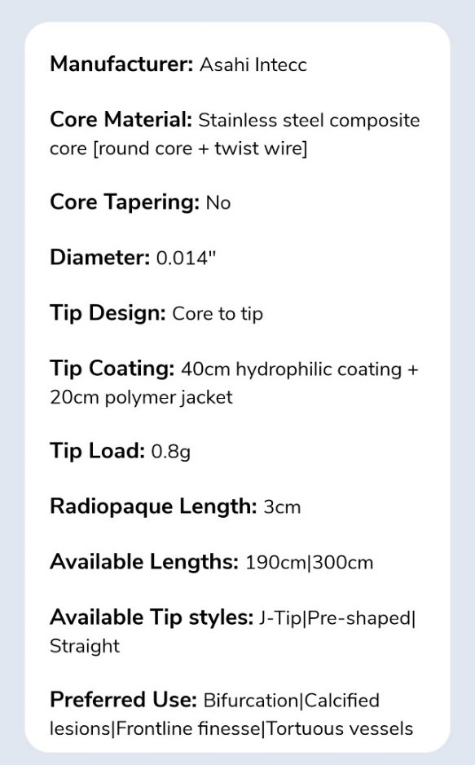
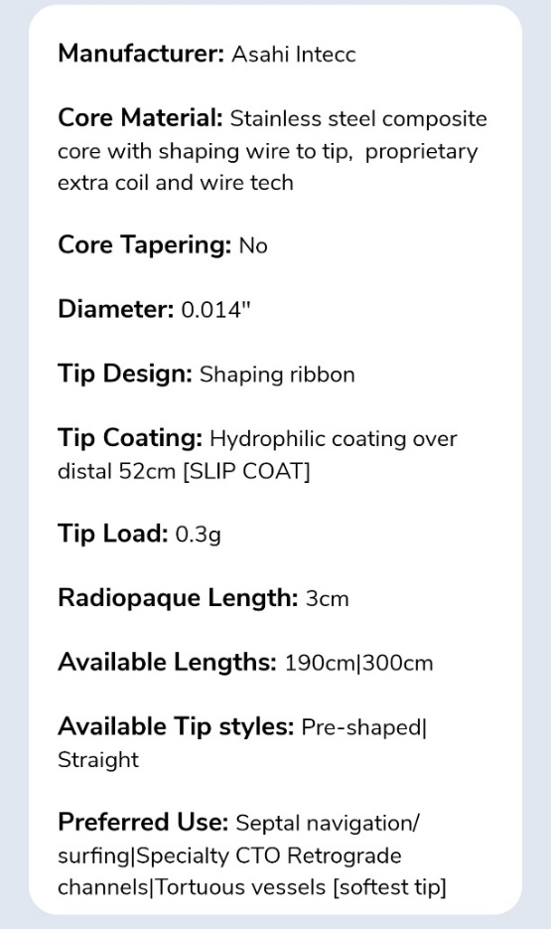
GuidewireAID – SUOH 03 and SION Black
SION Black
SUOH 03

Slide 15
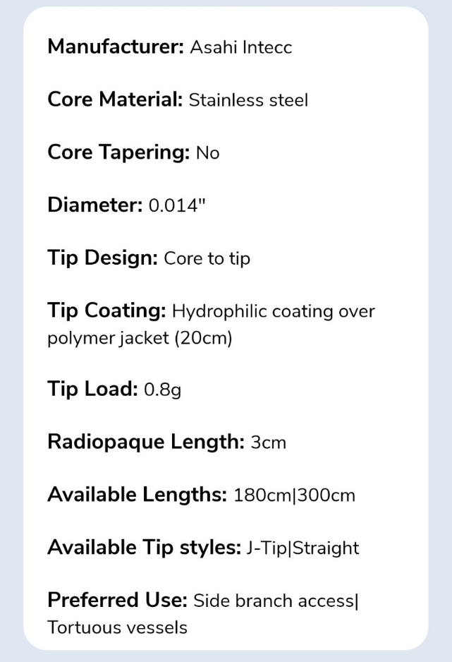
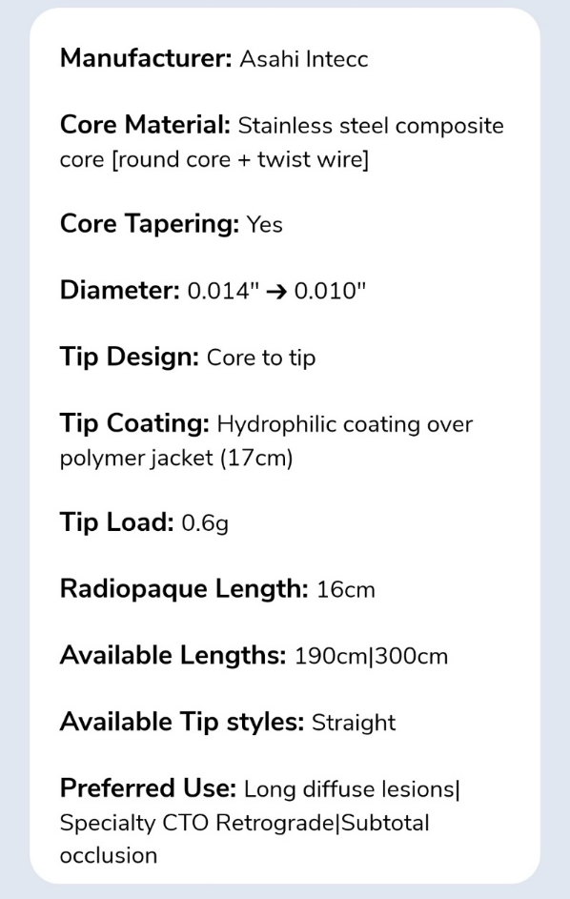
GuidewireAID – Fielder FC and Fielder XT-R
Fielder FC
Fielder XT-R

Slide 16
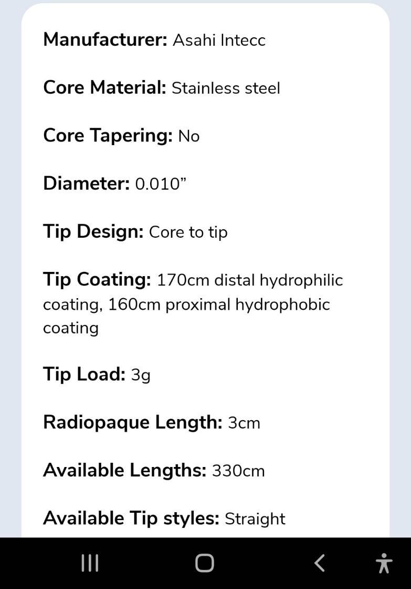
GuidewireAID – RG3

Slide 17
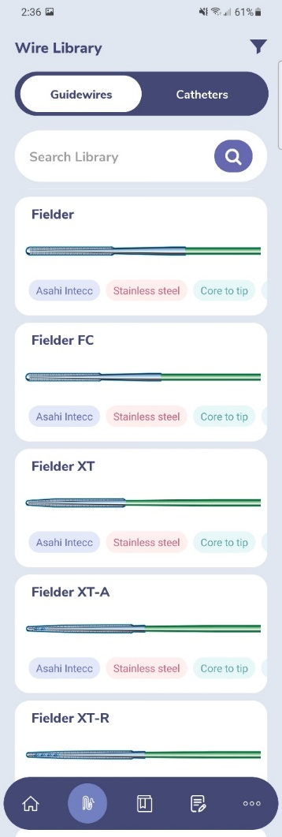
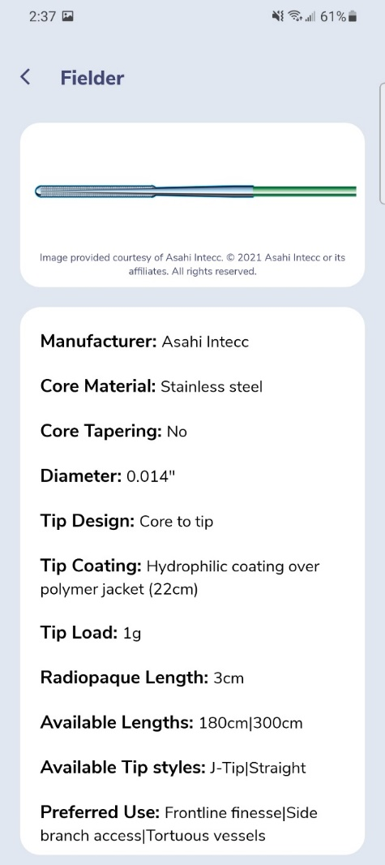
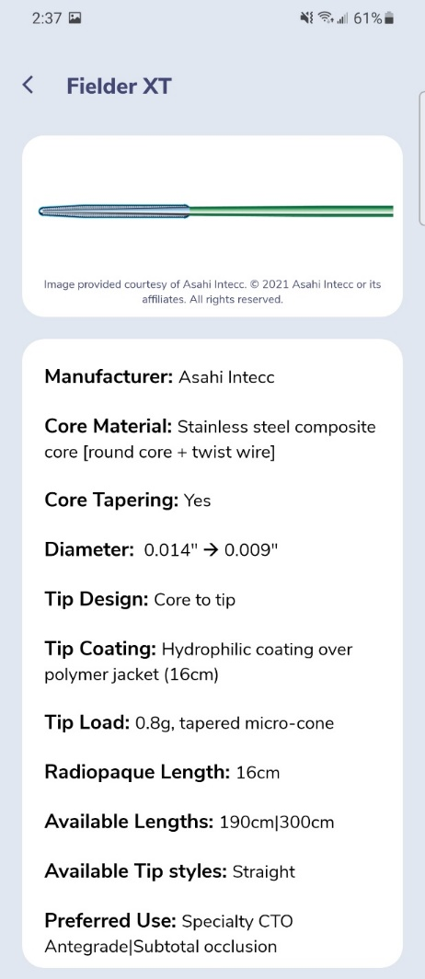
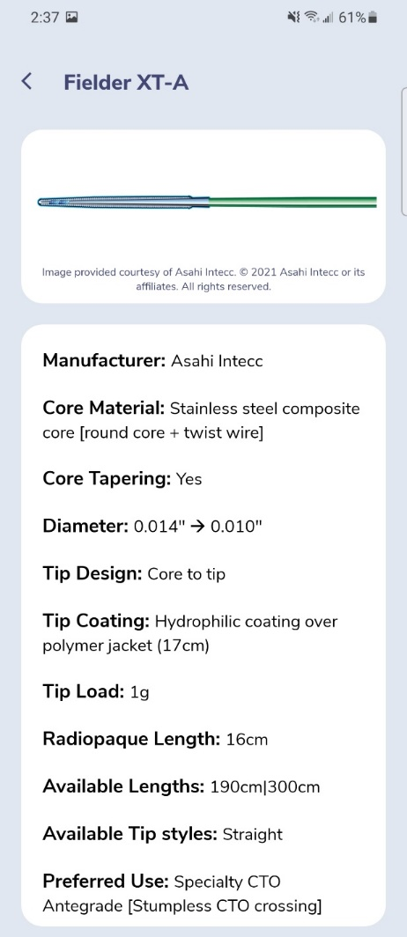
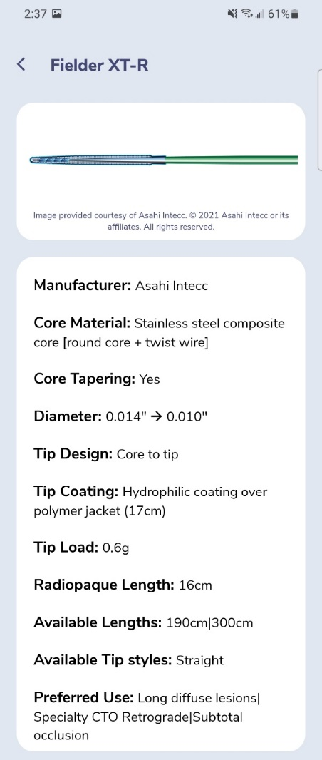
GuidewireAID – Knowing the Difference in One Wire Family

Slide 18
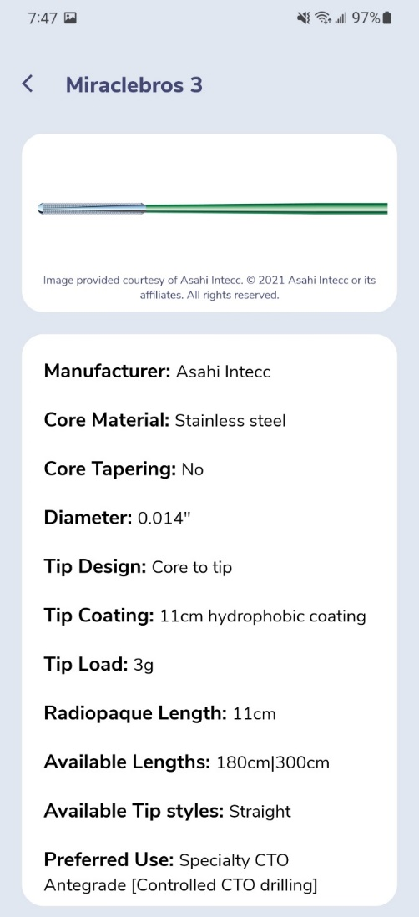
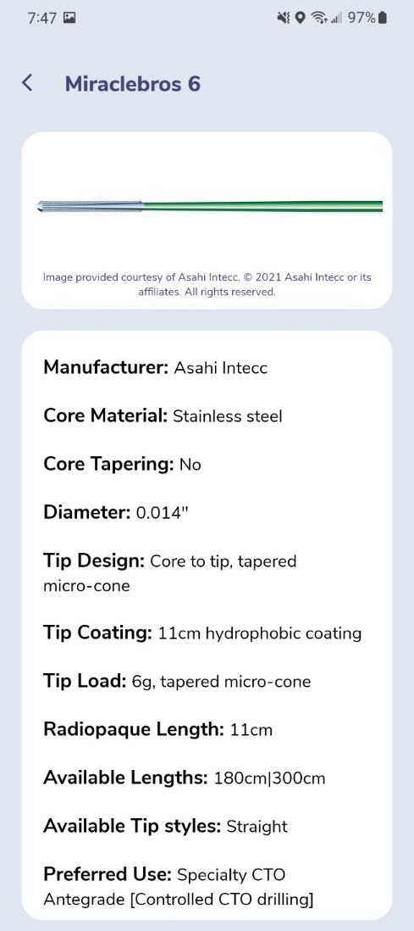
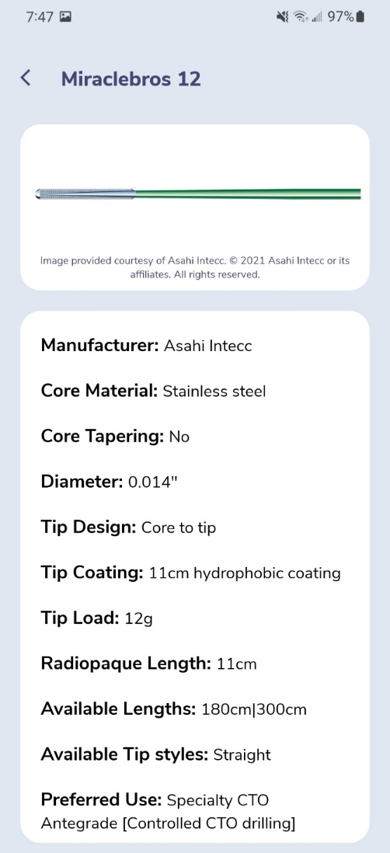
GuidewireAID – Knowing the Difference in One Wire Family

Slide 19
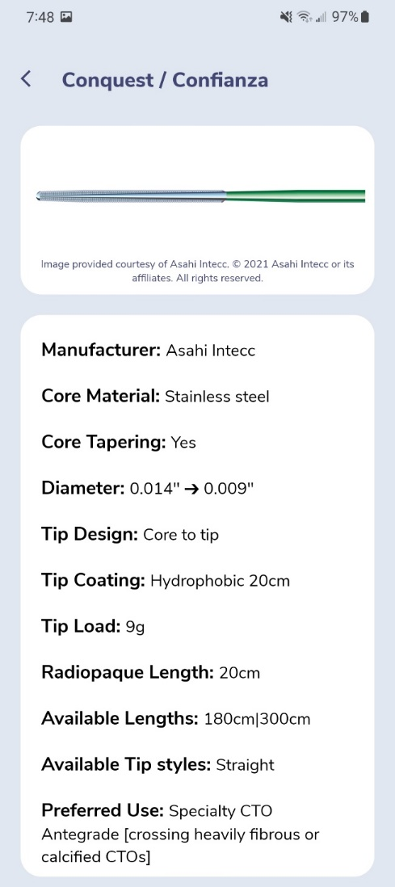
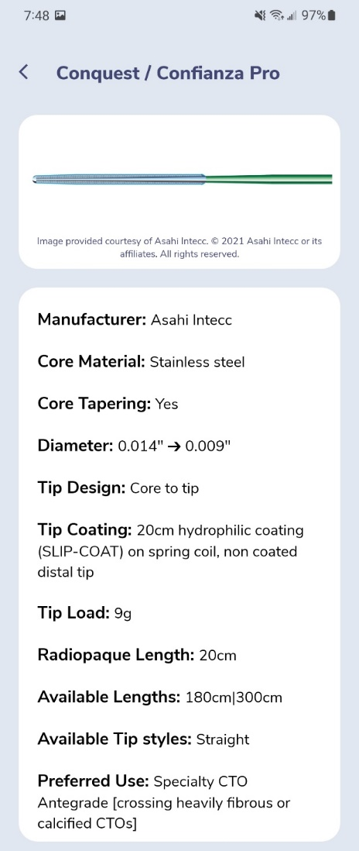
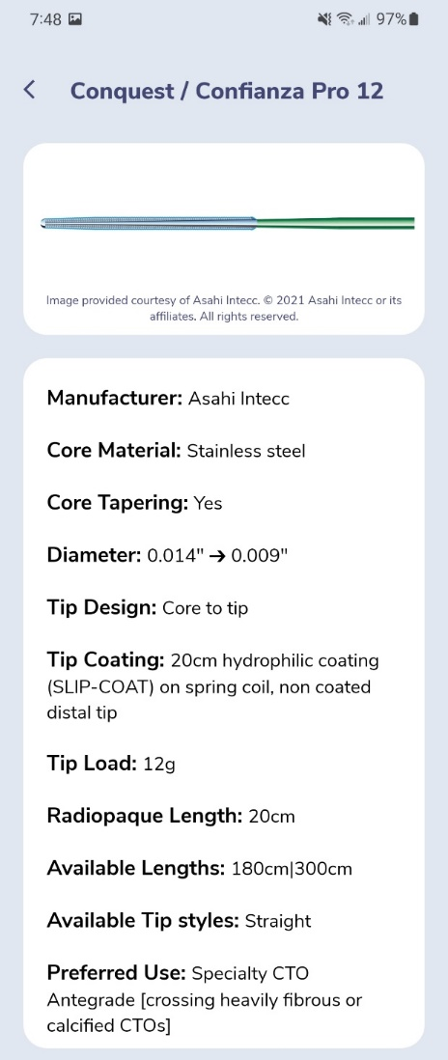
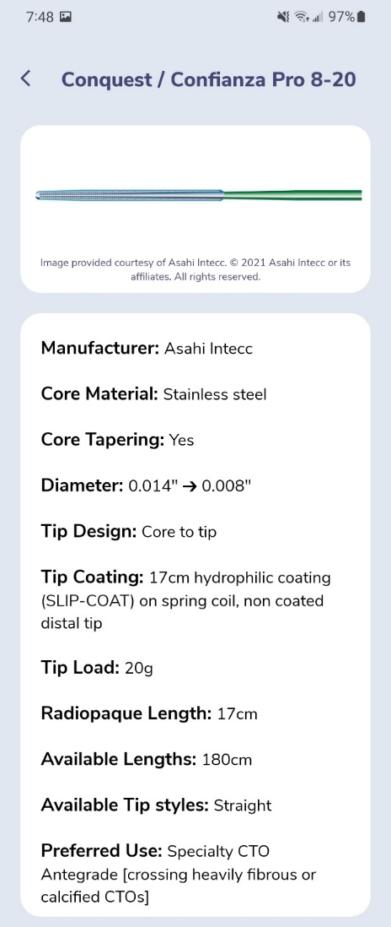
GuidewireAID – Knowing the Difference in One Wire Family

Slide 20
GuidewireAID – Our common CTO MicroCatheters

Slide 21
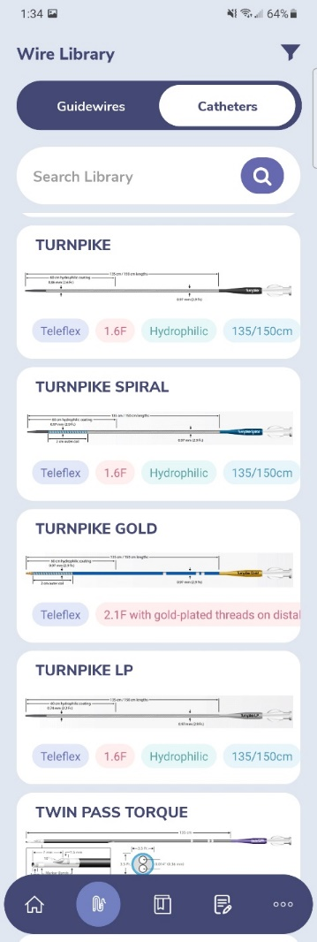
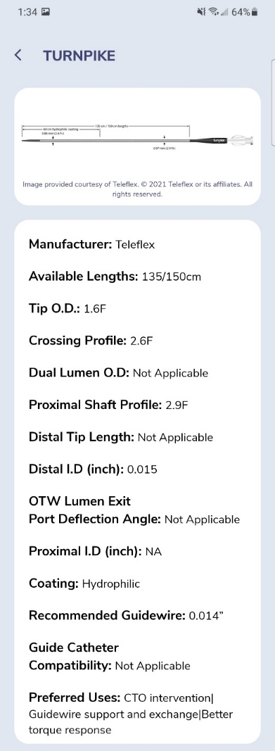
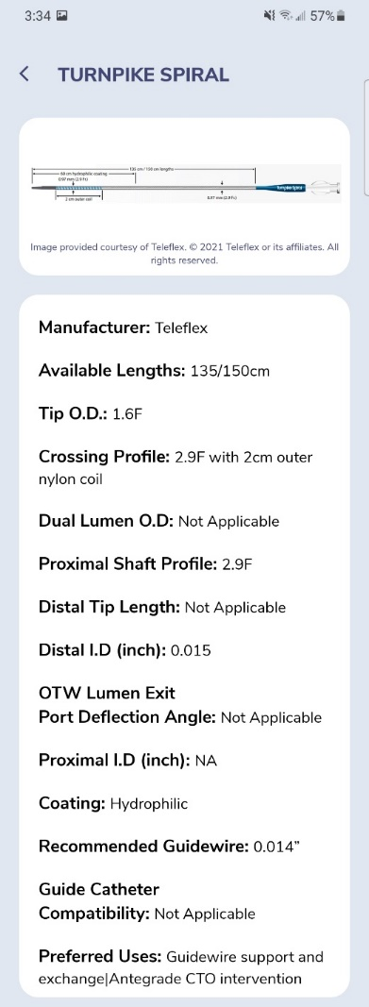
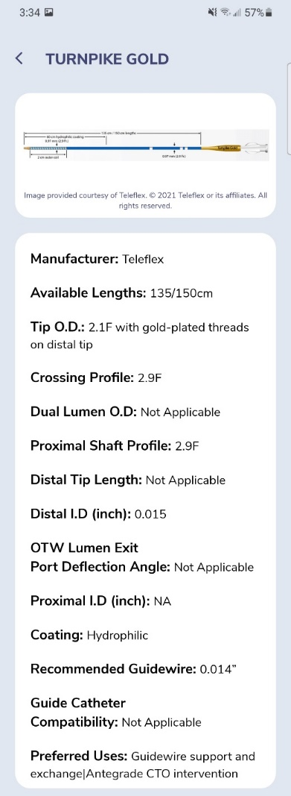
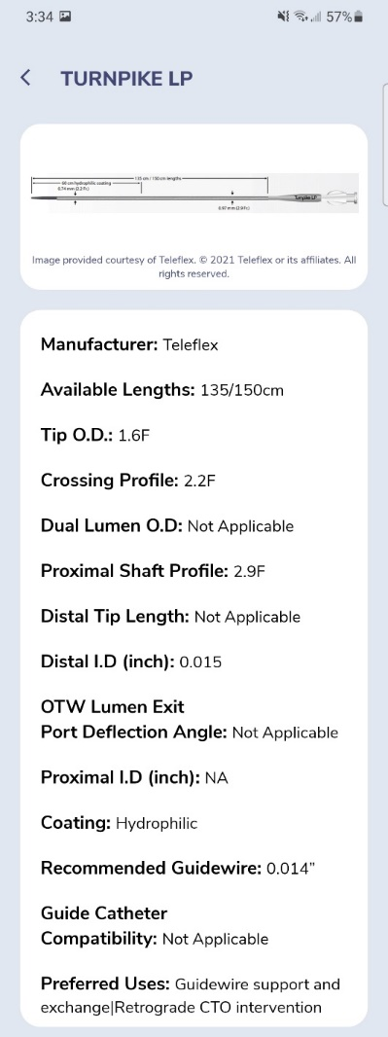
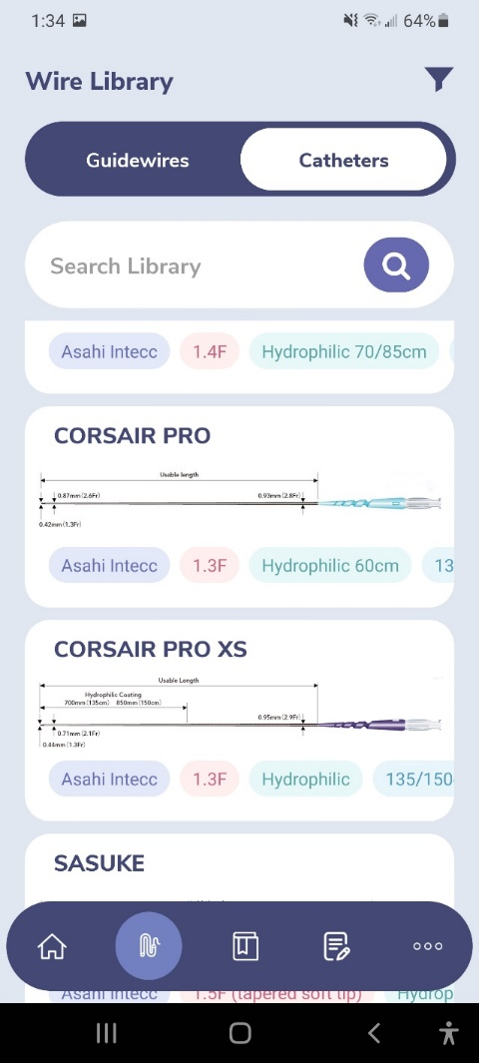
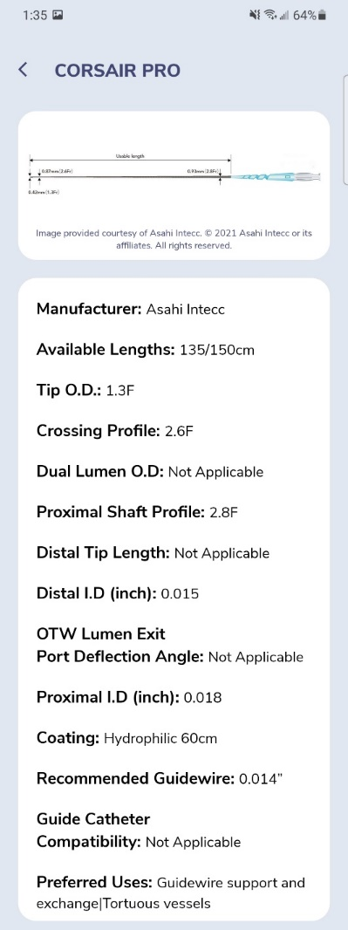
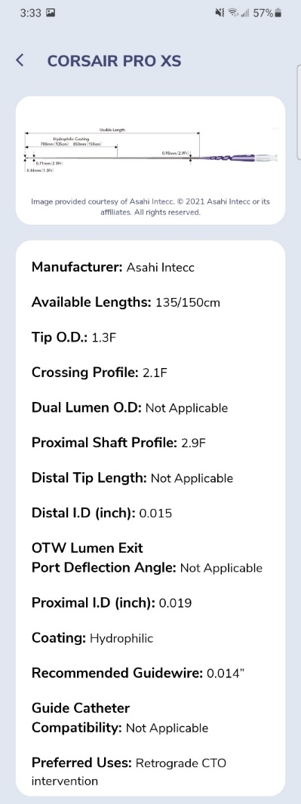
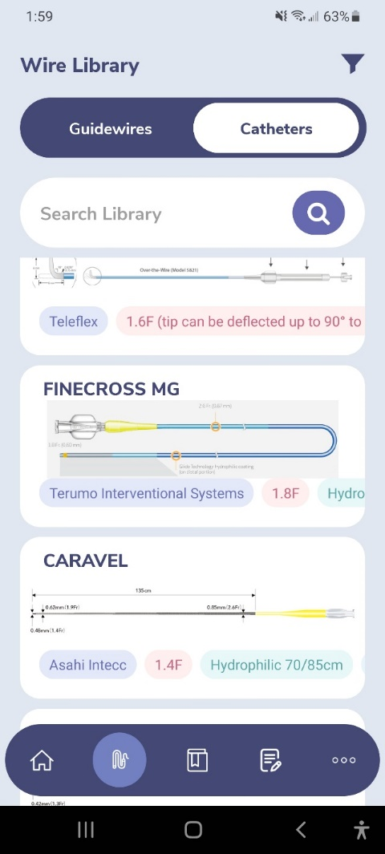
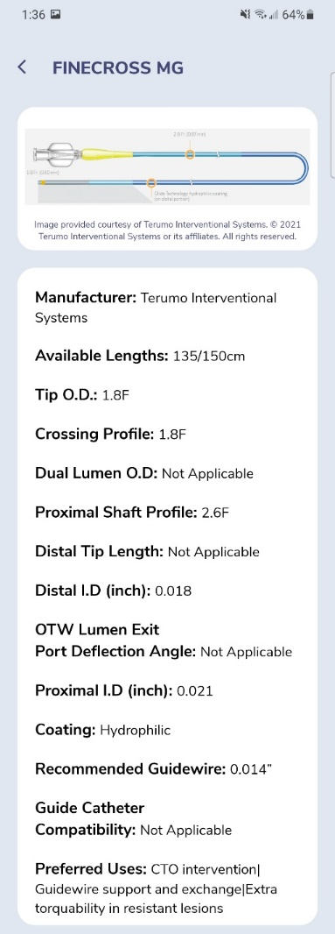
GuidewireAID – Our common CTO Microcatheters

Slide 22
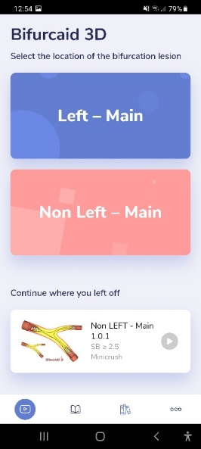
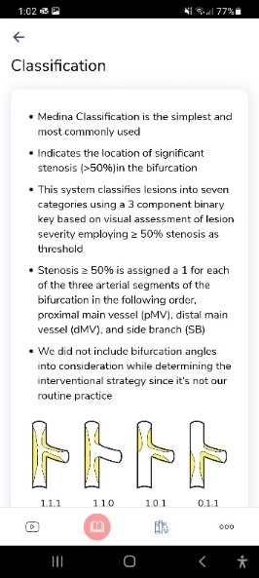
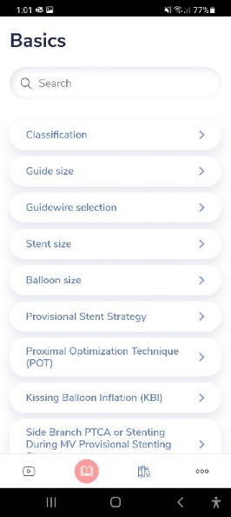
BifurcAID-3D
Available as both Mobile Application for Android and iOS devices
as well as
fully-featured Web-Application on
www.CardiologyApps.com/BifurcAID-3D
Select “Key Videos” for
A shortcut to techniques

Slide 23
Non-Left Main Minicrush
(+ Balloon Anchor scenario)

Slide 24
Cath Lab Apps CardiologyApps.com
Data Updated on Sep 7 2022*
>64,400 unique downloads and counting!
BifurcAID
OCTAID
TAVRcathAID
TranseptAID
CalcificAID
iOS ★ 4.96/5
12,989 downloads
Android ★ 5/5
10,880 downloads
Released sept 2017
iOS ★ 4.6/5
9,200 downloads
Android ★ 4.33/5
5,636 downloads
Released June 2018
iOS ★ 5/5
4,818 downloads
Android ★ 5/5
2,151 downloads
Released March 2019
iOS ★ 4.67/5
2,497 downloads
Android ★ 4.6/5
1,460 downloads
Released Sept 2018
iOS ★ 4.83/5
2,962 downloads
Android ★ 5/5
2,054 downloads
Released June 2019
ComplicAID
BifurcAID 3D
STEMIcathAID
GuidewireAID
32,809 page views
www.cardiologyapps.com/ComplicAID
Released August 2020
iOS ★ 5/5
3,583 downloads
Android ★ 5/5
2,218 downloads
Released June 2021
Clinical Care Application For Heart Attack patient transfers
Released Aug 2020
iOS ★ 5/5
2,129 downloads
Android ★ 4.94/5
1,814 downloads
Released Nov 2021
Apple ® and App Store® are registered trademarks of Apple Inc.
And 5 more in
development…
*Also available
as WebApp
*Also available
as WebApp
Notes:
These are the apps we have created which will provide digital algorithms for our future ambitious projects to make our cath labs smarter.

Slide 25
Thank you!

