Slide 1
Structural Heart Live Cases
Supported by:
Medtronic Inc.
Abbott Inc.
Bard Inc.
Cook Inc.

Slide 2
Faculty Involved and Disclosures
Samin K. Sharma, MD, FACC, MSCAI
Speaker’s Bureau – BSC Inc
Annapoorna S. Kini, MD, FACC
Nothing to disclose
Sahil Khera, MD
Nothing to disclose
Gilbert Tang, MD, MSc, MBA, FACC
Physician proctor for Medtronic
Stamatios Lerakis, MD, PhD, FACC, FAHA
Nothing to disclose
Pedro Moreno, MD, FACC [Moderator]
Nothing to disclose
Cardiac Anesthesiologist
Rafael Honikman, MD

Slide 3
Structural Heart Live Case # 49 : CD, 77 y/o M
Presentation: Worsening lightheadedness and dyspnea on exertion
PMH: HTN, HLD, Bicuspid AV s/p SAVR (25mm Mosaic) 2008, AF, prior stroke with left sided weakness, bladder cancer s/p resection (2018), stomach ca s/p partial gastrectomy (2010), prostate ca s/p brachy T (2007)
Medications: Atorvastatin, Warfarin, Metoprolol XL, Cholecalciferol
Labs: Hgb 12.0, PLT 208K, K 4.2, SCr 1.08
EKG (08/27/2022): NSR, PR 140ms, QRS 96ms
TTE (08/18/2022): Severe bio-prosthetic AV stenosis (PG/MG/AVA/PV: 67/42/0.7/4.1), mod-severe trans-valvular AR, mild MR/TR. LVEF 65%
TEE (07/20/2022): Severe trans-valvular AR (leaflet flail), severe AS
Cath: Non-obstructive CAD in 2008; cath to done pre-TAVR

Slide 4
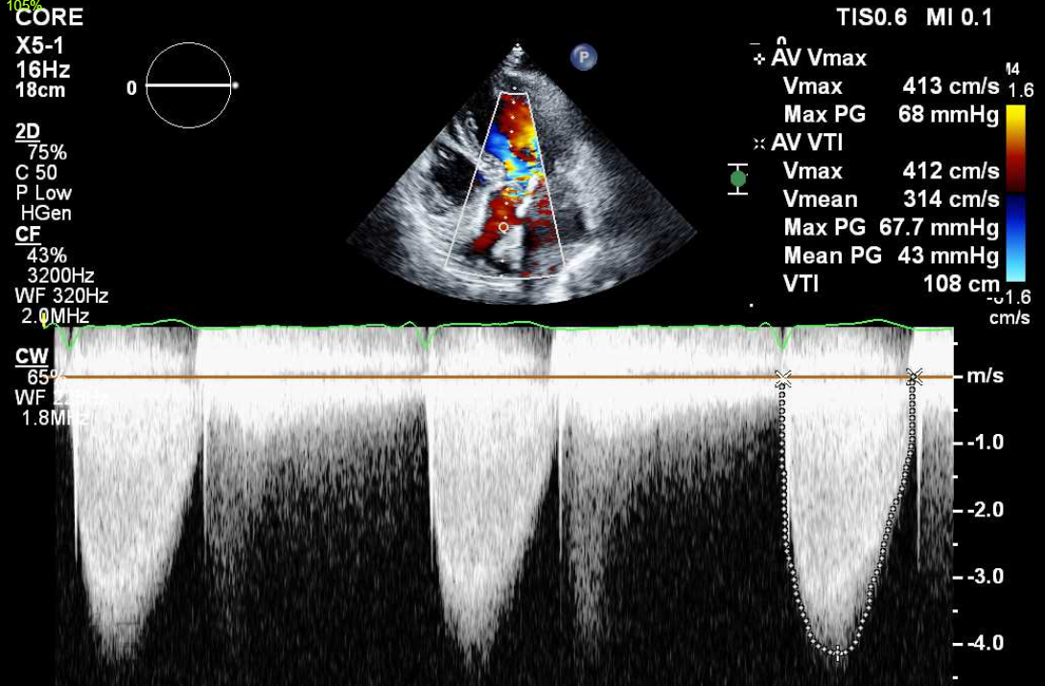
TTE
Prosthetic valve degeneration with severe AS and AR, no PVL

Slide 5
TEE
SAVR (25mm Mosaic) structural valve degeneration with severe stenosis and trans-valvular AR, no PVL

Slide 6
CTA: Aortic Annulus, LVOT
Aortic Annulus
Max: 22.0 mm
Min: 20.5 mm
Mean: 21.2 mm
Perimeter = 66.7 mm
Area = 353.2 mm²
LVOT
Max: 28.0 mm
Min: 19.8 mm
Mean: 23.9 mm
Perimeter = 24.5 mm
Area = 448.0 mm²

Slide 7
CTA: STJ and SOV
Sino-tubular Junction
Max: 39.1 mm
Min: 33.9 mm
Mean: 36.5 mm
SOV height: 26.0mm
SOV
SOV Right: 35.4 mm
SOV Left: 38.4 mm
SOV Non: 35.7 mm

Slide 8
CTA: STJ and Coronary Heights
SOV height: 26 mm
Left coronary height 15.4 mm
Right coronary height 16.9 mm

Slide 9
CTA: Aorta, Aortic Arch

Slide 10
CTA: Aorto-Iliac Bifurcation

Slide 11
Mosaic 25mm Valve
Possible 26mm Evolut FX Positioning within 25mm Mosaic SAVR
Suggested ViV :26mm Evolut FX
Valve positioning Evolut FX 4th node just below eyelets on the stent post tips

Slide 12
Summary of Case
Presentation: 77 yo M with severe symptomatic AS/AR due to SAVR degeneration
TTE: Severe prosthetic AS/AR no PVL, EF 64%
STS risk mortality for redo SAVR: 1.9%
Course: Patient was evaluated by heart team and recommended TF valve-in-valve TAVR
Plan: TF ViV (TAV-in-SAV) 26mm Evolut FX via right percutaneous femoral arterial access valve in degenerated 25mm Mosaic SAVR valve with bio-prosthetic valve fracture (with 24mmTrue balloon) and Sentinel cerebral embolic protection device

Slide 13
Latest Issues in Transcatheter Structural Heart Interventions
Recent publications in the TAVR Field:
- ViV TAVR for degenerated SAV data
- ViV TAVR with balloon fracture
- HALT long-term outcomes
- Newer TAVR valves
- Sex differences on TAVR outcomes
- TAVR alignment and coronary access

Slide 14
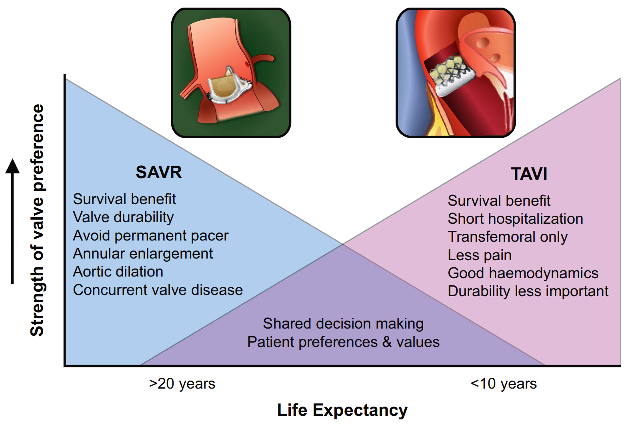
Balance of Factors Determining Strength of Valve Preference vs. Expected Remaining Years of Life
Oyetunji and Otto, Eur Heart J 2021;42:2920

Slide 15
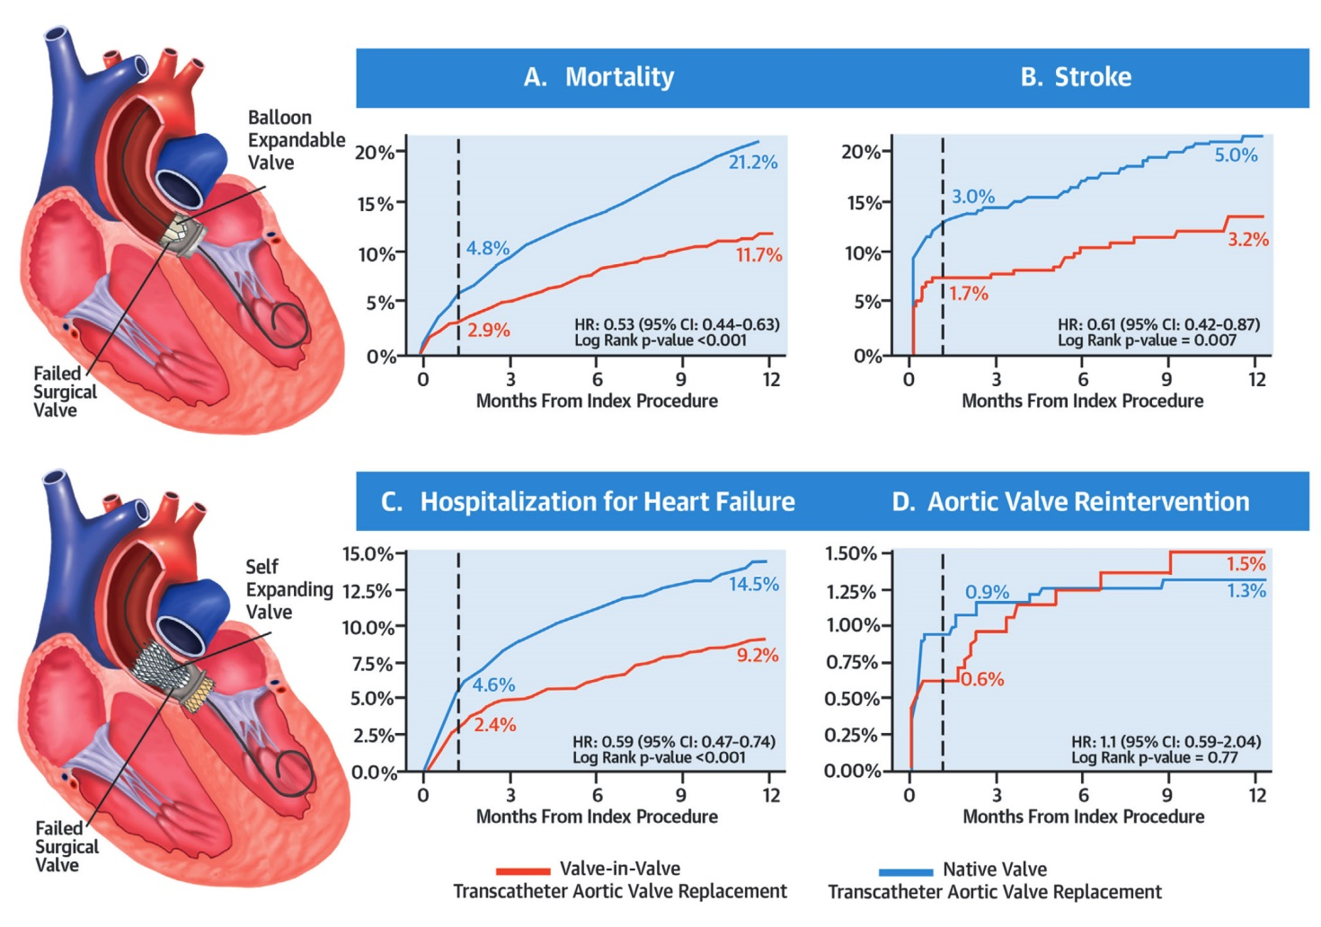
Valve-in-Valve TAVR vs Native Valve TAVR for AS
Tuzcu et al., J Am Coll Cardiol 2018;72:370

Slide 16
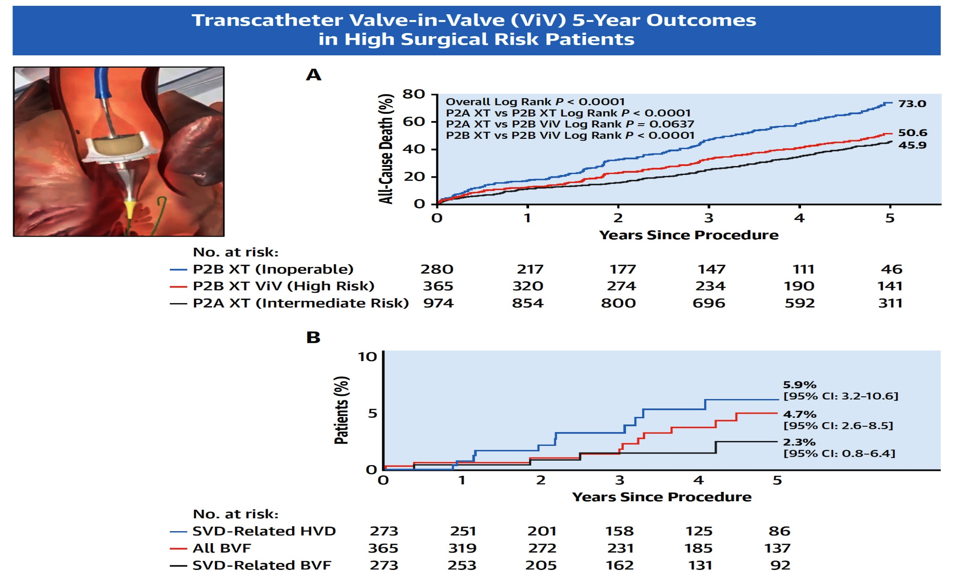
PARTNER 2A ViV Registry: Transcatheter ViV Implantation 5-Year Outcomes
Hahn et al., J Am Coll Cardiol Intv 2022;15:698

Slide 18
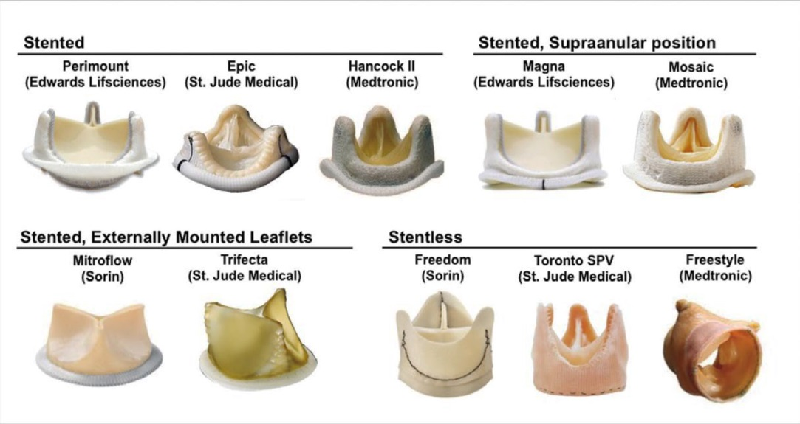
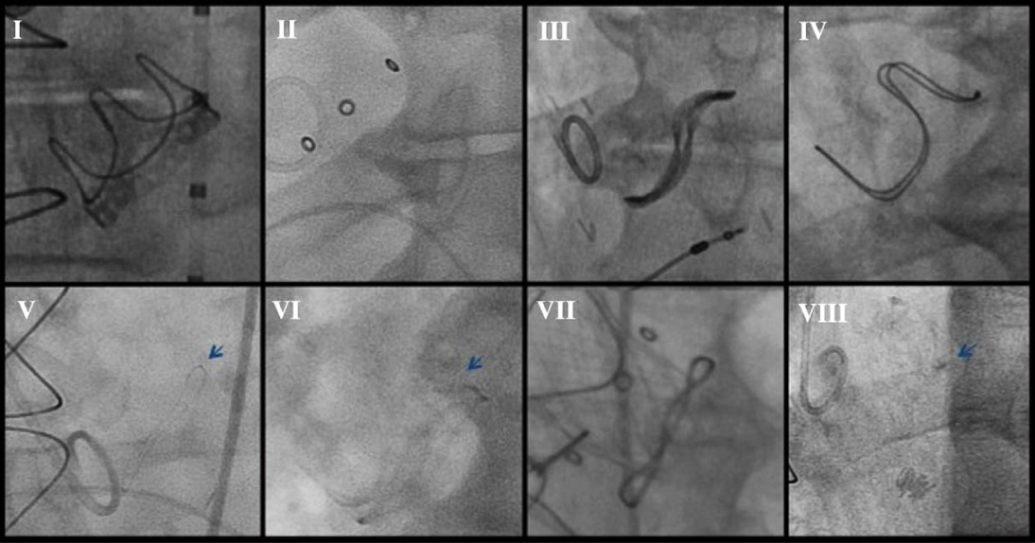
Bioprosthetic Surgical Valves
Common Bioprosthetic Surgical Valves
Fluoroscopic Images of Common Stented Bioprosthetic Valves
Perimount Mosaic Mitroflow Carpentier-Edwards
Epic Trifecta Hancock II Freestyle
Dvir et al., Circ J 2015;79:695

Slide 19
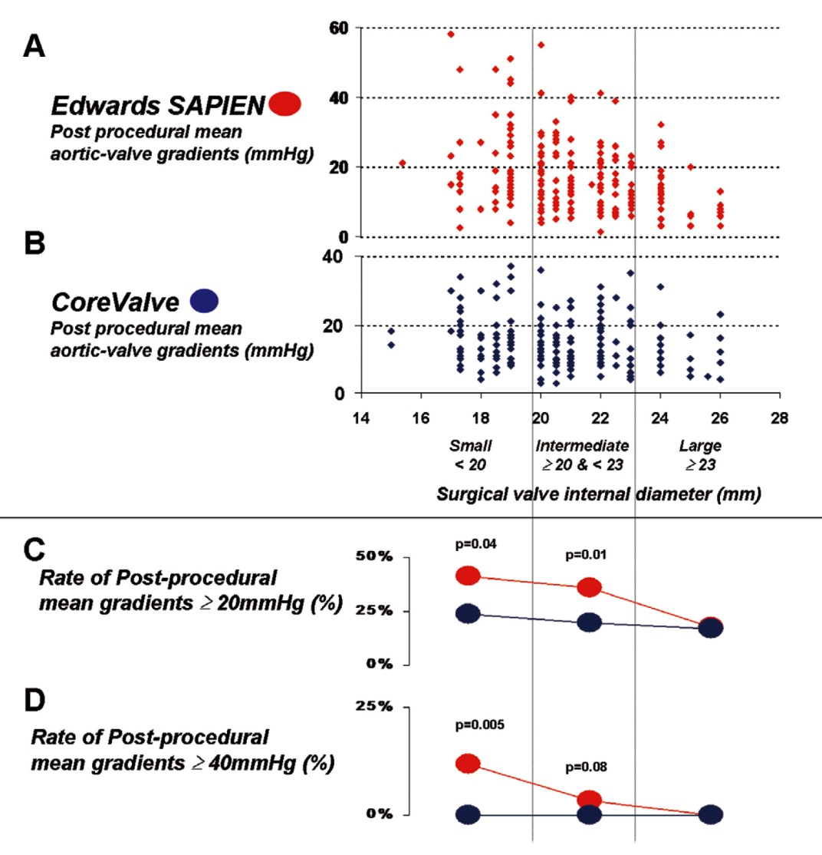
Analysis of Post-Procedure Gradients After ViV Procedures According to Surgical Bioprosthesis Size
Small (internal diameter <20 mm), Intermediate (≥20 mm and <23 mm) and Large (≥23 mm)
Dvir et al., Circ J 2015;79:695

Slide 20
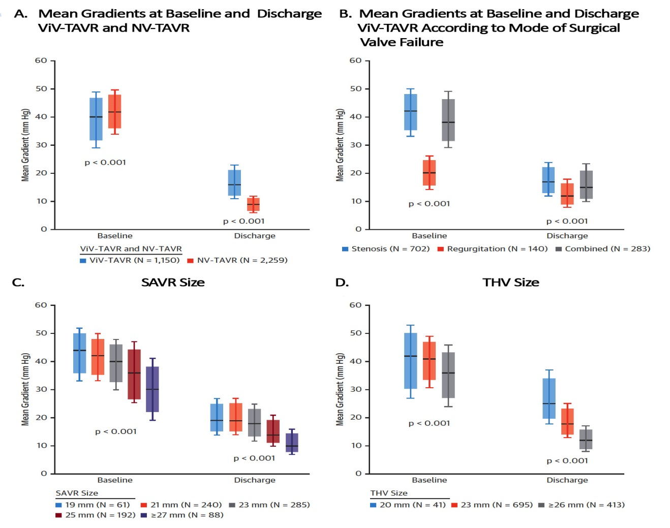
ViV TAVR: Echocardiographic Outcomes
Tuzcu et al., J Am Coll Cardiol 2018;72:370

Slide 21
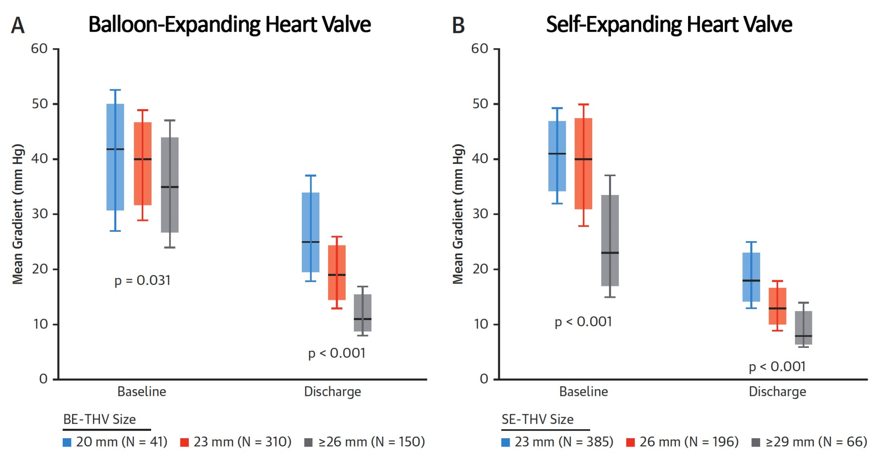
Mean Gradients at Baseline and Discharge
ViV-TAVR by Transcatheter Heart Valve (THV) Type
Tuzcu et al., J Am Coll Cardiol 2018;72:370

Slide 22
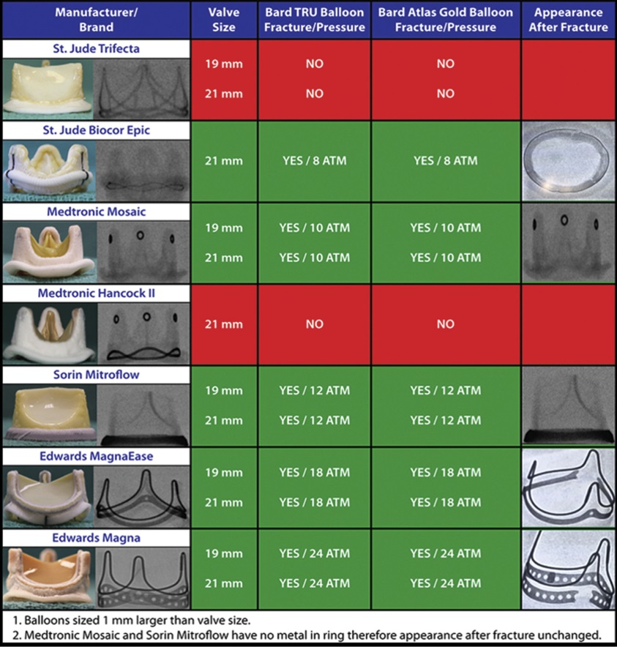
Summary of Bench Testing in High Pressure
Balloon Inflation to Fracture the Valve Frame of Surgical Tissue Valves
Allen et al., Ann Thorac Surg 2017;104:1501

Slide 23
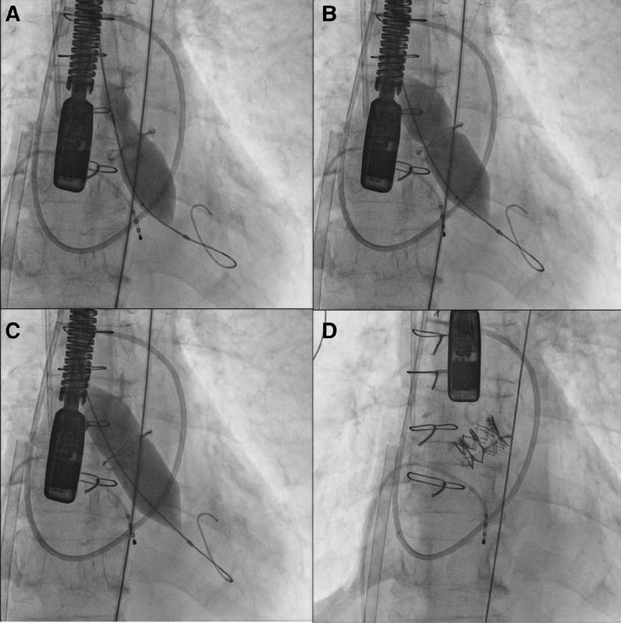
Bio-prosthetic Valve Fracture pre 20mm Sapien XT TAVR

Slide 24
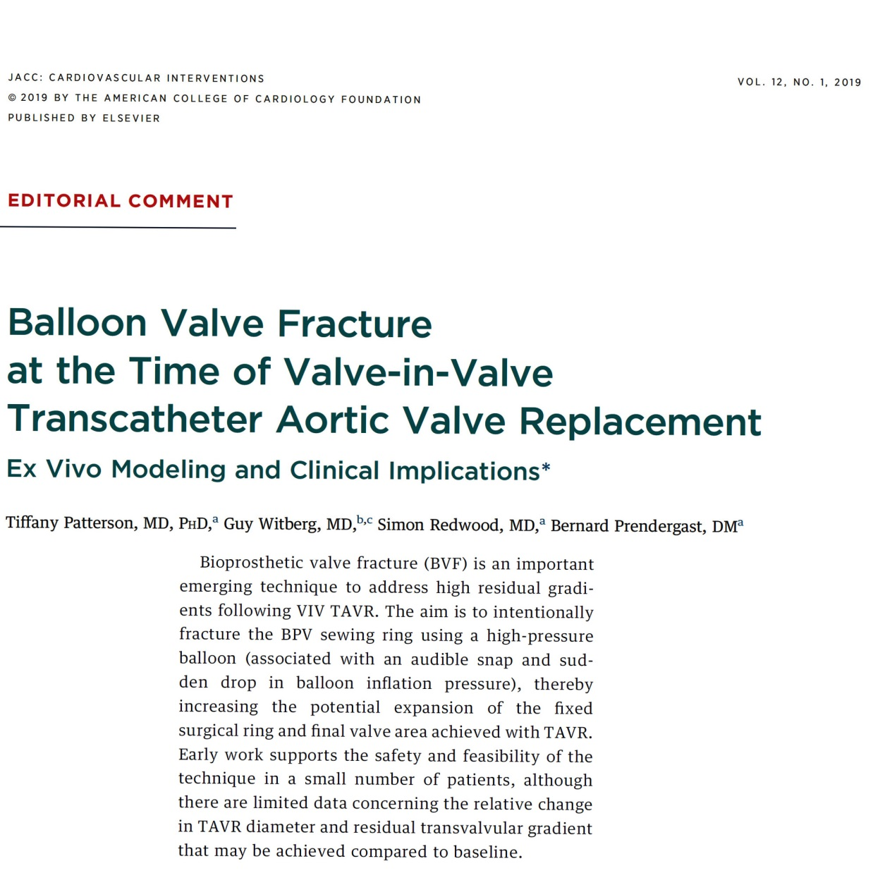

Slide 25
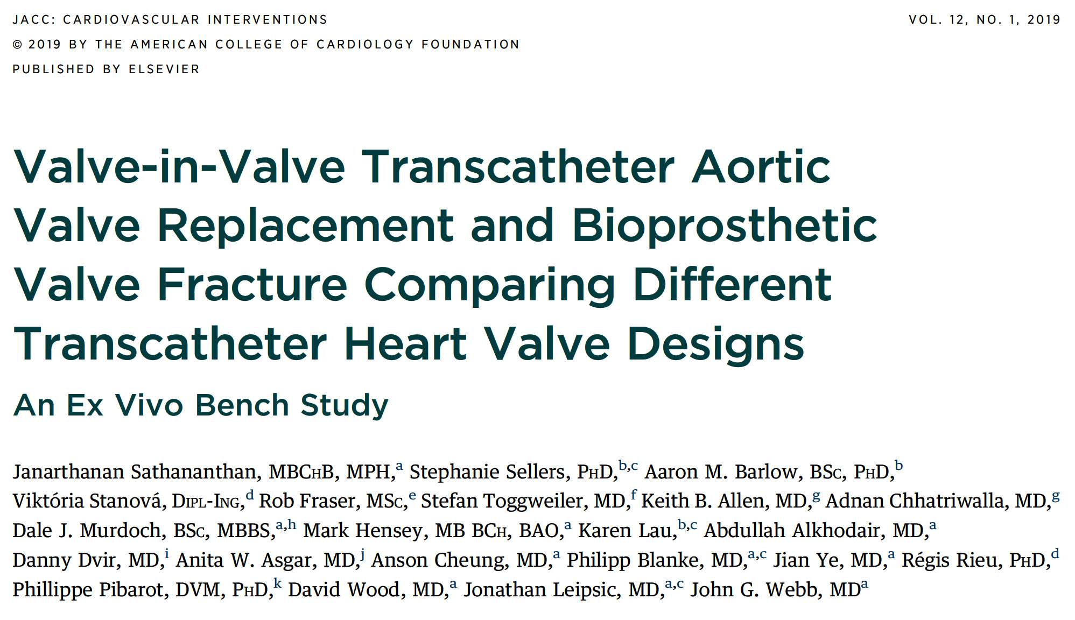

Slide 26
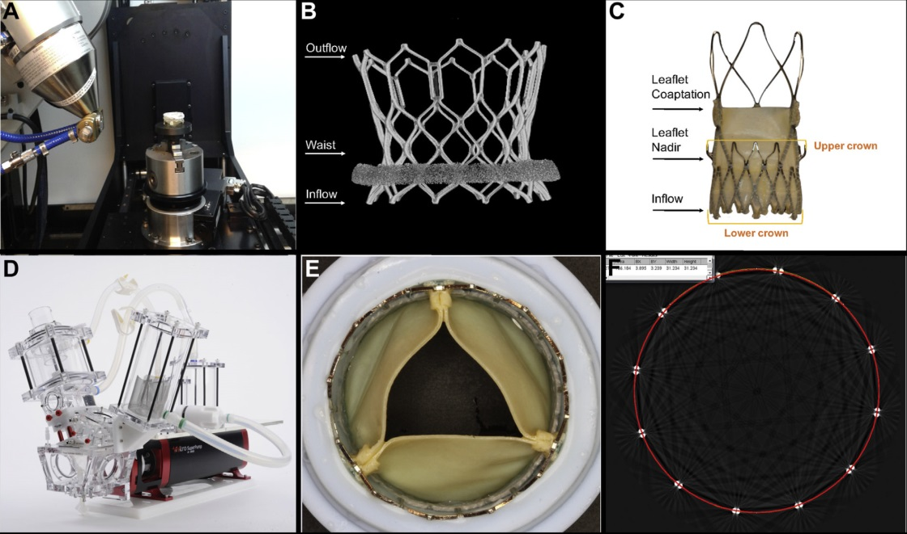
Ex Vivo Bench Testing Methodology
Micro CT used to scan THVs
Micro CT image of Sapien 3 THV (arrows indicate measurement made at inflow, middle and outflow of valve)
ACURATE neo THV (arrows indicate measurements made at inflow, leaflet nadir, and leaflet coaptation level of the valve)
Pulse duplicator used for hydrodynamic testing
THV silicon holder
Mid-strut measurements of THV
Sathananthan et al., J Am Coll Cardiol Intv 2019;12:65

Slide 27
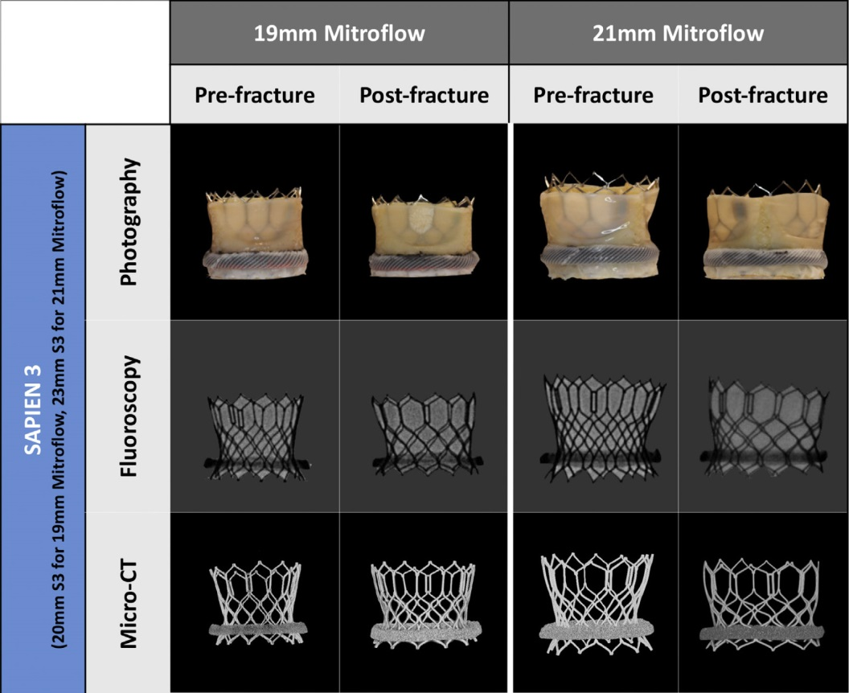
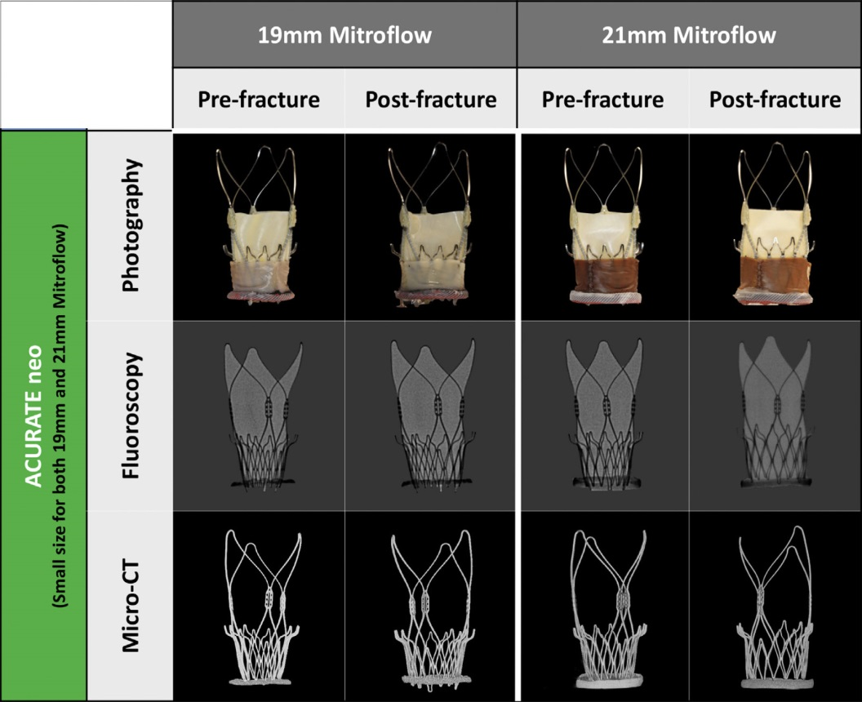
Ex Vivo Bench Study: Multimodality Imaging
Pre- and Post-BVF
Sathananthan et al., J Am Coll Cardiol Intv 2019;12:65

Slide 28
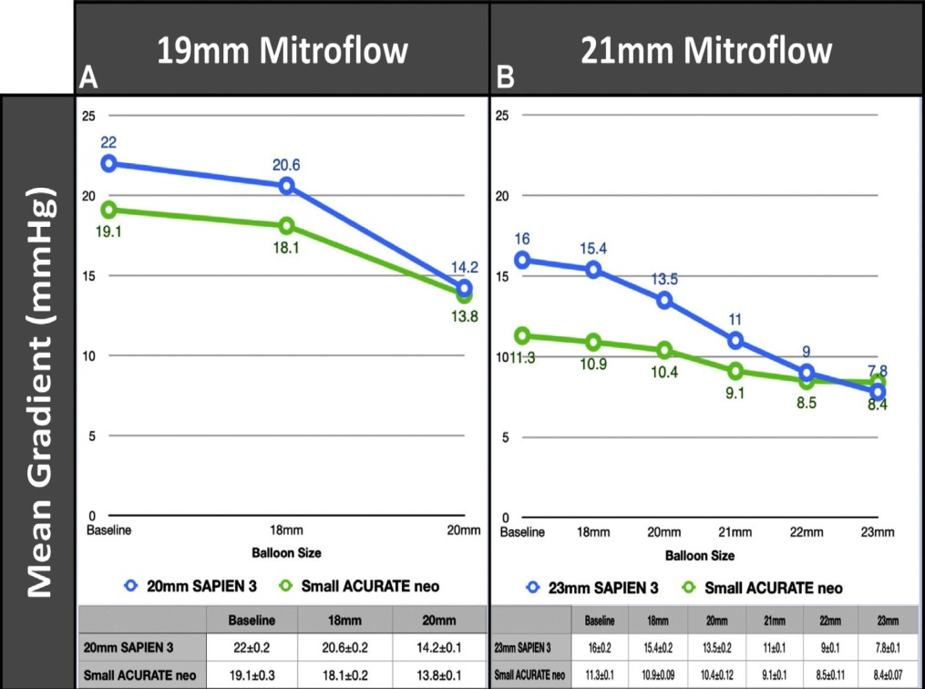
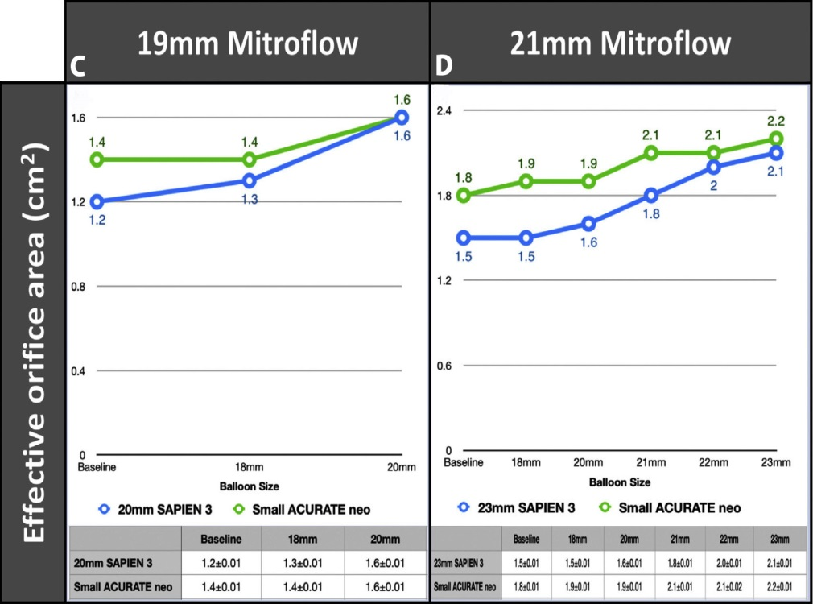
Ex Vivo Bench Study: Hydrodynamic Function at Baseline Following VIV TAVR and With Sequential Post-Dilatation and BVF
Sathananthan et al., J Am Coll Cardiol Intv 2019;12:65

Slide 29
Ex Vivo Bench Study: Pin-Wheeling Index (%)
Pre- and Post-Fracture
Pin-wheeling, as defined by the International Standards Organization guideline for THV testing, refers to twisting of the leaflet redundancy.
Sathananthan et al., J Am Coll Cardiol Intv 2019;12:65

Slide 30
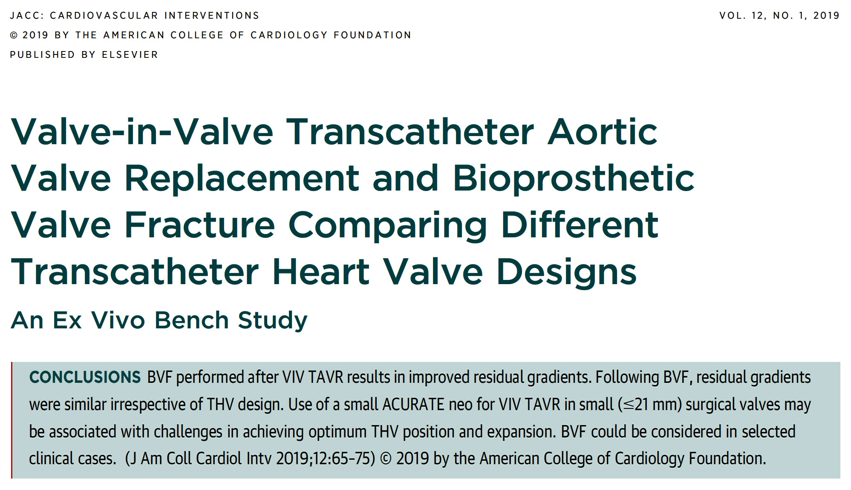

Slide 31
Balloon- Versus Self-Expanding Valve Systems for Treating Small Failed Surgical Aortic Bioprostheses:
The LYTEN Trial

Slide 32
LYTEN Trial: Study Population Flowchart
Valve-in-Valve TAVI with small SAV (<23mm) and randomized to either BEV or SEV
(n=102)
BEV Group
Patients randomized to receive a SAPIEN 3/ULTRA valve
(n=49)
SEV Group
Patients randomized to receive an Evolut R/PRO/PRO+ valve
(n=53)
3 patients did not undergo the
valve-in-valve TAVI procedure
(1 patient died before the procedure; 2 patients were treated medically)
1 patient did not undergo the
valve-in-valve TAVI procedure
(1 patient died before the procedure)
Patients who received intervention as randomized
(n=46)
Patients who received intervention as randomized
(n=52)
1 patient withdraw informed consent before the 30 days follow-up
Patients with echocardiographic measurements (corelab)
(n=45)
Patients with echocardiographic measurements (corelab)
(n=52)
Rodés-Cabau J, EuroPCR 2022

Slide 33
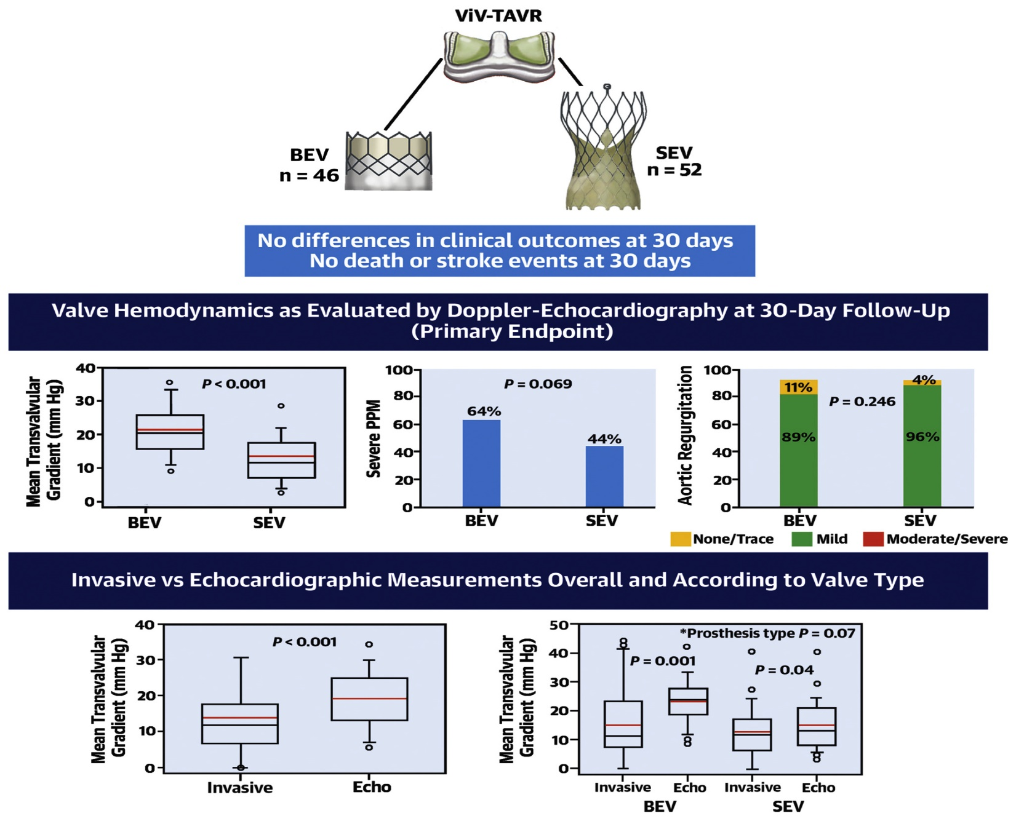
LYTEN Trial: Valve Hemodynamics Following ViV TAVR
with Balloon-Expandable and Self-Expanding Valve System
Rodés-Cabau et al., J Am Coll Cardiol 2022;80:681

Slide 34
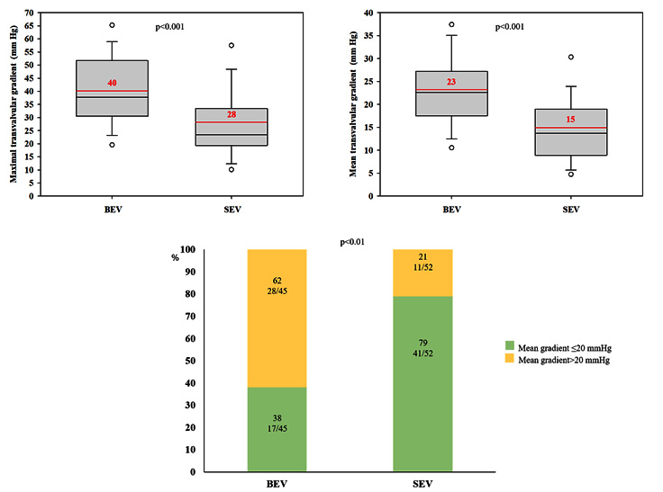
LYTEN Trial: Maximal/Mean Transvalvular Gradient, Mean Residual Gradient >20 mmHg at 30-Day F/U
There were no death or stroke in both groups
Rodés-Cabau J, J Am Coll Cardiol 2022;80:681

Slide 35
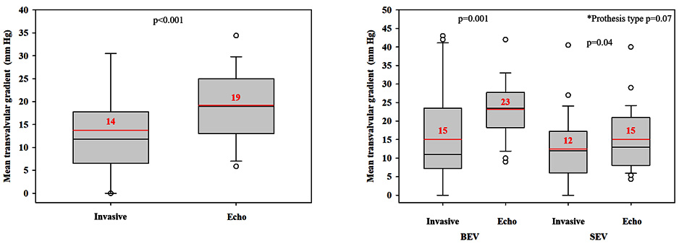
LYTEN Trial: Invasive vs Echocardiographic Measurements
Echocardiographic measurements: 1 day post-procedure (n=55)
Rodés-Cabau J, J Am Coll Cardiol 2022;80:681

Slide 36
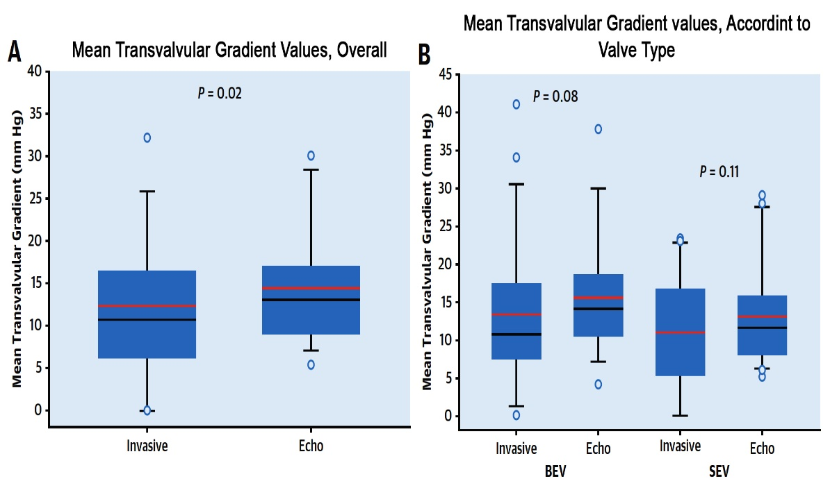
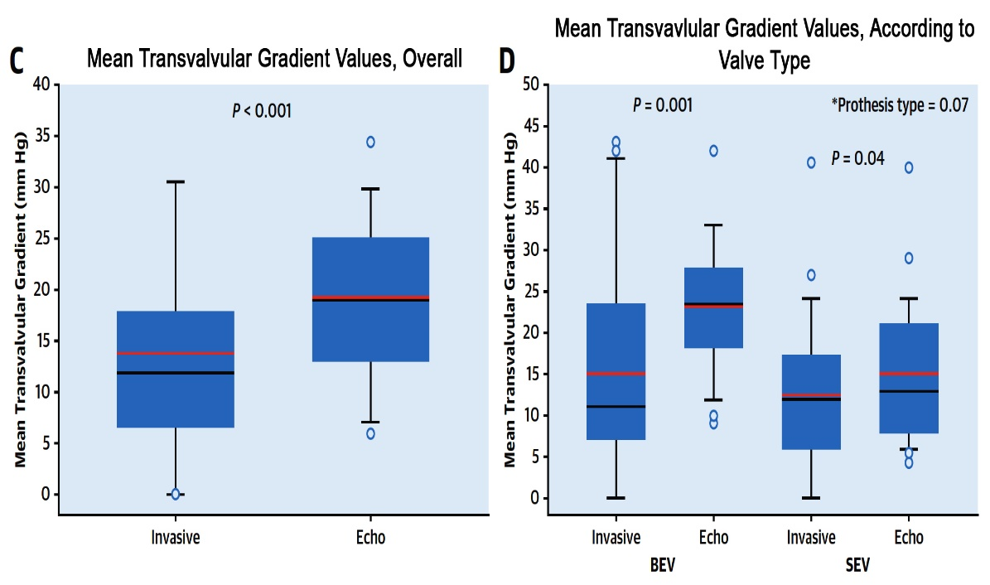
LYTEN Trial: Invasive vs Echocardiographic
Measurements Overall and According to Valve Type
Invasive Measurements During ViV-TAVR Procedures vs Echo Exam at Hosp D/C
at 1 day post-Procedure (n=55)
Patients with Echo Examination During the ViV-TAVR Procedure (n=45)
Rodés-Cabau et al., J Am Coll Cardiol 2022;80:681

Slide 37
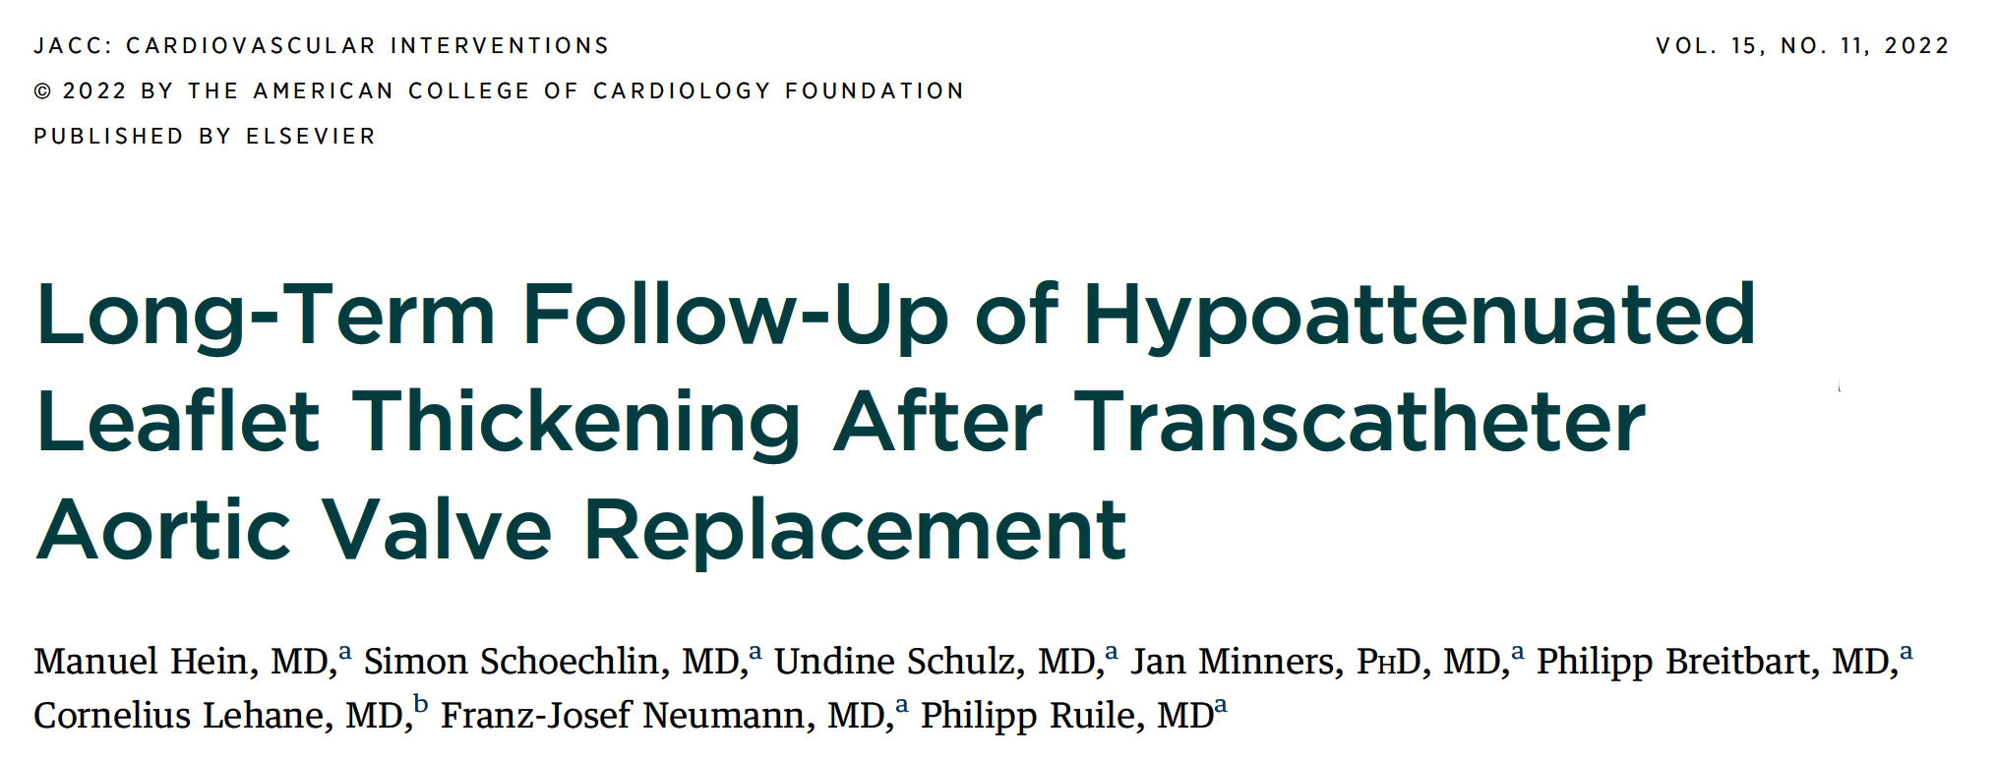

Slide 38
Early HALT Study: A Flowchart of Study Enrollment
TAVR Implantation
during May 2012 and Dec 2017
n=1606
Missing post-TAVR-CTA n=785 due to
denial of repeat CTA
renal failure
logistic reasons
severely reduced general state of health
Median interval between TAVR and CTA 5 days
post-TAVR CTA n=821
17 patients on intermittent oral anticoagulation due to early HALT
post-TAVR CTA n=804
Patients without HALT
n=689
Patients with HALT
n=115
Occurrence: 16.0%
Hein et al., J Am Coll Cardiol Intv 2022;15:1113

Slide 39
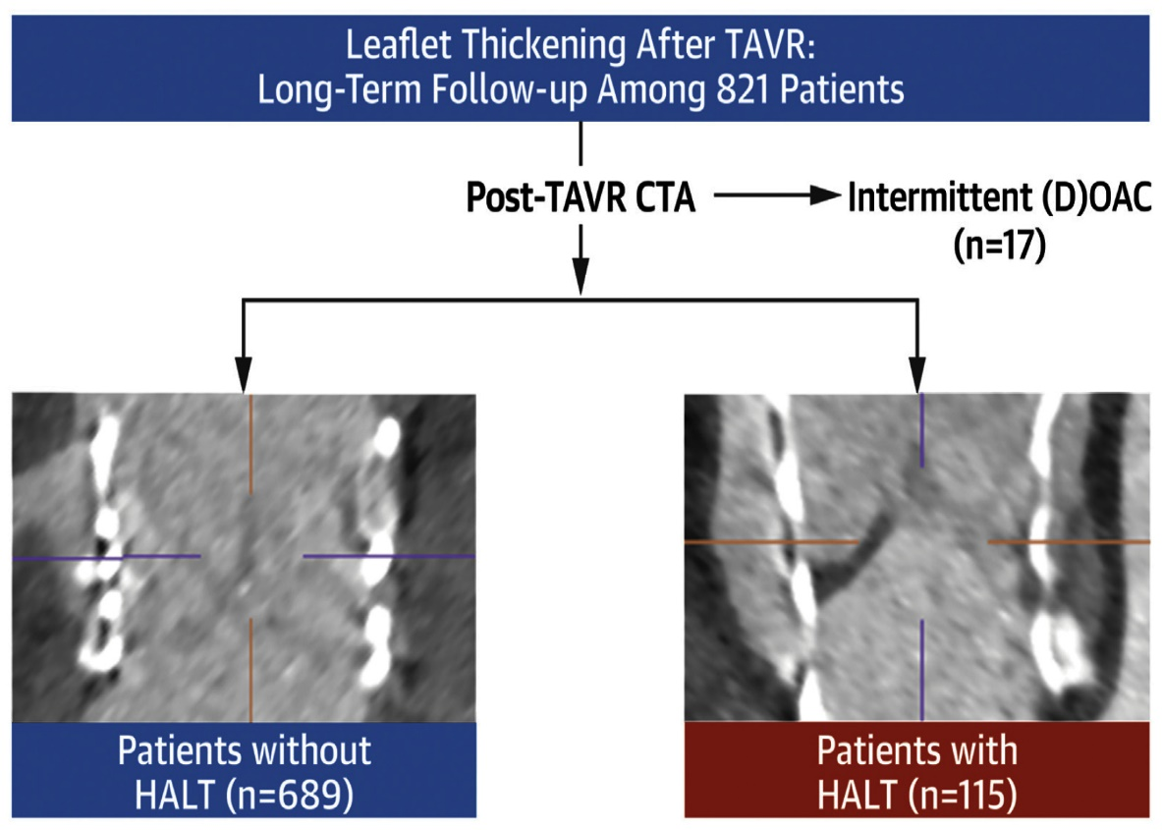
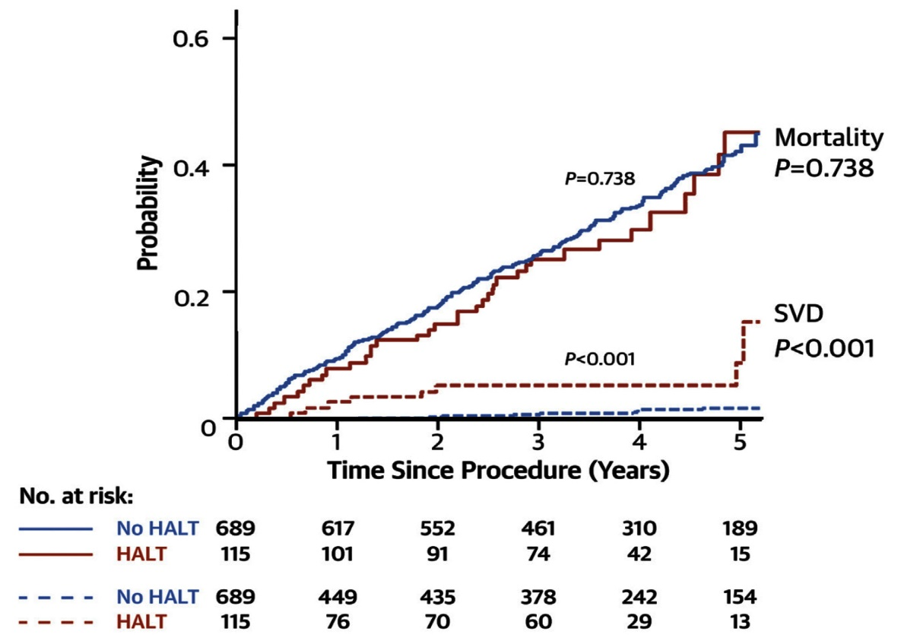
Early HALT Study: A Brief Study Flowchart and Main Findings
Brief Study Flowchart
Main Findings for Mortality and SVD
Hein et al., J Am Coll Cardiol Intv 2022;15:1113

Slide 41
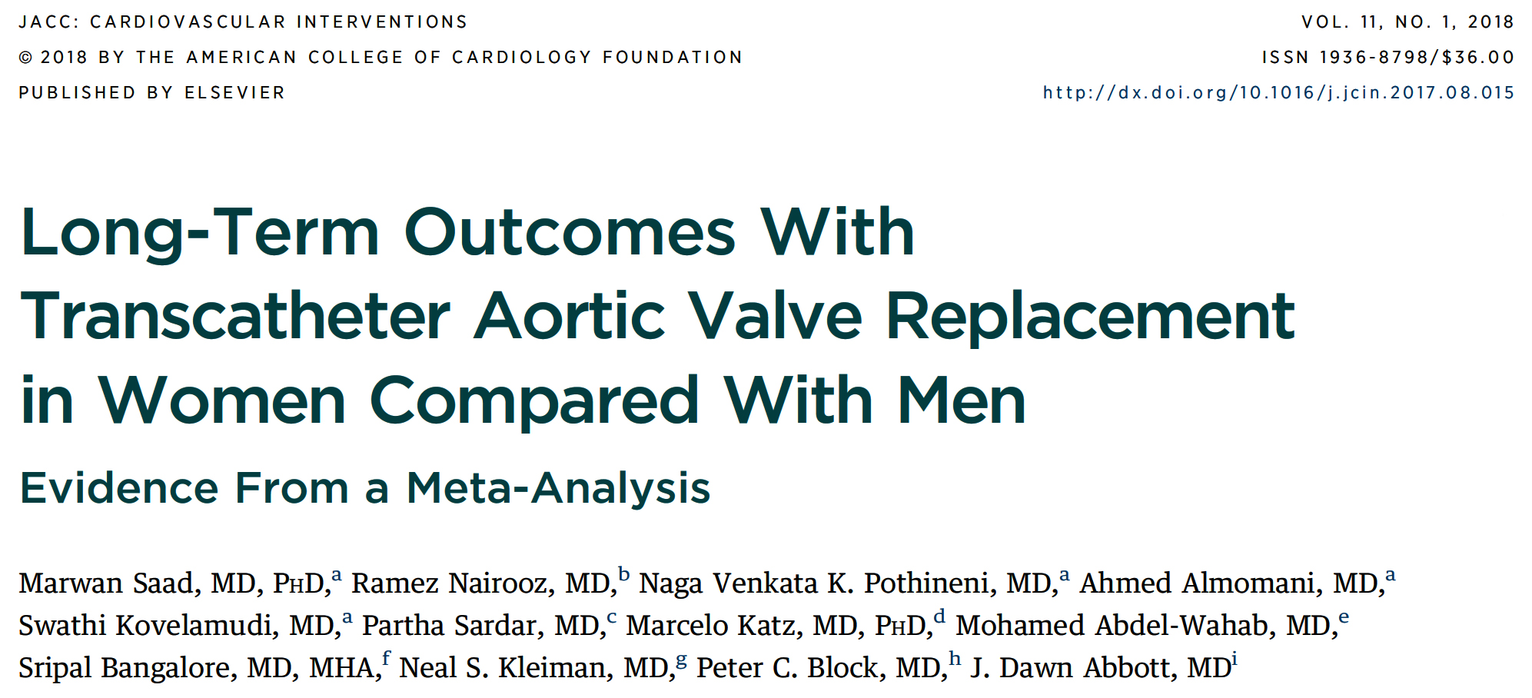

Slide 42
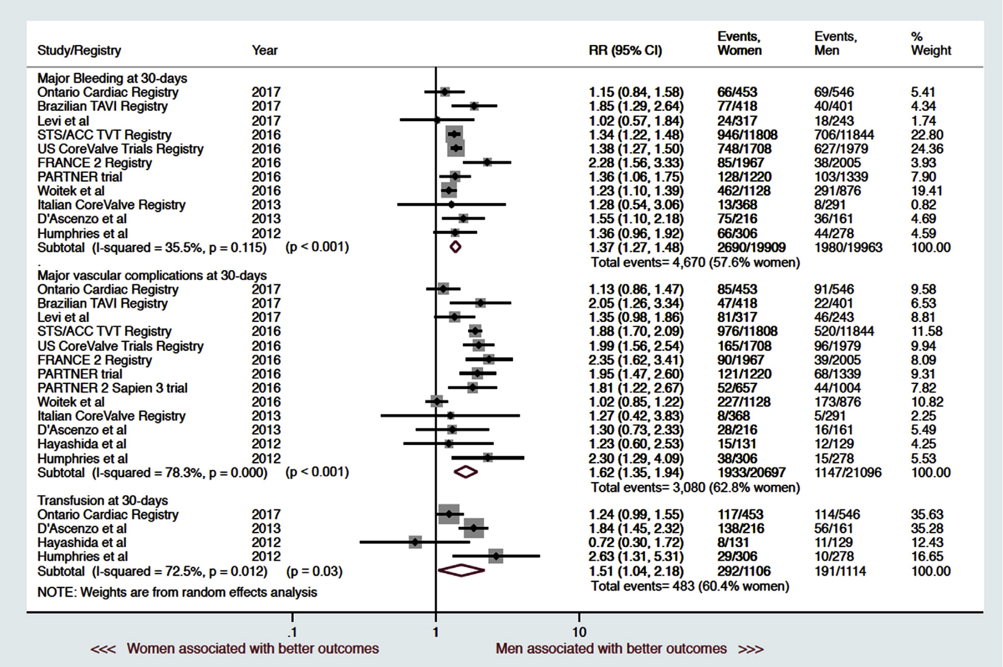
Summary Forest Plot of Major Bleeding, Need for Transfusion, and Vasc Access Complications in Women
vs Men at 30 Days After TAVR
Saad et al., J Am Coll Cardiol Intv 2018;11:24

Slide 43
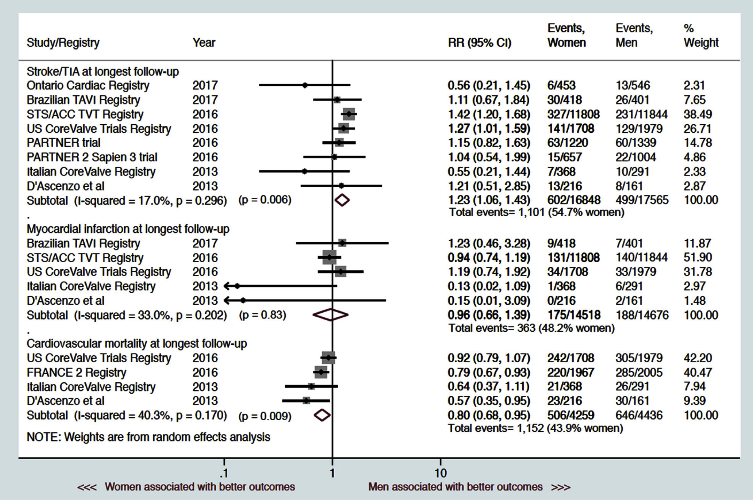
Summary Forest Plot of Stroke/TIA, MI, and CV Mortality
in Women vs Men at Long-Term F/U After TAVR
Saad et al., J Am Coll Cardiol Intv 2018;11:24

Slide 44
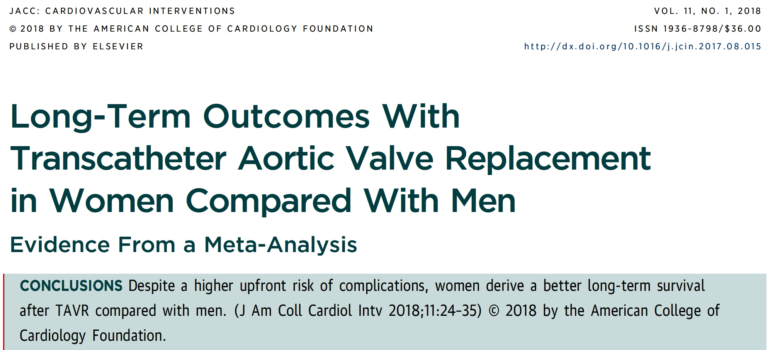

Slide 45
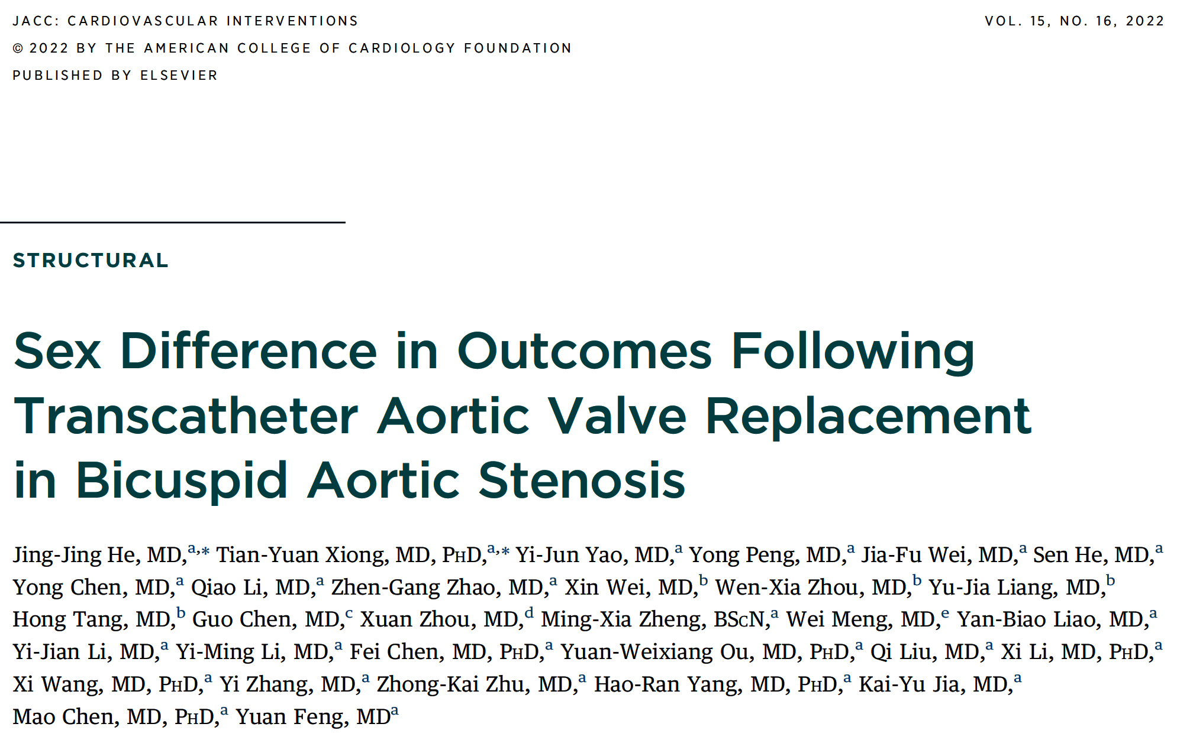

Slide 46
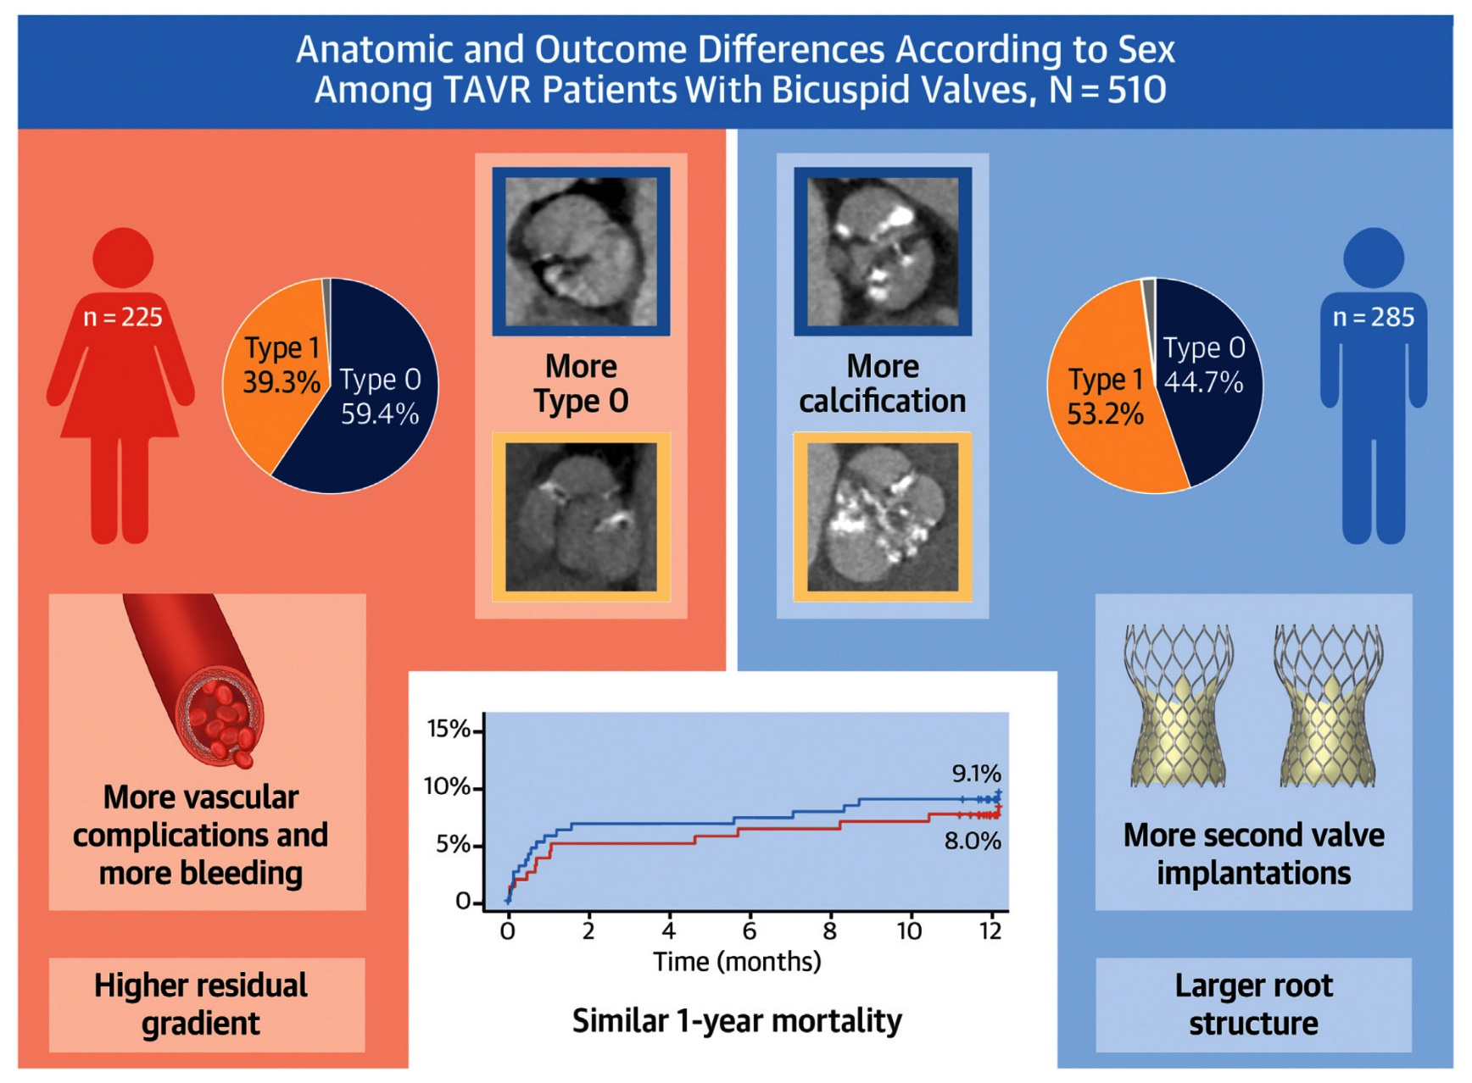
Sex Difference in Anatomies and Outcomes Following TAVR in Bicuspid AS
He et al., J Am Coll Cardiol Intv 2022;15:1652

Slide 48
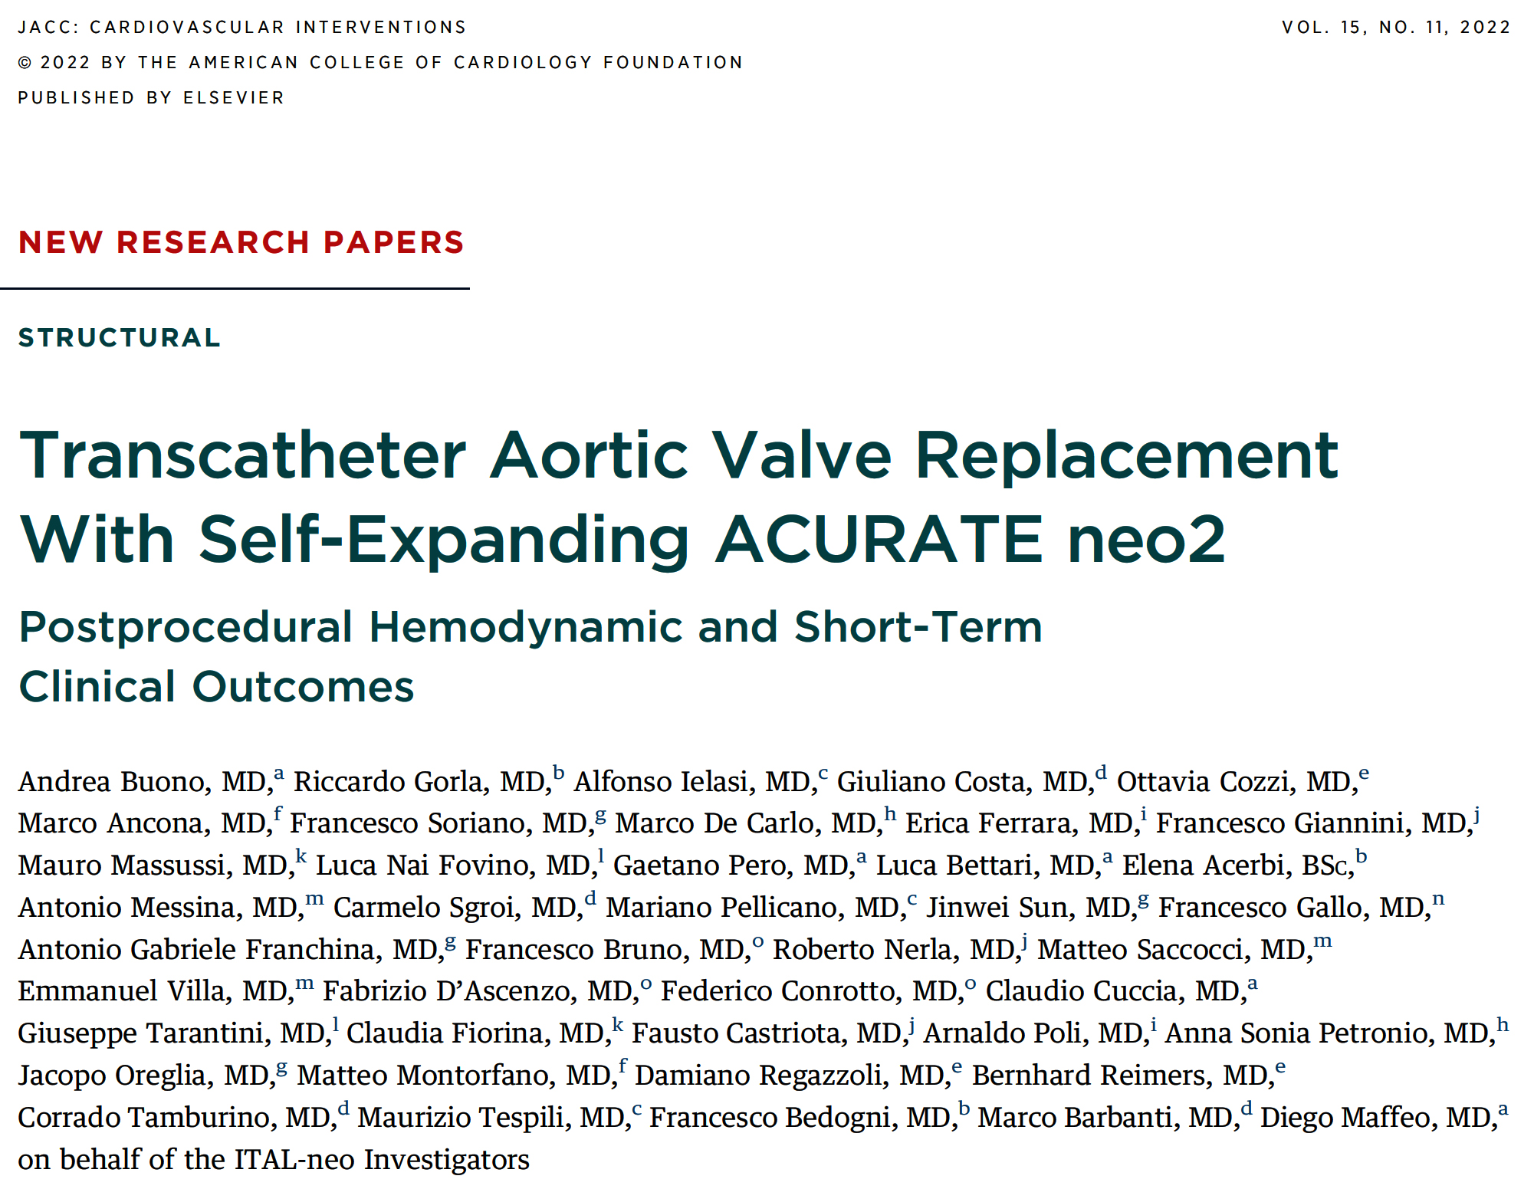

Slide 49
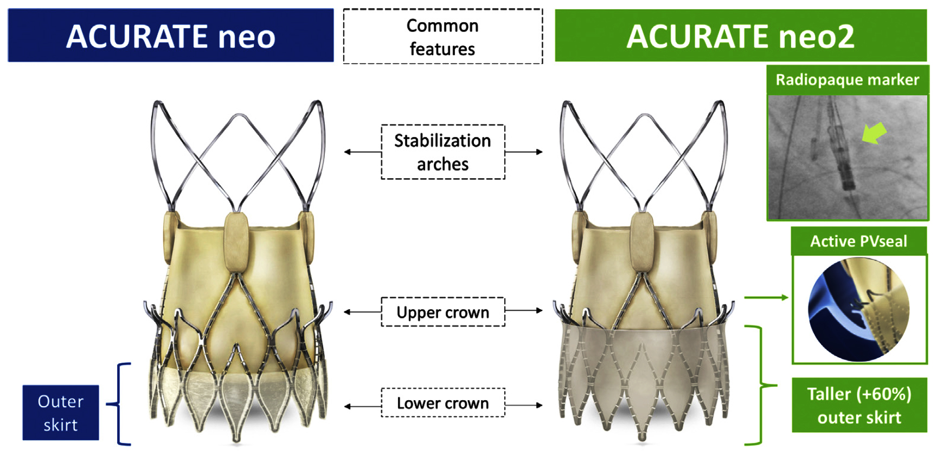
ITAL-neo Registry: Similarities and Differences Between the ACURATE neo and ACURATE neo2 THV
Buono et al., J Am Coll Cardiol Intv 2022;15:1101

Slide 50
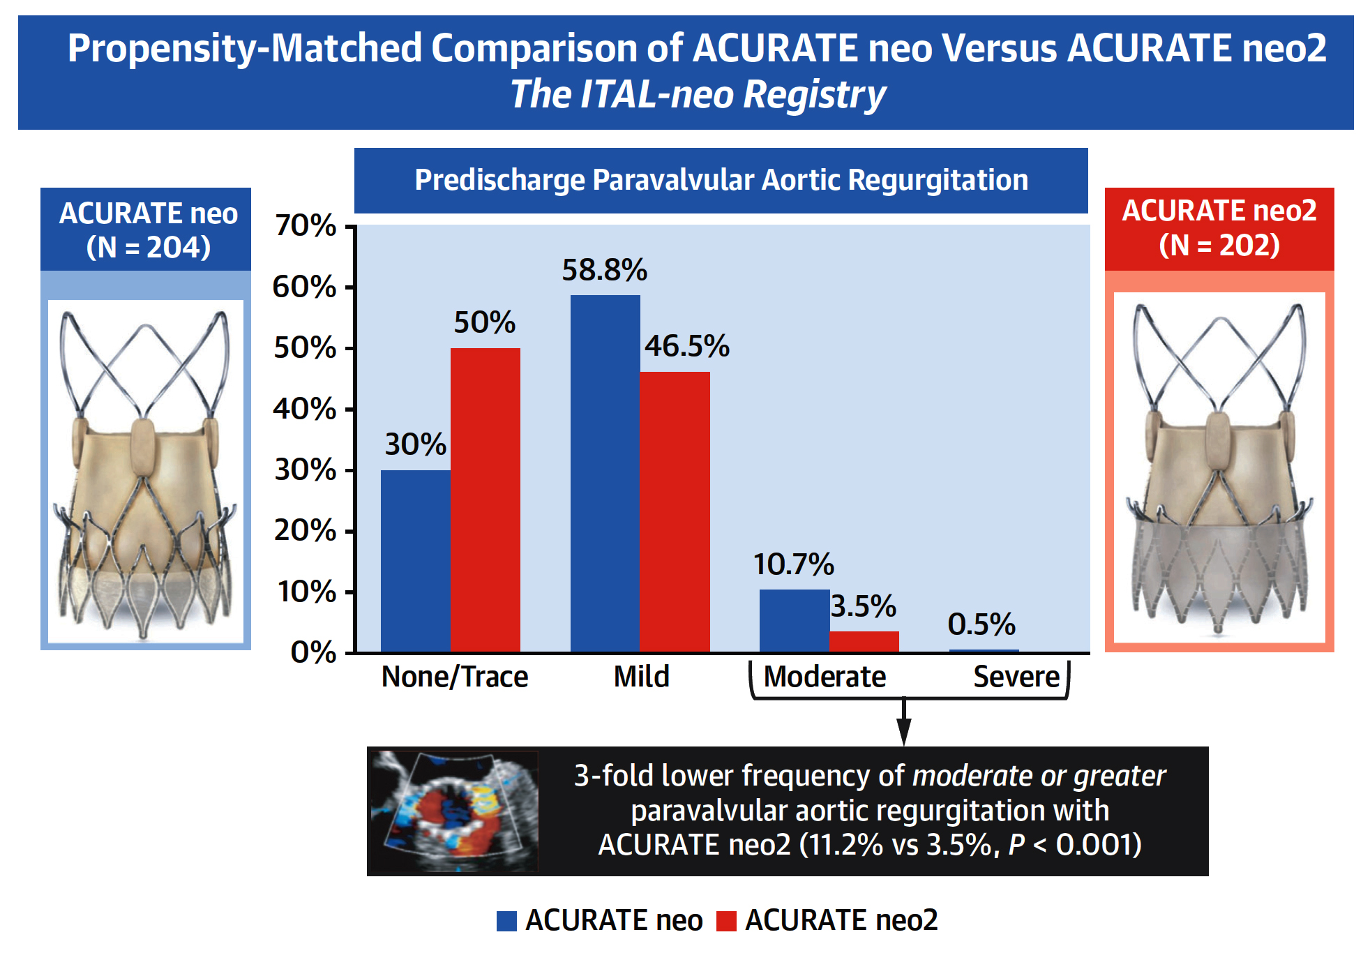
ITAL-neo Registry: Lower Frequency of Moderate
or Greater Paravalvular AR with the ACURATE neo2
Buono et al., J Am Coll Cardiol Intv 2022;15:1101

Slide 51
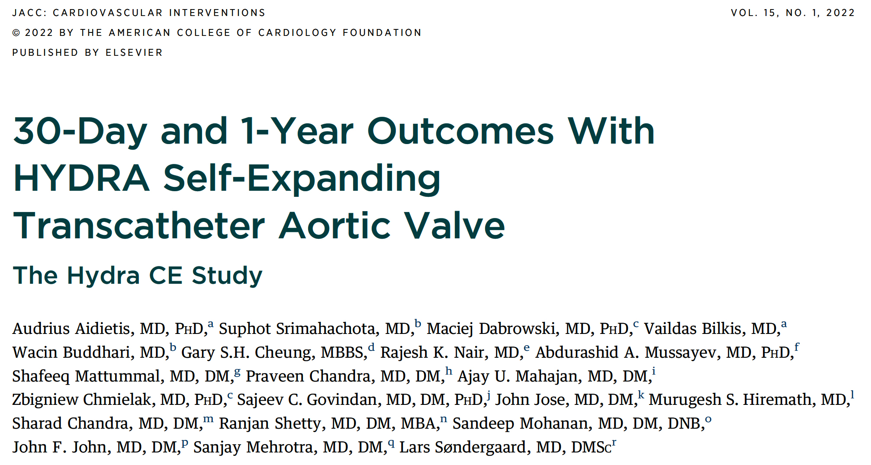

Slide 52
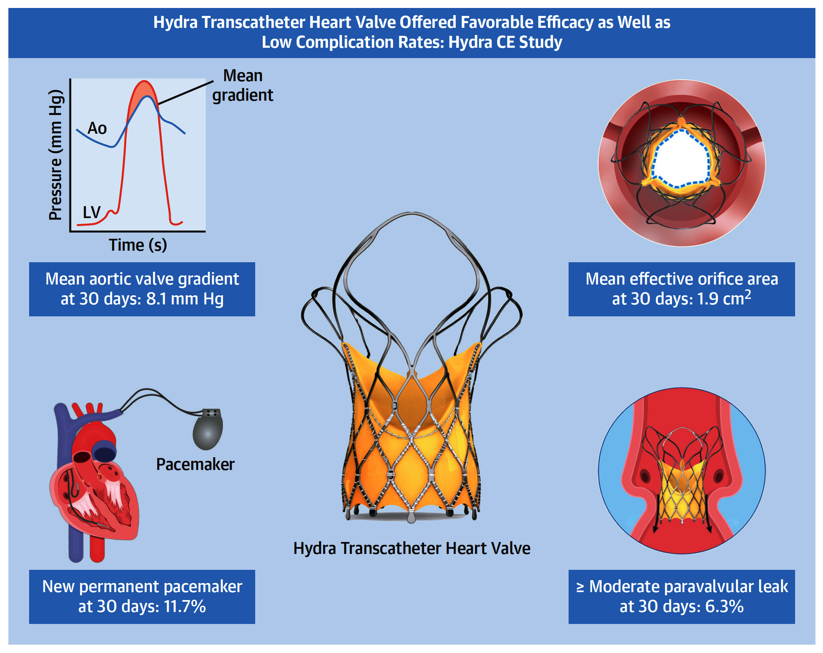
The Hydra CE Study: Safety and Clinical Performance
of Hydra Self-Expanding Transcatheter Aortic Valve
30-day Death = 7.0%
1-Yr Death = 14.6%
Aidietis et al., J Am Coll Cardiol Intv 2022;15;93

Slide 53
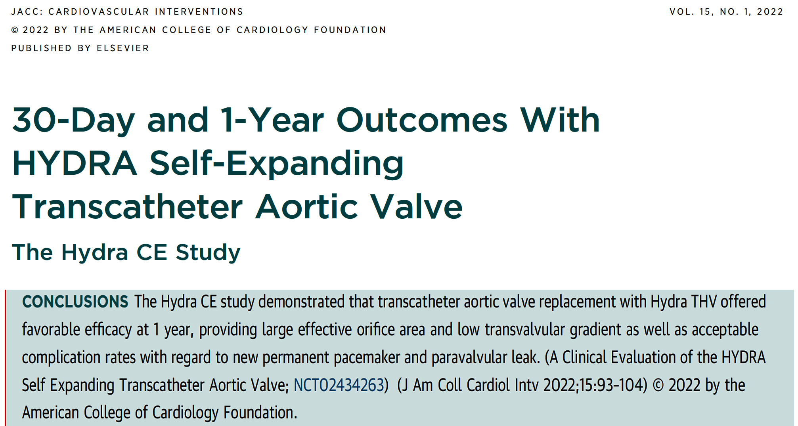

Slide 54
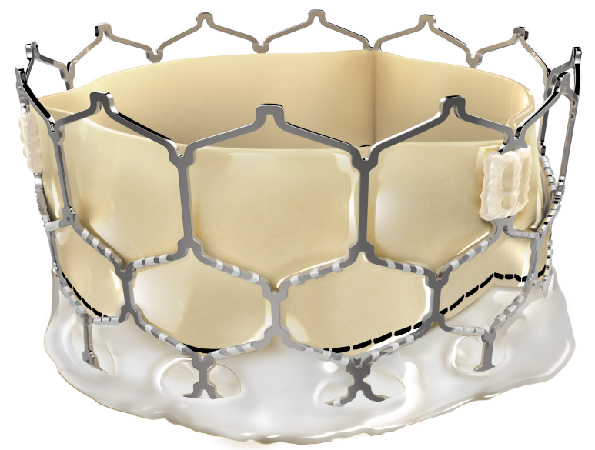
MyVal – Balloon Expandable THV Design Concept
MyVal THV has been indigenously developed by Meril Life Sciences, Vapi, India
Nickel Cobalt alloy frame for high radial strength & RO
Open cells on upper half to ensure un-jailing of coronary ostia
≈ 50%
Hybrid Honeycomb Cell Design Concept
Bovine pericardium
Tri-leaflet valve
Frame height 17-20 mm
Closed cells on lower half for high radial strength
≈ 50%
External PET buffing to minimize para-valvular leaks
Internal PET sealing cuff for lower profile & puncture resistance
Ø – 20 mm, 23 mm, 26 mm, 29 mm
Cost 60% of the US valves

Slide 55
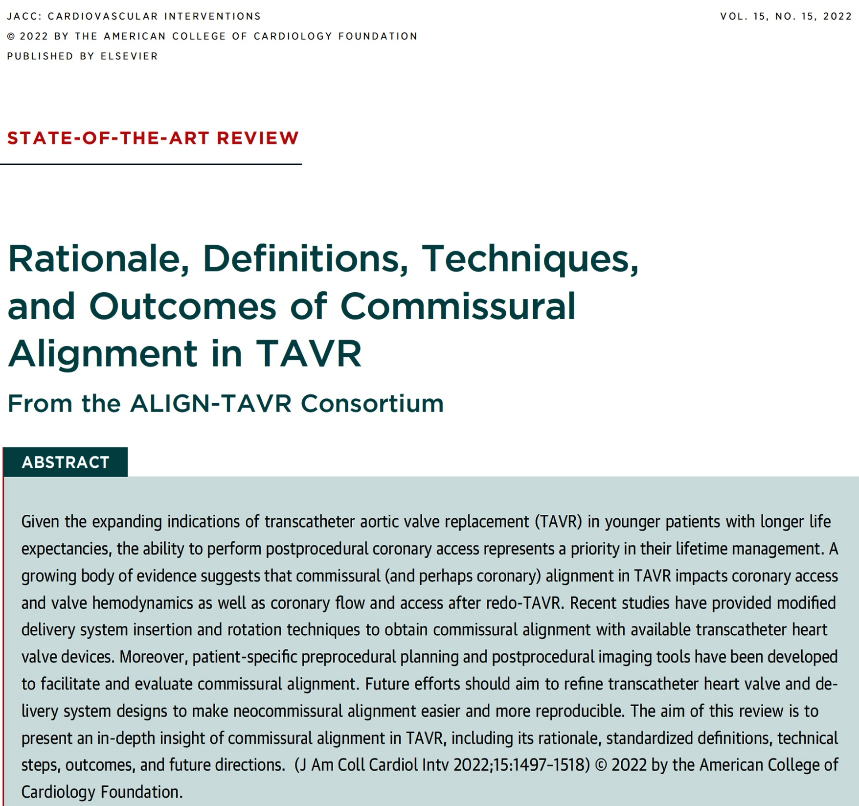

Slide 56
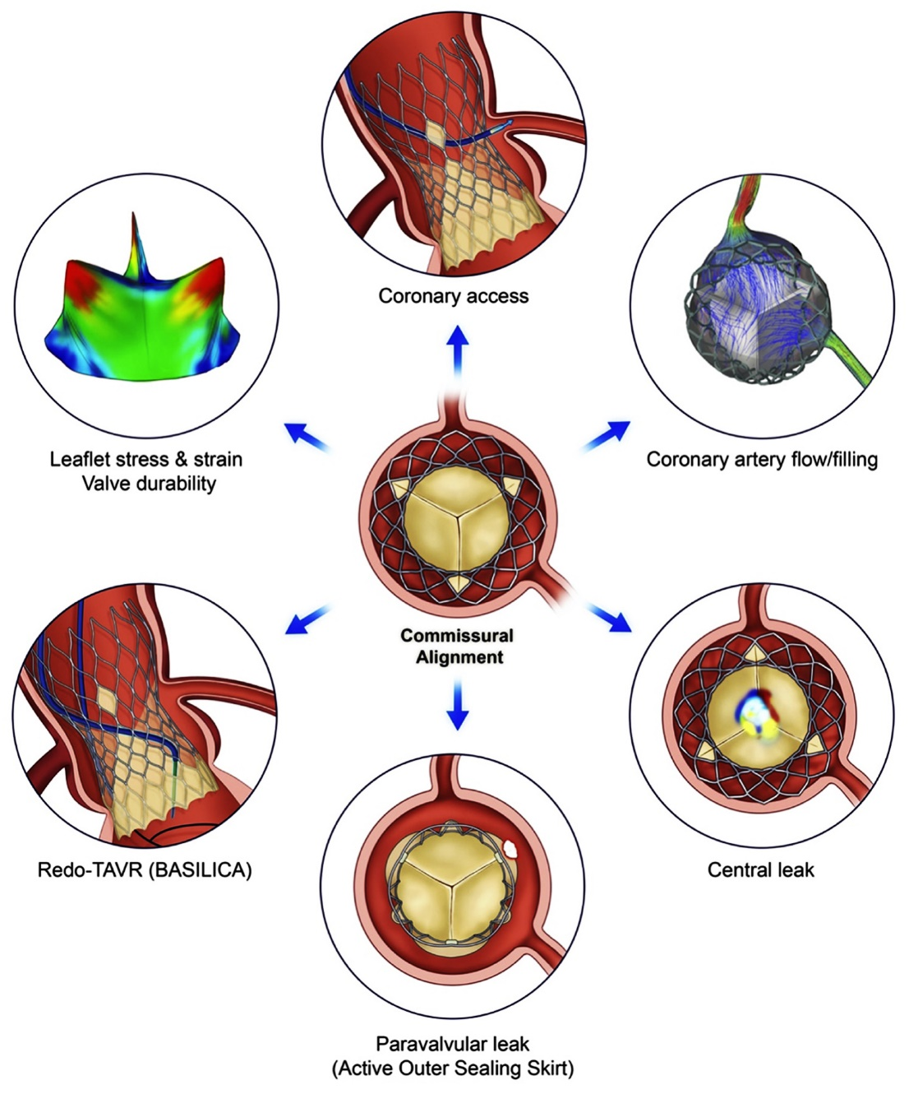
Possible Impact of Commissural Alignment in TAVR
Obtaining commissural alignment in TAVR can result:
in easier coronary access
better coronary artery flow/filling
reduce the risk of mild central leak
improve the function of the active outer sealing skirt
keep the possibility open to perform bioprosthetic aortic scallop intentional laceration to prevent iatrogenic coronary obstruction (BASILICA) (leaflet laceration) in case of redo-TAVR
reduce leaflet stress and strain, hence, may have a positive impact on valve durability
Tang et al., J Am Coll Cardiol Intv 2022;15:1497

Slide 57
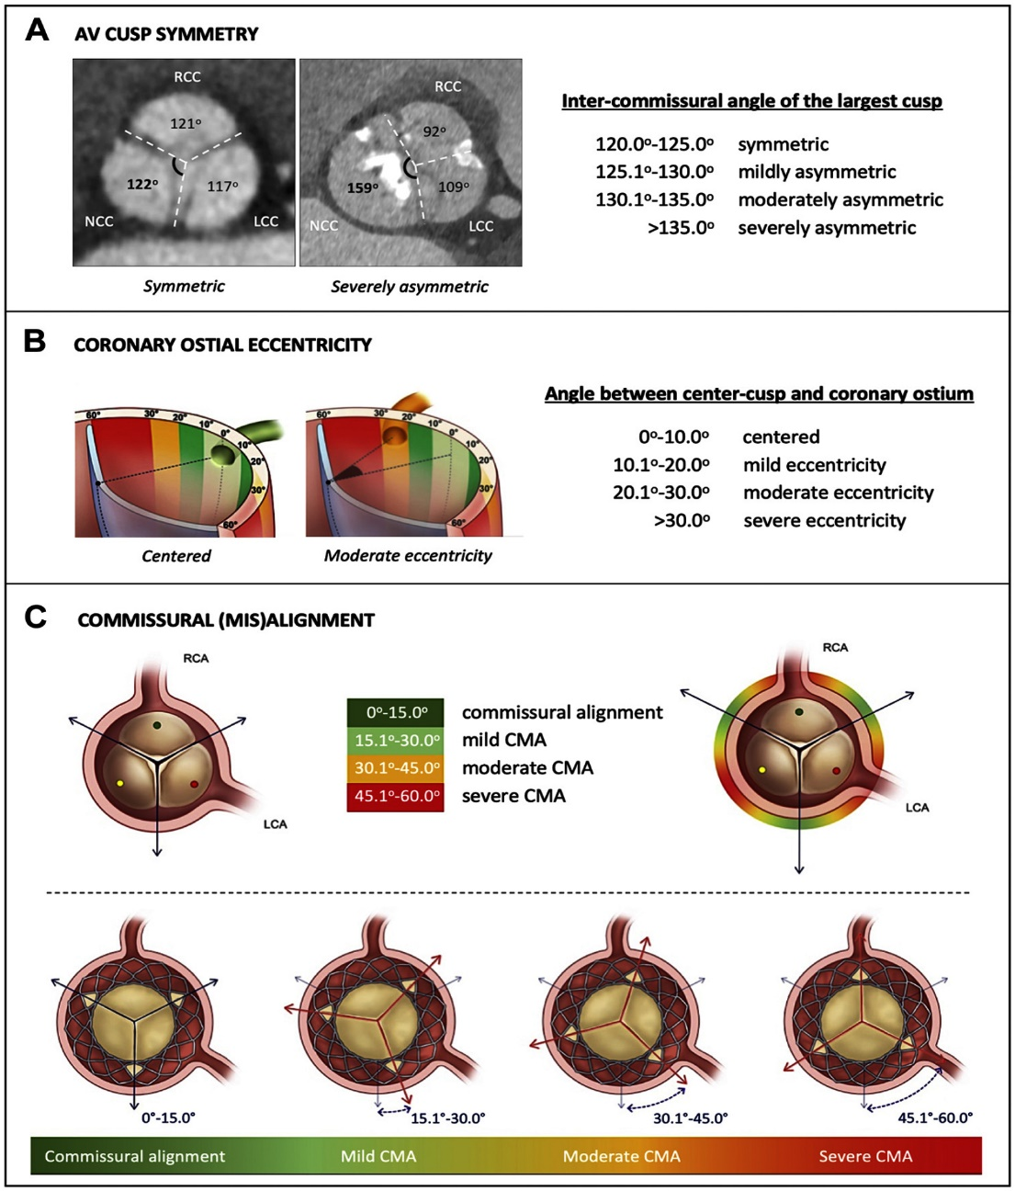
Proposed Standardized Definitions from the
ALIGN-TAVR Consortium
Proposed standardized definitions of AV cusp symmetry, coronary ostial eccentricity and commissural (mis) alignment to harmonize reporting in future literature and clinical trials in TAVR
Tang et al., J Am Coll Cardiol Intv 2022;15:1497

Slide 58
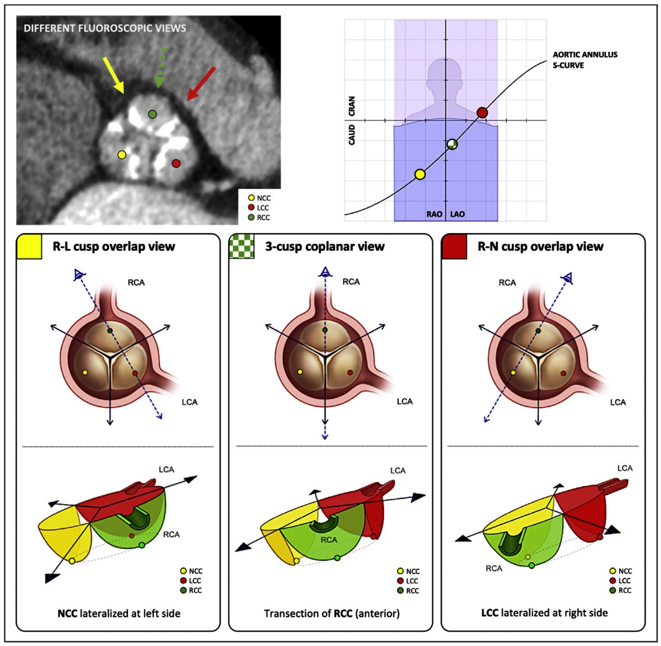
AV Cusps and Commissural Orientation to
Different CT-Derived Fluoroscopic Views
Tang et al., J Am Coll Cardiol Intv 2022;15:1497

Slide 59
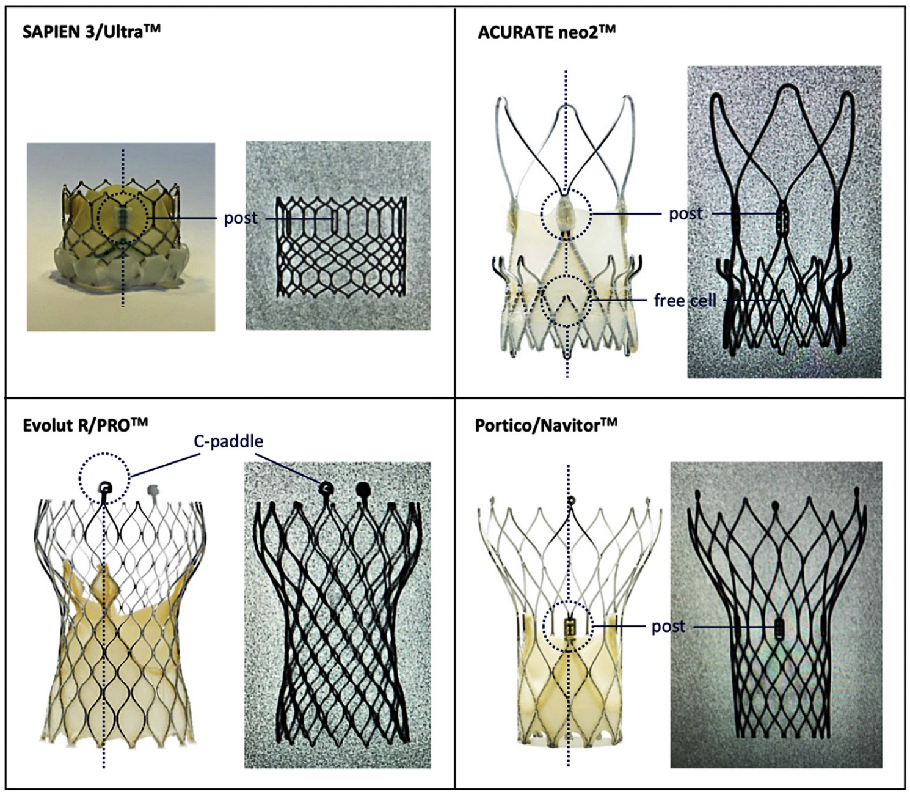
THV Fluoroscopic Markers Corresponding with
the THV Commissure(s)
Tang et al., J Am Coll Cardiol Intv 2022;15:1497

Slide 60
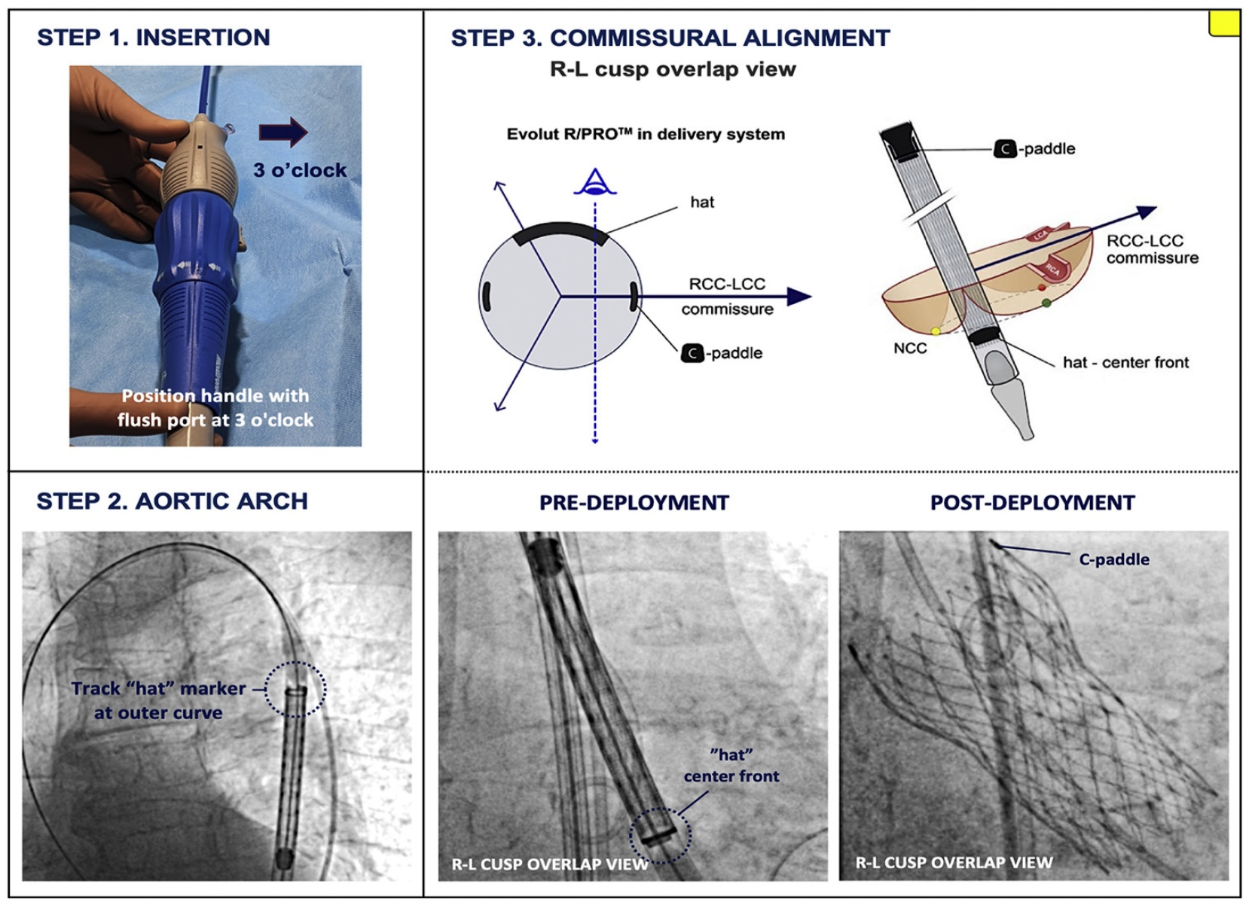
Evolut Commissural Alignment Steps
Three procedural steps in order to increase the chances of obtaining commissural alignment with the Evolut system
Tang et al., J Am Coll Cardiol Intv 2022;15:1497

Slide 61
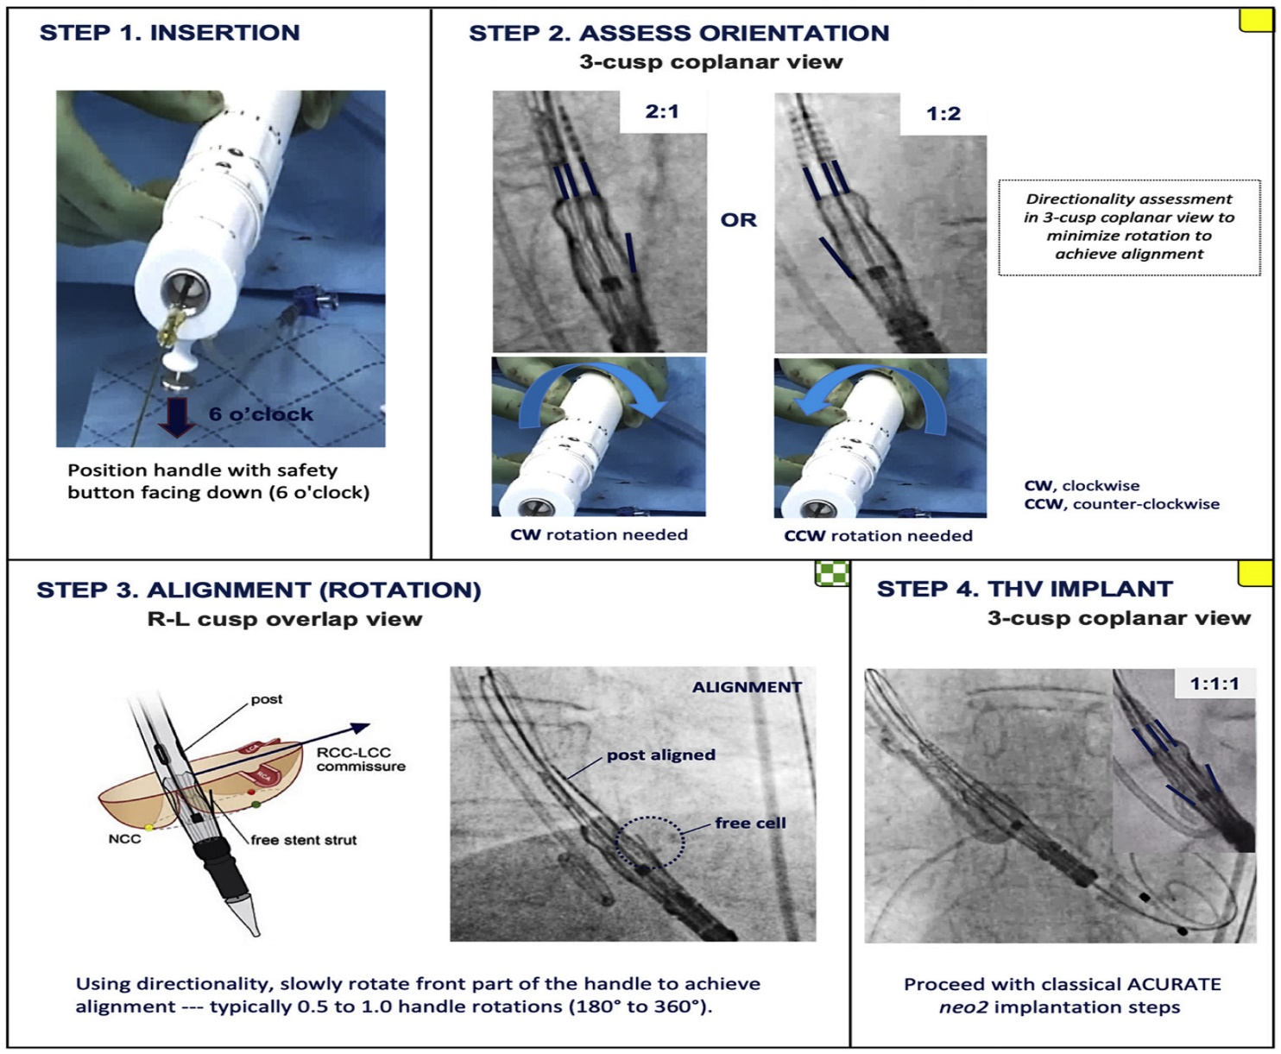
ACURATE-neo2 Commissural Alignment Steps
Four recommended procedural steps in order to obtain commissural alignment with the ACURATE-neo2 system
Tang et al., J Am Coll Cardiol Intv 2022;15:1497

Slide 62
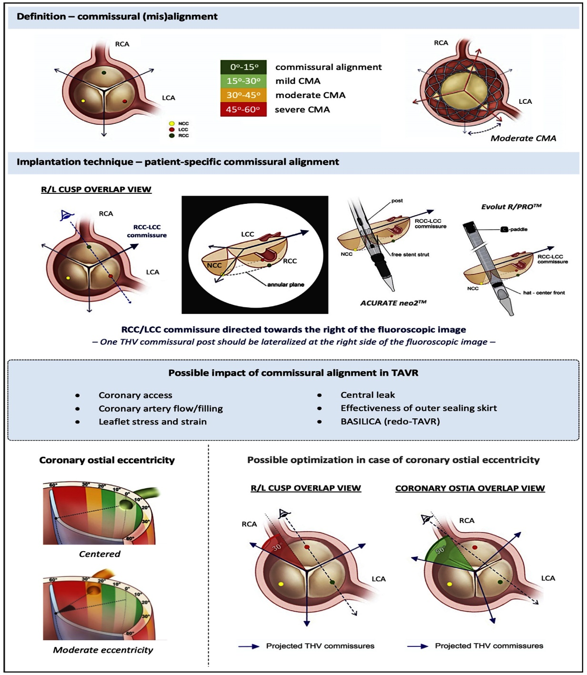
Summary of Commissural Alignment in TAVR
Tang et al., J Am Coll Cardiol Intv 2022;15:1497

Slide 64
Take Home Messages
Recent Publications in the TAVR Field
ViV TAVR including balloon valve fracture technique has established as an important procedure on intermediate to high risk SAV degeneration. SEV provides better hemodynamics and lower residual gradient compared to BEV especially in smaller surgical valves (<23mm). Long-term comparative efficacy data between 2 valve types are still awaited.
HALT noted post-TAVR is associated with higher valve degeneration and trend towards higher CVA without any effect on 5-year mortality. Women have higher short term complications post TAVR but similar or better longterm mortality compared to men
A series of newer TAVR valves are poised to flood the US market in next few years; giving us few choices AND will reduce the valve cost.
Every attempt should be made during the TAVR procedure the make TAVR and commissure alignments in order to improve valve performance, hemodynamics and future coronary access.

Slide 65
Question # 1
Following are the true observations from ViV TAVR except:
SEV has better hemodynamics vs BEV
SEV has similar short term outcomes vs BEV
Echocardiogram reports higher gradient then invasive data
All SAV can be fractured
Correct answer: D

Slide 66
Question # 2
Following statements is false regarding the TAVR outcomes in women vs men:
All cause death seems to better in women then men
Residual gradient is higher in women then men
Major bleeding is lower in women then men
Bicuspid valve anatomy is different in women vs men
Correct answer: C

Slide 67
Question # 3
Following is the false statement regarding TAVR procedure data:
A. HALT is associated with higher mortality at follow-up
B. HALT is associated with higher valve degenertaion at follow-up
C. HALT is more noted after BAV vs SEV
D. HALT improves after routine use of OAC
Correct answer: A

