Slide 1
Complex Coronary Live Case Series
In collaboration with
www.CCClivecases.org
from
Cardiac Cath Lab, Mount Sinai Heart, NY, USA
in
Association with CME MEDIQUEST

Slide 2
Disclosures
Samin K. Sharma, MD, MSCAI, FACC
Speaker’s Bureau – BSC
Annapoorna S. Kini, MD, MRCP, FACC
Nothing to disclose
Karunakar Rapolu, MD, DM (Guest Faculty)
K.M.K Reddy, MD, DM, FACC, FCSI, FESC (Moderator)

Slide 3
CORRECT ONE
Jimmy George, MBBS, MD, DM
Consultant Interventional Cardiologist
Lisie Heart Institute, Lisie Hospital
Kochi, Kerala
K. M. K. Reddy, MD, DM, FACC, FCSI, FESC
Prof. of Cardiology
HOD, Osmania Medical College, ICD
Senior Consultant Cardiologist, Apollo Hospitals, Hyderabad
Karunakar Rapolu, MD, DM (Cardiology)
Consultant Cardiologist
Apollo Hospitals,
Hyderabad
Jabir Abdullakutty, MD, DM, FRCP, FACC, FESC, FSCAI
Senior Consultant Cardiologist
Director, Academic Affairs and Clinical Research
Lisie Hospital, Kochi, Kerala
Dr. Rapolu is Consultant Cardiologist at Apollo hospitals, Hyderabad. He completed his graduation and post-graduation studies followed by DM in Cardiology from Osmania Medical College. He is a member of Medical Council of India (MCI) and Cardiological Society of India (CSI). He has special interest in Complex Coronary Interventions, Peripheral Interventions & Device Closures. He is actively involved in research and publication and have papers published in renowned journals.
Dr. Reddy is Senior Professor of Cardiology & HOD at Osmania Medical College, Hyderabad. He is also a Senior Consultant, Cardiology & Interventional Cardiology at Apollo hospitals, Hyderabad. He completed his graduation and post-graduation studies from SV Medical College,Tirupati followed by DM (Cardiology) from Andhra Medical College, Visakhapatnam. He was the President of Cardiological Society of India, Telangana Chapter, 2020-2022. He has more than 50 publications in various international and national journals. He is Principal Investigator (PI) in a Global Clinical Trial SELECT , ZEUS and many other national clinical trials.
Dr. Jimmy George is Consultant Interventional Cardiologist at Lisie Heart Institute, Lisie Hospital. He is Treasurer & Organising Secretary of Cardiovascular Research Society, Present Executive Committee Member of CSI Kerala, ICCK Interventional Cardiology Council Kerala, Society of Coronary Imaging & Physiology-India, Cochin Cardiology Forum and Lisie Research Executive Committee member 2022. He is International Faculty in 2022 TCT - AsiaPacific Seoul.

Slide 5
Live Case #22
Patient Demographics
79 yrs, M
Present Clinical Presentation
Presented with NSTEMI and + high risk MPI for MV ischemia May 2022. Also noted in HFrEF.
CAD Risk Factors
Controlled hypertension
Controlled hyperlipidemia
Controlled NIDDM
H/o CVA with no residuals
Clinical Variables
No prior cardiac medical history with no medical checkups. Echo revealed EF 30% with mod MR.
Medications
Aspirin, Clopidogrel, Metoprolol, Furosemide, Temisartan, Amlodipine, Atorvastatin, Glucophage, Sitaglaptin
Cath: Cardiac cath on June 9th 2022 revealed extensive diffuse 3 V CAD: 70-80% calcific mid LAD/D1 bifurcation, subtotal thrombotic LCx-OM1, 80% calcific RCA-RPDA & AV cont bifurcation, LVEF 28% and Syntax score 33. Pt underwent HFrEF GDMT optimization and referred for CABG, which was declined after heart team discussion.
Plan: Now planned for multivessel PCI of LCx and rotational atherectomy with multiple DES of LAD/D1 bifurcation and Impella LV support.

Slide 6
Assessment and Predicting Patient Risk
Recommendation for the Heart Team
Recommendation to Predicting Patient Risk of Death with CABG: STS Risk
Recommendation for Defining Coronary Artery Lesion Complexity: SYNTAX Score
Assessment of Risk Factors Not Qualified in the STS Score
Syntax score 33; STS score 3.1
Lawton et al., J Am Coll Cardiol 2022:79;e21-129

Slide 7
Use of Coronary Physiology to Guide Revascularization with PCI
Recommendations for the Use of Coronary Physiology to Guide Revascularization
Recommendations for Intravascular Ultrasound to Assess Lesion Severity
Lawton et al., J Am Coll Cardiol 2022:79;e21-129

Slide 8
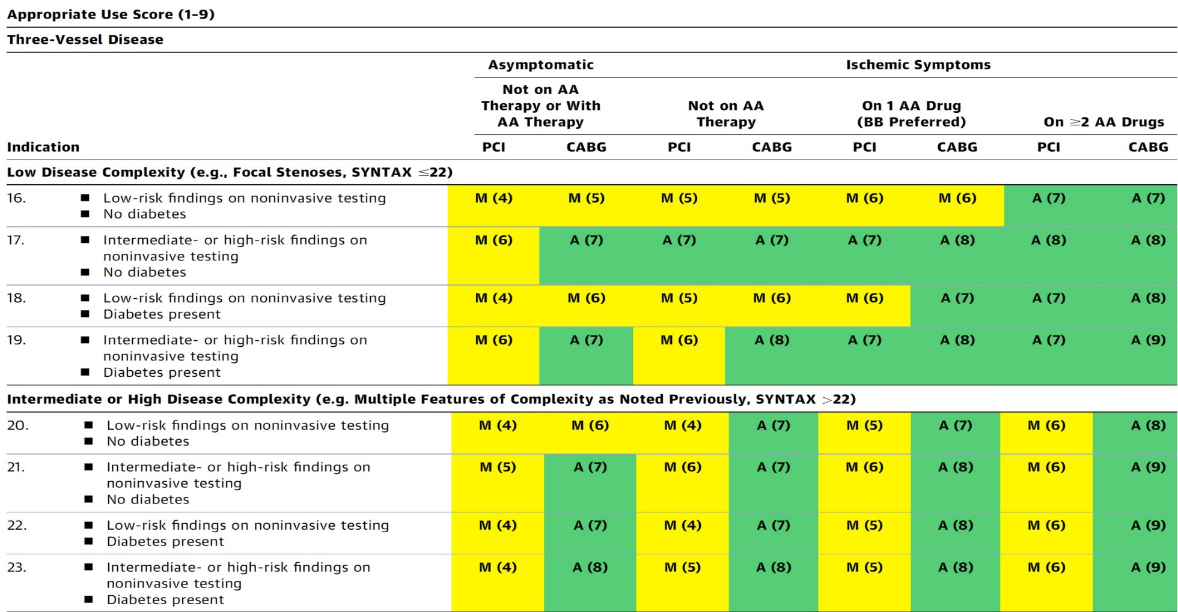
AUC 2017: Left Main + 2/3 V CAD
Patel et al., J Am Coll Cardiol 2017;69:2212

Slide 9
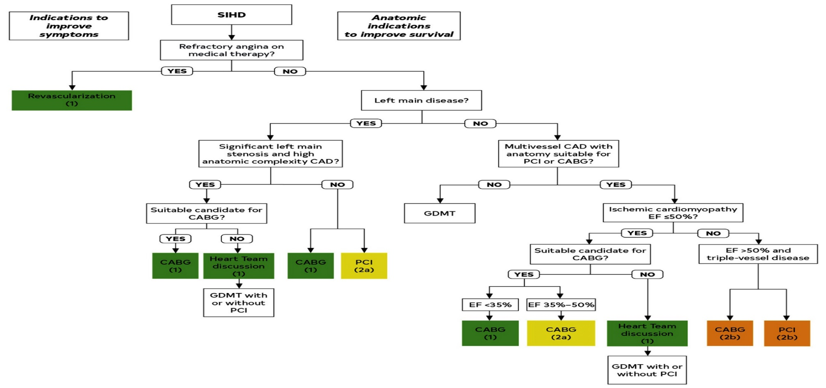
Revascularization to Improve Survival in SIHD Compared to Medical Therapy
Lawton et al., J Am Coll Cardiol 2022:79;e21-129

Slide 10
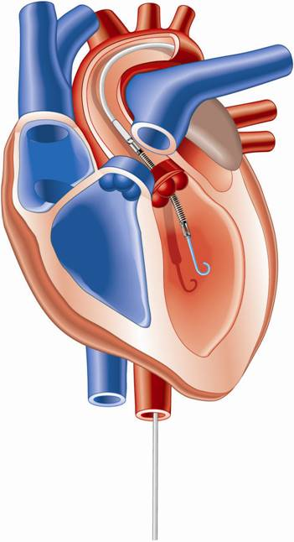
Percutaneous LV Assist Devices
PTVA:
TandemHeart
IMPELLA:
Recovers 2.5/CP
IABP

Slide 11
LV Support during High-risk PCI:
LVEF + Lesion Complexity
LVEF >40%
LVEF 20-40%
LVEF <20%
Simple PCI
Complex PCI
Simple PCI
Complex PCI: High Syntax score >32/ STS>5 Extensive revascularization
Simple or Complex: Inoperable cases
None
?IABP/?Impella
None or IABP
No support
Impella
/IABP (if Impella is CI)
Impella/PTVA
Notes:
11

Slide 12
LV Support during High-risk PCI:
LVEF + Lesion Complexity
LVEF >40%
LVEF 20-40%
LVEF <20%
Simple PCI
Complex PCI
Simple PCI
Complex PCI: High Syntax score >32/ STS>5 Extensive revascularization
Simple or Complex: Inoperable cases
None
Impella is ok
None or IABP
No support
Impella
/IABP (if Impella is CI)
Impella/PTVA
Notes:
12

Slide 13
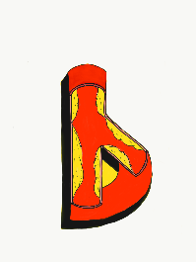
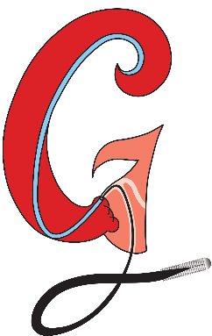
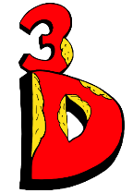
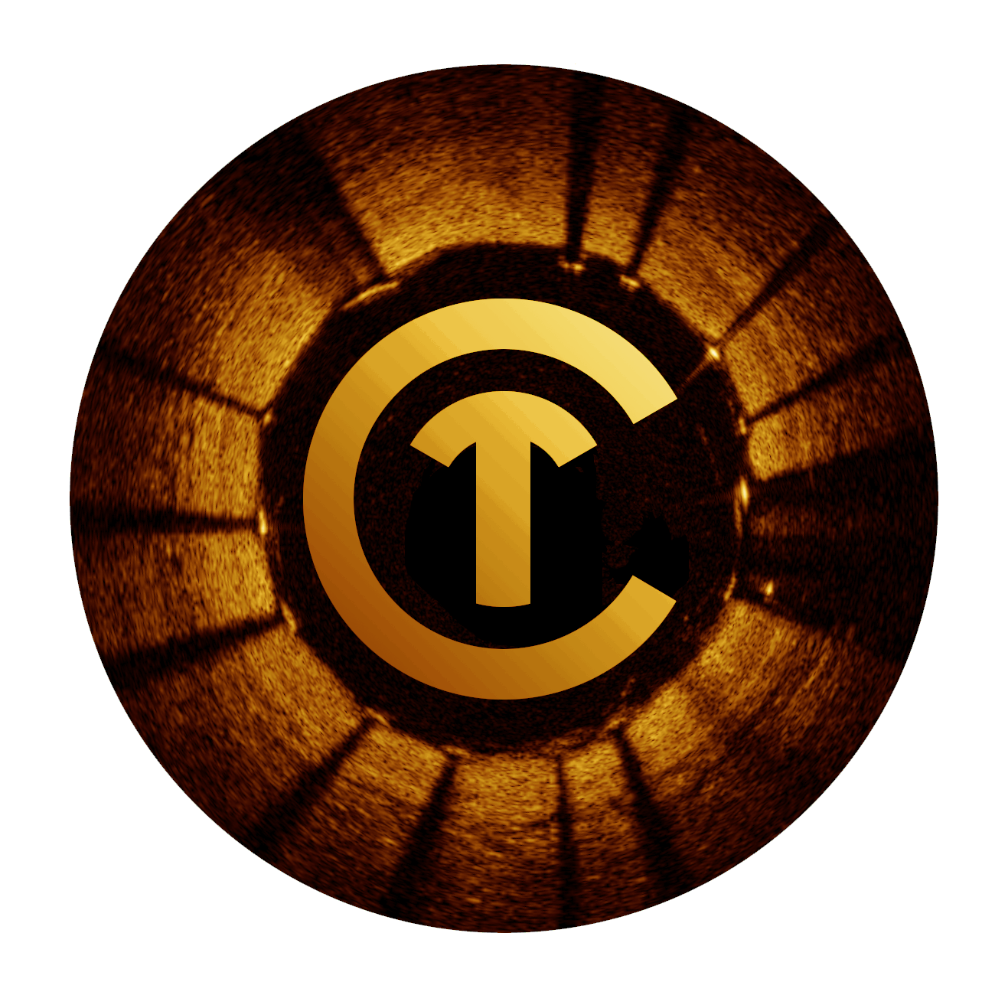
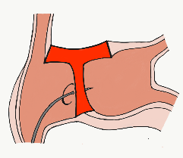
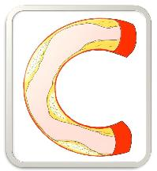
BifurcAID
TAVRcathAID
ComplicAID
Mobile App
Coming soon…
GuidewireAID
Cath Lab
Apps
BifurcAID 3D
CalcificAID
OCTAID
TranseptAID

Slide 14
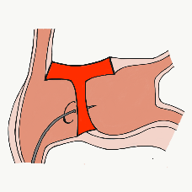
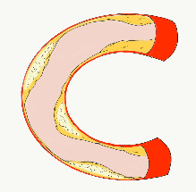
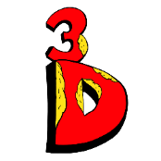
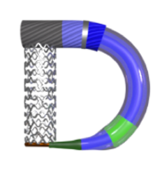
> 60,000 unique downloads and counting!
Cath Lab Apps CardiologyApps.com
Data Updated on Jun 9 2022*
BifurcAID
OCTAID
TAVRcathAID
TranseptAID
CalcificAID
iOS ★ 5/5
12,703 downloads
Android ★ 5/5
10,536 downloads
Released sept 2017
iOS ★ 5/5
8,731 downloads
Android ★ 4.7/5
5,242 downloads
Released June 2018
iOS ★ 5/5
4,546 downloads
Android ★ 5/5
2,017 downloads
Released March 2019
iOS ★ 5/5
2,277 downloads
Android ★ 4.6/5
1,298 downloads
Released Sept 2018
iOS ★ 5/5
2,805 downloads
Android ★ 5/5
1,918 downloads
Released June 2019
ComplicAID
BifurcAID 3D
STEMIcathAID
GuidewireAID
DeviceAID
30,248 page views
www.cardiologyapps.com/ComplicAID
Released August 2020
iOS ★ 5/5
2,932 downloads
Android ★ 4.9/5
1,847 downloads
Released June 2021
Clinical Care Application For Heart Attack patient transfers 555 downloads
Released Aug 2020
iOS ★ 5/5
1,678 downloads
Android ★ 5/5
1,302 downloads
Released Nov 2021
WebApp Out Now!
Mobile App is
Coming Soon
Apple ® and App Store® are registered trademarks of Apple Inc.
And 5 more in development…
Notes:
These are the apps we have created which will provide digital algorithms for our future ambitious projects to make our cath labs smarter.

Slide 15
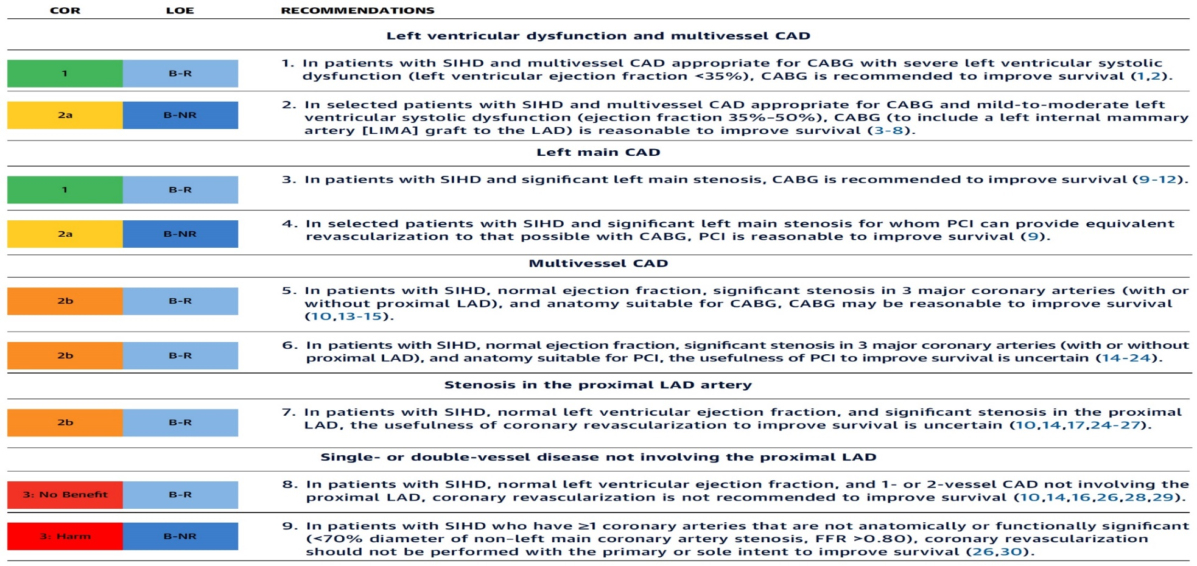
Revascularization to Improve Survival in SIHD Compared to Medical Therapy
Recommendations for Revasc to Improve Survival in SIHD Compared with Medical Therapy
Lawton et al., J Am Coll Cardiol 2022:79;e21-129

Slide 16
Specific Indications for PCI
Recommendations for Radial and Femoral Approach for PCI
Recommendations for Use of Intravascular Imaging
Lawton et al., J Am Coll Cardiol 2022:79;e21-129

Slide 17
Patients with Complex Disease & Diabetes
Recommendations for Patients with Complex Disease
Recommendations for Patients with Diabetes
Lawton et al., J Am Coll Cardiol 2022:79;e21-129

Slide 18
Revascularization to Improve Survival in SIHD Compared to Medical Therapy
Lawton et al., J Am Coll Cardiol 2022:79;e21-129

Slide 19
AUC 2017: Revascularization to Improve Survival
Compared with Medical Therapy
Syntax score 48; STS score 5.1
Patel et al., J Am Coll Cardiol 2017;69:2212

Slide 20
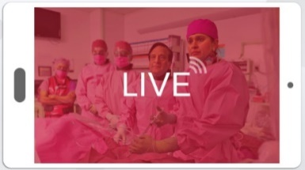
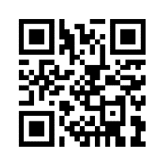
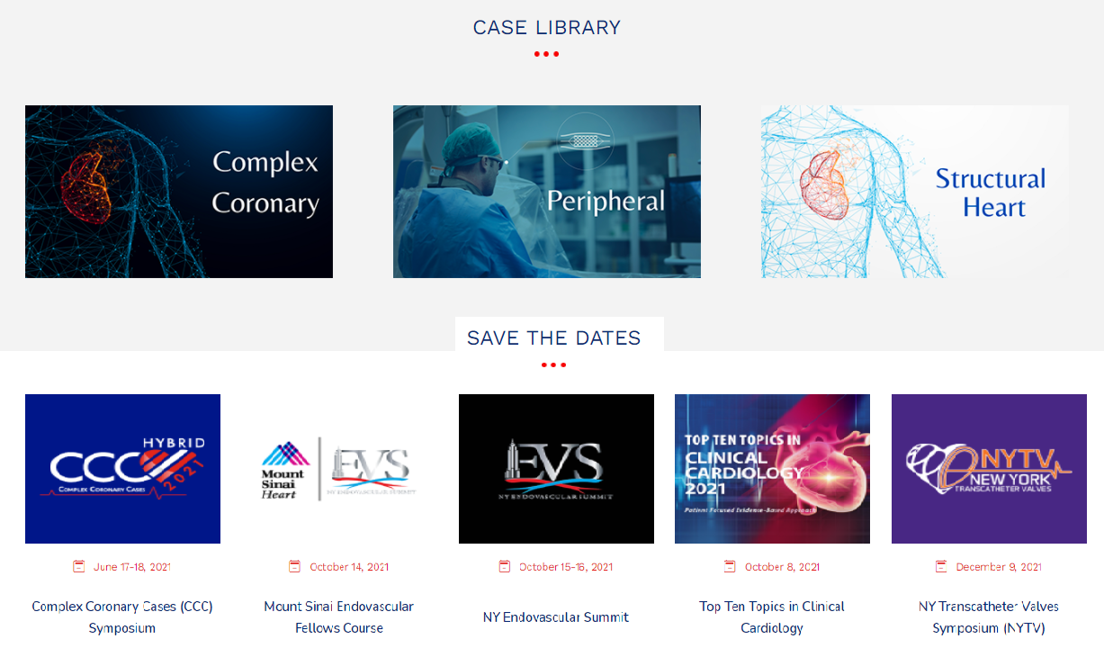
www.ccclivecases.org

Slide 21
CCClivecases: Total Page Views per Month (Past 2 Years)
Number of views

Slide 22
Protocol for Management of Calcific Lesions
Coronary Angiography
≈50%
Moderate-severe calcification
≈50%
ELCA, if no Rota/OA Wire could be crossed
IVUS/OCT assessment:
Calcium arc 180-270° (2points)
Calcium arc >270° (3 points)
Calcium length >5 mm (1 point)
Thickness >0.5 mm (1 point)
IVUS/OCT/balloon
did not cross
Un-crossable lesion/CTO
Angulated lesion
Tortuous lesion
Long lesion
Calcific Nodule
1-2 points
3-5 points
- High-pressure NC balloons
- Cutting/scoring balloon
Lithotripsy IVL (RA/OA for Ca 360°)
RA or OA ?ELCA
Suboptimal result
Does not cross
NC balloon/CB
Suboptimal balloon expansion
Optimal balloon expansion
Optimal balloon expansion
Lithotripsy IVL
Stent and OCT/IVUS optimization

