Slide 1
Complex Coronary Case
Supported by:
Sun Pharmaceutical Industries Ltd.

Slide 2
Disclosures
Samin K. Sharma, MD, MSCAI, FACC
Speaker’s Bureau – BSC, ABBOTT
Annapoorna S. Kini, MD, MRCP, FACC
Nothing to disclose
Jimmy George, MBBS, MD, DM (Guest Faculty)
Jabir Abdullakutty, MD, DM, FACC, FESC, FSCAI (Moderator)

Slide 3
Jimmy George, MBBS, MD, DM
Consultant Interventional Cardiologist
Lisie Heart Institute, Lisie Hospital
Kochi, Kerala
Jabir Abdullakutty, MD, DM, FRCP, FACC, FESC, FSCAI
Senior Consultant Cardiologist
Director, Academic Affairs and Clinical Research
Lisie Hospital, Kochi, Kerala
Dr. Jimmy George is Consultant Interventional Cardiologist at Lisie Heart Institute, Lisie Hospital. He is Treasurer & Organising Secretary of Cardiovascular Research Society, Present Executive Committee Member of CSI Kerala, ICCK Interventional Cardiology Council Kerala, Society of Coronary Imaging & Physiology-India, Cochin Cardiology Forum and Lisie Research Executive Committee member 2022. He is International Faculty in 2022 TCT - AsiaPacific Seoul.
Dr. Jabir Abdullakutty is Senior Consultant Cardiologist at Lisie hospital. He is involved in RCT and registries at national and international level including CANTOS, ATLAS TIMI 51, ODYSSEY and many more. He is the Life Member Indian Medical Association, Cardiological Society of India, Indian College of Cardiology. He is fellow of Society for Cardiac Angioplasty and Intervention, American College of Cardiology, European Society of Cardiology and Royal college of Physicians(Edinburgh). He is organising secretary for various conferences at national level and international level. He is National Secretary of Society for Heart Failure and transplantation and Secretary of Cardiovascular Research Society. He has many publications in renowned journals.

Slide 4
Imaging Guided PCI of distal Left Main CAD

Slide 5
Live Case #20
Patient Demographics
74 yrs, F, known ischemic CM
Present Clinical Presentation
Presented with new onset CCS class III angina and + stress echo for mod-severe LV dysfunction and multi-vessel ischemia
CAD Risk Factors
Controlled hypertension
Controlled hyperlipidemia
Controlled NIDDM
SAQ -7: 43
Clinical Variables
Known extensive CAD s/p PCIs and ischemic cardiomyopathy with EF 30-35%. Stable on GDMT for angina and HFrEF point of view until recently
Medications
Aspirin, Metoprolol, Furosemide, Temisartan, Atorvastatin, ISMN, Apixaban, Glucophage XR, Glucotrol XL
Cath: Cardiac cath on Feb 8th 2022 revealed 2V+LM CAD: 80%dLM, 80% stent jailed D2, 70% stent jailed RCA-AV cont and other prior patent stent sites in RCA, LAD and LCx, LVEF 32% and Syntax score 18. Pt was discharged for HFrEF GDMT optimization but continued to have angina and DOE.
Plan: Now planned for IVUS guided staged PCI of distal LM lesion.

Slide 6
Assessment and Predicting Patient Risk
Recommendation for the Heart Team
Recommendation to Predicting Patient Risk of Death with CABG: STS Risk
Recommendation for Defining Coronary Artery Lesion Complexity: SYNTAX Score
Assessment of Risk Factors Not Qualified in the STS Score
Syntax score 18; STS score 2.1
Lawton et al., J Am Coll Cardiol 2022:79;e21-129

Slide 7
Use of Coronary Physiology to Guide Revascularization with PCI
Recommendations for the Use of Coronary Physiology to Guide Revascularization
Recommendations for Intravascular Ultrasound to Assess Lesion Severity
Lawton et al., J Am Coll Cardiol 2022:79;e21-129

Slide 8
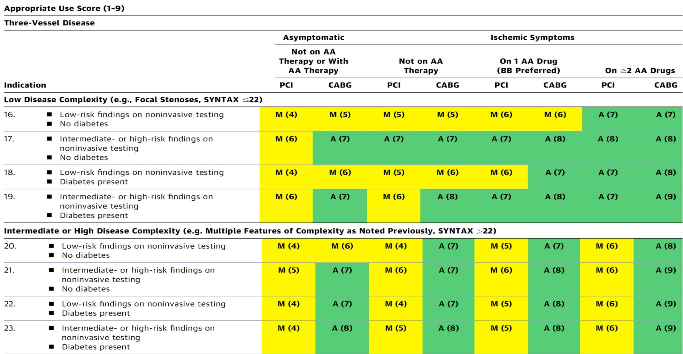
AUC 2017: Left Main + 2/3 V CAD
Patel et al., J Am Coll Cardiol 2017;69:2212

Slide 9
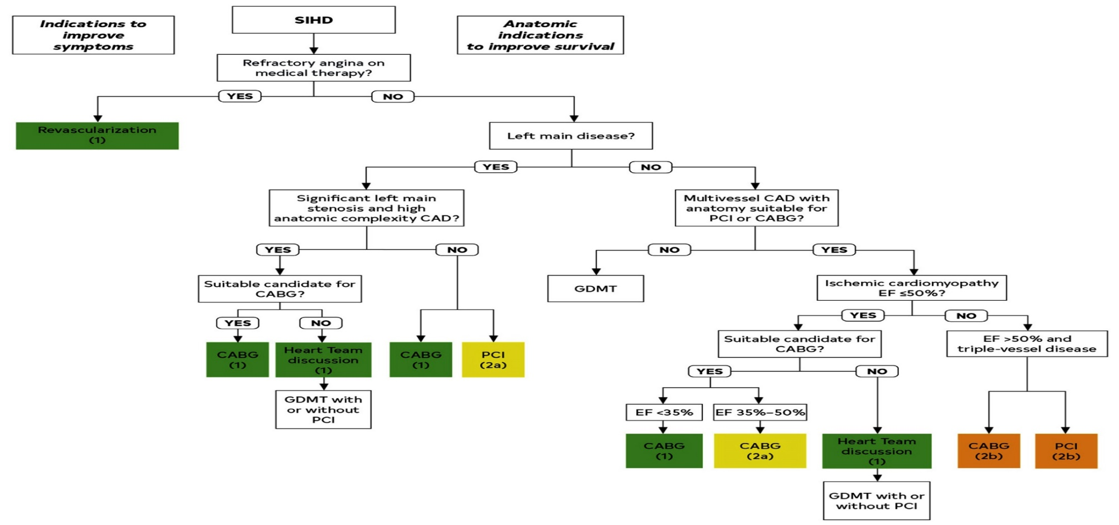
Revascularization to Improve Survival in SIHD Compared to Medical Therapy
Lawton et al., J Am Coll Cardiol 2022:79;e21-129

Slide 10
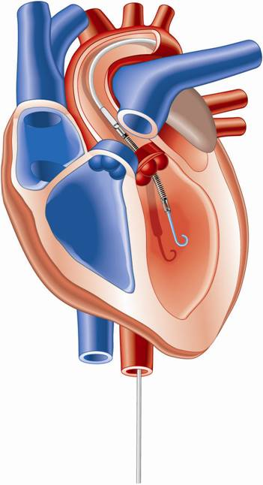
Percutaneous LV Assist Devices
PTVA:
TandemHeart
IMPELLA:
Recovers 2.5/CP
IABP

Slide 11
LV Support during High-risk PCI:
LVEF + Lesion Complexity
LVEF >40%
LVEF 20-40%
LVEF <20%
Simple PCI
Complex PCI
Simple PCI
Complex PCI: High Syntax score >32/ STS>5 Extensive revascularization
Simple or Complex: Inoperable cases
None
?IABP/?Impella
None or IABP
No support
Impella
/IABP (if Impella is CI)
Impella/PTVA
Notes:
11

Slide 12
LV Support during High-risk PCI:
LVEF + Lesion Complexity
LVEF >40%
LVEF 20-40%
LVEF <20%
Simple PCI
Complex PCI
Simple PCI
Complex PCI: High Syntax score >32/ STS>5 Extensive revascularization
Simple or Complex: Inoperable cases
None
Impella is ok
None or IABP
No support
Impella
/IABP (if Impella is CI)
Impella/PTVA
Notes:
12

Slide 13
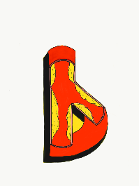
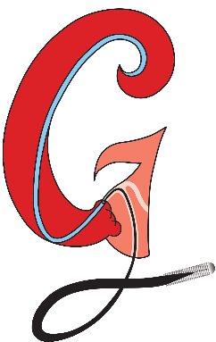
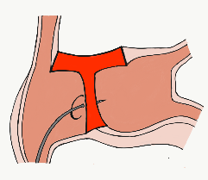
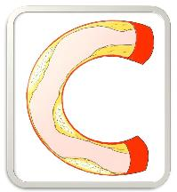
BifurcAID
TAVRcathAID
ComplicAID
Mobile App
Coming soon…
GuidewireAID
Cath Lab
Apps
BifurcAID 3D
CalcificAID
OCTAID
TranseptAID

Slide 14
www.CardiologyApps.com/BifurcAID-3D
Key Features:
Left Main and Non-Left Main bifurcation lesions
Secondary view highlighting key points such as stent crush
Android, iOS and WebApp
Many techniques:
DK Crush
Mini Crush
Culotte
Provisional Stenting
Bailout Techniques
Available for free on Android Google Play Store and Apple App Store in addition to our WebApp version on www.cardiologyapps.com/BifurcAID-3D

Slide 15
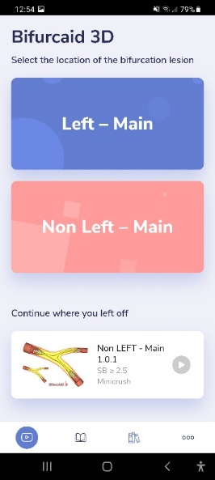
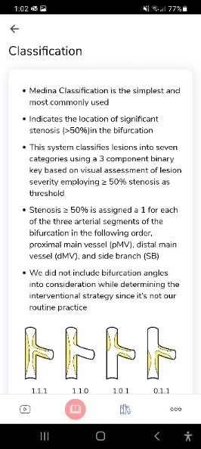
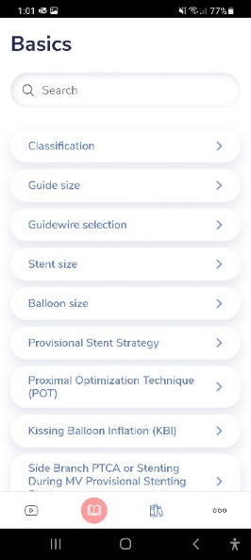
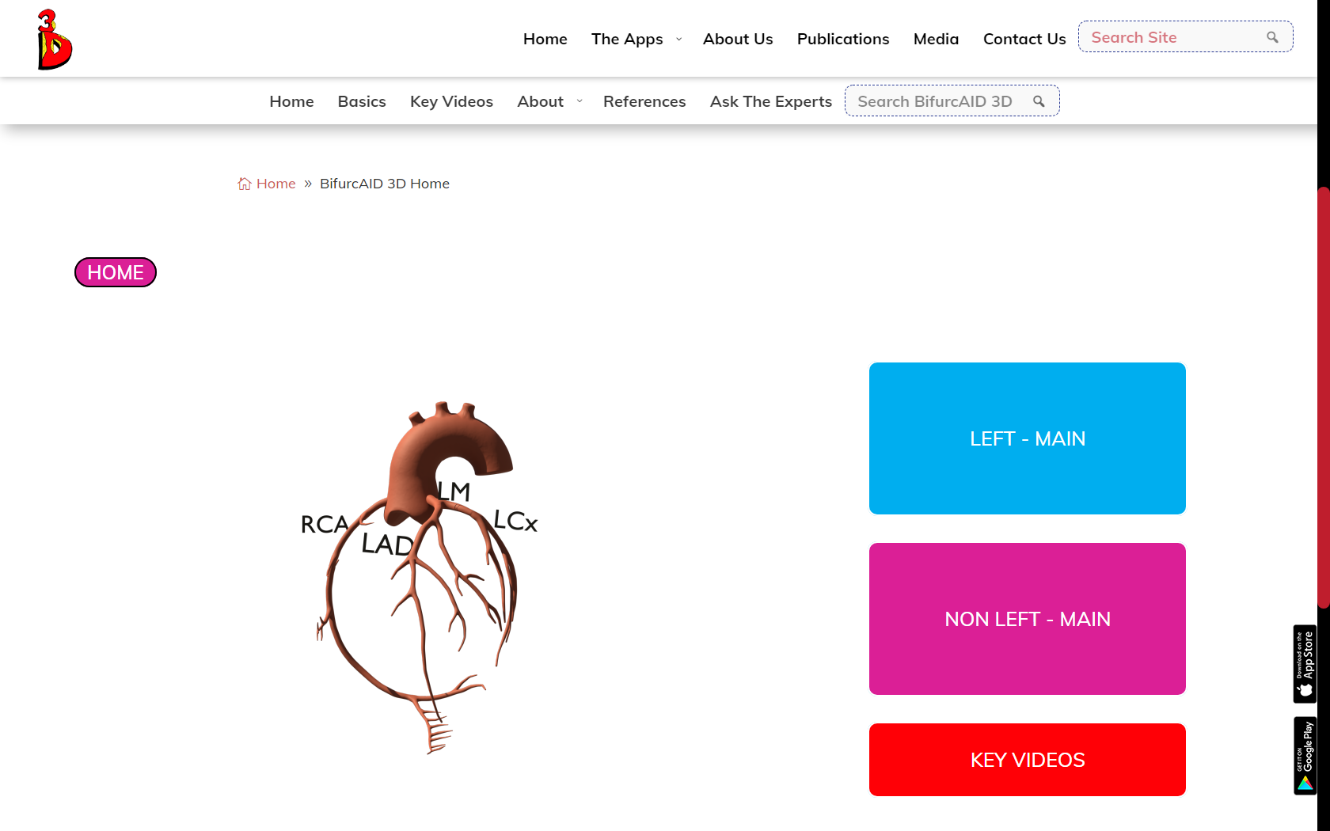
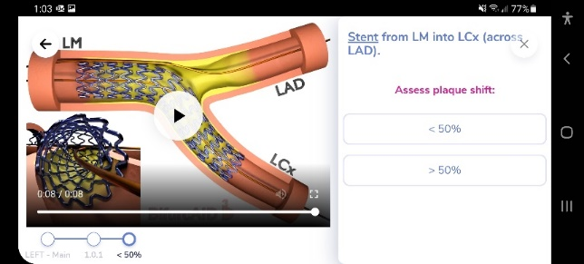
BifurcAID-3D
Available as both Mobile Application for Android and iOS devices
as well as
fully-featured Web-Application on
www.CardiologyApps.com/BifurcAID-3D
Select “Key Videos” for
A shortcut to techniques

Slide 16
www.CardiologyApps.com/BifurcAID-3D
WEB APP

Slide 17
BifurcAID 3D – Free Download Now

Slide 18
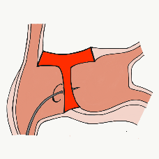
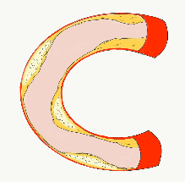
54,362 unique downloads and counting! (Up 14,000 in 2021)
Data Updated on Feb 14 2022*
Cath Lab Apps CardiologyApps.com
iOS ★ 5/5
12,227 downloads
Android ★ 4.96/5
9,372 downloads
Released sept 2017
iOS ★ 4.6/5
7,943 downloads
Android ★ 4.29/5
6,120 downloads
Released June 2018
iOS ★ 5/5
4,265 downloads
Android ★ 5/5
1,472 downloads
Released March 2019
iOS ★ 4.67/5
2,111 downloads
Android ★ 4.6/5
969 downloads
Released Sept 2018
iOS ★ 4.86/5
2,058 downloads
Android ★ 5/5
1,974 downloads
Released June 2019
Large Update Q3 19
Large Update Q1 21
BifurcAID
OCTAID
TAVRcathAID
TranseptAID
CalcificAID
*Also available
as WebApp
*Also available
as WebApp
Download Apps
For Free on Both:
WebApps available free on
www.CardiologyApps.com
Apple ® and App Store® are registered trademarks of Apple Inc.
Notes:
These are the apps we have created which will provide digital algorithms for our future ambitious projects to make our cath labs smarter.

Slide 19
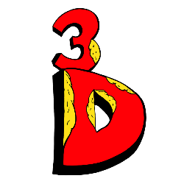
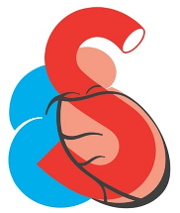
54,362 unique downloads and counting! (Up 14,000 in 2021)
Data Updated on Feb 14 2022*
Cath Lab Apps CardiologyApps.com
WebApp Only*
26,940 page views
www.cardiologyapps.com/ComplicAID
iOS ★ 5/5
2,179 downloads
Android ★ 5/5
1,405 downloads
Released June 2021
Clinical Care Application For Heart Attack patient transfers 475 downloads
Released Aug 2020
iOS ★ 5/5
1,142 downloads
Android ★ N/A
650 downloads
Released Nov 2021
Released August 2020
ComplicAID
BifurcAID 3D
STEMIcathAID
GuidewireAID
*Also available
as WebApp
*Also available
as WebApp
Download Apps
For Free on Both:
WebApps available free on
www.CardiologyApps.com
Apple ® and App Store® are registered trademarks of Apple Inc.
Notes:
These are the apps we have created which will provide digital algorithms for our future ambitious projects to make our cath labs smarter.

Slide 20
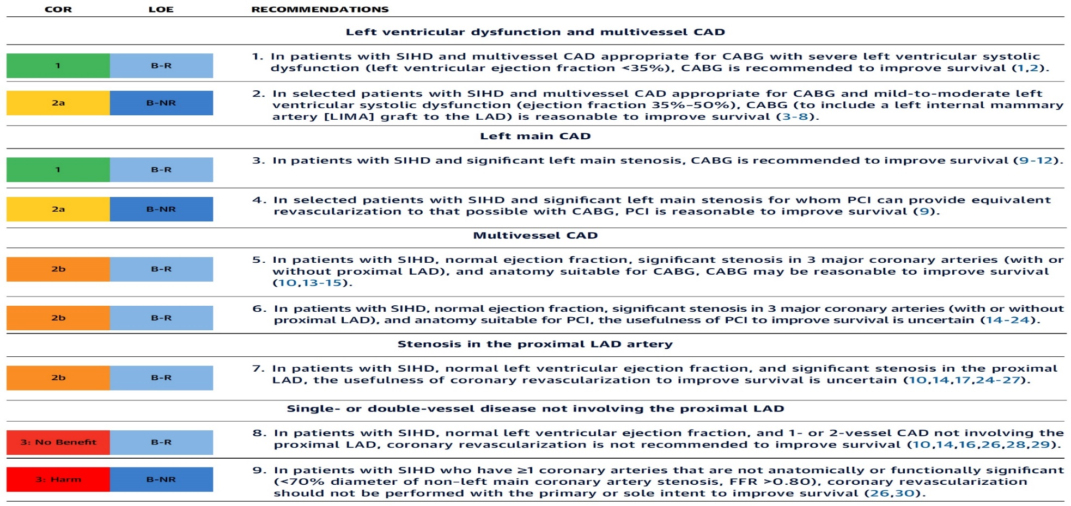
Revascularization to Improve Survival in SIHD Compared to Medical Therapy
Recommendations for Revasc to Improve Survival in SIHD Compared with Medical Therapy
Lawton et al., J Am Coll Cardiol 2022:79;e21-129

Slide 21
Specific Indications for PCI
Recommendations for Radial and Femoral Approach for PCI
Recommendations for Use of Intravascular Imaging
Lawton et al., J Am Coll Cardiol 2022:79;e21-129

Slide 22
Patients with Complex Disease & Diabetes
Recommendations for Patients with Complex Disease
Recommendations for Patients with Diabetes
Lawton et al., J Am Coll Cardiol 2022:79;e21-129

Slide 23
Revascularization to Improve Survival in SIHD Compared to Medical Therapy
Lawton et al., J Am Coll Cardiol 2022:79;e21-129

Slide 24
AUC 2017: Revascularization to Improve Survival
Compared with Medical Therapy
Syntax score 48; STS score 5.1
Patel et al., J Am Coll Cardiol 2017;69:2212

Slide 25
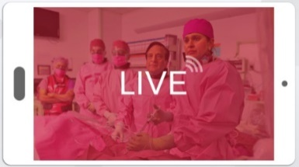
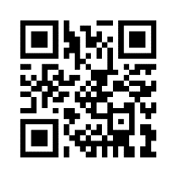
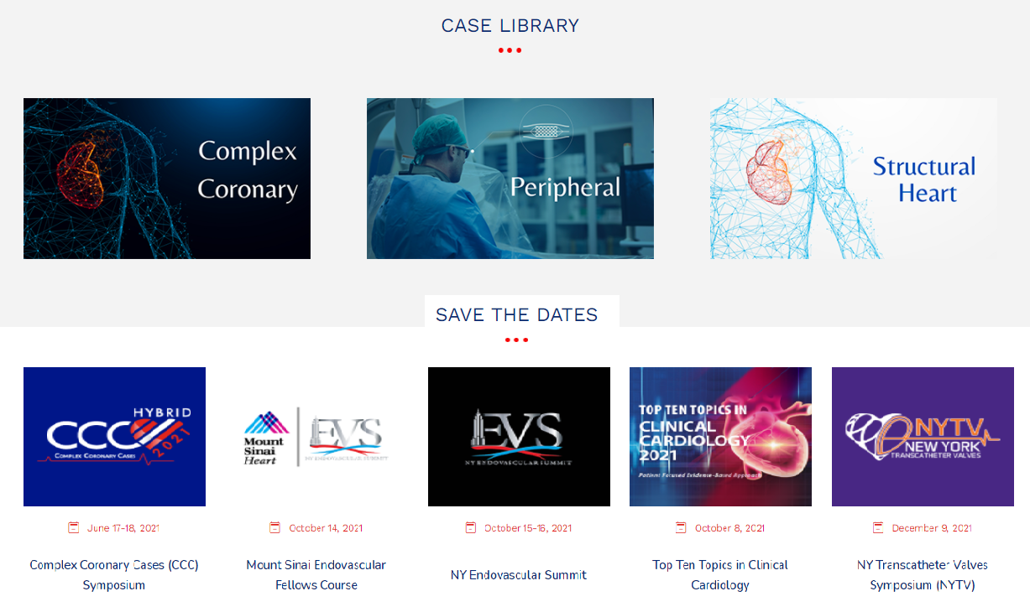
www.ccclivecases.org

Slide 26
CCClivecases: Total Page Views per Month (Past 2 Years)
Number of views

Slide 27
Protocol for Management of Calcific Lesions
Coronary Angiography
≈50%
Moderate-severe calcification
≈50%
ELCA, if no Rota/OA Wire could be crossed
IVUS/OCT assessment:
Calcium arc 180-270° (2points)
Calcium arc >270° (3 points)
Calcium length >5 mm (1 point)
Thickness >0.5 mm (1 point)
IVUS/OCT/balloon
did not cross
Un-crossable lesion/CTO
Angulated lesion
Tortuous lesion
Long lesion
Calcific Nodule
1-2 points
3-5 points
- High-pressure NC balloons
- Cutting/scoring balloon
Lithotripsy IVL (RA/OA for Ca 360°)
RA or OA ?ELCA
Suboptimal result
Does not cross
NC balloon/CB
Suboptimal balloon expansion
Optimal balloon expansion
Optimal balloon expansion
Lithotripsy IVL
Stent and OCT/IVUS optimization

