Slide 1
Complex Coronary Cases Supported by:
Abbott Vascular Inc.
Boston Scientific Corp.
Terumo Vascular Corp.
Cardiovascular Systems Inc.
Abiomed Inc.
Chiesi Inc.
Shockwave Medical Inc.
Cardinal Health Cordis Inc.

Slide 2
Disclosures
Samin K. Sharma, MD, MSCAI, FACC
Speaker’s Bureau – BSC Inc
Annapoorna S. Kini, MD, MRCP, FACC
Nothing to disclose
Sameer Mehta, MD, FACC (Moderator)
Nothing to disclose

Slide 3
CCC Live Case # 157
Patient Demographics
78 yrs, Male without known CAD
Present Clinical Presentation
Presented DOE/angina for few months and positive stress MPI for multi-vessel ischemia
CAD Risk Factors
Controlled Hyperlipidemia
Controlled Hypertension
Controlled DM
Liver cirrhosis/cancer, ETOH use, Afib
Multiple episodes of GIB, Platelet 70K
Clinical Variables
Multiple medical comorbid conditions of liver and GI with rectal bleeds, gall stones and has baseline exertional dyspnea. Echo revealed EF 32% without significant valvular disease
Medications
Furosemide, Carvedilol, ISMN, Atorvastatin, Repaglinide, Sitagliptan, Pantoprazole
Cath: Cath on 5/24/2022 @OSH revealed calcified 3 V + LM CAD: 80% dLM, 70-80% LAD/D2 bifurcation, 80% pLCx, 95% pRCA lesions and Syntax score 36. After heart team discussion, CABG was declined due to liver cirrhosis and multiple comorbidities. After planned decision for high risk PCI, a trial of Clopidogrel 75mg daily was done; no bleeding
Plan: Now planned for high risk PCI of calcified LM bifurcation using Rotational atherectomy +/- IVL & Impella support. ? 1 vs 2 Stents in view of GIB.

Slide 4
Assessment and Predicting Patient Risk
Recommendation for the Heart Team
Recommendation to Predicting Patient Risk of Death with CABG: STS Risk
Recommendation for Defining Coronary Artery Lesion Complexity: SYNTAX Score
Assessment of Risk Factors Not Qualified in the STS Score
Syntax score 36; STS score 6.1
Lawton et al., J Am Coll Cardiol 2022:79;e21-129

Slide 5
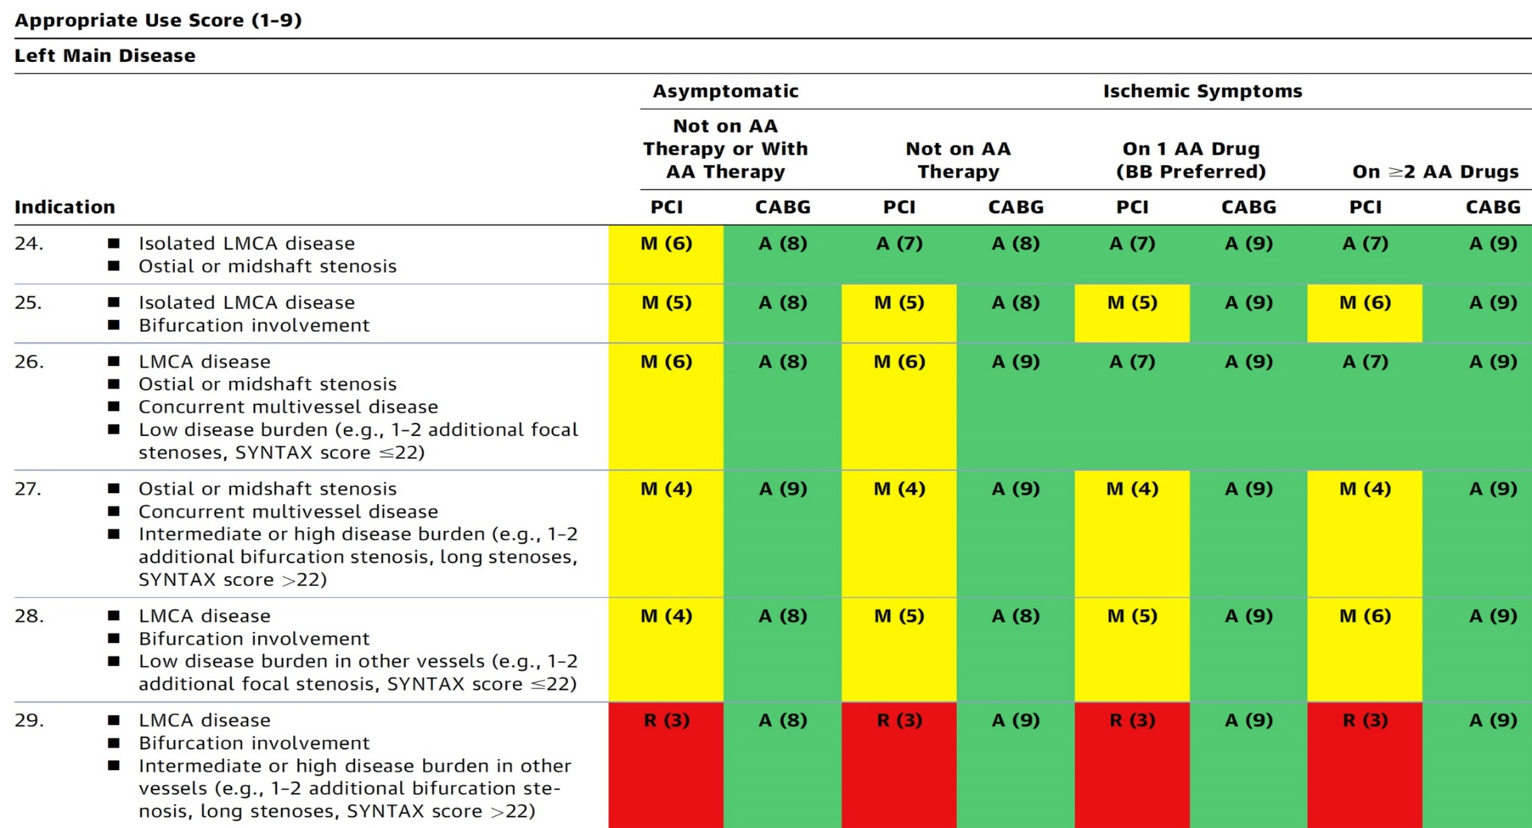
AUC 2017: LM+ 2/3 V Coronary Artery Stenosis
After Heart team discussion: A
Patel et al., J Am Coll Cardiol 2017;69:2212

Slide 6
LV Support during High-Risk PCI:
LVEF + Lesion Complexity
LVEF >35%
LVEF 20-35%
LVEF <20%
Simple PCI
Complex PCI
Simple PCI
Complex PCI: High Syntax score >32/ STS>5 Extensive revascularization
Simple or Complex: Inoperable cases
IABP/Impella
No support
None or Impella or IABP
Impella
/IABP (if Impella is CI)
Impella/PTVA
MSH of ≈320 PCIs/M: 4-5 IABP & 10-12 Impella per month are used for high risk PCIs
Notes:
6

Slide 7
Latest Issues in Coronary Intervention
Differential impact of CFR and FFR during PCI:
DEFINE-FLOW Study, ILIAS Registry for
Revasc based on FFR with CFR Interaction
Focused review of the month
Myocardial Infarction in Young Age:
Causes, Angiographic characteristics, and
Management of Premature Myocardial Infarction

Slide 8
Latest Issues in Coronary Intervention
Differential impact of CFR and FFR during PCI:
DEFINE-FLOW Study, ILIAS Registry for
Revasc based on FFR with CFR Interaction
Focused review of the month
Myocardial Infarction in Young Age:
Causes, Angiographic characteristics, and
Management of Premature Myocardial Infarction

Slide 9
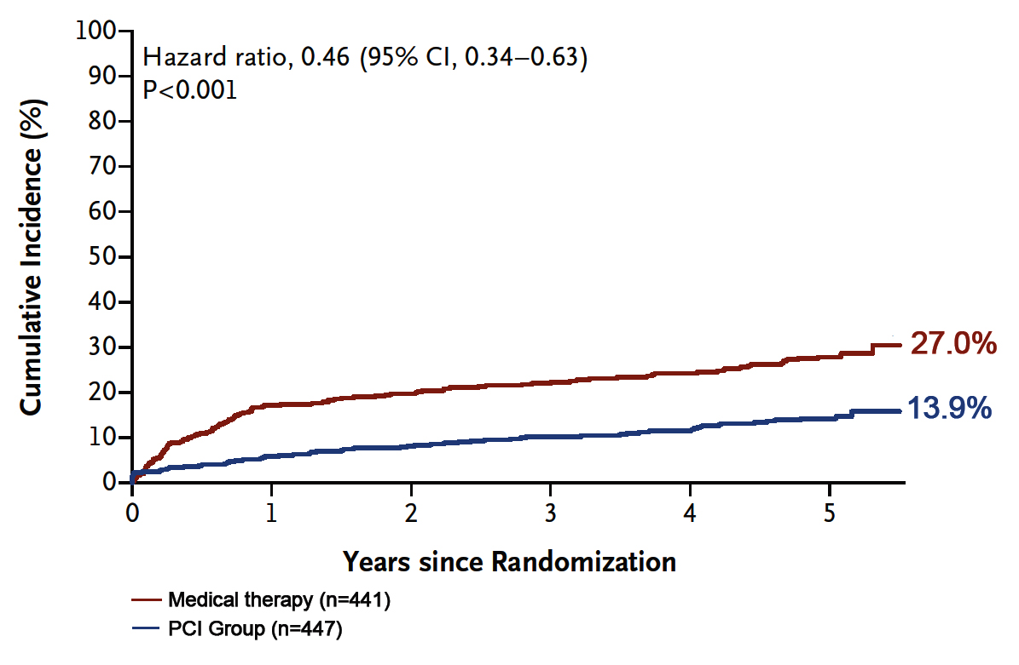
FAME 2 Trial: Kaplan-Meier Curves for Primary Endpoint Composite of Death from any cause, MI, or Urgent Revasc
Any Revasc
%
Xaplanteris et al., N Engl J Med 2018;379:250

Slide 10
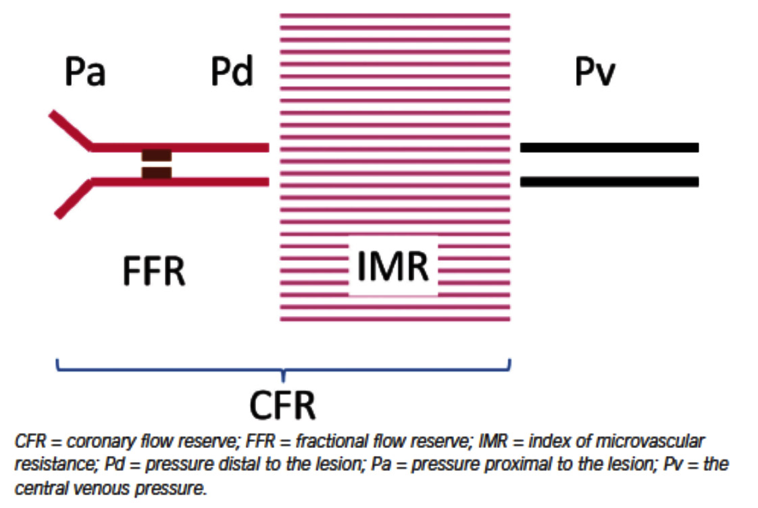
Coronary Circulation and Functional Imaging
Artery
Microcirculation
Vein
FFR/IFR

Slide 11
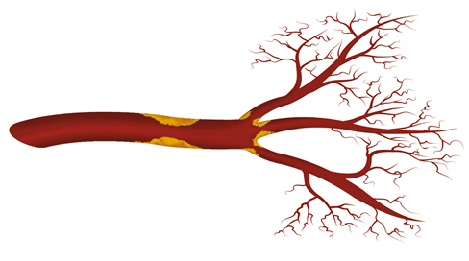
Hemodynamic Data for Entire Coronary Vasculature
Epicardial Assessment
FFR (fractional flow reserve)
RFR/iFR (resting full-cycle ratio) a non-hyperemic index that does not require adenosine infusion
Pd/Pa
Pullback measurements
Microvascular Assessment
CFR (coronary flow reserve)
IMR (index of microvascular resistance)
FFR, IFR, RFR, Pd/Pa
Assess only epicardial disease
CFR
Flow at rest vs at Hyperemia: affected by both microvascular and epicardial disease
IMR
Assesses microvascular disease

Slide 12
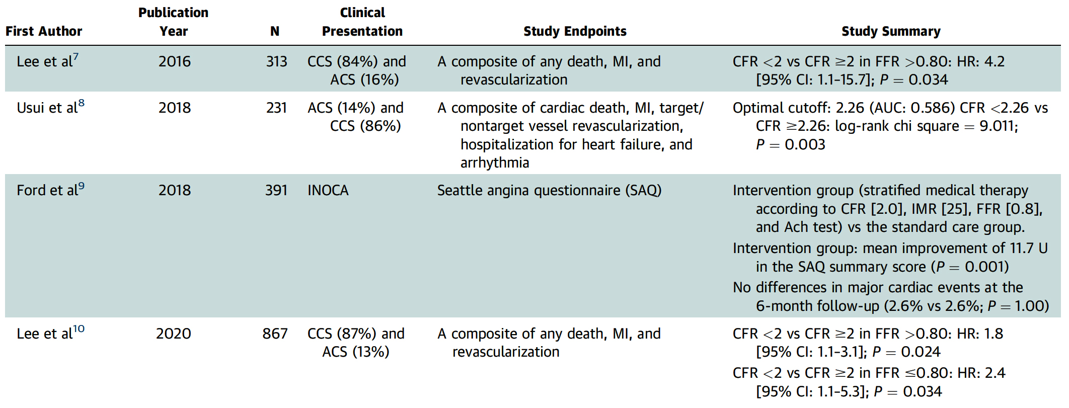
Prognostic Implications of CFR_{Thermo} in Previous Studies

Slide 13
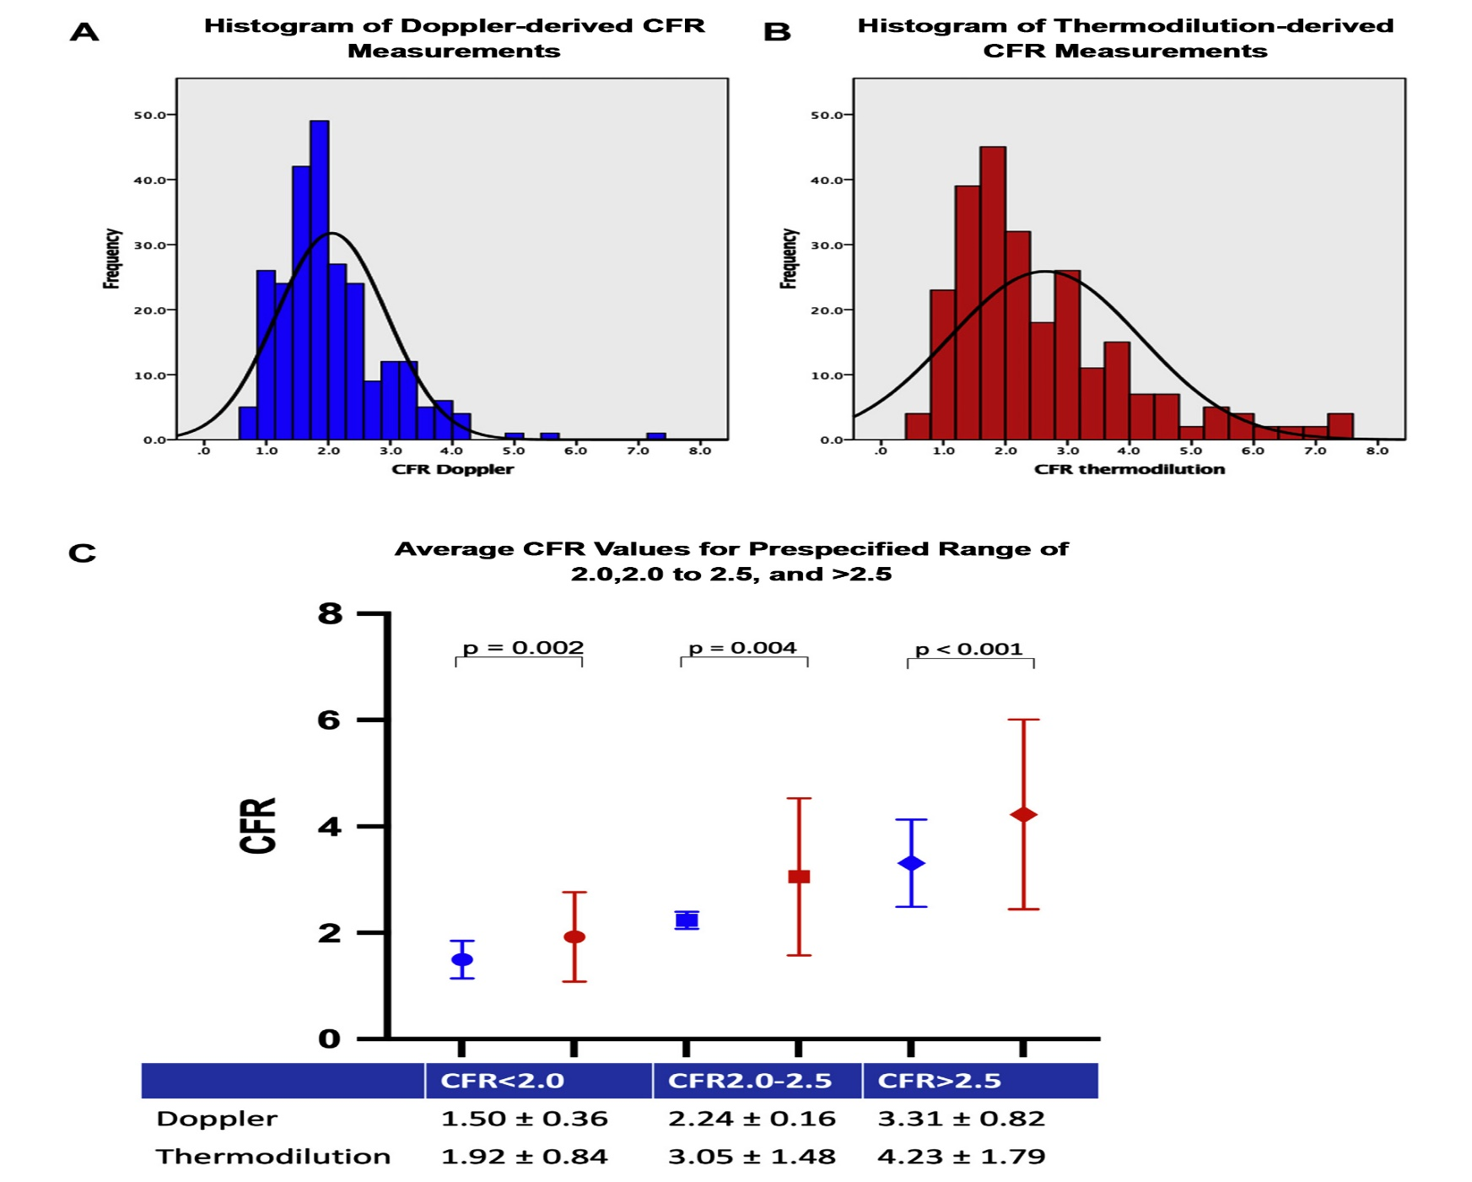
Distribution of CFR by Two Techniques
Demir et al., J Am Coll Cardiol Intv 2022;15:1060

Slide 14
Study Summary and Main Findings
Demir et al., J Am Coll Cardiol Intv 2022;15:1060

Slide 15
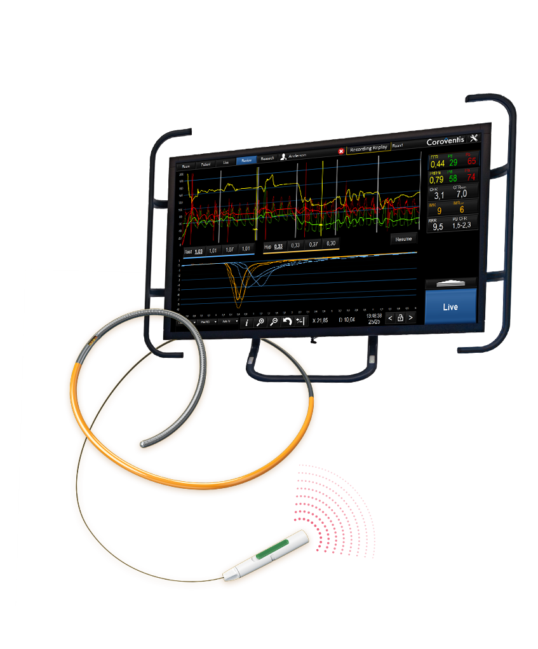
Coroventis^{ⱡ} CoroFlow^{ⱡ} Cardiovascular System

Slide 16
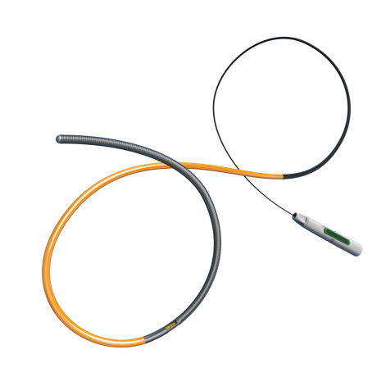
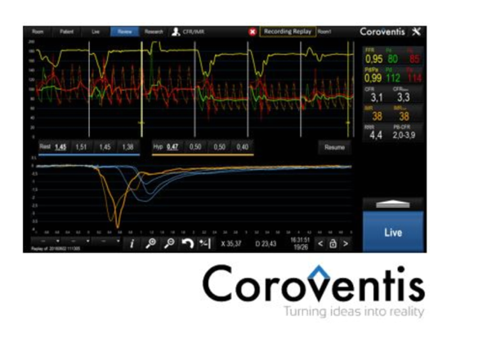
Coroventis CoroFlow Cardiovascular System
-The Coroventis CoroFlow Cardiovascular System is an advanced platform for assessment of both epicardial and microvascular physiology.
-The CoroFlow software allows Abbott’s PressureWire™ X Guidewire to diagnose coronary microvascular dysfunction caused by abnormalities in the heart’s smallest arteries.
-CoroFlow is easy to use for daily clinical practice while also providing powerful tools for advanced physiology.
The temperature sensor enables the IMR (Index of Microvascular Resistance) and CFR (Coronary Flow Reserve) measurements, which are physiological indices used to diagnose CMD
Pressure and temperature sensors

Slide 17
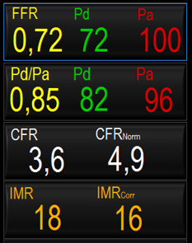
CoroFlow: About IMR
Normal IMR: < 25 (INOCA patients²)
- IMR indicates the level of microcirculatory
resistance in the target artery territory¹:
IMR = distal pressure (Pd) at hyperemia x T_{mn}
- High IMR values (≥ 25) indicate CMD² Normal IMR values (< 25) indicate no CMD
- To obtain an IMR value, use a PressureWire™ X Guidewire to:
Measure Pd during maximal hyperemia
Measure T_{mn} and flow at hyperemia using thermodilution
1. Fearon et al., Circulation 2003;107:3129
2. Ford et al., J Am Coll Cardiol 2020;13:33

Slide 18
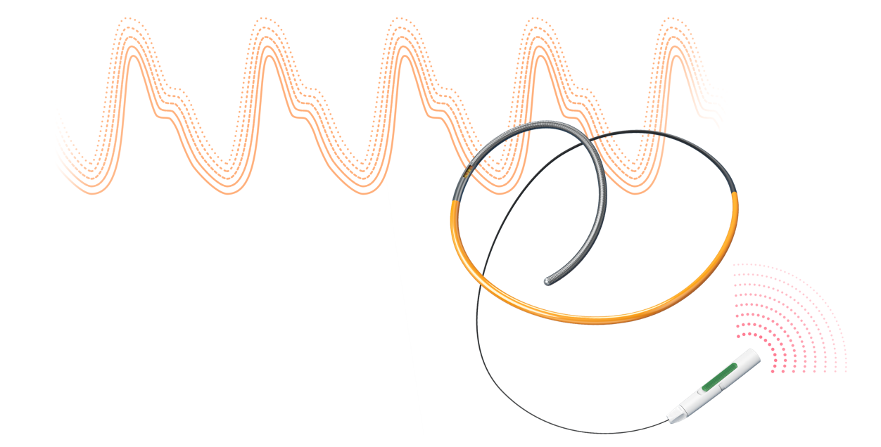
Appropriate Cut-Off Point Index
Physiological Index Guide
Abbott’s PressureWire™ X Guidewire and Coroventis‡ CoroFlow‡ Cardiovascular System COMPREHENSIVE PHYSIOLOGY DIAGNOSIS
 | RFR Resting Full Cycle Ratio | FFR Fractional Flow Reserve | CFR Coronary Flow Reserve | IMR Index of Microcirculatory Resistance
Cut-off (defer) | >0.89 | >0.80 | ≥2.0 | <25
1. Svanerud et al., EuroIntervention 2018;14:806
2. Tonino et al., J Am Coll Cardiol 2010;55:2816 3. Ford et al., J Am Coll Cardiol 2020;13:33

Slide 19
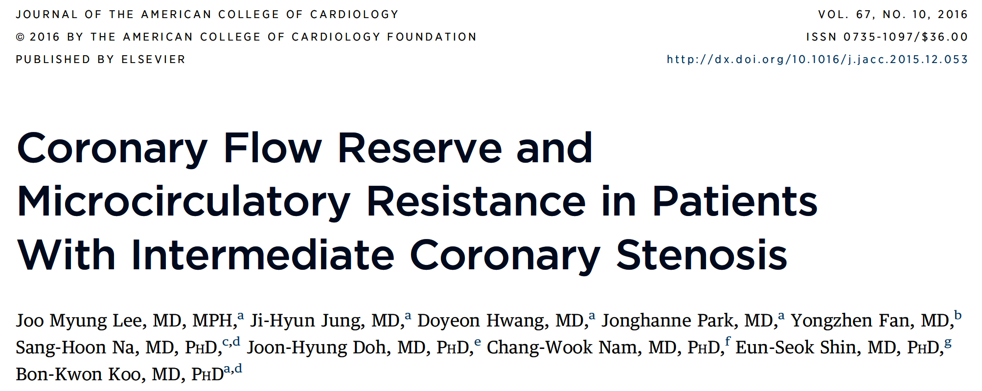

Slide 20
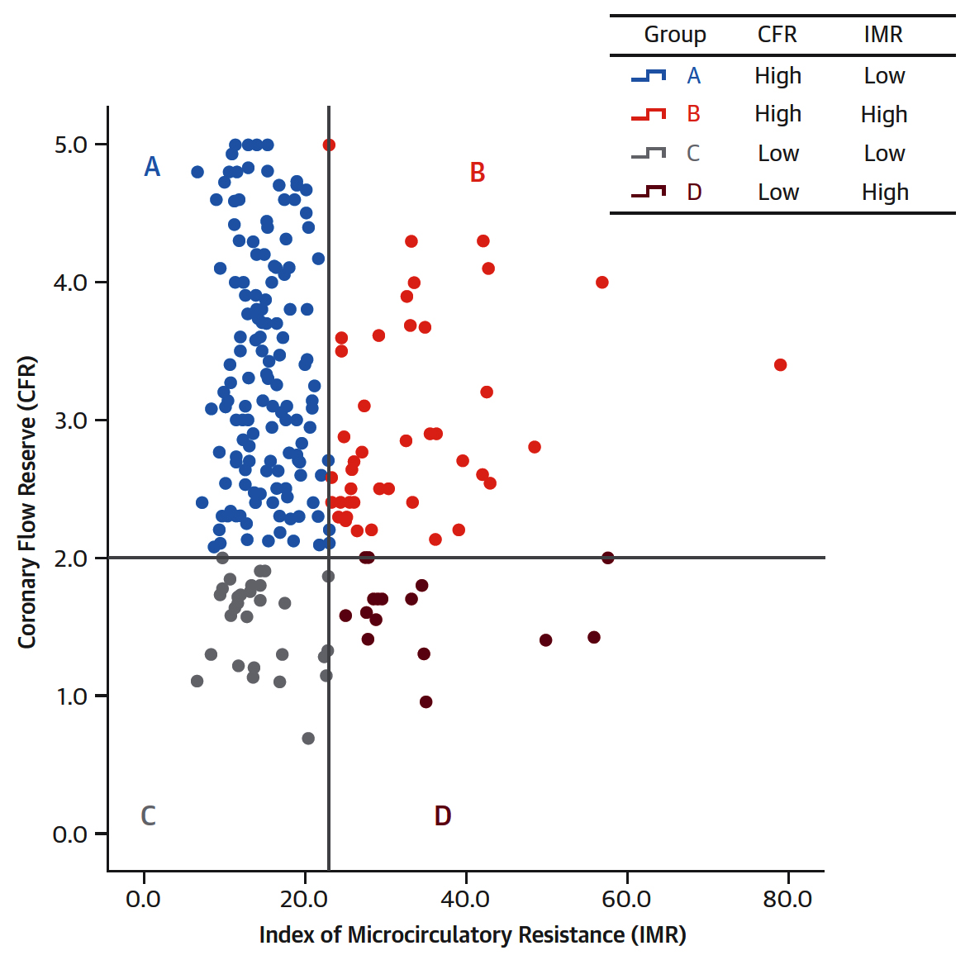
4 Patterns of Microvascular Status According to CFR and IMR Among Pts with High FFR
Lee et al., J Am Coll Cardiol 2016;67:1158

Slide 21
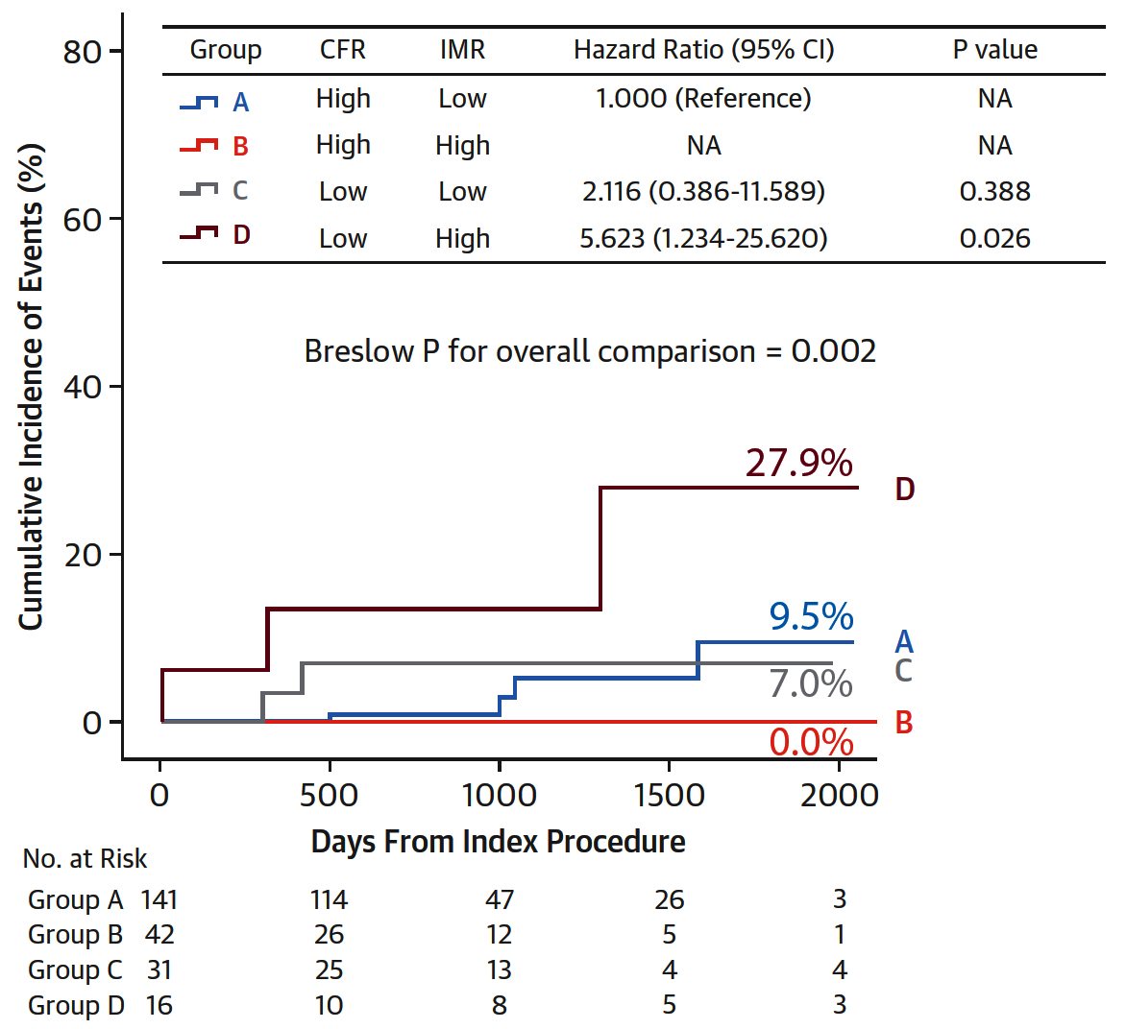
Clinical Outcomes According to Patterns of Microvascular Status Defined According to CFR
and IMR Among Pts with High FFR
Lee et al., J Am Coll Cardiol 2016;67:1158

Slide 22
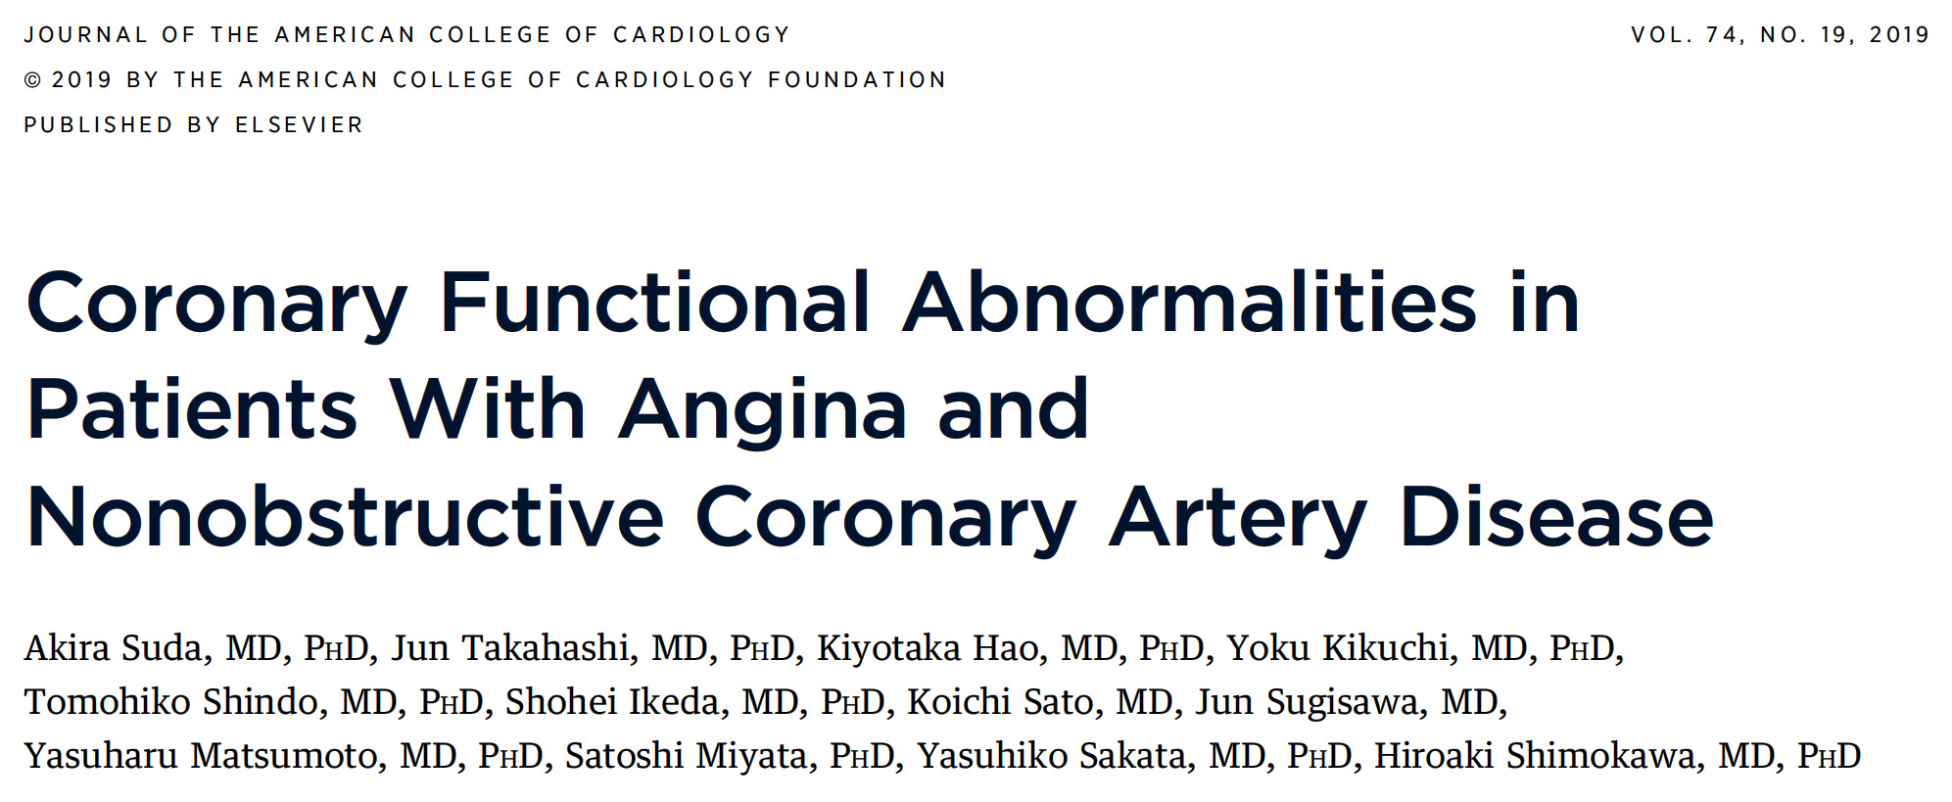

Slide 23
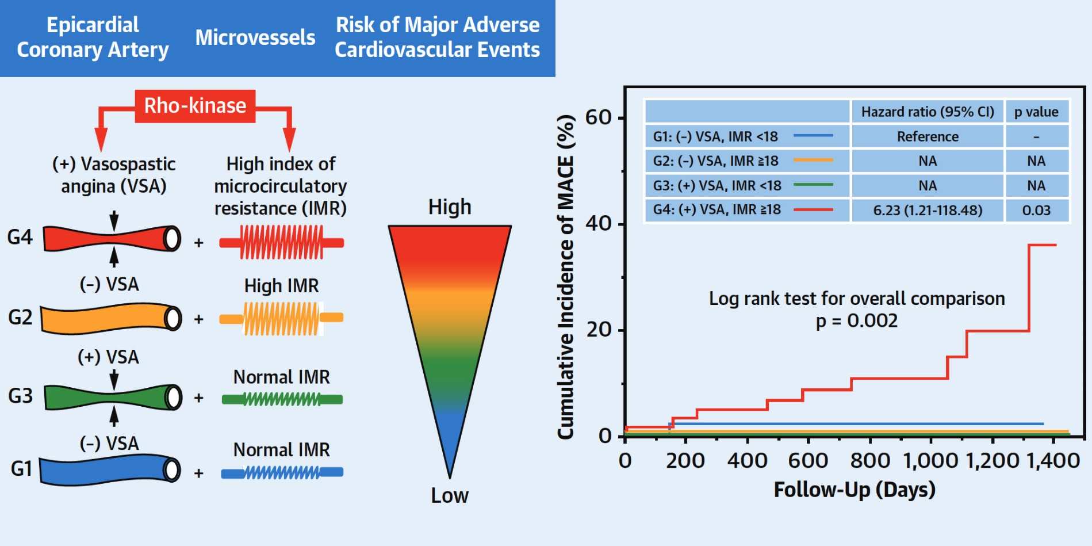
Vasopastic Angina and High Index of Microcirculatory Resistance(IMR): Prognostic Impact of Coexistence
Suda et al., J Am Coll Cardiol 2019;74:2350

Slide 24
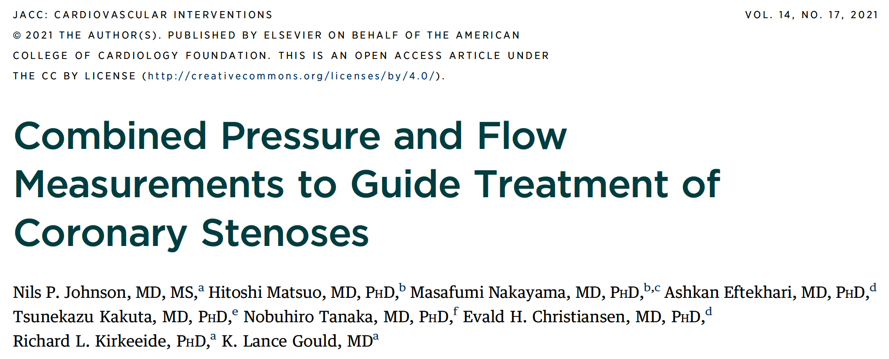
(DEFINE-FLOW Study)

Slide 25
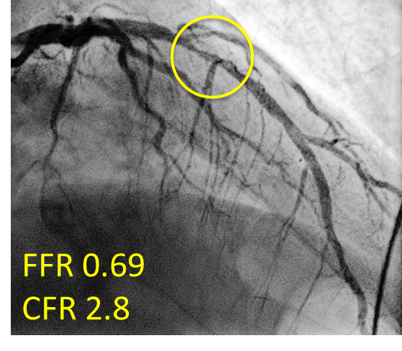
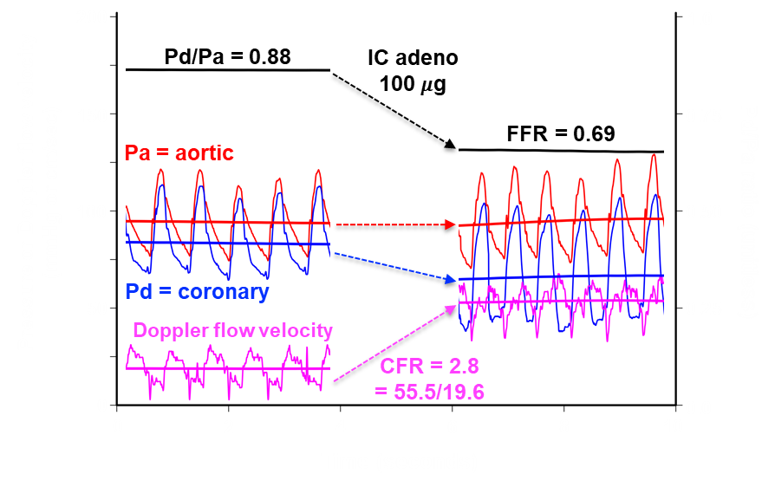
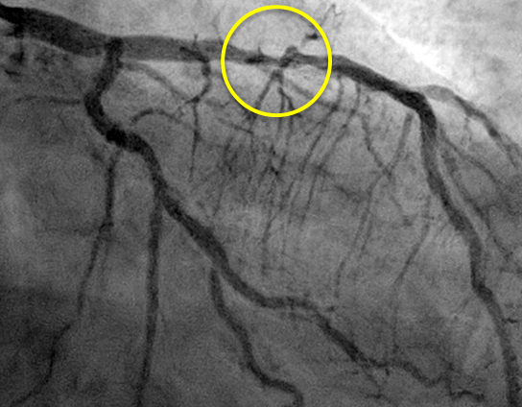
DEFINE-FLOW: How to Treat CFR/FFR Discordance?
57 year-old man with diabetes
and CCS class I angina
Subject FLOW196 from DEFINE-FLOW (clinicaltrials.gov NCT02328820)
Johnson N, TCT Connect 2020

Slide 26
DEFINE-FLOW Study: Treatment Protocol
Measure FFR and CFR
FFR>0.8
Defer PCI
(CFR adds value?)
FFR≤0.8
CFR≥2
Defer PCI!
(key difference))
CFR<2
Perform PCI
Johnson N, TCT Connect 2020

Slide 27
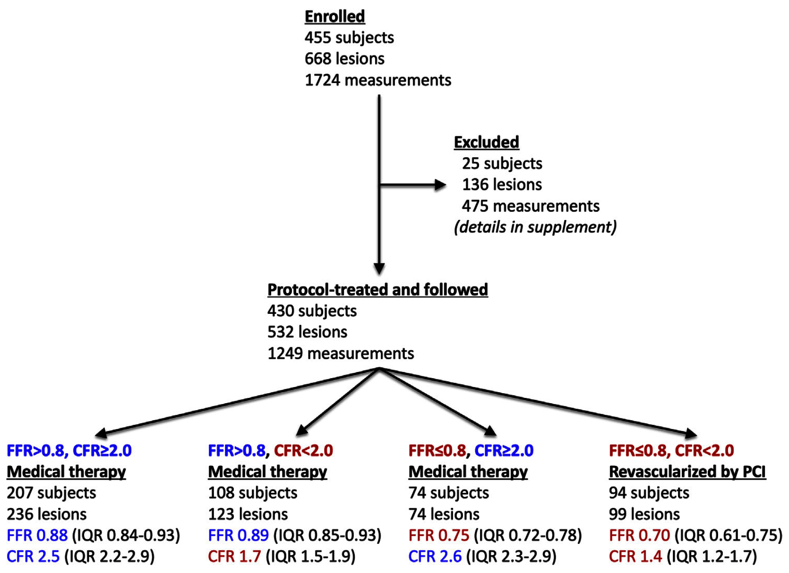
DEFINE-FLOW Study Flow Diagram
Johnson et al., J Am Coll Cardiol Intv 2021;14:1904

Slide 28
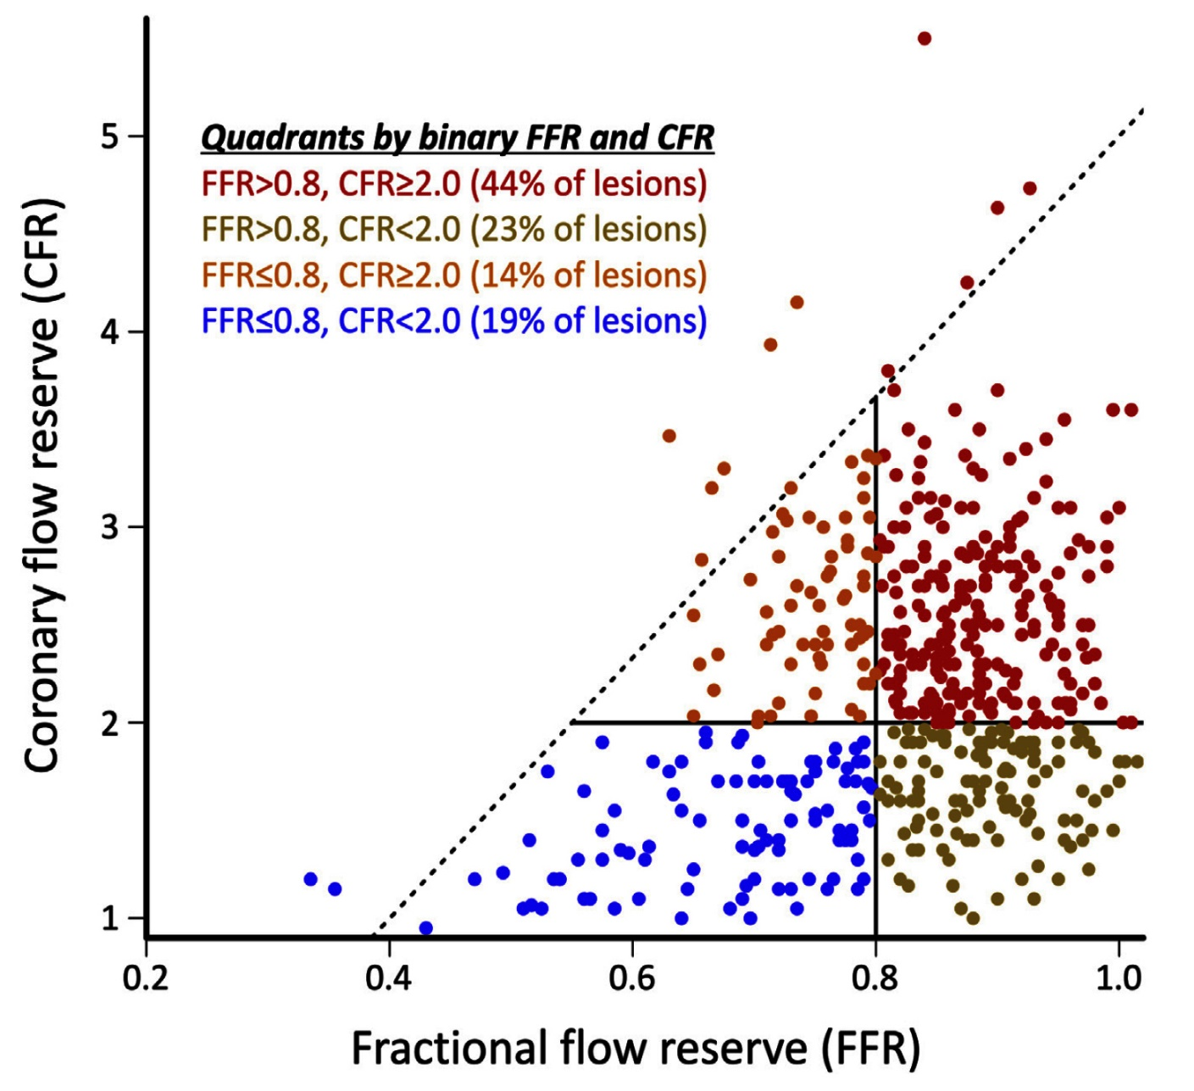
DEFINE-FLOW Study: Scatterplot of Combined
FFR and CFR
depicts the triangular relationships between simultaneous, continuous FFR and CFR
a majority of lesions displayed binary concordance (44% with both intact and 19% with both reduced)
37% of lesions were discordant (14% with intact CFR and 23% with intact FFR)
1
3
4
2
4
1
2
3
Johnson et al., J Am Coll Cardiol Intv 2021;14:1904

Slide 29
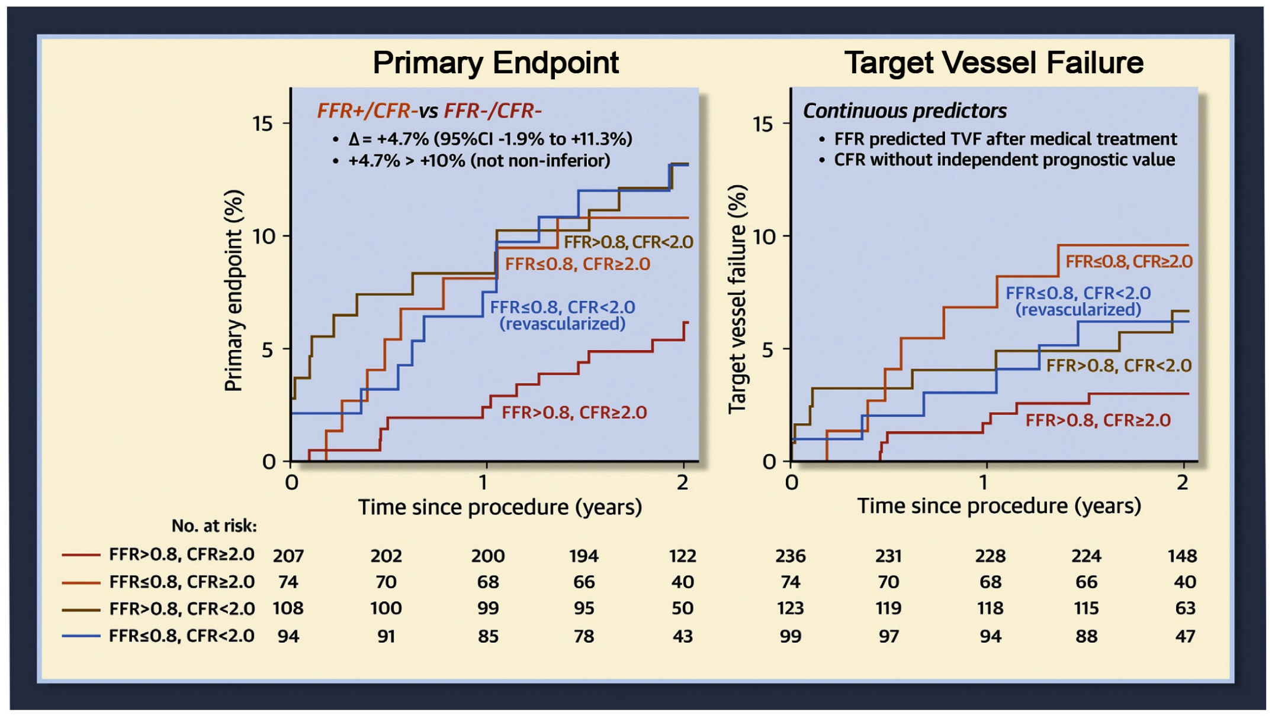
DEFINE-FLOW Study: Clinical Outcomes
Primary endpoint = composite of all-cause death, MI, and revasc (both elective and urgent)
TVF = composite of MI and revascularization
Johnson et al., J Am Coll Cardiol Intv 2021;14:1904

Slide 30
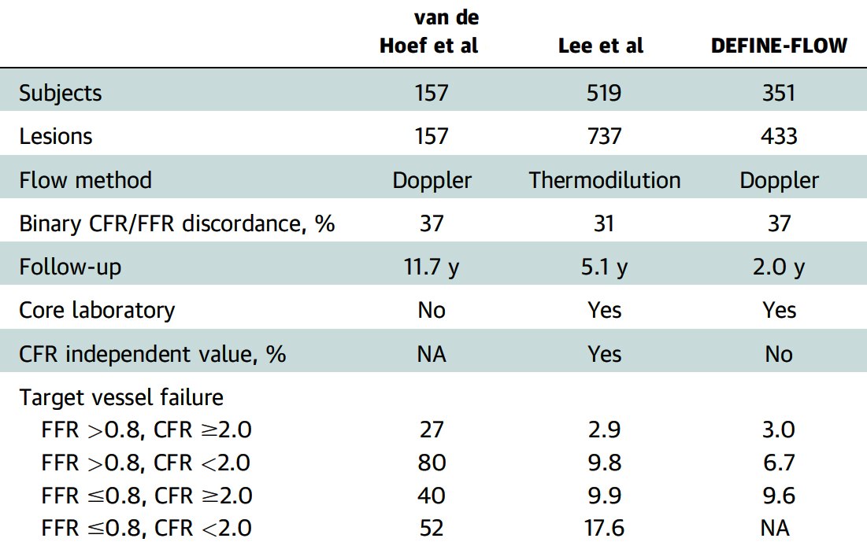
DEFINE-FLOW Study: Summary of Literature Regarding Natural History After Combined FFR/CFR
Johnson et al., J Am Coll Cardiol Intv 2021;14:1904

Slide 31
Inferior

Slide 32
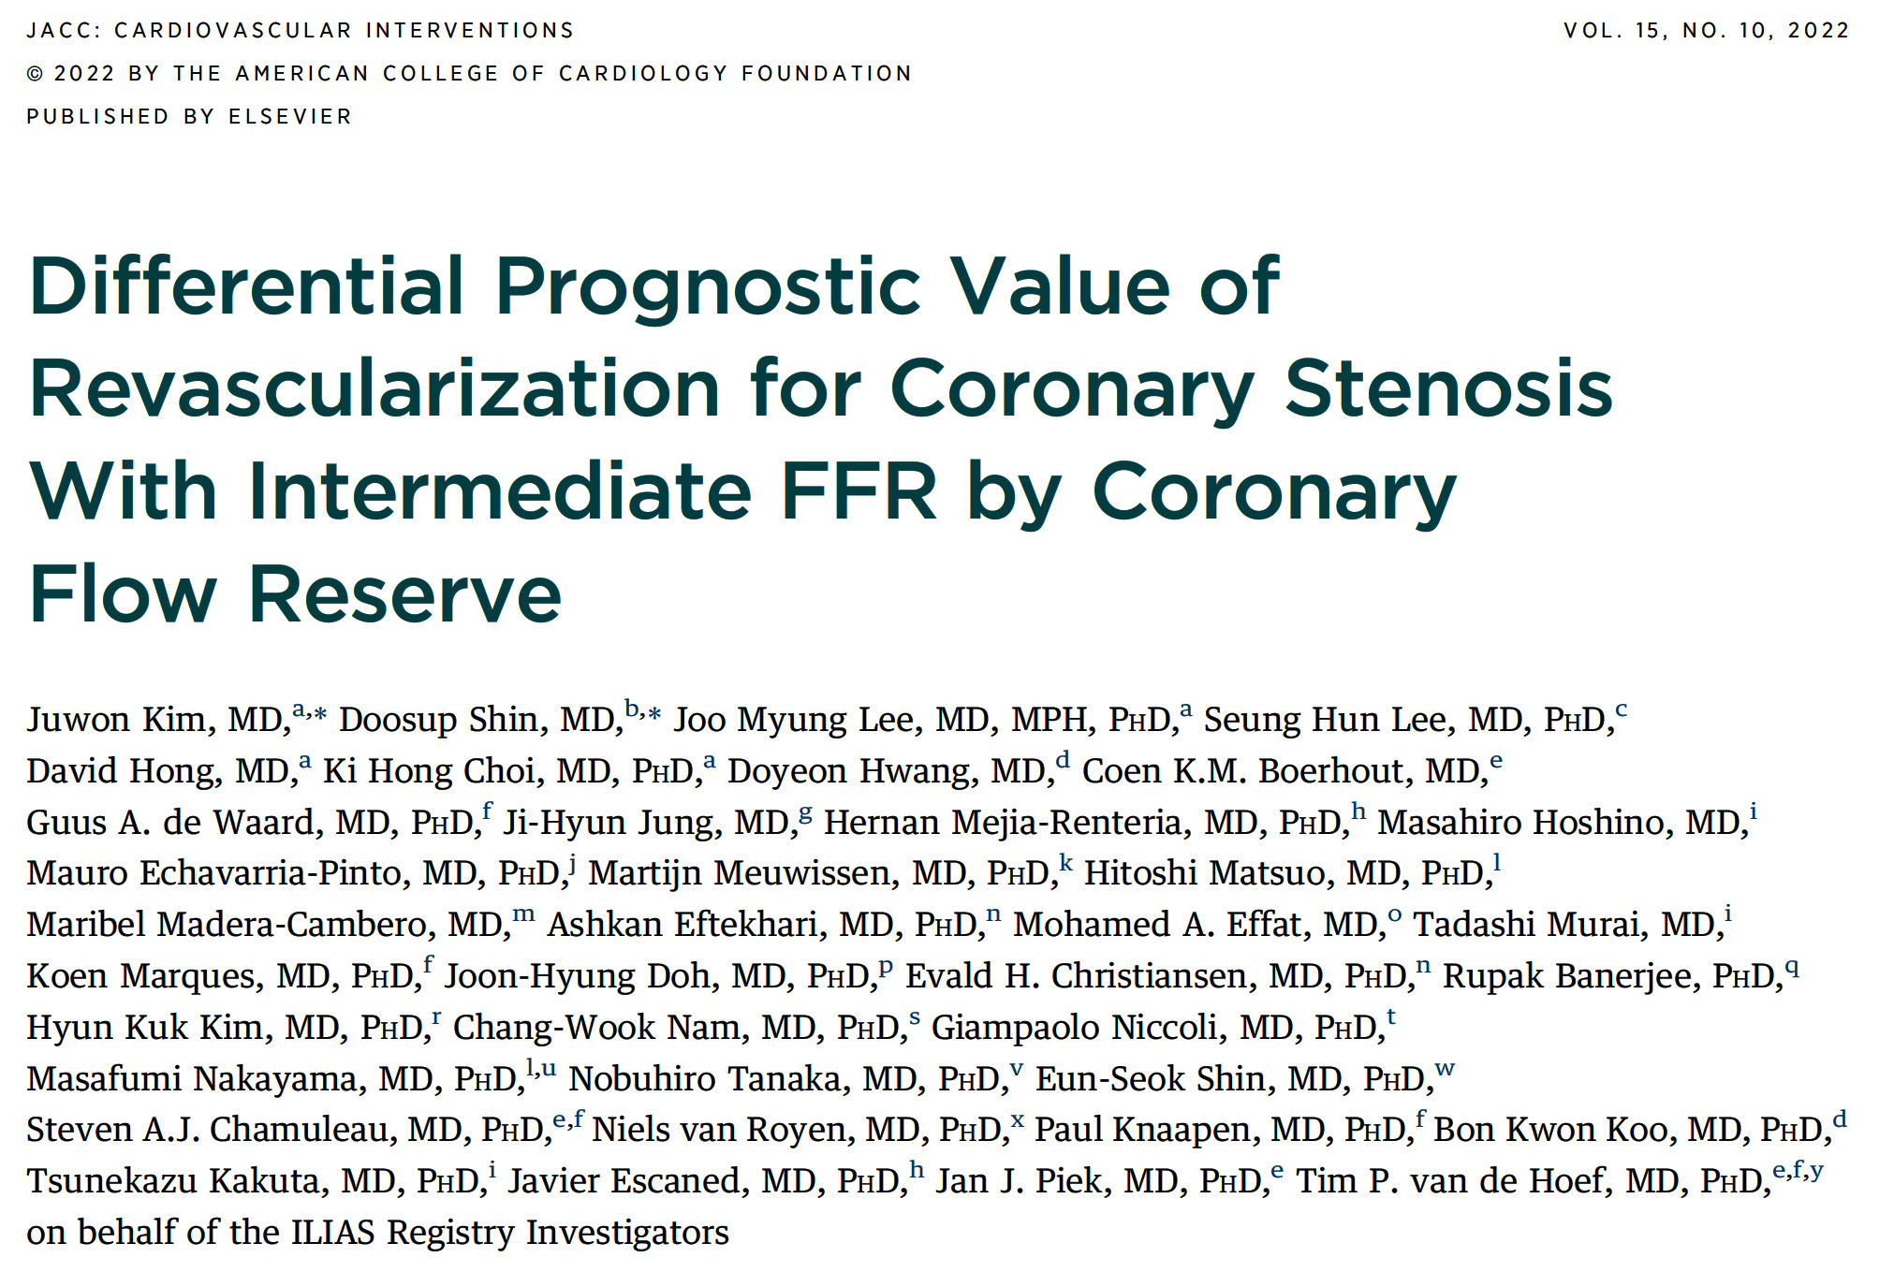

Slide 33
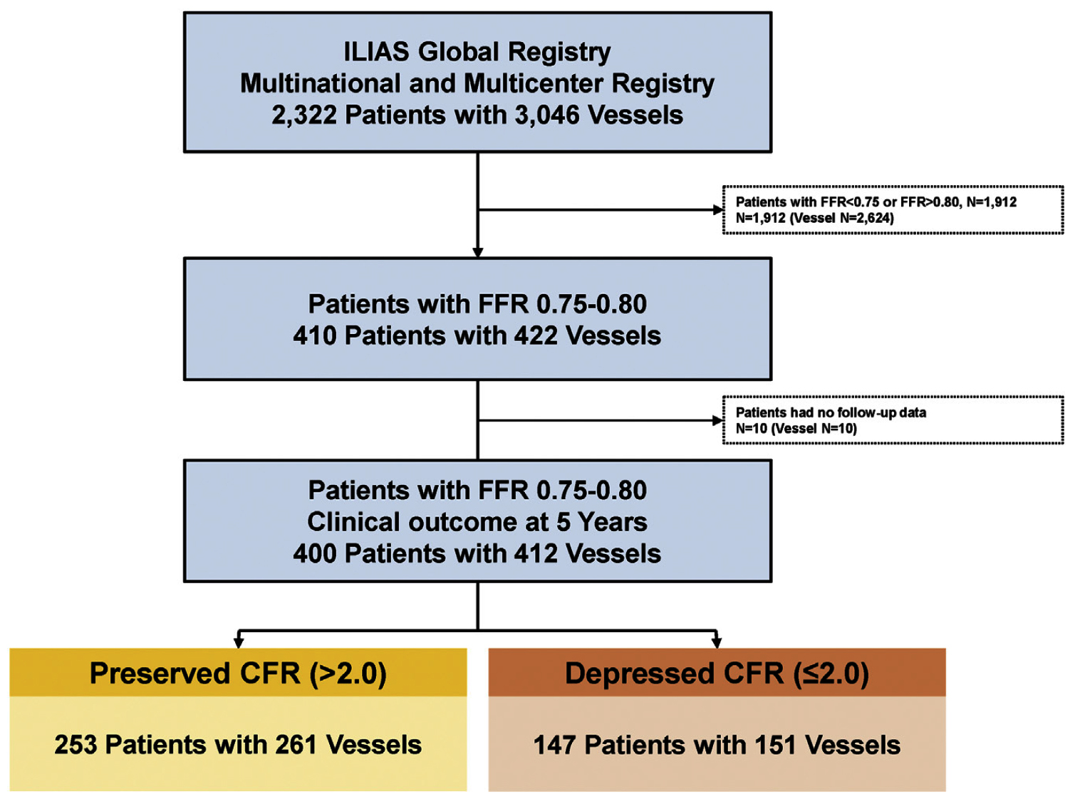
ILIAS Registry Study Flow
Kim et al., J AM Coll Cardiol Intv 2022;15:1033

Slide 34
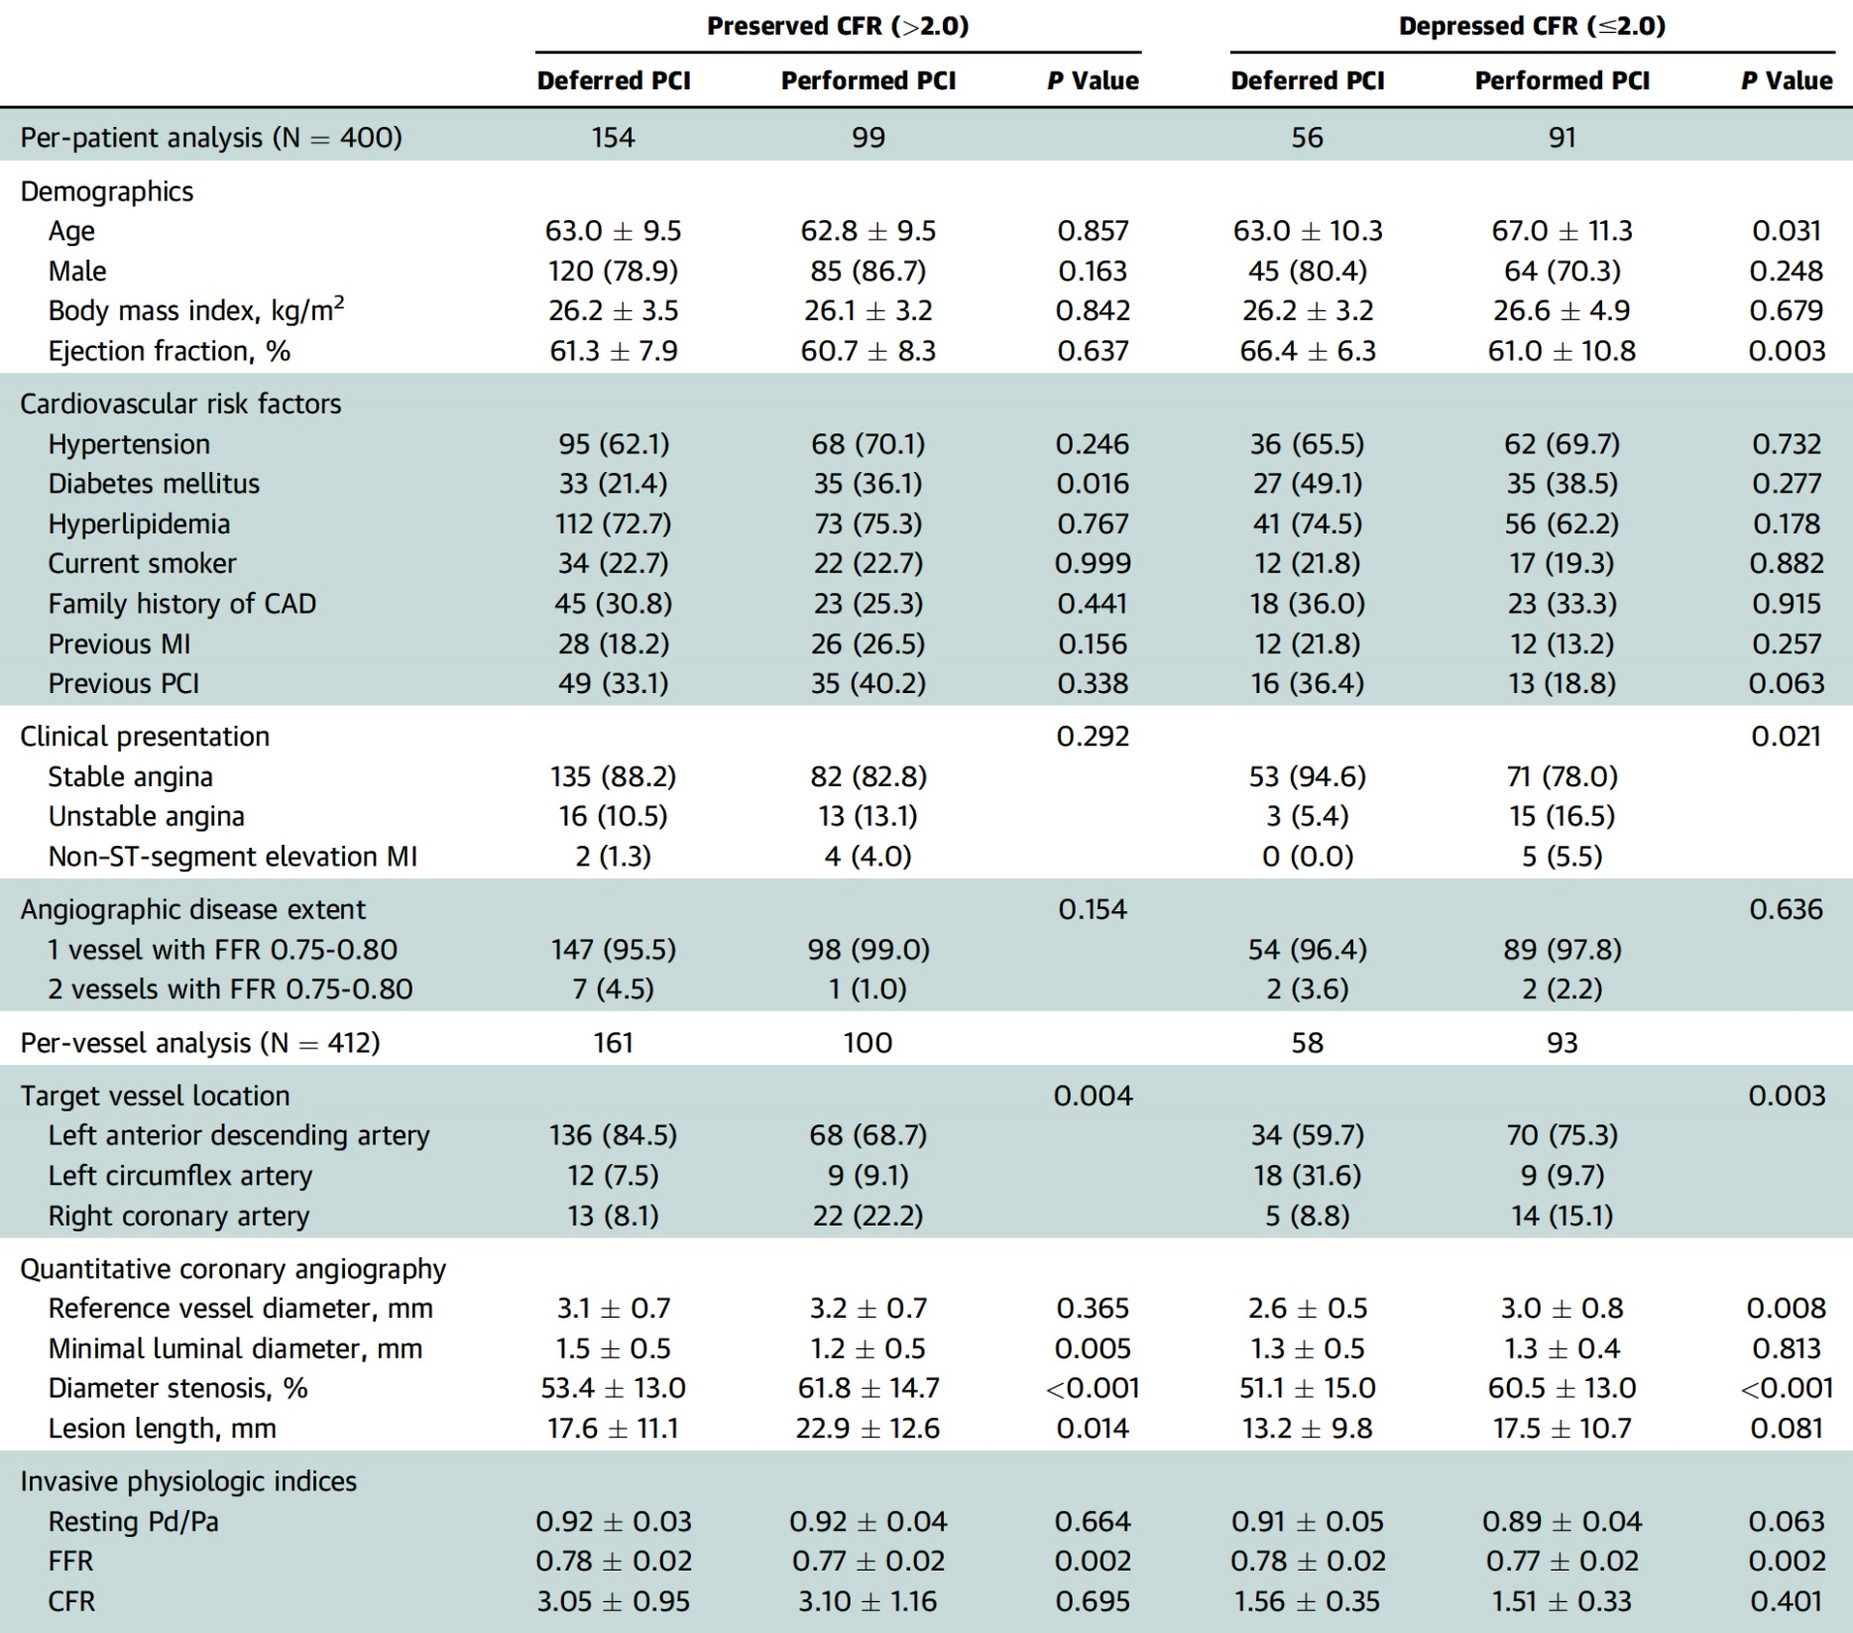
ILIAS Registry: Baseline Characteristics of
Patients and Lesions Between Deferred vs Performed PCI Among Vessels with FFR of 0.75 to 0.80 Stratified by CFR Values
Kim et al., J AM Coll Cardiol Intv 2022;15:1033

Slide 35
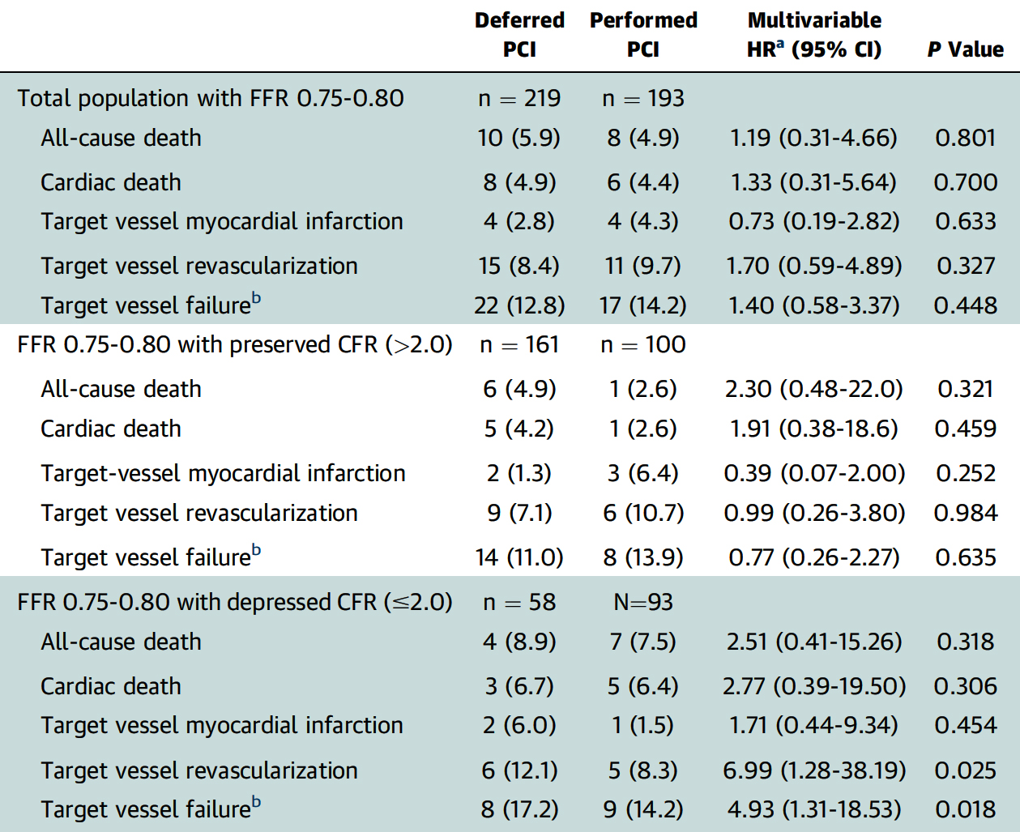
ILIAS Registry: Comparison of Clinical Outcomes Between
Deferred vs Performed PCI Among Vessels with FFR of 0.75 to 0.80 Stratified by CFR Values
Kim et al., J AM Coll Cardiol Intv 2022;15:1033

Slide 36
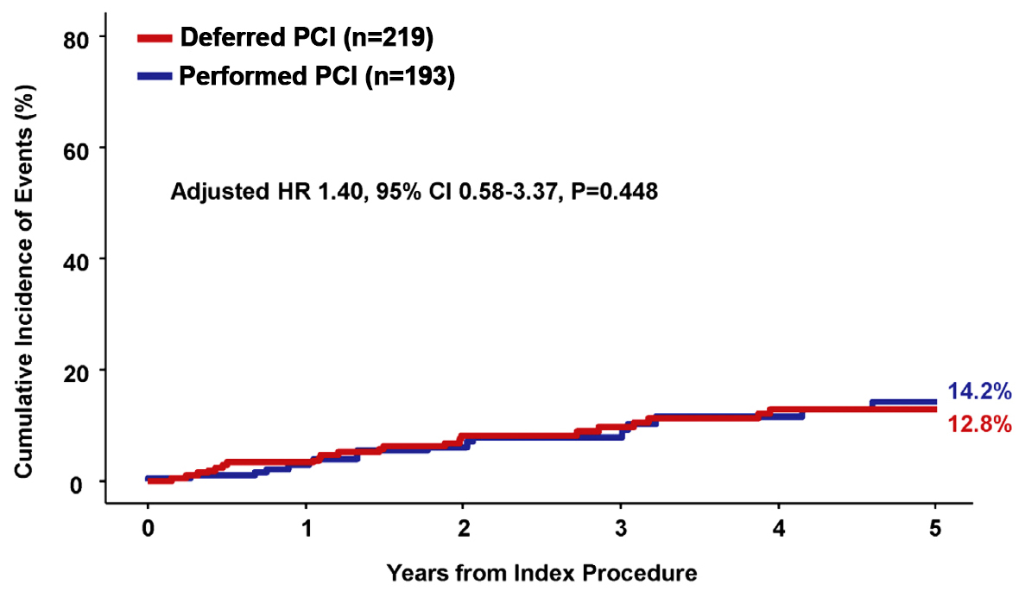
ILIAS Registry: Cumulative Risk of TVF Between the Deferred and Performed PCI Groups Among Vessels with FFR of 0.75 to 0.80
Kim et al., J AM Coll Cardiol Intv 2022;15:1033

Slide 37
ILIAS Registry: Cumulative Risk of TVF Between the Deferred and Performed PCI Groups Among Vessels with FFR of 0.75 to 0.80 Stratified by CFR Values
Kim et al., J AM Coll Cardiol Intv 2022;15:1033

Slide 38
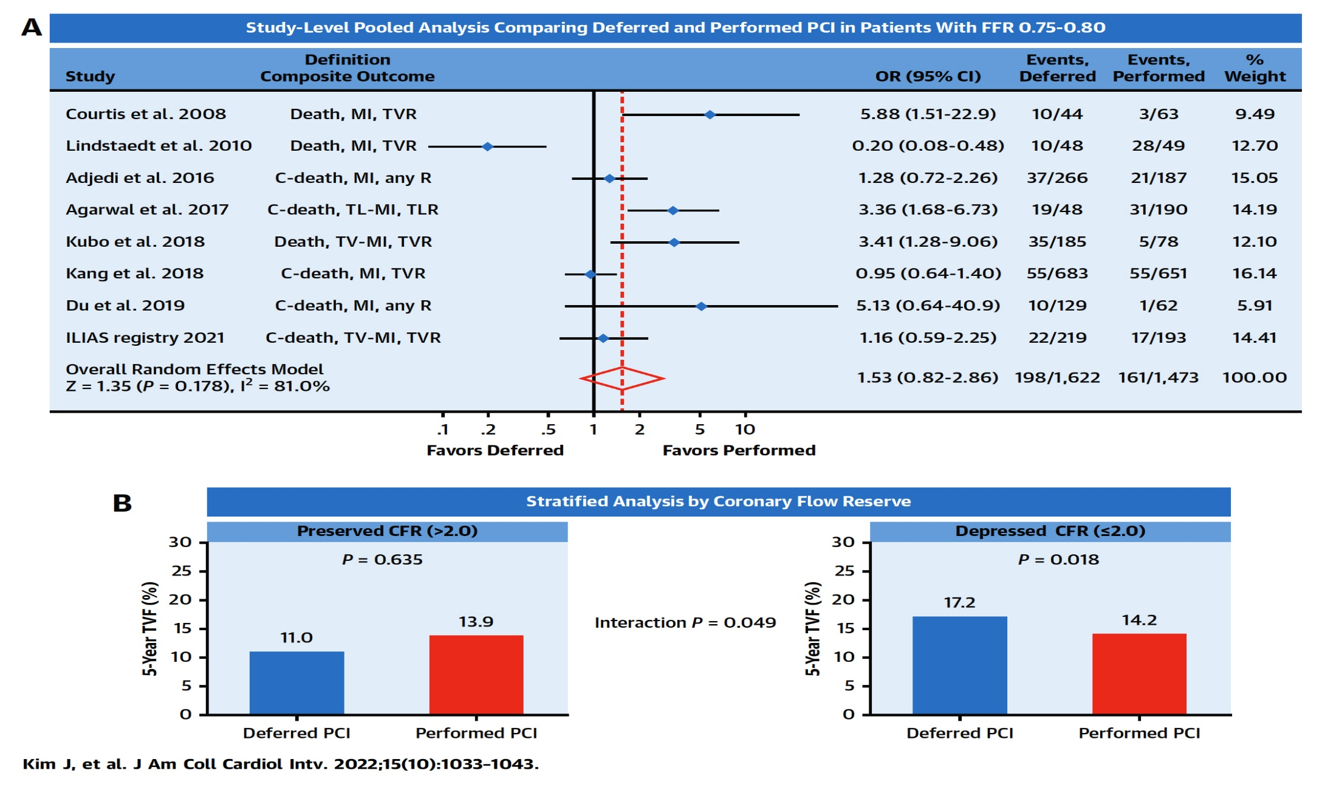
ILIAS Registry: Differential Prognostic value of Revasc for Coronary Stenosis with Intermediate FFR by CFR
Kim et al., J AM Coll Cardiol Intv 2022;15:1033

Slide 40
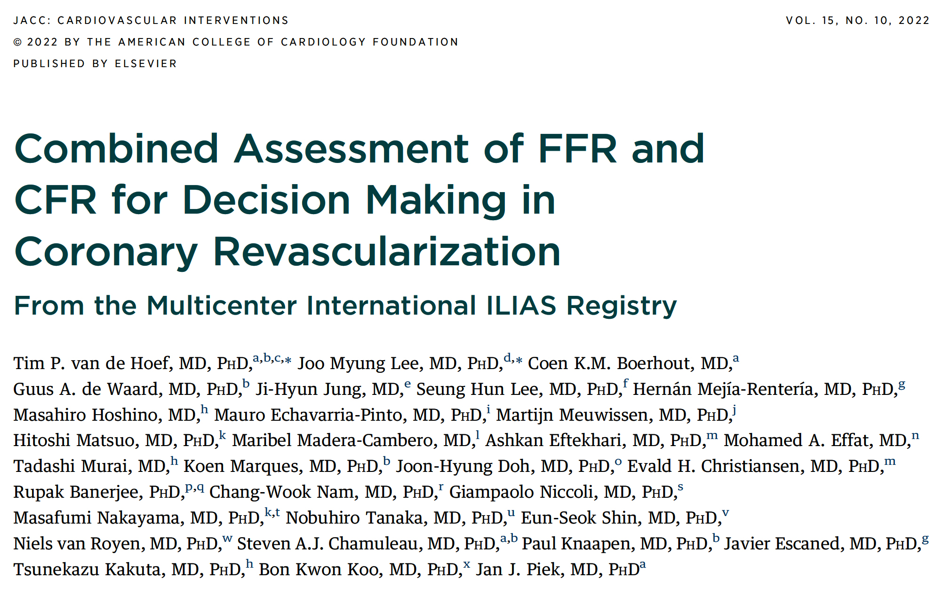

Slide 41
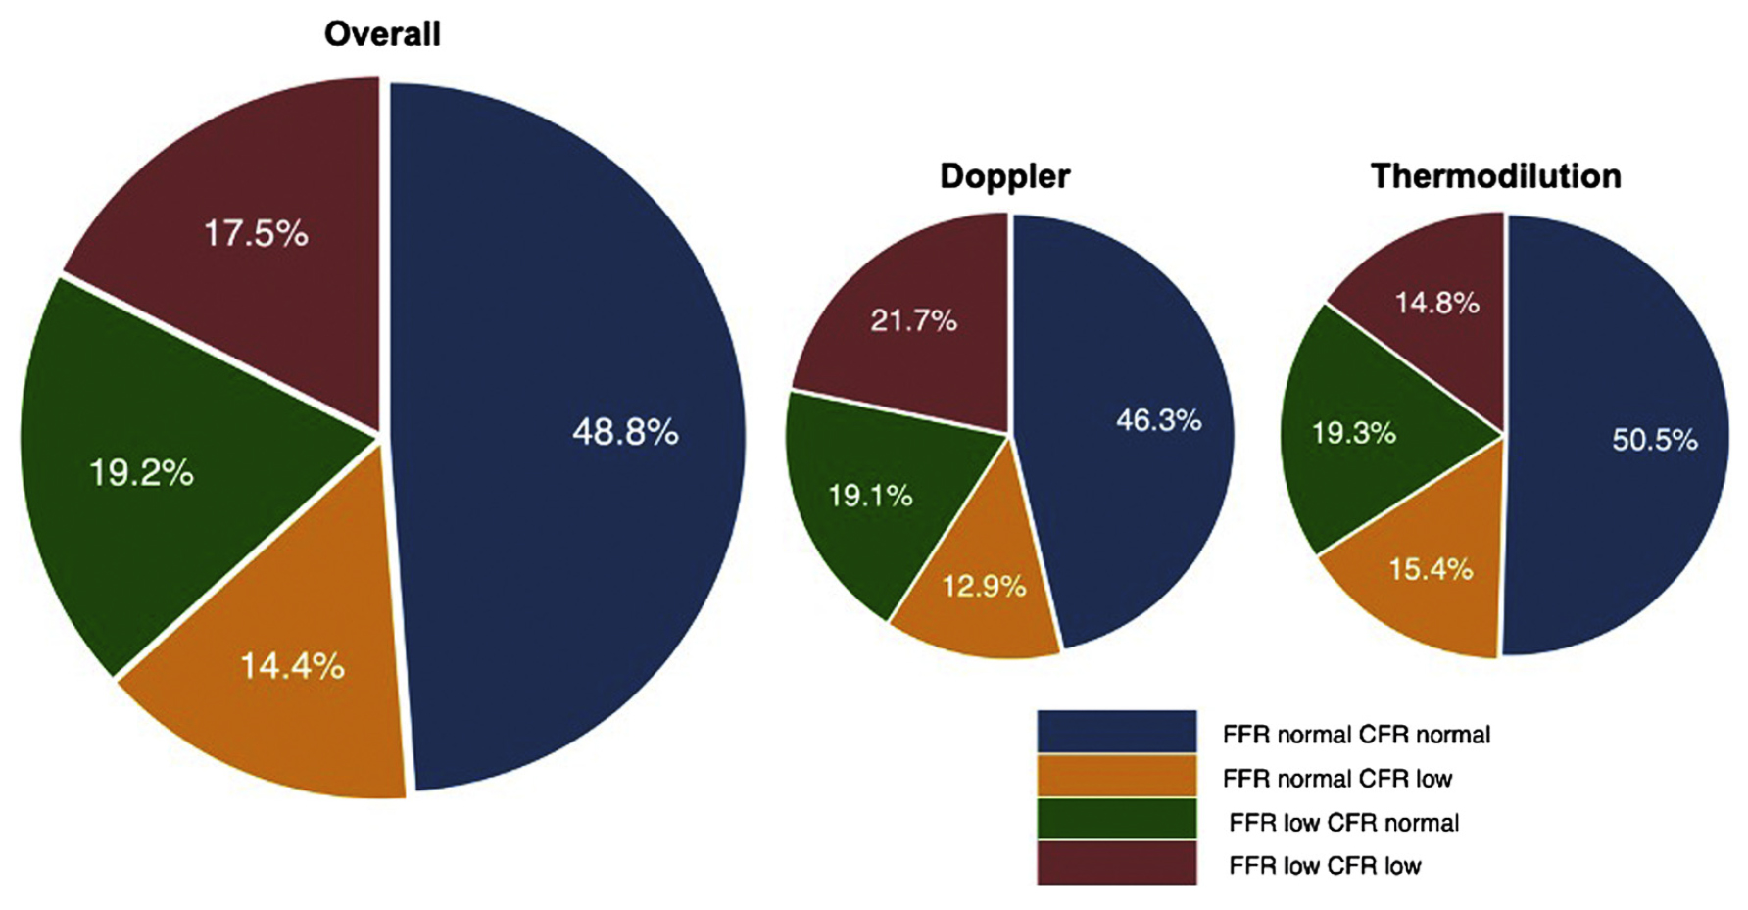
ILIAS Registry: Prevalence of FFR Concordance and Discordance
in the Overall Population and for Measurements Performed with Doppler Flow Velocity or Coronary Thermodilution
van de Hoef et al., J Am Coll Cardiol Intv 2022;15:1047

Slide 42
ILIAS Registry: Five-Year K-M Estimates of TVF and the Individual Components Across Groups Defined by Normal or Abnormal FFR and CFR or Revasc
van de Hoef et al., J Am Coll Cardiol Intv 2022;15:1047

Slide 43
ILIAS Registry: Five-Year K-M Estimates of TVF and the Individual Components Across Groups Defined by Normal or Abnormal FFR and CFR or Revasc
%
FFR Normal, FFR Normal, FFR Abnormal, FFR Abnormal,
CFR Normal CFR Abnormal CFR Normal CFR Abnormal
van de Hoef et al., J Am Coll Cardiol Intv 2022;15:1047

Slide 44
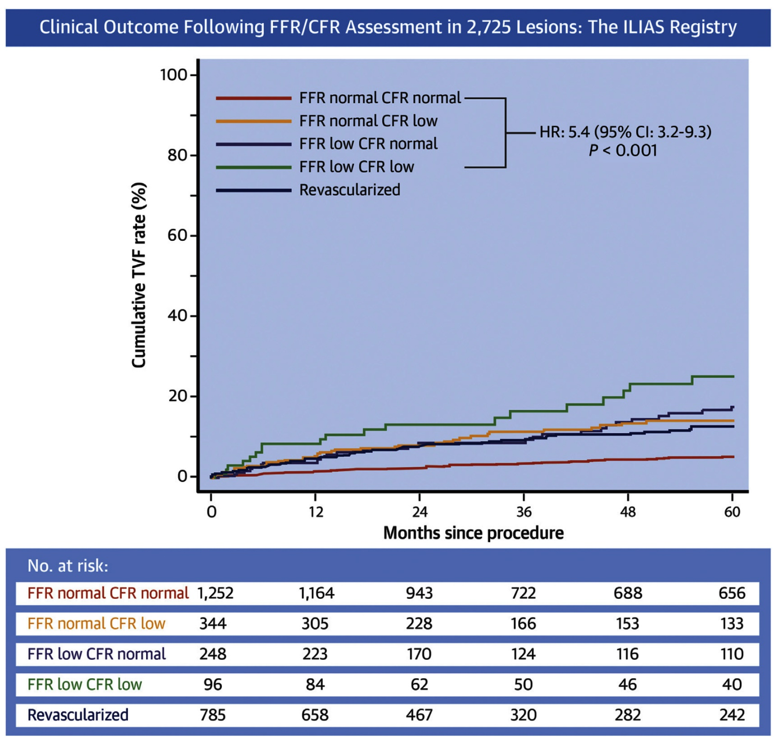
ILIAS Registry: Target Vessel Failure Over 5 Years
van de Hoef et al., J Am Coll Cardiol Intv 2022;15:1047

Slide 46
FFR/iFR+; not much more needed
FFR/iFR-; CFR may further risk stratify
FFR/iFR – and IMR + may explain chest pain
Comprehensive Invasive Coronary Evaluation of Suspected Cardiac Pain
 | Structural Coronary Angiography | Functional Coronary Angiography
Macrovascular Dysfunction (Epicardial Artery) | Is there a tight stenosis? (any late filling collaterals) What are the lesion characteristics? (IVUS/OCT) Is there a muscle bridge? | Is the stenosis obstructive? (FFR/iFR/RFR) Is the stenosis fixed or dynamic? (lesion response to IC nitrates) Is there inducible spasm? (>90% constriction to IC Ach bolus)
Microvascular Dysfunction | Is there impaired contrast flow (slow flow)? (TIMI flow grade 2/TIMI frame count) | Is there appropriate microvascular hyperemia response? (IV/IC adenosine-CFR, microvascular resistance, IMR) Is there an inappropriate microvascular constrictor response? (IC Ach bolus-ischemia in absence of epicardial spasm)

Slide 47
Latest Issues in Coronary Intervention
Differential impact of CFR and FFR during PCI:
DEFINE-FLOW Study, ILIAS Registry for
Revasc based on FFR with CFR Interaction
Focused review of the month
Myocardial Infarction in Young Age:
Causes, Angiographic characteristics, and
Management of Premature Myocardial Infarction

Slide 48
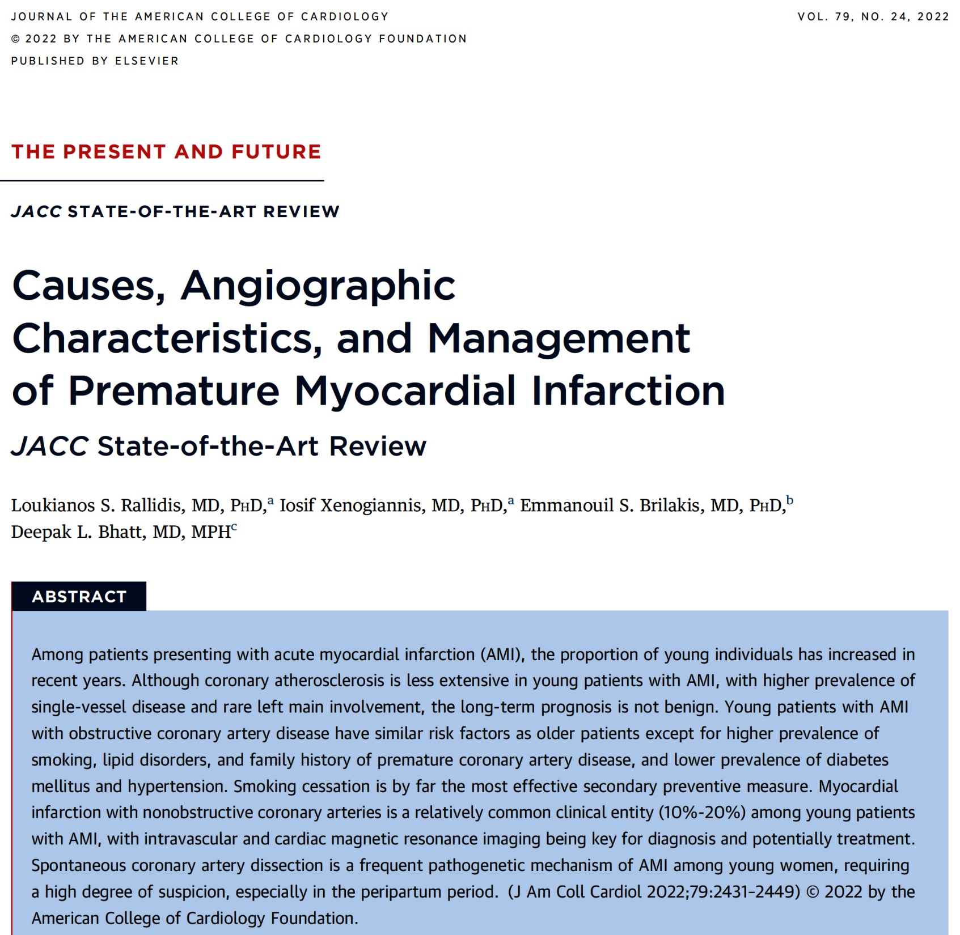
(Age <45 yrs)

Slide 49
Characteristics of Coronary Artery Involvement in Patients With Premature Acute Myocardial Infarction
Young individuals have less extensive disease compared with older patients.
Approximately 1 in 8 patients has nonobstructive (<50%) atheromatous plaques (MINOCA). The lower the age, the higher the prevalence of MINOCA.
Approximately one-half of patients have single-vessel disease.
The left anterior descending coronary artery is the most frequently involved artery.
Left main disease is uncommon (<5%).
Young women are more likely to have MINOCA and less likely to have multivessel disease compared with men.
Spontaneous coronary artery dissection accounts for up to 35% of women with AMI <50 years of age, particularly peripartum.
Rallidis et al., J Am Coll Cardiol 2022;79:2431

Slide 50
Major Studies Describing Angiographic Characteristics in Young Patients with AMI
Rallidis et al., J Am Coll Cardiol 2022;79:2431

Slide 51
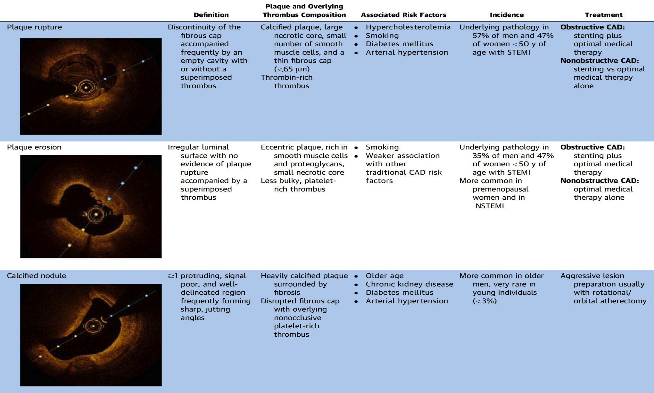
Characteristics of Unstable Coronary Plaque Types
in Young Patients with Acute Coronary Events
Rallidis et al., J Am Coll Cardiol 2022;79:2431

Slide 52
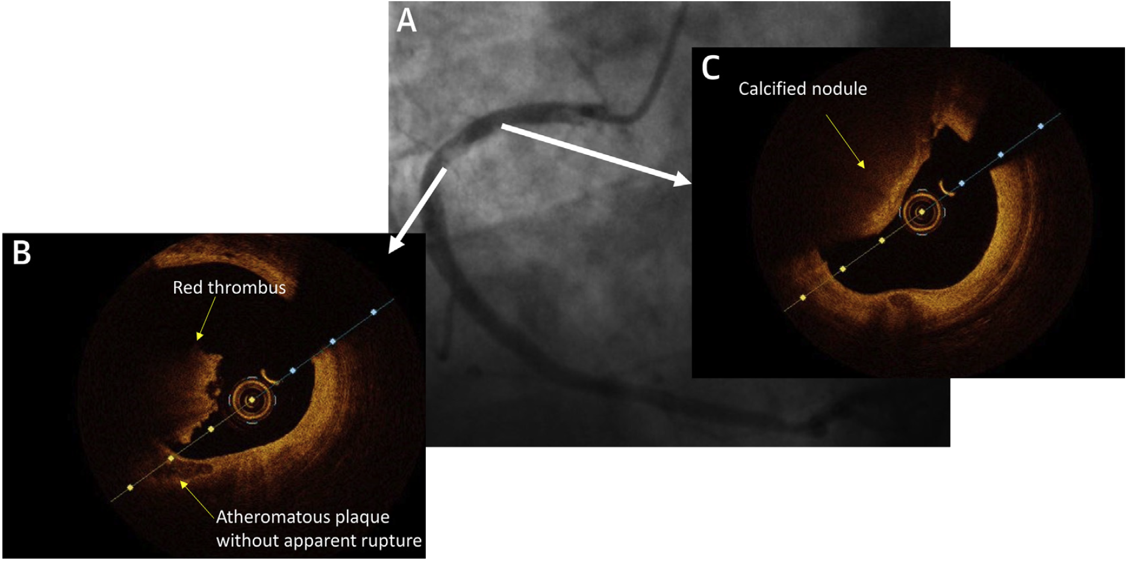
Plaque Erosion as the Underlying Mechanism of MI With Non-obstructive Coronary Arteries
50 yr old male presented with retrosternal chest pain and intermittent ST-segment elevation in the inferior leads
angio showing atheromatous RCA with no significant stenoses and an area of haziness in proximal segment
calcific nodule apparent a few mm proximally. No intervention performed
OCT showing atheromatous plaque with an intact fibrous cap and a superimposed red thrombus (plaque erosion)
Rallidis et al., J Am Coll Cardiol 2022;79:2431

Slide 53
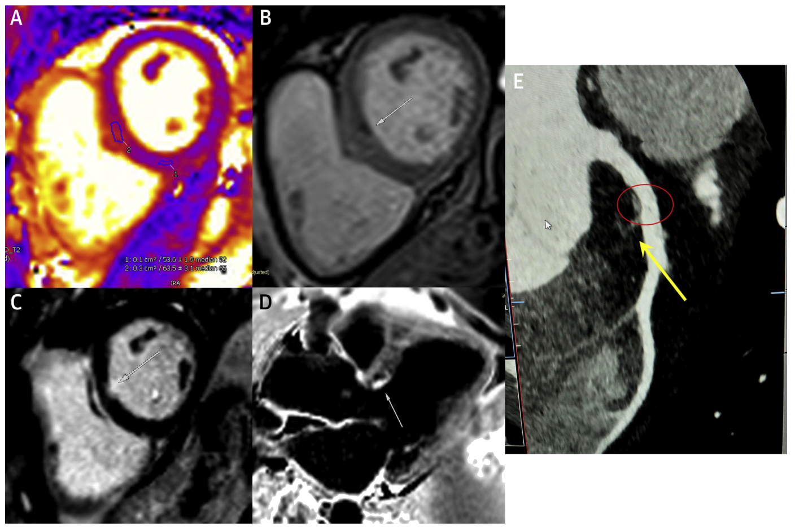
Multimodality Imaging in Myocardial Infarction
with Nonobstructive Coronary Arteries
40 yr old female presented with chest pain and elevated troponin I.
angio showing no stenosis. CMR T2 mapping showing focal area of increased T2 signal, suggesting local edema at basal anteroseptum
early gadolinium imaging showed discrete subendocardial area of microvascular obstruction (arrow).
late gadolinium imaging confirm discrete subendocardial infarction at same location of B (bright-blood imaging)
late gadolinium imaging confirm discrete subendocardial infarction at same location of B (dark-blood imaging)
coronary CTA demonstrated nonobstructive atherosclerotic plaque involving prox LAD coronary artery (red circle) that caused embolism to the first septal branch (yellow arrow)
Rallidis et al., J Am Coll Cardiol 2022;79:2431

Slide 54
Postpartum Spontaneous Coronary Artery Dissection
36 yr old female presented with retrosternal chest pain 2 months after labor
Initial ECG showed ST-segment elevation in leads V₃ to V₆
A & B – Coronary angio showed a long (>20 mm) lesion causing 95% stenosis in mid
LAD compatible with spontaneous coronary artery dissection type 2 (yellow arrows)
C – Patient treated medically with DAPT and a ẞ-blocker and underwent follow-up
angio 6 months later that revealed vessel healing
Rallidis et al., J Am Coll Cardiol 2022;79:2431

Slide 55
More Frequent Lipid Disorders in Patients With Premature Acute Myocardial Infarction
High LDL-C levels (prevalence of clinically defined heterozygous familial hypercholesterolemia: 10%-20%)
Low HDL-C levels
High Lp(a) levels (1 in 3 patients has Lp(a) >50 mg/dL)
High non-HDL-C levels
Functionally impaired HDL particles (less antioxidant capacity)
Rallidis et al., J Am Coll Cardiol 2022;79:2431

Slide 56
Gender Issues: Characteristics of Women and Men With Premature Acute Myocardial Infarction
vs
Atheromatous plaque characteristics Culprit: erosion more common Nonculprit: fewer, shorter, more stable | Angiographic findings Nonobstructive CAD more common Higher prevalence of SCAD Higher percentage of 1 V CAD Higher prevalence of CCA | Management Less likely to receive evidence-based medication Less likely to undergo angiography More likely to be treated conservatively, without revasc
Rallidis et al., J Am Coll Cardiol 2022;79:2431

Slide 57
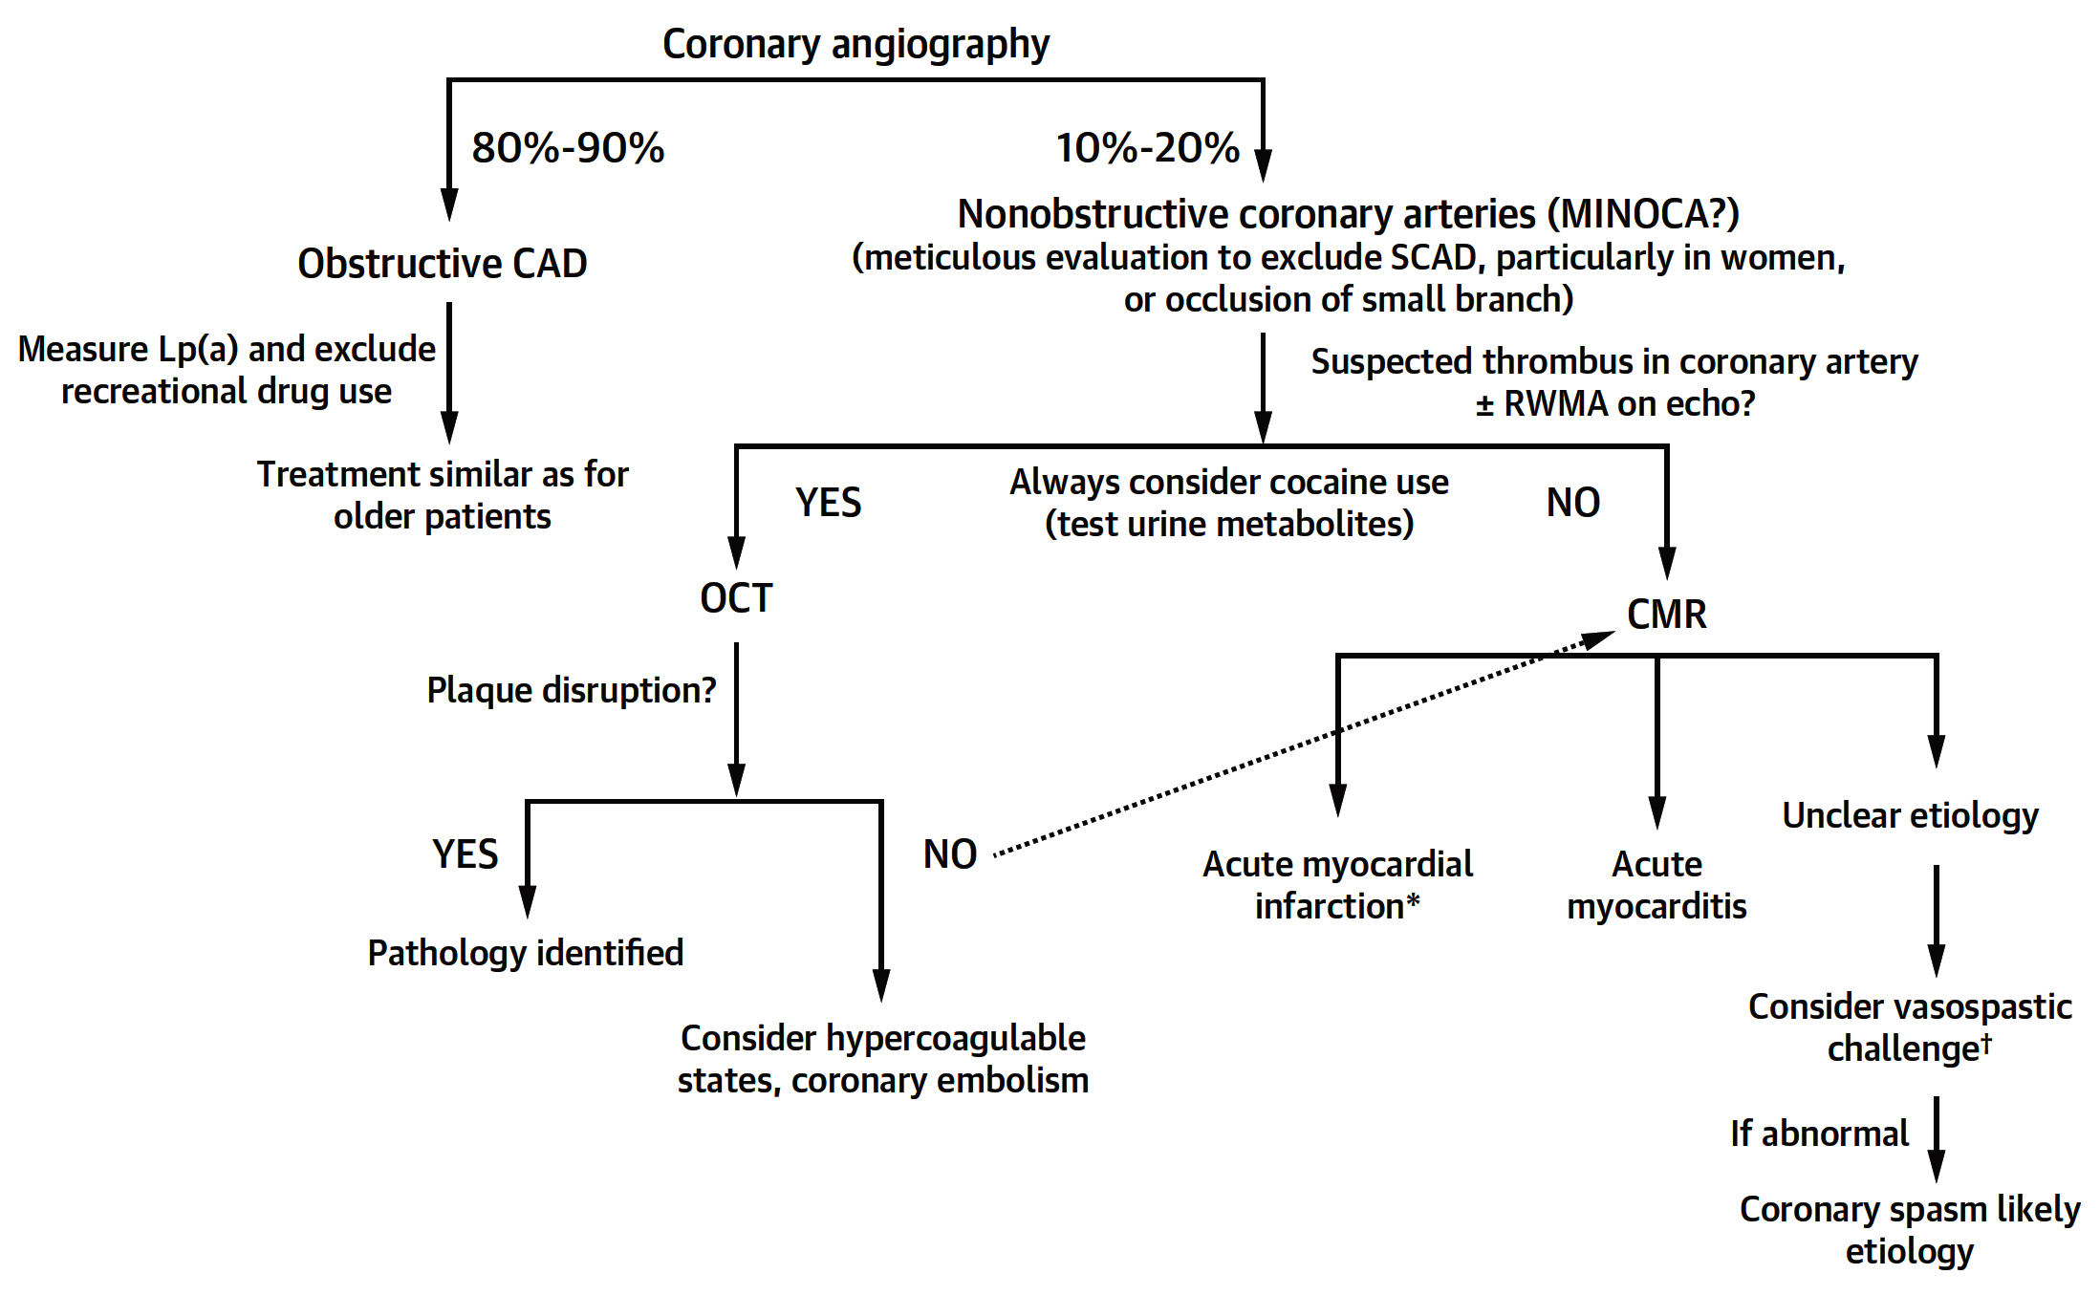
Diagnostic Algorithm for Premature Acute Myocardial Infarction
Rallidis et al., J Am Coll Cardiol 2022;79:2431

Slide 58
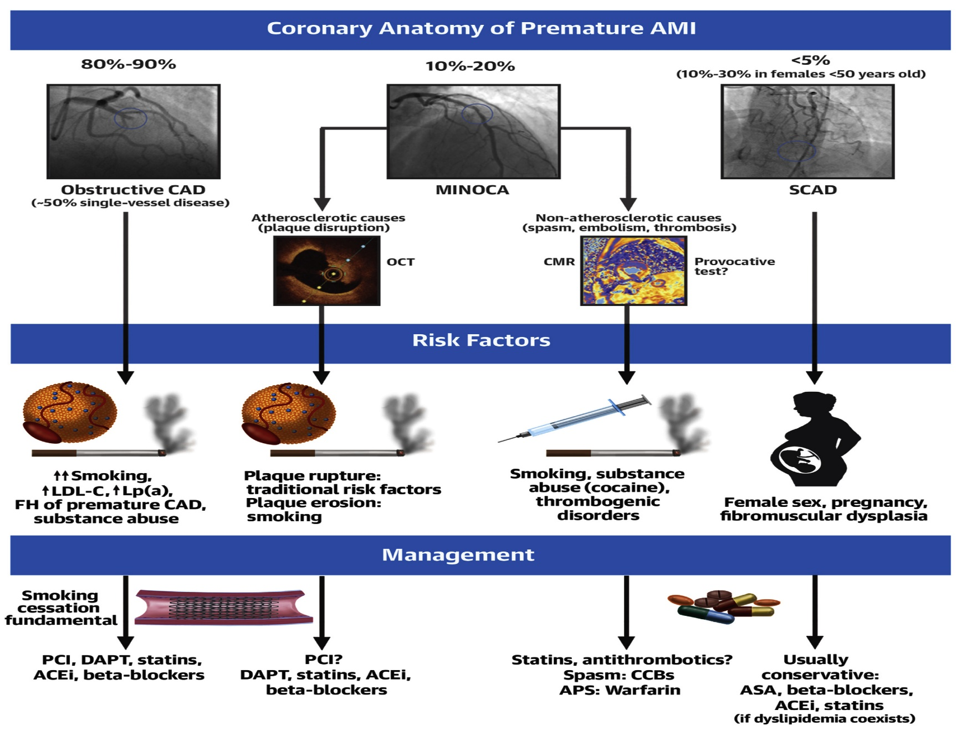
Angiography, Risk Factors, and Management of Premature Acute MI
Rallidis et al., J Am Coll Cardiol 2022;79:2431

Slide 59
Take Home Message: Differential Impact of FFR & CFR during PCI and Features/Management of Premature MI
FFR low and high CFR and PCI outcomes:
Intermediate FFR and high CFR and PCI outcomes:
Utility of combined FFR and CFR, impact of FFR:
Premature myocardial infarction is slowly rising and has different angiographic and lesion characteristics and risk factors. Prompt and accurate diagnosis is important in assessing the cause of MI and tailored treatment with extra emphasis on reduction of risk factors and smoking cessation. Overall managed properly premature MI has good prognosis.
Notes:
HbA1c in

Slide 60
Question # 1
Following is the true statement about the results of the DEFINE-FLOW study evaluating impact of FFR and CFR;
High FFR and high CFR has lowest MACE rates
Low FFR and high CFR had lower MACE rates
Low FFR and high CFR had higher MACE rates
Low FFR and low CFR usually get revascularized
High FFR and low CFR has intermediate MACE rates
The correct answer is C

Slide 61
Question # 2
Following statement is false regarding the results of ILIAS registry measuring FFR and CFR and IMR;
A. Normal FFR and normal CFR has best outcomes
B. Revascularized pts had intermediate outcomes
C. Normal FFR and low CFR has intermediate outcomes
D. Low FFR and normal CFR has intermediate outcomes
E. Low FFR and low CFR has intermediate outcomes
,
The correct answer is E

Slide 62
Question # 3
Following statement is false regarding the mechanism of premature MI:
Plaque erosion need not to be best treated by stenting
Plaque rupture is a common event
Spontaneous coronary dissection is common in females
Calcified nodule occurs in >50% of cases
Plaque erosion is common
The correct answer is D

