Slide 1
Structural Heart Live Cases
Supported by:
Medtronic Inc.
Abbott Inc.
Bard Inc.
Cook Inc.

Slide 2
Faculty Involved and Disclosures
Samin K. Sharma, MD, FACC, MSCAI
Speaker’s Bureau – BSC
Annapoorna S. Kini, MD, FACC
Nothing to disclose
Sahil Khera, MD, FACC
Nothing to disclose
Farzan Filsoufi, MD, FACC
Nothing to disclose
Stamatios Lerakis, MD, PhD, FACC, FAHA
Nothing to disclose
Gilbert Tang, MD, MSc, MBA, FACC [Moderator]
Physicain Proctor for Medtronic
Cardiac Anesthesiologist
Joseph Larese, MD

Slide 3
Structural Heart Live Case # 48: RR, 80 y/o M
Presentation: Chest pain, worsening NYHA Class III symptoms of heart failure for last few months
PMH: Hypertension, hyperlipidemia, non-obstructive CAD, HEpEF, s/p bio-prosthetic aortic valve replacement 2007 (23mm Perimount 2800Valve), peripheral venous stents RLE and LLE 2022 (on AC)
Medications: Lisinopril, Atorvastatin, Furosemide, Rivaroxaban
Labs: Hgb 7.6, PLT 235K, K 4.5, Cr 1.04, INR 1.6
EKG (6/24/22): Sinus rhythm, first degree AV block, PVC, RBBB
TTE (6/23/22): Severe bioprosthetic AS (PG/MG/PV: 85/51/4.6), mild to moderate MR, and mild TR. LVEF 50%.
TEE (6/24/22): Severe bio-prosthetic AS and moderate AI
Cath (6/22/22): Non-Obstructive coronary artery disease

Slide 4
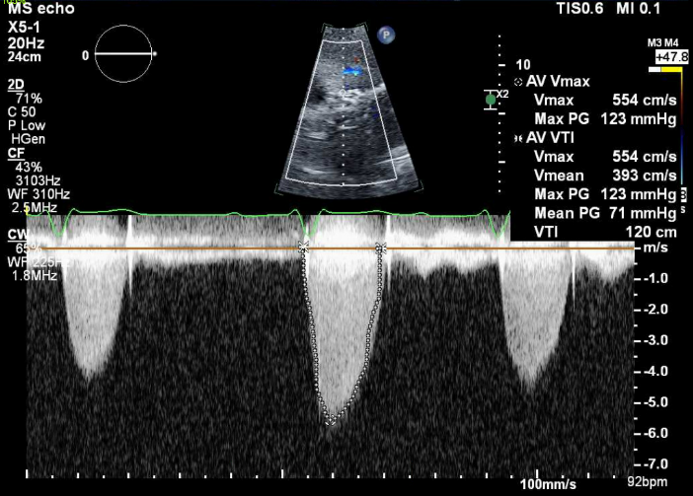
Transthoracic Echocardiogram (TTE)
Doppler to show aortic stenosis

Slide 5
Trans Esophageal Echocardiogram (TEE)

Slide 6
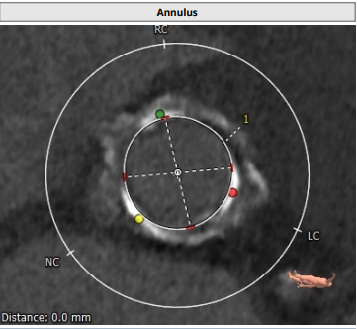
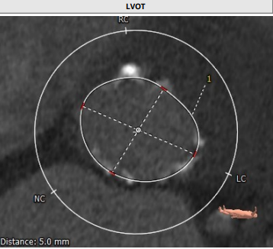
CTA: Aortic annulus, LVOT
Aortic Annulus
Max: 21.3 mm
Min: 20.7 mm
Mean: 21.0 mm
Perimeter = 65.9 mm
Area = 345.6 mm²
LVOT
Max: 30.1 mm
Min: 24.3 mm
Mean: 27.0 mm
Perimeter = 85.5 mm
Area = 570.7 mm²

Slide 7
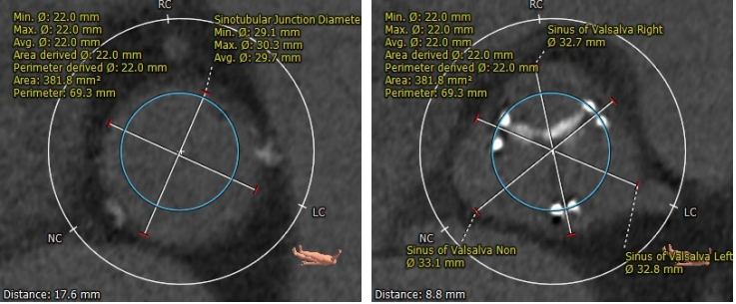
CTA: STJ and SOV
STJ
Min 29.1 mm
Max 30.3 mm
Mean 29.7 mm
Sinus of Valsalva
RCC 32.7 mm
LCC 32.8 mm
NCC 33.1 mm

Slide 8
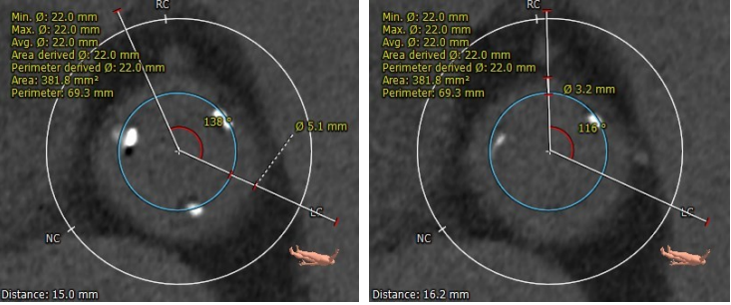
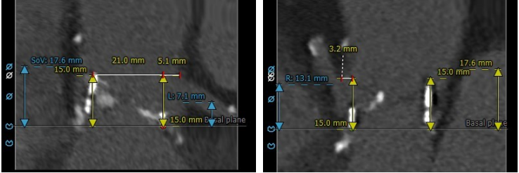
CTA: Valve-To-Coronary (VTC) and Coronary Height
VTC
Left VTC – 5.1 mm
Right VTC – 3.2 mm
Coronary Heights
LM – 7.1 mm
RCA – 13.1 mm

Slide 9
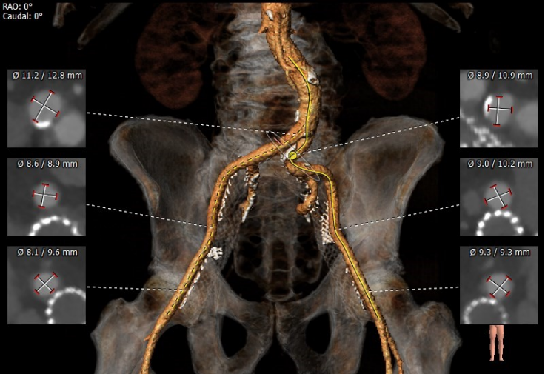
CTA: Vascular Access

Slide 10
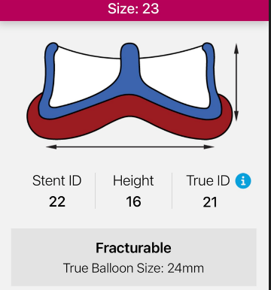
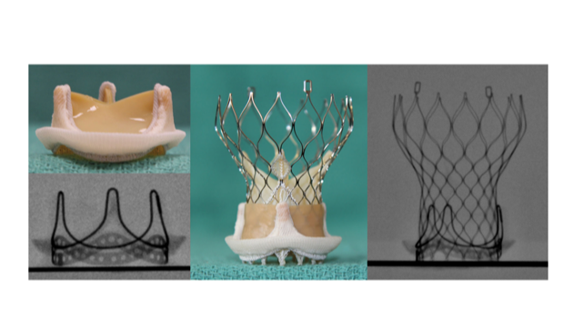
23 mm Perimount 2800 valve with bovine pericardial leaflets sutured “inside” the stent
Suggested ViV Evolut : 26mm
Valve in Valve positioning

Slide 11
Summary of Case
Presentation: 80 year old M with NYHA Class III HF for 4-5 mths
TEE: Abnormal aortic bio-prosthesis with severe stenosis and moderate AI (PG/MG/PV 85/51/4.6, PHT 115 ms), EF 50%
STS risk mortality: 2.97%
Course: Patient was evaluated by Heart Team and determined to be high risk for surgical AVR due to medical comorbidities
Plan: TF ViV TAVR using 26mm Evolut FX in a 23mm Perimount 2800 valve via right percutaneous femoral artery after valve fracture with Sentinel Cerebral Embolic Protection Device

Slide 12
Latest Issues in Transcatheter Structural Heart Interventions
SHD Trials from EuroPCR 2022:
- AMTRAC Registry
- Lyten Trial
- Optimize Pro Study
- Revasc-TAVI Trial
- STROke TAVI Study
- Jenavalve Trilogy TAVI

Slide 13
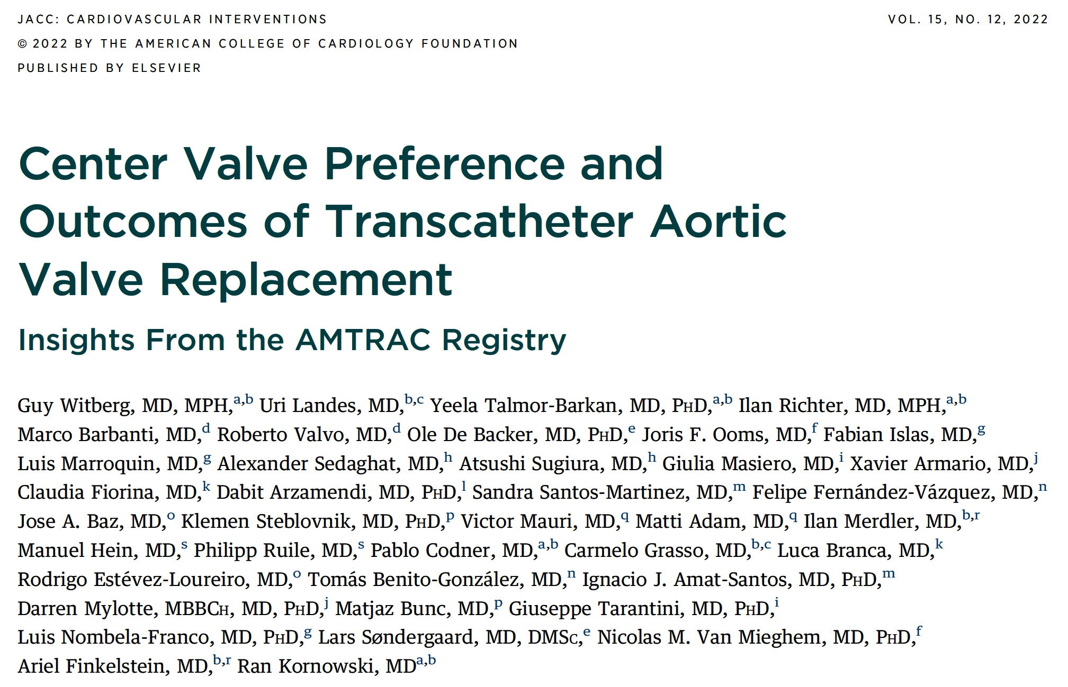

Slide 14
Outcomes from the AMTRAC (Aortic+Mitral Transcatheter) Registry
* p<0.05
Witberg et al., EuroPCR 2022; J Am Coll Cardiol Intv 2022;15;1266

Slide 16
Balloon- Versus Self-Expanding Valve Systems for Treating Small Failed Surgical Aortic Bioprostheses:
The LYTEN Trial

Slide 17
LYTEN Trial
Inclusion criteria:
Patients with surgical aortic bioprosthetic failure defined as severe aortic stenosis and/or regurgitation approved for a valve-in-valve TAVI procedure by the Heart Team
Small (≤23 mm, inner diameter ≤21 mm) stented surgical valves
Primary outcomes:
Residual (maximal and mean) transvalvular gradient at 30 days
Severe prosthesis-patient mismatch or moderate-severe aortic
regurgitation (VARC-2 definition) at 30 days
Secondary outcomes:
Clinical endpoints at 30 days
Hemodynamic measurements obtained by catheterization during the TAVI procedure (implemented at half of study enrollment)
Rodés-Cabau J, EuroPCR 2022

Slide 18
LYTEN Trial: Study Population Flowchart
Patients accepted for
Valve-in-Valve TAVI and randomized to either BEV or SEV
(n=102)
BEV Group
Patients randomized to receive a SAPIEN 3/ULTRA valve
(n=49)
SEV Group
Patients randomized to receive an Evolut R/PRO/PRO+ valve
(n=53)
3 patients did not undergo the
valve-in-valve TAVI procedure
(1 patient died before the procedure; 2 patients were treated medically)
1 patient did not undergo the
valve-in-valve TAVI procedure
(1 patient died before the procedure)
Patients who received intervention as randomized
(n=46)
Patients who received intervention as randomized
(n=52)
1 patient withdraw informed consent before the 30 days follow-up
Patients with echocardiographic measurements (corelab)
(n=45)
Patients with echocardiographic measurements (corelab)
(n=52)
Rodés-Cabau J, EuroPCR 2022

Slide 19
LYTEN Trial: Baseline Characteristics
 | BEV (n=49) | SEV (n=53) | P value
Clinical characteristics
Age, years | 79±6 | 80±6 | 0.30
Male | 59% | 47% | 0.22
STS, % | 5.9 (3.8-7.7) | 4.9 (3.7-7.0) | 0.75
Surgical valve prosthesis size, mm |  |  | 0.69
19 | 8% | 8%
21 | 43% | 49%
22 | 0% | 2%
23 | 49% | 42%
Surgical valve dysfunction |  |  | 0.89
Predominantly stenosis | 67% | 66%
Predominantly regurgitation | 33% | 34%
Echocardiographic characteristics
Left ventricular ejection fraction, % | 58±12 | 57±12 | 0.49
Mean aortic gradient, mm Hg | 39±16 | 35±14 | 0.23
Mean aortic gradient, mmHg (patients with stenosis dysfunction only) | 43±16 | 41±12 | 0.57
Maximal aortic gradient, mm Hg | 66±24 | 60±20 | 0.18
Maximal aortic gradient, mmHg (patients with stenosis dysfunction only) | 72±23 | 69±17 | 0.48
Effective valve area, cm² | 0.93±0.36 | 0.95±0.36 | 0.88
Rodés-Cabau J, EuroPCR 2022

Slide 20
LYTEN Trial: Procedural Characteristics
 | BEV (n=46) | SEV (n=52) | P value
Approach
Transfemoral | 91% | 87% | 0.46
Valve type |  |  | -
Sapien 3/ULTRA | 40/6
Evolut R/PRO/PRO+ |  | 20/31/1
Prothesis size, mm |  |  | <0.001
20 | 24% | 0
23 | 76% | 65%
26 | 0 | 35%
Successful valve implantation | 100% | 100% | -
Balloon pre-dilation | 7% | 8% | 0.85
Balloon post-dilation | 20% | 23% | 0.67
Surgical ring fracture (before/after valve implantation) | 35% (4/10) | 13% (0/7) | 0.04
Valve embolization | 0 | 0 | -
Need for a second valve | 0 | 0 | -
Coronary obstruction | 2% | 0 | 0.47
Conversion to surgery | 0 | 0 | -
Procedural death | 0 | 0 | -
Rodés-Cabau J, EuroPCR 2022

Slide 21
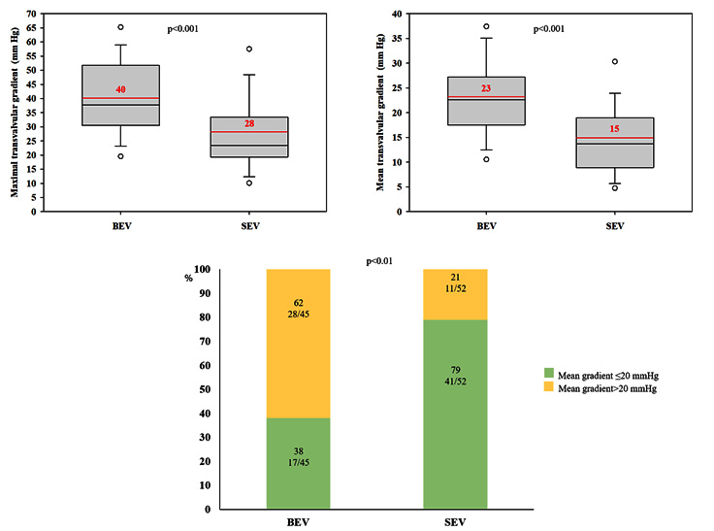
LYTEN Trial: Maximal/Mean Transvalvular Gradient, Mean Residual Gradient >20 mmHg at 30-Day F/U
There were no death or stroke in both groups
Rodés-Cabau J, EuroPCR 2022

Slide 22
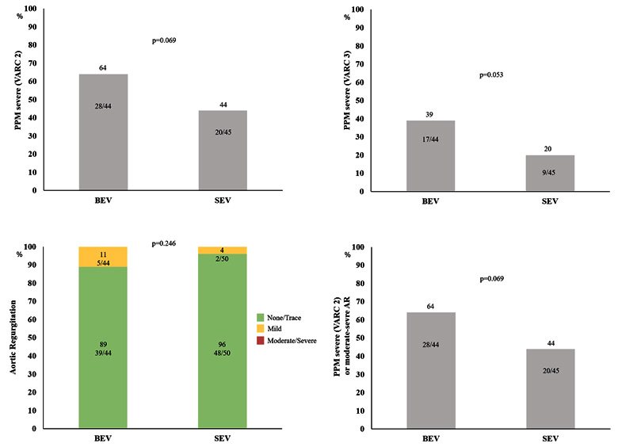
LYTEN Trial: Severe PPM and AR
Rodés-Cabau J, EuroPCR 2022

Slide 23
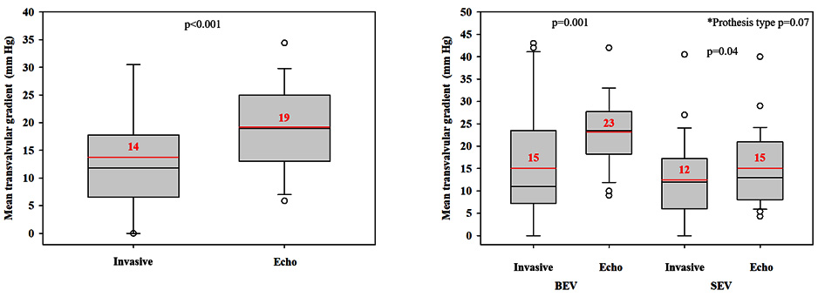
LYTEN Trial: Invasive vs Echocardiographic Measurements
Discharge echocardiographic measurements:
median of 1 day post-procedure (n=55)
Rodés-Cabau J, EuroPCR 2022

Slide 24
LYTEN Trial: Conclusions
In patients with small failed surgical bioprostheses, ViV-TAVI was associated with an extremely low rate of periprocedural complications and 30-day adverse events irrespective of valve type
The Evolut R/PRO/PRO+ valve system provided improved valve hemodynamics (lower transvalvular residual gradient, tendency towards a lower severe PPM rate) compared to the SAPIEN 3/ULTRA valve as evaluated by Doppler-echocardiography
Invasive hemodynamics exhibited lower transvalvular gradients compared to echocardiographic measurements
There were no significant differences between valve types in invasive hemodynamic measurements obtained during the ViV- TAVI procedure

Slide 25
Impact of a Standardized TAVI Technique and Care Pathway in the Optimize PRO Study

Slide 26
Optimize PRO Study: Background
Safety and efficacy of utilizing standardized implant protocols and care pathways is limited in large prospective studies of TAVI.
Post procedure conduction disturbance and new permanent pacemaker implantation (PPI) results after TAVI have been variable.
Protocolizing pre-, peri- and post-procedure pathways may improve outcomes.
Grubb K, EuroPCR 2022

Slide 27
Optimize PRO: Study Design
Non-randomized, prospective, post-market study
Conducted in the United States, Canada, Europe, Middle East, and Australia
Symptomatic Severe AS
“Optimized” post- procedure care pathway
Attempted Procedures
Medtronic Evolut PRO or Evolut Pro + device suitability inclusion criteria
“Optimized” procedure
“Optimized” post- procedure care pathway
“Optimized” conduction disturbance management pathway
No AV Conduction Disturbance
AV Conduction Disturbance
Procedural Efficiency & Collect
Economic Value Data
Validate post procedural conduction disturbance management
Primary Endpoint: Rate of all-cause mortality or all-stroke at 30 days
Secondary Endpoints:
Median days LOS
% of subjects with ≥ moderate AR at discharge
Rate of new PPI at 30 days
1 Year Follow-up
Grubb K, EuroPCR 2022

Slide 28
Optimize PRO Study: Optimized TAVI Care Pathway with Evolut PRO/PRO+
Pre-Procedure
Peri-Procedure
Post-Procedure
12-lead ECG
Early discharge plan with multi-disciplinary team
Screening checklist
Valve deployment using the cusp overlap technique
Pre-BAV not required
Avoid general anesthesia
Use transfemoral access only
Minimize central lines
12-lead ECG within 2 Hours
If no pre-existing RBBB or ECG changes remove all lines*
Mobilize within 4-6 hours
Consider PACU or stepdown unit vs ICU
TTE and ECG prior to discharge
* Follow to conduction disturbance pathway if patients has pre-existing RBBB or ECG changes (PR and QRS increase ≥20 ms)
Grubb K, EuroPCR 2022

Slide 29
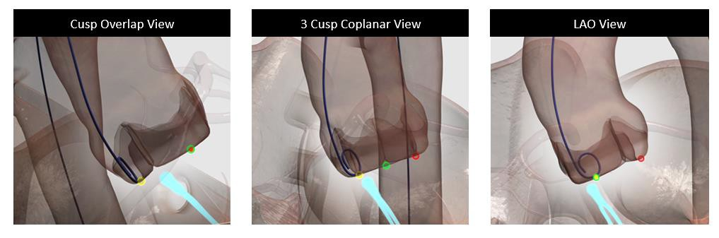
Optimize PRO Study: Cusp Overlap Technique with Evolut PRO/PRO+
Key Steps*
Initial deployment in the cusp overlap projection to estimate implant depth at the NCC
Deploy with the marker band positioned at mid-pigtail or higher
Assess depth in cusp overlap view
Roll LAO. Remove any remaining parallax. Estimated depth at the LCC
Redeployment in cusp overlap view, if applicable
Assess final implant depth on the NCC
*Use of Lunderquist guidewire is highly recommended.
Grubb K, EuroPCR 2022

Slide 30
Optimize PRO Study: Patient Flow
Roll-in*
N=104
Main Cohort*
N=400
Died: 1
Discharge
100%
(104/104)
Discharge
100%
(399/399)
Died: 2
Withdrew: 2
30 Days
94.2%
(98/104)
30 Days
93.2%
(368/395)
*10.4% screen failure rate for roll-in and main cohort
Grubb K, EuroPCR 2022

Slide 31
Optimize PRO Study: Procedural Characteristics
 | Roll-In (N=104) | Main Cohort (N=400) | Combined (N=504)
Total time in procedure room (minutes) | 121.5 ± 34.6 | 112.8 ± 38.1 | 114.6 ± 37.6
Femoral access site | 100.0 | 100.0 | 100.0
Lunderquist extra-stiff guide wire | 61.5 | 86.7 | 81.5
Anesthesia type
Conscious sedation/MAC | 85.6 | 84.3 | 84.5
General anesthesia | 14.4 | 15.5 | 15.3
Bioprosthesis used
Evolut PRO | 9.6 | 8.0 | 8.3
Evolut PRO+ | 90.4 | 91.5 | 91.3
Pre-BAV | 46.2 | 59.5 | 56.7
Post-dilatation | 18.3 | 12.3 | 13.5
Embolic protection device used | 34.6 | 33.8 | 33.9
Implant depth, NCC (mm), core lab | 3.4 ± 2.7 | 3.1 ± 3.0 | 3.1 ± 2.9
Resheathing | 26.0 | 20.3 | 21.4
Full recapture used | 20.4 | 27.8 | 26.2
Grubb K, EuroPCR 2022

Slide 32
Optimize PRO Study: Procedural Characteristics
 | Roll-In (N=104) | Main Cohort (N=400) | Combined (N=504)
Conduction Disturbance Group
No ECG changes | 51.0 | 64.0 | 61.3
Pre-existing RBBB & no ECG changes | 5.8 | 4.8 | 5.0
New onset LBBB | 28.8 | 18.3 | 20.4
ECG changes & pre-existing RBBB, LBBB, IVCD, or 1st degree AV block | 12.5 | 8.5 | 9.3
Peri-procedural HAVB | 1.9 | 4.5 | 4.0
Post procedure recovery used ICU | 26.0 | 27.6 | 27.2
Number of valves implanted
1 | 100.0 | 98.8 | 99.0
2 | 0.0 | 1.3 | 1.0
Length of stay (median days) | 1.0 | 1.0 | 1.0
Discharged with external Holter monitor | 25.0 | 21.1 | 21.9
Grubb K, EuroPCR 2022

Slide 33
Optimize PRO: 30-Day Clinical Outcomes
%
Grubb K, EuroPCR 2022

Slide 34
Optimize PRO Study: 30-Day Clinical Outcomes
%
Grubb K, EuroPCR 2022

Slide 35
Optimize PRO Study: Compliance with Key Cusp Overlap Steps (Main Cohort)
%
Grubb K, EuroPCR 2022

Slide 36
Optimize PRO Study: Hemodynamics
2.5
50.0
Effective orifice area (cm²)
2.3±0.6
AV Mean Gradient (mmHg)
2.0
39.7±11.2
40.0
1.5
Effective Orifice Area
30.0
AV Mean Gradient
1.0
0.9±0.2
20.0
0.5
10.0
8.2±4.0
0.0
0.0
Baseline
Discharge
# of evaluable echos
AV Mean Gradient | 389 | 380
Effective Orifice Area | 321 | 289
Echocardiographic outcomes assessed on the implanted population (N=398) and reviewed by a central core laboratory.
Grubb K, EuroPCR 2022

Slide 37
Optimize PRO: AR at Discharge (Main Cohort)
78% None/Trace Regurgitation with Evolut PRO/PRO+
0.0
0.0
Percent of Patients
Echocardiographic outcomes assessed on the implanted population (N=398) and reviewed by a central core laboratory.
*1 patient with mild-moderate PVL in the 34 mm group.
Grubb K, EuroPCR 2022

Slide 38
Optimize PRO Study: PVL at Discharge by
Valve Size
Percent of Patients
Echocardiographic outcomes assessed on the implanted population (N=398) and reviewed by a central core laboratory.
*1 patient with mild-moderate PVL in the 34 mm group.
Grubb K, EuroPCR 2022

Slide 39
Optimize PRO Study: Summary
Utilization of the Cusp Overlap Technique with an optimized care pathway provides excellent outcomes, low pacemaker implantation rate, expedited discharge and low rates of residual aortic regurgitation:
30-day mortality (0.8%) and new pacemaker (9.8%)
Compliance with key Cusp Overlap Technique steps resulted in numerically lower pacemaker implantation rate (8.1%)
Next-day discharge (median LOS 1 day)
0% moderate/severe PVL at discharge

Slide 40
Management of Myocardial Revascularization in Patients with Stable Coronary Artery Disease Undergoing Transcatheter Aortic Valve Implantation
REVASC-TAVI

Slide 41
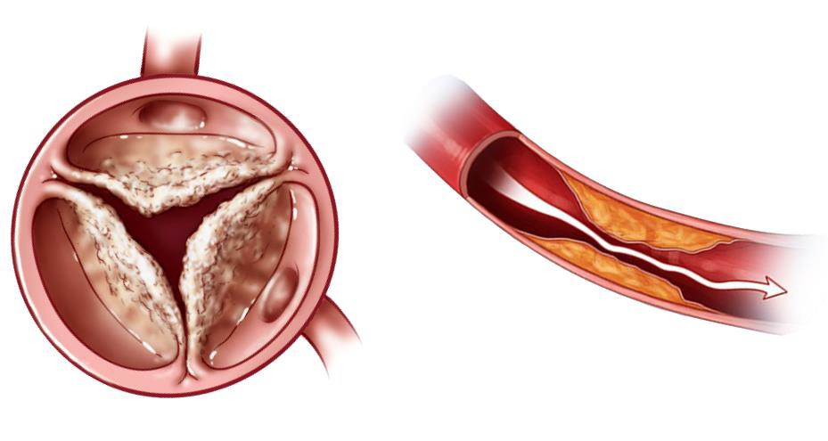
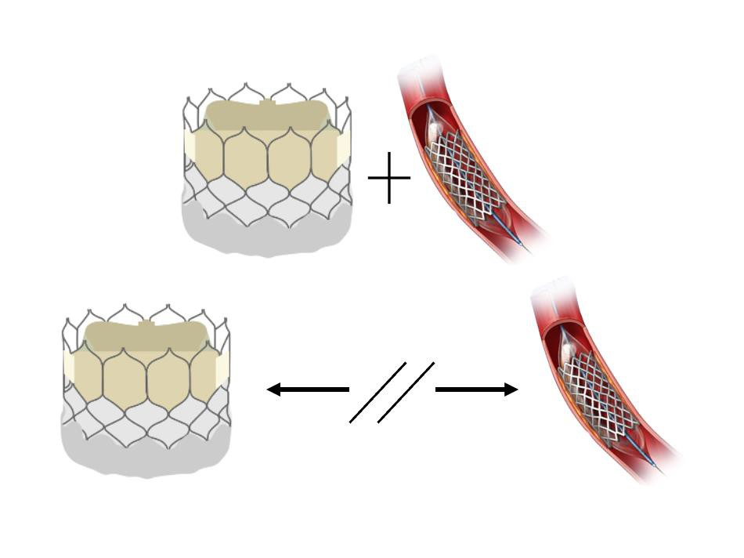
REVASC-TAVI Trial: Background
The benefit of myocardial revascularization in patients affected by severe AS and screened for SAVR or TAVI is currently unclear
AHA and ESC guidelines recommend to consider PCI in case of ≥70% stenosis in proximal coronary segments for patients undergoing TAVI (Class IIa, LoE C)
The possibility to schedule ad-hoc PCI procedures if needed, favours TAVI over SAVR+CABG
Costa G, EuroPCR 2022

Slide 42
REVASC-TAVI Trial: Primary and Secondary Outcomes
Outcomes of patients undergoing TAVI with stable, significant CAD (≥70% or ≥50% in LM) at baseline according to the completeness of myocardial revascularization achieved
Primary outcome
All-cause death at 2 years
Co-primary composite outcome
All-cause death, stroke, MI or HF rehospitalization at 2 years
Secondary outcomes
Stroke, MI, HF rehospitalization and unplanned PCI at 2 years
Costa G, EuroPCR 2022

Slide 43
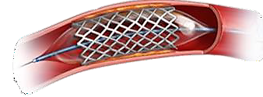
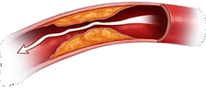
REVASC-TAVI Trial: Study Design
Patients undergoing TAVI with significant, stable CAD at baseline (n=2402)
No follow-up data available (n=231)
No data about the completeness of myocardial revascularization (n=146)
Patients with available data about baseline CAD and PCI performed (n=2025)
Complete revascularization
(n=1310)
Incomplete revascularization
(n=715)
675 pairs of patients compared
through 1:1 PS matching
Costa G, EuroPCR 2022

Slide 44
REVASC-TAVI Trial: CAD and PCI Characteristics
CAD and PCI characteristics | Overall (n=1314) | Complete revascularization (n=657) | Incomplete revascularization (n=657) | p-value
Diseased vessels |  |  |  | <0.001
1, n (%) | 668 (50.8) | 434 (66.1) | 234 (35.6)
2, n (%) | 382 (29.1) | 150 (22.8) | 232 (35.3)
≥3, n (%) | 264 (20.1) | 73 (11.1) | 191 (29.1)
Multivessel CAD, n (%) | 646 (49.2) | 223 (33.9) | 423 (64.4) | <0.001
Proximal CAD, n (%) | 834 (63.5) | 408 (62.1) | 426 (64.8) | 0.330
LM/proximal LAD CAD, n (%) | 485 (36.9) | 240 (36.5) | 245 (37.3) | 0.819
PCI, n (%) | 944 (71.8) | 657 (100.0) | 287 (43.7) | <0.01
PCI timing, n (%) |  |  |  | 0.027
Staged before TAVI | 579 (61.3) | 408 (62.1) | 171 (59.6)
Staged after TAVI | 102 (10.8) | 73 (11.1) | 29 (10.1)
Concomitant to TAVI, before valve | 190 (20.1) | 124 (18.9) | 66 (23.0)
Concomitant to TAVI, after valve | 59 (6.2) | 47 (7.2) | 12 (4.2)
Unplanned PCI | 3 (0.3) | 1 (0.2) | 2 (0.7)
PCI in proximal vessels, n (%) | 580 (61.4) | 392 (59.7) | 188 (65.5) | 0.095
Multivessel PCI, n (%) | 246 (26.1) | 148 (22.5) | 98 (34.2) | <0.01
LM/proximal LAD PCI, n (%) | 339 (35.9) | 222 (33.8) | 117 (40.8) | 0.046
Costa G, EuroPCR 2022

Slide 45
REVASC-TAVI Trial: Procedural Outcomes
 | Overall (n=1314) | Complete revascularization (n=657) | Incomplete revascularization (n=657) | p-value
Vascular access, n (%) |  |  |  | 0.080
Trans-femoral | 1238 (94.2) | 608 (92.5) | 630 (95.9)
Others | 66 (5.0) | 43 (6.6) | 23 (3.5)
SAT protection, n (%) | 47/1236 (3.8) | 25/610 (4.1) | 22/626 (3.5) | 0.656
TAV type, n (%) |  |  |  | -
SAPIEN 3/3 Ultra | 494 (37.6) | 267 (40.6) | 227 (34.6)
SAPIEN XT | 16 (1.2) | 6 (0.9) | 10 (1.5)
Evolut R/PRO/PRO+ | 493 (37.5) | 234 (35.6) | 259 (39.4)
CoreValve | 47 (3.6) | 24 (3.6) | 23 (3.5)
Portico | 69 (5.2) | 36 (5.5) | 33 (5.0)
Acurate NEO/NEO 2 | 131 (10.0) | 67 (10.2) | 64 (9.8)
Others | 57 (4.4) | 21 (3.2) | 36 (5.7)
Local anaesthesia, n (%) | 1103/1304 (84.6) | 558/653 (85.5) | 545/651 (83.7) | 0.186
Post dilatation, n (%) | 261/1197 (21.8) | 121/572 (21.1) | 140/625 (22.5) | 0.576
Need 2nd TAV, n (%) | 22/1294 (1.7) | 10/663 (1.5) | 12/631 (1.9) | 0.830
Costa G, EuroPCR 2022

Slide 46
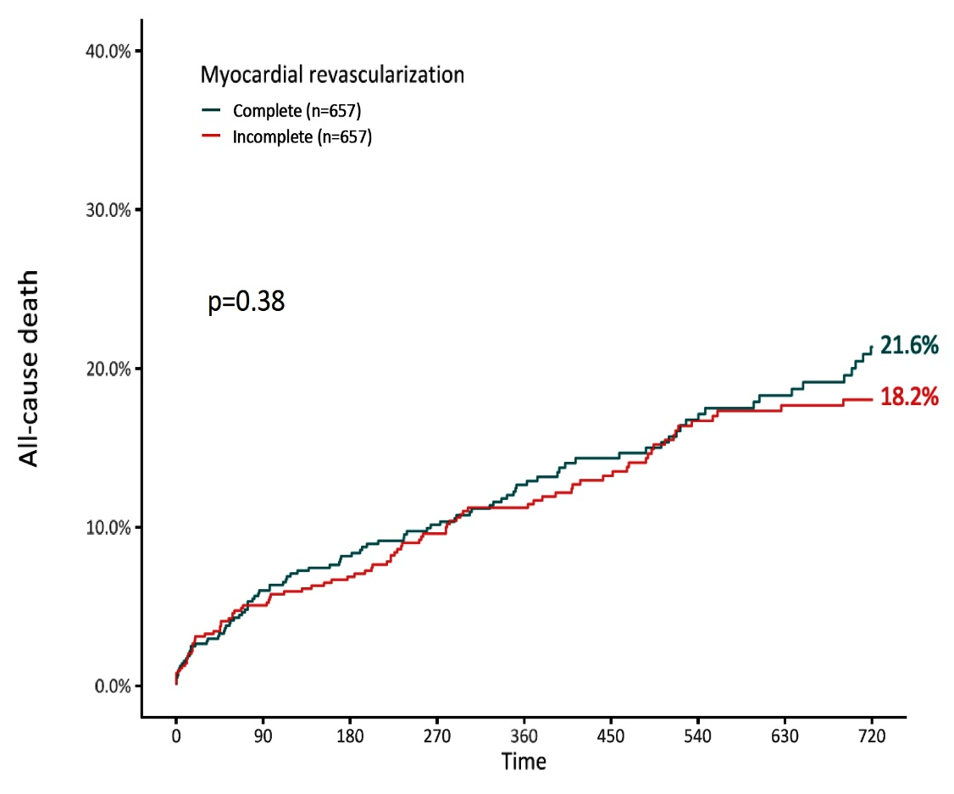
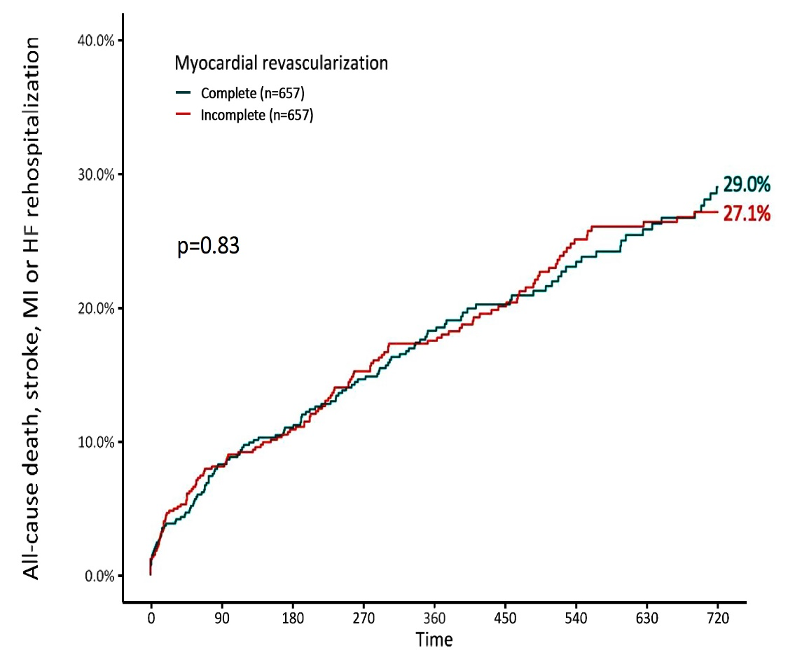
REVASC-TAVI Trial: Primary Outcomes
Complete Revasc vs Incomplete Revasc
Primary Outcome
(All-cause death)
Co-Primary Endpoint
(All-cause death, stroke, MI, or HF rehosp)
Costa G, EuroPCR 2022

Slide 47
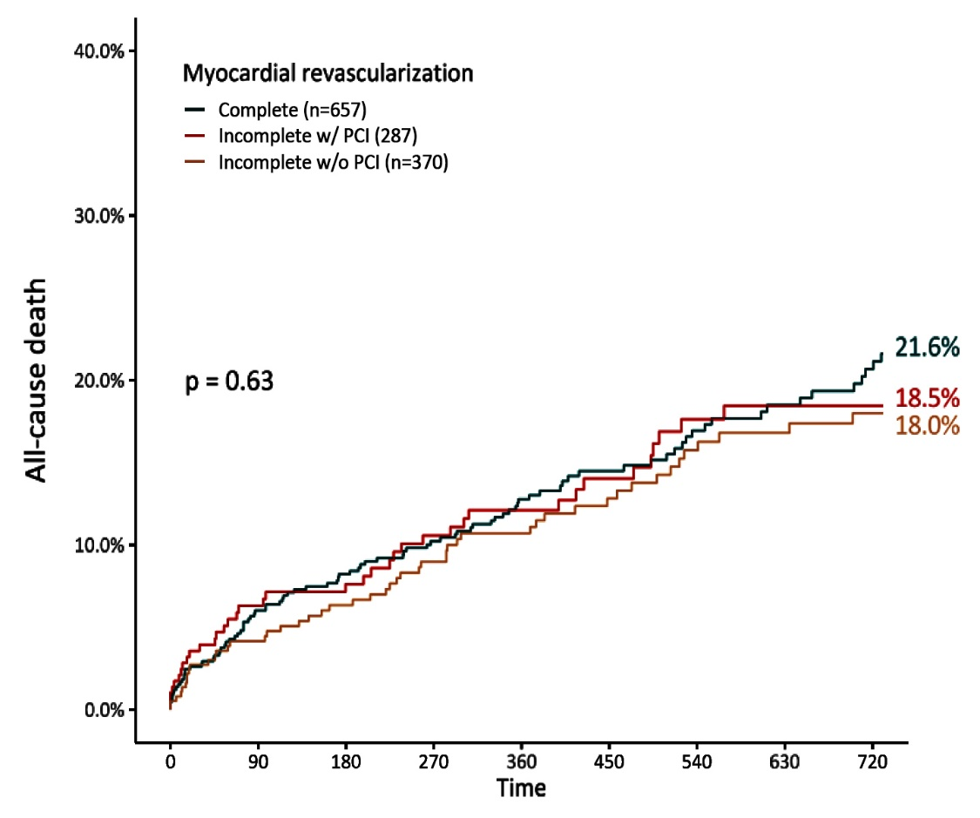
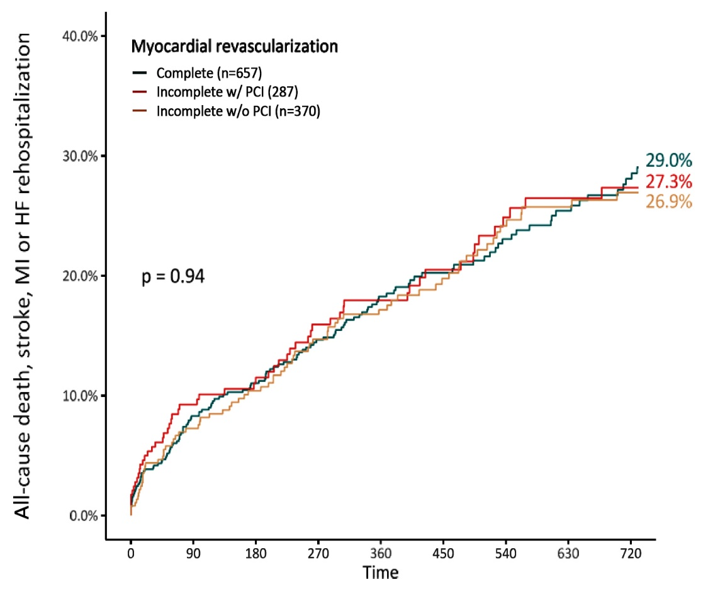
REVASC-TAVI Trial: Primary Outcomes
Complete Revasc vs Incomplete Revasc w/ PCI vs Incomplete Revasc w/o PCI
Primary Outcome
(All-cause death)
Co-Primary Endpoint
(All-cause death, stroke, MI, or HF rehosp)
Costa G, EuroPCR 2022
Costa G, EuroPCR 2022

Slide 48
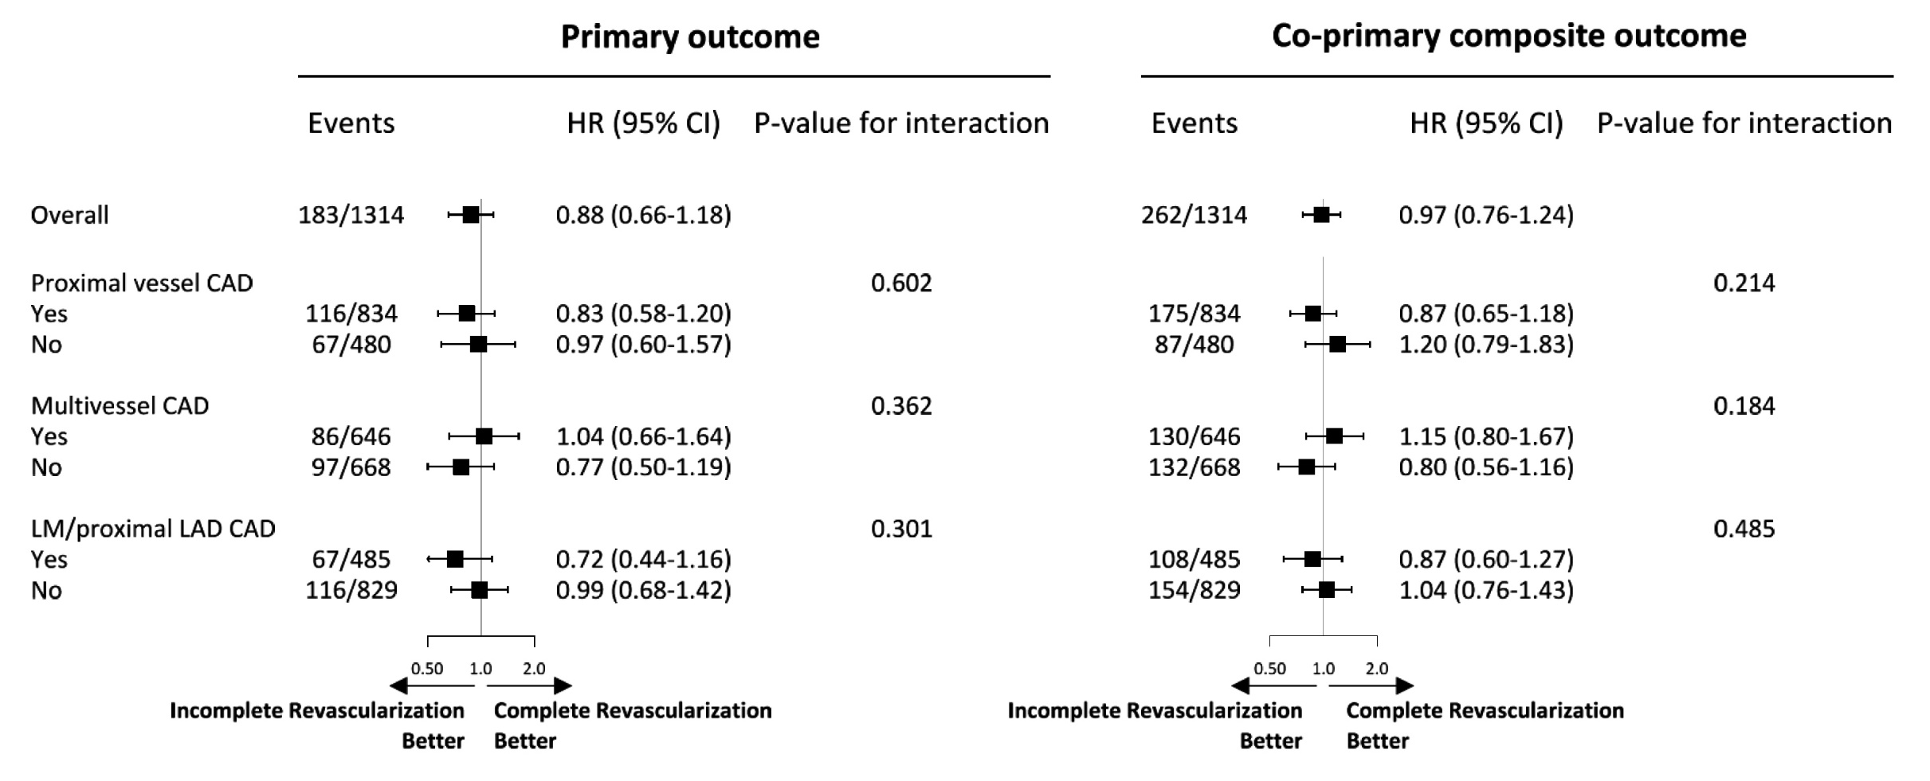
REVASC-TAVI Trial: Subgroup Analyses of the Primary Endpoint Outcome
Costa G, EuroPCR 2022

Slide 49
REVASC-TAVI Trial: Summary
This was the largest analysis evaluating the impact of myocardial revascularization in patients undergoing TAVI
The completeness of myocardial revascularization achieved in patients scheduled for TAVI did not impact on their prognosis at 2 years, regardless the clinical subset and the quote of myocardium at risk
Pending the validation of lesion functional assessment in the setting of severe AS, leaving angiographically significant, stable CAD untreated in TAVI patients is reasonable and gives the chance to reassess the need of revascularization thereafter
Coronary re-access difficulties after TAVI must be considered
Costa G, EuroPCR 2022

Slide 50
Management and Outcomes of Stroke Complicating Transcatheter Aortic Valve Implantation
The Acute STROke complicating TAVI collaboration

Slide 51
STROke TAVI Study: Objective
We aimed to explore the characteristics of acute stroke complicating TAVI and to describe the incidence and outcomes of emergent interventions to treat acute stroke complicating TAVI.
Levi A, EuroPCR 2022

Slide 52
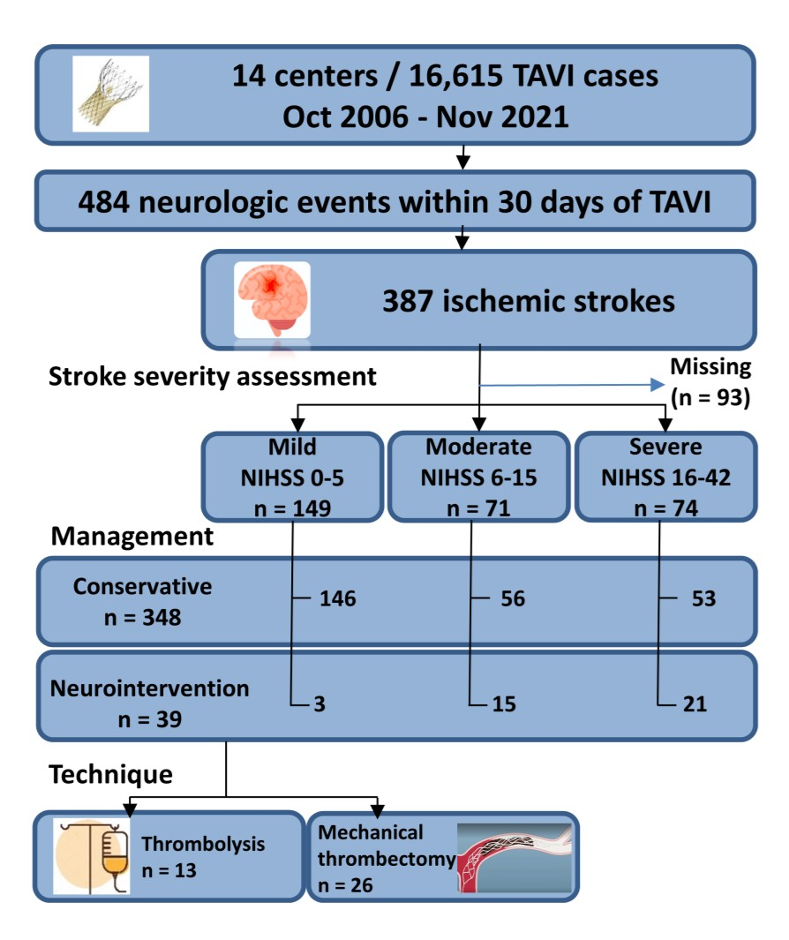
STROke TAVI Study Design
Consecutive periprocedural stroke cases were collected from 14 centers in a dedicated multinational database: ASTRO-TAVI
Stroke severity was assessed using the National Institute of Health Stroke Scale (NIHSS).
Prespecified primary outcomes were 1- year all cause death, and neurologic disability status at 60-90 days according to the modified rankin score (mRS).
Levi A, EuroPCR 2022

Slide 53
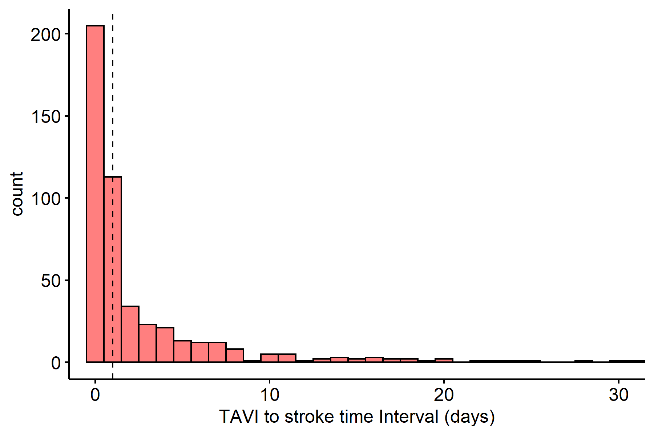
STROke TAVI Study: TAVI to Stroke
Time Interval
Levi A, EuroPCR 2022

Slide 54
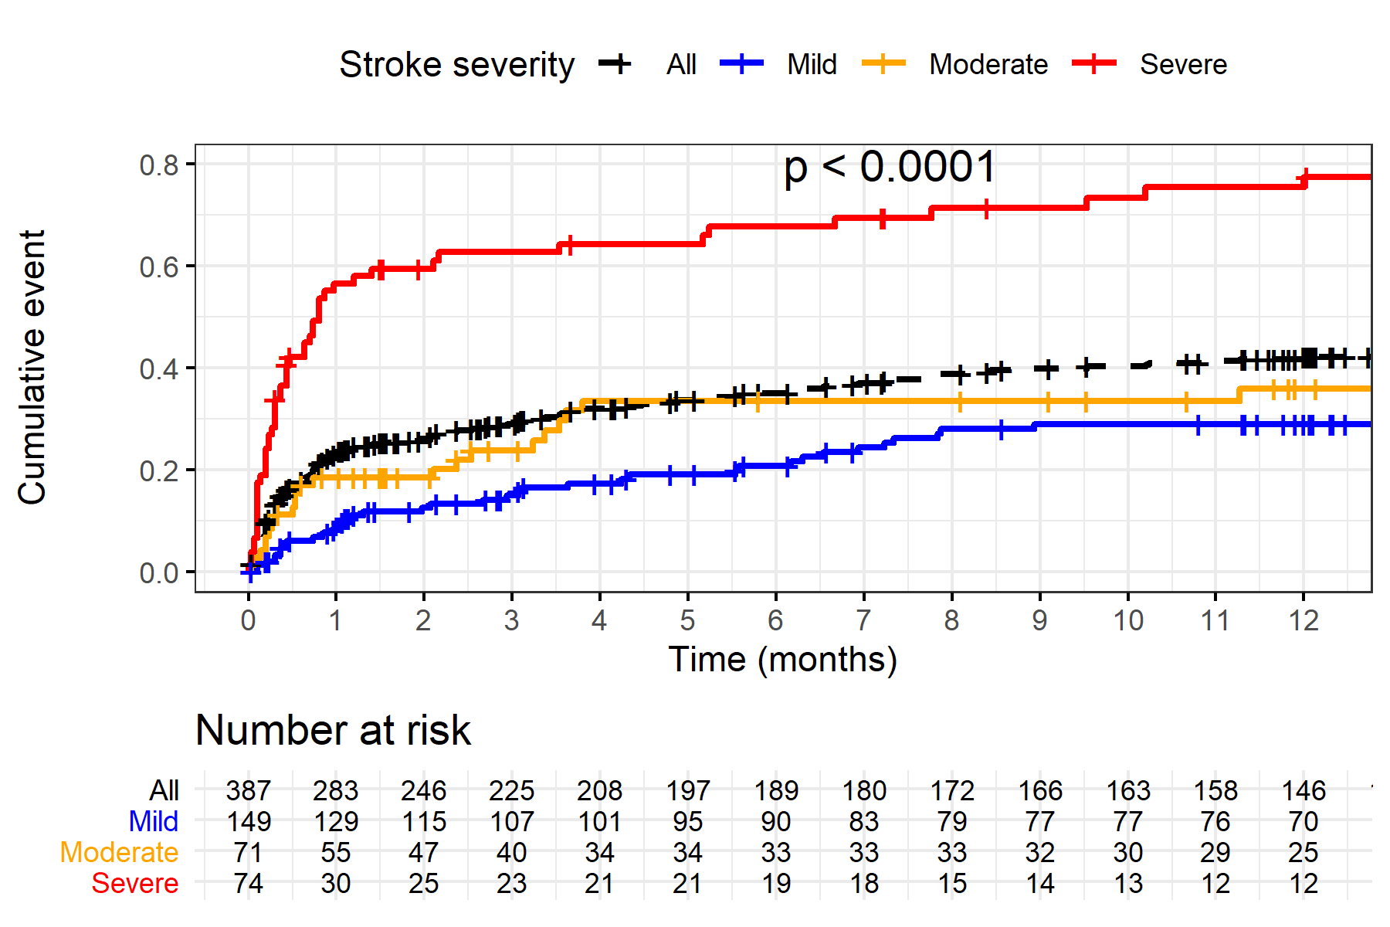
STROke TAVI Study: Mortality with Respect
to Stroke Severity
Levi A, EuroPCR 2022

Slide 55
STROke TAVI Study: Moderate and Severe Stroke – Baseline Characteristics
 | All n = 145 | Conservative n = 109 | Neurointervention n = 36 | P value
Age, mean (sd) | 81.3 (9.2) | 81.3 (10) | 81.5 (6.2) | 0.87
Male gender, n(%) | 51 | 46.8 | 63.9 | 0.09
Baseline NYHA, mean(sd) | 2.8 (0.6) | 2.8 (0.6) | 2.9 (0.7) | 0.55
Creatinine (g/dL), mean(sd) | 1.4 (1.2) | 1.4 (1.3) | 1.3 (0.5) | 0.28
COPD, n(%) | 17.2 | 18.3 | 13.9 | 0.62
Diabetes mellitus, n(%) | 31.7 | 30.3 | 36.1 | 0.6
Hypertension, n(%) | 76.6 | 75.7 | 79.4 | 0.82
Peak gradient, mean(sd) | 70.8 (27) | 68.6 (26.4) | 77.3 (28.1) | 0.12
Mean gradient, mean(sd) | 42.8 (17.6) | 41.2 (17.1) | 47.5 (18.7) | 0.08
Valve area cm2, mean(sd) | 0.7 (0.2) | 0.7 (0.2) | 0.7 (0.2) | 0.24
STS score, mean(sd) | 5.8 (4.6) | 6 (4.8) | 4.8 (4) | 0.16
Levi A, EuroPCR 2022

Slide 56
STROke TAVI Study: Moderate and Severe Stroke – Procedural Characteristics
 | All n = 145 | Conservative n = 109 | Neurointervention n = 36 | P value
General anesthesia, n(%) | 37.3 | 43.5 | 15.4 | 0.01
Embolic protective d, n(%) | 6.2 | 5.6 | 8.3 | 0.69
Self expandable d, n(%) | 68.3 | 67.9 | 69.4 | 1
Alternative access, n(%) | 21.5 | 25.9 | 8.3 | 0.03
Levi A, EuroPCR 2022

Slide 57
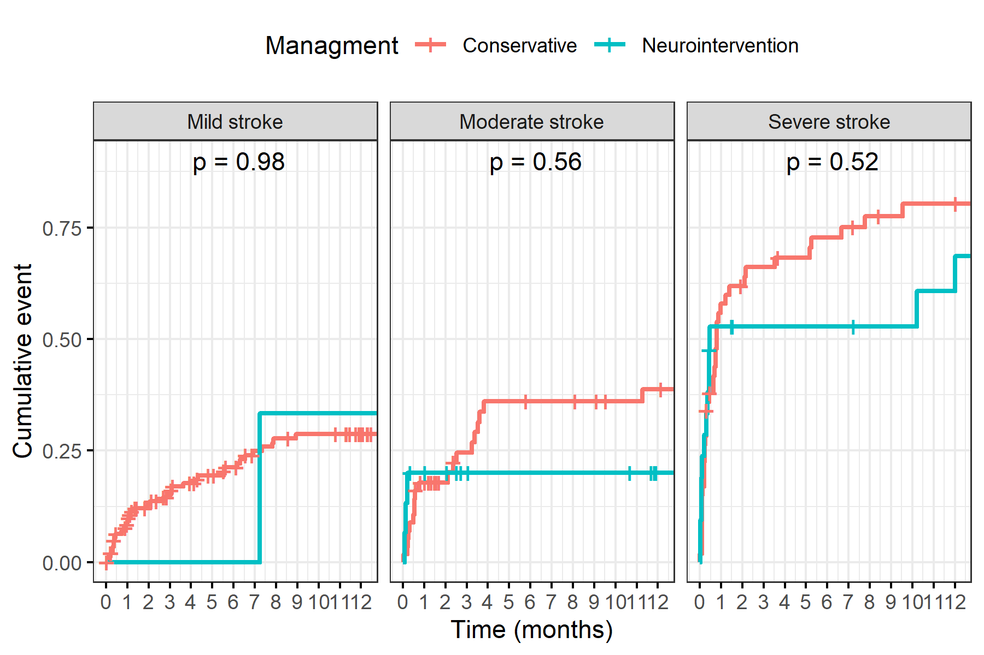
STROke TAVI Study: Mild to Severe Stroke Clinical Outcome
Levi A, EuroPCR 2022

Slide 58
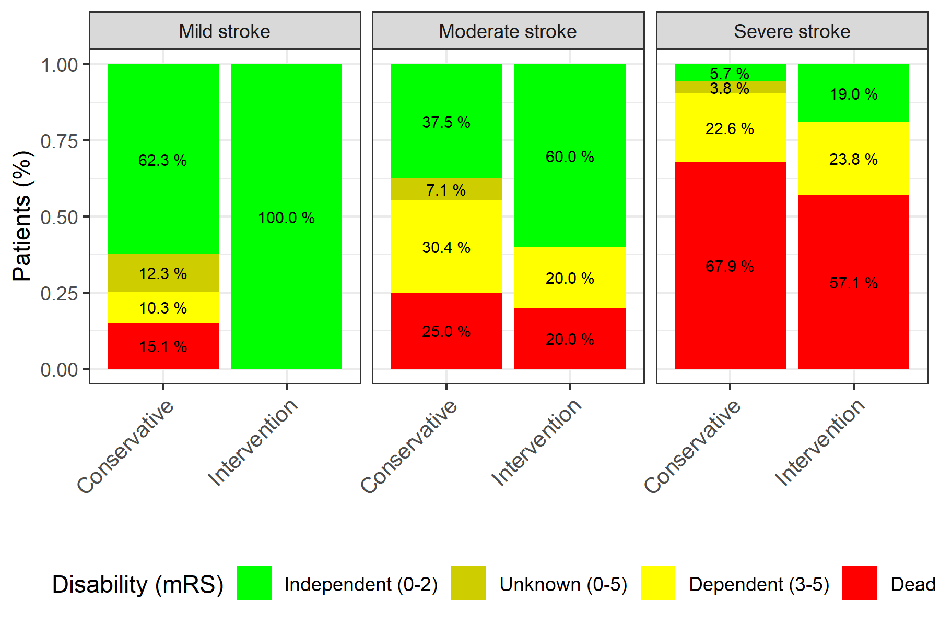
STROke TAVI Study: Stroke Disability at 90 Days Grouped by Stroke Severity
Independent survival at 90 days - neurointervetnion versus conservative therapy,
adjusted for NIHSS group and STS score: Odds Ratio 2.9 (95% CI 1.2-6.9, p=0.02)
Levi A, EuroPCR 2022

Slide 59
STROke TAVI Study Summary
Stroke after TAVI is a serious complication and frequently occurs in 0-2 days; mortality is high and is directly related to stroke severity
With the adoption of TAVI in a wider specrum of patients, we should not only focus on stroke prevention but also on aggressive medical and mechanical stroke treatment
Higher rates of independent survival could be achieved if neuro-intervention is applied rapidly in an appropriate indication
We herein demonstrate, for the first time, the potential benefit of neuro-intervention to treat stroke after TAVI
Levi A, EuroPCR 2022

Slide 60
TAVR STROKE Protocol at MSH

Slide 61
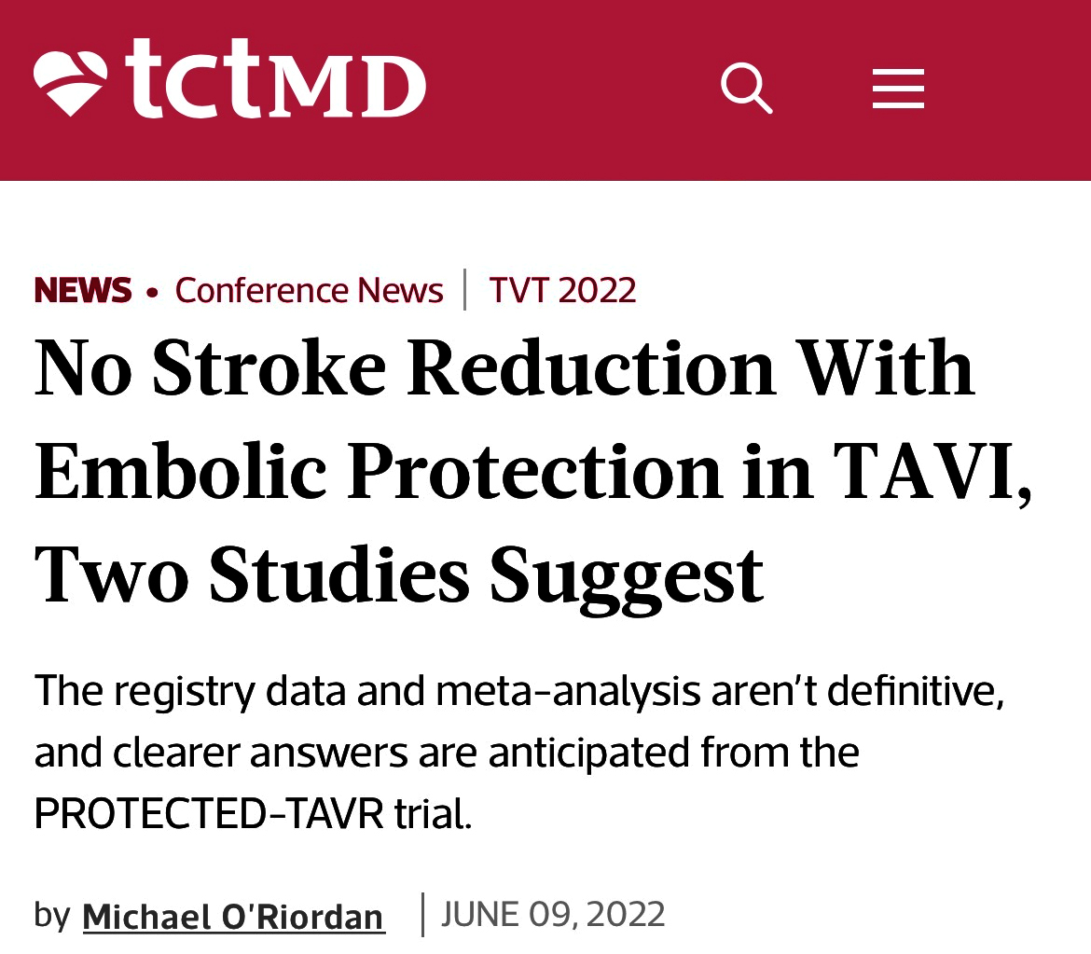
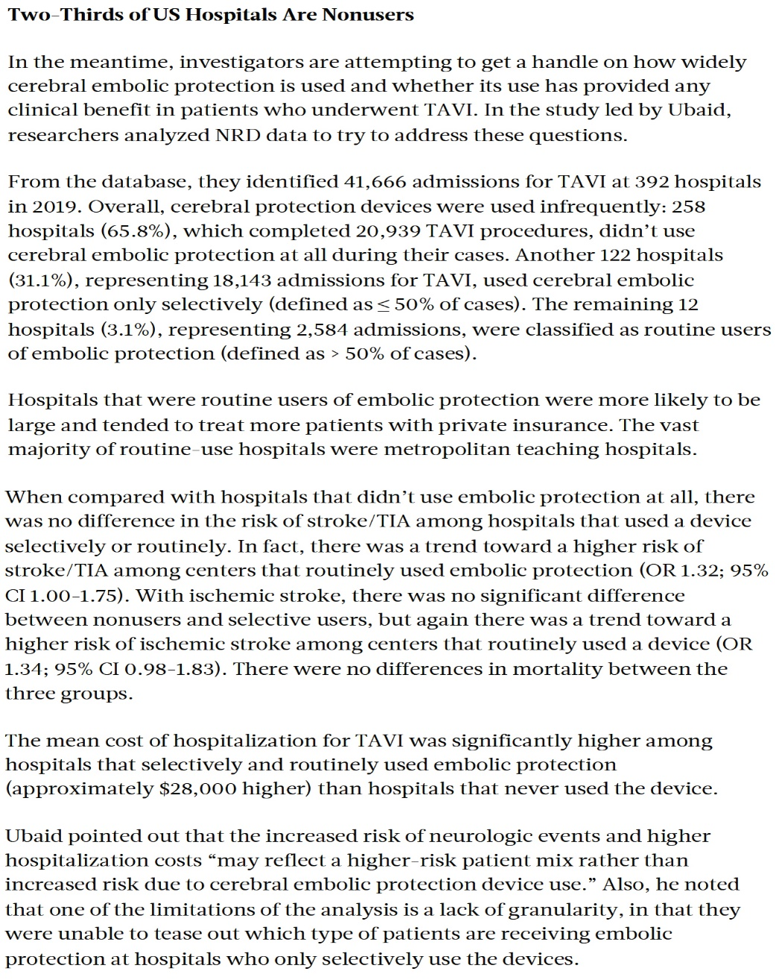
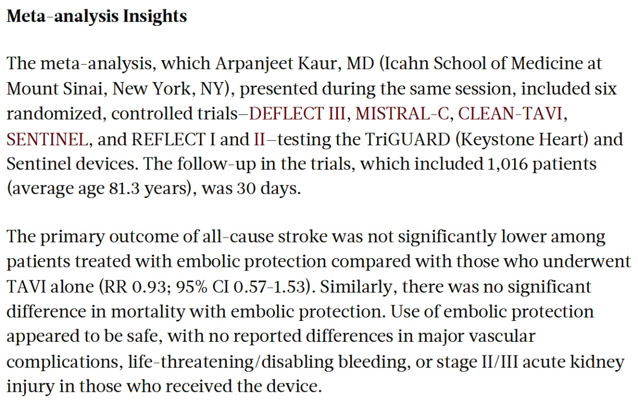

Slide 62
The Jenavalve Trilogy TAVI System for Treatment of Aortic Regurgitation:
Worldwide First Results in a Multicenter Real-World Cohort

Slide 63
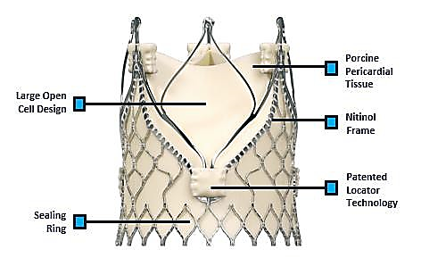
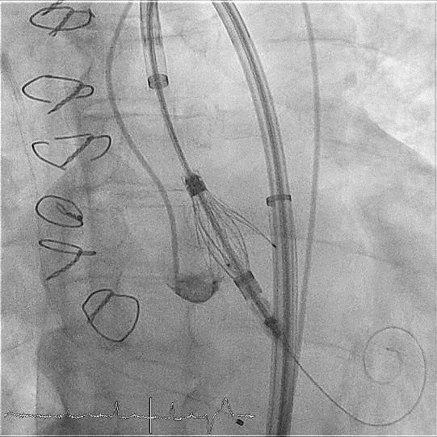
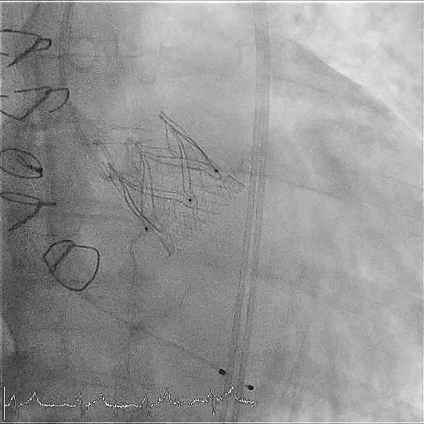
Jenavalve Trilogy TAVI System
The Trilogy TAVI System features unique locators that align the THV with the native cusps of the valve and ensures anatomically correct alignment
The locators “clip” onto the native leaflets, enabling anchoring in pure AR patients with non-calcified valves.
Jenavalve Trilogy Valve
Prosthesis with locators spread during implantation, seating locators in the sinuses
Jenavalve Trilogy valve after implantation with perfect position and no paravalvular regurgitation
Tamm A, EuroPCR 2022

Slide 64
Jenavalve Trilogy Endpoints
Primary Efficacy Endpoint:
Technical success with mean gradient < 20mmHg and reduction of AR grade by >1.
Combined Primary Safety Endpoint:
Major adverse events (death, myocardial infarction, cardiothoracic surgery, stroke) at discharge.
Tamm A, EuroPCR 2022

Slide 65
Jenavalve Trilogy: Baseline Characteristics
All Patients presented with moderate-severe or severe AR
Mean patient age was 77 years, with 40% female
Mean EuroSCORE II was 7.1%
71% of the patients were in functional NYHA class III or IV
13 patients (29%) had previous cardiac surgery
58% of patients with LVEF ≤50%
N = 45¹
Age (years) | 76.8 (9.52)
Sex (female) | 18 / 45 (40%)
EuroSCORE II | 7.08 (9.00)
NYHA III/IV | 32/45 (71%)
BMI (kg/m²) | 26.86 (5.70)
Atrial Fibrillation | 26 / 45 (58%)
COPD | 4 / 45 (8.9%)
Arterial hypertension | 42 / 45 (93%)
Diabetes mellitus | 10 / 45 (22%)
Previous cardiac surgery | 13 / 45 (29%)
Previous PCI | 13 / 35 (37%)
Previous pacemaker | 6 / 45 (13%)
Previous Stroke | 5 / 45 (11%)
Prior right bundle branch block | 1 / 45 (2.2%)
Prior left bundle branch block | 6 / 45 (13%)
LVEF ≤50% | 26/45 (58%)
Tamm A, EuroPCR 2022

Slide 66
Jenavalve Trilogy: Procedural Characteristics
N = 45¹
Valve Size
23 mm | 4 / 45 (8.9%)
25 mm | 14 / 45 (31%)
27 mm | 27 / 45 (60%)
Conscious sedation | 37 / 45 (82%)
Pre-dilatation | 0 / 45 (0%)
Post-dilatation | 2 / 45 (4.4%)
Procedure duration (min) | 76.49 (20.17)
Contrast (ml) | 180.58 (77.59)
Fluoroscopy time (min) | 19.20 (5.87)
All cases were performed via transfemoral access
82% of cases performed under conscious sedation
Post-dilatation was performed in 2 cases
Median procedure time of 77 mins
Tamm A, EuroPCR 2022

Slide 67
Jenavalve Trilogy: Clinical Results
N = 45¹
Technical success | 45 / 45 (100%)
Conversion to open surgery | 0 / 45 (0%)
Bleeding complications
minor bleeding | 3 / 45 (6.7%)
major or life-threatening bleeding | 0 / 45 (0%)
Major vascular complication | 1 / 45 (2.2%)
AKI – stage 2 or 3 | 0 / 45 (0%)
Stroke | 0 / 45 (0%)
In-hospital mortality | 0 / 45 (0%)
Mean aortic valve gradient, mmHg (discharge) | 4.04 (1.64)
Aortic valve area, cm² (discharge) | 2.62 (0.64)
New pacemaker | 9 / 39 (23%)
Paravalvular Regurgitation
91% None or Trace
Tamm A, EuroPCR 2022

Slide 68
Jenavalve Trilogy: Summary
Treatment of aortic regurgitation with TAVI is challenging and is associated with poorer outcomes
This is an analysis of the first, real-world, commercial experience of the recently approved Jenavalve Trilogy TAVI System in a multi-center cohort
45 consecutive patients with aortic regurgitation from 6 German centers were included in this study
This study demonstrated excellent clinical outcomes, meeting both the primary safety and efficacy endpoints with no major adverse events and no moderate or severe AR at discharge
The Jenavalve Trilogy System is the only THV in the world approved for use to treat both AS and AR. Further studies with expanded cohort of AI/AS pts will be needed to prove its safety and efficacy.
Tamm A, EuroPCR 2022

Slide 69
Take Home Messages
SHD TAVI/TAVR Trials from EuroPCR 2022
Peri-procedural and mortality outcomes were higher after SEV at BEV dominant centers while no difference in 2 valve outcomes at SEV dominant centers. This is important when we compares 2 valves.
ViV TAVR for surgical valves <23mm, with SEV had better hemodynamics and lower PPM compared to BEV. Hence SEV should be preferred in this setting, if these data translates into better clinical outcomes.
Dedicated protocolized strategy for SEV deployment has shown to have superior outcomes vs historical data and should be routinely practiced.
Coronary revascularization in pts with severe AS undergoing TAVI has not shown to impact survival and other clinical outcomes at 2 yrs. Hence PCI of significant coronary lesions is not routinely indicated. COMPLETE TAVR trial will give the final answer.
Stroke after TAVI has graded mortality depending on the severity. Aggressive management by neurointervention of these cases can improve subsequent outcomes and mortality
Jenavalve Trilogy TAVI system has shown optimal and safety outcomes in pts with pure severe AR. Jenavlave is poised to expand the TAVI horizon.

Slide 70
Question # 1
Following are the recommended components of Optimize PPRO study for TAVR in AS pts except:
Valve deployment using cusp overlap
If no heart blocks, then remove all central lines
Mobilize in 4-6 hrs
Pre-BAV is essential in all cases
Correct answer: D

Slide 71
Question # 2
Following statements is false regarding the results of REVASC-TAVI:
All cause death were similar in gps with or without revascularization
All cause death, stroke, MI or HF rehosp were similar in 2 gps
Group with Incomplete revascularization with PCI has worse outcomes
Outcomes were better with PCI in MV/LM CAD vs no PCI
Correct answer: C

Slide 72
Question # 3
Following are the results of the LYTEN trial comparing SEV vs BEV in small surgical valves except:
A. SEV had better clinical outcomes at 30-days vs BEV gp
B. SEV gp had lower maximal residual gradient vs BEV gp
C. SEV gp has lower severe PPM vs BEV gp
D. SEV gp has lower incidence of MG >20 mmHg vs BEV gp
Correct answer: A

