Slide 1
Learn From The Masters
Managing Calcified coronaries with Rotational Atherectomy
Supported by:
Boston Scientific Corporation (BSC) India
EHCC Jaipur
MSH New York

Slide 2
Disclosures
Samin K. Sharma, MD, MSCAI, FACC
Speaker’s Bureau – BSC, Abbott
Annapoorna S. Kini, MD, MRCP, FACC
Nothing to disclose

Slide 3
Live Case #3
Patient Demographics
71 yrs, M
Present Clinical Presentation
Presented with DOE & angina and + inferior ischemia due to CAD and AS
CAD Risk Factors
Hypertension
Hyperlipidemia
Controlled DM
ESRD/Dialysis
CVA without deficit
Clinical Variables
Cardiac cath on Feb 2nd 2022 pre-TAVR revealed 3 V CAD with patent LIMA to LAD and occluded SVG to D1 and OM2. Pt underwent successful TF TAVR using Sapien-3 Ultra valve and did well. LVEF 60%.
Medications
Aspirin, Clopidogrel, Metoprolol XL, Amlodipine, Losartan, Atorvastatin, Antidiabetic meds
Cath: Cath on Feb 2nd 2022 revealed 3 V CAD, LVEF 60% with multiple significant calcified lesions in RCA and branches.
Plan: Now planned for IVUS guided PCI of calcified multiple RCA lesions using rotational atherectomy and DES.

Slide 4
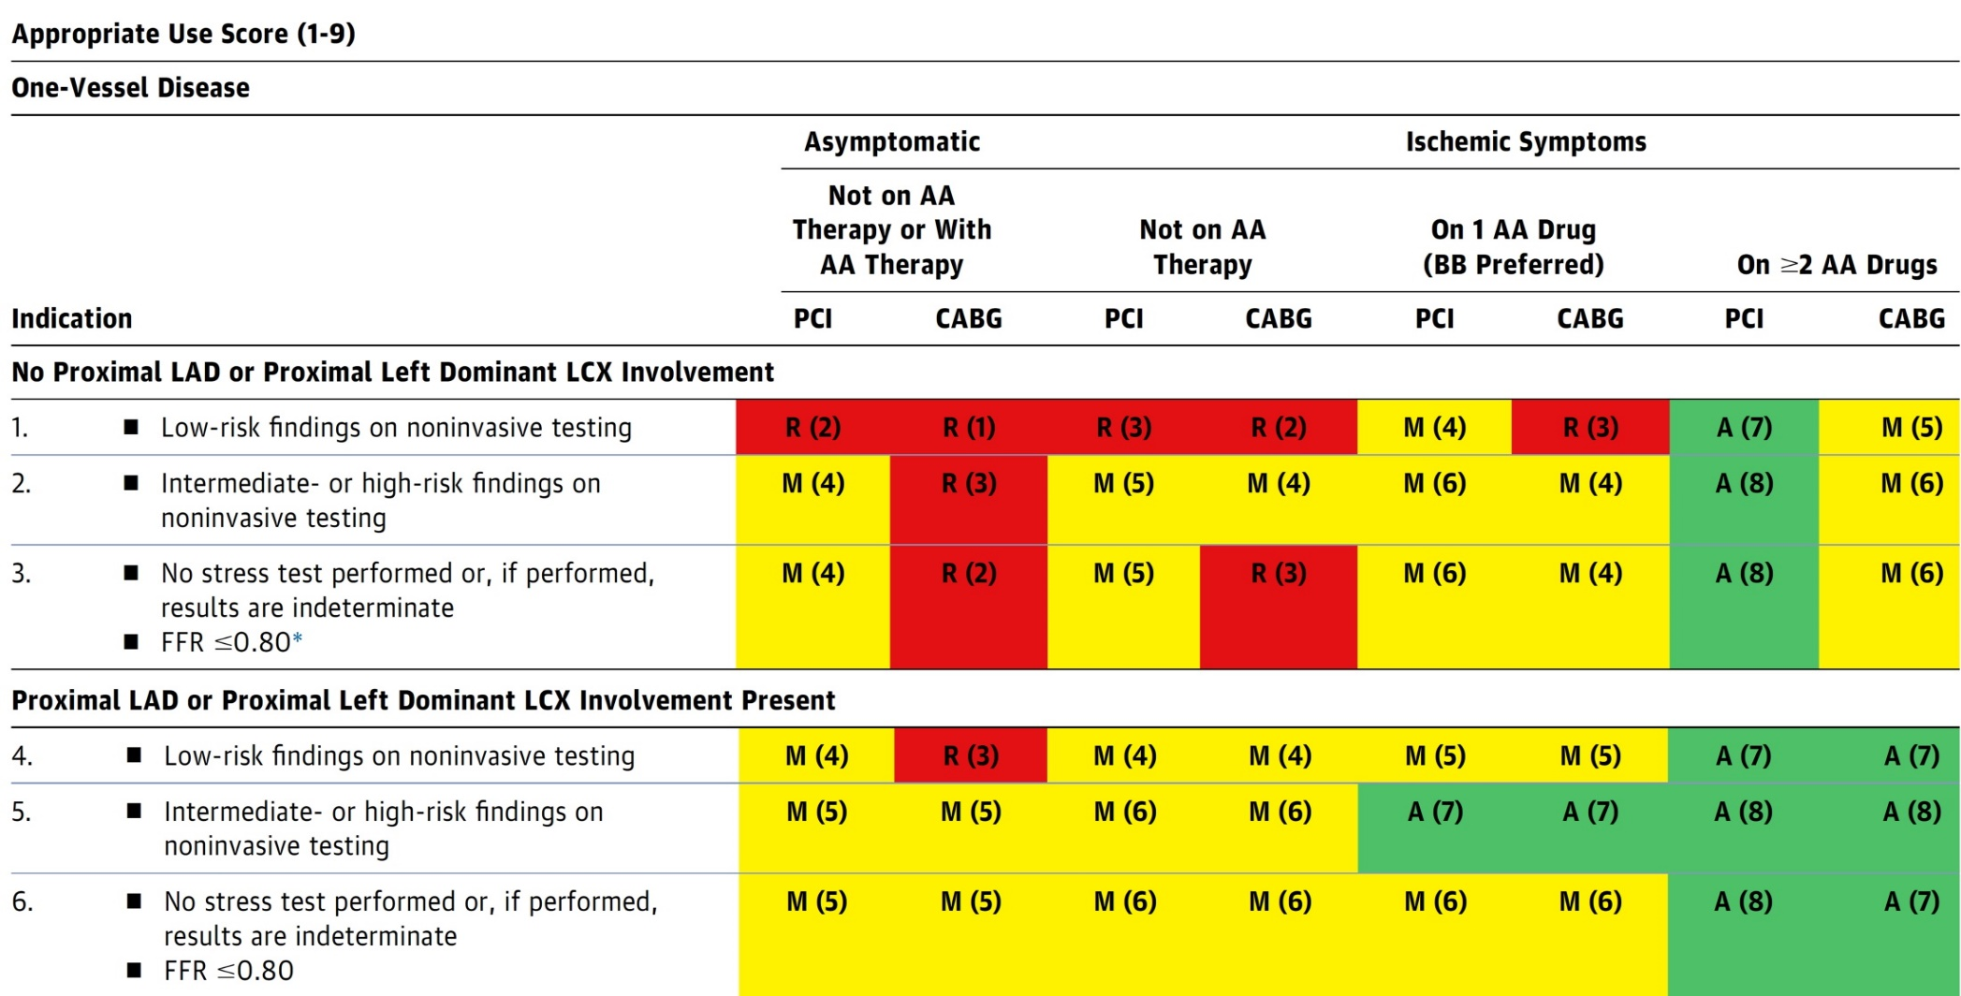
AUC 2017: One-Vessel Disease
Patel et al., J Am Coll Cardiol 2017;69:2212

Slide 5
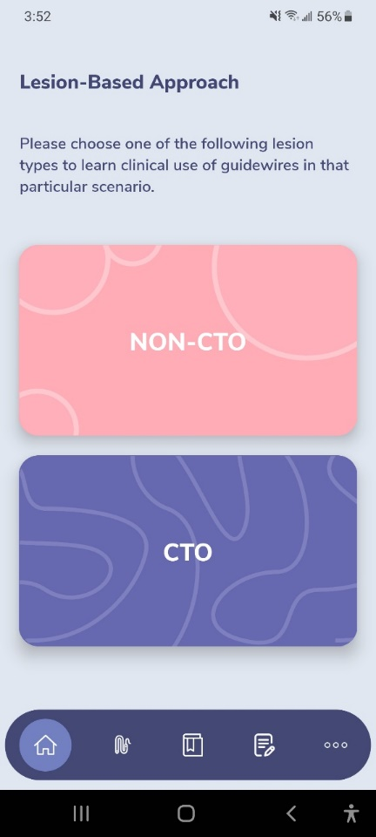
GuidewireAID – Out on both Android and iOS!
Apple ® and App Store® are registered trademarks of Apple Inc.
Download for Free!

Slide 6
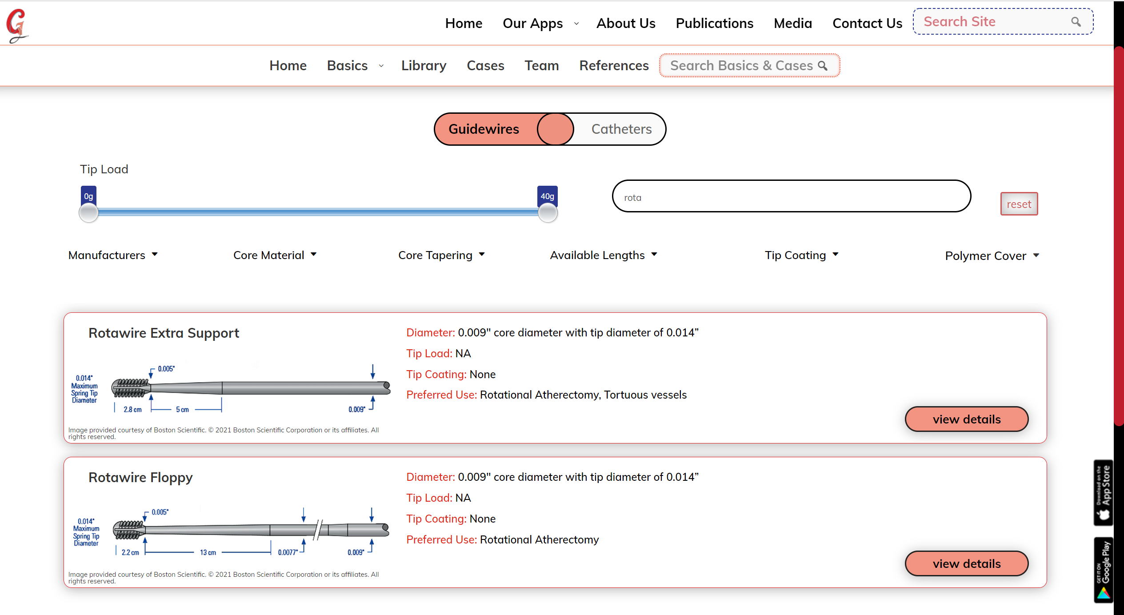
Also available as a WebApp on…
www.CardiologyApps.com/GuidewireAID

Slide 7
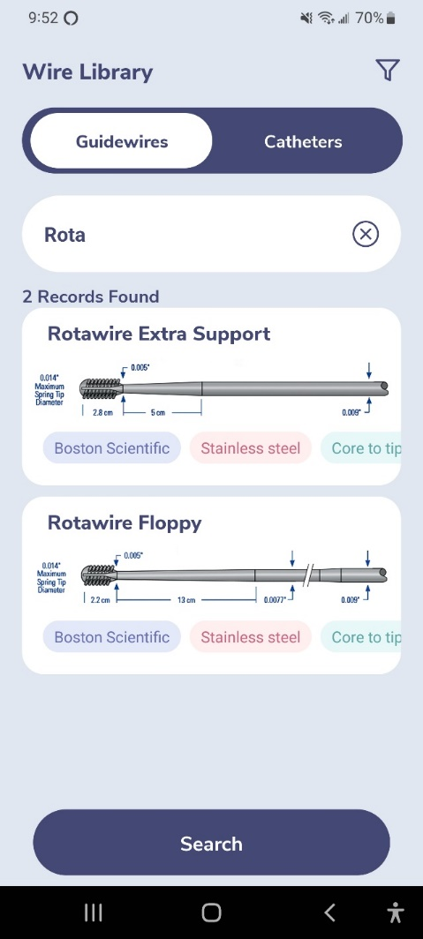
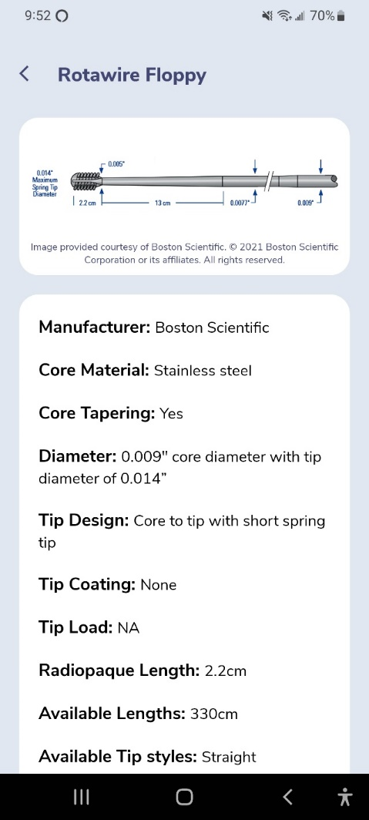
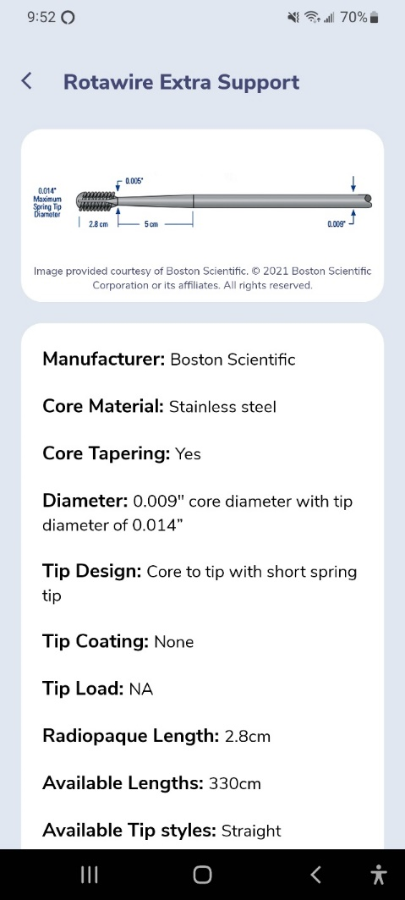
www.CardiologyApps.com/GuidewireAID

Slide 8
NEW!

Slide 9
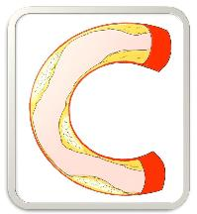
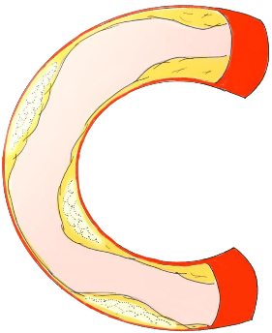
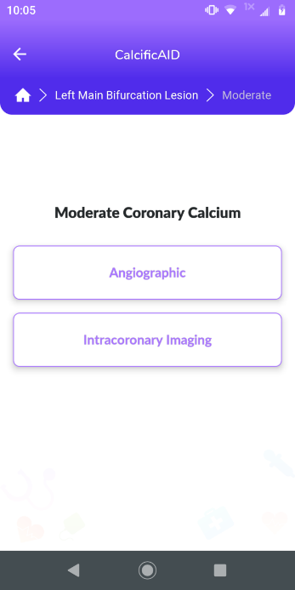
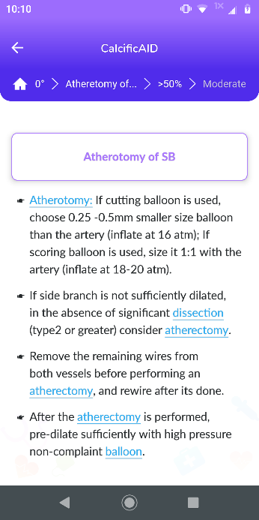
CalcificAID
Lesion selection
Calcium assessment
Treatment
Techniques
Basics
Complications
Notes:
In addition to the hundreds of possible treatment paths, CalcificAID has an educational background section with information about the imaging techniques, devices, and pharmacology of treating calcified lesions.

Slide 10
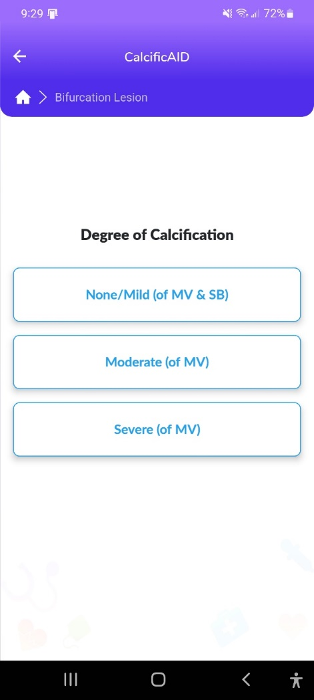
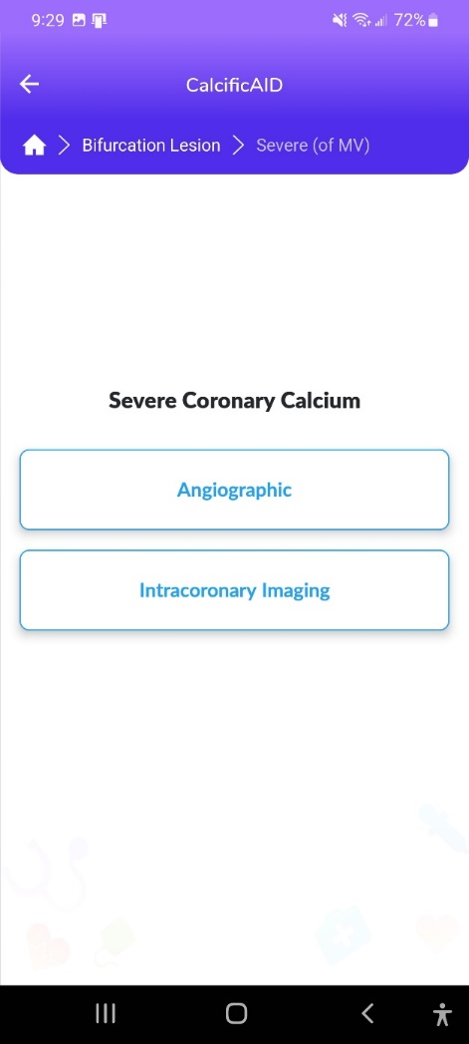
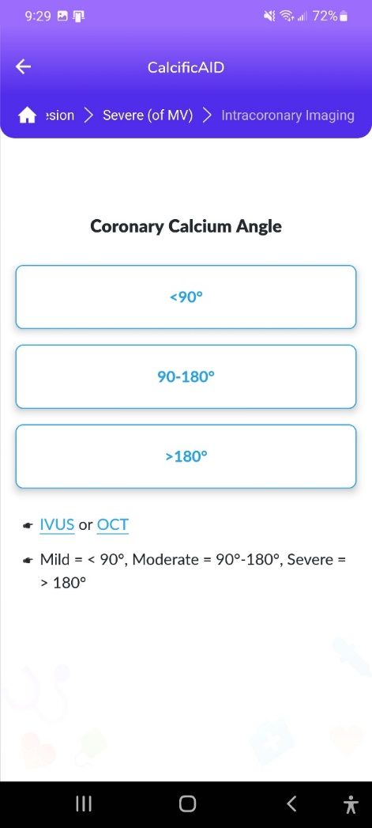
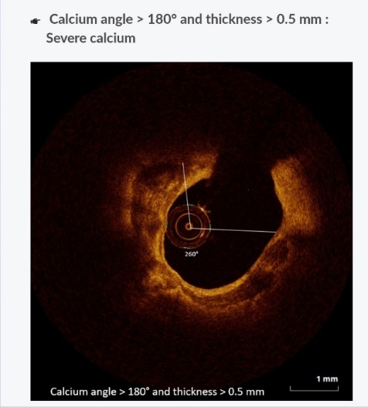
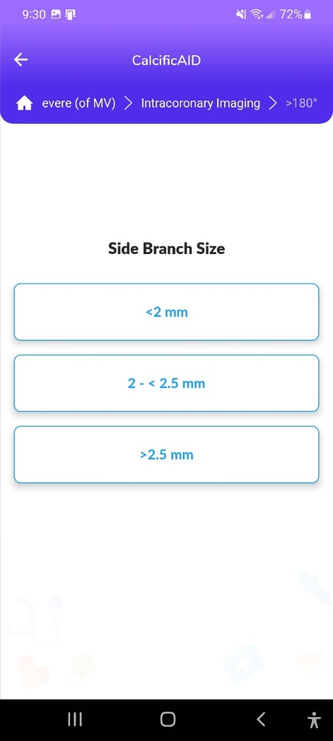
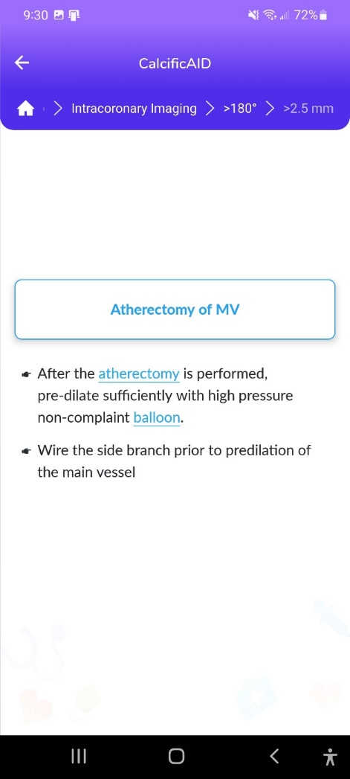
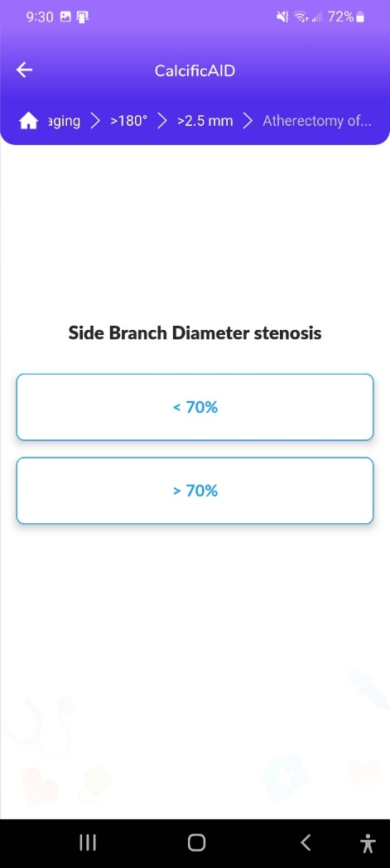
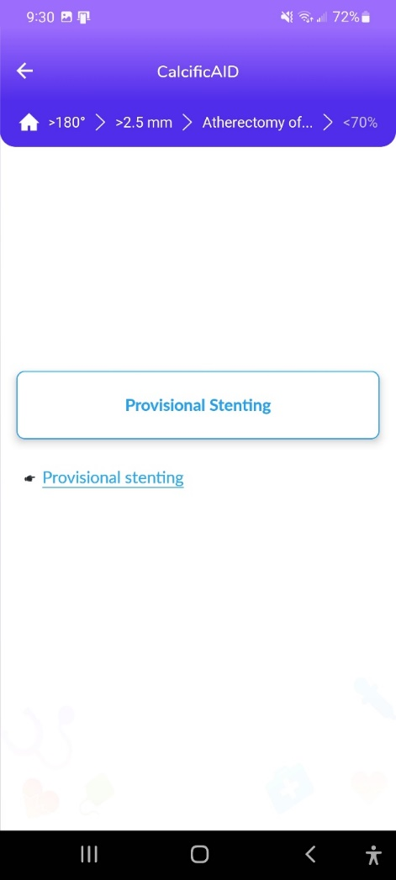
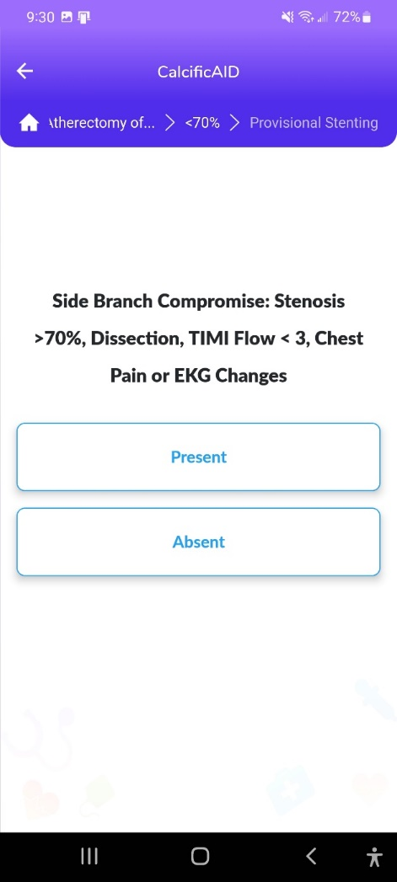
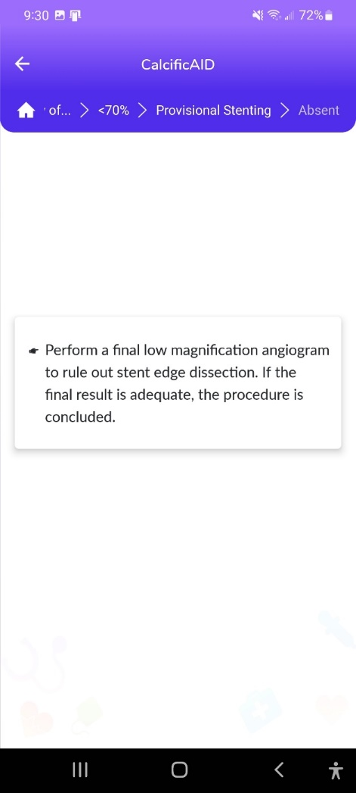
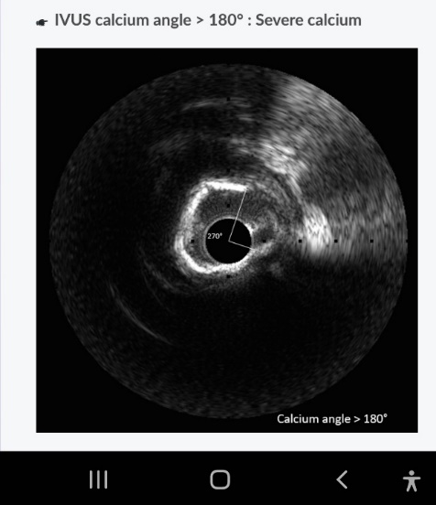
CalcificAID – NLM Bifurcation
Calcific Lesion Preparation
Notes:
These are the apps we have created which will provide digital algorithms for our future ambitious projects to make our cath labs smarter.

Slide 11
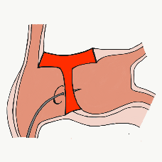
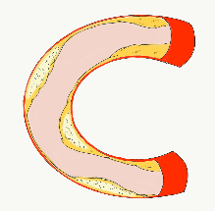
54,362 unique downloads and counting! (Up 14,000 in 2021)
Data Updated on Feb 14 2022*
Cath Lab Apps CardiologyApps.com
iOS ★ 5/5
12,227 downloads
Android ★ 4.96/5
9,372 downloads
Released sept 2017
iOS ★ 4.6/5
7,943 downloads
Android ★ 4.29/5
6,120 downloads
Released June 2018
iOS ★ 5/5
4,265 downloads
Android ★ 5/5
1,472 downloads
Released March 2019
iOS ★ 4.67/5
2,111 downloads
Android ★ 4.6/5
969 downloads
Released Sept 2018
iOS ★ 4.86/5
2,058 downloads
Android ★ 5/5
1,974 downloads
Released June 2019
Large Update Q3 19
Large Update Q1 21
BifurcAID
OCTAID
TAVRcathAID
TranseptAID
CalcificAID
*Also available
as WebApp
*Also available
as WebApp
Download Apps
For Free on Both:
WebApps available free on
www.CardiologyApps.com
Apple ® and App Store® are registered trademarks of Apple Inc.
Notes:
These are the apps we have created which will provide digital algorithms for our future ambitious projects to make our cath labs smarter.

Slide 12
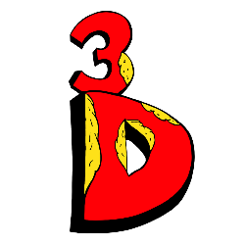
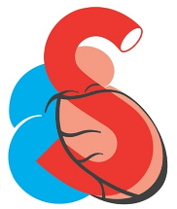
54,362 unique downloads and counting! (Up 14,000 in 2021)
Data Updated on Feb 14 2022*
Cath Lab Apps CardiologyApps.com
WebApp Only*
26,940 page views
www.cardiologyapps.com/ComplicAID
iOS ★ 5/5
2,179 downloads
Android ★ 5/5
1,405 downloads
Released June 2021
Clinical Care Application For Heart Attack patient transfers 475 downloads
Released Aug 2020
iOS ★ 5/5
1,142 downloads
Android ★ N/A
650 downloads
Released Nov 2021
Released August 2020
ComplicAID
BifurcAID 3D
STEMIcathAID
GuidewireAID
*Also available
as WebApp
*Also available
as WebApp
Download Apps
For Free on Both:
WebApps available free on
www.CardiologyApps.com
Apple ® and App Store® are registered trademarks of Apple Inc.
Notes:
These are the apps we have created which will provide digital algorithms for our future ambitious projects to make our cath labs smarter.

Slide 13
Outcomes of PCI vs CABG up to 5 yrs
What we know so far?
CABG++
Lower repeat revascularization
Durable angina relief
Lower mortality in subgroups of high syntax score & MV DM
Better QOL parameters
PCI++
Rapid recovery and lower LOS
Better short term results
Lower CVA
Improvement in LVEF
Similar outcomes in LM & low syntax score (<32) pts
What happens in 5-10+ yrs?

Slide 14
More than 35,800 unique downloads
Cath Lab Apps CardiologyApps.com
iOS 5/5 stars
9896 downloads
Android 4.4/5 stars
8245 downloads
Released sept 2017
iOS 5/5 stars
6068 downloads
Android 4.8/5 stars
3850 downloads
Released June 2018
iOS 5/5 stars
2073 downloads
Android N/A stars
549 downloads
Released March 2018
iOS 5/5 stars
1074 downloads
Android N/A stars
547 downloads
Released Sept 2018
iOS 5/5 stars
931 downloads
Android 5/5 stars
538 downloads
Released June 2019
WebApp Only*
2600 unique users
4800 sessions
Released August 2020
BifurcAID
OCTAID
TAVRcathAID
TranseptAID
CalcificAID
ComplicAID
*Also available
as WebApp
Download Apps
For Free on Both:
WebApps available free on
www.CardiologyApps.com
Apple ® and App Store® are registered trademarks of Apple Inc.
Notes:
These are the apps we have created which will provide digital algorithms for our future ambitious projects to make our cath labs smarter.

