Slide 1

Structural Heart Live Cases
Supported by:
Edwards Lifesciences
Cook Inc.
Terumo Medical
B-Braun

Slide 2
Faculty Involved and Disclosures
Samin K. Sharma, MD, FACC, MSCAI
Speaker’s Bureau – BSC, Abbott Vascular Inc
Annapoorna S. Kini, MD, FACC
Nothing to disclose
Sahil Khera, MD
Nothing to disclose
Gilbert Tang, MD, MSc, MBA, FACC
Physician proctor for Medtronic
Stamatios Lerakis, MD, PhD, FACC, FAHA
Nothing to disclose
Pedro Moreno, MD, FACC [Moderator]
Nothing to disclose
Cardiac Anesthesiologist
Benjamin Salter, MD

Slide 3
Structural Heart Live Case # 47: LS, 67 y/o F
Presentation: Worsening NYHA Class III symptoms of heart failure for 3M
PMH: HTN, HLD, Afib s/p ablation in 2012 (no longer on anticoagulant), asthma, OSA (on CPAP),thrombocytosis, severe AS s/p AVR (ATS 3F valve) in 2012, redo AVR (23 mm Magna Ease valve) with CABGx1 (LIMA to LAD) in 2015
Medications: Aspirin, Atorvastatin, Diltiazem, Albuterol, Hydroxyurea
Labs: Hgb 10.7, PLT 296K, K 4.8, Cr 0.7, INR 1.0
EKG (04/20/2022): Sinus rhythm, PR 124ms, QRS 92ms
TTE (03/14/2022): LVEF 55%, severe bio-prosthetic aortic valve stenosis (PG/MG/AVA/PV: 92/60/0.91/4.8), mild AR, mild MR & mild TR
TEE (04/20/2022): severely degenerated aortic bio-prosthesis with severe stenosis and moderate valvular AR and no paravalvular leak.

Slide 4

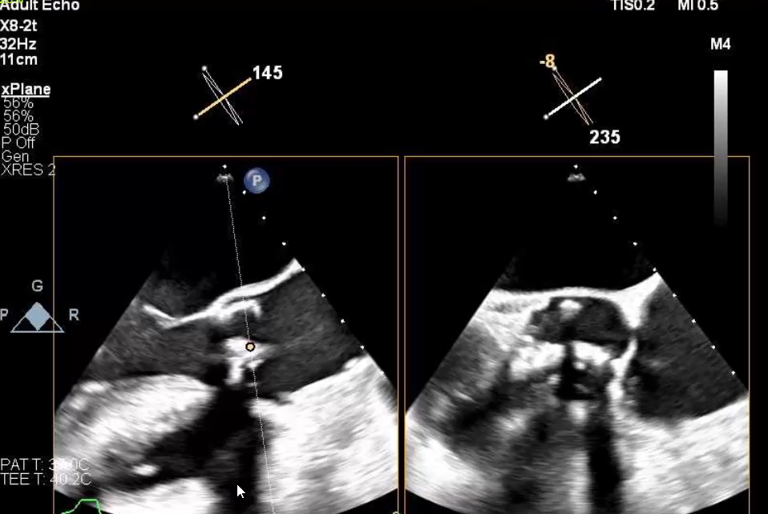
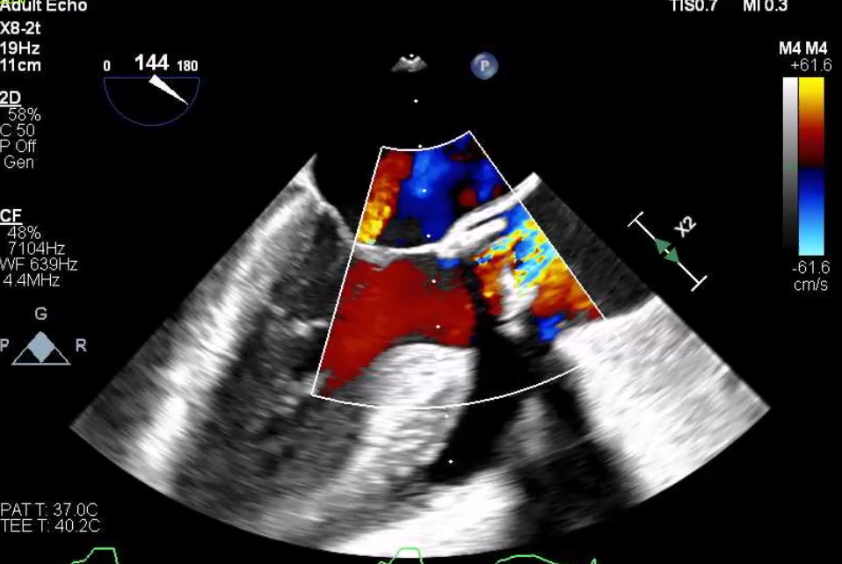
TEE
Bio-prosthetic aortic valve with thickened leaflets

Slide 5
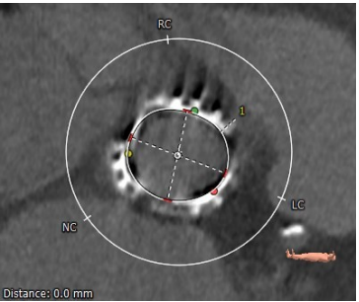
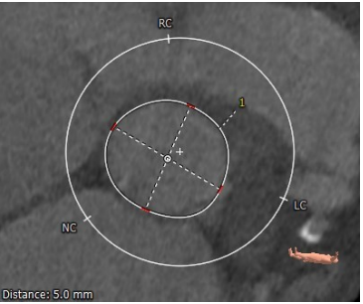
CTA: Aortic Annulus, LVOT
Aortic Annulus
Max: 22.4 mm
Min: 20.2 mm
Mean: 21.3 mm
Perimeter = 67.8 mm
Area = 363.3 mm²
LVOT
Max: 27.1 mm
Min: 24.8 mm
Mean: 25.9 mm
Perimeter = 82.6 mm
Area = 540 mm²

Slide 6
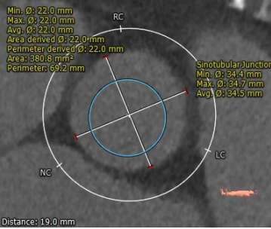
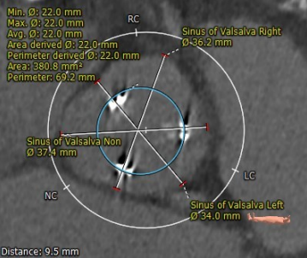
CTA: STJ and SOV
STJ
Min 34.4 mm
Max 34.7 mm
Mean 34.5 mm
Sinus of Valsalva
RCC 36.2 mm
LCC 34.0 mm
NCC 37.4 mm

Slide 7
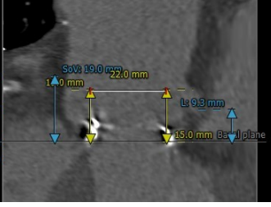
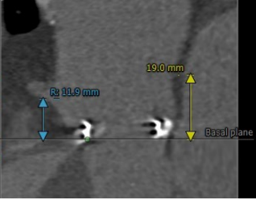
CTA: Coronary Artery Heights
LM – 9.3 mm
RCA – 11.9 mm

Slide 8
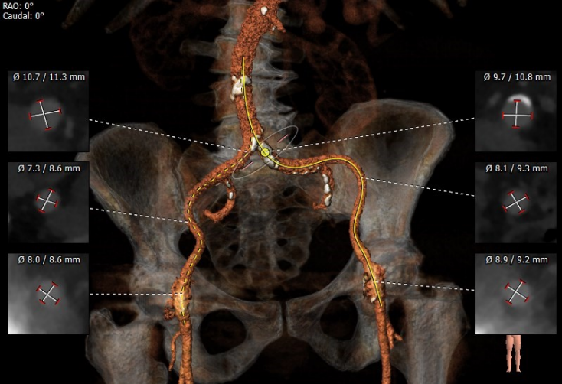
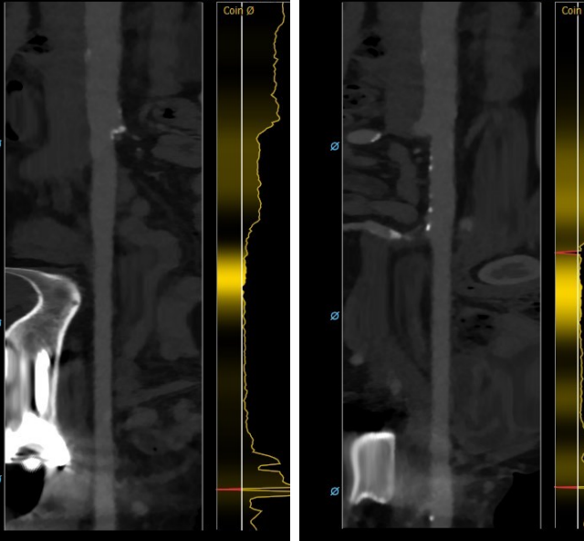
CTA: Femoral Arterial Access
Access 3D
Longitudinal view
Right Iliac/Femoral
Longitudinal view
Left Iliac/Femoral

Slide 9
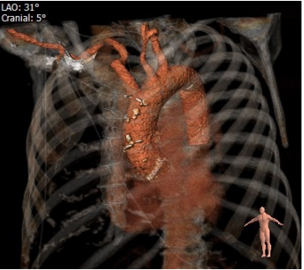
CTA: Arch Angiogram

Slide 10
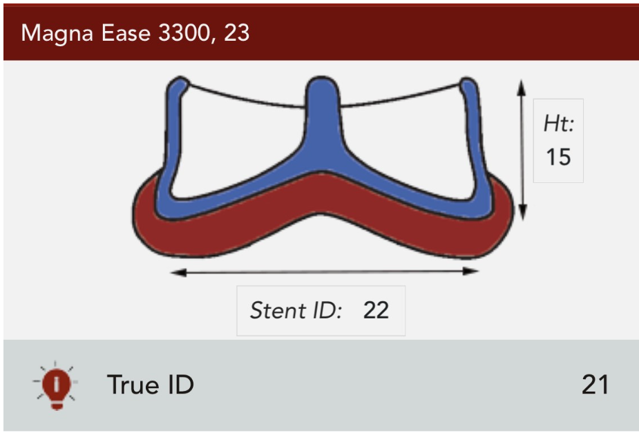
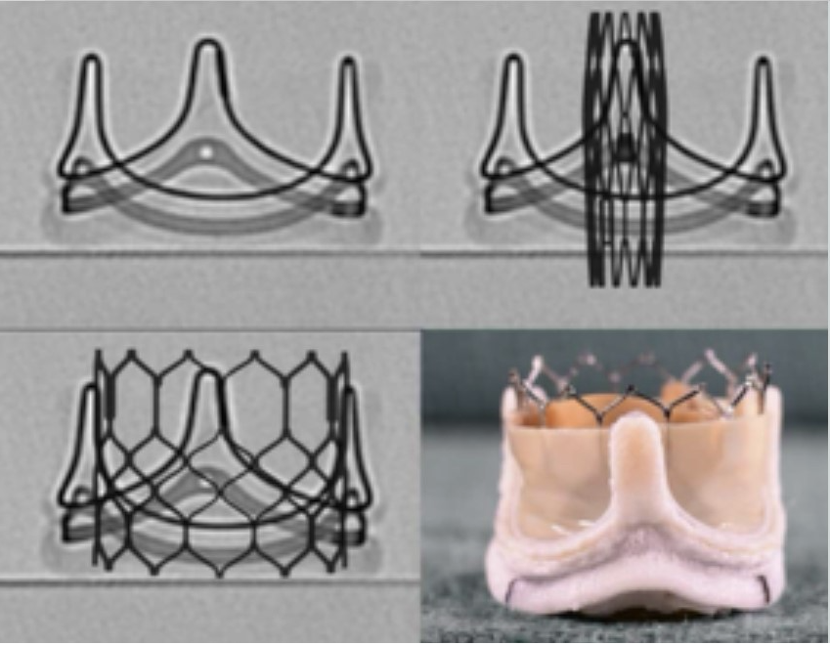
23mm Magna Ease valve with pericardial leaflets sutured “inside” the stent
Suggested ViV Sapien: 23mm
Valve in Valve positioning

Slide 11
Summary of Case
Presentation: 67 year old female with NYHA Class III HF for 3 M
TEE: Severely degenerated aortic bio-prosthesis with severe stenosis and moderate valvular regurgitation, EF 55%
STS risk mortality for second redo AVR: 5.2%
Heart Team Discussion: Patient was evaluated by heart team and recommended TF ViV TAVR after surgical valve fracture
Plan: TF valve in valve TAVR via right percutaneous femoral arterial access using 23mm Sapien-3 ultra valve in degenerated redo Magna Ease surgical valve after balloon valve fracture with Sentinel cerebral embolic protection device.

Slide 12
Latest Issues in Transcatheter Structural Heart Interventions
Recent publications in the TAVR Field:
- ViV TAVR in Partner-2 trial at 5 yrs
- Late BAV for THV (TAVR) dysfunction
- SVD after TAVR vs SAVR at 5 yrs
- Same day discharge after TAVR in Covid-19
- TAVR vs SAVR in asymptomatic severe AS

Slide 13
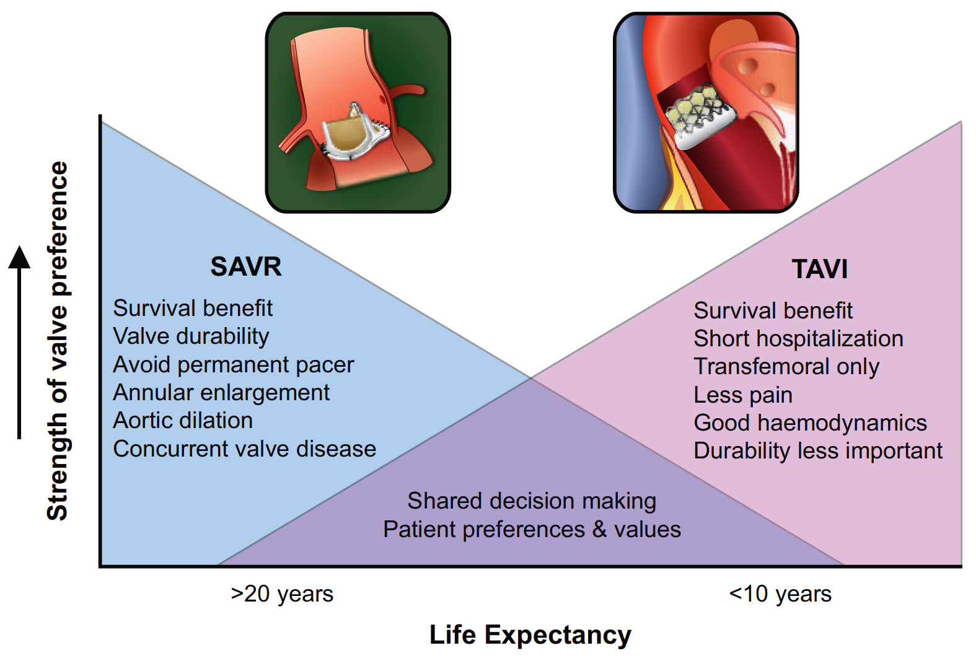
Balance of Factors Determining Strength of Valve Preference vs. Expected Remaining Years of Life
Oyetunji and Otto, Eur Heart J 2021;42:2920

Slide 14
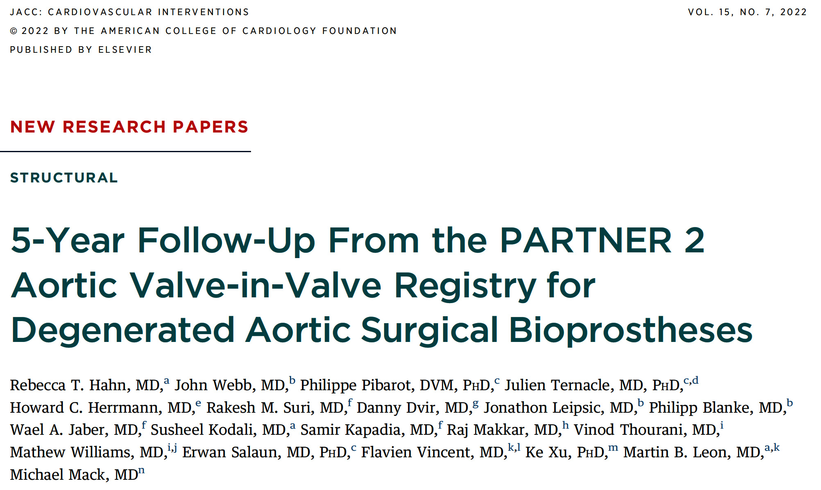

Slide 15
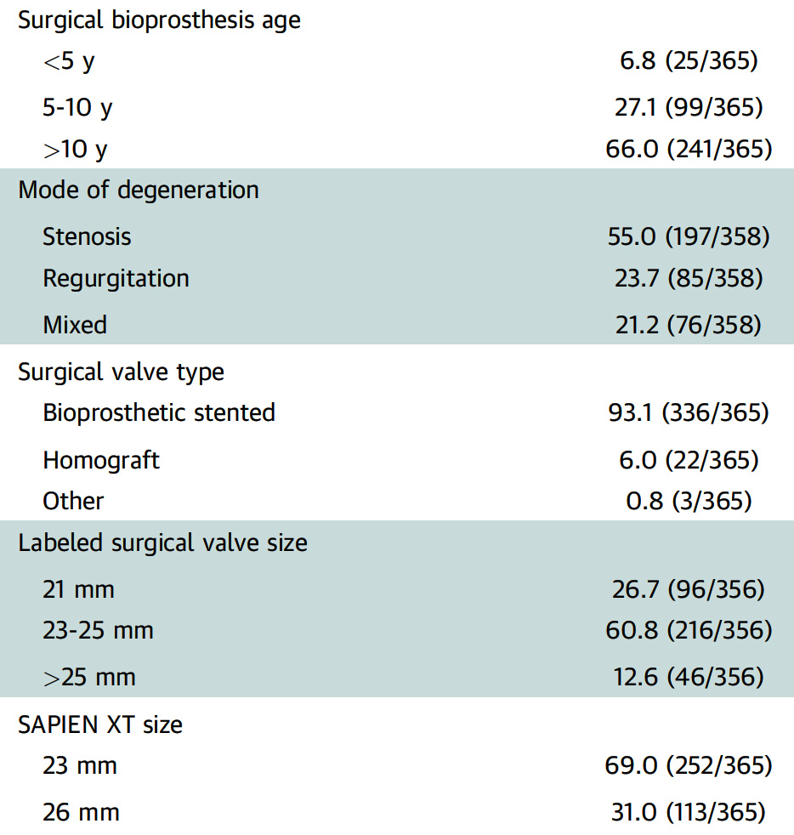
PARTNER 2 AViV Registry: Bioprosthetic Valve Characteristics
Hahn et al., J Am Coll Cardiol Intv 2022;15:698

Slide 16
PARTNER 2 AViV Registry: K-M Estimate of Clinical Outcomes – 30 Days to 5 Years
%
Hahn et al., J Am Coll Cardiol Intv 2022;15:698

Slide 17
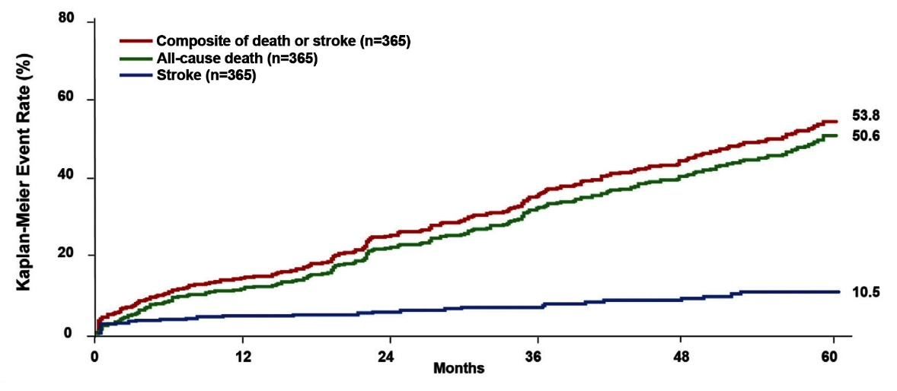
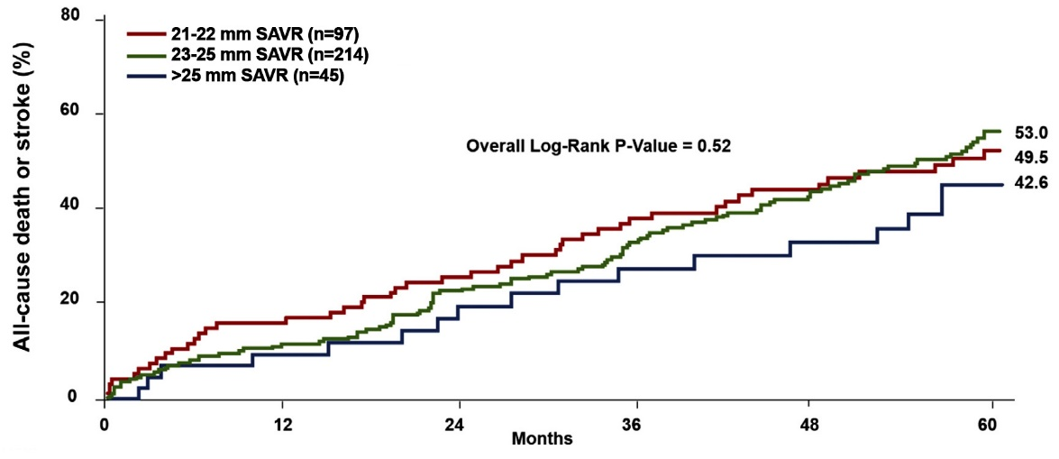
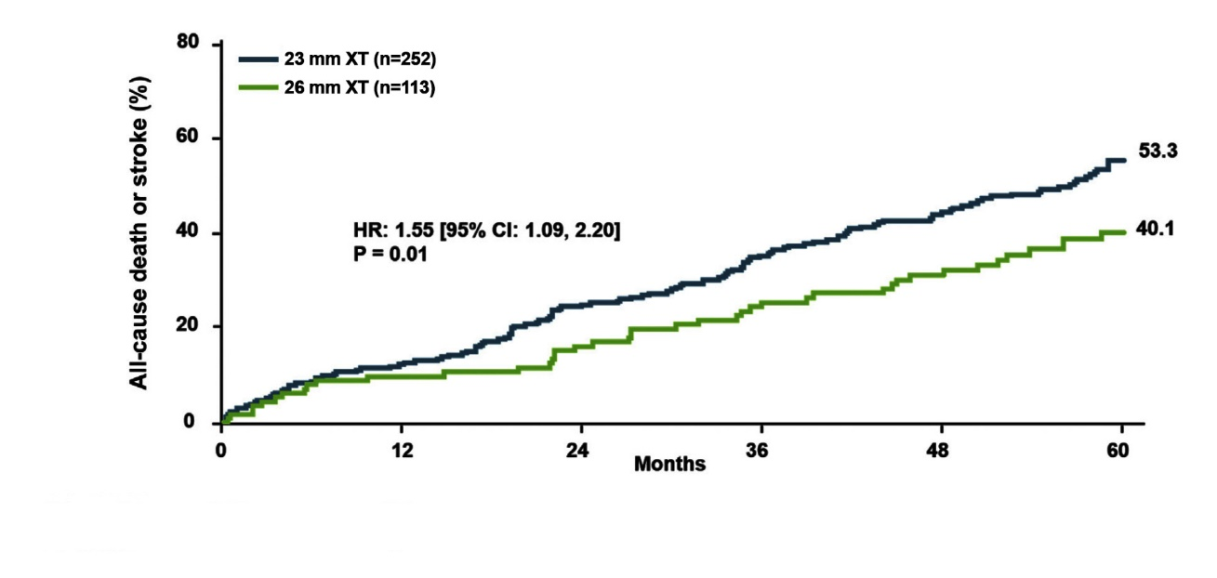
PARTNER 2 AViV Registry: 5-Year K-M Curves
Death/Stroke, All-Cause Death and Stoke for Entire Cohort
Death/Stroke for Prior Surgical
Valve Size
Death/Stroke by Size of the Implanted THV
Hahn et al., J Am Coll Cardiol Intv 2022;15:698

Slide 18
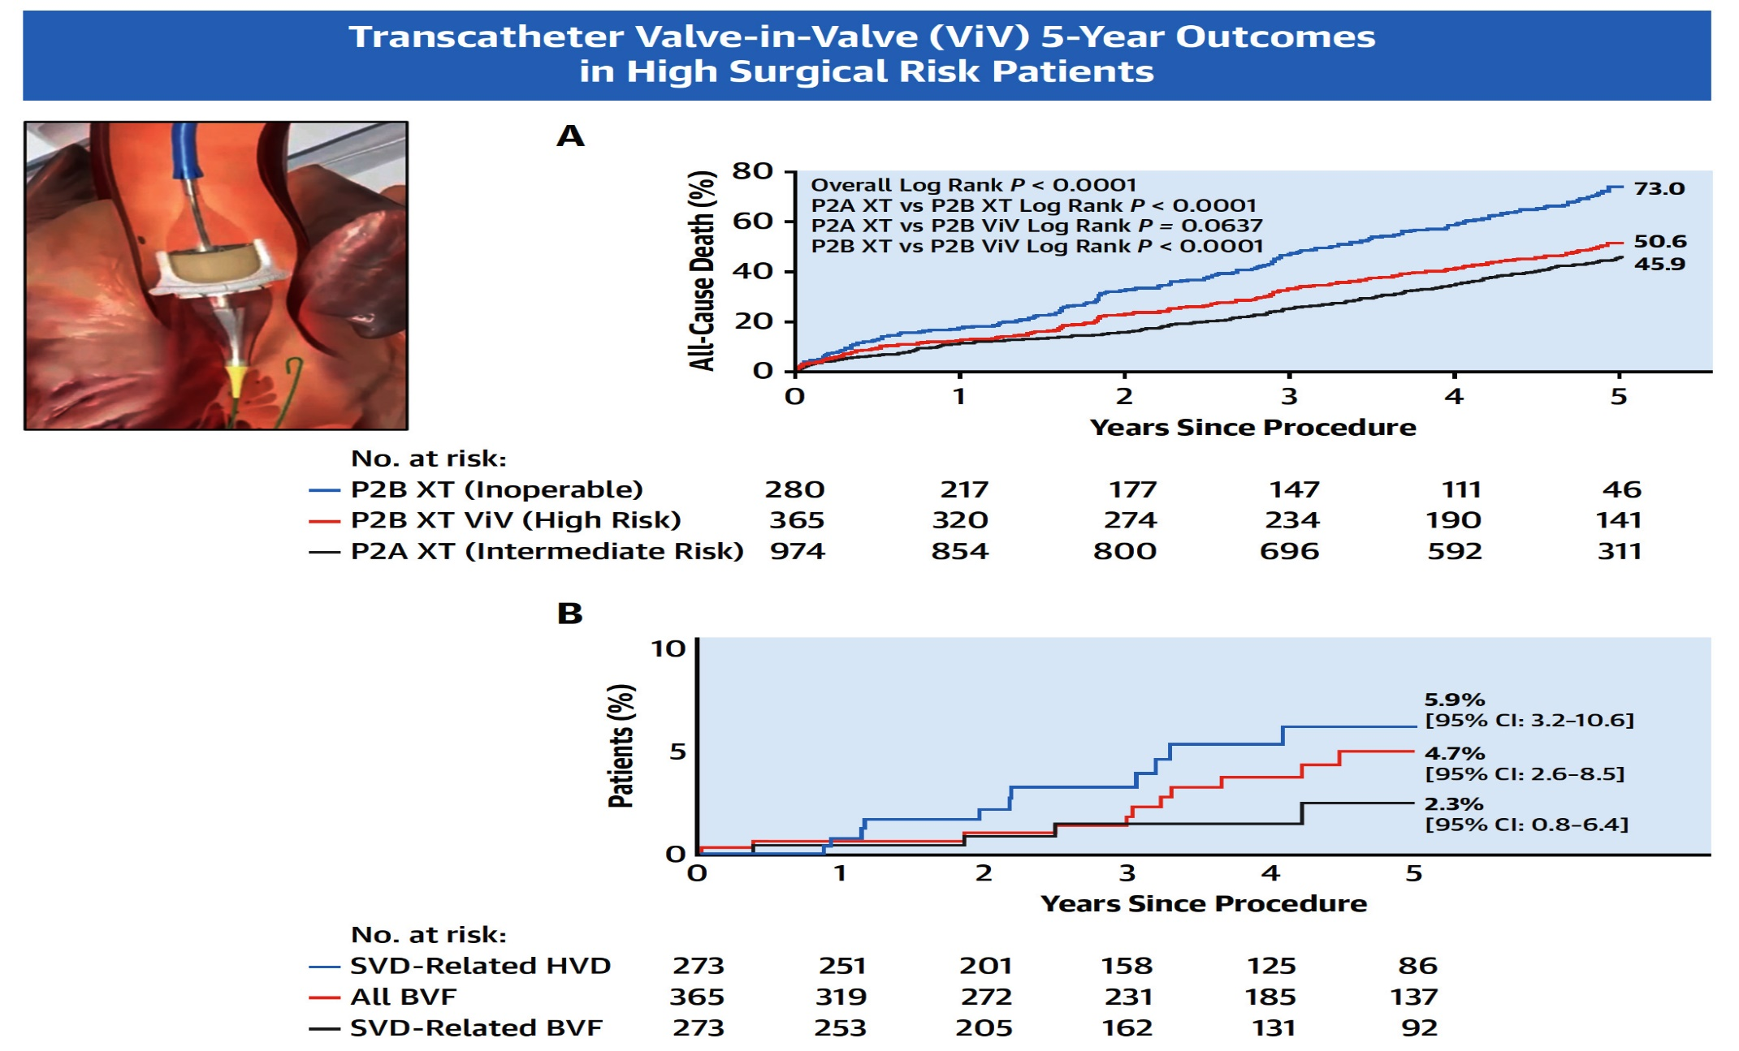
PARTNER 2 AViV Registry: Transcatheter ViV Implantation 5-Year Outcomes
Hahn et al., J Am Coll Cardiol Intv 2022;15:698

Slide 19
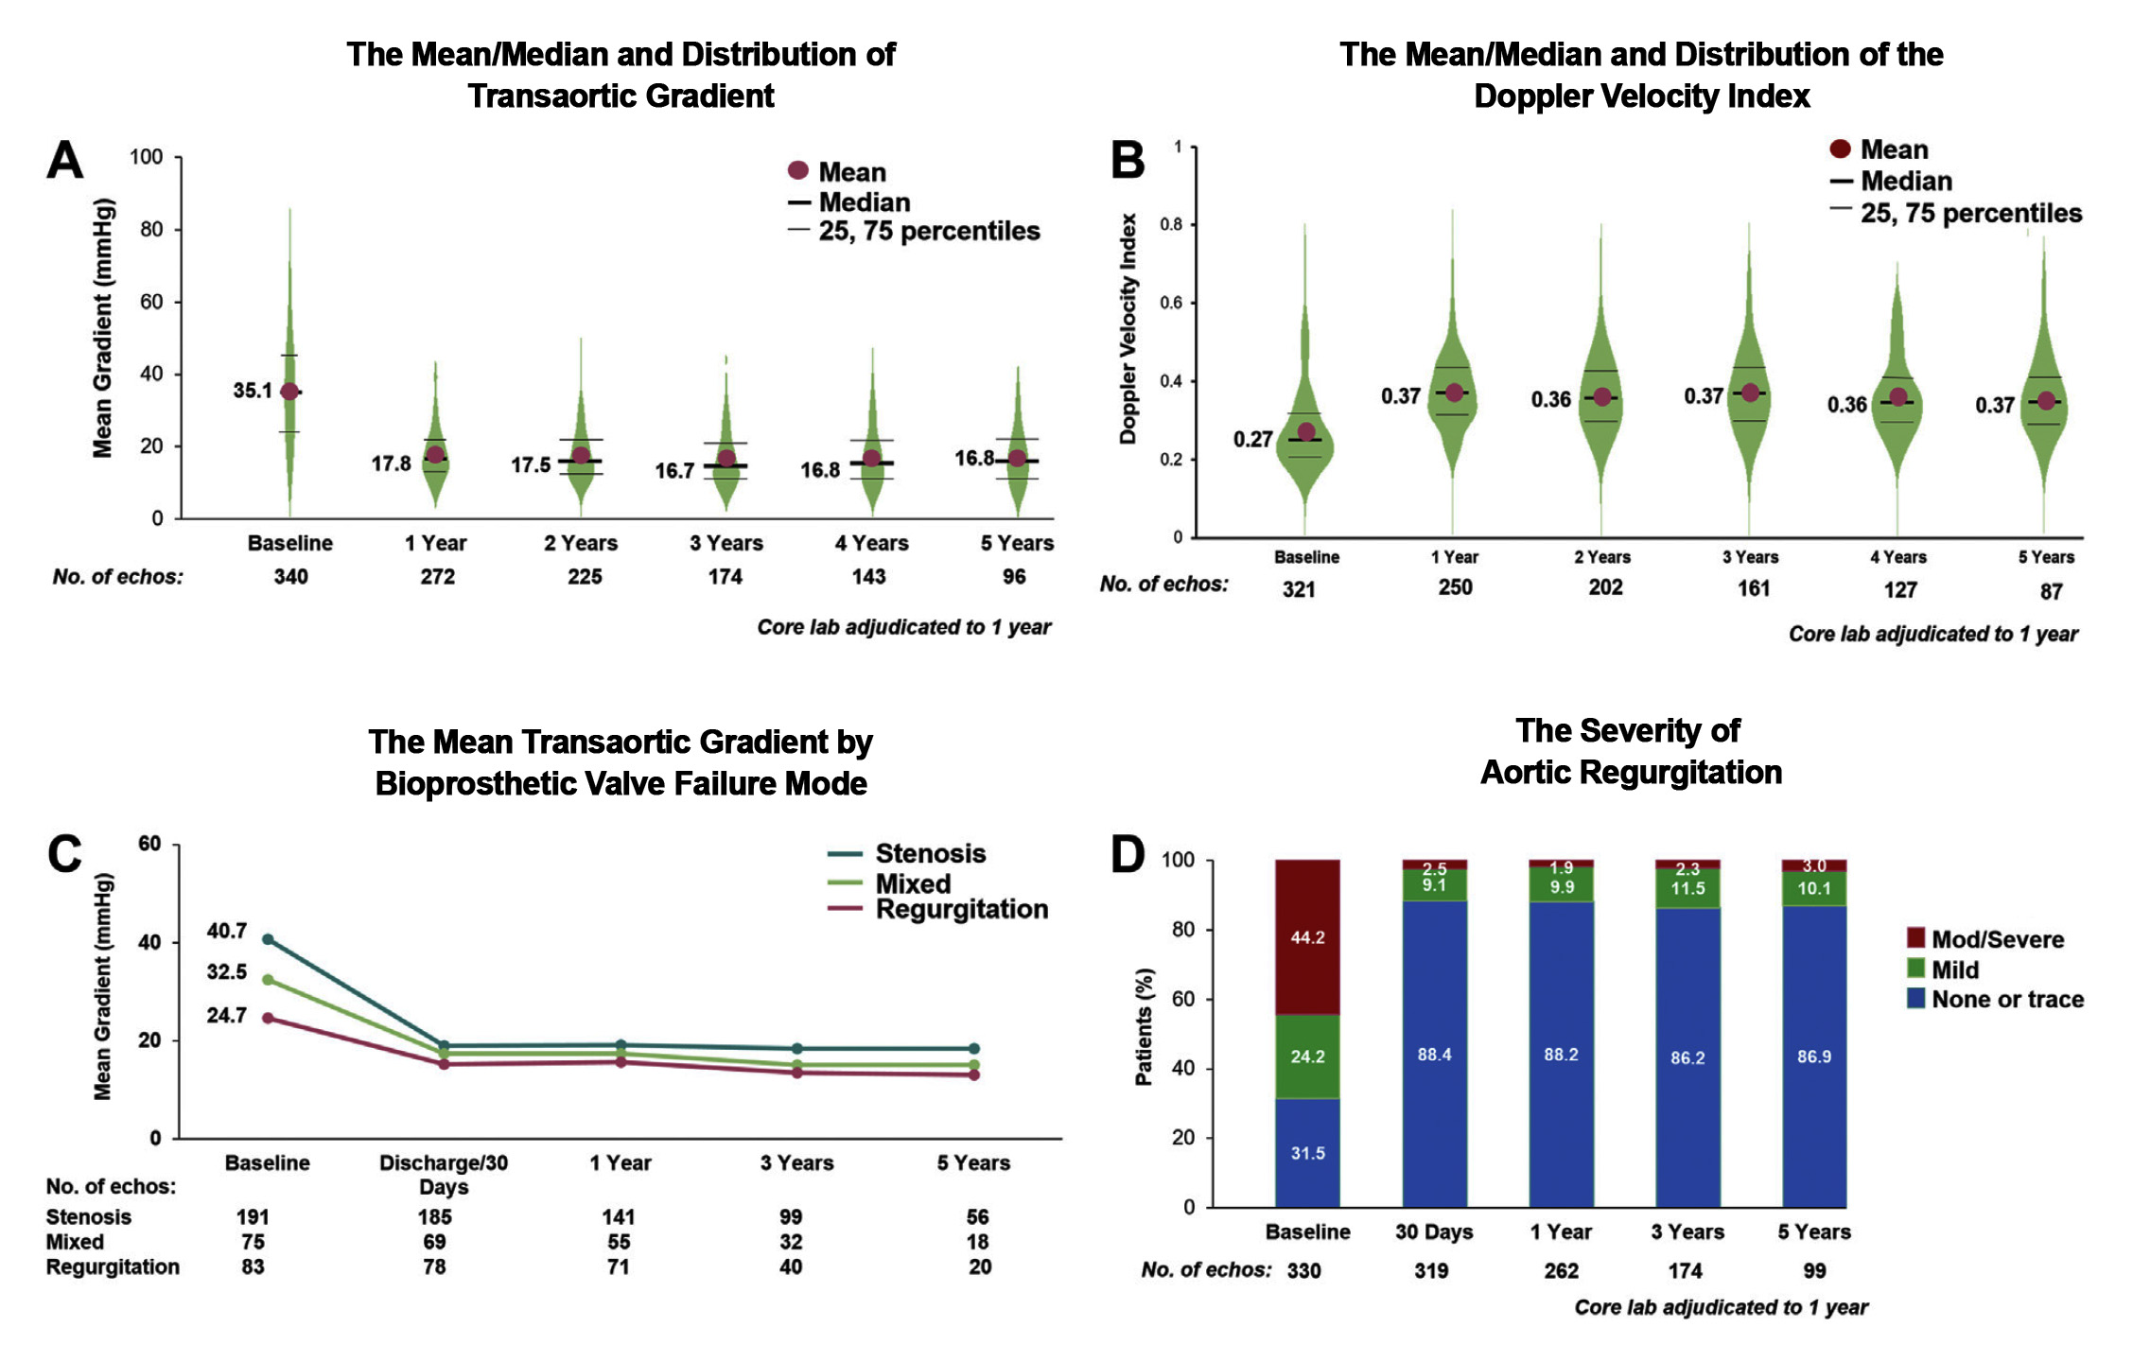
PARTNER 2 AViV Registry: Echocardiographic Outcomes to 5 Years
Hahn et al., J Am Coll Cardiol Intv 2022;15:698

Slide 20
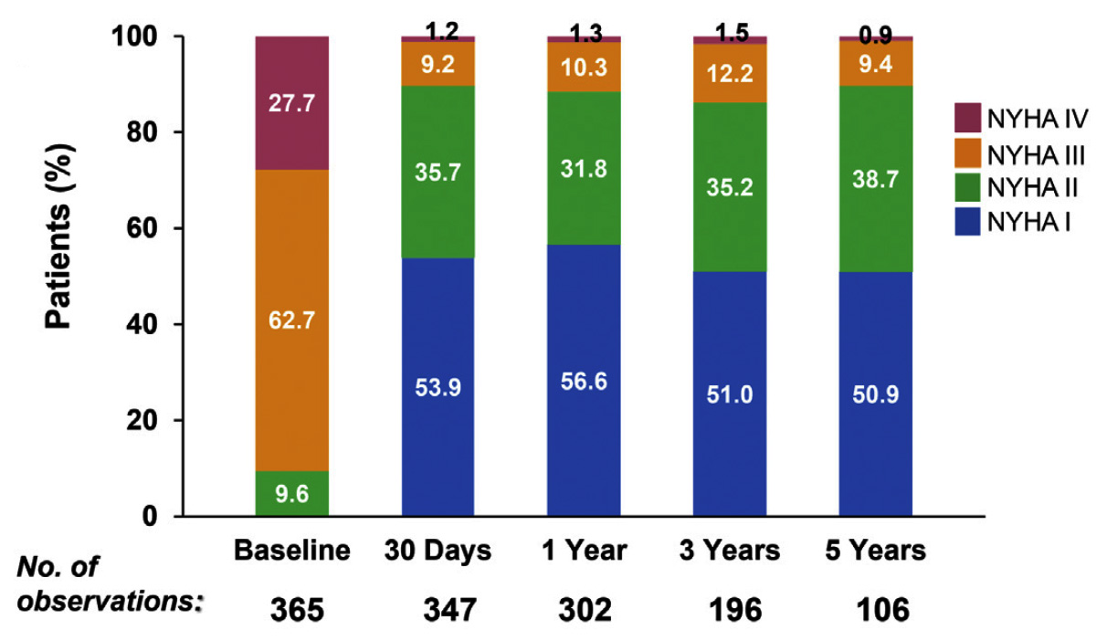
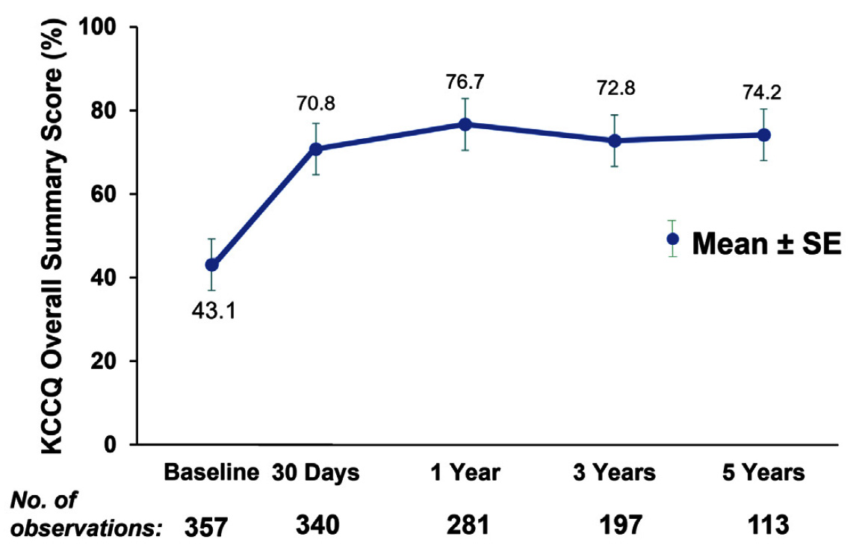
PARTNER 2 AViV Registry: Symptoms and QoL Outcomes at 5 Years
NYHA Functional Class Over the
5-Year Follow-Up Period
KCCQ Scores Through the
5-Year Follow-Up Period
Hahn et al., J Am Coll Cardiol Intv 2022;15:698

Slide 21
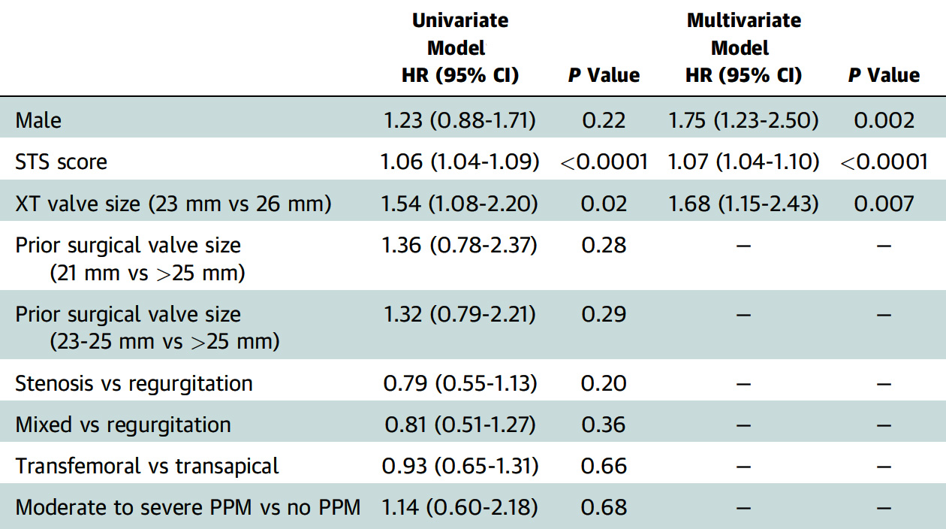
PARTNER 2 AViV Registry: Predictors of
All-Cause Mortality
Hahn et al., J Am Coll Cardiol Intv 2022;15:698

Slide 22
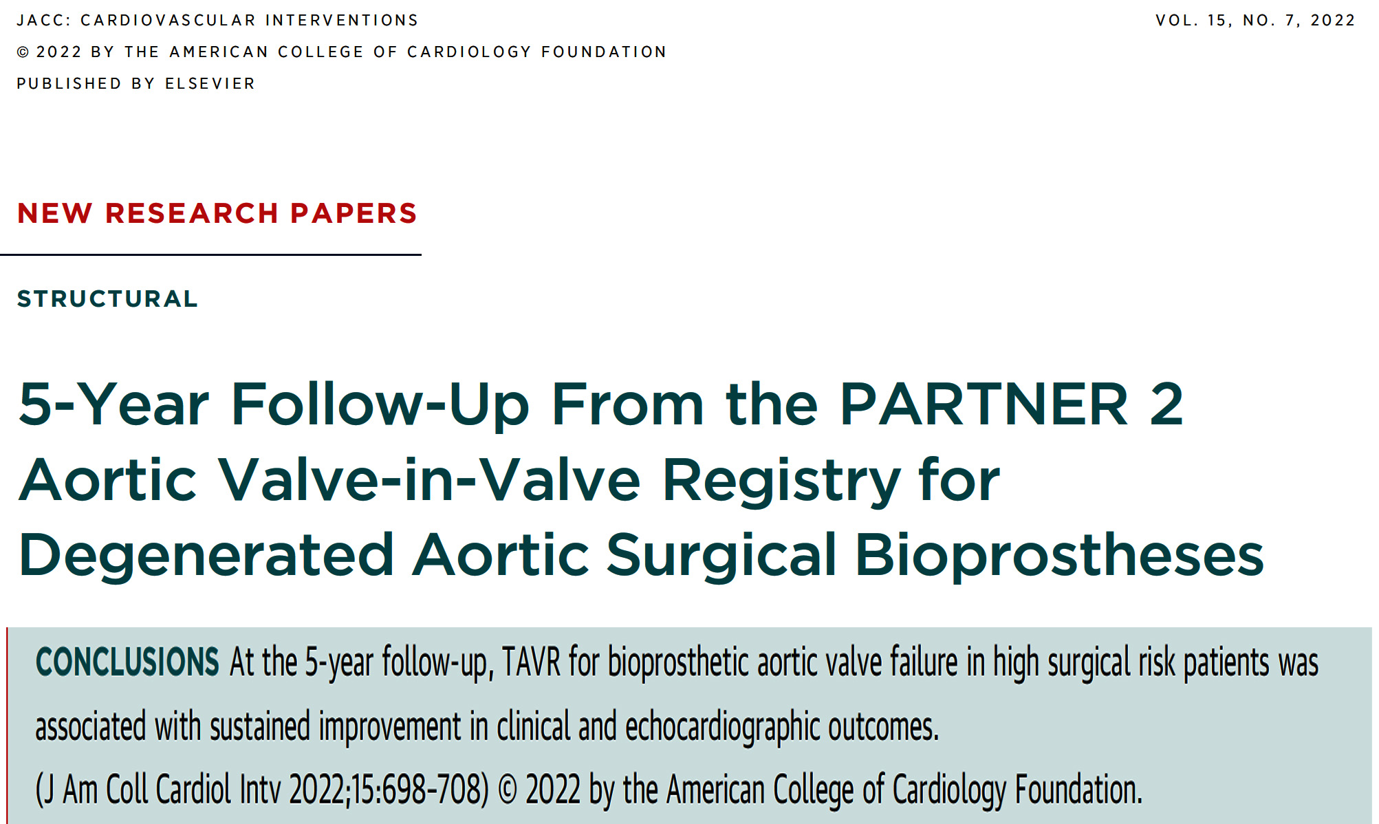

Slide 23
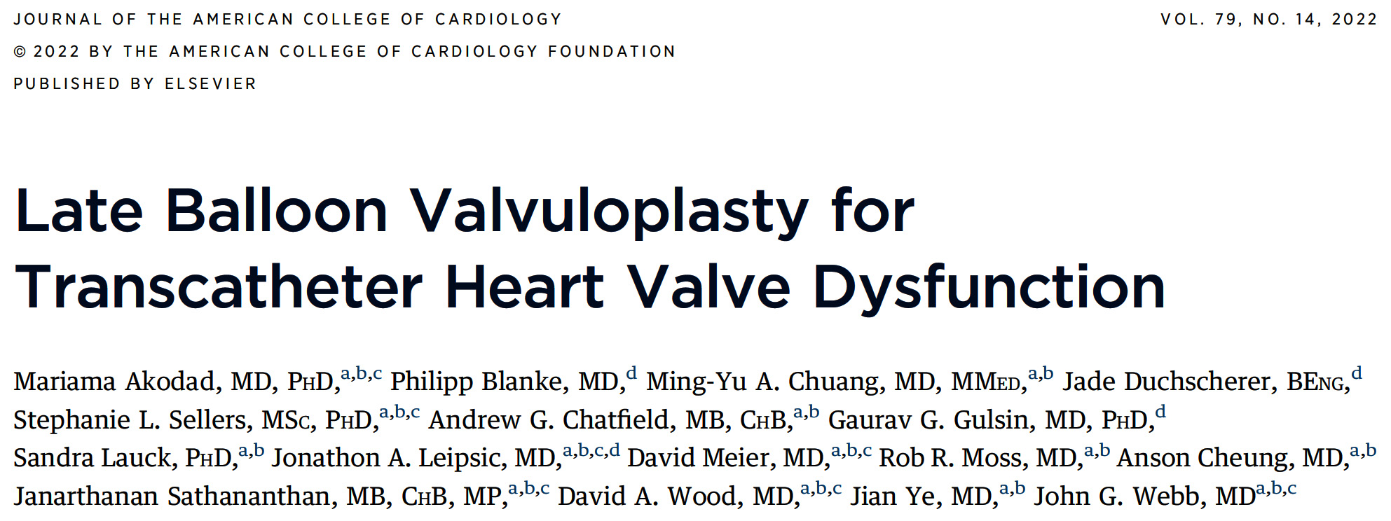

Slide 24
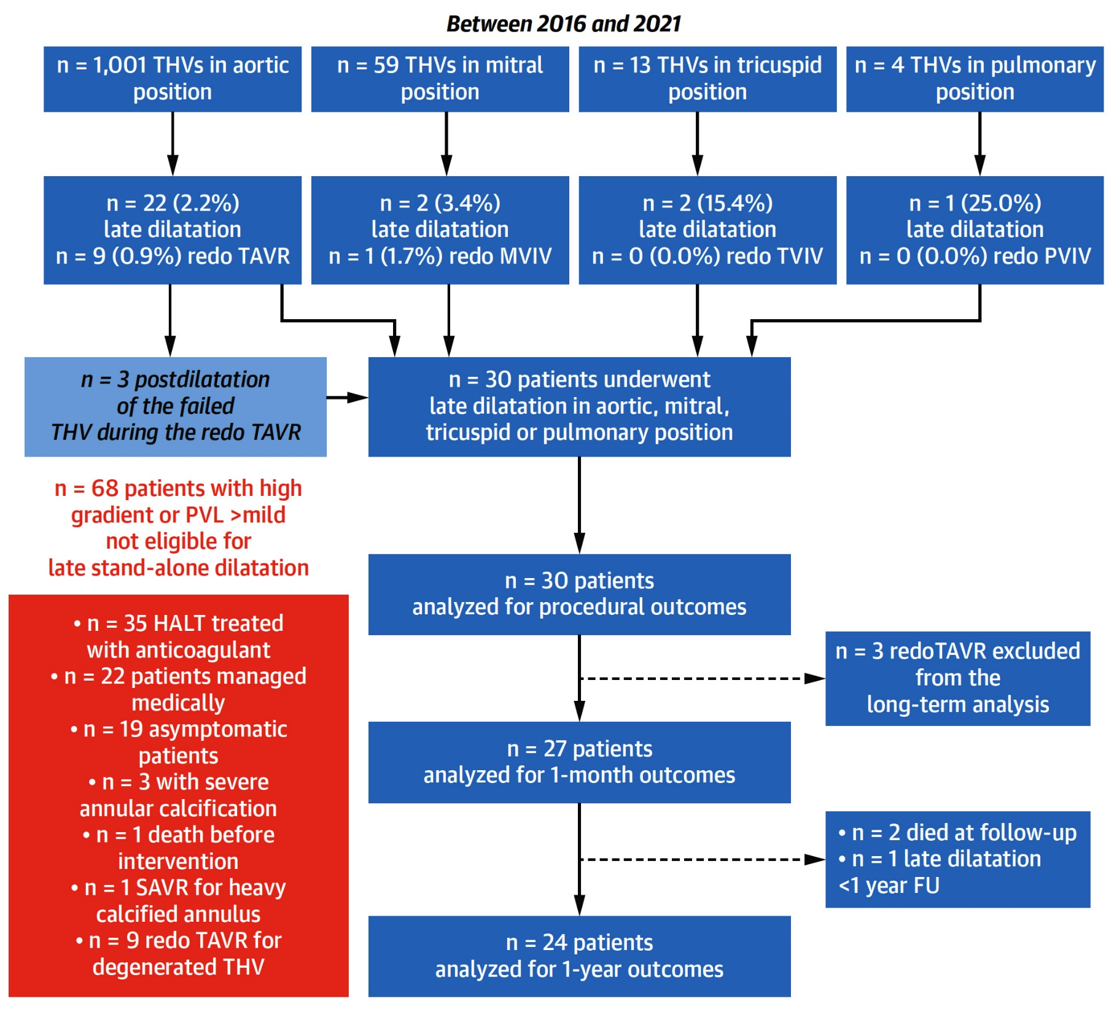
THV Dysfunction Study Flowchart
Total population who underwent aortic, mitral, tricuspid, and pulmonary THV implants between 2016-2021 and portion of patients in whom late dilatation was performed.
Akodad et al., J Am Coll Cardiol 2022;79:1340

Slide 25
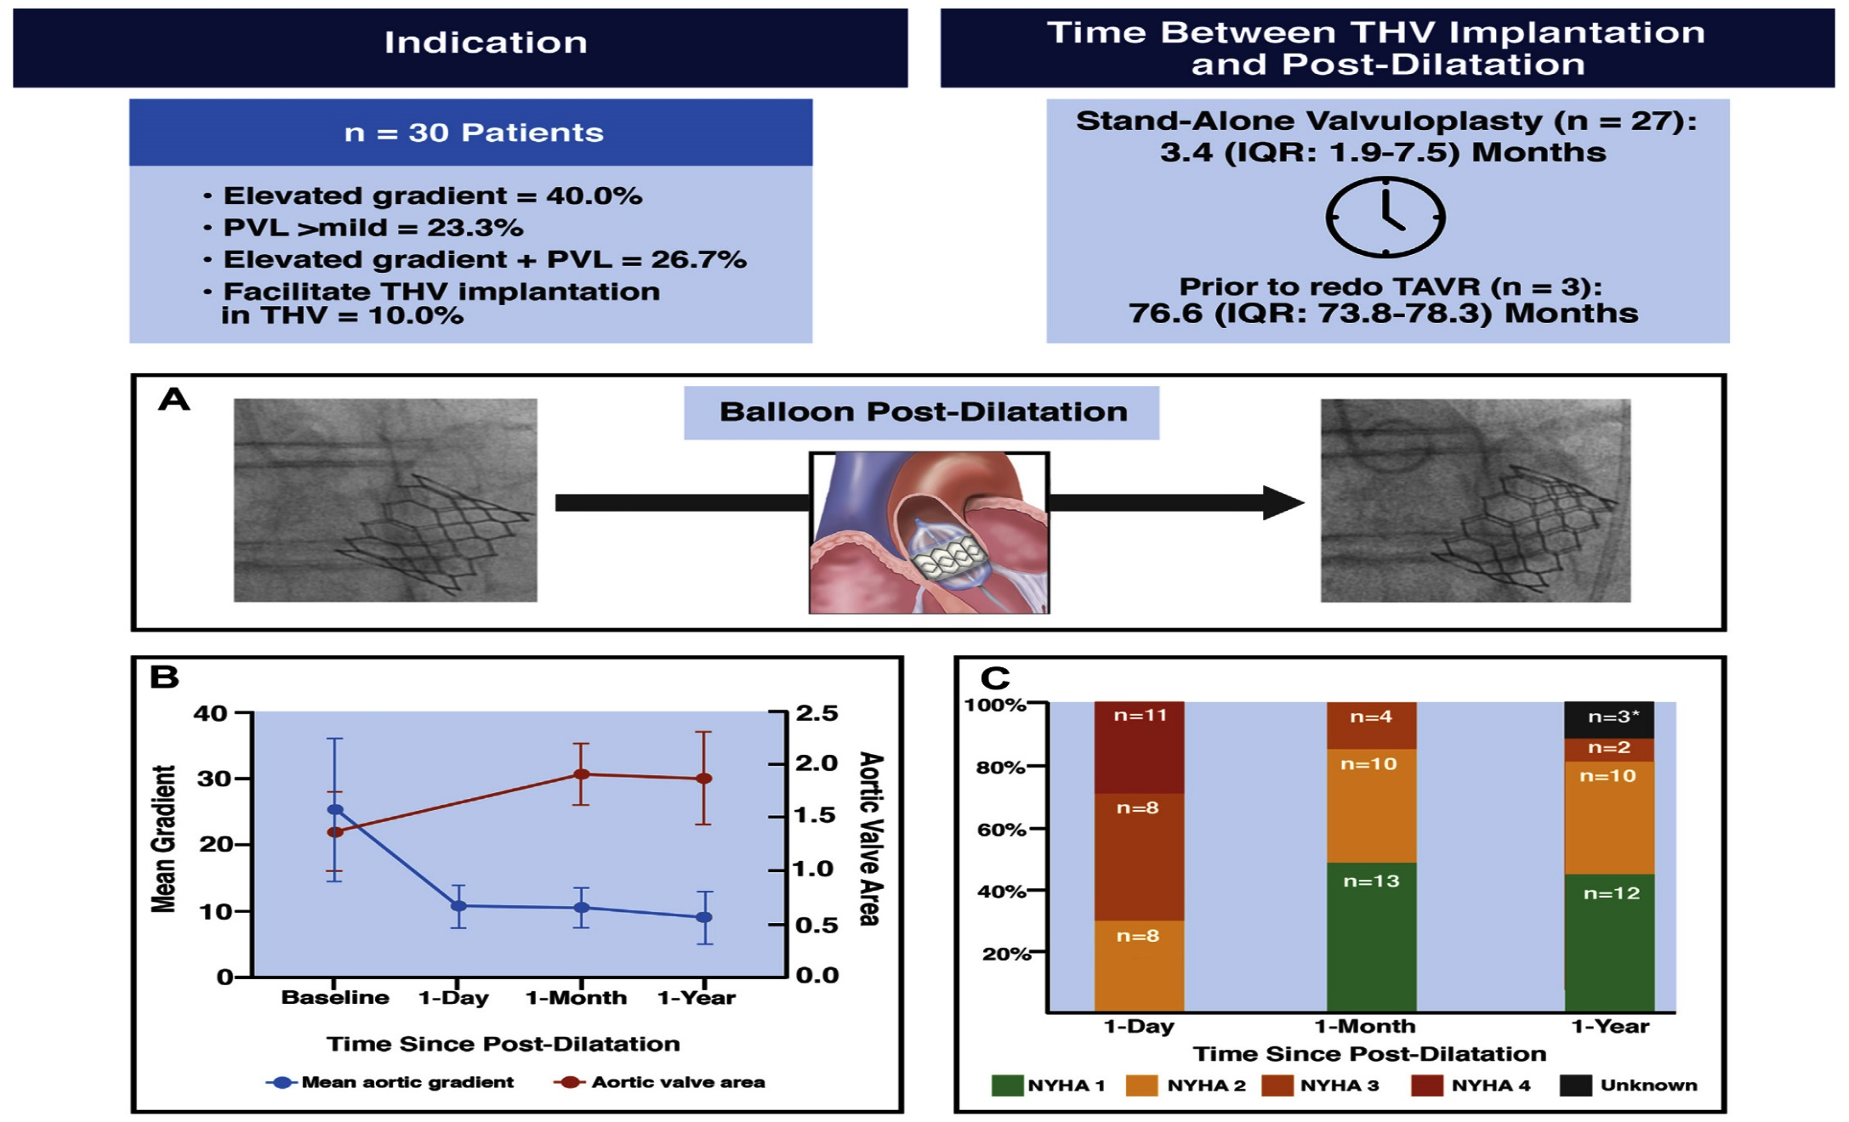
Indications, THV Hemodynamic Performance, and Symptoms After Late Balloon Dilatation
Akodad et al., J Am Coll Cardiol 2022;79:1340

Slide 26
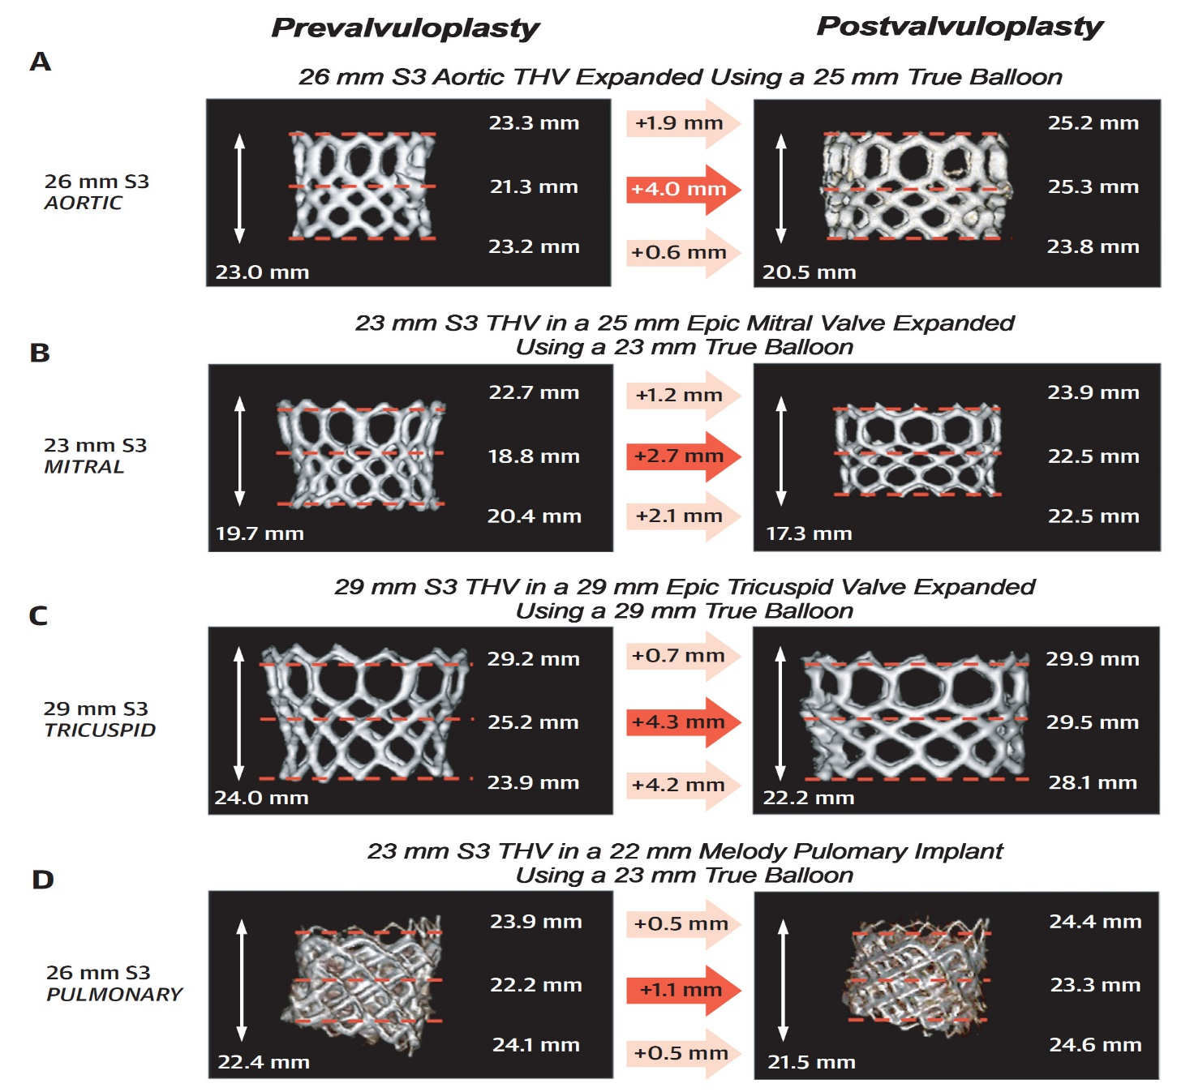
Volume Rendered MSCTs Showing Underexpanded
THVs with Improved Expansion Post-Valvuloplasty
Akodad et al., J Am Coll Cardiol 2022;79:1340

Slide 27
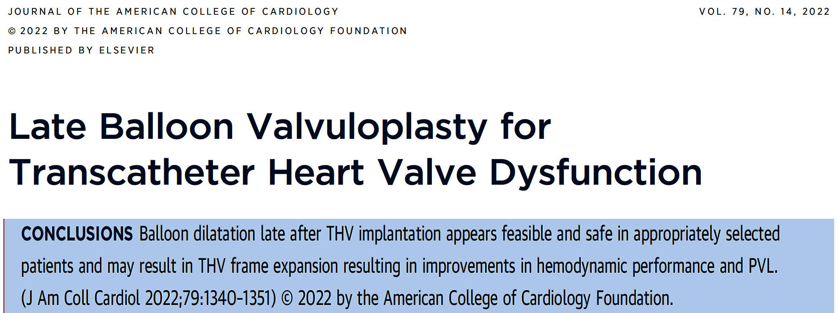

Slide 28
5-Year Incidence, Outcomes and Predictors of Structural Valve Deterioration of Transcatheter and Surgical Aortic Bioprostheses:
Insights from the CoreValve US Pivotal and SURTAVI Trials

Slide 29
CoreValve EVOLUT Pooled Analysis
Study Objective
To evaluate the 5-year incidence, outcomes and predictors of hemodynamic structural valve deterioration (SVD) in patients undergoing supra-annular, self-expanding TAVI and surgery from the CoreValve US Pivotal and SURTAVI trials
Reardon M, ACC 2022

Slide 30
CoreValve EVOLUT Pooled Analysis
Study Demographics
 | Surgery RCT (N=971) | TAVI RCT (N=1128) | TAVI Non-RCT (N=2663)
Age, years | 80.6 ± 6.3 | 80.9 ± 6.5 | 83.1 ± 8.0 *
Male | 527 (54.3) | 632 (56.0) | 1446 (54.3)
Body surface area, m² | 1.9 ± 0.2 | 1.9 ± 0.2 | 1.9 ± 0.3 *
STS-PROM, % | 5.3 ± 2.5 | 5.2 ± 2.4 | 8.7 ± 4.6 *
NYHA III/IV | 639 (65.8) | 757 (67.1) | 2288 (85.9) *
Prior percutaneous coronary intervention | 253 (26.1) | 280 (24.8) | 1052 (39.5) *
Prior coronary artery bypass surgery | 213 (21.9) | 229 (20.3) | 973 (36.5) *
Hypertension | 889 (91.6) | 1056 (93.6) | 2458 (92.3)
Creatinine > 2.0 mg/dL | 24 (2.5) | 24 (2.1) | 121 (4.5) *
Prior atrial fibrillation/flutter | 305 (31.4) | 348 (30.9) | 1132 (42.6) *
Baseline anticoagulation therapy | 236 (24.3) | 236 (20.9) | 558 (21.0)
Mean ± SD or no. (%)
No significant differences between RCT cohorts
* P<0.001 vs. TAVI RCT
Reardon M, ACC 2022

Slide 31
CoreValve EVOLUT Pooled Analysis
5-Year Adjusted for Competing Risk of Mortality
Significantly lower rate of SVD with TAVI vs. Surgery through 5 years
4.38%
P = 0.0095
2.57%
* CoreValve 88%, Evolut R 12%
Reardon M, ACC 2022

Slide 32
CoreValve EVOLUT Pooled Analysis
5-Year SVD in Smaller (≤23 mm) Annular Diameters
Significantly lower rate of SVD with TAVI vs. Surgery through 5 years in small annuli
5.86%
P = 0.049
1.39%
Reardon M, ACC 2022

Slide 33
CoreValve EVOLUT Pooled Analysis
5-Year SVD in Larger (>23 mm) Annular Diameters
Trend toward a lower rate of SVD with TAVI vs. Surgery through 5 years in larger annuli
3.96%
P = 0.067
2.48%
Reardon M, ACC 2022

Slide 34
CoreValve EVOLUT Pooled Analysis
Worsened Clinical Outcomes in Patients Who Develop SVD
 |  |  | HR (95% CI) | P value
Pooled Surgery RCT and All TAVI* (N=4762)
All-cause mortality |  |  | 1.98 (1.42, 2.76) | <0.001
Cardiovascular mortality |  |  | 1.82 (1.17, 2.84) | 0.008
Hospitalization for AV disease/worsening HF |  |  | 2.11 (1.19, 3.74) | 0.010
Composite † |  |  | 1.96 (1.38, 2.80) | <0.001
Surgery RCT (N=971)
All-cause mortality |  |  | 2.45 (1.40, 4.30) | 0.002
Cardiovascular mortality |  |  | 2.37 (1.10, 5.08) | 0.027
Hospitalization for AV disease/worsening HF |  |  | 2.20 (0.81, 5.98) | 0.121
Composite † |  |  | 2.73 (1.53, 4.88) | <0.001
All TAVI* (N=3791)
All-cause mortality |  |  | 2.24 (1.48, 3.38) | <0.001
Cardiovascular mortality |  |  | 2.07 (1.20, 3.59) | 0.009
Hospitalization for AV disease/worsening HF |  |  | 2.34 (1.16, 4.71) | 0.017
Composite † |  |  | 1.93 (1.23, 3.03) | 0.005
* RCT and Non-RCT cohorts: CoreValve 97%, Evolut R 3%
† All-cause mortality or hospitalization for AV disease or worsening HF
Lower risk with SVD Higher risk with SVD
Reardon M, ACC 2022

Slide 35
CoreValve EVOLUT Pooled Analysis
Univariate and Multivariate Predictors of 5-Year SVD
 | Univariate Model |  | Multivariate Model
Pooled Surgery RCT and All TAVI* (N=4762) | HR (95% CI) | P value | HR (95% CI) | P value
Age, years | 0.96 (0.94, 0.98) | <0.001 | 0.97 (0.95, 1.00) | 0.038
Male | 0.75 (0.51, 1.12) | 0.165 | 0.60 (0.38, 0.94) | 0.027
Body surface area (BSA), m² † | 1.21 (1.01, 1.44) | 0.040 | 1.28 (1.06, 1.55) | 0.011
STS-PROM, % | 0.92 (0.85, 0.99) | 0.025
NYHA III/IV | 0.73 (0.47, 1.13) | 0.160
Prior coronary artery bypass grafting | 0.68 (0.42, 1.09) | 0.106
Prior percutaneous coronary intvn | 0.57 (0.36, 0.92) | 0.021 | 0.60 (0.37, 0.98) | 0.040
Diabetes mellitus | 1.30 (0.87, 1.94) | 0.199
Hypertension | 0.58 (0.32, 1.05) | 0.071 | 0.56 (0.31, 1.02) | 0.059
Prior atrial fibrillation/flutter | 0.54 (0.34, 0.85) | 0.008 | 0.55 (0.34, 0.89) | 0.015
CT-measured aortic annulus ≤23 mm | 1.28 (0.82, 2.01) | 0.272
Body mass index, kg/m² | 1.04 (1.01, 1.07) | 0.005
Baseline anticoagulation therapy | 0.70 (0.41, 1.19) | 0.189
Baseline antiplatelet therapy | 0.70 (0.45, 1.08) | 0.104
Higher risk of developing SVD in patients with a higher body surface area
* RCT and Non-RCT cohorts; † HR units = 0.2
Backwards elimination multivariate modeling with stay criteria of P=0.1
Univariate analysis was also performed for additional covariates resulting in P>0.3 and included: Coronary artery disease, cerebrovascular disease, peripheral vascular disease, chronic lung disease/COPD, creatinine clearance <30 ml/min, baseline LVEF, baseline mean gradient, baseline EOA
Reardon M, ACC 2022

Slide 36
CoreValve EVOLUT Pooled Analysis
Conclusions
In patients with severe AS at intermediate or high surgical risk, the 5-year rate of SVD was 4.38% in patients undergoing surgery and 2.57% in patients undergoing TAVI (P=0.0095).
This difference in SVD was more profound in patients with smaller (≤23 mm) annuli (5.86% surgery vs. 1.39% TAVI; P=0.049), but a trend was also found in patients with larger (>23 mm) annuli (3.96% surgery vs. 2.48% TAVI; P=0.067).
The Doppler-derived SVD imparted a near 2-fold risk for all cause mortality (P< 0.001) and hospitalization for AV disease or worsening heart failure (P=0.01) at 5 years.
Multivariate predictor analysis found a higher risk of developing SVD in patients with a higher body surface area, and a lower risk of SVD in men, older patients and those with prior PCI and atrial fibrillation.

Slide 37
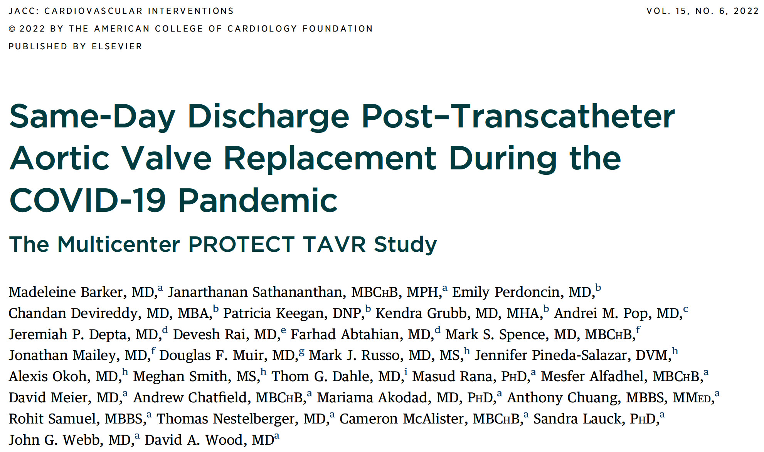

Slide 38
PROTECT TAVR: Consolidated Standards of Reporting Trials Diagram
Patient Selection for Same-Day Discharge (SDD)
2,100 elective transfemoral TAVRs from March 2020 to August 2021
1,976 patients excluded from SDD (94.1%)
124 patients (5.9%) selected for SDD
Barker et al., J Am Coll Cardiol Intv 2020;15:590

Slide 39
PROTECT TAVR: Procedural Characteristics (N=124)
Conscious sedation and local anesthesia | 80.7%
Local anesthesia only | 193%
Pacing through the LV wire | 21.0%
Contrast used, mL | 50.0 (25.0-75.0)
Total procedure time, min (n=94) | 71.0 (44.0-83.0)
Total radiation dose, cGy (n=101) | 361.0 (184.0-664.0)
Fluoroscopy time, min (n=100) | 12.4 (9.2-16.4)
Same-day TTE | 100.0%
AV mean gradient on TTE | 5.0 (3.5-7.0)
Type of valve Balloon expandable Self-expandable | 96.8% 3.2%
Event monitor | 29.8%
Time from initial puncture to pre-discharge ECG, h (n=61) | 6.35 (5.75-7.37)
Barker et al., J Am Coll Cardiol Intv 2020;15:590

Slide 40
PROTECT TAVR: Patient Outcomes
Periprocedural Outcomes [Index Admission] (N=124)
Procedural success | 100.0%
Same-day discharge | 100%
Death | 0.0%
Stroke/TIA | 0.0%
New PPM implantation | 0.8%
Major vascular complications | 0.0%
New complete LBBB | 0.0%
New complete RBBB | 0.0%
New high-grade AVB (2nd-degree type II and above | 0.8%
Barker et al., J Am Coll Cardiol Intv 2020;15:590

Slide 41
PROTECT TAVR: Patient Outcomes
Post-Discharge Follow-up (N=106)
Time follow-up, d | 31.0 (24.0-41.0)
NYHA functional class > II | 2.8%
CCS class > II | 1.5%
Post-TAVR EF, % | 60.0 (55.0-60.0)
AV mean gradient | 8.0 (6.0-10.0)
Barker et al., J Am Coll Cardiol Intv 2020;15:590

Slide 42
PROTECT TAVR: Patient Outcomes
30-Day Clinical Outcomes (N=106)
%
Composite Death CV death Stroke/TIA All-cause CV Major vasc New PPM MI COVID-19
outcomes readmission readmission compl implant infection
Barker et al., J Am Coll Cardiol Intv 2020;15:590

Slide 43
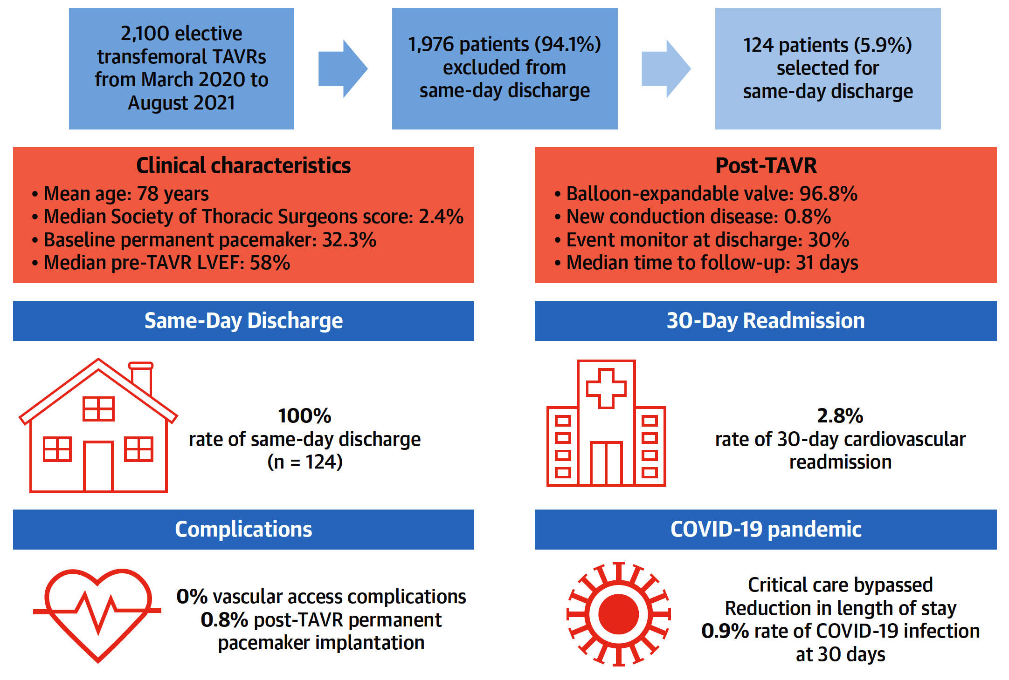
PROTECT TAVR: Same-Day Discharge Post-TAVR
Barker et al., J Am Coll Cardiol Intv 2020;15:590

Slide 44
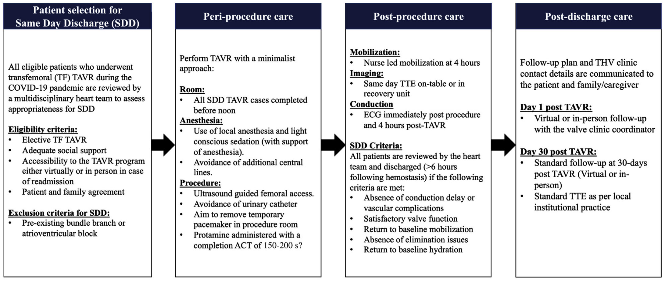
PROTECT TAVR: SDD Clinical Pathway to Facilitate Outpatient TAVR
Major issue will be down trended hospital reimbursement
in Outpt TAVR patients as valve cost is very high;
$32K for TAVR valve vs $5K for surgical valve)
Barker et al., J Am Coll Cardiol Intv 2020;15:590

Slide 45
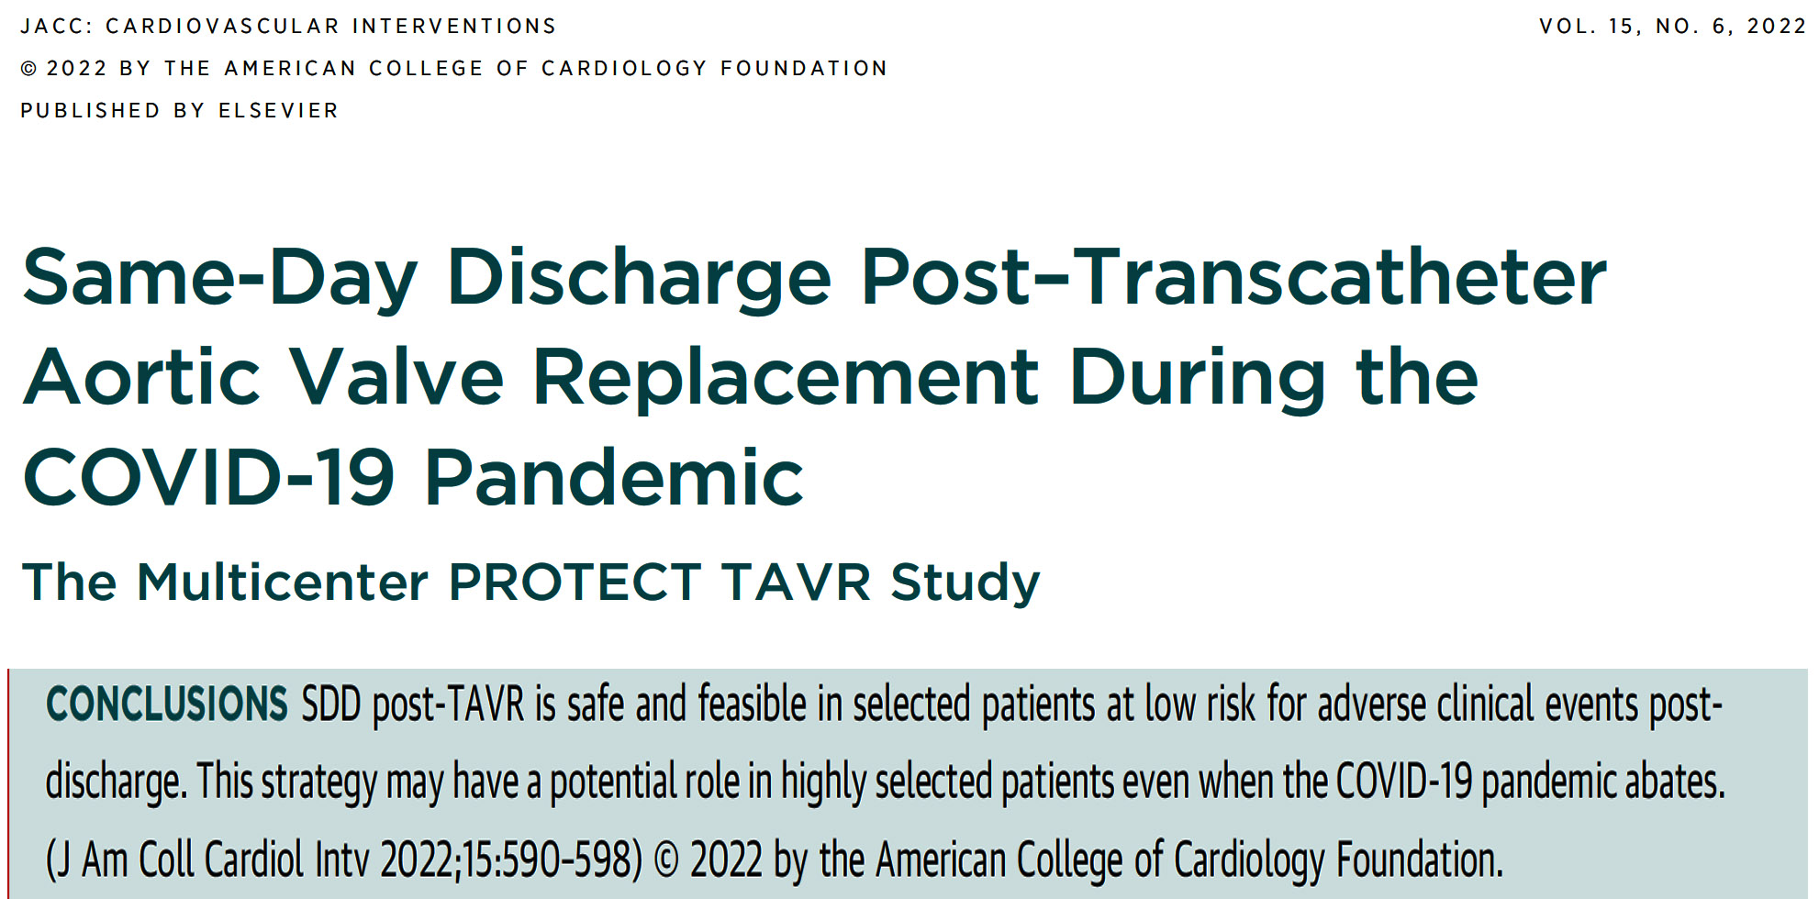

Slide 46


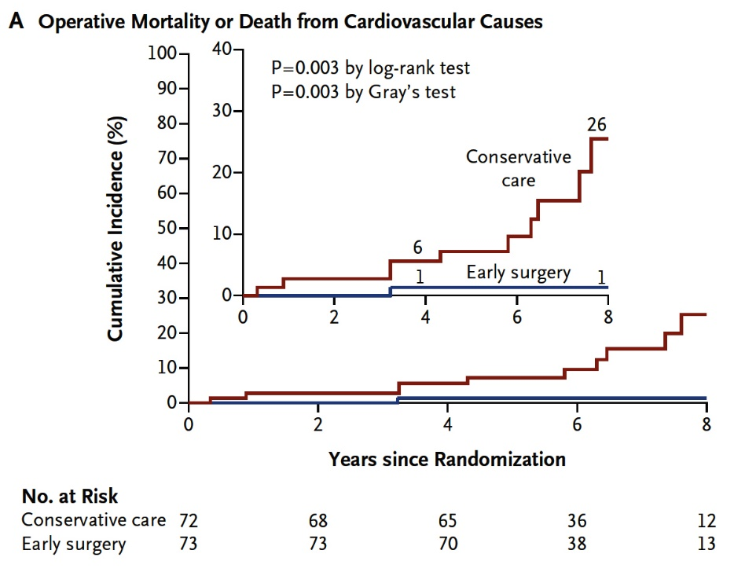
Severe AS with No Symptoms (Asymptomatic)
EARLY SAVR vs. Clinical Surveillance
AVATAR Trial (done in Serbia)
RECOVERY Trial (done in Korea)
Kang et al., N Engl J Med 2020;382:111
N=145 pts SAVR only
Banovic et al. Circulation Nov 13, 2021
N=157 pts SAVR only
2 small randomized trials; SAVR only

Slide 47
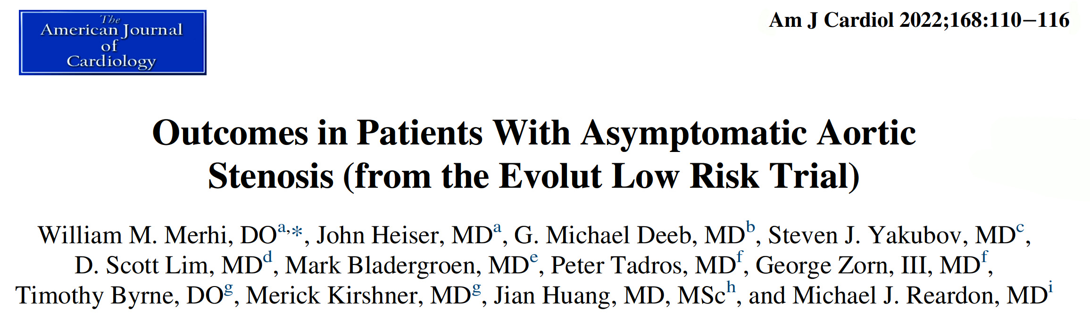

Slide 48
Patient Flow for Evolut Low Risk Trial Protocol
Attempted Implant
N=1403
TAVI
N=725
SAVR
N=678
Asymptomatic
N=76
Symptomatic
N=649
Asymptomatic
N=62
Symptomatic
N=616
Merhi et al., Am J Cardiol 2022;168:110

Slide 49
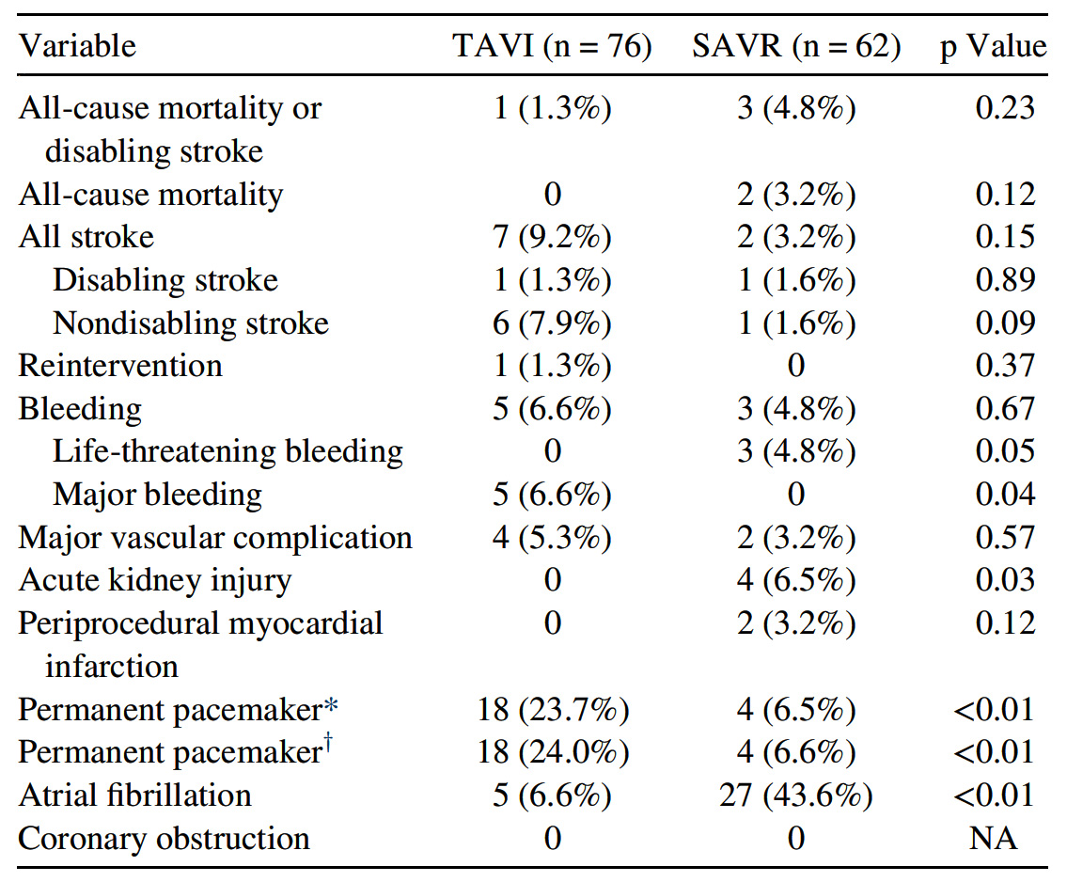
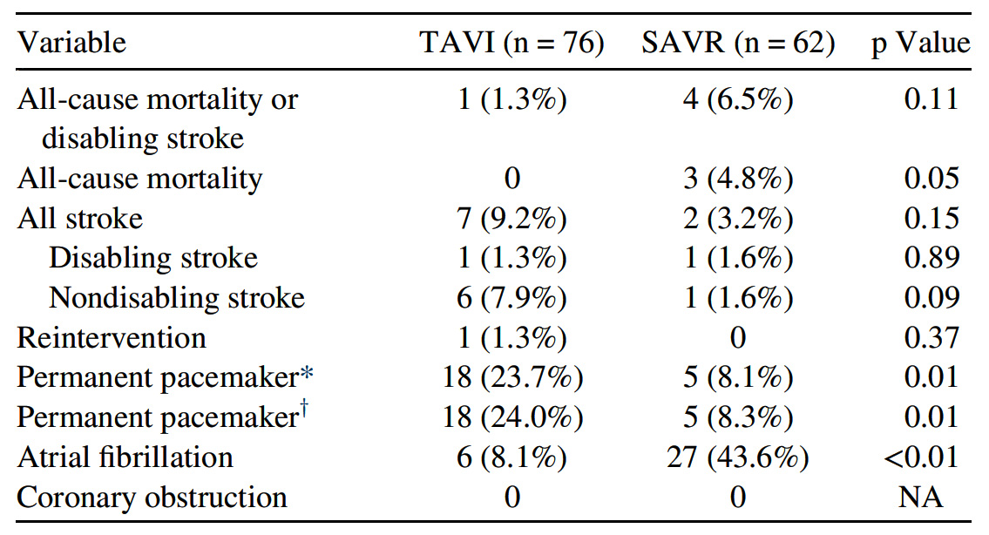
Evolut Low Risk Trial: Clinical Outcomes in Asymptomatic Patients
30 Days
1 Year
* Patients with pacemaker or ICD at baseline are included.
† Patients with pacemaker or ICD at baseline are not included.
Merhi et al., Am J Cardiol 2022;168:110

Slide 50
Evolut Low Risk Trial: Clinical Outcomes After
AVR In Asymptomatic Patients
30 Days
1 Year
p=0.11
p=0.23
p=0.05
p=0.12
%
p=0.89
%
p=0.89
Merhi et al., Am J Cardiol 2022;168:110

Slide 51
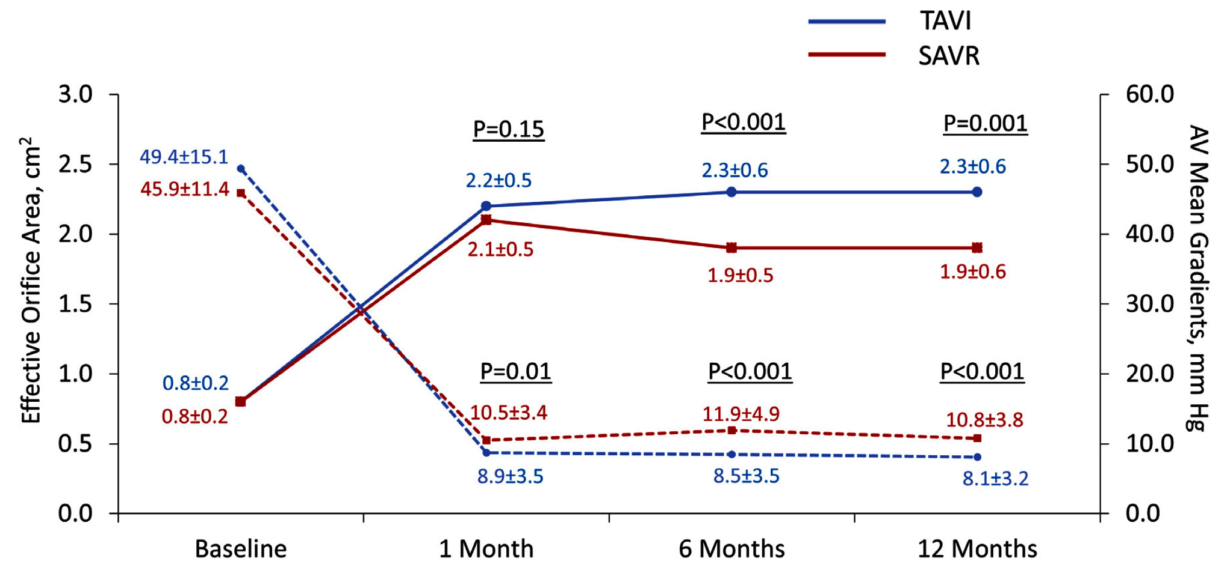
Evolut Low Risk Trial: Aortic Valve Bioprosthetic Performance After AVR
Merhi et al., Am J Cardiol 2022;168:110

Slide 52
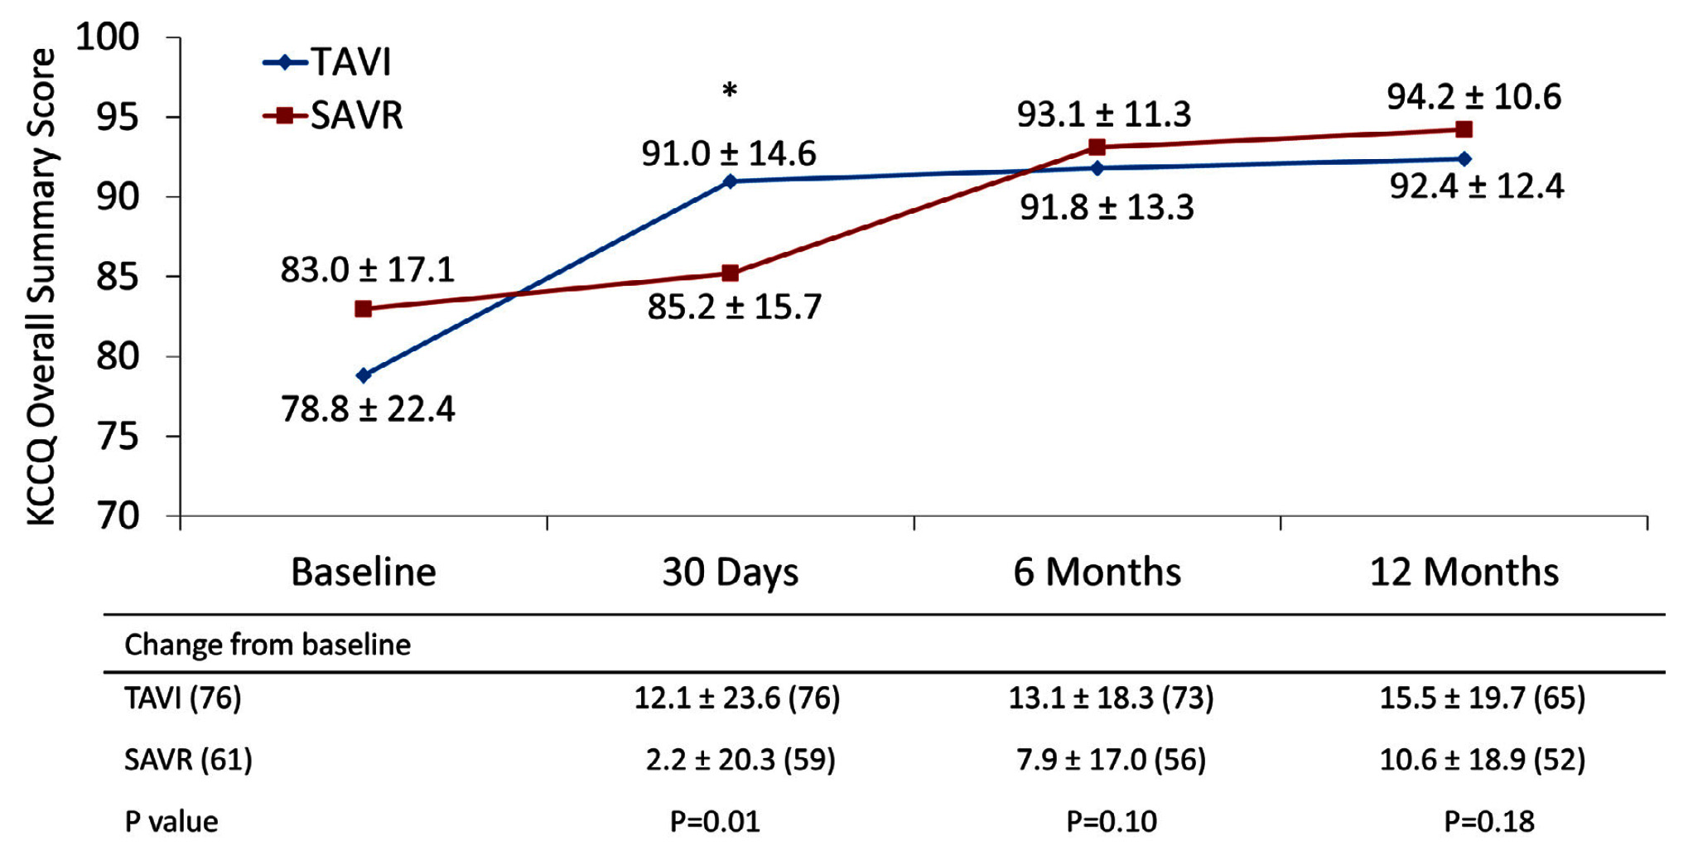
Evolut Low Risk Trial: KCCQ Overall Summary Score
for Asymptomatic Patients
*Significant difference in change from baseline between TAVI and SAVR asymptomatic patients
Merhi et al., Am J Cardiol 2022;168:110

Slide 53
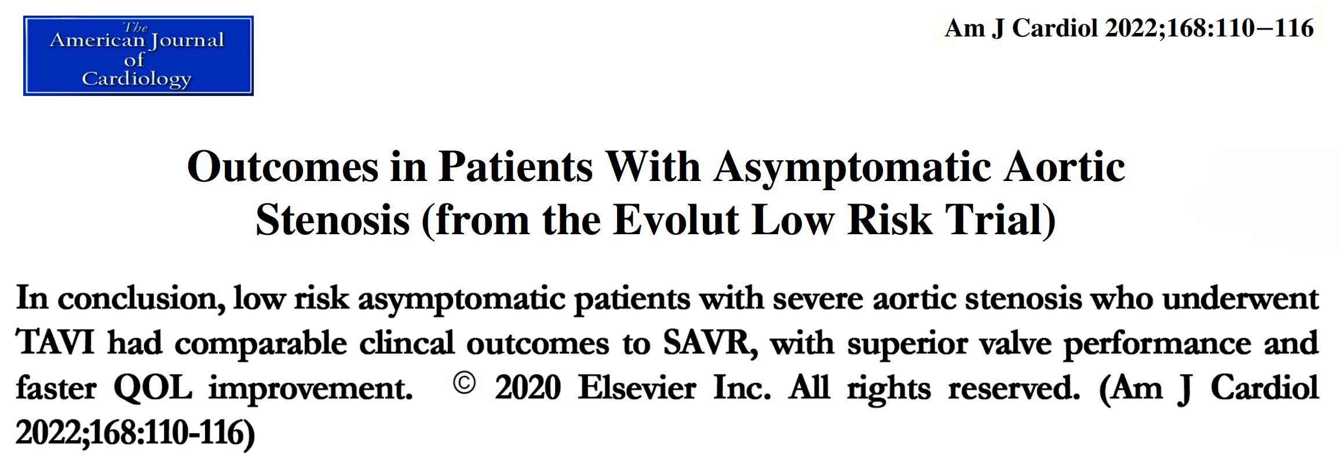

Slide 54

Study Design
Asymptomatic Severe, Calcific AS
Screening
Not eligible if <65, has Class 1 indication for AVR, bicuspid valve, not suitable for TF access or STS > 10
Asymptomatic N~900
Negative stress test OR confirmation via med history*
Symptomatic
Positive stress test
Randomization 1:1
Stratified by ability to perform stress test
Registry
TF- TAVR
Clinical Surveillance
Commercial AVR (TAVR or SAVR)
Clinical and Echo Follow-up:
30 days (TAVR only), 1, 2, 3 and 5 years
Telephone Follow-up:
1, 2, 3 and 5 years
Primary Endpoint (superiority):
2-year composite of all-cause death, all stroke, and unplanned cardiovascular hospitalization
Principal Investigator: Philippe Généreux, MD,
Chair: Martin B. Leon, MD
NCT03042104
Enrollment Completed

Slide 55

Take Home Messages
Recent Publications in the TAVR Field
Pts with intermediate or high surgical risk severe AS, the 5-year rate of SVD was twice higher after SAVR vs TAVR. This difference in SVD was more profound in pts with smaller (≤23 mm) but also a trend with larger (>23 mm) annuli. The echo-derived SVD imparted a 2-fold risk for all cause mortality, hospitalization or HF @ 5 yrs.
ViV TAVR for degenerated surgical valve has shown sustained improvement at 5-year follow-up.
Late BAV for TAVR valve degeneration has shown significant improvement in valve hemodynamics.
Outpt TF-TAVR in selected pts is viable options in current Covid-19 scenario. Cost of TAVR device remains a challenge in outpt set.
There are increasing consensus for AV replacement (by SAVR or TAVR) in asymptomatic severe AS pts to improve overall outcomes.

Slide 56

Question # 1
Following are true statements regarding the TAVR vs SAVR valve durability in intermediate-high risk AS pts except:
  Better long-term (upto 5yrs) valve durability with TAVR vs SAVR
  TAVR is noted to have lower SVD in both small or large annuli
  SVD pts have 2x higher mortality vs no SVD pts
  Similar rates of hospitalization in SVD vs no SVD pts
Correct answer: D

Slide 57
Question # 2
Following statements is false regarding ViV TAVR for surgical valve degeneration at 5-year follow-up:
  Sustained symptomatic benefit and QOL parameters
  Sustained improvement in survival
  Rapid deterioration of valve hemodynamics after 3 years
  Smaller TAVR valve size has higher mortality vs large TAVR valve size
Correct answer: C

Slide 58

Question # 3
Following are the trials of AV replacement vs witful watching in asymptomatic severe AS pts except:
  A. PARTNER 3 Trial
  B. RECOVERY Trial
  C. AVATAR Trial
  D. EARLY TAVR Trial
Correct answer: A

