Slide 1
Live Case
May 2022
SMA Artery Restenosis

Slide 2
CLINICAL
87 year old female presents with abdominal pain with food intake resulting in food aversion and failure to thrive.
Past medical history significant for 2 layers of stents in SMA artery, last being DES in 12/2020. Known occluded celiac artery.
Exam significant for cachectic and frail old female, feeble radial pulse.

Slide 3
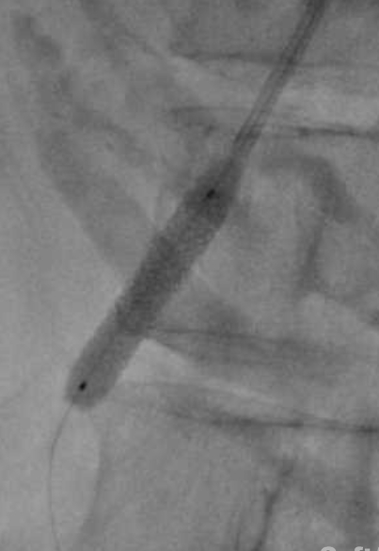

Slide 4
USG
05/2022
SMA stent patent with increased velocity 624 cm/s – 724 cm/s suggestive of > 50% in-stent restenosis
01/2022
SMA stent patent with velocity of 208/15 cm/s

Slide 5
Clinical Spectrum of Mesenteric Ischemia
Acute mesenteric Ischemia
Chronic mesenteric Ischemia
Non occlusive mesenteric ischemia
Mesenteric venous thrombosis
Colonic ischemia

Slide 6
Chronic Arterial Mesenteric ischemia
Incidence of symptomatic disease estimated 1 in 100,000 of the general population
Stenosis or occlusion of at least 2 out of three visceral arteries
50-60 year of age more common in women
Rarely gives symptoms due to many collaterals
Mortality /morbidity high if left untreated

Slide 7
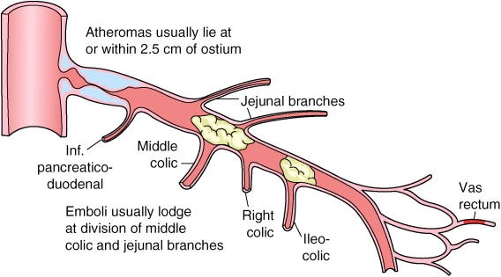

Slide 8
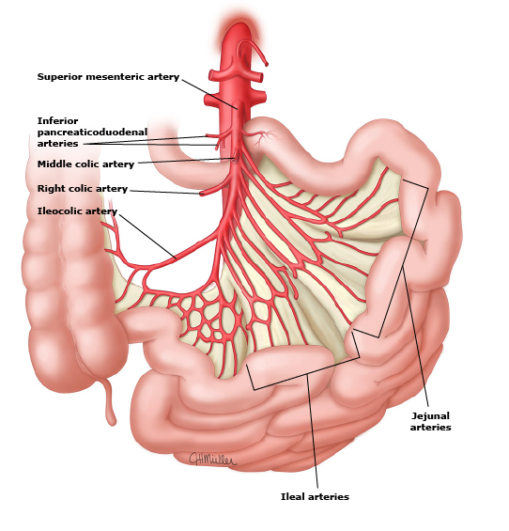
SMA supplies entire small intestine except for the
proximal duodenum
Jejunal and ileal branches supply the jejunum and
ileum
Ileocolic artery supplies the distal ileum, cecum, and proximal ascending colon
Right colic artery supplies blood to the mid-distal ascending colon

Slide 9
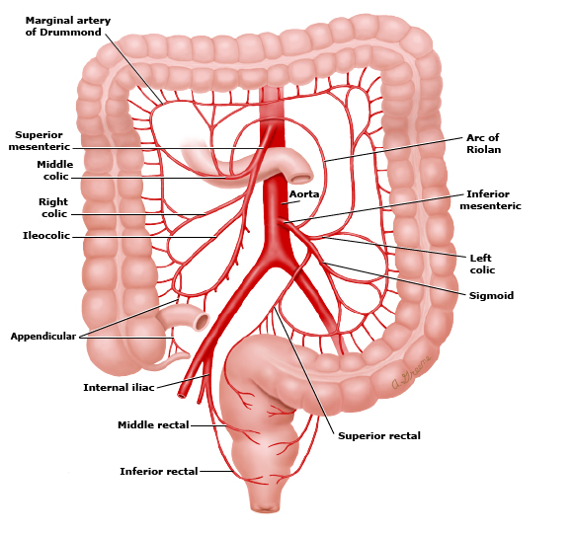
Middle colic artery arises supplies blood to the proximal
to midtransverse colon
Right colic artery supplies blood to the mid-distal ascending colon
IMA arising 6-7 cm below SMA -> left colic artery and sigmoid arteries , supplies distal to transverse colon
SMA and IMA communicate via the marginal artery of Drummond and the meandering mesenteric artery.

Slide 10
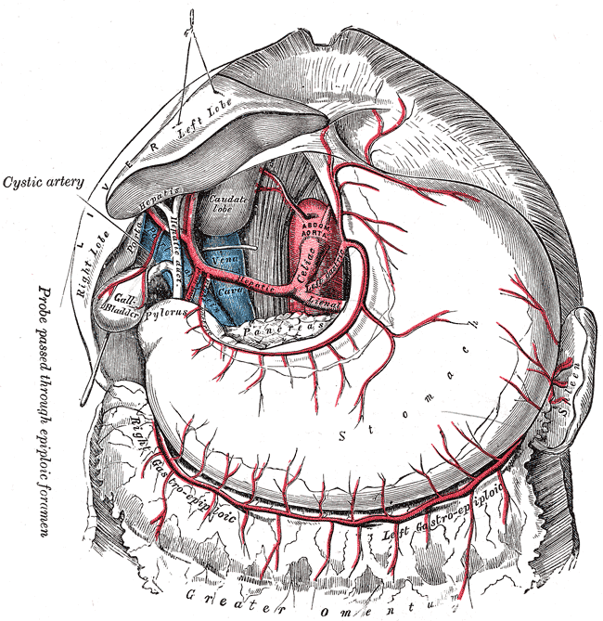
T12-L1

Slide 11
Causes of CMI

Slide 12
Symptoms
Post prandial angina
Extreme aversion to food/sitophobia
Weight loss
Bloating\diarrhea
Non specific GI symptoms
Diagnostics:
Duplex ultrasonography
CT angiography
MR angiography
Abdominal US
Upper and lower GI endoscopy

Slide 13
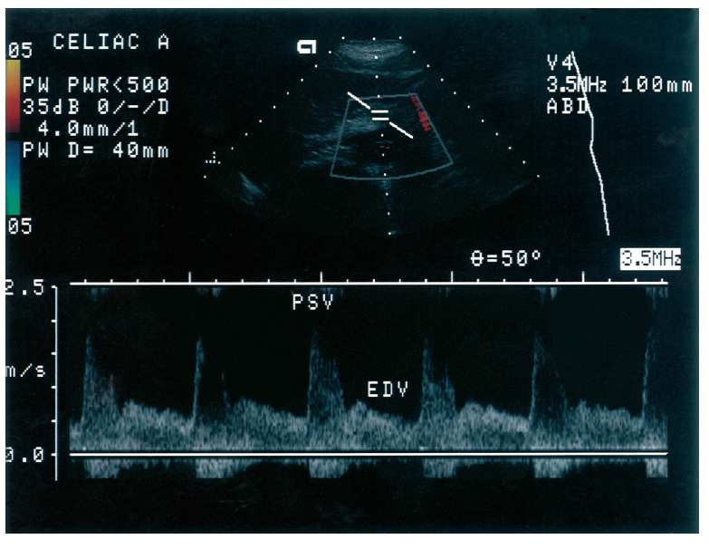
Celiac artery
Liver/spleen have high metabolic requirement
Constant low resistance
Biphasic
No reversal of flow
High EDV
PSV>275cm/sec –critical
Mansour and Labropoulos, Vascular Diagnosis, 2nd Ed. 2005

Slide 14
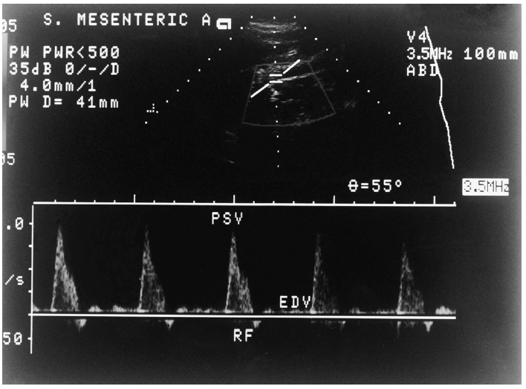
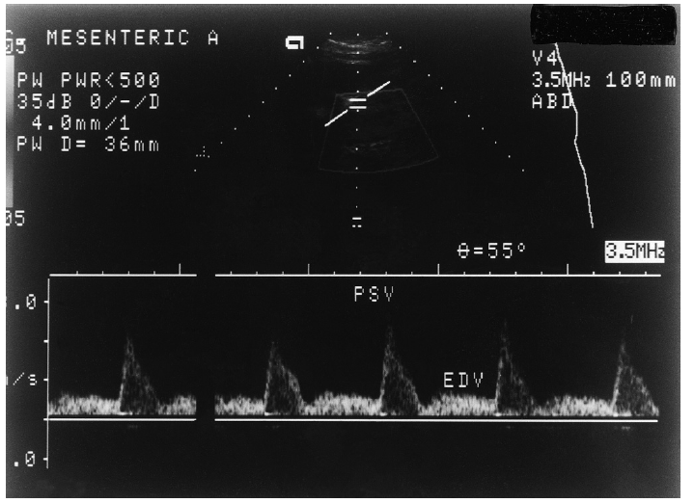
SMA
Fasting:
Triphasic, high arterial resistance, low EDV and slight flow reversal
Postprandial:
Biphasic
Low-resistance (dilated splanchnic arteriolar beds)
No flow reversal
PSV>200cm/sec - critical
Mansour and Labropoulos, Vascular Diagnosis, 2nd Ed. 2005

Slide 15
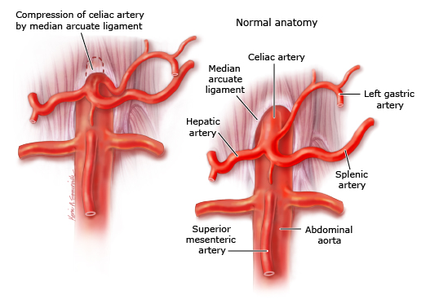
Arcuate ligament syndrome

Slide 16
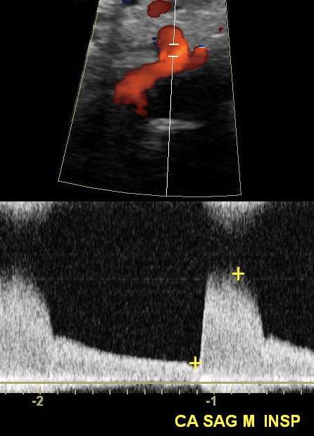
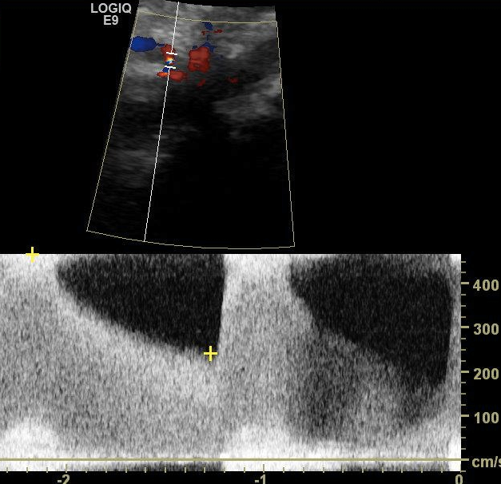
Arcuate ligament syndrome
Inspiratory increase in velocities

Slide 17
Conservative Management
Control of risk factors .
Smoking cessation.
Avoid any excessive increase in intestinal demand (e.g., large meals) or decrease in intestinal supply (e.g., hypovolemia)
Vasodilator agents such as oral nitrates may provide episodic relief.
In patients with CMI due to thrombosis, or non-occlusive thrombotic stenosis, systemic anticoagulation therapy is beneficial in the absence of contraindications.
Nutritional assessment and management

Slide 18
Revascularization
Percutaneous Endovascular Treatment (PEVT)
Open Surgical Revascularization (OSR)

Slide 19
Retrospective review of 42 patients / 66 arteries for CMI
30 day mortality – 10% (CAD and CKD – independent risk factors)
3 year primary patency : 65%
5-year survival rate of 70%

Slide 20
98 patients followed over 10 years
79 patients underwent multivessel reconstruction
5% in hospital mortality ( all over 70 yrs )
1-year, 5-year, and 8-year survival rates were 83%, 63%, and 55%
5 year symptom free survival – 92%
No difference between ante grade or retrograde surgical approach
No difference between single vessel vs multi vessel reconstruction

Slide 21
54 patients with 56 lesions (52 SMA)
2001-2013
Early mortality 45%/10%
Early morbidity 73%/50%
2 year primary patency 76+8% vs 90+8%

Slide 22
OSR
Significant morbidity (5-30%) and mortality ( 5-12% )
Durable results
Not suitable for malnourished and older people
Patients with CAD and CKD are at enhanced risk

Slide 23
PEVT
First attempted in 1980
Class IB recommendation by the ACC/AHA for the treatment of CMI due to mesenteric stenosis

Slide 24
Endovascular Intervention
30-day mortality 2.6%-4%
High restenosis rate in earlier studies
Stenting has significantly improved outcomes:
2-year primary patency (58 %) and primary assisted patency (65%)
Covered stents have better long- term patency
Median time for re-intervention 15 mos
At the beginning was bridge to surgical visceral revascularization
Taylor LM, Moneta GL, Porter JM. Treatment of chronic visceral ischemia. In: Rutherford RB, editor. Vascular surgery. Philadelphia: WB Saunders; 2000. p. 1532.18.
Schemerhorn ML, Giles KA, Hamdan AD, et al. Mesenteric revascularization: management and outcomes in United States 1988–2006. J Vasc Surg 2009;50:341–8.19.
Odurny A, Sniderman KW, Colapinto RF. Intestinal angina: percutaneous transluminal angioplasty of the celiac and superior mesenteric arteries. Radiology 1988;167:59.20.
Atkins MD, Kwolek CJ, LaMuraglia GM, et al. Surgical revascularization versus endovascular therapy for chronic mesenteric ischemia: a comparative experience. J Vasc Surg 2007;45:1162–71.21.
Peck MA, Conrad MF, Kwolek CJ, et al. Intermediate-term outcomes of endovascular treatment for symptomatic chronic mesenteric ischemia. Vasc Surg 2010;51:140–7.e1–2.

Slide 25
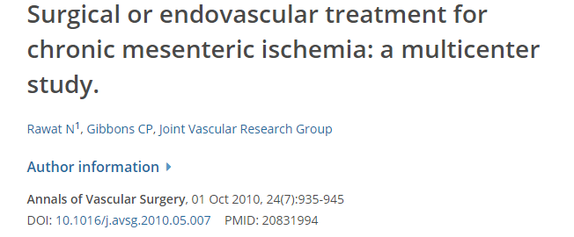
76 patients underwent 101 procedures (PTA 49; bypass 52)
Perioperative morbidity for bypass Vs PTA (32% vs. 6%).
Overall, 30-day mortality for bypass vs PTA (13% vs. 4%;)
1- and 5-year survival (bypass: 85%, 63%; PTA: 67%, 31%)
Primary patency (bypass: 81%, 69%; PTA: 54%, 32%)

Slide 26
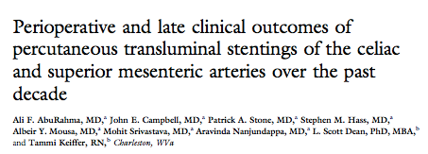
83 patients over 10 years
54 SMA stents
51 celiac stents
Technical success 97%
30 day mortality 2%

Slide 27
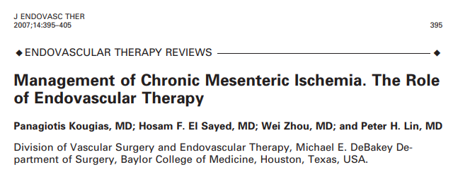

Slide 28
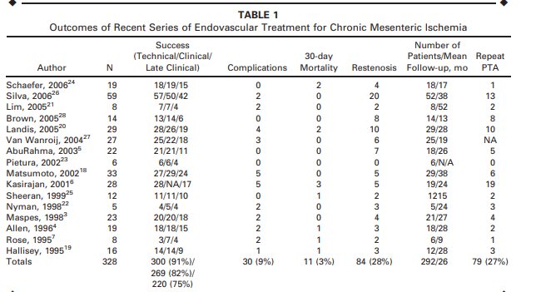

Slide 30
PEVT/OSR
High initial success rate with PEVT - 88 – 100%
Less complications and less short term mortality with PEVT
Similar long term survival
Restenosis significantly higher with PEVT
Herbert GS et al, Surg Clin North Am 2007

Slide 31
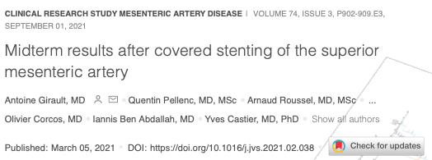
86 patients (mean age, 70 ± 9 years; 57% males), 35% CMI
96 stents were implanted, including 86 proximal CS
At 2 years, the overall primary patency, and secondary patency rates were 76% (95% CI, 76% ± 13%), and 95% (95% CI,95% ± 8%), respectively.
12 patients (14%) underwent reintervention at 15 months median follow up.

Slide 32
225 patients (65 male and 160 female; mean age, 72 ± 12 years)
Mean follow-up, 29 ± 12 months
Higher freedom from restenosis (89% ± 10% vs 49% ± 14%; P < 0.04 ) at median 24months

Slide 33
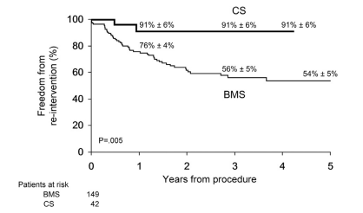
Better primary patency at 3 years (92% ± 6% vs 52% ± 5%; P < .003)
Higher freedom from reintervention (91% ± 6% vs 56% ± 5%; P = .005),

Slide 34
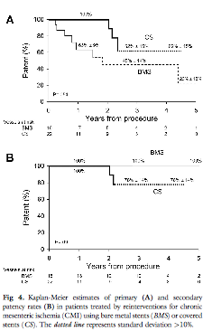
Covered vs. bare-metal stents-
reintervention
1 year-Primary patency 83-100%
2, 3 year primary patency > 75%
Secondary patency approaches 100%

Slide 35
2005 ACC/AHA guidelines:
Endo and open surgery equal weighing in the treatment of CMI
Open surgery deserved for low risk patients
Unfavorable anatomy or failed endo

Slide 36
Expedited workup, including a CTA → Exclude other potential causes.
Treatment requires revascularization with the primary target being the superior mesenteric artery.
Endovascular revascularization with a balloon-expandable covered intraluminal stent is the recommended initial treatment
Patient with recurrent symptoms after revascularization owing to recurrent stenoses should be treated with an endovascular-first approach, similar to the de novo lesion
Open repair reserved for select younger patients and those who are not endovascular candidates.

Slide 37
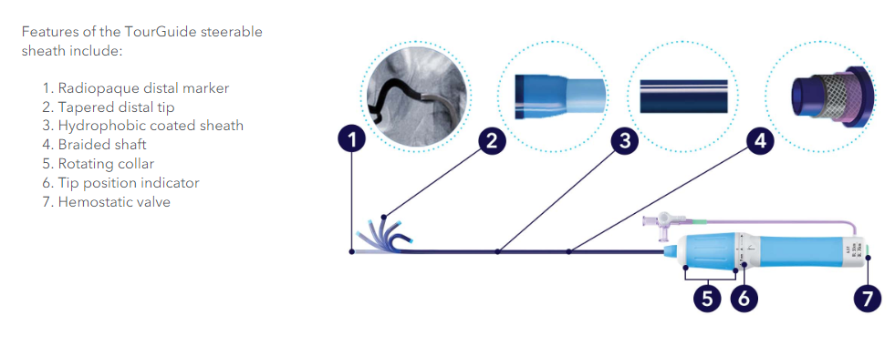
Available in 6.5, 7, 8.5 Fr inner diameter and 45, 55, 90 cm lengths

Slide 38
Thank you

