Slide 1
NYS-DOH Report of PCI 2018
Data on Top 10 Volume Centers for PCIs in NY State 30-Day RAMR
PCI Statistics 2018 | # cases | All cases | Non-Emergency cases
1. Mount Sinai Hospital | 3,348 | 0.92 | 0.56
2. St. Francis Hospital | 2,823 | 1.12 | 0.81
3. North Shore University Hospital | 2,334 | 0.85** | 0.47**
4. NYU Hospitals Center | 2,099 | 0.98 | 0.60
5. Columbia Presbyterian | 2,098 | 1.42 | 1.15
6. St. Josephs Hospital | 2,012 | 1.28 | 0.77
7. Lenox Hill Hospital | 1,759 | 0.73 | 0.55
8. Mount Sinai Beth Israel | 1,458 | 0.81 | 0.53
9. Buffalo General Medical Center | 1,397 | 1.36 | 0.64
10. Stony Brook University Hospital | 1,333 | 1.88 | 1.23
NYS Total 51,435 1.38 0.87
http:// www.nyhealth.gov **Risk Adjusted Mortality Rate (RAMR) significantly lower than NY statewide rate

Slide 2
NYS-DOH Report of PCI 2016-18
Data on Top 10 Volume Centers for PCIs in NY State 30-Day RAMR
PCI Statistics 2016-18 | # cases | All cases | Non-Emergency cases | Emergency cases
1. Mount Sinai Hospital | 10,160 | 1.02 | 0.68 | 2.87
2. St. Francis Hospital | 8,403 | 1.13 | 0.73 | 3.39
3. North Shore University Hospital | 7,197 | 1.13 | 0.79 | 2.75
4. Columbia Presbyterian Hospital | 6,460 | 1.21 | 0.82 | 3.04
5. NYU Hospitals Center | 6,032 | 1.25 | 0.86 | 2.75
6. St. Josephs Hospital | 5,960 | 1.30 | 0.85 | 3.49
7. Lenox Hill Hospital | 5,256 | 0.86** | 0.60 | 1.9
8. Mount Sinai Beth Israel | 4,632 | 0.88** | 0.40** | 3.75
9. Buffalo General Medical Center | 4,397 | 1.24 | 0.68 | 3.66
10.Stony Brook University Hospital | 4,291 | 1.50 | 0.83 | 4.58*
NYS Total 153,201 1.25 0.83 3.21
http:// www.nyhealth.gov **Risk Adjusted Mortality Rate (RAMR) significantly lower than NY statewide rate
* Risk Adjusted Mortality Rate (RAMR) significantly higher than NY statewide rate

Slide 3
NYS-DOH 30-day RAMR for TAVR 2016-2018
Data on Top 10 Volume Centers in NY State 30-Day RAMR
TAVR Statistics 2016-18 | # cases | Deaths | Emergency cases | RAMR | 95% CI for RAMR
1. St. Francis Hospital | 1,260 | 37 | 2.47 | 2.88 | (2.03, 3.97)
2. Columbia Presbyterian | 1,237 | 20 | 2.71 | 1.45** | (0.88, 2.24)
3. NYU Hospital Center | 1,031 | 13 | 1.73 | 1.77 | (0.94, 3.02)
4. Mount Sinai Hospital | 862 | 17 | 2.61 | 1.84 | (1.07, 2.94)
5. NYU Winthrop Hospital | 840 | 29 | 2.90 | 2.89 | (1.93, 4.15)
6. Buffalo General Medical Ctr | 808 | 19 | 2.25 | 2.54 | (1.53, 3.96)
7. North Shore University Hosp | 800 | 17 | 2.54 | 2.03 | (1.18, 3.24)
8. Albany Medical Center | 735 | 35 | 3.07 | 3.76* | (2.62, 5.24)
9. NYP-Weill Cornell | 569 | 11 | 1.89 | 2.47 | (1.23, 4.43)
10. St. Josephs Hospital | 497 | 10 | 2.71 | 1.80 | (0.86, 3.31)
NYS Total 12,579 305
http:// www.nyhealth.gov **Risk Adjusted Mortality Rate (RAMR) significantly lower than NY statewide rate
* Risk Adjusted Mortality Rate (RAMR) significantly higher than NY statewide rate

Slide 4
Hospital Observed, Expected and Risk-Adjusted Readmission Rates for All PCIs in New York State 2018
Hospital | # Cases | Readmissions | All cases RARR % | 95% CI for RARR
Mount Sinai Hospital | 2,661 | 178 | 6.83** | (5.86, 7.91)
NYS Total 45,956 4,150 9.03
http:// www.nyhealth.gov **Risk-adjusted readmission rate significantly lower than NY Statewide rate

Slide 5
NYS-DOH 30-day RAMR for PCI at MSH for last 5 Reports
**Star Interventionalists
Years/ # cases | All cases RAMR % | Non-Emergency cases RAMR % | **Interventionalist
2684 | 0.60** | 0.37** | Dr. Kini
763 | 0.17** | 0.12** | Dr. Moreno
3249 2555 725 | 0.72** 0.64** 0.21** | 0.50 0.34** 0.00 | Dr. Sharma Dr. Kini Dr. Moreno
3356 2693 | 0.66** 0.55** | 0.41** 0.19** | Dr. Sharma Dr. Kini
3566 2714 | 0.62** 0.55** | 0.36** 0.19** | Dr. Sharma Dr. Kini
2016-2018/
2015-2017/
2014-2016/
2013-2015/
2012-2014/
**Risk Adjusted Mortality Rate (RAMR) significantly lower than NY statewide rate
2010-2012/

Slide 6
NYS-DOH 30-day RAMR for PCI 2016-2018: Interventionalists with >1000 PCI cases
Interventionalist | Number of cases | All cases RAMR % | Non-Emergency cases RAMR % | Hospital
1. Dr. S. Sharma | 3604 | 0.98 | 0.65 | Mount Sinai Hospital, MS Morning Side
2. Dr. R. Shlofmitz | 2958 | 0.85 | 0.59 | St. Francis Hospital
3. Dr. A. Kini | 2684 | 0.60** | 0.37** | Mount Sinai Hospital
4. Dr. B. Kaplan | 1789 | 0.72 | 0.35** | North Shore Univ Hospital, LIJ Med. Ctr.,
5. Dr. J. Fox | 1662 | 1.15 | 0.73 | Mount Sinai Beth Israel, MS Morning Side
6. Dr. R. Jauhar | 1556 | 1.40 | 1.13 | LIJ Med. Ctr., North Shore Univ Hosp.
7. Dr. M. Attubato | 1410 | 1.12 | 0.79 | NYU Hospitals Center, Bellevue Hospital
8. Dr. L. Ong | 1344 | 1.69 | 1.05 | Rochester Gen Hosp, Unity Hosp, Cayuga M Ctr
9. Dr. Z. El-Khally | 1281 | 0.94 | 0.54 | St. Josephs Hospital
10. Dr. R. Caputo | 1253 | 1.63 | 1.17 | St. Josephs Hospital
…17. Dr. P. Meraj | 1037 | 1.20 | 0.72 | LIJ Medical Center, North Shore Univ Hosp
**Risk Adjusted Mortality Rate (RAMR) significantly lower than NY Statewide rate

Slide 7
Complex Coronary Cases Supported by:
Abbott Vascular Inc.
Boston Scientific Corp.
Terumo Vascular Corp.
Cardiovascular Systems Inc.
Abiomed Inc.
Chiesi Inc.
Shockwave Medical Inc.
Cardinal Health Cordis Inc.

Slide 8
Disclosures
Samin K. Sharma, MD, MSCAI, FACC
Speaker’s Bureau – BSC, Abbott
Annapoorna S. Kini, MD, MRCP, FACC
Nothing to disclose
Sameer Mehta, MD, FACC (Moderator)
Nothing to disclose

Slide 9
CCC Live Case # 154
Patient Demographics
64 yrs, Male with CAD and
prior PCIs
Present Clinical Presentation
Presented with new onset CCS class III angina and stress MPI positive for MV ischemia
CAD Risk Factors
Controlled Hyperlipidemia
Controlled Hypertension
Ex-smoker, SAQ-7: 62
Clinical Variables
Known CAD, H/o MI, s/p PCIs last in 2010, LVEF 50%, stable until recently with crescendo angina and MV ischemia on SPECT MPI
Medications
Aspirin, Clopidogrel, Metoprolol XL, Lisinopril, Amlodipine, Atorvastatin, HCTZ, Fenofibrate
Cath: Cath on 3/8/2022 revealed 2 V CAD: 80% calcified prox LAD, multiple severely calcified RCA lesions with ISR of pRCA and RPDA, LVEF 55% and Syntax score 25. Pt underwent RotaDES (Xience Skypoint) of pLAD and did well. Pt still has angina Class II symptoms,
Plan: Now planned for staged PCI of multiple lesions of RCA using Rotational Atherectomy and reDES with OCT guidance.

Slide 10
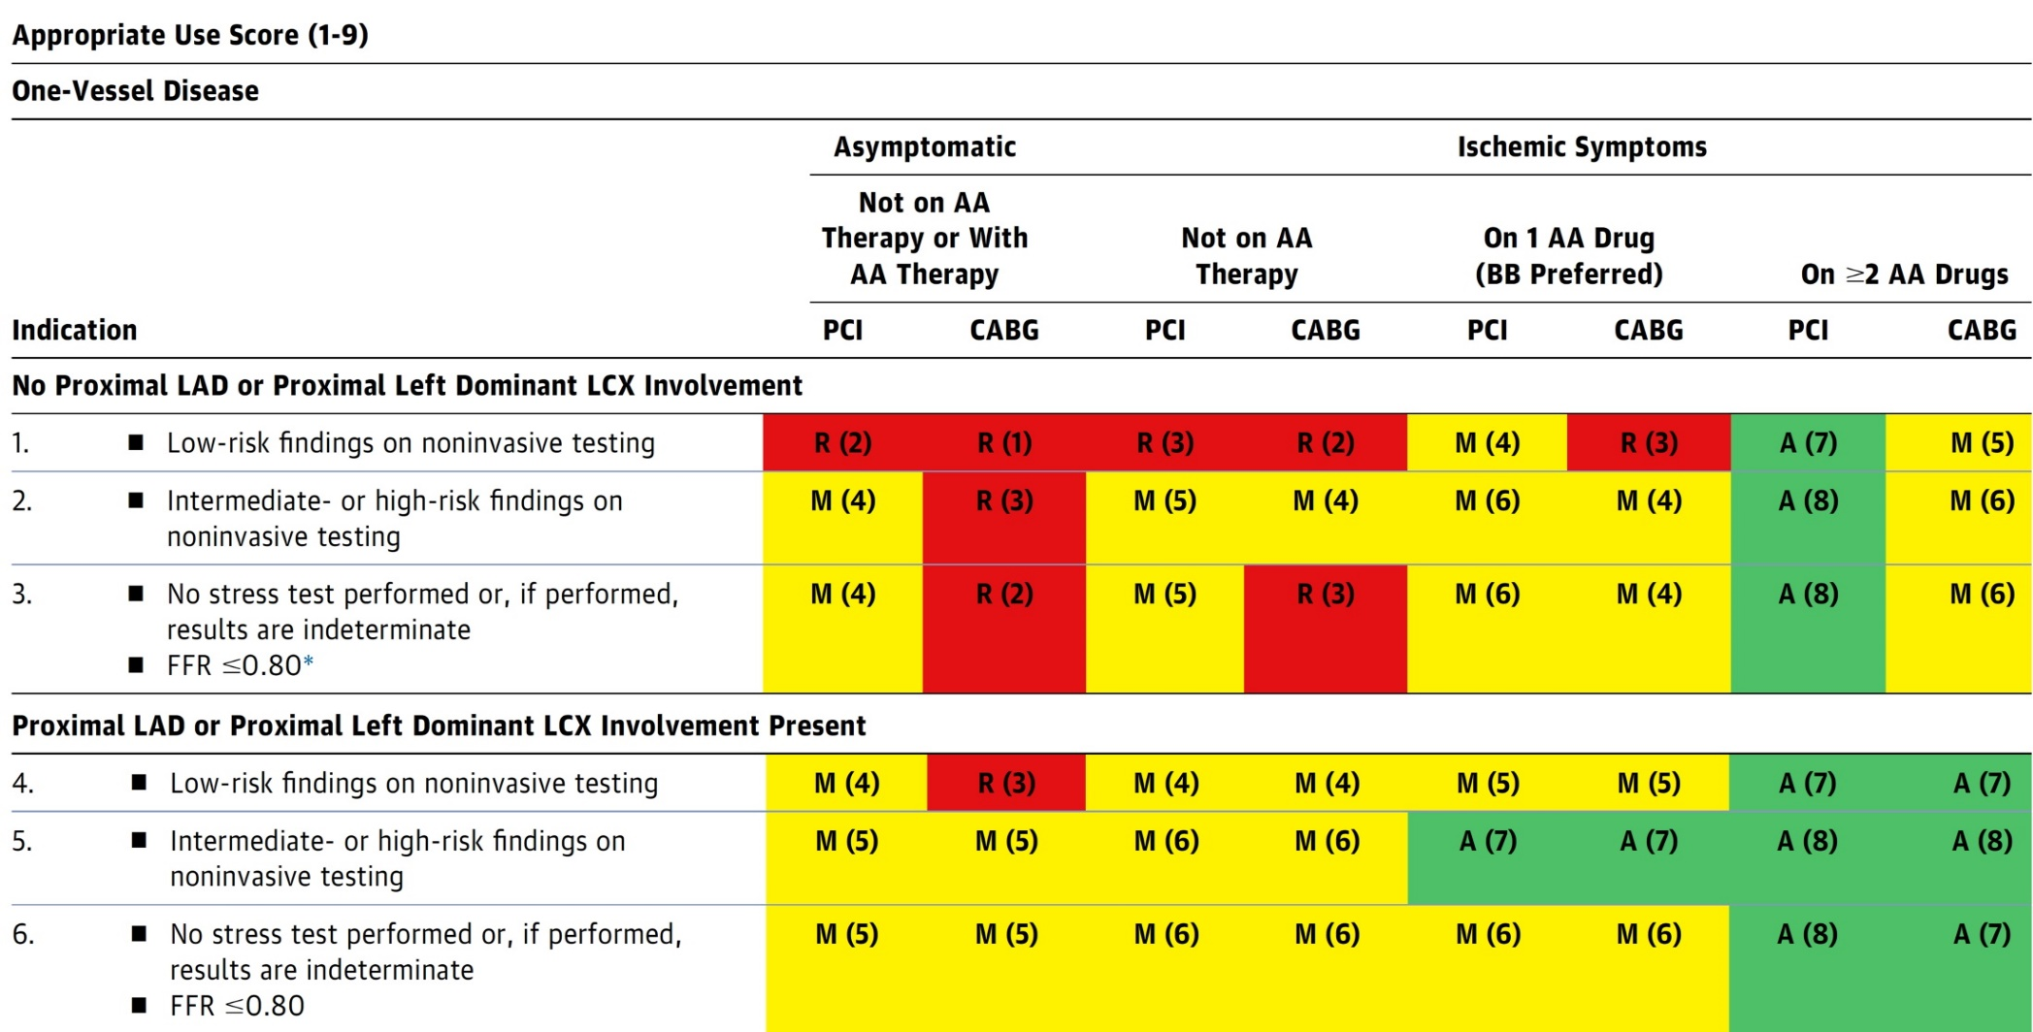
AUC 2017: One-Vessel Disease
Patel et al., J Am Coll Cardiol 2017;69:2212

Slide 11
Latest Issues in Coronary Intervention
Key Interventional Trials from ACC 2022:
FLAVOUR Trial- 2 Years, FAME-3 Trial QOL study,
COMPLETE Trial QOL study
Focused review of the month
2021 Coronary Revascularization Guidelines:
Updated ACC/AHA/SCAI Guidelines for Coronary
Artery Revascularization for PCI vs CABG

Slide 12
Latest Issues in Coronary Intervention
Key Interventional Trials from ACC 2022:
FLAVOUR Trial- 2 Years, FAME-3 Trial QOL study,
COMPLETE Trial QOL study
Focused review of the month
2021 Coronary Revascularization Guidelines:
Updated ACC/AHA/SCAI Guidelines for Coronary
Artery Revascularization for PCI vs CABG

Slide 13
Fractional Flow Reserve versus Intravascular Ultrasound to Guide Percutaneous Coronary Intervention
The FLAVOUR trial

Slide 14
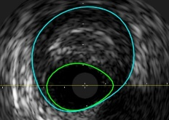
The FLAVOUR Trial: Background
The prognosis of patients with CAD is determined by multiple factors such as degree of luminal narrowing, plaque burden, plaque characteristics, physiologic significance and appropriateness of revascularization procedures.
Adjunctive tools are used to better determine the need for percutaneous coronary intervention (PCI) and its optimization.
An outcome-based comparison trial is needed to unravel the clinical relevance of the difference between physiology-guided PCI and imaging-guided PCI.
“Which approach can bring better clinical and patient-reported outcomes?”
Fractional Flow Reserve (FFR)
Invasive physiologic index to define ischemia-causing stenosis.
Intravascular Ultrasound (IVUS)
Invasive imaging tool to evaluate anatomical severity and plaque characteristics, and to optimize PCI
Koo B, ACC 2022

Slide 15
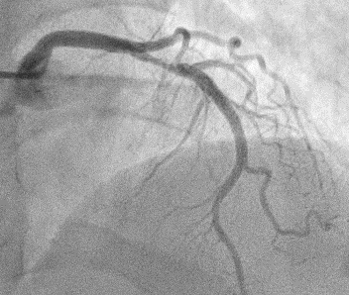
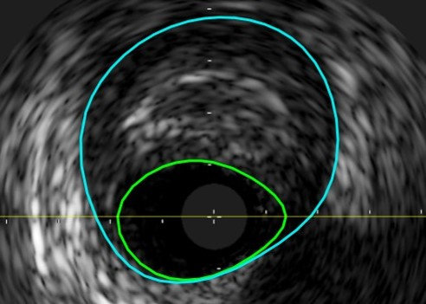
The FLAVOUR Trial: Objective
To compare the efficacy of FFR-guided PCI strategy with IVUS-guided PCI strategy in patients with intermediate coronary stenosis.
Working Hypothesis
The FFR-guided PCI strategy will be non-inferior to the IVUS-guided PCI strategy in regard to clinical outcomes at 2 years after the index procedure.
Koo B, ACC 2022

Slide 16
The FLAVOUR: Study Design and Patient Population
Patients with de novo intermediate stenosis (40-70% stenosis in major vessels) eligible for PCI
Inclusion and Exclusion criteria
Inclusion criteria
a) ≥ 19 years old b) Suspected to have ischemic heart disease and have intermediate coronary stenosis on coronary angiography c) Eligible for PCI, target vessel size ≥ 2.5mm d) Written informed consent
Exclusion criteria
a) Known hypersensitivity or contraindication to key medications b) Patients with active pathologic bleeding c) Target lesion in bypass graft or in left main artery d) History of bleeding diathesis, known coagulopathy e) Co-morbid conditions with life expectancy <2 years
Randomization
FFR-guided PCI
IVUS-guided PCI
Patient-oriented composite outcome* at 24 months after the index procedure
* Primary Endpoint: a composite of death, MI and any revascularization
Koo B, ACC 2022

Slide 17
The FLAVOUR Trial: Indications for PCI and PCI Optimization
FFR-guided PCI | IVUS-guided PCI
Indications for PCI
FFR ≤ 0.80 | Minimum lumen area (MLA) ≤ 3mm² or MLA 3-4mm² & Plaque burden > 70%
Criteria for optimal PCI
Post-PCI FFR ≥ 0.88 or Post-PCI ∆FFR (FFR across the stent) < 0.05 | Plaque burden at stent edge ≤ 55% Minimal stent area ≥ 5.5mm² or Minimal stent area ≥ distal reference lumen area
Koo B, ACC 2022

Slide 18
The FLAVOUR Trial: Study Flow
1700 eligible patients
18 patients excluded from randomization
1682 patients randomized
838 patients enrolled in the
FFR-guided PCI group
844 patients enrolled in the
IVUS-guided PCI group
3 failed to get adequate FFR
results
16 failed to get adequate IVUS
results
16 protocol violations
12 were deferred with
positive FFR
4 underwent PCI with
negative FFR
28 protocol violations
16 were deferred with positive IVUS
7 underwent PCI with negative IVUS
5 received PCI with POBA or DCB
treatment
6 were lost to follow-up
8 were lost to follow-up
832 (99.3%) patients completed
24 months follow-up
836 (99.1%) patients completed
24 months follow-up
Koo B, ACC 2022

Slide 19
The FLAVOUR Trial: Baseline Procedural Characteristics
 | Total | FFR-guided PCI | IVUS-guided PCI | P value
Angiographic findings | n=1682 | n=838 | n=844
Multi-vessel disease, n (%) | 875 (52.0) | 445 (53.1) | 430 (50.9) | 0.782
Patients who received PCI, n (%) | 923 (54.9) | 372 (44.4) | 551 (65.3) | <0.001
Total stent number/ total no. of pts | 0.8±0.9 | 0.6±0.9 | 0.9±1.0 | <0.001
Total stent length/ total no. of pts, mm | 20.9±26.6 | 16.5±24.1 | 25.2±28.1 | <0.001
Target vessel | n=1820 | n=919 | n=901
Lesion length, mm | 20.3±10.6 | 20.1±10.3 | 20.5±11.0 | 0.487
Reference vessel diameter, mm | 3.0±0.5 | 3.0±0.5 | 3.0±0.5 | 0.784
Diameter stenosis, % | 56.8±10.1 | 56.7±10.1 | 56.9±10.1 | 0.633
Target vessel PCI, n (%) | 831 (45.7) | 305 (33.2) | 526 (58.4) | <0.001
IVUS findings
Minimal luminal area, mm² |  |  | 3.4±1.3
Plaque burden, % |  |  | 70.1±10.2
Post PCI minimal stent area, mm² |  |  | 7.0±2.2
FFR findings
FFR |  | 0.83±0.09
Post PCI FFR |  | 0.88±0.06
Koo B, ACC 2022

Slide 20
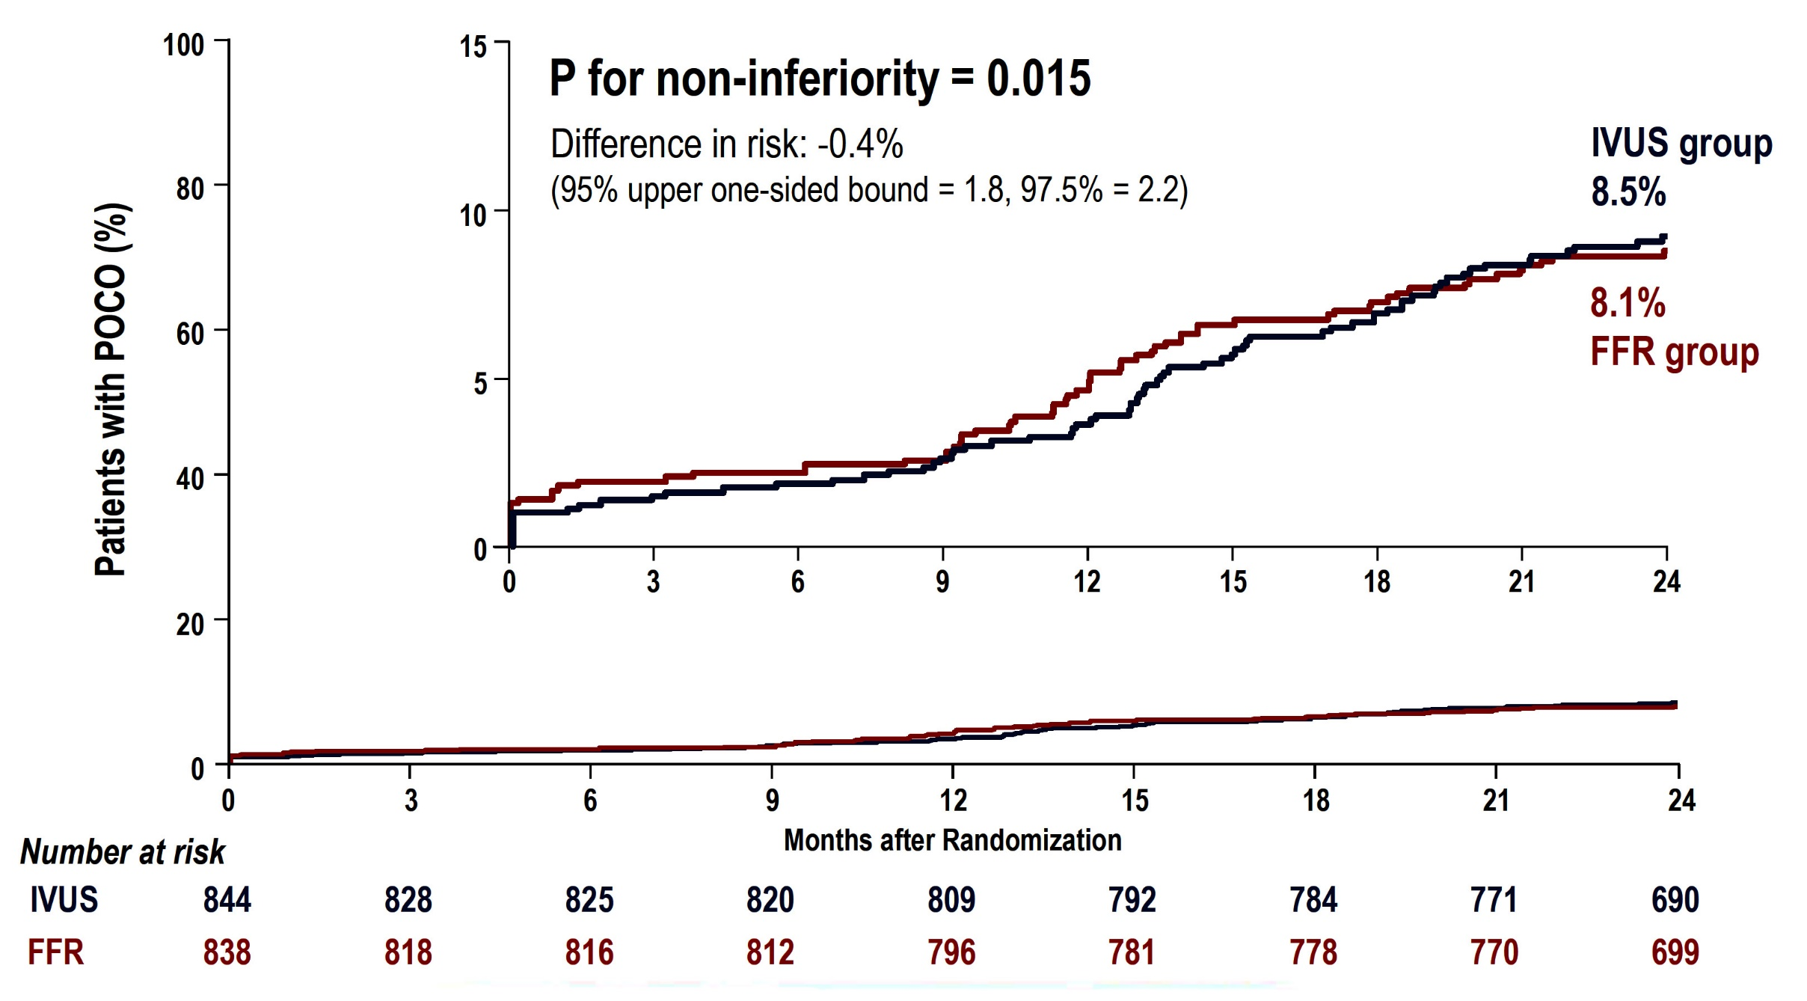
The FLAVOUR Trial: Primary Outcome
* Primary Endpoint: death from any cause, myocardial infarction, and any revascularization
Koo B, ACC 2022

Slide 21
The FLAVOUR Trial: Clinical Outcomes at 24 Months
p=0.71
%
p=0.15
p=0.70
p=0.32
Koo B, ACC 2022

Slide 22
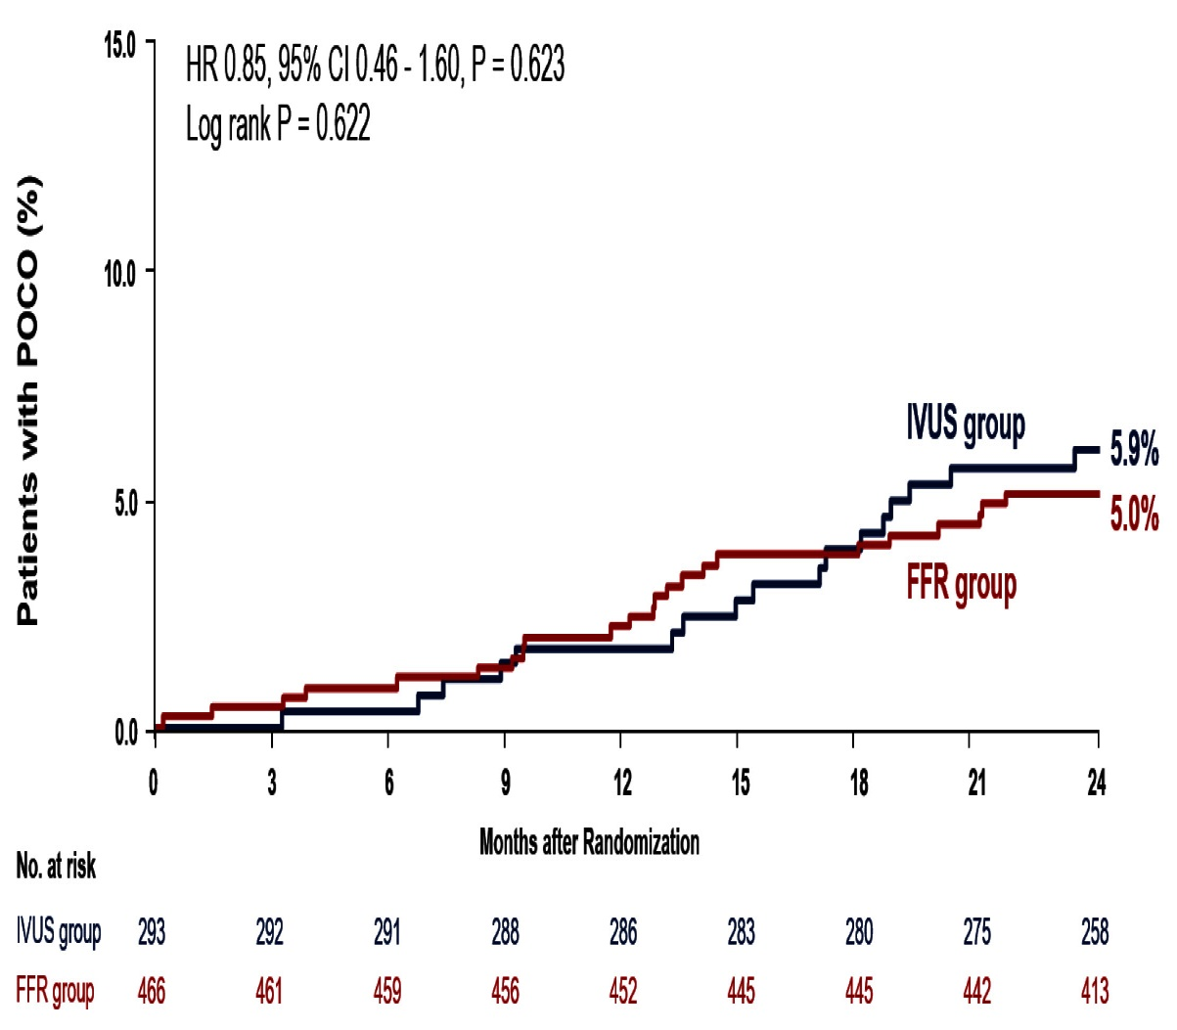
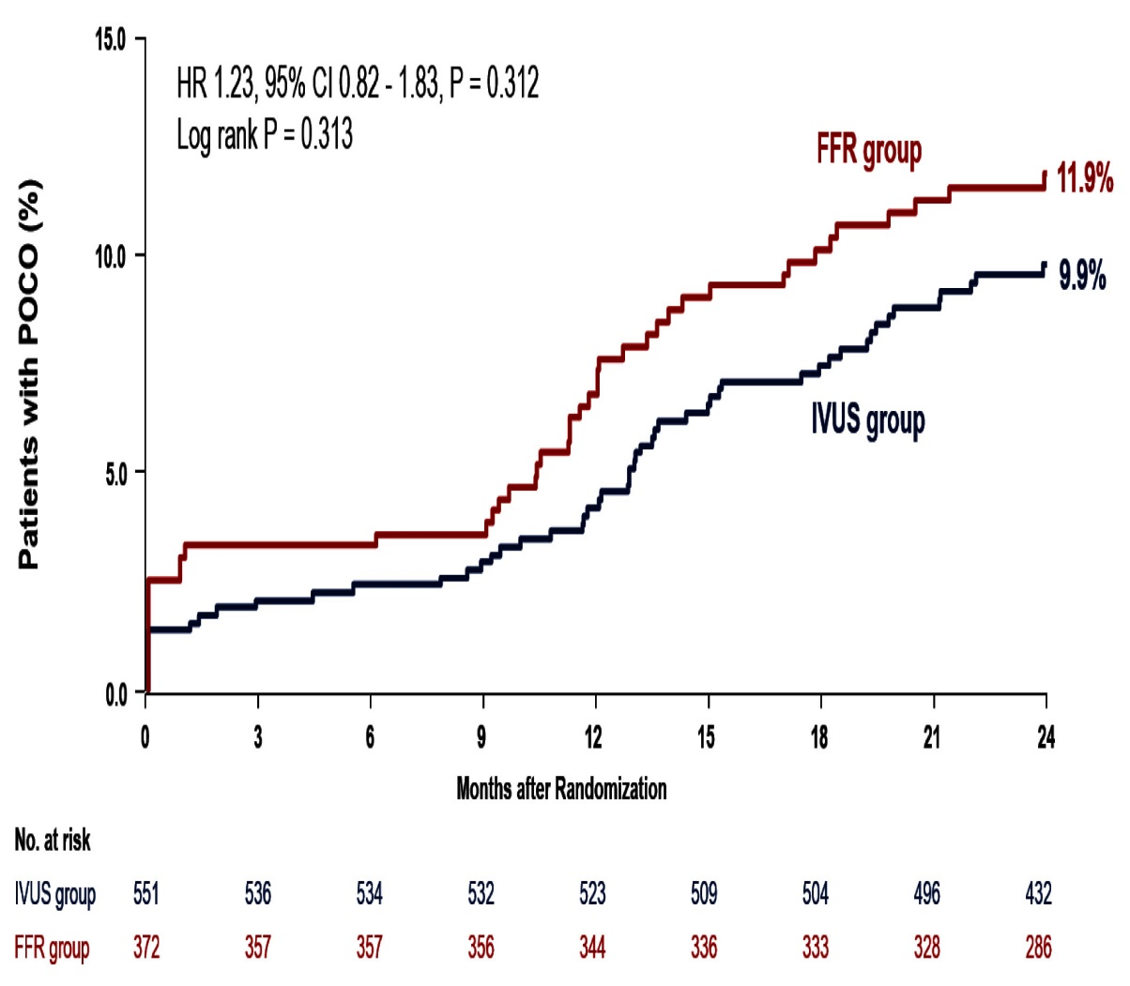
The FLAVOUR Trial: Primary Outcome According to Treatment
Medical Treatment
PCI
Koo B, ACC 2022

Slide 23
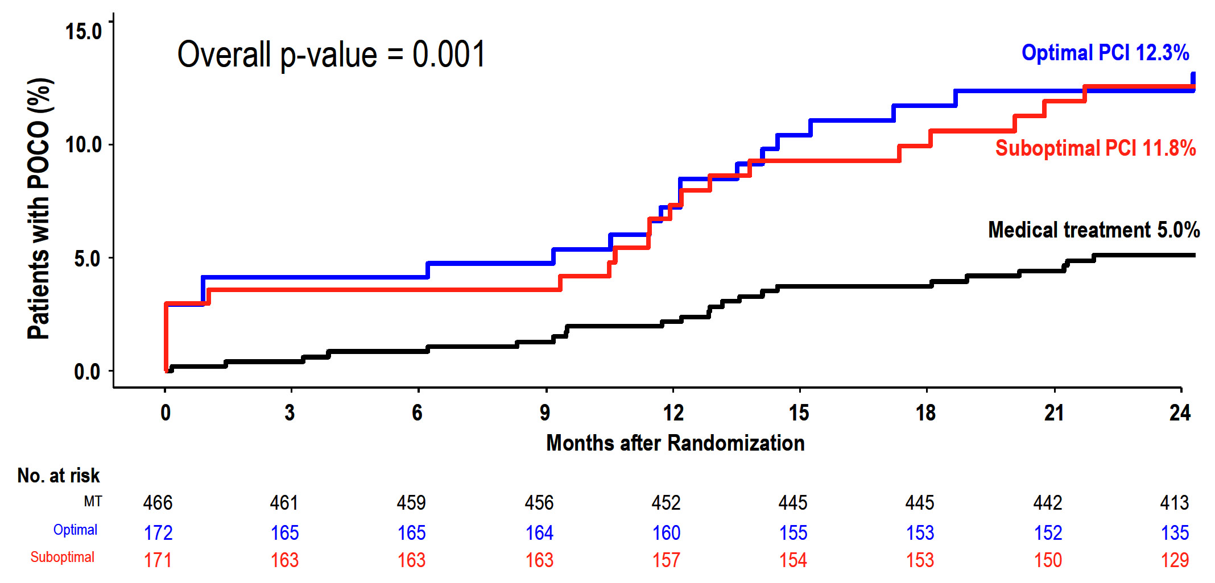
The FLAVOUR Trial: Optimal PCI vs Suboptimal PCI
Optimal PCI: FFR-guided PCI 50.1%, IVUS-guided PCI 54.8%
FFR-guided PCI
IVUS-guided PCI
Koo B, ACC 2022

Slide 24
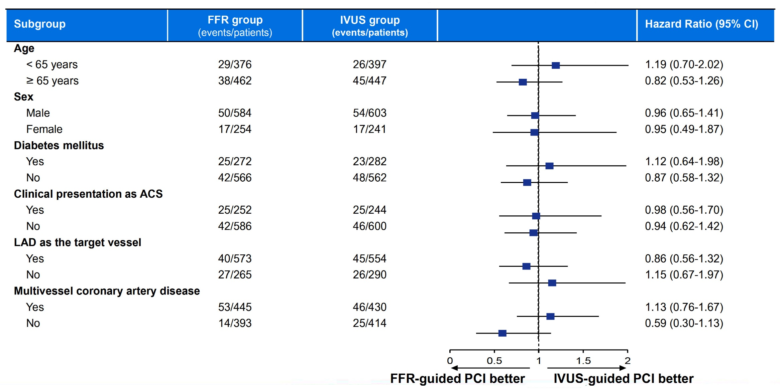
The FLAVOUR Trial: Subgroup Analysis
Koo B, ACC 2022

Slide 25
FLAVOUR Trial: Patient-Reported Outcomes
Seattle Angina Questionnaire (SAQ) scores at follow-up
No difference in SAQ scores
FFR-guided PCI
IVUS-guided PCI
%
Koo B, ACC 2022

Slide 26
The FLAVOUR Trial: Conclusions
Among patients with intermediate coronary stenosis,
FFR-guided PCI was noninferior to IVUS-guided PCI with respect to a composite of death from any cause, MI, and any revascularization at 24 months after the index procedure.
FFR-guided PCI was associated with a lower rate of stent implantation.
No difference was observed in patient-reported outcomes between the two strategies.

Slide 27
Quality Of Life (QOL) After
Fractional Flow Reserve-guided Stenting Compared
With Coronary Bypass Surgery in
FAME-3 Trial

Slide 28
FAME-3 Trial: Study Design
Investigator-initiated, multicenter, randomized, controlled study
All Comers with 3V-CAD (not involving Left Main)
amenable to PCI or CABG by Heart Team
at 48 centers in Europe, North America, Australia and Asia
FFR-Guided PCI
stent all lesions with FFR ≤0.80
(N=757)
CABG
based on coronary angiogram
(N=743)
Fearon et al., N Engl J Med 2022;386:128
Zimmermann et al, Am Heart J 2015;170:619

Slide 29
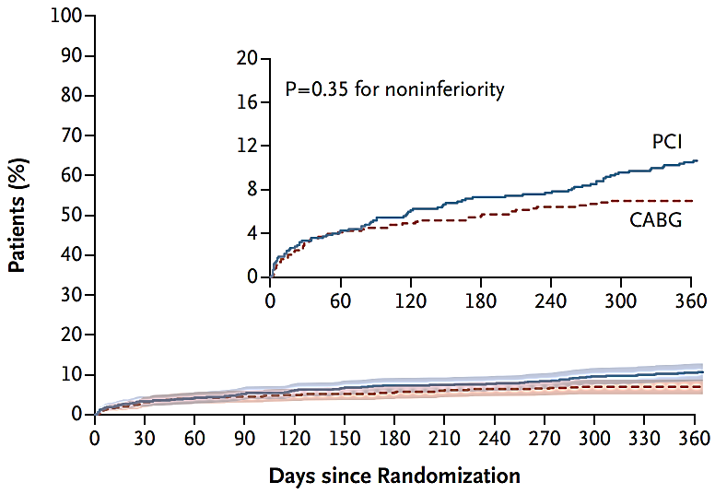
FAME-3 Trial: FFR-Guided PCI with Second-Generation DES vs CABG in Patients with 3VD
MACCE at 1 Year
(Death, MI, Stroke, or Repeat Revascularization)
Fearon et al., N Engl J Med 2022;386:128

Slide 30
FAME-3 Trial QOL Outcomes: Background
Previous studies have shown quality of life improves after coronary revascularization, more so after CABG than PCI.^{1,2}
However, prior studies did not use:
1. Fractional flow reserve (FFR)-guided PCI
2. Current generation drug-eluting stents (DES)
Cohen et al., N Engl J Med 2011;364:1016
Abdallah et al. JAMA 2013;310:1581

Slide 31
FAME-3 Trial QOL: Objective
In light of smaller differences in clinical events, the impact of FFR-guided PCI vs CABG on quality of life, chest pain, and work status becomes more important for clinical decision-making.
The goal of this study was to compare the effects of FFR-guided PCI vs CABG on these health-related quality of life outcomes: EQ-5D (developed by EuroQOL group)
EQ-5D uses self reported five dimensions of health status: mobility, self-care, usual activities, pain/discomfort, anxiety/depression on a 5 level scale
Zimmermann F, ACC 2022

Slide 32
FAME-3 Trial: Endpoints (QOL Substudy)
Primary
Comparison of EQ-5D Summary Index between the CABG and PCI arm at 12 months
Secondary
EQ-5D Visual analog scale (VAS)
Canadian Cardiovascular Society (CCS) Angina Grade (CCS grade 2 or higher)
Working status (pre-specified subgroup analysis on patients <65 years old)
Pre-specified subgroup analyses:
(SYNTAX category, ACS vs non-ACS, age group (<65 years or ≥65 years), sex, diabetes status, LVEF (>50% or ≤50%), and previous PCI.
Zimmermann F, ACC 2022

Slide 33
FAME-3 Trial QOL: Primary Endpoint
EQ-5D Summery Index in Patients Randomized to FFR-Guided PCI Compared with CABG at Each Time Point
p=0.95
0.874
0.873
median
mean
Zimmermann F, ACC 2022

Slide 34
FAME-3 Trial QOL: Primary Endpoint
EQ-5D Summery Index in Patients Randomized to FFR-Guided PCI Compared with CABG at Each Time Point
P<0.001 for the trajectory of improvement in EQ-5D
Summary Index favoring FFR-Guided PCI
median
mean
Zimmermann F, ACC 2022

Slide 35
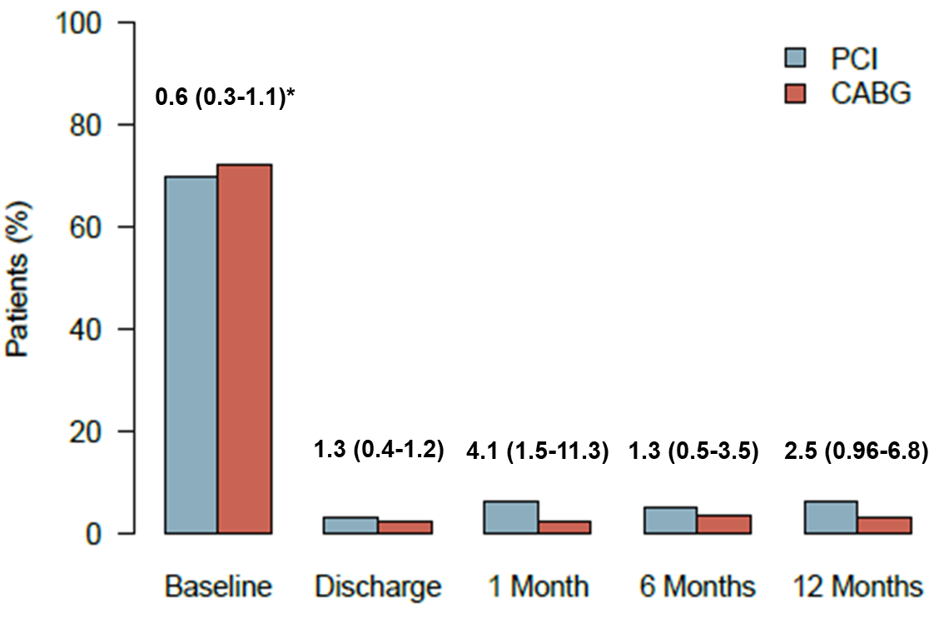
FAME-3 Trial QOL: Angina Status
Percentage of Patients Randomized to FFR-Guided PCI vs CABG
CCS Class ≥2 Angina
*OR and 95% CI for comparisons at each time point.
Zimmermann F, ACC 2022

Slide 36
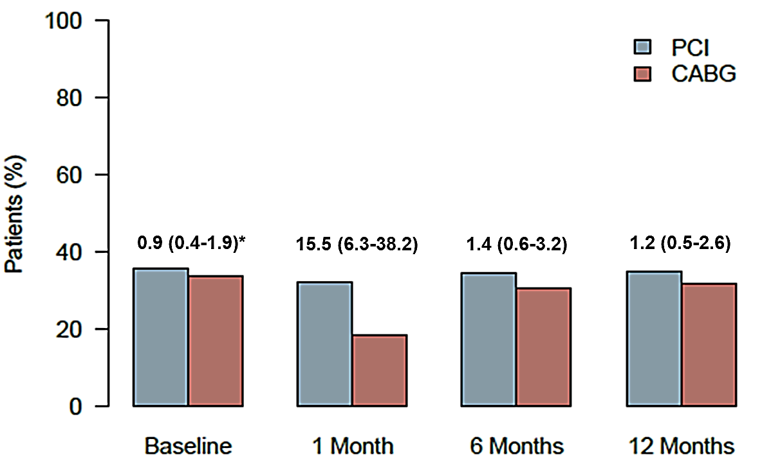
FAME-3 Trial QOL: Working Full/Part Time
Percentage of Patients Randomized to FFR-Guided PCI vs CABG
*OR and 95% CI for comparisons at each time point.
Zimmermann F, ACC 2022

Slide 37
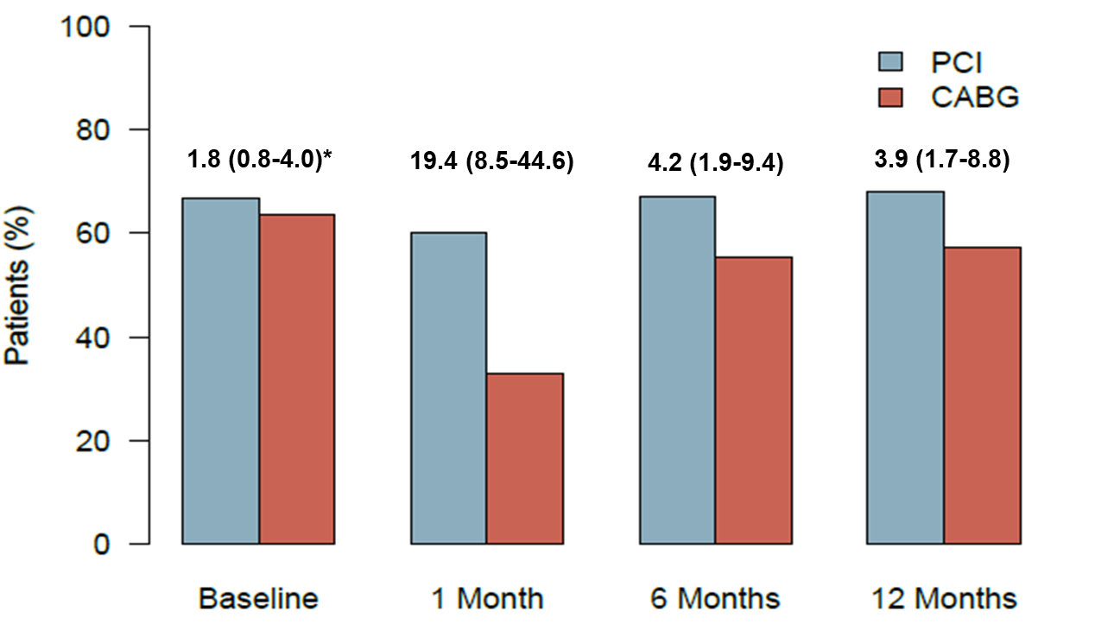
FAME-3 Trial QOL: Working Full/Part Time
Patients <65 Years Old
Percentage of Patients Randomized to FFR-Guided PCI vs CABG
*OR and 95% CI for comparisons at each time point.
Zimmermann F, ACC 2022

Slide 38
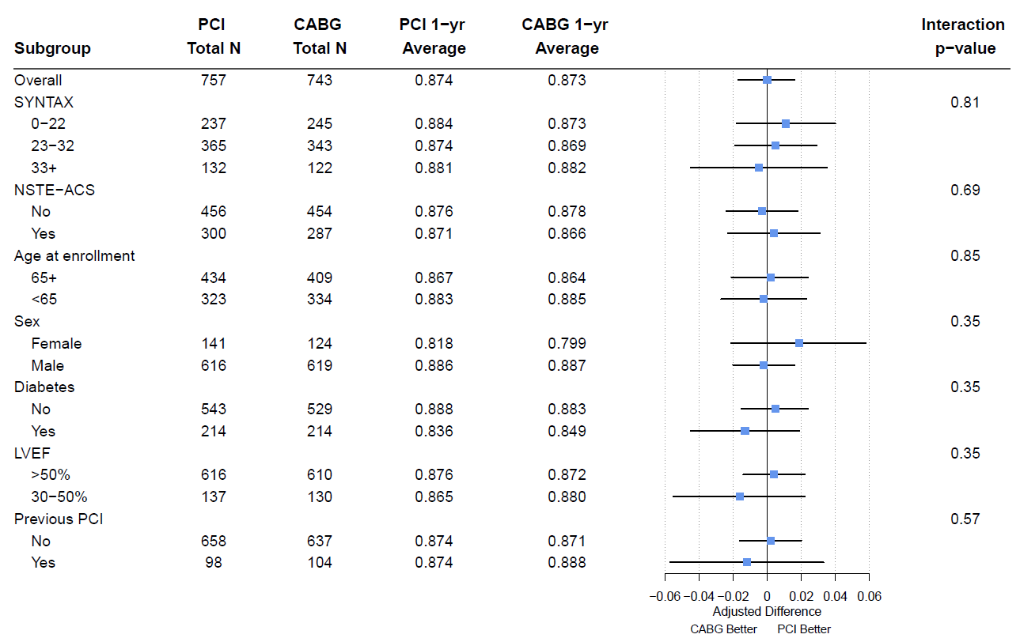
FAME-3 Trial: EQ-5D Summary Index at 12 M
Zimmermann F, ACC 2022

Slide 39
FAME-3 Trial QOL Sub-study: Conclusions
In patients with 3V-CAD, quality of life at 12 months is similar after FFR-guided PCI with current generation DES compared with CABG.
FFR-guided PCI results in a faster improvement in quality of life than CABG during the first year after revascularization, and improved working status in patients <65 years old.
The rate of significant angina was greatly reduced in both groups and not significantly different at 12 months.

Slide 40
Quality of Life After Fractional Flow Reserve-Guided PCI
Compared with Coronary Bypass Surgery
William F. Fearon, MD*^{1,2}, Frederik M. Zimmermann, MD*³, Victoria Y. Ding, MS⁴, Jo M. Zelis, MD, PhD,³ Zsolt Piroth, MD, PhD⁵, Giedrius Davidavicius, MD, PhD⁶, Samer Mansour, MD⁷, Rajesh Kharbanda, PhD⁸, Nikolaos Östlund-Papadogeorgos, MD⁹, Keith G. Oldroyd, MD¹⁰, Olaf Wendler, MD, PhD¹¹, Michael J. Reardon, MD¹², Y. Joseph Woo, MD¹³, Alan C. Yeung, MD¹, Nico H.J. Pijls, MD, PhD³, Bernard De Bruyne, MD, PhD^{14,15}, Manisha Desai, PhD⁴, and Mark A. Hlatky, MD^{1,16}
on behalf of the FAME 3 Investigators
¹Division of Cardiovascular Medicine and Stanford Cardiovascular Institute, Stanford University, Stanford, CA, ²VA Palo Alto Health Care System, Palo Alto CA; ³Catharina Hospital, Eindhoven, the Netherlands; ⁴Quantitative Sciences Unit, Stanford University, Stanford, CA; ⁵Gottsegen National Cardiovascular Center, Hungary; ⁶Clinic of Cardiac and Vascular Diseases, Institute of Clinical Medicine, Vilnius University, Lithuania and Vilnius University Hospital Santaros Klinikos, Vilnius, Lithuania; ⁷Centre Hospitalier de l'Université de Montréal, Canada; ⁸Oxford University Hospital NHS Trust, Oxford, UK; ⁹Danderyd University Hospital and Karolinska Institutet, Solna, Sweden; ¹⁰Golden Jubilee National Hospital, Glasgow, UK; ¹¹Kings College Hospital, London, UK; ¹²Houston Methodist Hospital, Houston, TX; ¹³Department of Cardiothoracic Surgery, Stanford University, Stanford, CA; ¹⁴Cardiovascular Center Aalst, Aalst, Belgium; ¹⁵Lausanne University Centre Hospital, Lausanne, Switzerland; and ¹⁶Department of Health Policy, Stanford University, Stanford, CA.
*These two authors contributed equally

Slide 41
COMPLETE Trial
Effects of Complete Revascularization on Angina-Related Quality of Life in Patients with ST-Segment Elevation Myocardial Infarction
To determine whether complete revascularization improves angina-related quality of life compared with culprit-lesion only PCI in patients with STEMI and multivessel CAD.

Slide 42
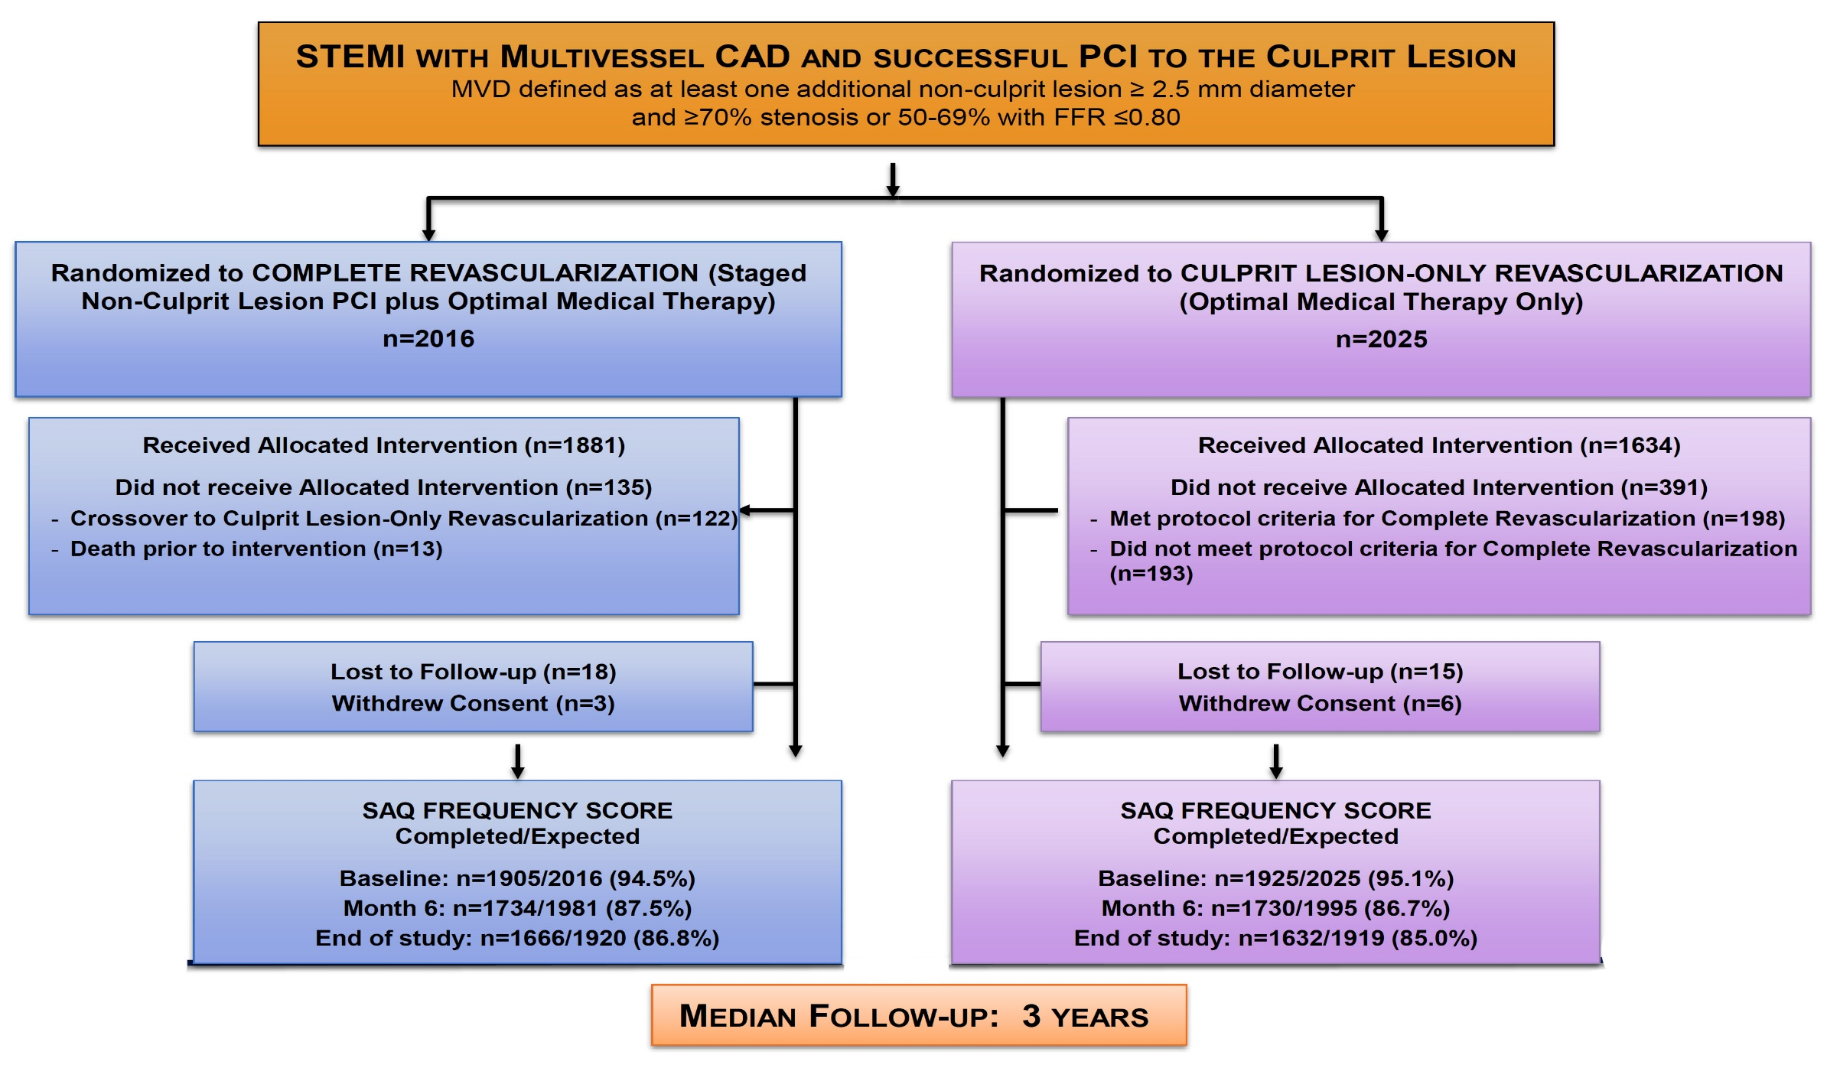
COMPLETE Trial: Study Design
Mehta S, ACC 2022

Slide 43
COMPLETE Trial: Baseline Clinical Characteristics and SAQ Score
 | Complete N=2016 | Culprit-only N=2025
Age (yrs) | 61.6 | 62.4
Gender (% male) | 80.5 | 79.1
Diabetes (%) | 19.1 | 19.9
Chronic renal insuff. (%) | 2.0 | 2.3
Prior MI (%) | 7.3 | 7.6
Current smoker (%) | 40.6 | 38.9
Hypertension (%) | 48.7 | 50.7
Dyslipidemia (%) | 37.9 | 39.4
Prior PCI (%) | 7.0 | 7.0
Prior stroke (%) | 3.2 | 3.1
 | Complete N=2016 | Culprit-only N=2025
SAQ score
Angina frequency | 87.1±17.8 | 87.2±18.4
Daily | 34/1905 (1.8) | 39/1925 (2.0)
Weekly | 211/1905 (11.1) | 211/1925 (11.0)
Monthly | 719/1905 (37.7) | 675/1925 (35.1)
None | 941/1905 (49.4) | 1000/1925 (51.9)
Physical limitation | 84.9±20.4 | 84.4±20.8
Treatment satisfaction | 93.0±12.4 | 92.5±12.5
Quality of life | 66.9±23.0 | 66.3±23.5
Summary score* | 79.6±15.7 | 79.3±16.7
Mehta S, ACC 2022

Slide 44
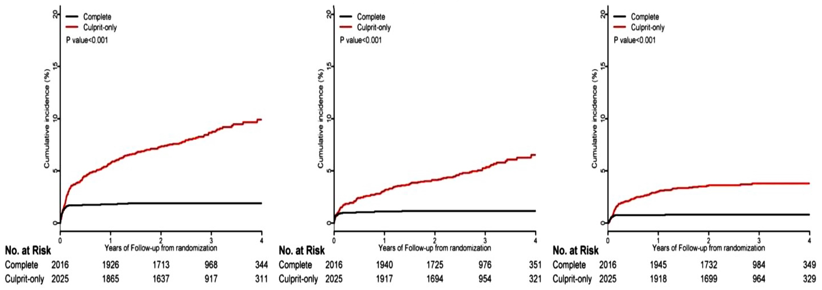
COMPLETE Trial: Crossover PCI of Non-culprit Lesion After Angina-Related Clinical Event
Composite of NCL PCI for New MI or NCL PCI for New MI NCL PCI for Hosp for
Hosp for Unstable Angina Unstable Angina
Mehta S, ACC 2022

Slide 45
COMPLETE Trial: SAQ Subscale Scores at Follow-Up (Median 3 Years)
SAQ Subscale | Score at Follow-up |  | Δ from Baseline |  | Difference (95% CI) | P Value
SAQ Subscale | Complete | Culprit | Complete | Culprit | Difference (95% CI) | P Value
Angina frequency | 97.1±9.7 | 96.3±10.9 | 9.8±18.9 | 8.6±19.9 | 0.97 (0.27-1.67) | 0.006
Physical limitation | 91.1±15.7 | 89.9±17.4 | 4.2±20.0 | 4.3±22.3 | 1.41 (0.24-2.59) | 0.018
Treatment satisfaction | 93.3±12.4 | 92.5±13.2 | 0.6±15.1 | 0.2±16.2 | 0.97 (0.10-1.84) | 0.028
Quality of life score | 83.6±18.0 | 82.5±18.4 | 16.3±25.6 | 15.9±27.2 | 1.25 (0.01-2.48) | 0.048
Summary score | 90.7±11.4 | 89.5±12.2 | 9.8±15.8 | 9.6±18.0 | 1.27 (0.44-2.11) | 0.003
Mehta S, ACC 2022

Slide 46
COMPLETE Trial: Angina Status at Study End
Residual Angina
Absolute Difference 3.21%
P=0.013
Proportion Angina Free
(SAQ-AF Score=100)
87.5% Complete Revasc
vs
84.3% Culprit-Lesion-only
ARD=3.2% 95% CI 0.7-5.7%
Number Needed to Treat=31
P=0.013
Mehta S, ACC 2022

Slide 47
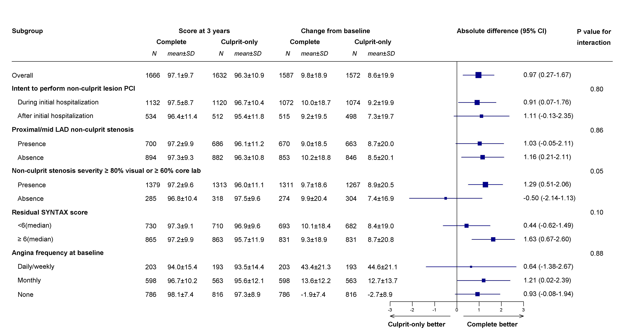
COMPLETE Trial: Pre-Defined Subgroups
(SAQ-AF Score)
Mehta S, ACC 2022

Slide 48
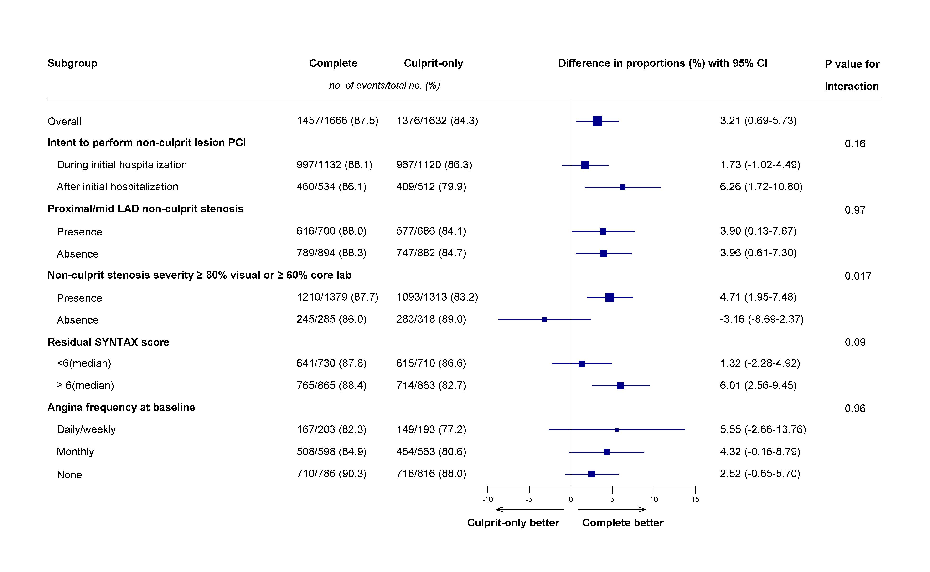
COMPLETE Trial: Pre-Defined Subgroups
(Angina-Free at 3 Years)
Mehta S, ACC 2022

Slide 49
COMPLETE Trial: Residual Angina at Median 3 Years According to Non-Culprit Lesion Stenosis Severity
ARD= +4.5%
ARD= -3%
Interaction P
=0.017
*Visual estimation or 60% by QCA (angiographic core lab)
Mehta S, ACC 2022

Slide 50
COMPLETE Trial: Total Angina Burden Randomization to Follow-Up
ARD 8.99%
P<0.001
ARD 8.56%
P<0.001
ARD 5.46%
P<0.001
ARD 4.20%
P=0.003
ARD 3.21%
P=0.013
Mehta S, ACC 2022

Slide 51
COMPLETE Trial QOL Sub-study: Conclusions
In Patients with STEMI and MVD:
Both a complete revascularization and a culprit-lesion-only strategy resulted in substantial improvements in overall angina-related quality of life compared with baseline.
At a median follow-up of 3 years, a greater proportion of patients were free of angina in the complete revascularization group than in the culprit-lesion-only group, translating into a number needed to treat of 31 patients to prevent one patient from experiencing angina at follow-up of 3 years.
The benefit of CR was observed entirely in patients with NCL stenosis >80%.
This difference is remarkable given the high rates of crossover to NCL PCI in the culprit lesion only group after an angina-related ischemic event
Total angina burden from randomization to follow-up (including all angina-related events and residual angina at study end) was substantially reduced with complete revascularization

Slide 52
Latest Issues in Coronary Intervention
Key Interventional Trials from ACC 2022:
FLAVOUR Trial- 2 Years, FAME-3 Trial QOL study,
COMPLETE Trial QOL study
Focused review of the month
2021 Coronary Revascularization Guidelines:
Updated ACC/AHA/SCAI Guidelines for Coronary
Artery Revascularization for PCI vs CABG

Slide 53
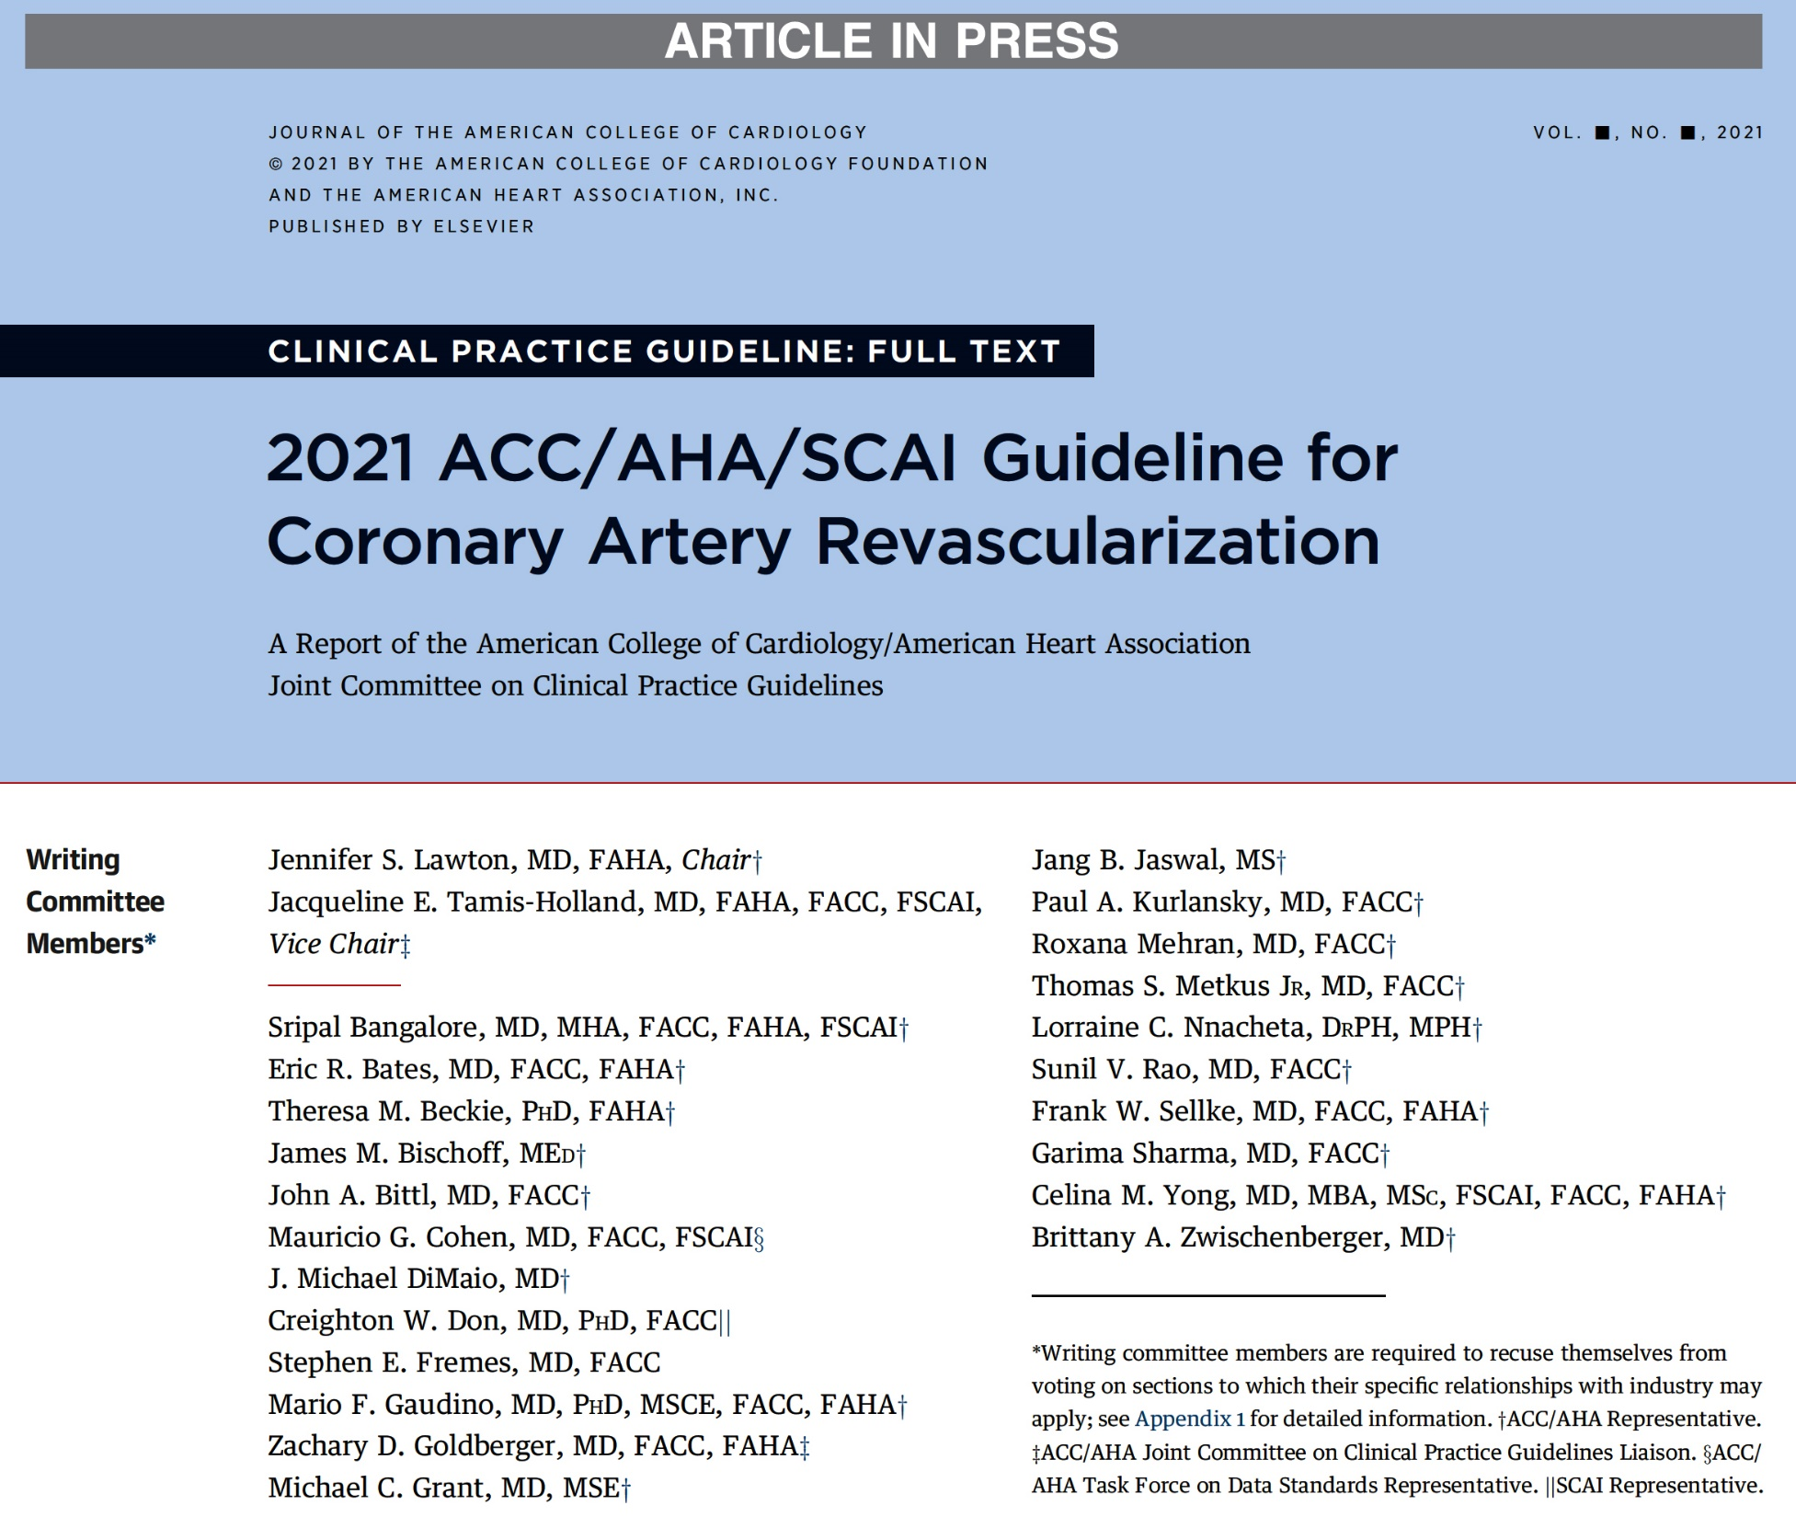

Slide 54
Improving Equity of Care in Revascularization
Recommendation to Improve Equity of Care in Revascularization
Recommendations for Shared Decision-Making and Informed Consent
Lawton et al., J Am Coll Cardiol Dec. 7, 2021 Epub ahead of print

Slide 55
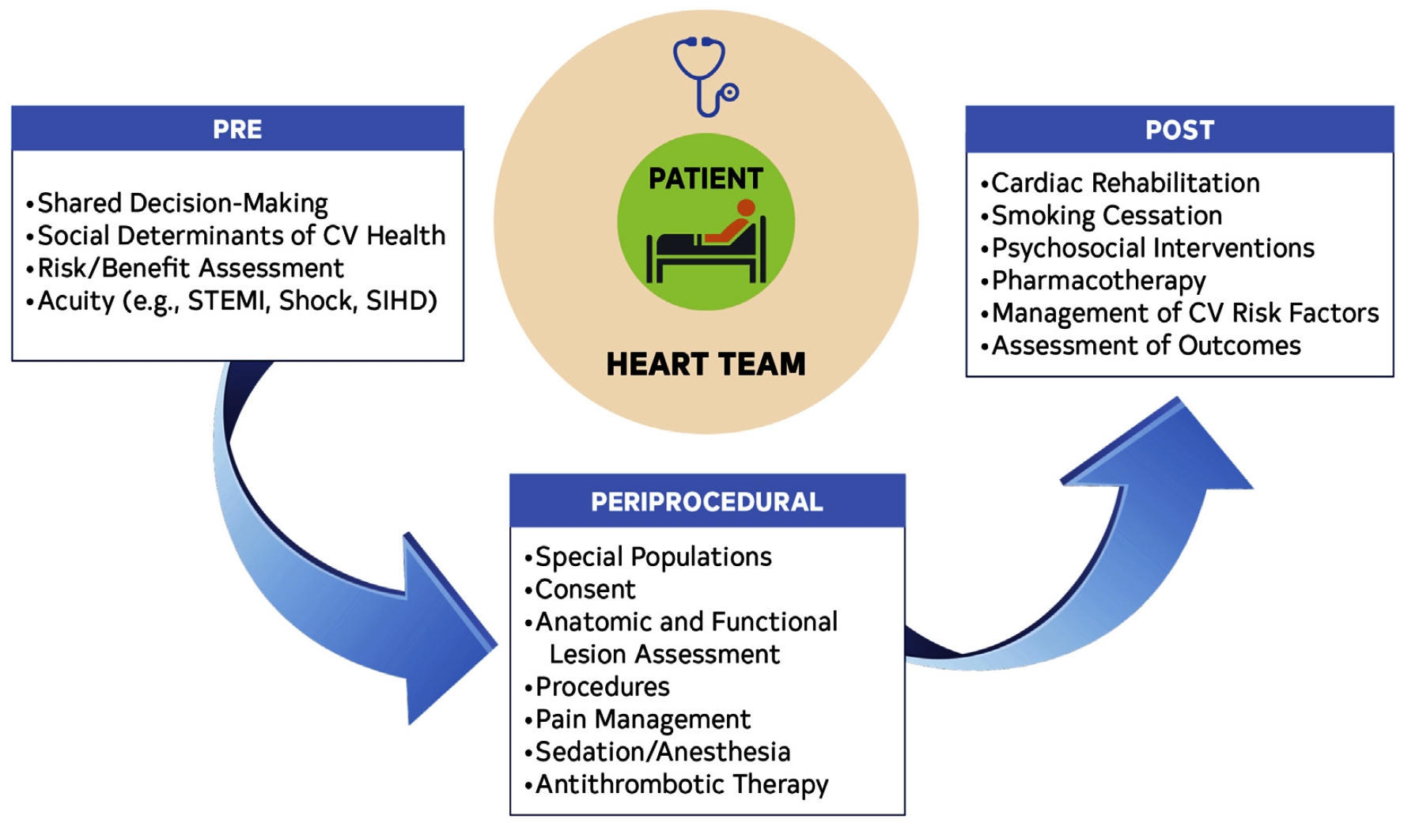
Preprocedural Assessment and the Heart Team
Phases of Patient-Centric Care in the Treatment of CAD
Lawton et al., J Am Coll Cardiol Dec. 7, 2021 Epub ahead of print

Slide 56
Assessment and Predicting Patient Risk
Recommendation for the Heart Team
Recommendation to Predicting Patient Risk of Death with CABG: STS Risk
Recommendation for Defining Coronary Artery Lesion Complexity: SYNTAX Score
Assessment of Risk Factors Not Qualified in the STS Score
Lawton et al., J Am Coll Cardiol Dec. 7, 2021 Epub ahead of print

Slide 57
Use of Coronary Physiology to Guide Revascularization with PCI
Recommendations for the Use of Coronary Physiology to Guide Revascularization with PCI
Recommendations for Intravascular Ultrasound to Assess Lesion Severity
Lawton et al., J Am Coll Cardiol Dec. 7, 2021 Epub ahead of print

Slide 58
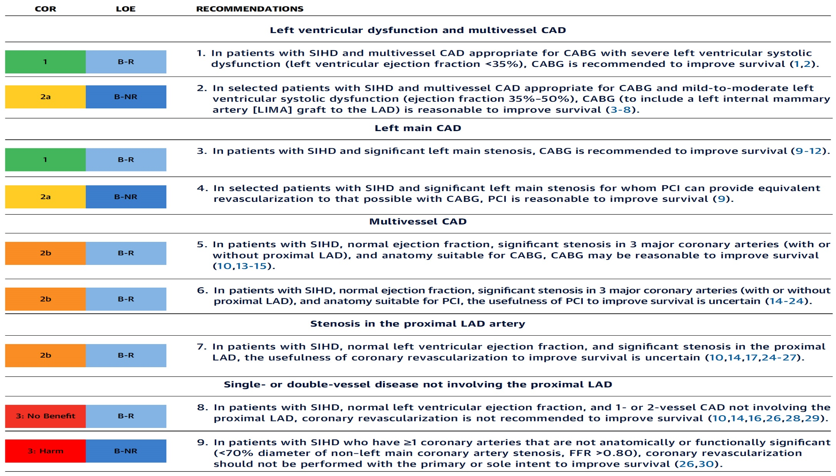
Revascularization to Improve Survival in SIHD Compared to Medical Therapy
Recommendations for Revasc to Improve Survival in SIHD Compared with Medical Therapy
Lawton et al., J Am Coll Cardiol Dec. 7, 2021 Epub ahead of print

Slide 59
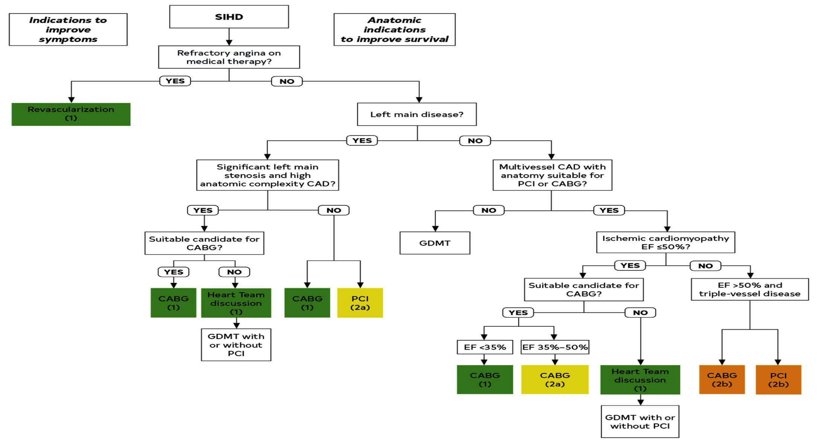
Revascularization to Improve Survival in SIHD Compared to Medical Therapy
Lawton et al., J Am Coll Cardiol Dec. 7, 2021 Epub ahead of print

Slide 60
Patients with Complex Disease & Diabetes
Recommendations for Patients with Complex Disease
Recommendations for Patients with Diabetes
Lawton et al., J Am Coll Cardiol Dec. 7, 2021 Epub ahead of print

Slide 61
Specific Indications for PCI
Recommendations for Radial and Femoral Approach for PCI
Recommendations for Use of Intravascular Imaging
Lawton et al., J Am Coll Cardiol Dec. 7, 2021 Epub ahead of print

Slide 62
Treatment of Individual Patients Subgroups
Recommendations for the Treatment of Calcified Lesions
Recommendations for the Treatment of Pts with Stent Restenosis
Recommendations for Hemodynamic Support in Complex PCI
Lawton et al., J Am Coll Cardiol Dec. 7, 2021 Epub ahead of print

Slide 63
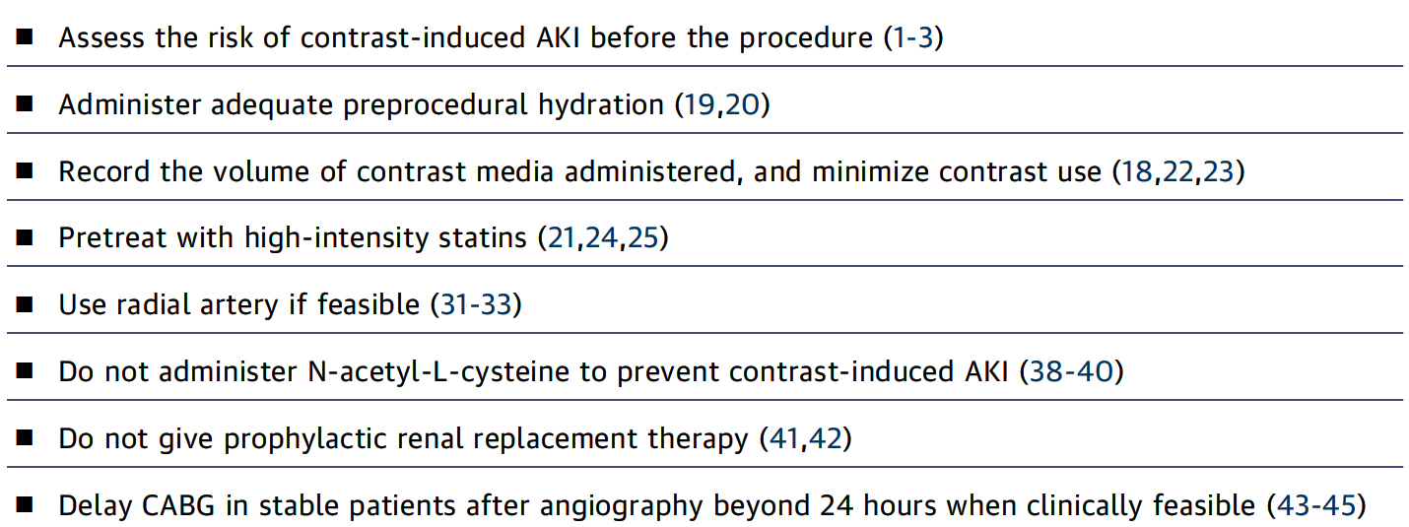
Best Practices in the Catheterization Laboratory
for Patients with CKD Undergoing Angiography
Lawton et al., J Am Coll Cardiol Dec. 7, 2021 Epub ahead of print

Slide 64
Aspirin & Oral P2Y12 Inhibitors in Pts with PCI
Recommendations for Aspirin and Oral P2Y12 Inhibitors Undergoing PCI
Lawton et al., J Am Coll Cardiol Dec. 7, 2021 Epub ahead of print

Slide 65
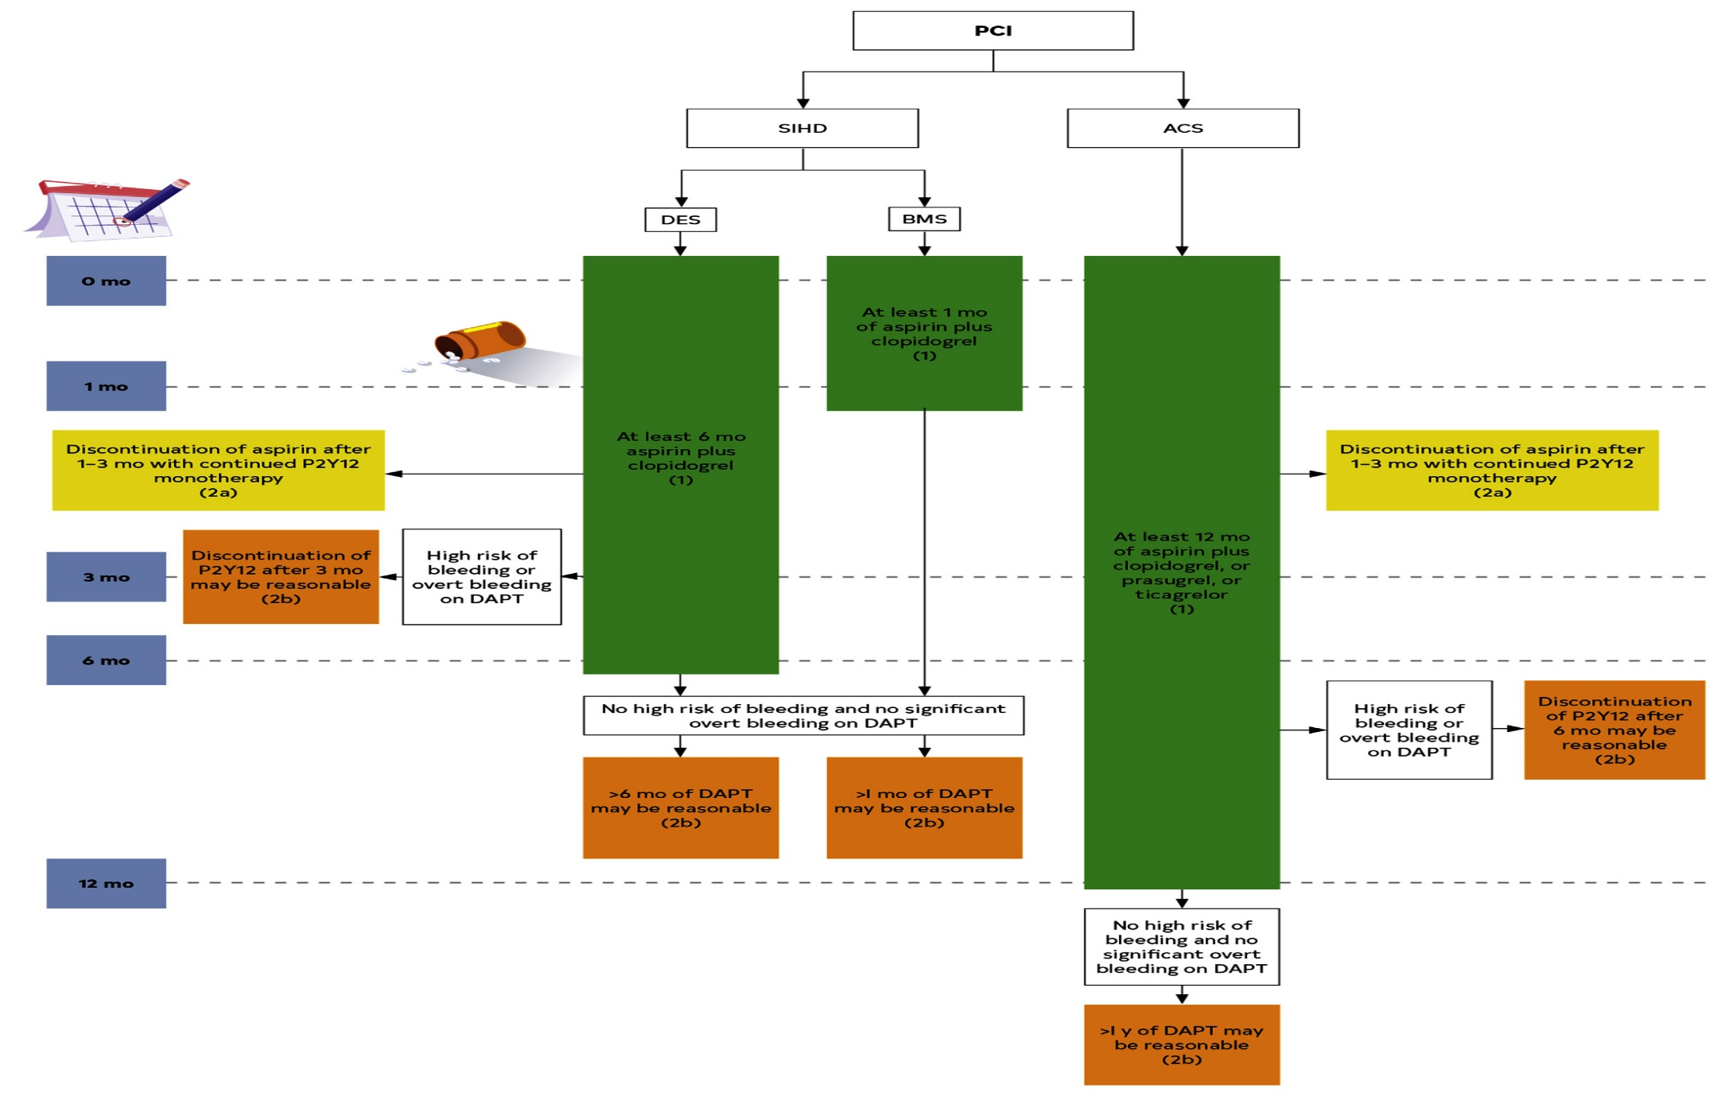
Use of DAPT for Patients After PCI
Lawton et al., J Am Coll Cardiol Dec. 7, 2021 Epub ahead of print

Slide 66
Antiplatelet Therapy in Pts with A-Fib on Anticoagulation After PCI
Recommendations for Antiplatelet Therapy in Pts with A-fib on Anticoagulation After PCI
Lawton et al., J Am Coll Cardiol Dec. 7, 2021 Epub ahead of print

Slide 67
Cardiac Rehabilitation, Education and Smoking Cessation after Revascularization
Recommendations for Cardiac Rehabilitation and Education
Recommendations for Smoking Cessation
Lawton et al., J Am Coll Cardiol Dec. 7, 2021 Epub ahead of print

Slide 68
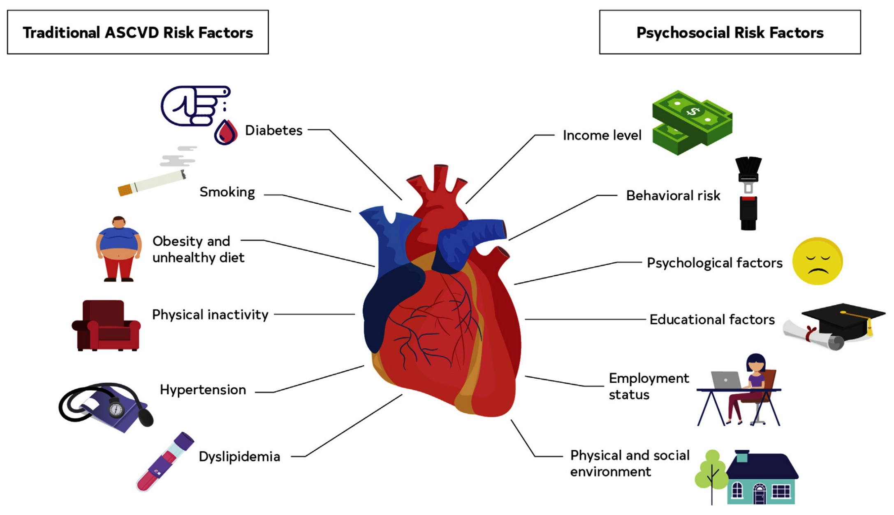
Traditional and Psychosocial Risk Factors
for ASCVD
Lawton et al., J Am Coll Cardiol Dec. 7, 2021 Epub ahead of print

Slide 69
Take Home Message: 2022 ACC Interventional Trials and 2021 Coronary Revascularization Guidelines
FFR vs IVUS guided PCI 2-yr POCO:
QOL improvement post FFR guided PCI vs CABG:
FFR guided PCI faster improvement in QOL & return to work pts <65 yrs:
Angina QOL with Complete vs Culprit lesion PCI:
Higher angina free at 3 yrs with CR vs CL PCI with NCL >80% stenosis:
Updated 2021 coronary revascularization guidelines emphasized heavily on heart team discussion, calculation of STS/Syntax scores, equity of care and pt level CV risk education/aggressive modifications. In view of multiple trials comparing PCI with CABG, Class I recommendations for CABG are LM CAD and MV CAD with low EF. In other pts subgroups, PCI and CABG both have 2a/2b indications for revascularization.
Notes:
HbA1c

Slide 70
Question # 1
Following is the false statement about the 2-year results of the FLAVOUR trial;
Primary endpoints were similar between IVUS and FFR groups
Death were similar between IVUS and FFR groups
Lower MI rates after FFR vs IVUS groups
POCO event rates were higher in PCI vs MT in both strategy gps
SAQ sores were not different between IVUS and FFR groups
The correct answer is C

Slide 71
Question # 2
Following statement is false regarding the FAME-3 trial health related QOL outcomes at 1-yr;
A. QOL parameters were similar after FFR guided PCI vs CABG
B. FFR guided PCI resulted in faster improvement in QOL vs CABG
C. Significant angina was greatly reduced after both FFR guided PCI and CABG
D. Angina reduction was not different between FFR guided PCI vs CABG
E. Working status improvement in pts <65ys old, was not different after FFR guided PCI vs CABG
,
The correct answer is E

Slide 72
Question # 3
Following statement is false regarding QOL sub-study of COMPLETE trial at 3 years after complete revascularization (CR) vs Culprit-lesion (CL) only in STEMI pts:
Both CR and CL only strategy resulted in improved angina QOL from baseline
There were high rates of crossover to NCL PCI in CL only gp
Higher angina free in CR group vs CL only group
Benefit of CR was seen in all pts with NCL stenosis <80% or >80%
Total angina burden was significantly lower in CR vs CL only
strategy
The correct answer is D

