Slide 1
Complex Coronary Case
Supported by:
Sun Pharmaceutical Industries Ltd.

Slide 2
Disclosures
Samin K. Sharma, MD, MSCAI, FACC
Speaker’s Bureau – BSC, ABBOTT
Annapoorna S. Kini, MD, MRCP, FACC
Nothing to disclose
Srinivasa Rao Maddury, MD, DM, FSCAI, FESC (Guest Faculty)
Narasa Raju Kavalipati, MD, DM, FACC (Moderator)

Slide 3
Srinivasa Rao Maddury, MD, DM, FSCAI, FESC
Head, Department of Cardiology
Senior Interventional Cardiologist
Apollo Hospital, Hyderguda, Hyderabad
Narasa Raju Kavalipati, MD, DM (Cardiology), FACC
Director, Cath Lab & Sr. Interventional Cardiologist
Apollo Hospital, Hyderguda, Hyderabad
Dr. Srinivasa Rao Maddury is Head, Department of Cardiology and Senior Interventional Cardiologist, at Apollo Hospital, Hyderabad. He is a fellow of Society for Cardiovascular Angiography and Interventions (FSCAI) and European College Of Cardiology (FESC). He is a life member of Cardiological Society of India and Indian College Of Cardiology. He is a gold medalist in MD (General Medicine). He is having a vast experience of more than 30 years in this field ad actively involved in many clinical trials ASPIRE, PARADIGM-HF, CANTOS, Triplet study, LCZ696 and many more. He has published in renowned journals & has presented many papers in various scientific meetings.
Dr. Narasa Kavalipati is Director, Cath Lab & Senior Interventional Cardiologist at Apollo Hospital, Hyderabad. He completed his MBBS from Andhra University, MD (General Medicine) from Andhra Medical College and DM (Cardiology) from AIIMS, New Delhi. He is a fellow of American College of Cardiology. He is involved as a Principal Investigator in two international multi-center clinical trials The RED-HF and The ATLAS ACS 2 TIMI 51 trial. He is the President of CSI, Telangana chapter.

Slide 4
India Case Title – Will Share Soon

Slide 5
Live Case #18
Patient Demographics
42 yrs, M
Present Clinical Presentation
Presented with new onset CCS class II angina and cCTA revealing moderate 40-75% 3 V disease with soft coronary plaques, Ca++ score 1001
CAD Risk Factors
Controlled hypertension
Controlled hyperlipidemia
Ex-smoker, + F/H,
?Aspirin allergy, SAQ -7: 92
Clinical Variables
No known CAD prior to current presentation
Medications
Amlodipine, Metoprolol XL, Atorvastatin, Prasugrel 10mg (started after recent PCI)
Cath: Cardiac cath on Feb 25th 2022 revealed 3V CAD: 90% RCA-AV cont, 80-90% multiple LAD-D1 lesions, 95% LCx-OM2 with LVEF 60% and Syntax score 22. Pt underwent successful PCI of RCA-AV cont and LCx-OM2 using 2 Promus Elite DES. Pt was also was desensitized for aspirin allergy and can receive low dose aspirin now (given today).
Plan: Now planned for FFR guided staged PCI of multiple LAD/Diagonal lesions.

Slide 6
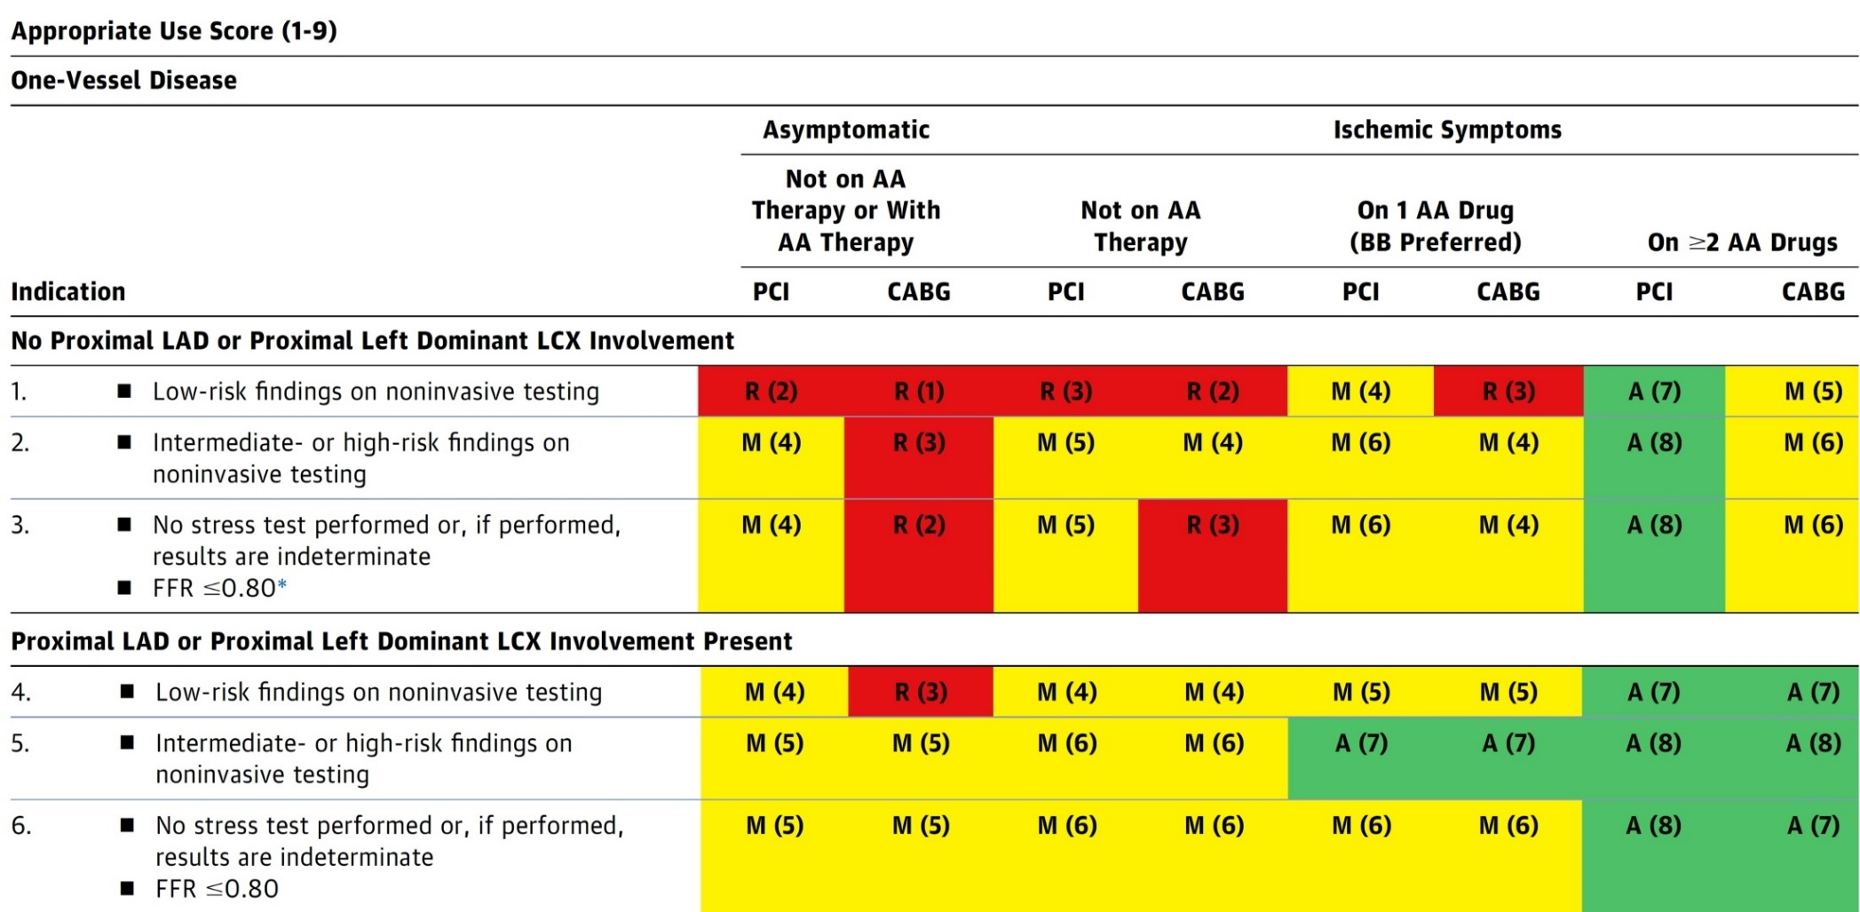
AUC 2017: One-Vessel Disease
Patel et al., J Am Coll Cardiol 2017;69:2212

Slide 7
Use of Coronary Physiology to Guide Revascularization with PCI
Recommendations for the Use of Coronary Physiology to Guide Revascularization with PCI
Recommendations for Intravascular Ultrasound to Assess Lesion Severity
Lawton et al., J Am Coll Cardiol 2022:79;e21-129

Slide 8
Assessment and Predicting Patient Risk
Recommendation for the Heart Team
Recommendation to Predicting Patient Risk of Death with CABG: STS Risk
Recommendation for Defining Coronary Artery Lesion Complexity: SYNTAX Score
Assessment of Risk Factors Not Qualified in the STS Score
Lawton et al., J Am Coll Cardiol 2022:79;e21-129

Slide 9
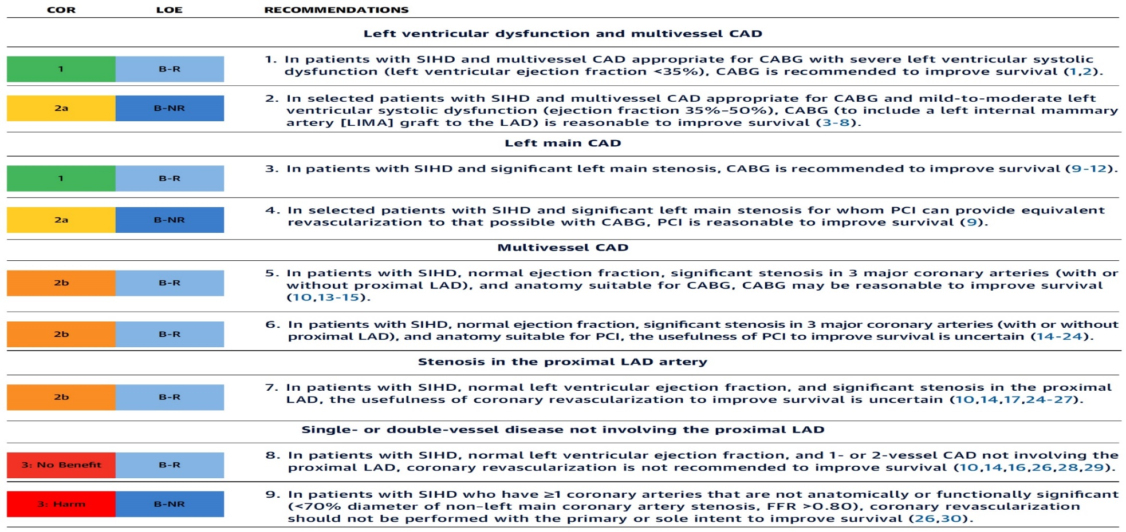
Revascularization to Improve Survival in SIHD Compared to Medical Therapy
Recommendations for Revasc to Improve Survival in SIHD Compared with Medical Therapy
Lawton et al., J Am Coll Cardiol 2022:79;e21-129

Slide 10
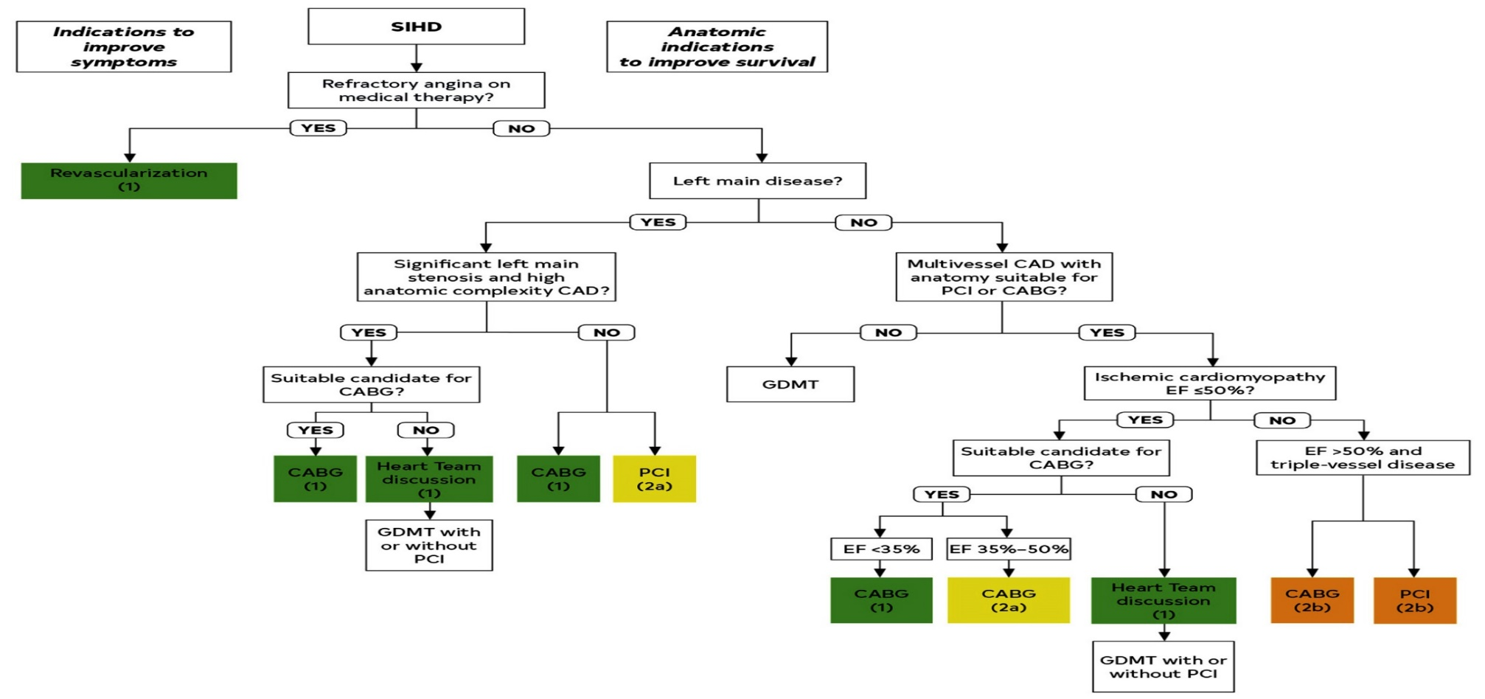
Revascularization to Improve Survival in SIHD Compared to Medical Therapy
Lawton et al., J Am Coll Cardiol 2022:79;e21-129

Slide 11
Specific Indications for PCI
Recommendations for Radial and Femoral Approach for PCI
Recommendations for Use of Intravascular Imaging
Lawton et al., J Am Coll Cardiol 2022:79;e21-129

Slide 12
Patients with Complex Disease & Diabetes
Recommendations for Patients with Complex Disease
Recommendations for Patients with Diabetes
Lawton et al., J Am Coll Cardiol 2022:79;e21-129

Slide 13
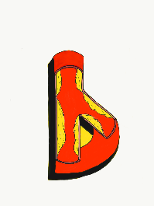
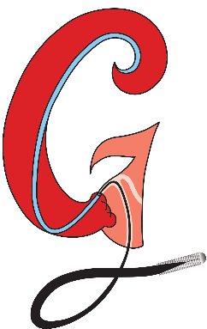
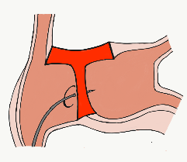
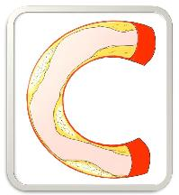
BifurcAID
TAVRcathAID
ComplicAID
Mobile App
Coming soon…
GuidewireAID
Cath Lab
Apps
BifurcAID 3D
CalcificAID
OCTAID
TranseptAID

Slide 14
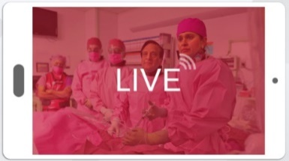
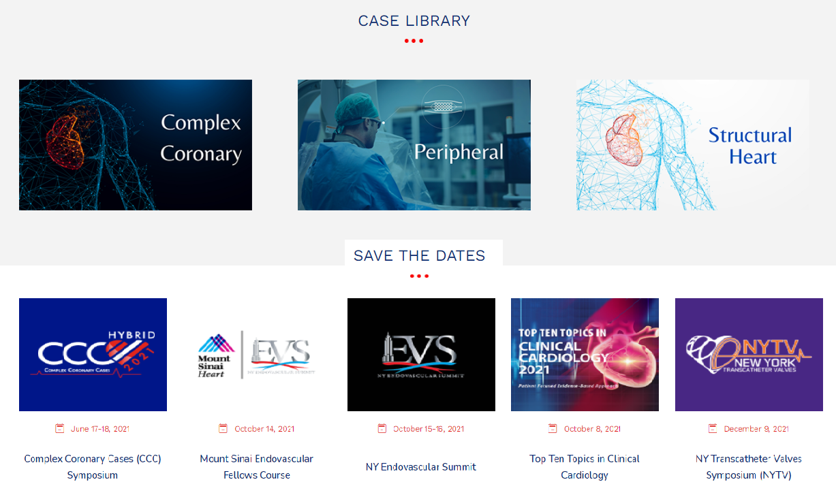
www.ccclivecases.org

Slide 15
CCClivecases: Total Page Views per Month (Past 2 Years)
Number of views

Slide 16
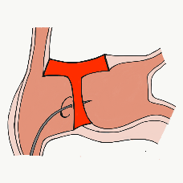
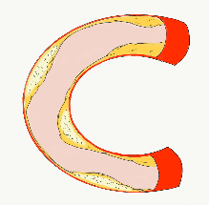
More than 35,800 unique downloads
Cath Lab Apps CardiologyApps.com
iOS 5/5 stars
9896 downloads
Android 4.4/5 stars
8245 downloads
Released sept 2017
iOS 5/5 stars
6068 downloads
Android 4.8/5 stars
3850 downloads
Released June 2018
iOS 5/5 stars
2073 downloads
Android N/A stars
549 downloads
Released March 2018
iOS 5/5 stars
1074 downloads
Android N/A stars
547 downloads
Released Sept 2018
iOS 5/5 stars
931 downloads
Android 5/5 stars
538 downloads
Released June 2019
WebApp Only*
2600 unique users
4800 sessions
Released August 2020
BifurcAID
OCTAID
TAVRcathAID
TranseptAID
CalcificAID
ComplicAID
*Also available
as WebApp
Download Apps
For Free on Both:
WebApps available free on
www.CardiologyApps.com
Apple ® and App Store® are registered trademarks of Apple Inc.
Notes:
These are the apps we have created which will provide digital algorithms for our future ambitious projects to make our cath labs smarter.

Slide 17
Apps Coming Soon…
STEMIcathAID – STEMI patient transfer platform designed to optimize communication between key members, record key performance metrics for AHA’s Mission: Lifeline program, and avoid costly false activations through direct CCL contact.
GuidewireAID – This application covers the design of coronary guidewires and the resulting properties they exhibit during use in the lab. Over two dozen teaching cases, a dense wire library with more than a hundred wires, and a robust search function provide a lot of tailored learning opportunities.
BifurcAID 3D – An animated bifurcation lesion treatment educational application and website. With two views, detailed descriptions, and more, BifurcAID 3D helps make clear the complex steps in techniques such as Minicrush, DK Crush and Culotte, as well as provisional approached and bailout techniques.

Slide 18
Protocol for Management of Calcific Lesions
Coronary Angiography
≈50%
Moderate-severe calcification
≈50%
ELCA, if no Rota/OA Wire could be crossed
IVUS/OCT assessment:
Calcium arc 180-270° (2points)
Calcium arc >270° (3 points)
Calcium length >5 mm (1 point)
Thickness >0.5 mm (1 point)
IVUS/OCT/balloon
did not cross
Un-crossable lesion/CTO
Angulated lesion
Tortuous lesion
Long lesion
Calcific Nodule
1-2 points
3-5 points
- High-pressure NC balloons
- Cutting/scoring balloon
Lithotripsy IVL (RA/OA for Ca 360°)
RA or OA ?ELCA
Suboptimal result
Does not cross
NC balloon/CB
Suboptimal balloon expansion
Optimal balloon expansion
Optimal balloon expansion
Lithotripsy IVL
Stent and OCT/IVUS optimization

