Slide 1
TIO 2022
Complex PCI of a Calcified Lesion
Mount Sinai Hospital, NY, USA

Slide 2
Disclosures
Annapoorna S. Kini, MD, MRCP, FACC
Nothing to disclose for the case
George Dangas, MD, PhD, FACC
Nothing to disclose for the case

Slide 3
Live Case from MSH, NY
Patient Demographics
61 yrs, M
Present Clinical Presentation
Presented with NSTEMI @OSH on Feb 7, 2022 with failed PCI of culprit RCA with 2 V CAD
CAD Risk Factors
Controlled hypertension
Controlled hyperlipidemia
Clinical Variables
No prior cardiac history until recent presentation.
Pt was transferred for salvage culprit PCI of RCA which required ELCA+DES. Pt did well subsequently but still with CCS class II angina. Echo LVEF 45%.
Medications
Aspirin, Lopressor XL, ISMN, Losartan, Ticagrelor, HCTZ, Atorvastatin
Cath: Cath on Feb 7th 2022 revealed 2 V CAD: 99-100% calcified segmental RCA, multiple calcified lesions in prox-mid LAD/D1 bifurcation and Syntax score 26. Pt underwent PCI of RCA requiring ELCA due to un-crossable lesion & 1 Promus Elite DES
Plan: Now planned for physiology/imaging guided staged PCI of calcified LAD/Diagonal bifurcation using RA+DES.

Slide 4
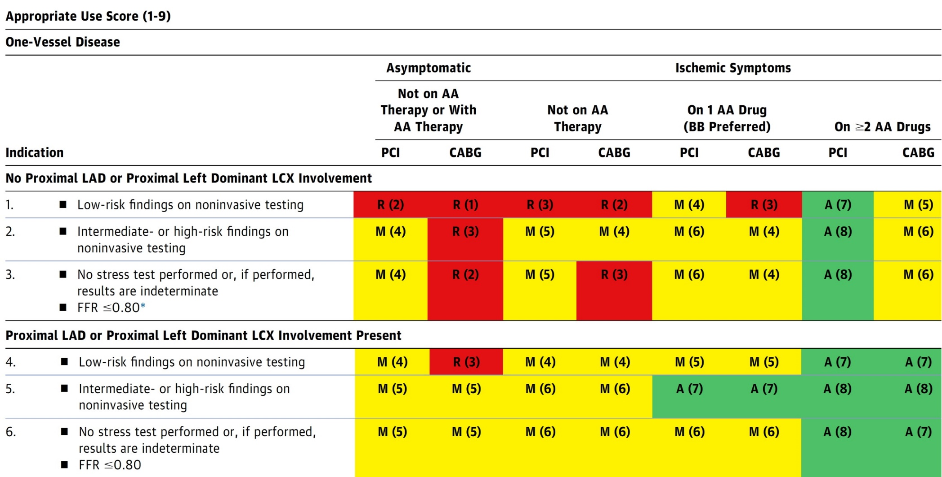
AUC 2017: One-Vessel Disease
Patel et al., J Am Coll Cardiol 2017;69:2212

Slide 5
Protocol for Management of Calcific Lesions
Coronary Angiography
≈50%
Moderate-severe calcification
≈50%
ELCA, if no Rota/OA Wire could be crossed
IVUS/OCT assessment:
Calcium arc 180-270° (2points)
Calcium arc >270° (3 points)
Calcium length >5 mm (1 point)
Thickness >0.5 mm (1 point)
IVUS/OCT/balloon
did not cross
Un-crossable lesion/CTO
Angulated lesion
Tortuous lesion
Long lesion
Calcific Nodule
1-2 points
3-5 points
- High-pressure NC balloons
- Cutting/scoring balloon
Lithotripsy IVL (RA/OA for Ca 360°)
RA or OA
Suboptimal result
Does not cross
NC balloon/CB
Suboptimal balloon expansion
Optimal balloon expansion
Optimal balloon expansion
Lithotripsy IVL
Stent and OCT/IVUS optimization

Slide 6
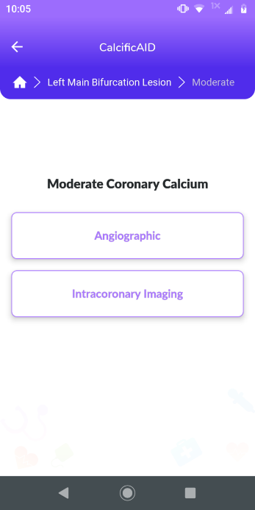
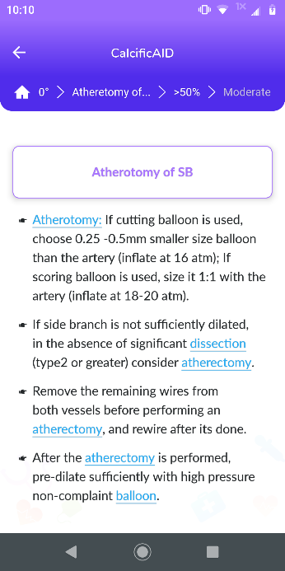
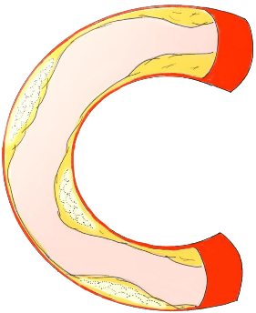
CalcificAID
Lesion selection
Calcium assessment
Treatment
Techniques
Basics
Complications
Notes:
In addition to the hundreds of possible treatment paths, CalcificAID has an educational background section with information about the imaging techniques, devices, and pharmacology of treating calcified lesions.

Slide 7
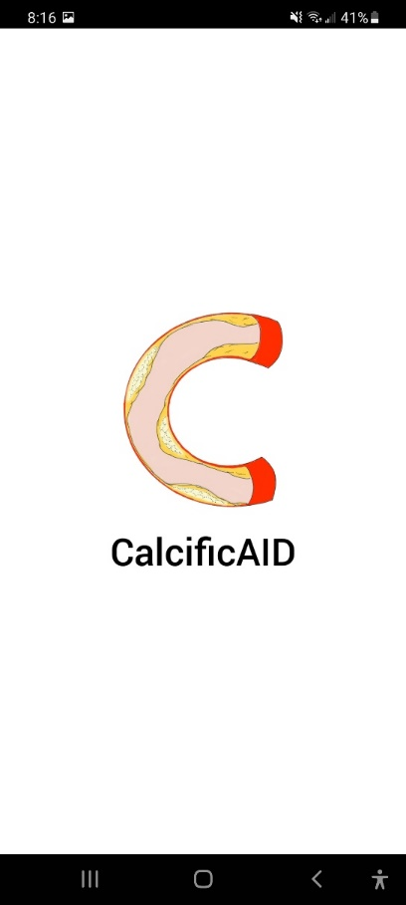
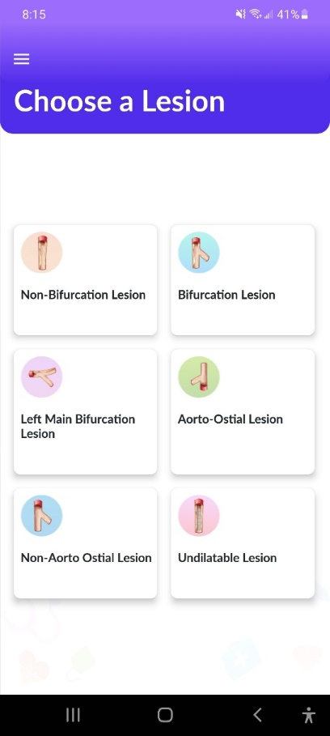
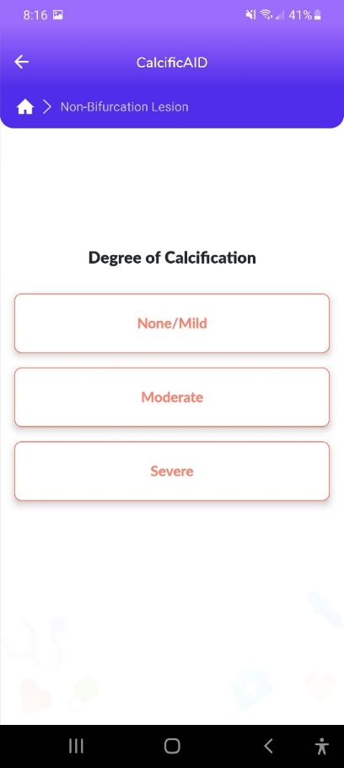
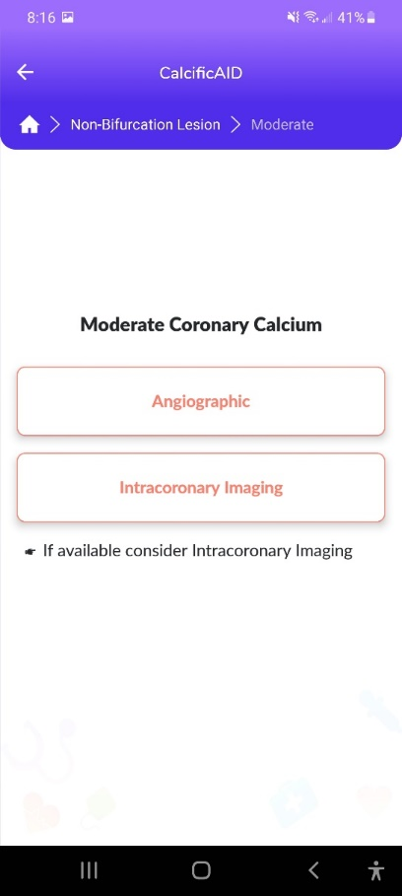
Select Assessment Method
CalcificAID RCA
Select Non-Bifurcation Lesion
Select Degree of Calcification

Slide 8
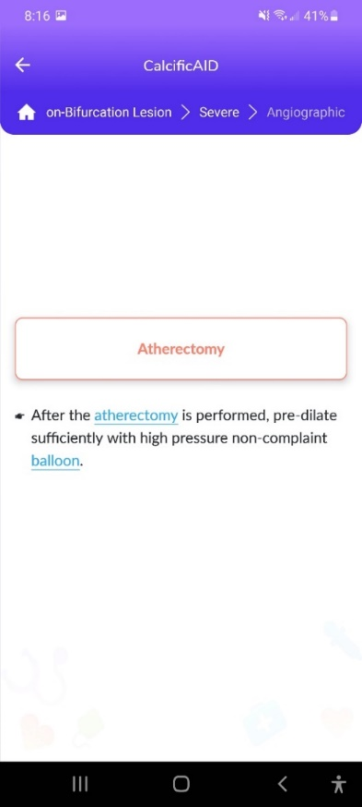
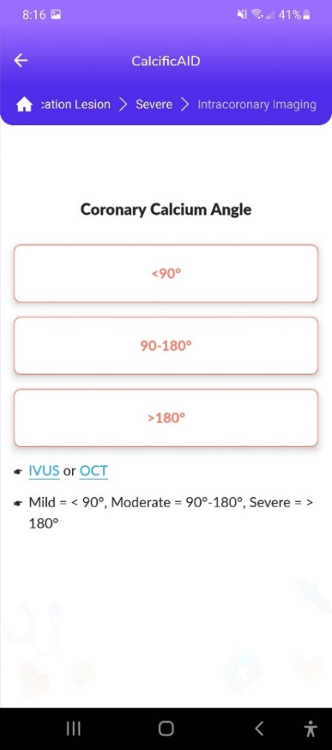
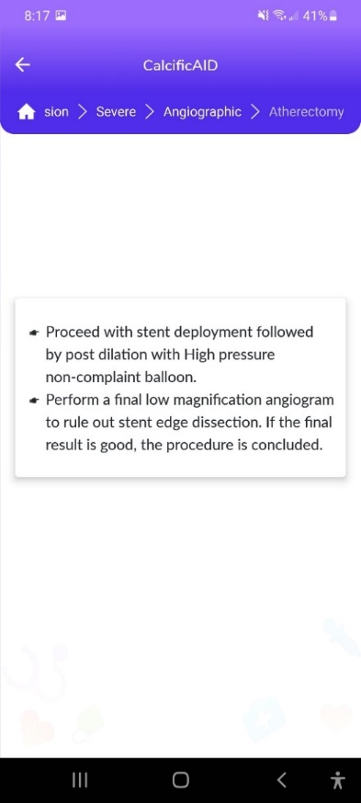
Angiographic
If using Imaging-Based Calcium Arc
Finish Procedure Post-Modification
Basics of Atherectomy

Slide 9
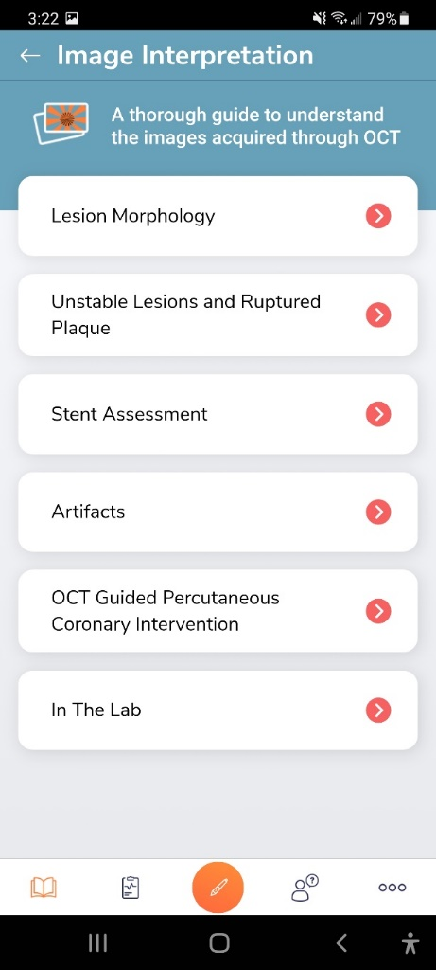
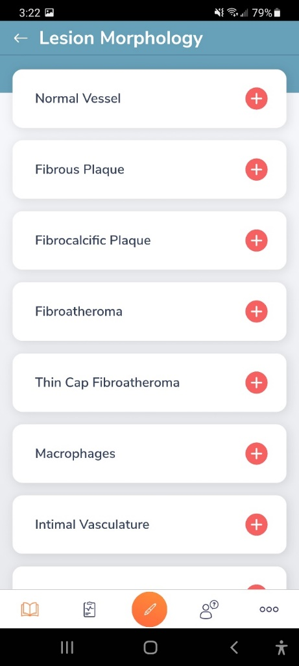
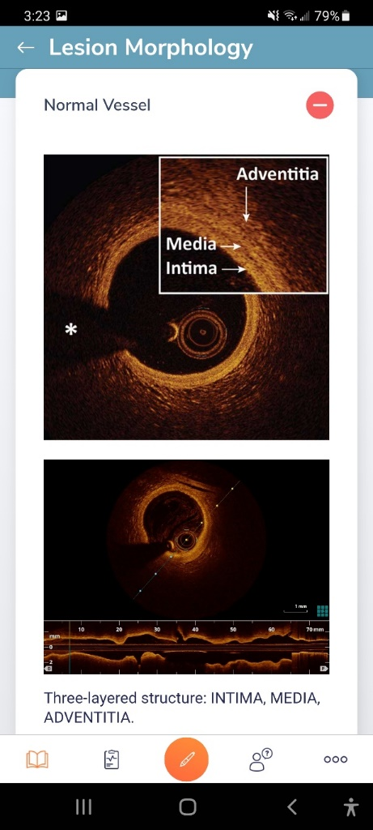
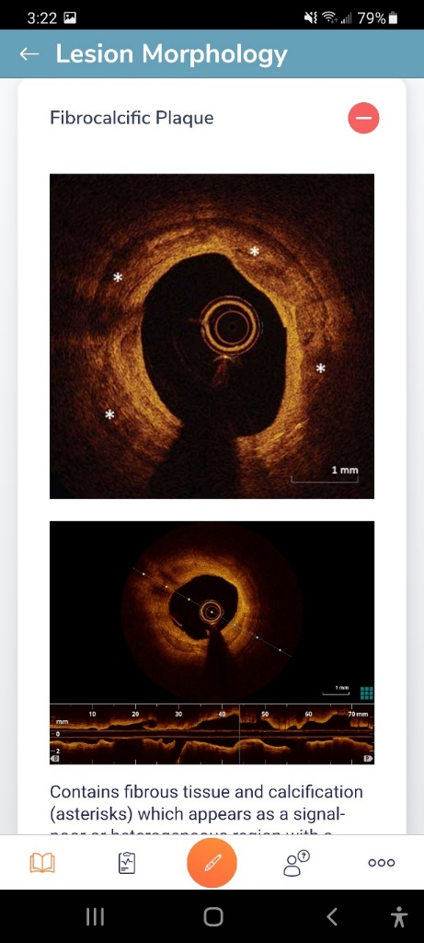
OCTAID – Sample Lesion Interpretation Sections Healthy vs Calcified Vessels
VS

Slide 10
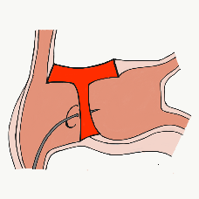
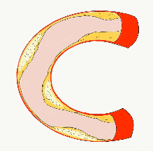
54,362 unique downloads and counting! (Up 14,000 in 2021)
Data Updated on Feb 14 2022*
Cath Lab Apps CardiologyApps.com
iOS ★ 5/5
12,227 downloads
Android ★ 4.96/5
9,372 downloads
Released sept 2017
iOS ★ 4.6/5
7,943 downloads
Android ★ 4.29/5
6,120 downloads
Released June 2018
iOS ★ 5/5
4,265 downloads
Android ★ 5/5
1,472 downloads
Released March 2019
iOS ★ 4.67/5
2,111 downloads
Android ★ 4.6/5
969 downloads
Released Sept 2018
iOS ★ 4.86/5
2,058 downloads
Android ★ 5/5
1,974 downloads
Released June 2019
Large Update Q3 19
Large Update Q1 21
BifurcAID
OCTAID
TAVRcathAID
TranseptAID
CalcificAID
*Also available
as WebApp
*Also available
as WebApp
Download Apps
For Free on Both:
WebApps available free on
www.CardiologyApps.com
Apple ® and App Store® are registered trademarks of Apple Inc.

Slide 11
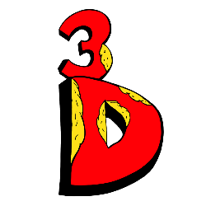
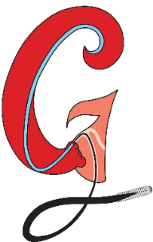
54,362 unique downloads and counting! (Up 14,000 in 2021)
Data Updated on Feb 14 2022*
Cath Lab Apps CardiologyApps.com
WebApp Only*
26,940 page views
www.cardiologyapps.com/ComplicAID
iOS ★ 5/5
2,179 downloads
Android ★ 5/5
1,405 downloads
Released June 2021
Clinical Care Application For Heart Attack patient transfers 475 downloads
Released Aug 2020
iOS ★ 5/5
1,142 downloads
Android ★ N/A
650 downloads
Released Nov 2021
Released August 2020
ComplicAID
BifurcAID 3D
STEMIcathAID
GuidewireAID
*Also available
as WebApp
*Also available
as WebApp
Download Apps
For Free on Both:
WebApps available free on
www.CardiologyApps.com
Apple ® and App Store® are registered trademarks of Apple Inc.

Slide 12
END

Slide 13
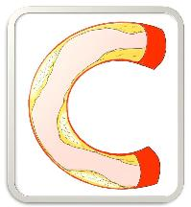
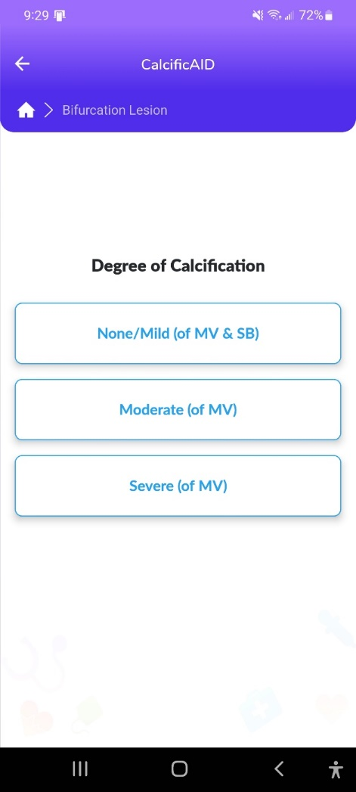
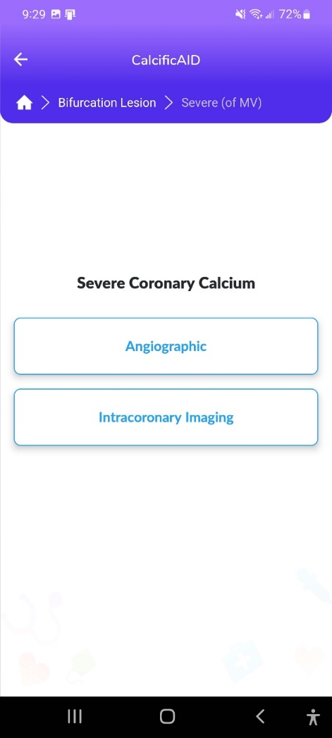
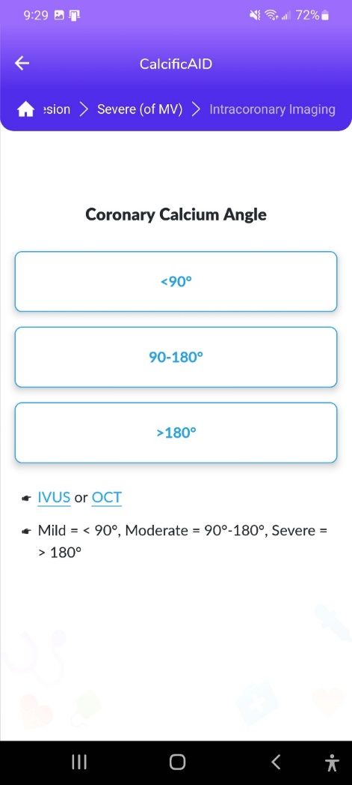
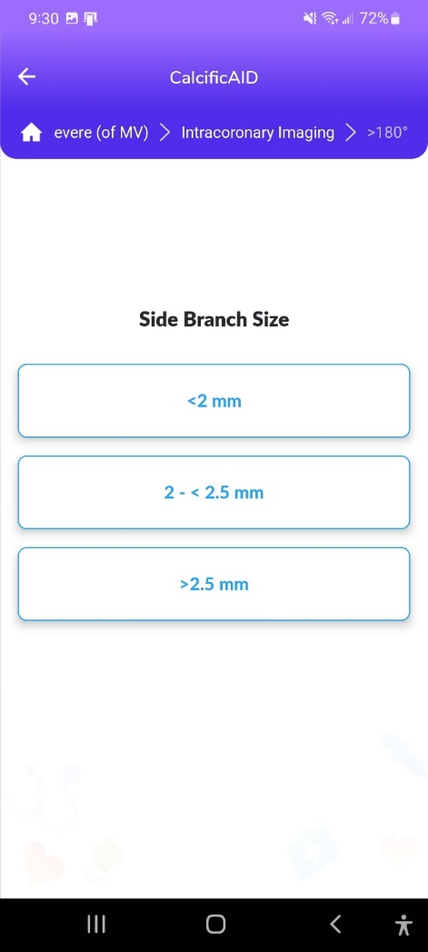
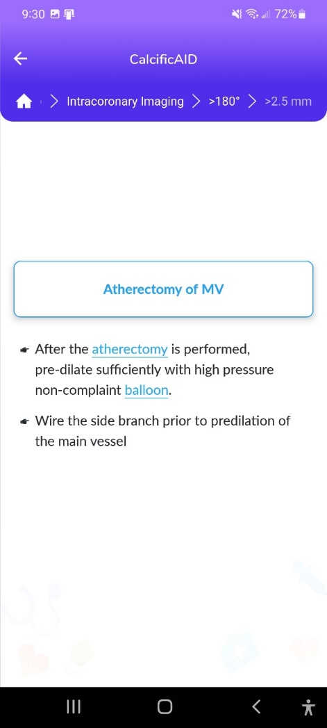
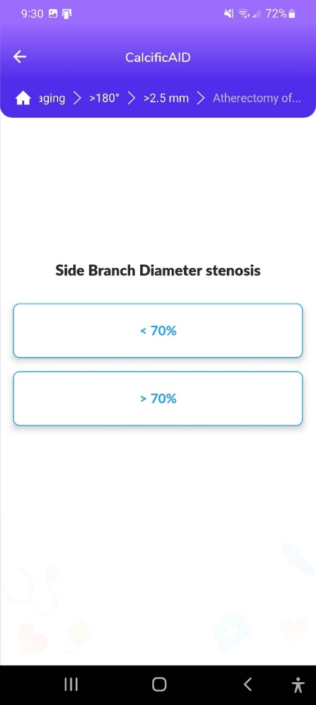
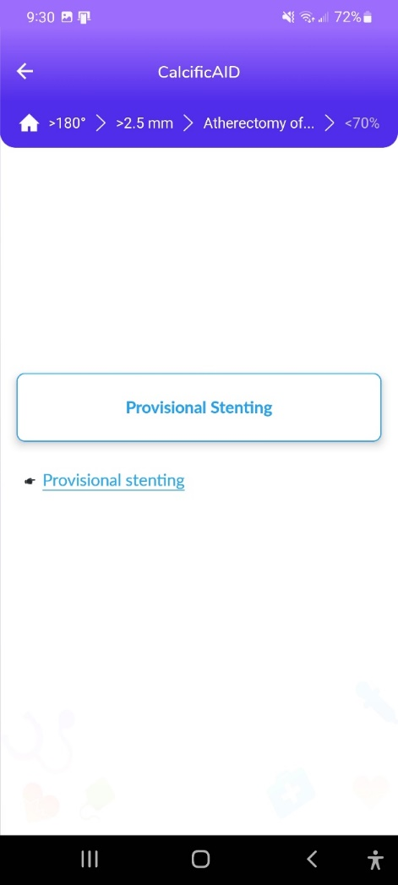
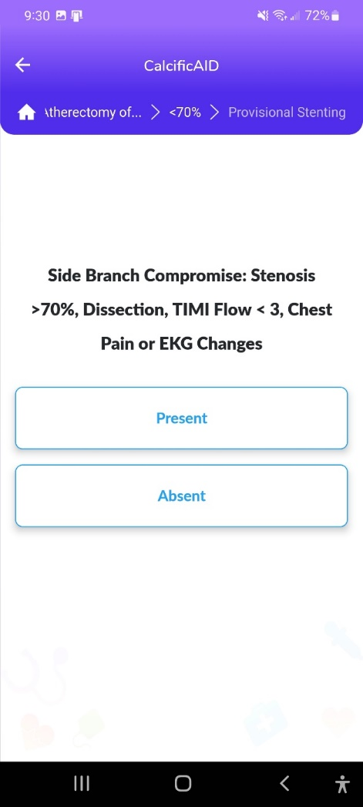
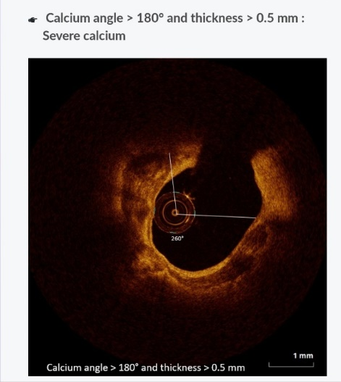
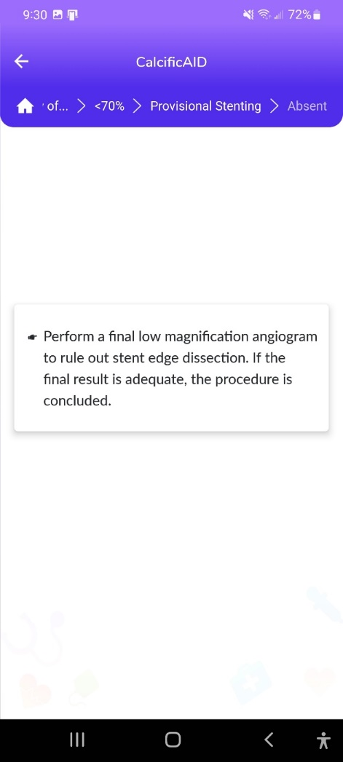
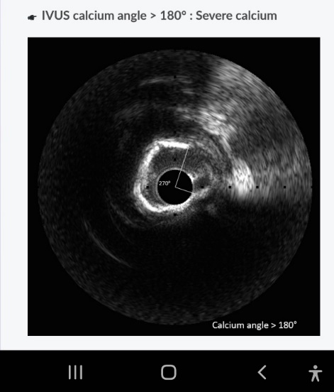
CalcificAID – Calcific Lesion Preparation
*Large Update coming in 2022

Slide 14
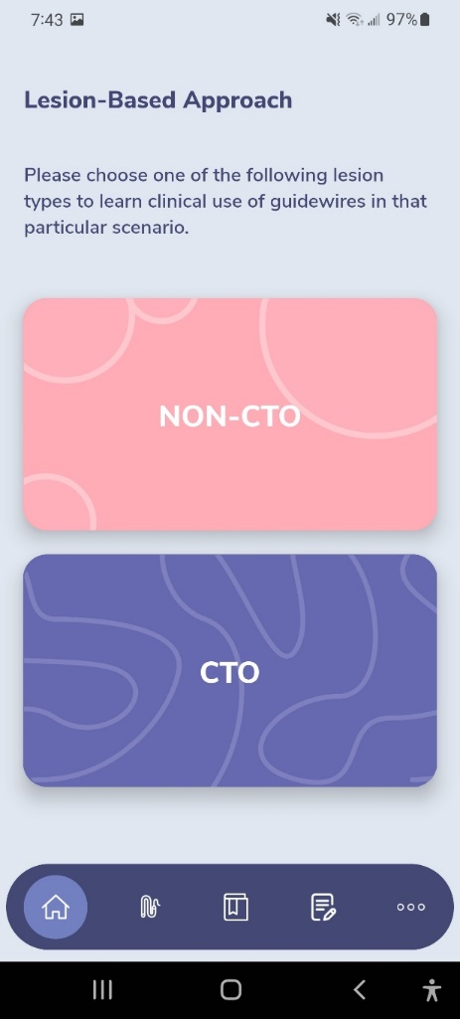
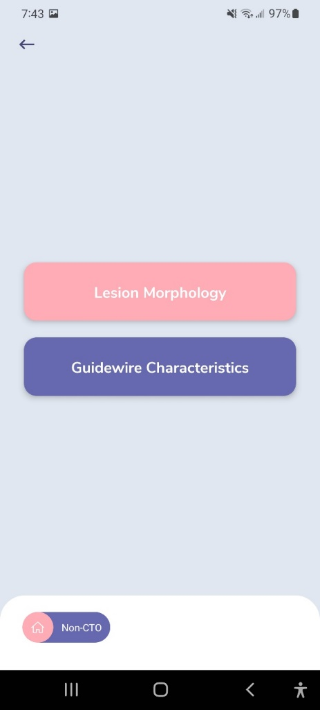
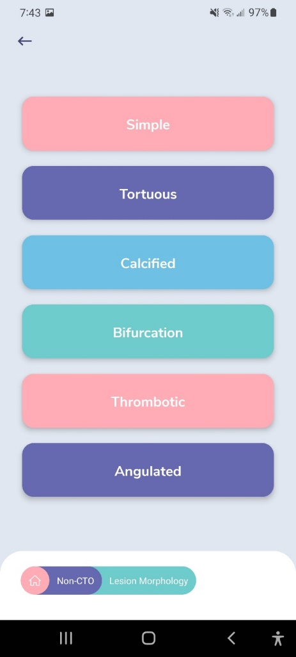
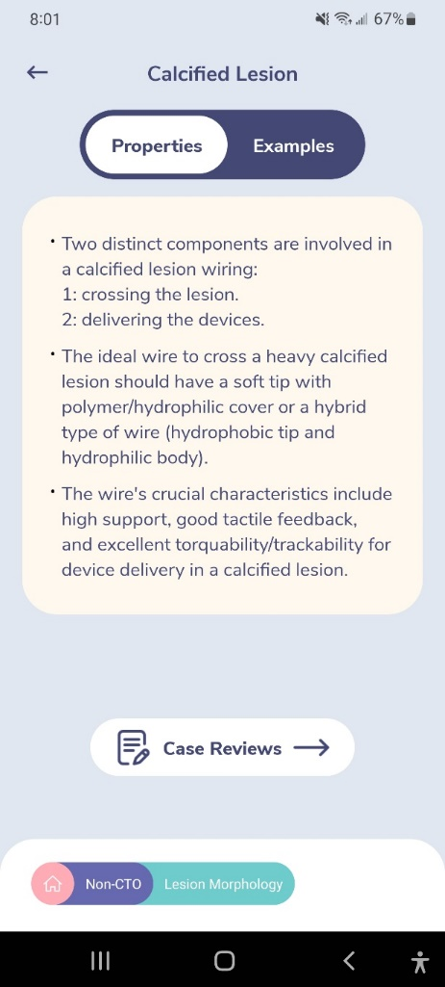
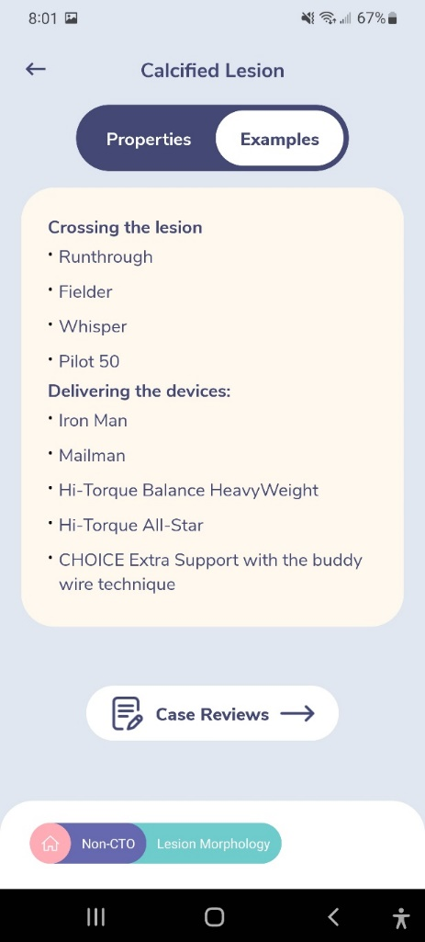
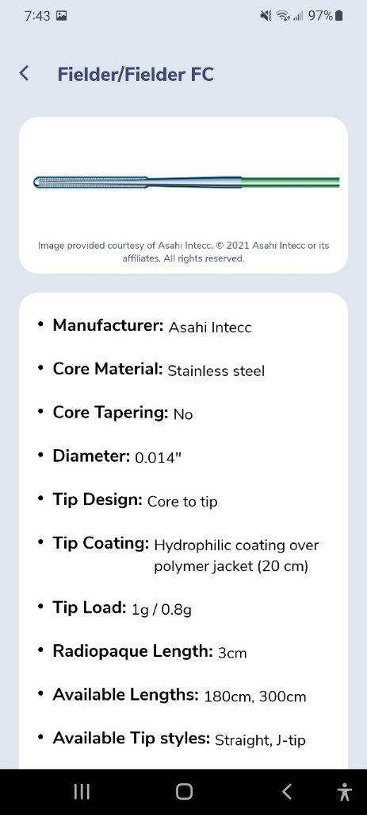
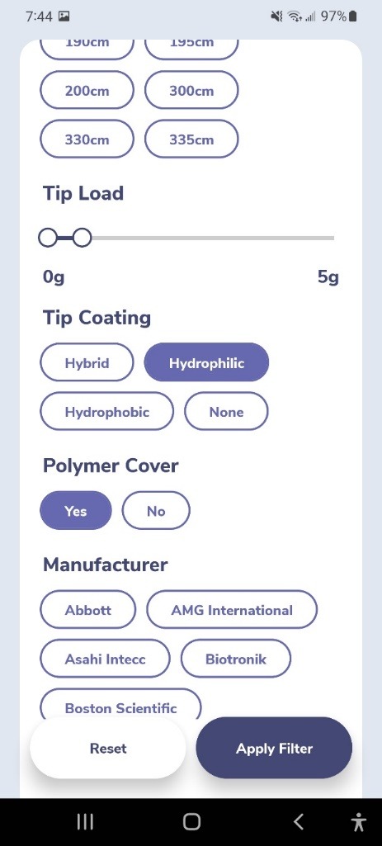
GuidewireAID – Wiring Calcified Lesions

