Slide 1
Complex Coronary Case
Supported by:
Sun Pharmaceutical Industries Ltd.

Slide 2
Disclosures
Samin K. Sharma, MD, MSCAI, FACC
Speaker’s Bureau – BSC, ABBOTT
Annapoorna S. Kini, MD, MRCP, FACC
Nothing to disclose
Prof C.N. Manjunath, MD, DM, FRCP, FACC, FICC (Guest Faculty)
Jayaranganath Mahimarangaiah, MD, DM (Moderator)

Slide 3
Prof. C. N. Manjunath, MD, DM, FRCP, FACC, FICC
Professor & Director
Sri Jayadeva Institute of Cardiovascular Sciences and Research, Bengaluru
Jayaranganath Mahimarangaiah, MD, DM
Professor & HOD, Department of Pediatric Cardiology, Sri Jayadeva Institute of Cardiovascular Sciences and Research, Bengaluru
Prof. C. N. Manjunath is Professor & Director at Sri Jayadeva Institute of Cardiovascular Sciences and Research, Bengaluru. The Government of India awarded him with most prestigious award Padma Shri, in 2007. The other award includes Millennium Plaque of Honour by Hon’ble Prime Minister of India, at 103rd Indian Science Congress, Mysuru, 2016, Life Time Achievement Award, Indian College of Cardiology 2015 and many more. He annually conducts 42000 Cathlab Procedures and Interventions. He has innovated a new technique of performing Balloon Mitral Valvuloplasty in difficult cases; this is being called Manjunath’s Technique published in Catheterization and Cardiovascular Diagnosis. Left atrial thrombus classification is called Manjunath’s classification which is published in Catheterization and Cardiovascular Interventions. He has published 300 National and International research papers to his credit.
Dr. Jayaranganath Mahimarangaiah is Professor and HOD, Department of Pediatric Cardiology at Sri Jayadeva Institute of Cardiovascular Sciences and Research, Bangalore. Dr. Jayaranganath graduated in medicine from Bangalore Medical College, Bangalore, secured his MD from the NHL Medical College, Ahmedabad and a DM in Cardiology from Grant Medical College, Mumbai. He completed his fellowship in Pediatric Cardiology from Royal Children’s Hospital, Melbourne.

Slide 4
PCI of Calcified LM Trifurcation with Impella Assist

Slide 5
Live Case #17
Patient Demographics
84 yrs, M known HF
Present Clinical Presentation
Presented with baseline NYHA class III DOE, developed progressive dyspnea on minimal exertion requiring hospital admission with NSTEMI (TnI 0.8)
CAD Risk Factors
Controlled hypertension
Controlled hyperlipidemia
CKD stage IV (Scr 1.4)
SAQ -7: 45
Clinical Variables
Echo revealed mod-severe MR/TR, mod pulm HTn, multiple segmental hypokinesis / akinesis, LVEF 21%.
Medications
Aspirin, Clopidogrel, Entresto, Spironolactone, Carvedilol, Furosemide, ISMN, Atorvastatin,
Cath: Cardiac cath on Feb 24th 2022 performed @OSH revealed 3V+LM trifurcation CAD with CTO of dRCA & mLAD, EF 20% and Syntax score 48. Pt has multiple areas of viability on PET scan. Heart team discussion declined CABG due to low EF and advanced age
Plan: Now planned for Impella supported complex PCI of LM trifurcation and RCA lesions.

Slide 6
AUC 2017: Revascularization to Improve Survival
Compared with Medical Therapy
Syntax score 48; STS score 5.1
Patel et al., J Am Coll Cardiol 2017;69:2212

Slide 7
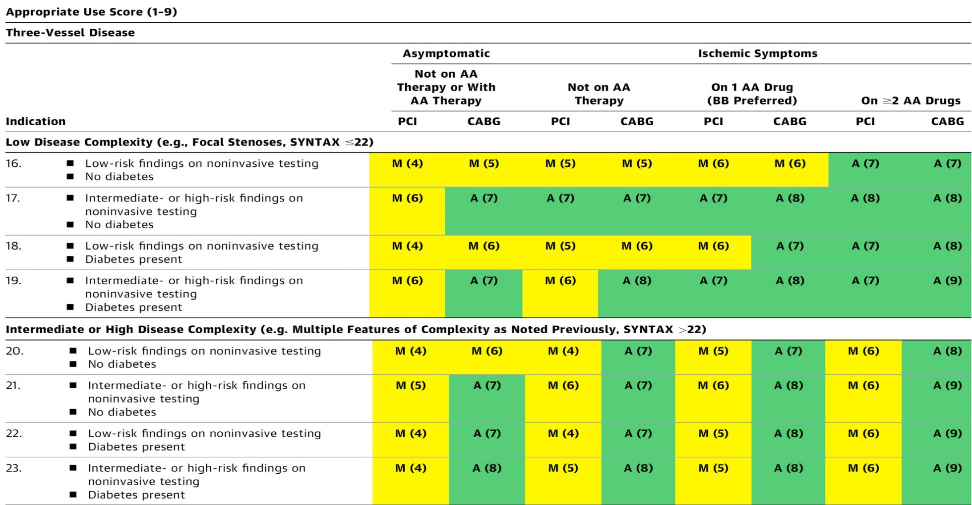
AUC 2017: Left Main + 3 V CAD
After Heart team discussion: A
Patel et al., J Am Coll Cardiol 2017;69:2212

Slide 8
LV Support during High-Risk PCI:
LVEF + Lesion Complexity
LVEF >35%
LVEF 20-35%
LVEF <20%
Simple PCI
Complex PCI
Simple PCI:1-2 V
Complex PCI: High Syntax score >32/ STS>5 Extensive revascularization
Simple or Complex: Inoperable cases
IABP
No support
None or Impella or IABP
Impella
/IABP (if Impella is CI)
Impella/PTVA
Notes:
8

Slide 10
LV Support during High-Risk PCI:
LVEF + Lesion Complexity
LVEF >35%
LVEF 20-35%
LVEF <20%
Simple PCI
Complex PCI
Simple PCI:1-2 V
Complex PCI: High Syntax score >32/ STS>5 Extensive revascularization
Simple or Complex: Inoperable cases
IABP/Impella
No support
None or Impella or IABP
Impella
/IABP (if Impella is CI)
Impella/PTVA
In 2021 @MSH of ≈340 PCIs/M: 3-4 IABP & 12-15 Impella per month are used for high risk PCI
Notes:
10

Slide 11
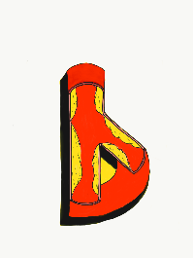
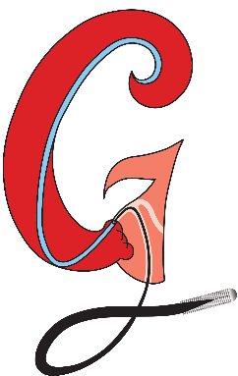
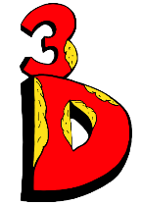
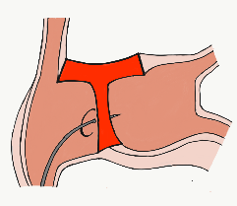
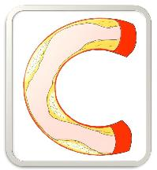
BifurcAID
TAVRcathAID
ComplicAID
Mobile App
Coming soon…
GuidewireAID
Cath Lab
Apps
BifurcAID 3D
CalcificAID
OCTAID
TranseptAID

Slide 12
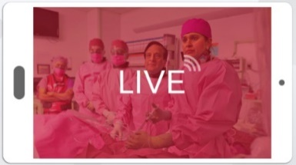
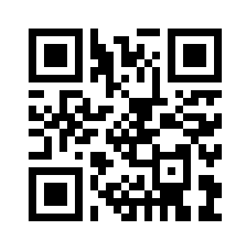
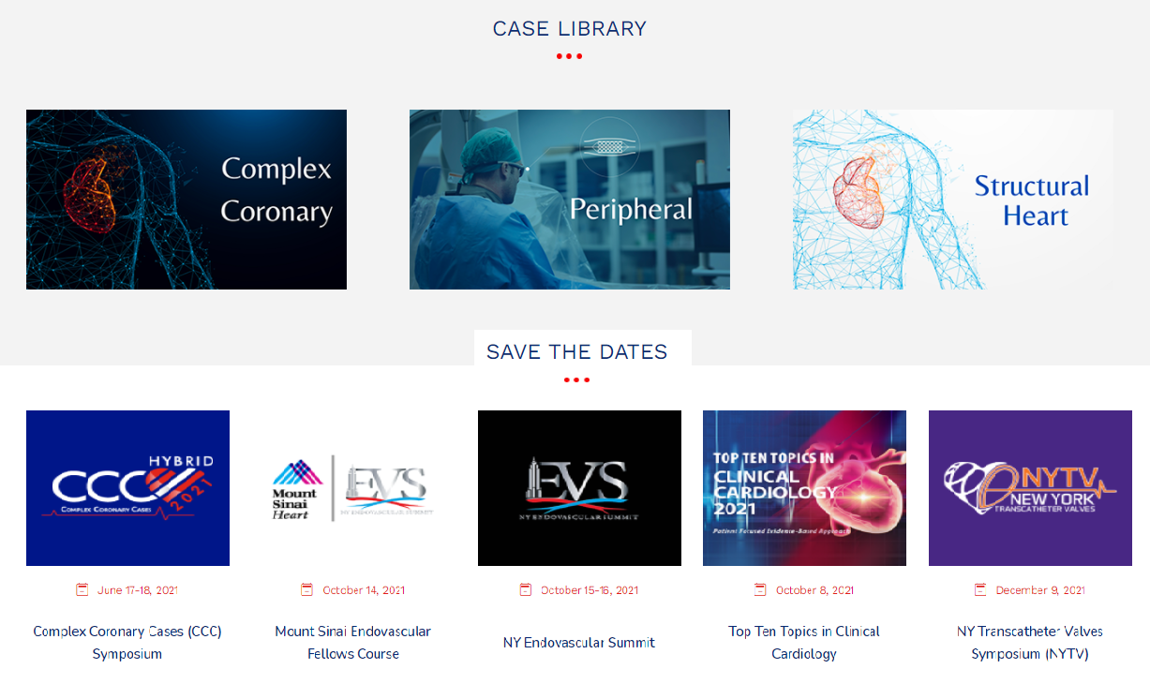
www.ccclivecases.org

Slide 13
CCClivecases: Total Page Views per Month (Past 2 Years)
Number of views

Slide 14
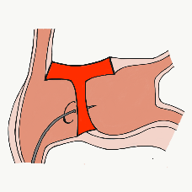
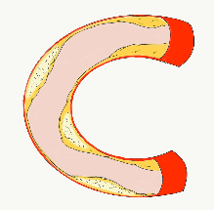
More than 35,800 unique downloads
Cath Lab Apps CardiologyApps.com
iOS 5/5 stars
9896 downloads
Android 4.4/5 stars
8245 downloads
Released sept 2017
iOS 5/5 stars
6068 downloads
Android 4.8/5 stars
3850 downloads
Released June 2018
iOS 5/5 stars
2073 downloads
Android N/A stars
549 downloads
Released March 2018
iOS 5/5 stars
1074 downloads
Android N/A stars
547 downloads
Released Sept 2018
iOS 5/5 stars
931 downloads
Android 5/5 stars
538 downloads
Released June 2019
WebApp Only*
2600 unique users
4800 sessions
Released August 2020
BifurcAID
OCTAID
TAVRcathAID
TranseptAID
CalcificAID
ComplicAID
*Also available
as WebApp
Download Apps
For Free on Both:
WebApps available free on
www.CardiologyApps.com
Apple ® and App Store® are registered trademarks of Apple Inc.
Notes:
These are the apps we have created which will provide digital algorithms for our future ambitious projects to make our cath labs smarter.

Slide 15
Apps Coming Soon…
STEMIcathAID – STEMI patient transfer platform designed to optimize communication between key members, record key performance metrics for AHA’s Mission: Lifeline program, and avoid costly false activations through direct CCL contact.
GuidewireAID – This application covers the design of coronary guidewires and the resulting properties they exhibit during use in the lab. Over two dozen teaching cases, a dense wire library with more than a hundred wires, and a robust search function provide a lot of tailored learning opportunities.
BifurcAID 3D – An animated bifurcation lesion treatment educational application and website. With two views, detailed descriptions, and more, BifurcAID 3D helps make clear the complex steps in techniques such as Minicrush, DK Crush and Culotte, as well as provisional approached and bailout techniques.

Slide 16
Protocol for Management of Calcific Lesions
Coronary Angiography
≈50%
Moderate-severe calcification
≈50%
ELCA, if no Rota/OA Wire could be crossed
IVUS/OCT assessment:
Calcium arc 180-270° (2points)
Calcium arc >270° (3 points)
Calcium length >5 mm (1 point)
Thickness >0.5 mm (1 point)
IVUS/OCT/balloon
did not cross
Un-crossable lesion/CTO
Angulated lesion
Tortuous lesion
Long lesion
Calcific Nodule
1-2 points
3-5 points
- High-pressure NC balloons
- Cutting/scoring balloon
Lithotripsy IVL (RA/OA for Ca 360°)
RA or OA ?ELCA
Suboptimal result
Does not cross
NC balloon/CB
Suboptimal balloon expansion
Optimal balloon expansion
Optimal balloon expansion
Lithotripsy IVL
Stent and OCT/IVUS optimization

