Slide 1
Structural Heart Live Cases
Supported by:
Medtronic Inc.
Cook Inc.
Terumo Medical
B-Braun

Slide 2
Faculty Involved and Disclosures
Samin K. Sharma, MD, FACC, MSCAI
Speaker’s Bureau – BSC, Abbott Vascular Inc
Annapoorna S. Kini, MD, FACC
Nothing to disclose
Gilbert Tang, MD, MSc, MBA, FACC
Physician proctor for Medtronics
Stamatios Lerakis, MD, PhD, FACC, FAHA (Imaging)
Nothing to disclose
Pedro Moreno, MD, FACC [Moderator]
Nothing to disclose
Cardiac Anesthesiologist
Morgan Montgomery MD

Slide 3
Structural Heart Live Case # 46: MN, 82 y/o F
Presentation: Worsening NYHA Class III symptoms of heart failure with recent admission for acute pulmonary edema
PMH: HTN, HLP, DM (insulin), PAD s/p PTAs (last 12/2021), Afib, H/o severe AS, s/p TAVR (23mm Sapien-3 in 2018), ESRD on HD
Medications: Labetalol, Losartan, Aldactone, Insulin, Nifedipine, Apixaban
Labs: Hgb 13.1, PLT 319, K 5, Cr 4.8
EKG (10/29/21): SR, 1˚ AVB, PR-328ms, QRS 94ms
TTE (10/29/21): TAVR AV-stenosis with mild/mod AR (PG/MG/PV: 46/38/3.9), mild/mod MR and TR, LVEF 65%
Cath: Non-obstructive CAD, patent intervention site at pRCA

Slide 4
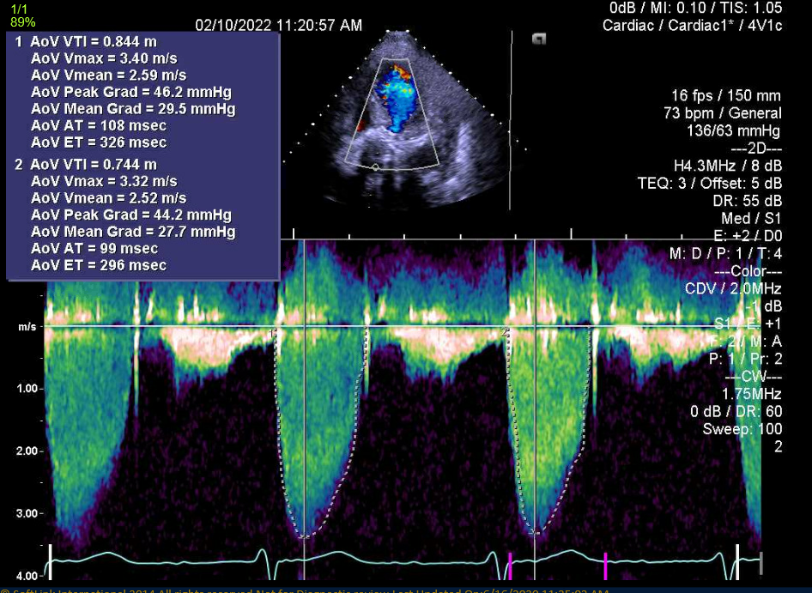
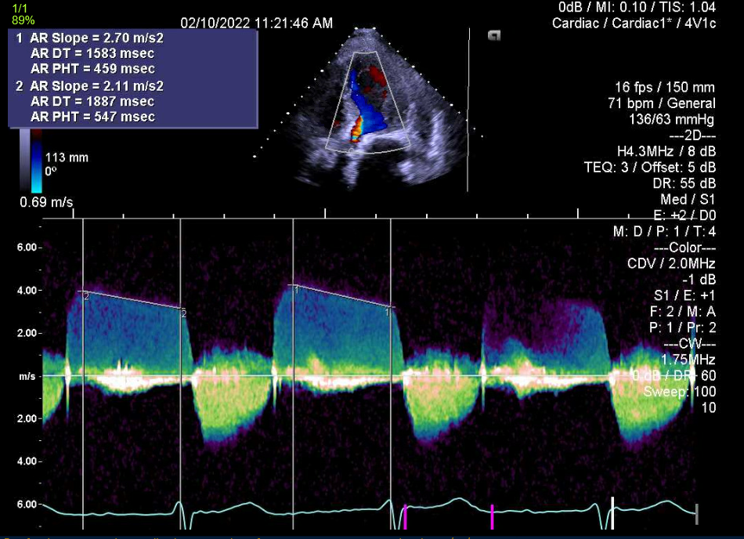
Transthoracic Echocardiogram
Severe AS
(PG/MG/PV:46/38/3.9)
Mild/moderate AI

Slide 5
Transthoracic Echocardiogram
Severe TAVR prosthetic AS and mild/moderate AR

Slide 6
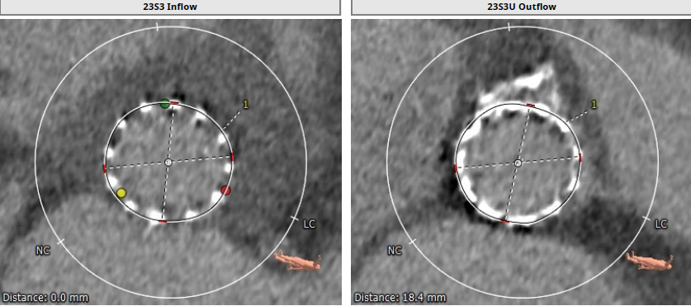
CTA: Aortic annulus, LVOT
23mm S3 Inflow
Max: 23.6 mm
Min: 21.9 mm
Mean: 22.8 mm
Perimeter = 72.2 mm
Area = 413 mm²
23mm S3 Outflow
Max: 23.1 mm
Min: 21.9 mm
Mean: 22.5 mm
Perimeter = 71.5 mm
Area = 405.1 mm²

Slide 7
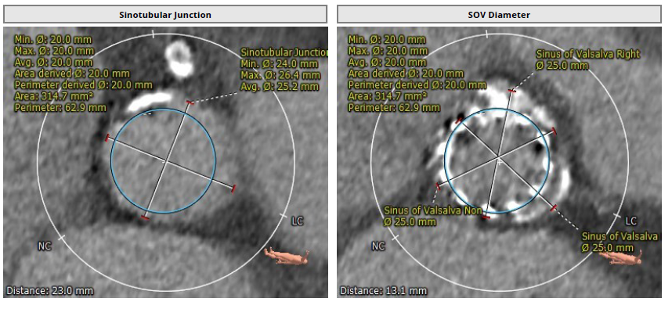
CTA: STJ and SOV
STJ
Min 24.0mm
Max 26.4mm
Mean 25.2mm
Sinus of Valsalva
RCC 25.0 mm
LCC 25.0 mm
NCC 25.0 mm

Slide 8
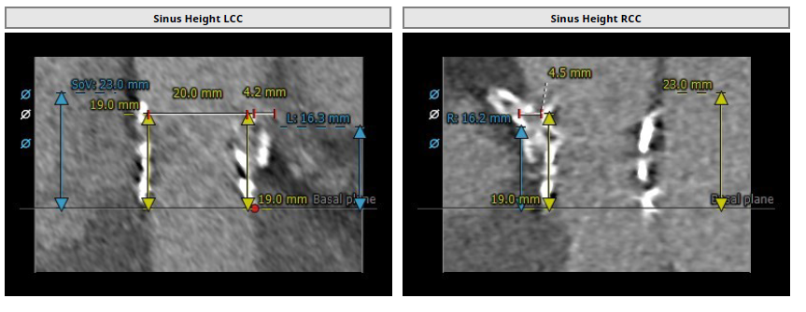
CTA: Coronary Heights
Coronary Heights
LM – 16.3 mm
RCA – 16.2 mm

Slide 9
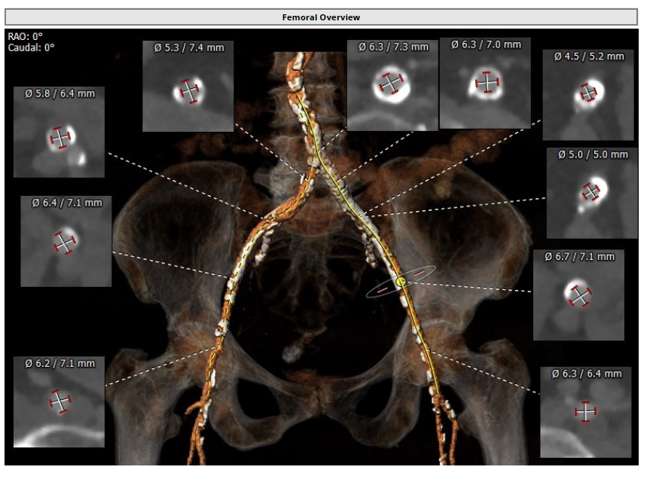
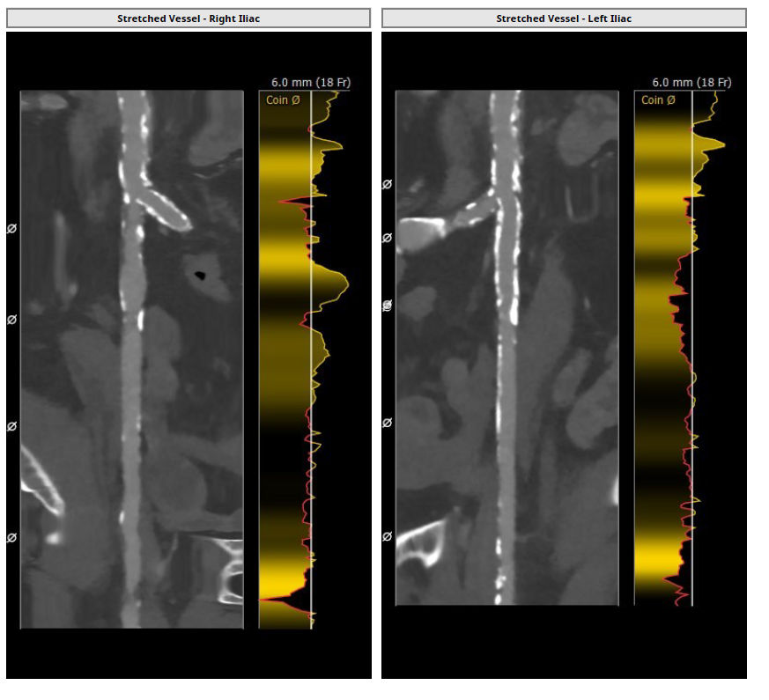
CTA: Femoral Arterial Access
Access 3D
Left common iliac artery stent (Protégé 12/40)
Longitudinal View
Right Iliac/Femoral
Longitudinal View
Left Iliac/Femoral

Slide 10
Summary of the Case
Presentation: 82 year old female with NYHA Class III and recent episode of pulmonary edema.
TTE: Severe TAVR valve aortic stenosis with mild/mod AR (PG/MG/PV: 46/38/3.9), mild/mod MR and TR, LVEF 67%
STS risk mortality: 14.1%
Course: Patient was evaluated by Heart Team and determined to have extreme STS risk and recovery after VIV-TAVR more likely than with SAVR.
Plan: TF TAVR-in-TAVR using 26mm Evolut PRO+ valve with Sentinel Cerebral Embolic Protection Device.

Slide 11
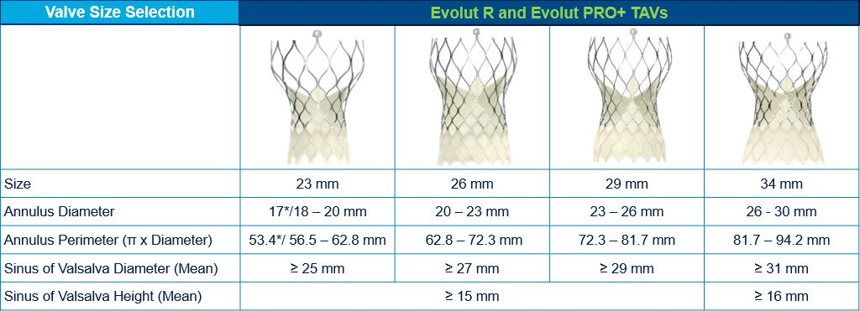
Medtronic Evolut PRO+ Patient Selection
Our Patient
Annulus: 22.8 mm
Perimeter: 72.2 mm
SOV diameter: 31.2mm
SOV Height: 25.0mm

Slide 12
Latest Issues in Transcatheter Structural Heart Interventions
Recent publications about TAVR
valve degeneration

Slide 13
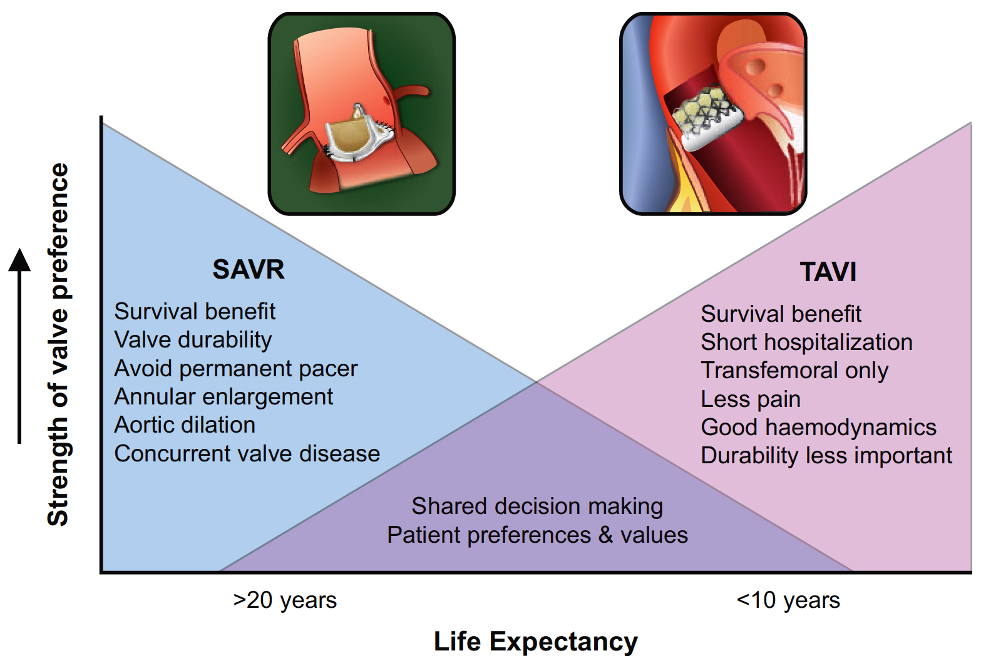
Balance of Factors Determining Strength of Valve Preference vs. Expected Remaining Years of Life
Oyetunji and Otto, Eur Heart J 2021;42:2920

Slide 14
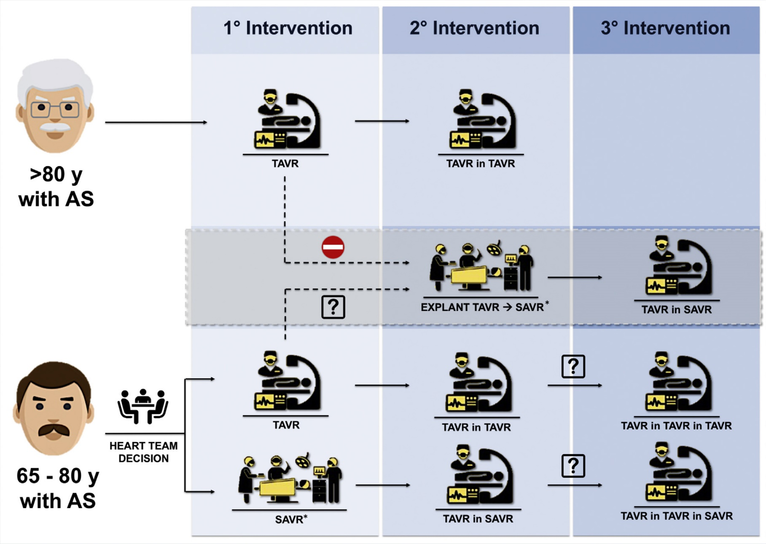
Contemporary Potential Strategies in the Lifetime Management of Patients with Severe Valvular AS
10yrs
10yrs
10yrs
10yrs
10yrs
Tarantini and Nai Fovino, J Am Coll Cardiol Intv 2021;14:1727

Slide 15
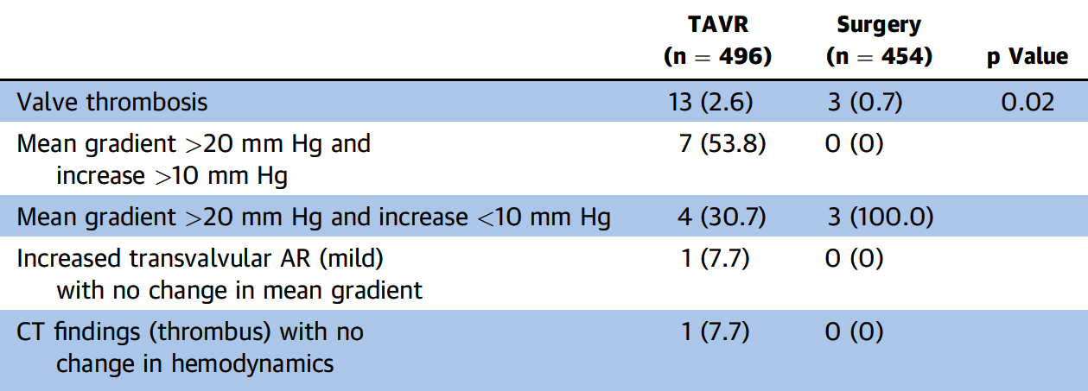
PARTNER 3 Trial: Valve Hemodynamic Changes
at 2 Years
AValve re-intervention <1% in both groups
Leon et al., J Am Coll Cardiol 2021;77:1149

Slide 16
SURTAVI Trial: Clinical Outcomes at 5 yrs
 | KM Rates to 2 Years |  |  | KM Rates to 5 Years |  |  | KM Rates from 2 to 5 Years
KM rates as % | TAVR | Surgery | p Value | TAVR | Surgery | p Value | TAVR | Surgery | p Value
Death | 11.5 | 10.5 | 0.53 | 30.0 | 28.7 | 0.55 | 20.9 | 20.3 | 0.79
Cardiovascular death | 7.8 | 17.1 | 0.66 | 17.8 | 17.4 | 0.84 | 10.9 | 11.1 | 0.89
Reintervention | 2.5 | 0.5 | 0.002 | 3.5 | 1.9 | 0.02 | 1.0 | 1.3 | 0.60
Any stroke | 6.0 | 8.5 | 0.05 | 11.6 | 13.6 | 0.16 | 6.0 | 5.5 | 0.76
MI | 2.7 | 2.1 | 0.51 | 6.2 | 4.7 | 0.23 | 3.7 | 2.6 | 0.30
Valve endocarditis | 0.4 | 0.8 | 0.25 | 1.0 | 1.8 | 0.15 | 0.6 | 1.0 | 0.39
Valve thrombosis | 0.4 | 0.0 | 0.10 | 0.5 | 0.4 | 0.51 | 0.2 | 0.4 | 047
AV or HF hospitalization | 12.8 | 9.5 | 0.06 | 23.9 | 20.8 | 0.13 | 12.7 | 12.5 | 0.89
Pacemaker* | 30.9 | 9.8 | <0.001 | 35.8 | 14.6 | <0.001 | 7.1 | 5.3 | 0.27
Van Mieghem N, TCT 2021

Slide 17
SURTAVI Trial: Core Lab Assessed Hemodynamics at 5 years
Effective Orifice Area, cm²
Mean Gradient, mm Hg
Time Since Procedure
TAVR had significantly better hemodynamics than surgery at each follow-up (all p < 0.001)
Van Mieghem N, TCT 2021

Slide 19
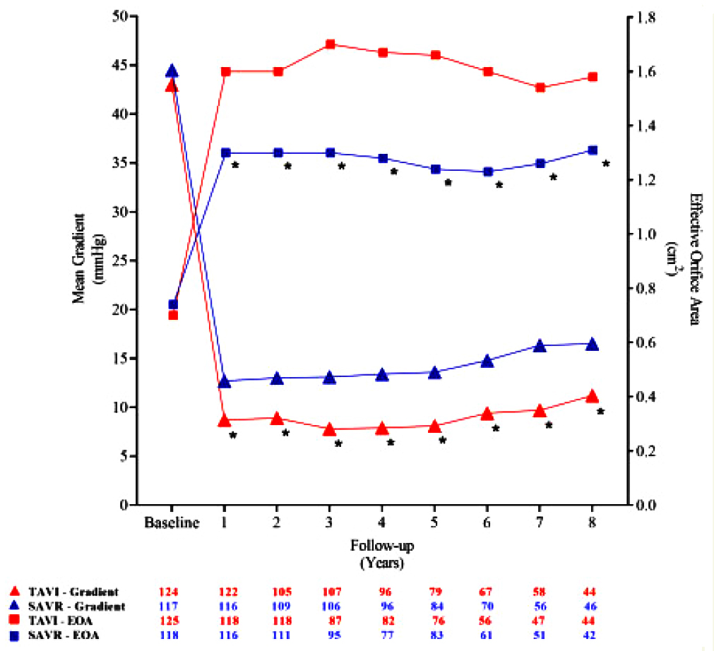
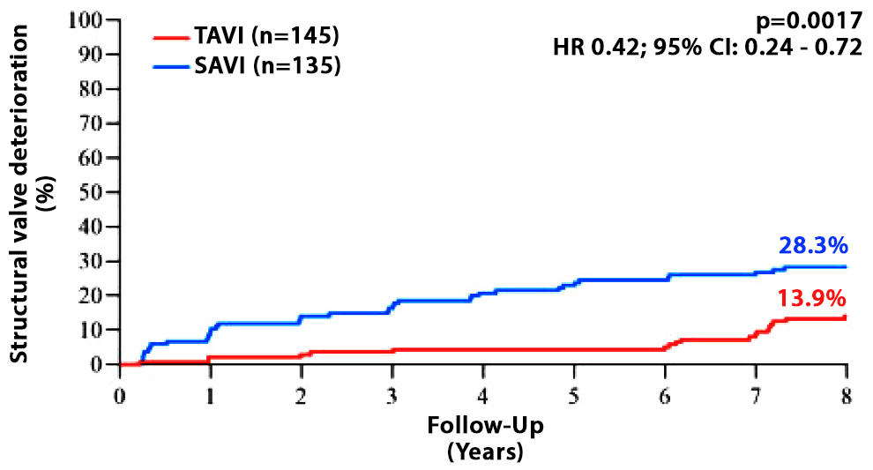
NOTION Trial: Echocardiographic Outcomes
and Valve Durability at 8 Yrs
Mean Gradient and Effective Orifice Area During Follow-Up
Any Structural Valve
Deterioration
Jorgensen et al., Eur Heart J 2021;42:2912

Slide 20
NOTION Trial: Bioprosthetic Valve Failure at 8 Yrs
 | TAVI (n=139) | SAVR (n=135) | P Value
Bioprosthetic valve failure | 8.7 | 10.5 | 0.61
Valve-related death | 5.0 | 3.7 | 0.60
Severe structural valve deterioration | 2.2 | 6.8 | 0.068
Aortic valve re-intervention | 3.6 | 2.3 | 0.51
Jorgensen et al., Eur Heart J 2021;42:2912

Slide 21
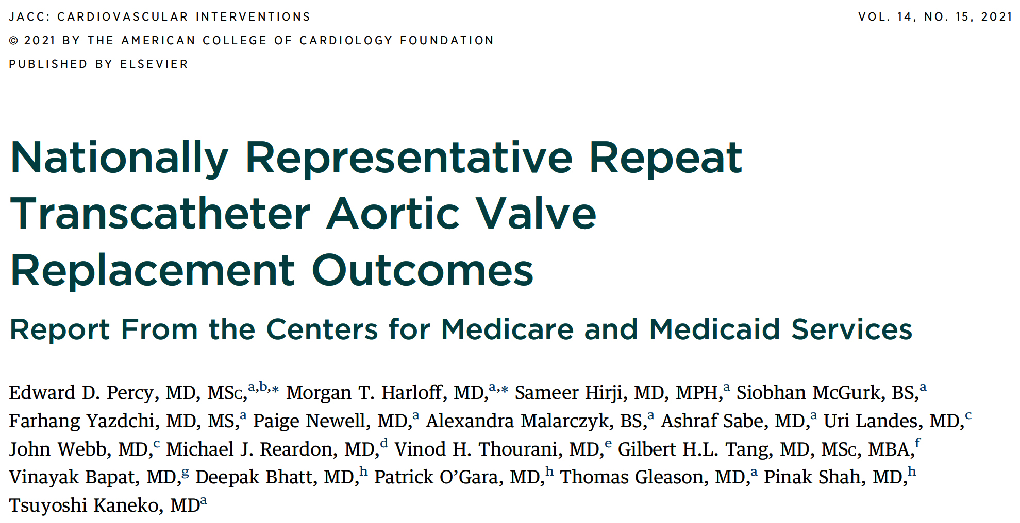

Slide 22
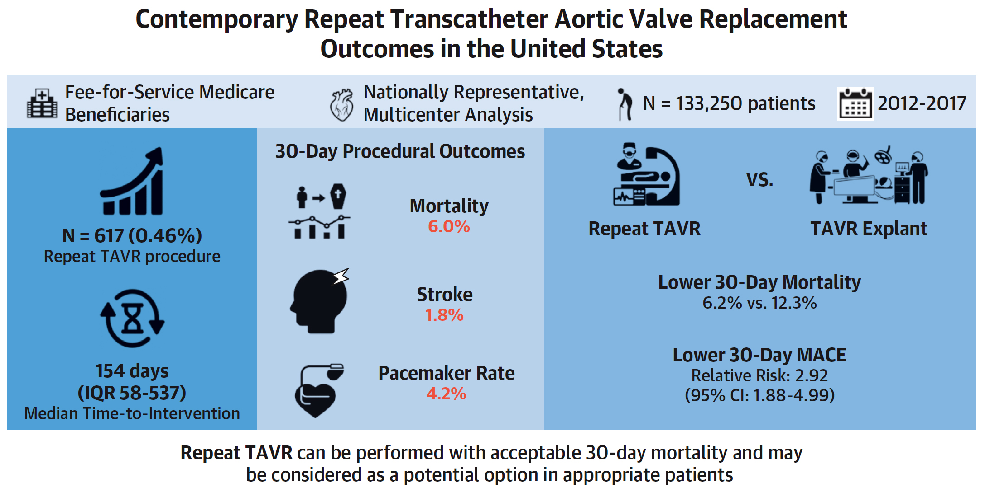
Contemporary Outcomes of Repeat TAVR in the United States Medicare Database
Percy et al., J Am Coll Cardiol Intv 2021;14:1717

Slide 24
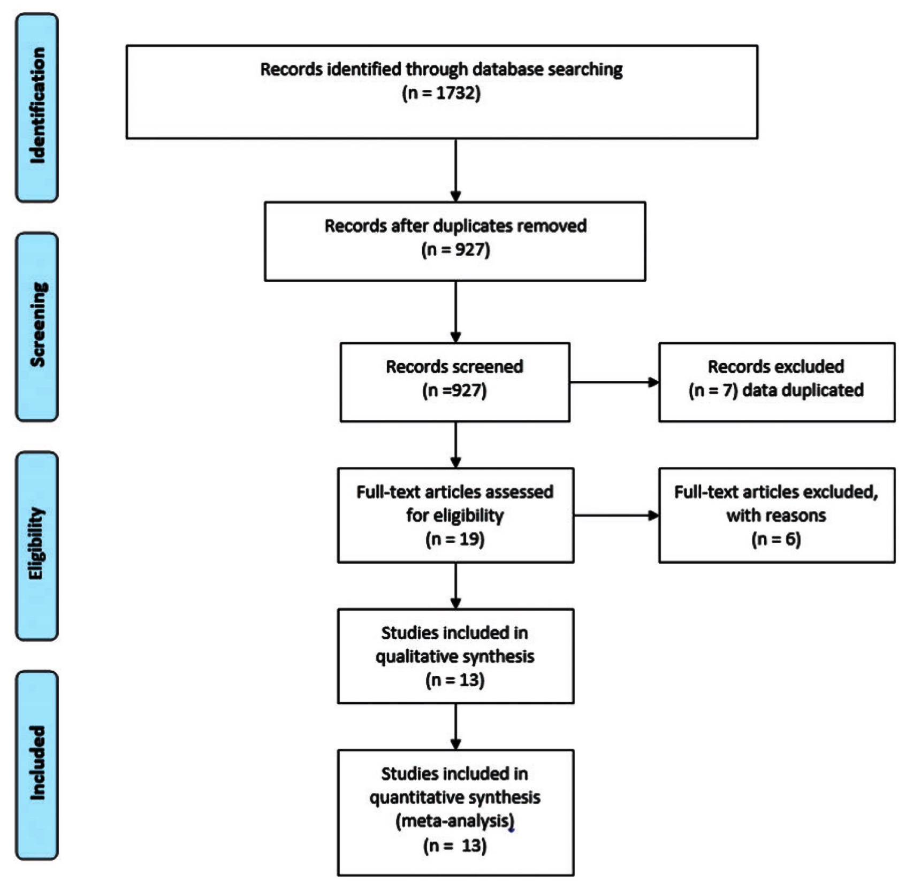
Flowchart of Literature Search Strategy
Gallo et al., Eur J Cardiothorac Surg Oct 18, 2021 Epub ahead of print

Slide 25
Indications for TAVR-in-TAVR
Gallo et al., Eur J Cardiothorac Surg Oct 18, 2021 Epub ahead of print

Slide 26
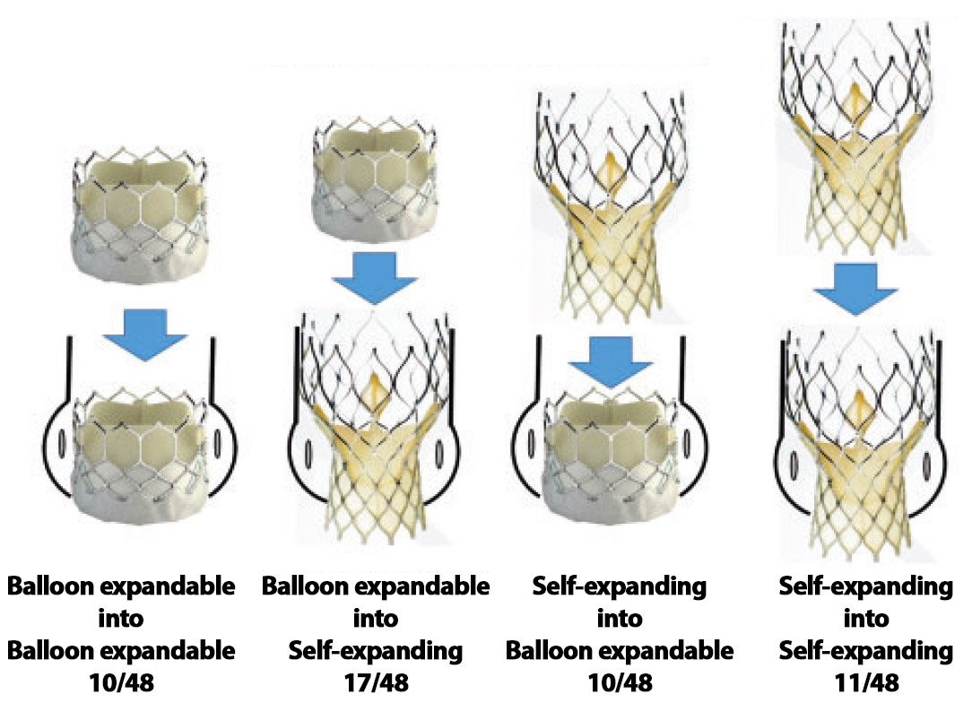
TAVR-in-TAVR Alternatives for Degenerated THV
Gallo et al., Eur J Cardiothorac Surg Oct 18, 2021 Epub ahead of print

Slide 27
TAVR-in-TAVR: Success Rate and Complications
at 6 Months Follow-up
Structural TAVR-in-TAVR Success = 86.8%
%
In- hosp Moderate Residual Stroke MI Major vasc AKI
mortality AR transvalvular compl
MG ≥20 mmHg
Gallo et al., Eur J Cardiothorac Surg Oct 18, 2021 Epub ahead of print

Slide 28
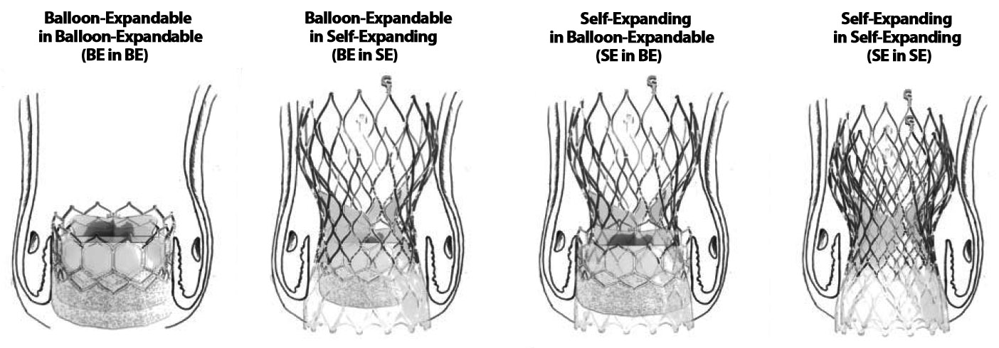
The Most Common Combinations of
TAVR-in-TAVR According to Deployment Mechanisms
Gallo et al., Eur J Cardiothorac Surg Oct 18, 2021 Epub ahead of print

Slide 29
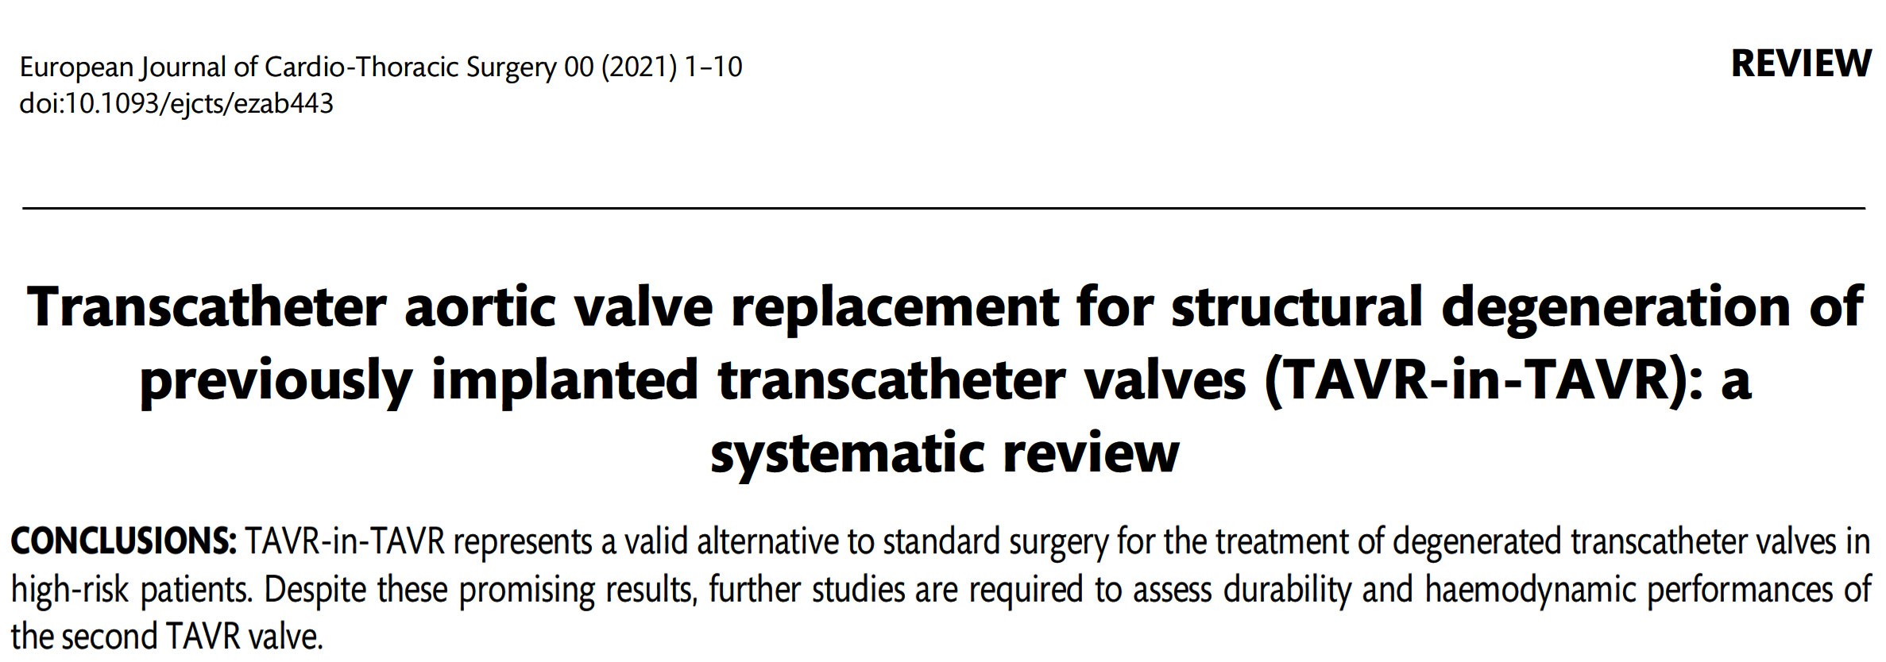

Slide 30
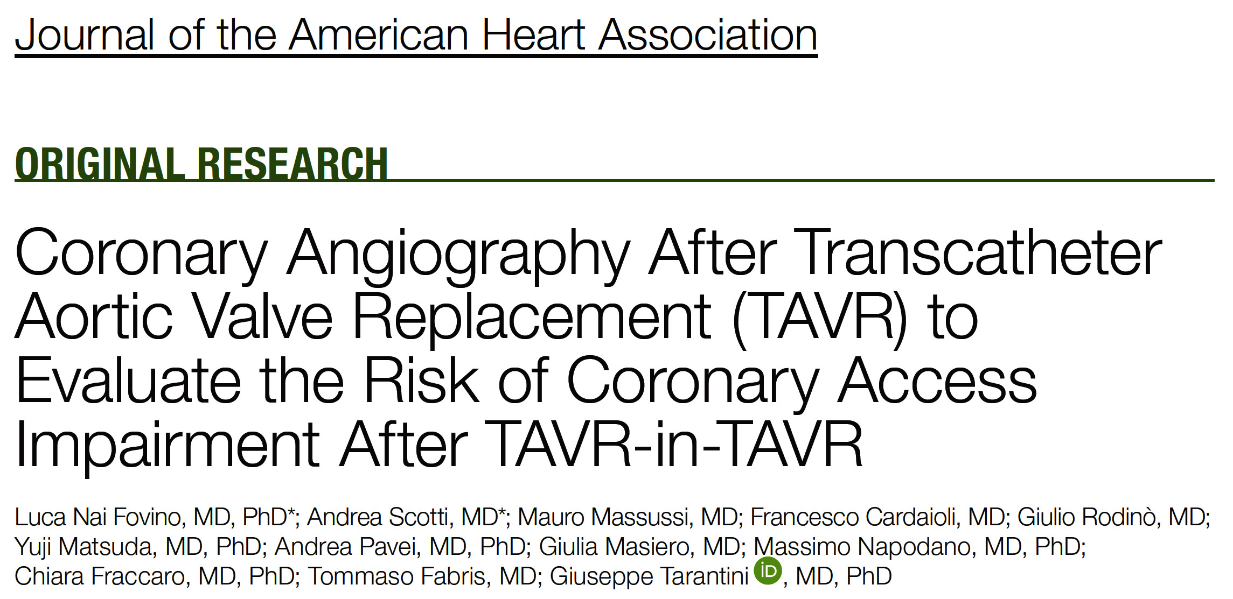
J Am Heart Assoc. 2020;9:e017409

Slide 31
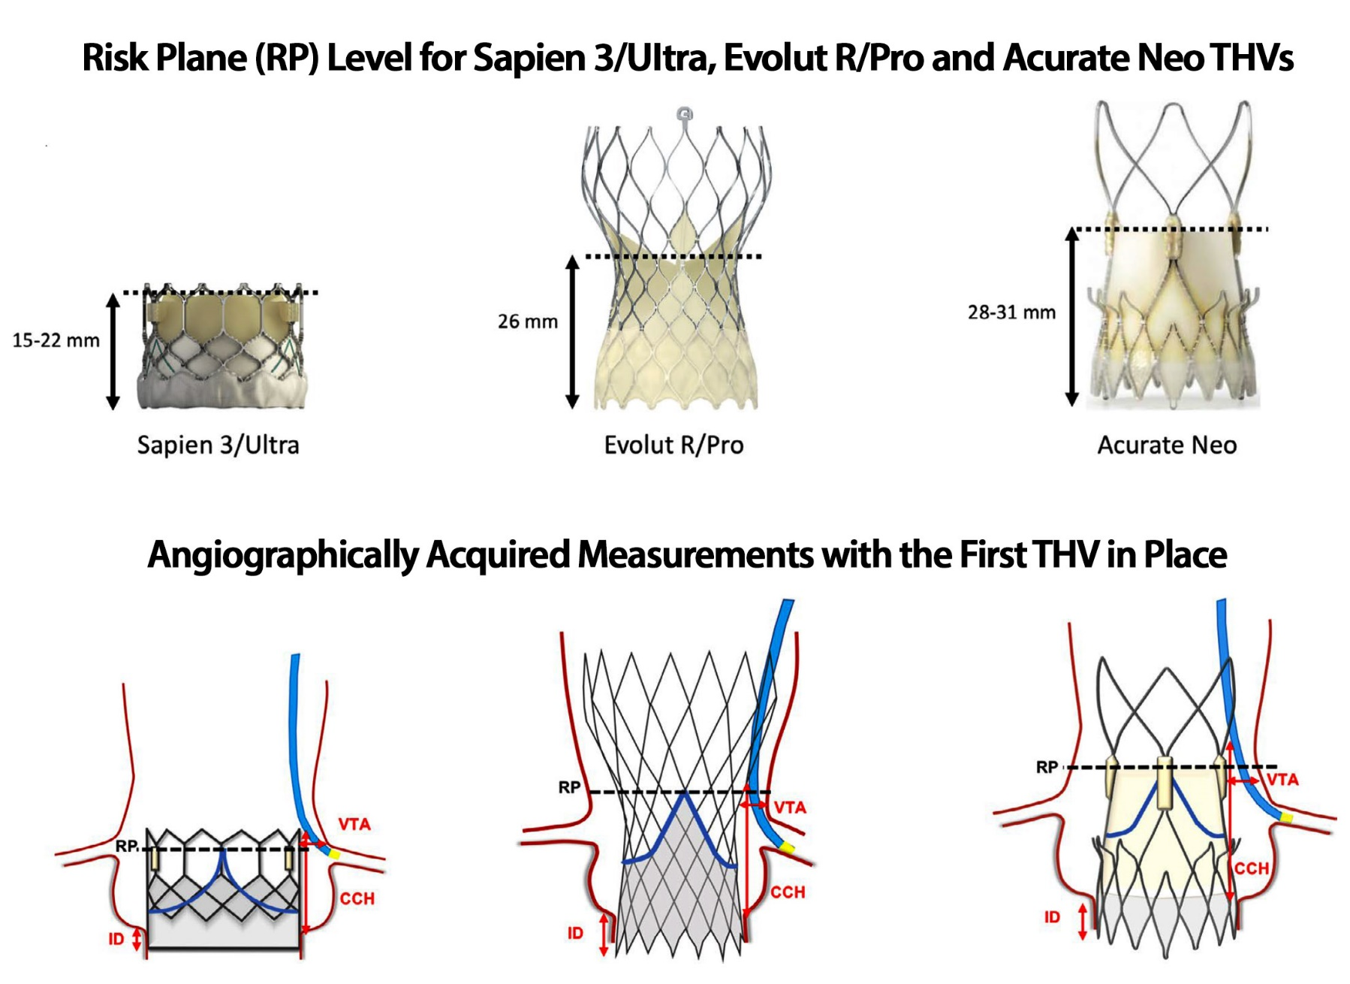
Risk-Plane Height and Angiographic Measurements to Assess Feasibility After TAVR-in-TAVR
Fovino et al., J Am Heart Assoc 2020;9:e016446

Slide 32
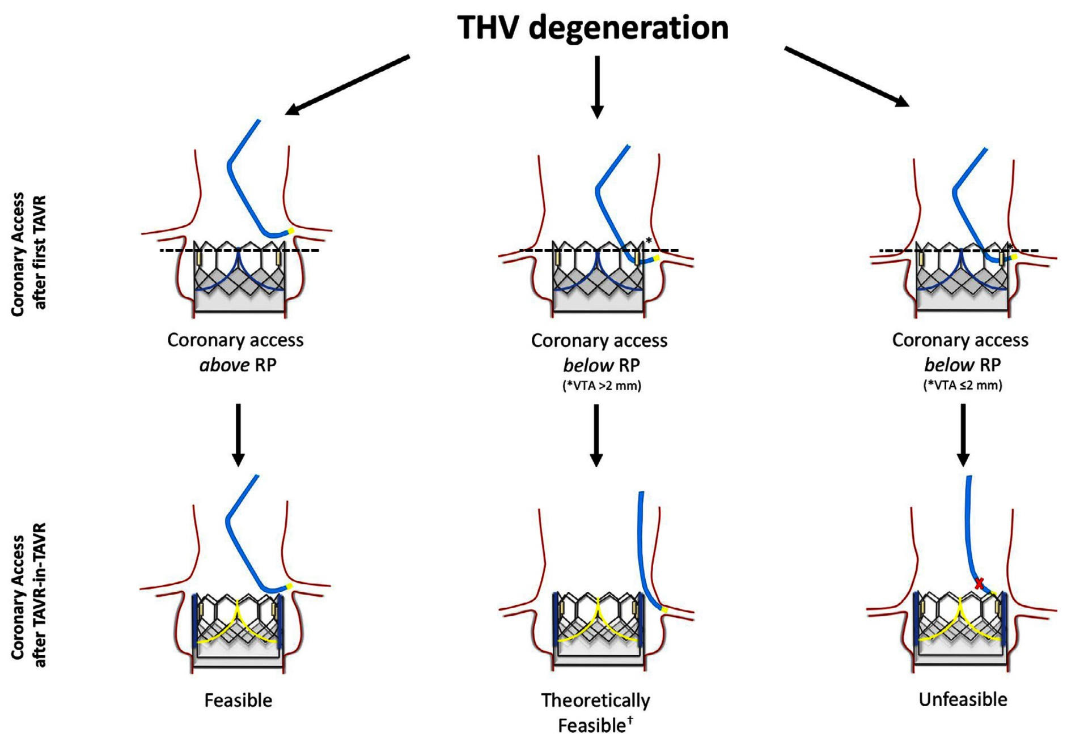
Proposed Algorithm for assessment for Coronary Access (CA) Feasibility After TAVR-in-TAVR
Fovino et al., J Am Heart Assoc 2020;9:e016446

Slide 33
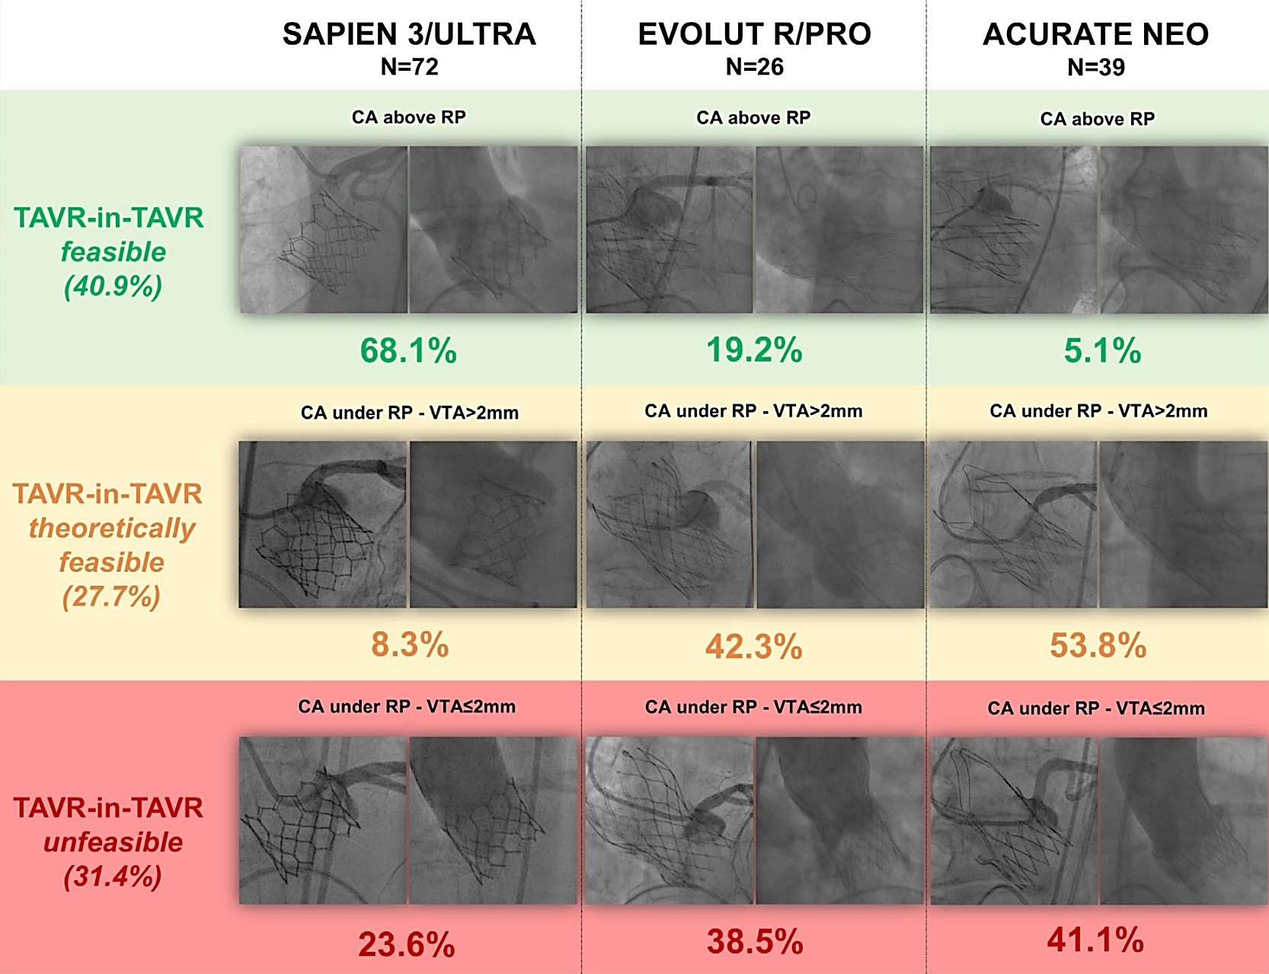
Incidence of Predicted CA Impairment After
TAVR-in-TAVR According to THV Type
Fovino et al., J Am Heart Assoc 2020;9:e016446

Slide 34
Multivariate Analysis of CA Impairment After TAVR-in-TAVR
Predictor Variable | Predictor Variable in Unfeasible vs Feasible | OR (95% CI) | P Value | C-Statistic | HL-Test
Female sex, % | 41 vs 22.5 | 3.99 (1.07-14.86) | 0.040 | 0.89 | 0.6
Supra-annular design, % | 41 vs 23 | 6.61 (1.96-22.03) | 0.002
STJ diameter, mean ± SD | 25.5 ± 2.3 vs 29 ± 3.6 | 0.62 (0.48-0.80) | <0.001
Left coronary cannulation height, mean ± SD | 14.8 ± 1.7 vs 16.8 ± 2.6 | 0.53 ( 0.37-0.74) | <0.001
Fovino et al., J Am Heart Assoc 2020;9:e016446

Slide 35
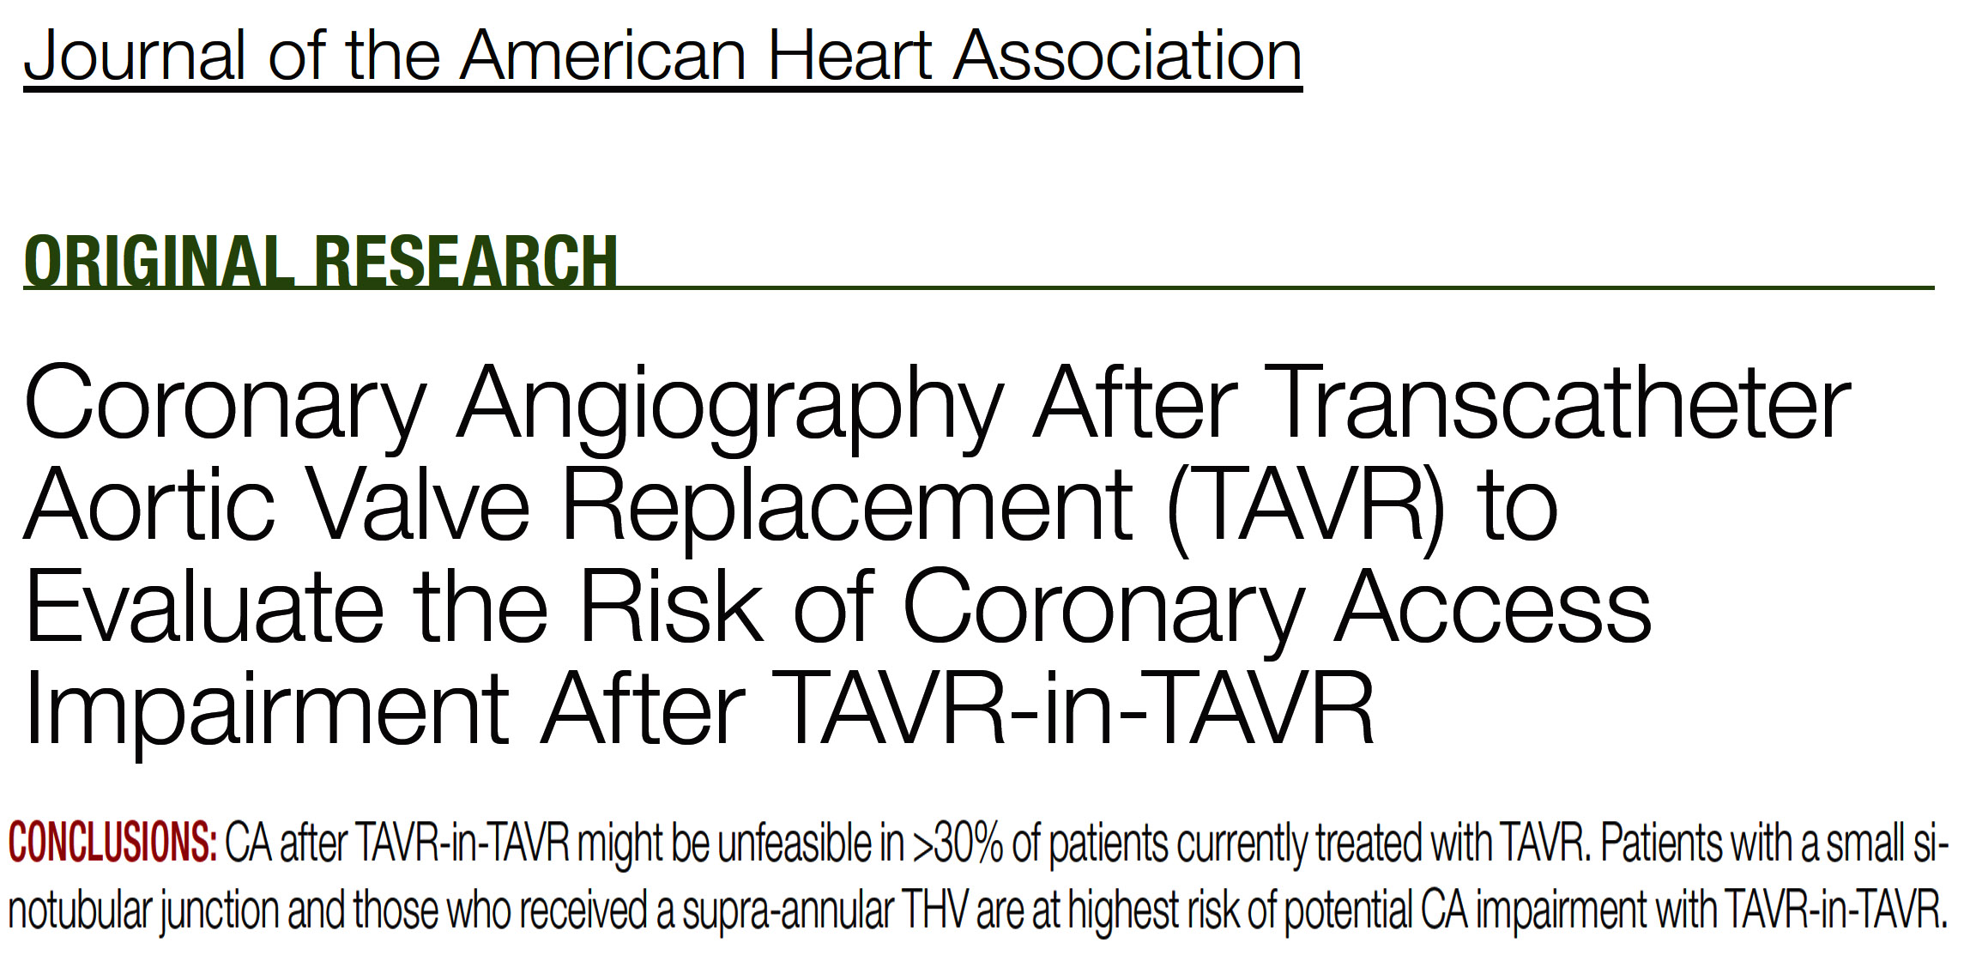
J Am Heart Assoc. 2020;9:e017409

Slide 36
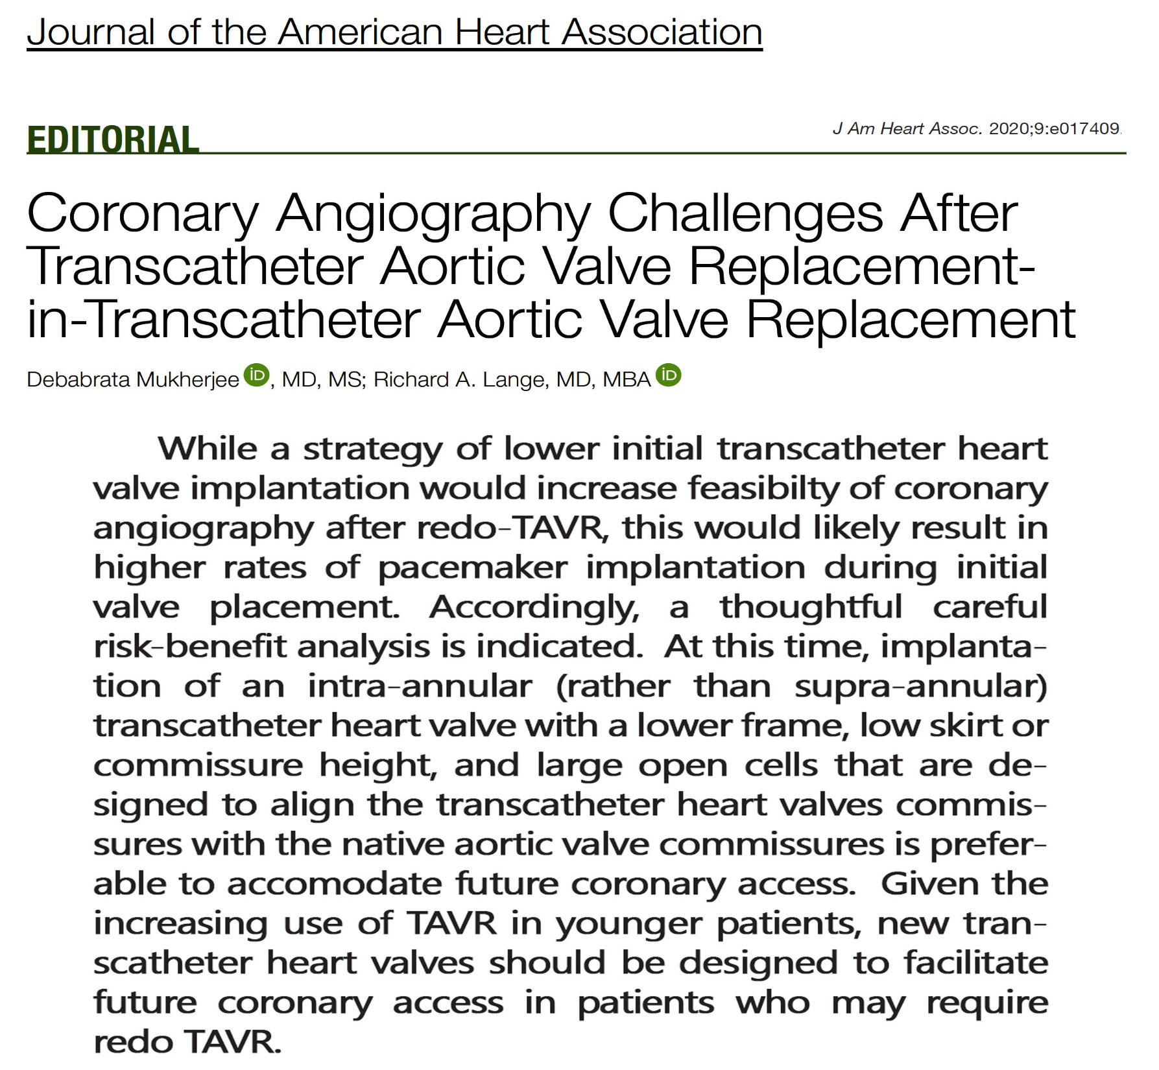

Slide 37
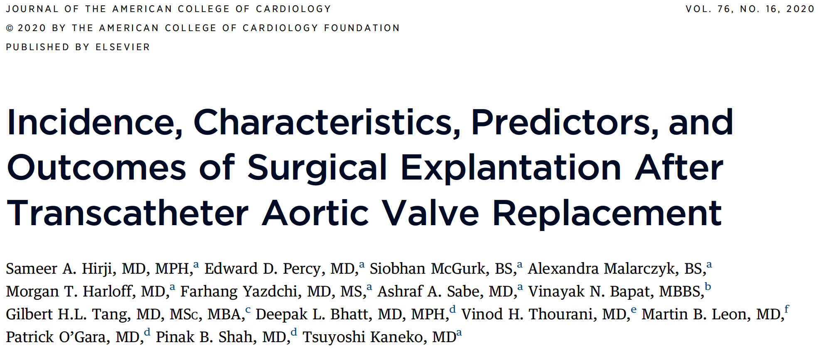

Slide 38
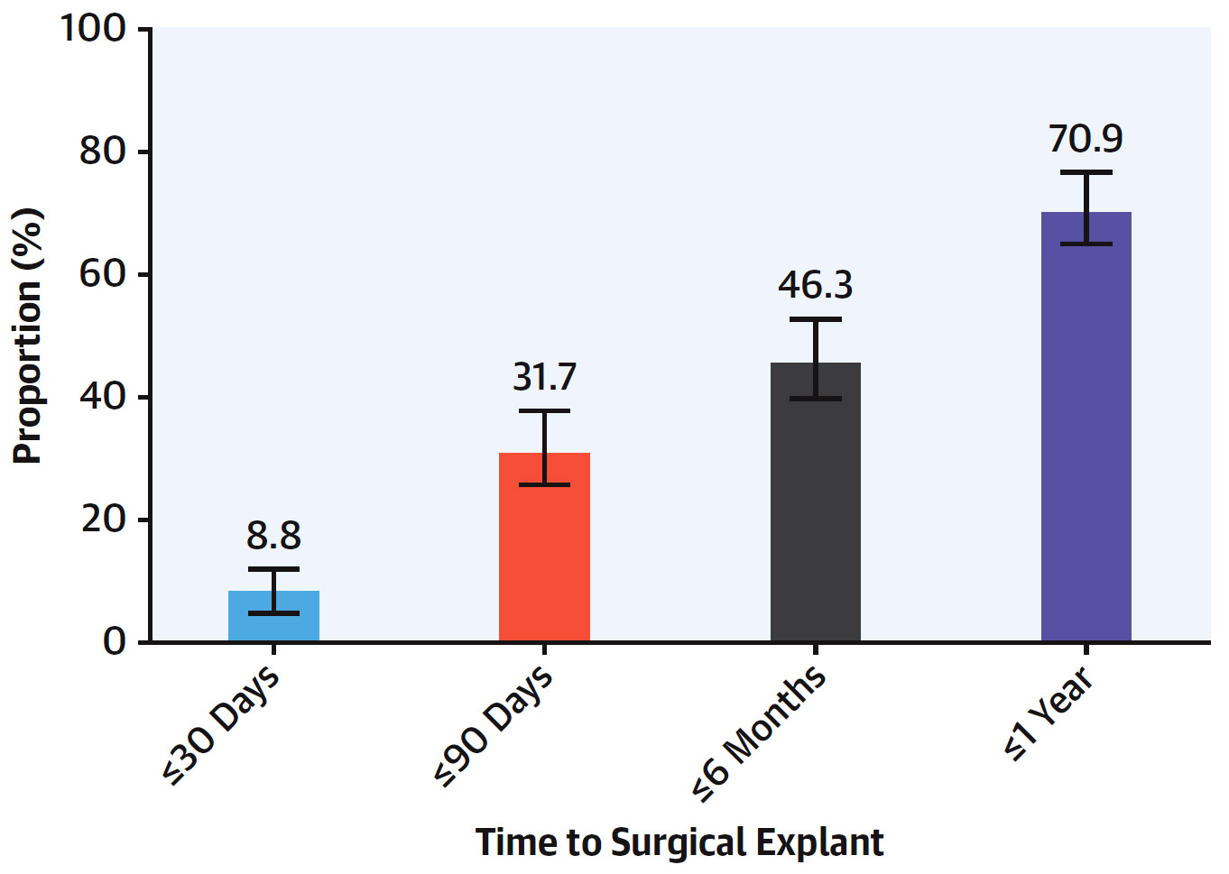
Time to Surgical Explant and Corresponding Proportions
Hirji et al., J Am Coll Cardiol 2020;76:1848

Slide 39
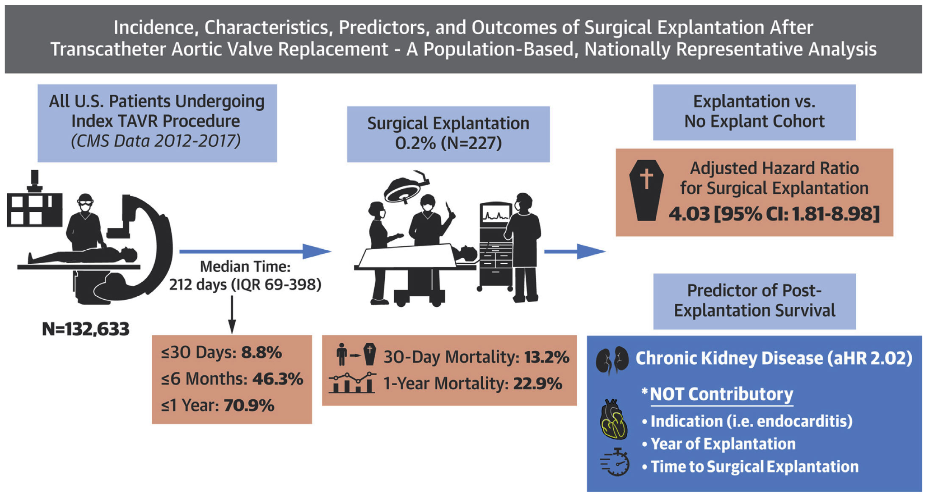
Summary of Key Findings of this Study: TAVR Explantation
Hirji et al., J Am Coll Cardiol 2020;76:1848

Slide 40
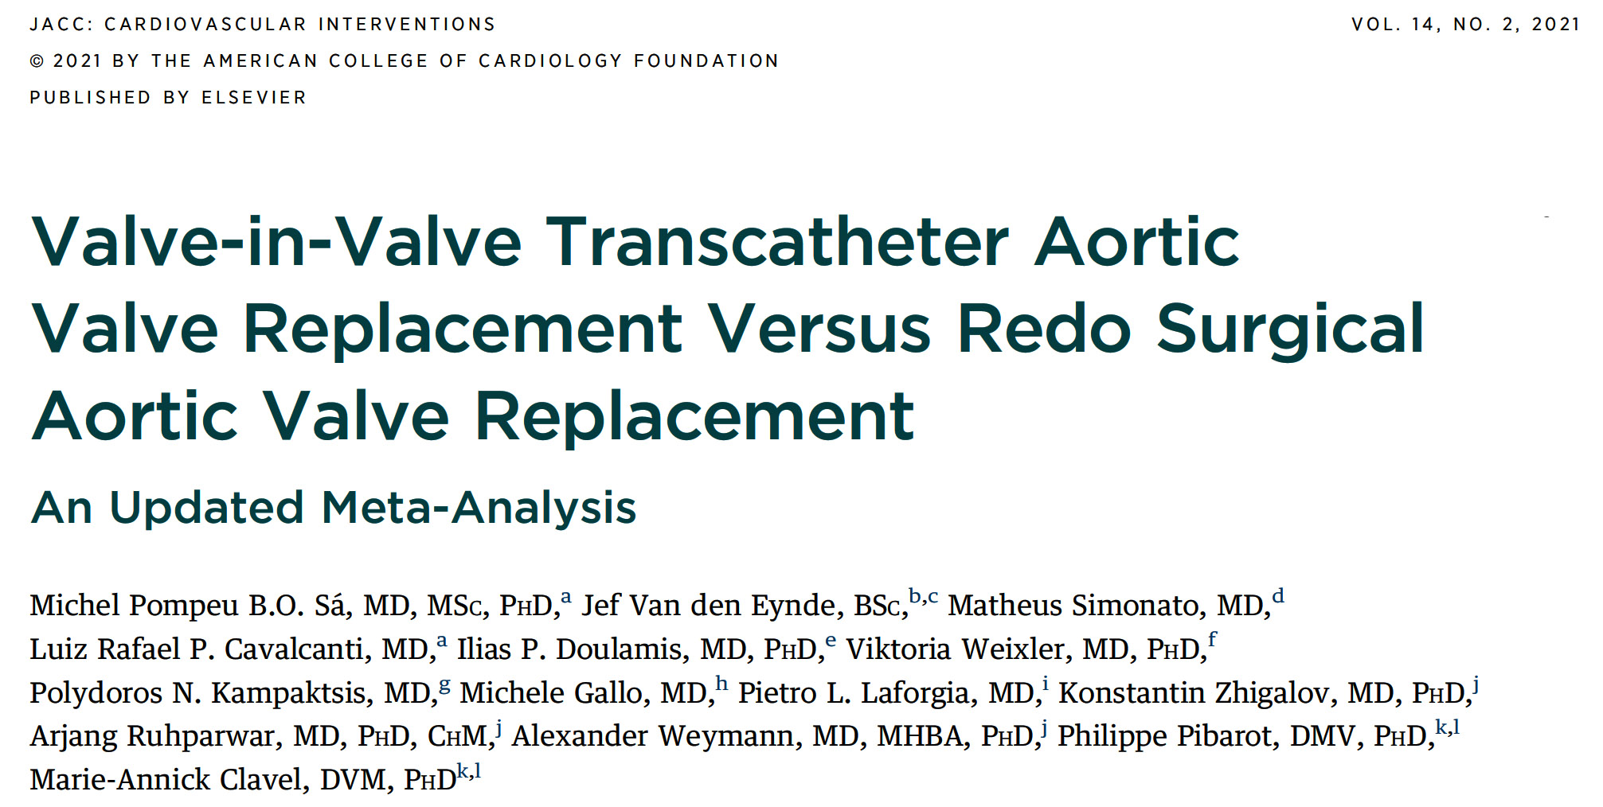

Slide 41
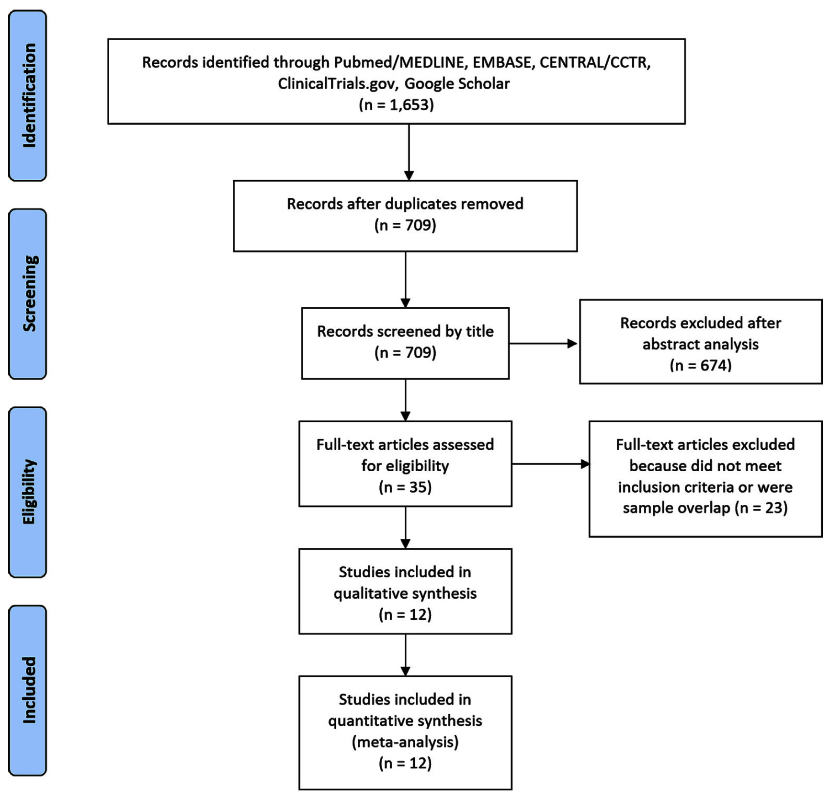
Flow Diagram of Studies Included in Data Search
Sá et al., J Am Coll Cardiol Intv 2021;14:211

Slide 42
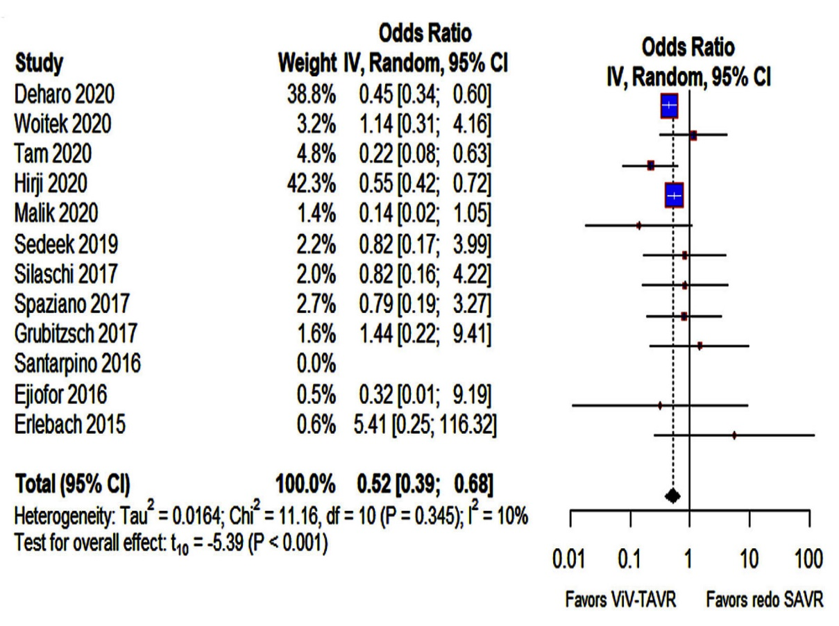
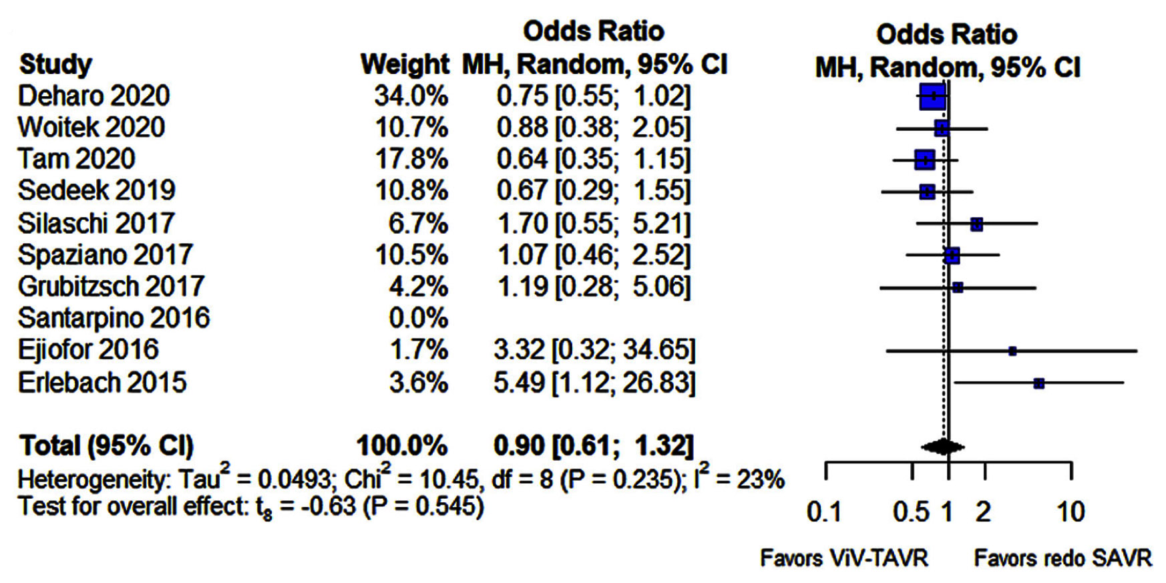
Pooled Odds Ratio and Conclusions Plot for
30-Day and 1-Year Mortality
30-Day Mortality
1-Year Mortality
Sá et al., J Am Coll Cardiol Intv 2021;14:211

Slide 43
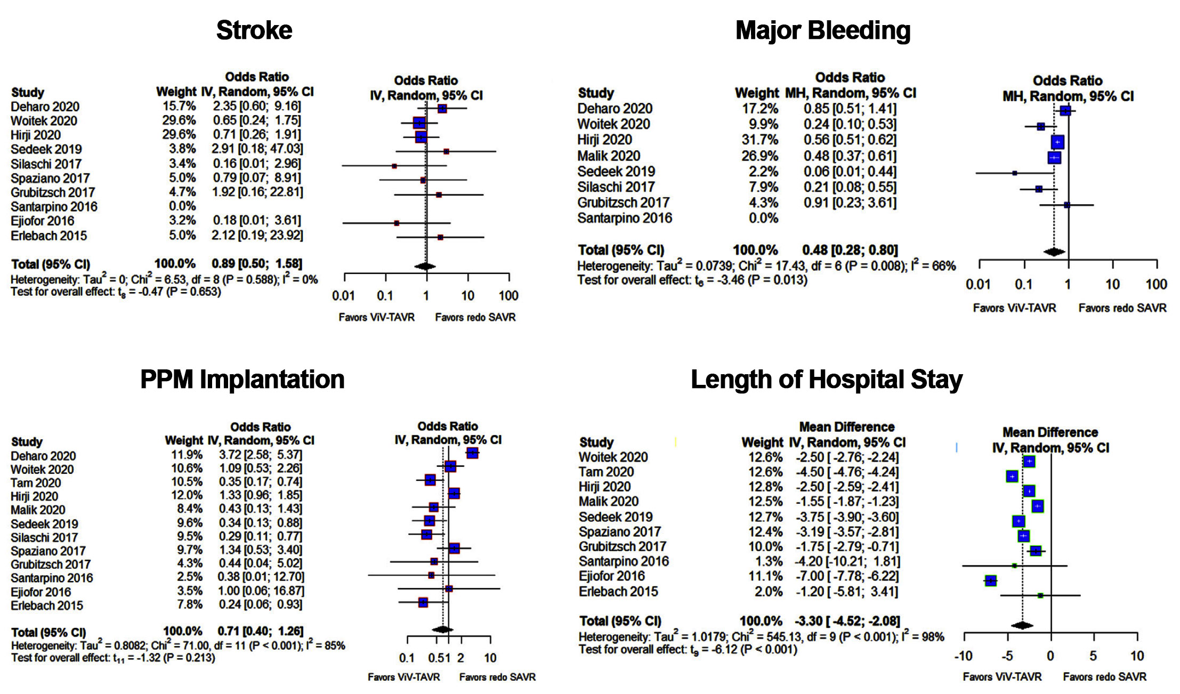
Forest Plots for Stroke, Major Bleeding, PPM Implantation and Length of Hospital Stay
Sá et al., J Am Coll Cardiol Intv 2021;14:211

Slide 44
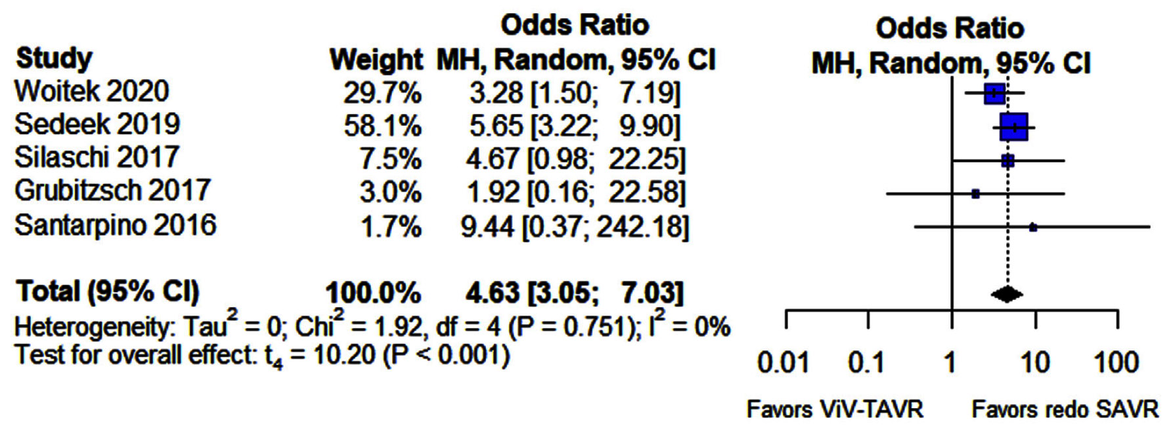
Forest Plots for Severe Patient-Prosthesis Mismatch
Sá et al., J Am Coll Cardiol Intv 2021;14:211

Slide 45
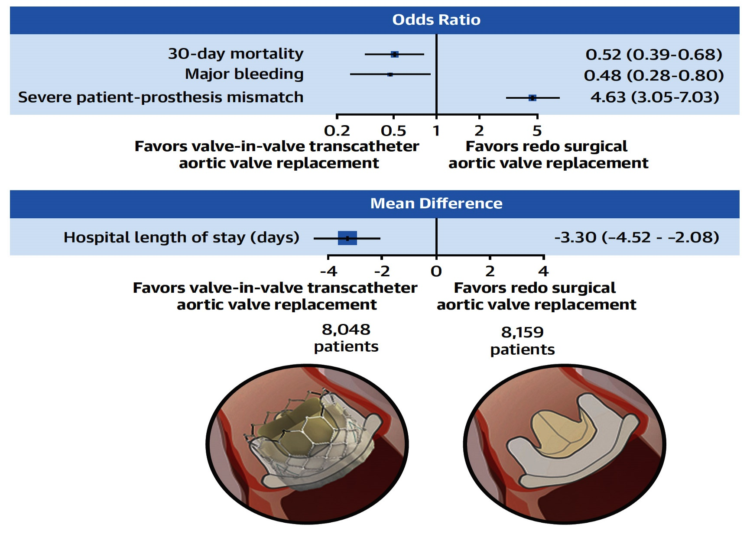
ViV-TAVR is Associated with Lower Rates of
30-Day Mortality, and Major Bleeding, But Higher Rates of Severe Patient-Prosthesis Mismatch
Sá et al., J Am Coll Cardiol Intv 2021;14:211

Slide 47
Take Home Messages
Recent Update on TAVR Valve Degeneration
Most of the studies have shown similar short-term and long-term valve durability of TAVR vs SAVR valves with better hemodynamics after TAVR vs SAVR in terms of lower MG & better AV orifice and slightly higher valve thrombosis in TAVR valve.
With increasing adoption of TAVR procedures especially in younger age, we will encounter more cases of TAVR valve re-intervention for valve degeneration presenting as both stenosis and insufficiency. TAVR-in-TAVR is a viable option for these pts. Surgical TAVR explantation in appropriate cases is possible but is associated with higher MACE rates.

Slide 48
Question # 1
Following are true statements regarding the TAVR vs SAVR valve durability except:
Similar long-term (upto 8yrs) valve durability with TAVR vs SAVR
Similar need for re-intervention between TAVR vs SAVR
Similar rates of endocarditis with TAVR vs SAVR
Similar rates of valve thrombosis with TAVR vs SAVR
Correct answer: D

Slide 49
Question # 2
Following statements is true regarding TAVR vs SAVR valve hemodynamics at long-term followup:
Similar AV orifice with TAVR vs SAVR
Similar AV gradient between TAVR vs SAVR
Significantly larger aortic valve area after TAVR vs SAVR
Consistently higher valve thrombosis with TAVR vs SAVR
Correct answer: C

Slide 50
Question # 3
Following are the viable options for the management of TAVR valve degeneration except:
A. Balloon aortic valvuloplasty
B. TAVR-in-TAVR procedure with similar to original TAVR valve
C. TAVR-in-TAVR procedure with different then original TAVR valve
D. Surgical explantation and SAVR
Correct answer: A

