Slide 1
Complex Coronary Cases Supported by:
Abbott Vascular Inc.
Boston Scientific Corp.
Terumo Vascular Corp.
Cardiovascular Systems Inc.
Abiomed Inc.
Chiesi Inc.
Shockwave Medical Inc.
Cardinal Health Cordis Inc.

Slide 2
Disclosures
Samin K. Sharma, MD, MSCAI, FACC
Speaker’s Bureau – BSC, Abbott
Annapoorna S. Kini, MD, MRCP, FACC
Nothing to disclose
Sameer Mehta, MD, FACC (Moderator)
Nothing to disclose

Slide 3
CCC Live Case # 153
Patient Demographics
59 yrs, Male
Present Clinical Presentation
Presented with new onset angina CCS class IV angina and cCTA revealing total occlusion of mLAD
CAD Risk Factors
Controlled Hyperlipidemia
SAQ-7: 38
Clinical Variables
No prior known CAD. LVEF 60%
Medications
Aspirin, Metoprolol XL, Atorvastatin
Cath: Cath on 2/25/2022 @OSH revealed 1 V CAD: 100% mid LAD with distal vessel filling antegradely via bridge collaterals and retrogradely via RCA septal collaterals, LVEF 65% and Syntax score 12. Attempt to open LAD antegradely failed. Pt was added on ISMN and still has Class III symptoms,
Plan: Now planned for re-attempt at PCI of mid LAD CTO via retrograde approach using RCA septal colletrals.

Slide 4
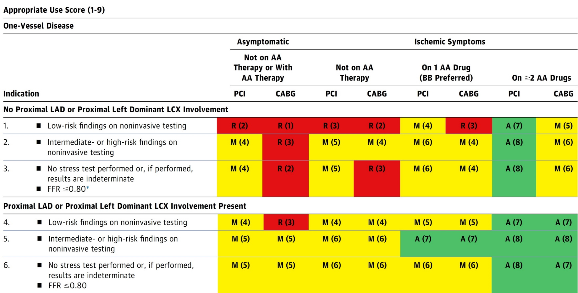
AUC 2017: One-Vessel Disease
Patel et al., J Am Coll Cardiol 2017;69:2212

Slide 5
Latest Issues in Coronary Intervention
Recent Interventional Publications;
DEFINE PCI trial-1Yr, IVUS guided PCI for long
lesions-3Yr, Predictors of LM CAD in Ischemia trial,
Jailed side-branch wire in COBIS III registry
Focused review of the month
PCI operator profiles and outcomes:
Percutaneous Coronary Intervention Operator Profile
and Associated In-hospital Mortality

Slide 6
Latest Issues in Coronary Intervention
Recent Interventional Publications;
DEFINE PCI trial-1Yr, IVUS guided PCI for long
lesions-3Yr, Predictors of LM CAD in Ischemia trial,
Jailed side-branch wire in COBIS III registry
Focused review of the month
PCI operator profiles and outcomes:
Percutaneous Coronary Intervention Operator Profile
and Associated In-hospital Mortality

Slide 7
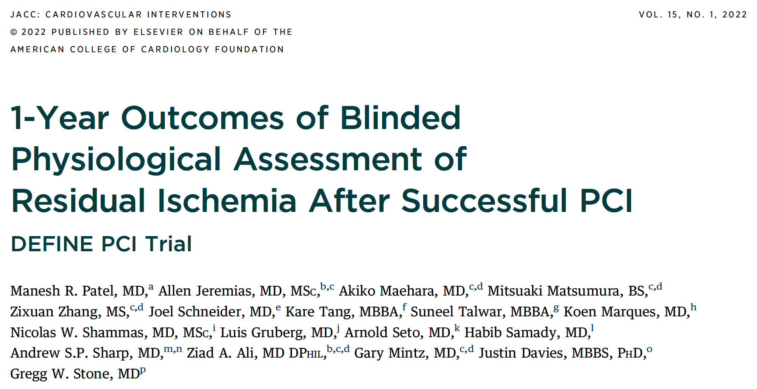

Slide 8
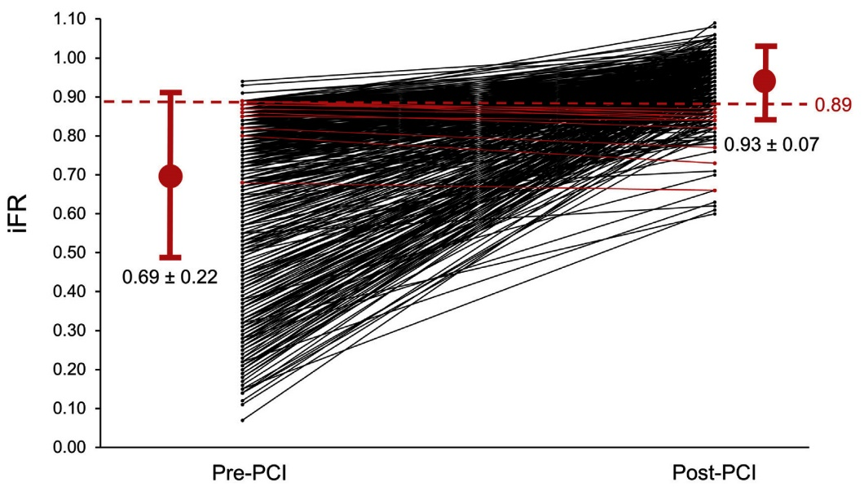
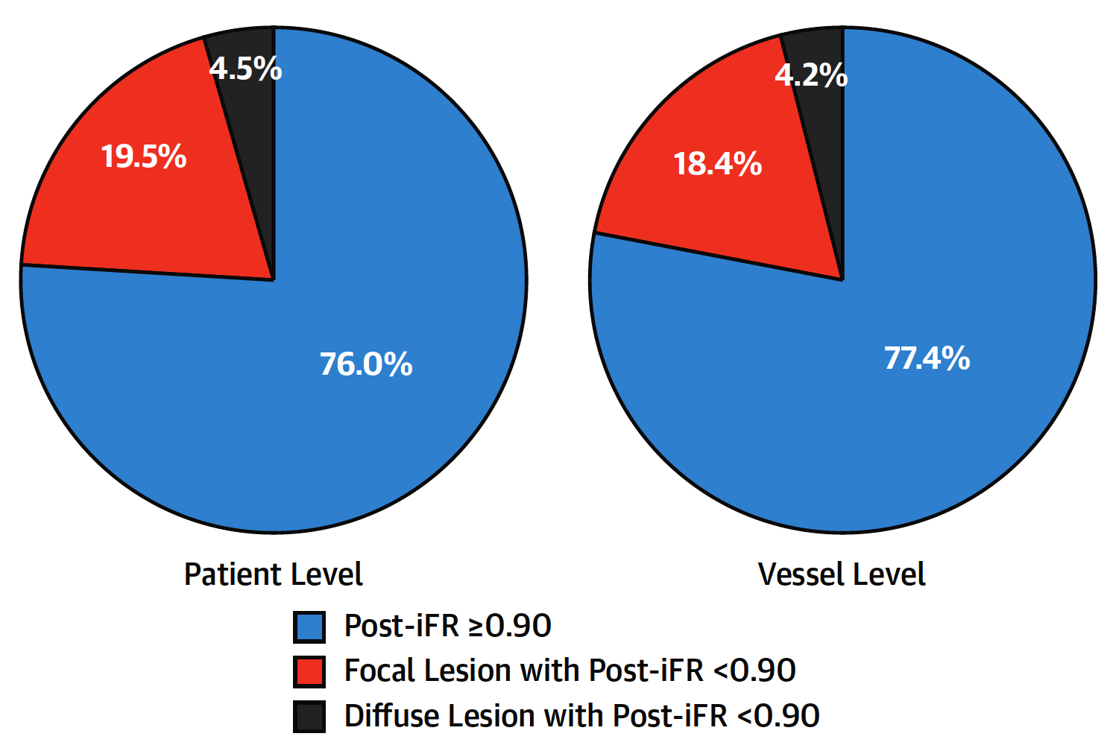
DEFINE-PCI: Pre- and Post-PCI iFR After Angiographically Successful PCI
Pre- and Post- PCI iFR
Jeremias et al., J Am Coll Cardiol Intv 2019;12:1991

Slide 9
DEFINE PCI: 1-Year Clinical Events According
to Post-PCI iFR
p=0.98
p=0.04
p=0.08
%
p=0.02
p=0.81
Patel et al., J Am Coll Cardiol Intv 2022;15:52

Slide 10
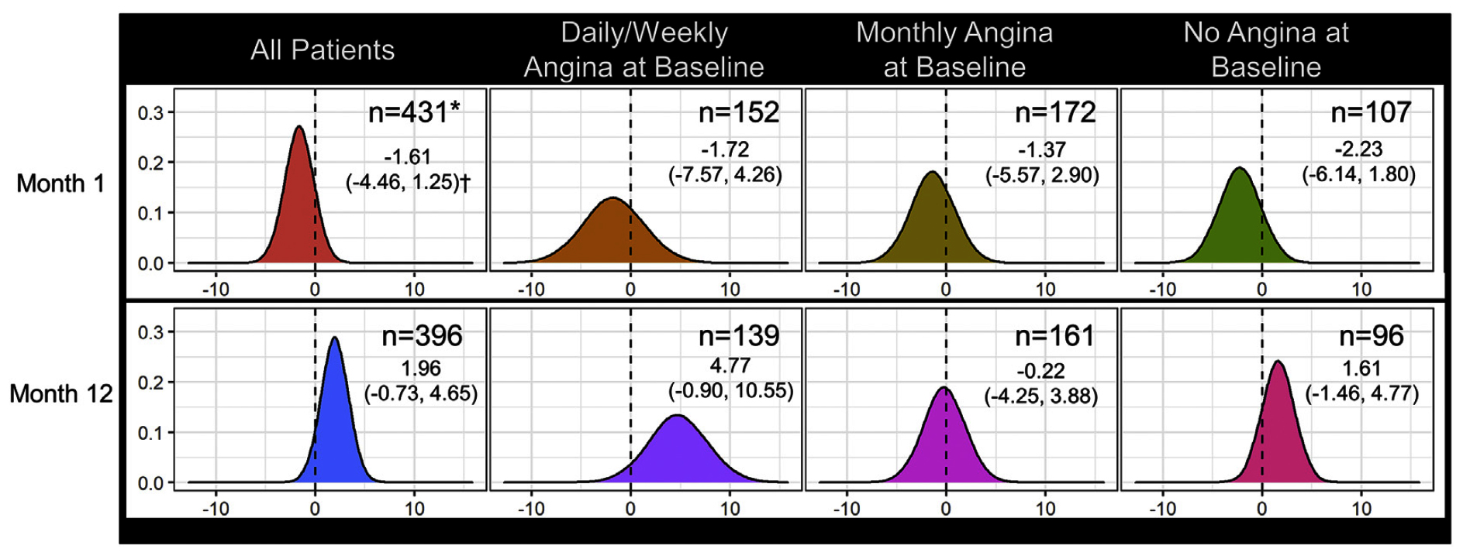
DEFINE PCI: Differences in SAQ-AF Scores at 1 and
12 Mos in Pts with Post-PCI iFR <0.95 vs ≥0.95 in All Pts and According to Baseline Frequency of Angina
Patel et al., J Am Coll Cardiol Intv 2022;15:52

Slide 11
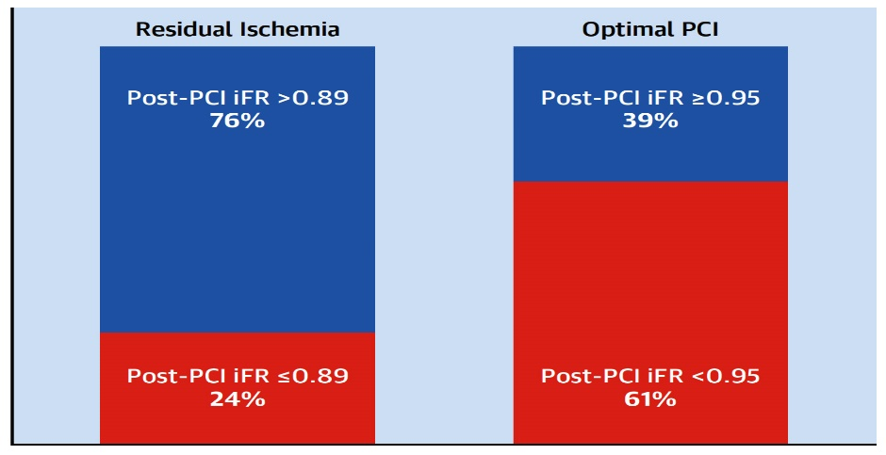
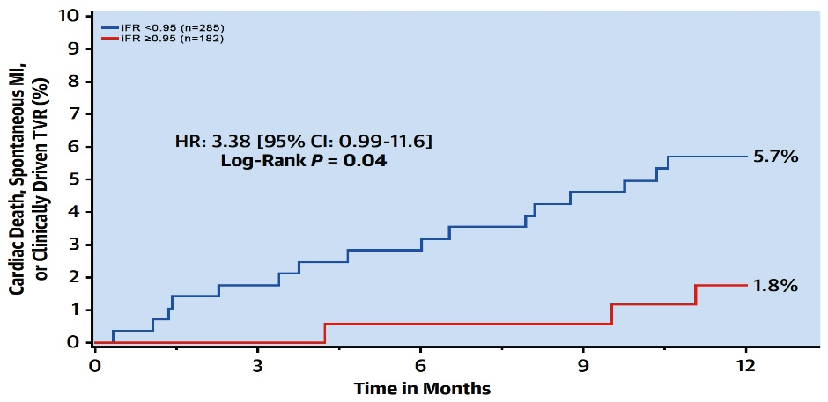
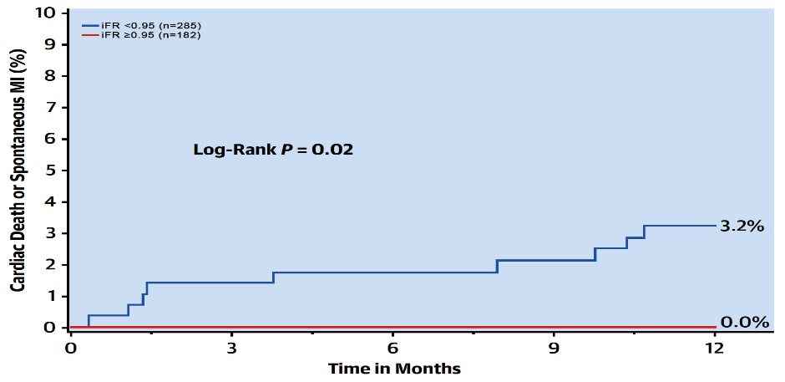
DEFINE PCI: Rate of Residual Ischemia Post-PCI and Clinical Outcomes
Residual Ischemia and
Post-PCI Optimal PCI
Cardiac death, Spontaneous MI, or CD-TVR at 1 yr by Post-iFR
Cardiac death or Spontaneous MI, at 1 yr by Post-iFR
Patel et al., J Am Coll Cardiol Intv 2022;15:52

Slide 13
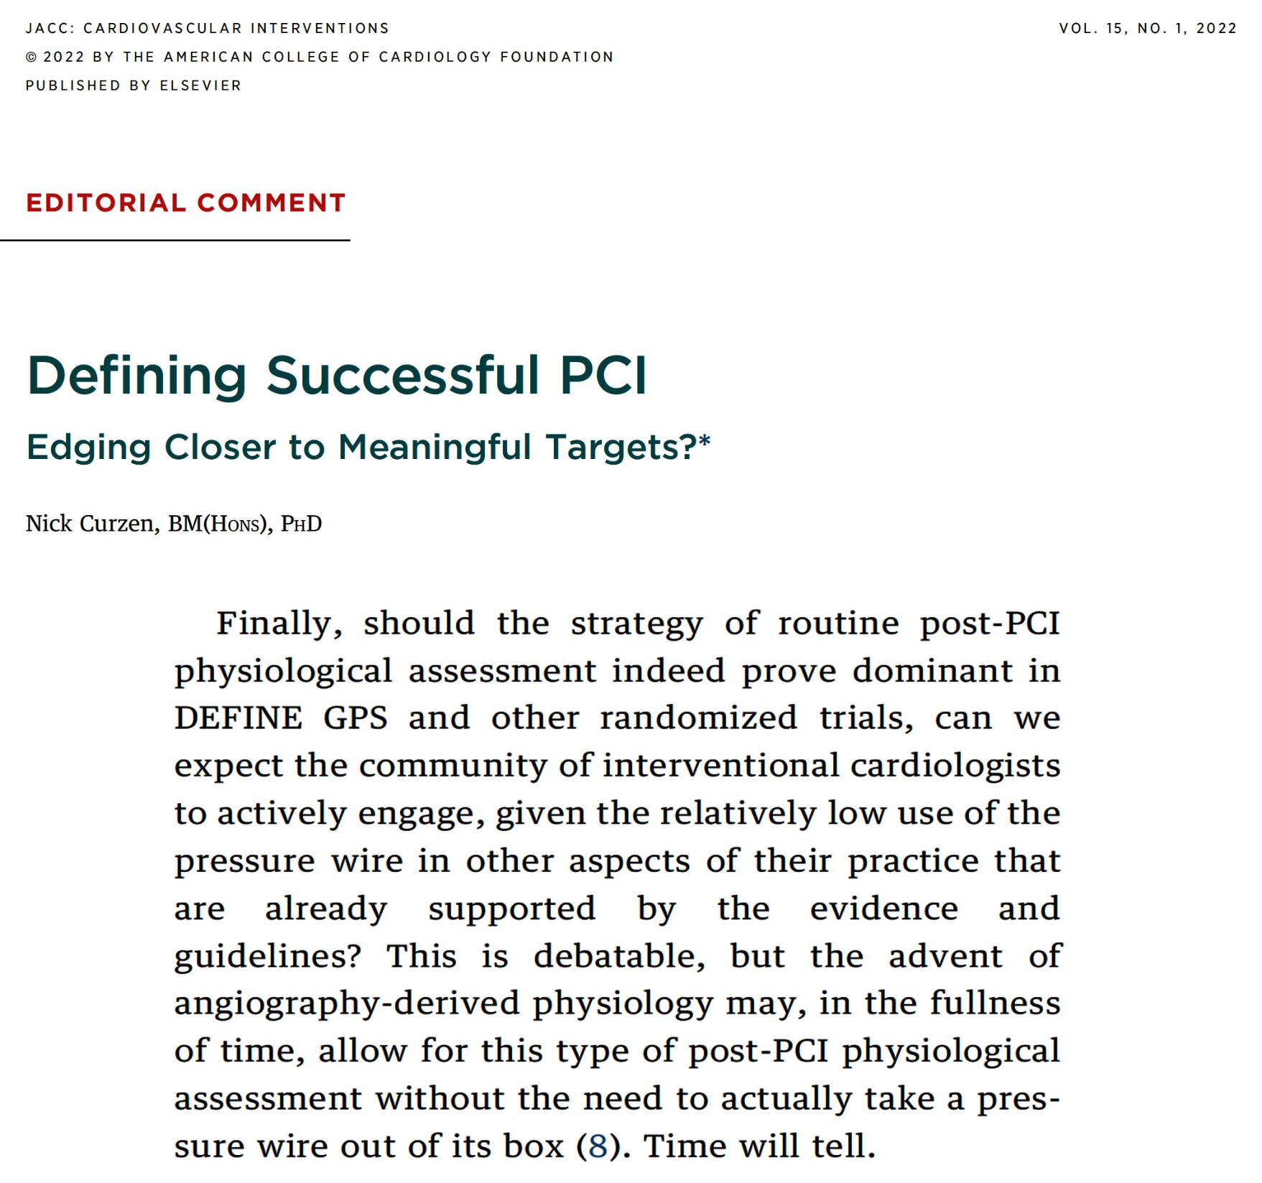

Slide 14
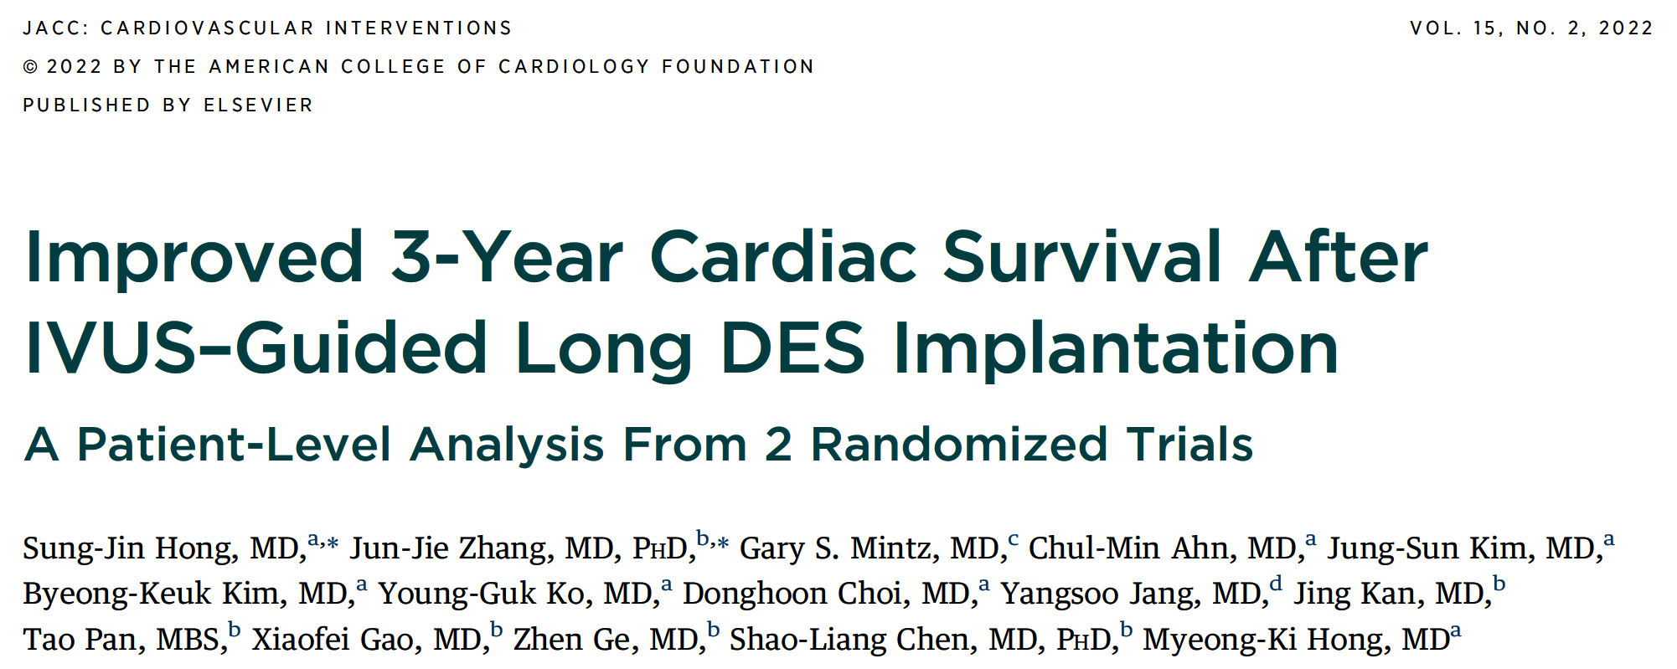

Slide 15
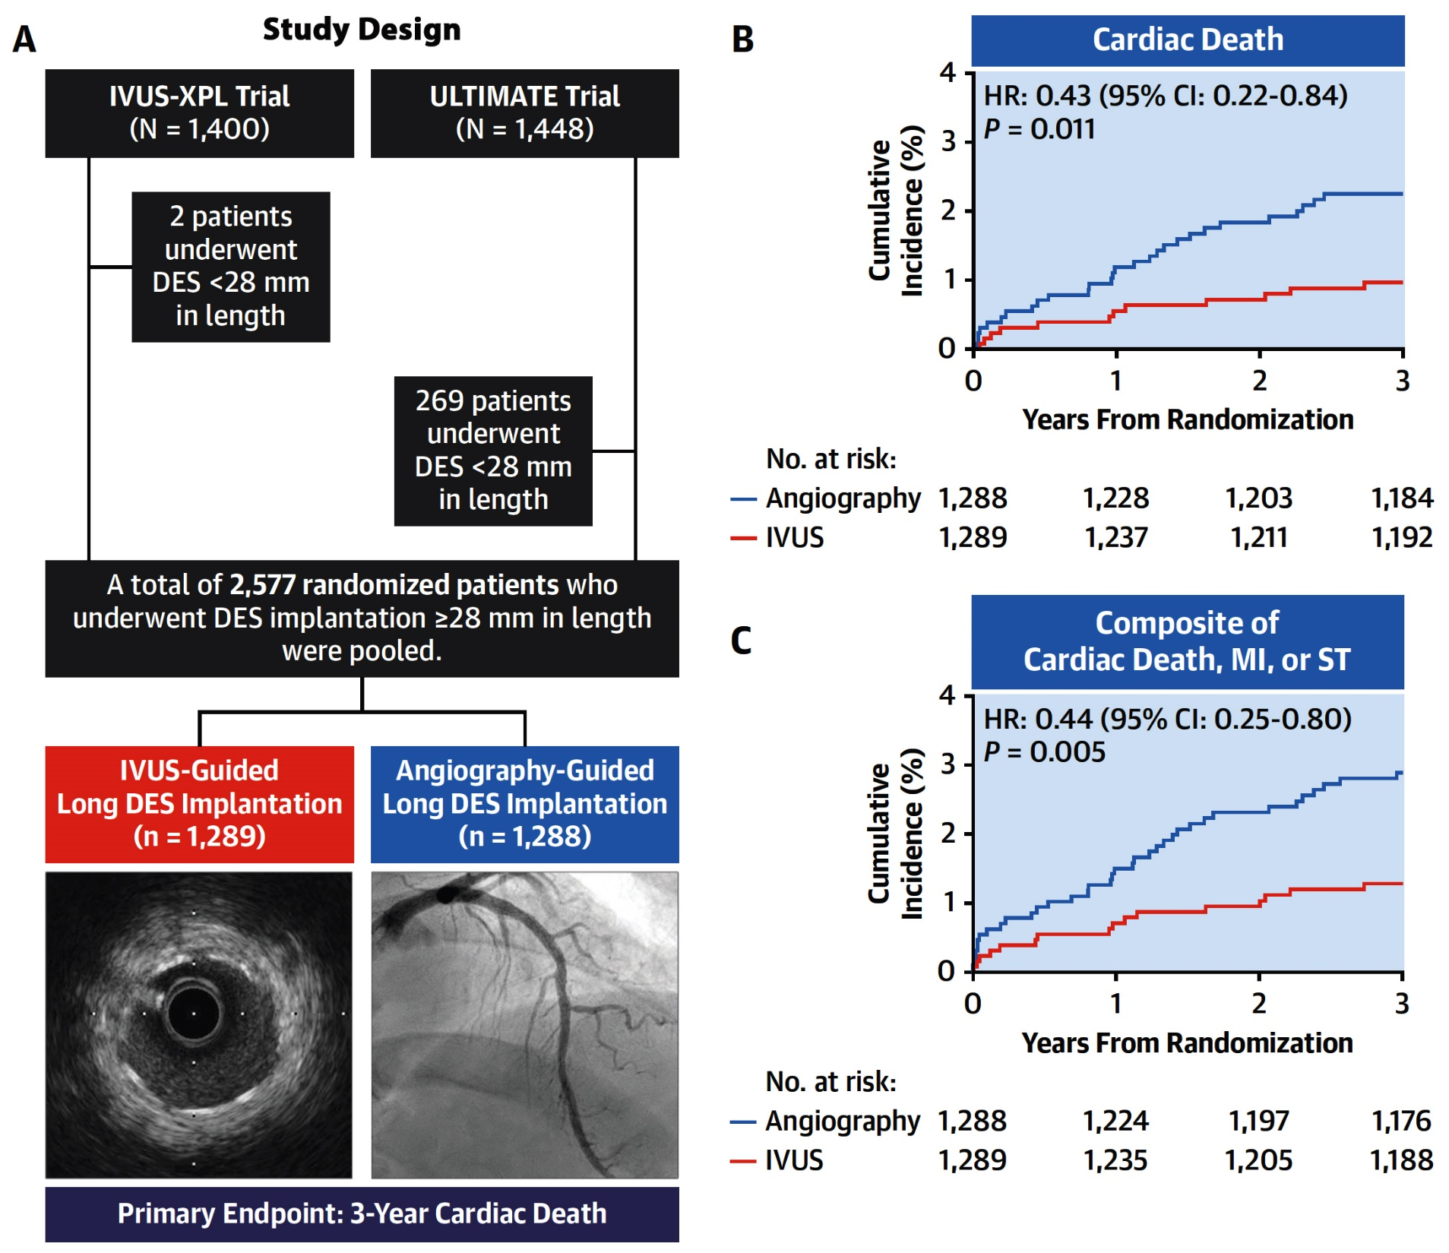
Improved 3-Year Cardiac Survival After IVUS-Guided
Long DES Implantation from a Patient-Level Pooled Analysis of 2 Randomized Trials
Hong et al., J Am Coll Cardiol Intv 2022;15:208

Slide 16
3-Year Clinical Outcomes
p=0.002
p=0.27
p=0.005
%
p=0.01
p=0.11
p=0.08
p=0.08
Hong et al., J Am Coll Cardiol Intv 2022;15:208

Slide 17
Post-Intervention IVUS Parameters of Target Lesions According to IVUS Optimization
 | Meeting IVUS Criteria | Not Meeting IVUS Criteria | P Value
Number of target lesions | 843 | 656
Proximal reference, mm² External elastic membrane area Lumen area | 16.17 ± 5.58 9.81 ± 4.14 | 15.47 ± 5.35 9.03 ± 3.71 | 0.04 0.001
Minimal lumen area, mm² | 6.18 ± 2.28 | 5.47 ± 1.87 | <0.001
Distal reference, mm² External elastic membrane area Lumen area | 8.55 ± 4.12 5.85 ± 2.58 | 9.17 ± 3.85 6.19 ± 1.95 | 0.004 0.005
Hong et al., J Am Coll Cardiol Intv 2022;15:208

Slide 18
3-Year Clinical Outcomes According to IVUS Optimization
p=0.002
p=0.02
p=0.008
%
p=0.06
p=0.01
p=0.07
p=0.07
Hong et al., J Am Coll Cardiol Intv 2022;15:208

Slide 19
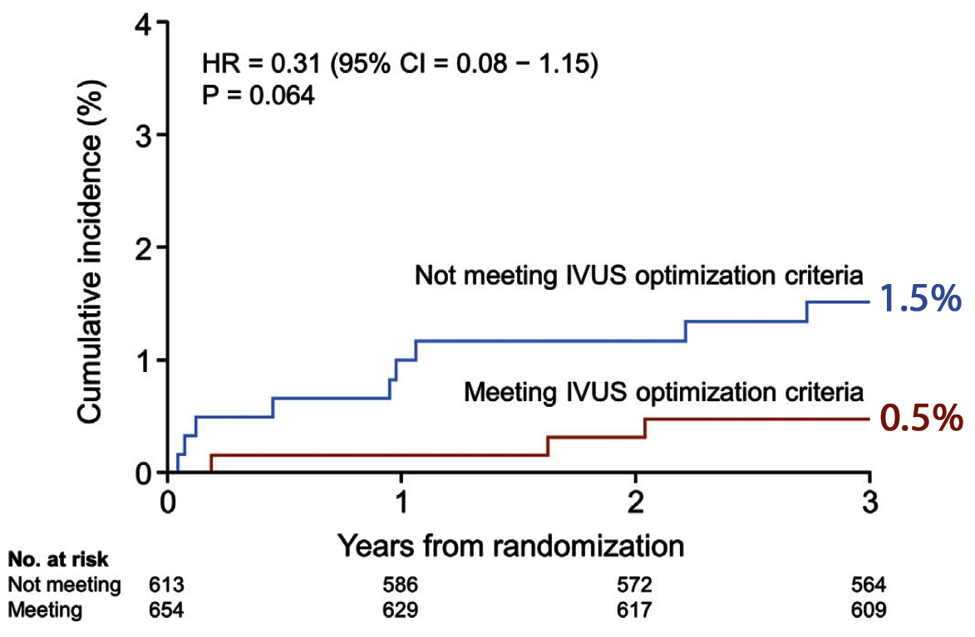
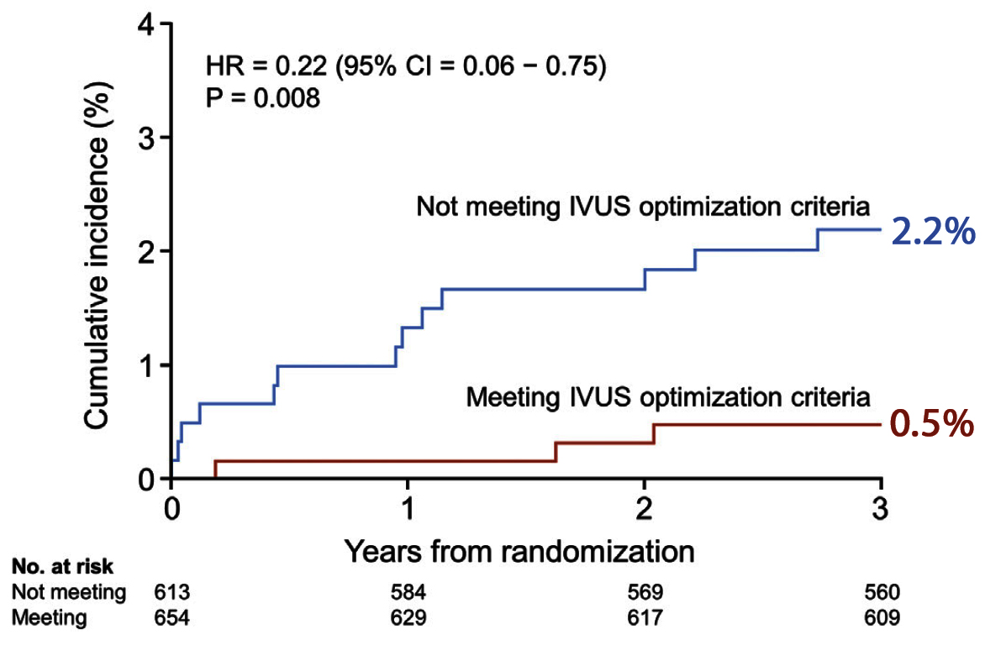
Clinical Outcomes at 3 Year According to
IVUS Optimization
Composite of Cardiac Death,
MI, or ST
Cardiac Death
Hong et al., J Am Coll Cardiol Intv 2022;15:208

Slide 21
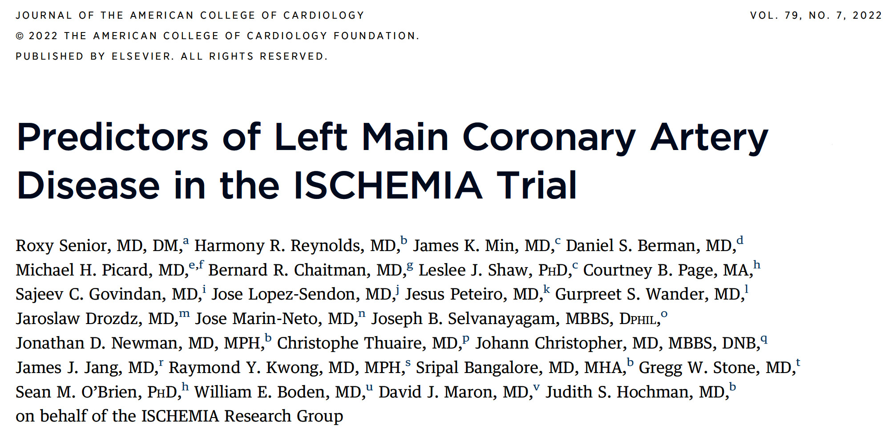

Slide 22
ISCHEMIA Trial: Study Flow Diagram
Total enrolled in ISCHEMIA
N=8,518
Excluded
No CTA (n=2,528)
Missing ischemia interpretation (n=365)
Participants with prior CABG (n=144)
Participants with LMD not present (n=42)
LMD uninterpretable (n=122) or nor reported (n=4)
CMR participants (n=167)
Final cohort for analysis of left main disease
N=5,146
Senior et al., J Am Coll Cardiol 2022;79:651

Slide 23
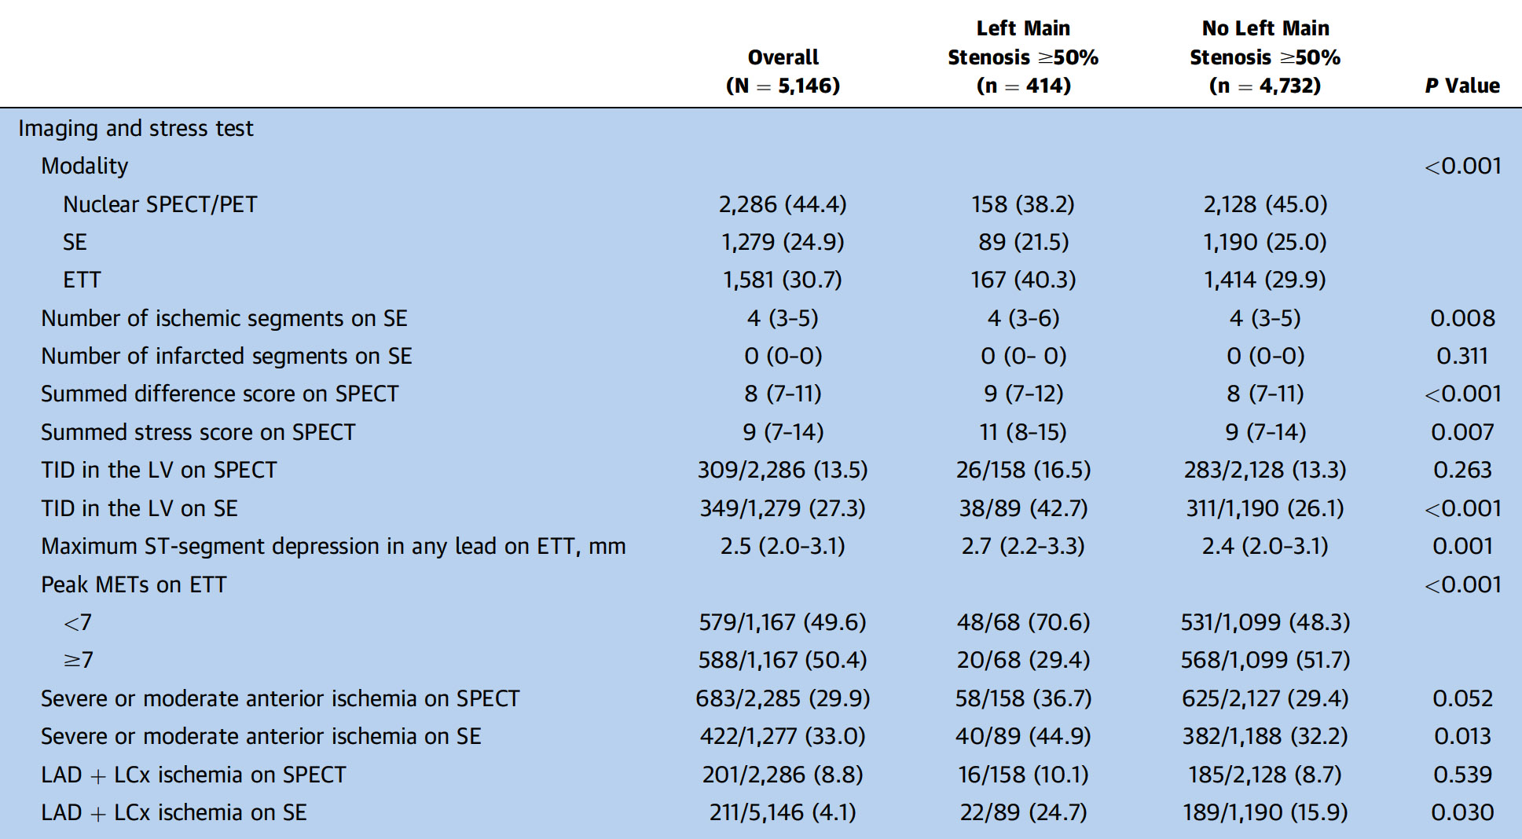
ISCHEMIA Trial: Baseline Clinical Characteristics
of the Study Population With and Without LMD
ISCHEMIA Trial: Baseline Clinical Characteristics
of the Study Population With and Without LMD
Senior et al., J Am Coll Cardiol 2022;79:651

Slide 24
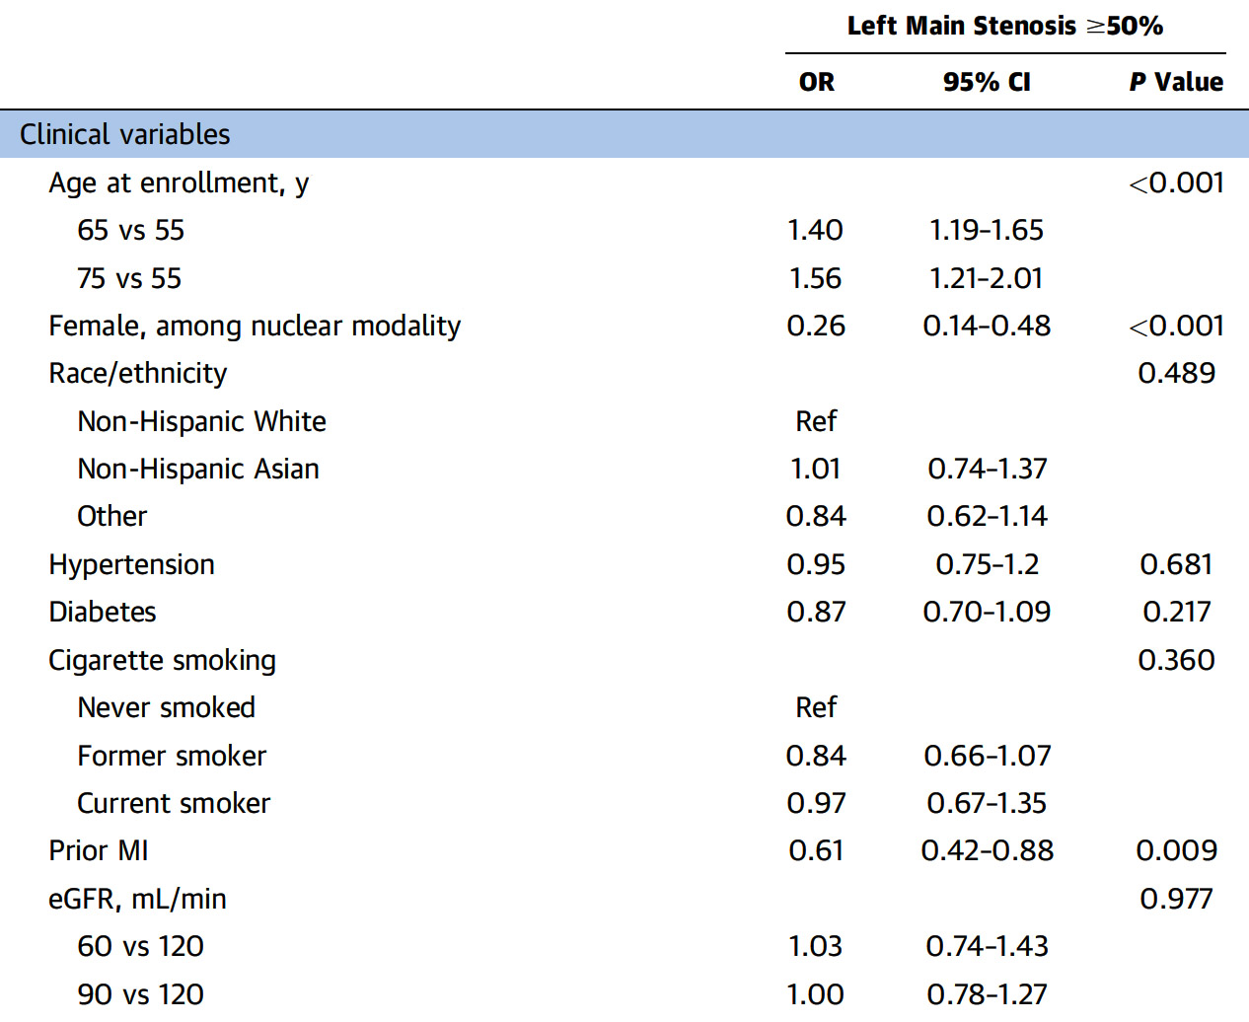
ISCHEMIA Trial: Results from Stress Test Model for LMD Adjusting for Clinical Factors
C-Index for left main stenosis ≥50%: 0.684
Exercise parameters after adjusting clinical factors:
significant predictors of LMD were older age, male sex, lack of prior MI
Senior et al., J Am Coll Cardiol 2022;79:651

Slide 25
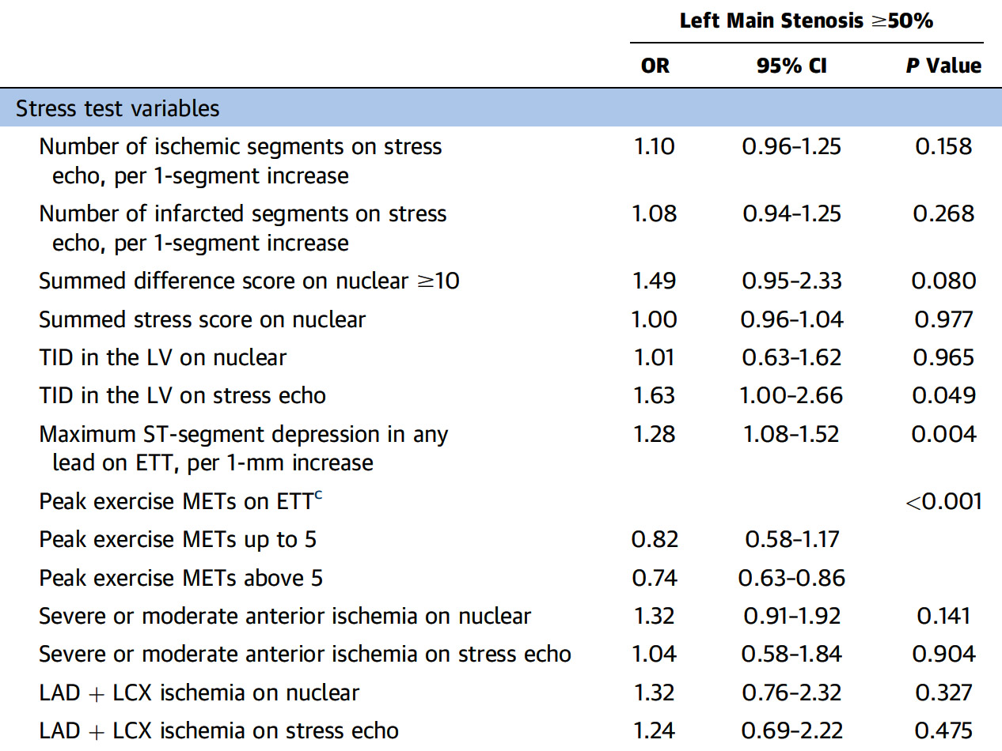
ISCHEMIA Trial: Results from Stress Test Model for LMD Adjusting for Clinical Factors
C-Index for left main stenosis ≥50%: 0.684
Imaging parameters after adjusting clinical factors:
greater ST-segment depression and lower peak METs on ETT and TID on SE
nuclear imaging parameters were not independently associated with LMD
Senior et al., J Am Coll Cardiol 2022;79:651

Slide 26
ISCHEMIA Trial: Distribution of the Predicted Risk Estimates of LMD
Stratified by qualifying stress test modality, whether nuclear, echo or ETT
Distribution of predicted risk estimates LMD, defined as ≥50% on coronary CTA, ranged from <2%- >30% by stress test modality
Senior et al., J Am Coll Cardiol 2022;79:651

Slide 27
ISCHEMIA Trial: Clinical and Imaging Parameters Associated with <2.5% Probability of LMD on Average
Subgroups with an Average Model-Predicted Probability of LMD That is ≤2.5%
(Combined Cohort)
Subgroups with an Average Model-Predicted Probability of LMD That is ≤2.5% Defined Using Modality-Specific Variables
Subgroup Definition | N | Mean Predicted Probability (Bootstrapped 95% CI)
Female; no, mild, or mod ischemia | 673 | 0.023 (0.019-0.024)
Female; mild or mod ischemia | 577 | 0.023 (0.019-0.024)
Female; mild or mod ischemia, aged ≤75 y | 501 | 0.022 (0.018-0.023)
Female; mild or mod ischemia, aged >55 y | 480 | 0.024 (0.020-0.025)
Female; mod ischemia | 444 | 0.024 (0.020-0.025)
Female; mod ischemia, aged >55 y | 376 | 0.025 (0.020-0.026)
Subgroup Definition | N | Mean Predicted Probability (Bootstrapped 95% CI)
Female; nuclear | 508 | 0.024 (0.018-0.026)
Female; stress echo | 446 | 0.025 (0.019-0.028)
Female; nuclear; summed difference score <10 | 389 | 0.021 (0.016-0.023)
Female; stress echo; number of ischemic segments ≤5 | 361 | 0.021 (0.016-0.024)
Senior et al., J Am Coll Cardiol 2022;79:651

Slide 28
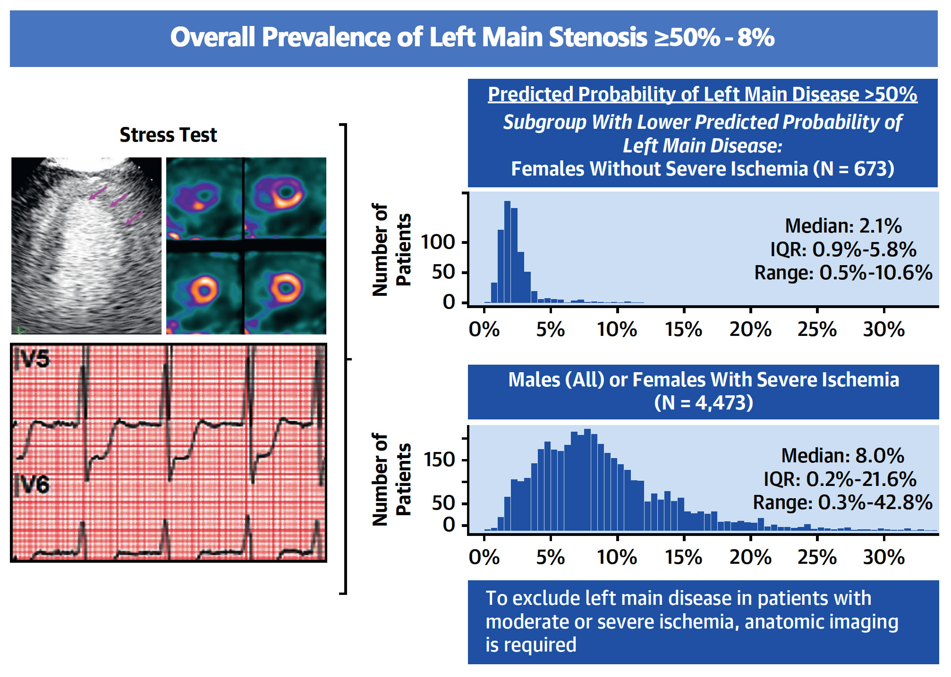
ISCHEMIA Trial: Left Main Disease in Patients with Moderate or Severe Ischemia
Senior et al., J Am Coll Cardiol 2022;79:651

Slide 30
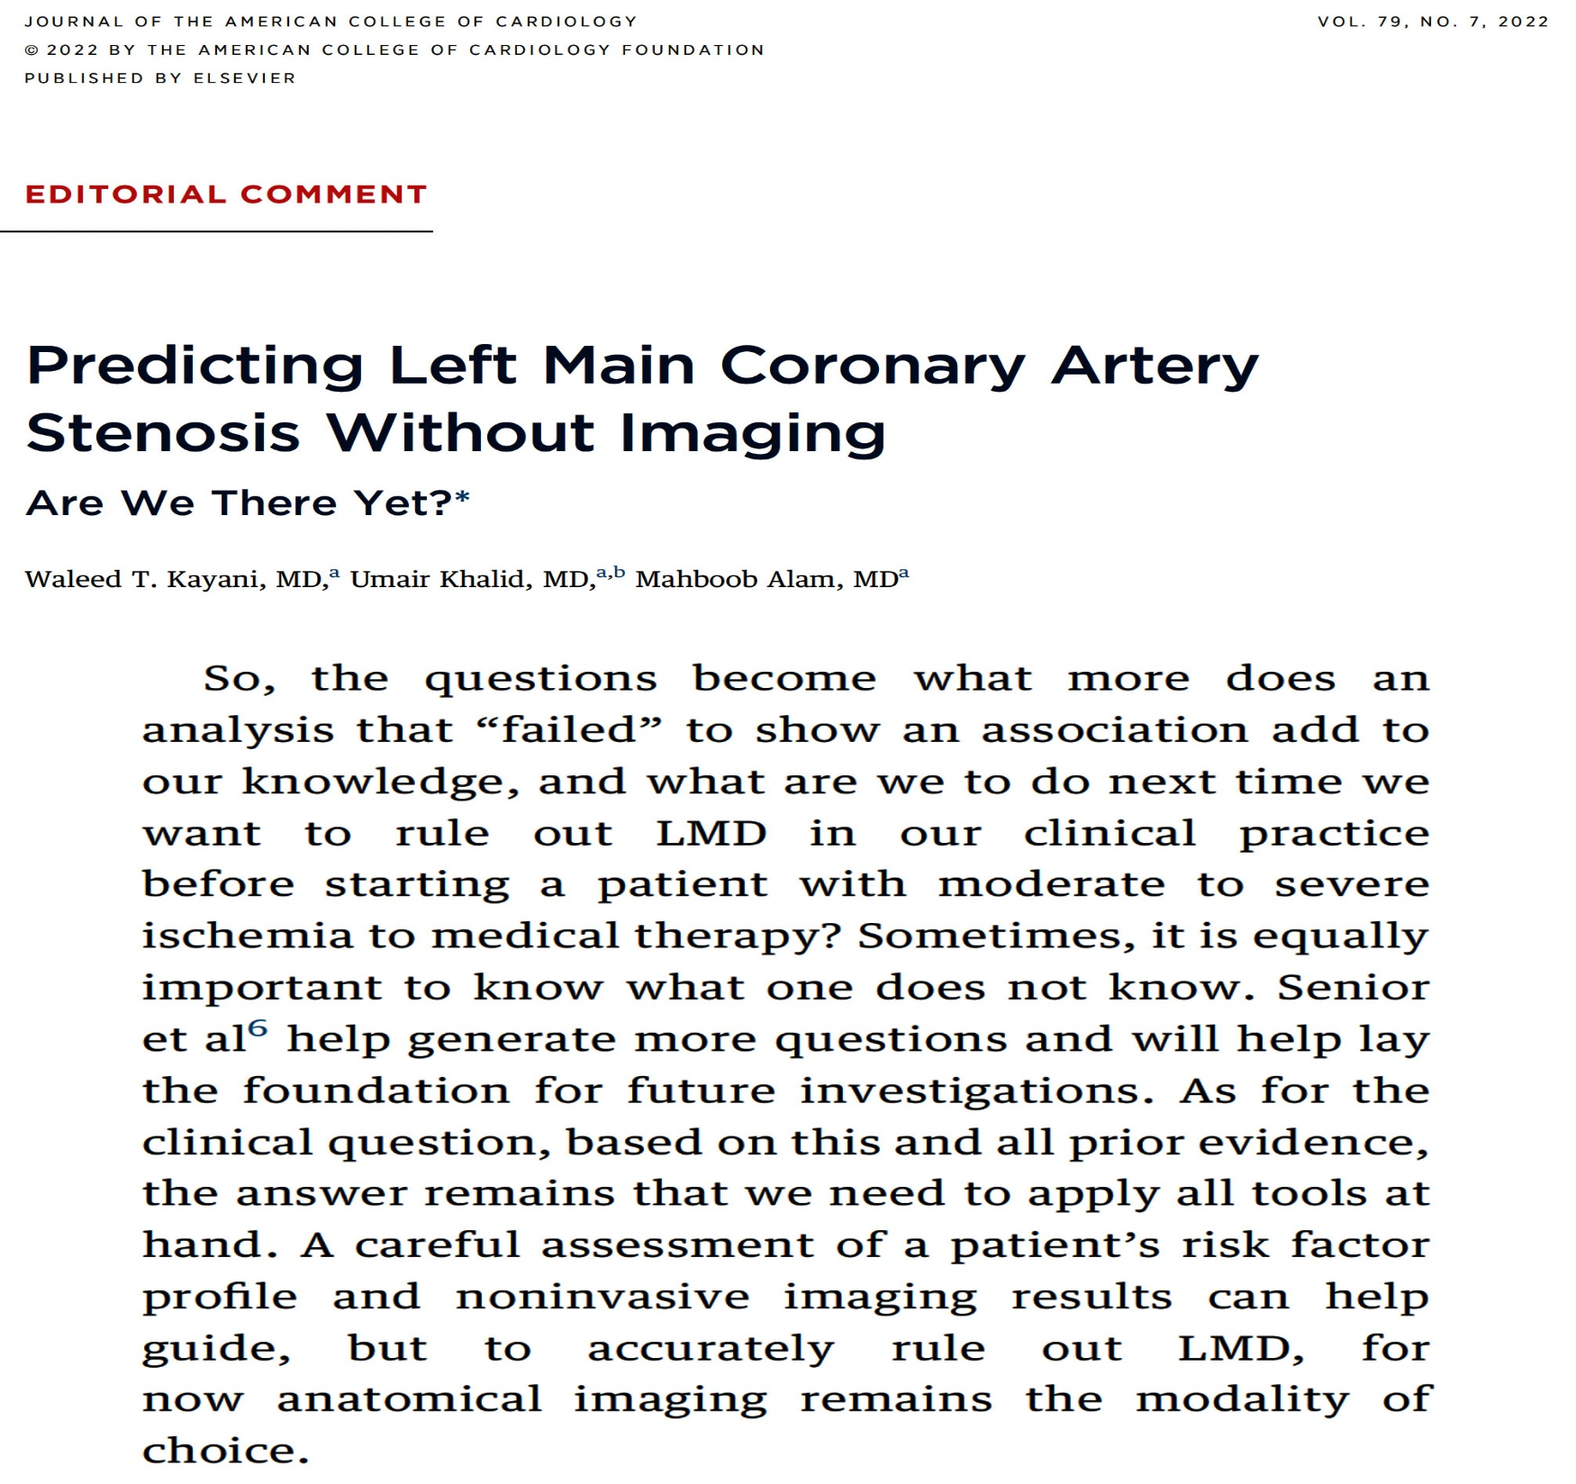

Slide 31
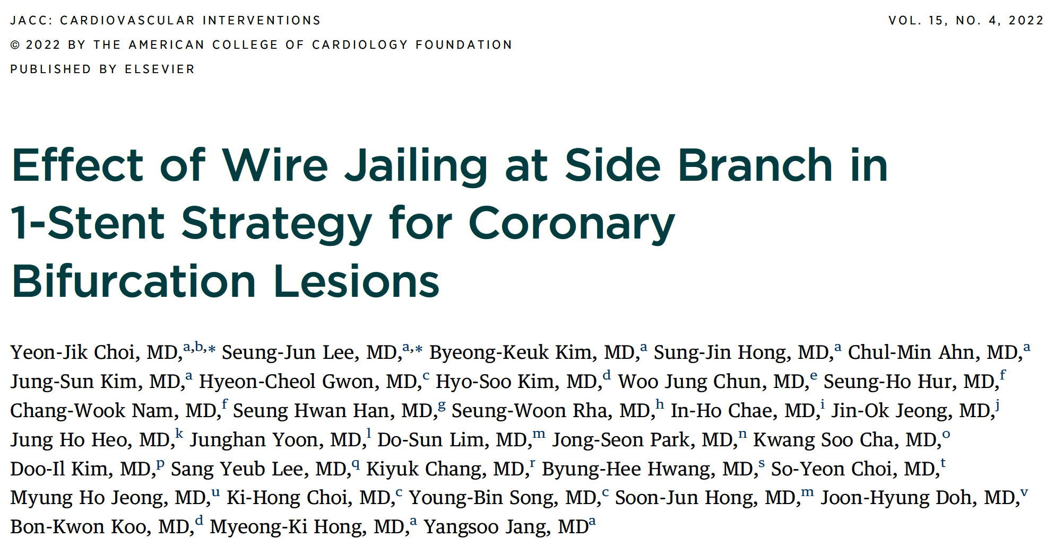

Slide 32
COBIS III Registry Study Flowchart
Patients undergoing coronary bifurcation intervention
with new-generation DES from COBIS III registry (n=2648)
Exclusion
499 underwent elective 2-stent technique
244 underwent SB pre-dilation before main-vessel stenting
15 had only significant stenosis at side branch without significant stenosis at main vessel (Medina 0.0.1)
A total of 1890 patients with bifurcation intervention using 1-stent technique were finally enrolled
Wire-jailing at SB
(n=819)
Non-wire-jailing
(n=1071)
Choi et al., J Am Coll Cardiol Intv 2022;15:443

Slide 33
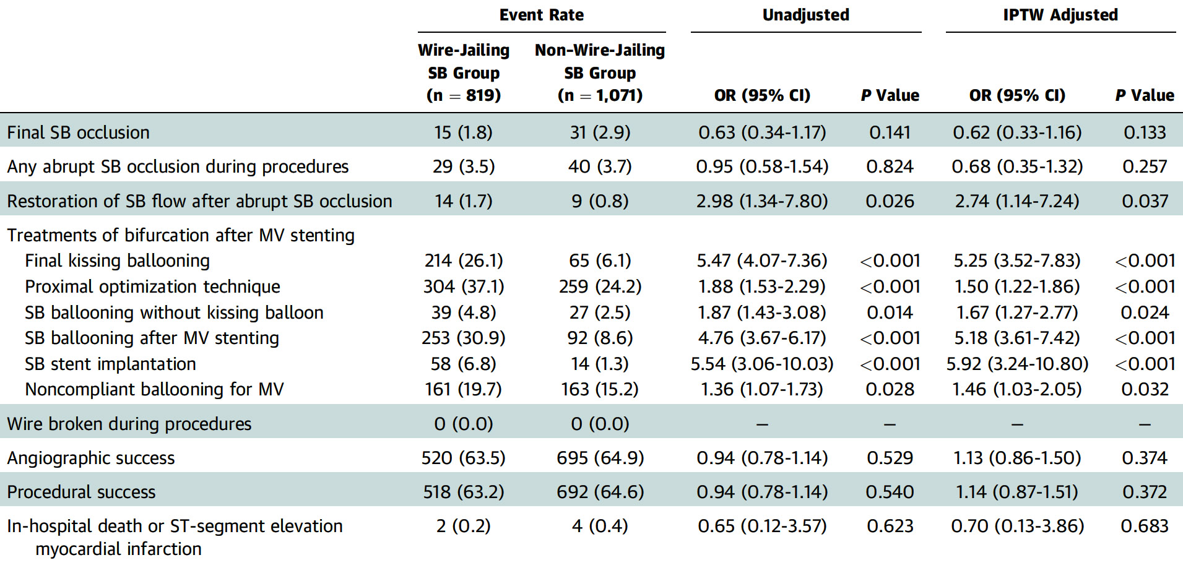
COBIS III Registry: Acute Angiographic
and Procedural Outcomes
Choi et al., J Am Coll Cardiol Intv 2022;15:443

Slide 34
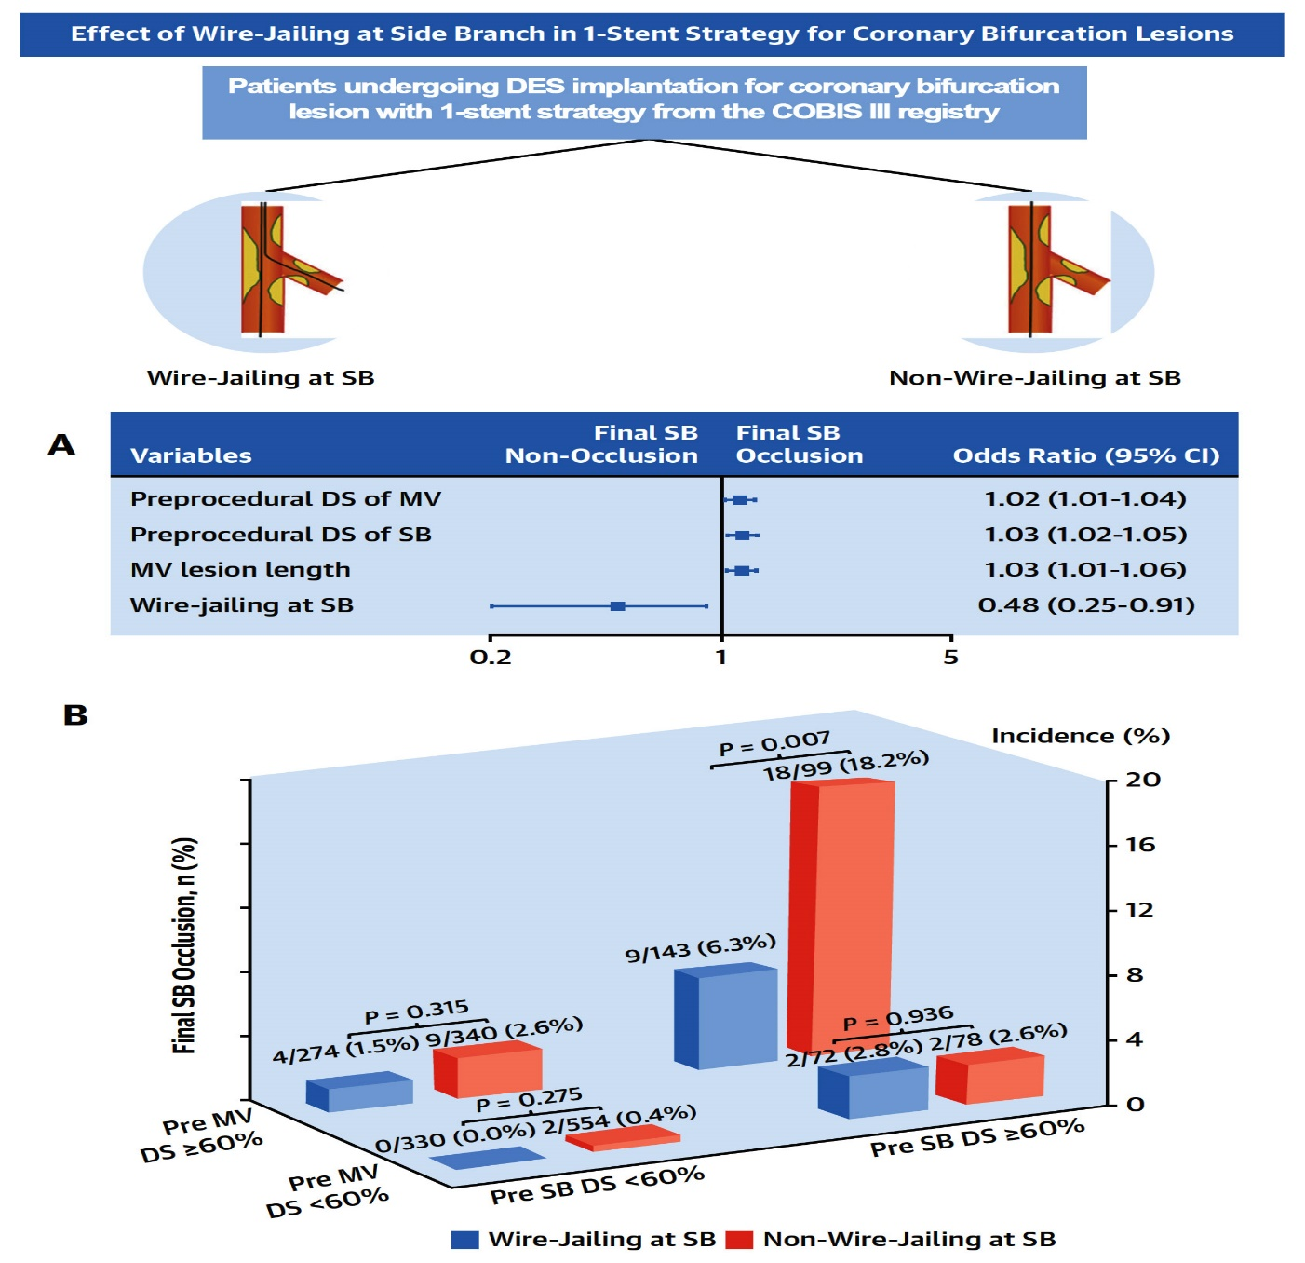
COBIS III Registry: Predictors for Final SB Occlusion and
the Impact of Wire Jailing According to the Disease Severity
Choi et al., J Am Coll Cardiol Intv 2022;15:443

Slide 35
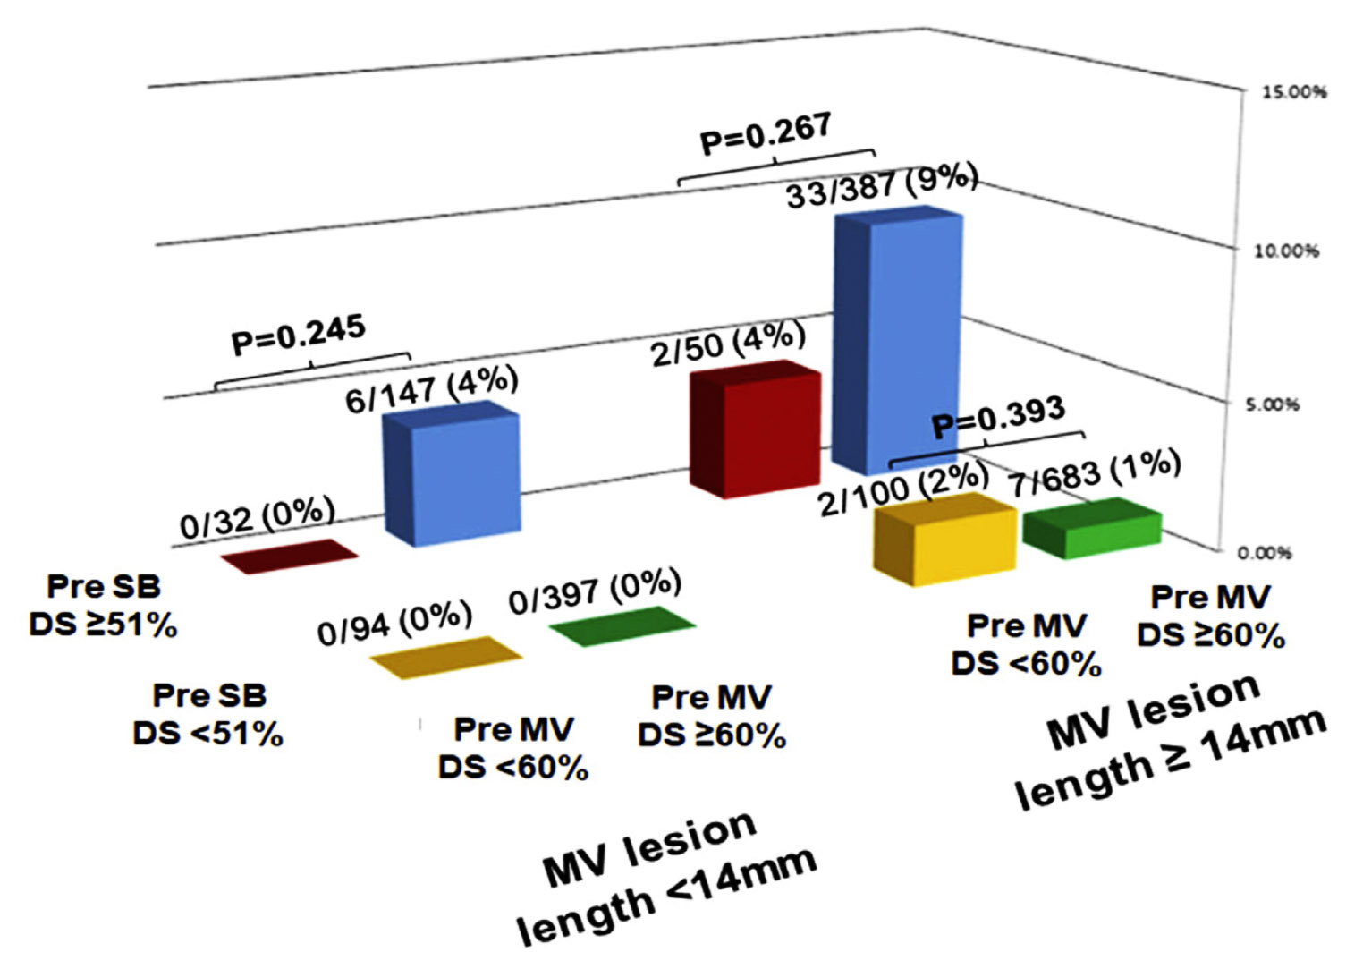
COBIS III Registry: Incidence of Final SB Occlusion According to the Severity of Stenosis in SB and MV and Lesion Length
Choi et al., J Am Coll Cardiol Intv 2022;15:443

Slide 36
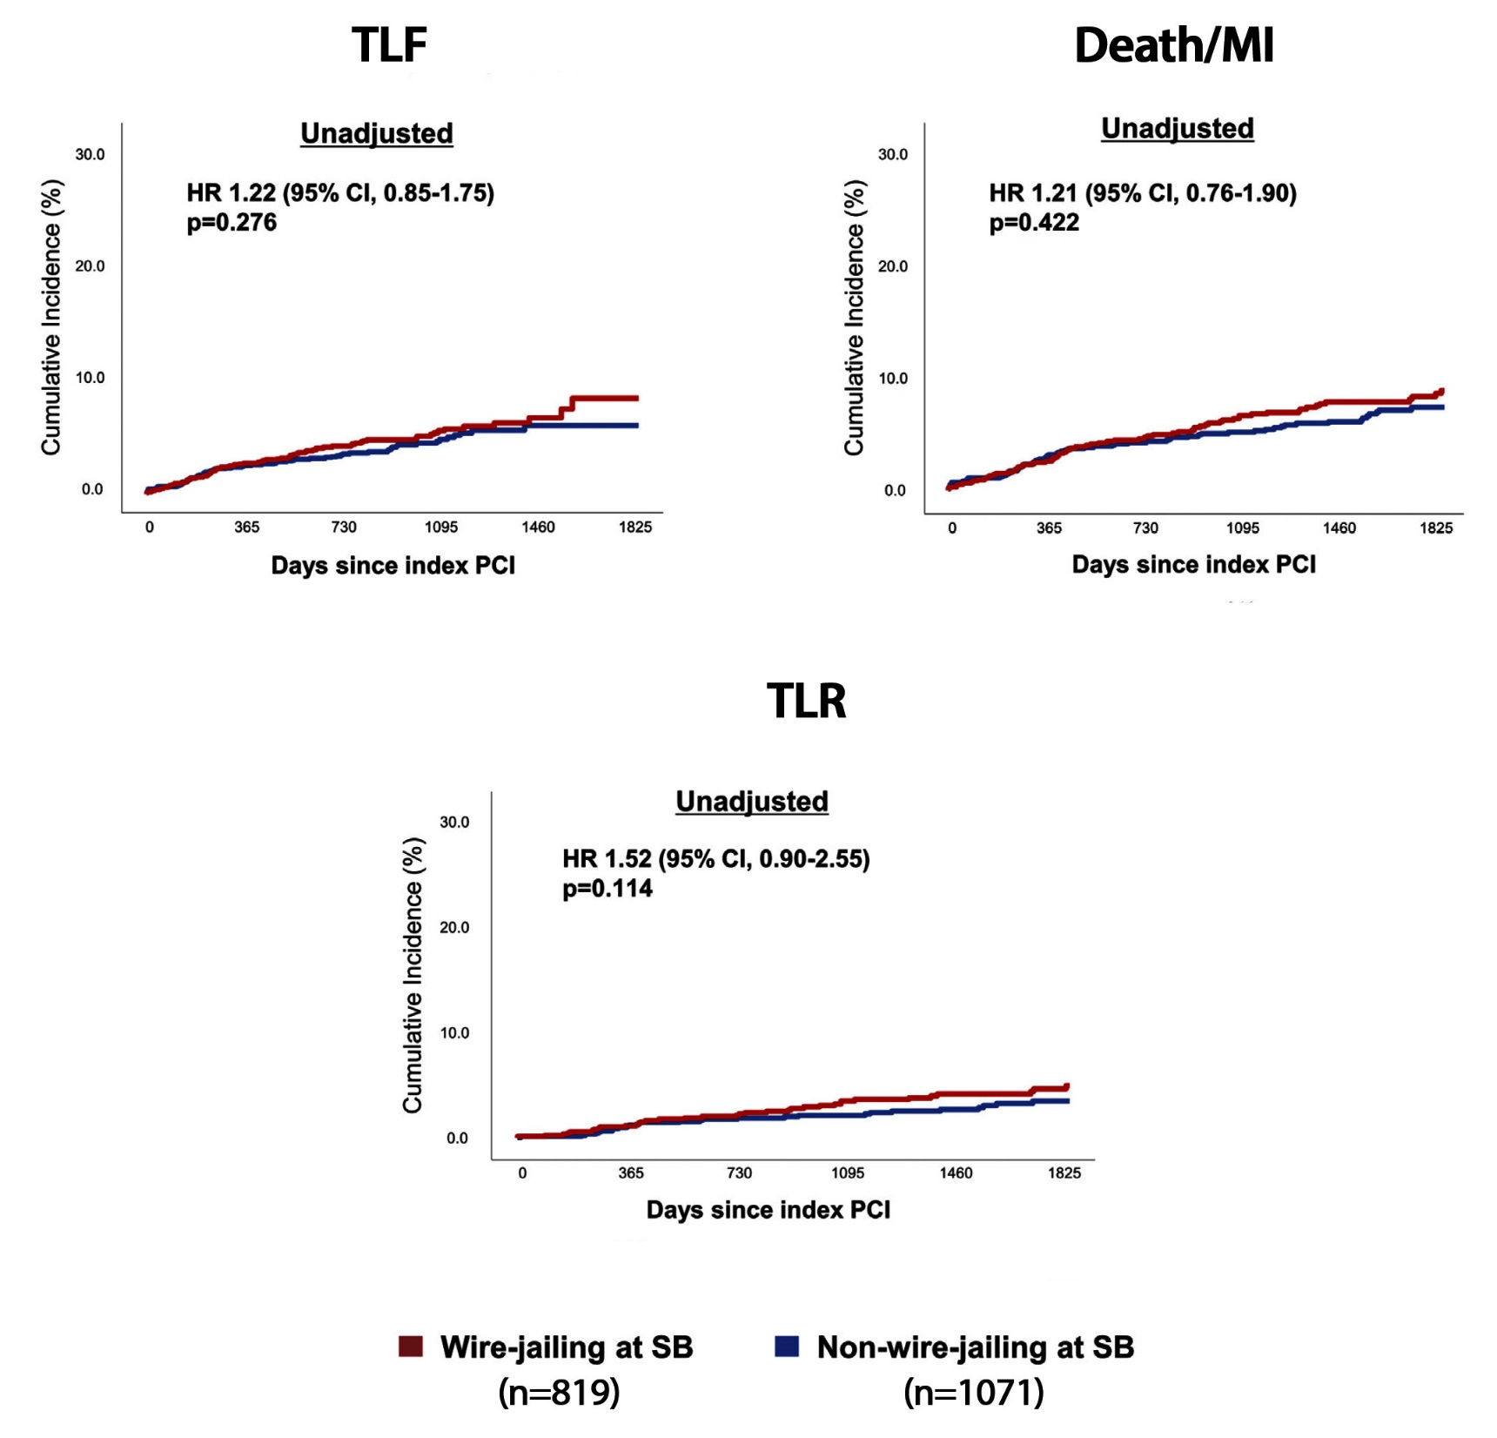
COBIS III Registry: Time-to-Event Curves for Clinical Outcomes According to Wire-Jailing at SB
Choi et al., J Am Coll Cardiol Intv 2022;15:443

Slide 38
Latest Issues in Coronary Intervention
Recent Interventional Publications;
DEFINE PCI trial-1Yr, IVUS guided PCI for long
lesions-3Yr, Predictors of LM CAD in Ischemia trial,
Jailed side-branch wire in COBIS III registry
Focused review of the month
PCI operator profiles and outcomes:
Percutaneous Coronary Intervention Operator Profile
and Associated In-hospital Mortality

Slide 39
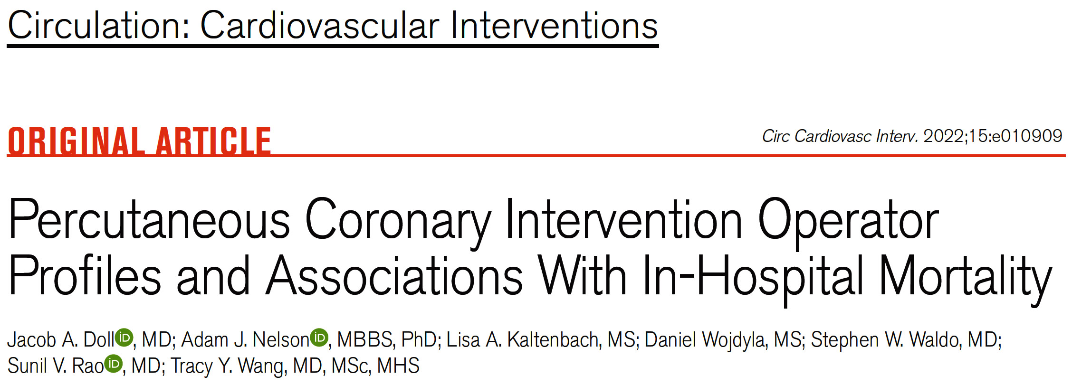

Slide 40
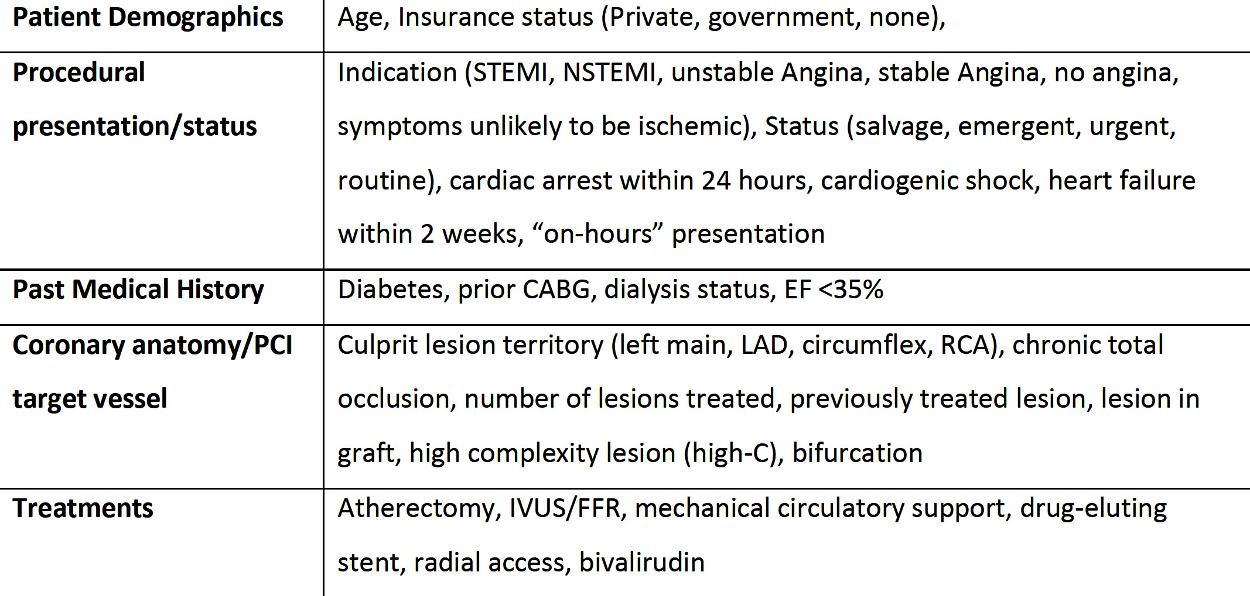
The 38 Factors Included in the Cluster Algorithm
Doll et al., Circ Cardiovasc Interv 2022;15:e010909

Slide 41
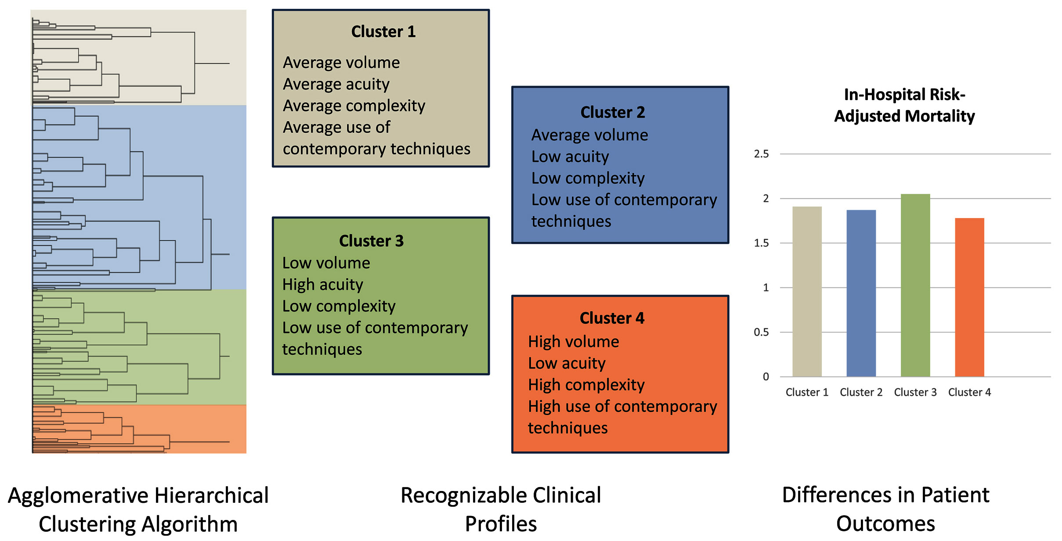
Clusters of PCI Operators Characterized by Machine Learning
Doll et al., Circ Cardiovasc Interv 2022;15:e010909

Slide 42
CONSORT Diagram
10,378 Operators
3,026,042 PCIs
NCDR CathPCI
2014-2018
11,134 PCIs without valid NPI number
61,637 PCIs performed by 2,602 operators with <25 PCI cases annually
15,852 PCIs performed by 70 operators without complete NPI characteristics
7,706 Operators
2,937,419 PCIs
Final Study Population
Cluster 1
3,345 Operators
1,291,577 PCIs
Cluster 2
1,993 Operators
823,681 PCIs
Cluster 3
1,513 Operators
392,503 PCIs
Cluster 4
855 Operators
429,658 PCIs
Doll et al., Circ Cardiovasc Interv 2022;15:e010909

Slide 43
Operator and Hospital Characteristics by Phenotypic Cluster of PCI Operators
Doll et al., Circ Cardiovasc Interv 2022;15:e010909

Slide 44
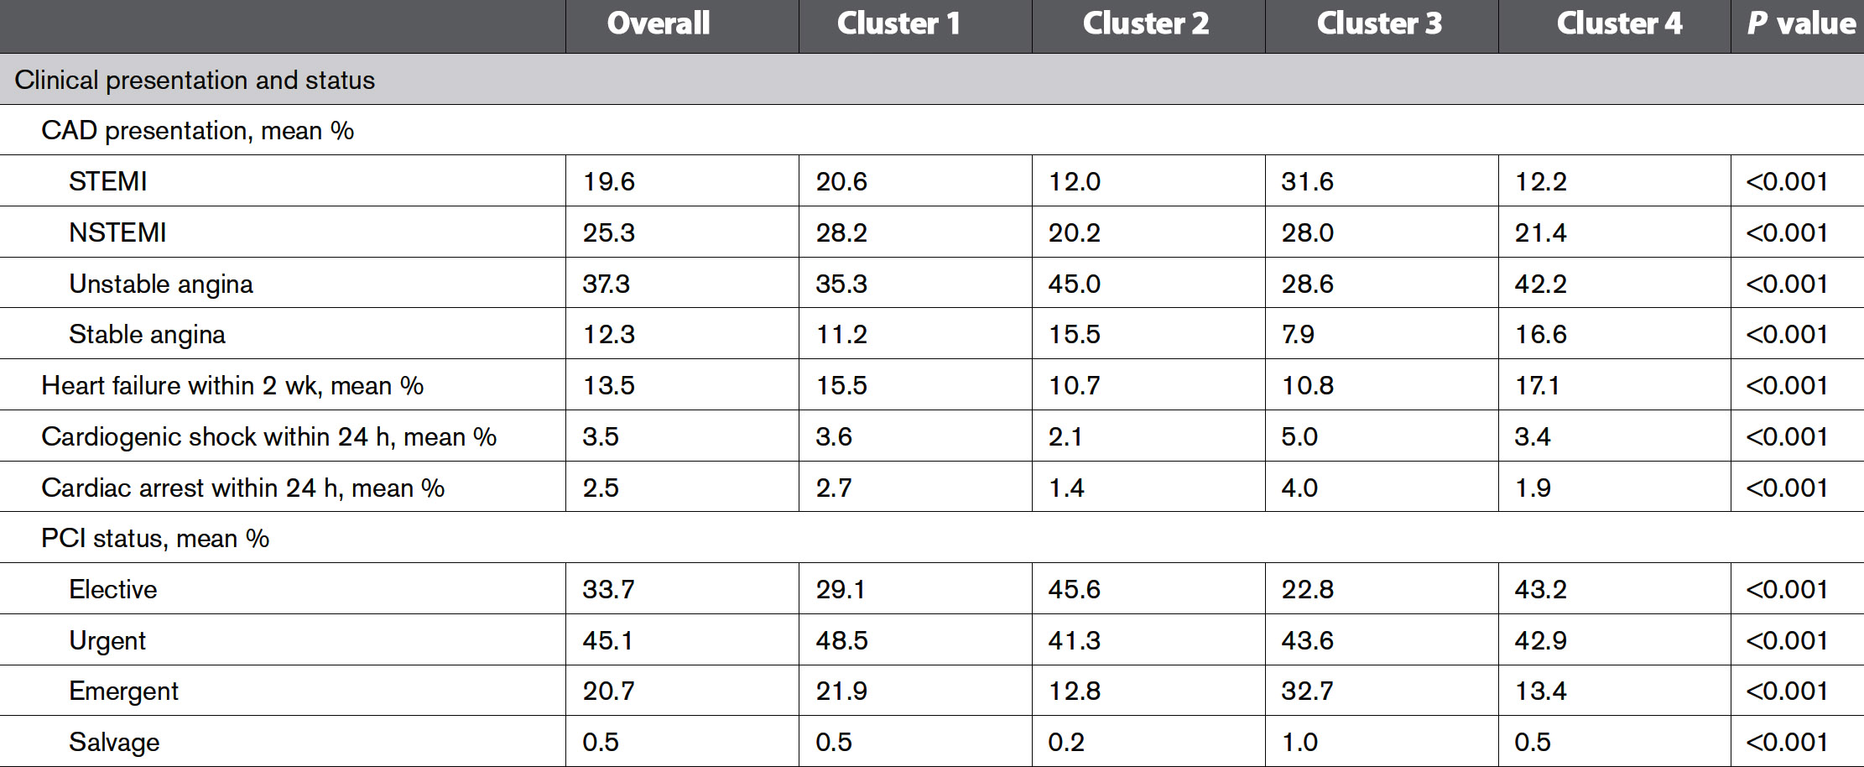
Operator-Level Mean Case Mix and Treatment Characteristics by PCI Operator Profile
Doll et al., Circ Cardiovasc Interv 2022;15:e010909

Slide 45
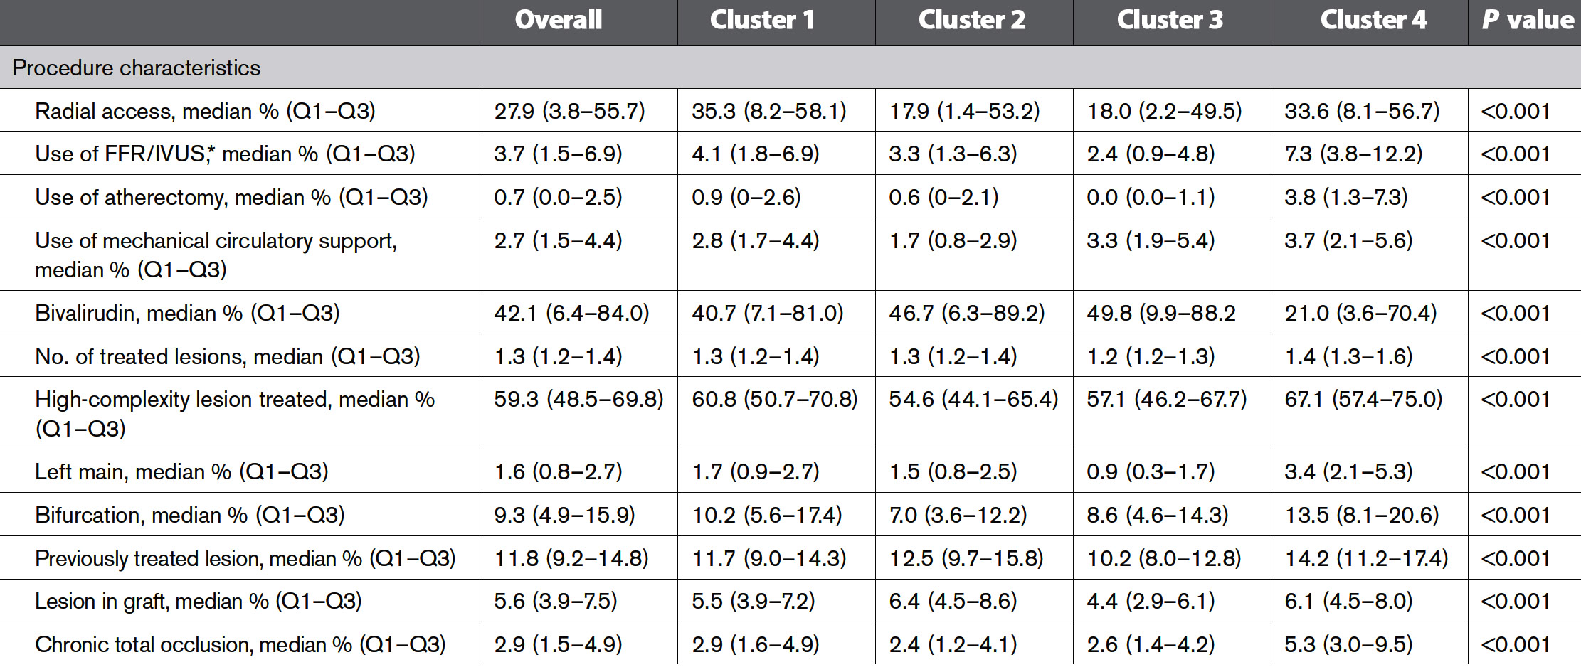
Operator-Level Mean Case Mix and Treatment Characteristics by PCI Operator Profile
Doll et al., Circ Cardiovasc Interv 2022;15:e010909

Slide 46
In-Hospital Mortality by PCI Operator Profile
 | Cluster 1 | Cluster 2 | Cluster 3 | Cluster 4
Observed in-hospital mortality, mean | 2.06 | 1.28 | 2.81 | 1.84
Predicted in-hospital mortality, mean | 1.86 | 1.15 | 2.39 | 1.77
Difference in RAMR, compared with cluster 1, mean (95% CI) | Reference | -0.03 (-0.10 to 0.04) | 0.14 (0.07 to 0.22) | -0.15 (-0.24 to -0.06)
Doll et al., Circ Cardiovasc Interv 2022;15:e010909

Slide 47
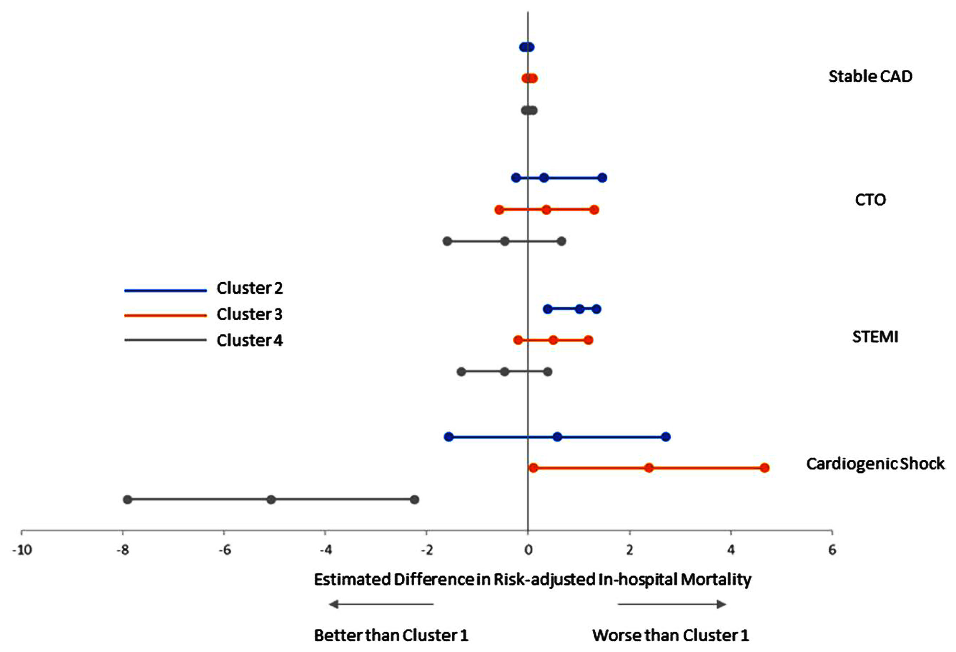
Risk-Adjusted In-Hospital Mortality Rate by Presentation Subgroup
Doll et al., Circ Cardiovasc Interv 2022;15:e010909

Slide 48
Secondary In-Hospital Outcomes by PCI Operator Profile
 | Cluster 1 | Cluster 2 | Cluster 3 | Cluster 4
Procedural success | Reference | -0.37 (-0.69 to -0.05) | -0.01 (-0.35 to 0.33) | -0.19 (-0.61 to 0.23)
Bleeding | Reference | 0.12 (-0.02 to 0.27) | -0.01 (-0.16 to 0.15) | 0.07 (-0.13 to 0.26)
Vascular complications | Reference | 0.01 (-0.03 to 0.04) | -0.02 (-0.06 to 0.02) | 0.03 (-0.02 to 0.07)
Fluoroscopy time | Reference | 0.37 (0.10 to 0.65) | 0.39 (0.09 to 0.68) | 0.08 (-0.28 to 0.45)
Contrast volume | Reference | 1.77 (-0.84 to 4.38) | 2.48 (-0.31 to 5.28) | -1.48 (-4.95 to 1.99)
Inappropriate PCI | Reference | -0.01 (-0.11 to 0.09) | 0.01 (-0.09 to 0.12) | -0.23 (-0.37 to -0.10)
Doll et al., Circ Cardiovasc Interv 2022;15:e010909

Slide 50
Take Home Message: Recent Interventional Publications & Operator Profile in PCI Outcomes
Final iFR >0.95 improves 1-Yr MACE rates:
IVUS guided PCI to improve mortality in LL:
Clinical and noninvasive tests for LMCAD:
Jailed SBr wire to improve PCI outcomes:
Simple novel machine learning from the NCDR PCI database has identified 4 different operator profiles associated with diverse in-hospital outcomes / mortality. ‘Main-stream’ and ‘low-risk elective’ operators has average outcomes but ‘acute access’ operators with infrequent use of contemporary techniques having worse outcomes and ‘high-complexity’ operators with greater use of contemporary techniques have better outcomes. This simple analysis can help physician profiling for advanced coronary interventions for reporting of highest safety and high quality.
Notes:
HbA1c

Slide 51
Question # 1
Following is the false statement about the 1-year results of Define PCI trial;
iFR of >0.95 is associated with lower MACE rates
iFR of <0.95 is associated with higher MACE rates
iFR of >0.95 is associated with higher TLR
About 25% of pts post PCI has iFR <0.89
Majority of low iFR is due to focal lesion issues
The correct answer is C

Slide 52
Question # 2
Following statements is false regarding the results of the LMCAD prediction in the Ischemia trial;
A. Exercise stress test is a poor predictor
B. Nuclear stress test is a poor predictor
C. Clinical characteristics are reasonable predictors
D. LMCAD >50% were excluded from the Ischemia trial
E. Anatomic factor by CTA has poor prediction for LMCAD detection
The correct answer is E

Slide 53
Question # 3
Following statement is false regarding machine learning analysis of physician profiling:
Different profiles have diverse in-hospital outcomes
Total 4 different profiles could be identified
Mainstream operators have average in-hospital mortality
Highly-complex operators have higher then average mortality
Use of contemporary techniques is associated lower mortality
The correct answer is D

