Slide 1
Live Case
03/2022

Slide 2
66 yo M with a PMHx of NIDDM, HTN, HLD, active smoking (1ppd). Presents with continued bilateral lifestyle limiting claudication R > L (Rutherford II-III) despite maximal medical therapy.
Meds: Amlodipine 10, Asa 81, Lipitor 40, Cilostazole 100 mg, Glipizide, HCTZ 25, Metformin 1000 mg
Labs: Hgb/Hct 11.4/34.3, Cr 1.27, INR 0.9

Slide 3
Rest ABI
R 0.56 L 0.97
Exercise ABI
R 0.10 L 1.0
Arterial duplex:
Occluded R SFA proximal to distal thigh with reconstitution at proximal popliteal.
Occluded mid to distal popliteal.
Occluded Peroneal and TP trunk
Patent AT and PT.

Slide 6
Limitations of currently available BTK treatments
CURRENT TREATMENT OPTIONS FOR TIBIAL CIRCULATION*
ANGIOPLASTY
Elastic recoil
Restenosis
Dissection
Primary patency 20%–50% (TASC II)
BMS
Restenosis
No on-label BMS (U.S.)
Permanent implant
Short lengths
Surgical reintervention
DCBs
Elastic recoil
Residual plaque
Dissection
Failed RCTs
No approved DCB (U.S.)
DES
No on-label DES (U.S.)
Permanent implant
Short lengths
Surgical reintervention
ATHERECTOMY
Device variability
Embolization
Lack of data

Slide 7
Endovascular therapies for BTK vessels
POBA is the most common technique
Poor patency ( 30-50% primary patency)
Elastic recoil and dissection – limit rates of technical success.
DEBs
Failed RCTs, No approved DCBs in US.
Balloon-expandable drug-eluting stents (DESs)
Reduce rates of restenosis → better patency
No on label dedicated BTK stent
Adjunct atherectomy

Slide 8
DEBs in BTK vessels
Lutonix BTK
InPACT DEEP
Biolux II

Slide 9
Lutonix BTK Trial
Paclitaxel coated balloon, 2.0 to 4.0 mm and lengths of 40 to 150 mm
Mustapha JA et al, JIC 2019

Slide 10
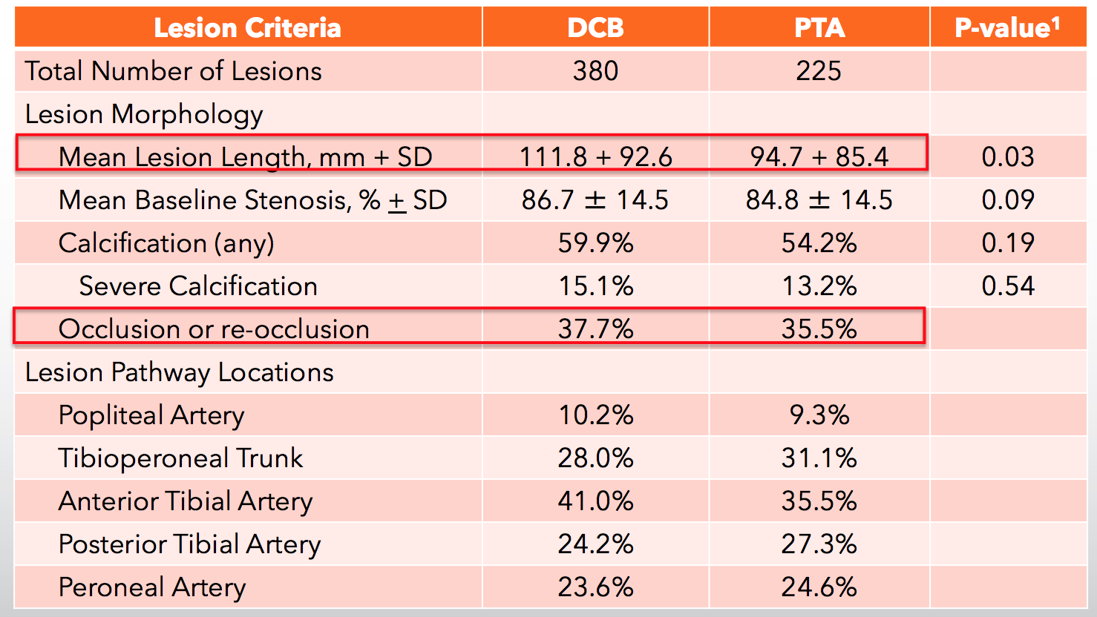
Mustapha JA et al, JIC 2019

Slide 11
Safety: 30-Day Freedom from Major Adverse Limb Events (MALE, which includes significant re-intervention and above ankle amputation) and Perioperative Death (POD)
Efficacy: 6-Month Freedom from Major Amputation, Target Vessel Occlusion, and Clinically-Driven Target Lesion Revascularization

Slide 12
Mustapha JA et al, JIC 2019

Slide 16
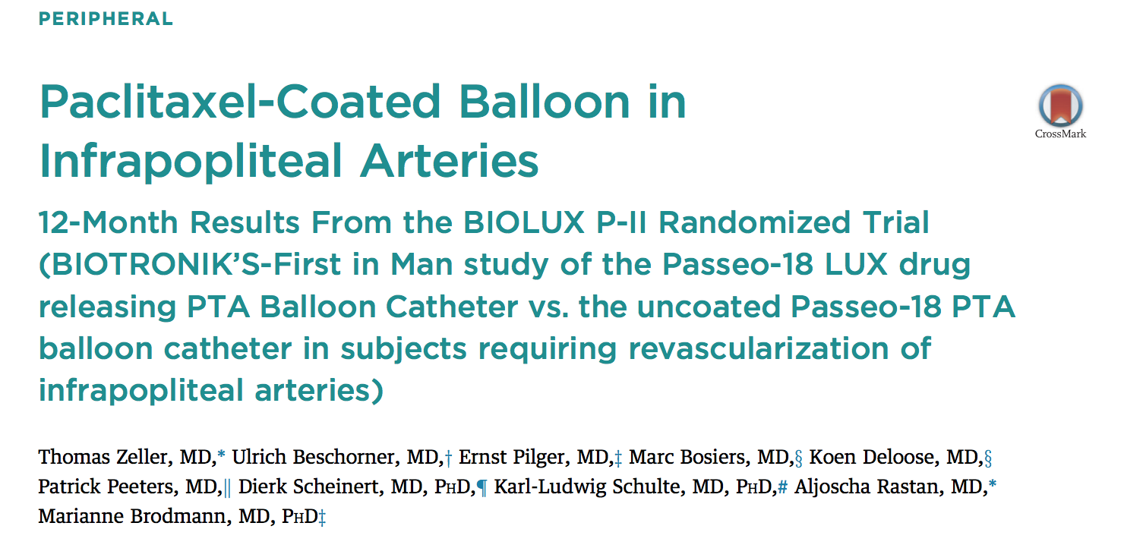
2015

Slide 17
Prospective, multicenter, randomized first-in-man study
72 patients were randomized 1:1 to either a Passeo-18 Lux DEB (Biotronik AG, Buelach, Switzerland) (n = 36) or Passeo-18 PTA (n = 36).
Follow up at 1, 6 and 12 months

Slide 18
The primary safety endpoint (a composite of all-cause mortality, target extremity major amputation, target lesion thrombosis, and target vessel revascularization at 30 days)
0% in the DEB group versus 8.3% in the PTA group (p 0.239).
Primary performance endpoint (patency loss at 6 months) was 17.1% in the DEB group versus 26.1% in the PTA group (p 0.298)
Major amputations of the target extremity occurred in 3.3% DEB versus 5.6% PTA of the patients at 12 months, respectively.

Slide 19
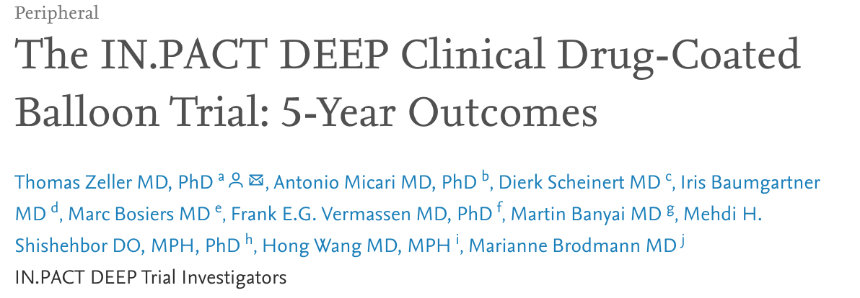
JACC Cardiovascular Interventions 2020

Slide 20
Prospective, multicenter, patient-blinded, randomized controlled trial of the IN.PACT Amphirion DCB versus PTA
358 patients were enrolled across 13 European sites from September 2009 to July 2012.
95 subjects in the DCB group and 49 subjects in the PTA group completed 60-month follow-up.

Slide 21
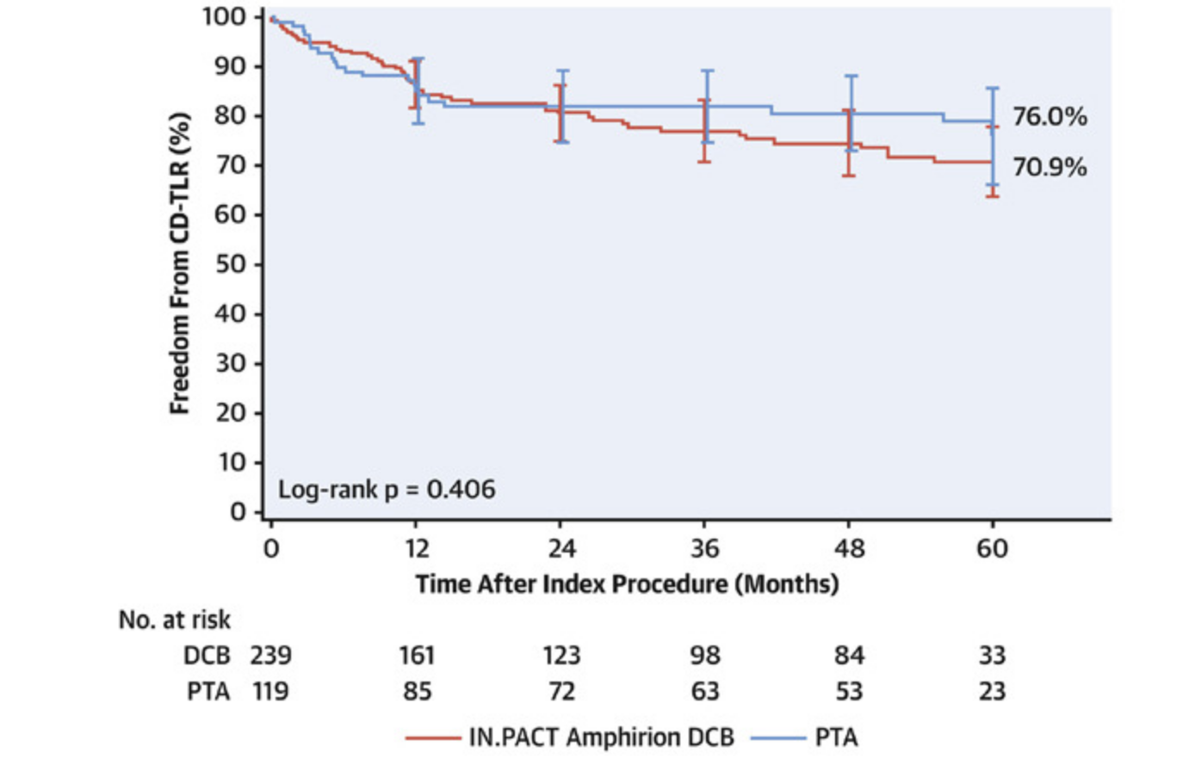

Slide 22
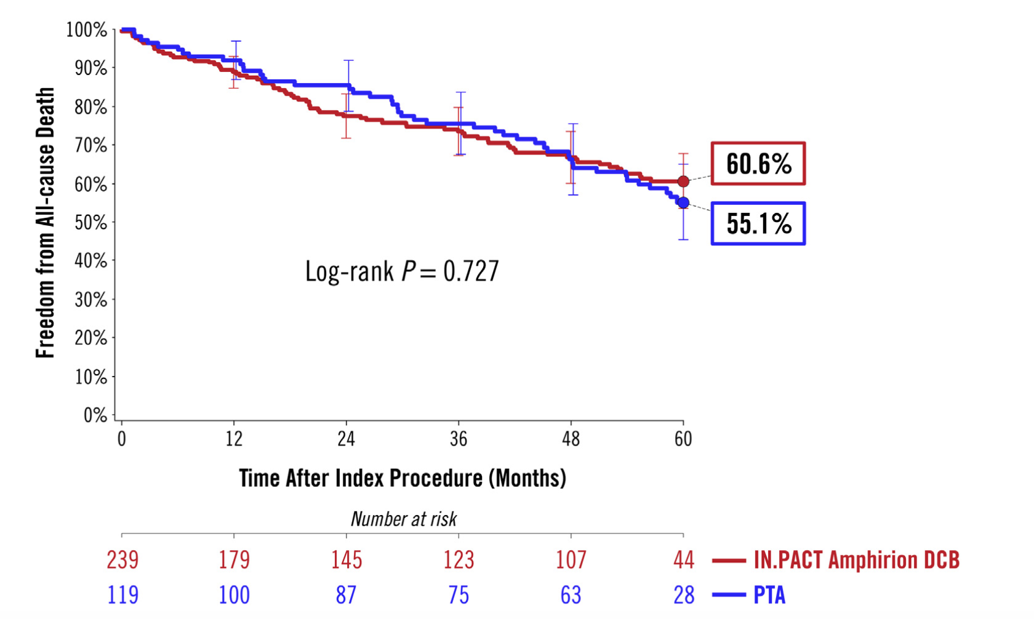

Slide 23
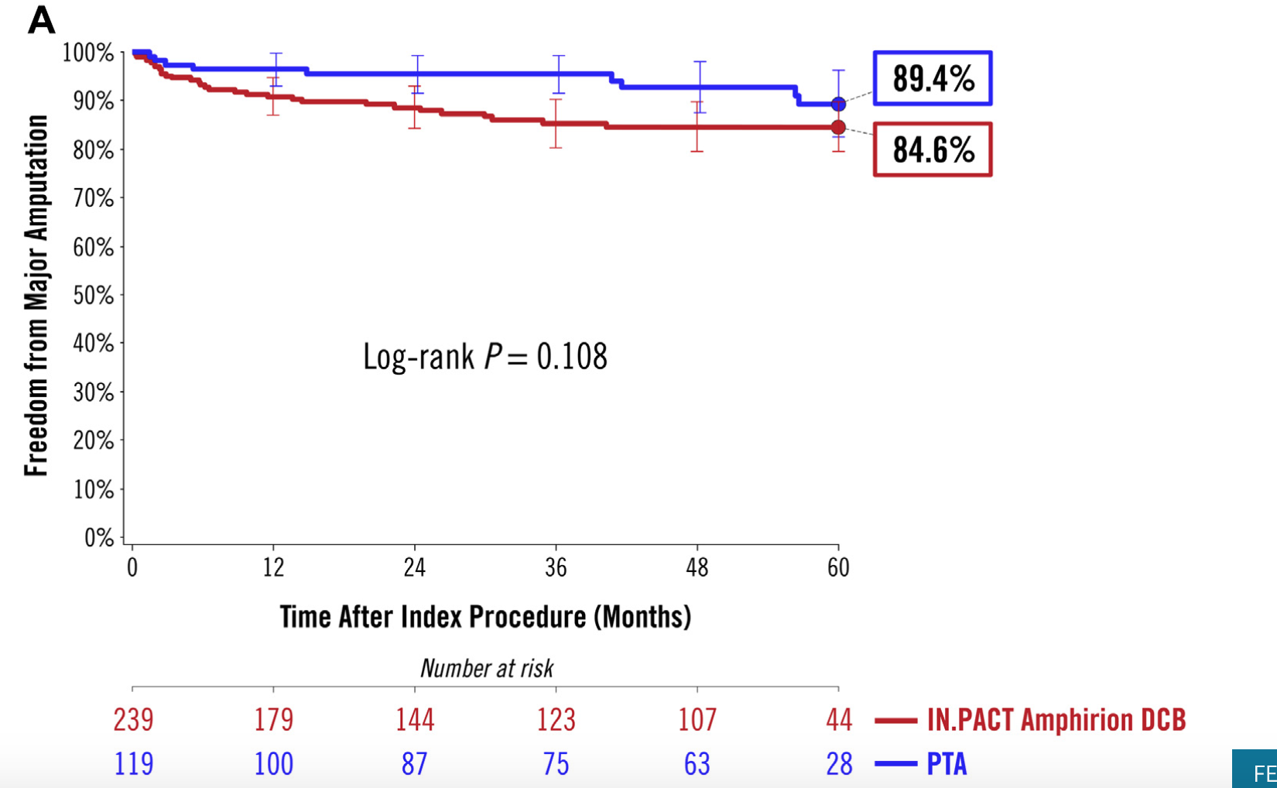

Slide 24
Evidence for DES in Infra-popliteal vessels
Spiliopolous et al, WJC, 2019

Slide 25
YUKON-BTK Trial
Study Profile
161 patients enrolled
82 SES
79 BMS
12 died
8 died
4 patients were lost to fu
3 patients were lost to fu
2 patients telephone contact
1 patient telephone contact
64 patients at 6 months follow-up
67 patients at 6 months follow-up
2 died
3 died
1 patient was lost to fu
62 patients at 12 months follow-up
63 patients at 12 months follow-up
Rastan et al. EHJ 2011 in revision

Slide 26
Target Lesion Characteristics and Acute Results
 | All Patients (N=161) | Sirolimus Stent (N=82) | Bare Metal Stent (N=79)
Reference vessel diameter (mm) | 3±0.4 | 3±0.4 | 3±0.4
Length of the lesion (mm) | 30±9 | 30±8 | 31±9
Occlusion (%) | 22.4 | 23.2 | 21.5
Target lesion diameter stenosis (%)
Pre intervention | 88±9 | 87±9 | 88±9
Post intervention | 3±5 | 3±5 | 3±5
Number of stents/target lesion (%)
1 | 69.6 | 52.7 | 47.3
2 | 28.5 | 48.9 | 51.1
3 | 1.9 | 1.2 | 2.6
Procedural success (%) | 100 | 100 | 100
ABI pre intervention | 0.48±0.16 | 0.47±0.18 | 0.49±0.14
ABI post intervention | 0.84±0.17 | 0.86±0.15 | 0.83±0.19
*Plus-minus values are means ±SD. There were no significant differences between the treatment groups

Slide 27
YUKON-BTK Trial Primary & Secondary Patency
P=0.004 (primary patency)
P=0.005 (secondary patency)
Rastan et al. EHJ 2011 in revision

Slide 28
Secondary Endpoint Ankle Brachial Index Baseline & 1-Year
P = 0.1 each comparison
Rastan et al. EHJ 2011

Slide 29
Rutherford-Becker Classification at 6 Months & 1 Year
6 months
 |  | N=131 | N=64 (SES) | N=67 (BMS) | P-Value
Median (IQR)* |  | 2 (1 to 3) | 1 (1 to 3) | 2 (1 to 3) | 0.3
Improvement by ≥1 Class |  | 93 (70.9%) | 49 (76.5%) | 44 (65.7%)
No Change |  | 35 (26.9%) | 14 (21.9%) | 21 (31.3%)
Worse by ≥ 1 Class |  | 3 (2.3%) | 1 (1.6%) | 2 (3.0%)
Median Change (IQR)* |  | -1.5 (-3 to 0) | -2 (-3 to-1) | -1 (-2 to 0) | 0.09
12 months
 | N=125 |  | N=62 (SES) | N=63 (BMS)
Median (IQR)* | 2 (1 to 3) |  | 2 (0.75 to 3) | 2 (1 to 3) | 0.01
Improvement by ≥1 Class | 91 (72.8%) |  | 52 (83.9%) | 39 (61.9%)
No Change | 30 (24%) |  | 8 (12.9%) | 22 (34.9%)
Worse by ≥ 1 Class | 4 (3.2%) |  | 2 (3.2%) | 2 (3.2%)
Median Change (IQR)* | -2 (-3 to 0) |  | -2 (-3 to -1) | -1 (-2 to 0) | 0.004
*IQR = interquartile range
Rastan et al. EHJ 2011

Slide 30
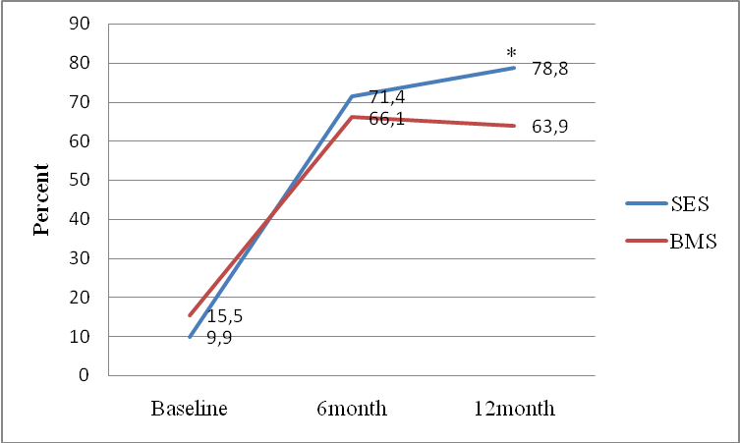
Proportion of Patients with Rutherford Class ≤ 2
at Baseline and 6 and 12 months of Each Treatment Group
*P = 0.04
Rastan et al. EHJ 2011

Slide 31
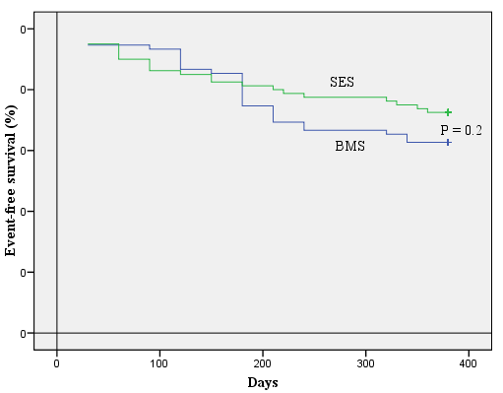
Event-free Survival at 12 months
Survival free from target lesion revascularisation, major and minor amputation, myocardial infarction and death was compared by
Kaplan-Meier analysis with the use of the Mantel-Cox log-rank test.
100
80
20
No. at risk
Sirolimus Stent | 82 | 71 | 64 | 63 | 62
Bare-metal Stent | 79 | 72 | 67 | 64 | 63
Rastan et al. EHJ 2011

Slide 32
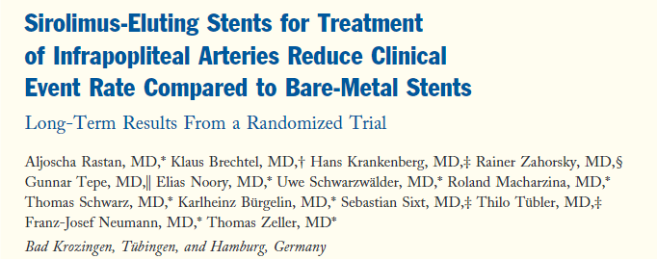

Slide 33
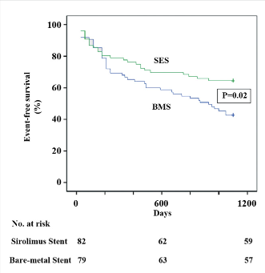
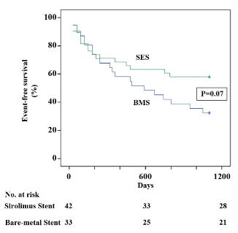
CLI patients only
Rastan et al. JACC 2012

Slide 34
Lesion description (N=154)
DESTINY study
BMS (76) DES (78) p
Left limb 51 % 46 % 0.63
Right limb 49 % 54 % 0.63
Lesion length in mm 18.9 15.9 0.07
Calcified lesion 74 % 64 % 0.94
Bosiers M. LINC 2011

Slide 35
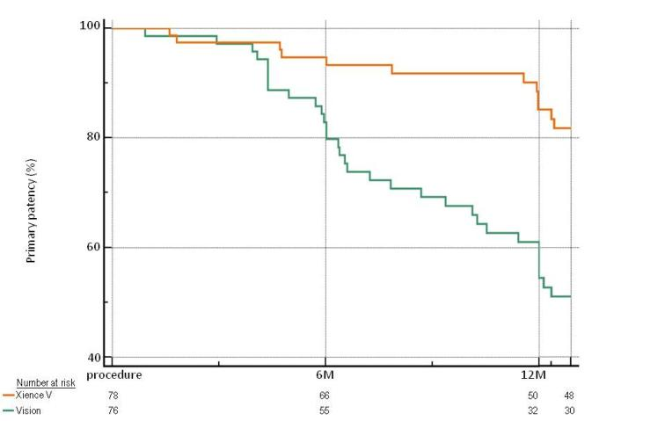
DESTINY - 12-month primary patency
MultiLink Vision vs Xience V
85.2%
P=0.0001
54.4%
Bosiers M. LINC 2011

Slide 36
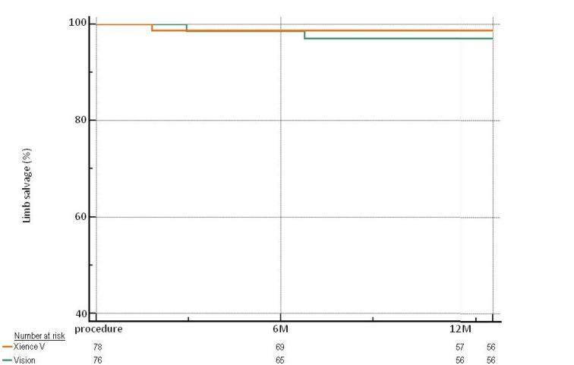
12-month limb salvage
MultiLink Vision vs Xience V
98.7%
97.1%
P=0.53

Slide 37
QVA analysis Late lumen loss @ 12 months
Multi-Link
Vision Xience V p-value
(N=34) (N=36)
Mean LLL (±SD), mm 1.41 ± 0.89 0.78 ± 0.63 0.001
Late Loss Index, % 46.00 26.59 0.001
Bosiers M. LINC 2011

Slide 40
SES and EES achieve significantly higher primary and secondary patency rates at 1 year as compared with BMS in the treatment of infrapopliteal lesions.
On the long run, the superior patency of SES may also improve limb salvage rates in patients with CLI Rutherford class 5 & 6 and with an appropriate life expectancy.

Slide 41
(NCT03551496)
3.5 mm X 80 mm
PI : Jihad Mustapha MD, FACC, FSCAI, Patrick Geraghty, MD, FACS, Hans van Overhagen, MD, PhD, EBIR

Slide 42
301 patients with CLI undergoing infrapopliteal endovascular treatment
are planned to be enrolled.
Approximately 201 patients with CLI (Rutherford class 4 and 5) will be randomly assigned (2:1) to the DES or PTA arms at up to 50 centers in the United States, Europe, and Japan.
Second phase of the SAVAL trial is a nonrandomized, single-arm study of 100 patients treated with the SavalTM DES BTK.
PI : Jihad Mustapha MD, FACC, FSCAI, Patrick Geraghty, MD, FACS, Hans van Overhagen, MD, PhD, EBIR

Slide 43
Drug-eluting, bioresorbable vascular scaffolds (BVSs) advantages
Delivery of antiproliferative drug directly to the site of the vascular intervention.
Mechanical support to treat recoil and dissection.
Does not preclude further surgical revascularization

Slide 44
Everolimus-eluting Absorb bioresorbable vascular scaffold (BVS)
Single center prospective study of 48 patients
Mean lesion length was 20.1±10.8 mm
Primary patency estimates at 12, 24, and 36 months were 92.2%, 90.3%, and 81.1%; freedom from clinically driven (CD) - TLR estimates were 97.2%, 97.2%, and 87.3% at the same time points.
Midterm follow-up demonstrates excellent safety, patency, and freedom from CD-TLR rates using the Absorb bioresorbable vascular scaffold below the knee.
Varcoe R et al, Journal of Endovascular Therapy 2018

Slide 45
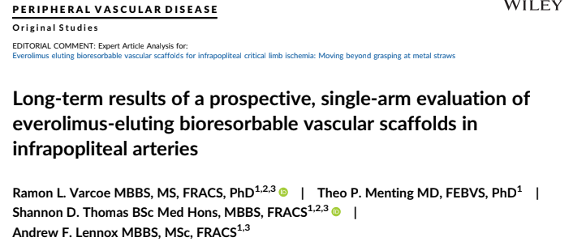
2020

Slide 46
Everolimus-eluting Absorb bioresorbable vascular scaffold (BVS)
Single center prospective study of 48 patients / 55 limbs
INCLUSION CRITERIA
Chronic lower limb ischemia (Rutherford-Becker category 3–6)
>60% de novo stenosis (on angiography)
≤5 cm long in distal popliteal (P3) or tibial arteries
2.5 to 4.0 mm in diameter.
Critical limb ischemia (72.7%) or severe claudication (27.3%).

Slide 47
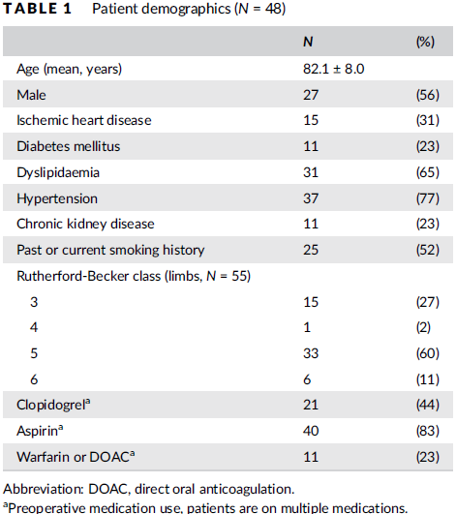

Slide 48
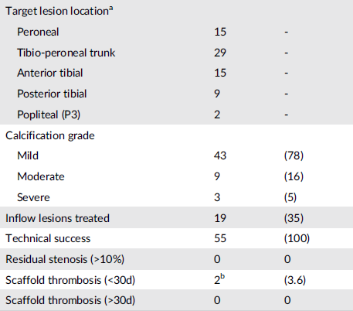
Mean lesion length : 20 mm

Slide 49
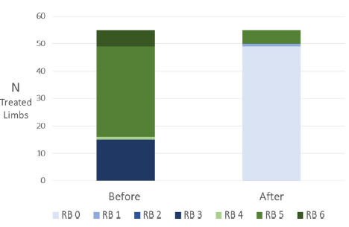

Slide 50
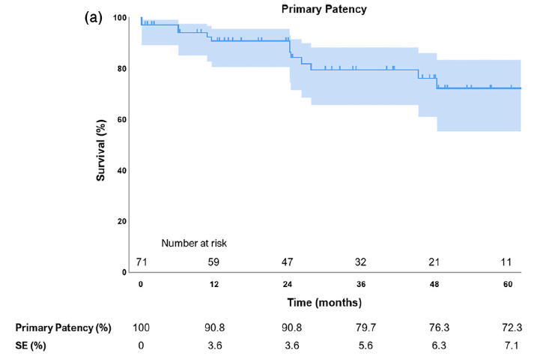

Slide 51
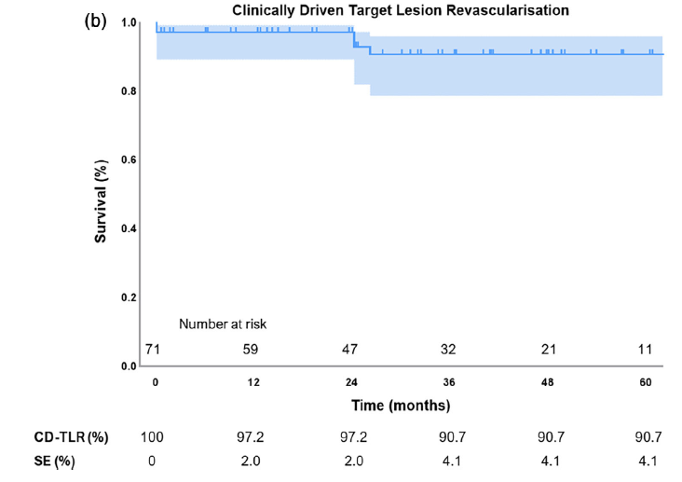

Slide 52
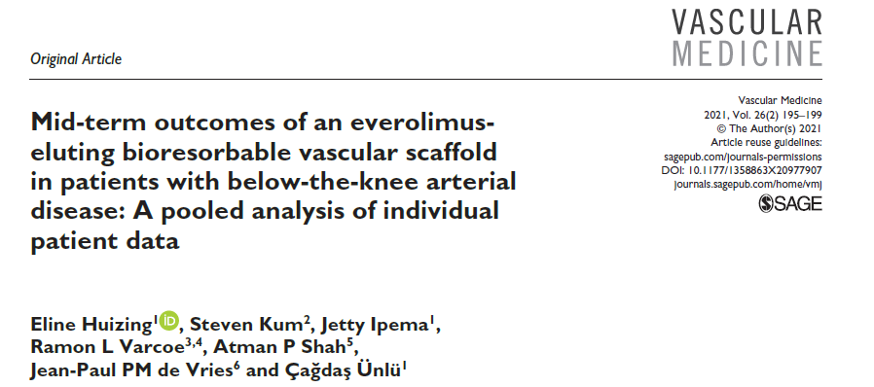
Huizing E et al, Vascular Medicine, 2021

Slide 53
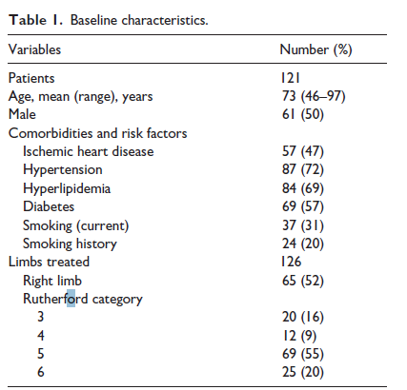
Huizing E et al, Vascular Medicine, 2021

Slide 54
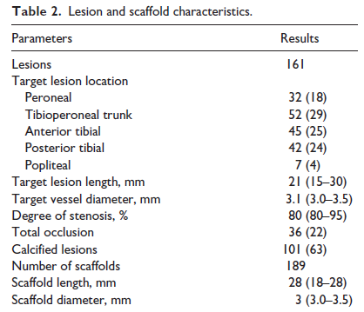
Huizing E et al, Vascular Medicine, 2021

Slide 55
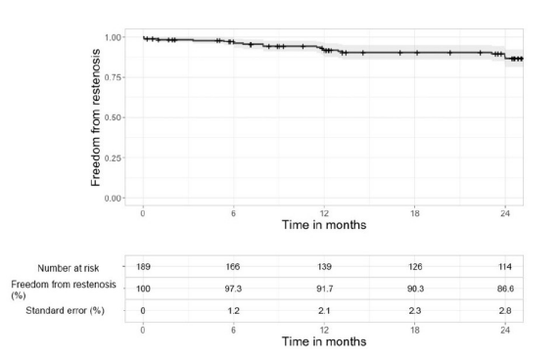
Freedom from restenosis at 24 months : 86.6 %
Huizing E et al, Vascular Medicine, 2021

Slide 56
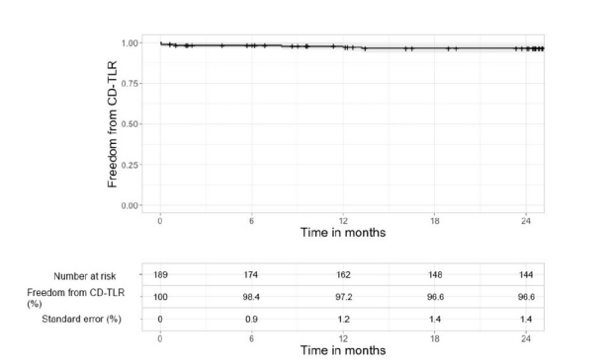
Freedom from CD TLR at 24 months – 96.6 %
Major amputation occurred in 1.6% of the limbs.
Overall survival was 85% at 24 months
Huizing E et al, Vascular Medicine, 2021

Slide 57
DEBs when compared with PTA show non inferior safety outcomes and comparable efficacy outcomes.
SES and EES achieve significantly higher primary and secondary patency rates at 1 year as compared with BMS – for focal lesions
No dedicated on label DES is available BTK
Everolimus Eluting bioresorbable scaffold achieve high primary efficacy endpoints at 24 months, however no randomized trials available.

Slide 58
Live BTK Clinical trial – Objective
Evaluate the safety and efficacy of a new device, the EspritTM BTK
System*, for treatment of diseased infrapopliteal lesions in patients
with CLI (critical limb ischemia)

Slide 59
Investigational Device Overview
Drug eluting temporary scaffold that will fully resorb over time
Scaffold backbone comprised of 100% poly(L-lactide) (PLLA)
Coating - everolimus and bioresorbable poly (D,L- lactide) (PDLLA)
Radiopacity – 4 platinum markers

Slide 60
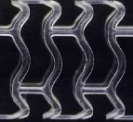
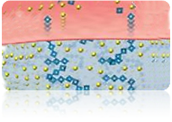
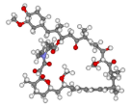
Esprit™ BTK System device design
PLLA
SCAFFOLD
PDLLA
COATING
Everolimus
Fully resorbable
Platinum markers for angiographic visualization
99 µm strut thickness (for < 3 mm)
Supports treated artery
Allows for uniform delivery of everolimus
Resorbs ~36 months
Fully resorbable
Conformal coating
1:1 PDLLA: everolimus blend
Provides sustained everolimus release to maximize long term patency without downstream particulates
Cytostatic
Patented for restenosis reduction
Broad therapeutic range
100 µg/cm² dose density
Elution rate matched to restenosis cascade

Slide 61
TRIAL DESIGN
Prospective, multicenter, single-blind, randomized controlled clinical study
Approx. 225 patients in up to 50 sites in the US, Australia, New Zealand, Singapore and Taiwan
Randomized in a 2:1 ratio (Esprit™ BTK:PTA)
Subjects will be followed for 5 years
TRIAL STATUS
Trial is currently enrolling

Slide 62
LIFE-BTK Key Inclusion/Exclusion Criteria
KEY Inclusion Criteria
KEY Exclusion Criteria
Symptomatic CLI, Rutherford Becker Clinical Category 4 or 5
At least 18 years of age
Requires primary treatment of up to 2 de novo or restenotic (prior PTA) infrapopliteal lesions
Subject has had any amputation to the ipsilateral or contralateral extremity, other than the toe or forefoot
Known allergic reaction, hypersensitivity or contraindication to aspirin or ADP antagonists such as Clopidogrel, Prasugrel or Ticagrelor
Currently on dialysis
BMI < 18
Subject has signs or symptoms of advanced limb infection or septicemia*
Extensive tissue loss salvageable only with complex foot reconstruction or non-traditional transmetatarsal amputations
* Subjects with osteomyelitis limited to phalanges or metatarsal heads, or cellulitis of the foot amenable to treatment with IV antibiotics at the time of revascularization, can be enrolled.

