Slide 1
Learn From The Masters
Tools and Techniques of Managing Calcification
Supported by:
Boston Scientific Corporation (BSC)
EHCC
MSH

Slide 2
Disclosures
Samin K. Sharma, MD, MSCAI, FACC
Speaker’s Bureau – BSC, Abbott
Annapoorna S. Kini, MD, MRCP, FACC
Nothing to disclose

Slide 3
Live Case #2
Patient Demographics
75 yrs, M
Present Clinical Presentation
Presented with crescendo CCS class III angina
CAD Risk Factors
Hypertension
Hyperlipidemia
Morbid obesity
Smoker, SAQ 46
Clinical Variables
Cardiac cath done @OSH on Jan 28th 2022 revealed extensive calcified 2 V CAD and LVEF 65%. CABG was offered due to high Syntax score but declined and referred for high risk multi-vessel staged PCI
Medications
Aspirin, Metoprolol XL, Amlodipine, Losartan, Atorvastatin, HCTZ
Cath: Cath on Jan 28th 2022 revealed extensive 2 V CAD, LVEF 65% and syntax score 46. Pt underwent RotaDES PCI of LAD/Diagonal using 4 Promus Elite DES
Plan: Now planned for IVUS guided staged PCI of calcified tortuous multiple RCA lesions using rotational atherectomy and Promus DES.

Slide 4
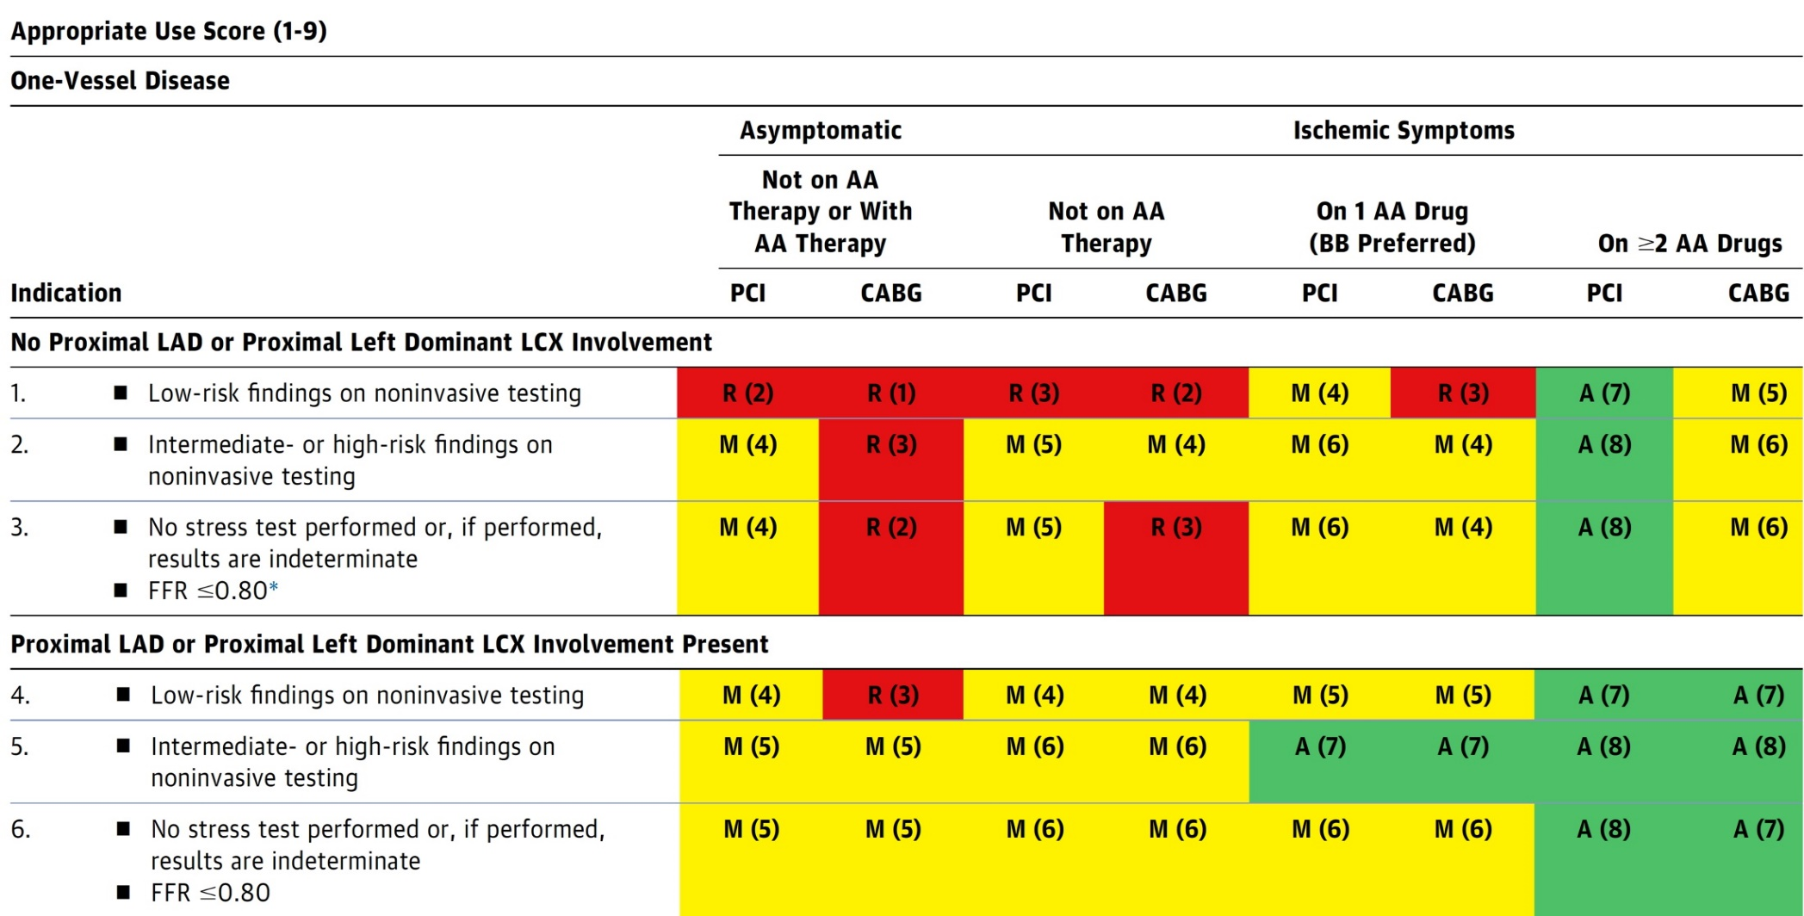
AUC 2017: One-Vessel Disease
Patel et al., J Am Coll Cardiol 2017;69:2212

Slide 5
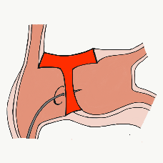
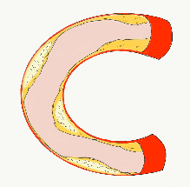
More than 45,800 unique downloads
Cath Lab Apps CardiologyApps.com
iOS 5/5 stars
9896 downloads
Android 4.4/5 stars
8245 downloads
Released sept 2017
iOS 5/5 stars
6068 downloads
Android 4.8/5 stars
3850 downloads
Released June 2018
iOS 5/5 stars
2073 downloads
Android N/A stars
549 downloads
Released March 2018
iOS 5/5 stars
1074 downloads
Android N/A stars
547 downloads
Released Sept 2018
iOS 5/5 stars
931 downloads
Android 5/5 stars
538 downloads
Released June 2019
WebApp Only*
2600 unique users
4800 sessions
Released August 2020
BifurcAID
OCTAID
TAVRcathAID
TranseptAID
CalcificAID
ComplicAID
*Also available
as WebApp
Download Apps
For Free on Both:
WebApps available free on
www.CardiologyApps.com
Apple ® and App Store® are registered trademarks of Apple Inc.
Notes:
These are the apps we have created which will provide digital algorithms for our future ambitious projects to make our cath labs smarter.

Slide 6
Apps Coming Soon…
STEMIcathAID – STEMI patient transfer platform designed to optimize communication between key members, record key performance metrics for AHA’s Mission: Lifeline program, and avoid costly false activations through direct CCL contact.
GuidewireAID – This application covers the design of coronary guidewires and the resulting properties they exhibit during use in the lab. Over two dozen teaching cases, a dense wire library with more than a hundred wires, and a robust search function provide a lot of tailored learning opportunities.
BifurcAID 3D – An animated bifurcation lesion treatment educational application and website. With two views, detailed descriptions, and more, BifurcAID 3D helps make clear the complex steps in techniques such as Minicrush, DK Crush and Culotte, as well as provisional approached and bailout techniques.

Slide 7
Outcomes of PCI vs CABG up to 5 yrs
What we know so far?
CABG++
Lower repeat revascularization
Durable angina relief
Lower mortality in subgroups of high syntax score & MV DM
Better QOL parameters
PCI++
Rapid recovery and lower LOS
Better short term results
Lower CVA
Improvement in LVEF
Similar outcomes in LM & low syntax score (<32) pts
What happens in 5-10+ yrs?

Slide 8
More than 35,800 unique downloads
Cath Lab Apps CardiologyApps.com
iOS 5/5 stars
9896 downloads
Android 4.4/5 stars
8245 downloads
Released sept 2017
iOS 5/5 stars
6068 downloads
Android 4.8/5 stars
3850 downloads
Released June 2018
iOS 5/5 stars
2073 downloads
Android N/A stars
549 downloads
Released March 2018
iOS 5/5 stars
1074 downloads
Android N/A stars
547 downloads
Released Sept 2018
iOS 5/5 stars
931 downloads
Android 5/5 stars
538 downloads
Released June 2019
WebApp Only*
2600 unique users
4800 sessions
Released August 2020
BifurcAID
OCTAID
TAVRcathAID
TranseptAID
CalcificAID
ComplicAID
*Also available
as WebApp
Download Apps
For Free on Both:
WebApps available free on
www.CardiologyApps.com
Apple ® and App Store® are registered trademarks of Apple Inc.
Notes:
These are the apps we have created which will provide digital algorithms for our future ambitious projects to make our cath labs smarter.

