Slide 1
Complex Coronary Case
Supported by:
Sun Pharmaceutical Industries Ltd.

Slide 2
Disclosures
Samin K. Sharma, MD, MSCAI, FACC
Speaker’s Bureau – BSC, ABBOTT
Annapoorna S. Kini, MD, MRCP, FACC
Nothing to disclose
Shireesh P Sathe, MD, DM (Guest Faculty)
Prashant R Mishra, MBBS, DNB, FSCAI, FESC (Moderator)

Slide 3
Shireesh P. Sathe, MD (General Medicine), DM (Cardiology)
Director of Cardiology
Deenanath Mangeshkar Hospital, Pune
Interventional Cardiologist
MMF's Joshi Hospital and Ratna Hospital, Pune
Prashant R. Mishra, MBBS, DNB (Gen Medicine), DNB (Cardiology),
PDF (Interventional Cardiology), FSCAI, FESC
Consultant Cardiologist
Deenanath Mangeshkar Hospital and Research Centre, Pune
Dr. Shireesh P. Sathe is Director of Cardiology at Deenanath Mangeshkar Hospital and Interventional Cardiologist at MMF’s Joshi Hospital and Ratna Hospital, Pune. He is the Gold Medalist in MD. He completed his fellowship in Intervention Cardiology from Royal Prince Alfred Hospital, Australia. His area of expertise includes Primary Angioplasty in Myocardial Infarct Complex PTCA, ASD closure, SVG angioplasty, IVC filter Implantation, Pace maker Implantation (Dual chamber and single chamber), Renal Angioplasty, Carotid Angioplasty and Peripheral vessel angioplasty. He is the principal Investigator in many clinical trials. He organizes regular CMEs for physicians and general surgeons every six months at Deenanath Mangeshkar Hospital.
Dr. Prashant R. Mishra is Consultant Cardiologist, Deenanath Mangeshkar Hospital and Research Centre, Pune. He is also Hon. Panel Cardiologist at Joshi and Ratna Memorial Hospital, Mai Mangeshkar Hospital, Krishna Hospital, Pune and Hon. Executive Committee Member of Cardiological Society of India. He completed his Post Doctoral Fellowship in Interventional Cardiology in 2013. He is Co-Guide of DNB-NBE (Cardiology) and postgraduate guide in Medical Technology at Symbiosis Institute of Health Sciences, Pune. He is investigator in multiple international drug and device trials. He is a fellow of European college of Cardiology (FESC) and Society for Coronary Angioplasty and Interventions (FSCAI).

Slide 5
Live Case #16
Patient Demographics
78 yrs, M with severe AS
Present Clinical Presentation
Presented with NYHA class III DOE due to severe AS and CAD. Planned for TAVI
CAD Risk Factors
Controlled hypertension
Controlled hyperlipidemia
AAA, Lymphoma s/p surgery
Clinical Variables
Echo revealed severe AS, LVEF 60% and Cardiac cath on Dec 7th 2021 performed preTAVI procedure revealed 2 V CAD. Pt underwent successful TAVI using 26mm Sapienn-3 Ultra valve and did well
Medications
Aspirin, Pravachol, Zestril
Cath: Cath on Dec 7th 2021 revealed calcific 2 V CAD: 90% calcified focal eccentric mid LAD, 95% calcified prox RCA and Syntax score 14. Pt underwent successful TAVI and still has NYHA class II DOE despite added Amlodipine 5mg.
Plan: Now planned for complex PCI of calcified RCA and of LAD using rotational atherectomy+IVL and DES.

Slide 6
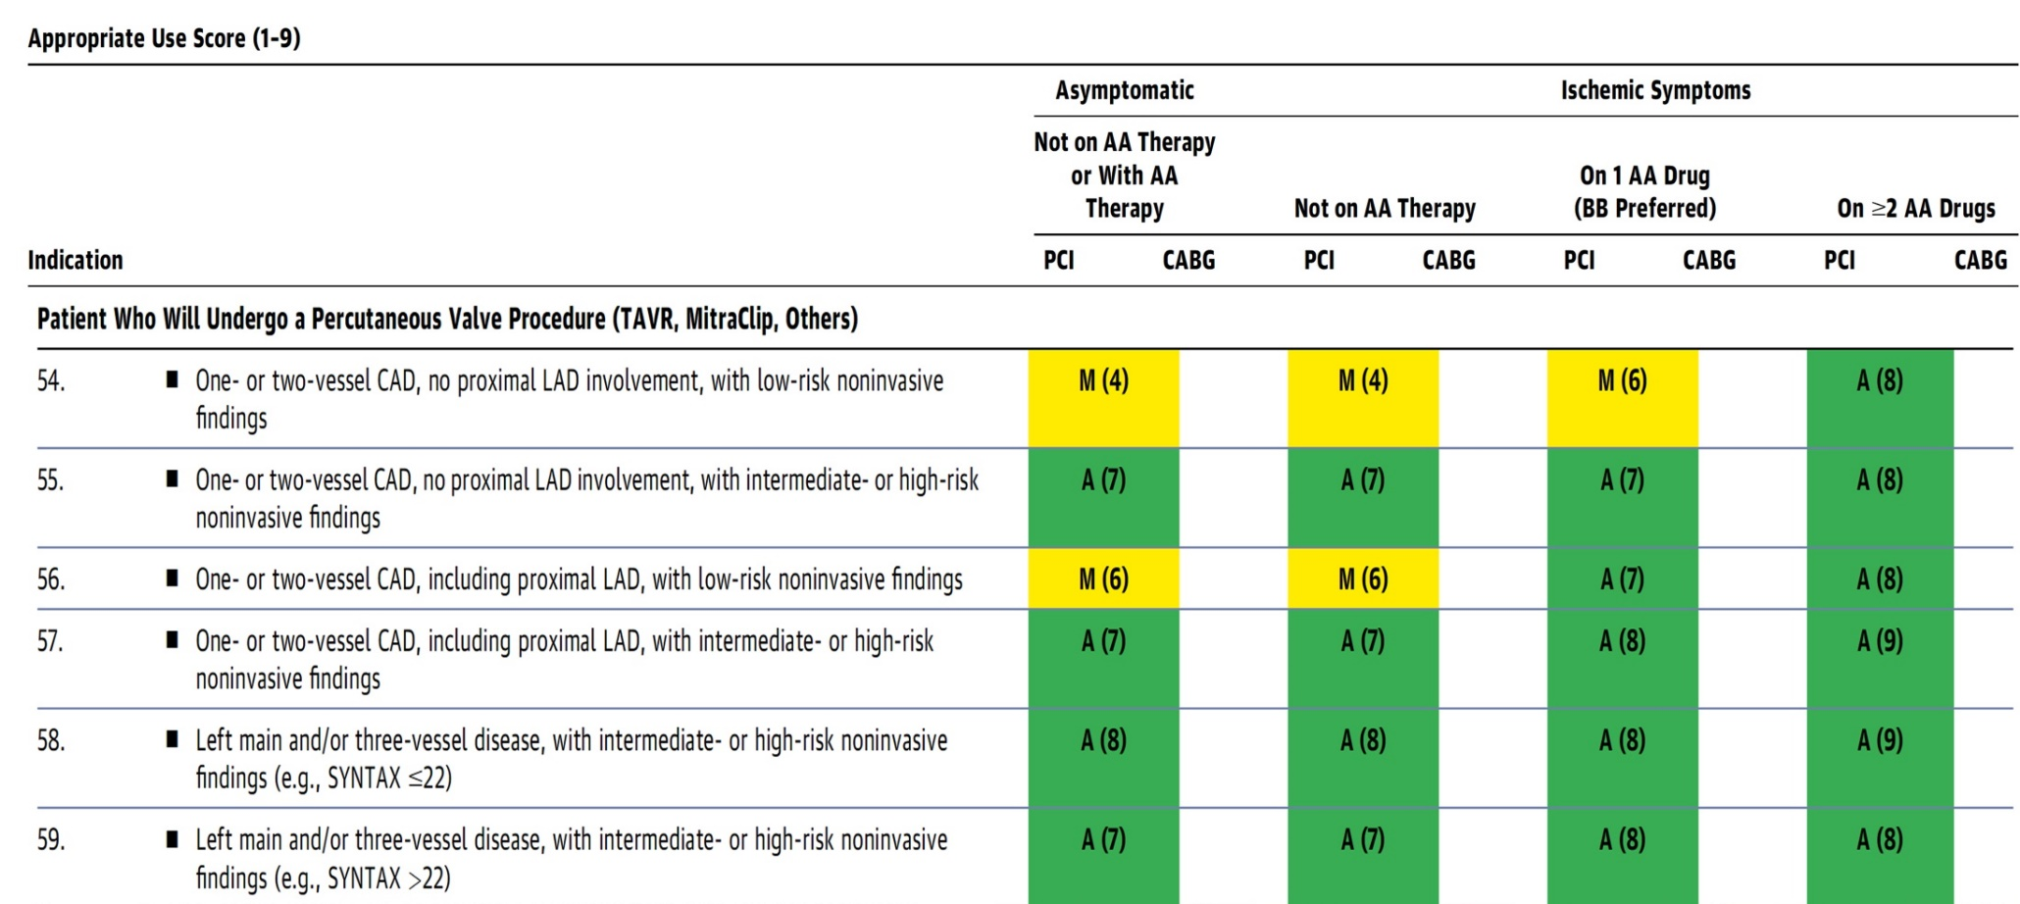
AUC 2017: TAVR and Stable CAD for which Coronary Revascularization May Be Considered
Patel et al., J Am Coll Cardiol 2017;69:2212

Slide 7
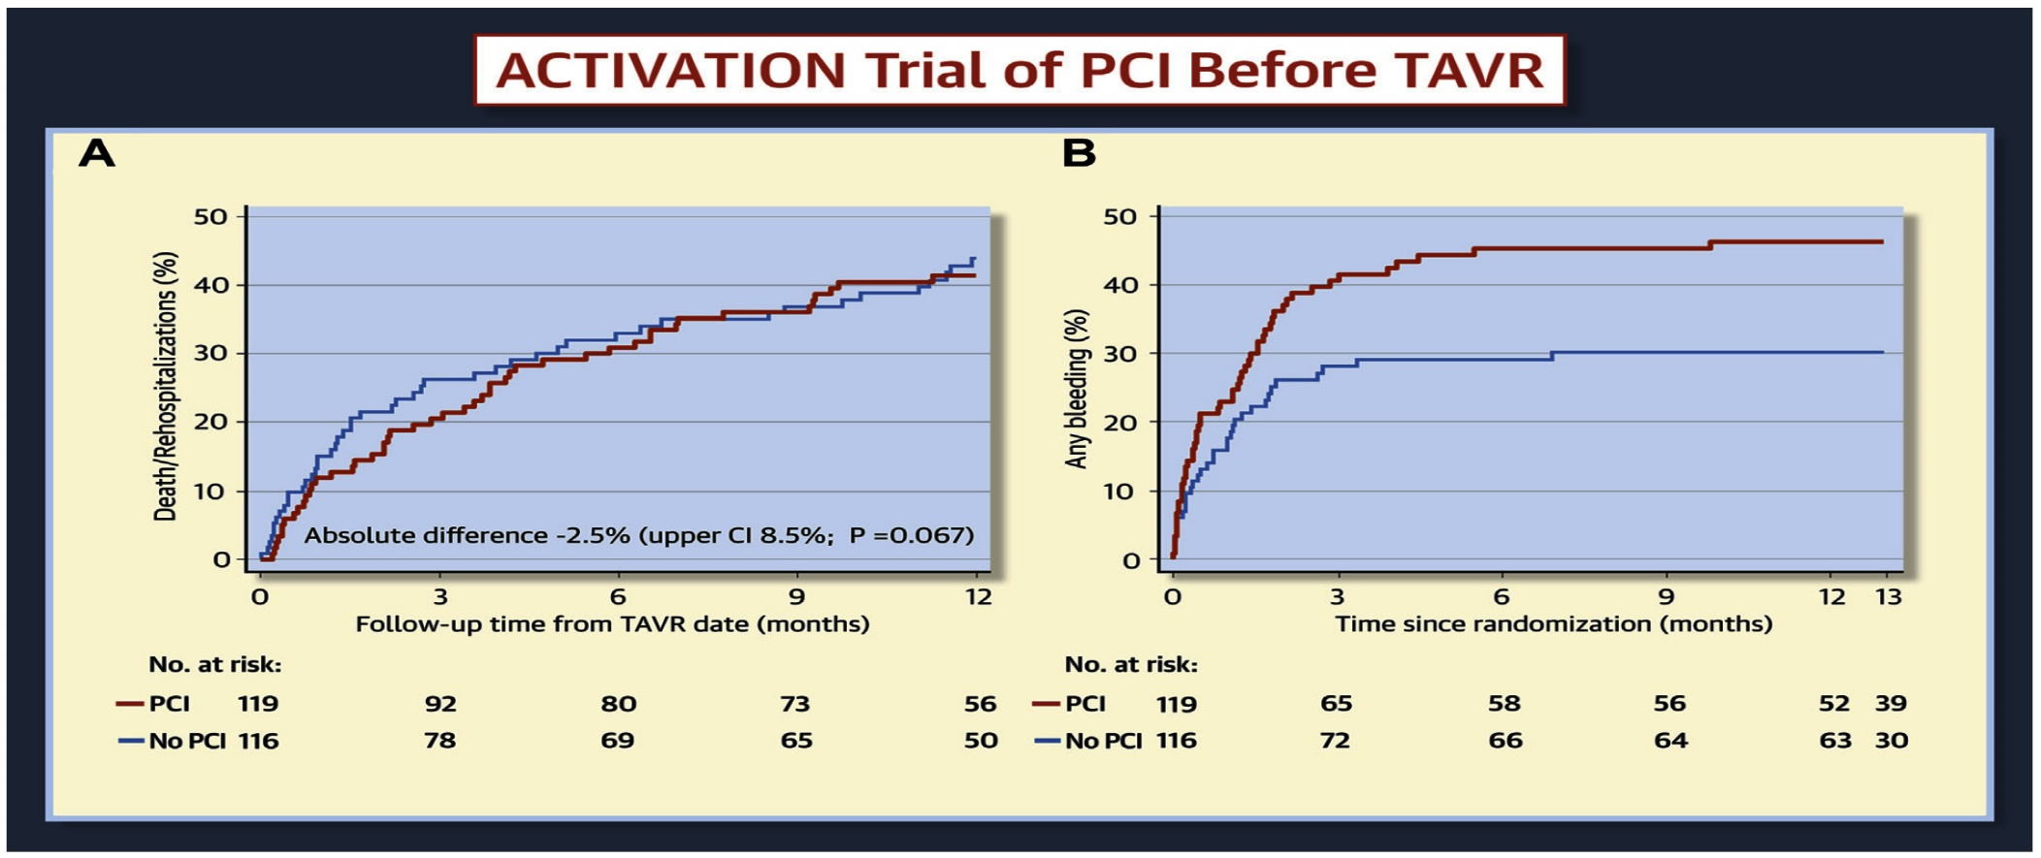
ACTIVATION Trial: No Evidence of a Difference in Primary Endpoint of Death or Rehosp at 1 Yr Between PCI or No PCI Prior to TAVR and Increased Bleeding Events in the PCI Arm
Patterson et al., J Am Coll Cardiol Intv 2021;14:1965

Slide 8
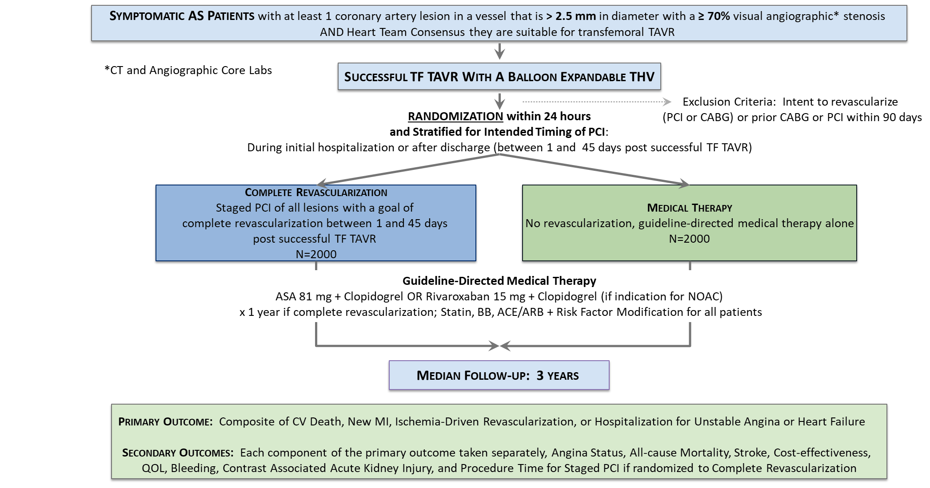
COMPLETE TAVR: Study Design

Slide 9
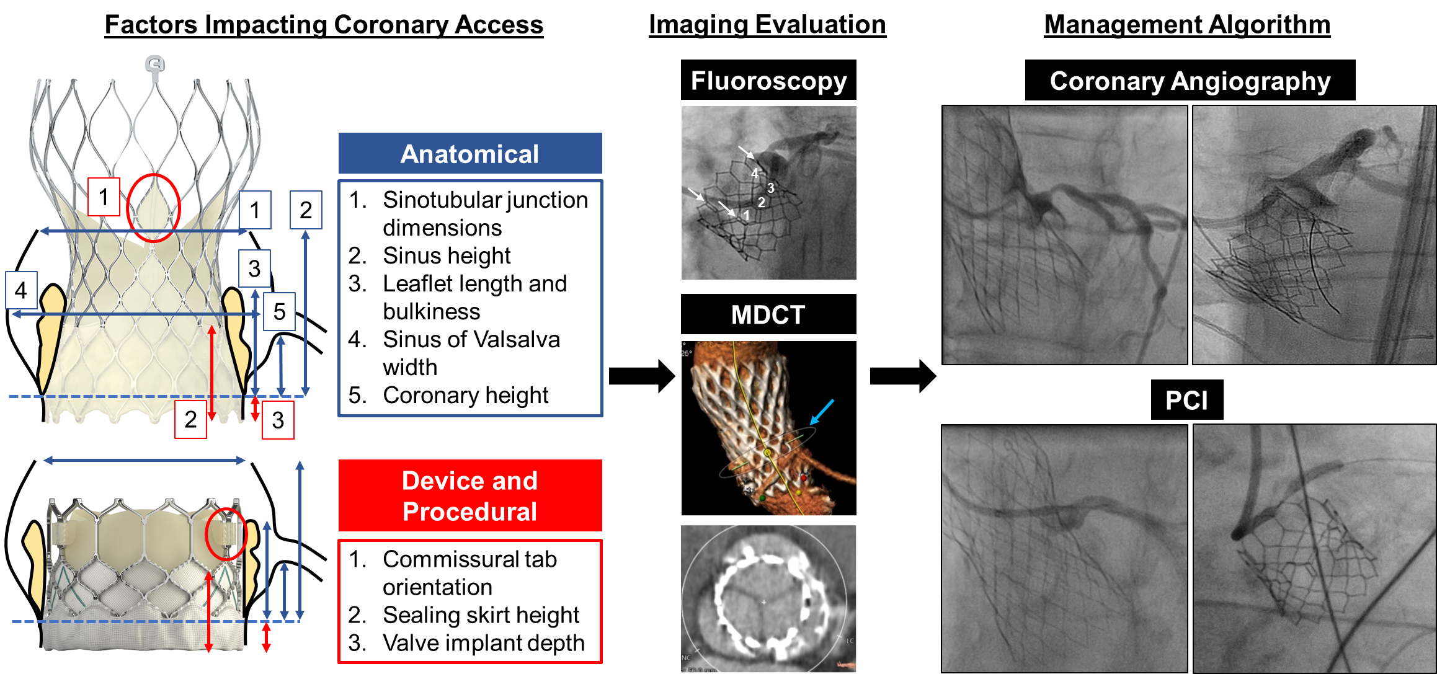
Summary of Factors Impacting Coronary Access and Imaging Evaluation After TAVR
Yudi, Sharma and Kini et al., J Am Coll Cardiol 2018;71:1360

Slide 10
Protocol for Management of Calcific Lesions
Coronary Angiography
≈50%
Moderate-severe calcification
≈50%
ELCA, if no Rota/OA Wire could be crossed
IVUS/OCT assessment:
Calcium arc 180-270° (2points)
Calcium arc >270° (3 points)
Calcium length >5 mm (1 point)
Thickness >0.5 mm (1 point)
IVUS/OCT/balloon
did not cross
Un-crossable lesion/CTO
Angulated lesion
Tortuous lesion
Long lesion
Calcific Nodule
1-2 points
3-5 points
- High-pressure NC balloons
- Cutting/scoring balloon
Lithotripsy IVL (RA/OA for Ca 360°)
RA or OA ?ELCA
Suboptimal result
Does not cross
NC balloon/CB
Suboptimal balloon expansion
Optimal balloon expansion
Optimal balloon expansion
Lithotripsy IVL
Stent and OCT/IVUS optimization

Slide 11
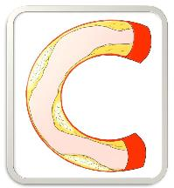
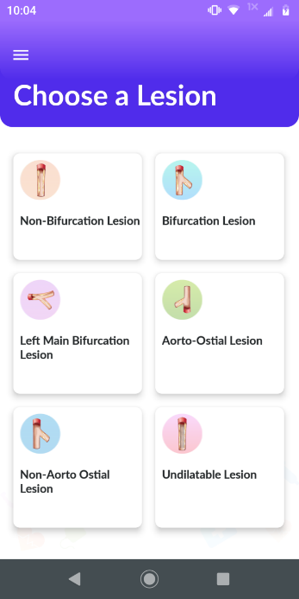
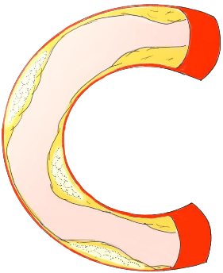
*Large Update coming in 2022
CalcificAID – Calcific Lesion Treatment
Apple ® and App Store® are registered trademarks of Apple Inc.
Download for Free!
CalcificAID

Slide 12
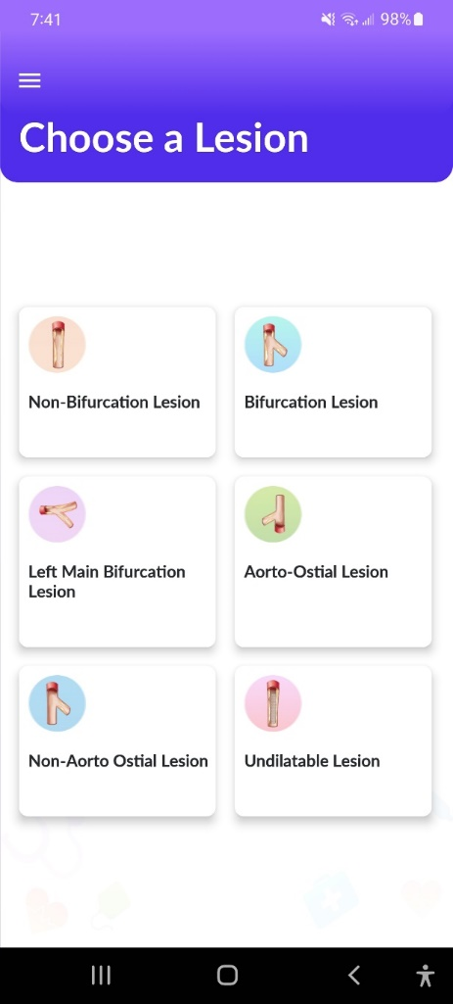
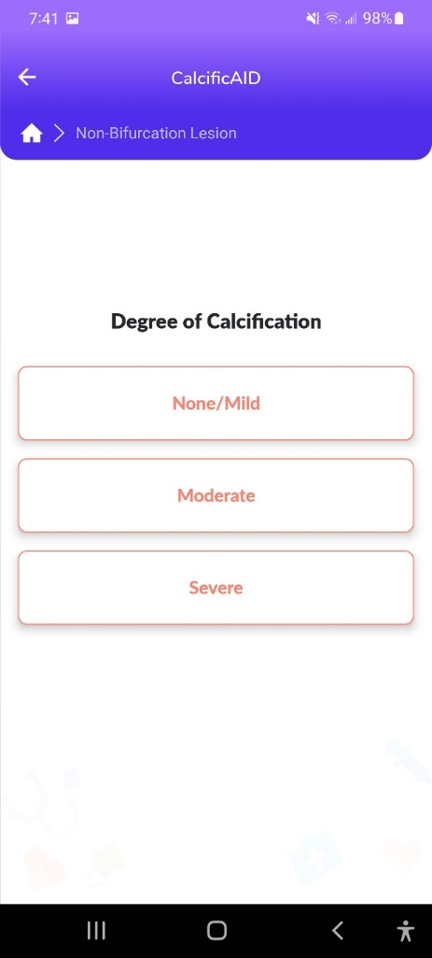
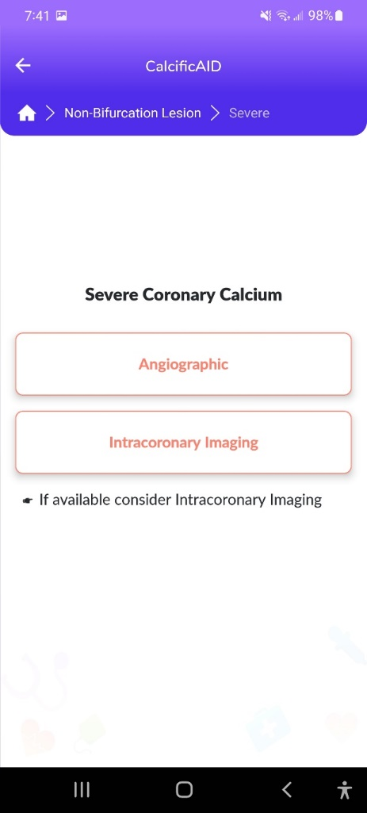
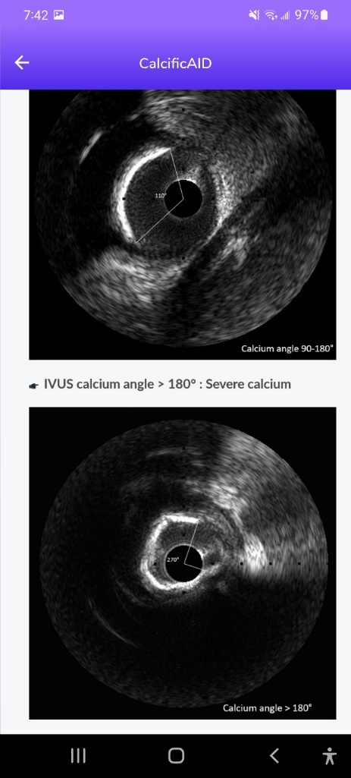
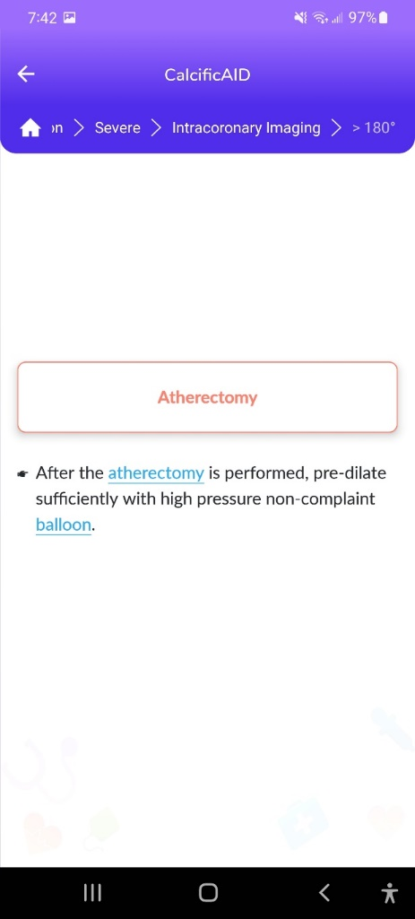
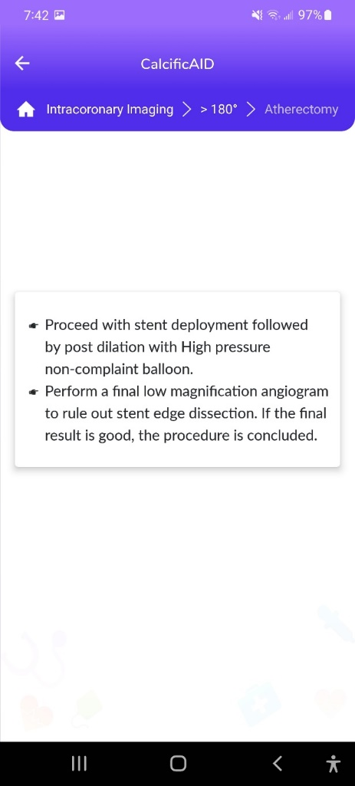
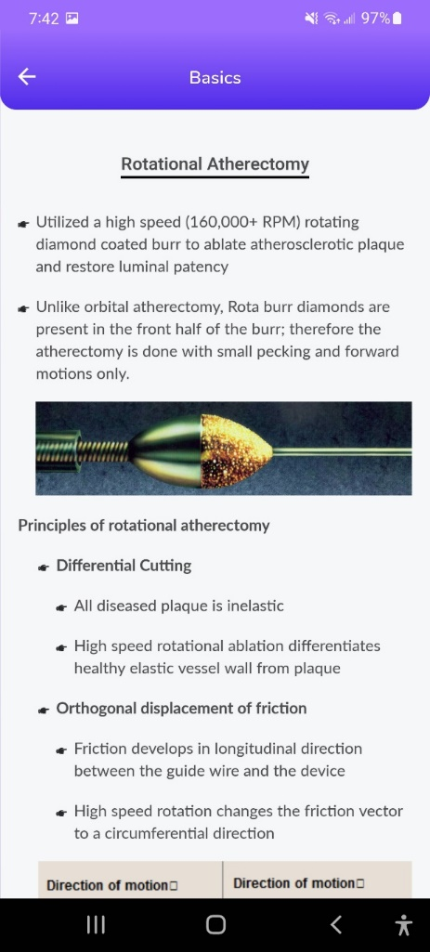
*Large Update coming in 2022
CalcificAID – Calcific Lesion Preparation
Notes:
These are the apps we have created which will provide digital algorithms for our future ambitious projects to make our cath labs smarter.

Slide 13
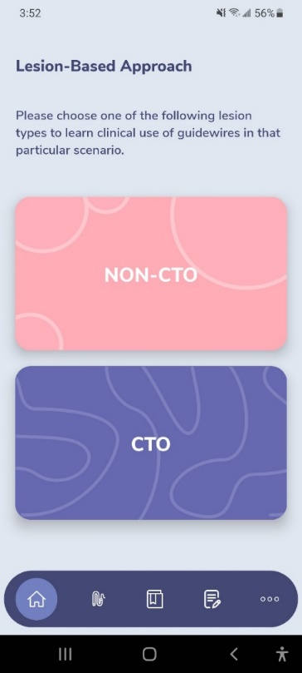
GuidewireAID – Out on both Android and iOS!
Apple ® and App Store® are registered trademarks of Apple Inc.
Download for Free!

Slide 14
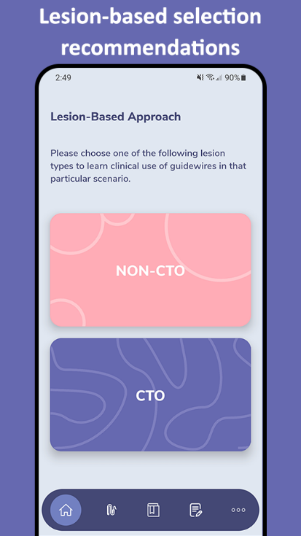
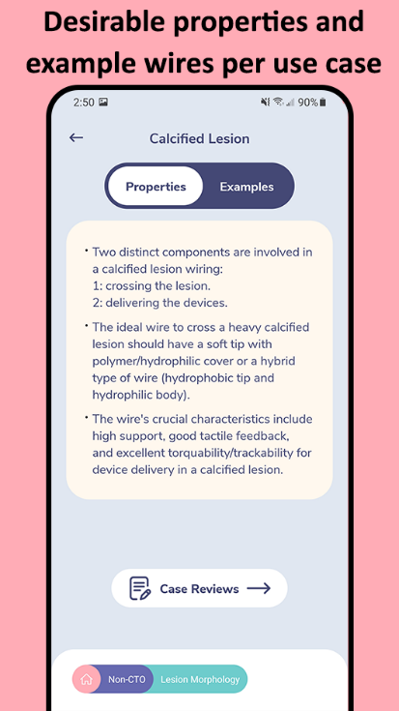
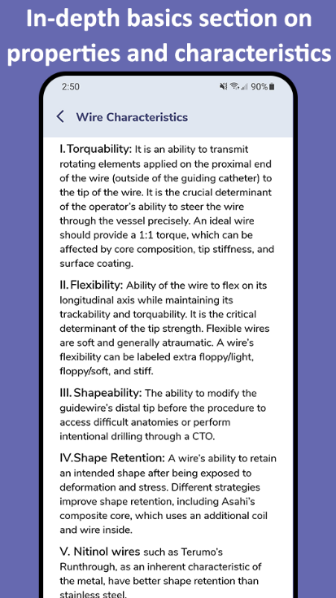
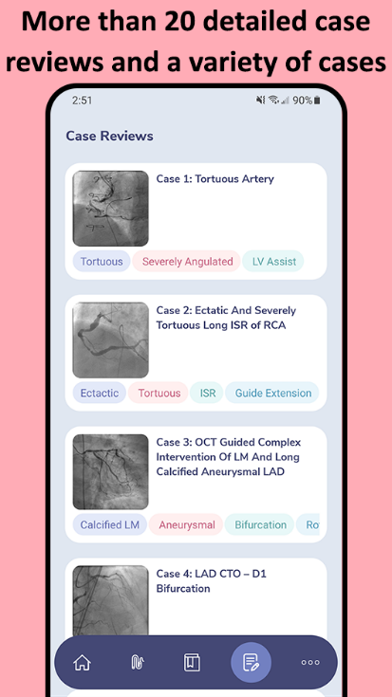
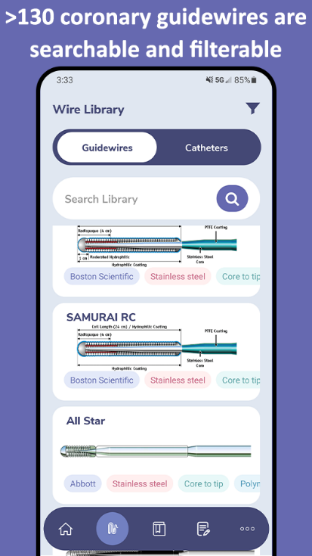
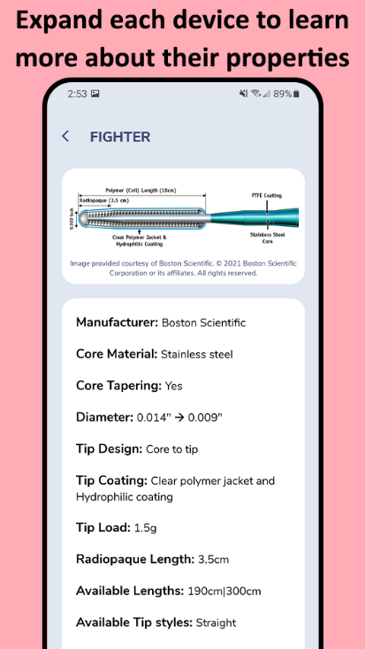
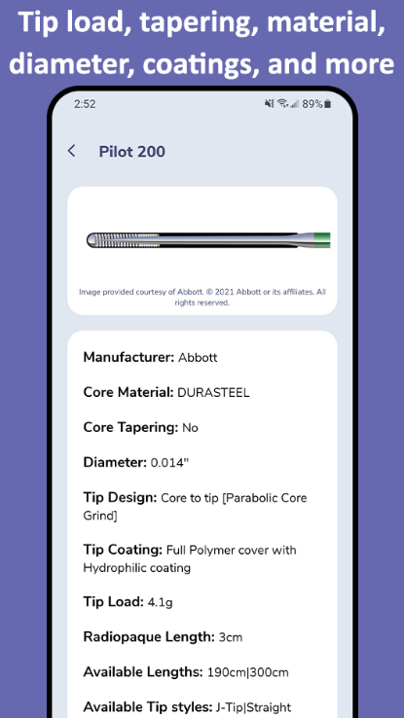
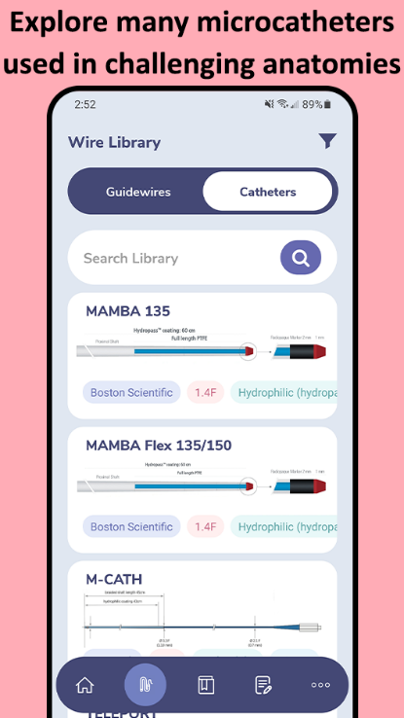
In addition to the web app at www.CardiologyApps.com/GuidewireAID, the iOS and Android mobile app is out now to download for free!

Slide 15
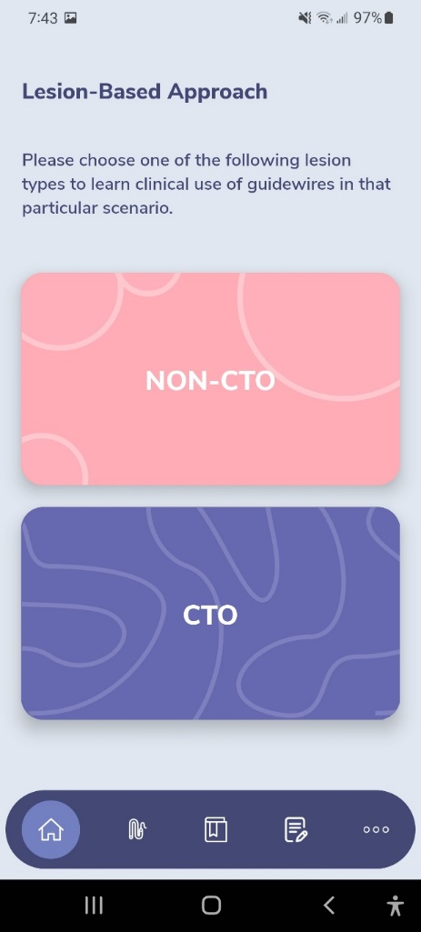
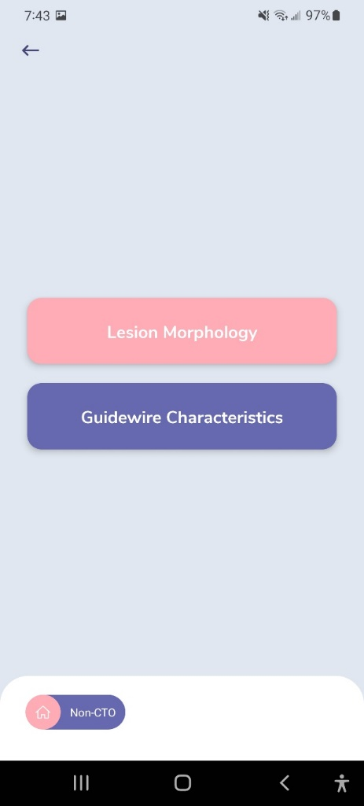
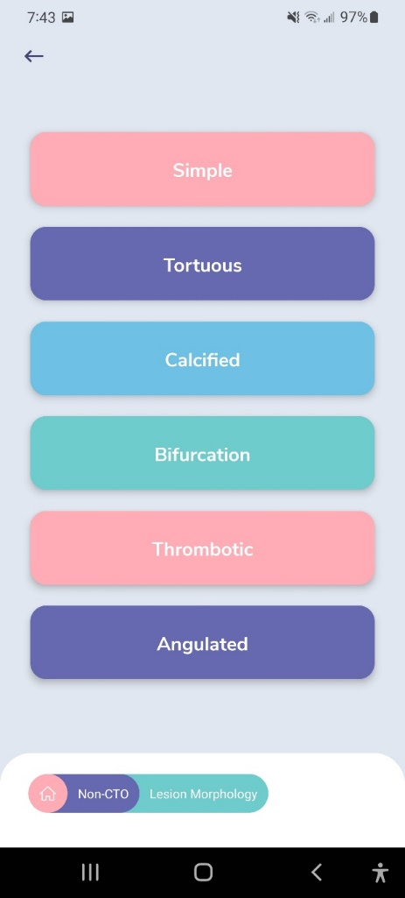
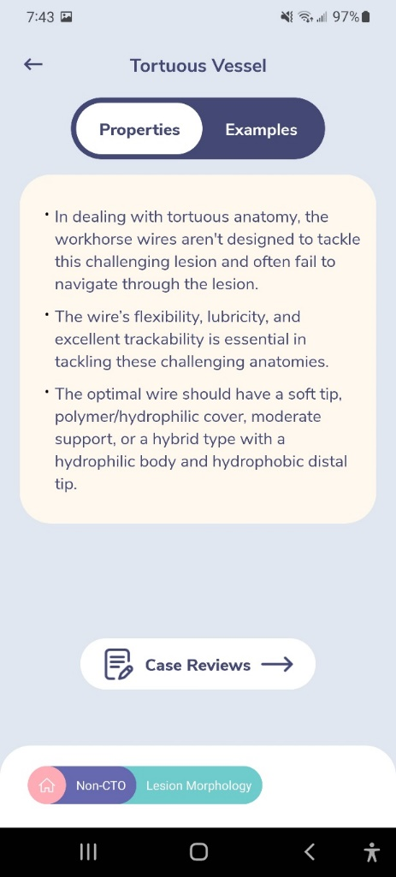
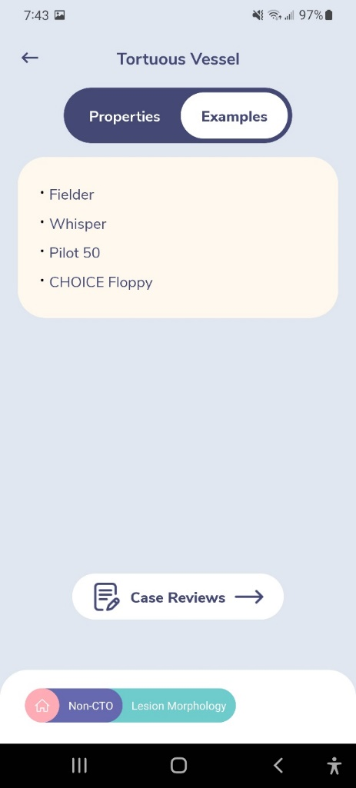
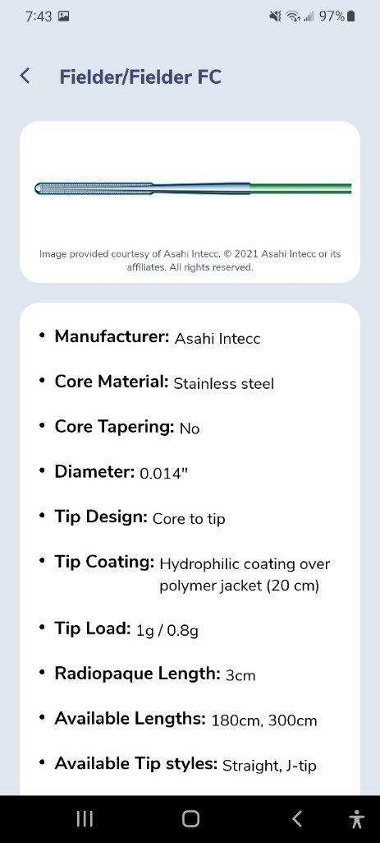
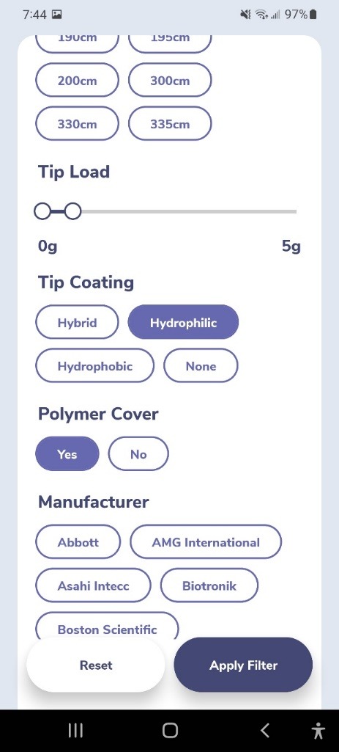
GuidewireAID – Wiring Tortuous Lesions

Slide 16
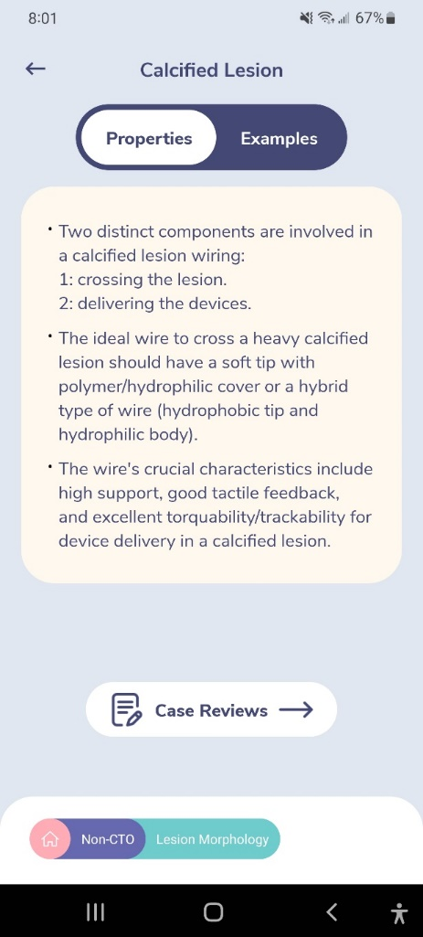
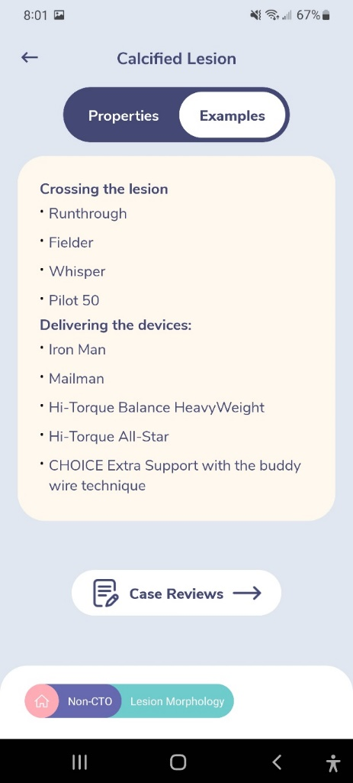
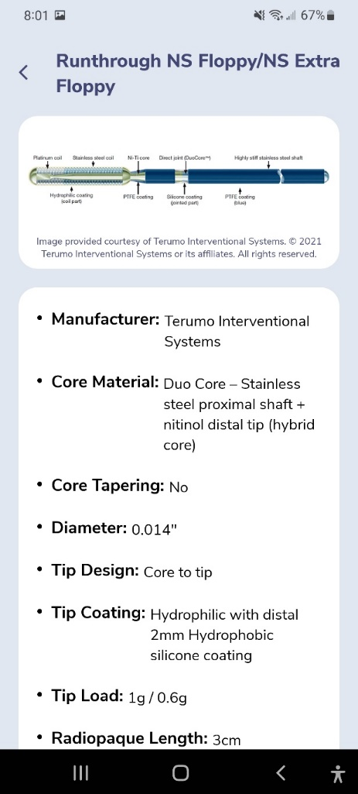
GuidewireAID – Wiring Calcified Lesions

Slide 17
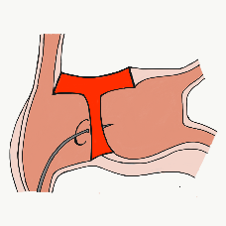
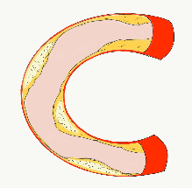
54,362 unique downloads and counting! (Up 14,000 in 2021)
Data Updated on Feb 14 2022*
Cath Lab Apps CardiologyApps.com
iOS ★ 5/5
12,227 downloads
Android ★ 4.96/5
9,372 downloads
Released sept 2017
iOS ★ 4.6/5
7,943 downloads
Android ★ 4.29/5
6,120 downloads
Released June 2018
iOS ★ 5/5
4,265 downloads
Android ★ 5/5
1,472 downloads
Released March 2019
iOS ★ 4.67/5
2,111 downloads
Android ★ 4.6/5
969 downloads
Released Sept 2018
iOS ★ 4.86/5
2,058 downloads
Android ★ 5/5
1,974 downloads
Released June 2019
Large Update Q3 19
Large Update Q1 21
BifurcAID
OCTAID
TAVRcathAID
TranseptAID
CalcificAID
*Also available
as WebApp
*Also available
as WebApp
Download Apps
For Free on Both:
WebApps available free on
www.CardiologyApps.com
Apple ® and App Store® are registered trademarks of Apple Inc.
Notes:
These are the apps we have created which will provide digital algorithms for our future ambitious projects to make our cath labs smarter.

Slide 18
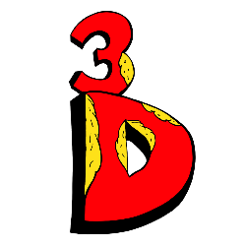
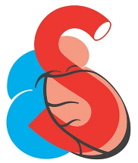
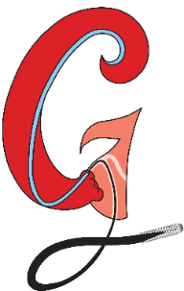
54,362 unique downloads and counting! (Up 14,000 in 2021)
Data Updated on Feb 14 2022*
Cath Lab Apps CardiologyApps.com
WebApp Only*
26,940 page views
www.cardiologyapps.com/ComplicAID
iOS ★ 5/5
2,179 downloads
Android ★ 5/5
1,405 downloads
Released June 2021
Clinical Care Application For Heart Attack patient transfers 475 downloads
Released Aug 2020
iOS ★ 5/5
1,142 downloads
Android ★ N/A
650 downloads
Released Nov 2021
Released August 2020
ComplicAID
BifurcAID 3D
STEMIcathAID
GuidewireAID
*Also available
as WebApp
*Also available
as WebApp
Download Apps
For Free on Both:
WebApps available free on
www.CardiologyApps.com
Apple ® and App Store® are registered trademarks of Apple Inc.
Notes:
These are the apps we have created which will provide digital algorithms for our future ambitious projects to make our cath labs smarter.

Slide 19
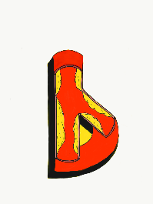
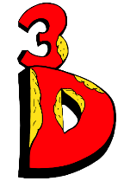
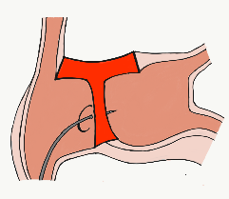
STEMIcathAID
BifurcAID
TAVRcathAID
ComplicAID
GuidewireAID
BifurcAID 3D
Cath Lab
Apps
OCTAID
TranseptAID
CalcificAID
www.CardiologyApps.com

Slide 20
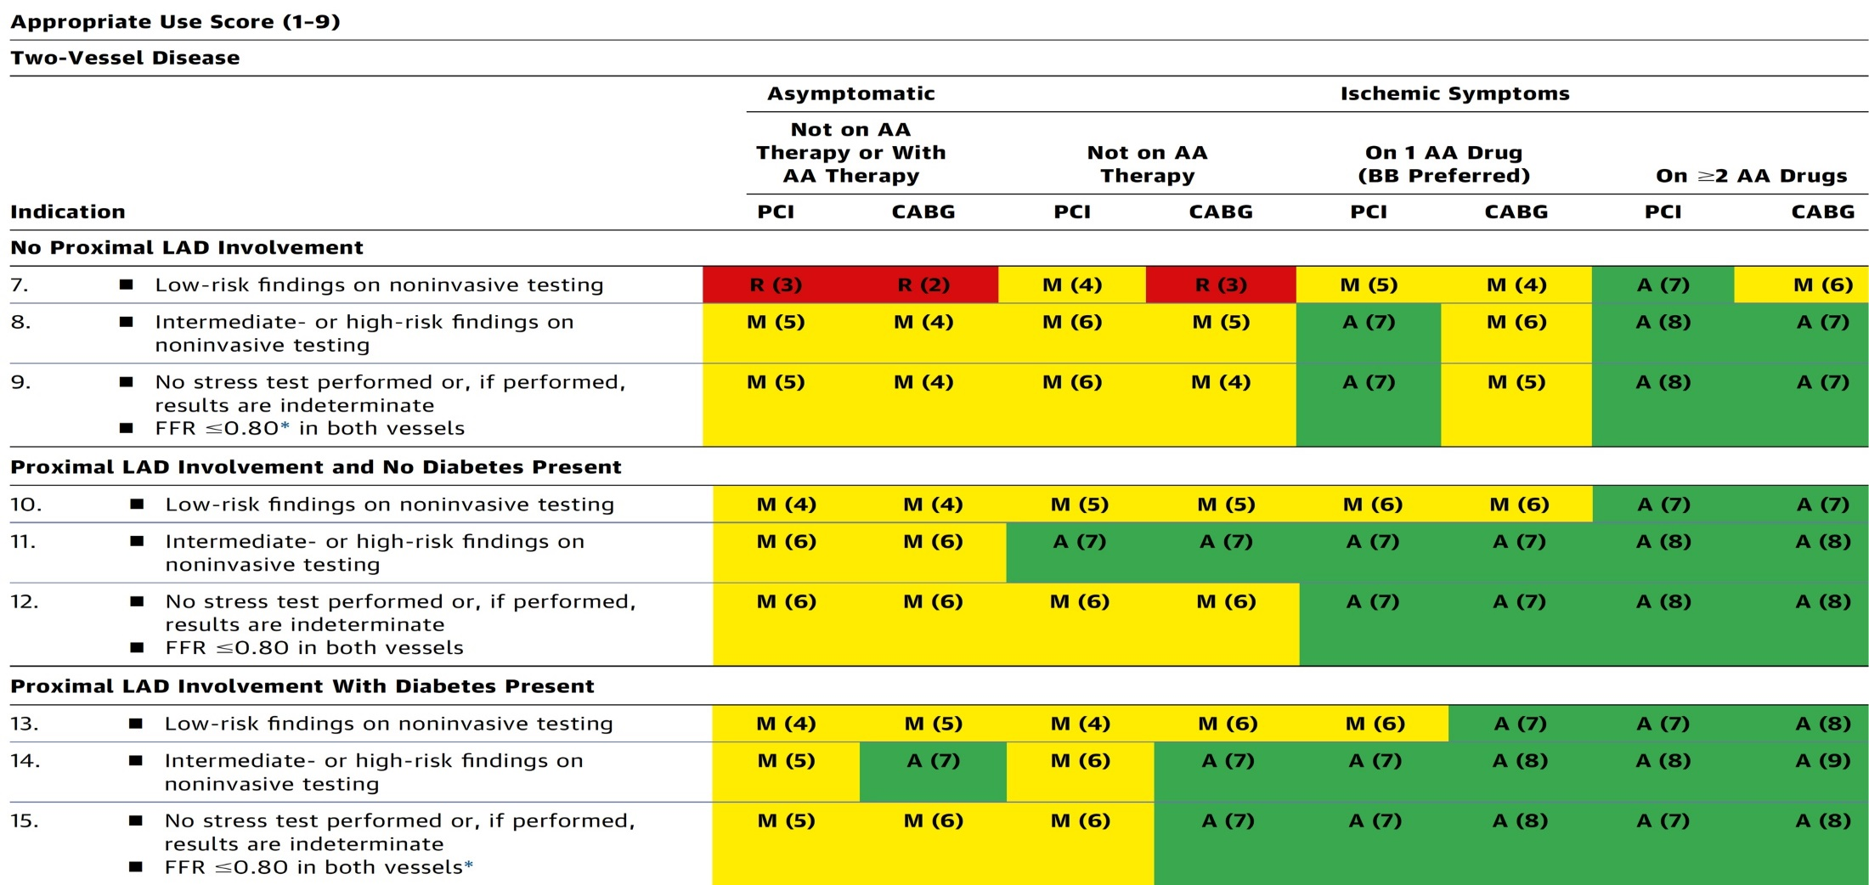
AUC 2017: Two-Vessel Disease
Patel et al., J Am Coll Cardiol 2017;69:2212

