Slide 1
Live Case
02/2022

Slide 2
55 yr old male with PMH of HTN, Tuberculosis at age of 38 yrs (completed full treatment), cardiomyopathy 45% presented for cardiac catheterization.
Non obstructive coronaries, however found to have descending thoracic aorta stenosis with a gradient of 60 mmHg and bilateral subclavian stenosis.
Meds: Amlodipine 10, asa81, crestor 10, Enalapril 20, Triamterene-HCTZ 37.5/25
Work up: ESR : 44 , HsCRP 61, Quantiferon gold negative, ANA negative

Slide 3
Left 135/87 HR 108
Right taken 2nd 150/96 HR 108
HEENT: Jugular venous pressure was normal. There was a loud supraclavicular bruit on the right and a soft on on the left. Thyroid not enlarged. No lymphadenopathy
Cardiovascular: Heart sounds were regular, with normal S1 and S2, and no murmurs.
Respiratory: Lungs were clear bilaterally, without wheezing or crackles
Abdomen: The abdomen was soft, nontender, and nondistended. There is an epigastric systolic bruit. No organ enlargement. Aorta palpable, non-tender and not enlarged.
Back: A loud systolic bruit is heard in between the scapula.
Extremities: Legs were warm and well perfused, with no edema.
Skin: No rash or other skin abnormalities
Musculoskeletal: No hypermobility, no joint swelling.
Neuro: Oriented x 3, speech and affect normal. No focal findings.
Radial pulses: not palpable bilaterally

Slide 6
CT angiogram
There is a bovine arch
The ascending aorta measures 40-41 mm
The right subclavian artery has severe stenosis. The mid and distal portions are not well seen due to intravenous contrast. The axillary artery is reconstituted and a number of small collaterals are visualized.
The left subclavian artery is occluded it in the mid and distal portions. It is reconstituted in the axillary artery. Collaterals are visualized.
The descending thoracic aorta tapers down to 1 cm in after a short segment resumes its normal size.
It is important to note that there is no wall thickening in any of the arteries.
The descending thoracic aorta has calcified plaque present.
The celiac, superior mesenteric, bilateral renal, inferior mesenteric arteries are normal in appearance.
The iliac arteries are normal in appearance.

Slide 7
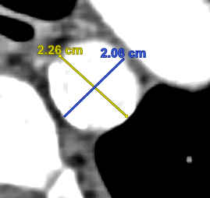
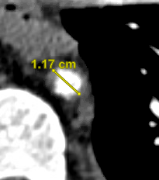
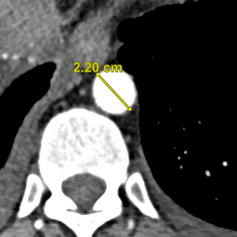
Narrowest luminal diameter
Mild wall thickening
Distal reference diameter
Proximal reference diameter

Slide 8
Working differential diagnosis: Large artery vasculitis/Takayasu, milliary tuberculosis
Rheumatology recommendations:
Close monitoring until distal thoracic aortic stent
Will start immunosuppression MTX vs AZA s/p stent

Slide 9
Plan
Percutaneous intervention of thoracic aortic stenosis with a stent graft via right femoral artery access.
18 fr sheath (pre closes), IVUS, 11.0 VBX versus 22 mm cook alpha stent depending on IVUS

Slide 10
Aortitis
Aortitis is the pathological term for inflammation of the aortic wall.
Important cause of aortic aneurysms and dissections.
Infectious versus non fectious/inflammatory.

Slide 11
Clinical spectrum
Back or abdominal pain with fever
Systemic inflammatory syndrome caused by vasculitis
Aneurysmal disease
Cardiac abnormalities
Aortic insufficiency (acute or chronic)
Stable angina pectoris or acute coronary syndrome caused by coronary involvement
Aortic thrombosis with distal embolization
Aortic dissection or rupture (rare)
Upper- and/or lower-extremity claudication with pulse deficits

Slide 12
Non-infectious Aortitis
Large vessel vasculitis: Giant cell arteritis and Takayasu arteritis
GCA is one of the most common form of aortitis in North America, accounting for more than 75% of cases.
Aortic involvement occurs in 15% of GCA patients
GCA should be suspected in individuals over the age of 50 presenting with new-onset headache, visual disturbances and elevated inflammatory markers.

Slide 13
Criterion
Age at disease onset > 50 years
New headache
Temporal artery abnormality
Elevated erythrocyte sedimentation rate (ESR)
Abnormal artery biopsy
3/5 criteria should be met.
Gold standard for GCA remains temporal biopsy.

Slide 14
Takayasu’s arteritis (TAK)
Idiopathic necrotizing granulomatous large-vessel pan-arteritis.
Preferentially involves the aorta, its proximal branches, and the pulmonary arteries.
Aneurysmal dilation in 45% patients.
Predilection for young women in 25 to 30 years of age.

Slide 15
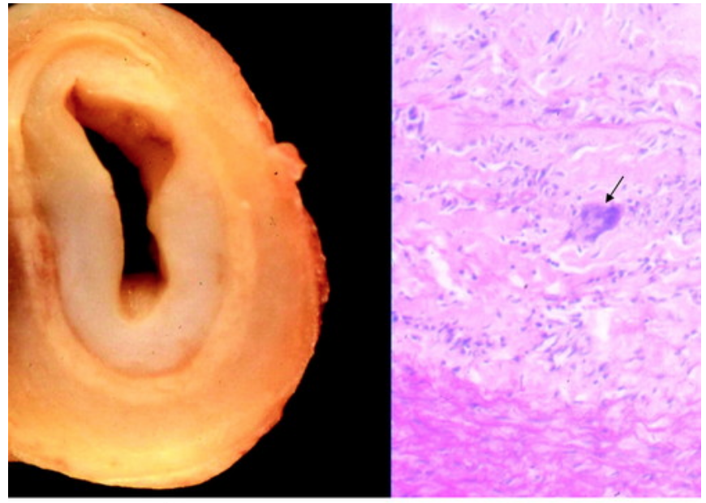
TAK pathology
Pathologic analysis demonstrates granulomas and inflammation of the arterial wall, with marked infiltration and proliferation of mononuclear cells in the adventitia and media
Perivascular cuffing of the vasa vasorum in the early stage → fibrosis and calcification in the late stage → occlusion and narrowing of the aorta and its branches.
Gornik H L Circulation 2008

Slide 16
Non-infectious aortitis/aneurysm formation.
Behçet's Disease :
Can present with saccular aortic aneurysm or acute insufficiency in association with uveitis and oral and/or genital ulceration
Vascular issues were seen in up to 50% of patients,
Can involve both upper and lower extremities.
Aorta is the most common site of aneurysm formation.
Cogan's syndrome
Large and medium-sized vasculitis
Vestibular and acute ocular symptoms (eg, interstitial keratitis, iritis, subconjunctival or conjunctive hemorrhage)

Slide 17
Non-infectious aortitis/aneurysm formation
Longstanding ankylosing spondylitis
aortic valvulitis or ascending thoracic aneurysm
Rheumatoid arthritis vasculitis
SLE: large-vessel vasculitis with a similar distribution to Takayasu's arteritis
Relapsing polychondritis
Recurrent inflammation of cartilaginous tissues. Can be complicated by large-vessel involvement with aortitis leading to thoracic and abdominal aortic aneurysms.

Slide 18
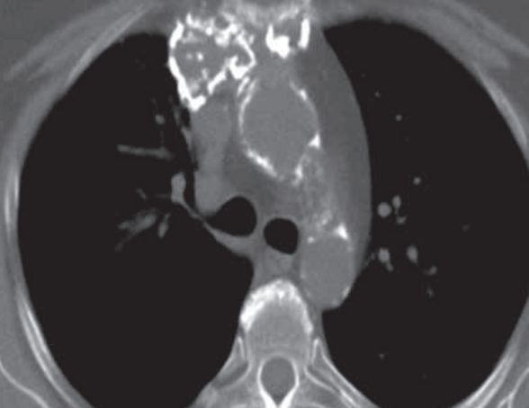
Non-infectious aortitis/aneurysm formation
Idiopathic Aortitis
Inflammation of the aorta discovered incidentally on
histology
3% to 10% of surgical aortic aneurysm repairs.
75% of these are due to IgG4-related disease.
Radiation Aortitis
Develops decade after exposure, limited to irradiated field
Accelerated calcification

Slide 19
CT angiography is essential in the work-up of these patients because it allows early diagnosis. Findings include concentric thickening of the vessel wall, thrombosis, stenosis, and occlusion. Other associated findings include vessel ectasia, aneurysms, and ulcers (Fig 2). Aortic wall thickening, which has been described as a “double ring” appearance at contrast-enhanced CT, is the typical finding in the early stage, with a poorly enhanced internal ring (the swollen intima) and an enhancing outer ring (the inflamed media and adventitia)

Slide 20
It has also been associated with mycobacterial infection (tuberculosis), with occurrence after streptococcal infections, and with rheumatoid arthritis.
Aortic and branch vessel disease may manifest as stenosis or luminal narrowing, or less commonly as aneurysmal dilatation that ensues after inflammation destroys the media.
Aneurysmal dilatation and rupture of the affected aorta are not rare, with a prevalence of 45% and 33%, respectively

Slide 21
Infectious Aortitis
Common pathogens :
Treponema Pallidum
M Tuberculosis
Salmonella
Staphylococcus aureus
Listeria
Bacteroides fragilis
Clostridium septicum, and Campylobacter jejuni
Mechanisms of infection → hematogenous spread, contiguous seeding from adjacent infection, and traumatic or iatrogenic inoculation

Slide 22
Infectious Aortitis
M> F, usually after the 5th decade of life
Infected aortic or mycotic aneurysms are part of the spectrum of infectious aortitis.
Infected aortic aneurysm is infrequent, with a documented prevalence of 0.06%–2.6% among all aneurysms

Slide 23
Infectious Aortitis
Syphilitic aortitis:
Cardiovascular manifestations are usually evident 5–30 years after the primary infection
Secondary to endarteritis obliterans of the vasa vasorum.
Disease spectrum : aortitis, aortic aneurysm, aortic valvulitis with aortic regurgitation, and coronary ostial stenosis.

Slide 24
Infectious Aortitis
Tuberculous aortitis usually involves the distal aortic arch and descending aorta.
It occurs in less than 1% of patients with latent tuberculosis, with mortality rates as high as 60%
Pathologic samples demonstrate caseous granulomas, multinucleated giant cells, and epithelioid cells.

Slide 25
Infectious Aortitis
In a study of 39 cases of tuberculous mycotic aneurysms
75% of the aneurysms appeared to originate from aortic wall erosion by a contiguous focus
90% were saccular and false, and disseminated tuberculosis was present in almost one-half of cases.
Long Ret al CHEST 1999

Slide 26
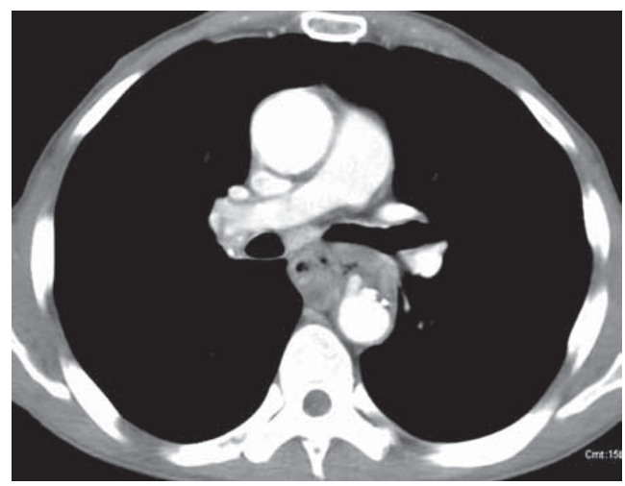
Contrast-enhanced CT is usually the imaging modality of choice. Imaging manifestations of infectious aortitis include
aortic wall thickening,
periaortic fluid or soft-tissue accumulation,
rapidly progressing saccular aneurysm or pseudoaneurysm
occasionally air in the aortic wall

Slide 27
Initial evaluation of suspected aortitis
ESR, CRP
CBC ,CMP, LFTs
Blood cultures → to exclude the unlikely but critical diagnosis of infectious aortitis.
A rheumatologic panel : ANA, ANCA and RF in the appropriate clinical setting
Skin testing for tuberculosis and serological testing for syphilis

Slide 28
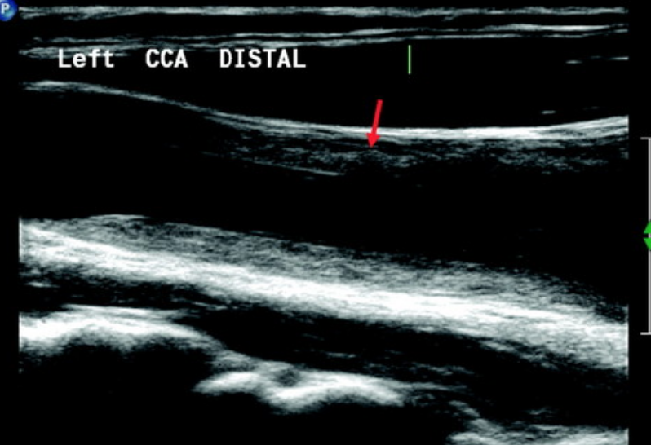
Markedly thickened internal media/ macroni sign

Slide 29
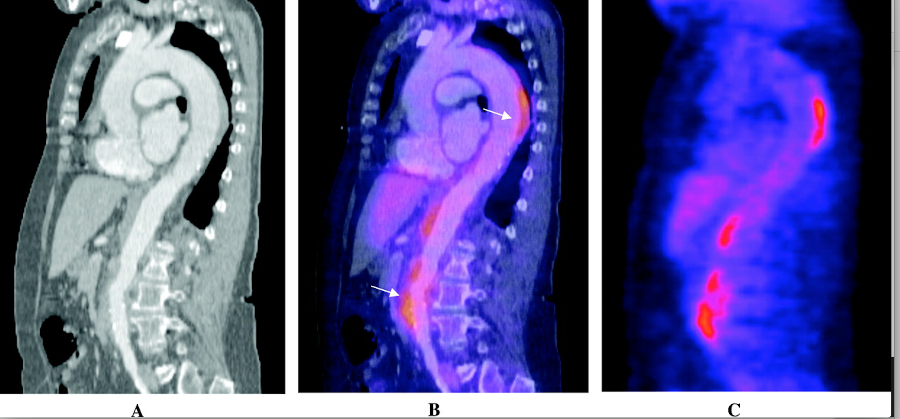
Combination of ¹⁸F-FDG PET and CTA for assessment of Takayasu arteritis.

Slide 30
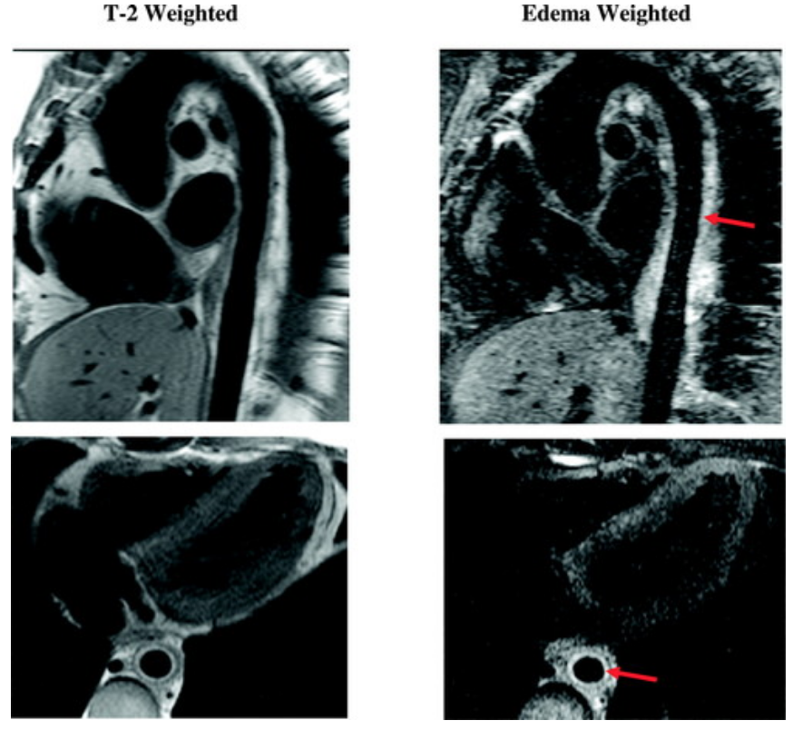
MRA of active aortitis
Wall thickening of the descending thoracic with increased signal consistent with edema and inflammation can be seen.
MR imaging is superior to conventional angiography because it allows early detection of subtle changes in the aortic wall as well as disease activity.

Slide 31
Thoraco-abdominal aortic aneurysms

Slide 32
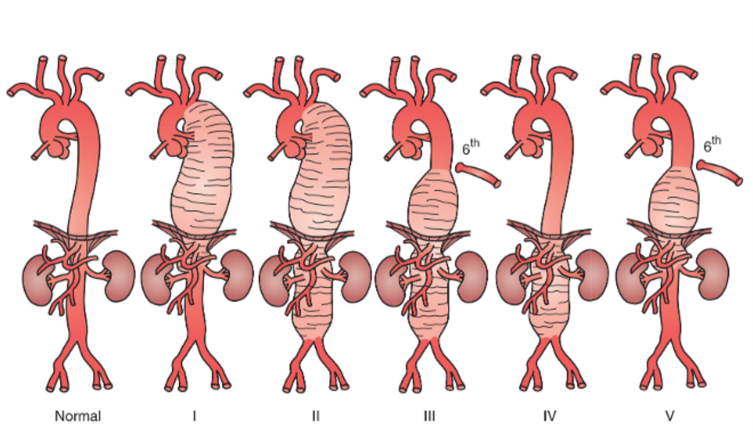
Crawford classification of thoracoabdominal aortic aneurysms

Slide 33
Degenerative/atherosclerotic aneurysms
abnormal levels of metalloproteinases in the media of aneurysm specimens.
Deficit of antiproteolytic enzymes that inhibit metalloproteinases
The intensity and duration of cigarette smoking by patients affected with aneurysm disease is the most significant risk factor for the development of these degenerative aneurysms.

Slide 34
Inflammatory aneurysms:
Infrarenal abdominal aorta
Takayasu arteritis, giant cell arteritis, polyarteritis nodosa, Behçet disease, Cogan syndrome, and cystic medial necrosis represent other inflammatory arterial conditions that are associated with aneurysmal degeneration.
Infectious/mycotic aneurysms:
Commonly saccular
Many strains of bacteria and fungi (e.g., Candida, Aspergillus), tuberculosis, and syphilis have been documented to be causative

Slide 35
Inflammatory/idiopathic aortic aneurysms
The prevalence has been reported as 5%–25% of all abdominal aortic aneurysms.
Associated with smoking and a family history of aortic aneurysm
periaortic fibrosis
limited to the aorta and periaortic tissues
IgG4 related systemic disease

Slide 36
Inflammatory aortic aneurysms
Contrast-enhanced CT -> 83% sensitivity and almost 100% specificity for this diagnosis
Higher mortality during surgical repair due to peri aortic fibrosis
Posterior wall is spared

Slide 37
Acute aortic syndromes (aortic dissection, intramural hematoma, and penetrating aortic ulcers) can induce TAAAs
Ascending aorta aneurysms are typically degenerative or the sequela of prior aortic dissection

Slide 39
Rupture risk
The UK Small Aneurysm Trial reported an annual rupture rate of 2.2%, with most occurring in patients with an AAA diameter of 5 to 5.5 cm.
Female sex, larger initial AAA diameter, smoking, lower FEV₁, and higher mean blood pressure.
Saccular aneurysm morphology > fusiform aneurysms.
CTA: presence of a dissection, mural thrombus
Size criterion for AAA elective repair is 5.5 cm for men and 5 cm for women or a 12-month growth rate of equal to or greater than 10 mm in both sexes
Patients with symptoms should undergo TAAA repair

Slide 40
CTA
External and endoluminal diameter of the aorta at the proximal and distal seal zones
Length of aortic coverage
Degree of angulation and tortuosity of the aorta
Identification of important side branches
Characteristics of the lumen and wall of the aorta
Thrombus burden and calcification.

Slide 41
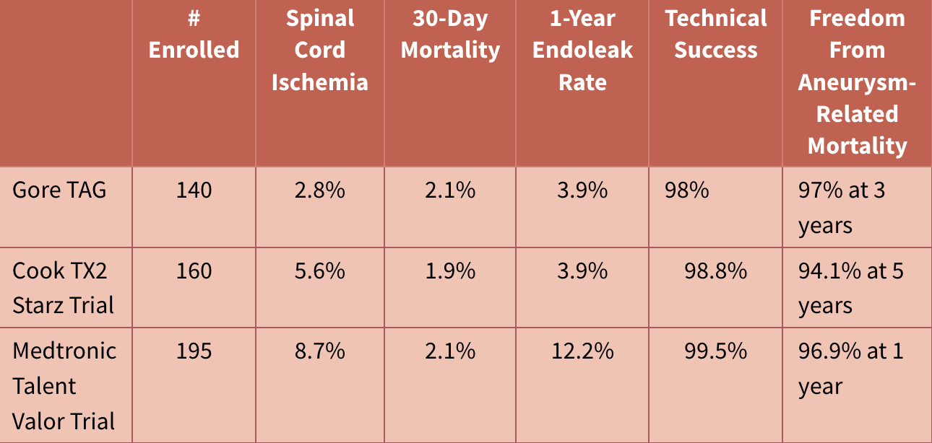
Endovascular versus open repair for TAAA

Slide 42
30 day mortality higher in open surgical group far more than TEVAR
TAG (Gore) 2% vs. 12%
STARZ (Cook) 1.9% vs. 5.7%
VALOR (Medtronic) 2.1% vs. 7.9%
At 5 years, overall survival rates do not differ between open versus endovascular group.
TAG: TEVAR and open groups (68% and 67%)
Starz TEVAR and open (62.9% and 62.8%)

Slide 43
Forty-two nonrandomized studies involving 5,888 patients were included (38 comparative studies, 4 registries).
All-cause mortality at 30 days (odds ratio [OR]: 0.44, 95% confidence interval [CI]: 0.33 to 0.59) and paraplegia (OR: 0.42, 95% CI: 0.28 to 0.63) were reduced for TEVAR versus open surgery.
No significant difference in stroke, myocardial infarction, aortic reintervention, and mortality beyond 1 year.
Cheng D et al JACC 2010

Slide 44
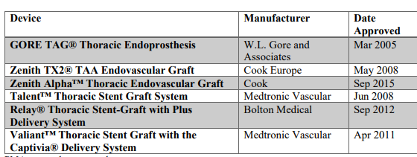

Slide 45
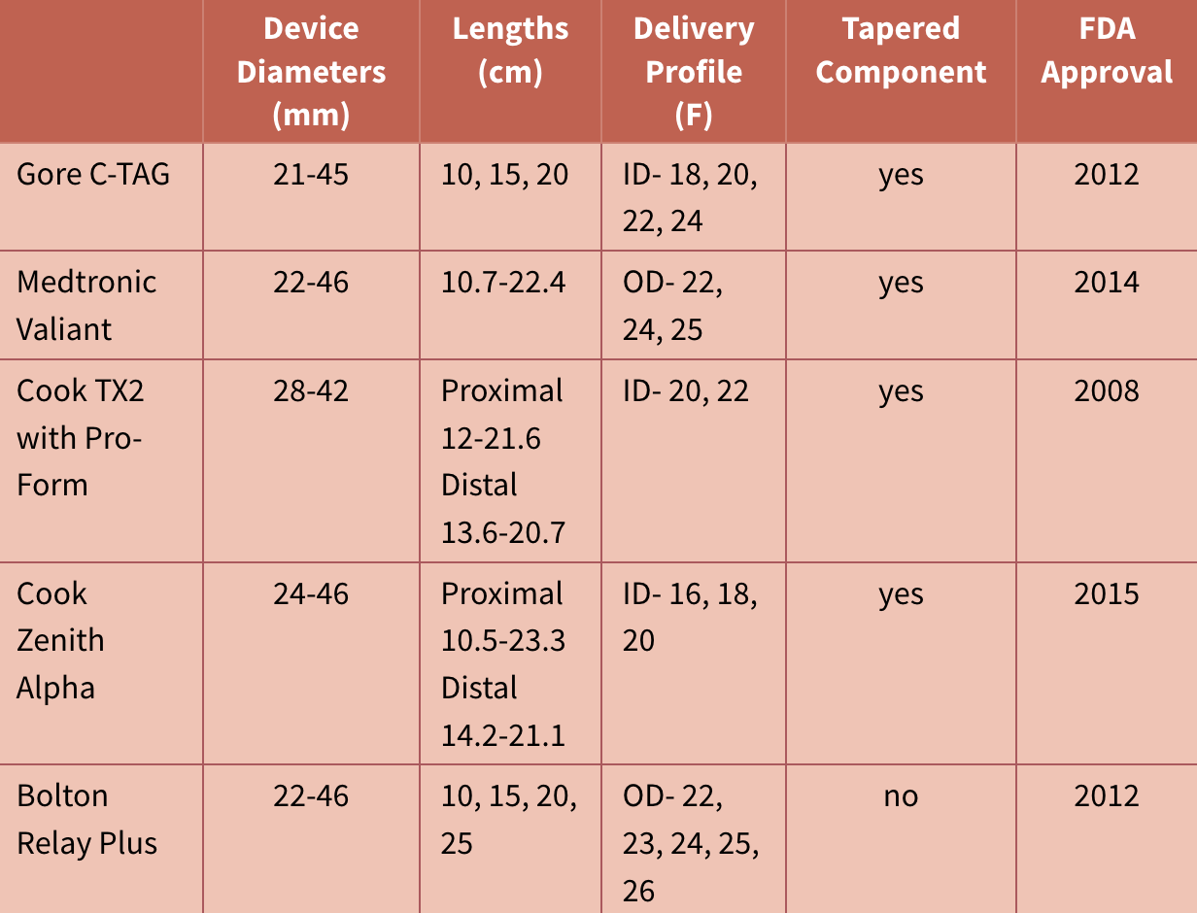

Slide 46
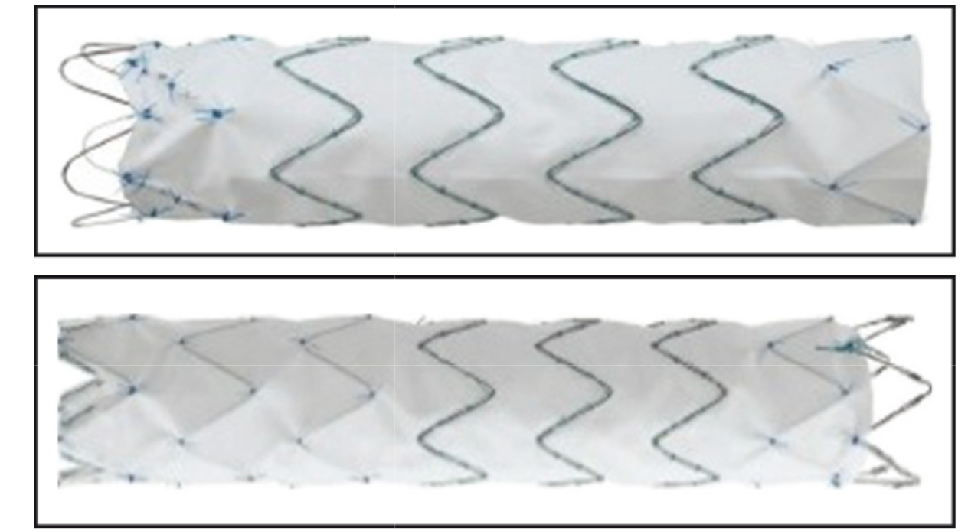
Cook Zenith Alpha lower-profile
thoracic endograft.
The two-piece modular graft consists of external nitinol stents and woven polyester fabric sewn together.
lower profile device (18 or 20 F)

Slide 47
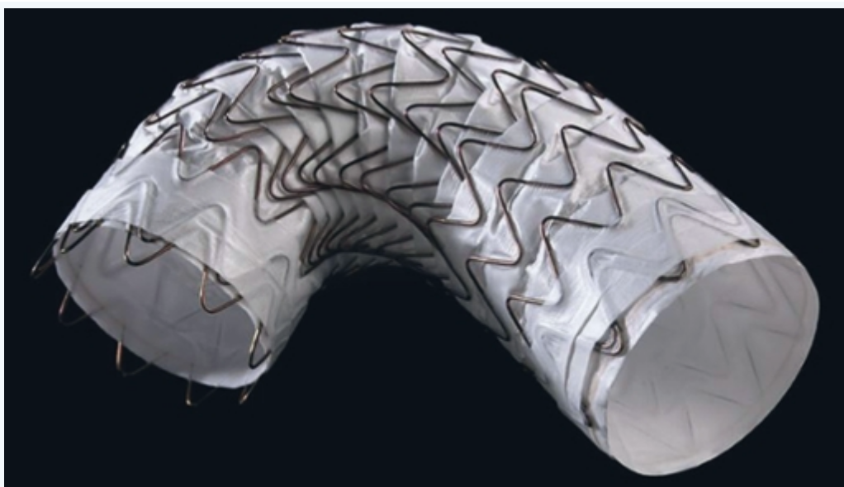
The Gore thoracic aortic graft
(TAG) endoprosthesis
Constructed with an expanded (ePTFE) tube and an external nickel-titanium (nitinol) self-expanding stent affixed to the graft
Conforms to the aortic wall
Deploys from the middle of the graft outward
C-TAG is designed to be oversized 7% to 22%.

Slide 48
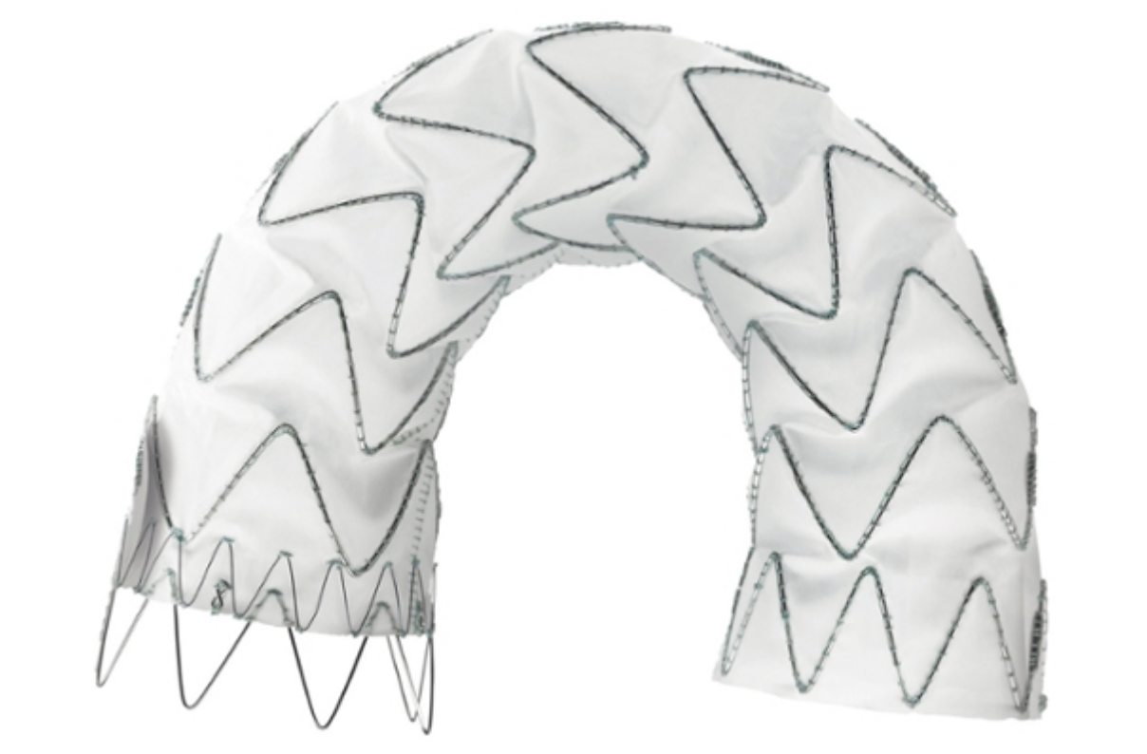
Medtronic Valiant stent-graft
Monofilament woven polyester graft attached to sinusoidal nitinol springs that are placed on the outside of the graft.
Oversize 10% to 20%

Slide 49
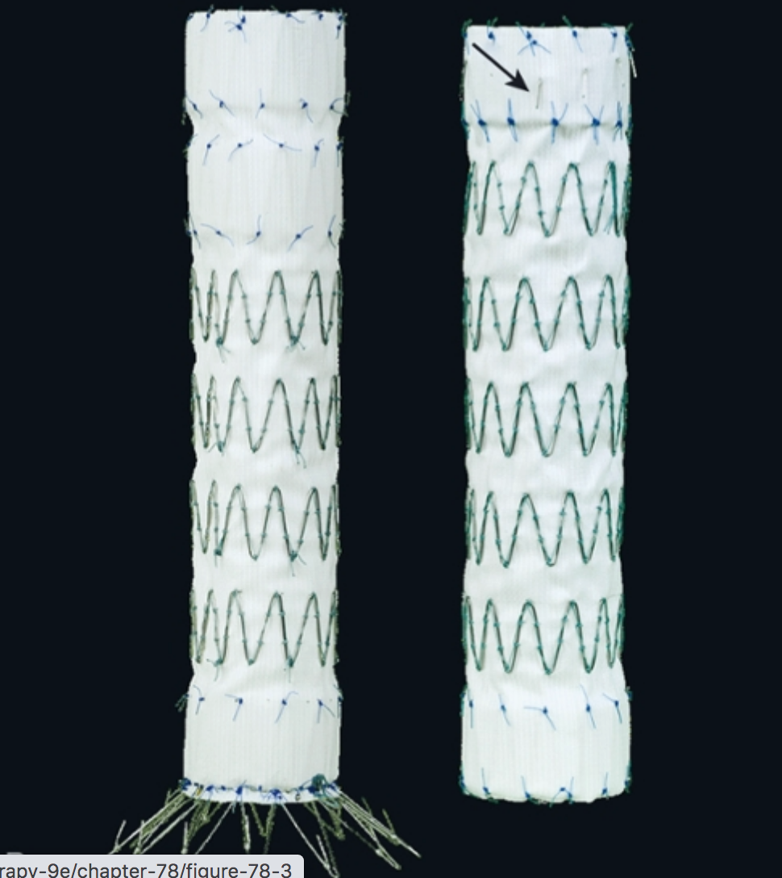
Cook TX2 with Pro-Form
Two-piece modular graft consisting of woven
Dacron fabric sewn to self-expanding
stainless steel Z-stents.
Metal stents are located on the inside of the
graft in the sealing zone but outside on the remainder
Active fixation is provided by barbs on both ends

Slide 50
Thank you

