Slide 1
Complex Coronary Cases Supported by:
Abbott Vascular Inc.
Boston Scientific Corp.
Terumo Vascular Corp.
Cardiovascular Systems Inc.
Abiomed Inc.
Chiesi Inc.
Shockwave Medical Inc.
Cardinal Health Cordis Inc.

Slide 2
Disclosures
Samin K. Sharma, MD, MSCAI, FACC
Speaker’s Bureau – BSC, Abbott
Annapoorna S. Kini, MD, MRCP, FACC
Nothing to disclose
Sameer Mehta, MD, FACC (Moderator)
Nothing to disclose

Slide 3
CCC Live Case # 152
Patient Demographics
67 yrs, Male
Present Clinical Presentation
Presented with new onset angina equivalent dyspnea and
+ SPECT MPI for multivessel ischemia; anterior and inferior
CAD Risk Factors
Controlled Hyperlipidemia
SAQ-7: 60
Clinical Variables
No prior known CAD. LVEF 40%
Medications
Aspirin, Atorvastatin
Cath: Cath on 1/28/2022 revealed 2 V CAD: 80% calcified prox-mid LAD, 100% mid-distal RCA with distal vessel filling via bridge and retrograde collaterals, LVEF 40% and Syntax score 26. Pt underwent successful PCI of LAD using rotational atherectomy and Promus Elite DES (3.5/38mm) and did well. Pt still has mild dyspnea symptoms on added MT of Zestoretic, Metoprolol XL, ISMN and Clopidogrel.
Plan: Now planned for staged PCI of RCA CTO via antegrade, if failed retrograde approach with dual injection.

Slide 4
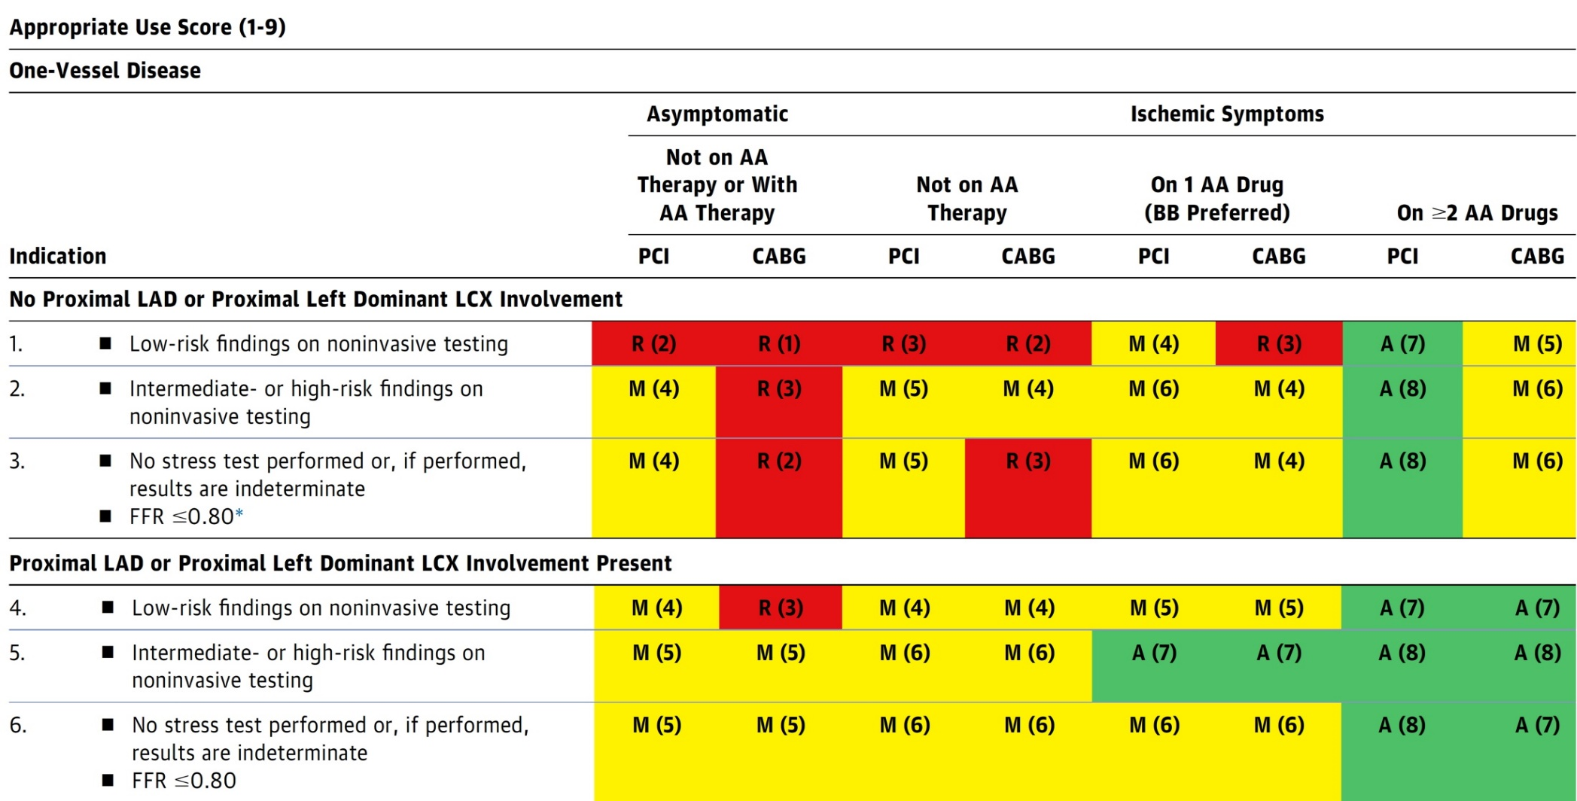
AUC 2017: One-Vessel Disease
Patel et al., J Am Coll Cardiol 2017;69:2212

Slide 5
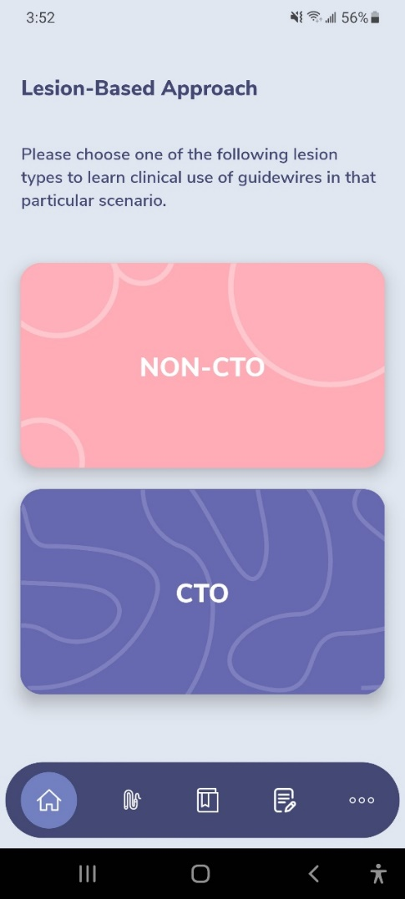
GuidewireAID – Out on both Android and iOS!
Apple ® and App Store® are registered trademarks of Apple Inc.
Download for Free!

Slide 6
CTO Wire Escalation – Sample Toolkit

Slide 7
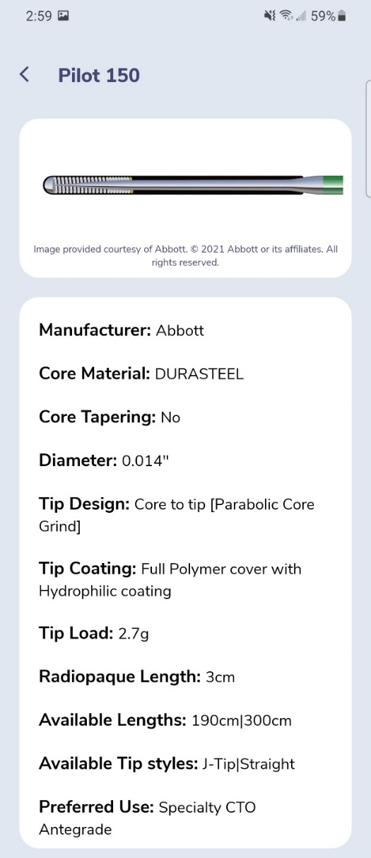
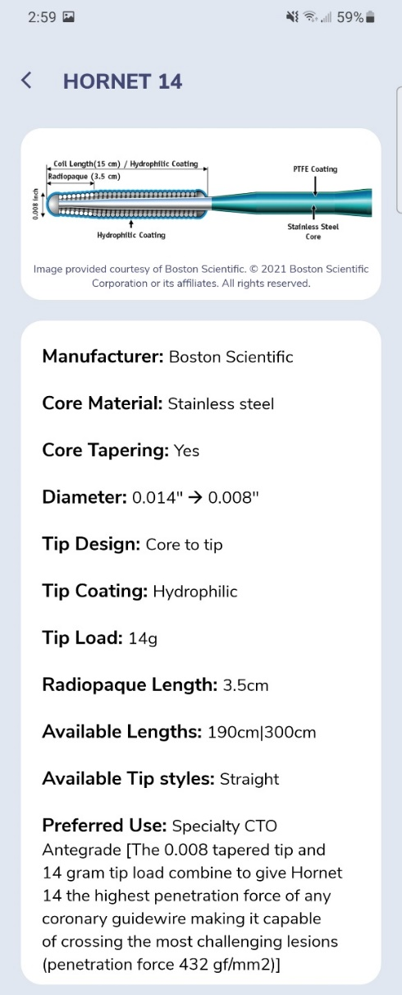
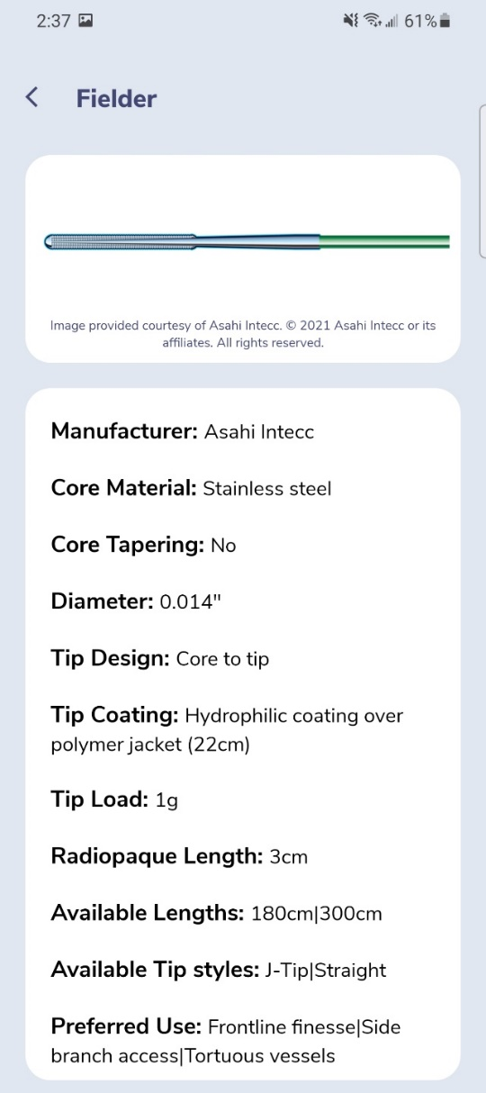
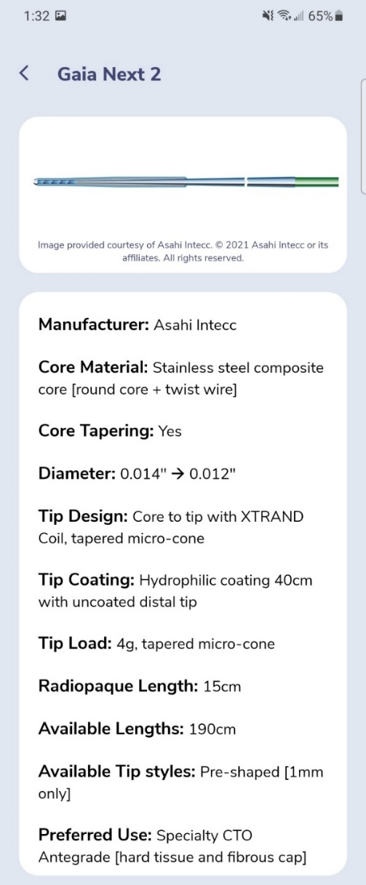
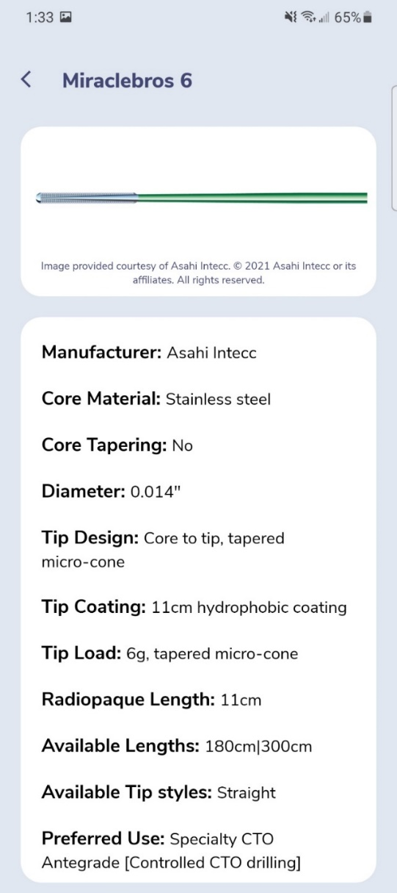
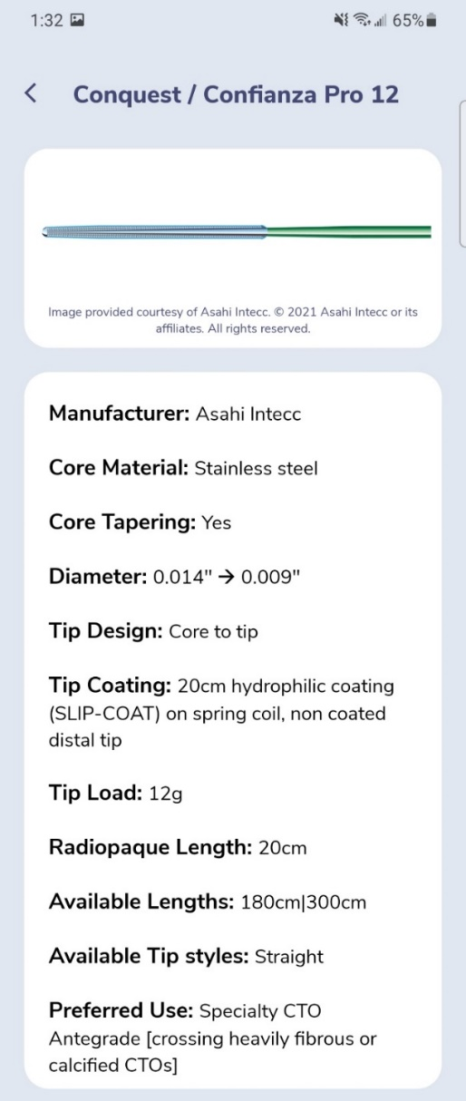
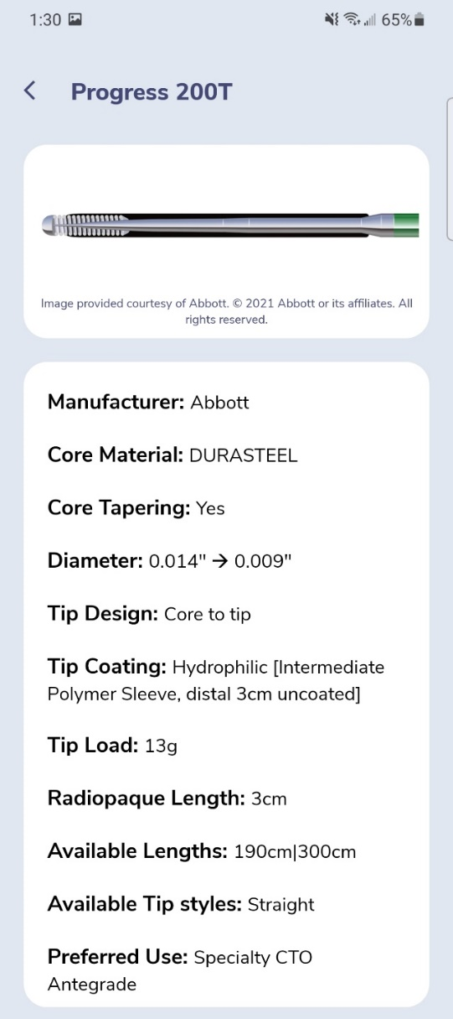
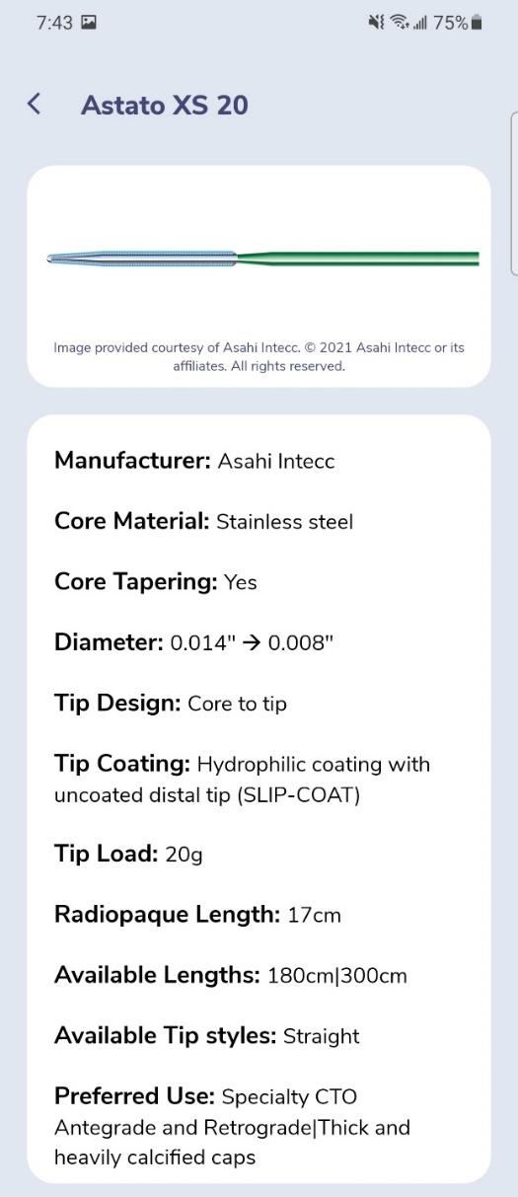
Low Tip Load
Non-tapered
High Tip Load
Tapered
CTO Wire Escalation

Slide 8
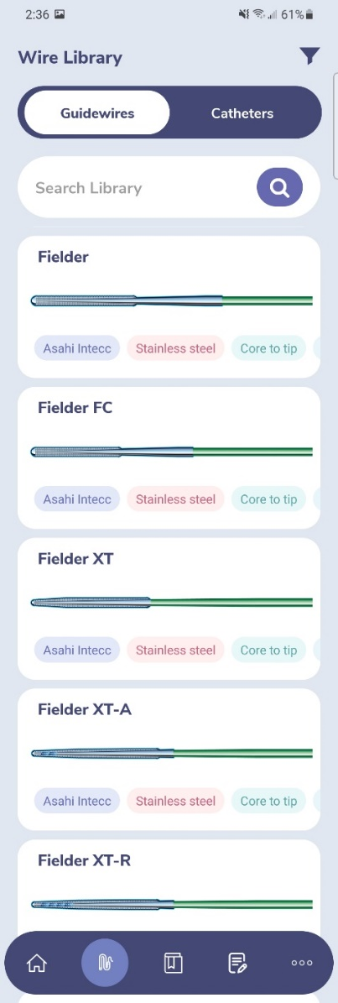
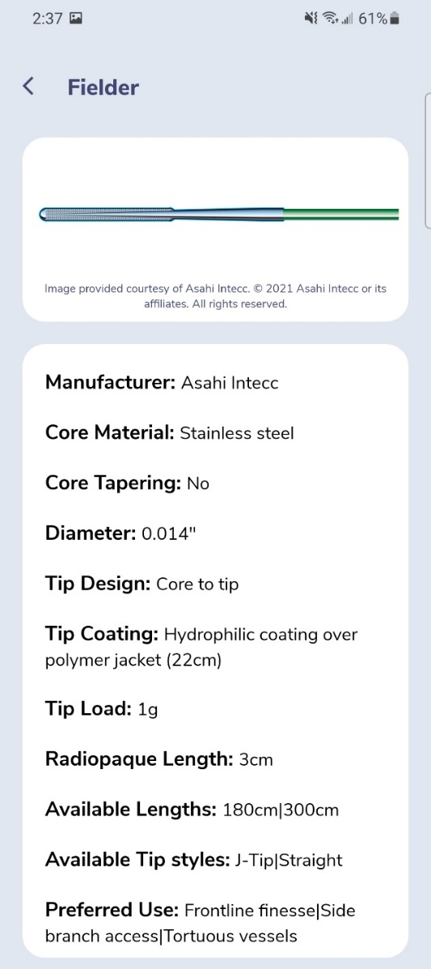
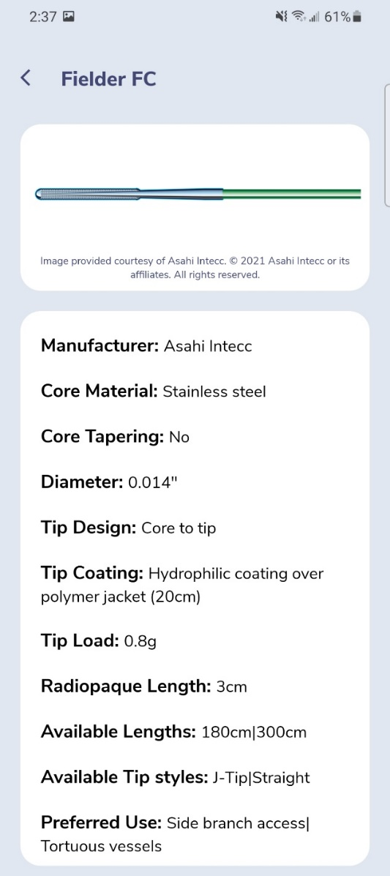
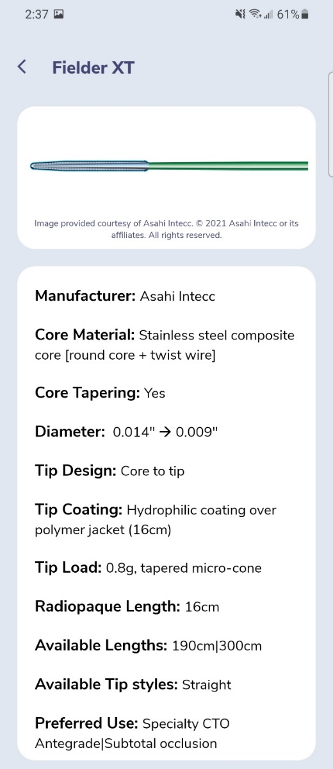
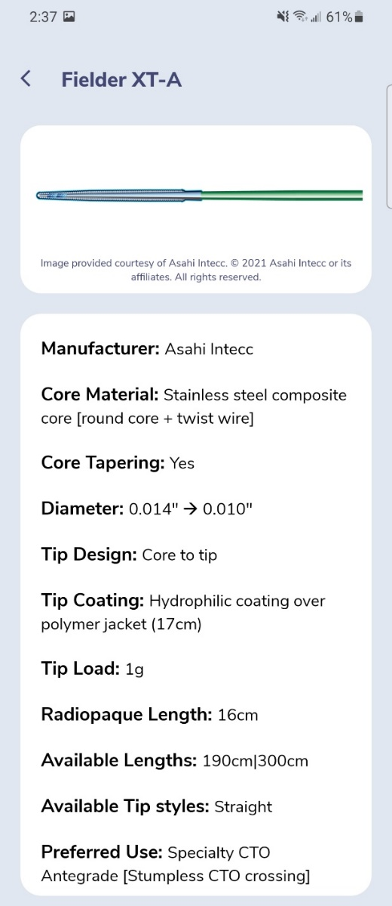
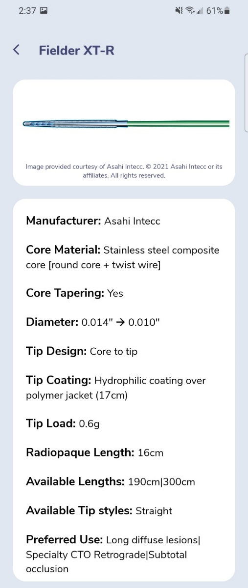
GuidewireAID – Knowing the Difference in One Wire Family

Slide 9
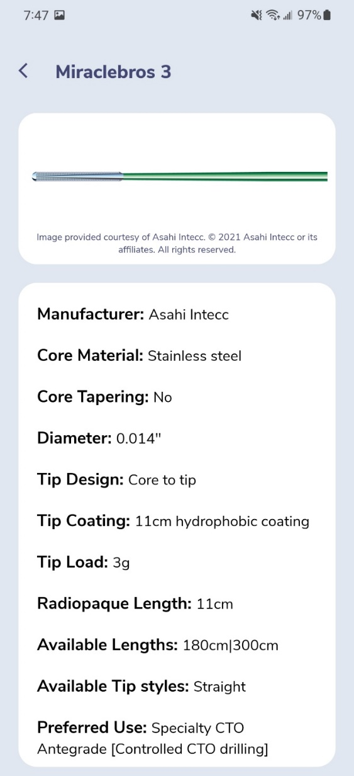
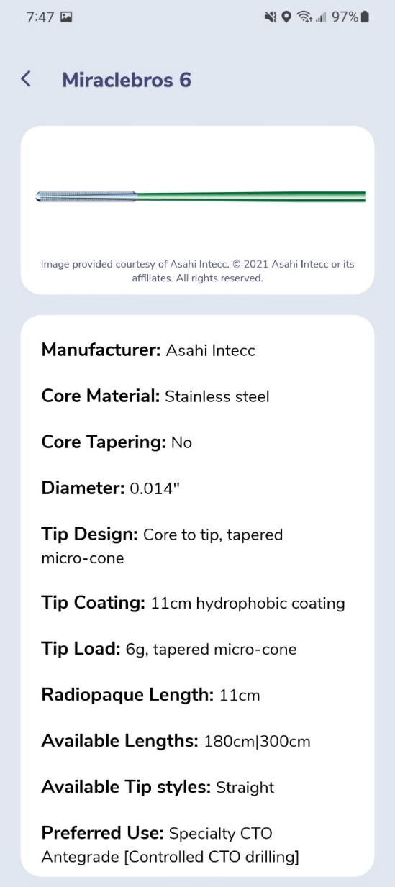
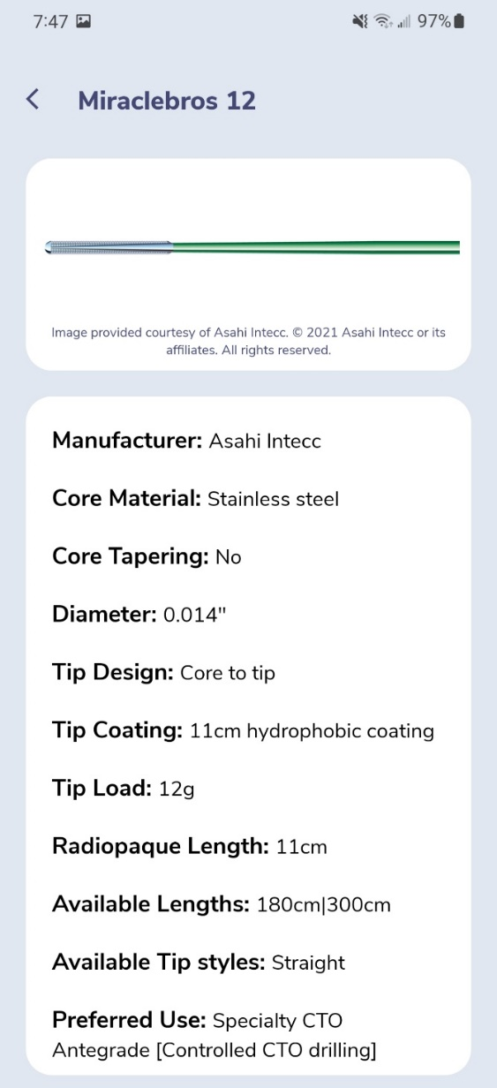
GuidewireAID – Knowing the Difference in One Wire Family

Slide 10
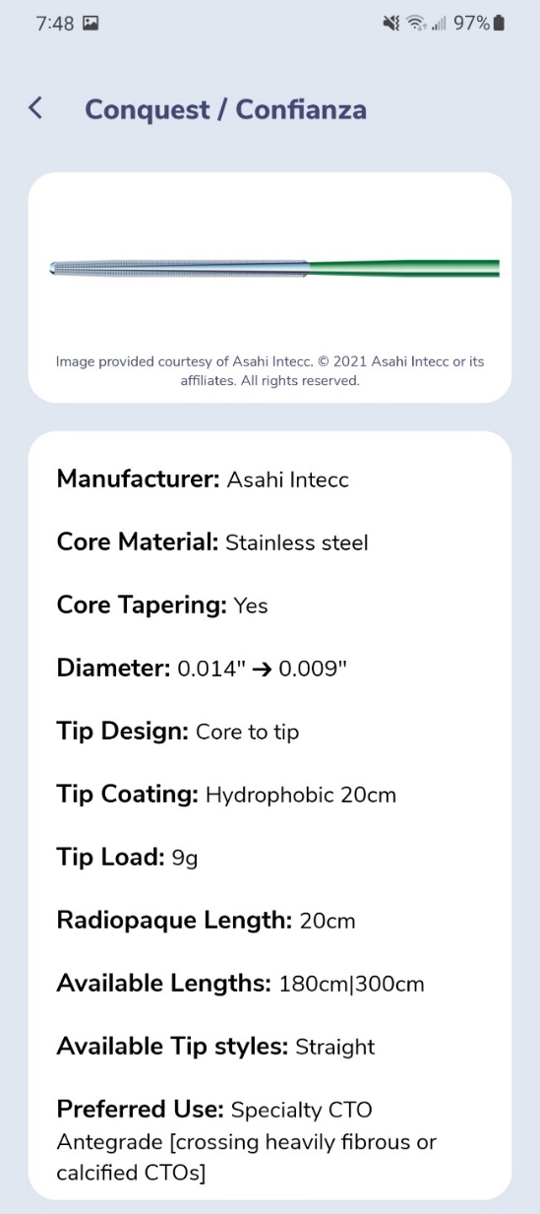
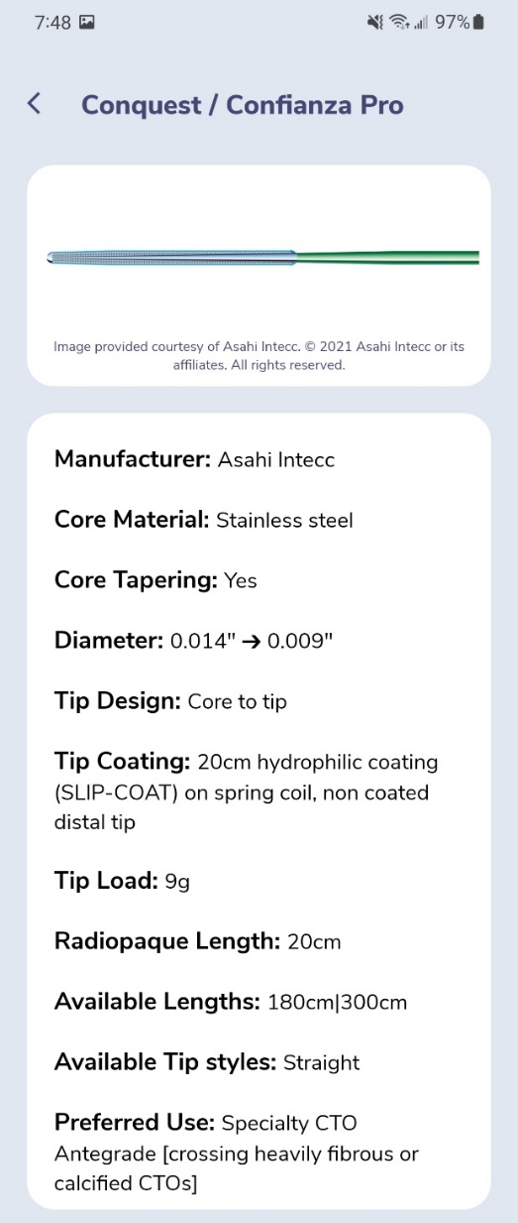
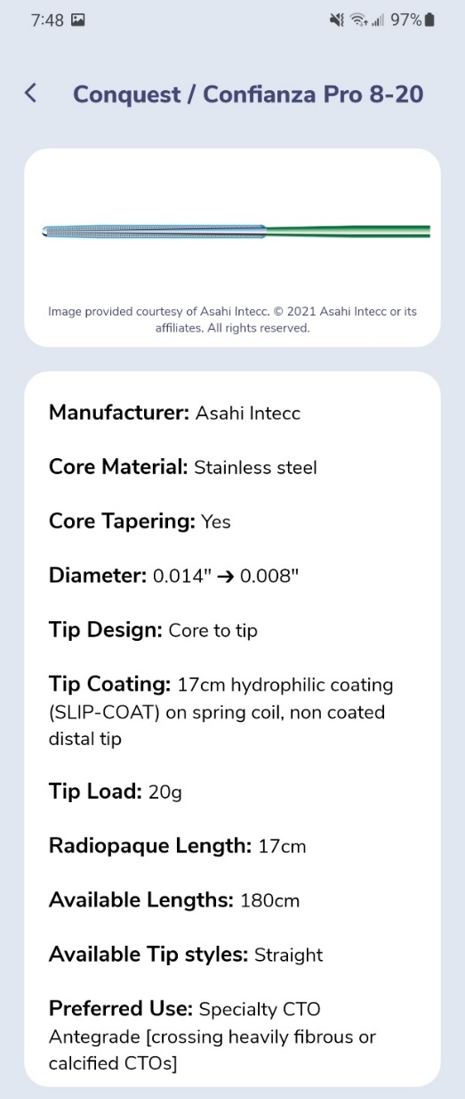
GuidewireAID – Knowing the Difference in One Wire Family

Slide 11
GuidewireAID – Our common CTO MicroCatheters

Slide 12
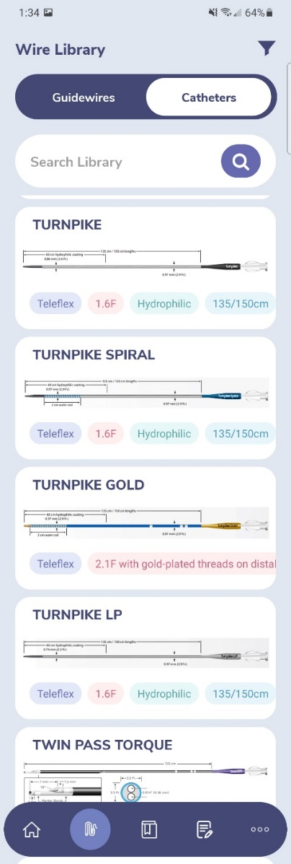
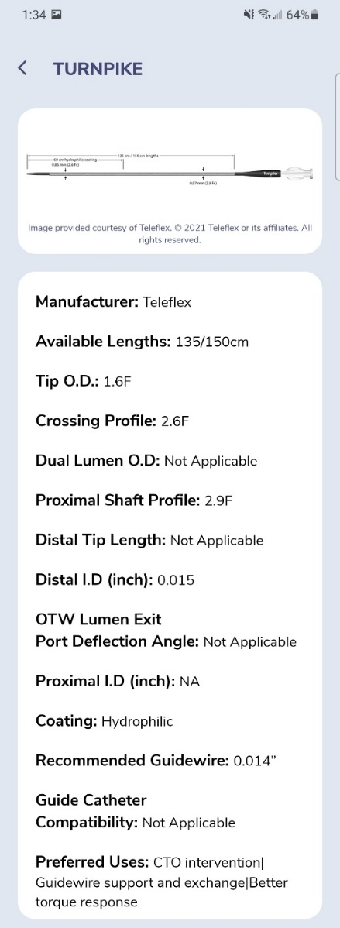
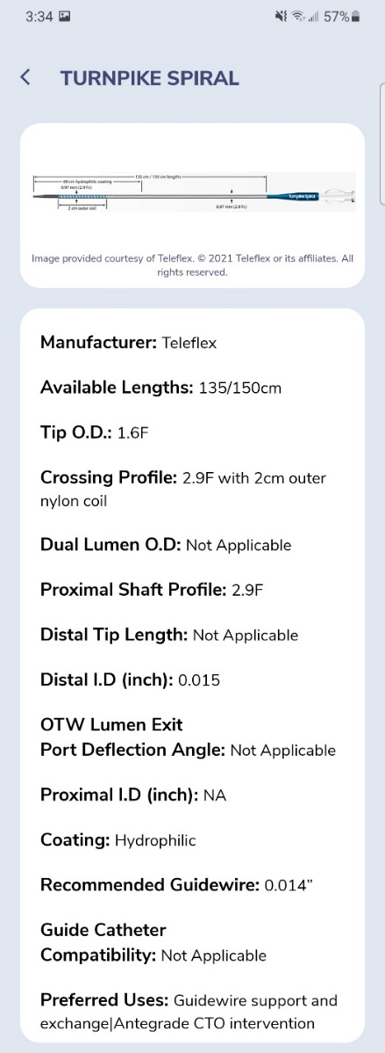
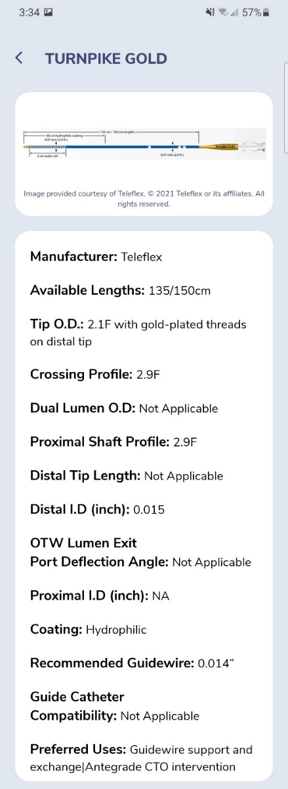
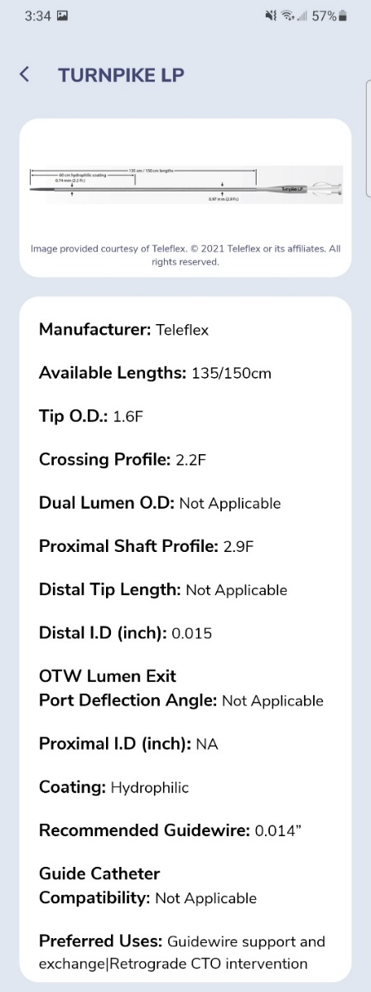
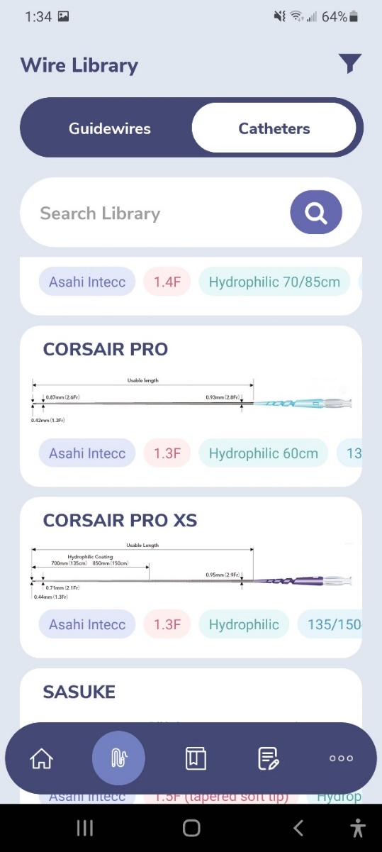
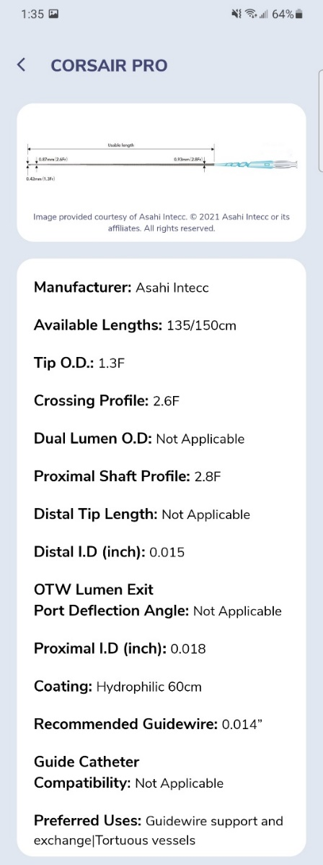
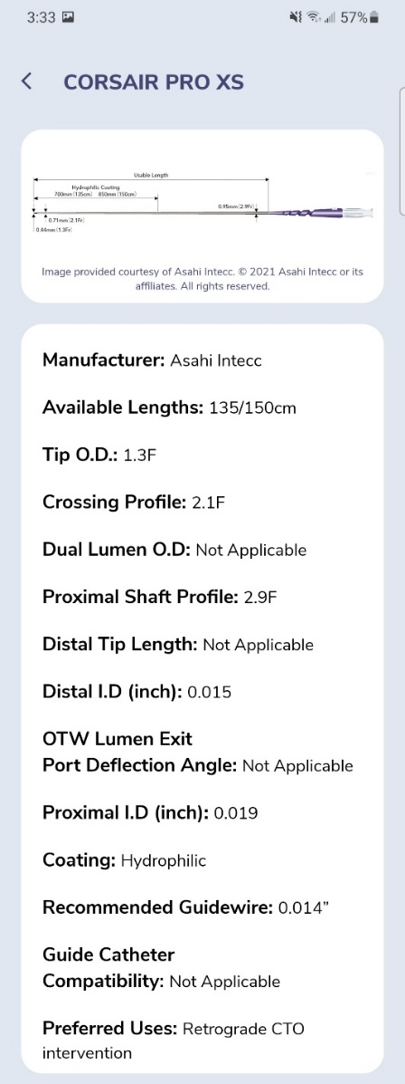
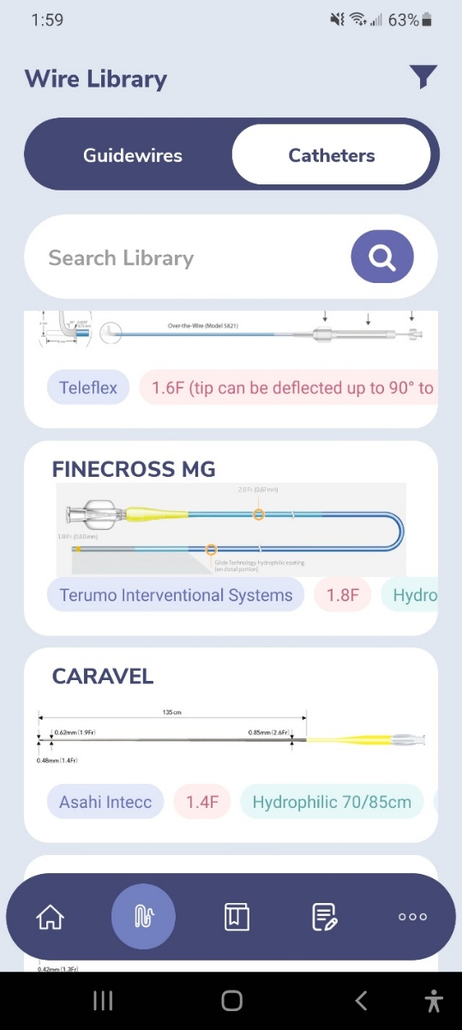
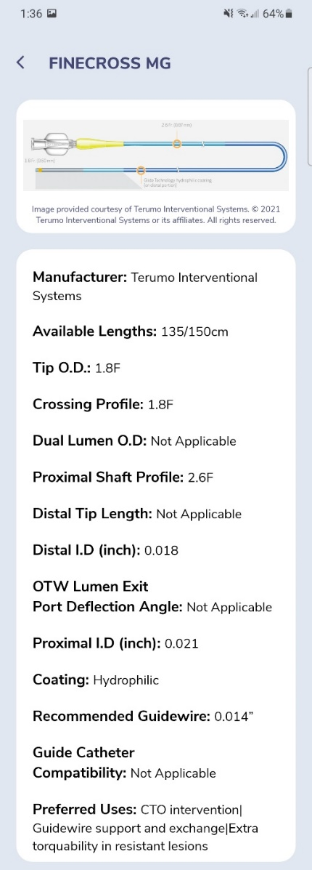
GuidewireAID – Our common CTO Microcatheters

Slide 13
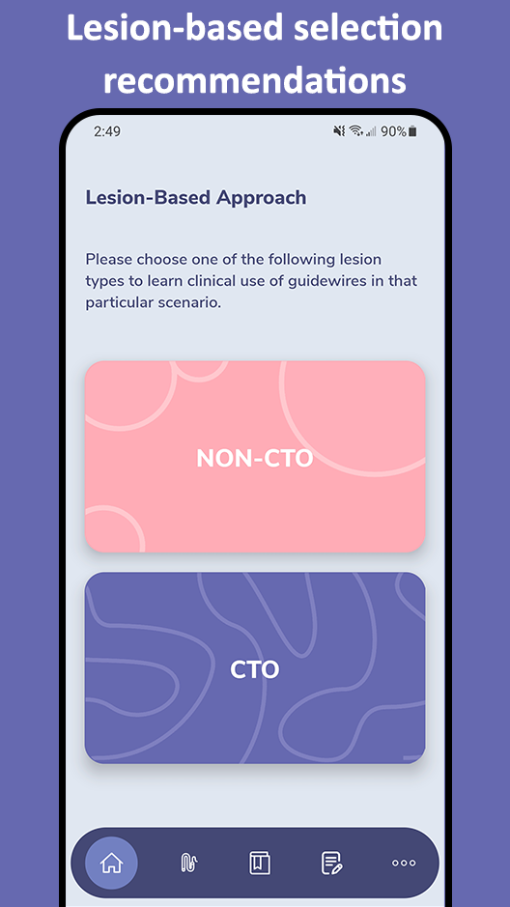
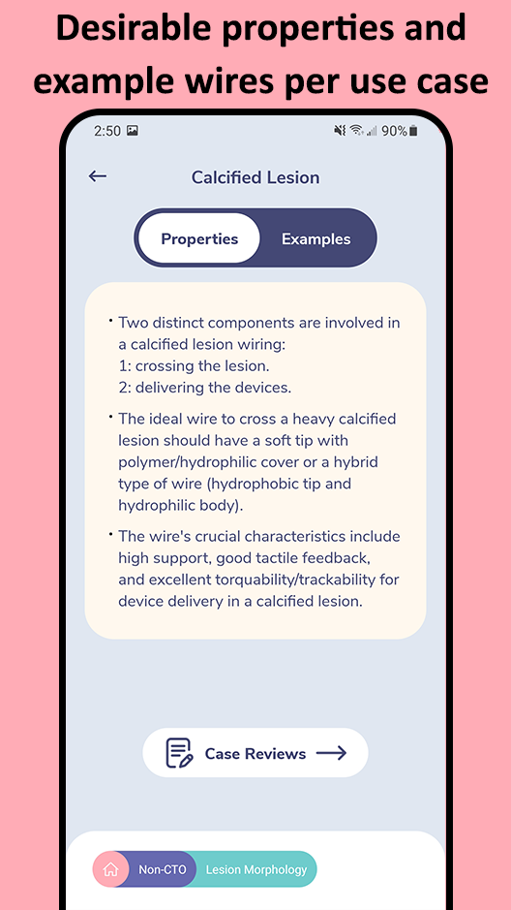
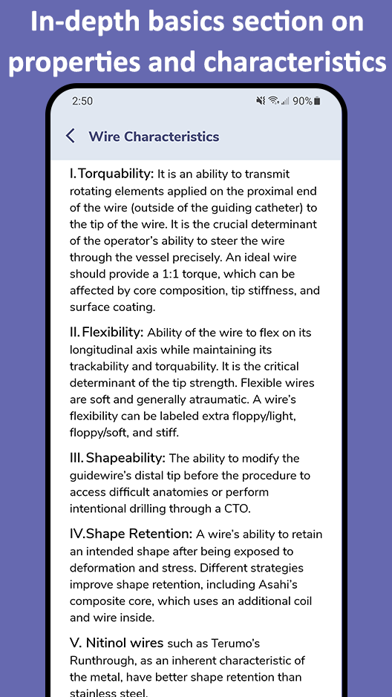
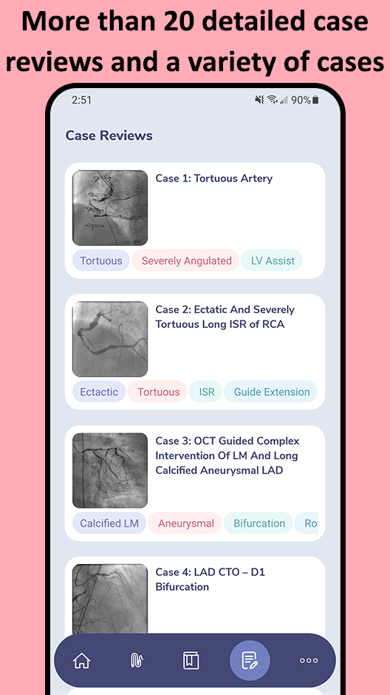
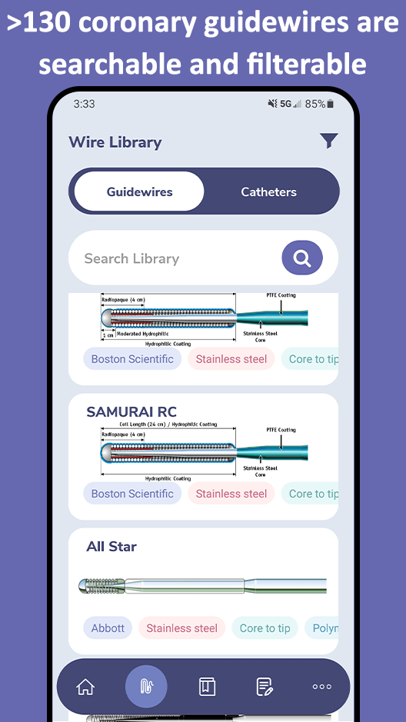
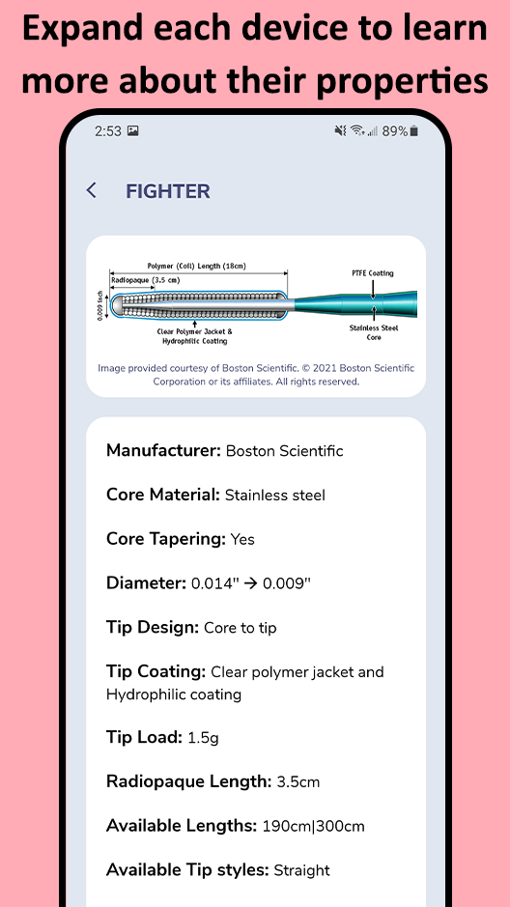
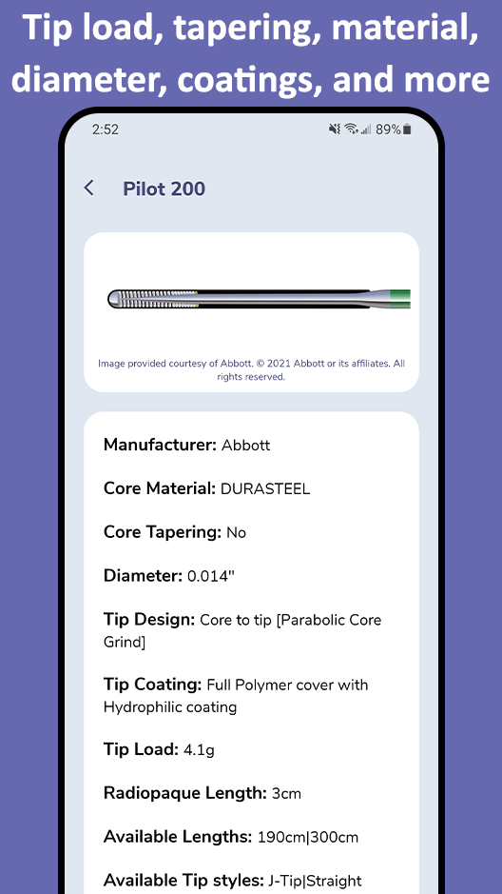
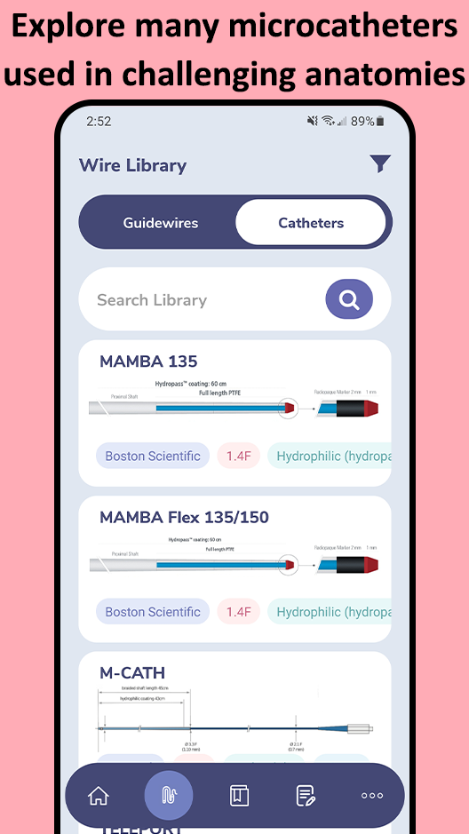
In addition to the web app at www.CardiologyApps.com/GuidewireAID, the iOS and Android mobile app is out now to download for free!
Diwali Special

Slide 14
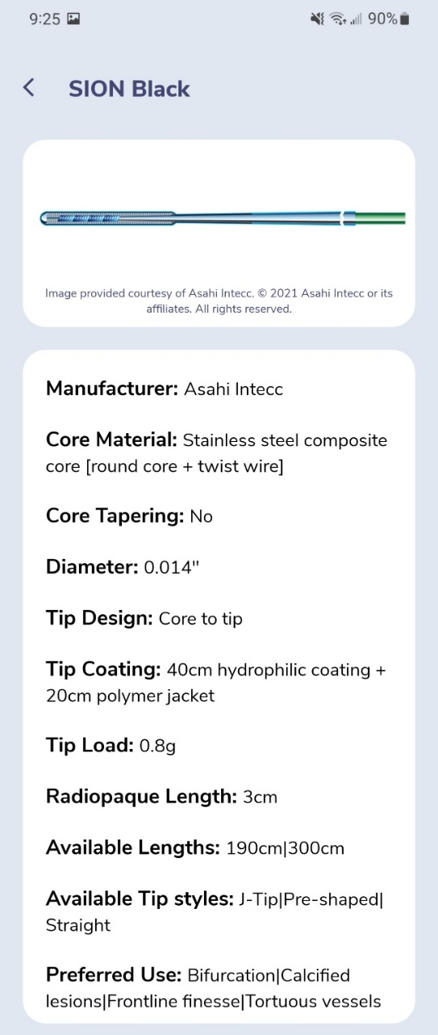
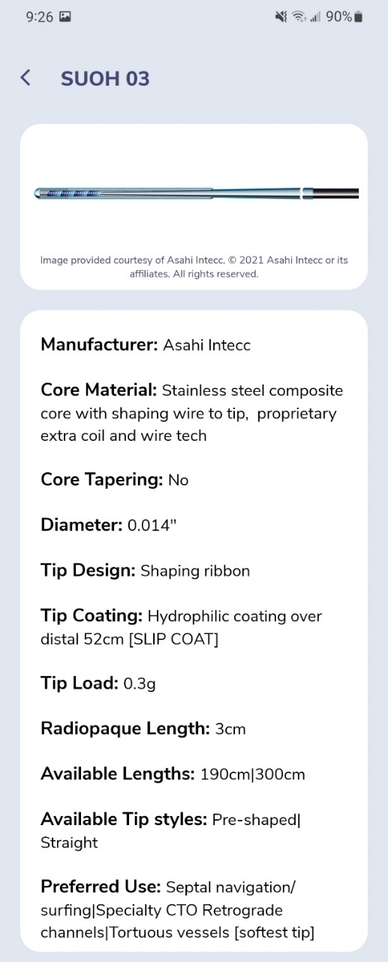
GuidewireAID – SUOH 03 and SION Black

Slide 15
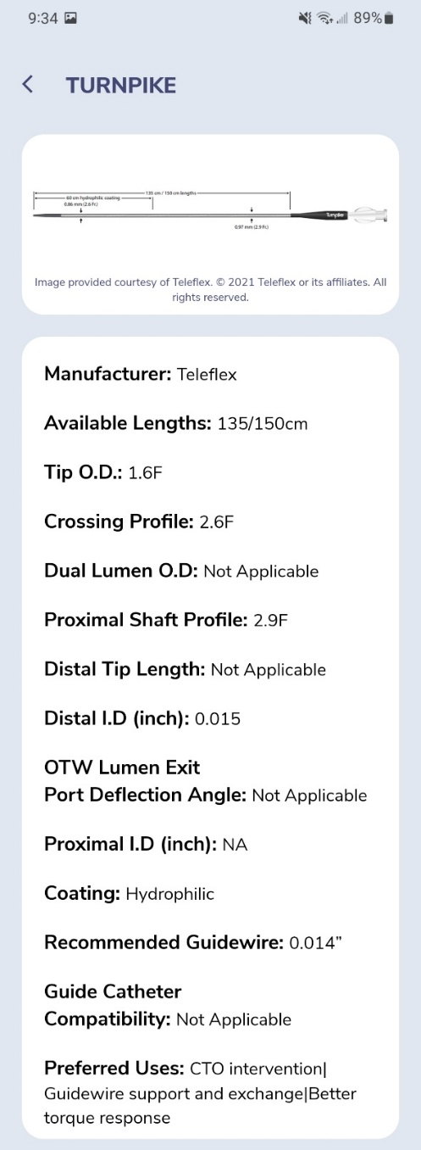
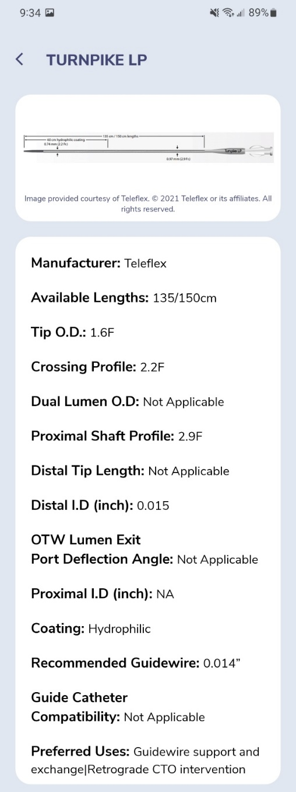
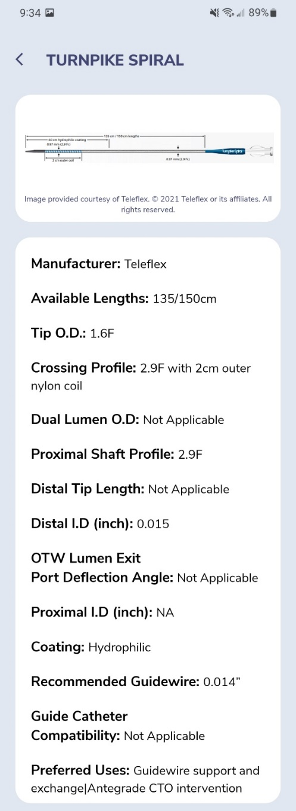
GuidewireAID – Turnpike Family

Slide 16
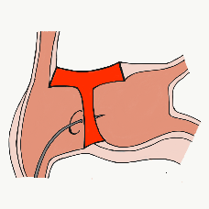
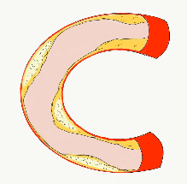
54,362 unique downloads and counting! (Up 14,000 in 2021)
Data Updated on Feb 14 2022*
Cath Lab Apps CardiologyApps.com
iOS ★ 5/5
12,227 downloads
Android ★ 4.96/5
9,372 downloads
Released sept 2017
iOS ★ 4.6/5
7,943 downloads
Android ★ 4.29/5
6,120 downloads
Released June 2018
iOS ★ 5/5
4,265 downloads
Android ★ 5/5
1,472 downloads
Released March 2019
iOS ★ 4.67/5
2,111 downloads
Android ★ 4.6/5
969 downloads
Released Sept 2018
iOS ★ 4.86/5
2,058 downloads
Android ★ 5/5
1,974 downloads
Released June 2019
Large Update Q3 19
Large Update Q1 21
BifurcAID
OCTAID
TAVRcathAID
TranseptAID
CalcificAID
*Also available
as WebApp
*Also available
as WebApp
Download Apps
For Free on Both:
WebApps available free on
www.CardiologyApps.com
Apple ® and App Store® are registered trademarks of Apple Inc.
Notes:
These are the apps we have created which will provide digital algorithms for our future ambitious projects to make our cath labs smarter.

Slide 17
54,362 unique downloads and counting! (Up 14,000 in 2021)
Data Updated on Feb 14 2022*
Cath Lab Apps CardiologyApps.com
WebApp Only*
26,940 page views
www.cardiologyapps.com/ComplicAID
iOS ★ 5/5
2,179 downloads
Android ★ 5/5
1,405 downloads
Released June 2021
Clinical Care Application For Heart Attack patient transfers 475 downloads
Released Aug 2020
iOS ★ 5/5
1,142 downloads
Android ★ N/A
650 downloads
Released Nov 2021
Released August 2020
ComplicAID
BifurcAID 3D
STEMIcathAID
GuidewireAID
*Also available
as WebApp
*Also available
as WebApp
Download Apps
For Free on Both:
WebApps available free on
www.CardiologyApps.com
Apple ® and App Store® are registered trademarks of Apple Inc.
Notes:
These are the apps we have created which will provide digital algorithms for our future ambitious projects to make our cath labs smarter.

Slide 18
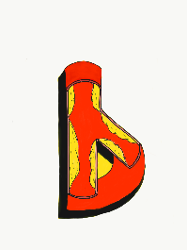
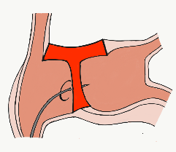
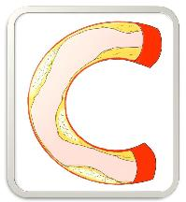
BifurcAID
STEMIcathAID
TAVRcathAID
ComplicAID
GuidewireAID
BifurcAID 3D
Cath Lab
Apps
OCTAID
TranseptAID
CalcificAID

Slide 19
Latest Issues in Coronary Intervention
Recent Interventional Trials 2021;
Basket-Small 2 Trial, Bio-Rise China Trial,
Combine OCT-FFR Trial
Focused review of the month
Complex parameters and PCI outcomes:
Defining Percutaneous Coronary Intervention
Complexity and Risk of In-hospital Outcomes

Slide 20
Latest Issues in Coronary Intervention
Recent Interventional Trials 2021;
Basket-Small 2 Trial, Bio-Rise China Trial,
Combine OCT-FFR Trial
Focused review of the month
Complex parameters and PCI outcomes:
Defining Percutaneous Coronary Intervention
Complexity and Risk of In-hospital Outcomes

Slide 22
BASKET-SMALL 2: Trial Profile
Jeger et al., Lancet 2018;392:849

Slide 23
BASKET-SMALL 2: Primary and Secondary Endpoints
p=0.95
p=0.83
p=0.52
%
p=0.49
p=0.18
Jeger et al., Lancet 2020;396:1504

Slide 24
BASKET-SMALL 2: K-M Estimates of the
Cumulative Probabilities of MACE
Probabilities of MACE in the two study group during 3 years for the full analysis set
Probabilities of MACE in the different device subgroups during 3 years
Jeger et al., Lancet 2020;396:1504

Slide 26
BASKET-SMALL 2: K-M Estimates of the Cumulative Probabilities of Nonfatal MI and All-Cause Death
Nonfatal MI
All-cause death
14.85%
12.20%
9.82%
7.05%
5.12%
5.39%
4.75%
4.37%
Wöhrle et al., J Am Coll Cardiol Intv 2021;14:1789

Slide 27
BASKET-SMALL 2: Event Rates with DCB and DES in
De Novo Coronary Lesions of Diabetic and Nondiabetic pts
HR: 1.93 (95% CI: 1.14-3.25)
P = 0.014
Wöhrle et al., J Am Coll Cardiol Intv 2021;14:1789

Slide 28
Possible Explanations;
1) No metal or polymer left behind
2) No long-term ST risk
3) Abbreviated DAPT

Slide 29
BELLO trial
PICCOLETO II trial
RESTORE trial
SEQUENT Please registry
BASKET SMALL-2 trial

Slide 30
BIO-RISE CHINA
A Randomized Trial of a Biolimus-Coated Balloon vs Plain Old Balloon Angioplasty in Small Vessel Coronary Artery Disease

Slide 31
BIO-RISE CHINA Trial: Background
Drug coated balloons are a safe and effective option for patients undergoing PCI.
Prior randomized trials of drug coated balloons have exclusively utilized paclitaxel coated devices.
Polymer free biolimus coated stents have shown excellent safety and efficacy in LEADERS FREE and ONYX ONE
In this first-in-human study, we have assessed the safety and efficacy of a biolimus coated balloon (BCB) in patients with small vessel coronary artery disease undergoing PCI.
Han Y, TCT 2021

Slide 32
BIO-RISE CHINA Trial: Study Flowchart
224 patients
assessed for eligibility
12 ineligible
(Inclusion/exclusion not met)
Primary endpoints: LLL @9M
Secondary endpoints: TLF, POCO
Restenosis
212 enrolled
3 had no device implanted
212 randomized
106 assigned DCB BA9
103 assigned POBA
1 discontinued
treatment
[device used but withdrawn]
2 discontinued
treatment
[device used but withdrawn]
105 treatment ongoing
101 treatment ongoing
13 missed 9M f/u angiography
3 had bailout stent
10 missed 9M f/u angiography
3 had bailout stent
106 included in the full analysis set
103 included in the full analysis set
89 patients included in pre-protocol population
88 patients included in pre-protocol population
Han Y, TCT 2021

Slide 33
BIO-RISE CHINA Trial: Primary Endpoint
Late Lumen Lost at 9 Months
Per protocol population
0.16 ± 0.29 mm vs 0.30 ± 0.35 mm
Δ 0.14 mm; 95% CI -0.23 to -0.05; p=0.001
Full analysis set
0.17 ± 0.32 mm vs 0.29 ± 0.35 mm
Δ 0.13 mm; 95% CI -0.21 to -0.02; p=0.003
Patients with late lumen enlargement
29.7% vs 9.7%
p=0.0007
Han Y, TCT 2021

Slide 34
BIO-RISE CHINA Trial: QCA Data
 | Biolimus Coated Balloon (89 pts, 91 lesions) | POBA (88 pts, 92 lesions) | P Value
Pre-procedure
Lesion length (mm | 12.07 (5.84) | 10.93 (4.17) | 0.38
Reference vessel diameter (mm) | 1.99 (0.31) | 2.05 (0.31) | 0.18
Minimal lumen diameter (mm) | 0.67 (0.28) | 0.76 (0.27) | 0.03
Diameter stenosis (%) | 66.8 (12.18) | 63.72 (10.86) | 0.14
Post-procedure
Minimal lumen diameter (mm) | 1.47 (0.32) | 1.51 (0.29) | 0.41
Diameter stenosis (%) | 25.15 (13.57) | 25.0 (12.56) | 0.93
9 months follow-up
Minimal lumen diameter (mm) | 1.29 (0.32) | 1.17 (0.39) | 0.03
Diameter stenosis (%) | 32.54 (16.0) | 41.92 (18.49) | 0.0003
Binary restenosis | 9/91 (9.9%) | 26/92 (28.3%) | 0.002
Late-lumen loss (mm) | 0.16 (0.29) | 0.30 (0.35) | 0.001
Positive remodeling | 27/91 (29.7%) | 9/92 (9.7%) | 0.0007
Han Y, TCT 2021

Slide 35
BIO-RISE CHINA trial: Clinical Outcomes
p=0.16
p=0.28
p=0.09
p=0.18
%
p=0.36
p=0.24
Han Y, TCT 2021

Slide 37
COMBINE OCT-FFR Trial: Patient Flowchart
550 patients enrolled
3 violation of exclusion criteria
2 malignancies
1 failure to revascularize the culprit lesion
547 entered study procedure
6 had no eligible target lesion (restenosis)
6 had no FFR performed
423 had FFR >0.80
112 FFR ≤0.80
3 had PCI in FFR (-)
30 had no OCT or not analyzable OCT
19 had no revasc in FFR (+) lesions
390 had valid OCT
93 had revasc
292 No-TCFA
98 TCFA
1 lost to FU
1 lost to FU
1 lost to FU
291 18M FU
91 18M FU
92 18M FU
Kedhi et al., Eur Heart J 2021;42:4671

Slide 38
COMBINE OCT-FFR: Lesion Level Qualitative OCT Analysis Results in Pts With and Without Thin-Cap Fibroatheroma
Kedhi et al., Eur Heart J 2021;42:4671

Slide 39
COMBINE OCT-FFR Trial: Incidence of Primary Endpoint at 18 Months
Composite of death, MI, TLR or hospitalization due to UA
5x
Kedhi et al., Eur Heart J 2021;42:4671

Slide 40
COMBINE OCT-FFR Trial: Clinical Outcomes
at 18 Months Follow Up
p<0.001
p<0.001
p=0.002
%
p=0.03
p=0.01
p=NS
Kedhi et al., Eur Heart J 2021;42:4671

Slide 41
COMBINE OCT-FFR Study Design and Main Results
Kedhi et al., Eur Heart J 2021;42:4671

Slide 43
In Search of Vulnerable Patients
Naghavi et al., Circulation 2003;108:1772

Slide 44
(Modified)
Timeline of Development and Future Directions for Clinical Trials in Coronary VP

Slide 45
The Final Word
Ischemia, Vulnerable Plaque, Prognosis and Treatment
Symptoms of ischemia (angina, exertional dyspnea)
Ischemia
Treat to relieve symptoms (anti-angina drugs, revasc)
CV risk factors, inflammation, recent ACS
Vulnerable plaque
Treat to prevent CV death, MI, ACS (APT, lipid lowering, revasc?)

Slide 46
Latest Issues in Coronary Intervention
Recent Interventional Trials 2021;
Basket-Small 2 Trial, Bio-Rise China Trial,
Combine OCT-FFR Trial
Focused review of the month
Complex parameters and PCI outcomes:
Defining Percutaneous Coronary Intervention
Complexity and Risk of In-hospital Outcomes

Slide 48
CHIP-PCI: Risk Factors for In-Hospital MACCE Post-PCI
in the UK 2006-2016
Multivariate Adjusted Baseline and Procedural Covariates Associated With
In-Hospital MACCE
CHIP Factors associated with increased in-hospital MACCE:
Patient factors:
age ≥80 yrs, female sex, previous stroke, previous MI, PVD, EF <30%, and CKD
Procedural factors:
RA, LM PCI, 3-V PCI, dual arterial access, planned LV mechanical support, and lesion length >60 mm
CHIP score:
Planned LV mechanical support – 3 pts
chronic renal disease – 2 pts
Remaining factors – 1 point
Protty et al., J Am Coll Cardiol Intv 2022;15:39

Slide 49
CHIP-PCI: Distribution of CHIP Factors/Case
Distribution of and Temporal Changes in CHIP Score During PCI in the U.K.
2006-2016
Protty et al., J Am Coll Cardiol Intv 2022;15:39

Slide 50
CHIP-PCI: Temporal Trends in CHIP Score and CHIP Factors During PCI in the U.K. 2006-2016
Protty et al., J Am Coll Cardiol Intv 2022;15:39

Slide 51
CHIP-PCI: Crude Clinical Outcomes for Each CHIP Factor During PCI in the U.K. 2006-2016
Protty et al., J Am Coll Cardiol Intv 2022;15:39

Slide 52
CHIP-PCI: In-Hospital Mortality and Major Bleeding,
and Procedural Complications by the Number of CHIP Factors Present
Protty et al., J Am Coll Cardiol Intv 2022;15:39

Slide 53
CHIP-PCI: In-Hospital Major Adverse Cardiac or Cerebrovascular Events
High risk 10+
Intermediate risk 7-10
Low risk 0-6
Protty et al., J Am Coll Cardiol Intv 2022;15:39

Slide 56
Take Home Message: Recent Interventional Trials 2021 and Impact of PCI Complexity on In-hospital Outcomes
PCI with DCB over POBA in small vessels:
DCB vs DES in small vessels:
DCB better then DES in small vessel in diabetics:
TCFA on OCT in - FFR and long-term outcomes:
Simple clinical (7) and procedural factors (6) are easy to measure and can accurately predict in hospital MACCE and MB; higher events with increasing complexity. This simple CHIP calculator tool can help to strategize the resources for post PCI management and need for intense monitoring. This CHIP tool can also modify pre-PCI strategy by medical optimization (of renal, EF, TRA) and performing planned staged procedures.
Notes:
HbA1c

Slide 57
Question # 1
Following is the true statement about the results of BASKET-Small 2 trial;
MACE rates are higher with DCB vs DES in diabetics
TVR is lower with DES vs DCB in diabetics
TVR is lower with DCB vs DES in diabetics
MACE rates are higher with DCB vs DES in non-diabetics
TVR is lower with DES vs DCB in non-diabetics
The correct answer is C

Slide 58
Question # 2
Following statements is true regarding the results of the COMBINE OCT-FFR trial;
A. No difference in MACE outcomes in FFR+ vs FFR- cases
B. No difference in MACE outcomes in TCFA+ vs TCFA- cases
C. Non-significant difference in MACE in TCFA+ vs TCFA- cases
D. No difference in Revascularization in TCFA- vs TCFA cases
E. Five times higher MACE in TCFA+ vs TCFA- cases even in FFR- cases
The correct answer is E

Slide 59
Question # 3
Following statements are true regarding the PCI risk factor (CHIP-PCI) associated with higher MACCE/MB except:
Total 7 patients related risk factors
Total 6 procedural related risk factors
Planned LV mechanical support is the highest predictive risk factor
More than 50% pts do not have any CHIP risk factor
Overall planned LV support declined during the study period
The correct answer is D

