Slide 1
Complex Coronary Case
Supported by:
Sun Pharmaceutical Industries Ltd.

Slide 2
Disclosures
Samin K. Sharma, MD, MSCAI, FACC
Speaker’s Bureau – BSC, Abbott, CSI
Annapoorna S. Kini, MD, MRCP, FACC
Nothing to disclose
Sharath Reddy Annam, MD, DM, FACC (Guest Faculty)
Damodhar Reddy Gouni, MD, DM (Guest Faculty)

Slide 3
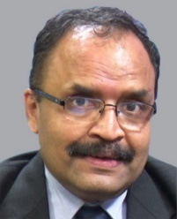
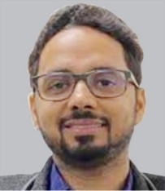
Sharath Reddy Annam, MD, DM,
FSCAI, FACC
Senior Consultant Intervention Cardiologist
Director, Cath lab
Director CTO and Chip-Interventional
Director TAVR & Structural Heart Disease
Medicover Hospitals, Hyderabad,
Telangana, India
Damodhar Reddy Gouni, MD (Gen. Med), DM (Cardiology)
Consultant Interventional Cardiologist
Medicover Hospitals
Hyderabad, Telangana, India
Dr. Sharath Reddy Annam currently working as Senior Consultant Interventional Cardiologist, Director Cath Lab, Director CTO and Chip-Interventional, Director TAVR & Structural Heart Disease at Medicover Hospitals, India. His area of interests include CTO,TAVR, structural heart interventions, imaging-guided interventions, complex high-risk and indicated percutaneous coronary interventions. He is a fellow of Society for Cardiovascular Angiography and Interventions (FSCAI), American College of Cardiology (FACC) and Fellowship in American Heart Association (FAHA). He is awarded with many awards including Gold Medal for ‘Best Presentation in 2010 By The Andhra Pradesh Cardiological Society Of India, Excellence Award by Delhi–Telugu Academy For Rendering Quality Cardiac Treatment And Care. He is PI of ongoing clinical trials and published and presented may research papers.
Dr. Damodhar Reddy specializes in interventional cardiology and complex coronary and structural interventions. He has scored many academic awards during his long clinical career. He has special interest in the vastly advancing field of structural cardiac interventions. He has best skills in clinical management of heart failure and various cardiomyopathies like dilated cardiomyopathy , hypertrophic cardiomyopathy etc.He was awarded with many awards including 5 Gold Medals for Best performance in Pharmacology, General surgery ,orthopaedics, and merit award in OBG and ENT exams conducted by NTR university and best oration paper award in general medicine in APICON .His research papers are published in renowned journals.

Slide 4
OCT-guided PCI of calcified LAD-D1 bifurcation using IVL + Rota

Slide 5
Live Case #15
Patient Demographics
85 yrs, F with new onset angina
Present Clinical Presentation
Presented with CCS class III angina and +SPECT MPI for MV ischemia
CAD Risk Factors
Controlled hypertension
Controlled hyperlipidemia
Controlled NIDDM
CVA with residual hemiparesis
SAQ-7 score 56, PAF, Asthma
Clinical Variables
Cardiac cath on Nov 18, 2021 revealed 2 V CAD, Syntax score 21 and normal LV function. Pt underwent PCI of RCA using 2 (Promus Elite) DES and did well
Medications
Aspirin, Lopressor XL, Lisinopril, Amlodipine, Rosuvastatin, Glucophage, Clopidogrel, Apixiban, Singulair, Furosemide, Ranolazine
Cath: Cath on Nov 18, 2021 revealed 2 V CAD: 70% calcified prox-mid LAD, 80% D1, 80% lesions in prox and distal RCA, LVEF 60% and Syntax score 21. Pt underwent 2 DES (Promus Elite) to RCA and did well
Plan: Now planned for imaging guided complex staged PCI of calcified LAD-D1
bifurcation using IVL+ RA with OCT imaging for ca++ characterization.

Slide 6
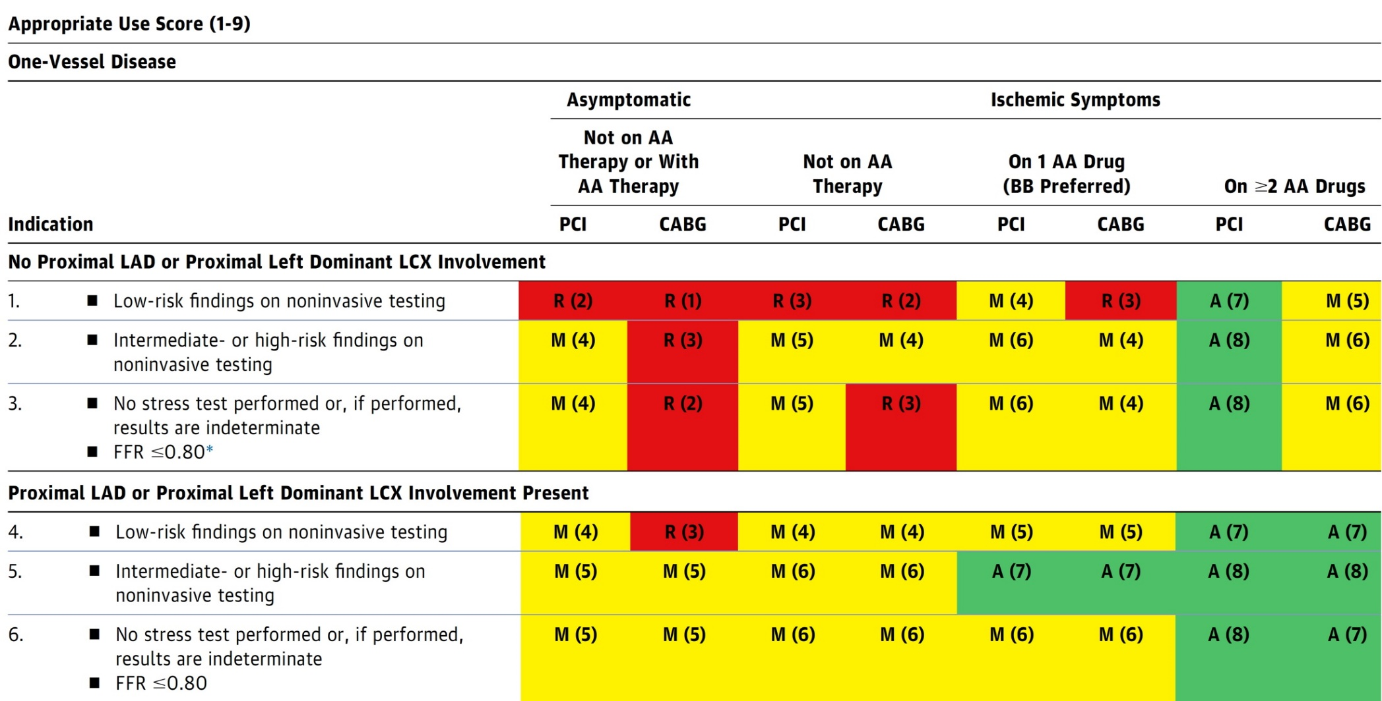
AUC 2017: One-Vessel Disease
Patel et al., J Am Coll Cardiol 2017;69:2212

Slide 7
Protocol for Management of Calcific Lesions
Coronary Angiography
≈50%
Moderate-severe calcification
≈50%
ELCA, if no Rota/OA Wire could be crossed
IVUS/OCT assessment:
Calcium arc 180-270° (2points)
Calcium arc >270° (3 points)
Calcium length >5 mm (1 point)
Thickness >0.5 mm (1 point)
IVUS/OCT/balloon
did not cross
Un-crossable lesion/CTO
Angulated lesion
Tortuous lesion
Long lesion
Calcific Nodule
1-2 points
3-5 points
- High-pressure NC balloons
- Cutting/scoring balloon
Lithotripsy IVL (RA/OA for Ca 360°)
RA or OA ?ELCA
Suboptimal result
Does not cross
NC balloon/CB
Suboptimal balloon expansion
Optimal balloon expansion
Optimal balloon expansion
Lithotripsy IVL
Stent and OCT/IVUS optimization

Slide 8
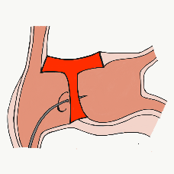
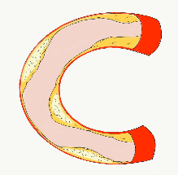
More than 35,800 unique downloads
Cath Lab Apps CardiologyApps.com
iOS 5/5 stars
9896 downloads
Android 4.4/5 stars
8245 downloads
Released sept 2017
iOS 5/5 stars
6068 downloads
Android 4.8/5 stars
3850 downloads
Released June 2018
iOS 5/5 stars
2073 downloads
Android N/A stars
549 downloads
Released March 2018
iOS 5/5 stars
1074 downloads
Android N/A stars
547 downloads
Released Sept 2018
iOS 5/5 stars
931 downloads
Android 5/5 stars
538 downloads
Released June 2019
WebApp Only*
2600 unique users
4800 sessions
Released August 2020
BifurcAID
OCTAID
TAVRcathAID
TranseptAID
CalcificAID
ComplicAID
*Also available
as WebApp
Download Apps
For Free on Both:
WebApps available free on
www.CardiologyApps.com
Apple ® and App Store® are registered trademarks of Apple Inc.
Notes:
These are the apps we have created which will provide digital algorithms for our future ambitious projects to make our cath labs smarter.

Slide 9
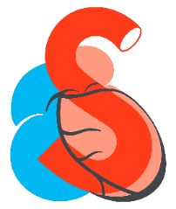
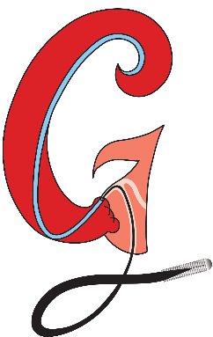
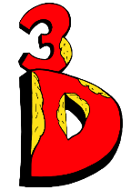
Apps Coming Soon…
STEMIcathAID – STEMI patient transfer platform designed to optimize communication between key members, record key performance metrics for AHA’s Mission: Lifeline program, and avoid costly false activations through direct CCL contact.
GuidewireAID – This application covers the design of coronary guidewires and the resulting properties they exhibit during use in the lab. Over two dozen teaching cases, a dense wire library with more than a hundred wires, and a robust search function provide a lot of tailored learning opportunities.
BifurcAID 3D – An animated bifurcation lesion treatment educational application and website. With two views, detailed descriptions, and more, BifurcAID 3D helps make clear the complex steps in techniques such as Minicrush, DK Crush and Culotte, as well as provisional approached and bailout techniques.

